Slide 1
IT Fundamentals
Chapter 11:
Business Continuity and Computer Support

Slide 2
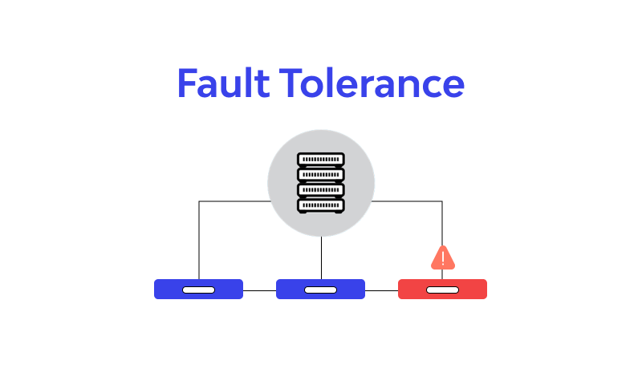
Fault Tolerance
Contingency plans
Perform business impact analysis
Identify preventive systems
Develop a recovery plan
Test the recovery plan
Set up a maintenance and review schedule
Implement training
Notes:
**Fault Tolerance:**
Fault tolerance aims to ensure that systems remain operational even in the face of failures, ensuring business continuity, data integrity, and minimizing disruptions to operations. It involves proactive planning, redundancy, and continuous testing to be prepared for various failure scenarios.
1. **Contingency Plans:** Develop comprehensive contingency plans that outline steps to take in case of system failures or disasters.
2. **Business Impact Analysis:** Assess the potential impact of system failures on business operations, revenue, reputation, and customer satisfaction.
3. **Identify Preventive Systems:** Implement preventive measures such as redundant systems, load balancing, and failover mechanisms to minimize the risk of failures.
4. **Develop a Recovery Plan:** Create a recovery plan outlining steps to restore systems, data, and operations to normal after a failure.
5. **Test the Recovery Plan:** Regularly test the recovery plan through simulations or drills to ensure its effectiveness and identify any weaknesses.
6. **Set Up a Maintenance and Review Schedule:** Establish a schedule for regular maintenance and reviews of the fault tolerance measures and recovery plans.
7. **Implement Training:** Train employees on how to respond to system failures, including their roles in the recovery process.

Slide 3
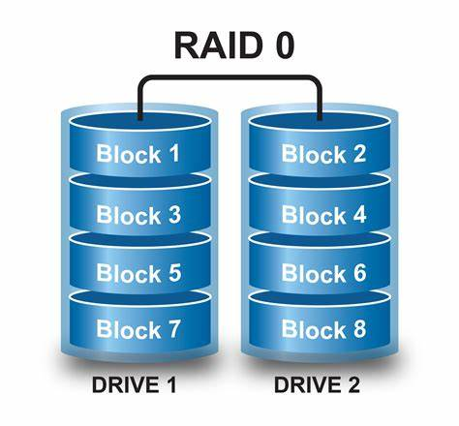
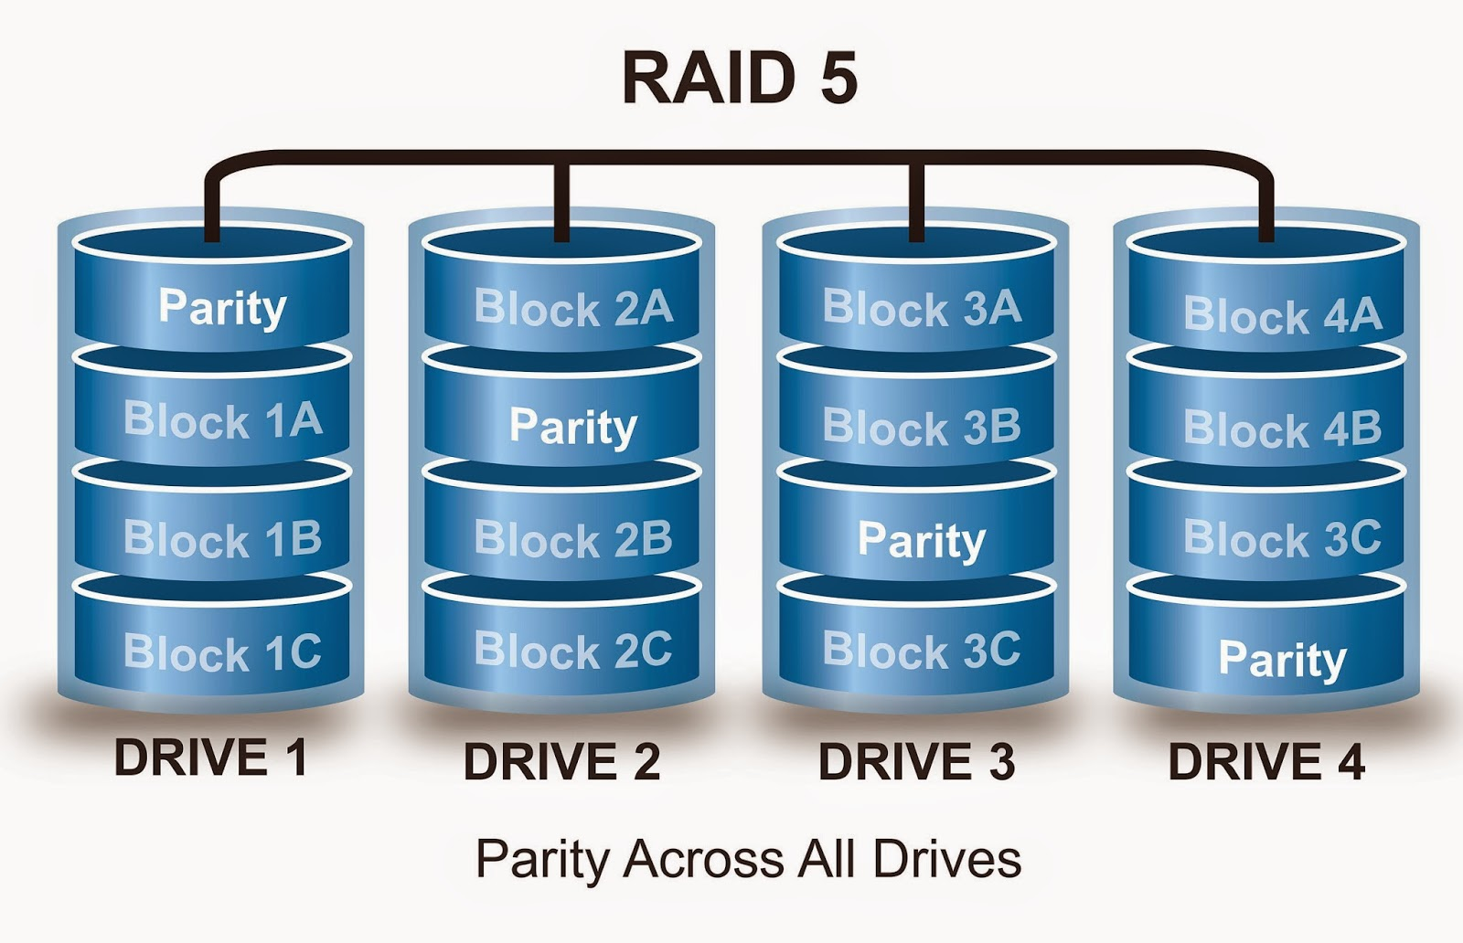
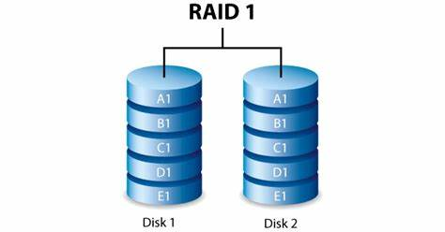
Replication and Redundancy
Data redundancy
RAID 0
RAID 1
RAID 5
Network redundancy
Power redundancy
Notes:
**RAID (Redundant Array of Independent Disks) Explained:**
RAID technology offers improved performance, redundancy, or a combination of both by aggregating multiple physical disk drives into a single logical unit. Here's a detailed explanation of RAID 0, RAID 1, and RAID 5:
Imagine you have a bunch of hard drives that you want to use together to store your important stuff. RAID is like a way to make those hard drives work better and keep your data safe.
---------------------------------------------
**RAID 0 (Striping):** In RAID 0, data is divided into small segments, or stripes, and simultaneously written across multiple disks. This parallelism boosts both read and write speeds, as the workload is distributed across multiple drives. However, RAID 0 lacks redundancy, making it vulnerable to data loss. If a single drive fails, the entire array is compromised, resulting in data loss. RAID 0 is ideal for scenarios where speed is prioritized over data protection, such as video editing or gaming. The minimum requirement is 2 disks.
- **RAID 0 (Striping):** Think of it like cutting a picture into pieces and giving each piece to a friend. Your friends can work on their pieces at the same time, making things faster. But, if one friend loses their piece, the whole picture is ruined. So, it's fast but risky.
---------------------------------------------
**RAID 1 (Mirroring):** RAID 1 involves mirroring, where data is duplicated on two or more drives simultaneously. Each drive contains an exact copy of the data, ensuring fault tolerance. If one drive fails, the other(s) continue to function seamlessly. While RAID 1 provides excellent data protection, it sacrifices storage capacity, as only half the total capacity is usable due to the mirrored configuration. RAID 1 suits scenarios where data integrity is paramount, such as critical databases or financial records. It also requires a minimum of 2 disks.
- **RAID 1 (Mirroring):** Picture having a friend who is a copycat. You show them your favorite toy, and they make an exact copy of it. Now you both have the same toy. If one of you loses your toy, the other still has the same one. It's safe because you have a backup, but you need extra toys.
--------------------------------------------
**RAID 5 (Striping with Parity):** Combining features of RAID 0 and RAID 1, RAID 5 employs striping for data distribution and adds parity information to enhance fault tolerance. Parity is a calculated value that enables data reconstruction in case of drive failure. Data and parity information are striped across at least 3 disks. If one drive fails, the lost data can be regenerated using the remaining data and parity information. RAID 5 offers a good balance between performance, capacity, and data protection. However, write performance may be slower due to parity calculations. RAID 5 is suitable for environments where a compromise between performance and redundancy is needed.
- **RAID 5 (Striping with Parity):** Imagine you and your friends are building a puzzle together. Each of you gets a part of the puzzle, and there's also a person who knows how to recreate the missing piece if one of you loses it. This way, if someone's piece goes missing, you can still complete the puzzle. It's kind of like teamwork and having a backup plan in case someone can't find their puzzle piece.
-------------------------------------------
Each RAID level caters to different priorities and requirements. RAID 0 excels in speed but lacks redundancy, RAID 1 ensures data integrity but reduces capacity, and RAID 5 balances performance and protection while needing at least 3 disks. Choosing the right RAID level depends on the specific needs of the data storage environment.
So, RAID helps make your hard drives work faster, keeps your data safe, or does both depending on how you set it up. Just like picking between speed and safety, you can choose the RAID level that suits what you need to do with your important stuff.

Slide 4
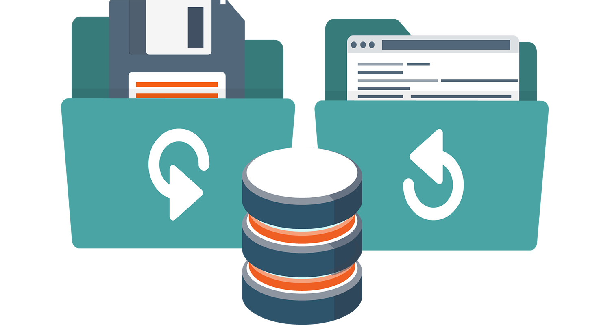
Importance of Computer Backups
Importance of data
How easily replaceable is it?
Notes:
**Importance of Backups:**
This effects everyone who uses digital devices – the importance of backups. Think of backups as the insurance policy for your digital belongings. Whether it's the extensive collection of research papers, the memorable photographs from your vacation, or critical project files, these data assets are valuable and often irreplaceable.
Now, we all know that technology isn't infallible. Devices can fail, accidents can happen, and security breaches can occur. This is where the concept of backups comes into play. Imagine you have a safeguard mechanism that creates duplicate copies of your valuable digital content. These copies are securely stored away, acting as a safety net in case the unexpected occurs.
Consider this scenario: Your laptop suddenly decides to take an unscheduled vacation and refuses to turn on. Panic sets in as you realize that all your assignments, research, and personal files are trapped within that seemingly lifeless machine. But wait, you've been diligent about backups! With a sense of relief, you access your backup repository and retrieve all your data, unaffected by the laptop's meltdown.
Backups not only shield you from hardware failures but also safeguard against threats like malware attacks or accidental deletions. They grant you the peace of mind that even if your primary device meets an untimely demise, your data remains intact and recoverable.

Slide 5
How Backups Work
Archive bit
Backup software programs
Notes:
Absolutely, here's a detailed expansion of the information you provided:
**Archive Bit and Its Role in Backups:**
Let's dive into a concept that plays a crucial role in backup processes – the archive bit. Imagine this bit as a tiny digital flag that's attached to each file or folder on your computer. It's like a little helper that keeps track of whether a file has been changed or created since the last backup.
This helper comes in two forms: a "1" and a "0". When a file is freshly created or modified, the operating system sets the archive bit to "1", signaling that the file is ready for a backup. This is akin to putting a sticky note on a bookshelf to indicate which books you've recently read and need to return.
When you initiate a backup, whether manually or through backup software, this clever bit helps out. The software looks at the archive bits of all your files. If it sees a "1", it knows that the file has changed since the last backup and needs to be saved anew. It's like the software's way of finding those sticky notes and grabbing the books you haven't returned yet.
Now, here's the cool part: once the backup is done and your precious data is safely stored, the software does its job and sets the archive bit back to "0". This tells the system, "Hey, this file is all backed up now, no need to worry about it during the next backup." It's like a neat and tidy checklist – you know what's been backed up and what's all set.
**Popular Backup Programs:**
Speaking of backup software, there's a whole array of options out there to help you with this important task. Let's take a look at some of the well-known ones:
1. **Acronis True Image:** Picture this as your all-in-one solution. It's not just about backing up – it does disk imaging, integrates with cloud storage, and handles files and folders with ease.
2. **Veeam Backup & Replication:** This one's like your superhero for virtual environments, working wonders with systems like VMware and Hyper-V. It's all about backup and recovery, especially for your virtual world.
3. **Macrium Reflect:** Think of this as your reflection in the backup mirror. It images disks, supports incremental and differential backups, and even dabbles in disk cloning and encryption.
4. **EaseUS Todo Backup:** This versatile tool covers all the bases – system, files, disks, partitions, and even the cloud. It's like your "do-it-all" backup buddy.
5. **Paragon Backup & Recovery:** Here's your comprehensive solution, offering disk imaging, incremental backups, and a buffet of storage choices. It's like your backup buffet!
6. **Cobian Backup:** It's the free and lightweight option, perfect for those who want simplicity with features like incremental backups, encryption, and compression. Think of it as your reliable backup sidekick.
7. **Duplicati:** This one's for the open-source enthusiasts. It's cross-platform, supports incremental backups, encryption, and various storage options – including cloud services. It's your data's open-source guardian.
Remember, this is just the tip of the iceberg. There's a vast array of backup programs out there to fit different needs and preferences. The key takeaway? Regularly backup your data. It's like your digital safety net, ensuring that even if the unexpected happens, your precious files remain safe and sound. So, don't forget to hit that "backup" button and let your archive bit know it's time to do its thing!

Slide 6
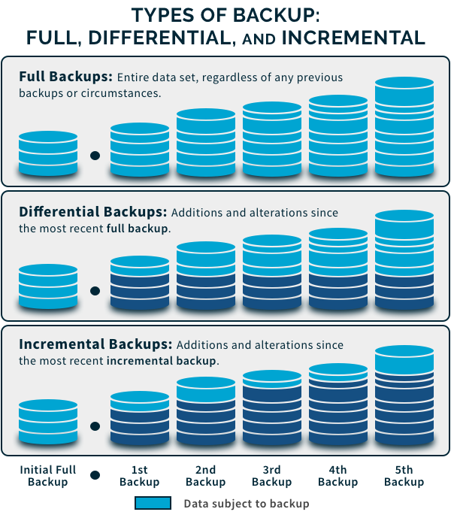
Backup Types
Normal
Copy
Incremental
Differential
Daily
Notes:
These terms refer to different types of backup strategies used to safeguard data:
Normal (Full) backup: In a normal or full backup, all the selected data is backed up completely. This method provides the highest level of data protection, but it can be time-consuming and requires more storage space. Restoring from a full backup is typically faster than other backup types, as all the data is in one location.
Copy backup: A copy backup is similar to a full backup, but it does not affect the archive bit or other markers used to track changes. This means that running a copy backup will not interfere with the schedule of incremental or differential backups. Copy backups are useful for creating additional copies of data without disrupting the backup routine.
Incremental backup: Incremental backups only save the changes made since the last successful backup, whether it was a full, incremental, or differential backup. This method reduces the amount of storage space and time needed for backups but requires more time during restoration, as data from the full backup and all subsequent incremental backups must be combined. The archive bit is typically reset after an incremental backup.
Differential backup: Differential backups save all changes made since the last successful full backup. This means that each differential backup contains all the modifications since the last full backup, regardless of the number of differential backups performed. Restoring from a differential backup is faster than an incremental backup, as you only need the last full backup and the most recent differential backup. However, differential backups can require more storage space compared to incremental backups. The archive bit is not reset in this backup type.
Daily backup: Daily backups involve backing up any files that have been modified within the past 24 hours, typically based on the system's date. Unlike incremental or differential backups, daily backups do not rely on the archive bit or other tracking mechanisms. This backup type can be useful for capturing daily snapshots of your data, but restoration may involve combining data from multiple daily backups, depending on the changes made.
Choosing the right backup strategy depends on factors such as data size, available storage space, backup frequency, and acceptable restoration times. It is common to use a combination of these backup types to achieve an optimal balance between data protection and resource utilization.

Slide 7
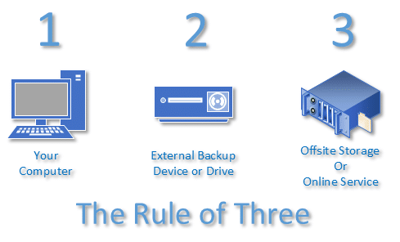
Backup Locations
Locally attached storage
Network attached storage
Internet or cloud-based
Notes:
The Rule of Three, also known as the 3-2-1 backup rule, is a widely recommended best practice for creating a reliable and robust backup strategy. The rule provides a straightforward approach to help prevent data loss and ensure that your data is safe and easily recoverable in case of any disasters or failures. The rule consists of the following guidelines:
Keep at least three copies of your data: This includes the original data and at least two backup copies. Having multiple copies ensures that if one backup fails, you still have another one to fall back on.
Use at least two different storage media: Store your backups on at least two different types of storage media, such as an external hard drive, cloud storage, or a network-attached storage (NAS) device. Using different media types reduces the risk of a single storage media failure leading to data loss.
Keep one backup copy offsite: Store at least one backup copy in a geographically separate location, such as a secure cloud storage provider or an offsite storage facility. This protects your data against local disasters such as fires, floods, or theft that could potentially destroy all local copies of your data.
By following the 3-2-1 rule, you can greatly reduce the risk of losing valuable data and ensure that you can recover from various data loss scenarios.

Slide 8
Backup Frequency and Scheduling
Frequency depends on rate of change and importance
Scheduling prevents forgetting
Notes:
**Frequency and Scheduling in Backups:**
The frequency of backups refers to how often you create copies of your data to ensure its safety. This frequency is determined by two main factors: the rate of change of your data and its importance.
**Rate of Change:**
Some data changes frequently, like files in a work project that you're actively editing. Other data changes rarely, like old family photos that remain unchanged over time. The more often your data changes, the more frequently you should back it up. This prevents loss of recent changes in case of data corruption or hardware failure.
**Importance:**
The importance of your data also plays a role in determining how often you should back it up. Critical data that would be difficult or impossible to replace, such as business documents or personal records, should be backed up more frequently than less important data.
**Scheduling:**
Setting a backup schedule helps ensure that backups occur regularly without the need for manual intervention. It's like setting a recurring reminder to perform a task. By scheduling backups, you reduce the risk of forgetting to back up your data, especially when life gets busy.
For instance, if you're working on a project that involves frequent updates, scheduling daily backups might be necessary. On the other hand, family photos that hardly change may only need monthly backups.
In summary, the frequency of backups depends on how often your data changes and how important it is. Scheduling backups helps automate the process, reducing the chance of forgetting to back up important information. By tailoring your backup strategy to your data's dynamics and significance, you're ensuring its safety and availability in case of unexpected events.

Slide 9
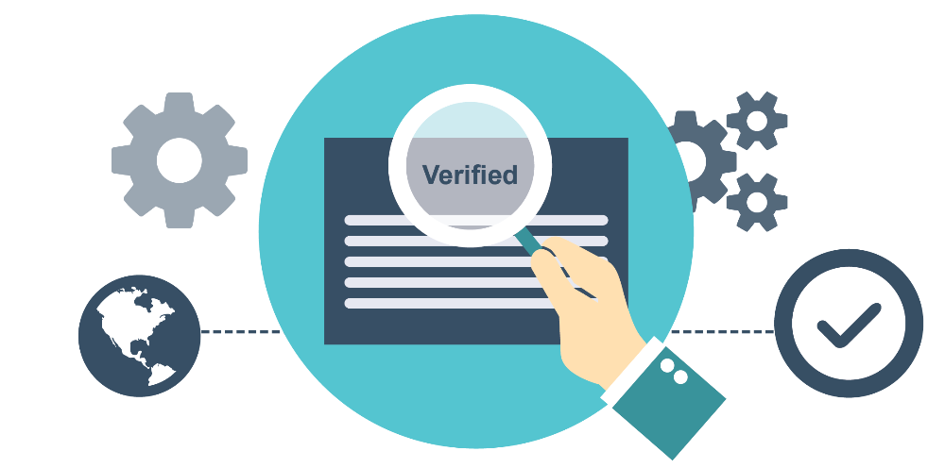
Backup Verification and Testing
Important step
Frequently overlooked
Won’t know something is wrong until it’s too late
Notes:
Backup verification and testing are crucial steps in the backup process, often overlooked but with immense importance. They serve as a way to ensure that your backups are reliable and can be successfully restored if needed.
**Importance of Verification and Testing:**
Think of it like double-checking your work. Just as you would review an important document before submitting it, verifying and testing backups confirms that your data is securely stored and can be recovered without hiccups. This step prevents situations where you assume your backups are valid, only to discover a critical error when you actually need to restore them.
**Why It's Overlooked:**
Verification and testing are sometimes seen as time-consuming and unnecessary steps. People may assume that since their backup software says the process is complete, everything is fine. However, errors can occur, and it's not uncommon for data corruption or other issues to arise during the backup process.
**Discovering Problems Before It's Too Late:**
Imagine discovering that your car's brakes don't work when you're already speeding down a hill. Similarly, finding out that your backups are faulty during a data loss event can be disastrous. Verifying and testing backups lets you catch any issues before they become critical.
**How Verification and Testing Work:**
Verification involves confirming that the backup files are accurately copied and haven't been corrupted. Testing goes a step further by attempting to restore data from the backup. This process ensures that the backed-up data can indeed be recovered successfully.
**Regularly Scheduled Testing:**
It's wise to schedule regular testing, like fire drills, to confirm that your backup strategy is effective. This involves simulating a data loss event and restoring data from the backup to ensure everything works smoothly. If any problems are identified, you can address them before an actual emergency occurs.
In a nutshell, backup verification and testing are like a safety net for your data. Just as you wouldn't trust a parachute without checking it, you shouldn't trust your backups without confirming their reliability. By dedicating time to these steps, you're minimizing the risk of data loss and ensuring that your efforts to protect your data are indeed effective.

Slide 10
Disaster Recovery
Have a plan in place
Train appropriate personnel on plan
Clearly documented
Notes:
Disaster recovery is like having a well-rehearsed emergency response plan for your data and systems. It involves preparing for worst-case scenarios, such as server crashes, data breaches, or natural disasters, and having a clear plan in place to quickly restore operations and minimize downtime.
**Creating a Disaster Recovery Plan:**
Think of it as creating a detailed playbook for handling emergencies. Just as a sports team practices various plays, a disaster recovery plan outlines step-by-step actions to take when a crisis hits. This includes who does what, how to access backups, and how to restore systems.
**Training Personnel:**
Imagine emergency responders receiving specialized training. Similarly, the key personnel responsible for disaster recovery should be trained on the plan's procedures. This ensures that everyone knows their roles and can act swiftly when needed, reducing confusion and potential mistakes during high-pressure situations.
**Clear Documentation:**
Documentation is like a map guiding you through unfamiliar terrain. Your disaster recovery plan should be well-documented, providing clear instructions that anyone can follow. This documentation is crucial not only for training personnel but also for executing the plan accurately and efficiently during a crisis.
**Why It Matters:**
Disasters are unpredictable, and without a plan, you're essentially navigating the storm without a compass. Having a solid disaster recovery plan in place prepares you for the unexpected, helping you recover data and operations more swiftly. It's not just about preventing downtime; it's about ensuring business continuity and minimizing the impact of disruptions.
**Testing and Revising:**
Consider it like a fire drill. Just as you periodically practice fire drills to ensure everyone knows the escape routes, you should regularly test your disaster recovery plan. This helps identify any weaknesses or changes needed and ensures that the plan stays up-to-date and effective.
**Staying Prepared:**
Disaster recovery is about being proactive rather than reactive. It's like having a spare tire in your car—you hope you won't need it, but it's there just in case. By having a well-thought-out plan, trained personnel, and clear documentation, you're ready to face unexpected challenges and ensure that your data and systems can recover from any disaster.

Slide 11
Troubleshooting Theory
Identify the problem
Research knowledge sources, if applicable
Establish a theory of what’s wrong
Test the theory
Establish a plan of action to fix the problem
Implement the solution
Verify functionality
Document the findings
Notes:
Troubleshooting theory is like solving a puzzle to figure out what's causing an issue with a computer, device, or system. It's a systematic approach that helps you methodically address problems and find effective solutions.
**Identify the Problem:**
Think of it as recognizing that something is amiss. You start by acknowledging that there's a problem, whether it's a software glitch, hardware malfunction, or any other issue affecting functionality.
**Research Knowledge Sources:**
Just like consulting a manual or asking for advice, you gather information about the problem. This could involve looking up error messages, searching online forums, or checking official documentation to better understand the issue.
**Establish a Theory:**
This is like forming a hypothesis in a science experiment. Based on your research and understanding of the problem, you develop an educated guess about what might be causing the issue. This theory guides your troubleshooting process.
**Test the Theory:**
Imagine conducting experiments to confirm your hypothesis. You take steps to see if your theory holds true by performing tests, running diagnostics, or checking specific conditions that could confirm or rule out your initial guess.
**Plan of Action:**
Think of it as plotting your course of action. You create a detailed plan outlining the steps you'll take to address the problem based on your theory. This plan helps keep you organized and focused during the troubleshooting process.
**Implement the Solution:**
Similar to fixing a mechanical issue in a car, you take action to address the problem based on your plan. This could involve adjusting settings, updating software, or replacing faulty components.
**Verify Functionality:**
Imagine test-driving a car after fixing it. You check to see if the changes you made have resolved the problem and restored normal functionality. This step confirms whether your solution was successful.
**Document the Findings:**
Just as a scientist records experiment results, you document what you did, what worked, and any relevant details. This documentation becomes valuable for future reference and can help others facing similar issues.
**Why It Matters:**
Troubleshooting theory is essential because it helps you tackle problems systematically and avoid random trial-and-error approaches. By following a structured process, you're more likely to identify the root cause of an issue and implement effective solutions.
**Continuous Learning:**
Troubleshooting isn't just about fixing one problem—it's a skill that grows with experience. Just like a detective learns from each case, you learn from each troubleshooting situation, which improves your ability to address a wide range of issues in the future.

Slide 12
Identifying the Problem
Talk to the user/customer
Gather information
Try to isolate the issue
When/where/how does it happen
Notes:
Certainly, let's break down the process of troubleshooting a technical issue step by step:
**1. Talk to the User/Customer:**
Initiate a conversation with the user to get a clear understanding of the problem they are facing. Encourage them to describe the issue in their own words and provide any relevant details. Actively listen to their description without making assumptions.
**2. Gather Information:**
Ask specific questions to collect essential information. Find out details such as the device they're using, the software involved, any error messages displayed, recent changes made, and the tasks they were trying to complete when the problem occurred.
**3. Try to Isolate the Issue:**
Analyze the information gathered to narrow down the possible causes of the problem. Determine if the issue is related to hardware, software, network connectivity, or a combination of factors. This helps you focus your troubleshooting efforts effectively.
**4. Understand When/Where/How It Happens:**
Probe for details about the circumstances surrounding the issue. Ask when the problem started occurring, where the user was at the time, and what specific actions triggered the problem. This helps you identify patterns and potential triggers.
**5. Research Possible Solutions:**
Based on the information gathered, explore potential solutions. Consult knowledge bases, documentation, or relevant resources to find solutions that match the symptoms described by the user.
**6. Test the Solutions:**
Implement the solutions one by one, testing each to see if it resolves the issue. This could involve adjusting settings, reinstalling software, or performing specific actions based on the recommended solutions.
**7. Implement the Final Solution:**
Once you identify a solution that works, apply it to address the problem. Make sure the user understands the steps you're taking and the changes being made.
**8. Verify Functionality:**
After applying the solution, check if the problem is resolved as expected. Test the system or application to ensure that the issue no longer persists.
**9. Communicate and Document:**
Inform the user of the steps taken and the solution applied. Document the entire troubleshooting process, including the problem description, solutions attempted, and the final solution that resolved the issue. This documentation can be valuable for future reference.
Throughout this process, effective communication with the user is key. By following these steps, you're systematically working through the issue, identifying potential solutions, and ensuring that the problem is resolved to the user's satisfaction.

Slide 13
Research Knowledge Sources
Manuals
Manufacturer web sites
Google
Forums/blogs
Notes:
Absolutely, here's a more expanded explanation of various knowledge sources you can rely on when troubleshooting technical issues:
**1. Manuals:**
Official product manuals and documentation provided by manufacturers offer detailed information about hardware, software, and devices. These manuals include setup guides, user manuals, technical specifications, and troubleshooting instructions.
**2. Manufacturer Websites:**
Manufacturers often have dedicated websites where you can find product information, FAQs, troubleshooting guides, software updates, and driver downloads. These resources are reliable and tailored to their products.
**3. Online Search Engines (Google):**
Using search engines like Google is a common practice for troubleshooting. Enter the symptoms or keywords related to the issue, and you may find forum discussions, blog posts, and articles that provide solutions shared by other users and experts.
**4. Forums and Blogs:**
Online forums and blogs are platforms where users and experts share their experiences and solutions to common problems. Websites like Stack Exchange, Reddit, and specialized forums related to specific software or hardware can be valuable sources of information.
**5. Knowledge Bases and Support Portals:**
Many software developers and hardware manufacturers maintain comprehensive knowledge bases and support portals. These repositories contain articles, tutorials, troubleshooting guides, and step-by-step instructions to address common issues.
**6. Online Communities and Social Media:**
Communities on platforms like Reddit, Quora, and LinkedIn can be helpful for finding solutions to technical problems. You can also reach out to experts on social media platforms who are willing to assist.
**7. Vendor-Specific Support Channels:**
Reach out to official customer support channels provided by the manufacturer. They may offer phone, email, or live chat support to help troubleshoot and resolve issues.
**8. User Groups and User Manuals:**
User groups and forums specific to a product, software, or technology can be valuable sources of real-world experiences and solutions shared by fellow users.
**9. YouTube Tutorials:**
Video tutorials on platforms like YouTube can visually guide you through troubleshooting steps. Video content can be especially useful for visual learners.
**10. Professional Networks and Peers:**
If you're part of a professional network or have peers with expertise in the area, they can provide guidance and solutions based on their experiences.
Remember to critically evaluate the reliability of the sources and ensure that the information you're using comes from reputable and trustworthy sources. By exploring these knowledge sources, you can gather a range of perspectives and solutions to effectively address technical issues.

Slide 14
Establish a Theory
Question the obvious
Eliminate possibilities
Divide and conquer
Notes:
**Question the Obvious:**
**Eliminate Possibilities:**
Systematically eliminate potential causes of the problem by testing each one. Start with the most likely scenarios and work your way down the list. By ruling out possibilities, you narrow down the range of potential causes and refine your theory.
**Divide and Conquer:**
Break down the problem into smaller components or sections. Test each part individually to identify which specific area is causing the issue. This approach helps you pinpoint the source of the problem and establish a more accurate theory.
**Consider Context and Patterns:**
Examine the context of the problem and look for patterns. Is the issue occurring under specific conditions or in certain scenarios? Analyze if there are any common factors that could be contributing to the problem.
**Gather Data and Evidence:**
Collect relevant data, logs, error messages, and any information that can provide insights into the problem. Analyze this data to identify trends and correlations that can guide you in forming a theory.
**Collaborate and Consult:**
Engage with colleagues, online forums, or other experts who might have encountered similar issues. Their insights and experiences can contribute to forming a well-rounded theory.
**Consider Multiple Theories:**
Be open to multiple possible explanations for the issue. Formulating alternative theories helps you explore different angles and ensures that you're not fixated on a single solution.
**Test and Validate:**
Once you've established a theory, conduct tests to validate it. Implement the solutions or actions that are based on your theory and observe the results. If your theory is correct, the problem should either be resolved or show improvement.
**Refine and Iterate:**
If your initial theory doesn't yield the expected results, don't be discouraged. Use the feedback from your tests to refine and adjust your theory. Iterate through the process until you identify the root cause and an effective solution.
Establishing theories during troubleshooting is a systematic and logical process that involves critical thinking, data analysis, and a willingness to explore different possibilities. By following these steps, you increase your chances of accurately identifying the underlying problem and finding an appropriate solution.

Slide 15
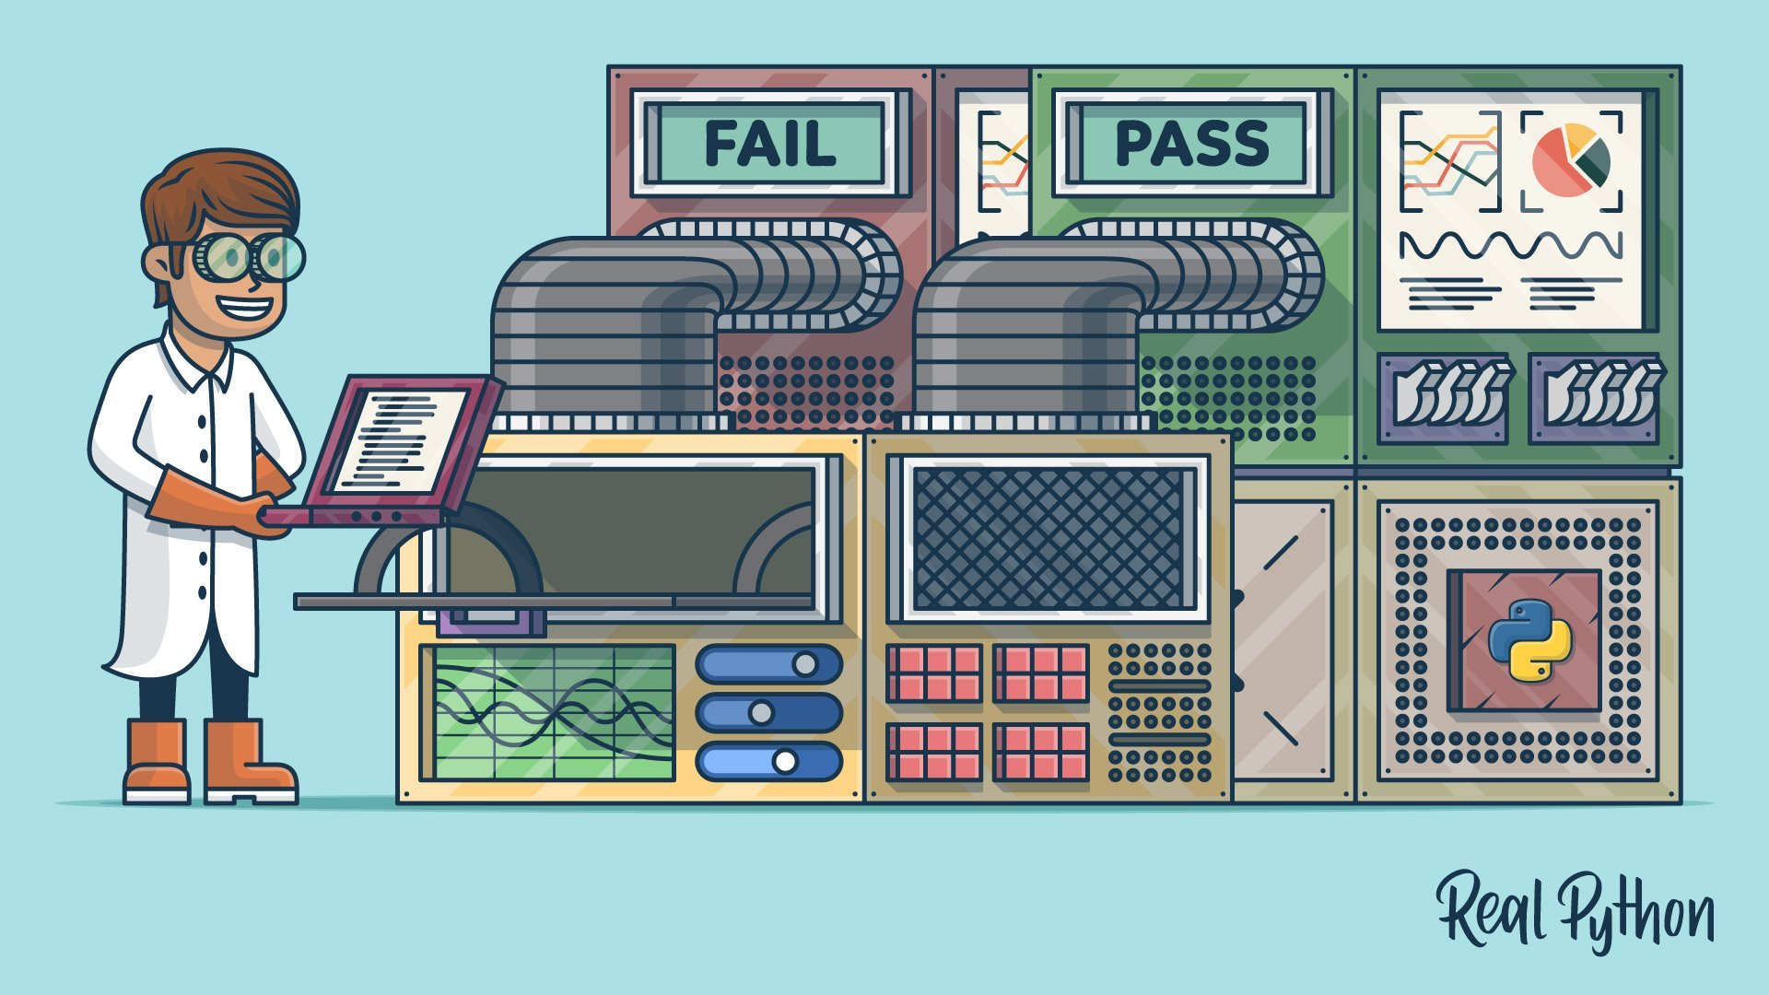
Testing the Theory
Check the simple stuff first
Check to see if it’s user error
Restart the computer
Notes:
**Check the Simple Stuff First:**
Before delving into complex solutions, always start by checking the basics. Verify that all cables are properly connected, devices are powered on, and any physical components are in good condition. Sometimes, the issue might be as simple as a loose cable or a disconnected power source.
**Check for User Error:**
User error is a common cause of technical issues. Politely and respectfully inquire about the steps the user took before the problem occurred. Sometimes, a small mistake or misunderstanding in using a device or software can lead to perceived issues.
**Restart the Computer or Device:**
Restarting the computer or device can resolve various minor glitches and software-related problems. This action clears temporary caches and resets processes that might be causing the issue. It's a quick and effective way to eliminate common issues without diving into complex troubleshooting steps.
**Examine Error Messages:**
If there are error messages or alerts, carefully read and analyze them. Error messages often provide valuable information about the nature of the problem, and they might suggest specific actions to take.
**Isolate the Issue:**
If the issue is occurring with a specific program or component, try to isolate it. Test the affected program or component separately to determine if the issue persists. This helps in identifying whether the problem is localized or systemic.
**Check for Recent Changes:**
Inquire if any recent changes were made to the system, such as software installations, updates, or configuration changes. Sometimes, issues arise after updates or changes that could have unintended consequences.
**Try Different User Accounts:**
If the problem is user-specific, try logging in with a different user account. If the issue doesn't occur with another user account, it suggests that the problem might be related to the user's profile or settings.
**Use Diagnostic Tools:**
Many operating systems and devices come with built-in diagnostic tools that can help identify and resolve issues. These tools can perform hardware tests, check system logs, and provide insights into potential problems.
**Document Your Steps:**
As you test the theory and take various actions, document each step you've taken. This documentation is crucial for tracking your progress and ensuring that you don't repeat unsuccessful steps.
By following these testing steps, you systematically rule out common and straightforward causes of the problem. This approach helps you efficiently narrow down the possibilities and move closer to identifying the actual root cause of the issue.

Slide 16
Establishing a Plan of Action
The fix might or might not have worked
If needed, try again
Spread the solution as needed
Document the solution (take notes)
Notes:
**The Fix Might or Might Not Have Worked:**
After implementing a solution, carefully observe whether the problem has been resolved. Sometimes, the issue might persist, or new issues might arise as a result of the attempted solution. Take note of any changes, improvements, or lack thereof.
**If Needed, Try Again:**
If the initial fix didn't work or only partially resolved the issue, don't be discouraged. Troubleshooting often requires multiple iterations. Analyze the situation to determine whether the solution needs to be refined, adjusted, or attempted again with different parameters.
**Spread the Solution as Needed:**
If the solution successfully resolves the problem, consider whether it can be applied to other similar scenarios. If the issue you've resolved is something that others might encounter, share the solution with colleagues, team members, or the broader community. This not only helps others facing the same problem but also reinforces your role as a valuable resource.
**Document the Solution (Take Notes):**
Recording the steps you took to identify and solve the problem is crucial. Create detailed documentation that outlines the issue, the steps you took, the solution you applied, and the outcome. Include any relevant error messages, configuration changes, or diagnostic results. These notes will serve as a valuable reference in case the same or a similar issue arises in the future.
**Consider Long-Term Solutions:**
While the immediate focus is on resolving the current issue, also think about whether there are any underlying causes that could lead to similar problems in the future. Addressing these root causes can prevent recurring issues and enhance the overall stability of the system.
**Communicate with Stakeholders:**
If the problem affected other individuals or teams, communicate the resolution to them. Transparent communication helps build trust and ensures that everyone is aware of the status of the issue.
**Reflect on the Process:**
After completing the troubleshooting process and documenting the solution, take a moment to reflect on the experience. Consider what you learned, whether there were any unexpected challenges, and how you might approach similar problems differently in the future. This reflective practice contributes to your growth as a troubleshooter.
By following these steps, you not only resolve the immediate issue but also contribute to a culture of continuous improvement and knowledge sharing within your organization or community.

Slide 17
Implement the Solution
If the problem was isolated, you may not need this step
Reapply fix to other computers as needed
Escalate if necessary
Notes:
**Implementing Solutions:**
When you've successfully identified the root cause of the problem and devised a solution, the next step is to implement that solution. This involves applying the necessary changes, configurations, or fixes to the affected systems or components.
**Considering Isolation:**
If the problem was isolated to a specific instance and doesn't have wider implications, you may not need to go through a full-scale implementation process. For example, if the issue was caused by a single misconfiguration on a particular machine, you can apply the fix directly to that machine without affecting others.
**Reapplying Fix to Other Computers:**
If the problem was systemic and affected multiple systems or components, you should replicate the solution across those affected entities. This could involve configuring settings, applying patches, updating software, or making similar changes to ensure consistent performance and functionality.
**Escalation if Necessary:**
In some cases, the issue might be complex or beyond your expertise to resolve. If your initial attempts at solving the problem have been unsuccessful, or if the problem requires specialized knowledge or higher-level intervention, it's time to escalate the issue. Escalation involves involving experts, managers, or support teams who have the required skills and authority to address the problem effectively.
**Considering the Impact of Changes:**
Before implementing a solution, especially in a production environment, consider the potential impact of the changes. Will the solution disrupt ongoing operations or affect other systems? Implement solutions during scheduled maintenance windows whenever possible to minimize disruptions.
**Documentation and Communication:**
As with the previous steps, documentation is vital during implementation. Record the steps you took, the changes you made, and any configurations you modified. This documentation serves as a reference for future troubleshooting efforts and helps others understand what changes were made.
**Test the Solution:**
Before fully deploying the solution, it's a good practice to test it in a controlled environment. This can help identify any unforeseen issues or conflicts that might arise when the solution is rolled out to a broader audience.
**Follow-Up and Monitoring:**
After implementing the solution, continue monitoring the system to ensure that the problem is indeed resolved and that no new issues arise as a result of the changes. This post-implementation monitoring phase ensures that the solution continues to work effectively over time.
In essence, the implementation phase involves applying the solution you've identified in a careful and well-coordinated manner. This ensures that the problem is effectively addressed, and the systems can resume normal operations without further interruptions.

Slide 18
Verifying Functionality
Be sure the error or problem is not coming back
Check other major systems or applications to ensure the fix didn’t cause obvious problems
Notes:
Absolutely, let's delve into the process of verifying functionality after implementing a solution:
**Verifying Functionality:**
After you've implemented a solution to address a problem, the next critical step is to verify whether the solution was effective and if the problem has been fully resolved. Verification helps ensure that the issue has been completely addressed and that no unintended consequences have arisen from the changes made.
**Confirming Problem Resolution:**
Before you consider the issue fully resolved, you should thoroughly test the system or component where the problem occurred to ensure that the symptoms have disappeared. This might involve reproducing the conditions that initially led to the problem to see if it recurs.
**Stress Testing:**
If the issue was related to performance or stability, consider conducting stress testing or load testing to assess how well the system handles various levels of demand. This helps ensure that the problem won't resurface under heavy usage conditions.
**Check for Side Effects:**
As you verify the functionality, be vigilant about any potential side effects caused by the implemented solution. Sometimes, a solution designed to fix one problem might inadvertently introduce new issues or conflicts in other areas. Thoroughly testing related systems or applications can help identify any such unintended consequences.
**Regression Testing:**
If the solution involved changes to software or configurations, perform regression testing. This means checking whether other functionalities or features of the system have been affected by the changes. It's essential to ensure that the implemented solution doesn't break something else in the process.
**User Feedback:**
If the problem was initially reported by users, seek feedback from them after implementing the solution. This helps you confirm from the user's perspective whether the issue has been resolved to their satisfaction.
**Monitoring:**
Continued monitoring is crucial, even after verifying functionality. Watch the system closely in the hours and days following the implementation to ensure that the problem doesn't reappear and that no new issues arise as a result of the changes.
**Documentation:**
Remember to document the results of your verification process. Record whether the issue was resolved, any testing you conducted, and any observations about the system's behavior before and after the solution was applied. This documentation aids future troubleshooting efforts and helps build a knowledge base for similar issues.
**Communication:**
If the solution involved multiple teams or stakeholders, communicate the results of your verification. Provide updates on the status of the problem, the solution applied, and the successful verification. This transparent communication fosters collaboration and ensures that everyone is on the same page regarding the resolution.
In summary, verifying functionality ensures that the implemented solution has indeed addressed the problem and that no new issues have arisen in the process. This step is essential for maintaining system stability, user satisfaction, and the overall health of the technology environment.

Slide 19
Document the Work
Most critical step!
Carry a notebook
Design a process that works for you
Use openly available journals if multiple people troubleshoot problems
Notes:
**Importance of Documentation:**
Documenting your troubleshooting process and the solutions you implement serves multiple important purposes:
1. **Knowledge Retention:** Documenting your actions helps you remember the steps you've taken, which can be valuable if you encounter a similar issue in the future.
2. **Knowledge Sharing:** Clear documentation allows others, including colleagues and future team members, to understand and replicate your troubleshooting process, even if they weren't involved in the initial problem-solving.
3. **Efficiency:** Documenting your work can save time. When a similar issue arises in the future, you can refer to your documentation rather than starting from scratch.
4. **Accountability:** Documentation provides a record of the actions you've taken. It can be helpful in situations where accountability and transparency are important.
**Effective Documentation Practices:**
1. **Detailed Notes:** Keep detailed notes of each step you take during the troubleshooting process. Include information about the problem, the steps you've tried, and the results you've observed.
2. **Time Stamps:** Include timestamps to track when you performed specific actions. This can be useful for identifying patterns or understanding how long each step took.
3. **Tools Used:** Note the tools, software, or equipment you used during troubleshooting. This can be valuable information for replicating the process.
4. **Error Messages:** If you encountered error messages, record them accurately. They can provide important clues for diagnosing the issue.
5. **Screenshots and Logs:** If relevant, take screenshots of error messages, system configurations, or any abnormal behavior. Additionally, save relevant log files.
6. **Solutions Tried:** Document the solutions you attempted, even if they didn't work. This prevents you from retracing your steps and trying the same failed solutions in the future.
7. **Results:** Describe the results of each step. Did the solution work? Did it partially work? Did it create new issues?
8. **Final Resolution:** Once the issue is resolved, clearly state the final solution and its outcomes.
**Shared Documentation:**
If multiple people are involved in troubleshooting within a team or organization, having a centralized and shared documentation system is highly beneficial. This could be an internal knowledge base, a shared drive, or a collaborative platform. When multiple people contribute to documentation, it ensures consistency and allows team members to build on each other's knowledge.
**Updating Documentation:**
Remember that documentation isn't static; it should be updated as needed. If you encounter new information related to the issue or if you find a more efficient solution later on, update the documentation accordingly.
In essence, documenting your troubleshooting process is like creating a map for yourself and others to navigate similar challenges in the future. It's a valuable practice that enhances efficiency, knowledge sharing, and the overall effectiveness of your problem-solving efforts.

Slide 20
Troubleshooting Examples
Computer won’t boot up
Operating system errors
Application failures
Hardware failures
Notes:
Troubleshooting is an essential skill in the world of technology, and it involves systematically identifying and resolving issues that can arise in various aspects of computing. Let's break down the troubleshooting process for the specific scenarios you mentioned:
**1. Computer Won't Boot Up:**
When a computer fails to start up properly, it can be due to a variety of reasons:
- **Power Issues:** Ensure the power source and cables are connected properly, and there's power to the system.
- **Hardware Connection:** Check that components like RAM, graphics card, and hard drive are properly seated.
- **Corrupted BIOS:** Resetting the BIOS to default settings might help.
- **Hardware Failure:** If all else fails, hardware components like the motherboard or power supply might be faulty.
**2. Operating System Errors:**
If you encounter errors while the operating system is running, consider these steps:
- **Restart:** Sometimes, a simple restart can resolve temporary glitches.
- **Safe Mode:** Boot into safe mode to isolate the issue. Safe mode loads the OS with minimal drivers and settings.
- **Check for Updates:** Ensure the operating system and drivers are up-to-date.
- **System Restore:** Roll back to a point where the system was functioning correctly using System Restore (Windows) or Time Machine (Mac).
**3. Application Failures:**
When specific applications crash or behave abnormally:
- **Restart:** Close the application and restart it.
- **Check for Updates:** Ensure the application is updated to the latest version.
- **Corrupted Files:** If a particular file is causing the issue, try opening other files or reinstalling the software.
- **Compatibility:** Verify if the application is compatible with your operating system and hardware.
**4. Hardware Failures:**
Hardware issues can be challenging, and the following steps might help:
- **Diagnostic Tools:** Many systems have built-in diagnostics to identify hardware problems.
- **Temperature Monitoring:** Overheating can cause crashes. Ensure proper ventilation and cooling.
- **Hardware Tests:** Use third-party tools to test individual hardware components like memory, hard drive, and graphics card.
- **Replacement:** If a specific hardware component is identified as faulty, consider replacing it.
Remember, each troubleshooting scenario might require a different approach, and it's important to follow a systematic process. Start by identifying the problem, gathering information, and then proceed with isolating and testing potential solutions. Document each step and result to help you if the issue reoccurs or if you need to share your findings with others. Keep in mind that patience and persistence are key when troubleshooting, as some issues might be more complex to resolve than others.

Slide 21
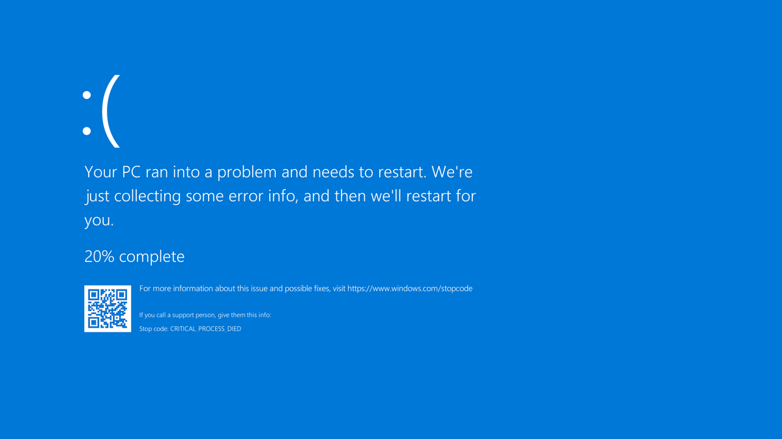
Computer Won’t Boot
Nothing on the monitor
Black screen or blue screen
Windows won’t load
Using Safe Mode
Using System Restore
Using the System Configuration utility
Using the Recovery Environment
Mac OS X won’t load
Notes:
Encountering boot issues can be frustrating, but with the right approach, you can often resolve the problem. Here's how to tackle some common boot-related problems:
**1. Nothing on the Monitor:**
If you turn on your computer and the monitor remains blank:
- **Check Connections:** Ensure that the monitor's power cable and display cable (HDMI, VGA, etc.) are securely connected to both the monitor and the computer.
- **Monitor Power:** Make sure the monitor is turned on and receiving power.
- **Graphics Card:** If you have a separate graphics card, ensure it's properly seated in the slot.
**2. Black or Blue Screen:**
If your computer displays a black or blue screen after booting:
- **Safe Mode:** Try booting into Safe Mode. This loads the operating system with minimal drivers and settings and can help isolate the issue.
- **Last Known Good Configuration:** On Windows, this option can revert system settings to a previously working state.
- **Check Hardware:** Ensure that RAM and other hardware components are properly seated.
**3. Windows Won't Load:**
If Windows doesn't start properly:
- **System Restore:** Use System Restore to roll back to a point when the system was working.
- **System Configuration Utility (msconfig):** On Windows, you can use this tool to manage startup programs and services.
- **Startup Repair:** Windows has a built-in Startup Repair tool that can fix common boot issues.
**4. Mac OS X Won't Load:**
For Mac users encountering boot problems:
- **Safe Boot:** Similar to Windows, Macs have a Safe Boot mode that loads a minimal environment.
- **Disk Utility:** Boot into Recovery mode and use Disk Utility to repair disk permissions or verify/repair disk errors.
- **Recovery Mode:** This allows you to reinstall macOS or restore from a Time Machine backup.
**5. Blue Screen of Death (Windows):**
A blue screen (BSOD) indicates a serious system error. It's often caused by hardware or driver issues.
- **Note Error Message:** Pay attention to the error message displayed on the blue screen.
- **Check Drivers:** Outdated or incompatible drivers can trigger BSODs. Update drivers or roll them back to a previous version.
- **Hardware Issues:** RAM, hard drive, and graphics card problems can cause BSODs. Test hardware components if necessary.
Boot issues can stem from a variety of causes, including hardware conflicts, driver problems, software errors, and even malware. The key is to methodically troubleshoot, starting with simple solutions and gradually moving to more complex ones. Keep in mind that if you're unsure or uncomfortable with advanced troubleshooting, it's a good idea to seek help from a knowledgeable friend or a professional technician.

Slide 22
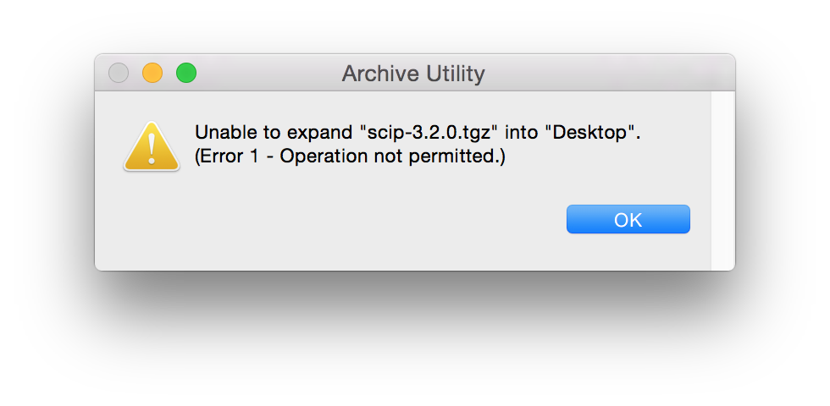
Operating System Errors
Look for error messages online
OS slowdown or lockup could be overheating
Notes:
Encountering errors with your operating system (OS) can be frustrating, but there are steps you can take to diagnose and potentially resolve these issues:
**1. Error Messages:**
When you encounter an error message on your computer, note down the exact text of the error. This information can be helpful when researching solutions online. Many error messages have specific codes or keywords that can lead you to relevant troubleshooting resources.
**2. Online Research:**
Search for the exact error message or description online. Many others may have faced the same issue, and forums or official support sites might offer solutions or workarounds. Be cautious of downloading software from unknown sources while searching for solutions.
**3. Overheating and Slowdowns:**
If your OS is experiencing slowdowns or lockups, overheating could be a potential cause. Overheating can lead to performance problems and even system crashes. Here's what you can do:
- **Check Cooling:** Ensure that your computer's cooling system (fans, vents) is working properly and not clogged with dust.
- **Ventilation:** Place your computer in a well-ventilated area to prevent heat buildup.
- **Temperature Monitoring:** Use software tools to monitor the temperature of your CPU and other components. If temperatures are consistently high, consider cleaning or replacing cooling components.
**4. Software Conflicts:**
Sometimes, software conflicts can cause OS errors or slowdowns. Follow these steps:
- **Uninstall Recent Software:** If the problem started after installing new software, try uninstalling it to see if the issue goes away.
- **Update Drivers:** Outdated or incompatible drivers can lead to errors. Make sure your drivers are up to date.
- **Safe Mode:** Boot your computer in Safe Mode to see if the problem persists. Safe Mode loads only essential drivers and can help identify if third-party software is causing the issue.
**5. System File Check (Windows):**
For Windows users, you can use the System File Checker (SFC) tool to scan and repair corrupted system files that might be causing errors. Open the Command Prompt as an administrator and run the command `sfc /scannow`.
**6. Restore Points and Backups:**
If you're encountering errors after a recent change or update, consider using System Restore (Windows) or Time Machine (Mac) to revert your system to a previous state when it was working properly.
**7. Professional Help:**
If you've tried troubleshooting on your own but the issue persists, it might be time to seek help from a professional technician or IT support.
Remember that OS errors can vary widely in their causes and solutions. It's a good practice to back up your important data regularly so that you can restore your system if needed. Additionally, be cautious about making major changes to your system settings without proper guidance or understanding of the potential consequences.

Slide 23
Application Failures
Application fails to install or fails to run
App used to work, but no longer does
Persistent application crashes
Notes:
Encountering issues with applications can be frustrating, but there are steps you can take to troubleshoot and potentially resolve these problems:
**1. Installation Failures:**
If an application fails to install, consider the following steps:
- **Check System Requirements:** Ensure that your computer meets the minimum system requirements for the application. Some applications might not work on older hardware or unsupported operating systems.
- **Administrator Rights:** Install the application using an account with administrative privileges.
- **Antivirus/Firewall:** Temporarily disable your antivirus or firewall and attempt the installation. Sometimes, security software can interfere with installations.
**2. Application Fails to Run:**
If an application used to work but no longer does, try the following:
- **Check for Updates:** Applications might have updates available that address bugs or compatibility issues. Check the application's official website or update functionality within the application itself.
- **Compatibility Mode:** Right-click on the application's executable file, go to Properties, and try running it in compatibility mode for an earlier version of the operating system.
- **Run as Administrator:** Right-click on the application and choose "Run as administrator." This can help bypass certain permissions-related issues.
**3. Persistent Application Crashes:**
If an application frequently crashes, consider these steps:
- **Check for Updates:** Ensure you have the latest version of the application, as updates often include bug fixes.
- **Check System Resources:** Insufficient system resources (such as RAM) can lead to crashes. Close other resource-intensive applications before using the problematic application.
- **Safe Mode:** If the application crashes in normal mode, try running it in Safe Mode. This can help identify if the issue is caused by third-party software or drivers.
- **Event Viewer (Windows):** Check the Windows Event Viewer for error messages related to the application crash. These messages can provide insights into the root cause.
- **Corrupted User Profile:** Create a new user profile and test the application there. If it works fine in the new profile, your original profile might be corrupted.
**4. Application Uninstallation and Reinstallation:**
If an application behaves erratically, you might consider uninstalling and reinstalling it:
- **Uninstall:** Use the standard uninstallation process or a third-party uninstaller tool to remove the application completely.
- **Reinstall:** After uninstalling, download the latest version of the application from the official website and install it again.
**5. Contact Support:**
If none of the above steps resolve the issue, reach out to the application's official support channels. They might have additional troubleshooting steps specific to that application.
**6. System-wide Issues:**
If multiple applications are experiencing issues, it could be due to system-wide problems, such as hardware failures, operating system corruption, or malware infections. In such cases, seeking professional help might be necessary.
Remember that application issues can have various underlying causes. Taking a systematic approach to troubleshooting and ruling out possible factors can help you pinpoint the problem and find a solution.

Slide 24
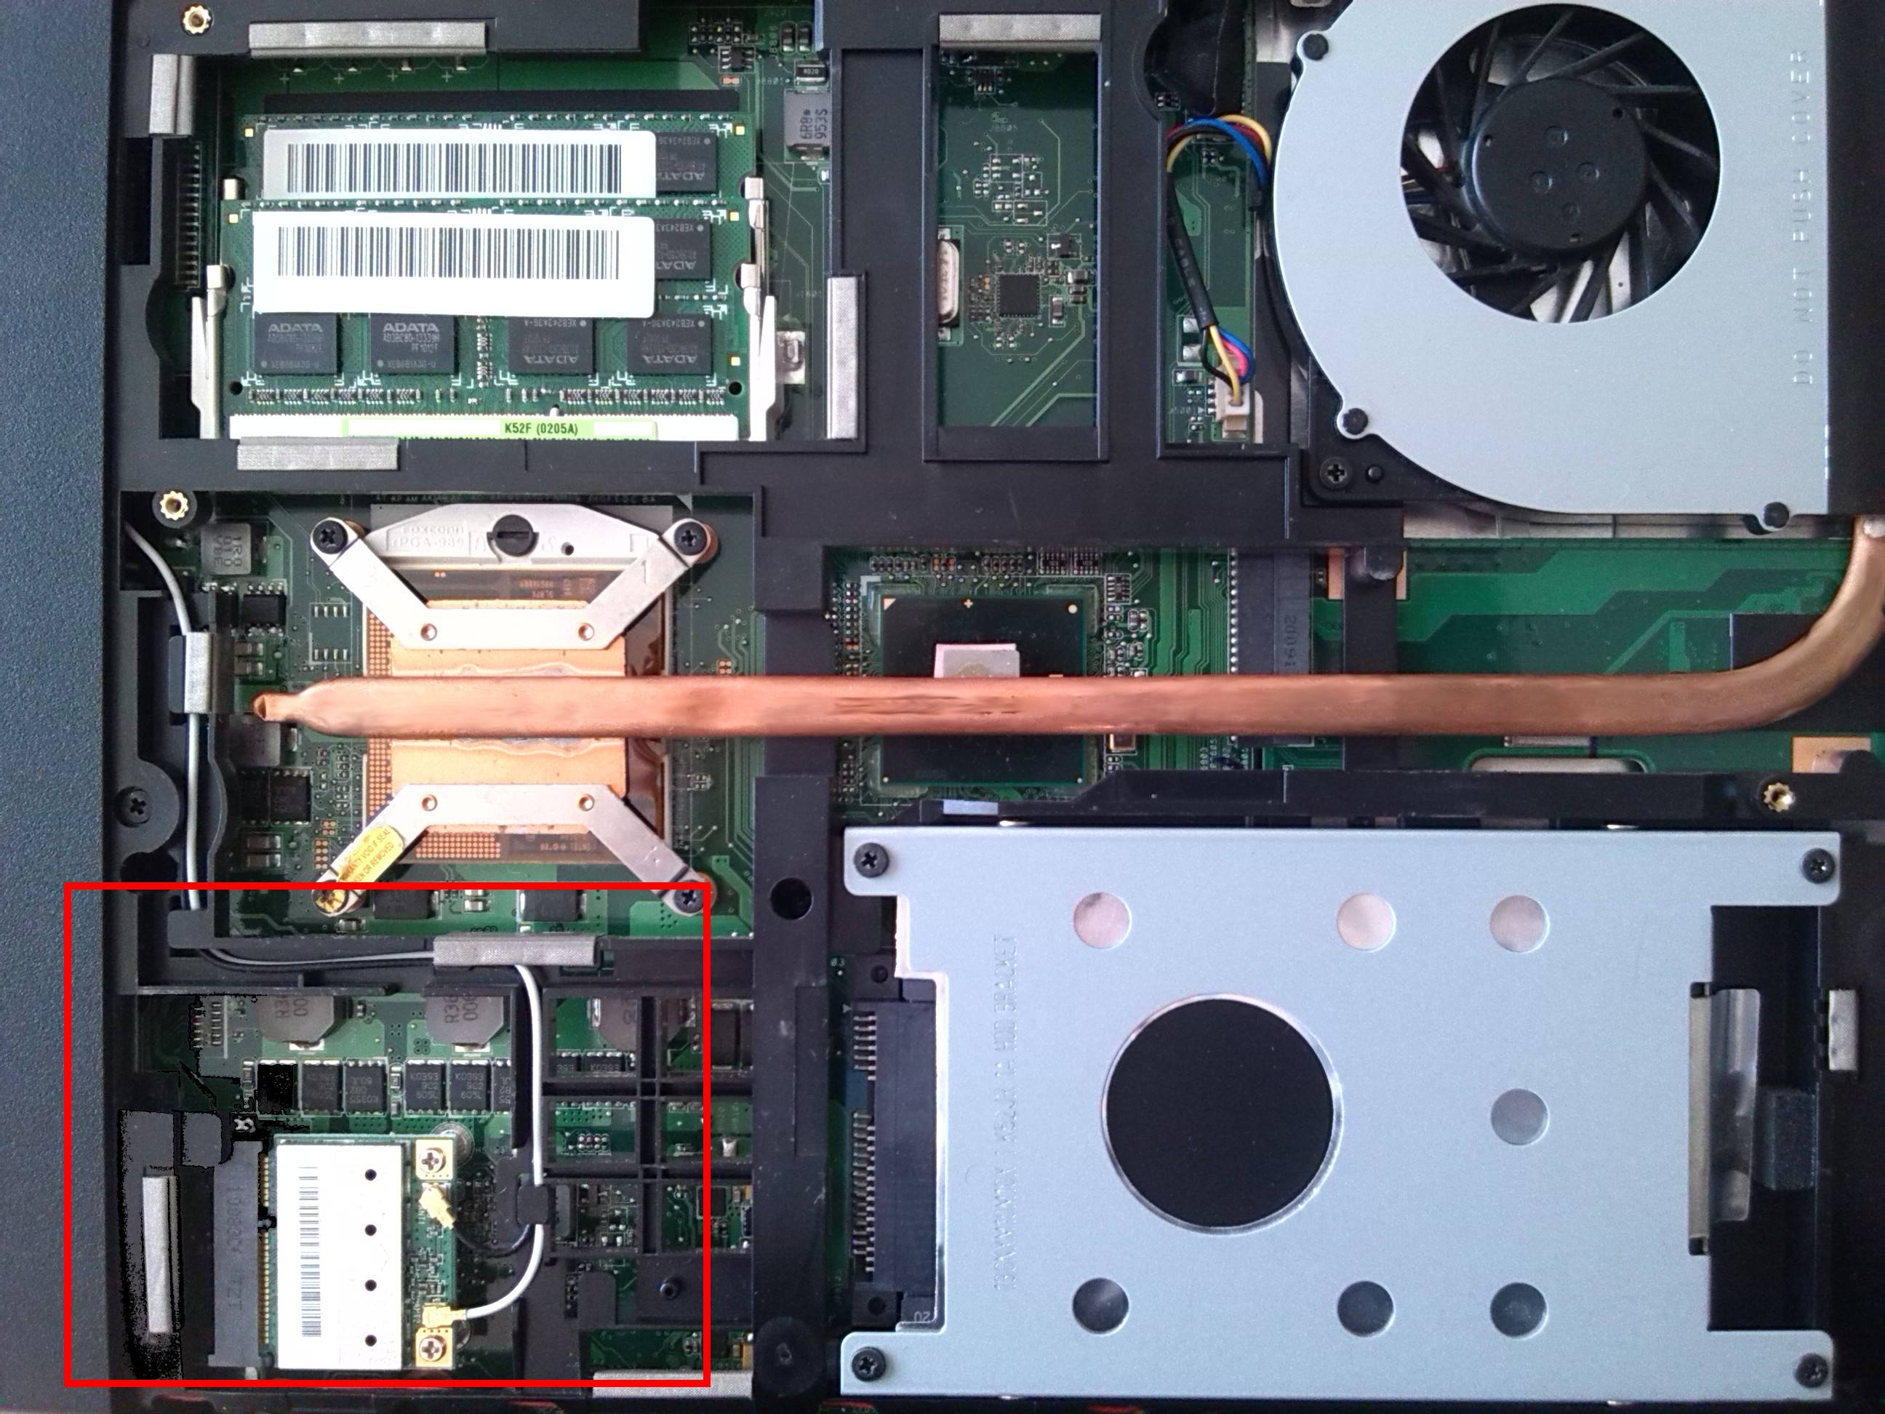
Hardware Failures
Hardware/driver compatibility issues
Malfunctioning input devices
Troubleshooting network connectivity
Notes:
Encountering hardware-related problems can be quite challenging, but with the right approach, you can identify and address the issues:
**1. Hardware/Driver Compatibility:**
If you're experiencing hardware-related problems, consider the following steps:
- **Check Compatibility:** Ensure that all hardware components and peripherals are compatible with your operating system and each other. Manufacturers usually provide compatibility information on their websites.
- **Update Drivers:** Outdated or incompatible drivers can lead to hardware malfunctions. Update your drivers from the manufacturer's official website or through the Device Manager (Windows) or System Preferences (Mac).
**2. Malfunctioning Input Devices:**
Issues with input devices like keyboards, mice, and other peripherals can be frustrating. Try these steps:
- **Check Connections:** Ensure that the device is connected properly to the correct port. Sometimes, loose connections can cause malfunctions.
- **Check for Updates:** Some peripherals might require driver updates for proper functionality. Check the manufacturer's website for the latest drivers.
- **Try on Another Computer:** Test the malfunctioning device on another computer to determine if the issue is with the device itself or your current setup.
**3. Troubleshooting Network Connectivity:**
Network connectivity problems can disrupt your workflow. Here's what you can do:
- **Restart Modem/Router:** Power cycle your modem and router by unplugging them, waiting a few seconds, and then plugging them back in. This can often resolve connectivity issues.
- **Check Network Cables:** Ensure that Ethernet cables are securely connected and not damaged. For wireless connections, check if your Wi-Fi is turned on and connected to the correct network.
- **IP Configuration Issues:** For network-related problems, you can try releasing and renewing your IP address using the command prompt (ipconfig /release and ipconfig /renew on Windows).
- **Network Troubleshooter:** Both Windows and macOS offer built-in network troubleshooters that can help diagnose and fix common network issues.
Remember, hardware issues can vary greatly, and it's important to approach troubleshooting systematically. Gather as much information as you can about the problem, check for updates and compatibility, and consider seeking professional assistance if you're unsure about how to proceed.

Slide 25
Chapter 11: Business Continuity and Computer Support
Explain the troubleshooting methodology
Identify the problem
Research knowledge base/Internet, if applicable
Establish a theory of probable cause
Test the theory to determine the cause
Establish a plan of action to resolve the problem and identify potential effects
Implement the solution or escalate as necessary
Verify full system functionality and, if applicable, implement preventive measures
Document findings/lessons learned, actions, and outcomes
Explain business continuity concepts
Fault tolerance
Replication
Redundancy
Backup considerations
Contingency plan
Disaster recovery
Data restoration
Prioritization
Restoring access
Notes:
**Troubleshooting Methodology:**
1. **Identify the Problem:** Clearly define the issue you're facing. Gather details like error messages, symptoms, and affected systems.
2. **Research Knowledge Base/Internet:** Check available resources, including manuals, forums, and websites, to understand the problem and potential solutions.
3. **Establish a Theory of Probable Cause:** Based on your research, formulate a hypothesis about what might be causing the problem.
4. **Test the Theory:** Put your theory to the test by applying the suggested solution. This could involve adjusting settings, reinstalling software, or trying different configurations.
5. **Plan of Action:** Decide on a course of action to address the problem. Consider potential effects and any risks associated with your plan.
6. **Implement the Solution or Escalate:** Put your plan into action. If your solution works, the problem may be resolved. If not, consider escalating to more experienced colleagues or seeking professional help.
7. **Verify Full System Functionality:** Make sure the issue is completely resolved and that no new problems have arisen due to your solution. Implement preventive measures to avoid similar issues in the future.
8. **Documentation:** Record what you did, the steps you took, and the outcome. This documentation can be invaluable for future reference or for sharing insights with colleagues.
**Business Continuity Concepts:**
**1. Fault Tolerance:**
This involves designing systems to continue functioning even if a component fails. Redundant hardware, such as backup power supplies, ensures that critical systems remain operational during failures.
**2. Replication:**
Replicating data involves creating copies of critical information and distributing them across different locations or servers. This ensures data availability and helps with load balancing.
**3. Redundancy:**
Redundancy involves having backup components or systems ready to take over in case of a failure. For example, redundant servers can quickly take over if the main server goes down.
**4. Backup Considerations:**
Creating regular backups of data is crucial for disaster recovery. Backups should be stored in a secure location to prevent loss due to hardware failures, data corruption, or disasters.
**5. Contingency Plan:**
A contingency plan outlines how a business will continue operating in case of disruptions. It includes steps to take during and after a disruption, often covering aspects like communication, resource allocation, and recovery procedures.
**6. Disaster Recovery:**
Disaster recovery involves quickly restoring normal business operations after a significant disruption. This could involve recovering data from backups, setting up temporary infrastructure, and gradually transitioning back to regular operations.
**7. Data Restoration:**
This is the process of recovering data from backups. It's crucial for retrieving lost or corrupted data and ensuring business continuity.
**8. Prioritization:**
In business continuity planning, it's important to prioritize critical systems and data. Not all components are equally important, so focusing on those that are essential for business operations is key.
**9. Restoring Access:**
Ensuring that employees and stakeholders have access to necessary systems, applications, and data is vital for business continuity.
Business continuity planning aims to minimize disruptions and ensure that a business can continue functioning even in the face of challenges. It involves proactive measures to prevent and prepare for potential problems, as well as reactive strategies for dealing with unexpected issues.

