Slide 1
IT Fundamentals
Chapter 10:
Security Best Practices

Slide 2
Device Hardening
Updating devices and using system passwords
01
Protecting against network threats
02
Removing and disabling software and services
03
Notes:
Device hardening is a process that involves securing and fortifying devices, such as computers, servers, routers, and other hardware, to make them more resistant to cybersecurity threats and attacks. Here's an expansion of the concepts you've mentioned:
**Updating Devices and Using System Passwords:**
Regularly updating devices is crucial for ensuring that known vulnerabilities and weaknesses are patched. Operating systems, applications, and firmware should be kept up to date with the latest security patches and updates. Additionally, using strong and unique system passwords is essential to prevent unauthorized access. Strong passwords should include a combination of letters, numbers, and special characters, and they should be changed periodically.
**Protecting Against Network Threats:**
Devices are often exposed to various network threats, including malware, viruses, and hacking attempts. Implementing firewalls, intrusion detection and prevention systems, and antivirus software helps protect devices from these threats. Firewalls can block unauthorized network traffic, while intrusion detection and prevention systems monitor and respond to suspicious activities.
**Removing and Disabling Software and Services:**
Devices often come with pre-installed software and services that might not be necessary for their intended use. Unused or unnecessary software and services can introduce vulnerabilities. It's important to regularly review the software installed on devices and disable or remove anything that is not needed. This reduces the potential attack surface and minimizes the opportunities for exploitation.
**Minimizing Attack Surfaces:**
Hardening also involves reducing the attack surface by disabling unused ports, services, and protocols. This limits the number of entry points that attackers can exploit. Additionally, unnecessary user accounts should be removed, and access permissions should be configured to adhere to the principle of least privilege, where users and processes are only granted the minimum access required to perform their tasks.
**Enforcing Strong Security Policies:**
Implementing and enforcing security policies helps guide device usage and behavior. Policies can include requirements for password complexity, encryption, data backup, and more. These policies provide a framework for secure practices and ensure consistency across devices.
**Regular Auditing and Monitoring:**
Device hardening is an ongoing process. Regularly auditing devices for compliance with security policies and monitoring them for suspicious activities are important steps. Security logs and event monitoring can help detect and respond to potential threats in real time.
Overall, device hardening is essential for maintaining the security and integrity of devices in the face of evolving cybersecurity threats. By taking proactive measures to secure devices, organizations can reduce the risk of breaches, data leaks, and other security incidents.

Slide 3
Web Browsing Preparation and Maintenance
Internet browser versions
Plugins, toolbars, and extensions
Autofill
Browser security settings
Cookies
Notes:
**Internet Browser Versions:**
Internet browsers, such as Google Chrome, Mozilla Firefox, Microsoft Edge, and Safari, regularly release new versions that include updates, bug fixes, and security enhancements. Keeping your browser up to date ensures that you have the latest features and security patches, reducing the risk of vulnerabilities being exploited.
**Plugins, Toolbars, and Extensions:**
Plugins, toolbars, and extensions are additional software components that can enhance the functionality of internet browsers. While they can provide useful features, they can also introduce security risks. It's important to only install plugins and extensions from reputable sources, as malicious ones can compromise your browser's security and privacy.
**Autofill:**
Autofill is a browser feature that automatically populates fields such as usernames, passwords, and addresses in online forms. While convenient, autofill can pose security risks if used carelessly. It's important to use autofill with caution and consider disabling it for sensitive information.
**Browser Security Settings:**
Browsers offer various security settings that allow you to control your online privacy and security. These settings include options to control cookies, manage pop-ups, enable phishing and malware protection, and block unsafe content. Configuring these settings according to your preferences and security needs can enhance your browsing experience.
**Cookies:**
Cookies are small pieces of data that websites store on your computer to remember information about your browsing habits and preferences. While cookies can enhance your browsing experience by remembering login details and site preferences, they can also be used for tracking and targeted advertising. Browsers provide options to control how cookies are managed, including blocking third-party cookies or deleting cookies periodically.
**Privacy Mode (Incognito/Private Browsing):**
Most browsers offer a private browsing mode (such as Incognito in Chrome or Private Browsing in Firefox) that allows you to browse without storing your browsing history, cookies, or search data. This can be useful when you want to keep your online activities private and prevent websites from tracking your browsing behavior.
**Secure Connections (HTTPS):**
Browsers display a padlock icon in the address bar when you're visiting a website over a secure connection using HTTPS. Secure connections encrypt the data exchanged between your browser and the website, helping to protect your information from interception by malicious actors.
By understanding and managing these aspects of web browsing, users can have a safer and more secure online experience. It's important to stay informed about best practices for browser security and regularly review your browser settings to ensure that your personal information is protected.

Slide 4
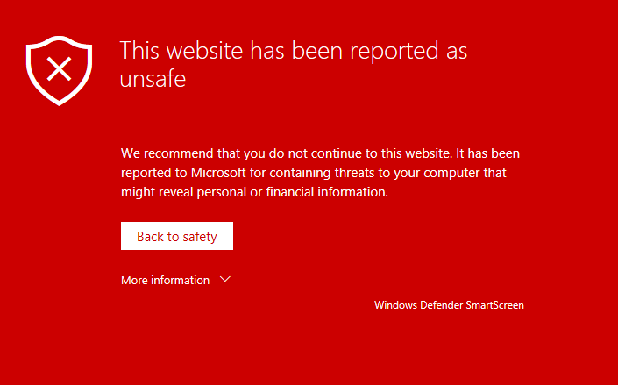
Safe Internet Browsing
Do not visit questionable sites
Limit the use of personally identifiable information (PII)
Notes:
Safe internet browsing involves following best practices to protect your online security and privacy.
**Avoiding Questionable Sites:**
Visiting reputable and well-known websites reduces the risk of encountering malicious content, phishing scams, and malware. Avoid clicking on suspicious links or visiting websites that promote illegal or harmful activities. Cybercriminals often create fake websites that mimic legitimate ones, so it's important to double-check the website's URL and ensure it matches the official site.
**Limiting Personally Identifiable Information (PII):**
PII includes sensitive data like your full name, address, phone number, social security number, and financial information. Limiting the sharing of PII online can help prevent identity theft, fraud, and targeted advertising. Be cautious when providing personal information on websites and social media platforms, and only share information when necessary.
**Additional Safe Browsing Practices:**
1. **Use Strong Passwords:** Create strong, unique passwords for your online accounts, and consider using a reputable password manager to help you manage and store your passwords securely.
2. **Update Software:** Keep your operating system, browser, and security software up to date with the latest patches and updates to protect against known vulnerabilities.
3. **Use Antivirus and Security Software:** Install reputable antivirus and anti-malware software to provide an additional layer of protection against malicious software and threats.
4. **Be Cautious with Email Links and Attachments:** Avoid clicking on links or opening attachments in emails from unknown or unexpected sources. Phishing emails often contain malicious links or attachments designed to steal your information.
5. **Enable Two-Factor Authentication (2FA):** Whenever possible, enable 2FA for your online accounts. This adds an extra layer of security by requiring a second form of verification in addition to your password.
6. **Use HTTPS:** Look for the padlock icon and "https://" in the URL before entering sensitive information on a website. Secure connections encrypt data transmitted between your browser and the website's server.
7. **Avoid Public Wi-Fi for Sensitive Transactions:** Public Wi-Fi networks may not be secure. Avoid conducting sensitive transactions, such as online banking, on public networks to prevent unauthorized access to your data.
8. **Regularly Review Privacy Settings:** Review the privacy settings of your social media accounts and online services to control what information you share with others and adjust your preferences.
9. **Educate Yourself:** Stay informed about the latest online threats and scams. Cybercriminals constantly develop new tactics, so ongoing education is essential.
By following these safe browsing practices, you can minimize the risks associated with online activities and maintain a higher level of security and privacy while using the internet.

Slide 5
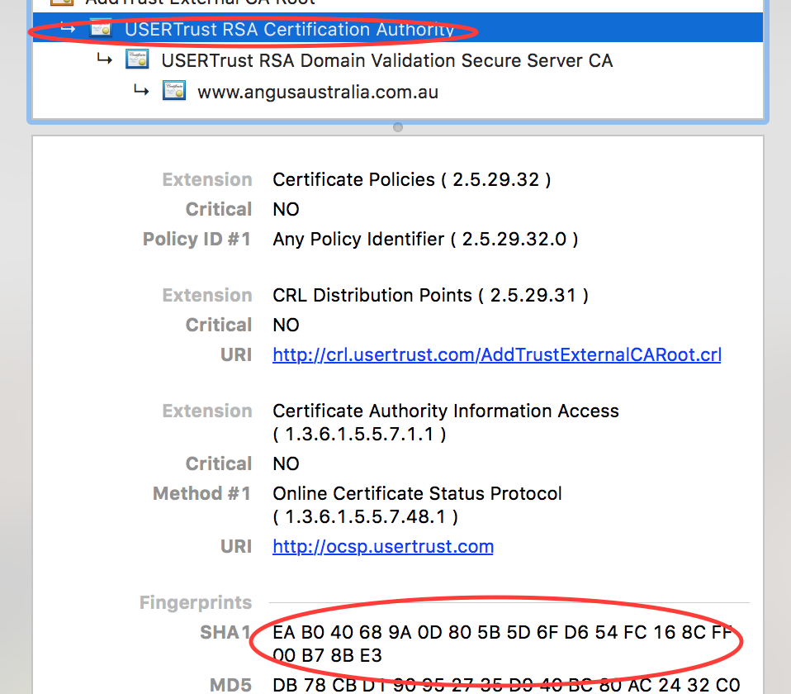
Recognizing Secure Websites
Secure sites use Secure Sockets Layer (SSL) or Transport Layer Security (TLS) to secure transmissions
https:// vs. http://
Lock icon
Green address bar
Notes:
Secure websites use encryption protocols like Secure Sockets Layer (SSL) or its successor, Transport Layer Security (TLS), to ensure that data transmitted between your web browser and the website's server is encrypted and secure. Here's a closer look at the indicators of a secure website:
**1. HTTPS vs. HTTP:**
When you visit a secure website, the URL begins with "https://" instead of the standard "http://". The "s" in "https" stands for "secure," indicating that the website is using SSL/TLS encryption to protect the data being exchanged between your browser and the server.
**2. Lock Icon:**
Most modern browsers display a lock icon in the address bar when you visit a secure website. This lock icon serves as a visual confirmation that the connection to the website is encrypted and secure. You can click on the lock icon to view more information about the website's security and the SSL certificate.
**3. Green Address Bar:**
In some cases, websites with an Extended Validation (EV) SSL certificate display a green address bar in the browser. This provides an extra level of assurance that the website is legitimate and has undergone a thorough validation process to confirm its identity.
**Importance of Secure Websites:**
Secure websites are crucial for protecting sensitive information such as login credentials, personal data, and financial details. Without encryption, data transmitted between your browser and the server could be intercepted and accessed by malicious actors, leading to identity theft, financial fraud, and other security breaches.
When browsing the internet, especially when sharing personal or financial information, it's essential to look for these indicators of a secure website. Avoid entering sensitive information on websites that do not use HTTPS encryption or lack the lock icon, as this could put your data at risk. Additionally, keep your web browser and security software up to date to ensure a safe browsing experience.

Slide 6
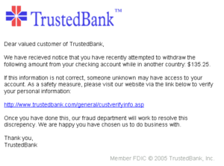
Recognizing Suspicious Sites, Links, and Ads
Look for signs of security
Incorrect spelling
Bad grammar
Threats
Too good to be true
Notes:
Identifying and avoiding suspicious websites, links, and ads is crucial to maintaining your online security. Here are some strategies to help you recognize potential threats:
**1. Signs of Security:**
Legitimate websites often display security indicators such as the lock icon in the address bar (indicating a secure connection), "https://" in the URL, and a green address bar for websites with Extended Validation (EV) SSL certificates. Always check for these indicators before sharing any sensitive information.
**2. Incorrect Spelling and Bad Grammar:**
Many malicious websites are created hastily and may have misspelled words or grammatical errors in their content. Pay attention to language errors, as they can indicate a lack of professionalism and authenticity.
**3. Threats and Intimidation:**
Be cautious of websites that use aggressive language or threats to manipulate you into taking action, such as clicking a link or providing personal information. Legitimate organizations typically communicate in a respectful and professional manner.
**4. Too Good to Be True:**
If a website or ad promises incredible deals, prizes, or offers that seem too good to be true, exercise skepticism. Scammers often use these tactics to lure users into revealing their personal information or engaging in fraudulent activities.
**5. Verify the Source:**
Before clicking on links or ads, hover your cursor over them to preview the URL. This can help you identify if the link matches the expected destination. Be cautious of links that lead to suspicious-looking websites.
**6. Check the Domain Name:**
Scammers often create websites with domain names that are similar to well-known and trusted sites. Look closely at the domain name to ensure it matches the legitimate organization's name.
**7. Use a Reputable Antivirus and Ad Blocker:**
Installing reputable antivirus software and ad blockers can help protect you from malicious websites and ads by blocking harmful content and warning you about potential threats.
**8. Avoid Pop-Up Windows:**
Be cautious of pop-up windows that appear unexpectedly, especially those that prompt you to provide personal information or download software. Legitimate organizations typically don't use aggressive pop-ups.
**9. Educate Yourself:**
Stay informed about common online scams and phishing techniques. Being aware of the latest threats will help you recognize and avoid potential dangers.
By staying vigilant and following these guidelines, you can minimize the risk of falling victim to suspicious websites, links, and ads. Remember that your online security is your responsibility, and taking proactive steps to protect yourself is essential in today's digital landscape.

Slide 7
Managing Users
Account types
Administrators
Users
Guests
Expectations and behaviors
Expectations of privacy
Handing confidential information
Notes:
Managing users in a digital environment involves defining different account types, setting expectations and behaviors, and ensuring appropriate security measures are in place. Here's a breakdown of these aspects:
**Account Types:**
1. **Administrators:** Administrators have elevated privileges and control over the system. They can manage users, modify settings, and often have access to sensitive data. It's important to limit the number of administrators and ensure their credentials are well-protected.
2. **Users:** Regular users have standard access rights and are limited to their designated areas. They can perform tasks within their permissions but don't have administrative control.
3. **Guests:** Guests are temporary or limited users who may have restricted access. They're often granted access to specific resources for a limited time.
**Expectations and Behaviors:**
1. **Expectations of Privacy:** Clearly communicate the level of privacy users can expect within the system. Users should know what data is being collected, how it's being used, and whether their activities are monitored.
2. **Handling Confidential Information:** Define guidelines for handling confidential or sensitive information. Educate users on best practices for protecting such data, including encryption, secure sharing, and appropriate storage.
**Security Measures:**
1. **Access Control:** Implement strong access control mechanisms. Assign users to appropriate groups with specific access rights based on their roles.
2. **Authentication and Authorization:** Ensure robust authentication methods are in place to verify users' identities. Authorization mechanisms should limit users to the minimum level of access required for their tasks (principle of least privilege).
3. **Encryption:** Use encryption to protect data both in transit and at rest. This prevents unauthorized access to sensitive information.
4. **Multi-Factor Authentication (MFA):** Implement MFA whenever possible. This adds an extra layer of security by requiring users to provide multiple forms of verification.
5. **Audit Logs:** Maintain detailed audit logs that track user activities and system events. These logs can be useful for monitoring, troubleshooting, and detecting any suspicious behavior.
6. **User Training:** Provide regular user training on security best practices, including avoiding phishing scams, using strong passwords, and recognizing social engineering attempts.
**User Education:**
1. **Privacy Policies:** Clearly outline your organization's privacy policies so users understand how their data will be used, stored, and protected.
2. **Data Handling Guidelines:** Educate users on how to handle data responsibly, including proper file management, secure sharing methods, and appropriate disposal practices.
3. **Security Awareness:** Regularly educate users about the latest security threats and how to recognize and respond to them.
Managing users effectively involves a balance between providing access for necessary tasks and maintaining the security and integrity of the system. By implementing appropriate account types, setting clear expectations, and ensuring strong security measures, you can create a safe and productive digital environment for all users.

Slide 8
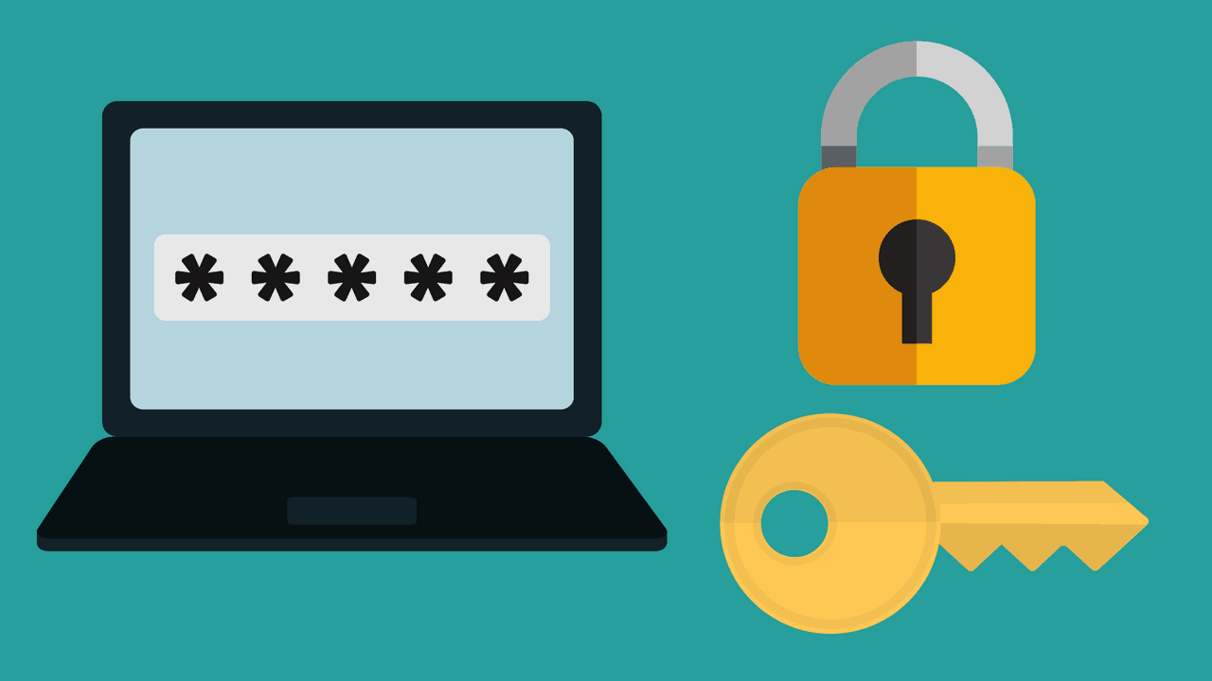
Managing Passwords
Creating effective passwords
Long
Complex
Unusual
Password changes
Notes:
Managing passwords is a critical aspect of maintaining cybersecurity. Effective password management involves creating strong passwords and regularly changing them to enhance security. Here's a detailed explanation:
**Creating Effective Passwords:**
1. **Long:** Longer passwords are generally more secure. Aim for a minimum of 12 characters or more to make it harder for attackers to guess or crack the password.
2. **Complex:** Use a combination of uppercase and lowercase letters, numbers, and special characters. This complexity makes passwords more resistant to brute-force attacks.
3. **Unusual:** Avoid using common words, phrases, or easily guessable information like birthdays or names. Instead, use random combinations of characters that are not easily associated with you.
4. **Avoid Dictionary Words:** Avoid using words that can be found in the dictionary. Attackers often use dictionary-based attacks to crack passwords.
5. **No Personal Information:** Don't use easily accessible information like your name, username, or the name of the website or service.
6. **Avoid Patterns:** Avoid using sequential or repeated characters (e.g., "123456" or "aaaaaa"). Attackers often try such patterns.
7. **Passphrases:** Consider using passphrases, which are longer combinations of words or sentences that are memorable to you but difficult for others to guess.
**Password Changes:**
Regularly changing passwords is a good practice to prevent unauthorized access. Here are some guidelines:
1. **Frequency:** Change passwords periodically, typically every 3 to 6 months. More frequent changes may be necessary for highly sensitive accounts.
2. **After Security Incidents:** Change passwords immediately if you suspect or have evidence of a security breach or unauthorized access.
3. **Complexity After Changes:** Ensure that the new password adheres to the same principles of length, complexity, and uniqueness.
4. **Avoid Reuse:** Avoid using the same password across multiple accounts. Each account should have a unique password.
5. **Two-Factor Authentication (2FA):** Whenever possible, enable 2FA for accounts. This adds an extra layer of security even if the password is compromised.
6. **Password Managers:** Consider using a password manager to generate, store, and manage complex passwords securely.
7. **Educate Users:** Educate users about the importance of password changes and provide guidelines for creating strong passwords.
Remember that while changing passwords is important, the effectiveness of this practice depends on the quality of the new passwords. Encourage users to create strong and unique passwords that are difficult for attackers to crack. Additionally, staying vigilant against phishing attempts and other social engineering tactics is crucial to maintaining the security of passwords and accounts.

Slide 9
Using Data Encryption
Encrypting data at rest
File level
Disk level
Encrypting data in transit
Email
Internet – HTTPS
Virtual Private Network (VPN)
Mobile applications
Notes:
Data encryption is a fundamental technique used to protect sensitive information from unauthorized access and ensure its confidentiality and integrity. Here's a detailed explanation of data encryption methods:
**Encrypting Data at Rest:**
1. **File-Level Encryption:** This involves encrypting individual files or folders. Each file is encrypted using a unique encryption key. Even if an attacker gains access to the storage medium, they cannot read the encrypted data without the appropriate key.
2. **Disk-Level Encryption (Full Disk Encryption):** With disk-level encryption, the entire storage device or disk is encrypted. This includes the operating system, applications, and data. Disk encryption is transparent to users and requires authentication before the system boots up.
**Encrypting Data in Transit:**
1. **Email Encryption:** Encrypting email messages ensures that the content of the email is only readable by the intended recipient. This is particularly important for sensitive information sent via email.
2. **Internet - HTTPS (Hypertext Transfer Protocol Secure):** When browsing the internet, HTTPS is used to encrypt the data transmitted between your browser and the website's server. It prevents eavesdropping and tampering of data during transit.
3. **Virtual Private Network (VPN):** A VPN creates an encrypted tunnel between your device and a remote server. It's commonly used to secure internet connections and protect data from interception, especially when using public Wi-Fi networks.
4. **Mobile Applications:** Mobile apps that handle sensitive data, such as financial transactions or personal information, often use encryption to ensure that data remains secure while in transit between the app and the server.
Encryption involves using encryption algorithms and keys to scramble data into an unreadable format (ciphertext). To access the original data (plaintext), an authorized user needs the decryption key. Encryption can be symmetric (same key for encryption and decryption) or asymmetric (different keys for encryption and decryption).
It's important to note that encryption doesn't just protect against external threats; it also safeguards data in case of physical theft, data breaches, or unauthorized access. However, encryption is only effective when used correctly and when keys are securely managed. Encryption should be accompanied by robust key management practices, access controls, and proper security configurations to ensure the overall security of the system.

Slide 10
Chapter 10: Security Best Practices
Explain methods to secure devices and best practices
Securing devices (mobile/workstation)
Antivirus/anti-malware
Host firewall
Changing default passwords
Enabling passwords
Safe browsing practices
Patching/updates
Device use best practices
Software sources
Validating legitimate sources
Researching legitimate sources
OEM websites vs. third-party websites
Removal of unwanted software
Removal of unnecessary software
Removal of malicious software
Summarize behavioral security concepts
Expectations of privacy when using
The Internet
Social networking sites
Email
File sharing
Instant messaging
Mobile applications
Desktop software
Business software
Corporate network
Written policies and procedures
Handling of confidential information
Passwords
Personal information
Customer information
Company confidential information
Notes:
**Securing Devices and Best Practices:**
1. **Antivirus/Anti-Malware:** Install reputable antivirus and anti-malware software to detect and remove malicious software from your device.
2. **Host Firewall:** Enable the built-in firewall on your device to control incoming and outgoing network traffic.
3. **Changing Default Passwords:** Change default passwords on devices to prevent unauthorized access.
4. **Enabling Passwords:** Set strong and unique passwords for your device, accounts, and applications.
5. **Safe Browsing Practices:** Avoid suspicious websites, only download files from trusted sources, and be cautious with clicking on links or downloading attachments from unknown senders.
6. **Patching/Updates:** Regularly update your operating system, software applications, and firmware to address security vulnerabilities.
7. **Device Use Best Practices:** Lock your device when not in use, enable automatic locking, and use biometric authentication if available.
8. **Software Sources:** Only download software from official app stores or trusted websites.
9. **Validating Legitimate Sources:** Verify the authenticity of websites and sources before providing personal information or downloading files.
10. **Researching Legitimate Sources:** Research online to confirm the legitimacy of unfamiliar software or offers.
11. **OEM Websites vs. Third-Party Websites:** Obtain software and drivers from the original equipment manufacturer's (OEM) official website to ensure authenticity.
12. **Removal of Unwanted Software:** Regularly uninstall unused or unnecessary applications to reduce the attack surface.
13. **Removal of Malicious Software:** Use reliable anti-malware software to scan for and remove malicious programs.
**Behavioral Security Concepts:**
1. **Expectations of Privacy:** Understand that certain actions online may compromise your privacy, and be cautious about sharing personal information.
2. **Social Networking Sites:** Be mindful of the information you share on social media, as it can be used for social engineering or other malicious purposes.
3. **Email:** Avoid sharing sensitive information in emails, and be cautious of phishing attempts.
4. **File Sharing:** Share files only with trusted individuals and use secure sharing methods.
5. **Instant Messaging:** Be cautious when clicking on links or downloading files through instant messaging apps.
6. **Mobile Applications:** Download apps from official app stores, review app permissions, and be cautious of suspicious apps.
7. **Desktop Software:** Only download software from legitimate sources and avoid cracks or pirated software.
8. **Business Software:** Follow company policies for software usage, updates, and security practices.
9. **Corporate Network:** Comply with workplace security policies, use secure connections, and avoid using public networks for work-related tasks.
10. **Written Policies and Procedures:** Adhere to company security policies and procedures to protect confidential information.
11. **Handling of Confidential Information:** Safeguard confidential data and share it only with authorized individuals.
12. **Passwords:** Use strong, unique passwords for different accounts, and avoid sharing them.
13. **Personal Information:** Be cautious when sharing personal information online and limit the amount of personal data you disclose.
14. **Customer Information:** Protect customer data as a responsibility and adhere to privacy regulations.
15. **Company Confidential Information:** Treat sensitive company data with care and follow data protection protocols.
Adopting these practices helps maintain the security and privacy of your devices and data, contributing to a safer digital environment.

Slide 11
Chapter 10: Security Best Practices (con’t)
Explain password best practices
Password length
Password complexity
Password history
Password expiration
Password reuse across sites
Password managers
Password reset process
Explain common uses of encryption
Plain text vs. cipher text
Data at rest
File level
Disk level
Mobile device
Data in transit
Email
HTTPS
VPN
Mobile application
Notes:
**Password Best Practices:**
1. **Password Length:** Use passwords with a minimum length of 12-16 characters to increase complexity and make them harder to crack.
2. **Password Complexity:** Include a mix of uppercase and lowercase letters, numbers, and special characters in your passwords.
3. **Password History:** Implement a policy that prevents users from reusing recent passwords, ensuring a history of unique passwords.
4. **Password Expiration:** Regularly change passwords, typically every 60 to 90 days, to prevent unauthorized access due to compromised credentials.
5. **Password Reuse Across Sites:** Avoid using the same password for multiple accounts, as a breach in one site could compromise others.
6. **Password Managers:** Consider using a reputable password manager to generate and store complex passwords securely.
7. **Password Reset Process:** Set up a secure password reset process that involves multi-factor authentication or security questions.
**Common Uses of Encryption:**
1. **Plain Text vs. Cipher Text:** Plain text refers to readable data, while cipher text is data that has been encrypted to prevent unauthorized access.
2. **Data at Rest:**
- **File Level:** Encrypt individual files or folders to protect sensitive data stored on a device.
- **Disk Level:** Encrypt entire disk drives to safeguard all data stored on the device.
3. **Data in Transit:**
- **Email:** Use encryption to secure the content of emails during transmission.
- **HTTPS:** Secure web communication using SSL/TLS encryption for safe browsing.
- **VPN (Virtual Private Network):** Encrypt data sent between your device and the VPN server, providing privacy on public networks.
- **Mobile Application:** Encrypt data sent and received by mobile apps to prevent interception.
Encryption plays a critical role in ensuring the confidentiality and integrity of data. By converting information into unreadable cipher text, encryption prevents unauthorized access and ensures that even if intercepted, the data remains protected. It is utilized both for securing data stored on devices and for securing data while it's being transmitted across networks.

