Slide 1
IT Fundamentals
Chapter 9:
Security Concepts and Threats

Slide 2
Understanding Hackers and Motives
Stealing passwords or personal information
Gaining remote access to a server or an operating system
Logging in locally and stealing data
Changing a website’s content
Gaining access to the contents of a database (perhaps one that contains passwords or credit card information)
Surreptitiously analyzing network traffic
Installing software designed to cause harm or steal data
Creating a condition in which a computer or network no longer works well
Modifying existing software so that it no longer performs as it should or so that it secretly does harmful things in addition to its usual activity
Notes:
Hacker motivations encompass a range of activities, often driven by a mix of curiosity, financial gain, and the desire to challenge systems. Here's an expanded explanation of the motivations you listed:
**1. Stealing Passwords or Personal Information:**
Hackers may target user accounts to steal sensitive data, including passwords, credit card information, and personal details. This stolen information can be used for identity theft, financial fraud, or unauthorized access to other accounts.
**2. Gaining Remote Access to a Server or OS:**
Gaining remote access allows hackers to control a server or operating system from a distance. This can lead to unauthorized data access, system manipulation, and potential disruption of services.
**3. Logging In Locally and Stealing Data:**
By gaining local access to a system, hackers can steal valuable data stored on that device, compromise user privacy, and exploit vulnerabilities present in the system.
**4. Changing Website Content:**
Hackers with malicious intent might alter the content of websites, spreading false information, defacing pages, or even embedding malware to target unsuspecting visitors.
**5. Accessing Database Contents:**
Database breaches can lead to the exposure of sensitive information, such as passwords and credit card data. Hackers may exploit these vulnerabilities for financial gain or to sell the data on the black market.
**6. Analyzing Network Traffic:**
Surreptitious analysis of network traffic allows hackers to intercept and study data being exchanged between systems, potentially uncovering valuable information or vulnerabilities for exploitation.
**7. Installing Harmful Software:**
Hackers might deploy malicious software, such as viruses, worms, or trojans, to gain control over systems, steal data, or disrupt operations.
**8. Causing System Dysfunction:**
Some hackers seek to compromise the functionality of a computer or network, making it unstable or unusable. This can disrupt business operations, cause inconvenience, or even lead to financial losses.
**9. Modifying Software:**
Hackers may alter existing software, injecting malicious code that behaves differently from the original intended purpose. This can compromise data integrity and system stability.
Understanding these motivations is crucial for organizations and individuals to implement robust cybersecurity measures, ensuring the protection of sensitive data, systems, and networks from potential threats and attacks.

Slide 3
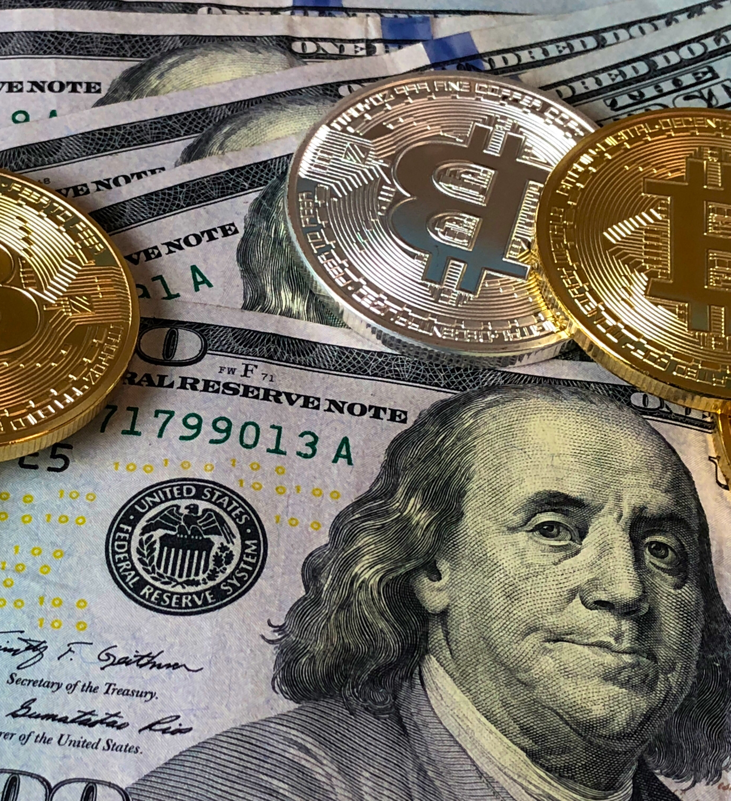
The Value of Data
Data as a driver of business decisions
Intellectual property
Trademarks
Copyright
Patents
Digital products
Notes:
The value of data extends beyond its raw form, impacting various aspects of business and intellectual property. Here's an expanded explanation of the points you mentioned:
**1. Data as a Driver of Business Decisions:**
In today's data-driven world, information holds immense value as it can provide insights into consumer behavior, market trends, and operational efficiency. Organizations leverage data analytics to make informed decisions, tailor their strategies, and improve customer experiences.
**2. Intellectual Property:**
Intellectual property refers to creations of the mind, such as inventions, literary and artistic works, designs, symbols, names, and images used in commerce. Protecting intellectual property is crucial for businesses to maintain their competitive edge and prevent unauthorized use or duplication.
**3. Trademarks:**
Trademarks are distinctive signs, symbols, or names used to identify and distinguish products or services from others in the market. They play a vital role in branding and brand recognition, helping consumers associate specific qualities with a company's offerings.
**4. Copyright:**
Copyright protects original literary, artistic, and intellectual works, such as books, music, software, and artistic creations. It grants creators exclusive rights to reproduce, distribute, and display their works, promoting creativity while safeguarding against unauthorized copying.
**5. Patents:**
Patents are legal protections granted to inventors for new and useful inventions, processes, or methods. They provide exclusive rights to the inventor for a specified period, allowing them to control the commercial use of their innovation.
**6. Digital Products:**
The digital age has given rise to digital products, such as software, e-books, online courses, and multimedia content. These products can be easily distributed online and provide revenue streams for creators and businesses.
Understanding the value of data and intellectual property is essential for individuals and organizations alike. Safeguarding data, respecting intellectual property rights, and effectively leveraging these assets can contribute to business success, innovation, and ethical practices in the digital realm.

Slide 4
Understanding Security Threats
CIA Triad
Notes:
The CIA Triad refers to three fundamental principles of information security: Confidentiality, Integrity, and Availability. These principles guide the design and implementation of security measures to protect sensitive data and ensure the proper functioning of systems. Here's an expanded explanation of each component:
**1. Confidentiality:**
Confidentiality focuses on restricting access to information only to authorized individuals or entities. It ensures that sensitive data remains private and is not disclosed to unauthorized parties. Measures to maintain confidentiality include encryption, access controls, user authentication, and secure communication channels.
**2. Integrity:**
Integrity ensures the accuracy and reliability of data and systems. It involves preventing unauthorized modifications, deletions, or alterations of information. Maintaining data integrity is essential to prevent unauthorized tampering or data corruption. Techniques like data checksums, digital signatures, and data validation mechanisms help ensure data integrity.
**3. Availability:**
Availability ensures that authorized users can access information and systems when needed. It involves measures to prevent disruptions, downtime, or unavailability of critical resources. Redundancy, backup systems, disaster recovery plans, and network load balancing are strategies to maintain high availability.
The CIA Triad forms the foundation of information security strategies and helps organizations assess risks and design comprehensive security solutions. Balancing these three principles is essential for creating a secure environment that protects sensitive data, maintains the accuracy of information, and ensures uninterrupted access to critical resources.

Slide 5
Confidentiality Concerns
Snooping
Eavesdropping
Wiretapping
Social Engineering
Phishing
Shoulder surfing
Dumpster diving
Notes:
Confidentiality concerns in the realm of information security revolve around preventing unauthorized access to sensitive and private data. Here's an expansion of the terms you've mentioned:
1. **Snooping:** Unauthorized individuals trying to access private information by covertly observing or monitoring digital communications, often over unsecured networks.
2. **Eavesdropping:** Similar to snooping, eavesdropping involves intercepting and listening to private conversations, data transmissions, or electronic communications without the knowledge or consent of the parties involved.
3. **Wiretapping:** Illegally intercepting or tapping into telephone lines, VoIP calls, or communication channels to listen to conversations or gather information without authorization.
4. **Social Engineering:** A manipulation technique where attackers trick individuals into revealing confidential information or performing actions that compromise security. This involves psychological manipulation rather than technical exploits.
5. **Phishing:** A form of cyberattack where attackers impersonate legitimate entities through emails, messages, or websites to deceive recipients into disclosing sensitive information, such as login credentials or financial details.
6. **Shoulder Surfing:** The act of observing someone's sensitive information (like passwords or PINs) by looking over their shoulder as they enter it on a device or keypad.
7. **Dumpster Diving:** Physically searching through trash or discarded materials to find valuable information, such as confidential documents, that could be used for malicious purposes.
These confidentiality concerns highlight the various ways in which sensitive information can be compromised. Organizations and individuals must implement security measures such as encryption, strong authentication, security awareness training, and proper disposal of sensitive materials to mitigate these risks and protect confidential data.

Slide 6
Integrity Concerns
Man-in-the-middle attack
Replay attack
Impersonation
Unauthorized information alteration
Notes:
Integrity concerns in the context of information security focus on safeguarding the accuracy and trustworthiness of data and ensuring that it remains unaltered by unauthorized parties. Here's an expansion on the terms you mentioned:
1. **Man-in-the-Middle Attack:** In this attack, an attacker intercepts and alters communication between two parties without their knowledge. This allows the attacker to eavesdrop, manipulate messages, and potentially compromise the integrity of the transmitted data.
2. **Replay Attack:** In a replay attack, an attacker intercepts valid data transmissions and maliciously retransmits them. This can lead to the unauthorized replication of actions or commands, potentially causing unintended consequences or data corruption.
3. **Impersonation:** Attackers may impersonate legitimate users, systems, or entities to gain unauthorized access or manipulate data. This could involve pretending to be an authorized user to execute malicious actions.
4. **Unauthorized Information Alteration:** This refers to unauthorized modifications, edits, or changes made to data, systems, or configurations. Attackers might alter data to manipulate outcomes, commit fraud, or disrupt business processes.
To mitigate integrity concerns, organizations employ various security measures, including cryptographic techniques like digital signatures and message authentication codes to verify data authenticity, access controls to restrict unauthorized alterations, and intrusion detection systems to detect suspicious activity that could compromise data integrity. Maintaining strong security practices helps ensure the reliability and integrity of sensitive information.

Slide 7
Availability Concerns
Denying service
Hardware concerns
Hardware damage
Hardware theft
Notes:
Availability concerns in information security revolve around ensuring that systems, data, and resources are accessible and operational when needed. Here's an expansion on the terms you mentioned:
1. **Denial of Service (DoS):** A denial-of-service attack aims to disrupt the availability of a system or network by overwhelming it with excessive traffic, making it inaccessible to legitimate users. This can lead to system crashes or downtime.
2. **Distributed Denial of Service (DDoS):** Similar to a DoS attack, a DDoS attack involves multiple compromised systems working together to flood a target with traffic. This amplifies the impact and can be challenging to mitigate.
3. **Hardware Concerns:** The physical hardware components that support systems and services are vulnerable to various threats:
- **Hardware Damage:** Accidents, natural disasters, power surges, or other unforeseen events can damage hardware, leading to system outages and data loss.
- **Hardware Theft:** Unauthorized access to hardware or theft can result in a loss of sensitive data and disrupt services.
To address availability concerns, organizations implement strategies such as redundancy (backup systems), load balancing (distributing traffic among multiple servers), disaster recovery plans, and off-site backups. Additionally, security measures such as firewalls and intrusion detection systems help prevent and mitigate availability-related attacks. Regular monitoring, maintenance, and preparedness play crucial roles in ensuring that systems remain available to users and can quickly recover from unexpected disruptions.

Slide 8
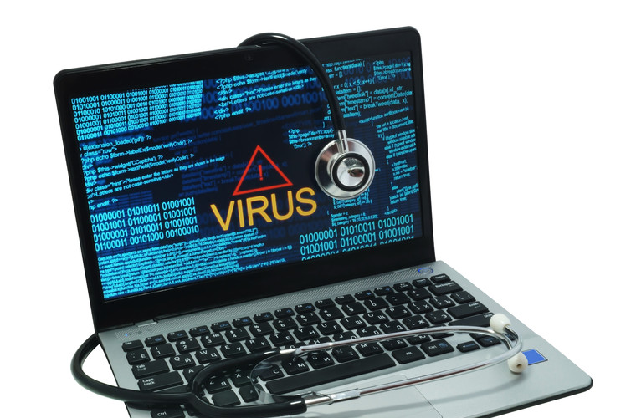
Software-Based Security Threats
OS and Application Exploits
Viruses
Worms
Trojan horses
Adware
Spyware
Ransomware
Rootkits
Backdoors
Spam
Password cracking
Notes:
Software-based security threats pose significant risks to both individual users and organizations. Here's an expansion on the terms you mentioned:
1. **OS and Application Exploits:** Attackers exploit vulnerabilities in operating systems or software applications to gain unauthorized access, execute malicious code, or manipulate system behavior. Patches and updates are essential to address these vulnerabilities.
2. **Viruses:** Viruses are malicious programs that attach themselves to legitimate files and spread when those files are executed. They can corrupt or delete data, replicate themselves, and even damage hardware.
3. **Worms:** Worms are self-replicating malware that spread across networks, exploiting vulnerabilities to infect other systems. Unlike viruses, worms don't need a host file to spread.
4. **Trojan Horses:** Trojan horses appear to be legitimate software but contain hidden malicious functions. They often trick users into installing them, allowing attackers to gain unauthorized access or steal sensitive data.
5. **Adware:** Adware displays unwanted advertisements to users, often bundled with legitimate software. While not necessarily malicious, it can impact system performance and user experience.
6. **Spyware:** Spyware silently collects user information and activities without consent, often for malicious purposes like identity theft or unauthorized monitoring.
7. **Ransomware:** Ransomware encrypts users' data and demands a ransom in exchange for the decryption key. It can cause significant disruptions and financial losses for individuals and organizations.
8. **Rootkits:** Rootkits are advanced malware that gain deep access to a system, often concealing their presence from traditional security tools. They can provide unauthorized control over the system.
9. **Backdoors:** Backdoors are hidden entry points left by attackers in software or systems, allowing them to bypass regular authentication and gain unauthorized access later.
10. **Spam:** Unsolicited and often malicious emails or messages sent in bulk, spam can contain phishing attempts, malware, or fraudulent offers.
11. **Password Cracking:** Attackers use various techniques to guess or crack passwords, gaining unauthorized access to accounts, systems, or networks.
Protecting against software-based threats involves a multi-layered approach, including regular software updates, robust antivirus software, firewalls, intrusion detection/prevention systems, user education, and secure practices like strong password usage and cautious email handling. Organizations and individuals must stay vigilant and proactive in defending against these threats to maintain the security and integrity of their systems and data.

Slide 9
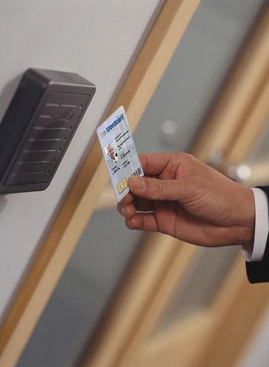
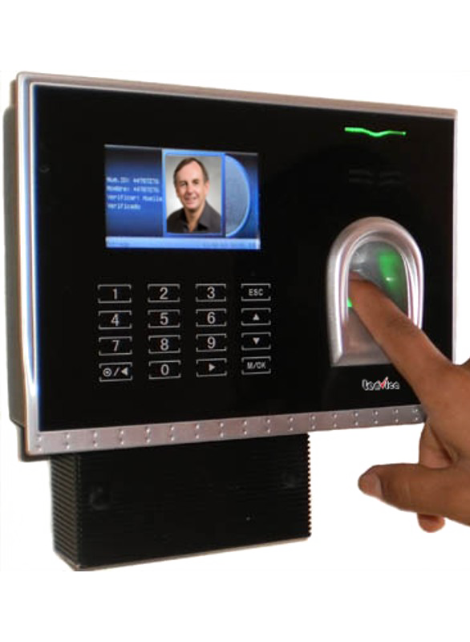
Understanding Access Control
Triple A:
Authentication
Authorization
Accounting
(and non-repudiation)
This Photo by Unknown author is licensed under CC BY.
Notes:
Understanding access control is crucial for maintaining the security of digital systems and data. The "Triple A" concept, also known as AAA, encompasses three fundamental components of access control: Authentication, Authorization, and Accounting. Non-repudiation is an additional concept that reinforces security and accountability.
1. **Authentication:** Authentication verifies the identity of users and entities attempting to access a system or resource. It ensures that only authorized individuals gain entry. Common authentication methods include passwords, biometrics (fingerprint or facial recognition), multi-factor authentication (MFA), and hardware tokens. Authentication prevents unauthorized access by ensuring that users are who they claim to be.
2. **Authorization:** Once users are authenticated, authorization defines what actions they are allowed to perform within the system. It involves setting permissions and access rights based on roles, responsibilities, and privileges. Authorization ensures that users have appropriate access to resources while preventing them from accessing sensitive or unauthorized data.
3. **Accounting:** Accounting, also known as auditing or monitoring, involves keeping track of user activities within a system. It includes recording events such as logins, resource access, modifications, and other actions. Accounting helps in detecting and investigating security breaches, ensuring compliance, and holding users accountable for their actions.
4. **Non-repudiation:** Non-repudiation is the concept of ensuring that an individual or entity cannot deny having performed a particular action. It ensures that actions are traceable to their source and cannot be falsely denied later. Digital signatures and timestamping are common methods to achieve non-repudiation, enhancing accountability and preventing disputes.
Implementing strong access control mechanisms is essential for preventing unauthorized access, protecting sensitive information, and maintaining the confidentiality, integrity, and availability of systems and data. Organizations should tailor their access control strategies to their specific needs, considering factors like user roles, the sensitivity of data, and regulatory requirements.

Slide 10
Authentication
Validates identity
Types of authentication
Single-factor
Multifactor
One-time password
Smart card or security token
Location-specific
Biometrics
Single sign-on (SSO)
Notes:
Authentication is a critical security process that verifies the identity of users or entities attempting to access a system, application, or resource. It ensures that only authorized individuals gain access and helps protect sensitive information from unauthorized access. Various authentication methods are used to establish identity, each offering different levels of security and convenience.
1. **Single-Factor Authentication:** This is the simplest form of authentication, where users provide a single piece of information to prove their identity. Typically, it involves a username and a password. While easy to implement, single-factor authentication can be vulnerable to password breaches and phishing attacks.
2. **Multi-Factor Authentication (MFA):** MFA adds an additional layer of security by requiring users to provide multiple forms of verification. This can include something they know (password), something they have (security token or smartphone), and something they are (biometric data). MFA significantly enhances security by reducing the risk of unauthorized access even if one factor is compromised.
3. **One-Time Password (OTP):** OTP is a time-sensitive authentication method that generates a unique password that is valid for a short period. It is often sent to the user's mobile device or email. OTPs are useful for temporary access and are effective against replay attacks.
4. **Smart Card or Security Token:** Smart cards or security tokens are physical devices that store authentication credentials. They provide an extra layer of security because the physical possession of the device is required along with knowledge of a PIN or password.
5. **Location-Specific Authentication:** This method considers the geographical location of the user as an additional factor for authentication. It helps prevent unauthorized access from unfamiliar locations.
6. **Biometrics:** Biometric authentication uses unique physical characteristics or behavioral traits to verify identity. Examples include fingerprints, facial recognition, iris scans, and voice recognition. Biometrics offer a high level of security but may require specialized hardware and have privacy considerations.
7. **Single Sign-On (SSO):** SSO allows users to access multiple applications or systems using a single set of credentials. Once authenticated, users can seamlessly navigate between different services without needing to log in again. SSO improves user convenience while maintaining security.
Organizations often choose authentication methods based on the sensitivity of the information being accessed, user convenience, and the level of security required. Implementing strong authentication measures is crucial for preventing unauthorized access and protecting sensitive data.

Slide 11
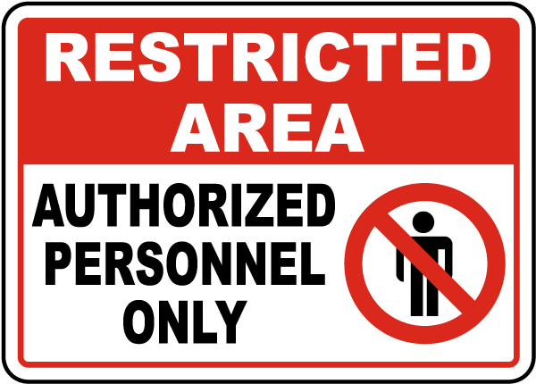
Authorization
Determines what users can do
Mandatory access control
Discretionary access control
Role-based access control
Rule-based access control
Notes:
Authorization is a fundamental security concept that determines what actions or operations users are allowed to perform within a system, application, or resource after they have been successfully authenticated. It defines the level of access and permissions granted to users based on their roles, responsibilities, and the security policies in place.
Different types of access control mechanisms exist to manage authorization:
1. **Mandatory Access Control (MAC):** In a MAC system, access decisions are based on security labels assigned to both users and objects (such as files or resources). These labels define the sensitivity of data and the clearance level of users. Access is granted or denied based on predefined rules that consider the labels, ensuring that only users with appropriate clearance can access specific data.
2. **Discretionary Access Control (DAC):** DAC allows the owner of a resource to determine who can access it and what level of access they have. The owner can grant or restrict access to specific users or groups and define permissions such as read, write, and execute. DAC provides flexibility but may lead to security risks if users do not manage access properly.
3. **Role-Based Access Control (RBAC):** In an RBAC system, users are assigned roles based on their responsibilities and job functions. Each role is associated with certain permissions, and users inherit those permissions based on their assigned role. RBAC simplifies access management by grouping users and reducing the need for individual permission assignments.
4. **Rule-Based Access Control:** Rule-based access control uses specific conditions or rules to determine access. These rules can be based on factors such as time of day, location, user attributes, or other contextual information. If the conditions match, access is granted according to the predefined rule.
Authorization ensures that users have the appropriate level of access needed to perform their tasks while preventing unauthorized actions that could compromise security or violate policies. Properly implementing authorization mechanisms is essential for maintaining data integrity, confidentiality, and overall system security.

Slide 12
Accounting
Records who does what
OS and application logs
Web browser history
Notes:
Accounting, in the context of information security, refers to the practice of monitoring and recording user activities and system events to create an audit trail of actions taken within an IT environment. This audit trail helps in tracking the actions of users and the operations performed on various resources, providing a means to investigate security incidents, analyze system performance, and ensure compliance with organizational policies and legal regulations.
Several components and practices are involved in accounting:
1. **Logs:** Logs are records of events, actions, and activities that occur within an operating system, application, network device, or other system component. They capture valuable information such as user logins, file accesses, system configurations, errors, and security events.
2. **Audit Trails:** An audit trail is a chronological record of events and actions, often used for forensic analysis and compliance purposes. It helps reconstruct what happened in a system and who was responsible for specific actions.
3. **Logging Mechanisms:** Operating systems, applications, and network devices often have built-in logging mechanisms that allow administrators to enable and configure what events are logged, where logs are stored, and the level of detail captured.
4. **Log Analysis Tools:** Tools and software applications are used to collect, analyze, and correlate logs from various sources. These tools help identify patterns, anomalies, and potential security threats.
5. **Web Browser History:** Web browsers maintain a history of visited websites, which can be useful for tracking users' online activities. This history can be important for both security analysis and personal usage monitoring.
Accounting supports various security objectives, including:
- **Intrusion Detection:** Monitoring logs and audit trails can help identify unauthorized or suspicious activities that might indicate an intrusion attempt.
- **Forensic Analysis:** When a security incident occurs, audit trails and logs are critical for forensic investigations to understand how an incident occurred, what data was affected, and who might be responsible.
- **Compliance:** Many industries and organizations are required to adhere to regulatory compliance standards. Accounting data helps demonstrate compliance with security policies and regulations.
- **Performance Analysis:** Logs and accounting data can be used to monitor system performance, identify bottlenecks, and optimize resource utilization.
Implementing effective accounting practices enhances the ability to detect and respond to security incidents, maintain system integrity, and ensure accountability for user actions.

Slide 13
Chapter 9: Security Concepts and Threats
Explain the value of data and information
Data and information as assets
Importance of investing in security
Relationship of data to creating information
Intellectual property
Trademarks
Copyright
Patents
Digital products
Data-driven business decisions
Data capture and collection
Data correlation
Meaningful reporting
Summarize confidentiality, integrity, and availability concerns
Confidentiality concerns
Snooping
Eavesdropping
Wiretapping
Social engineering
Dumpster diving
Integrity concerns
Man-in-the-middle
Replay attack
Impersonation
Unauthorized information alteration
Availability concerns
Denial of service
Power outage
Hardware failure
Destruction
Service outage
Notes:
The value of data and information lies at the heart of modern business operations and decision-making. Data and information are regarded as valuable assets that organizations rely upon to drive their strategies, operations, innovation, and overall success. Here's an exploration of these concepts:
**Data and Information as Assets:**
Data refers to raw facts, figures, and observations. Information, on the other hand, is the result of processing and organizing data into a meaningful context. Both data and information hold intrinsic value for businesses, as they provide insights, knowledge, and understanding that can be used to make informed decisions and achieve business objectives.
**Importance of Investing in Security:**
Given the significance of data and information, investing in their security is paramount. This involves safeguarding data against unauthorized access, protecting it from integrity threats, and ensuring its availability when needed. Robust security measures help maintain trust with customers, comply with regulations, and prevent financial and reputational losses due to security breaches.
**Relationship of Data to Creating Information:**
Data is the foundation upon which information is built. Through processing, analysis, and interpretation, data is transformed into meaningful information that can guide decision-making. This relationship underscores the importance of accurate and reliable data for generating valuable insights.
**Intellectual Property, Trademarks, Copyrights, Patents, and Digital Products:**
Intellectual property encompasses creations of the mind, such as inventions, literary and artistic works, symbols, names, and designs used in commerce. Trademarks protect brand names and logos, copyrights safeguard creative works, and patents offer protection for inventions. Digital products, which include software, media, and other digital assets, are often protected by intellectual property rights.
**Data-Driven Business Decisions:**
Data-driven decision-making involves using data and analysis to guide business strategies and choices. Organizations can identify trends, opportunities, and challenges by analyzing data, leading to more effective and informed decisions.
**Data Capture and Collection:**
Collecting accurate and relevant data is essential for producing meaningful insights. Proper data capture methods ensure that the information generated is trustworthy and relevant to the organization's goals.
**Data Correlation and Meaningful Reporting:**
Correlating data from various sources allows organizations to uncover patterns and relationships that might not be apparent in individual datasets. Meaningful reporting involves presenting information in a clear and understandable manner, enabling stakeholders to make well-informed decisions.
**Confidentiality, Integrity, and Availability Concerns:**
Confidentiality focuses on keeping sensitive data private and accessible only to authorized individuals. Integrity ensures that data remains accurate and unaltered. Availability guarantees that data and systems are accessible when needed. These three principles, often referred to as the CIA triad, form the foundation of information security.
The value of data and information extends beyond simple numbers and facts. In today's data-driven world, their careful management, protection, and utilization are essential for organizations to thrive, innovate, and succeed in a competitive landscape.

Slide 14
Chapter 9: Security Concepts and Threats (con’t)
Compare and contrast authentication, authorization, accounting, and non-repudiation concepts
Authentication
Single factor
Multifactor
Examples of factors
Password
PIN
One-time password
Software token
Hardware token
Biometrics
Specific location
Security questions
Single sign-on
Authorization
Permissions
Least privilege model
Role-based user access
User account types
Rule-based user access
Mandatory access controls
Discretionary access controls
Accounting
Logs
Tracking
Web browser history
Non-repudiation
Video
Biometrics
Signature
Receipt
Notes:
Authentication, authorization, accounting, and non-repudiation are fundamental concepts in information security that work together to ensure the integrity, confidentiality, and availability of data. Let's compare and contrast these concepts:
**Authentication:**
Authentication is the process of verifying the identity of a user, system, or entity attempting to access a resource. It ensures that only authorized individuals can access specific data or systems.
- **Single-factor Authentication:** Involves using a single method to verify identity, such as a password or PIN.
- **Multifactor Authentication:** Requires multiple methods of verification, increasing security. Factors can include something the user knows (password), something the user has (token), and something the user is (biometrics).
- **Examples of Factors:** Passwords, PINs, one-time passwords, software or hardware tokens, biometrics, specific location, security questions, single sign-on.
**Authorization:**
Authorization determines what actions or operations an authenticated user is allowed to perform within a system. It defines the level of access granted based on the user's identity and role.
- **Permissions:** Specify what a user is allowed to do, such as read, write, execute.
- **Least Privilege Model:** Users are granted the minimum access necessary to perform their tasks.
- **Role-Based User Access:** Access is determined by the user's assigned role.
- **Rule-Based User Access:** Access is determined by predefined rules or conditions.
- **Mandatory Access Controls:** Access is determined by system-enforced rules.
- **Discretionary Access Controls:** Access is controlled by the owner of the resource.
**Accounting:**
Accounting involves tracking and recording the activities of users within a system. It ensures that actions are traceable and accountable, helping to identify unauthorized or malicious activities.
- **Logs:** Records of user activities, system events, and actions performed.
- **Tracking:** Monitoring and recording user interactions with resources.
- **Web Browser History:** Keeping a record of websites visited and actions taken.
**Non-Repudiation:**
Non-repudiation ensures that an individual cannot deny their actions or transactions. It prevents individuals from claiming they did not perform a certain action.
- **Video:** Visual evidence of actions or transactions.
- **Biometrics:** Unique biological traits, such as fingerprints or retina scans, provide irrefutable evidence of an individual's presence.
- **Signature:** Digitally signing a document or message with a unique cryptographic key.
- **Receipt:** Providing a digital or physical receipt as proof of transaction.
In summary, authentication verifies identity, authorization grants access rights, accounting tracks user activities, and non-repudiation prevents denial of actions. These concepts work together to create a comprehensive security framework that safeguards data and systems from unauthorized access and malicious activities.

