Slide 1
IT Fundamentals
Chapter 8:
Networking Concepts and Technologies

Slide 2
Chapter 8: Networking Concepts and Technologies
Compare and contrast common Internet service types
Fiber optic
Cable
DSL
Wireless
Radio Frequency
Satellite
Cellular
Compare and contrast storage types
Local network storage types
NAS
File server
Cloud storage service
Explain basic networking concepts
Basics of network communication
Basics of packet transmission
DNS
URL-to-IP translation
LAN vs. WAN
Device addresses
IP address
MAC address
Basic protocols
HTTP/S
POP3
IMAP
SMTP
Devices
Modem
Router
Switch
Access point
Firewall
Given a scenario, install and configure a basic wireless network
802.11a/b/g/n/ac
Older vs. newer standards
Speed limitations
Interference and attenuation factors
Best practices
Change SSID
Change default password
Encrypted vs. unencrypted
Open
Captive portal
WEP
WPA
WPA2

Slide 3
External Network Connections
Telephone/POTS
DSL
Cable
Fiber-Optic Internet
Satellite
Cellular networking
Radio frequency Internet
Notes:
**External Network Connections:**
External network connections are ways to connect to the internet or other networks from your location. They vary in terms of speed, availability, and technology. Here are some common types:
**1. Telephone/POTS (Plain Old Telephone Service):**
POTS uses traditional telephone lines for internet connectivity. It's one of the slowest options and is gradually being replaced by faster alternatives.
**2. DSL (Digital Subscriber Line):**
DSL uses telephone lines but provides faster internet speeds by utilizing different frequency bands. It's popular in areas where faster options like fiber-optic aren't available.
**3. Cable:**
Cable internet uses the same infrastructure as cable TV. It offers higher speeds than DSL but can slow down during peak usage times when many users are online.
**4. Fiber-Optic Internet:**
Fiber-optic cables transmit data using light signals. This technology offers incredibly fast speeds and high reliability. It's ideal for heavy internet usage and streaming.
**5. Satellite:**
Satellite internet connects via a satellite dish on your property. It's available in remote areas where other options are limited, but it can have higher latency due to the signal traveling to space and back.
**6. Cellular Networking:**
Cellular networks use mobile phone towers to provide internet access to devices like smartphones, tablets, and mobile hotspots. It's widely used for mobile connectivity.
**7. Radio Frequency Internet:**
Radio frequency technology uses radio signals to provide internet access. Wi-Fi is a common example, allowing devices to connect wirelessly within a certain range of a router.
Each of these connection types has its own advantages and limitations, making it essential to choose the one that best fits your needs, location, and usage requirements.

Slide 4
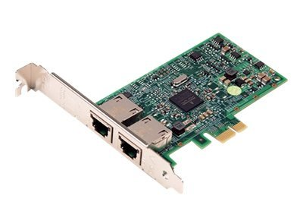
Internal Network Connections
Wired
Ethernet
Copper vs. Fiber-optic
Wireless
WiFi (802.11a/b/g/n/ac)
Bluetooth
Infrared
Notes:
**Internal Network Connections:**
Internal network connections refer to the ways devices within a local area network (LAN) or within a specific location communicate with each other. These connections are essential for sharing resources, files, and information within an organization or household. Here are some common types of internal network connections:
**1. Wired Connections:**
Wired connections involve physically connecting devices using cables. They offer stable and reliable connections, making them ideal for devices that require consistent and high-speed data transfer.
**2. Ethernet:**
Ethernet is a standard wired network connection technology that uses twisted-pair cables and connectors like RJ45. It offers fast data transfer speeds and is commonly used in both homes and businesses.
**3. Copper vs. Fiber-Optic:**
Copper cables, such as Cat5e or Cat6, are commonly used for Ethernet connections due to their affordability. Fiber-optic cables, on the other hand, use light signals for data transmission, offering faster speeds and better immunity to interference, making them suitable for high-demand environments.
**4. Wireless Connections:**
Wireless connections eliminate the need for physical cables, allowing devices to communicate over the airwaves. They provide flexibility and convenience for mobile devices and areas where wired connections are impractical.
**5. WiFi (802.11a/b/g/n/ac):**
WiFi is a wireless technology that allows devices to connect to a network without physical cables. Different WiFi standards (such as 802.11a, 802.11b, 802.11g, 802.11n, and 802.11ac) offer varying speeds and ranges.
**6. Bluetooth:**
Bluetooth is a short-range wireless technology used for connecting devices like smartphones, headphones, and keyboards. It's commonly used for transferring small amounts of data between nearby devices.
**7. Infrared:**
Infrared (IR) connections use infrared light to transmit data between devices. While not as common as other wireless technologies, IR can be found in remote controls and some older devices.
Choosing between wired and wireless connections depends on factors like the device's mobility, data transfer speed requirements, and interference considerations. Both wired and wireless connections play a crucial role in maintaining efficient communication and collaboration within a network.

Slide 5
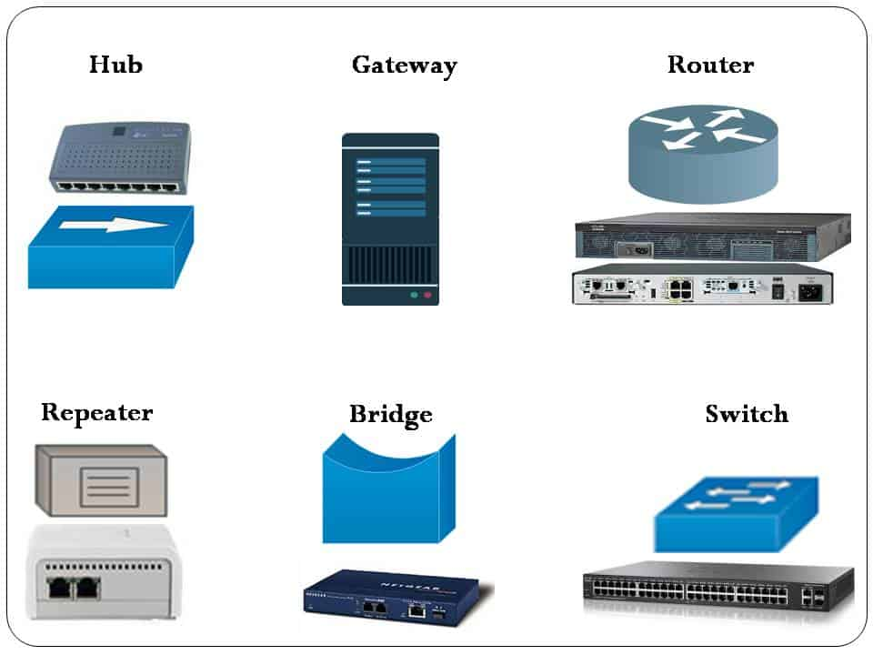
Networking Devices
Modem
Switch
Access point
Router
Firewall
Notes:
**Network Connections and Devices:**
Network connections and devices play a vital role in establishing communication and data transfer within computer networks. Here are some key network devices and their functions:
**1. Modem:**
A modem (short for modulator-demodulator) is a device that connects a computer or local network to an external network, such as the internet. It converts digital data from the computer into analog signals for transmission over telephone lines, cable systems, or fiber-optic networks. Modems also convert incoming analog signals back into digital data for the computer to understand.
**2. Switch:**
A switch is a networking device that connects multiple devices within a local network. It operates at the data link layer (Layer 2) of the OSI model and forwards data only to the specific device it's intended for, improving network efficiency and reducing data collisions.
**3. Access Point:**
An access point (AP) is a device that enables wireless devices to connect to a wired network. It acts as a bridge between wired and wireless networks, allowing devices like laptops, smartphones, and tablets to communicate with the network without the need for physical cables.
**4. Router:**
A router is a central device that connects multiple networks together, such as a local network and the internet. It directs data packets between different networks based on their IP addresses. Routers also often provide network address translation (NAT) to allow multiple devices in a local network to share a single public IP address.
**5. Firewall:**
A firewall is a network security device that monitors and controls incoming and outgoing network traffic. It establishes a barrier between a trusted internal network and untrusted external networks, helping to prevent unauthorized access and potential cyber threats.
These network devices work together to create a seamless and secure communication environment within a network. Modems connect networks to the external world, switches and access points facilitate local network communication, routers manage data flow between networks, and firewalls protect networks from potential security risks. Understanding these devices and their functions is crucial for setting up and maintaining effective and secure network connections.

Slide 6
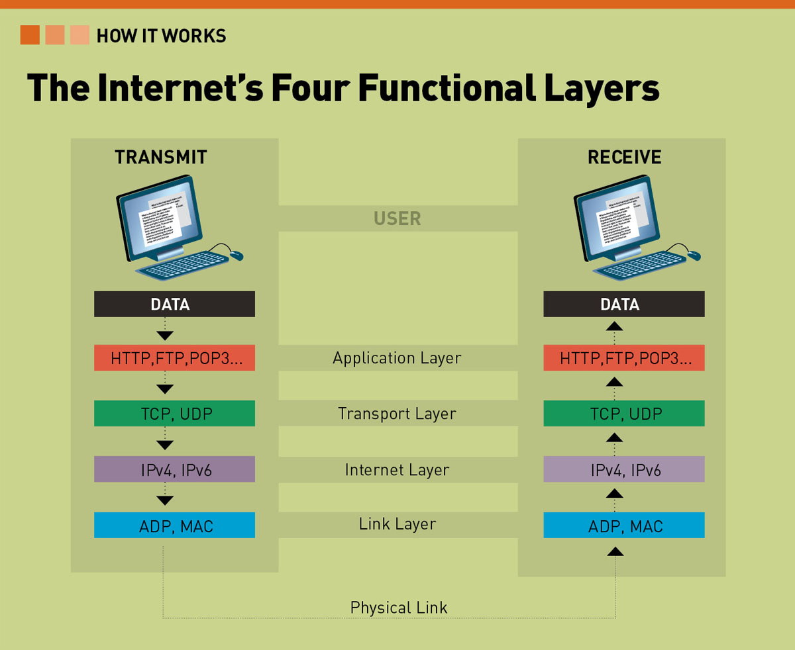
Network Protocols
Language that computers speak
Transmission Control Protocol/ Internet Protocol (TCP/IP) is the most common one
Notes:
**Network Protocols:**
Network protocols serve as languages that computers use to communicate and exchange data within a network. They provide a standardized set of rules, conventions, and procedures that ensure seamless and consistent data transmission. One of the most widely used network protocols is the Transmission Control Protocol/Internet Protocol (TCP/IP). Here's a bit more detail on network protocols and TCP/IP:
**Network Protocols:**
Network protocols are essential for enabling communication between devices in a network. They define how data is formatted, transmitted, received, and interpreted. By following a specific protocol, devices can understand and interpret each other's data, ensuring successful communication. Different protocols are designed for various purposes, such as sending emails, browsing websites, or file sharing.
**TCP/IP (Transmission Control Protocol/Internet Protocol):**
TCP/IP is the foundational set of protocols that serves as the backbone of the internet and most local networks. It consists of two main protocols: Transmission Control Protocol (TCP) and Internet Protocol (IP).
- **TCP (Transmission Control Protocol):** TCP is responsible for ensuring reliable data transmission between devices. It breaks down data into packets, sends them to the destination device, and then verifies if all packets were received correctly. If any packets are missing or corrupted during transmission, TCP requests retransmission to ensure accurate data delivery.
- **IP (Internet Protocol):** IP is responsible for addressing and routing packets of data across networks. It assigns unique IP addresses to devices connected to the network and determines how data packets are routed from the source device to the destination device. IP also handles the fragmentation and reassembly of data packets as they travel through different networks.
TCP/IP provides a standardized framework that allows devices to communicate across different types of networks, from local area networks (LANs) to wide area networks (WANs) like the internet. It's used for various applications such as web browsing, email, file transfers, and more.
In addition to TCP/IP, there are numerous other network protocols designed for specific tasks and applications. Examples include HTTP (Hypertext Transfer Protocol) for web browsing, SMTP (Simple Mail Transfer Protocol) for sending emails, and FTP (File Transfer Protocol) for transferring files. These protocols collectively enable the diverse range of activities we perform on the internet and within local networks.

Slide 7
TCP/IP Fundamentals
Suite of protocols working together
IP addresses
Dynamic Host Configuration Protocol (DHCP)
Domain Name System (DNS)
Automatic Private IP Addressing (APIPA)
Public vs. private IP addresses
Notes:
**TCP/IP Suite and IP Addressing:**
The TCP/IP suite is a collection of networking protocols that work together to enable communication between devices on a network. It provides a standardized framework for data transmission, addressing, and routing across various networks, including the internet. Within the TCP/IP suite, several protocols and concepts are crucial for effective network communication:
**IP Addresses:**
IP addresses are numerical labels assigned to each device connected to a network. They serve as unique identifiers that allow devices to send and receive data to and from each other. IP addresses are essential for routing data packets accurately across networks.
**Dynamic Host Configuration Protocol (DHCP):**
DHCP is a protocol used to automatically assign IP addresses to devices on a network. Instead of manually configuring IP addresses, DHCP servers dynamically assign them to devices when they join the network. This simplifies network administration and prevents IP address conflicts.
**Domain Name System (DNS):**
The DNS translates human-readable domain names (like www.example.com) into IP addresses. When you enter a web address in your browser, DNS servers translate it into the corresponding IP address to locate the server hosting the website. This makes it easier for users to access websites without remembering complex numerical IP addresses.
**Automatic Private IP Addressing (APIPA):**
APIPA is a feature that allows devices to assign themselves an IP address if they cannot obtain one from a DHCP server. This is useful in situations where DHCP servers are unavailable, ensuring that devices can still communicate within a local network.
**Public vs. Private IP Addresses:**
IP addresses can be categorized as public or private:
- **Public IP Addresses:** Public IP addresses are globally unique and are used to identify devices on the public internet. They allow devices to communicate with other devices across the internet. Websites and servers accessible from the internet are assigned public IP addresses.
- **Private IP Addresses:** Private IP addresses are used within local networks, such as home or office networks. These addresses are not directly accessible from the public internet and are used for internal communication. Devices within a local network can communicate with each other using private IP addresses.
Network Address Translation (NAT) is a technique that allows multiple devices within a local network to share a single public IP address when communicating with the internet. This conserves the limited supply of available public IP addresses.
Overall, the TCP/IP suite and the concepts associated with IP addressing play a fundamental role in enabling devices to communicate effectively over networks, both within local environments and on the broader internet.

Slide 8
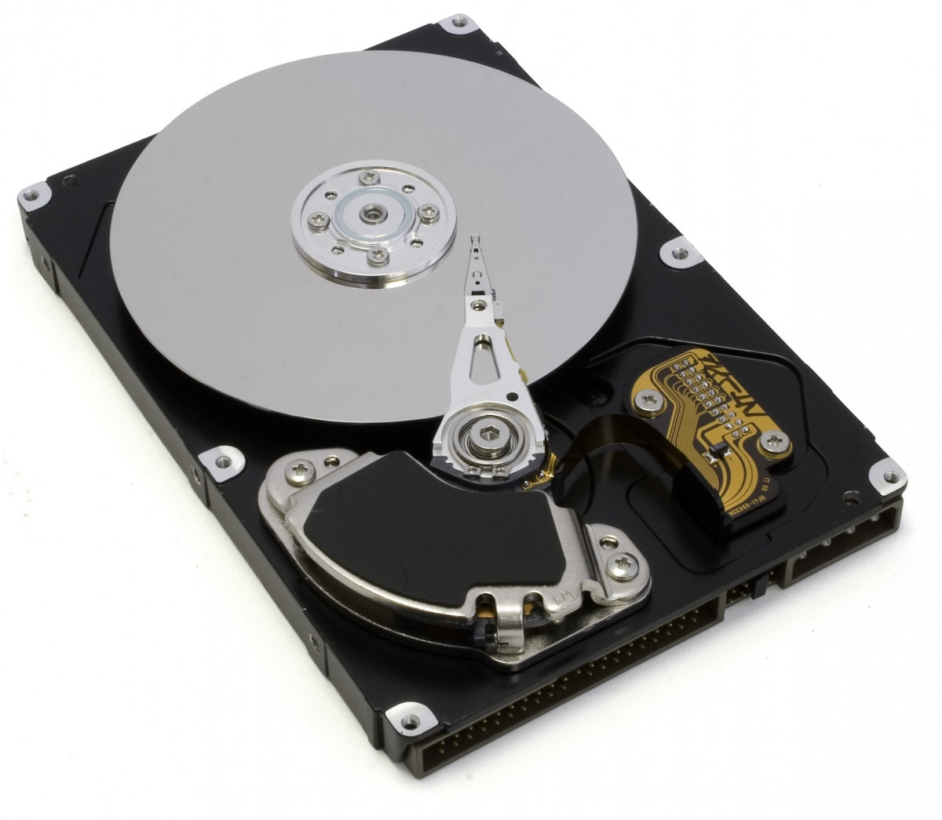
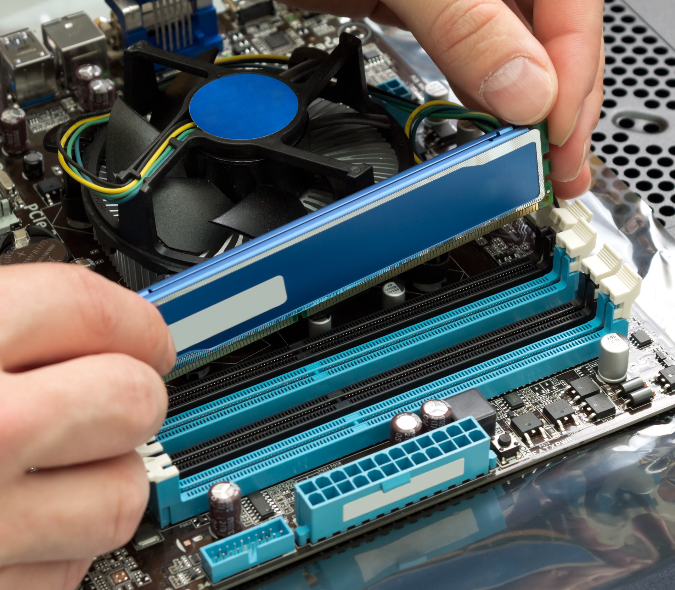
Network Storage Options
Local network storage
File server
Network attached storage (NAS)
Cloud storage
Notes:
**Network Storage Options:**
Network storage options provide efficient ways to store and manage data across networks, whether within a local environment or in the cloud. Here are some common network storage solutions:
**Local Network Storage:**
Local network storage involves storing data on devices that are part of the local network. This can include individual computers, servers, or dedicated storage devices. Two primary types of local network storage are:
- **File Server:** A file server is a dedicated computer or server that stores and manages files and data accessible to multiple users on a network. It acts as a central repository for shared files and provides features such as access control, security, and data organization.
- **Network Attached Storage (NAS):** NAS is a specialized storage device connected to the network, designed solely for data storage and file sharing. NAS devices are compact, cost-effective, and offer features like automated backups, remote access, and data redundancy. They are particularly suitable for home or small business environments.
**Cloud Storage:**
Cloud storage involves storing data on remote servers managed by third-party providers. Users can access their data over the internet from anywhere with an internet connection. Cloud storage offers several advantages:
- **Scalability:** Cloud storage can easily scale to accommodate growing storage needs without the need for physical hardware upgrades.
- **Accessibility:** Cloud-stored data can be accessed from various devices, making it convenient for remote work or collaboration.
- **Redundancy:** Cloud providers often replicate data across multiple data centers, enhancing data redundancy and disaster recovery capabilities.
- **Pay-as-You-Go:** Cloud storage services typically offer flexible pricing models, allowing users to pay for the storage they use.
Popular cloud storage services include Google Drive, Dropbox, Microsoft OneDrive, and Amazon S3.
Choosing the right network storage option depends on factors such as the size of the organization, data storage needs, budget constraints, and the level of control required over data management and security.

Slide 9
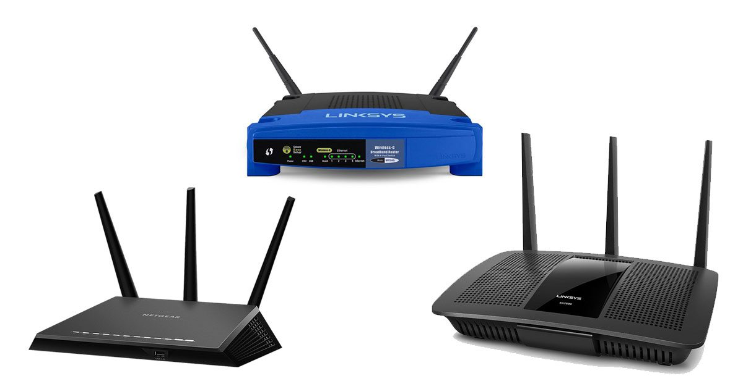
Basic Steps for Setting Up a SOHO Router
Change the router’s SSID
Change the administrator username and password. Give it a strong password.
Enable WPA2 Personal with AES
Choose a high-quality passphrase
From the client side, select WPA2 and enter the security passphrase to connect
Notes:
**Steps for Setting up a Small Office/Home Office (SOHO) Network:**
Setting up a SOHO network involves configuring your router and devices to ensure secure and reliable connectivity. Here are the steps to set up your SOHO network:
1. **Access the Router's Configuration Interface:**
- Connect your computer to the router using an Ethernet cable or wirelessly through the default SSID (network name).
- Open a web browser and enter the router's IP address (usually 192.168.1.1 or 192.168.0.1) to access the router's configuration page.
2. **Change the SSID (Network Name):**
- Access the wireless settings section in the router's interface.
- Change the default SSID to a unique and meaningful name that doesn't reveal personal information.
3. **Change the Administrator Username and Password:**
- Locate the admin or management settings in the router's interface.
- Change the default administrator username and set a strong, unique password to secure access to the router's settings.
4. **Enable WPA2 Personal with AES Encryption:**
- In the wireless security settings, choose WPA2 Personal (or WPA3 if available) as the security protocol.
- Select AES (Advanced Encryption Standard) as the encryption method for better security.
5. **Choose a High-Quality Passphrase:**
- Set a strong and complex passphrase for your Wi-Fi network. It should be a mix of upper and lowercase letters, numbers, and special characters.
6. **Connect Clients to the Network:**
- On your client devices (laptops, smartphones, tablets), search for available Wi-Fi networks.
- Select your new SSID and enter the security passphrase when prompted.
7. **Test Connectivity:**
- Once connected, test the internet connectivity on your devices to ensure they can access websites and online services.
8. **Optional: Set up Guest Network:**
- If your router supports it, consider setting up a separate guest network for visitors. This network should have limited access to your main network and its resources.
9. **Optional: Update Firmware:**
- Check if there are firmware updates available for your router. If so, update the firmware to ensure the latest security patches and features.
10. **Optional: Configure Additional Settings:**
- Explore other settings in the router's interface, such as port forwarding, parental controls, and Quality of Service (QoS), depending on your needs.
Remember that network security is essential, especially for SOHO environments. Regularly update your router's firmware, change passwords periodically, and ensure that devices connected to your network are also secure.
Following these steps will help you set up a secure and efficient SOHO network for your home or small office.

Slide 10
Network Name
Wireless network name is the Service Set Identifier (SSID)
Uniquely identifies a wireless network
All clients must be configured with the appropriate SSID
Notes:
The Wireless Network Name, commonly referred to as the Service Set Identifier (SSID), serves as a unique identifier for a wireless network. Each wireless network has its own SSID, which distinguishes it from other networks in the vicinity. This SSID plays a crucial role in enabling devices to connect to the correct network. Here's a closer look at its significance:
**1. Identifying Wireless Networks:**
The SSID is akin to a nameplate for your wireless network. It allows devices like smartphones, laptops, and tablets to recognize and display the available wireless networks in the vicinity. When you scan for available networks on your device, you'll see a list of SSIDs that correspond to different networks.
**2. Uniqueness and Differentiation:**
Because each SSID must be unique, it helps prevent confusion between networks with similar names. For example, if multiple neighbors have Wi-Fi routers, the unique SSIDs ensure that you can distinguish your network from theirs.
**3. Connecting to the Correct Network:**
When you want to connect a device to a specific Wi-Fi network, you need to configure the device with the correct SSID. This ensures that the device connects to the right network, especially in environments where multiple networks are present.
**4. Security and Privacy:**
While SSIDs are visible to anyone in the vicinity who scans for networks, they do not reveal detailed information about the network's configuration or security. Network administrators can choose whether to broadcast the SSID openly or hide it from public view, but the SSID is still required for devices to connect.
**5. Security Considerations:**
Using a unique and non-generic SSID can contribute to network security. Default SSIDs that come with routers might be easily guessed, potentially making your network susceptible to unauthorized access. By creating a custom and distinct SSID, you can enhance the security of your network.
**6. SSID Configuration:**
You can configure the SSID through your router's settings. Most routers allow you to change the default SSID to a custom name that is meaningful to you but doesn't reveal personal information. Additionally, if you have multiple bands (2.4 GHz and 5 GHz) on your router, you can set different SSIDs for each band.
In summary, the SSID is a critical component of wireless networking. It enables devices to identify and connect to specific networks accurately, fostering seamless and secure wireless communication.

Slide 11
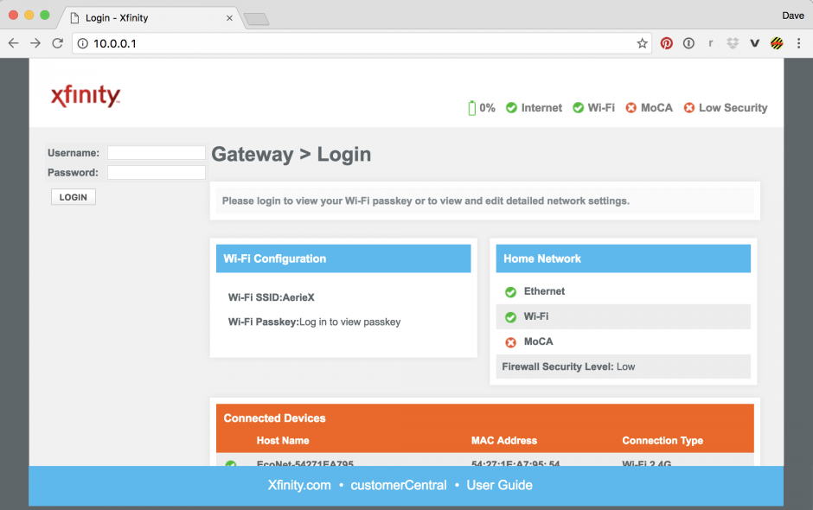
Router Administrator Account
Change the name of the account (if possible) from the default
Makes it harder to hack
Set a strong password – do not give it out
What to do if you forget the password
Notes:
The Router Administrator Account holds significant control over your router's settings and configurations, making it a prime target for hackers. To enhance the security of your network and prevent unauthorized access, it's crucial to take appropriate measures when managing the router administrator account:
**1. Change the Account Name:**
If your router allows it, changing the default name of the administrator account is a smart security move. This adds an extra layer of obscurity, making it harder for potential attackers to identify the account they're targeting.
**2. Strong Password Implementation:**
Setting a strong and unique password for the router administrator account is paramount. This password should be a combination of letters (both upper and lower case), numbers, and special characters. Avoid using easily guessable information like birthdays or names. The more complex the password, the more challenging it is to crack.
**3. Keep the Password Confidential:**
Never share your router administrator account password with others unless absolutely necessary. Only grant access to trusted individuals who need to manage the network settings. The fewer people who know the password, the better you can control access.
**4. Forgotten Password Recovery:**
If you forget the password to your router administrator account, don't panic. Most routers offer a process to reset the password and regain access to your router settings. This usually involves a physical reset of the router, which may include pressing a reset button or accessing the router's web interface using default login credentials. However, be aware that this process may revert your router settings to their factory defaults, so be prepared to reconfigure your network settings afterward.
**5. Keep Firmware Updated:**
Regularly updating your router's firmware is important for security. Firmware updates often include patches to address vulnerabilities that hackers might exploit. Keeping your router's firmware up to date minimizes the risk of unauthorized access.
**6. Enable Remote Management Cautiously:**
Some routers offer remote management capabilities that allow you to access and configure your router from anywhere. While this can be convenient, it also introduces potential security risks. If you enable remote management, ensure you set a strong password for it and use secure connections (HTTPS).
By taking these precautions, you can significantly bolster the security of your router administrator account and protect your network from potential cyber threats. Remember that securing your router is a critical step in maintaining a safe and reliable home network environment.

Slide 12
Choosing a Passphrase
This is the password clients will use to access the network
Generally, not given to clients but typed in by an administrator
Make sure the password is different than the administrator password
Notes:
Selecting a strong passphrase for your wireless network is essential to maintain its security. Here are some guidelines to consider when choosing a passphrase:
**1. Length:** Opt for a passphrase that is at least 12-16 characters long. Longer passphrases are generally more secure as they provide more combinations for potential attackers to guess.
**2. Complexity:** Include a mix of uppercase and lowercase letters, numbers, and special characters in your passphrase. This complexity increases the difficulty of cracking the passphrase using brute force or dictionary attacks.
**3. Avoid Predictability:** Avoid using common words, phrases, or easily guessable information like birthdays, pet names, or favorite sports teams. Instead, use a combination of unrelated words or create a sentence that is meaningful only to you.
**4. Uniqueness:** Ensure that your passphrase is unique and not reused across multiple accounts or networks. This prevents a breach in one area from compromising other accounts.
**5. Personalization:** Create a passphrase that has personal significance to you, but isn't something that can be easily deduced from publicly available information.
**6. Randomness:** Generating a random passphrase, perhaps using a password manager or passphrase generator, can provide an extra layer of security. Just ensure that it's something you can remember or store securely.
**7. Avoid Common Phrases:** Don't use well-known quotes, song lyrics, or famous sayings, as these can be easily guessed or cracked using dictionary attacks.
**8. Long and Memorable:** A good passphrase strikes a balance between complexity and memorability. It should be long enough to deter attackers while being something you can remember without writing it down.
**9. Admin vs. Network Passphrases:** As you've mentioned, ensure that the passphrase for your wireless network is distinct from the administrator password for your router. This separation prevents an attacker from gaining access to your network by compromising the router admin password.
**10. Regular Updates:** Consider changing your passphrase periodically. This practice reduces the potential risk of long-term exposure.
Remember that passphrases are an essential line of defense against unauthorized access to your network. A strong passphrase helps safeguard your data, devices, and privacy, making it a crucial aspect of maintaining a secure home network environment.

Slide 13
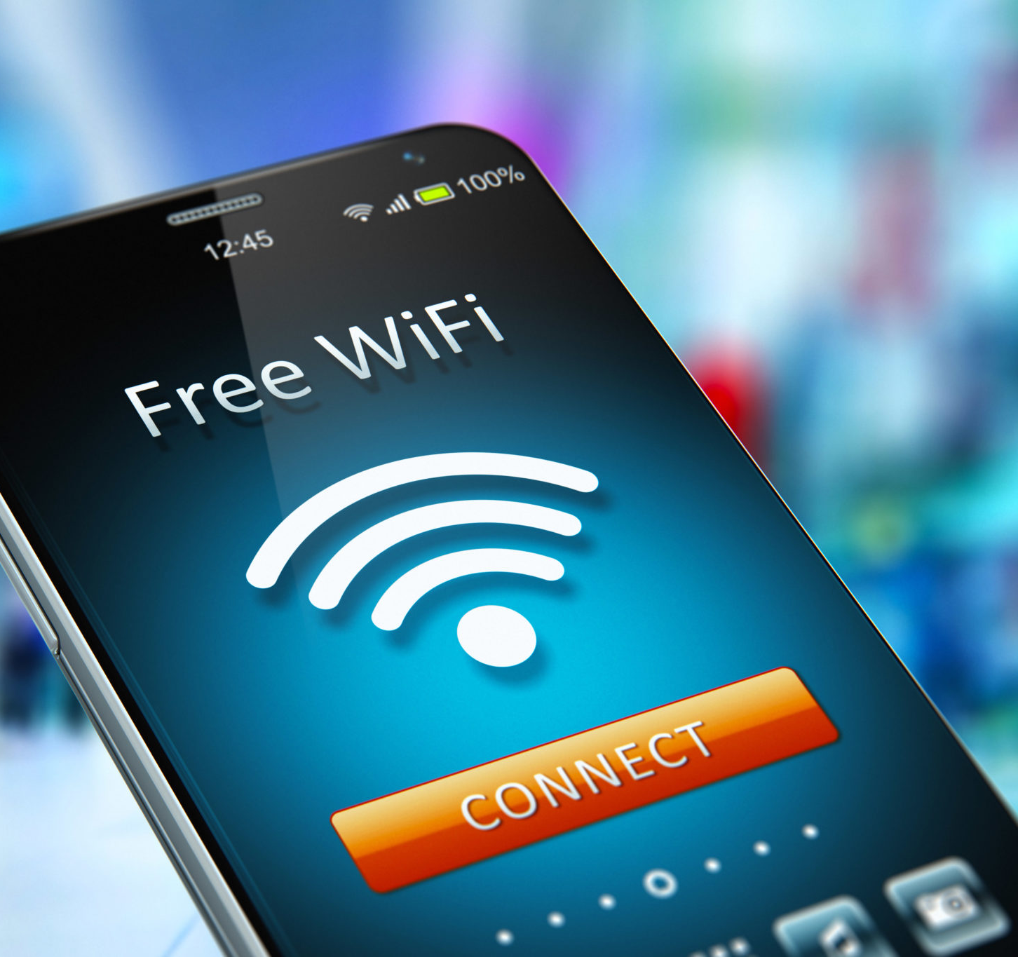
Client Configuration
Search for or provide SSID
Ensure security is set to the appropriate standard
Enter the passphrase
Notes:
**1. Search for or Provide SSID:**
The SSID (Service Set Identifier) is the name of the wireless network you want to connect to. This is the unique identifier that differentiates your network from others. When connecting to a network, you can either search for available networks on your device and select the correct SSID or manually enter the SSID if you know it.
**2. Ensure Security is Set to the Appropriate Standard:**
Before connecting to a wireless network, ensure that the security settings match the appropriate standard. The most secure option is typically WPA2 (Wi-Fi Protected Access 2) with AES (Advanced Encryption Standard) encryption. This ensures that data transmitted over the network is encrypted and protected from unauthorized access.
**3. Enter the Passphrase:**
Once you've selected the correct SSID and verified the security settings, you'll be prompted to enter the passphrase. The passphrase is the secret code that provides access to the network. Make sure to enter the correct passphrase as it was set by the network administrator.
By following these steps, you can establish a secure and reliable connection to a wireless network, ensuring that your data and communication remain protected from potential threats.

Slide 14
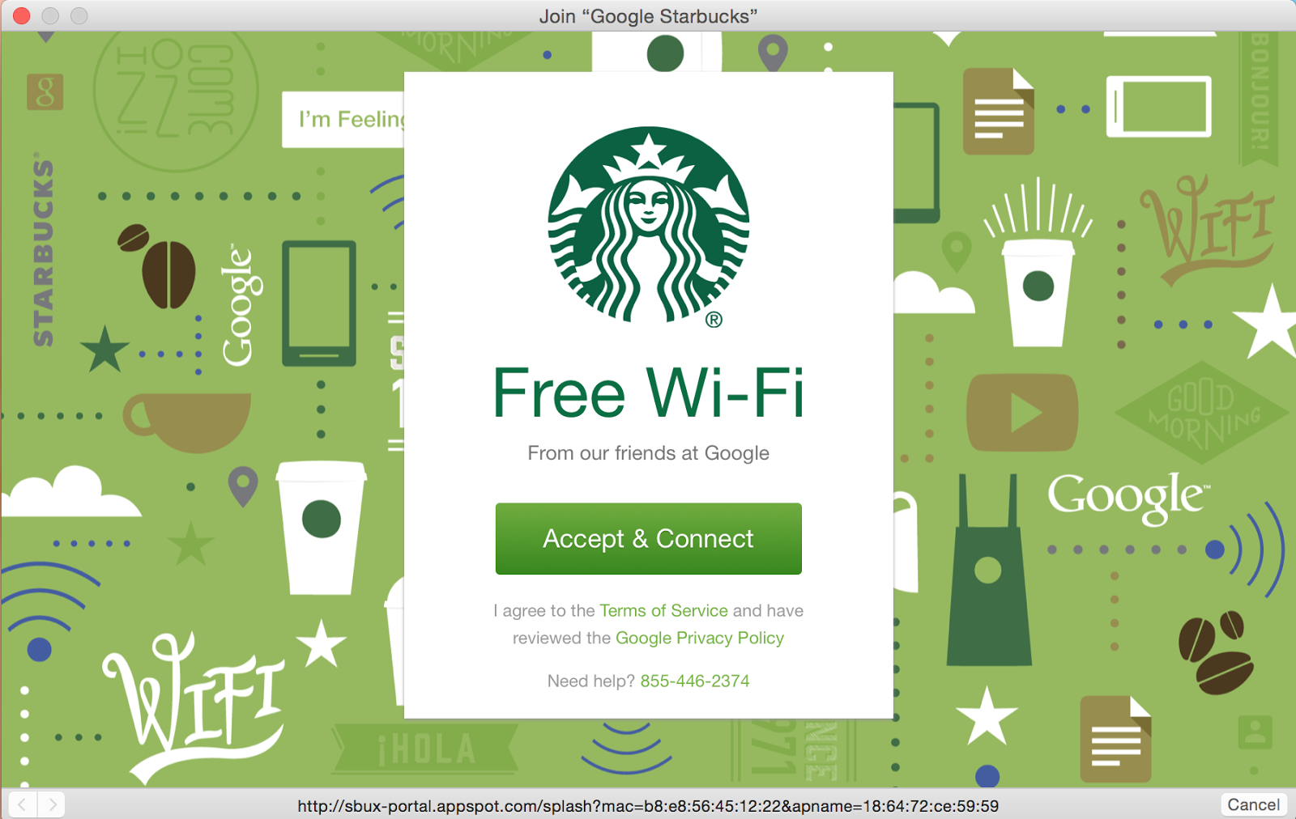
Wireless Security
Open portals (not secure at all)
Captive portal
Wired Equivalency Protocol (WEP)
WiFi Protected Access (WPA)
WiFi Protected Access 2 (WPA2)
Notes:
Absolutely, wireless security is crucial to protect your network and data from unauthorized access and potential threats. Here's an expanded explanation of the terms you mentioned:
**1. Open Portals:**
An open wireless network is not secure at all. It doesn't require any authentication to connect, which means anyone within range can access it without any restrictions. This lack of security makes it vulnerable to various types of attacks and unauthorized use.
**2. Captive Portal:**
A captive portal is a mechanism often used in public Wi-Fi networks or guest networks. When you connect to such a network, you're redirected to a web page where you need to provide certain information or agree to terms and conditions before gaining full access. While captive portals provide a level of access control, they might not always offer strong security.
**3. Wired Equivalent Protocol (WEP):**
WEP was one of the earliest encryption protocols used for wireless networks. However, it's highly insecure and easily crackable due to its weak encryption algorithms. WEP has been deprecated and is not recommended for use due to its vulnerability to attacks.
**4. WiFi Protected Access (WPA):**
WPA was introduced as an improvement over WEP. It uses stronger encryption and authentication methods, making it more secure. However, WPA also has vulnerabilities, and it's recommended to use its successor, WPA2, for better security.
**5. WiFi Protected Access 2 (WPA2):**
WPA2 is currently the recommended security standard for Wi-Fi networks. It employs the Advanced Encryption Standard (AES) encryption algorithm, which is much stronger than the encryption used in WEP and the original WPA. WPA2 provides robust protection against various types of attacks and is widely adopted for securing wireless networks.
Selecting the right wireless security protocol, such as WPA2, and regularly updating your network's passphrase are essential steps to maintain the security and privacy of your wireless network, ensuring that only authorized users can access it while keeping potential threats at bay.

Slide 15
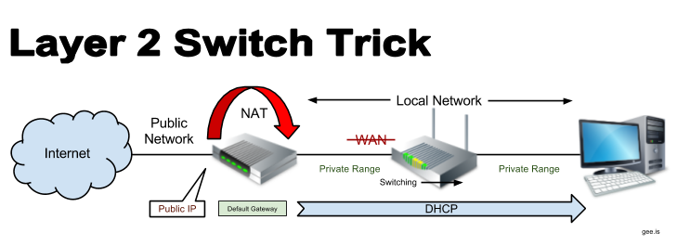
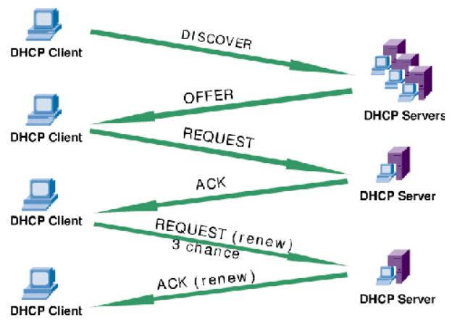
Additional Wireless Router Services
Guest access
DHCP
NAT
QoS
Firewall
Notes:
**1. Guest Access:**
Guest access is a feature that allows you to provide internet access to visitors or guests without giving them access to your main network. This helps keep your main network secure while still offering connectivity to guests. They are typically provided with a separate SSID and may have restricted access to certain resources on the network.
**2. DHCP (Dynamic Host Configuration Protocol):**
DHCP is a protocol that automatically assigns IP addresses and network configuration settings to devices connected to a network. It eliminates the need for manual configuration and ensures efficient use of available IP addresses in a network.
**3. NAT (Network Address Translation):**
NAT is a technique that allows multiple devices in a local network to share a single public IP address. It provides an extra layer of security by hiding internal IP addresses from the external network. NAT enables devices within the private network to access the internet while also helping to prevent unsolicited inbound connections.
**4. QoS (Quality of Service):**
QoS is a feature that prioritizes and manages network traffic to ensure a certain level of performance for specific applications or services. For example, you can allocate more bandwidth to video streaming or online gaming, ensuring a smooth experience even when the network is under load.
**5. Firewall:**
A firewall is a security feature that monitors and controls incoming and outgoing network traffic based on predefined security rules. It acts as a barrier between your network and potential threats from the internet, helping to prevent unauthorized access, malware, and other cyberattacks.
These additional router services enhance the functionality and security of your wireless network, making it more versatile, user-friendly, and protected against potential risks and vulnerabilities.

