Slide 1
IT Fundamentals
Chapter 7:
Database Fundamentals

Slide 2
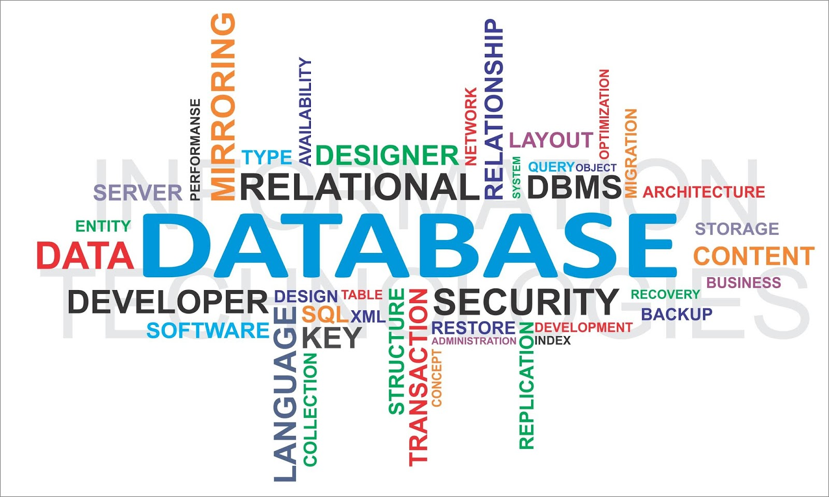
When to Use Databases
Multiple concurrent users
Scalability
Speed
Variety of data
Number of records
Data persistence
Security
Notes:
Databases are used in various scenarios when specific requirements and factors come into play:
**Multiple Concurrent Users:** Databases are designed to handle multiple users accessing and manipulating data simultaneously. They provide mechanisms to ensure data integrity and prevent conflicts when multiple users are interacting with the same data.
**Scalability:** As your data grows, databases can be scaled to accommodate increasing amounts of information. This can be done by optimizing the database design, adding more hardware resources, or using techniques like sharding and replication.
**Speed:** Databases are optimized for fast data retrieval and manipulation. They use indexing, caching, and query optimization techniques to ensure that even with large amounts of data, operations are performed efficiently.
**Variety of Data:** Databases can handle various types of data, including structured, semi-structured, and unstructured data. This makes them suitable for scenarios where you're dealing with different data formats, such as text, images, and videos.
**Number of Records:** When you have a large number of records that need to be organized and searched efficiently, databases provide a structured way to manage and query these records.
**Data Persistence:** Databases offer data persistence, meaning that data is stored and preserved even after the application or system is shut down. This is crucial for applications that need to retain information over time.
**Security:** Databases provide security features to control access to data. They allow you to define user roles and permissions, ensuring that only authorized users can access, modify, or delete specific data.
In summary, databases are valuable when you have to manage a significant amount of data, accommodate multiple users, ensure data integrity, and provide efficient ways to retrieve and manipulate information. They're essential for applications that need to store, organize, and access data reliably and securely.

Slide 3
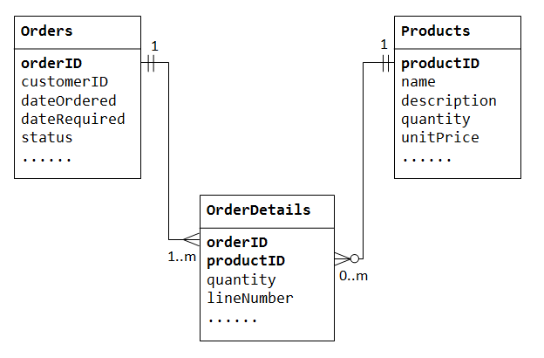
Relational Databases
Managed by a relational database management system (RDBMS)
Schema
Logical schema
Physical schema
Notes:
Relational databases are a type of database management system (DBMS) that organize and store data in a structured manner using a system of tables with rows and columns. They are managed by a relational database management system (RDBMS), which provides the tools and mechanisms to create, modify, and query the database.
**Schema:** The schema of a relational database defines its structure and organization. It includes two main components:
- **Logical Schema:** The logical schema describes the high-level structure of the database, including the tables, their relationships, and the attributes (columns) they contain. It defines the logical view of the data and how it's organized conceptually.
- **Physical Schema:** The physical schema describes how the data is actually stored on the underlying hardware. It includes details about storage mechanisms, indexing, and access paths. The physical schema focuses on the technical implementation of the database on the storage devices.
Relational databases use a structured query language (SQL) to interact with the data. SQL allows you to create tables, define relationships, insert, update, and delete data, and perform complex queries to retrieve specific information from the database.
The key concepts of relational databases include tables, rows (records), columns (attributes), primary keys, foreign keys, and normalization. Tables represent entities in the real world, rows contain individual records, and columns hold specific pieces of information. Primary keys uniquely identify each row in a table, and foreign keys establish relationships between tables.
Relational databases excel at managing structured data with well-defined relationships, making them suitable for applications that require data consistency, integrity, and complex querying capabilities. However, they may not be the best choice for scenarios with highly unstructured or hierarchical data.

Slide 4
Relational Database Components
Tables
Fields
Records
Forms
Queries
Reports
Macros and modules
Notes:
Relational databases are ideal for scenarios where structured data needs to be organized, stored, and efficiently managed. They provide a strong foundation for applications that require consistent and well-defined data relationships. Here are some situations where relational databases are commonly used:
**1. Structured Data:** When dealing with structured data, where information can be organized into tables, fields (columns), and records (rows), relational databases are a good choice. This includes scenarios such as managing customer information, product inventory, financial transactions, and employee records.
**2. Data Integrity and Consistency:** Relational databases excel at enforcing data integrity through constraints and rules. If maintaining accurate and consistent data is crucial for your application, such as preventing duplicate entries or maintaining referential integrity, a relational database can help maintain data quality.
**3. Complex Queries:** When your application requires complex querying and reporting capabilities, relational databases are well-suited. SQL allows you to perform various types of queries, filtering, sorting, and aggregation to extract specific information from your data.
**4. Multi-User Environments:** Relational databases are designed to handle multiple concurrent users accessing and modifying data simultaneously. This makes them suitable for applications used by many users, such as e-commerce platforms, content management systems, and enterprise resource planning (ERP) systems.
**5. Scalability:** Relational databases offer scalability options. While they might not be as scalable as some NoSQL databases for certain use cases, relational databases can handle moderate to large-scale applications with proper design and optimization.
**6. Data Relationships:** If your data has well-defined relationships that can be represented using foreign keys and joins, a relational database is a good fit. This is especially important for applications that involve connecting data from different tables to derive meaningful insights.
**7. Reporting and Analysis:** Relational databases are commonly used for generating reports and performing data analysis. By structuring data in a tabular format, you can easily aggregate and analyze data to make informed business decisions.
**8. Transaction Management:** For applications that require robust transaction management, like banking systems or online payment platforms, relational databases provide ACID (Atomicity, Consistency, Isolation, Durability) compliance, ensuring the reliability of data transactions.
In summary, relational databases are best suited for scenarios where structured data, data integrity, complex querying, and multiple user interactions are important. They provide a strong foundation for applications that require data organization, consistency, and reliability.

Slide 5
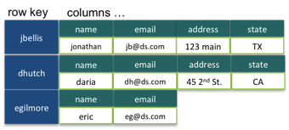
Non-relational databases
Managed by a database management system (DBMS)
Hold non-structured (or unstructured) or semi-structured data
Document databases
Key/value databases
Notes:
Non-relational databases, often referred to as NoSQL databases, offer an alternative approach to data storage and management compared to traditional relational databases. They are particularly suitable for scenarios where data does not fit neatly into structured tables and rows or where high scalability and performance are paramount. Here's a closer look at some key aspects of non-relational databases:
**Managed by DBMS:** Just like relational databases have their relational database management systems (RDBMS), non-relational databases are managed by various types of DBMS tailored for their specific structures and requirements.
**Non-Structured or Semi-Structured Data:** Non-relational databases are well-suited for handling data that doesn't conform to the rigid structure of tables and columns found in relational databases. This includes data like JSON documents, XML files, graphs, and other forms of unstructured or semi-structured data.
**Document Databases:** Document databases store data in flexible, schema-less documents, often using formats like JSON or BSON. These databases are well-suited for scenarios where data structures can evolve over time or where different types of data need to be stored together without a predefined schema.
**Key/Value Databases:** Key/value databases store data as simple key-value pairs. They are efficient for scenarios where quick data retrieval and minimal processing are crucial. Caching systems and certain types of real-time applications benefit from key/value databases.
**Scalability and Performance:** Non-relational databases are designed with scalability and performance in mind. They are often used in applications with high volumes of data and traffic, such as social media platforms, e-commerce websites, and content delivery networks.
**Flexibility:** One of the main advantages of non-relational databases is their flexibility. You're not bound by a fixed schema, so you can adapt your data structures as your application evolves.
**High Availability:** Many non-relational databases offer features that ensure high availability and fault tolerance. This is important for applications that cannot afford downtime or data loss.
**Big Data and Analytics:** Non-relational databases are commonly used in big data and analytics applications. They can efficiently store and process large volumes of data, making them suitable for applications involving real-time data processing and analysis.
**Graph Databases:** Another type of non-relational database is graph databases. These databases are designed to store and retrieve data in the form of nodes and edges, making them ideal for applications involving complex relationships and network data.
**Use Case-Specific:** The choice between a non-relational and relational database depends on your application's requirements. If your data is hierarchical, needs flexible storage, or demands high scalability, non-relational databases can be a great fit.
In summary, non-relational databases are suitable for scenarios where data is unstructured, semi-structured, or where high scalability and performance are critical. They offer flexibility and efficiency for handling various types of data, making them valuable tools in modern application development.

Slide 6
Working with Databases
Manual access
Direct access
Programmatic access
User interface and utility access
Database permissions
Notes:
Working with databases involves various methods of accessing and interacting with the stored data. Here's a breakdown of the different ways you can work with databases:
**Manual Access:** This involves using tools provided by the database management system (DBMS) to manually input, modify, or retrieve data. Users interact with the database directly through interfaces designed for data entry, such as forms, spreadsheets, or text-based interfaces.
**Direct Access:** Direct access refers to interacting with the database using SQL (Structured Query Language) commands. SQL provides a standardized language for querying, updating, and managing relational databases. Direct access is commonly used by developers, analysts, and administrators to perform specific actions on the data.
**Programmatic Access:** Databases can be accessed programmatically using programming languages. Developers use libraries and APIs (Application Programming Interfaces) to connect their applications to the database, allowing them to perform operations like inserting, updating, and retrieving data from within the application code.
**User Interface and Utility Access:** Many databases offer user interfaces and utility tools that provide more user-friendly ways to interact with the database. These interfaces often include features for browsing data, creating queries, and generating reports without the need for writing SQL commands manually.
**Database Permissions:** Databases provide mechanisms to control access to data through permissions. Permissions define what actions users or applications are allowed to perform on the data. This includes actions like reading, writing, modifying, or deleting records. Database administrators can assign different levels of access to different users or roles, ensuring data security and integrity.
In a working database environment, you might have database administrators managing permissions and ensuring data integrity, developers writing code to access and manipulate data programmatically, users using interfaces to perform manual tasks, and analysts running SQL queries to extract insights from the data. The choice of access method depends on the task at hand and the expertise of the individual interacting with the database.

Slide 7
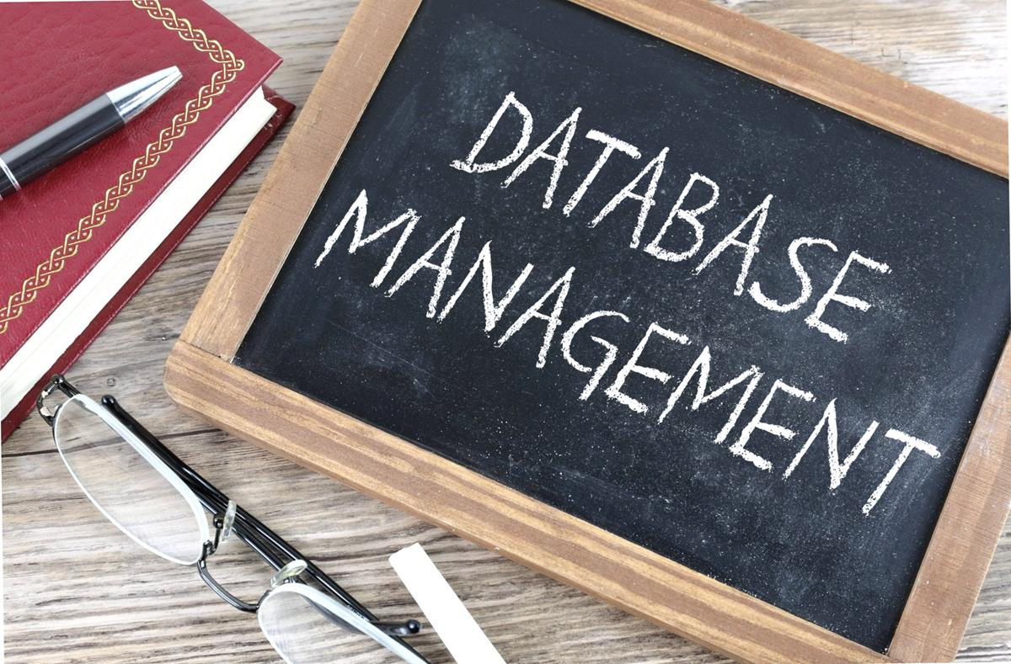
Creating and Managing a Relational Database
Commands
Create
Alter
Importing data
Load command
Removing databases and tables
Drop command
Notes:
Creating and managing a relational database involves a series of commands and actions to set up, modify, import data, and remove the database and its tables. Here's an overview of the key commands and steps involved:
**Creating a Database:**
1. **Create Database:** To create a new database, you use the `CREATE DATABASE` command followed by the desired name of the database. For example:
```sql
CREATE DATABASE MyDatabase;
```
**Altering a Database:**
2. **Alter Database:** The `ALTER DATABASE` command is used to modify the attributes or properties of an existing database. This may include changing the database's name, collation, or other settings.
```sql
ALTER DATABASE MyDatabase
COLLATE Latin1_General_CI_AS;
```
**Importing Data:**
3. **Loading Data:** To import data into a database, you use various commands depending on the DBMS you are using. For example, SQL Server has the `BULK INSERT` command, while MySQL has the `LOAD DATA INFILE` command. These commands allow you to load data from external files into database tables.
```sql
BULK INSERT Employees
FROM 'C:\Data\Employees.csv'
WITH (FIELDTERMINATOR = ',', ROWTERMINATOR = '\n');
```
**Removing Databases and Tables:**
4. **Drop Database:** The `DROP DATABASE` command is used to completely remove a database and its associated tables, data, and objects. Be cautious when using this command, as it irreversibly deletes all data.
```sql
DROP DATABASE MyDatabase;
```
5. **Drop Table:** The `DROP TABLE` command removes a specific table from the database. Similar to dropping a database, this action is irreversible.
```sql
DROP TABLE Employees;
```
These are some of the fundamental commands for creating and managing relational databases. They allow you to create new databases, modify their attributes, import data, and remove databases or tables when necessary. It's important to exercise caution when using commands that can result in data loss, and to ensure you have backups in place before performing irreversible actions. Additionally, the exact syntax and behavior of these commands may vary depending on the specific relational database management system you are using.

Slide 8
Manipulating Data
Commands
Insert
Update
Delete
Select
Notes:
Manipulating databases involves using various commands to perform operations such as inserting, updating, deleting, and selecting data within database tables. Here's an explanation of these commands:
**Insert:**
The `INSERT` command is used to add new records or rows to a database table. It specifies the table name and the values to be inserted into the corresponding columns.
```sql
INSERT INTO Employees (FirstName, LastName, Age)
VALUES ('John', 'Doe', 30);
```
**Update:**
The `UPDATE` command modifies existing records in a database table. It allows you to change the values of specific columns based on certain conditions.
```sql
UPDATE Employees
SET Age = 31
WHERE LastName = 'Doe';
```
**Delete:**
The `DELETE` command is used to remove records from a database table. Similar to the `UPDATE` command, you can specify conditions to identify which records should be deleted.
```sql
DELETE FROM Employees
WHERE LastName = 'Doe';
```
**Select:**
The `SELECT` command retrieves data from a database table. It allows you to specify which columns you want to retrieve and apply conditions to filter the results.
```sql
SELECT FirstName, LastName
FROM Employees
WHERE Age > 25;
```
These commands are essential for manipulating the data within a relational database. `INSERT` is used to add new records, `UPDATE` modifies existing records, `DELETE` removes records, and `SELECT` retrieves specific data based on specified conditions. Using these commands, you can effectively manage the content of your database tables. Remember to exercise caution when performing `UPDATE` and `DELETE` operations, as they can impact a significant amount of data if not used carefully.

Slide 9
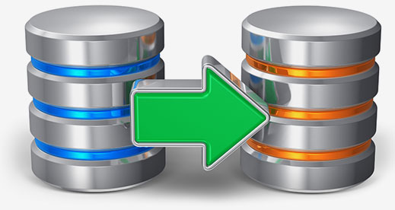
Backing Up Databases
Database dump
Backup
Notes:
Backing up databases is a crucial practice to ensure the safety and availability of your data. There are various methods for backing up databases, and two common approaches are database dumps and backups:
**Database Dump:**
A database dump is a snapshot of the entire database or specific tables that are exported to a file. This file contains the structure of the database, as well as the data stored within it. The dump file can be used to recreate the database in case of data loss or system failures.
**Backup:**
Backups involve creating copies of the database's files or data and storing them in a separate location. These backups can be incremental or full, and they serve as a way to recover data if the original database becomes corrupted, inaccessible, or compromised.
Both database dumps and backups serve the purpose of safeguarding your data. Database dumps are often used for transferring data between different database systems or versions, while backups are more comprehensive and provide a way to restore the entire database or selected parts of it. Regularly performing backups, whether in the form of database dumps or full backups, is essential to prevent data loss and maintain the integrity of your database.

Slide 10
Chapter 7: Database Fundamentals
Explain database concepts and the purpose of a database
Usage of database
Create
Import/input
Query
Reports
Flat file vs. database
Multiple concurrent users
Scalability
Speed
Variety of data
Records
Storage
Data persistence
Compare and contrast various database structures
Structured vs. semi-structured vs. non-structured
Relational databases
Schema
Tables
Rows/records
Fields/columns
Primary key
Foreign key
Constraints
Non-relational databases
Key/value databases
Document databases
Summarize methods used to interface with databases
Relational methods
Data manipulation
Select
Insert
Delete
Update
Data definition
Create
Alter
Drop
Permissions
Database access methods
Direct/manual access
Programmatic access
User interface/utility access
Query/report builders
Export/import
Database dump
Backup
Notes:
**Database Concepts and Purpose:**
A database is a structured collection of data that is organized, stored, and managed for efficient retrieval and manipulation. Its purpose is to provide a reliable and efficient way to store, retrieve, and manage large volumes of data while ensuring data integrity, security, and accessibility. Databases are used in various applications, from small-scale projects to enterprise-level systems, to store and manage data in a structured and organized manner.
**Usage of Database:**
Databases serve multiple functions in different contexts:
- **Creation:** Databases are used to create structured repositories for data, allowing easy organization and categorization.
- **Import/Input:** Data can be imported or input into databases, ensuring accuracy and consistency.
- **Query:** Users can retrieve specific information from the database using queries, enabling efficient data retrieval.
- **Reports:** Databases enable the generation of reports summarizing or analyzing stored data.
**Flat File vs. Database:**
A flat file is a simple file that contains data without any structured relationships, while a database is a more sophisticated system that organizes data into tables with defined relationships. Databases offer advantages in terms of data integrity, efficient querying, and scalability over flat files.
**Multiple Concurrent Users:**
Databases can handle multiple users simultaneously, allowing various users to access and modify data concurrently. This is crucial for applications used by many users simultaneously.
**Scalability and Speed:**
Databases can scale to handle large amounts of data and a growing number of users. They are optimized for quick data retrieval and manipulation, ensuring efficient performance even as the dataset grows.
**Variety of Data and Records:**
Databases accommodate a variety of data types, such as text, numbers, dates, images, and more. Data is organized into records, which represent individual instances or entities in a dataset.
**Storage and Data Persistence:**
Databases store data on persistent storage, such as hard drives or cloud storage, ensuring data is retained even after the system is powered off. This enables data to be available for future use.
**Structured vs. Semi-Structured vs. Non-Structured Databases:**
- **Structured:** Data is organized in predefined tables with well-defined relationships (e.g., relational databases).
- **Semi-Structured:** Data has some structure but allows for flexible schemas (e.g., document databases like MongoDB).
- **Non-Structured:** Data has no specific structure and can be stored in various formats (e.g., key-value databases like Redis).
**Relational Databases:**
- Managed by an RDBMS (Relational Database Management System).
- Data is organized into tables with rows (records) and columns (fields).
- Relationships are established using primary keys and foreign keys.
- Schema defines the structure of the database.
**Non-Relational Databases:**
- Managed by various DBMS types.
- Different structures, like key/value or document-based.
- Suitable for unstructured or semi-structured data.
- More flexible than relational databases.
**Methods to Interface with Databases:**
- **Relational Methods:** Used with relational databases, including data manipulation (select, insert, delete, update) and data definition (create, alter, drop).
- **Programmatic Access:** APIs and programming languages allow developers to interact with databases using code.
- **User Interface/Utility Access:** Users can interact with databases through user-friendly interfaces or utilities.
- **Query/Report Builders:** Tools for creating queries and reports without writing code.
- **Export/Import:** Moving data between databases or applications.
- **Database Dump:** Creating a snapshot of the database's structure and data.
- **Backup:** Creating copies of the database to prevent data loss.

