Slide 1
IT Fundamentals
Chapter 6:
Software Development

Slide 2
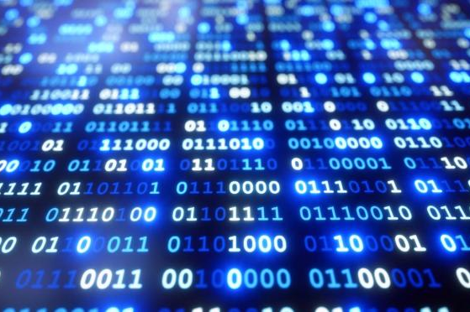
Notational Systems
Binary – 1s and 0s
Decimal – 0 through 9
Hexadecimal – 0 through F (15)
ASCII
Unicode – superset of ASCII
Notes:
Notational systems are used to represent data in a way that can be understood by humans and computers. There are several notational systems used in computer science, each with its specific purpose and representation. Here's a quick summary of some common notational systems:
Binary (Base-2): The binary system uses only two digits: 0 and 1, to represent data. It is the foundation of digital computing, as the basic components of computers, like transistors, can represent these two states (on/off, high/low). In binary, numbers are expressed as a sequence of 0s and 1s.
Decimal (Base-10): The decimal system, also known as the base-10 system, is the most common numerical system used by humans. It consists of 10 digits: 0, 1, 2, 3, 4, 5, 6, 7, 8, and 9. Computers often use decimal notation for data input and output, as it is more intuitive for humans to work with.
Octal (Base-8): The octal system uses a base of 8, with digits ranging from 0 to 7. Octal notation is less common today but was historically used in computer systems, particularly for representing file permissions in UNIX-based operating systems.
Hexadecimal (Base-16): The hexadecimal system, or base-16, uses 16 symbols: 0, 1, 2, 3, 4, 5, 6, 7, 8, 9, A, B, C, D, E, and F. Hexadecimal is a more compact way of representing binary data, as each hexadecimal digit can represent four binary digits (bits). It is often used in programming and computing for tasks like memory addressing, color codes, and debugging.
ASCII (American Standard Code for Information Interchange): ASCII is a character encoding standard that assigns unique numeric values to letters, digits, punctuation marks, and control characters. It is used as a common format for representing text data in computers and communication systems. ASCII uses 7 bits to represent 128 different characters, with values ranging from 0 to 127.
These notational systems are essential for computer science and programming, as they facilitate data representation, storage, and manipulation in ways that both humans and machines can understand and process.
Unicode is a computing industry standard for the consistent encoding, representation, and handling of text expressed in most of the world's writing systems. Developed by the Unicode Consortium, the primary goal of Unicode is to provide a unique code point (numeric value) for every character, regardless of the platform, program, or language.
Unicode has several advantages over other character encoding standards, such as ASCII:
Universal Character Set: Unicode covers a vast range of characters, including letters, digits, symbols, and emojis from many languages and scripts worldwide. This enables the representation of text in various languages, facilitating global communication and data exchange.
Consistency: Unicode ensures that the same character encoding is used across different platforms, operating systems, and applications, allowing for consistent text display and data interchange.
Extensibility: Unicode has a large address space, with over 1.1 million code points available. This allows for the addition of new characters and scripts as they are developed or discovered.
Compatibility: Unicode is designed to be compatible with existing character encoding standards, such as ASCII. The first 128 characters of Unicode are identical to ASCII, allowing for easy conversion and backward compatibility.
In practice, Unicode is often implemented using different character encoding schemes, such as:
UTF-8: A variable-length encoding that uses 1 to 4 bytes to represent each Unicode code point. It is the most widely used Unicode encoding on the internet, as it is backward compatible with ASCII and more efficient for representing common characters.
UTF-16: A variable-length encoding that uses 2 or 4 bytes to represent Unicode code points. It is commonly used in programming languages and operating systems, like Windows and Java, where it provides a balance between storage efficiency and processing simplicity.
UTF-32: A fixed-length encoding that uses 4 bytes to represent each Unicode code point. It is less commonly used due to its larger storage requirements but provides faster random access and processing of characters in some cases.
Unicode has become the standard for text representation in modern computing, allowing for consistent handling of text data across languages, platforms, and applications.

Slide 3
Categories of Programming Languages
Assembly
Compiled
Interpreted
Query

Slide 4
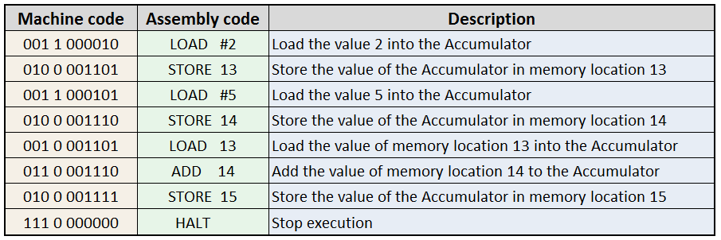
Assembly Language
Lowest-level of code
Write instructions directly to the CPU
Used a lot in embedded systems
Notes:
Assembly language is often considered the lowest-level of programming languages. It provides a way to write instructions that are understood directly by the computer's central processing unit (CPU). Unlike higher-level languages that are more human-readable, assembly language instructions closely resemble the machine code that the CPU can execute.
In assembly language, you work with mnemonic codes (short, symbolic names) that correspond to specific machine code instructions. These instructions perform basic operations like arithmetic calculations, memory access, and control flow. For example, an assembly instruction might represent adding two numbers together, storing data in memory, or jumping to a different part of the program.
Assembly language offers a level of control over the hardware that higher-level languages can't achieve. This makes it ideal for tasks that require precise control over hardware resources and performance, such as programming microcontrollers or other embedded systems. Embedded systems often have limited resources, and assembly programming allows developers to optimize code to run efficiently on such systems.
However, writing in assembly language can be complex and time-consuming. Each CPU architecture has its own set of instructions and syntax, so code written in assembly is not easily portable between different hardware platforms. Additionally, assembly programming requires a deep understanding of the underlying hardware, which can make it more challenging for newcomers to grasp compared to higher-level languages.
Despite its challenges, assembly language is still valuable for specific use cases where performance and control are paramount. Programmers who work with assembly language gain insights into how computers work at a fundamental level, which can be useful even when working with higher-level languages.

Slide 5
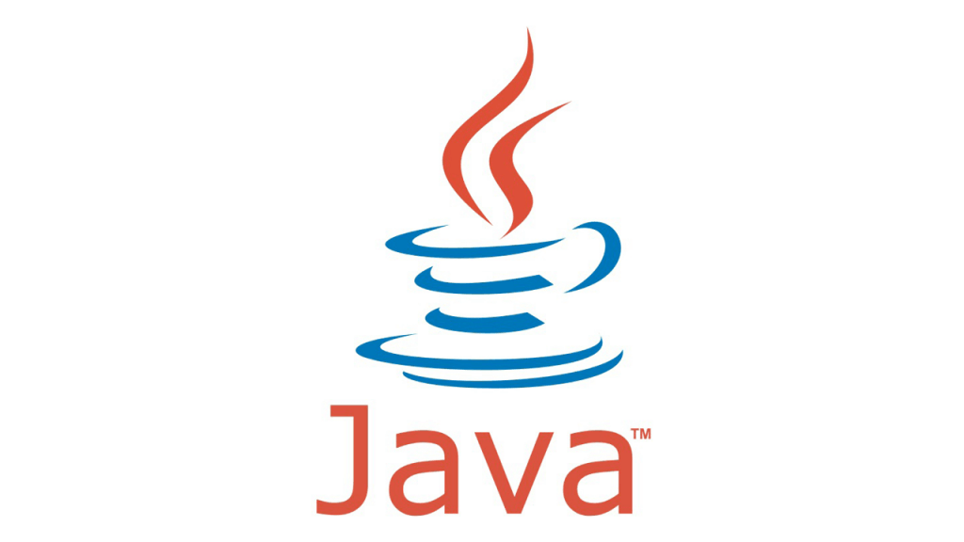
Compiled Languages
Requires the use of a compiler before it can be executed
Compile once, run many times
Java, C, C++, C#
Notes:
Compiled languages are a category of programming languages that follow a distinct process before code can be executed. When a programmer writes code in a compiled language, it's referred to as the "source code." However, this source code is not directly understood by a computer's processor. Instead, it needs to be translated into machine code, which is a set of instructions that the computer can execute.
The translation process is carried out by a special software tool called a "compiler." This compiler takes the human-readable source code as input and generates either machine code or an intermediate form known as "bytecode." This machine code or bytecode is what the computer's processor can execute to perform the desired tasks outlined in the source code.
Some important points about compiled languages include:
1. **Performance:** One of the key advantages of compiled languages is their performance. Because the code is translated into machine code ahead of time, it's optimized for direct execution by the computer's processor. This results in faster execution times compared to languages that are interpreted line by line at runtime.
2. **Compilation Time:** The compilation step adds an extra layer of preparation before the program can be run. This can increase the time it takes to develop and test software. However, the trade-off is often well worth it, as compiled programs tend to be more efficient and faster during actual execution.
3. **Platform Dependency:** Compiled languages often produce platform-specific executables. This means that the resulting compiled program may work on one operating system or hardware architecture but might need to be recompiled for it to work on a different system. This can add some complexity when trying to make a program run on multiple platforms.
4. **Runtime Flexibility:** Unlike interpreted languages, compiled languages offer less flexibility at runtime. If you want to make changes to the program's behavior or functionality, you typically need to make those changes in the source code and then recompile the program. This can slow down the process of making quick adjustments.
Examples of compiled languages include C, C++, and Rust. These languages are often used in scenarios where performance is critical, such as system-level programming, game development, or applications that require fine-tuned control over hardware resources. The compilation process contributes to their ability to produce efficient and high-performance software.

Slide 6
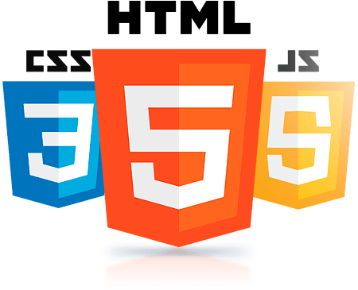
Interpreted Languages
Each line of code is interpreted (by an interpreter) every time the program is executed
Often used for shorter elements and specific tasks
Three types:
Markup languages (HTML, XML)
Scripting languages (JavaScript, VB Script, PHP, Python)
Scripted languages (Lua, Lisp)
Notes:
Interpreted languages belong to a category of programming languages that are executed directly from the source code, skipping the compilation step that is common in compiled languages. Instead of converting the source code into machine code or bytecode before execution, an interpreter reads and processes the source code line by line in real-time during the program's runtime.
Here are some important points to understand about interpreted languages:
1. **Flexibility:** Interpreted languages offer a higher degree of flexibility at runtime. This means that changes made to the source code can take effect immediately without the need to go through a separate compilation process. This flexibility can speed up development and allow for quicker adjustments to the program's behavior.
2. **Platform Independence:** Since interpreted languages rely on an interpreter to execute the source code, they are generally platform-independent. The same source code can be executed on different operating systems or hardware architectures as long as a compatible interpreter is available for each platform.
3. **Slower Performance:** One of the trade-offs of interpreted languages is that they tend to have slower runtime performance compared to compiled languages. This is because the interpreter needs to read, translate, and execute each line of the source code in sequence. This approach is more time-consuming than executing compiled machine code directly.
4. **Ease of Development:** Interpreted languages often prioritize simplicity and ease of development. They are frequently used for rapid application development, scripting, and prototyping. This makes them particularly well-suited for scenarios where getting a functional program quickly is more important than achieving the highest performance.
Examples of interpreted languages include Python, JavaScript, Ruby, and PHP. These languages are widely used in various domains, such as web development, scripting, automation, and data analysis. Their focus on quick development turnaround, platform independence, and ease of use makes them popular among developers working on a wide range of projects.

Slide 7
Query Languages
Used to retrieve (query) data from databases
Very specialized, limited syntax
SQL
LDAP
Notes:
Query languages belong to a specific group of programming languages that are designed with a particular purpose: querying, managing, and manipulating data stored in databases, data warehouses, and similar data storage systems. These languages provide a way for humans to interact with structured or semi-structured data, allowing them to retrieve, insert, update, or delete data based on specific criteria.
Here are some key points to understand about query languages:
1. **Focus on Data:** Query languages are all about working with data. They're used to perform various tasks like searching for specific information, filtering data, calculating aggregates (like sums or averages), and transforming data from one form to another.
2. **Declarative Nature:** Most query languages are declarative, which means users state what they want to achieve without specifying the detailed steps to get there. This allows the underlying database system to optimize how the queries are executed, making them more efficient.
3. **Tailored to Data Models:** Query languages are often designed to work with specific data models, like relational databases, hierarchical data, or graphs. They're customized to work seamlessly with the underlying database structures.
4. **Integration with Other Languages:** These languages can be integrated into other programming languages. Developers can embed queries within their code to perform data-related tasks within their applications.
Examples of query languages include:
- **SQL (Structured Query Language):** Used for managing relational databases like MySQL, PostgreSQL, and Microsoft SQL Server. It's used to create, retrieve, update, and delete data in tables.
- **XPath and XQuery:** These are used for querying and manipulating XML data. They're often used in situations where data is stored in XML format.
- **SPARQL:** This is used to query RDF (Resource Description Framework) data, which is commonly used in applications involving the semantic web.
- **GraphQL:** A modern query language used to request specific data from servers via APIs. It gives clients more control over the data they receive.
Query languages are fundamental for data-driven applications. They allow efficient interaction with various data storage systems and simplify complex data management tasks. Whether it's retrieving specific customer data from a database or finding relevant information from a massive dataset, query languages are a crucial tool in the realm of data management and utilization.

Slide 8
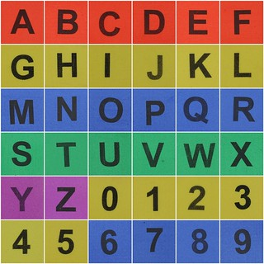
Data Types
Char
a
String
“a string”
Integer
19
Floats
19.1
Boolean
True (1) or False (0)
Notes:
Think of data types as different categories that data can belong to. Just like you sort things into boxes based on what they are, data types help computers understand and manage the information you give them. Here are some common data types and what they mean:
1. **Char (Character):** This represents a single character, like a letter, number, or symbol. For example, the letter 'a' or the number '5'.
2. **String:** A string is a sequence of characters, like a word or a sentence. It's enclosed within quotation marks. For instance, "Hello, World!" is a string.
3. **Integer:** An integer is a whole number without any decimal places. It's used to represent things like counts or quantities. So, 19 is an integer.
4. **Float (Floating Point):** This is used for numbers with decimal places. It can represent fractions or more precise values. For example, 19.1 is a float.
5. **Boolean:** Booleans are like switches. They can have only two values: True (meaning on or yes, often represented as 1) or False (meaning off or no, often represented as 0). They're used for making decisions in programming.
Imagine you're telling a computer about different things: letters, numbers, sentences, and whether something is true or false. These data types help you explain to the computer what kind of information you're giving it, so it knows how to handle and work with that information correctly.

Slide 9
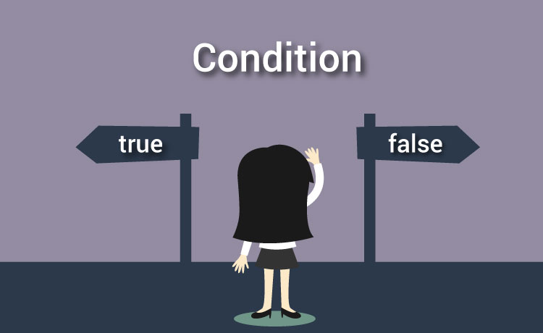
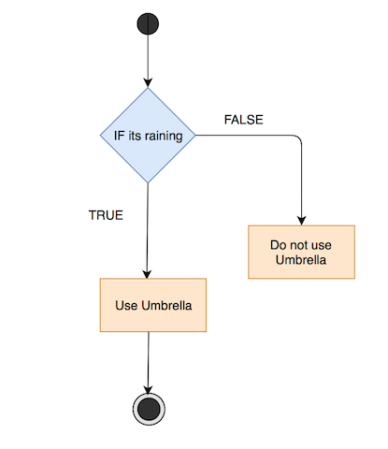
Programming Logic
Branching
if, then
else if, then
Looping
while
Notes:
Absolutely! Let's dive into the world of programming logic.
Imagine you're trying to teach a computer how to solve problems. Programming logic is like giving the computer a set of clear instructions, just like a recipe, to accomplish a task. Here's what it's all about:
1. **Algorithms:** Think of algorithms as recipes. They're step-by-step instructions that tell the computer exactly what to do. Just like you follow a recipe to make a cake, algorithms break down complex tasks into smaller, manageable steps that the computer can understand.
2. **Control Structures:** These are like traffic signs for your code. They help the computer decide what to do next. For example, "if-else" statements act like forks in the road, where the computer chooses one path based on certain conditions. "Loops" make the computer repeat a task until it's done, like a song on repeat.
3. **Data Structures:** Picture data structures as containers for your information. They help you store and organize data so that the computer can access it efficiently. Imagine a tool belt with different pockets for different tools – that's how data structures hold various types of data.
4. **Functions and Modularity:** Functions are like magic spells that you create. You give them a name, and when you say the name, they perform a specific task. This makes your code organized and easier to understand. Think of them as building blocks you can use again and again.
5. **Variables and Data Types:** Imagine a box where you keep things. Variables are those boxes, and they hold different types of information. Just like you can't fit a soccer ball into a small box, you can't put letters in a box meant for numbers. Data types help the computer understand what's inside the box.
6. **Problem-Solving and Critical Thinking:** Programming is like solving puzzles. You need to break down big problems into smaller pieces, figure out how to put them together, and find creative solutions. It's like being a detective – you gather clues (data) and use your brainpower to crack the case (solve the problem).
Programming logic is the language that computers understand. It's the art of teaching a computer how to think and act in a logical, organized, and efficient way. Just like learning a new language, understanding programming logic empowers you to communicate and create with computers.
Absolutely, let's explore branching and looping in programming.
**Branching:**
Think of branching like making decisions in real life. You're faced with choices, and each choice leads to a different outcome. In programming, "if" statements help the computer make decisions. It's like telling the computer, "If something is true, then do this; otherwise, do something else."
- **if, then:** Imagine you're deciding whether to go out based on the weather. If it's sunny, you go for a walk. If it's not sunny, you stay in. In code, it's like saying:
```python
if sunny:
go_for_a_walk()
```
- **else if, then:** Sometimes you have more than two choices. It's like ordering food – if you want pizza, great! If not, maybe you'll have a burger. In code, it looks like:
```python
if hungry and want_pizza:
order_pizza()
elif hungry and want_burger:
order_burger()
```
**Looping:**
Looping is like repeating a task until you're satisfied. It's like practicing a dance move until you get it right. In programming, "while" loops help you repeat a block of code as long as a condition is true.
- **while:** Imagine you're playing a game where you roll dice until you get a 6. You keep rolling until you achieve the desired outcome. In code, it's like:
```python
while dice_roll != 6:
roll_dice()
```
These concepts make your programs smarter and more interactive. Branching helps your programs make choices, and looping makes them repeat actions until they're done. Together, they give your code the ability to make decisions and keep working until the task is complete.

Slide 10
Organizing Code
Flowcharts
Pseudocode
Containers
Functions
Objects
Notes:
Certainly, let's dive into these concepts in a straightforward manner.
**Flowcharts:**
Imagine creating a map for completing a task, like making a sandwich. Flowcharts do something similar for computer programs. They use symbols to show the steps and choices a program takes. Just like following a map to make a sandwich, a flowchart helps programmers follow the path of a program.
**Pseudocode:**
Think of pseudocode as a mix between human language and programming. It's like jotting down the steps of a recipe without worrying about perfect grammar. Pseudocode helps programmers plan out how their program will work before actually writing detailed code. It's like outlining your thoughts before writing a story.
**Containers:**
Containers are like virtual boxes where you can keep things. Imagine a box where you put all your toys. In programming, containers hold different pieces of data, like numbers or words. Containers help keep data organized, and you can easily find, add, or remove items from them.
**Functions:**
Functions are like helpers you call by name. Imagine you have a friend who's great at drawing, so whenever you need a picture, you just say, "Hey, draw me a cat!" In programming, functions are those helpers. You give them information, they do something with it, and then they give you back a result.
**Objects:**
Think of objects like little software machines. Imagine a toy car – it has a color (data) and can move (behavior). In programming, objects are like these toy cars. They combine information (data) and actions (methods) into one package. This way, you can create more complex programs that mimic real-world things and actions.
These concepts help programmers plan, design, and create software in a more organized and understandable way. Just like having a recipe or a blueprint makes building things easier, using flowcharts, pseudocode, containers, functions, and objects makes programming more efficient and manageable.

Slide 11
Chapter 6: Software Development
Compare and contrast notational systems
Binary
Hexadecimal
Decimal
Data representation
ASCII
Unicode
Compare and contrast fundamental data types and their characteristics
Char
Strings
Numbers
Integers
Floats
Boolean
Compare and contrast programming language categories
Interpreted
Scripting languages
Scripted languages
Markup languages
Compiled programming languages
Query languages
Assembly language
Given a scenario, use programming organizational techniques and interpret logic
Organizational techniques
Pseudocode concepts
Flow chart concepts
Sequence
Logic components
Branching
Looping
Explain the purpose and use of programming concepts
Identifiers
Variables
Constants
Containers
Arrays
Vectors
Functions
Objects
Properties
Attributes
Methods
Notes:
**Notational Systems:**
Binary, hexadecimal, and decimal are ways to represent numbers. Binary uses only 0s and 1s and is how computers internally work. Hexadecimal uses 16 symbols (0-9 and A-F) and is often used to write memory addresses and colors. Decimal is what we use in everyday life, with base 10 numbers.
**Data Representation:**
ASCII and Unicode are encoding systems for representing characters. ASCII uses 7 or 8 bits to represent common characters in English, like letters and symbols. Unicode is a more extensive system that assigns unique codes to characters from many languages, allowing computers to handle text in different scripts.
**Fundamental Data Types:**
- Char: Represents a single character, like 'A'.
- Strings: Represents a sequence of characters, like "Hello, World!".
- Integers: Whole numbers without decimal points.
- Floats: Numbers with decimal points.
- Boolean: Represents either true or false.
**Programming Language Categories:**
- Interpreted: Code is executed line by line, directly from the source code.
- Scripting Languages: Special type of interpreted language for automating tasks.
- Scripted Languages: Another term for scripting languages.
- Markup Languages: Used to describe the structure of documents, like HTML for web pages.
- Compiled Programming Languages: Code is transformed into machine-readable format before execution.
- Query Languages: Used to interact with databases.
- Assembly Language: Low-level language that's a step above machine code.
**Programming Organizational Techniques:**
- Pseudocode Concepts: Informal, high-level way to plan out code.
- Flow Chart Concepts: Visual representation of a process or algorithm.
- Sequence: Doing things step by step.
- Logic Components: Using if-else conditions, loops, and functions.
- Branching: Making decisions in code.
- Looping: Repeating actions until a condition is met.
**Programming Concepts:**
- Identifiers: Names given to entities like variables and functions.
- Variables: Containers for storing data during program execution.
- Constants: Fixed values that don't change during program execution.
- Containers: Data structures like arrays and lists.
- Arrays: Collections of similar data items.
- Vectors: Similar to arrays but often used in mathematical contexts.
- Functions: Reusable blocks of code that perform specific tasks.
- Objects: Instances of classes in object-oriented programming.
- Properties: Characteristics of objects.
- Attributes: Another term for properties.
- Methods: Functions that belong to objects and perform actions on them.
Understanding these concepts helps programmers work with data, design code, and build software that accomplishes specific tasks. Just like learning the alphabet, understanding these programming elements is essential for writing effective and functional programs.

