Slide 1
IT Fundamentals
Chapter 4:
Operating Systems

Slide 2
Operating System Fundamentals
Differences between:
Operating system
Application
Driver
Notes:
Understanding the distinctions between an operating system, an application, and a driver is fundamental to comprehending how computer systems function. Let's delve into the core characteristics of each:
**Operating System:**
- The operating system (OS) is the fundamental software that manages and controls the computer's hardware and software resources.
- It acts as an intermediary between users, applications, and the computer's hardware components.
- The OS provides essential services such as managing memory, handling file systems, coordinating input and output operations, and ensuring security and user authentication.
**Application:**
- An application is a program designed to perform specific tasks or provide functionalities to users.
- Applications can be diverse, ranging from word processors, web browsers, and media players to complex software like video editors, graphic design tools, and video games.
- Users interact with applications directly to achieve their intended tasks or goals.
**Driver:**
- A driver is a software component that enables communication between the operating system and specific hardware devices.
- Drivers act as intermediaries, allowing the OS to control and utilize hardware devices such as printers, graphics cards, network adapters, and storage devices.
- Different types of hardware devices require specific drivers tailored to their functionality and compatibility.
In summary, the operating system is the foundation that manages computer resources and provides an interface for users and applications. Applications are software programs used to perform tasks, while drivers facilitate communication between the operating system and hardware devices. Understanding these distinctions is crucial for comprehending the roles and interactions of these core components in a computer system.

Slide 3
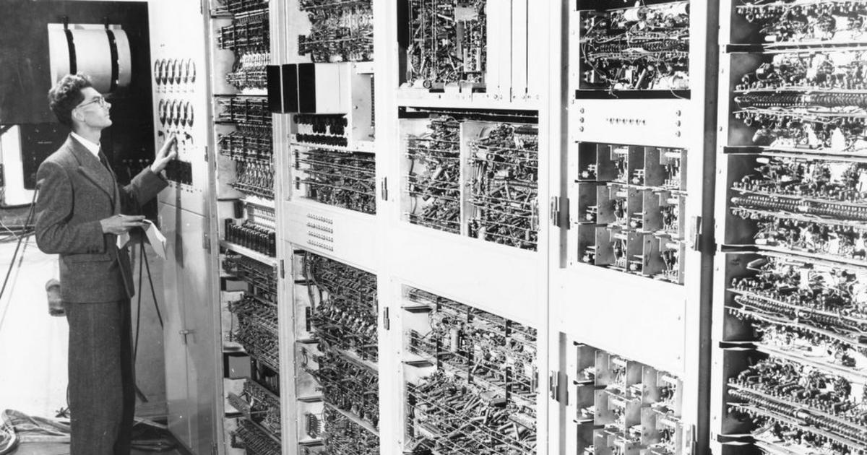
Brief History of OSs
Pre-OS
The Early OSs
Standardization
Modern OSs
Notes:
**Pre-OS:**
- During the early days of computing, there were no recognizable operating systems (OSs) as we understand them today.
- Computers were primarily programmed using machine language or assembly language directly, without the abstraction of an OS.
**The Early OSs:**
- As computers grew in complexity, the need for better management of hardware resources arose.
- The first recognizable operating systems emerged in the 1950s and 1960s. These were primarily batch processing systems that allowed users to submit jobs to the computer, which were then executed one after the other.
**Standardization:**
- The 1970s witnessed the development of more sophisticated operating systems, like Unix and IBM's System/360 OS.
- These systems introduced the concept of time-sharing, allowing multiple users to interact with the computer simultaneously.
- The standardization of programming languages and interfaces during this era paved the way for improved compatibility and portability of software.
**Modern OSs:**
- The late 20th century saw the rise of personal computers, leading to the development of operating systems like Microsoft's MS-DOS and Apple's Macintosh System Software.
- The 1990s marked the transition to graphical user interfaces (GUIs) with the release of Microsoft Windows and Apple's Mac OS.
- The 21st century brought further advancements, with the emergence of open-source operating systems like Linux and the development of mobile OSs like Android and iOS.
- Modern operating systems emphasize multitasking, security, networking capabilities, and user-friendly interfaces.
In summary, the history of operating systems has evolved from early batch processing systems to modern, sophisticated OSs that power a wide range of devices and applications. The journey from rudimentary management of hardware resources to multitasking, graphical interfaces, and networking capabilities has shaped the way we interact with computers and technology today.

Slide 4
Basic OS Definitions
Kernel
Version
Source
Shell
Graphical User Interface (GUI)
Cooperative multitasking
Preemptive multitasking
Multithreading
32-bit vs. 64-bit
Notes:
Workstation: A workstation is a high-performance computer designed for professional use, often in areas such as engineering, graphics design, video editing, and scientific computing. Workstations typically have more powerful processors, more memory, and better graphics capabilities than standard desktop computers.
Kernel: The kernel is the core component of an operating system, responsible for managing system resources, such as memory and processes, and providing an interface between the hardware and software. The kernel handles tasks like process scheduling, memory management, and device drivers, enabling applications to run smoothly and efficiently.
Version: In the context of software, a version refers to a specific release or iteration of a program. Different versions of an operating system or application may include new features, bug fixes, or improvements in performance and stability. Version numbers typically consist of a major version, a minor version, and sometimes a build or patch number (e.g., 1.2.3).
Source: The term "source" refers to the source code, which is a collection of human-readable programming code that defines how software operates. In the context of an operating system, the source code includes all the instructions and logic needed for the OS to function. Open-source operating systems, like Linux, have publicly available source code, allowing developers to view, modify, and contribute to the system's development.
Shell: A shell is a command-line interface (CLI) that allows users to interact with the operating system by entering text commands. Shells enable users to perform various tasks, like managing files, launching programs, and configuring system settings. Common shell programs include Bash (Bourne Again SHell) in UNIX/Linux systems and PowerShell in Windows systems.
Graphical User Interface (GUI): A GUI is a visual interface that allows users to interact with an operating system or application using graphical elements like windows, icons, and menus, rather than text commands. GUIs make computers more accessible to non-technical users, as they can navigate and perform tasks using a mouse or touchscreen instead of memorizing and typing commands.
Cooperative multitasking: Cooperative multitasking is a form of multitasking where each running program is responsible for voluntarily releasing control of the CPU, allowing other programs to execute. This approach can lead to issues when a program fails to release control, causing the entire system to become unresponsive.
Preemptive multitasking: Preemptive multitasking is a more advanced form of multitasking where the operating system takes control of CPU time allocation and can forcibly interrupt a running program to allow other processes to execute. This approach provides better system stability and responsiveness compared to cooperative multitasking.
Multithreading: Multithreading is a technique where a single process is divided into multiple concurrent threads, allowing for parallel execution and more efficient use of CPU resources. Multithreading can improve the performance of programs, especially on multi-core processors, as it enables different parts of a program to run simultaneously.
32-bit vs. 64-bit: These terms refer to the architecture of a computer's processor and the amount of data it can process in a single instruction. A 32-bit processor can handle 32 bits of data at once, while a 64-bit processor can handle 64 bits of data. 64-bit processors generally offer better performance and can address larger amounts of memory (more than 4 GB) compared to 32-bit processors. Operating systems and applications are often designed specifically for either 32-bit or 64-bit architectures.

Slide 5
Compatibility
Hardware compatibility
32-bit vs. 64-bit
Software compatibility
Notes:
**Hardware Compatibility:**
- Hardware compatibility refers to the ability of software or an operating system to work seamlessly with different hardware components.
- It involves ensuring that software can communicate effectively with various hardware devices such as processors, memory, graphics cards, and peripherals.
**32-bit vs. 64-bit:**
- The terms "32-bit" and "64-bit" refer to the width of a computer's memory address.
- 32-bit systems can access up to 4GB of RAM, while 64-bit systems can address much larger amounts of memory.
- Software needs to be compatible with the system's architecture; a 32-bit program might not fully utilize the capabilities of a 64-bit system, and vice versa.
In a 64-bit system, the CPU uses 64 bits to represent memory addresses.
This expanded address space allows 64-bit systems to access vastly more memory, theoretically up to 18.4 million terabytes (TB) of RAM (2^64), which is well beyond what current technology supports.
The increased addressable memory is particularly advantageous for memory-intensive applications and tasks that involve working with massive datasets.
**Software Compatibility:**
- Software compatibility involves ensuring that applications or software programs can run correctly on a particular operating system or platform.
- It encompasses compatibility across different versions of an OS, as well as compatibility with other software and libraries.
**Challenges and Considerations:**
- Hardware and software compatibility can be challenging due to the vast array of hardware configurations and software environments.
- Upgrades to hardware or operating systems can lead to compatibility issues if software is not updated accordingly.
- Some software may be designed for specific architectures or operating systems, limiting its compatibility across different platforms.
**Solutions:**
- Hardware manufacturers often provide drivers and updates to ensure compatibility with new operating systems.
- Software developers aim to create applications that work across various platforms and architectures.
- Virtualization and emulation technologies can help bridge compatibility gaps by simulating different hardware and software environments.
**Importance:**
- Compatibility ensures that users can make the most of their hardware investments and use software effectively.
- Incompatibility can lead to crashes, performance issues, and data loss, impacting both user experience and productivity.
**Testing and Certification:**
- Software developers and hardware manufacturers engage in rigorous testing and certification processes to ensure compatibility.
- Certification programs help users identify hardware and software components that have been verified to work together seamlessly.
In summary, compatibility plays a critical role in ensuring that software, operating systems, and hardware components work harmoniously together. Hardware compatibility involves addressing architecture differences, while software compatibility ensures that applications run smoothly across different platforms and versions. Overcoming compatibility challenges requires collaboration between hardware manufacturers, software developers, and end-users to provide a seamless and reliable computing experience.

Slide 6
Core OS functions
Coordinating users and hardware
Provide environment for software to function
Provide structure for data management
Monitor system health and functionality
Notes:
The core functions of an operating system (OS) are essential for managing the hardware, software, and user interactions of a computer system. Here's a more detailed exploration of these functions:
**1. Coordinating Users and Hardware:**
- The OS acts as an intermediary between users and the computer's hardware components.
- It manages user authentication, ensuring that authorized users can access the system while maintaining security.
- The OS also handles user interfaces, allowing users to interact with the computer through graphical user interfaces (GUIs) or command-line interfaces (CLIs).
**2. Providing Environment for Software to Function:**
- The OS provides an environment in which software applications can execute and interact with hardware resources.
- It manages processes, allocating CPU time and memory to different programs to ensure smooth multitasking and efficient resource utilization.
- The OS creates an abstraction layer that isolates applications from the complexities of hardware, allowing software to be developed independently of specific hardware details.
**3. Providing Structure for Data Management:**
- The OS manages file systems, allowing users and applications to organize and access data stored on various storage devices.
- It provides functions for file creation, deletion, reading, and writing, ensuring that data is organized, secure, and accessible to authorized users.
**4. Monitoring System Health and Functionality:**
- The OS monitors system health and performance, checking for issues and anomalies that could affect the system's stability or efficiency.
- It provides diagnostic tools and system logs to help identify and troubleshoot problems.
- The OS also manages hardware errors and issues, often attempting to recover gracefully from errors without disrupting the entire system.
**5. Managing Hardware Resources:**
- The OS manages hardware components like central processing units (CPUs), memory, input/output devices, and storage devices.
- It allocates resources to different processes and applications based on priority and demand, optimizing overall system performance.
- The OS also handles hardware interactions, including device drivers that allow the OS to communicate with and control various hardware devices.
**6. Providing Security and Access Control:**
- The OS enforces access control mechanisms to protect data and resources from unauthorized access.
- It implements user permissions, authentication, and encryption to ensure data security and privacy.
- The OS also manages firewall settings, antivirus software, and other security features to defend against threats.
**7. Managing Networking and Connectivity:**
- In modern computing environments, the OS often manages network connections, allowing users and applications to connect to the internet and other devices.
- It handles network protocols, IP addresses, and network configuration settings to facilitate communication.
**8. Providing User Interfaces:**
- The OS offers user interfaces that enable users to interact with the computer system. This includes graphical interfaces, command-line interfaces, and touch-based interfaces in the case of mobile devices.
In summary, the core functions of an operating system are multifaceted and encompass a wide range of tasks, from managing hardware resources to providing an environment for software execution, ensuring data integrity, and safeguarding system security. These functions collectively create the foundation that allows modern computer systems to operate efficiently and effectively.

Slide 7
Types of Operating Systems
Workstation
Linux
Mac OS
Windows
Chrome OS
Server
Linux-based
Mac-based
Windows-based
Mobile
Apple iOS
Android
Windows Mobile
Virtual
Embedded
Notes:
These terms represent different categories of operating systems that cater to various computing needs and platforms. Let's explore each category in more detail:
**Workstation:**
- Workstation operating systems are optimized for high-performance tasks like graphic design, video editing, and scientific simulations.
- Examples include Linux distributions like Ubuntu Studio, macOS for Apple workstations, and Windows 10 Pro for PCs.
**Linux:**
- Linux is an open-source operating system kernel that forms the basis of numerous distributions (distros).
- Popular Linux distros include Ubuntu, Fedora, and Debian, each offering its own user interface and software ecosystem.
**Mac OS:**
- Mac OS is the operating system developed by Apple for its Mac computers.
- It provides a unique user experience and integrates seamlessly with Apple hardware and software.
**Windows:**
- Windows is Microsoft's operating system for personal computers.
- Windows versions like Windows 10 provide a wide range of functionalities and support for various applications.
**Chrome OS:**
- Chrome OS is designed by Google and primarily runs on Chromebooks.
- It's optimized for web-based activities and relies heavily on cloud services and online applications.
**Server:**
- Server operating systems are designed to manage and serve resources, applications, and services to other devices over a network.
- Linux-based servers (Ubuntu Server, CentOS), macOS-based servers, and Windows Server are common examples.
**Mobile:**
- Mobile operating systems power smartphones and tablets, providing user interfaces optimized for touchscreens.
- Apple iOS powers iPhones and iPads, Android is used by many smartphone manufacturers, and Windows Mobile is developed by Microsoft.
**Virtual:**
- Virtual operating systems are designed to run within a virtualized environment, allowing multiple operating systems to coexist on a single physical machine.
- Examples include virtual machines running on software like VMware or VirtualBox.
**Embedded:**
- Embedded operating systems are designed for specific devices with limited computing resources.
- They power devices like smart TVs, routers, IoT devices, and industrial machinery.
Each of these operating systems serves a unique purpose and is tailored to specific platforms and requirements, contributing to the diverse computing landscape we have today.

Slide 8
Linux
Developed in 1991
Open source
Many versions
Uncommon for workstations
Very popular for servers
Notes:
Linux: Linux is a free, open-source operating system based on the UNIX operating system.
**Linux: A Brief Overview**
Developed in 1991 by Linus Torvalds, Linux is an open-source operating system kernel that has evolved into a powerful and versatile ecosystem. Let's delve into the details of Linux's history, characteristics, and applications:
**Historical Context:**
- Linux originated as a personal project by Linus Torvalds, a Finnish computer science student, who aimed to create a free and open-source operating system kernel.
- Linus released the first version of the Linux kernel in 1991, which marked the beginning of the Linux ecosystem's development.
**Open Source Philosophy:**
- Linux embodies the open-source philosophy, allowing anyone to view, modify, and distribute its source code.
- The open-source nature of Linux encourages collaboration and contributions from a global community of developers, resulting in continuous improvements and innovation.
**Diverse Versions (Distributions):**
- Linux is not just an operating system but a kernel that serves as the foundation for various operating system distributions (distros).
- Each Linux distribution includes the Linux kernel along with a selection of software packages, user interfaces, and system management tools.
- Popular Linux distributions include Ubuntu, Fedora, Debian, CentOS, and more, catering to different user preferences and use cases.
**Usage on Workstations:**
- While Linux is less common on traditional workstations compared to Windows and macOS, it has gained popularity among developers, researchers, and individuals who value customization and control.
- Linux provides a wide array of desktop environments (such as GNOME, KDE, and XFCE) that offer unique user interfaces and experiences.
**Prominence on Servers:**
- Linux has a significant presence in server environments, powering a substantial portion of web servers, data centers, cloud infrastructure, and supercomputers.
- Its stability, security features, and ability to be tailored to specific server needs have contributed to its popularity in server-centric applications.
**Community and Contributions:**
- The Linux community is characterized by its collaborative spirit and dedication to improving the operating system.
- Developers, users, and organizations contribute to various aspects of Linux, from coding and testing to documentation and support.
**Security and Stability:**
- Linux is known for its robust security features, with its open-source nature allowing for swift identification and resolution of security vulnerabilities.
- Its Unix-like architecture and permission system contribute to enhanced security and control over system resources.
**Conclusion:**
Linux's journey from its inception in 1991 to becoming a versatile and influential operating system reflects the power of open-source development and collaborative innovation. While it might not be as prevalent on workstations as some other operating systems, its impact on servers, embedded systems, supercomputing, and software development is undeniable. Linux continues to evolve and adapt to the ever-changing landscape of technology, driven by a vibrant and passionate community.

Slide 9
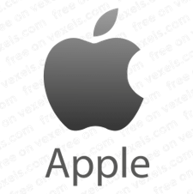
Mac OS
Introduced in 1984 by Apple
“System Software”
First common GUI
Current version is macOS, which followed OS X
Version names based on big cats or now California locations
Proprietary to Mac computers
Loyal users
Considered the best for graphics programs
Notes:
**macOS: Evolution of Apple's Operating System**
macOS, developed by Apple Inc., has a rich history that spans decades. From its early beginnings to its current state, macOS has undergone significant transformations. Let's explore the journey and characteristics of this operating system:
**Introduction and Early Stages:**
- macOS was initially introduced in 1984 under the name "System Software" for the Apple Macintosh.
- It marked a significant milestone by bringing the graphical user interface (GUI) to the mainstream, making personal computing more accessible and intuitive.
**Transition to Modern macOS:**
- The journey of macOS continued through various iterations, including System 7, Mac OS 8, Mac OS 9, and Mac OS X.
- Mac OS X, introduced in 2001, was a pivotal release that brought Unix-based architecture and advanced features to Apple's operating system.
**Naming Convention:**
- Mac OS X evolved into macOS with the release of macOS Sierra in 2016.
- The naming convention for macOS versions shifted from big cats (e.g., Leopard, Snow Leopard) to locations in California, reflecting the company's heritage and its California roots.
**Proprietary Nature:**
- macOS is exclusively designed for and tightly integrated with Apple hardware, such as Mac desktops and laptops.
- Apple's control over both the hardware and software aspects of its ecosystem contributes to a cohesive and optimized user experience.
**Loyal User Base:**
- macOS has cultivated a dedicated and loyal user base over the years.
- Apple's focus on design, user experience, and integration across devices has resonated with users seeking a seamless and elegant computing environment.
**Graphics and Creative Capabilities:**
- macOS is renowned for its capabilities in graphic design, media production, and creative tasks.
- Apple's emphasis on color accuracy, display quality, and tools like Final Cut Pro and Logic Pro has made macOS a preferred platform for professionals in the creative industries.
**Stability and User Experience:**
- Apple's control over the hardware and software ecosystem contributes to the stability and reliability of macOS.
- macOS is known for its user-friendly interface, consistent design language, and attention to detail.
**App Ecosystem:**
- The macOS App Store offers a wide range of applications, including productivity tools, creative software, and utilities.
- The store's curated approach ensures that apps meet certain quality and security standards.
**Continual Evolution:**
- With each new release, macOS introduces new features, improvements, and optimizations, enhancing the user experience and keeping pace with technological advancements.
**Conclusion:**
macOS, tracing its roots back to 1984, has evolved into a sophisticated and feature-rich operating system. Its focus on design aesthetics, user experience, creative capabilities, and tight integration with Apple's hardware ecosystem has garnered a loyal following. As technology continues to progress, macOS remains a symbol of Apple's commitment to innovation and user-centric computing.

Slide 10
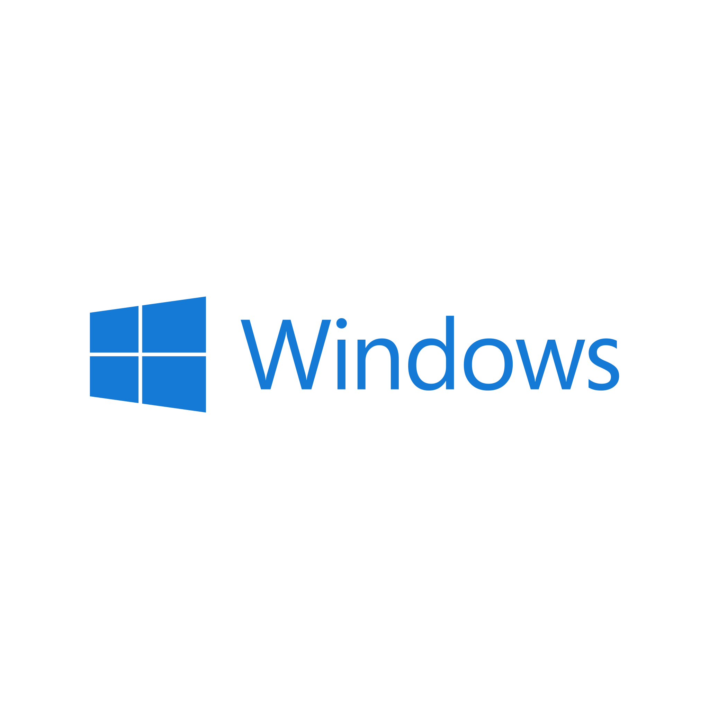
Windows
Launched by Microsoft in 1985
Most widely-used workstation OS in the world
Closed source
Notes:
**Windows: Microsoft's Iconic Operating System**
Since its launch in 1985, Windows has become synonymous with personal computing. Developed by Microsoft, Windows has left an indelible mark on the world of technology. Let's explore the key aspects and impact of the Windows operating system:
**Inception and Early Years:**
- Windows was introduced by Microsoft in 1985 with Windows 1.0.
- It aimed to provide a graphical user interface (GUI) on top of the existing MS-DOS operating system, making computing more accessible and user-friendly.
**Dominance in Workstations:**
- Windows has established itself as the most widely-used operating system for workstations around the globe.
- Its user-friendly interface, extensive software support, and compatibility with a wide range of hardware contributed to its popularity.
**Evolution of Versions:**
- Windows evolved through various versions, including Windows 3.1, Windows 95, Windows 98, and Windows ME.
- Windows NT introduced a more robust and stable platform for businesses and professional users.
- Windows 2000, Windows XP, Windows Vista, Windows 7, Windows 8, and Windows 10 followed, each with its own improvements and features.
**Closed Source Model:**
- Windows is considered a closed-source operating system, which means its source code is not publicly available.
- Microsoft controls the development, distribution, and licensing of Windows, allowing them to maintain a level of control over the platform.
**Graphical User Interface (GUI) Standardization:**
- Windows played a pivotal role in popularizing the GUI paradigm in personal computing.
- The familiar Windows interface, featuring windows, icons, menus, and pointers (WIMP), became a standard for graphical interfaces.
**Software Ecosystem:**
- The Windows ecosystem boasts a vast array of software applications, ranging from productivity tools to multimedia software and games.
- This software diversity has contributed to Windows' dominance in the consumer and business markets.
**User Customization and Productivity:**
- Windows offers customization options, allowing users to personalize their desktops and workflows.
- Microsoft has continually worked to improve user productivity, introducing features like the Start Menu, taskbar, and virtual desktops.
**Challenges and Innovations:**
- Windows faced challenges with certain versions, such as the mixed reception of Windows Vista and the radical departure from traditional interfaces in Windows 8.
- Microsoft addressed these challenges with subsequent releases, culminating in the well-received Windows 10.
**Continued Relevance:**
- Windows remains an integral part of computing, serving as the foundation for a wide range of devices, including desktops, laptops, tablets, and even some smartphones.
**Conclusion:**
Windows' journey from its inception in 1985 to its present state has solidified its place as a transformative and influential operating system. Its evolution, dominance in workstations, closed-source nature, and impact on user interfaces have left an enduring legacy in the world of technology. Windows continues to adapt to changing user needs and technological advancements, maintaining its role as a cornerstone of modern computing.

Slide 11
Chrome OS
Google launched in 2011
Installed on Chromebooks
Designed to be lightweight
Based on the Chrome browser
Very little local storage – uses the cloud
Versions updated automatically
Notes:
Chrome OS: Chrome OS is a lightweight operating system developed by Google, designed primarily for Chromebook laptops and other devices. It is built around the Google Chrome web browser and relies heavily on web-based applications and cloud storage, making it an ideal choice for users with constant internet access.
**Chrome OS: Streamlined Computing by Google**
Introduced by Google in 2011, Chrome OS is a unique operating system that focuses on simplicity, speed, and cloud-centric computing. Let's delve deeper into the characteristics and impact of Chrome OS:
**Inception and Purpose:**
- Google unveiled Chrome OS as an operating system designed to complement the Chrome web browser.
- It aimed to provide a lightweight, fast, and secure computing experience centered around web applications and services.
**Chromebooks:**
- Chrome OS is predominantly found on devices known as Chromebooks.
- These laptops are optimized to run Chrome OS efficiently and are characterized by their simplicity, speed, and affordability.
**Lightweight Design:**
- Chrome OS is intentionally designed to be lightweight, enabling quick boot times and responsive performance even on modest hardware.
- This design choice aligns with Google's vision for an efficient and streamlined computing experience.
**Chrome Browser Integration:**
- Chrome OS is built on the foundation of the Chrome web browser, leveraging its speed and security features.
- Applications on Chrome OS are often web-based, utilizing the browser's capabilities to provide functionality.
**Cloud-Centric Approach:**
- Chrome OS relies heavily on cloud services for storage, applications, and data.
- Local storage on Chromebooks is minimal, with the emphasis on storing data in the cloud and accessing it from anywhere with an internet connection.
**Automatic Updates:**
- One of Chrome OS's distinctive features is its automatic update system.
- Chromebooks receive regular updates that ensure security, stability, and access to the latest features without user intervention.
**User Interface:**
- Chrome OS offers a user-friendly interface that resembles a traditional desktop but is optimized for web-based tasks.
- The user interface emphasizes simplicity and ease of use.
**Education and Enterprise Focus:**
- Chrome OS has gained traction in education and enterprise sectors due to its ease of management and cost-effectiveness.
- Schools and businesses appreciate its ability to provide a secure and controlled computing environment.
**App Ecosystem:**
- While Chrome OS primarily relies on web applications, it also supports a variety of Android apps through the Google Play Store, broadening its software ecosystem.
**Conclusion:**
Chrome OS's arrival in 2011 marked a departure from traditional operating systems, embracing cloud computing and streamlined functionality. Designed for users seeking a simple and efficient computing experience, Chrome OS has found its niche in education, enterprise, and casual use. With automatic updates, integration with the Chrome browser, and a focus on cloud services, Chrome OS continues to evolve and offer an alternative approach to computing in a world increasingly connected to the web.

Slide 12
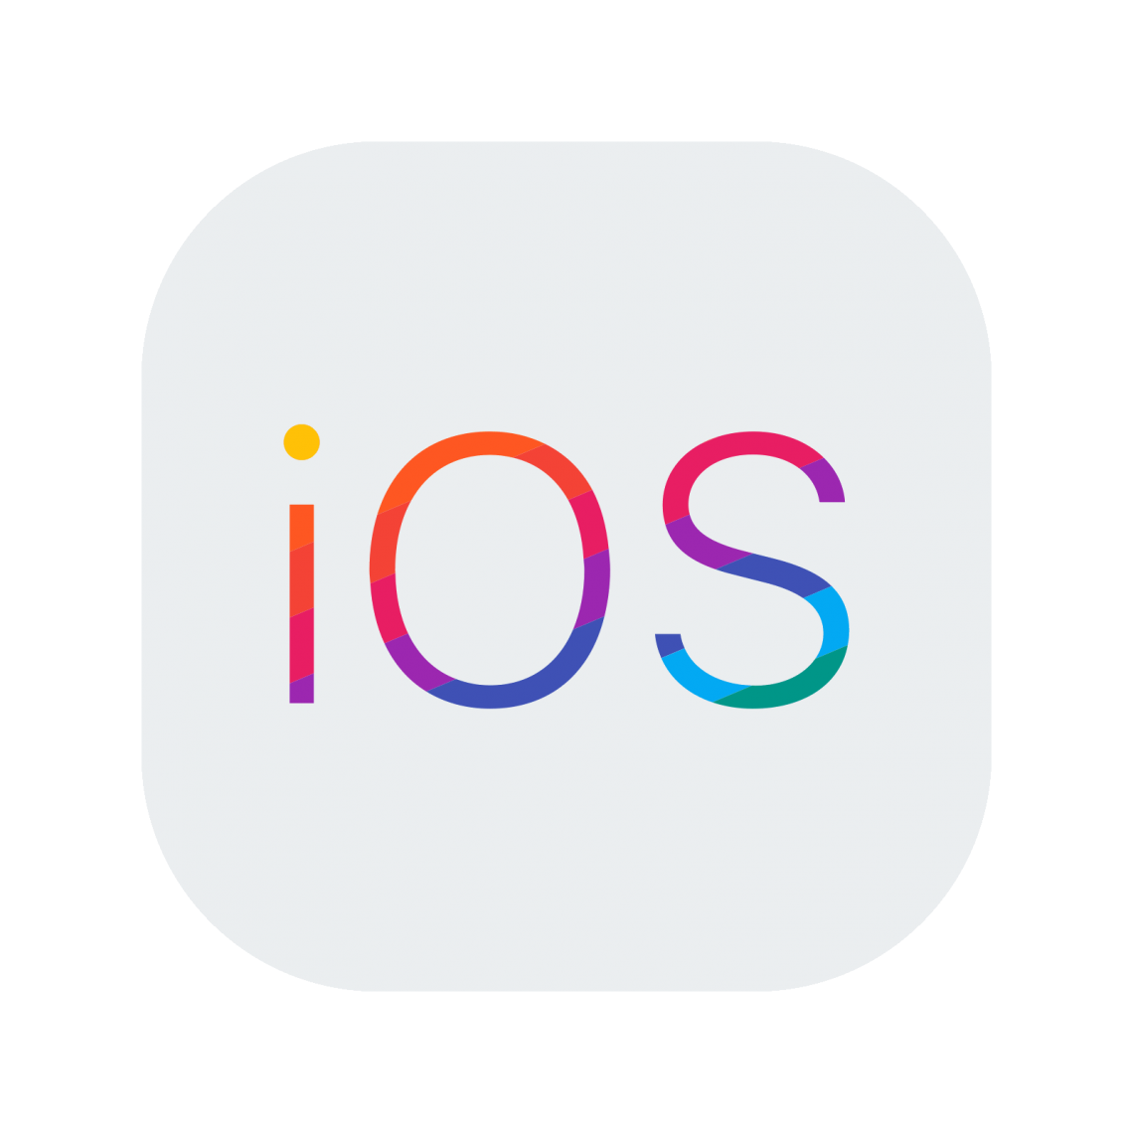
Apple iOS
Launched in 2007 with the first iPhone
Proprietary to Apple devices
iPad, iPhone, iPod
Very popular
Notes:
**iOS: Apple's Mobile Operating System**
Debuting in 2007 alongside the first iPhone, iOS has become synonymous with the seamless and intuitive mobile experience provided by Apple devices. Here's a closer look at the evolution and defining features of iOS:
**Introduction with the iPhone:**
- iOS made its debut in 2007 as the operating system for the revolutionary iPhone, transforming the mobile landscape with its touch-based interface and innovative features.
**Exclusively Apple:**
- iOS is exclusively developed for Apple devices, including the iPad, iPhone, and iPod Touch.
- This proprietary approach enables Apple to tightly integrate hardware and software, resulting in a cohesive user experience.
**Range of Devices:**
- iOS powers a range of devices, from the compact iPod Touch to the iconic iPhone and the versatile iPad.
- Each device type offers a tailored experience, optimized for its form factor and capabilities.
**User-Focused Design:**
- iOS is renowned for its user-focused design, characterized by a minimalist interface, fluid animations, and intuitive gestures.
- Apple's emphasis on simplicity and elegance has resonated with users worldwide.
**App Ecosystem:**
- The App Store, an integral part of iOS, offers a vast array of applications covering diverse categories, from productivity to entertainment.
- The curated store ensures a level of quality and security for users.
**Regular Updates:**
- iOS receives regular updates that introduce new features, enhancements, and security improvements.
- These updates often provide users with access to innovative capabilities and refinements.
**Synchronization and Continuity:**
- iOS devices seamlessly integrate with other Apple devices, enabling features like Handoff, which allows users to start a task on one device and continue on another.
**Privacy and Security:**
- Apple places a strong emphasis on user privacy and data security.
- iOS features privacy controls and encryption measures to safeguard user information.
**Ecosystem Integration:**
- iOS devices are part of a larger Apple ecosystem that includes macOS, watchOS, and tvOS.
- This integration enables seamless interactions across devices and services.
**App Store Ecosystem:**
- Developers have embraced the iOS platform, creating a wide range of applications that cater to various needs and interests.
- The App Store's popularity has contributed to iOS's widespread adoption.
**Global Popularity:**
- iOS's user-friendly interface, strong security features, and vibrant app ecosystem have led to its widespread popularity around the world.
**Conclusion:**
iOS's journey began with the launch of the first iPhone in 2007, ushering in a new era of mobile computing. Its focus on user experience, integration with Apple's ecosystem, emphasis on privacy, and robust app ecosystem have solidified iOS's position as a leading mobile operating system. As Apple continues to innovate and release new devices, iOS remains at the heart of its commitment to providing users with intuitive, reliable, and enjoyable digital experiences.

Slide 13
Android
Launched by Google in 2008
Not open source, but cross-platform; supported by many hardware vendors
Biggest OS install base in the world
Notes:
**Android: A Global Mobile Operating System**
Introduced by Google in 2008, Android has reshaped the mobile landscape by offering a versatile and open platform for a wide range of devices. Let's delve into the key characteristics and impact of the Android operating system:
**Inception and Google's Involvement:**
- Android was founded in 2003 by Andy Rubin, Rich Miner, Nick Sears, and Chris White.
- Google acquired Android Inc. in 2005, which laid the foundation for its growth and eventual dominance.
**Open and Cross-Platform:**
- Android is built on an open-source foundation, making its source code accessible to developers.
- It is designed to be cross-platform, meaning it can run on various hardware devices from multiple manufacturers.
**Ecosystem Diversity:**
- Android is supported by a broad range of hardware vendors, leading to a diverse ecosystem of smartphones, tablets, smartwatches, and other devices.
- This diversity gives consumers a wide array of choices to fit their preferences and needs.
**App Ecosystem:**
- The Google Play Store hosts an extensive collection of applications catering to various interests and requirements.
- The open nature of Android has encouraged developers to create a vast array of apps.
**Customization and Personalization:**
- Android offers users a high degree of customization and personalization, allowing them to tweak the user interface, widgets, and overall experience.
- This flexibility has resonated with users who value individuality and control.
**Regular Updates:**
- Android receives updates regularly, often improving performance, introducing new features, and enhancing security.
- However, due to fragmentation, not all devices receive updates simultaneously.
**Global Reach:**
- Android has achieved remarkable global adoption, especially in emerging markets, due to its accessibility and affordability.
**Fragmentation Challenges:**
- While the open nature of Android has contributed to its growth, it has also led to fragmentation.
- Different manufacturers customize Android's user interface and features, leading to variations in user experience and software availability.
**Google Services Integration:**
- Android is deeply integrated with Google's suite of services, including Google Search, Maps, Gmail, and more.
- This integration enhances the overall user experience and provides seamless access to various Google offerings.
**Versatility and Innovation:**
- Android's openness has fueled innovation, giving developers the freedom to experiment with new ideas and technologies.
- This adaptability has led to the development of various device types, including smartphones, tablets, smart TVs, and wearables.
**Conclusion:**
Android's introduction in 2008 marked a significant turning point in the mobile industry. Its open nature, diverse ecosystem, customization options, and global reach have solidified its position as the largest mobile operating system in terms of the install base. While fragmentation poses challenges, Android's ability to cater to a wide range of user preferences and needs has contributed to its continued growth and innovation. As technology evolves, Android remains a driving force in shaping the future of mobile computing.

Slide 14
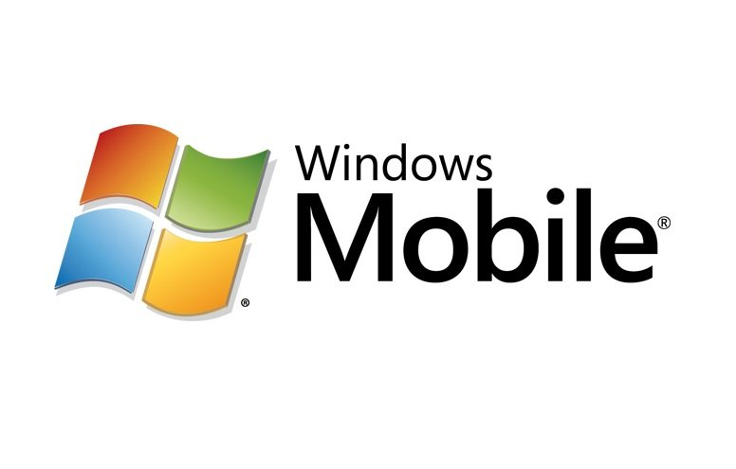
Windows Mobile
Developed by Microsoft
Current look/feel launched in 2010
Look and feel similar to Windows on a workstation
Not very popular
Microsoft stopped developing it in 2017
Notes:
**Windows Mobile: A Brief Journey**
Developed by Microsoft, Windows Mobile had a journey marked by transformation and change. Although it did not achieve widespread popularity, it left its mark on the mobile operating system landscape. Here's a closer look at its key aspects:
**Origins and Transformation:**
- Windows Mobile emerged as an early contender in the mobile operating system market, targeting PDAs and early smartphones.
- Over the years, Windows Mobile underwent multiple transformations in terms of user interface and functionality.
**Unified Look and Feel:**
- In 2010, Microsoft introduced a new version of Windows Mobile with a look and feel that was reminiscent of Windows on desktop workstations.
- This design aimed to provide users with a consistent experience across different devices, leveraging their familiarity with Windows.
**Similarity to Windows Workstations:**
- Windows Mobile's interface sought to emulate the desktop Windows experience, making it easier for users to transition between their computers and mobile devices.
**Challenges and Popularity:**
- Despite Microsoft's efforts, Windows Mobile struggled to gain widespread popularity and market share, especially in comparison to competing platforms like Android and iOS.
- Factors such as user experience, app availability, and competition from other platforms played a role in its limited success.
**Discontinuation:**
- In 2017, Microsoft officially announced the discontinuation of Windows Mobile and ceased active development.
- The decision to shift focus away from Windows Mobile reflected Microsoft's strategic redirection in the mobile space.
**Legacy and Impact:**
- Windows Mobile's legacy is one of innovation and influence, even if it didn't attain the level of popularity Microsoft had hoped for.
- Its attempts to unify the experience across different devices laid the groundwork for the convergence of desktop and mobile computing.
**Conclusion:**
Windows Mobile's journey from its early days to its discontinuation in 2017 reflects the complexities and challenges of the mobile operating system market. While it faced hurdles in terms of adoption and competition, its efforts to bridge the gap between desktop and mobile experiences had a lasting impact on the evolution of user interfaces and the concept of device convergence. Despite its discontinuation, Windows Mobile remains a part of Microsoft's history in the mobile space.

Slide 15
Virtual OSs
Multiple OSs running concurrently on one physical computer
Virtualization
Virtual machine (VM)
Critical for cloud computing
Hypervisor enables virtualization
Type 1 – bare-metal hypervisor
Type 2 sits on an existing OS
Notes:
**Virtual Operating Systems: Unlocking Multi-OS Environments**
The concept of virtual operating systems (OSs) has transformed the way we interact with computing environments, allowing multiple operating systems to coexist on a single physical machine. This technological innovation, facilitated by virtualization, has profound implications for various industries, especially in the realm of cloud computing. Let's delve into the world of virtual OSs:
**Introduction to Virtualization:**
- Virtualization involves creating a virtual instance of a computer system, including its operating system, applications, and resources.
- This technology allows multiple virtual machines (VMs) to run concurrently on a single physical host, each operating as if it were on its own dedicated hardware.
**Key Components:**
- **Virtual Machine (VM):** A VM is a self-contained environment that emulates a complete computer system, including its OS, memory, storage, and network resources.
- **Hypervisor:** The hypervisor is the software layer responsible for managing and orchestrating VMs on the physical hardware.
**Critical Role in Cloud Computing:**
- Virtualization is a cornerstone of cloud computing, enabling the creation and management of numerous virtualized instances on a shared physical infrastructure.
- Cloud service providers leverage virtualization to offer scalable and efficient computing resources to clients.
**Types of Hypervisors:**
- **Type 1 (Bare-Metal Hypervisor):** This hypervisor runs directly on the physical hardware, without the need for a host operating system. It's ideal for enterprise environments and data centers.
- **Type 2 (Hosted Hypervisor):** Type 2 hypervisors are installed on top of an existing host operating system. They are commonly used for development, testing, and personal virtualization.
**Benefits of Virtual OSs:**
- **Resource Efficiency:** Virtualization optimizes hardware utilization, allowing multiple VMs to share physical resources while maintaining isolation.
- **Isolation and Security:** Each VM operates independently, providing strong isolation between different OSs and applications.
- **Flexibility and Scalability:** Virtual OSs can be easily created, cloned, and scaled up or down as needed, offering flexibility to accommodate changing workloads.
- **Testing and Development:** Virtual environments provide a safe and controlled space for software testing, development, and experimentation.
- **Legacy Software Support:** Virtualization enables running legacy applications on modern hardware, preserving compatibility.
**Challenges and Considerations:**
- **Performance Overhead:** Virtualization introduces some overhead due to the abstraction layer, which can impact performance compared to native systems.
- **Resource Allocation:** Proper allocation of resources among VMs is crucial to prevent resource contention and ensure optimal performance.
- **Security Management:** Managing security across multiple VMs requires careful consideration to prevent vulnerabilities and breaches.
**Conclusion:**
Virtual OSs, empowered by virtualization technology, have revolutionized the way we harness computing power. From efficient resource utilization and scalable cloud environments to versatile development and testing platforms, virtualization offers a multitude of benefits. As technology advances and demands evolve, the role of virtual OSs will continue to shape the landscape of computing, contributing to innovation, agility, and efficiency across various sectors.

Slide 16
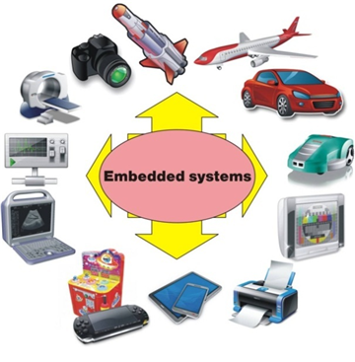
Embedded OSs
Designed to be small and efficient
Often responsible for a single task
Firmware is an example
Used in very small devices such as wristwatches and children’s toys
Typically not upgradeable
Notes:
**Embedded Operating Systems: Powering Specialized Devices**
Embedded operating systems (OSs) play a crucial role in powering a wide range of specialized devices, from small gadgets to industrial machinery. These compact and purpose-built systems are tailored to specific tasks and have distinct characteristics that set them apart. Let's delve into the world of embedded OSs:
**Small and Efficient Design:**
- Embedded OSs are crafted to be small and efficient, optimized for the limited resources available on embedded devices.
- They prioritize minimal memory usage and low processing power requirements to ensure smooth operation.
**Single-Task Focus:**
- Often, embedded OSs are dedicated to a single task or a specific set of tasks.
- This focused approach ensures that the OS remains streamlined and dedicated to its intended purpose.
**Firmware and Hardware Interaction:**
- Firmware is a prime example of an embedded OS. It's a type of software that is closely integrated with hardware components.
- Firmware provides essential functions for hardware initialization, configuration, and control.
**Wide Range of Applications:**
- Embedded OSs are found in a diverse range of devices, including wristwatches, children's toys, medical devices, automotive systems, industrial equipment, and more.
- Their presence is often unnoticed by users as they quietly power everyday objects.
**Notable Characteristics:**
- **Efficiency:** Embedded OSs prioritize efficient use of resources to ensure that devices can perform their tasks without excessive power consumption or slowdowns.
- **Predictability:** These OSs are engineered for deterministic behavior, ensuring that they consistently respond to inputs and events within predictable time frames.
- **Reliability:** Embedded OSs prioritize reliability to ensure that the devices they power function consistently and without interruptions.
- **Limited Upgradability:** Unlike consumer devices, embedded devices often lack the ability to upgrade their OSs due to hardware limitations or the complexity of the integration process.
**Challenges and Trade-offs:**
- Developing embedded OSs involves striking a delicate balance between performance, resource constraints, and the specific needs of the device.
- Due to limited hardware resources, debugging and troubleshooting embedded systems can be more challenging.
**Conclusion:**
Embedded operating systems are the unsung heroes that power a vast array of specialized devices, ranging from the smallest gadgets to complex industrial equipment. Their ability to efficiently manage resources, perform specific tasks reliably, and interact closely with hardware components makes them indispensable in the world of technology. As the Internet of Things (IoT) continues to expand, the role of embedded OSs will only become more crucial in powering the connected devices that shape our lives.

Slide 17
Operating Systems

Slide 18
Things Operating Systems Manage
User accounts
Access control
Applications
Processes
Services
Devices
Disk space
Memory
Files, folders, and permissions
Notes:
**Key Aspects of Operating System Management**
Efficiently managing an operating system involves overseeing a multitude of essential components and processes. These aspects collectively ensure the proper functioning, security, and performance of the system. Let's explore these key aspects in detail:
**User Accounts:**
- User accounts enable individuals to access the system and its resources while maintaining security through authentication.
- User account management involves creating, modifying, and deleting accounts, as well as defining their access privileges.
**Access Control:**
- Access control governs who can access the system's resources and what actions they can perform.
- Permissions and privileges are assigned to users or groups, restricting unauthorized access and maintaining data security.
**Applications:**
- Managing applications involves installing, updating, and uninstalling software programs on the system.
- Ensuring compatibility, resolving conflicts, and maintaining a balance between functionality and performance are crucial.
**Processes:**
- Processes are running instances of programs that interact with the system's resources.
- Managing processes includes monitoring their performance, prioritizing their execution, and ensuring efficient resource allocation.
**Services:**
- Services are background processes that provide system functionalities or network-related tasks.
- Managing services involves starting, stopping, and configuring them to optimize performance and resource utilization.
**Devices:**
- Managing devices encompasses interactions with hardware components, such as printers, scanners, and external storage devices.
- Proper configuration and driver management are essential to ensure seamless device operation.
**Disk Space:**
- Efficient disk space management involves monitoring storage usage, optimizing file systems, and performing routine maintenance tasks to prevent data loss and performance issues.
**Memory:**
- Memory management focuses on allocating and deallocating memory resources for processes.
- Balancing memory demands, preventing memory leaks, and optimizing memory utilization are vital for system stability.
**Files, Folders, and Permissions:**
- Managing files and folders includes creating, organizing, and securing data.
- Permissions dictate who can access, modify, or delete files and folders, safeguarding sensitive information.
**Conclusion:**
The management of an operating system encompasses a wide array of crucial components, processes, and resources. Balancing efficient user account management, access control, applications, processes, services, devices, disk space, memory, and file systems contributes to a well-functioning and secure computing environment. By effectively overseeing these aspects, administrators ensure the optimal performance, stability, and reliability of the operating system, enabling users to harness its capabilities while maintaining data integrity and security.

Slide 19
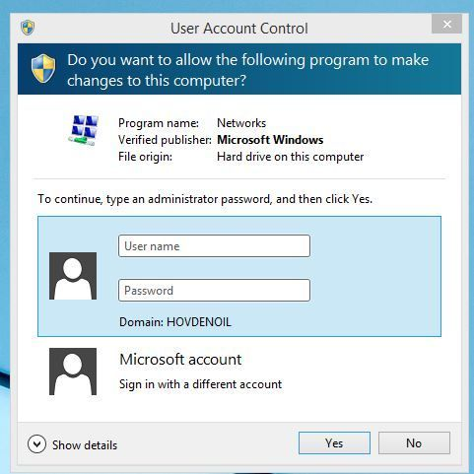
User Accounts
Gives user access to the computer
Determines which resources the user can access, and what the user can do with them
Administrator, User, Guest
Notes:
**User Accounts: Balancing Access and Control**
User accounts are a fundamental element of operating systems, enabling users to interact with computers while maintaining security and control over system resources. Here's a closer look at the roles and functions of user accounts:
**Access Provision:**
- User accounts serve as gateways to the computer system, allowing individuals to log in and gain access to its functionalities.
- Each user account is associated with a unique set of credentials, typically a username and password.
**Resource Allocation:**
- User accounts determine the level of access a user has to various resources, including files, applications, and system settings.
- Access control mechanisms ensure that users can only interact with resources for which they have been granted permission.
**User Roles:**
- **Administrator:** Administrators have elevated privileges, allowing them to configure system settings, install software, and manage user accounts.
- **User:** Regular users have standard access rights and can perform everyday tasks without altering system configurations.
- **Guest:** Guest accounts offer limited access, often restricting users from making significant changes to the system.
**Functionality and Security:**
- User accounts balance the need for system functionality with security considerations.
- While administrators can make system-wide changes, the limitations of user and guest accounts prevent inadvertent or malicious alterations.
**User Profiles:**
- Each user account is associated with a user profile, which stores personal settings, preferences, and customizations.
- User profiles ensure a personalized computing experience, even when multiple individuals share the same computer.
**Single Sign-On and Authentication:**
- Some systems support single sign-on, enabling users to access multiple services with a single set of credentials.
- Strong authentication methods, such as two-factor authentication, enhance security by requiring additional verification steps.
**Guest Accounts: A Limited Approach:**
- Guest accounts are often provided for temporary or restricted access, such as in public computing environments.
- These accounts typically have limited permissions and erase user data after each session.
**Conclusion:**
User accounts play a pivotal role in managing access and control within operating systems. By defining roles, access levels, and privileges, user accounts strike a balance between enabling users to harness the system's capabilities and ensuring the security and integrity of the system and its resources. Through these mechanisms, operating systems provide a secure and efficient environment for users to perform tasks, customize settings, and interact with computing technologies.

Slide 20
Access Control
Security in place to control system configuration changes
Microsoft implements it with User Account Control (UAC)
Notes:
**Access Control: Safeguarding System Integrity**
Access control is a cornerstone of system security, ensuring that authorized users can access the resources they need while preventing unauthorized access or modifications. It plays a crucial role in maintaining the integrity and confidentiality of sensitive data within an operating system. Microsoft's User Account Control (UAC) is an example of how access control is implemented to enhance system security:
**System Configuration Changes:**
- Access control focuses on regulating changes to the system's configuration, settings, and critical files.
- It prevents unauthorized users or processes from altering configurations that could compromise system stability or security.
**User Account Control (UAC):**
- UAC is a security feature implemented in Microsoft Windows operating systems, starting with Windows Vista.
- It prompts users for permission or confirmation before allowing certain system-level changes to be made.
**User Account Control Mechanisms:**
- UAC works by requesting user approval or administrative privileges when attempting actions that could affect system settings, files, or applications.
- It employs consent prompts, password requirements, and user prompts to ensure that only authorized users can make changes.
**Elevated Privileges:**
- UAC separates standard user privileges from administrative privileges.
- Even users with administrative accounts must provide explicit consent to perform administrative tasks, reducing the risk of accidental or unauthorized changes.
**Benefits of Access Control:**
- **Security:** Access control prevents unauthorized users or malicious software from making unauthorized changes that could compromise system security.
- **System Integrity:** It safeguards system files and configurations, ensuring that the operating system functions as intended.
- **Data Protection:** Access control prevents unauthorized access to sensitive data, safeguarding privacy and compliance.
**Challenges and Considerations:**
- Striking the right balance between security and user experience is essential. Overly frequent prompts can be intrusive, while too few prompts may compromise security.
- Organizations need to establish proper access control policies and ensure that users understand the implications of their actions.
**Conclusion:**
Access control is a vital component of system security, especially in environments where multiple users access the same operating system. Implementing mechanisms like User Account Control (UAC) helps prevent unauthorized or accidental system changes, enhancing the overall security and stability of the operating system. By striking a balance between user convenience and security, access control contributes to a robust computing environment where users can confidently perform tasks without compromising system integrity.

Slide 21
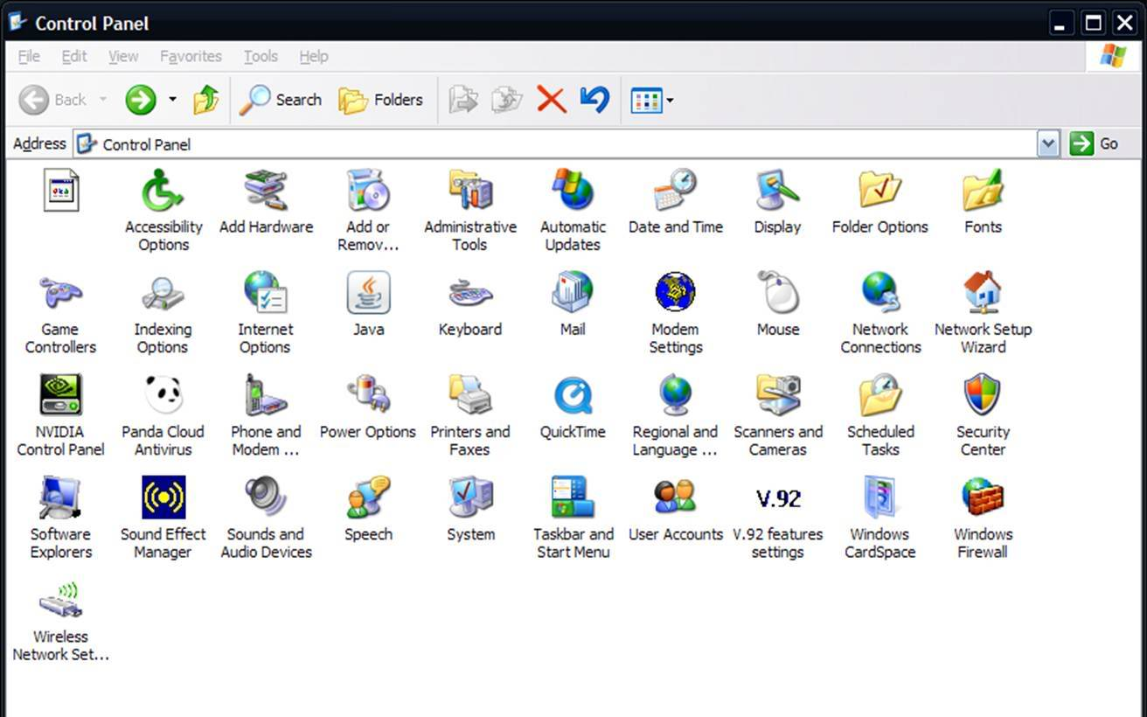
Application Management
Windows Registry
Compartmentalized installation and easy uninstallation
Windows uses Programs and Features in Control Panel
Notes:
**Application Management: Organizing and Optimizing Software**
Efficient application management is crucial for maintaining a well-organized and functional operating system. It involves installing, organizing, updating, and uninstalling software applications to ensure a seamless computing experience. Here's how application management is handled, with a focus on Windows systems:
**Windows Registry: Central Configuration Hub:**
- The Windows Registry is a centralized database that stores configuration settings and options for both the operating system and installed applications.
- Applications may store their settings, preferences, and configuration details in the registry for easy access and retrieval.
**Installation and Uninstallation:**
- Modern operating systems provide compartmentalized installation and uninstallation processes for applications.
- During installation, applications are typically placed in designated directories, ensuring organized storage and separation from system files.
**Windows Programs and Features:**
- Windows provides a built-in utility called "Programs and Features" within the Control Panel.
- This utility allows users to view, modify, and uninstall installed applications in a user-friendly interface.
**Benefits of Effective Application Management:**
- **Resource Optimization:** Efficient application management prevents unnecessary resource consumption, improving system performance.
- **Conflict Prevention:** Well-managed applications reduce the risk of conflicts and compatibility issues between different software packages.
- **Security:** Regularly updating applications ensures that security patches are applied, safeguarding against vulnerabilities.
**Challenges and Considerations:**
- Over time, application clutter can accumulate, occupying storage space and potentially causing system slowdowns.
- Ensuring that users follow best practices when installing and uninstalling applications can prevent clutter and maintain system health.
**Application Lifecycles:**
1. **Installation:** Users or administrators initiate the installation of an application. During this phase, the application's files and configurations are placed on the system.
2. **Configuration:** Users set preferences, customize settings, and configure the application according to their needs.
3. **Usage:** Users interact with the application, performing tasks and utilizing its features.
4. **Updates and Maintenance:** Developers release updates and patches to address bugs, security vulnerabilities, and introduce new features.
5. **Uninstallation:** If an application is no longer needed, it can be uninstalled to free up resources and space.
**Conclusion:**
Efficient application management is essential for maintaining a well-organized and high-performing operating system. By effectively installing, organizing, updating, and uninstalling applications, users can optimize system resources, reduce conflicts, and ensure a secure and stable computing environment. The use of tools like the Windows Registry and built-in utilities simplifies the management process, contributing to a streamlined and productive user experience.

Slide 22
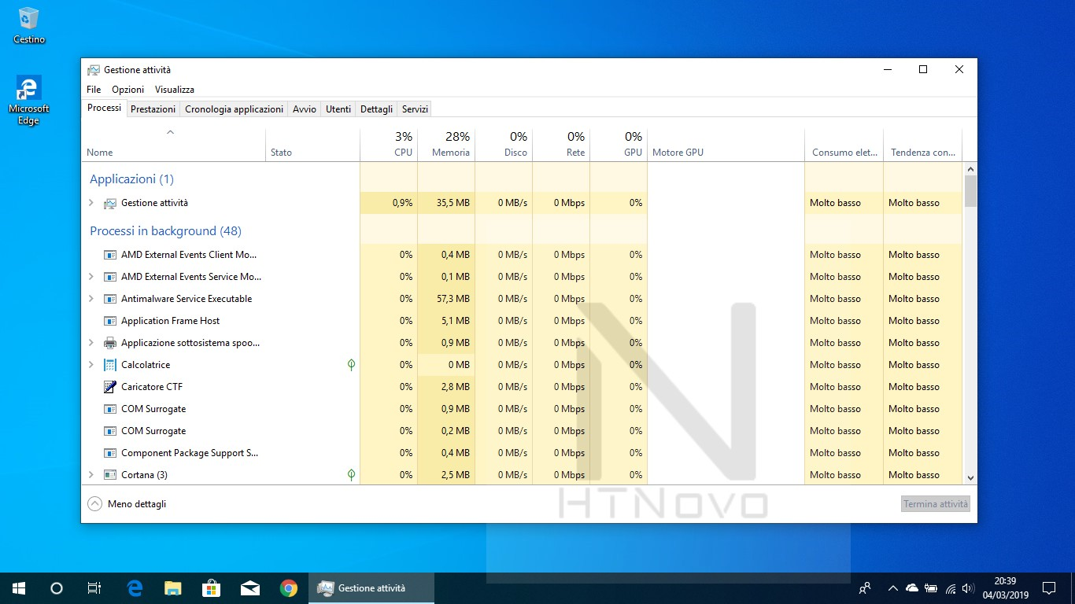
Process Management
Every task on a computer is run as a process
If the process hangs (freezes), user can stop (or kill) it
Windows Task Manager
Notes:
**Process Management on macOS and Windows: A Comparative Overview**
Process management is a critical aspect of both macOS and Windows operating systems, ensuring efficient resource allocation and task execution. While both systems share common principles, they have distinct implementations to cater to their respective user experiences. Here's a comparative look at process management on macOS and Windows:
**macOS Process Management:**
- **Activity Monitor:** macOS provides the "Activity Monitor" tool, which serves a similar purpose as the Windows Task Manager. It displays a list of running processes, resource utilization, and system performance metrics.
- **Force Quit:** In macOS, users can use the "Force Quit Applications" feature to terminate unresponsive or problematic applications. This is similar to the "End Task" function in Task Manager.
**Windows Process Management:**
- **Task Manager:** Windows offers the Task Manager, a comprehensive utility for managing processes, applications, and system performance. Users can view running processes, monitor resource usage, and terminate unresponsive tasks.
- **Process Explorer:** For more advanced users, Windows also provides "Process Explorer," a tool that provides detailed information about running processes, including handles and DLLs.
**Resource Allocation and Prioritization:**
- Both macOS and Windows employ process management to allocate system resources like CPU time, memory, and disk access.
- The operating systems prioritize processes based on factors like user interaction, task criticality, and system responsiveness.
**Force Termination:**
- On both macOS and Windows, users can forcefully terminate unresponsive processes to free up system resources.
- Force termination helps prevent hung processes from affecting the overall system performance.
**Process States:**
- Both operating systems recognize process states such as running, waiting, and terminated, providing insight into the status of each process.
**User Experience:**
- macOS and Windows offer user-friendly interfaces to manage processes, with visual representations and detailed information about resource usage.
- The management tools aim to empower users to troubleshoot and optimize their systems for a smooth experience.
**Conclusion:**
Process management is a universal necessity for maintaining system performance, stability, and user experience. While macOS and Windows have their own process management tools, they share common objectives in allocating resources, monitoring tasks, and providing users with the means to optimize their systems. Both operating systems aim to deliver efficient multitasking, responsive applications, and a seamless computing experience through effective process management.

Slide 23
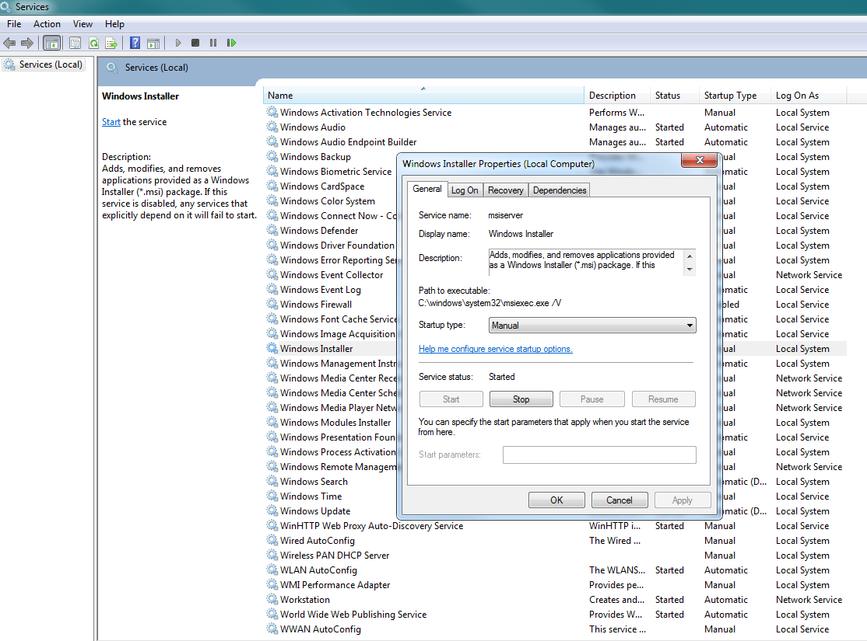
Service Management
Services extend computer functionality, such as by managing print requests
Can start automatically at startup, or need to be manually started
Services management console in Windows used to start, stop, and configure
Notes:
**Service Management on macOS and Windows: A Comparative Insight**
Service management is a critical component of operating systems, allowing users to control and configure background processes and services that run continuously to support various functions. While both macOS and Windows offer service management functionalities, they have unique approaches tailored to their respective ecosystems. Here's a comparative overview of service management on macOS and Windows:
**macOS Service Management:**
- **LaunchDaemons and LaunchAgents:** In macOS, services are managed through "launchd," a unified system that controls daemons (background services) and agents (processes started on user login). It replaces traditional system startup mechanisms.
- **Preference Panes:** Some services can be configured using preference panes accessible through the System Preferences. These panes allow users to manage specific services and their settings.
**Windows Service Management:**
- **Services.msc:** Windows provides the "Services" management console (services.msc) to view and manage system and third-party services. Users can start, stop, and configure services through this utility.
- **Task Manager:** In recent Windows versions, Task Manager also includes a "Services" tab that displays running services and allows users to stop or restart them.
**Service States and Configuration:**
- Both macOS and Windows allow users to start, stop, restart, and configure services according to their needs.
- Some services are set to start automatically during system boot, while others are triggered by specific events or user actions.
**Automatic vs. Manual Startup:**
- On macOS, services can be configured to start automatically during system boot or on-demand based on user actions.
- Windows offers similar options, allowing users to set services to start automatically, manually, or only when required.
**Service Dependencies:**
- Both operating systems support service dependencies, allowing one service to start based on the status of another.
- These dependencies help ensure that services required for specific tasks are available when needed.
**User Experience and Customization:**
- macOS and Windows provide user-friendly interfaces to manage services, enabling users to control background processes.
- The management tools aim to enhance user control over system behavior while maintaining stability and performance.
**Conclusion:**
Service management is crucial for ensuring a well-functioning operating system that supports various tasks and functions seamlessly. While macOS and Windows offer distinct tools for service management, they share common goals of allowing users to configure, control, and optimize background processes. Both operating systems empower users to tailor their system's behavior to their needs, contributing to a responsive and efficient computing experience.

Slide 24
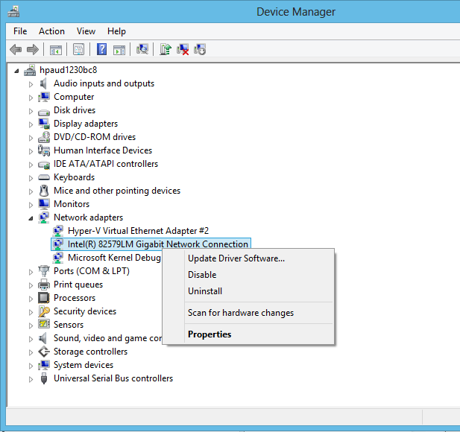
Device Management
Manage hardware devices, including installing and updating drivers
Device Manager in Windows
Notes:
**Device Management on macOS and Windows: A Comparative Overview**
Device management is a fundamental aspect of operating systems, enabling users to interact with and control hardware components efficiently. Both macOS and Windows offer comprehensive device management capabilities, each tailored to their respective ecosystems. Here's a comparative look at device management on macOS and Windows:
**Device Management on macOS:**
- **System Preferences:** macOS provides the "System Preferences" interface, where users can manage various hardware components and devices. This includes settings related to displays, printers, keyboards, mice, trackpads, and more.
- **Bluetooth and Wi-Fi:** macOS allows users to configure and manage Bluetooth devices and Wi-Fi connections through the "Bluetooth" and "Network" sections of System Preferences.
- **Automatically Installed Drivers:** macOS often includes drivers for a wide range of hardware components, reducing the need for manual driver installation.
**Device Management on Windows:**
- **Device Manager:** Windows offers the "Device Manager" utility, allowing users to view and manage hardware devices, drivers, and their properties. Device Manager provides a detailed overview of connected hardware components.
- **Settings App:** Recent versions of Windows include the "Settings" app, where users can configure hardware settings, manage Bluetooth devices, printers, and more.
- **Driver Installation:** Windows often requires users to manually install drivers for specific hardware components. This is done through Windows Update, manufacturer websites, or installation files.
**Plug and Play:**
- Both macOS and Windows support "plug and play," automatically recognizing and configuring new hardware devices when they are connected.
**Device Drivers:**
- In Windows, device drivers are essential for hardware communication, and users often need to ensure that the correct drivers are installed for optimal device performance.
- macOS usually includes built-in drivers for a wide range of devices, reducing the need for manual installations.
**User Experience and Customization:**
- Both operating systems aim to provide user-friendly interfaces for managing hardware devices, ensuring an intuitive and efficient experience.
- The tools and settings are designed to allow users to personalize their device settings and configurations.
**Conclusion:**
Device management is crucial for enabling users to interact effectively with hardware components and peripherals. While macOS and Windows have distinct tools and interfaces for device management, their goals remain consistent: providing users with easy access to hardware settings, configurations, and drivers. Both operating systems strive to ensure that users can optimize the performance of their hardware devices while enjoying a seamless and personalized computing experience.

Slide 25
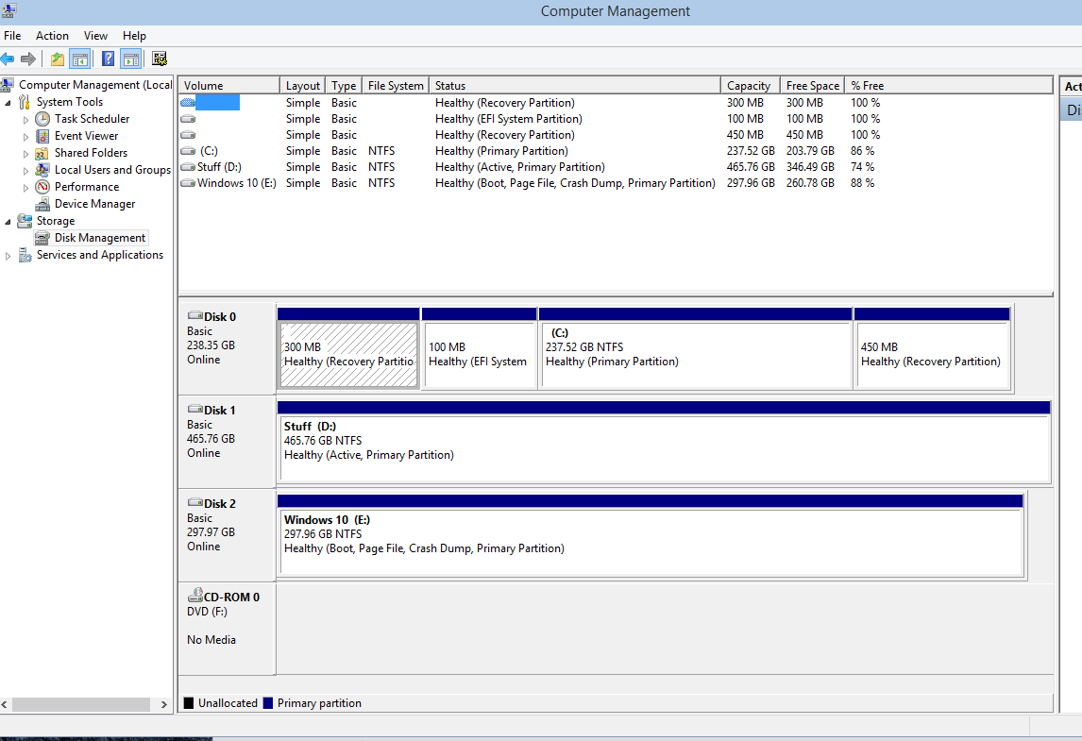
Disk Management
Manages hard drives, optical drives, other storage media
Creating and deleting partitions
Formatting partitions
Windows uses Disk Management console
Notes:
**Disk Management: Ensuring Efficient Storage on Your Computer**
Disk management is a vital component of operating systems that oversees the organization and utilization of storage media, including hard drives, optical drives, and other storage devices. Both Windows and macOS offer disk management tools to help users optimize their storage space and enhance system performance. Here's a closer look at disk management, with a focus on its implementation in Windows systems:
**Hard Drive Management:**
- Disk management encompasses various tasks related to hard drives and storage media. It allows users to allocate space effectively, create partitions, format drives, and perform maintenance tasks.
**Partition Creation and Deletion:**
- Disk management tools enable users to create multiple partitions on a single hard drive. Partitions can help segregate data and operating systems for better organization.
- Users can also delete partitions when they are no longer needed or to repurpose the space.
**Partition Formatting:**
- Formatting is the process of preparing a partition for use. It involves setting up a file system that the operating system can understand.
- Common file systems include NTFS (Windows) and HFS+ (macOS).
**Disk Management in Windows:**
- Windows provides the "Disk Management" console as the primary tool for disk management tasks.
- Users can access Disk Management through the Control Panel or by searching for "Disk Management" in the Start menu.
**Disk Status and Information:**
- The Disk Management console displays a graphical representation of all connected hard drives and their partitions.
- Users can view details such as disk capacity, partition sizes, and the layout of the partitions.
**Resizing Partitions:**
- Disk Management allows users to resize partitions, adjusting their sizes to accommodate changing storage needs.
**Disk Maintenance and Troubleshooting:**
- Disk Management can also be used for disk maintenance, including marking partitions as active, changing drive letters, and checking disk integrity.
**Benefits of Effective Disk Management:**
- **Optimized Storage:** Proper disk management prevents data fragmentation and ensures efficient use of available space.
- **Organization:** Creating multiple partitions aids in organizing data, applications, and system files separately.
- **System Performance:** Well-maintained disks contribute to faster data access and improved overall system performance.
**Challenges and Considerations:**
- Resizing partitions can involve data loss, so it's important to back up data before making changes.
- Care should be taken to avoid inadvertently formatting or deleting partitions containing critical data.
**Conclusion:**
Disk management plays a crucial role in maintaining an efficient and organized storage environment. Whether it's creating partitions, formatting drives, or resizing partitions, proper disk management tools and practices contribute to enhanced data management and system performance. Windows' Disk Management console empowers users to take control of their storage resources and optimize them according to their needs.

Slide 26
Memory Management
OS manages physical memory
Virtual memory (hard drive space) used as a backup
Swap file or page file
Virtual memory manager
Notes:
**Memory Management: Ensuring Efficient Use of System Resources**
Memory management is a pivotal function of operating systems that involves overseeing the allocation and utilization of both physical and virtual memory. Both Windows and macOS employ sophisticated memory management techniques to optimize system performance and ensure smooth multitasking. Here's a closer look at memory management, with a focus on its role in the operating systems:
**Physical Memory Management:**
- Operating systems manage physical memory (RAM), ensuring that each running process has sufficient space to execute and store data.
- Memory management is responsible for allocating and deallocating memory blocks to processes as they are needed.
**Virtual Memory:**
- To provide an extended pool of memory beyond physical RAM, operating systems use virtual memory, which involves utilizing hard drive space as an extension of RAM.
- The swap file or page file is a portion of the hard drive reserved for this purpose.
**Page File and Swap File:**
- Windows and macOS use a page file (Windows) or swap file (macOS) to manage virtual memory.
- When physical memory becomes saturated, the operating system moves less-used data from RAM to the page or swap file, freeing up RAM for more critical processes.
**Virtual Memory Manager:**
- The virtual memory manager is a key component of the operating system responsible for coordinating the interaction between physical and virtual memory.
- It determines what data should be swapped between RAM and the page or swap file.
**Benefits of Effective Memory Management:**
- **Optimized Performance:** Proper memory management ensures that processes receive the memory resources they require, preventing slowdowns due to memory bottlenecks.
- **Multitasking:** Efficient memory allocation allows the system to support multiple processes simultaneously, enhancing multitasking capabilities.
- **Reduced Crashes:** By utilizing virtual memory as a backup, the risk of system crashes due to running out of physical memory is minimized.
**Challenges and Considerations:**
- Overusing virtual memory can lead to reduced system performance, as accessing data from the hard drive is slower than accessing it from RAM.
- Insufficient memory allocation can lead to slowdowns, freezes, or even crashes.
**Conclusion:**
Memory management is a crucial element of operating systems that contributes to overall system performance and user experience. By expertly managing physical and virtual memory resources, both Windows and macOS ensure that processes run efficiently, multitasking is smooth, and users can work without interruptions. Effective memory management is a cornerstone of modern computing, enabling users to harness the full potential of their systems.

Slide 27
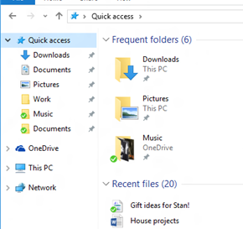
Managing Folders and Files
File systems manage:
Disk space and file access
File names and directories (folders)
File metadata
Security
Notes:
**File Systems: Efficient Management of Data and Resources**
File systems are a fundamental component of operating systems, responsible for organizing and managing data on storage devices. Both Windows and macOS incorporate sophisticated file systems to facilitate efficient data storage, access, and organization. Let's delve deeper into the role of file systems, focusing on their management of various aspects in both operating systems:
**Disk Space and File Access:**
- File systems allocate and manage disk space to store files. They ensure that data is stored in a structured manner to prevent fragmentation.
- They handle file access, allowing users and applications to read, write, and modify files stored on the disk.
**File Names and Directories (Folders):**
- File systems manage file names and organize files into directories (also known as folders).
- They maintain a hierarchical structure of directories, making it easier to locate and manage files.
**File Metadata:**
- File systems store metadata associated with each file, including attributes like creation date, modification date, file size, and permissions.
- This metadata helps the operating system and users track and manage files effectively.
**Security:**
- File systems implement security measures to control access to files and directories.
- They enforce file permissions, ensuring that only authorized users or applications can access or modify specific files.
**File Systems in Windows:**
- Windows employs the New Technology File System (NTFS) as its primary file system.
- NTFS supports advanced features such as file encryption, compression, access control lists (ACLs), and more.
**File Systems in macOS:**
- macOS uses the Hierarchical File System Plus (HFS+) as its traditional file system.
- In recent versions, macOS has transitioned to the Apple File System (APFS), which offers improved performance, space efficiency, and data integrity.
**Benefits of Effective File Systems:**
- **Efficient Storage:** Proper file systems ensure that data is stored in a manner that minimizes fragmentation and optimizes disk space utilization.
- **Data Organization:** Hierarchical organization of directories and files makes it easy to find and manage data.
- **Data Integrity:** File systems maintain file metadata and provide mechanisms to prevent data corruption and ensure data consistency.
**Challenges and Considerations:**
- Choosing the appropriate file system is important based on the intended use case and the operating system being used.
- File systems need to manage file system metadata efficiently to prevent performance degradation.
**Conclusion:**
File systems are the backbone of data storage and management in operating systems. By effectively managing disk space, providing organized file access, maintaining metadata, and enforcing security measures, file systems contribute to the reliable and efficient storage and retrieval of data. Both Windows and macOS leverage sophisticated file systems to ensure that users can interact with their data seamlessly and securely.

Slide 28
Common File Systems
FAT
NTFS
HFS
Ext4
Notes:
**Exploring Different File Systems: FAT, NTFS, HFS, Ext4**
File systems play a critical role in managing data on storage devices, and various file systems are used in different operating systems to meet specific needs. Let's take a closer look at some commonly used file systems—FAT, NTFS, HFS, and Ext4—exploring their characteristics and implementations:
**FAT (File Allocation Table):**
- Developed in the 1970s, FAT was one of the earliest file systems used in computers.
- FAT file systems are simple and widely compatible, making them suitable for devices like USB drives and memory cards.
- Versions include FAT12, FAT16, and FAT32, each specifying the size of clusters used to store data.
- While suitable for small devices and compatibility, FAT lacks advanced features like journaling and security.
**NTFS (New Technology File System):**
- Introduced by Microsoft in the mid-1990s, NTFS is the primary file system for Windows operating systems.
- NTFS offers advanced features such as support for large file sizes, file compression, encryption, access control lists (ACLs), and journaling for enhanced data integrity.
- Journaling helps prevent data loss in case of power outages or crashes.
- NTFS supports long file names and efficient storage of small files.
**HFS (Hierarchical File System):**
- HFS was the original file system used in early Macintosh computers.
- HFS offered features like support for metadata and file forks, allowing the storage of resource and data forks in a single file.
- HFS underwent an evolution with HFS+ (also known as Mac OS Extended), which introduced enhancements like larger file sizes, improved data structure, and Unicode support.
**Ext4 (Fourth Extended File System):**
- Ext4 is a widely used file system in Linux operating systems.
- It's a successor to Ext3, introducing improvements like support for larger file sizes and volumes, faster file system checks, and delayed allocation.
- Ext4 supports journaling, which aids in maintaining file system integrity.
**Choosing the Right File System:**
- The choice of file system depends on factors like the operating system being used, the intended use case, and desired features.
- NTFS is ideal for Windows systems due to its advanced features, including security and data integrity.
- HFS and HFS+ are designed for macOS systems and offer compatibility and support for Mac-specific features.
- Ext4 is commonly used in Linux systems, offering reliability and performance for diverse workloads.
**Compatibility and Interoperability:**
- While file systems are optimized for specific operating systems, tools and drivers can allow some level of compatibility between them.
- For example, Windows can read and write to FAT and NTFS, while Linux can read and write to Ext4.
**Conclusion:**
File systems like FAT, NTFS, HFS, and Ext4 form the foundation of data storage and management in various operating systems. Each file system brings unique features and capabilities to the table, catering to specific needs and requirements. Selecting the appropriate file system is essential to ensure optimal data organization, performance, and security for the given operating system and use case.

Slide 29
Navigating a File System
Search, sort, and display files
Identify file and folder size
Understand file and folder permissions
Read-only versus modifiable files
Notes:
**Navigating a File System: Mastering File and Folder Interaction**
Navigating a file system is a fundamental skill in working with computers, allowing users to efficiently find, organize, and interact with files and folders. Whether on Windows, macOS, or Linux, understanding how to search, sort, and interpret file attributes is essential. Here's a closer look at navigating a file system:
**Search, Sort, and Display Files:**
- Operating systems provide search functionality to quickly locate files by name, date, or content.
- Users can sort files by attributes such as name, size, type, or modification date.
- The ability to customize how files are displayed—icons, lists, or details—improves usability.
**Identify File and Folder Size:**
- File and folder size helps users manage storage space effectively.
- File explorers display size information in bytes, kilobytes, megabytes, or gigabytes.
- Identifying large files and folders assists in cleaning up and optimizing storage usage.
**Understanding File and Folder Permissions:**
- Operating systems enforce access control through permissions.
- Permissions dictate who can read, write, execute, or modify files and folders.
- Permissions are often represented using symbols like r (read), w (write), and x (execute).
**Read-Only versus Modifiable Files:**
- Read-only files cannot be modified, ensuring data integrity.
- Modifiable files can be edited, allowing users to update content.
**Graphical User Interface (GUI) Explorers:**
- GUI-based file explorers offer an intuitive interface for navigating file systems.
- Users interact with files and folders by clicking, dragging, and dropping.
- Context menus provide quick access to common actions like copy, paste, delete, and rename.
**Command-Line Interface (CLI):**
- CLI users navigate file systems using commands.
- Common commands include "cd" (change directory), "ls" (list files), "mkdir" (make directory), and "rm" (remove).
- CLI offers powerful scripting capabilities for advanced users.
**Benefits of Efficient File Navigation:**
- Time Efficiency: Efficient navigation minimizes time spent searching for files.
- Organization: Effective navigation contributes to an organized file structure.
- Collaboration: Understanding permissions ensures secure sharing and collaboration.
- Space Optimization: Identifying large files aids in optimizing storage.
**Challenges and Considerations:**
- Navigating complex directory structures can be challenging; creating an organized hierarchy is important.
- Misinterpreting file permissions can lead to accidental data exposure or restricted access.
**Conclusion:**
Mastering file system navigation is a cornerstone of computer literacy. Whether using a GUI explorer or a CLI, users benefit from the ability to quickly find files, understand their attributes, and manage them efficiently. Navigational skills enhance productivity, aid in file organization, and ensure effective collaboration across different operating systems.

Slide 30
Manipulating Files
Open
Edit
Save
Move
Copy
Cut
Paste
Delete
Rename
Notes:
**Manipulating Files: Essential File Operations for Productivity**
Manipulating files is a core skill that empowers users to interact with their data effectively, whether for editing, organizing, or managing content. Understanding and mastering essential file operations like opening, editing, moving, copying, and deleting are vital for productive computer use across various operating systems. Here's an exploration of these key file manipulation actions:
**Open:**
- Opening a file launches the associated application, allowing you to view or modify its content.
- Files can be opened by double-clicking them or selecting "Open" from the context menu.
**Edit:**
- Editing files involves making changes to their content using relevant software.
- Text editors, word processors, graphic design software, and more are used to edit different types of files.
**Save:**
- Saving a file updates its content with your edits.
- It's crucial to save files periodically to preserve changes.
**Move:**
- Moving a file involves transferring it from one location to another within the file system.
- This operation is useful for reorganizing files and folders.
**Copy:**
- Copying a file duplicates it, allowing you to place the duplicate in a different location.
- Useful for creating backups or sharing files without affecting the original.
**Cut:**
- Cutting a file prepares it for moving. It's like copying but removes the file from the original location once pasted elsewhere.
**Paste:**
- Pasting places a copied or cut file into a designated location.
- It's a quick way to duplicate or move files.
**Delete:**
- Deleting a file removes it from the file system.
- Deleted files are usually sent to the recycle bin or trash folder, allowing for recovery before permanent deletion.
**Rename:**
- Renaming a file changes its name without altering its content.
- Useful for giving files more meaningful names.
**Benefits of File Manipulation Skills:**
- **Efficiency:** Performing these operations seamlessly saves time and effort.
- **Organization:** Skillful file manipulation aids in keeping your data organized and accessible.
- **Collaboration:** Copying and moving files enable efficient collaboration and data sharing.
- **Data Management:** Deleting or renaming files ensures proper data maintenance.
**Considerations:**
- **Data Loss Prevention:** Carefully manage copy, cut, and delete operations to prevent accidental data loss.
- **Backup:** Before performing major file operations, consider creating backups to safeguard important data.
**Conclusion:**
Proficiency in manipulating files is a cornerstone of effective computer use. Whether editing documents, organizing media, or managing work-related files, these fundamental operations empower users to work efficiently and maintain an organized digital environment. By mastering these skills, users can confidently navigate their file systems, collaborate with others, and manage their data effectively across various operating systems.

Slide 31
Programs and Shortcuts
How to execute a program
Differences between shortcuts and applications
Notes:
A shortcut and an application are two distinct concepts in computer systems, particularly when referring to software and user interfaces. Here's the difference between the two:
Application: An application, also known as an app or software program, is a set of instructions and data designed to perform specific tasks on a computer or mobile device. Applications are created by developers using programming languages and typically have a user interface, which allows users to interact with the software to accomplish tasks. Examples of applications include web browsers (e.g., Google Chrome, Mozilla Firefox), office suites (e.g., Microsoft Office, Google Workspace), and multimedia players (e.g., VLC, Windows Media Player).
Shortcut: A shortcut is a reference or link to a file, folder, or application, typically represented by an icon on the desktop or within a file explorer. Instead of containing the actual application or data, a shortcut points to the original location, allowing users to access the target item more quickly and conveniently. Shortcuts can be created for various types of files, including applications, documents, and images, among others.
In summary, an application is a software program designed to perform specific tasks, while a shortcut is a link that provides quick access to a file, folder, or application.

Slide 32
Chapter 4: Operating Systems
Manage applications and software
Interface between applications and hardware
Disk management
Process management/ scheduling
Kill process/ end task
Application management
Memory management
Device management
Access control/ protection
Types of OS
Mobile Device OS
Workstation OS
Server OS
Embedded OS
Firmware
Hypervisor (Type 1)
Compare and contrast components of an operating system
File systems and features
File systems
NTFS
FAT32
HFS
Ext4
Features
Compression
Encryption
Permissions
Journaling
Limitations
Naming rules
File management
Folders/directories
File types and extensions
Permissions
Services
Processes
Drivers
Utilities
Task scheduling
Interfaces
Console/command line
GUI
Notes:
**Mastering Operating System Functions and Types**
Operating systems (OS) serve as the foundation of computer functionality, managing various tasks to ensure smooth interaction between hardware, software, and users. Understanding OS functions and recognizing different types of OS is key to comprehending how computers operate. Let's delve into these aspects:
**Manage Applications and Software:**
- OS facilitates application execution, managing resource allocation and ensuring proper interaction between software and hardware.
- User interfaces, like graphical user interfaces (GUIs) and command-line interfaces (CLIs), allow application management.
**Interface Between Applications and Hardware:**
- OS acts as an intermediary, translating application requests into instructions for hardware execution.
- Device drivers facilitate communication between applications and hardware components.
**Disk Management:**
- OS handles storage resources, organizing data, and managing file systems.
- Functions include creating, formatting, and managing partitions, as well as file organization and data retrieval.
**Process Management/Scheduling:**
- OS manages processes, allocating CPU time and system resources.
- Scheduler ensures fair and efficient utilization of resources among competing processes.
**Kill Process/End Task:**
- OS enables termination of unresponsive or unwanted processes.
- This prevents resource wastage and system slowdown.
**Application Management:**
- OS oversees application installation, execution, and interaction.
- Virtual environments or containers enhance application isolation and security.
**Memory Management:**
- OS allocates and manages system memory for efficient resource utilization.
- Techniques include virtual memory management and memory protection.
**Device Management:**
- OS communicates with hardware devices using device drivers.
- It facilitates device recognition, configuration, and coordination.
**Access Control/Protection:**
- OS enforces user authentication and authorization, ensuring data security.
- File permissions and user roles restrict access to sensitive information.
**Types of OS:**
1. **Mobile Device OS:** Tailored for smartphones, tablets, and other mobile devices. Examples include Android, iOS.
2. **Workstation OS:** Designed for personal computers and workstations. Examples include Windows, macOS, Linux.
3. **Server OS:** Optimized for server operations, offering scalability and performance. Examples include Windows Server, Linux-based servers.
4. **Embedded OS:** Customized for specific devices or appliances, often with real-time capabilities.
5. **Firmware:** Low-level software controlling hardware components, essential for booting.
6. **Hypervisor (Type 1):** Manages multiple virtual machines on a host system, crucial for virtualization in data centers.
**Benefits of Understanding OS Functions and Types:**
- Enables efficient interaction with computers.
- Enhances troubleshooting and problem-solving skills.
- Aids in selecting appropriate OS for specific needs.
- Supports informed discussions on computing topics.
**Considerations:**
- Different types of OS have distinct features and requirements.
- Security measures are crucial for protecting data and resources.
**Conclusion:**
A grasp of OS functions and types is essential for anyone interacting with computers. From managing applications to handling hardware resources, each aspect contributes to a smooth and productive computing experience. Recognizing the diversity of OS types empowers users to choose the right platform for their needs, whether on mobile devices, workstations, servers, or embedded systems.
**Comparing and Contrasting Operating System Components**
Operating systems (OS) encompass various components that collectively manage computer hardware, software, and user interaction. This comparison sheds light on key OS components such as file systems, features, file management, services, processes, utilities, task scheduling, and interfaces.
**File Systems and Features:**
**File Systems:**
- **NTFS (New Technology File System):** Used in Windows OS, supports advanced features like encryption, compression, and permissions.
- **FAT32 (File Allocation Table 32):** Older Windows file system with limited features, lacking advanced security and file size support.
- **HFS (Hierarchical File System):** Used in macOS, supports metadata and journaling, enhancing data integrity.
- **Ext4 (Fourth Extended File System):** Common in Linux, features improved performance and scalability over its predecessors.
**Features:**
- **Compression:** Reduces file size to save space, commonly available in NTFS and some Linux file systems.
- **Encryption:** Ensures data security by encoding files, prevalent in modern file systems.
- **Permissions:** Regulate access to files and directories, supported in NTFS, HFS, and Linux file systems.
- **Journaling:** Enhances file system reliability by logging changes, found in HFS, NTFS, and Ext4.
**Limitations:**
- **Naming Rules:** Different file systems have varying rules for file naming and character usage.
- **File Management:** Not all file systems support the same file management capabilities, affecting organization and search.
**File Management:**
**Folders/Directories:**
- Common to all file systems, folders/directories organize files hierarchically.
**File Types and Extensions:**
- Present in all file systems, extensions indicate file format/type.
**Permissions:**
- Supported by NTFS, HFS, and Linux file systems, permissions control file access.
**Services, Processes, and Drivers:**
**Services:**
- OS services are background processes that manage system-level tasks.
- Windows and Linux offer service management capabilities.
**Processes:**
- OS handles process creation, scheduling, and termination.
- Windows Task Manager and Linux terminal tools manage processes.
**Drivers:**
- Drivers enable OS interaction with hardware components.
- Windows Device Manager and Linux's modprobe manage drivers.
**Utilities and Task Scheduling:**
**Utilities:**
- OS utilities offer tools like disk cleanup, defragmentation, and backup.
- Windows Disk Cleanup and Linux dd are examples.
**Task Scheduling:**
- OS schedules tasks and processes to ensure efficient resource utilization.
- Windows Task Scheduler and Linux's cron facilitate scheduling.
**Interfaces:**
**Console/Command Line:**
- Command-line interfaces (CLIs) provide direct text-based interaction.
- Windows Command Prompt and Linux Terminal are examples.
**GUI (Graphical User Interface):**
- GUIs offer visual interaction, easing user experience.
- Windows Explorer, macOS Finder, and Linux desktop environments are GUI examples.
**Comparison and Contrast:**
- **File Systems:** Vary in features, security, and compatibility among OS.
- **File Management:** Universal concepts, but implementations differ.
- **Services/Processes/Drivers:** Common functions with varying management tools.
- **Utilities/Task Scheduling:** Similar objectives, distinct tools based on OS.
- **Interfaces:** CLI offers direct control; GUI enhances user-friendliness.
**Conclusion:**
Understanding and comparing OS components aids users in navigating their computing environments. Whether it's managing files, services, processes, or interfaces, awareness of these components empowers users to optimize their interaction with operating systems, regardless of the platform they use.

