Slide 1
IT Fundamentals
Chapter 3:
Computing Devices and the Internet of Things

Slide 2
Chapter 3: Computing Devices and the Internet of Things
Compare and contrast common computing devices and their purposes
Mobile phones
Tablets
Laptops
Workstations
Servers
Gaming consoles
IoT
Home appliances
Home automation devices
Thermostats
Security systems
Modern cars
IP cameras
Streaming media devices
Medical devices

Slide 3
Servers
Centralized computers that many clients (workstations) can access
Provide services such as:
File servers
Print servers
Web servers
Dedicated vs. non-dedicated
Notes:
Servers are crucial components of network infrastructures that provide various services to clients or users. Here's a more detailed exploration of servers:
**Centralized Access:**
Servers are centralized computers designed to handle and manage resources, services, and data that multiple clients (such as workstations, laptops, or other devices) can access over a network. Servers play a vital role in sharing resources and delivering services efficiently.
**Types of Server Services:**
Servers offer a range of services to clients based on their functions and purposes. Some common server services include:
- **File Servers:** These store and manage files that can be accessed and shared by clients. They help in centralizing data and maintaining consistent versions of files.
- **Print Servers:** Print servers manage print jobs from clients and control printing tasks on networked printers, making printing more organized and efficient.
- **Web Servers:** Web servers host websites and web applications, delivering content to clients' web browsers when they request it. They handle requests for web pages, images, videos, and other web resources.
**Dedicated vs. Non-Dedicated Servers:**
- **Dedicated Servers:** These servers are solely dedicated to a specific task or service. For instance, a web server that exclusively hosts websites. Dedicated servers provide optimized performance for their designated tasks.
- **Non-Dedicated Servers (Shared Servers):** These servers handle multiple tasks or services simultaneously. For example, a server that hosts both web pages and email services. While they might not provide the same level of performance as dedicated servers, they offer cost-effective solutions for smaller organizations.
**Benefits of Servers:**
- **Resource Centralization:** Servers centralize resources like files, applications, and services, making them easier to manage and access.
- **Security:** Servers can offer enhanced security by controlling user access, implementing authentication methods, and maintaining data integrity.
- **Backup and Redundancy:** Servers often include backup and redundancy mechanisms to ensure data safety in case of hardware failures.
- **Scalability:** Servers can be scaled up to accommodate growing demands by adding more hardware resources or optimizing software configurations.
- **Remote Access:** Servers enable remote access, allowing users to access resources and services from different locations.
In summary, servers play a vital role in modern computing environments, providing various services to clients and contributing to efficient resource management, data sharing, and centralized control. The choice between dedicated and non-dedicated servers depends on the organization's specific needs and requirements.

Slide 4
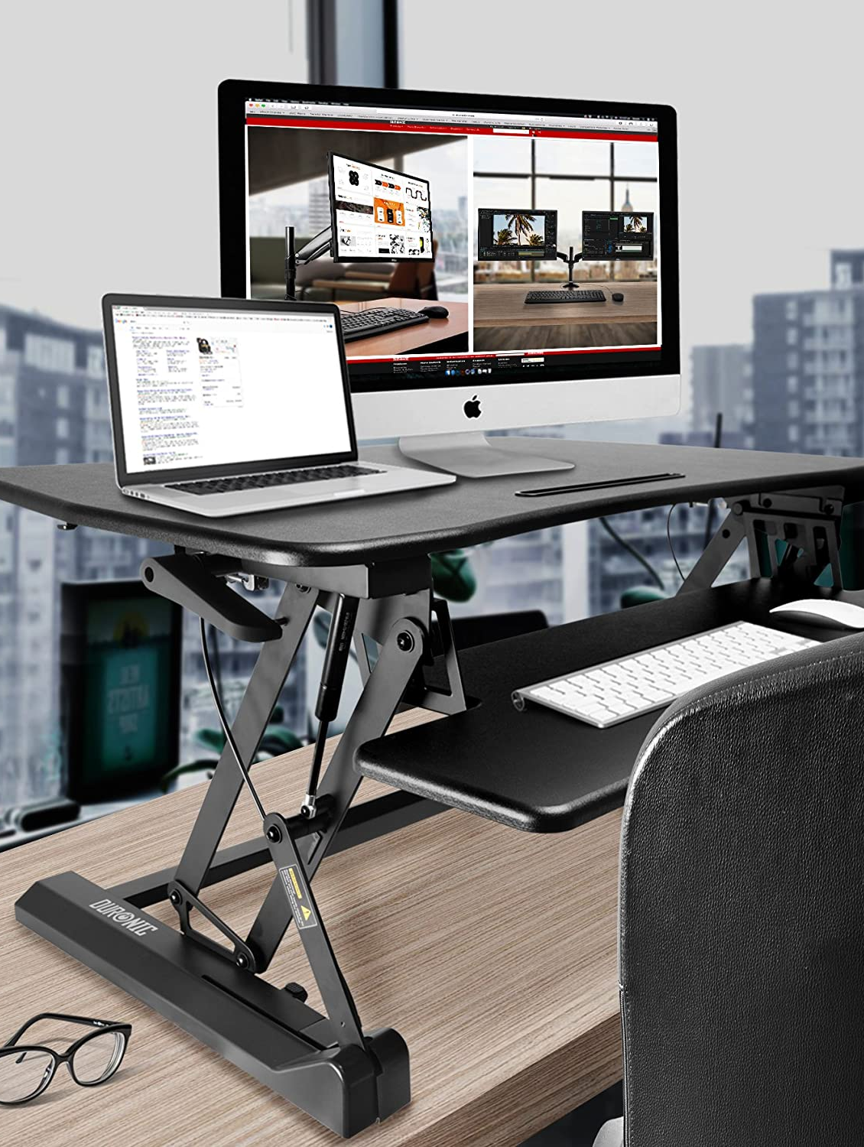
Workstations
The computers that “regular” users use to do daily work
Needs a network interface card (NIC)
Notes:
Workstations are specialized computers designed to handle tasks that demand high performance and are commonly utilized by professionals across various industries. Here's a more detailed exploration of workstations:
**Origin and Evolution:**
Workstations were first introduced in the 1960s and 1970s as minicomputers, which were smaller and more affordable than mainframe computers. Over time, they evolved to become the high-performance machines known as workstations that we see today.
**Characteristics of Workstations:**
- **High Performance:** Workstations are equipped with powerful processors, substantial RAM, and dedicated graphics cards. This enables them to manage demanding tasks such as graphic design, video editing, scientific simulations, and more.
- **Reliability:** Workstations are constructed with premium components and undergo rigorous testing to ensure consistent and reliable performance over extended periods.
- **Specialized Hardware:** Some workstations feature hardware tailored to specific industries. For example, workstations in graphics design might include color-accurate displays, while those in engineering might support high-performance computing.
- **Expandability:** Workstations often offer the flexibility to accommodate multiple hard drives, RAM modules, and other components, enabling users to customize their systems according to specific requirements.
- **Optimized Software:** Many workstations come with software optimizations for certain applications, enhancing overall performance and user experience.
**Role of Workstations:**
Workstations find use in a wide range of tasks, including:
- **Graphic Design and 3D Rendering:** Workstations are indispensable for tasks like video editing, 3D modeling, animation, and other graphics-intensive work.
- **Engineering and CAD:** Engineers employ workstations to execute complex simulations, computer-aided design (CAD), and computer-aided engineering (CAE) software.
- **Scientific Research:** Workstations play a key role in fields such as scientific research, simulations, and data analysis.
- **Financial Modeling:** Financial institutions utilize workstations for tasks like quantitative analysis, risk assessment, and the development of trading algorithms.
- **Software Development:** Developers rely on workstations for coding, compiling, and testing software, especially for resource-intensive projects.
**Network Interface Card (NIC):**
A Network Interface Card (NIC) is an essential component for connecting computers, including workstations, to networks. It enables communication between the workstation and other devices over a network, allowing users to access resources, share data, and communicate with others.
In summary, workstations are specialized computers that have evolved since their inception in the 1960s and 1970s. They are designed to efficiently handle resource-intensive tasks and are indispensable tools for professionals across various industries who require high performance and reliability in their work.

Slide 5
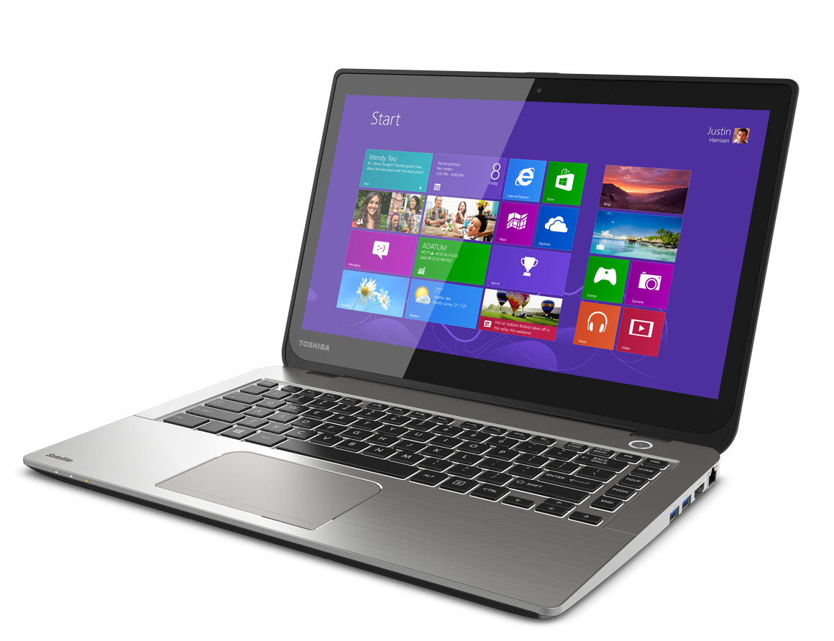
Laptops
Portable devices
Like desktop computers, but smaller components
Built-in keyboard and monitor
Need a power adapter
Docking stations
Cable locks
Notes:
Laptops, also known as notebooks, are portable computing devices that offer convenience and mobility. They were first introduced in the early 1980s and have since become an integral part of modern computing. Here's a more detailed exploration of laptops:
**Portability and Convenience:**
- Laptops were designed to provide a portable alternative to desktop computers, allowing users to carry their work, entertainment, and communication tools with them wherever they go.
- Their compact size and integrated components make laptops a versatile option for various tasks.
**Compact Design:**
- Laptops feature all the essential components of a desktop computer, including a central processing unit (CPU), memory (RAM), storage, graphics processing unit (GPU), and more.
- Despite their smaller form factor, laptops are equipped to handle a wide range of applications, from web browsing to complex tasks like video editing and software development.
**Built-In Keyboard and Monitor:**
- Laptops come with a built-in keyboard and monitor, allowing users to interact with the device without the need for external peripherals.
**Power Adapter:**
- Laptops require power to operate, and they come with a power adapter for charging the built-in battery. This battery allows the laptop to function without being connected to a power source for a certain amount of time, providing portability.
**Docking Stations:**
- Some laptops support docking stations, which allow users to easily connect their laptops to a larger monitor, keyboard, mouse, and other peripherals when they're working at a desk. Docking stations provide a desktop-like experience when needed.
**Cable Locks:**
- Cable locks are security devices that can be attached to laptops to deter theft. They typically consist of a cable that can be looped around a secure object, and a locking mechanism that prevents the laptop from being easily removed.
**Use Cases:**
- Laptops are widely used by students, professionals, and individuals who need to work or access information while on the move.
- They're suitable for tasks like word processing, web browsing, email, multimedia consumption, video conferencing, and more.
**Limitations:**
- Due to their compact size, laptops may have slightly reduced performance compared to their desktop counterparts with similar specifications.
- Upgrading certain components like the graphics card or CPU can be challenging or impossible in some laptops.
In summary, laptops have a history dating back to the early 1980s, when they were first introduced as a portable computing solution. They offer a portable and convenient way to perform various tasks while maintaining the capabilities of a desktop computer. Laptops have become an essential tool for individuals who need computing power while on the go or in environments where a traditional desktop setup is not feasible.

Slide 6
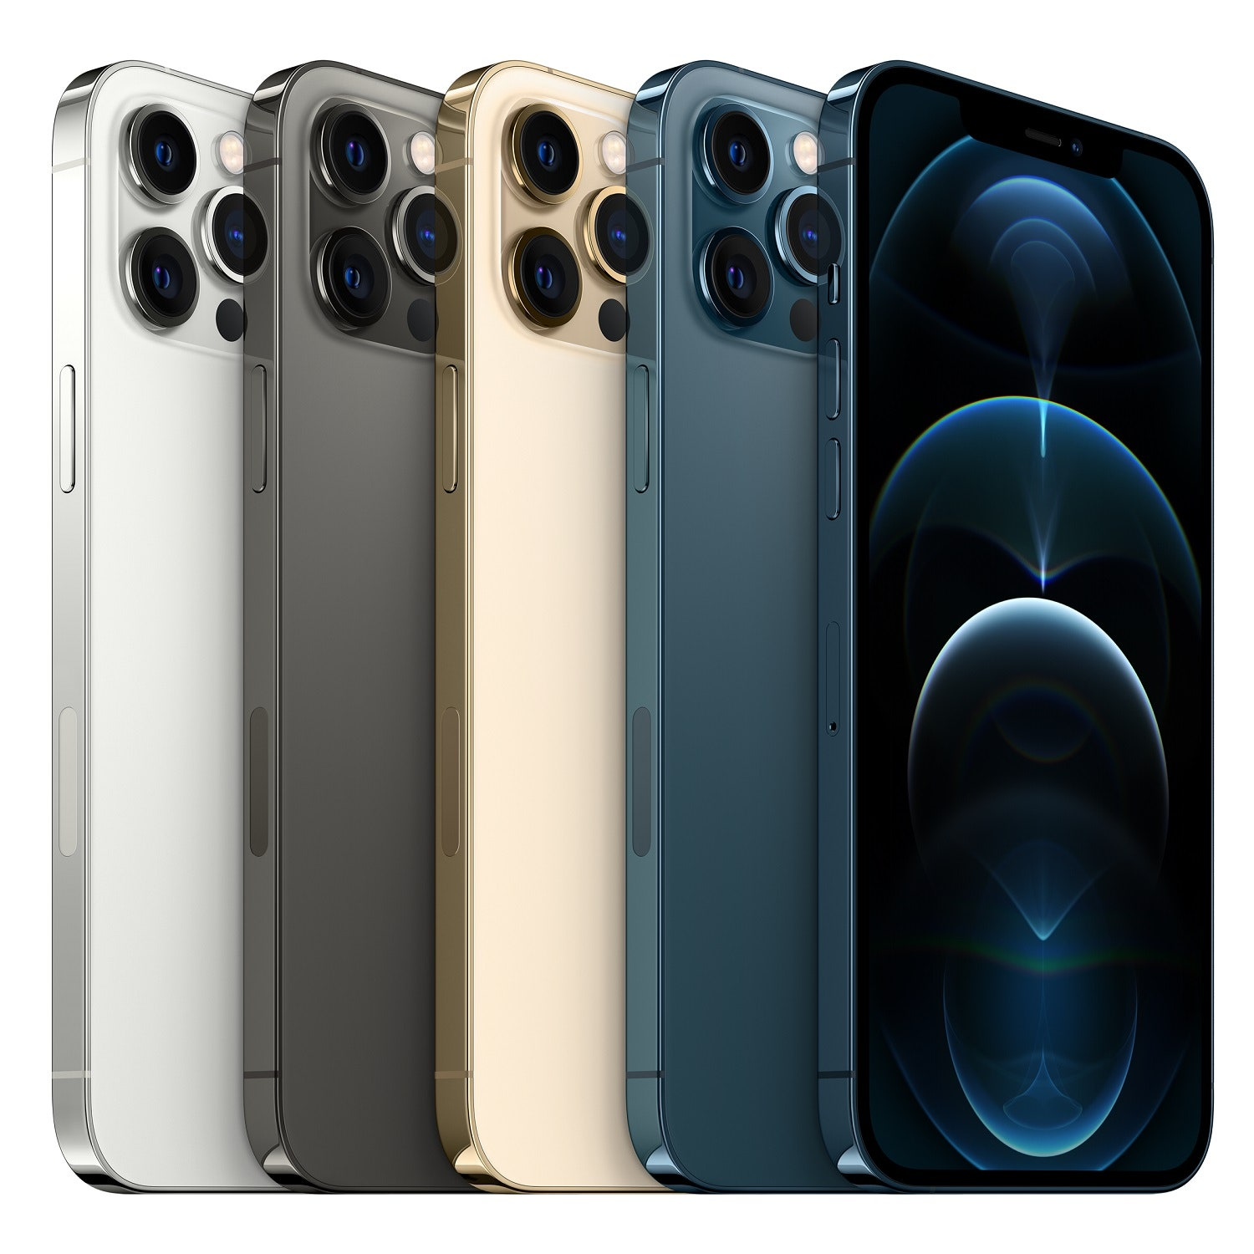
Tablets and Smartphones
Smaller than laptops, very portable
No built-in hardware keyboard
Typically run a mobile OS, such as Android or iOS
Notes:
Tablets and smartphones represent a new era of mobile computing, offering compact size, portability, and powerful functionality. Here's a more detailed exploration of tablets and smartphones:
**Tablets:**
- Tablets are portable devices that fall between smartphones and laptops in terms of size and functionality.
- They are larger than smartphones, making them suitable for tasks like browsing, media consumption, and light productivity.
- Tablets lack a built-in hardware keyboard, relying primarily on touchscreens for input.
- Their form factor is well-suited for tasks that demand more screen real estate than smartphones can provide.
- Tablets typically run mobile operating systems like Android or iOS, offering app ecosystems optimized for touch interactions.
- The first modern tablet, the "Tablet PC," was introduced in the early 2000s. However, tablets gained significant popularity with the launch of the Apple iPad in 2010.
**Smartphones:**
- Smartphones are pocket-sized devices that are primarily used for communication, productivity, entertainment, and accessing the internet.
- They have a smaller form factor compared to tablets and laptops, making them highly portable and convenient to carry.
- Smartphones lack a built-in hardware keyboard as well, relying on touchscreen keyboards for text input.
- They are powered by mobile operating systems like Android or iOS, providing access to a wide range of apps.
- Smartphones have become essential tools in modern life, offering features beyond traditional calling and texting.
- The first commercially available smartphone was the IBM Simon Personal Communicator, released in 1994. However, smartphones experienced explosive growth in the late 2000s with the introduction of devices like the iPhone and various Android smartphones.
**Use Cases:**
- Tablets are often used for tasks like reading eBooks, watching videos, light gaming, web browsing, and taking notes.
- Smartphones serve as versatile communication devices, providing features like calling, texting, email, social media, and accessing a multitude of apps.
**Evolution and Impact:**
- Tablets and smartphones have revolutionized the way people interact with technology and consume content.
- Their touch-based interfaces and app ecosystems have driven significant changes in user behavior and expectations.
- The introduction of tablets and smartphones has led to a boom in mobile app development and a shift towards mobile-first design in various industries.
In summary, tablets and smartphones have significantly altered the way people interact with technology, offering portability, convenience, and a wide array of functionalities. Tablets gained prominence in the early 2010s, while smartphones have evolved over several decades to become integral parts of modern life.

Slide 7
Interacting with Mobile Devices
Gesture-based interactions
Tap
Swipe
Pinch
Kinetics
Notes:
Interacting with mobile devices has evolved significantly with the introduction of gesture-based interactions, which enable users to control and navigate their devices in intuitive ways. Here's a more detailed exploration of these interactions:
**Gesture-Based Interactions:**
- Gesture-based interactions involve using physical movements or actions to control and interact with mobile devices, typically via touchscreens.
- These interactions offer a natural and intuitive way for users to communicate with their devices and perform various tasks.
**Tap:**
- Tapping is a fundamental gesture where users touch the screen briefly with a finger to trigger an action, select an item, open an app, or activate a link.
- It is one of the most common and basic gestures used for navigation and selection on mobile devices.
**Swipe:**
- Swiping involves dragging a finger across the screen in a specific direction, typically used for scrolling through content, navigating between pages, or dismissing notifications.
- Swipes can be used vertically, horizontally, or diagonally to achieve different functions.
**Pinch:**
- The pinch gesture involves placing two fingers on the screen and bringing them closer together or spreading them apart.
- Pinching is often used to zoom in or out on images, maps, and content, allowing users to control the level of detail.
**Kinetics:**
- Kinetics, also known as flicking or flinging, is a gesture where users quickly swipe a screen and then release their finger to initiate a motion that continues based on the initial speed and direction.
- This gesture is commonly used to scroll quickly through long lists or web pages.
**Additional Gestures:**
- Gestures have evolved to include more complex interactions, such as double-tap, long-press, and multi-finger gestures, offering users a variety of ways to interact with their devices.
**Impact and Evolution:**
- Gesture-based interactions have transformed the user experience on mobile devices, making them more intuitive and accessible to a wide range of users.
- These interactions have influenced user interface design, encouraging the development of touch-friendly interfaces that prioritize user convenience and fluidity.
**User Learning Curve:**
- While gestures enhance usability, there might be a learning curve as users adapt to new interaction methods.
- Consistency and visual cues in interface design can help users quickly grasp and become comfortable with different gestures.
In summary, gesture-based interactions, including tapping, swiping, pinching, and kinetics, have become integral to how users interact with mobile devices. These interactions offer a more natural and intuitive way to control devices, transforming the way people navigate through content, applications, and interfaces.

Slide 8
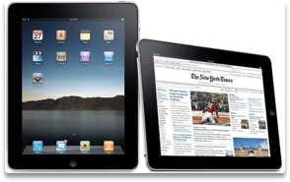
Screen Orientation
Portrait vs. Landscape
Apps need to be programmed to rotate
Notes:
Screen orientation, whether in portrait or landscape mode, plays a significant role in how users interact with mobile devices and apps. Let's delve into the details of these orientations:
**Portrait Orientation:**
- In portrait mode, the device's screen is taller than it is wide, resembling the orientation of a portrait painting or photograph.
- Portrait mode is commonly used for activities like reading, scrolling through content, and making phone calls.
- It is well-suited for apps that primarily involve vertical scrolling, such as messaging apps and social media feeds.
- Portrait mode provides a more natural and ergonomic way to hold the device when using it with one hand.
**Landscape Orientation:**
- In landscape mode, the device's screen is wider than it is tall, resembling the orientation of a landscape painting or photograph.
- Landscape mode is often used for activities that benefit from a wider view, such as watching videos, playing games, and working with documents.
- It is suitable for apps that require horizontal interaction, like games that involve tilting the device or viewing wide tables or charts.
- Landscape mode provides a broader canvas for content and interactions that span horizontally.
**Dynamic Screen Rotation:**
- Many modern mobile devices are equipped with sensors that can detect changes in orientation, enabling automatic screen rotation.
- Apps need to be programmed to support screen rotation, allowing them to adapt their layout and content based on the orientation of the device.
- The ability to dynamically switch between portrait and landscape modes enhances user experience and flexibility.
**App Programming and User Experience:**
- Developers must carefully design app interfaces to ensure that content and controls remain usable and visually appealing in both portrait and landscape modes.
- Properly programmed screen rotation prevents users from having to manually adjust orientation, enhancing convenience.
**Impact on App Design:**
- App designers must consider how content and interactions will behave in both portrait and landscape orientations.
- Certain elements, such as navigation bars and buttons, might need to be repositioned or adapted to suit different orientations.
**User Preference and Context:**
- Users often have individual preferences for orientation based on the type of task they're performing.
- Context also plays a role; for instance, users might prefer portrait mode for reading and browsing, but switch to landscape mode for gaming.
In summary, screen orientation, whether in portrait or landscape mode, influences how users engage with mobile devices and apps. The ability of apps to dynamically adapt to different orientations enhances usability and user experience, allowing for seamless interactions in various scenarios.

Slide 9
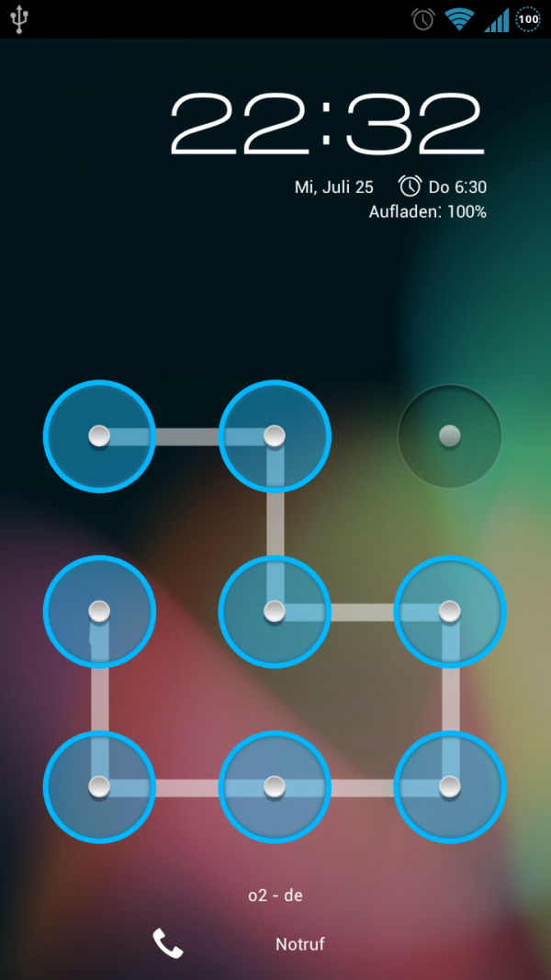
Mobile Locking and Security
Mobile OS security lock
Need a passcode to enter
Newer phones use biometrics
Notes:
Mobile locking and security measures are crucial to protecting the sensitive data and personal information stored on mobile devices. Let's explore the details of these security methods:
**Mobile OS Security Lock:**
- A mobile OS security lock serves as the first line of defense against unauthorized access to the device.
- Users set up a security lock, which requires them to provide a valid authentication method before gaining access to the device's contents.
**Passcode:**
- One of the most common security lock methods is a passcode. Users define a numeric or alphanumeric code that must be entered to unlock the device.
- Passcodes are effective for preventing unauthorized access and maintaining privacy.
**Biometrics:**
- Newer phones are increasingly incorporating biometric security methods to enhance user convenience and security.
- Biometric authentication uses unique physical characteristics or traits to verify a user's identity.
**Fingerprint Recognition:**
- Fingerprint recognition involves using the user's fingerprint to unlock the device.
- Fingerprint data is securely stored on the device and is not easily accessible.
**Facial Recognition:**
- Facial recognition uses the device's front-facing camera to scan and analyze the user's face.
- The user's facial features are matched against stored facial data for authentication.
**Iris Scanning:**
- Some devices use iris scanning to authenticate users based on the unique patterns in their irises.
- Iris scans offer a high level of security due to their complexity.
**Additional Security Measures:**
- Some devices support more advanced security measures, such as voice recognition or palm vein authentication, although these methods are less common.
**Two-Factor Authentication (2FA):**
- Mobile OS security can be enhanced by enabling two-factor authentication.
- In addition to the primary security lock, 2FA requires users to provide an additional authentication method, such as a code sent to their email or phone.
**Remote Lock and Wipe:**
- In case of theft or loss, users can remotely lock or wipe their devices to prevent unauthorized access to their personal data.
**Importance of Mobile Security:**
- Mobile devices store a wealth of personal information, making them attractive targets for hackers and cybercriminals.
- Robust security measures help prevent unauthorized access, data breaches, and identity theft.
**User Convenience vs. Security:**
- The balance between user convenience and security is important. Biometrics offer a quicker and more seamless authentication process compared to passcodes.
- However, biometric data can be more difficult to change if compromised.
In summary, mobile locking and security measures, such as passcodes and biometrics, are critical for safeguarding the data and information stored on mobile devices. These measures enhance user privacy and protect against unauthorized access, ensuring a safer and more secure digital experience.

Slide 10
Setting up a Wireless Connection
Usually in OS settings
Wi-Fi
Bluetooth
Notes:
Setting up a wireless connection, whether it's Wi-Fi or Bluetooth, is a fundamental step to access networks and connect devices without physical cables. Here's a more detailed exploration of setting up these wireless connections:
**Wi-Fi Connection:**
- Wi-Fi is a wireless networking technology that allows devices to connect to the internet and local networks.
- Setting up a Wi-Fi connection typically involves the following steps:
**1. Access OS Settings:** Open the operating system's settings menu on your device.
**2. Wi-Fi Settings:** Locate and select the "Wi-Fi" or "Wireless" section within the settings menu.
**3. Enable Wi-Fi:** Turn on the Wi-Fi feature if it's not already enabled. Your device will start scanning for available Wi-Fi networks.
**4. Select Network:** From the list of available networks, choose the network you want to connect to.
**5. Enter Password:** If the network is secured with a password, enter the correct password to establish the connection.
**6. Connect:** Once the password is entered, your device will attempt to connect to the chosen Wi-Fi network. Upon successful connection, you'll see the Wi-Fi symbol in the status bar.
**Bluetooth Connection:**
- Bluetooth is a wireless technology that enables devices to communicate and share data over short distances.
- Setting up a Bluetooth connection typically involves the following steps:
**1. Access OS Settings:** Open the operating system's settings menu on your device.
**2. Bluetooth Settings:** Locate and select the "Bluetooth" section within the settings menu.
**3. Enable Bluetooth:** Turn on the Bluetooth feature if it's not already enabled. Your device will start searching for nearby Bluetooth devices.
**4. Pairing:** If you want to connect to a specific Bluetooth device, such as headphones or a speaker, put the device into pairing mode. This usually involves holding down a button or following specific instructions provided by the device's manual.
**5. Select Device:** In your device's Bluetooth settings, you'll see a list of available devices. Select the device you want to connect to.
**6. Confirm Pairing:** Your device will prompt you to confirm the pairing code displayed on both devices. Confirm the code to establish the Bluetooth connection.
**7. Connected:** Once paired, the devices will be connected, and you'll be able to use them together for tasks like audio streaming or file sharing.
**User Experience and Troubleshooting:**
- Wireless connection setup is usually user-friendly, but users may encounter issues like incorrect passwords, weak signal, or incompatible devices.
- Properly following the setup steps and referring to device manuals can help troubleshoot any connection problems.
In summary, setting up wireless connections, such as Wi-Fi and Bluetooth, is essential for accessing networks and connecting devices. Accessing the relevant settings in the operating system and following the setup steps enable users to enjoy the benefits of wireless connectivity.

Slide 11
Airplane Mode
Option in OS settings
Turns off all external connections
Cellular
WiFi
Bluetooth
Notes:
Airplane mode is a useful feature found in mobile devices that allows users to quickly disable all external wireless connections. This is particularly important when flying or in situations where electromagnetic interference could pose a risk. Here's a more detailed exploration of airplane mode:
**Activating Airplane Mode:**
- Airplane mode is usually accessed through the device's operating system settings.
**1. Access OS Settings:** Open the device's settings menu.
**2. Airplane Mode:** Locate and select the "Airplane Mode" option.
**3. Toggle On:** Turn on airplane mode. This action will disable all external wireless connections on the device.
**Benefits of Airplane Mode:**
- **Flight Safety:** Airplane mode is mandated by airlines during flights to prevent potential interference with aircraft systems.
- **Reduced Radiation:** Disabling wireless connections reduces the device's electromagnetic radiation emissions, which can be useful in situations where you want to minimize exposure.
**Connections Disabled in Airplane Mode:**
- When airplane mode is activated, the following wireless connections are typically disabled:
**1. Cellular:** Airplane mode turns off the cellular network connection, preventing calls, texts, and data usage.
**2. Wi-Fi:** Wi-Fi connections are disabled, preventing the device from connecting to Wi-Fi networks.
**3. Bluetooth:** Bluetooth is turned off, preventing device pairing and data transfer via Bluetooth.
**Usage Scenarios:**
- Airplane mode is used not only during flights but also in various situations where you need to disable wireless connections:
**1. Flight Travel:** Airplane mode ensures compliance with regulations and guidelines for using electronic devices on airplanes.
**2. Meetings and Theaters:** Enabling airplane mode prevents disruptions and ensures your device remains silent.
**3. Battery Conservation:** Using airplane mode conserves battery life by disabling energy-consuming wireless connections.
**Emergency Calls and Wi-Fi:**
- Airplane mode does not completely disable the device's capabilities; it simply disconnects it from external networks. You can usually enable Wi-Fi and connect to available Wi-Fi networks even while in airplane mode. However, cellular communication remains disabled.
**Customizable Settings:**
- Some devices allow users to customize which connections are disabled in airplane mode. For example, you might choose to enable Wi-Fi or Bluetooth while keeping cellular networks off.
In summary, airplane mode is a valuable feature that ensures compliance with flight regulations, reduces electromagnetic interference, and conserves battery life. It provides users with a convenient way to disable all wireless connections while keeping the device functional for other tasks, such as reading or watching pre-downloaded content.

Slide 12
Getting Additional Apps
Apps are built for the specific OS
Apple iTunes
Google Play
Notes:
Apps are designed and developed specifically for different operating systems (OS) to ensure compatibility and optimal performance on various devices. Let's explore this topic in more detail:
**Platform-Specific Apps:**
- Apps are tailored to work seamlessly on specific operating systems, such as iOS for Apple devices and Android for devices using the Android OS.
- These platform-specific apps are built using programming languages and frameworks that are optimized for the respective OS.
**Apple iTunes:**
- Apple's ecosystem, including iPhones, iPads, and iPods, primarily uses the iOS operating system.
- Apps for iOS devices can be downloaded from the Apple App Store, which is accessible through the iTunes software on desktop or the App Store app on mobile devices.
**Google Play:**
- Android devices, such as smartphones and tablets, run on the Android operating system.
- The Google Play Store serves as the primary marketplace for Android apps, offering a wide range of applications for users to download and install.
**App Development Process:**
- App development involves creating code, graphical elements, and user interfaces that are optimized for a specific OS.
- Developers use software development kits (SDKs) provided by Apple or Google to create apps that follow the design guidelines and APIs of the respective OS.
**Design and User Interface:**
- Each OS has its own design principles and user interface guidelines.
- Developers tailor the app's appearance and user experience to match the specific platform's design standards, ensuring a consistent and familiar feel for users.
**Programming Languages:**
- iOS apps are commonly developed using programming languages like Swift or Objective-C.
- Android apps are often developed using Java or Kotlin.
**Distribution and Approval:**
- Before being available to users, apps must go through an approval process by the platform's respective app store.
- The stores ensure that apps meet quality standards, security requirements, and do not violate any policies.
**Cross-Platform Development:**
- Some developers choose to create cross-platform apps that can run on multiple operating systems using frameworks like React Native or Flutter.
- While cross-platform development offers versatility, it might not fully leverage the unique features of each OS.
**User Choice and Experience:**
- Users have the option to choose from a wide range of apps available on their preferred app store.
- The availability of platform-specific apps ensures that users can enjoy apps that are optimized for their devices and operating systems.
In summary, apps are built to cater to the specific features and design principles of different operating systems. Apple iTunes and Google Play are the respective marketplaces for iOS and Android apps, offering users access to a diverse array of applications tailored to their devices and preferred OS.

Slide 13
Synchronization Options
Allows you to access files from your device or online
Acts as a backup
Can synchronize to a local computer or to the cloud
Notes:
Synchronization options provide users with the ability to access their files and data seamlessly across devices and platforms. These options offer convenience, data backup, and flexibility for users. Here's a detailed exploration of synchronization options:
**Accessing Files Across Devices:**
- Synchronization allows users to access their files and data from multiple devices, such as smartphones, tablets, laptops, and desktop computers.
- Changes made to files on one device are reflected on all synchronized devices.
**Backup Functionality:**
- Synchronization serves as a backup mechanism, ensuring that important data is stored on multiple devices or in the cloud.
- If a device is lost, damaged, or replaced, the synchronized data can be retrieved from other devices or cloud storage.
**Local Synchronization:**
- Local synchronization involves connecting a device directly to a computer using cables, Wi-Fi, or Bluetooth.
- Users can synchronize files and data between their device and the connected computer, enabling data transfer and backup.
**Cloud Synchronization:**
- Cloud synchronization involves storing data in remote servers hosted by cloud service providers.
- Data is accessible from any device with internet access, and changes are automatically synchronized across devices.
**Benefits of Cloud Synchronization:**
- **Accessibility:** Cloud-synced data can be accessed from anywhere with an internet connection, eliminating the need to carry physical storage devices.
- **Data Security:** Cloud providers often implement security measures like encryption to protect synchronized data.
- **Automatic Backup:** Changes made to files are instantly backed up in the cloud, reducing the risk of data loss.
**Use Cases:**
- **File Synchronization:** Users can synchronize documents, photos, videos, and other files between devices, ensuring that the latest versions are available everywhere.
- **Email and Calendar Synchronization:** Email clients and calendar apps can synchronize messages, appointments, and events across devices.
- **Browser Synchronization:** Browsers can synchronize bookmarks, history, and settings, allowing a consistent browsing experience on different devices.
- **Note and Task Synchronization:** Note-taking and task management apps can synchronize notes, to-do lists, and reminders.
**Popular Synchronization Services:**
- **Google Drive:** Offers file storage, synchronization, and collaboration features.
- **Apple iCloud:** Provides cloud storage and synchronization for Apple devices and apps.
- **Microsoft OneDrive:** Allows file synchronization, collaboration, and integration with Microsoft Office.
**Considerations:**
- Users should be aware of the storage limitations of their chosen synchronization service.
- Privacy concerns should be addressed when synchronizing sensitive or personal data to the cloud.
In summary, synchronization options enable users to access their files and data from various devices, act as backup mechanisms, and offer flexibility in how data is stored and retrieved. Whether through local synchronization or cloud-based services, synchronization plays a crucial role in enhancing productivity and data accessibility across different devices and platforms.

Slide 14
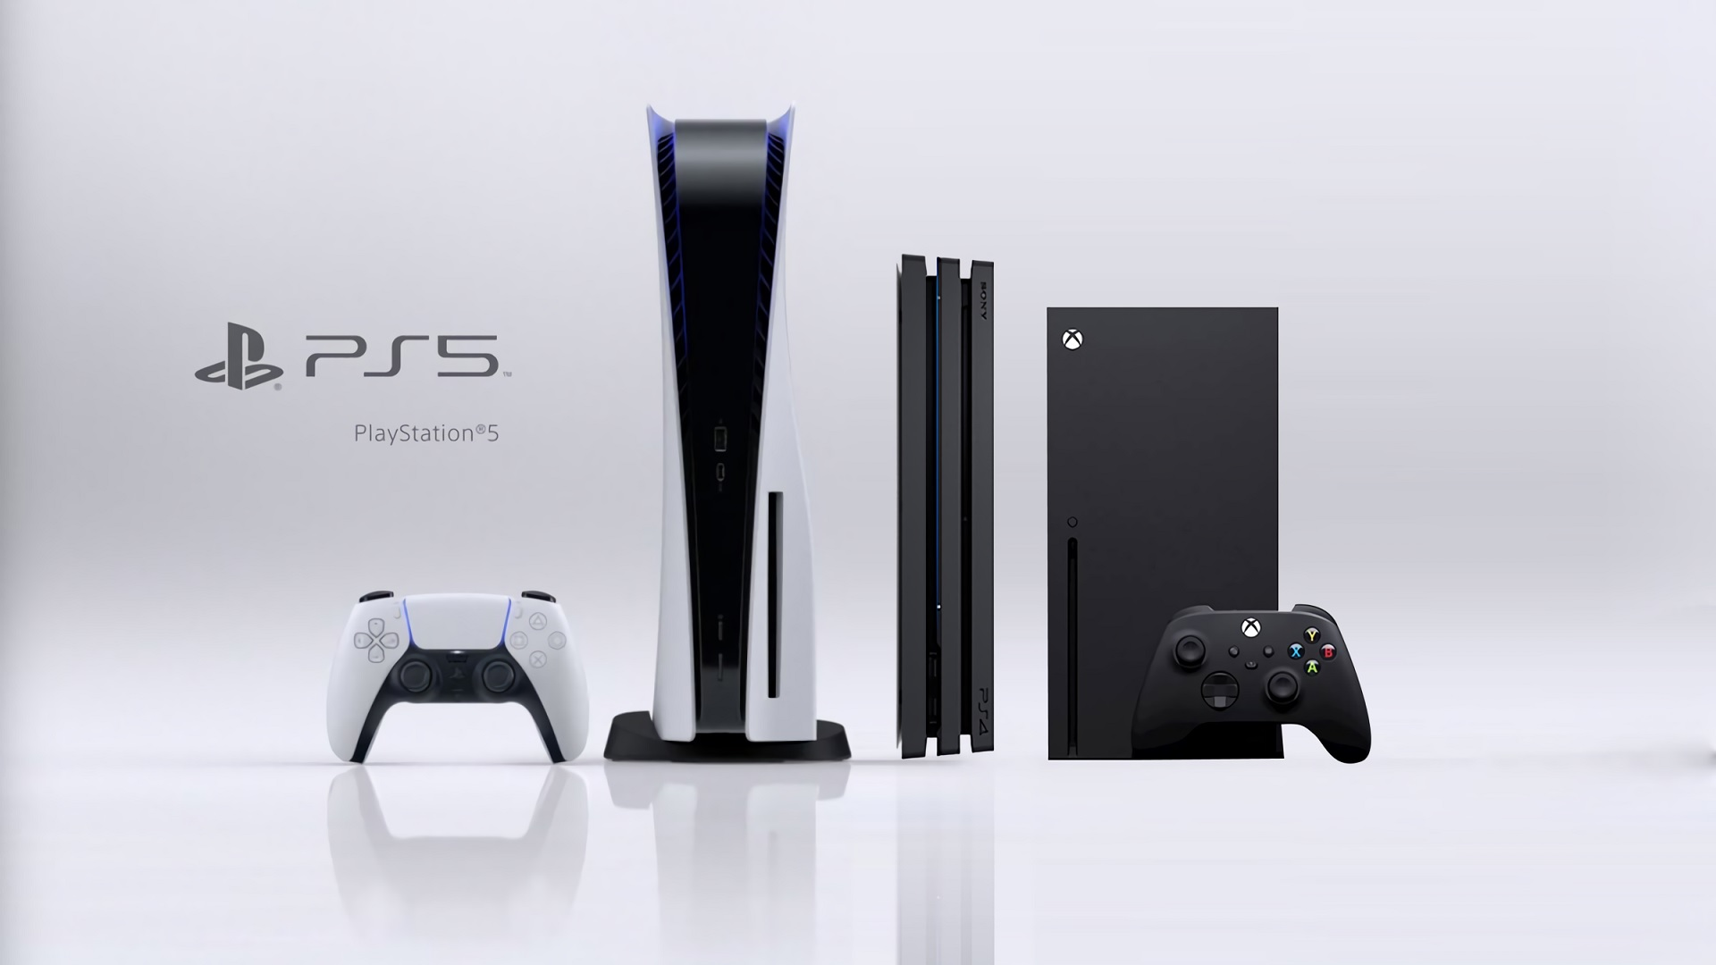
Gaming Consoles
Specialized for playing games, watching digital media, or connecting to the Internet
Often connects to an external display such as a TV
Usually not very upgradable
Notes:
Gaming consoles are dedicated devices designed primarily for playing video games, as well as for streaming digital media and accessing the internet. Let's dive deeper into the characteristics and features of gaming consoles:
**Gaming and Entertainment:**
- Gaming consoles are optimized for interactive gaming experiences, offering a wide range of video games catering to various genres and player preferences.
- Beyond gaming, modern gaming consoles often support streaming services for movies, TV shows, music, and online content consumption.
**Connection to External Displays:**
- Gaming consoles are typically connected to external displays, such as televisions or monitors, to provide a larger and more immersive gaming experience.
- High-definition graphics and audio enhance the visual and auditory aspects of gaming.
**Limited Upgradability:**
- Unlike gaming PCs, gaming consoles are generally not designed for extensive hardware upgrades.
- Users cannot replace key components like the CPU or GPU, which limits the potential for enhancing performance over time.
**Fixed Hardware Configuration:**
- Each generation of gaming consoles comes with a fixed hardware configuration, offering a consistent and standardized gaming experience for all users.
- This also ensures developers can optimize games to run smoothly on a specific console's hardware.
**Online Connectivity:**
- Gaming consoles provide online connectivity through Wi-Fi or Ethernet connections.
- Online multiplayer gaming, digital game purchases, software updates, and content downloads are facilitated through online services.
**Exclusive Games:**
- Gaming consoles often have exclusive titles developed by first-party studios or partnerships, which can incentivize players to choose a specific console.
- These exclusive games contribute to each console's unique identity and library of titles.
**User Interface and Experience:**
- Gaming consoles offer user-friendly interfaces tailored for gaming and media consumption.
- The interface allows users to navigate games, apps, settings, and online services.
**Social Gaming and Interaction:**
- Many gaming consoles integrate social features, such as friend lists, voice chat, and online communities.
- Players can connect with friends, join multiplayer matches, and share achievements.
**Controller Design:**
- Gaming consoles come with specialized controllers optimized for gaming.
- Controllers often include buttons, triggers, thumbsticks, and motion-sensing capabilities.
**Gaming Console Brands:**
- Notable gaming console brands include Sony PlayStation, Microsoft Xbox, and Nintendo Switch.
- Each brand offers its own unique lineup of consoles and exclusive games.
**Gaming Ecosystem:**
- Gaming consoles are part of larger gaming ecosystems that include online stores, subscription services, and additional peripherals like virtual reality headsets.
**Longevity and Generational Updates:**
- Gaming consoles typically have a lifespan of several years before being succeeded by a new generation with updated hardware and features.
In summary, gaming consoles provide a specialized platform for gaming, entertainment, and online connectivity. They offer a standardized and consistent gaming experience, though their limited upgradability contrasts with gaming PCs. Gaming consoles play a significant role in the gaming industry, catering to a diverse audience of players and contributing to the evolution of video game culture.

Slide 15
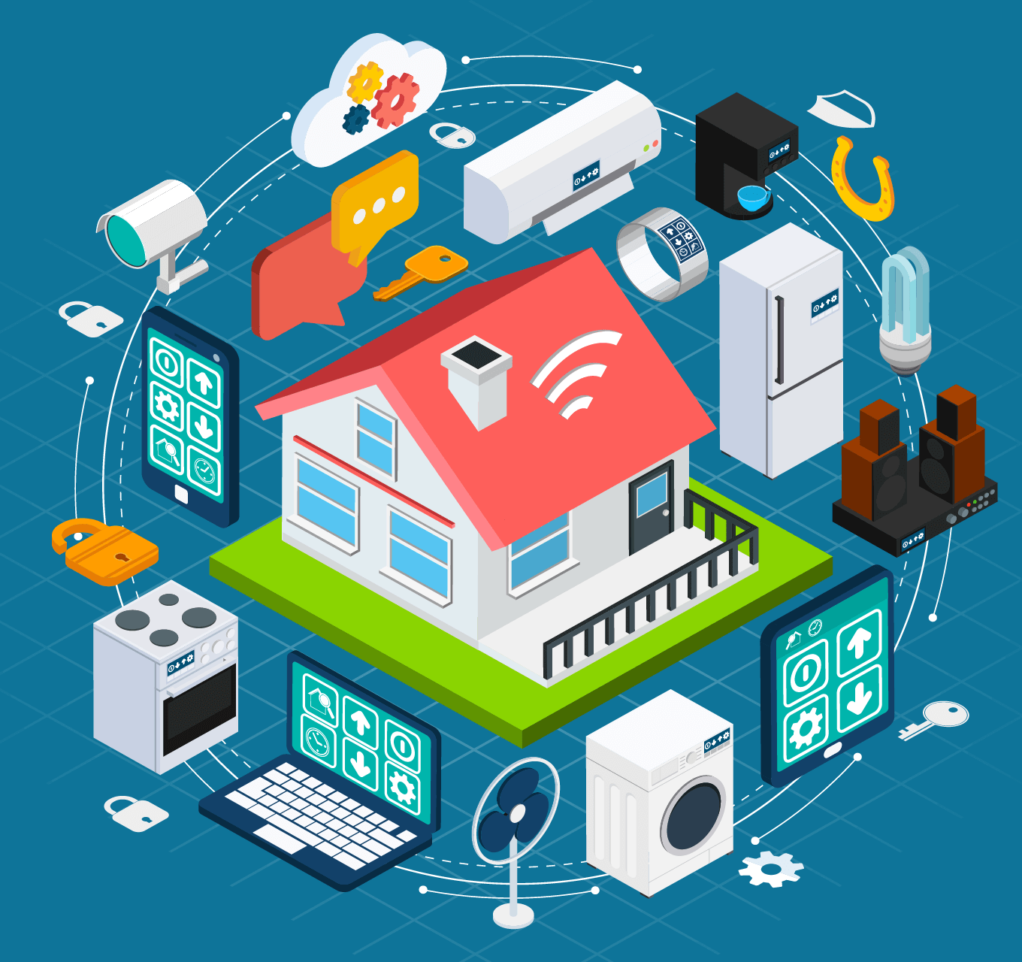
The Internet of Things (IoT)
Allows practically any device to be connected to the Internet
Uses include:
Home entertainment systems
Heating and cooling (thermostats)
Home appliances
Security systems and IP cameras
Modern cars
Medical devices
Manufacturing
Transportation
Infrastructure
Notes:
The Internet of Things (IoT) is a revolutionary concept that enables a wide range of devices to be connected to the internet, allowing them to communicate, share data, and perform tasks in a smarter and more interconnected way. Let's delve deeper into the Internet of Things and its diverse applications:
**IoT Connectivity:**
- IoT extends internet connectivity beyond traditional devices like computers and smartphones to a vast array of everyday objects and systems.
- These objects, often referred to as "smart devices," are embedded with sensors, software, and connectivity capabilities that allow them to interact with each other and with users.
**Applications of IoT:**
- The applications of IoT are vast and span various industries. Some prominent examples include:
**1. Home Entertainment Systems:**
- IoT enables seamless integration between devices like smart TVs, streaming devices, and audio systems, enhancing the user's entertainment experience.
**2. Smart Home Devices:**
- IoT-powered thermostats, lighting systems, and home appliances allow users to remotely control and automate their home environment.
**3. Security Systems and IP Cameras:**
- IoT-enabled security systems and cameras allow users to monitor and manage their properties remotely through smartphone apps.
**4. Modern Cars:**
- IoT is transforming the automotive industry with connected cars that offer navigation, entertainment, real-time diagnostics, and vehicle-to-vehicle communication.
**5. Medical Devices:**
- IoT facilitates remote monitoring and data collection from medical devices, providing healthcare professionals with valuable patient information.
**6. Manufacturing and Industrial Automation:**
- IoT optimizes manufacturing processes by connecting machines, sensors, and production lines to enhance efficiency, monitor equipment health, and track inventory.
**7. Transportation:**
- IoT is used in transportation systems for vehicle tracking, traffic management, fleet optimization, and public transportation services.
**8. Infrastructure:**
- IoT plays a role in smart city initiatives by integrating technology into urban infrastructure for improved energy management, waste disposal, and public services.
**Benefits of IoT:**
- **Efficiency:** IoT devices can automate tasks, reducing manual intervention and improving efficiency.
- **Data Insights:** IoT generates vast amounts of data that can be analyzed to gain insights and make informed decisions.
- **Convenience:** IoT-enabled devices offer convenience through remote control and automation.
- **Safety:** In areas like healthcare and security, IoT enhances safety by providing real-time monitoring and alerts.
**Challenges and Considerations:**
- **Security and Privacy:** IoT devices can be vulnerable to cyberattacks, raising concerns about data security and privacy.
- **Data Management:** Managing and analyzing the large volume of data generated by IoT devices can be challenging.
- **Interoperability:** Ensuring seamless communication between different IoT devices from various manufacturers is an ongoing challenge.
**Future Trends:**
- The IoT ecosystem is continuously evolving, with advancements in AI, 5G connectivity, edge computing, and blockchain expected to shape its future.
In summary, the Internet of Things represents a transformative shift in how devices interact and communicate. From homes to industries and beyond, IoT applications offer enhanced convenience, efficiency, and connectivity across a diverse range of sectors, setting the stage for a more connected and intelligent world.

Slide 16
Potential IoT Issues
Standards and governance
Data security and privacy
Data storage and usage
Notes:
The Internet of Things (IoT) presents a range of potential issues and challenges that need to be addressed for its widespread adoption and successful implementation. Here's a closer look at some of these key issues:
**1. Standards and Governance:**
- Lack of standardized protocols and communication frameworks can lead to compatibility issues and hinder interoperability among different IoT devices and platforms.
- Establishing common standards and governance models is crucial to ensure seamless communication and collaboration between diverse IoT devices.
**2. Data Security and Privacy:**
- IoT devices collect and transmit vast amounts of sensitive data, raising concerns about data security and privacy.
- Inadequate security measures can make IoT devices susceptible to hacking, data breaches, and unauthorized access.
- Ensuring strong encryption, authentication mechanisms, and regular security updates is essential to protect IoT devices and the data they handle.
**3. Data Storage and Usage:**
- The immense volume of data generated by IoT devices presents challenges in terms of storage, processing, and analysis.
- Deciding what data to store, how to store it, and how to efficiently process and extract valuable insights from the data are critical considerations.
- Striking a balance between real-time processing at the device level and sending data to the cloud for analysis is a key challenge.
**4. Connectivity Reliability:**
- IoT devices rely on connectivity to transmit and receive data. Dropped connections or unreliable networks can disrupt the functioning of IoT systems.
- Ensuring consistent connectivity, especially in remote or challenging environments, is essential for the reliable operation of IoT devices.
**5. Power Consumption and Battery Life:**
- Many IoT devices operate on batteries, making power consumption a critical factor.
- Efficient power management and optimization are needed to extend battery life and reduce the frequency of battery replacements.
**6. Scalability and Maintenance:**
- As IoT ecosystems expand, managing and maintaining a large number of devices becomes complex.
- Scalability challenges can arise in terms of device management, firmware updates, and overall system maintenance.
**7. Ethical and Regulatory Considerations:**
- The collection and usage of personal data by IoT devices raise ethical concerns about consent, data ownership, and transparency.
- Striking a balance between innovation and adhering to privacy regulations becomes essential to build trust among users.
**8. Complexity and User Experience:**
- IoT systems often involve multiple devices, platforms, and interfaces, leading to potential complexity for users.
- Ensuring a seamless user experience and intuitive interfaces are critical to encourage user adoption and engagement.
**9. Vendor Lock-In:**
- Depending heavily on a single vendor's ecosystem can lead to vendor lock-in, limiting flexibility and hindering interoperability with other devices and platforms.
**10. Environmental Impact:**
- The proliferation of IoT devices can contribute to electronic waste if proper recycling and disposal practices are not followed.
Addressing these challenges requires collaboration among manufacturers, policymakers, researchers, and other stakeholders. It involves implementing robust security measures, developing interoperable standards, fostering privacy-conscious practices, and building a foundation for a sustainable and responsible IoT ecosystem.

