Slide 1
IT Fundamentals
Chapter 2:
Peripherals and Connectors

Slide 2
Chapter 2: Peripherals and Connectors
Given a scenario, set up and install common peripherals devices to a laptop/PC
Devices
Printer
Scanner
Keyboard
Mouse
Camera
External hard drive
Speakers
Display
Installation types
Plug-and-play vs. driver installation
Other required steps
IP-based peripherals
Web-based configuration steps

Slide 3
Chapter 2: Peripherals and Connectors
Throughput is a measure of the amount of data that can be transmitted through a communication channel per unit of time. Here are some common units of measure used to express throughput:

Slide 4
Chapter 2: Peripherals and Connectors
Bps (Bits per second)
Kbps (Kilobits per second)
Mbps (Megabits per second)
Gbps (Gigabits per second) backbone networks.
Tbps (Terabits per second)
Notes:
Peripherals and connectors play a vital role in expanding the capabilities of computer systems and facilitating communication between devices. Throughput, on the other hand, is a crucial metric that measures the amount of data that can be transmitted through a communication channel within a specific time frame. The following units of measure are commonly used to express throughput:
1. **Bits per Second (bps):** This is the fundamental unit for measuring throughput. It represents the number of individual bits transmitted or received per second. It's often used to describe data transfer rates for network connections and communication links.
2. **Kilobits per Second (Kbps):** One kilobit is equal to 1,000 bits. Kbps represents a higher level of throughput, typically used to describe internet connection speeds, data transfer rates, and communication speeds.
3. **Megabits per Second (Mbps):** One megabit is equal to 1,000 kilobits or 1,000,000 bits. Mbps is commonly used to describe higher-speed network connections, such as broadband internet, LANs, and digital video streams.
4. **Gigabits per Second (Gbps):** One gigabit is equal to 1,000 megabits or 1,000,000 kilobits. Gbps represents extremely high-speed data transmission rates, often associated with advanced network technologies, data centers, and high-performance computing environments.
5. **Bytes per Second (Bps):** This unit represents the number of bytes transmitted or received per second. It's often used to describe data storage transfer rates and communication speeds for devices like hard drives and solid-state drives.
6. **Kilobytes per Second (KBps):** One kilobyte is equal to 1,024 bytes. KBps is used to measure data transfer rates involving larger data volumes, such as file downloads and data backups.
7. **Megabytes per Second (MBps):** One megabyte is equal to 1,024 kilobytes or 1,048,576 bytes. MBps is commonly used to measure data transfer rates for tasks involving substantial data sizes, like video editing and large file transfers.
Understanding these units of measure for throughput is essential for evaluating the speed and efficiency of data transfer and communication within a computer system and across networks. It allows users to make informed decisions about hardware, connectivity options, and the overall performance of their computing environments.

Slide 5
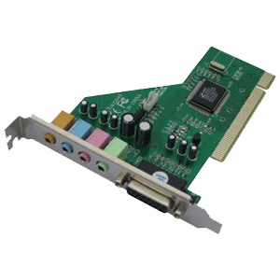
Audio Connectors
Sound cards
Speakers use 1/8” (3.5mm) plugs
Usually green
Older sound cards had a DA-15 game port for a joystick
Notes:
Audio connectors are essential components for enabling sound output and input on computers, particularly in conjunction with sound cards. Here's an expansion on the provided information about audio connectors:
**Sound Cards and Audio Output:**
Sound cards are responsible for processing audio data and producing sound output through connected speakers or headphones. They are integral for enhancing the multimedia experience and enabling communication through audio applications.
**1/8” (3.5mm) Audio Plugs:**
Speakers and headphones often utilize 1/8” (3.5mm) audio plugs, also known as mini-jacks, to connect to the audio output ports of sound cards. These connectors are widely used due to their compact size and compatibility with various audio devices.
**Color-Coded Connectors:**
1/8” audio plugs are typically color-coded for easy identification. The most common color for audio output is green, making it straightforward for users to connect their speakers or headphones to the appropriate port on the sound card.
**Legacy Game Ports:**
In the past, sound cards included additional ports beyond audio output and input. One notable example is the DA-15 game port, which was used for connecting peripherals such as joysticks and game controllers. These ports allowed users to interact with games and applications using physical input devices.
As technology has advanced, the need for dedicated game ports has diminished, and modern sound cards focus primarily on audio output, input, and advanced audio processing capabilities.
In summary, audio connectors and sound cards are vital for enabling audio output and input on computer systems. 1/8” (3.5mm) audio plugs and color-coded ports simplify the connection of speakers and headphones to sound cards. Legacy game ports, like the DA-15 port, were once prevalent for connecting gaming peripherals, but advancements in technology have shifted the focus of modern sound cards toward audio quality and processing capabilities.

Slide 6
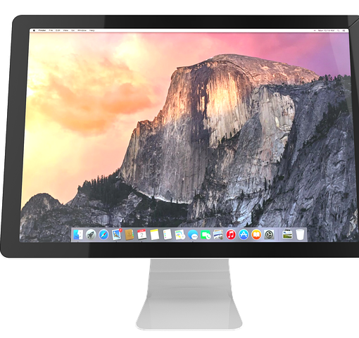
Display Devices
Four categories:
CRTs
Projectors
Flat screens
Touchscreens
Notes:
Display devices are crucial components that allow users to visually interact with and consume information from computer systems. Here's a more detailed exploration of the four categories of display devices mentioned:
**1. CRTs (Cathode Ray Tube Displays):**
CRTs were one of the earliest display technologies and were widely used in older computer systems and televisions. They operate by projecting an electron beam onto a phosphorescent screen, creating images through the illumination of pixels. CRTs were characterized by their bulky design and curved screens. However, their use has significantly diminished over time due to the emergence of more advanced display technologies.
**2. Projectors:**
Projectors are devices that project images or video onto a screen or surface, making them suitable for presentations, multimedia, and large-scale displays. They are commonly used in business settings, classrooms, and home theaters. Modern projectors use technologies like LCD (Liquid Crystal Display) or DLP (Digital Light Processing) to create high-quality images.
**3. Flat Screens:**
Flat screen displays encompass a wide range of technologies, including LCD, LED, and OLED. These displays feature flat, thin panels that emit light to create images. They are widely used in computer monitors, televisions, laptops, and mobile devices. Flat screens offer various benefits, including space-saving designs, energy efficiency, and vibrant color reproduction.
**4. Touchscreens:**
Touchscreens are displays that allow users to interact with the device by directly touching the screen. They are commonly used in smartphones, tablets, interactive kiosks, and some laptops. Touchscreens offer intuitive and interactive user experiences, enabling gestures like tapping, swiping, and pinching to control applications and navigate content.
Each category of display device has its own advantages and drawbacks, making them suitable for different applications and environments. As technology continues to evolve, display devices continue to improve in terms of resolution, color accuracy, energy efficiency, and interactive capabilities, enhancing the overall user experience across various devices and scenarios.

Slide 7
Cathode Ray Tube (CRT)
Older “deep” monitors
Use electron guns
Dot pitch
Resolution
Notes:
CRT (Cathode Ray Tube) monitors are a type of display technology that was widely used in the past. Here's a more detailed look at the characteristics of CRT monitors:
**Older "Deep" Monitors:**
CRT monitors are often referred to as "deep" monitors due to their bulky and curved design. Unlike modern flat-panel displays, CRT monitors use a cathode ray tube, which contributes to their larger size and depth.
**Use of Electron Guns:**
CRT monitors work by using electron guns to project a focused beam of electrons onto a phosphorescent screen. This electron beam interacts with the phosphorescent materials, causing them to emit light and create the images that users see on the screen.
**Dot Pitch:**
Dot pitch is a measurement that indicates the distance between individual phosphorescent dots on the screen. A smaller dot pitch generally indicates a sharper and more detailed image. However, as technology advanced, dot pitch became less relevant with the introduction of higher-resolution display technologies.
**Resolution:**
The resolution of a CRT monitor refers to the number of pixels that make up the display's image. CRT monitors were available in various resolutions, typically ranging from lower resolutions like 640x480 to higher resolutions like 1600x1200. The resolution impacted the clarity and detail of the displayed content.
Despite their historical significance and prevalence in earlier computing environments, CRT monitors have largely been phased out in favor of more advanced and compact display technologies, such as LCD, LED, and OLED. These modern technologies offer improved image quality, energy efficiency, and space-saving designs compared to traditional CRT displays.

Slide 8
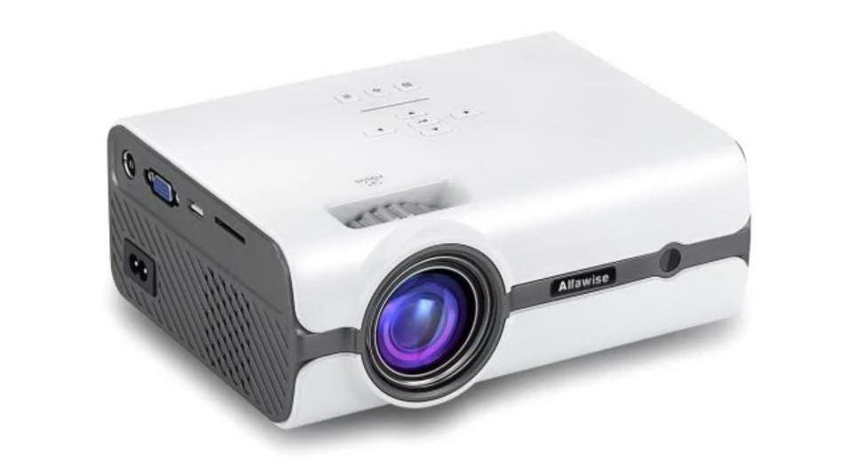
Projectors
Can be CRT or Liquid Crystal Display (LCD)
Often portable
Output measured in lumens
Notes:
Projectors are versatile display devices that can be used for a variety of applications, ranging from business presentations to home theater setups. Here's an expansion on the provided information about projectors:
**CRT and LCD Projectors:**
Projectors can utilize different technologies to create images. While CRT (Cathode Ray Tube) projectors were used in the past, modern projectors often employ LCD (Liquid Crystal Display) or other advanced technologies to produce high-quality images.
**Portability:**
Many projectors are designed to be portable, allowing users to easily transport them for presentations, events, or personal use. Portable projectors are compact and lightweight, making them convenient for on-the-go applications.
**Output Measured in Lumens:**
The output brightness of a projector is measured in lumens. Lumens indicate the amount of light emitted by the projector, which directly affects how well the projected image is visible in different lighting conditions. Projectors with higher lumen ratings are suitable for brighter environments or larger screens.
**Applications:**
Projectors have a wide range of applications, including:
- **Business Presentations:** Projectors are commonly used in boardrooms and conference rooms for displaying presentations, slideshows, and charts.
- **Home Theater:** Projectors can create a large cinematic experience at home, projecting movies and videos onto a screen or wall.
- **Education:** Projectors are used in classrooms to display educational content to a larger audience.
- **Digital Signage:** Large-scale projectors are used for digital signage in commercial spaces and public areas.
- **Entertainment Events:** Projectors are used for outdoor movie nights, live events, and performances.
**Technological Advancements:**
Projector technology has advanced significantly, leading to higher resolutions, improved color accuracy, and features like 3D projection and wireless connectivity. Some projectors even use laser light sources for longer lifespan and more consistent performance.
In summary, projectors are versatile devices that can use different technologies to project images onto screens or surfaces. They find applications in various fields, offering portability and the ability to create large, visually engaging displays. The brightness of a projector is measured in lumens, and advancements in technology continue to enhance the capabilities and features of projectors for both professional and personal use.

Slide 9
Flat Screen Monitors and Touchscreens
Flat screen technologies
LCD
Light-Emitting Diode (LED)
Plasma
Touchscreens are flat screens that are sensitive to touch
Popular for laptops, tablets, smartphones
Considered input & output devices
Notes:
Flat screen monitors and touchscreens are integral components of modern computing and interactive devices. Here's a more detailed exploration of these technologies:
**Flat Screen Technologies:**
Flat screen monitors have revolutionized the way we interact with computers and consume digital content. They come in several technologies:
- **LCD (Liquid Crystal Display):** LCD monitors use liquid crystal cells to control the passage of light, creating images on the screen. They offer a balance between image quality, energy efficiency, and cost-effectiveness.
- **LED (Light-Emitting Diode):** LED monitors are a type of LCD monitor that uses LED backlighting instead of traditional fluorescent lamps. They offer improved color accuracy, energy efficiency, and thinner designs.
- **Plasma:** Plasma displays were once popular for larger screens due to their deep black levels and vibrant colors. However, they have become less common due to the prevalence of LCD and OLED technologies.
**Touchscreens:**
Touchscreens are display devices that allow users to interact with the screen by directly touching it. They have gained immense popularity and are used in various devices, including:
- **Laptops:** Some laptops feature touchscreens, allowing users to interact with applications using touch gestures in addition to traditional input methods.
- **Tablets:** Tablets are built around touchscreens, providing an intuitive and versatile interface for browsing, gaming, productivity, and more.
- **Smartphones:** Touchscreens are a defining feature of smartphones, enabling users to navigate, type, and interact with apps using their fingertips.
**Input & Output Devices:**
Touchscreens are unique devices that serve as both input and output mechanisms. They display visual information (output) and also sense touch interactions (input). Users can tap, swipe, pinch, and perform other gestures to control applications and navigate content.
**Advancements and Applications:**
Advancements in flat screen and touchscreen technologies have led to higher resolutions, faster response times, improved color accuracy, and enhanced touch sensitivity. Touchscreens have enabled the development of interactive kiosks, digital whiteboards, and other innovative applications.
In summary, flat screen monitors, including LCD, LED, and plasma technologies, offer improved image quality and space-saving designs compared to older CRT monitors. Touchscreens, commonly found in laptops, tablets, and smartphones, provide a dynamic and intuitive interface that merges input and output functionalities. Both technologies have transformed how we interact with digital content and devices in the modern computing landscape.

Slide 10
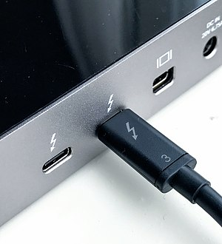
Video Connectors
Video Graphics Array (VGA)
Digital Visual Interface (DVI)
Universal Serial Bus (USB)
High Definition Multimedia Interface (HDMI)
Display Port
Mini-DisplayPort
Thunderbolt
Notes:
Video connectors play a pivotal role in establishing connections between display devices and computer systems, enabling the transmission of video and audio signals. Here's a detailed exploration of the mentioned video connectors:
**1. Video Graphics Array (VGA):**
VGA is an older analog video connector that was widely used for connecting monitors and displays to computers. It uses a 15-pin connector and provides standard-definition video output. VGA has largely been replaced by digital interfaces that offer higher-quality video transmission.
**2. Digital Visual Interface (DVI):**
DVI is a versatile video connector that comes in different formats: DVI-A (analog), DVI-D (digital), and DVI-I (integrated analog and digital). DVI is capable of transmitting both analog and digital signals, making it compatible with a range of display devices.
**3. Universal Serial Bus (USB):**
While primarily known as a data transfer interface, USB connectors have also been utilized for video transmission. USB-C, a reversible and versatile connector, supports video output in addition to data and power delivery. This feature allows devices like laptops and smartphones to connect to displays using a single USB-C cable.
**4. High Definition Multimedia Interface (HDMI):**
HDMI is a widely used digital video and audio interface that supports high-definition video and audio transmission. It's commonly found in televisions, monitors, projectors, and multimedia devices. HDMI cables carry both video and audio signals, making them convenient for home theater setups and gaming consoles.
**5. DisplayPort:**
DisplayPort is a digital video and audio interface that offers high-quality video transmission and multiple display support from a single connector. It's used in various applications, including computer monitors, laptops, and graphics cards. DisplayPort can carry both video and audio signals, and it supports advanced features like daisy-chaining multiple displays.
**6. Mini-DisplayPort:**
Mini-DisplayPort is a smaller version of DisplayPort commonly used in laptops, tablets, and compact devices. It provides similar capabilities as its larger counterpart.
**7. Thunderbolt:**
Thunderbolt is a high-speed interface that combines data transfer, video output, and power delivery through a single cable. It uses a Mini-DisplayPort connector and is often found in Mac computers and certain Windows systems. Thunderbolt offers fast data transfer rates and is suitable for connecting external displays and peripherals.
In summary, video connectors enable the transmission of video and audio signals between computer systems and display devices. Different connectors offer varying levels of video quality, compatibility, and features. The choice of connector depends on factors such as the display device, computer system, desired video quality, and available ports.

Slide 11
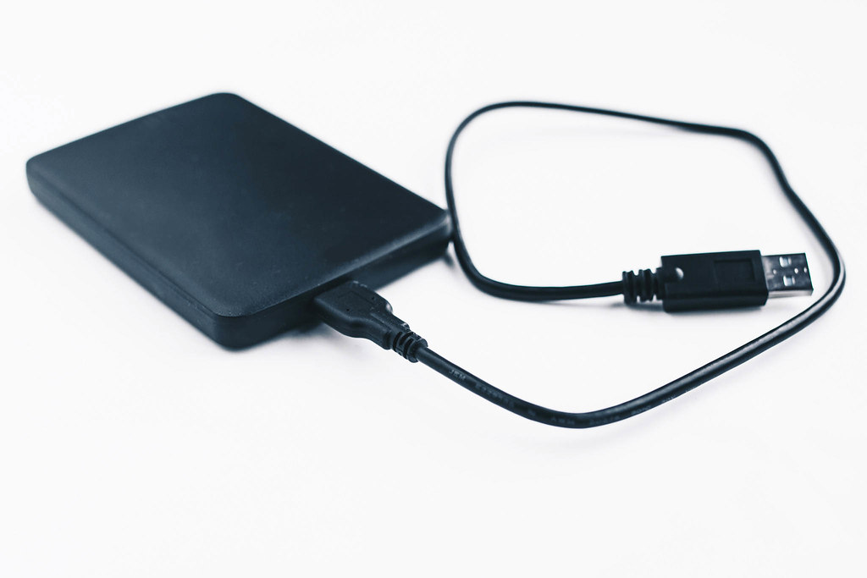
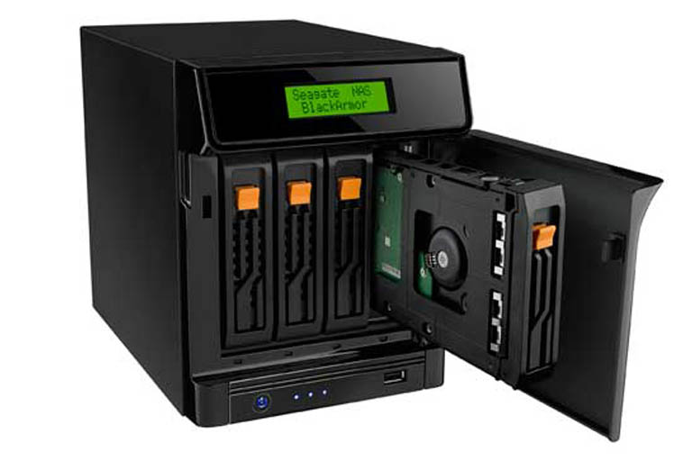
External Storage Devices
Flash drives
Memory cards
External hard drives
External optical drives
Network attached storage (NAS)
Notes:
Extended storage devices are essential for expanding the storage capacity of computers and providing a convenient way to store and access data. Here's a detailed exploration of the mentioned extended storage devices:
**1. Flash Drives:**
Flash drives, also known as USB drives or thumb drives, are portable storage devices that use flash memory to store data. They connect to a computer's USB port and offer a quick and easy way to transfer files between devices. Flash drives come in various storage capacities, making them ideal for carrying documents, media files, software, and more.
**2. Memory Cards:**
Memory cards are small storage devices used primarily in devices like cameras, smartphones, and tablets. They offer expandable storage and are available in different formats such as SD (Secure Digital), microSD, CompactFlash, and more. Memory cards are useful for capturing photos, videos, and other media on devices with limited internal storage.
**3. External Hard Drives:**
External hard drives are separate storage devices that connect to a computer via USB, Thunderbolt, or other interfaces. They offer large storage capacities and are commonly used for backup, data storage, and transferring large files. External hard drives can be portable or desktop models and come in various storage sizes and speeds.
**4. External Optical Drives:**
External optical drives, such as DVD or Blu-ray drives, provide the ability to read and write optical discs. While optical media usage has declined due to digital distribution, external optical drives can still be useful for tasks like burning discs, watching movies, or accessing older software.
**5. Network Attached Storage (NAS):**
NAS is a more advanced form of extended storage that involves dedicated network-connected devices. NAS devices consist of one or more hard drives and provide centralized storage accessible by multiple devices over a network. They are commonly used for data backup, file sharing, media streaming, and even hosting websites.
These extended storage devices cater to different needs, from convenient data transfer with flash drives to the comprehensive storage solutions offered by network attached storage (NAS). The choice of device depends on factors such as the amount of data you need to store, portability requirements, connectivity options, and intended usage scenarios.

Slide 12
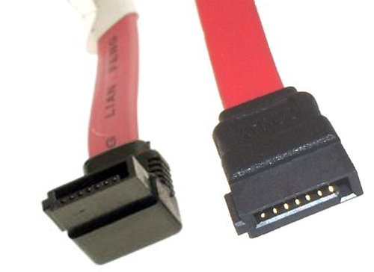
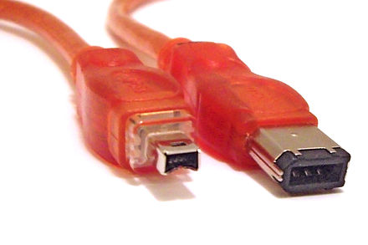
External Storage Connectors
USB
external Serial ATA (eSATA)
FireWire
Thunderbolt
Notes:
Extended storage connectors play a vital role in establishing connections between computers and external storage devices, enabling data transfer and expanding storage capabilities. Here's a more detailed exploration of the mentioned extended storage connectors:
**1. USB (Universal Serial Bus):**
USB connectors are among the most widely used and versatile connectors for extended storage devices. USB ports are found on almost every computer, making them a convenient choice for connecting devices like flash drives, external hard drives, and more. USB supports various data transfer speeds, with USB 3.0 and later versions offering faster rates for quick data transfer.
**2. External Serial ATA (eSATA):**
eSATA is an external version of the SATA (Serial ATA) interface used for connecting storage devices like external hard drives to computers. eSATA offers higher data transfer speeds compared to USB, making it suitable for tasks that involve transferring large files or working with high-definition media content.
**3. FireWire (IEEE 1394):**
FireWire, also known as IEEE 1394, was once a popular connector for connecting devices like external hard drives, digital cameras, and video cameras. It provided high-speed data transfer and was commonly used in professional audio and video production. While it has been largely replaced by USB and Thunderbolt, FireWire still finds use in legacy systems and equipment.
**4. Thunderbolt:**
Thunderbolt is a high-speed interface that combines data transfer, video output, and power delivery through a single cable. Thunderbolt connectors use the same physical interface as Mini-DisplayPort, making them versatile for connecting a range of devices. Thunderbolt offers fast data transfer rates and is particularly popular in professional and creative environments.
Each of these connectors offers distinct advantages and is suited to different use cases. USB is versatile and universally compatible, eSATA provides high-speed data transfer for storage devices, FireWire is used in legacy systems, and Thunderbolt offers exceptional speed and versatility for various devices, including external storage solutions. The choice of connector depends on factors such as data transfer requirements, device compatibility, and the intended usage scenario.

Slide 13
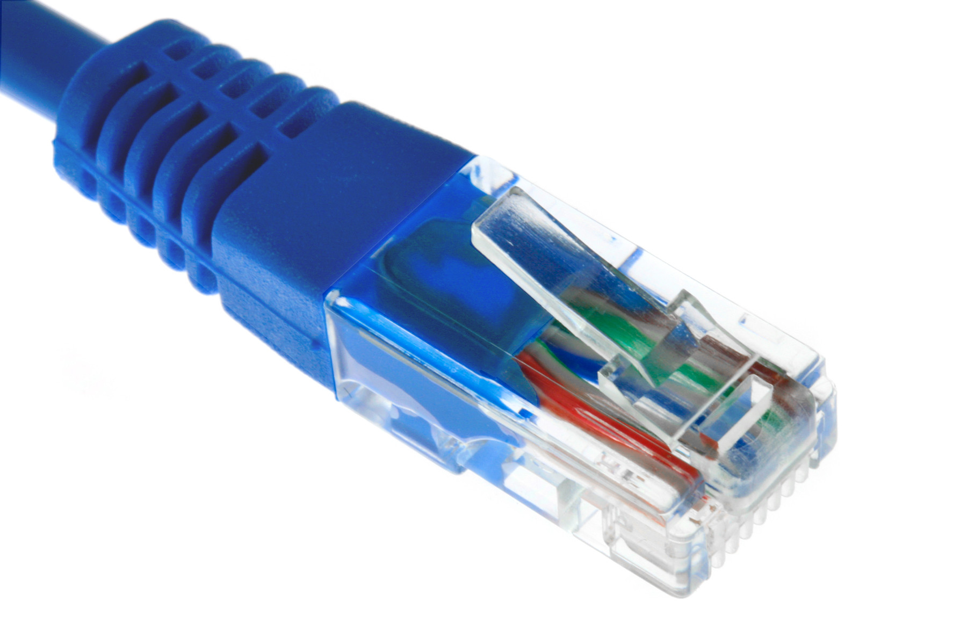
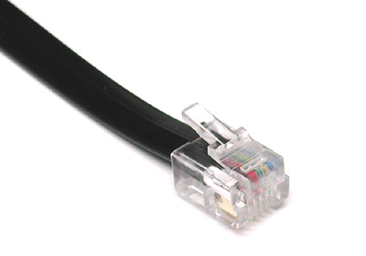
Communications Connectors
Network connectors (RJ-45)
Telephone connectors (RJ-11)
Notes:
Communication connectors are essential components for establishing connections between devices and networks, enabling data transmission and communication. Here's a more detailed exploration of the mentioned communication connectors:
**1. Network Connectors (RJ-45):**
RJ-45 connectors are commonly used for networking purposes, specifically for Ethernet connections. They are used to establish wired connections between computers, routers, switches, and other networking equipment. RJ-45 connectors are associated with various Ethernet standards, such as Cat 5e, Cat 6, and Cat 6a, which determine the speed and quality of the network connection. These connectors are crucial for creating local area networks (LANs) and connecting devices to the internet.
**2. Telephone Connectors (RJ-11):**
RJ-11 connectors are used for telephone connections. They are commonly associated with landline telephones and fax machines. RJ-11 connectors support analog signals and are used to connect devices to a telephone line for voice communication. These connectors are recognizable by their small size and four or six contacts.
Both RJ-45 and RJ-11 connectors have standardized pinouts and are widely used in homes and businesses for communication purposes. RJ-45 connectors are essential for creating wired computer networks, while RJ-11 connectors are primarily used for traditional telephone connections. The choice of connector depends on the communication requirements and the specific devices being connected.
Analog and digital are two fundamental methods of representing and transmitting information. Here's a detailed comparison of analog and digital:
**Analog:**
Analog signals are continuous and represent information as varying physical quantities. In the context of sound, for example, analog signals represent sound waves as a continuous stream of voltage levels. Key characteristics of analog include:
1. **Continuous Nature:** Analog signals are continuous and can take on an infinite number of values within a given range.
2. **Smooth Transitions:** Analog signals provide smooth transitions between values, allowing for a theoretically infinite level of detail.
3. **Susceptibility to Interference:** Analog signals can be susceptible to interference and noise, which may degrade signal quality.
4. **Complexity:** Analog signal processing can be complex, especially when dealing with high-resolution or intricate signals.
Examples of analog devices include traditional landline telephones, vinyl records, and analog radios.
**Digital:**
Digital signals, on the other hand, represent information as discrete values, typically using binary code (0s and 1s). Digital signals are processed and transmitted using digital electronics. Key characteristics of digital include:
1. **Discrete Values:** Digital signals have discrete values and are quantized into a finite number of levels.
2. **Error Correction:** Digital signals are more resistant to noise and interference, and error correction techniques can be applied to ensure accurate data transmission.
3. **Easy Reproduction:** Digital signals can be reproduced exactly, making them highly reliable for storage and transmission.
4. **Less Susceptible to Quality Loss:** Digital signals do not degrade with distance or time as much as analog signals.
5. **Digital Processing:** Digital signals allow for efficient processing, manipulation, and storage using computers and digital devices.
Examples of digital devices include digital cameras, smartphones, CDs, and digital TVs.
**Choosing Between Analog and Digital:**
The choice between analog and digital depends on factors such as the nature of the data, the purpose of communication, and the technology being used. While analog signals can be more natural for certain types of data, digital signals offer advantages in terms of accuracy, reliability, and efficient processing. The shift toward digital technology has led to significant advancements in communication, data storage, and multimedia experiences.

Slide 14
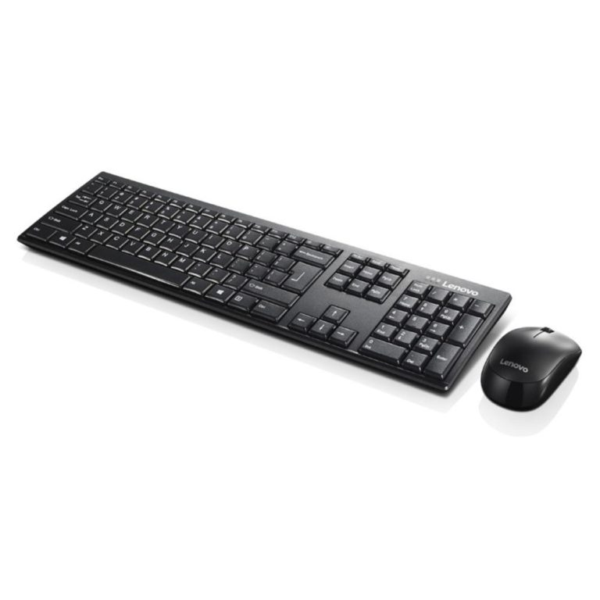
Primary Input Devices
Keyboard
Pointing devices
Mouse
Touchpad
Joystick
Stylus pen
Trackball
Notes:
Primary input devices are essential components that allow users to interact with computers by providing input to control and manipulate the system. Here's a more detailed exploration of the mentioned primary input devices:
**1. Keyboard:**
The keyboard is a primary input device that enables users to enter text, numbers, and commands into a computer. It consists of a set of keys representing letters, numbers, symbols, and function keys. Keyboards come in various layouts and designs, such as QWERTY, AZERTY, and Dvorak, and they are integral for tasks ranging from word processing to coding.
**2. Pointing Devices:**
Pointing devices are used to move a cursor or pointer on the screen and interact with graphical user interfaces. They include:
- **Mouse:** A mouse is a hand-held device that allows users to move the cursor by sliding it across a surface. It typically has buttons for left-clicking, right-clicking, and scrolling.
- **Touchpad:** A touchpad is a built-in pointing device found on laptops. Users move their fingers across the touchpad to control the cursor, and tapping or clicking on the pad simulates mouse clicks.
- **Joystick:** Joysticks are primarily used for gaming and flight simulation. They provide precise control over movement and direction.
- **Stylus Pen:** Stylus pens are used on touchscreens, particularly on devices like tablets and smartphones. They offer a more precise way to interact with touch-sensitive displays, ideal for drawing and handwriting.
- **Trackball:** A trackball is a stationary pointing device that allows users to control the cursor by rotating a ball with their fingers. It's an alternative to the mouse.
Each of these primary input devices serves a specific purpose and caters to different types of tasks and preferences. They provide users with various options for interacting with computers and software in ways that are most comfortable and efficient for them.

Slide 15
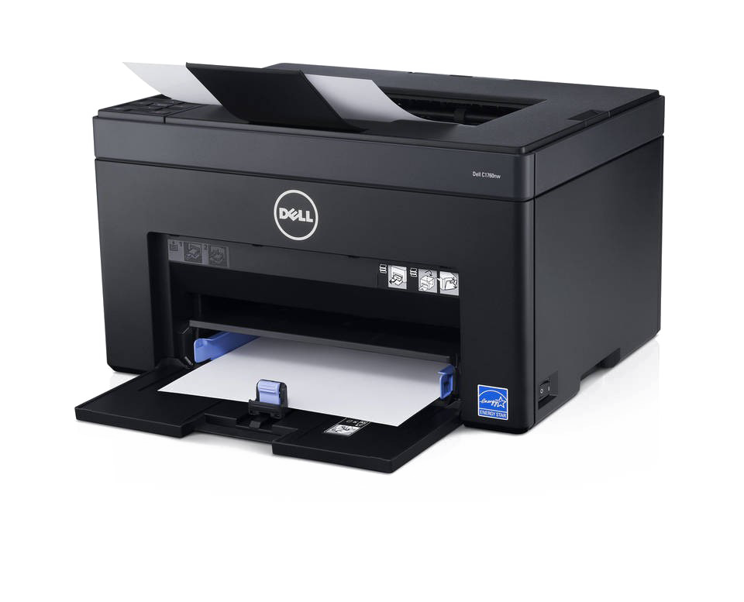
Printer Technologies
Inkjet
Laser
Some printers include fax services
Multifunctional or all-in-one printer
Considered input & output device
Notes:
Printer technologies have evolved to offer various methods of producing hard copies of digital documents and images. Here's a more detailed exploration of the mentioned printer technologies:
**1. Inkjet Printers:**
Inkjet printers create images by spraying tiny droplets of ink onto paper. They are versatile and capable of producing high-quality color prints. Inkjet printers are popular for home and small office use due to their affordability, ability to produce photo-quality prints, and compact size. They are suitable for tasks such as printing documents, photos, and graphics.
**2. Laser Printers:**
Laser printers use a laser beam to create an electrostatic image on a photosensitive drum. The drum then attracts toner particles, which are transferred onto paper and fused using heat. Laser printers are known for their fast print speeds, sharp text output, and efficient performance. They are commonly used in business environments for printing large volumes of documents.
**3. Multifunctional or All-in-One Printers:**
Multifunctional or all-in-one (AIO) printers combine multiple functionalities in a single device. They typically include printing, scanning, copying, and sometimes faxing capabilities. AIO printers offer convenience and space savings by consolidating various tasks into a single machine. They are suitable for both home and office environments.
**4. Fax Services:**
Some printers include integrated fax capabilities, allowing users to send and receive fax messages directly from the printer. While faxing has become less common due to digital communication methods, certain industries and offices may still require fax functionality.
**5. Input & Output Device:**
Printers are considered both input and output devices. They receive digital data from a computer (input) and produce physical hard copies (output). This dual functionality allows users to interact with both digital and physical formats.
Printer technologies continue to advance, offering improved print quality, speed, connectivity options, and energy efficiency. The choice of printer technology depends on factors such as the intended use, budget, print volume, and specific features required.

Slide 16
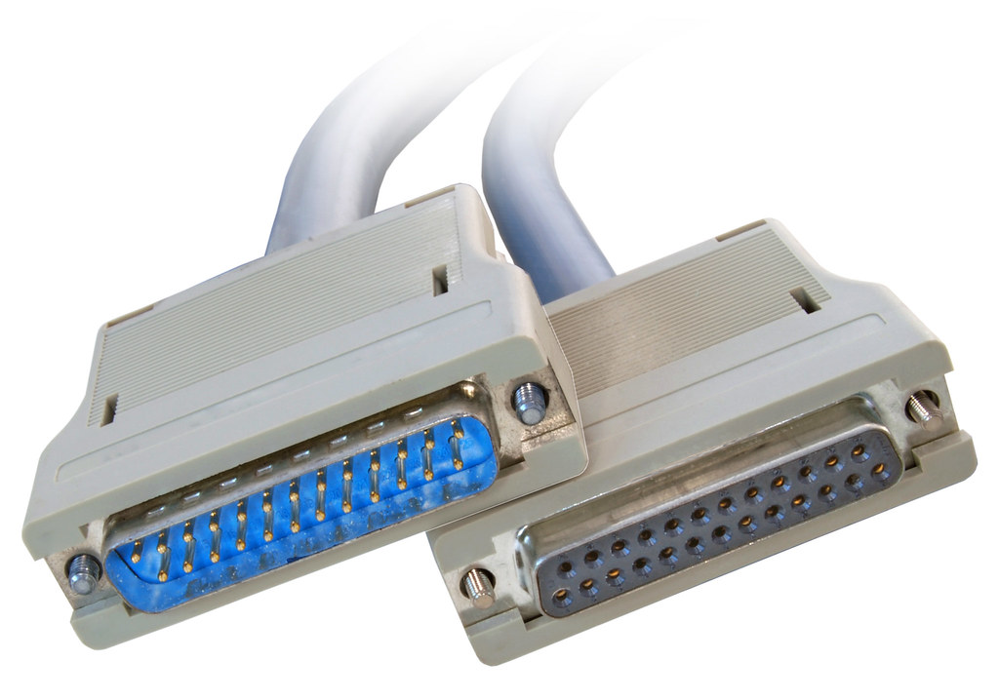
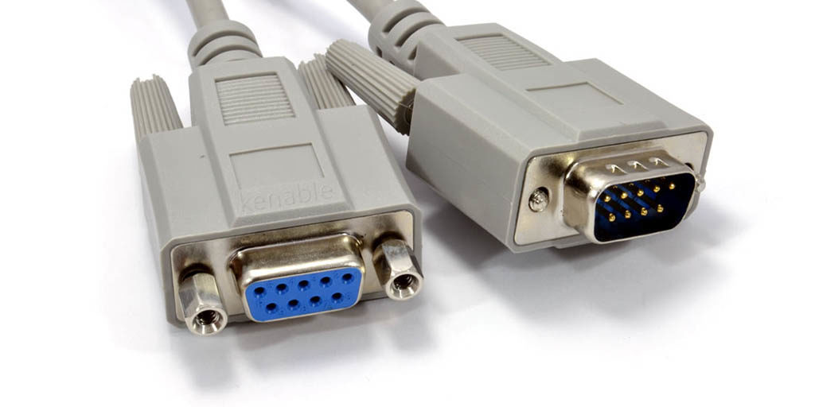
Printer Connections
Serial
In Serial Transmission, data-bit flows from one computer to another computer in bi-direction. In this transmission, one bit flows at one clock pulse. In Serial Transmission, 8 bits are transferred at a time having a start and stop bit.
Parallel
In Parallel Transmission, many bits are flow together simultaneously from one computer to another computer. Parallel Transmission is faster than serial transmission to transmit the bits. Parallel transmission is used for short distance.
USB
USB is an industry standard that establishes specifications for cables, connectors and protocols for connection, communication and power supply (interfacing) between computers, peripherals and other computers
Network
An internet based connection through wifi.
Notes:
Printer connections are vital for linking printers to computers or networks, facilitating the transfer of data for printing. Here's a more detailed exploration of the mentioned printer connection methods:
**1. Serial Connection:**
In serial transmission, data bits are sent sequentially, one after the other. This method is often used for connecting devices that are relatively far apart and require simple communication. Each bit is transmitted at a clock pulse, with a start and stop bit framing a data byte. Serial connections are slower compared to parallel connections but are suitable for longer distances.
**2. Parallel Connection:**
Parallel transmission involves sending multiple bits simultaneously over separate channels or wires. This method is faster than serial transmission for transferring data but is typically limited to short distances due to potential signal degradation. Parallel connections were more common in the past for connecting printers, but they have become less prevalent with the emergence of other connection types.
**3. USB (Universal Serial Bus):**
USB is a widely used standard for connecting various devices, including printers, to computers. USB offers multiple benefits, such as high data transfer rates, plug-and-play functionality, and the ability to provide power to connected devices. USB printers are common in home and office environments due to their ease of use and compatibility.
**4. Network Connection:**
Network-based printer connections utilize a network, often through Wi-Fi, to enable multiple devices to access and print documents on the same printer. This method is particularly useful in office environments where multiple users need access to a shared printer. Network printers can be conveniently placed in central locations, making them accessible to all authorized users.
Each printer connection method has its advantages and limitations, and the choice depends on factors such as the printer's location, the number of devices that need to connect, the required data transfer speeds, and the available infrastructure. As technology evolves, USB and network connections have become more common due to their convenience, speed, and ability to support a range of devices.

Slide 17
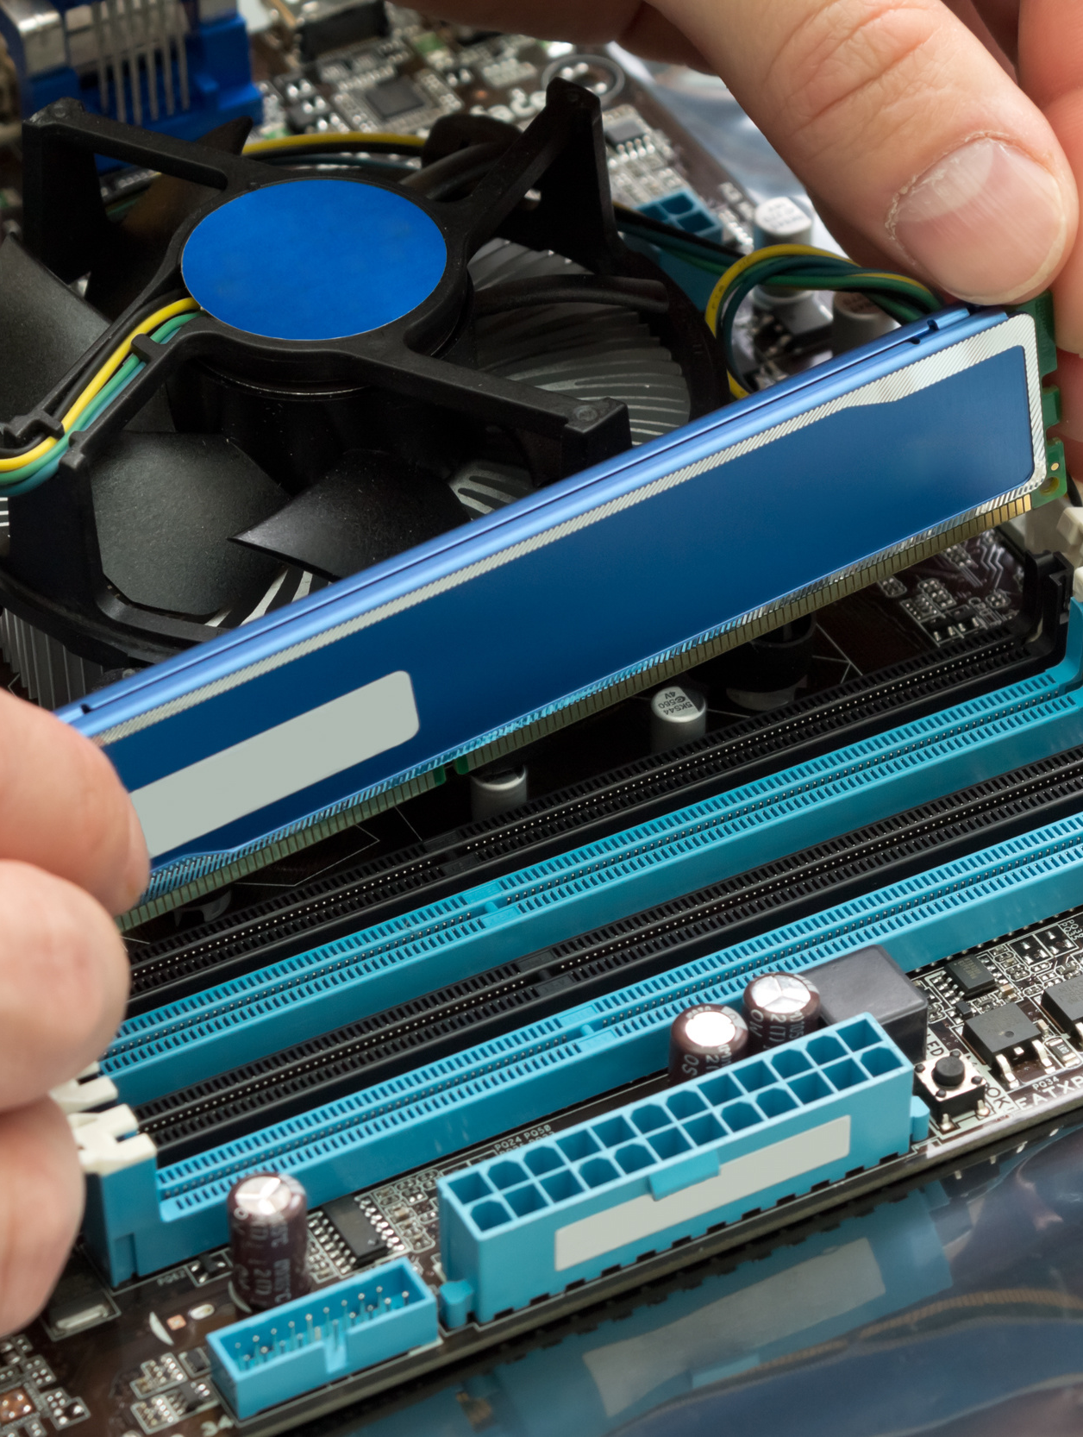
Installing Internal Devices
Power the computer off
Can leave it plugged in
Remove the old component
Identify slot or connection for new device
Insert new device and attach power if needed
Turn the computer back on
After verifying functionality, put the case back together.
Notes:
Installing internal devices in a computer requires careful steps to ensure proper installation and avoid any damage to components. Here's a more detailed breakdown of the process:
**1. Power Off the Computer:**
Before beginning any installation, make sure the computer is completely powered off. This prevents electrical shocks and ensures the safety of both the components and the installer.
**2. Leave It Plugged In (Optional):**
It's generally safe to leave the computer plugged into a power outlet while installing internal components, as long as the power switch is turned off and the power cable is unplugged from the power supply unit.
**3. Remove the Old Component:**
If you are replacing an existing component (e.g., upgrading a graphics card), carefully remove the old component from its slot or connection. Make sure to disconnect any power cables, data cables, and screws holding the component in place.
**4. Identify Slot or Connection for New Device:**
Identify the appropriate slot or connection on the motherboard for the new device. This may be a PCI Express slot, RAM slot, SATA connector, or other designated interface.
**5. Insert New Device and Attach Power (If Needed):**
Gently insert the new device into the designated slot or connection. Ensure that it is properly aligned and securely seated. If the new device requires power, connect the necessary power cables from the power supply unit.
**6. Turn the Computer Back On:**
Once the new component is installed and all connections are secure, turn the computer back on. This is an important step to test if the new device is recognized and functioning correctly.
**7. Verify Functionality:**
Check if the computer recognizes the new device and if it's functioning as expected. This may involve installing drivers or software to ensure proper functionality. Test any relevant features or functions associated with the new device.
**8. Put the Case Back Together:**
After confirming that the new device is working properly, carefully reassemble the computer case. Securely fasten any screws, close the case, and ensure that all cables are neatly organized and properly connected.
**Important Note:**
Always follow the manufacturer's instructions and guidelines when installing internal components. Proper grounding and anti-static precautions are essential to prevent damage to sensitive electronic components.
By following these steps, you can safely and effectively install new internal devices in your computer, enhancing its functionality and performance.

Slide 18
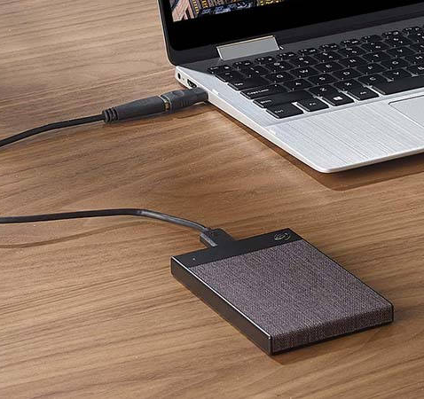
Installing External Devices
Make sure there is an available port
Plug it in to the computer
Plug in to power if needed
Notes:
Installing external devices is generally a straightforward process, but it's important to follow a few basic steps to ensure a proper and safe setup. Here's a more detailed guide to installing external devices:
**1. Check for Available Ports:**
Before connecting an external device, ensure that your computer has an available and compatible port for the device you intend to install. Different devices may require USB, Thunderbolt, HDMI, Ethernet, or other types of ports.
**2. Plug It into the Computer:**
Connect the external device's cable or connector to the corresponding port on your computer. Make sure the connection is secure but avoid using excessive force, as connectors can be delicate.
**3. Plug in to Power (If Needed):**
Some external devices, such as printers, monitors, or external hard drives, may require their own power source. If needed, plug the device into a power outlet or power strip. Ensure that the device's power supply is properly connected and functioning.
**4. Install Drivers or Software (If Needed):**
Depending on the device, you may need to install drivers or software to enable proper functionality. This is common for printers, graphics tablets, and certain peripherals. Follow the manufacturer's instructions to install any necessary software.
**5. Configure Settings (If Needed):**
For certain devices, such as monitors or external storage, you might need to configure settings to ensure optimal performance. This might involve adjusting display resolution, setting up automatic backups, or configuring network settings.
**6. Test Functionality:**
After connecting the device, test its functionality to make sure it's working as expected. For example, if you connected a printer, try printing a test page. If it's a monitor, ensure that it displays the expected content.
**7. Safely Disconnect the Device:**
Before disconnecting an external device, it's important to properly eject or disconnect it to avoid data corruption. For storage devices, use the "Safely Remove Hardware" option on your computer before unplugging.
By following these steps, you can ensure a smooth and hassle-free installation of external devices. Always consult the manufacturer's documentation for specific instructions and any additional setup requirements for the particular device you're installing.

Slide 19
Review of Connector Types
Video
VGA
DVI
USB
HDMI
Display Port
Mini Display Port
Thunderbolt
General
FireWire
eSATA
Thunderbolt
USB
PS/2
Parallel
Serial
RJ-45
RJ-11
Audio
Notes:
These are a variety of connectors used for different purposes in the world of computing and technology. Here's a detailed overview of the connectors you mentioned:
**Video Connectors:**
- **VGA (Video Graphics Array):** An analog video connector used to connect monitors and displays to computers. It's now less common due to the prevalence of digital interfaces.
- **DVI (Digital Visual Interface):** A versatile connector supporting both analog and digital video signals. It comes in various formats (DVI-A, DVI-D, DVI-I) and is commonly found on monitors and graphics cards.
- **USB (Universal Serial Bus):** USB technology is used for various purposes, including connecting devices like webcams that provide video input.
- **HDMI (High Definition Multimedia Interface):** A digital video and audio interface widely used for connecting devices like TVs, monitors, projectors, and multimedia players.
- **Display Port:** A digital video and audio interface known for its versatility and high data transfer rates.
- **Mini Display Port:** A smaller version of Display Port, commonly used in laptops and tablets.
- **Thunderbolt:** A high-speed interface that combines data transfer, video output, and power supply. It's commonly used on Mac computers and certain Windows systems.
**General Connectors:**
- **FireWire (IEEE 1394):** Used for high-speed data transfer and often used in professional audio/video applications.
- **eSATA:** External SATA connection used to connect external storage devices directly to the computer.
- **USB:** A versatile and widely used connector for connecting various peripherals to computers.
- **PS/2:** Used for connecting keyboards and mice to computers, now mostly replaced by USB.
- **Parallel:** An older connector used for connecting printers and other devices, largely replaced by USB and network connections.
- **Serial:** Used for connecting devices over longer distances, but less common due to advances in other technologies.
- **RJ-45:** Used for Ethernet network connections, commonly known as Ethernet or LAN cables.
- **RJ-11:** Used for telephone connections, often seen in landline phones.
**Audio Connectors:**
- **Audio:** Audio connectors are used for connecting audio devices such as speakers, headphones, microphones, and more.
Each of these connectors serves a specific purpose and technology need, enabling the seamless integration of various devices and peripherals with computers and other equipment.

