Slide 1
IT Fundamentals
Chapter 1:
Core Hardware Components
Notes:
ifhepiojhfeif

Slide 2
Description
This IT Fundamentals course is designed to provide students with a comprehensive introduction to the world of information technology. This course covers a wide range of topics, including hardware, software, networking, cybersecurity, and basic IT troubleshooting. Students will gain a solid foundation in essential IT concepts and skills, preparing them for further studies and careers in the technology industry.

Slide 3
Chapter 1: Core Hardware Components
Compare and contrast storage types
Local storage types
RAM
Hard drive
Solid state vs. spinning disk
Optical
Flash drive

Slide 4
Course Objectives
Understand the fundamental components of computer systems, including hardware, peripherals, and operating systems.
Identify and describe the functions of various types of software, including system software, application software, and utility software.
Explain basic networking concepts, such as network types, topologies, protocols, and addressing schemes.
Demonstrate an understanding of cybersecurity principles, including types of threats, protection mechanisms, and best practices for securing data and devices.
Troubleshoot common IT issues using a systematic approach, applying knowledge of hardware, software, and networking concepts.
Understand the importance of IT ethics, privacy, and compliance in the modern technology landscape.
Prepare for the CompTIA IT Fundamentals (ITF+) certification exam.

Slide 5
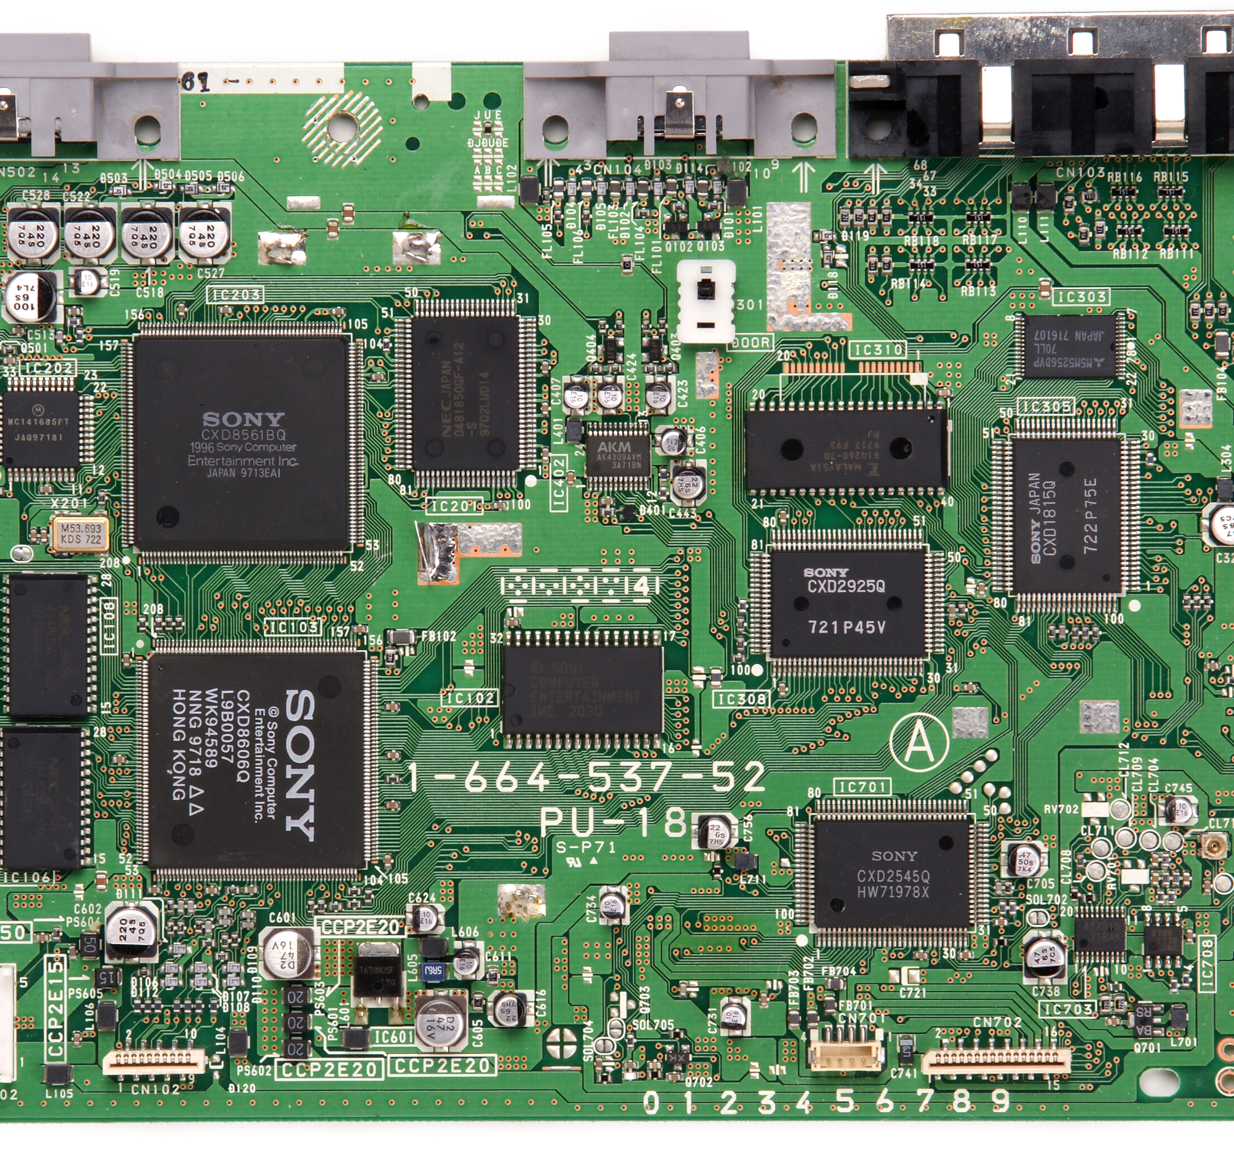
Motherboard Overview
Connect all components together
Also called system board or mainboard
Form factor refers to size and shape
Chipset is the technology on the motherboard – perform interface and peripheral functions
Notes:
Let's delve into a comprehensive understanding of the concept of a "Motherboard Overview" and the process of connecting all components together within a computer system.
The motherboard, also referred to as the system board or mainboard, plays a pivotal role in the functionality of a computer. It serves as a central hub that connects and facilitates communication between various hardware components within the system.
When we talk about connecting all components together, we are essentially discussing the intricate network of connections that enable different hardware elements such as the CPU (Central Processing Unit), RAM (Random Access Memory), storage devices, graphics card, and more to interact and function as a cohesive unit.
One key aspect of the motherboard is its form factor, which dictates its size, shape, and layout. The form factor is a critical consideration as it determines the compatibility of the motherboard with the computer case and other components. Common form factors include ATX, MicroATX, and Mini-ITX, each with its own dimensions and features.
The chipset is a fundamental technological component embedded on the motherboard. It holds paramount importance as it manages the communication between the CPU and various peripheral devices. This includes functions such as controlling data flow, managing memory access, and facilitating interactions with devices like USB ports, audio interfaces, and network connectors. In essence, the chipset acts as a bridge between the processor and the rest of the components, ensuring seamless data exchange and efficient system performance.
In conclusion, the motherboard serves as the backbone of a computer system, providing the physical and logical infrastructure necessary for all components to work in harmony. The form factor determines its size and compatibility, while the chipset is the driving force behind communication and interaction among components. Understanding these elements is essential for anyone seeking to build or comprehend the intricacies of computer hardware.

Slide 6
Motherboard Connectivity
Contains sockets or slots for:
Processor (CPU)
Memory (RAM)
Expansion cards (PCI, PCIe)
Disk controllers (PATA, SATA)
Power connectors
BIOS/firmware
CMOS and CMOS battery
Back panel connectors
Front panel connectors
Notes:
The motherboard serves as a hub containing various sockets and slots that play vital roles in enabling a computer system to function seamlessly. Here's a detailed exploration of these essential components:
1. **Processor (CPU) Socket:** The motherboard features a designated socket where the Central Processing Unit (CPU) is installed. This socket is engineered to accommodate a specific type of CPU and provides the electrical and mechanical connections necessary for the processor to communicate with other components.
2. **Memory (RAM) Slots:** Multiple slots on the motherboard are designated for installing Random Access Memory (RAM) modules. RAM is a type of volatile memory that stores data temporarily for quick access by the CPU. These slots are designed to match the type and speed of RAM modules supported by the motherboard.
3. **Expansion Card Slots (PCI, PCIe):** The motherboard incorporates slots for expansion cards, which enhance the system's capabilities. These slots include PCI (Peripheral Component Interconnect) and PCIe (Peripheral Component Interconnect Express) slots. Expansion cards like graphics cards, sound cards, and network cards are inserted into these slots to provide additional functionality.
4. **Disk Controller Connectors (PATA, SATA):** The motherboard is equipped with connectors for connecting storage devices such as hard drives and solid-state drives. These connectors may include PATA (Parallel ATA) or SATA (Serial ATA) interfaces, allowing for data transfer between the storage devices and the rest of the system.
5. **Power Connectors:** Power connectors on the motherboard facilitate the supply of electrical power to various components, including the CPU, RAM, and other integrated circuits. These connectors ensure that the motherboard and its components receive the required power to function properly.
6. **BIOS/Firmware Chip:** The motherboard contains a BIOS (Basic Input/Output System) chip or similar firmware component. The BIOS is responsible for initializing hardware components during the boot-up process and provides low-level system functions before the operating system takes over.
7. **CMOS and CMOS Battery:** The motherboard features a complementary metal-oxide-semiconductor (CMOS) chip that stores BIOS settings and system configuration data. A small battery, often referred to as the CMOS battery, powers the CMOS chip, ensuring that the settings are retained even when the system is powered off.
8. **Back Panel Connectors:** These connectors are located on the rear side of the motherboard and provide ports for various external devices such as USB devices, audio peripherals, Ethernet cables, and video outputs. Back panel connectors enable communication between the computer system and external devices.
9. **Front Panel Connectors:** These connectors are located on the front or edge of the motherboard and provide connections for buttons, LEDs, and other components present on the computer's front panel case. They facilitate the interaction between the user and the system.
In summary, the motherboard's sockets and slots collectively form the foundation upon which a computer system is built. Each of these components has a specific function, contributing to the overall performance, expandability, and functionality of the system. Understanding these elements is essential for anyone involved in computer hardware assembly and troubleshooting.

Slide 7
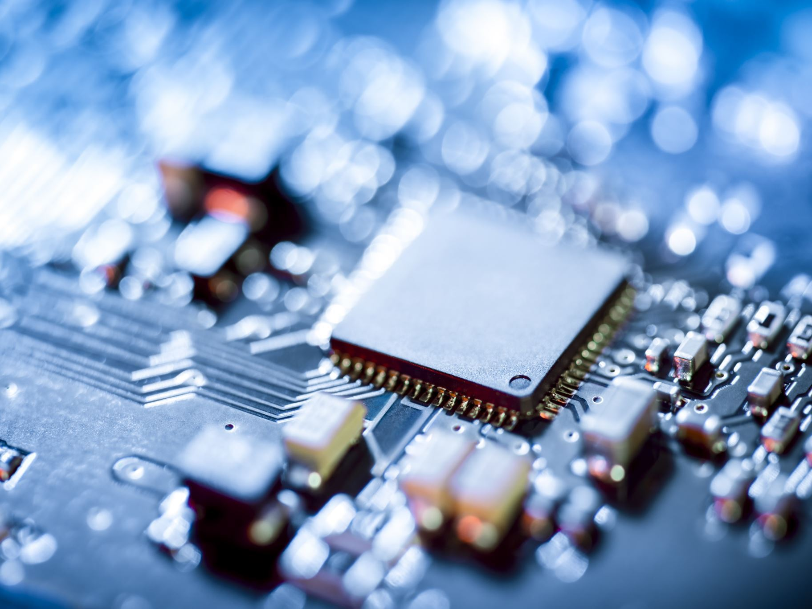
Processors (CPUs)
Central Processing Unit (CPU)
The “brain” of the computer
Intel and AMD major manufacturers
Speed measured in gigahertz (GHz)
Processors perform binary math
Notes:
The Central Processing Unit (CPU), often referred to as the computer's "brain," is a critical component that governs the system's processing power and overall performance.
As the core processing unit, the CPU executes instructions, performs calculations, and manages data manipulation. It acts as the central hub for all tasks, coordinating the flow of information between various components and ensuring that software instructions are carried out accurately and efficiently.
Two prominent manufacturers in the CPU market are Intel and AMD. These companies produce a wide range of processors that cater to different performance levels and use cases. The choice between Intel and AMD often depends on factors such as computing needs, budget constraints, and specific requirements.
The speed of a CPU is measured in gigahertz (GHz), indicating how many cycles it can execute in one second. Higher GHz values generally signify faster processing capabilities, leading to quicker task execution and improved multitasking performance.
One of the primary functions of processors is to perform binary math operations. Computers communicate and process data using binary code, which consists of ones and zeros. CPUs excel at executing these binary operations, allowing them to perform complex calculations and logic operations at incredible speeds.
In essence, the CPU is the nucleus of computational activity within a computer system. Its processing power directly influences the system's ability to run applications, handle multitasking, and deliver responsive user experiences. As technology advances, CPUs continue to evolve, leading to higher speeds, improved efficiency, and enhanced capabilities for various computing tasks.

Slide 8
Processors (CPUs)
CPU slots usually square
Pin Grid Array (PGA), Land Grid Array (LGA)
Characteristics
Architecture
32-bit
64-bit
ARM
Speed
GHz – billion cycles per second
Cache
Built-in memory, small and fast
Notes:
CPU slots, typically square in shape, play a crucial role in housing and facilitating the connection of Central Processing Units (CPUs) within computer systems.
Two common types of CPU socket designs are the Pin Grid Array (PGA) and the Land Grid Array (LGA). In a PGA socket, the CPU has pins that fit into holes on the socket, creating a secure connection. Conversely, in an LGA socket, the CPU has pads that align with contacts on the socket, ensuring efficient communication. These socket types determine the compatibility between CPUs and motherboards.
Key characteristics of CPUs include their architecture, which defines how the processor is designed and how it processes data. Processors can be categorized as 32-bit or 64-bit, with 64-bit CPUs capable of handling larger amounts of memory and more complex tasks. Additionally, some CPUs utilize ARM (Advanced RISC Machine) architecture, which is known for its energy efficiency and prevalence in mobile devices.
The speed of a CPU is measured in gigahertz (GHz), indicating the number of cycles it can execute per second. A higher GHz value translates to faster processing, enabling quicker execution of tasks and more responsive system performance.
CPU cache is another essential aspect. Cache refers to built-in memory that stores frequently used data and instructions, enabling faster access compared to fetching data from main memory. It acts as a buffer between the CPU and main memory, reducing the time it takes to retrieve data and improving overall processing speed.
In summary, CPU slots, often square in shape, accommodate CPUs within computer systems. Different socket types like PGA and LGA determine how CPUs are connected to motherboards. CPUs come in various architectures, such as 32-bit, 64-bit, and ARM, each with its own benefits. CPU speed, measured in GHz, impacts the rate of task execution. Lastly, CPU cache, a built-in memory, enhances processing speed by providing quick access to frequently used data and instructions. Understanding these characteristics aids in selecting the appropriate CPU for specific computing needs.

Slide 9
Memory
Read only memory (ROM)
Permanent, no changes allowed
Example: BIOS
Random access memory (RAM)
Can be static or dynamic
Static is nonvolatile, like a thumb drive
Dynamic used inside computers
Analogous to short-term memory
Needs power to retain contents
Notes:
Read-Only Memory (ROM) serves as a permanent storage medium within a computer system where no modifications are allowed after initial programming.
One common example of ROM usage is the Basic Input/Output System (BIOS), a firmware that initializes hardware components during system startup. BIOS remains unaltered over time and retains its programmed instructions, ensuring stable system initialization.
On the other hand, Random Access Memory (RAM) functions as a volatile memory type in which data can be read from and written to while the computer is running. RAM can be classified as static or dynamic. Static RAM (SRAM) is nonvolatile, similar to a USB thumb drive, preserving data even when power is off. SRAM is often used in memory cache due to its speed. Dynamic RAM (DRAM), however, is more commonly used in computers. DRAM is analogous to short-term memory, as it stores data temporarily for quick access by the CPU. However, it requires a constant power supply to retain its contents, which is why data is lost when the system is powered down.
In essence, ROM and RAM fulfill distinct roles in a computer system. ROM provides a stable foundation of information that remains unchanged, while RAM serves as a dynamic workspace for processing data during active system use. Understanding the differences between these memory types is crucial for comprehending how data is managed and accessed within a computer environment.

Slide 10
More Memory
Form factors:
Desktops
Double data rate 2 (DDR2)
Double data rate 3 (DDR3)
Double data rate 4 (DDR4)
Laptops
Small outline dual inline memory module (SODIMM)
Virtual Memory
Notes:
Form factors in the realm of computing play a significant role in shaping the physical and operational characteristics of various components and systems. Let's explore some key form factors and concepts:
**Desktops:**
Desktop computers come in different form factors, referring to the physical size, shape, and layout of the computer case. These factors affect component compatibility and the overall appearance of the system. Desktop form factors include various sizes like tower, mini-tower, and small form factor (SFF), each tailored to different space and performance requirements.
When discussing memory in desktops, we encounter different generations of Double Data Rate (DDR) technology, namely DDR2, DDR3, and DDR4. These iterations represent advancements in memory speed and efficiency. DDR2, DDR3, and DDR4 modules offer increasing levels of performance, with higher data transfer rates and improved energy efficiency as you move from DDR2 to DDR4.
**Laptops:**
Laptop computers also adhere to specific form factors designed to optimize portability without sacrificing functionality. A significant aspect of laptop memory is the Small Outline Dual Inline Memory Module (SODIMM). Unlike the larger DIMMs used in desktops, SODIMMs are compact memory modules tailored to fit within the limited space of laptop chassis. They allow laptops to efficiently use memory while maintaining a sleek and lightweight design.
**Virtual Memory:**
Virtual memory is a memory management technique used by operating systems to provide the illusion of more available memory than physically present in the system. It involves using a portion of the computer's storage, typically the hard drive or SSD, as an extension of physical RAM. When the physical RAM becomes insufficient for running applications, the operating system swaps data between RAM and the storage drive, mimicking the presence of additional memory.
In summary, understanding form factors is crucial for selecting compatible components and systems. Desktops encompass various case sizes, while laptop memory is optimized through SODIMM modules. Virtual memory is a concept employed by operating systems to maximize system performance by utilizing storage space as additional memory. These aspects collectively contribute to the diverse and evolving landscape of computer hardware and functionality.

Slide 11
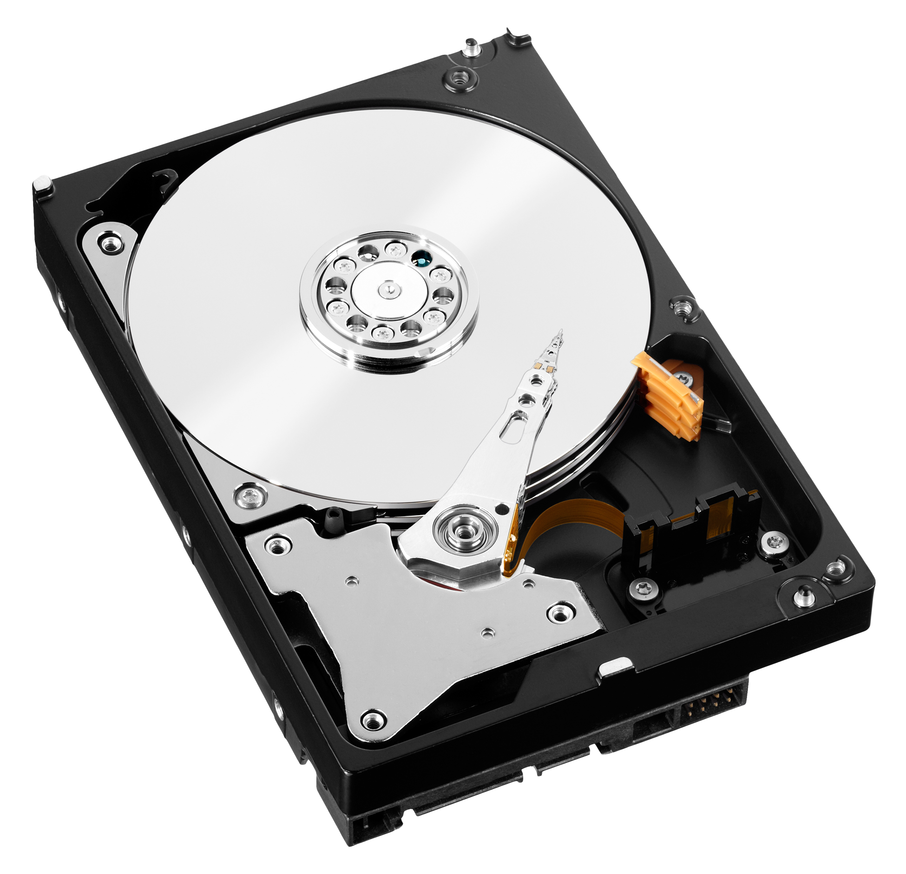
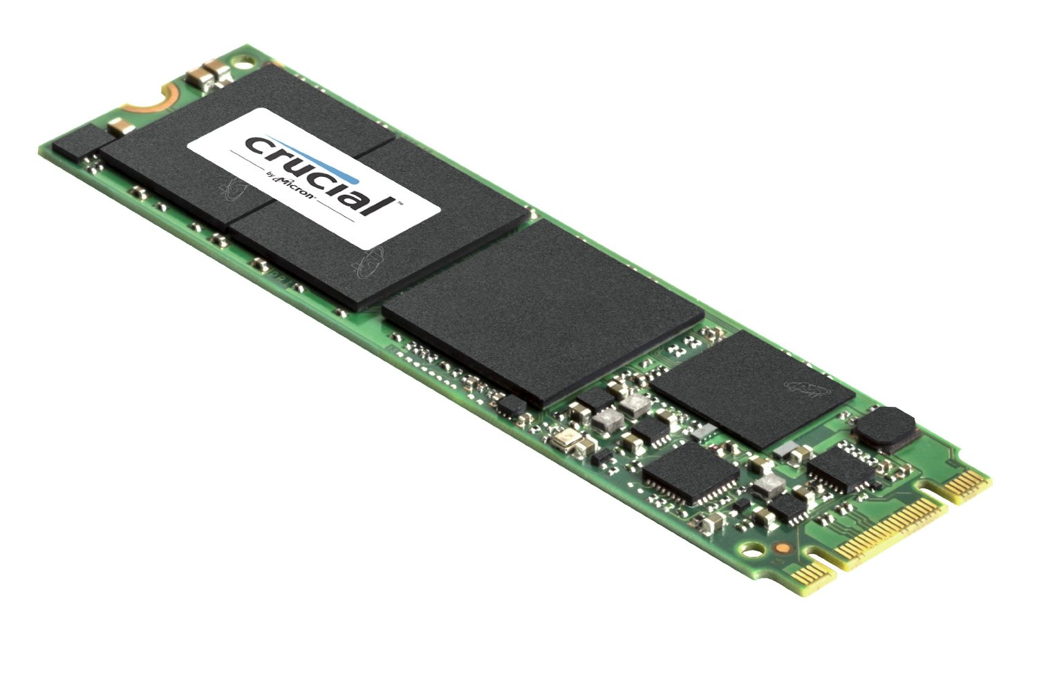
Hard Drives
Permanent long-term storage
Size usually in hundreds of gigabytes (GB) or terabytes (TB)
Spinning (or mechanical) hard disk drives (HDD) versus solid state hard drives (SSD)
Connected via SATA or PATA
Notes:
Hard drives are fundamental components in computers, providing permanent long-term storage for data and files.
These drives are available in various sizes, commonly measured in hundreds of gigabytes (GB) or terabytes (TB). This storage capacity allows users to store a multitude of documents, applications, multimedia files, and other data.
Two prominent types of hard drives are spinning (or mechanical) hard disk drives (HDD) and solid-state hard drives (SSD). HDDs consist of spinning disks (platters) and read/write heads that move across the platters to access data. On the other hand, SSDs use NAND-based flash memory to store data, resulting in significantly faster access times and improved durability compared to HDDs.
Hard drives are connected to the motherboard using different interfaces. SATA (Serial Advanced Technology Attachment) and PATA (Parallel ATA) are two common interfaces used for this purpose. SATA, being newer and faster, has largely replaced the older PATA technology. SATA cables are used to connect hard drives to the motherboard, facilitating data transfer and power supply.
In summary, hard drives play a crucial role in storing and preserving data over the long term. They come in varying sizes, ranging from hundreds of gigabytes to terabytes. The choice between HDDs and SSDs influences factors like speed, durability, and power consumption. These drives are connected to the motherboard via interfaces like SATA or PATA, enabling seamless data transfer between the storage device and other system components.

Slide 12
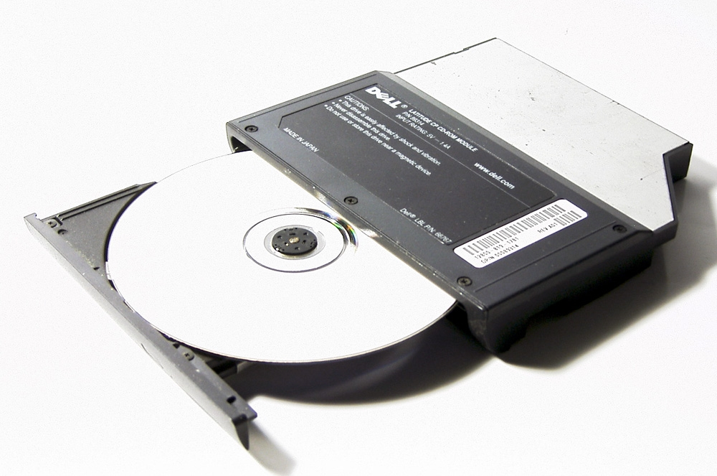
Optical drives
CD-ROM
Compact Disc Read Only Memory
DVD-ROM
Digital Video Disc Read Only Memory
BD-ROM
Blu-ray Read Only Memory
Notes:
Optical drives, which were introduced as hardware components to read various types of optical discs, have played a significant role in data storage and media consumption. Here, we'll explore three common types of optical drives along with their associated disc formats and their respective creation periods:
1. **CD-ROM (Compact Disc Read Only Memory):**
CD-ROM drives were introduced in the early 1980s, marking a revolutionary advancement in data storage and distribution. Compact discs, which CD-ROM drives read, allowed for the distribution of software, multimedia content, and music in a standardized digital format.
2. **DVD-ROM (Digital Video Disc Read Only Memory):**
DVD-ROM drives emerged in the late 1990s, building upon the foundation of CD technology. DVDs, with their higher storage capacity, enabled the storage of more substantial multimedia files, movies, and complex software programs.
3. **BD-ROM (Blu-ray Read Only Memory):**
BD-ROM drives came into existence in the early 2000s, with Blu-ray technology introducing an even higher storage capacity compared to DVDs. This technology was particularly noteworthy for its ability to store high-definition video content and large data files.
These optical drives utilize lasers and sophisticated mechanisms to accurately read the data stored as microscopic indentations on the optical discs. Over time, the significance of optical drives has evolved due to the advent of digital distribution and cloud-based storage methods. While their popularity has waned, optical drives remain relevant for specific use cases, particularly those involving legacy software, physical media collections, and niche data storage needs.

Slide 13
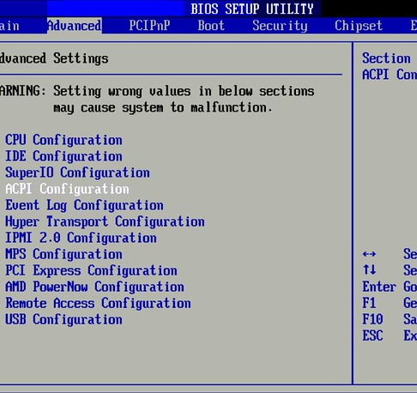
Power, BIOS, and CMOS Battery
Power Connectors for power supply
Basic Input/Output System (BIOS) boots the system and initiates hard drive and memory
Complimentary Metal Oxide Semiconductor (CMOS) chip holds BIOS
CMOS battery helps chip store BIOS information when powered off

Slide 14
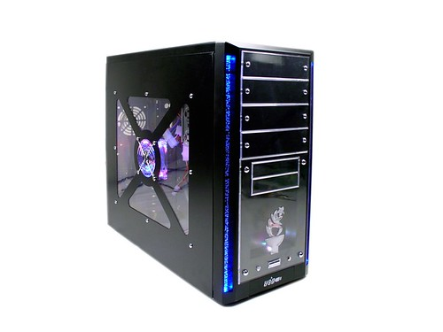
Back and Front Panel
Back panel connectors
For keyboards, mice, network cables, and more
Will cover in detail in Chapter 2
Front panel connectors
Power and reset buttons
Drive activity lights
Audio ports
Other connectors, such as USB
Notes:
The back and front panels of a computer serve as crucial interfaces that facilitate connections, interactions, and control over various hardware components. Let's delve into the specific functionalities of these panels:
**Back Panel Connectors:**
The back panel of a computer features a range of connectors that provide access to external devices and peripherals. These connectors play a pivotal role in expanding the functionality of the computer. For instance, they accommodate connections for keyboards, mice, network cables, displays, audio devices, and more. These connectors facilitate seamless communication between the computer system and external hardware. A detailed exploration of back panel connectors will be provided in Chapter 2, where you'll gain insights into their roles and applications.
**Front Panel Connectors:**
The front panel of a computer, situated on the computer case's front side, offers easy access to several essential components and features. It includes controls and indicators that enable users to interact with the system conveniently. The front panel connectors typically include:
- **Power and Reset Buttons:** These buttons allow you to turn the computer on and off or initiate a system reset.
- **Drive Activity Lights:** These indicators provide visual feedback about the activity of hard drives or SSDs. They blink or light up when data is being read from or written to storage devices.
- **Audio Ports:** Front panel audio ports allow users to connect headphones, microphones, and other audio devices directly to the computer case, enabling convenient audio input and output.
Additionally, the front panel may include connectors such as USB ports, providing easy access for connecting USB devices like flash drives, external hard drives, and smartphones.
Understanding the functionalities of the back and front panels of a computer is essential for effectively utilizing the various connectors and controls available. These panels enable efficient communication between the computer and external devices, enhancing the overall user experience and system functionality.

Slide 15
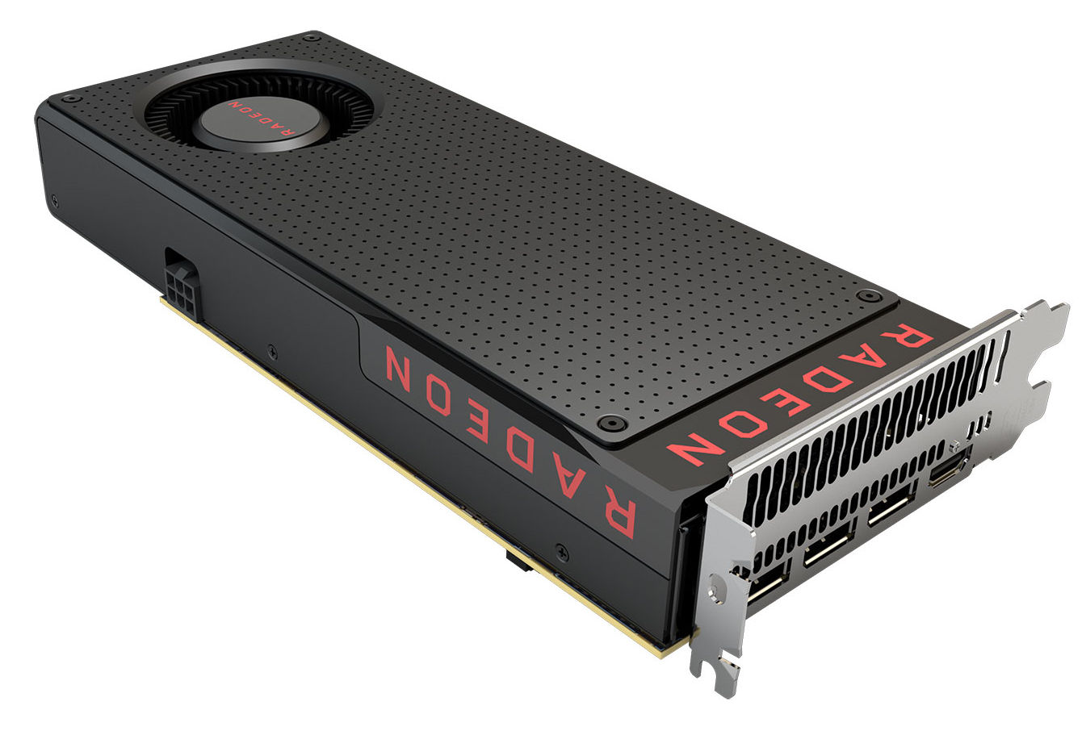
Video Cards
Also called graphics cards or video adapters
Responsible for rendering video
Monitor is connected to them
Good ones will have a graphics processing unit (GPU) and their own memory
Typically PCIe
Notes:
Video cards, also known as graphics cards or video adapters, are integral components of computer systems that play a critical role in rendering video and graphics-intensive content. These cards are responsible for generating images, videos, and animations that are displayed on computer monitors and other output devices.
The key functions and characteristics of video cards include:
1. **Rendering Video:** Video cards are designed to handle the complex calculations required for rendering graphics and videos. They process data related to colors, textures, lighting, and other visual elements to create the images you see on your screen.
2. **Monitor Connectivity:** Video cards provide the necessary ports and connectors to connect computer monitors and other display devices. They offer a variety of output options, including HDMI, DisplayPort, DVI, and VGA, allowing users to connect their systems to various types of displays.
3. **Graphics Processing Unit (GPU):** High-quality video cards feature a dedicated Graphics Processing Unit (GPU), a specialized processor designed for handling graphics-related computations. GPUs are optimized for parallel processing, making them particularly effective at tasks like rendering 3D graphics and video playback.
4. **Dedicated Memory:** Advanced video cards often come equipped with their own dedicated memory, referred to as Video RAM (VRAM). This memory is used to store textures, frame buffers, and other graphics-related data, ensuring smoother performance and reduced reliance on the system's main memory.
5. **Interface:** Video cards are typically connected to the motherboard through a PCIe (Peripheral Component Interconnect Express) slot. PCIe offers high data transfer rates, which are essential for handling the large amount of data involved in rendering complex graphics.
6. **Gaming and Graphics Performance:** Video cards are especially important for gaming and graphics-intensive applications. A high-performance video card can significantly improve the quality and smoothness of gameplay, as well as the overall visual experience when working with graphic design, video editing, and 3D modeling software.
In summary, video cards are pivotal components that enhance the visual experience of a computer system. They are responsible for rendering graphics and videos, connecting monitors, and enabling tasks that demand intense graphical processing. The inclusion of a dedicated GPU and dedicated memory in advanced video cards contributes to improved performance and better graphics quality. The use of PCIe ensures efficient data communication between the video card and the rest of the system.

Slide 16
Sound Cards
Produce sound
Often integrated into the motherboard
Notes:
Sound cards are hardware components responsible for producing audio output from a computer system. They play a crucial role in generating sound effects, music, and speech that users hear through speakers or headphones. Sound cards enhance the multimedia experience by enabling high-quality audio playback and enabling communication through voice applications.
While many modern motherboards come with integrated audio capabilities, separate sound cards can offer several benefits:
1. **Enhanced Audio Quality:** Dedicated sound cards often provide superior audio quality compared to integrated solutions. They have specialized components and circuitry designed to minimize interference and produce clearer, more accurate sound.
2. **Audio Customization:** Some sound cards come with software that allows users to customize audio settings, equalizers, and effects. This enables users to tailor the audio output to their preferences and the type of content they're enjoying.
3. **Support for Surround Sound:** High-end sound cards can support surround sound formats like 5.1 or 7.1, creating a more immersive audio experience for gaming, movies, and multimedia content.
4. **Reduced System Load:** Offloading audio processing to a dedicated sound card can free up system resources (CPU) that would otherwise be used for audio processing. This can result in improved overall system performance, especially when multitasking or running resource-intensive applications.
5. **Specialized Audio Work:** Professionals in fields such as music production, audio engineering, and content creation may require specialized sound cards with advanced features and connectivity options to ensure precise audio recording and mixing.
6. **Connectivity Options:** Dedicated sound cards may offer a range of input and output options, including optical or coaxial digital outputs, analog outputs, and microphone inputs. This variety of connections allows users to connect a wide range of audio devices.
In summary, sound cards are responsible for producing audio output in computer systems. While integrated audio solutions are common, dedicated sound cards can provide improved audio quality, customization options, support for surround sound, and reduced strain on system resources. The choice between integrated audio and dedicated sound cards depends on the user's audio needs and preferences, as well as the intended usage of the computer system.

Slide 17
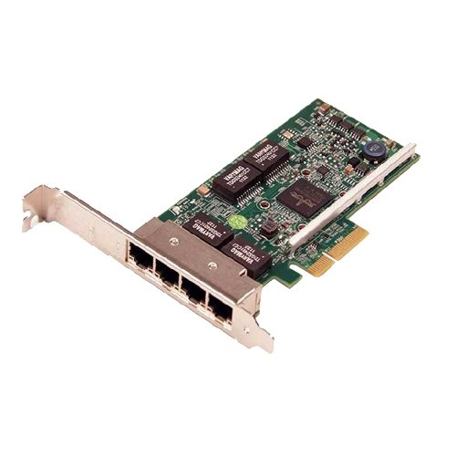
Network Cards
Network Interface Card (NIC)
Allow the computer to participate on a network
Wired (needs a cable to send/receive network signals) or wireless (no cable needed)
Notes:
Network cards, also known as Network Interface Cards (NICs), are vital components that enable computers to connect and participate in networks, whether local or global. They serve as the bridge between the computer and the network, facilitating communication and data exchange. Network cards play a crucial role in enabling internet connectivity, file sharing, and various network-based applications.
Key features and aspects of network cards include:
1. **Network Participation:** Network cards provide the essential hardware interface that allows computers to join and interact with networks. They enable the transmission and reception of data packets between the computer and other devices on the network.
2. **Wired and Wireless Connectivity:** Network cards come in two main types: wired and wireless. Wired network cards require a physical cable connection to send and receive network signals. They are commonly used in Ethernet networks. Wireless network cards, also known as wireless adapters, enable connectivity without the need for cables, using radio signals to communicate with wireless routers or access points.
3. **Data Transmission:** Network cards convert digital data from the computer into signals that can be transmitted over the network medium. They also interpret incoming signals and convert them back into usable data for the computer.
4. **Speed and Bandwidth:** Network cards are available in various speeds, often measured in megabits per second (Mbps) or gigabits per second (Gbps). The speed of the network card impacts the data transfer rate and overall network performance.
5. **Compatibility:** Network cards need to be compatible with the network type and protocols in use. For example, Ethernet network cards are designed to work with Ethernet networks, and wireless network cards support Wi-Fi protocols.
6. **Driver Software:** To ensure proper functioning, network cards require driver software that allows the operating system to communicate with the card effectively. These drivers provide necessary instructions for data transmission, reception, and network configuration.
In summary, network cards, or NICs, enable computers to participate in networks, whether wired or wireless. They serve as the conduit for data exchange, enabling internet connectivity, file sharing, and network-based applications. Wired network cards use physical cables to connect to networks, while wireless network cards utilize radio signals for communication. The choice between wired and wireless network cards depends on factors such as network infrastructure and mobility requirements.

Slide 18
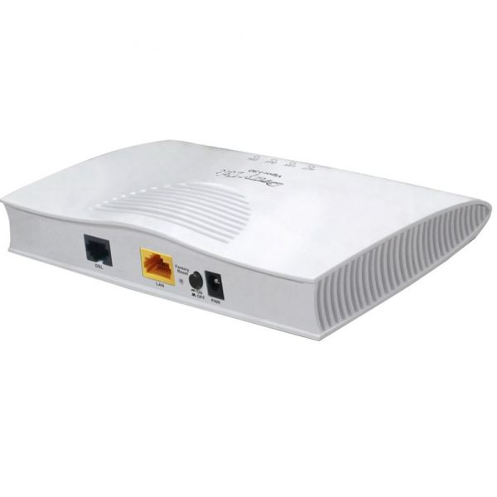
Modems
Practically obsolete today
Allows a computer to participate on a network via standard telephone lines
Notes:
Modems, although practically obsolete in modern computing environments, once played a crucial role in facilitating network connectivity through standard telephone lines.
A modem, short for "modulator-demodulator," is a device that converts digital data from a computer into analog signals that can be transmitted over telephone lines. It also performs the reverse operation, converting incoming analog signals back into digital data that the computer can understand.
Key points about modems include:
1. **Network Connectivity:** Modems were essential for connecting computers to networks, particularly the internet, through standard telephone lines. They enabled users to access online services, websites, and other network resources.
2. **Telephone Line Usage:** In the past, modems utilized the existing infrastructure of telephone lines to transmit data. Computers were connected to modems, which were then connected to telephone lines for data transmission.
3. **Data Transmission Speeds:** Modems were characterized by their data transmission speeds, measured in bits per second (bps). Over time, modem technology advanced from slow speeds like 300 bps to higher speeds like 56 Kbps (kilobits per second) and even higher.
4. **Obsolete Technology:** Modems have become practically obsolete today due to the advent of faster and more efficient broadband internet technologies such as DSL (Digital Subscriber Line), cable, fiber optics, and wireless connections. These technologies offer significantly higher data transmission speeds compared to traditional modem-based connections.
5. **Legacy Applications:** While modems are no longer a primary means of internet connectivity, they might still have limited use in specialized applications, remote locations with limited infrastructure, or as a backup option in case of primary connection failure.
In summary, modems were once indispensable devices that allowed computers to participate in networks, particularly through standard telephone lines. However, with the advancement of broadband and high-speed internet technologies, modems have become largely obsolete in modern computing contexts. The increased efficiency and speed of broadband connections have contributed to the shift away from traditional modem-based connections.

Slide 19
Power Supplies
Power Supply Unit (PSU)
Converts AC from wall to DC the computer needs
Capacity measured in watts
Has connectors for the motherboard as well as peripherals such as hard drives, optical drives, and video cards
Notes:
Power supplies, also referred to as Power Supply Units (PSUs), are essential components within computer systems that provide the necessary electrical power to operate the various hardware components. They play a critical role in converting the alternating current (AC) received from the electrical outlet into the direct current (DC) required by the computer's internal components.
Key aspects and functions of power supplies include:
1. **AC to DC Conversion:** Power supplies are responsible for converting the standard alternating current (AC) supplied from the wall outlet into the direct current (DC) needed by the computer's internal components. DC is the type of electrical current that most computer components, including CPUs, memory, and storage devices, operate on.
2. **Capacity and Wattage:** The capacity of a power supply is measured in watts (W) and indicates the maximum amount of power it can deliver. It's important to choose a power supply with sufficient wattage to meet the demands of all the components in the computer system. Insufficient wattage can lead to instability, crashes, or even system damage.
3. **Connectors:** Power supplies are equipped with a variety of connectors designed to provide power to different components within the computer. These connectors include those for the motherboard, CPU, hard drives, optical drives, graphics cards, and other peripherals. Different types of connectors ensure that power is delivered precisely where it's needed.
4. **Modular and Non-Modular PSUs:** Some power supplies are modular, allowing users to attach only the necessary cables and connectors, reducing cable clutter within the computer case. Non-modular power supplies have fixed cables, which can lead to more cable clutter but may be more cost-effective.
5. **Efficiency and Certification:** Power supplies are rated for efficiency, with higher efficiency percentages indicating that the PSU wastes less energy as heat. The efficiency of a PSU can impact power consumption and heat generation within the system. Additionally, some power supplies are certified by organizations like 80 PLUS, indicating their efficiency levels.
6. **Protection and Safety:** Power supplies often include various safety features, such as over-voltage protection, under-voltage protection, over-current protection, and short-circuit protection. These features help safeguard the components from potential damage due to power irregularities.
In summary, power supplies are critical components that ensure a stable and reliable power source for all computer hardware. They convert AC to DC, providing the appropriate electrical current to each component. The capacity, connectors, efficiency, and safety features of power supplies are essential considerations when selecting the appropriate PSU for a computer build.

Slide 20
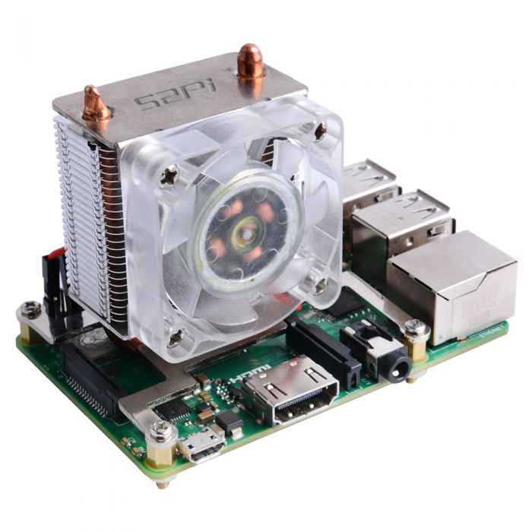
Cooling Systems
Computers get hot – components such as the processor can melt
Case cooling
Front intake fan
Rear exhaust fan
Power supply exhaust fan
CPU cooling
On the processor itself
Usually heat sink and a fan
Liquid cooling and other advanced methods available
Notes:
Cooling systems are critical components in computer systems, serving the vital purpose of dissipating heat generated by various hardware components. Excessive heat can lead to performance degradation, instability, and even permanent damage to sensitive parts. Here's a detailed look at the importance of cooling systems and their different aspects:
**Heat Generation and Cooling Necessity:**
Computers generate heat during operation due to the energy consumption and electronic processes occurring within components like the CPU, GPU, and other integrated circuits. Excessive heat can lead to thermal throttling, reduced lifespan of components, and even catastrophic failures.
**Case Cooling:**
Case cooling involves managing the temperature within the computer case by maintaining proper airflow. This is achieved through various cooling fans strategically placed within the case:
- **Front Intake Fan:** Located at the front of the case, this fan draws in cooler air from the environment.
- **Rear Exhaust Fan:** Positioned at the rear of the case, this fan expels warm air out of the case.
- **Power Supply Exhaust Fan:** The power supply unit (PSU) also contributes to case cooling by expelling warm air generated within the power supply itself.
**CPU Cooling:**
Efficient CPU cooling is crucial because the processor can generate substantial heat during operation. CPU cooling methods include:
- **Heat Sink and Fan:** Most CPUs come with a heat sink and fan assembly. The heat sink draws heat away from the CPU and transfers it to the metal fins, while the fan helps dissipate the heat into the surrounding air.
- **Liquid Cooling:** Liquid cooling systems use a liquid coolant to transfer heat away from the CPU. These systems include a pump, radiator, and a liquid block that contacts the CPU.
- **Advanced Cooling Methods:** Some enthusiasts and professionals opt for more advanced cooling solutions, such as custom liquid cooling loops or phase-change cooling, which involve sub-ambient cooling using techniques like refrigerants.
**GPU Cooling:**
Graphics cards (GPUs) also require effective cooling due to their intense processing activities. GPUs often come with cooling solutions similar to those used for CPUs, including heat sinks and fans or even liquid cooling options.
In conclusion, cooling systems are essential to prevent overheating and ensure the optimal performance and longevity of computer components. Adequate case cooling, CPU cooling, and GPU cooling mechanisms are critical for maintaining stable operation and safeguarding hardware from heat-related issues. As computer components become more powerful and energy-efficient, managing heat becomes an increasingly important consideration for both casual users and enthusiasts.

