Slide 1
ITI 499 - Mastering Windows Fundamentals
Session IV
Part VI - Installing and Removing Devices
Part VII - Using Windows 10 Security Features
www.profburnett.com
Master a Skill / Learn for Life

Slide 2
Part VI - Installing and Removing Devices

Slide 3
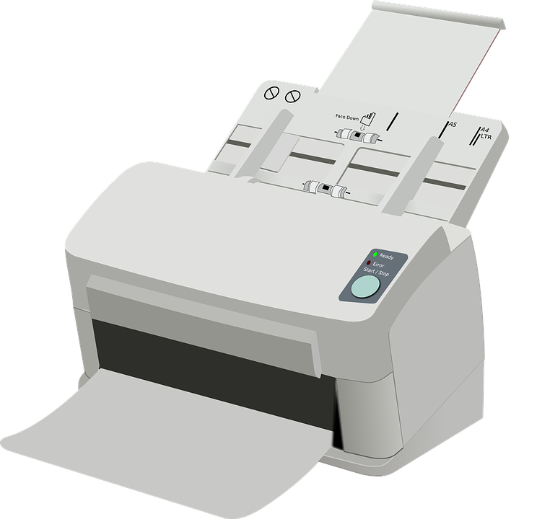
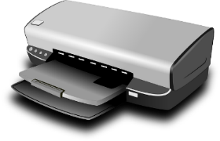
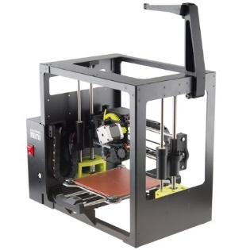
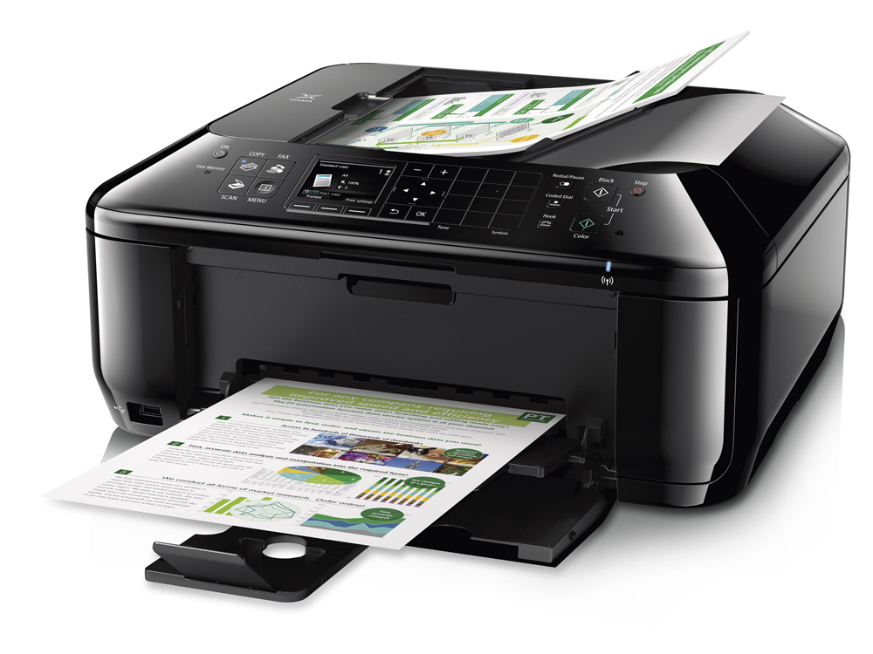
Printers
Laser Printer
Inkjet Printer
Other Types of Device (for example, 3D printer)
Multifunction Device (for example, printer + scanner)
Print to File Option (for example, PDF)

Slide 4
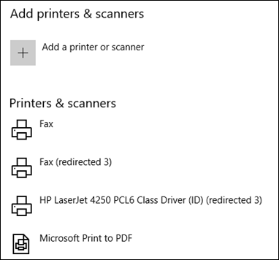
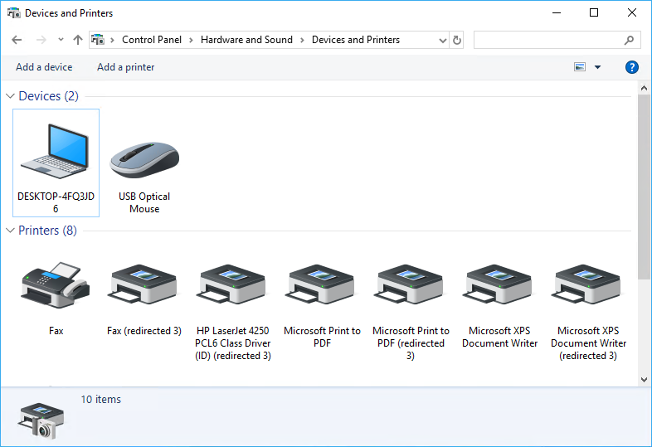
Printer Installation
From Settings app
From Control Panel
View available printers

Slide 5
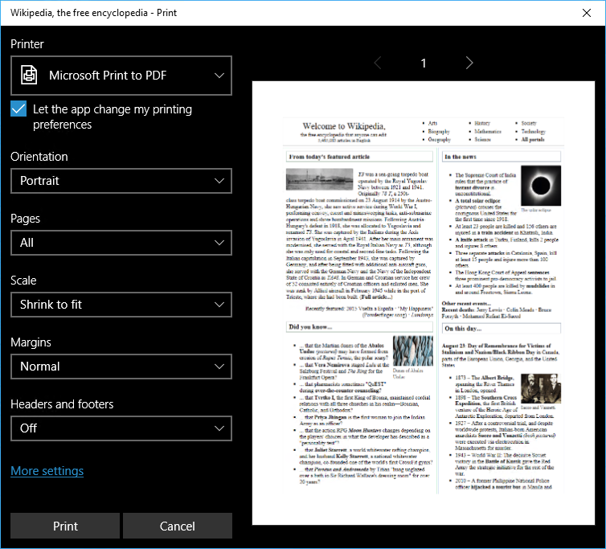
Dialog Boxes
Select print device or send output to an application
Select pull-down menus for options
Document Preview
Settings options such as page layout

Slide 6
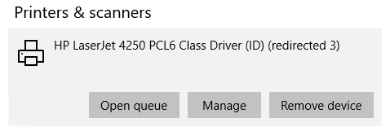
Printer Removal

Slide 7
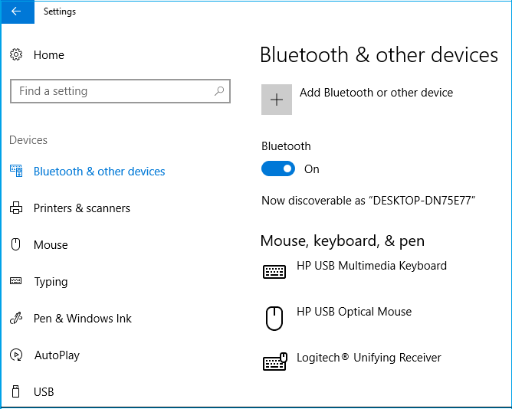
Peripheral Devices
Add devices
View available devices

Slide 8
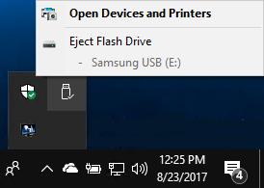
Peripheral Device Removal
Safely Remove Hardware and Eject Media Icon
Show Hidden Icons

Slide 9
Reflective Questions
Do you plan to have multiple printers connected to your device? Do you feel confident you know how to set the default printer?
Do you install your own peripheral devices or do you have an IT person at your office who does that for you?

Slide 10
Class Exercises
ACTIVITY 6-1 Printing a Document, Page 134
ACTIVITY 6-2 Managing Peripheral Devices, Page 138

Slide 11
Part VII - Using Windows 10 Security Features

Slide 12
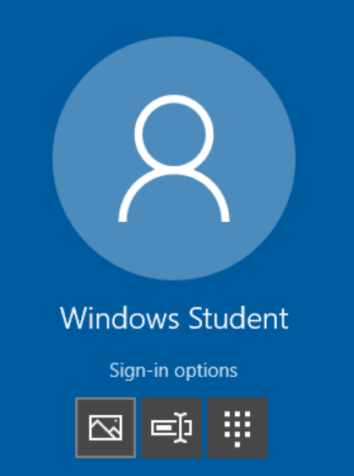
Sign-in Options
Select link to see icons.
Picture
Password
PIN

Slide 13
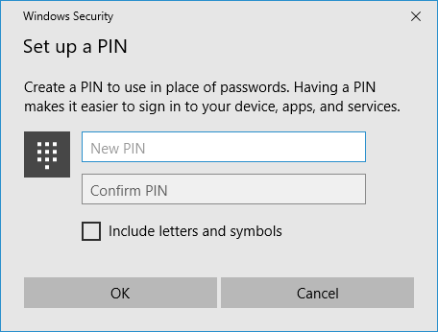
PIN

Slide 14
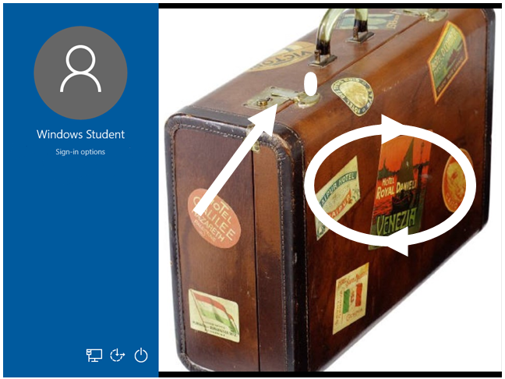
Picture Passwords

Slide 15
Guidelines for Creating Passwords
Picture Password > Password > PIN
>
>
When creating a password:
Use 8 or more characters.
Include a random mix of upper- and lowercase letters, numbers, and symbols.
Don’t use personal information easily found via an Internet search.
Don’t use the same password for multiple accounts.
When creating a PIN:
Use four different digits.
Do not use four sequential numbers.
Do not use easily researched numbers like your house number or family members’ birthdays.
When creating a picture password:
Pick a photo that has at least 10 “points of interest.”
Do not repeat the same gesture twice.
Clean the screen to avoid people deciphering your password via smudges.

Slide 16
Privacy Settings
Privacy Setting | Provides Settings To
General | Turn on/off apps customized advertising. Turn on/off websites providing content based on languages. Turn on/off sending Microsoft information about app launches. Turn on/off Windows showing you suggested content in Settings.
Location | Turn location services on/off, set default location, and clear history. Manage location history stored in the cloud. Select apps that can use precise location data. Manage which apps can use your location or geofencing.
Camera, Microphone, Calendar, Messaging, Radios, Notifications Contacts, Call history, Email, Radios, and Tasks | Turn off access to each feature for entire device or specific apps.
Speech, inking, & typing | Stop Cortana from getting to know you. Manage Bing personalization settings.
Account info | Manage which apps can access your account information.
Other devices | Let your apps use trusted devices like Xbox One, TVs, and projectors.
Feedback & diagnostics | Manage how often Windows can ask for feedback. Manage the amount of diagnostic information sent to Microsoft.
Background apps | Manage which apps can receive and send data even when not in active use.
App diagnostics | Turn on/off apps being able to access diagnostic information.
App-requested downloads | Unblock apps from downloading files from the cloud if previously blocked.

Slide 17
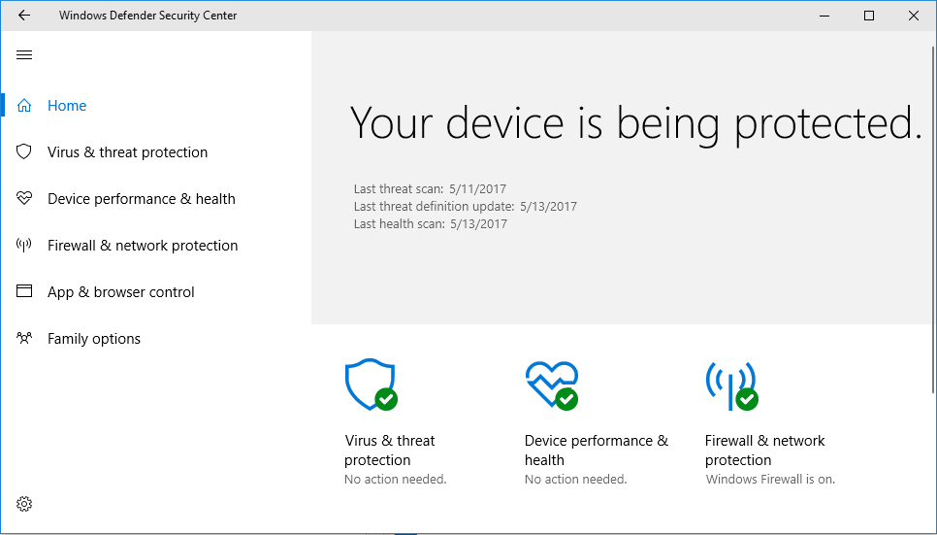
The Windows Defender Dashboard
View current protection status and perform scans.
Update virus definitions.
Check device health.
Check firewall status.
Configure SmartScreen.
Configure parental controls.

Slide 18
Reflective Questions
How likely are you to use one of the alternative password types in Windows 10?
What privacy settings do you think you'll turn on or off in Windows 10?

Slide 19
Class Exercises
ACTIVITY 7-1 Setting New Password Types, Page 146
ACTIVITY 7-2 Changing Privacy Settings, Page 151
ACTIVITY 7-3 Checking for Viruses in Windows Defender, Page 156

