Slide 1
ITI 499 - Mastering Windows Fundamentals
Session III
Part V - Customizing the Windows 10 Environment
www.profburnett.com
Master a Skill / Learn for Life

Slide 2
Part V - Customizing the Windows 10 Environment

Slide 3
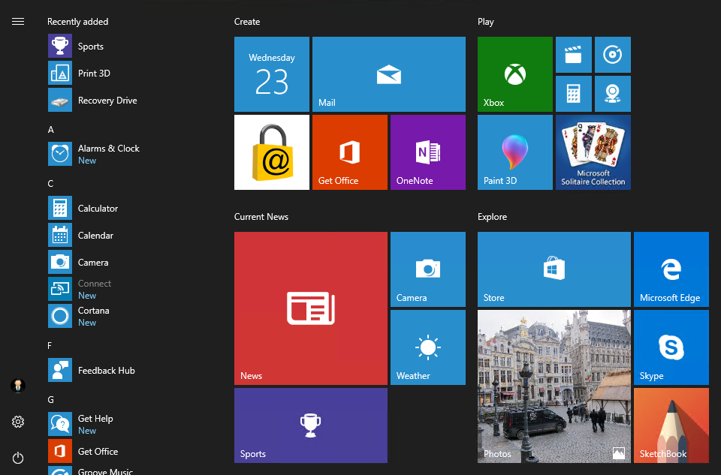
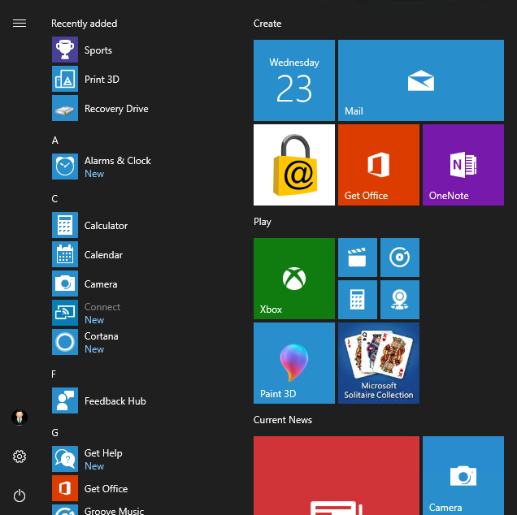
Start Menu Resizing
Original Start Menu
Resized Start Menu

Slide 4
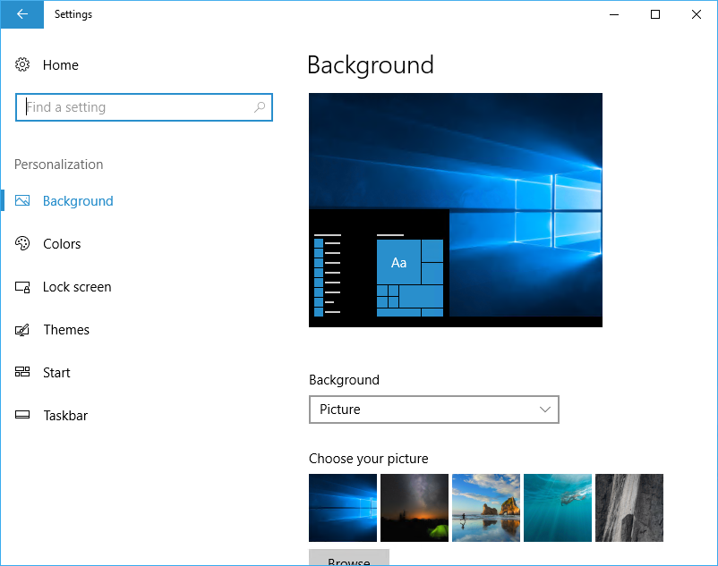
Personalization Settings

Slide 5
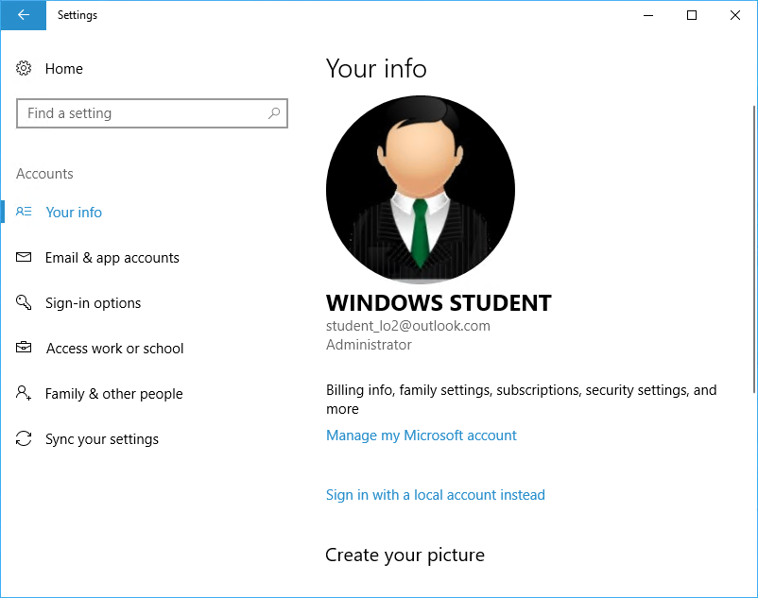
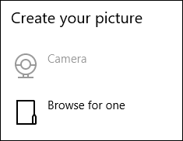
Account ID
Select an image

Slide 6
Tile Command Menu Options
Tile Command Menu Option | Allows You To
Pin to Start/Unpin from Start | Save or remove a program tile on the Start menu.
Pin to taskbar/Unpin from taskbar | Save or remove program icons on the taskbar.
Uninstall | Uninstall an app or an application.
Resize | Change the size of a tile.
Turn Live Tile on/Turn Live Tile off | Activate or deactivate live updates for an app.
Rate and review | Provide a rating and write a review for an app in the Windows Store.
Share | Share an app with your contacts.
Run as administrator | Run application in an elevated security context. Does not apply to apps.
Open file location | Open location of the application's executable file in File Explorer.

Slide 7
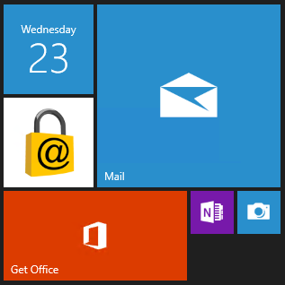
Resized Tiles

Slide 8
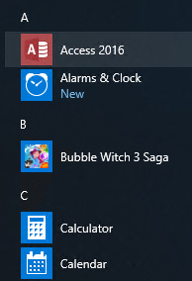
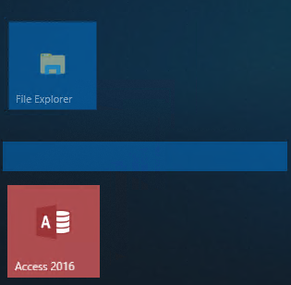
Tile Groups
1
Drag a program from the All apps list or a pinned tile to a blank section.
Name the Group
2

Slide 9
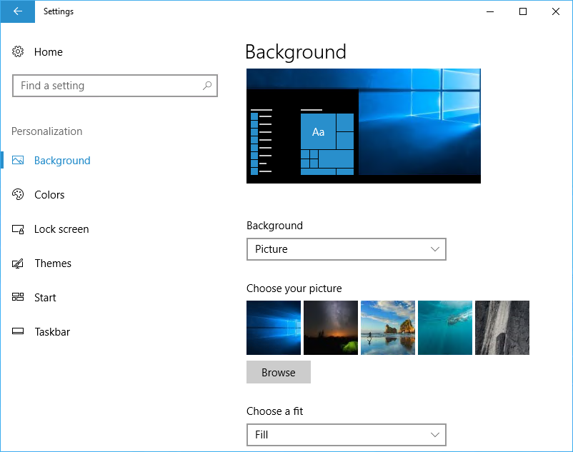
Background
Select background option
Choose your picture
Choose the fit of the picture

Slide 10
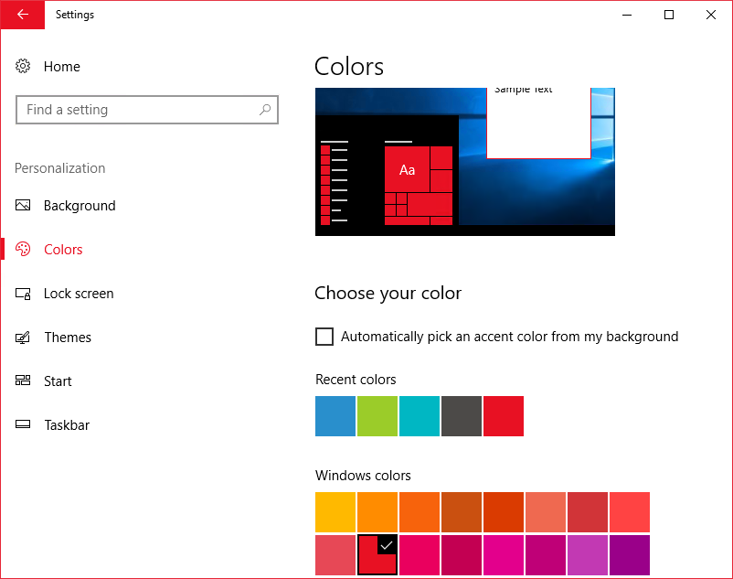
Colors
Color applied to various interface elements
Selected color

Slide 11
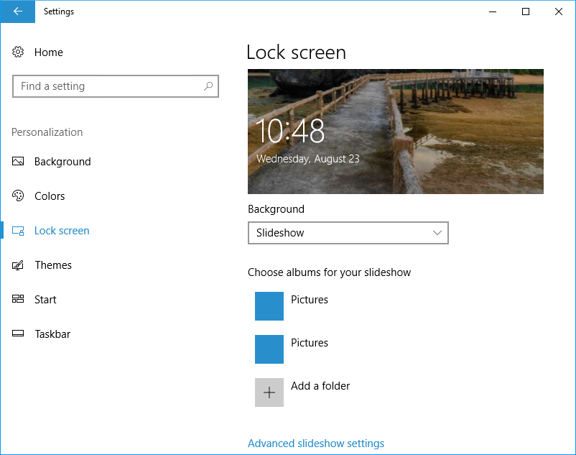
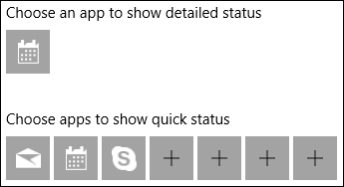
Lock Screen
Choose background picture options
Choose apps for Lock screen notifications
Select pictures or albums

Slide 12
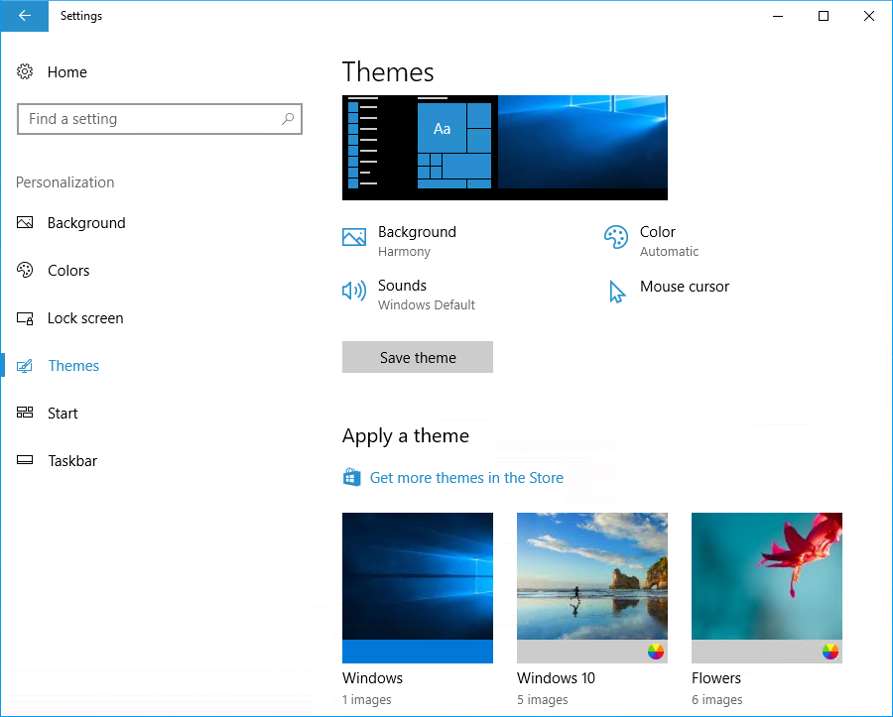
Themes

Slide 13
Ease of Access Options
Ease of Access Option | Uses
Narrator | Enables you to choose options for having text and controls read aloud to you.
Magnifier | Enables you to magnify or reduce your screen and choose the type of magnification view you want to see.
Color & high contrast | Enables you to select and adjust elements in a high-contrast theme such as colors for text, hyperlinks, and more.
Closed captions | Enables you to adjust how closed captions appear in Windows apps.
Keyboard | Enables you to select keyboard options, including the ability to use the on-screen keyboard.
Mouse | Enables you to change mouse settings.
Other options | Enables you to change visual display options.

Slide 14
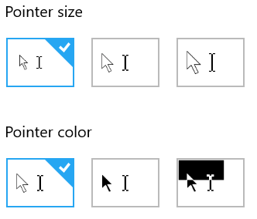
Pointer Options

Slide 15
Reflective Questions
How might tile groups help you in your day-to-day work?
Why might you customize the look of your computer and pointer?

Slide 16
Class Exercises
ACTIVITY 5-1 Changing Start Menu Options, Page 113
ACTIVITY 5-2 Working with Tiles and Tile Groups, Page 117
ACTIVITY 5-3 Customizing the Desktop and Lock Screen, Page 125

