Slide 1
ITI 499 - Mastering Windows Fundamentals
Session II
Part III - Working with Files and Folders
Part IV - Using Cortana and Edge
www.profburnett.com
Master a Skill / Learn for Life

Slide 2
Part III - Working with Files and Folders

Slide 3
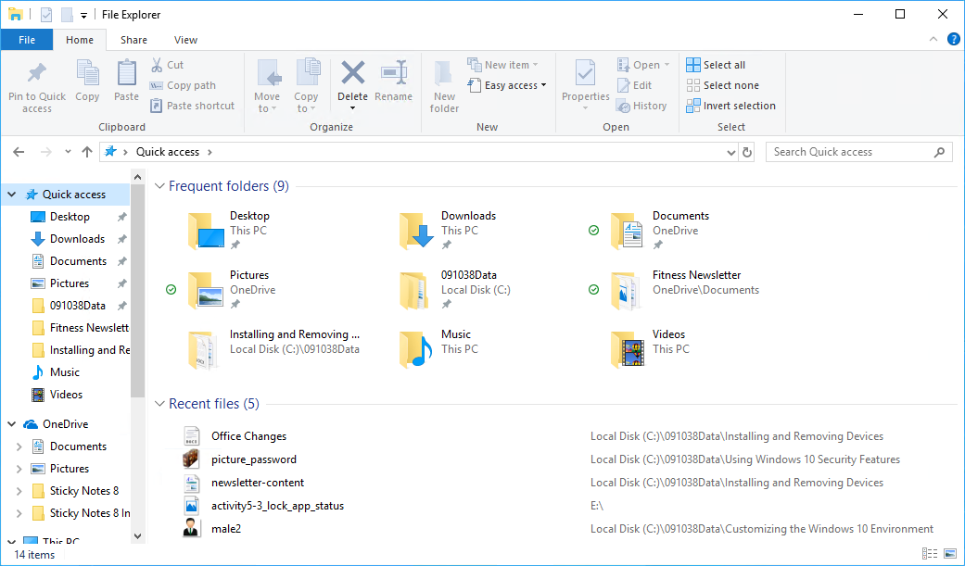
File Explorer
Navigation Pane
Content Pane

Slide 4
File Explorer Window
Address Bar
Search Bar
Ribbon
Back and Forward Buttons
Up to Button
Caret

Slide 5
File Explorer Ribbon
Ribbon Tabs

Slide 6
Ribbon Tabs
Ribbon Tab | Description
File | Accessing command-line functionality Changing folder and search options Accessing Help Exiting File Explorer
Home | Copying and pasting files Organizing files Creating new files Opening files Selecting files to work with
Share | Sharing files with apps Sharing folder access with other users or groups Compressing (zipping) folders Sending files to devices such as printers, fax machines, or discs Setting security preferences for files
View | Selecting which panes to display Selecting the layout of icons Selecting sort options Selecting display columns Showing or hiding items Changing folder and search options

Slide 7
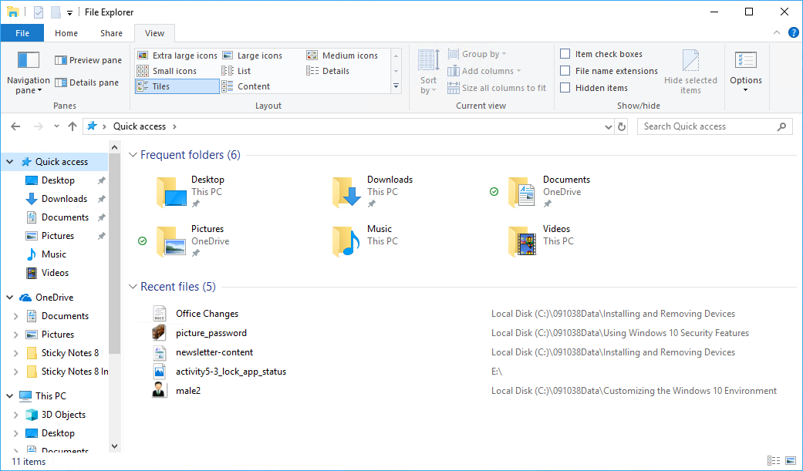
Quick Access
Quick Access

Slide 8
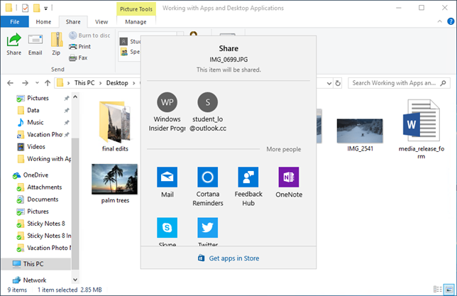
File Share
Share Icon
Apps with the Share Contract

Slide 9
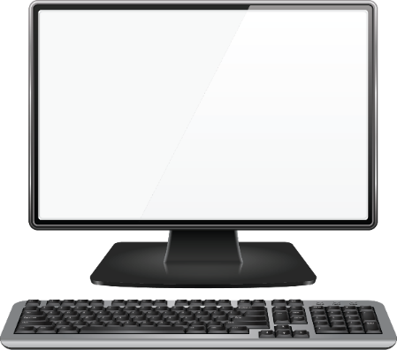
Cloud Computing
Cloud
File 1
Folder A
Personal Computer
Tablet
File 1
File 1
Folder A
Folder A

Slide 10
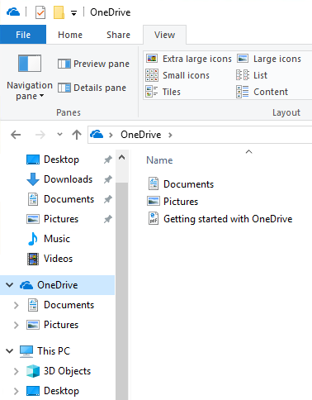
OneDrive
Cloud-based file storage.
Files are accessible at any time, from any device connected to the Internet.
Files are kept up to date on local device and the cloud.
Good for backing up files.

Slide 11
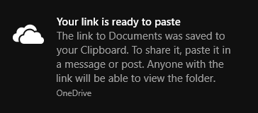
OneDrive Sharing
Share a link to the file in the cloud so that there is only one copy.
Can share files and folders with specific permissions.
Edit
Read-only

Slide 12
File Sync
OneDrive Icon | Description
 | In sync with online version.
 | Syncing.
 | Local version is out of sync. You will need to check the sync status in the taskbar.

Slide 13
Reflective Questions
How does saving files with OneDrive differ from saving them locally?
How do you share files with colleagues when you need to collaborate?

Slide 14
Class Exercises
ACTIVITY 3-1 Managing Files and Folders, Page 63
ACTIVITY 3-2 Uploading and Sharing Files with OneDrive, Page 68

Slide 15
Part IV - Using Cortana and Edge

Slide 16
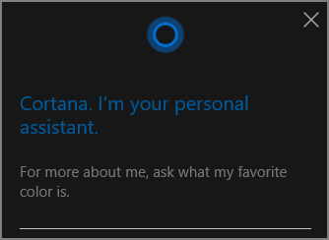
Cortana
Continually learns about you.
Scans your location history, contacts, search history, calendar, and emails.
You can also directly add interests in Notebook settings.
Helps you organize.
Reminds you of events.
Transcribes an email.
Searches your device for files.
Can interact with Windows Store apps.

Slide 17
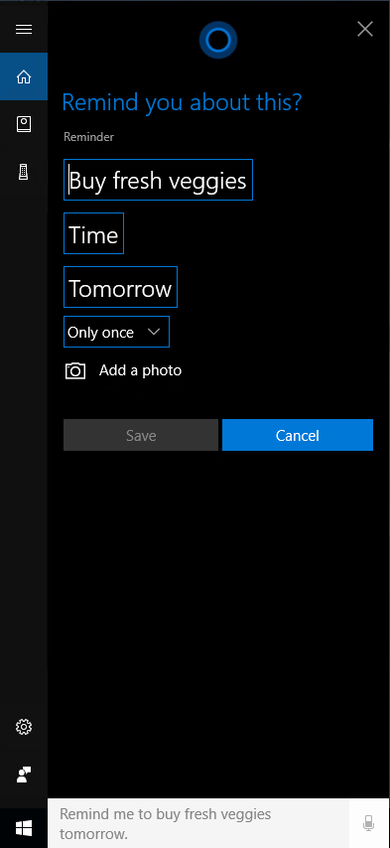
Natural Language Interaction with Cortana
Use natural language when speaking or typing.
Remind me to buy fresh veggies tomorrow.

Slide 18
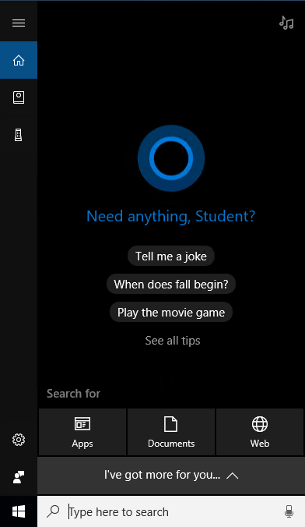
Cortana Home Screen
Daily Glance
Microphone Icon
Search Box

Slide 19
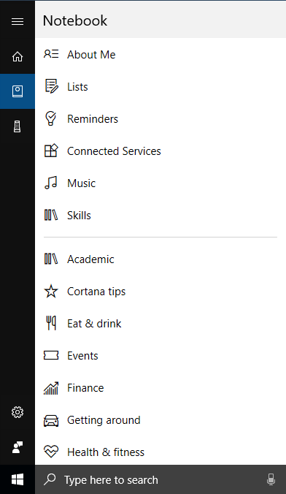
Cortana Notebook
Basic Cortana Settings
Interests

Slide 20
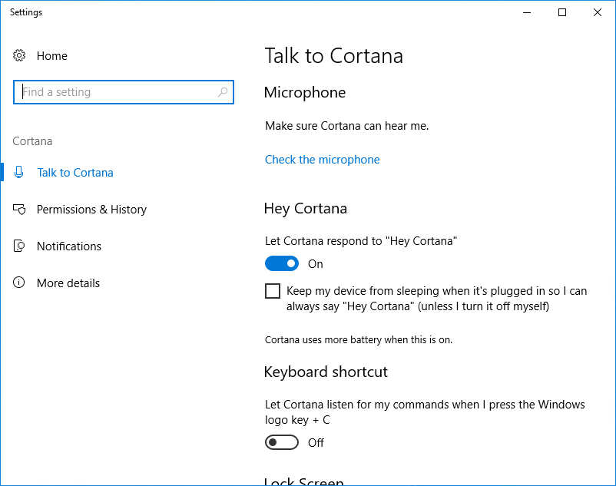
Cortana Settings
Set up a microphone, shortcuts, Lock screen, and language
Manage the data that Cortana and Microsoft store
Activate Cortana notifications
Learn more about Cortana

Slide 21
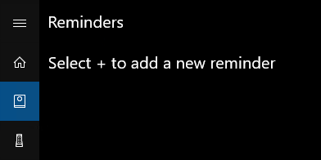
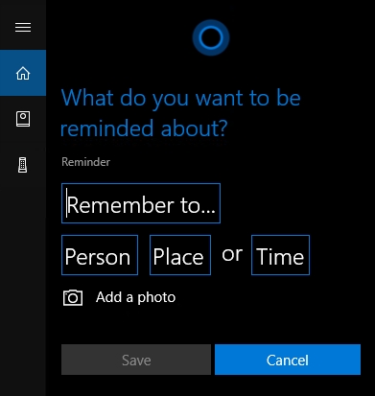
Reminders
Notebook Icon
Add a reminder

Slide 22
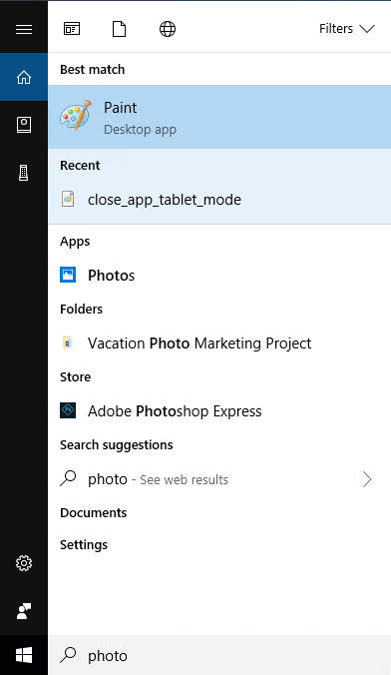
Search
Search documents
Search apps
Search the web
Filter options
App
Recent file
Apps in Windows Store
Search suggestions
Search your device and OneDrive
Search the web with exact text you typed

Slide 23
General Cortana Commands
Category | Sample Command/Questions
Alarm | Set alarm for 6 A.M. tomorrow.
App Commands | Open File Explorer.
Calendar | Create a meeting with Bob at noon Wednesday. What appointments do I have tomorrow?
Facts | What is 735 divided by 10?
Local Businesses | Show me pizza restaurants nearby.
Maps/Directions | What’s the traffic like on the way to work?
Music | What song is playing?
Notes to OneNote | Take note: left car on level 4.
Phone/Skype | Call boss at home.
Reminders | Remind me at 4:30 to email boss with status update.
Weather | Do I need an umbrella today?

Slide 24
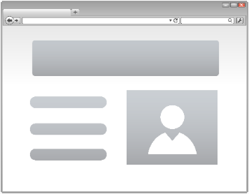
Web Browser
Your Computer
Web Browser
The Internet

Slide 25
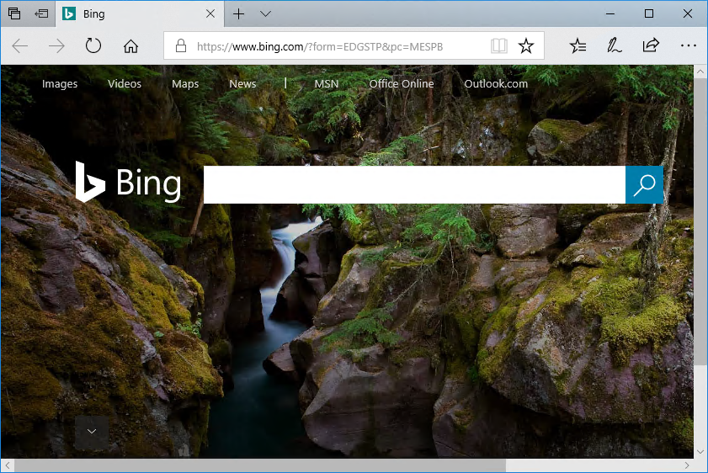
Edge
Add Tab
Tabs
Website preview
Navigation Bar
Address Bar
Web page content

Slide 26
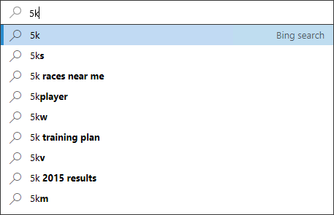
Search in the Address Bar
Enter text in the Address bar text box
Search suggestions are listed

Slide 27
Edge Navigation Bar
Add Notes
Tabs set aside
Tab previews
Hub
Share
Tabs set aside
Back/Forward Buttons
Reading view
Refresh Button
Address Bar
More Actions
Favorites
Home Button

Slide 28
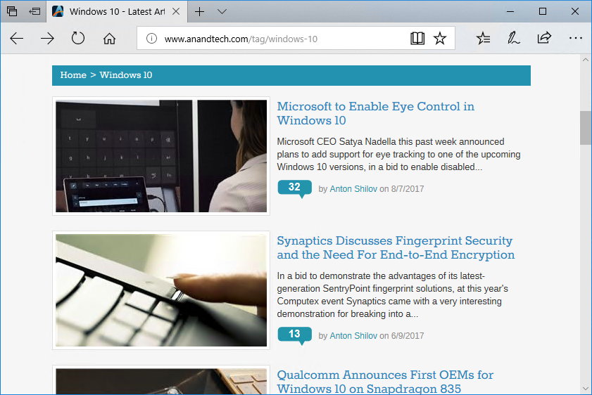
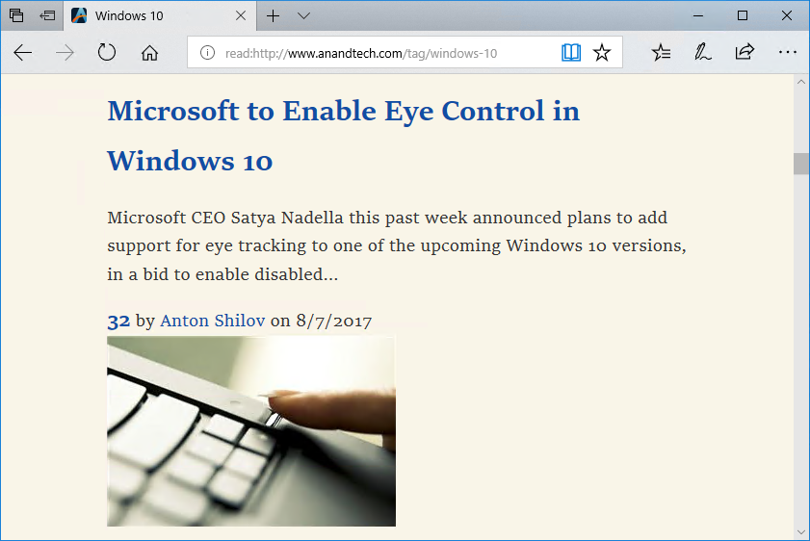
Reading View
Original Website
Reading View

Slide 29
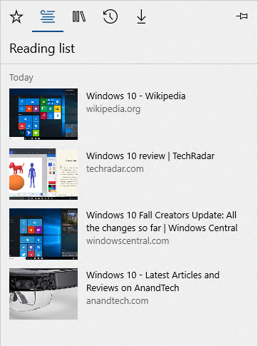
Reading List
Chronological list of articles

Slide 30
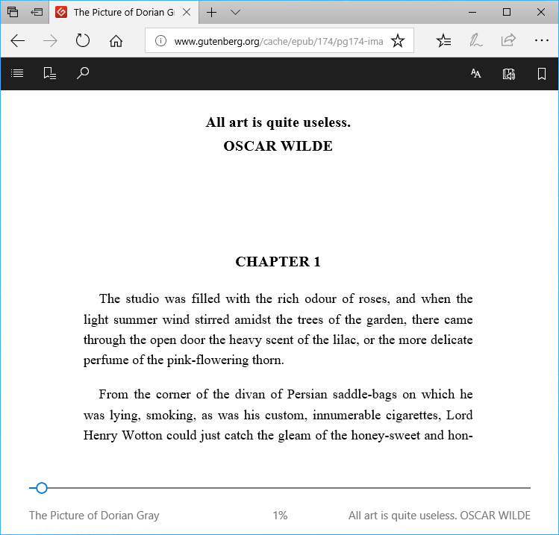
Edge Books
Search
Text Options
Read Aloud
Table of Contents
Add a Bookmark
Bookmarks
Text
Progress Bar

Slide 31
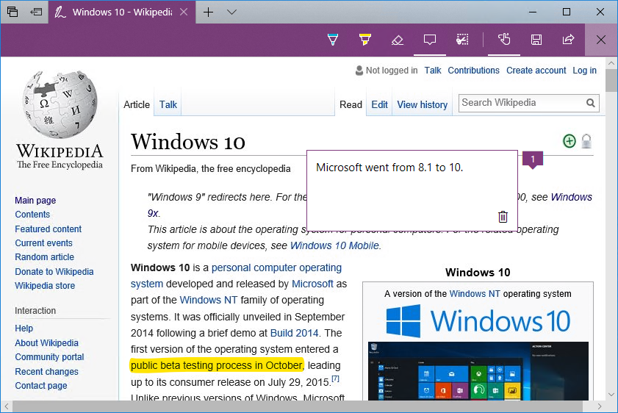
Web Note Tools
Erase
Touch writing
Highlight
Clip
Save Web Note
Exit
Pen
Add Note
Share Web Note

Slide 32
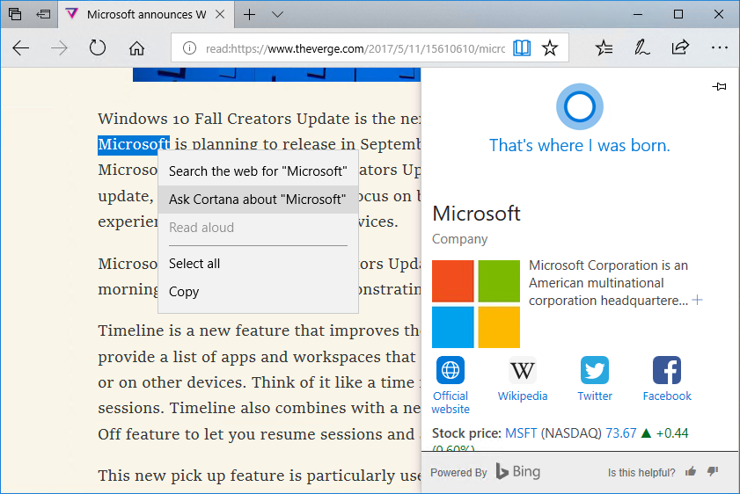
Ask Cortana
Cortana's Results
Ask Cortana

Slide 33
More Actions
Action | Description
New window | Open a second instance of Edge.
New InPrivate window | Open an instance of Edge that won't save your browsing data.
Zoom | Make the page view smaller or larger.
Favorites | Open your saved favorites.
Cast media to device | Connect to a wireless display and audio devices.
Find on page | Find specific text within a page.
Read aloud | Have Edge read the contents of the current page aloud.
Print | Print a website with a printer or to a PDF.

Slide 34
More Actions (Cont.)
Action | Description
Pin this page to Start | Pin the current web page to the Start menu for easy access.
Pin this page to the taskbar | Pin the current web page to the taskbar for easy access.
F12 Developer Tools | Open a window into the web page's code.
Open with Internet Explorer | Open the page with the legacy browser Internet Explorer.
Send feedback | Share your experience of using Cortana and Edge with Microsoft.
Extensions | Personalize the browser and extend its capabilities.
What's new and tips | New browser features and tips to optimize your experience.
Settings | Access browser settings.

Slide 35
Edge Settings
Setting | Description
Choose a theme | Choose between light and dark themes.
Open Microsoft Edge with | Determine what will display when you open Edge.
Open new tabs with | Determine what will display when you add a tab.
Import from another browser | Import bookmarks from other browsers.
Show the favorites bar | Display selected favorites in a menu bar.
Clear browsing data | Select the specific types of data you want to clear from the browser history.
Device sync settings | Sync Windows settings to other devices.
View advanced settings | More advanced customization options.

Slide 36
Edge Advanced Settings
Setting | Description
Show the home button | Add a home icon to the Navigation bar.
Block pop-ups | On by default.
Use Adobe Flash Player | On by default.
Open sites in apps | On by default.
Downloads | On by default. Default location for downloaded files.
Proxy setup | Set to automatically detect settings.
Website permissions | Manage permissions granted to specific websites.
Offer to save passwords | Turned on by default.
Save form entries | Turned on by default. Remembers common information you enter.
Send Do Not Track requests | Off by default. When on, sends a Do Not Track request to websites.

Slide 37
Edge Advanced Settings (Cont.)
Setting | Description
Have Cortana assist me in Microsoft Edge | On when you activate Cortana.
Search in the address bar with | Bing is the default search engine, but you can add others.
Show search and site suggestions as I type | Allows Bing to provide suggestions as you begin typing in the Address bar.
Show search history | On by default.
Optimize taskbar web search results for screen readers | Off by default. Opens Cortana search results in IE for screen readers.
Show sites I frequently visit in Top sites | Frequently visited sites show up as thumbnails on a new blank tab.
Cookies | Default is Do Not Block.
Let sites save protected media licenses | On by default.
Use page prediction | Data sent to Microsoft to predict what pages you will likely browse to next.
Help protect me from malicious sites | On by default. Blocks malicious URLs and content downloads.

Slide 38
Security and Privacy in Edge
Edge continually learns about you.
Scans your location history, contacts, search history, calendar, and emails.
Cuts off support for known attack vectors like ActiveX.
Rendering engine based on more modern secure web standards.
SmartScreen filter to block malicious sites is on by default.

Slide 39
Reflective Questions
Will you use Cortana? Is the decision different for home or the office?
How does Edge compare to other browsers you have used?

Slide 40
Class Exercises
ACTIVITY 4-1 Customizing Cortana's User Interface, Page 78
ACTIVITY 4-2 Searching with Cortana, Page 84
ACTIVITY 4-3 Using Cortana as a Personal Assistant, Page 88
ACTIVITY 4-4 Browsing the Web with Edge, Page 99
ACTIVITY 4-5 Customizing Edge, Page 105

