Slide 1
ITI 494 Microsoft Word and Excel Foundations
Session VI
www.profburnett.com
Master a Skill / Learn for Life

Slide 2
Outline
Lesson 5: Printing Workbooks
Lesson 6: Managing Workbooks

Slide 3
Printing Workbooks
Preview and Print a Workbook
Set Up the Page Layout
Configure Headers and Footers

Slide 4
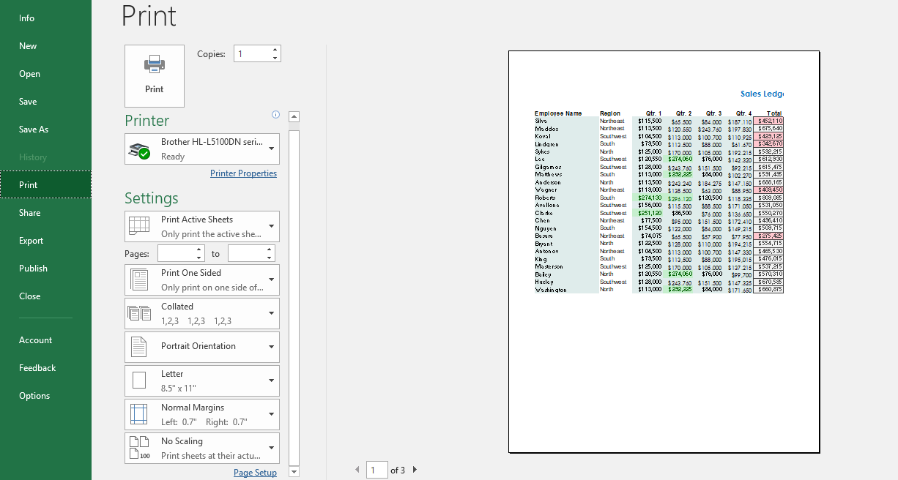
The Print Tab
Print commands
Printer menu
Printer properties
Page setup
Print settings
Print preview pane

Slide 5
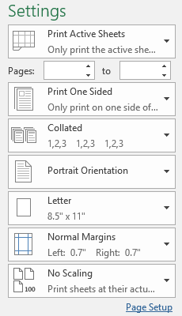
Print Settings
Print selection settings
Duplexing settings
Collating settings
Orientation settings
Paper size settings
Margins settings
Scaling settings

Slide 6
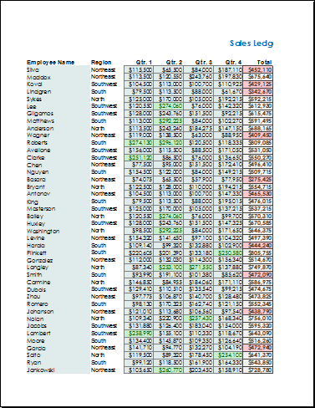
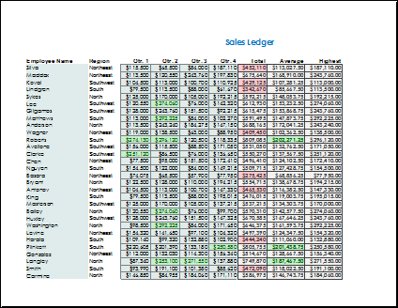
Page Orientation
Portrait orientation
Landscape orientation

Slide 7
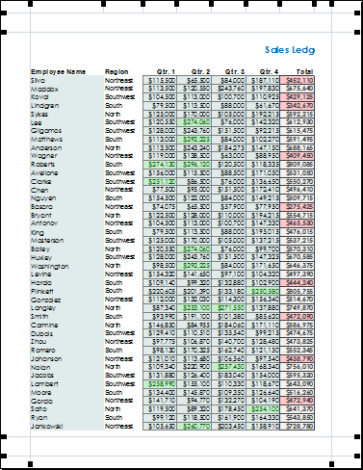
Margins
Header margin
Top margin
Side margin
Bottom margin
Footer margin

Slide 8
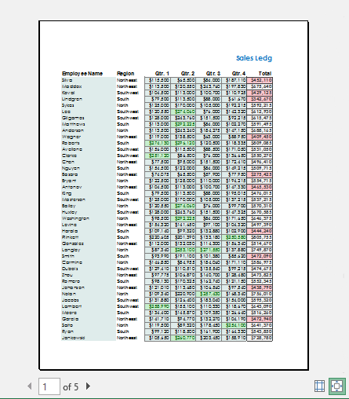
Print Preview
Preview image
Show Margins button
Zoom to Page button
Navigation controls

Slide 9
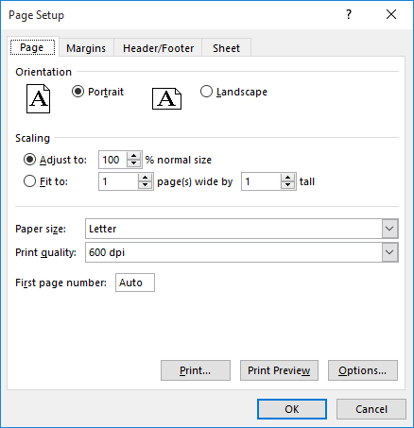
The Page Setup Dialog Box

Slide 10
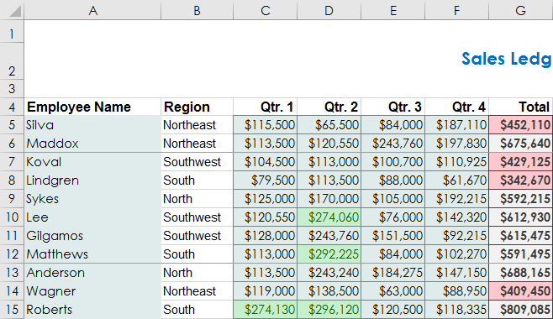
The Print Area
Print area border
Print area border

Slide 11
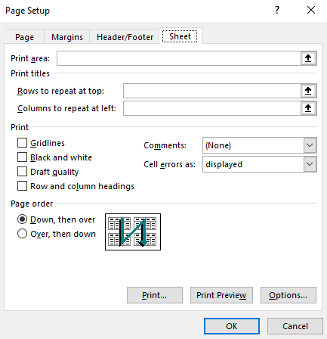
The Print Titles Command
Select rows or columns to print on every page

Slide 12
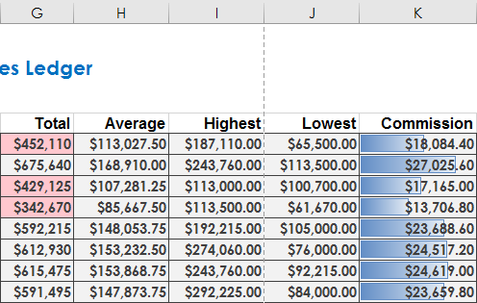
Page Breaks
Default page break

Slide 13
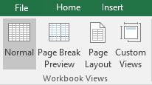
Workbook Views

Slide 14
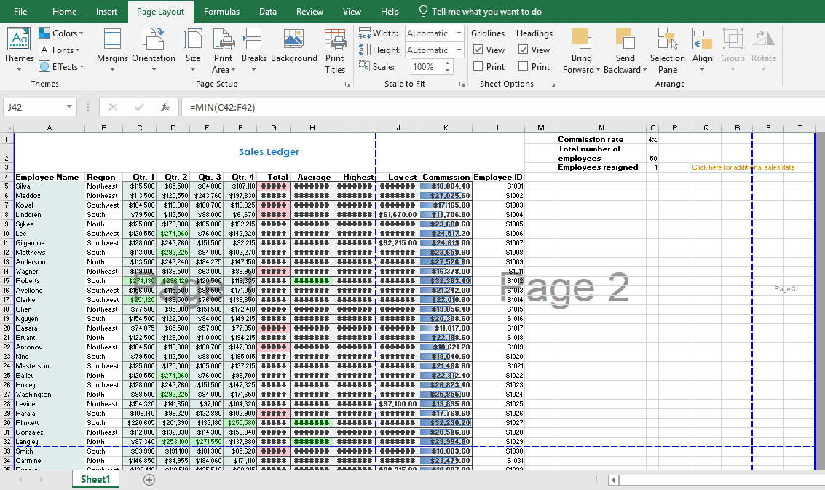
Page Break Preview View

Slide 15
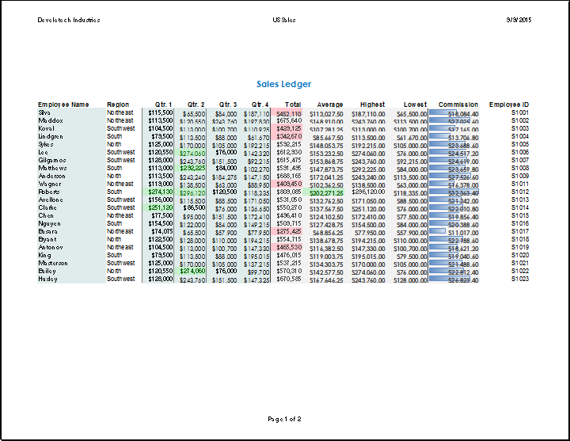
Headers and Footers
Headers
Footer

Slide 16
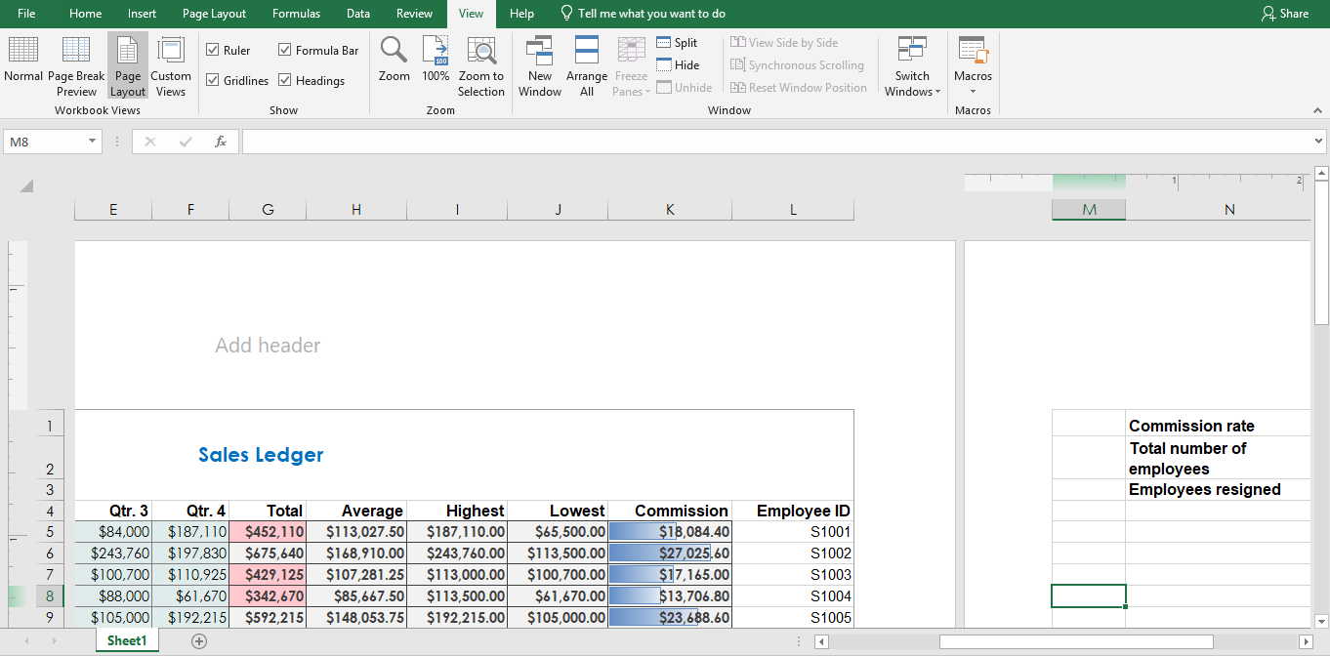
Page Layout View

Slide 17
Contextual Tabs

Slide 18
The Header & Footer Tools Contextual Tab

Slide 19
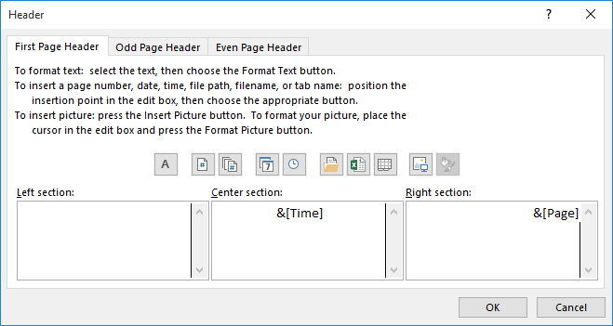
The Header and Footer Dialog Boxes

Slide 20
Managing Workbooks
Manage Worksheets
Manage Workbook and Worksheet Views
Manage Workbook Properties

Slide 21
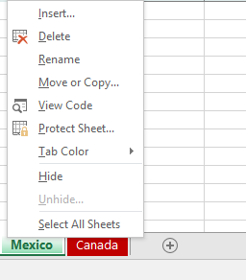
Methods of Inserting and Deleting Worksheets
The worksheet context menu opens when you right-click worksheet tabs.
New sheet button

Slide 22
Tab Formatting Options

Slide 23
Drag to Reposition Worksheets
Location marker

Slide 24
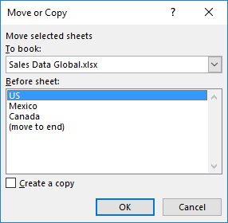
The Move or Copy Dialog Box

Slide 25
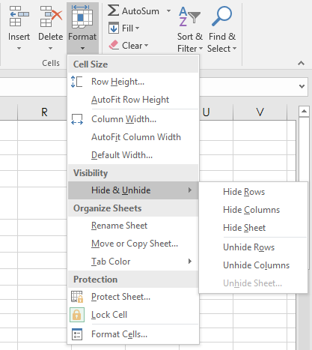
The Hide and Unhide Worksheet Options

Slide 26
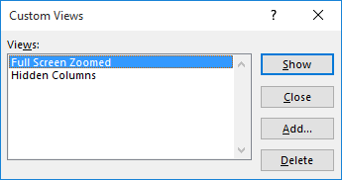
Custom Views

Slide 27
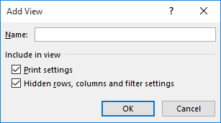
The Add View Dialog Box

Slide 28
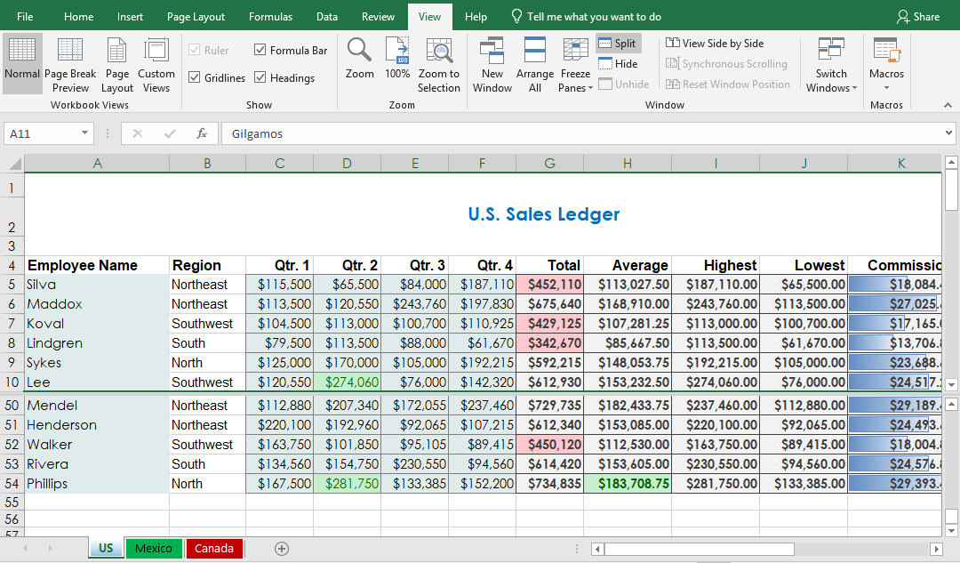
The Split Command
Independent scroll bars
Split bar

Slide 29
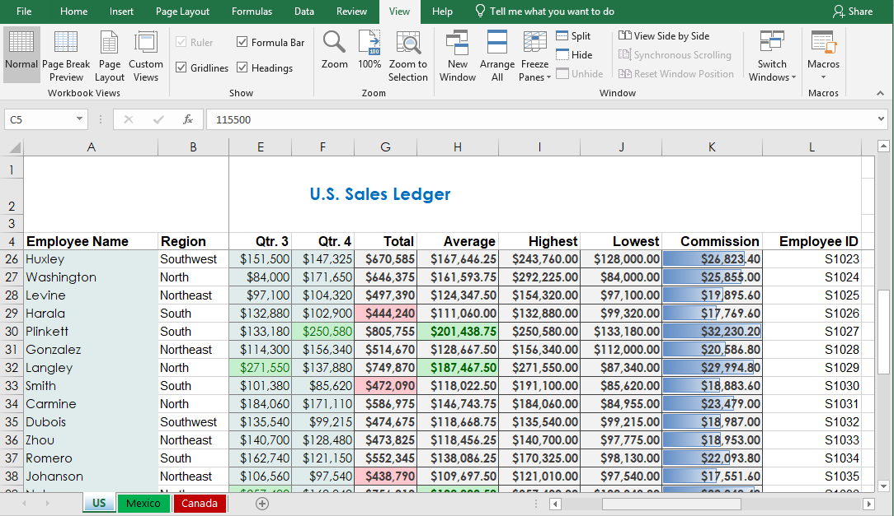
The Freeze Panes Options
Rows 1 through 4 are frozen and won’t scroll vertically.
All other cells scroll normally.
Columns A and B are frozen and won’t scroll horizontally.

Slide 30
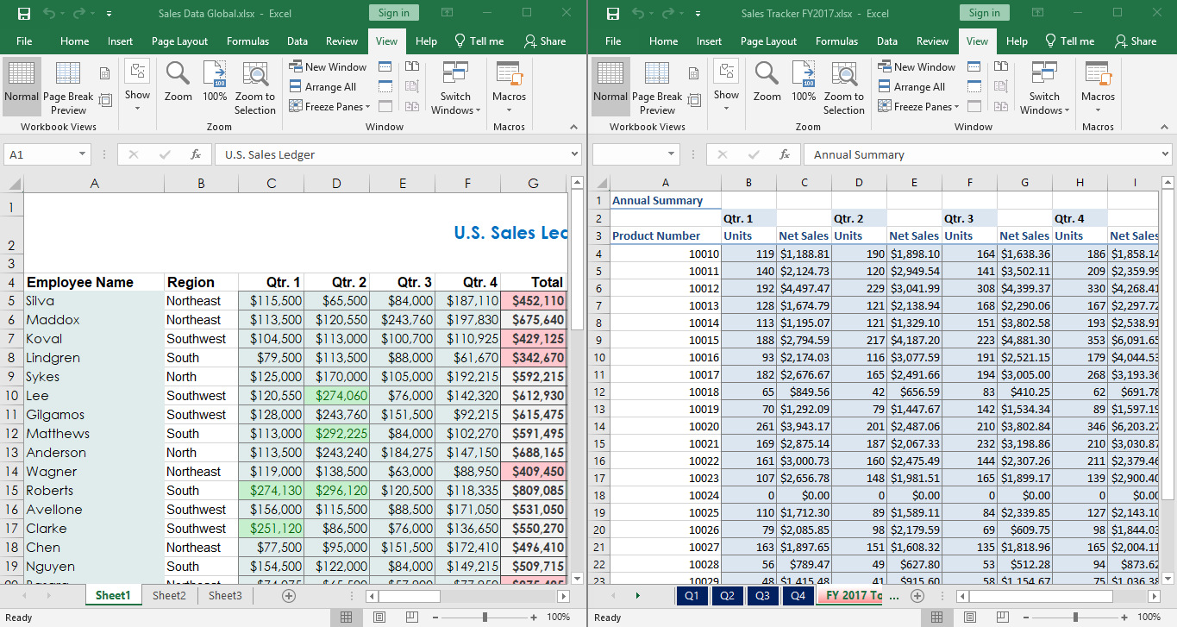
The Arrange All Command

Slide 31
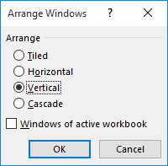
The Arrange Windows Dialog Box

Slide 32
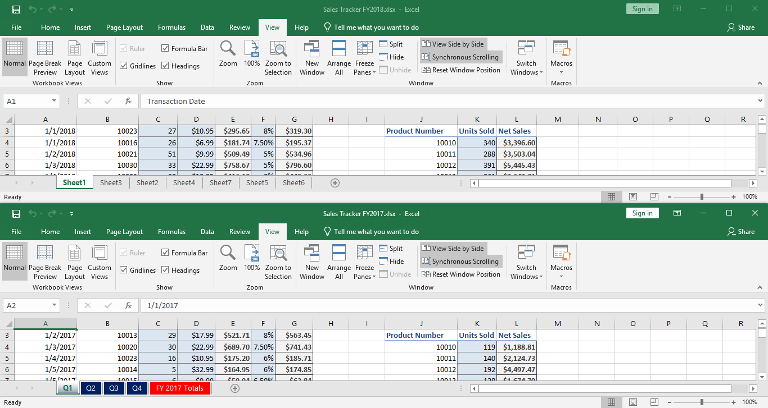
The View Side by Side Command
Synchronous scroll bars

Slide 33
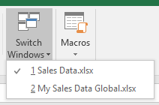
The Switch Windows Command

Slide 34
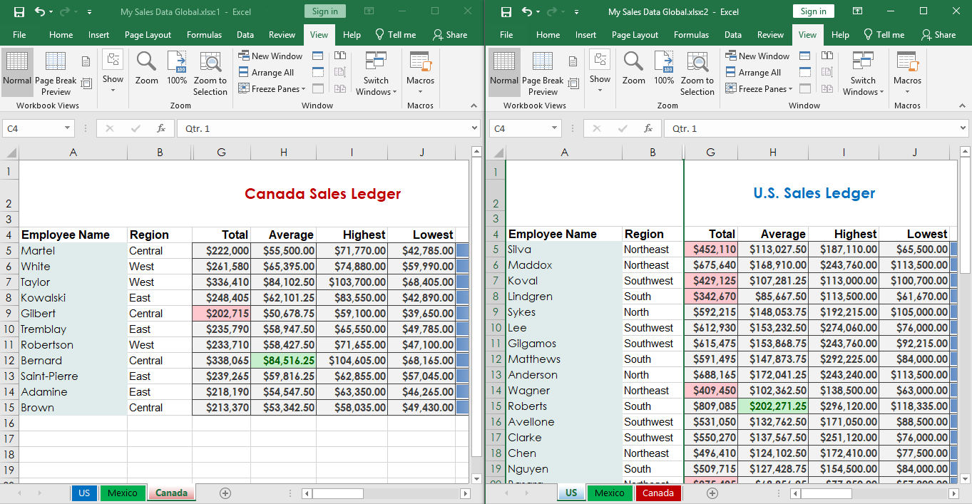
The New Window Command
My Sales Data Global.xlsx:1
My Sales Data Global.xlsx:2

Slide 35
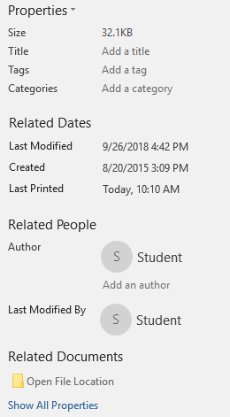
Workbook Properties in the Backstage View

Slide 36
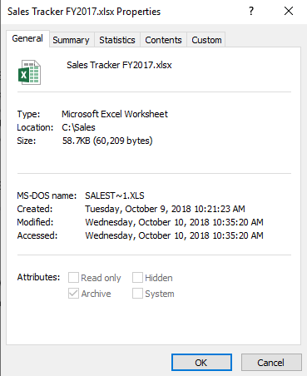
The Properties Dialog Box

Slide 37
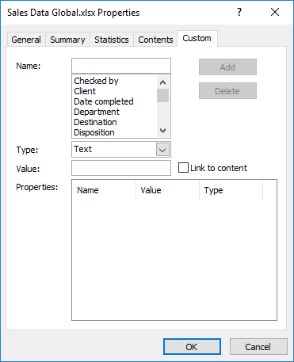
Custom Workbook Properties

