Slide 1
ITI 494 Microsoft Word and Excel Foundations
Session V
www.profburnett.com
Master a Skill / Learn for Life

Slide 2
Outline
Lesson 3: Modifying a Worksheet
Lesson 4: Formatting a Worksheet

Slide 3
Modifying a Worksheet
Insert, Delete, and Adjust Cells, Columns, and Rows
Search for and Replace Data
Use Proofing and Research Tools

Slide 4
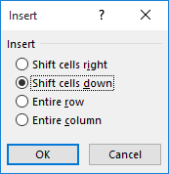
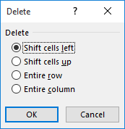
The Insert and Delete Options

Slide 5
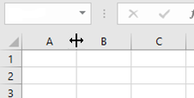
Manual Width and Height Adjustments
Drag to adjust

Slide 6
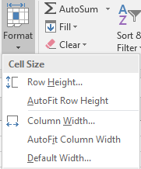
The AutoFit Feature

Slide 7
Manual Fit
Double-click
to adjust

Slide 8
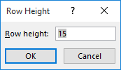
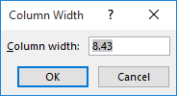
The Row Height and Column Width Dialog Boxes

Slide 9
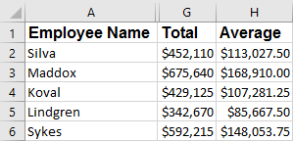
The Hide and Unhide Commands
Columns B – F are hidden

Slide 10
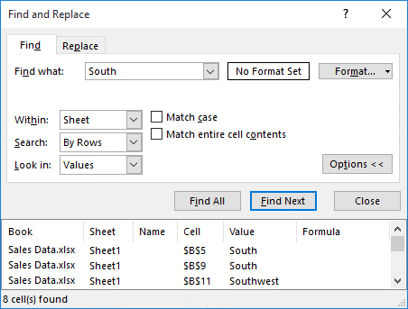
The Find Command
Search query
Format indicator
Scope of search
Search results list

Slide 11
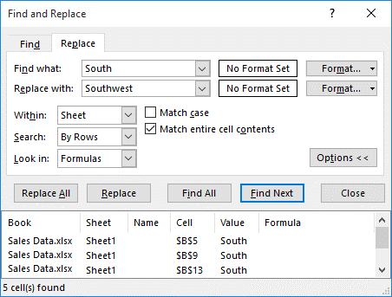
The Replace Command
Search query
Replacement phrase

Slide 12
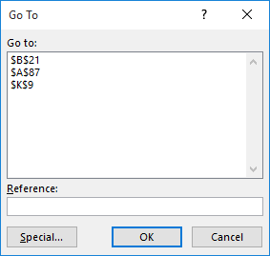
The Go To Dialog Box
Navigation history

Slide 13
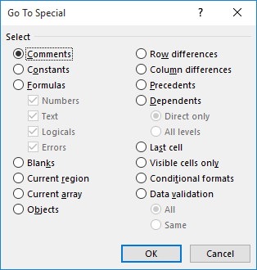
The Go To Special Dialog Box

Slide 14
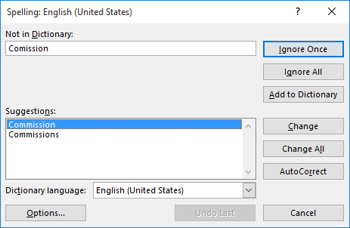
The Spelling Dialog Box

Slide 15
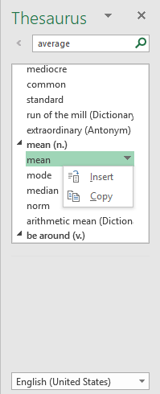
The Thesaurus Task Pane
Search term
Search results
Result options
Dictionary drop-down menu

Slide 16
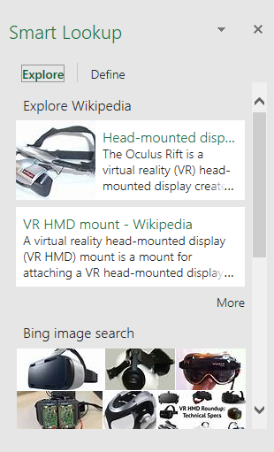
The Smart Lookup Task Pane

Slide 17
Formatting a Worksheet
Apply Text Formats
Apply Number Formats
Align Cell Contents
Apply Styles and Themes
Apply Basic Conditional Formatting
Create and Use Templates

Slide 18
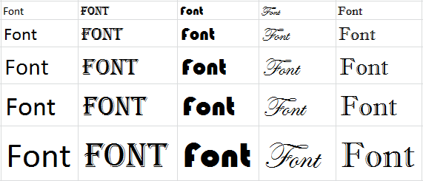
Fonts
Differing fonts and font sizes can:
Give certain data prominence over other data.
Simply make your worksheets more visually pleasing.

Slide 19
The Font Group
Font Size
drop-down menu
Increase Font Size
button
Font drop-down menu
Decrease Font Size
button
Bold button
Italic button
Underline button
Font Color drop-down menu

Slide 20
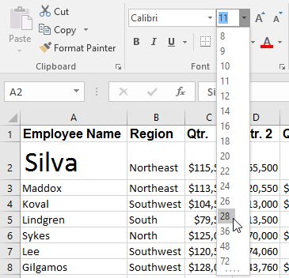
Live Preview

Slide 21
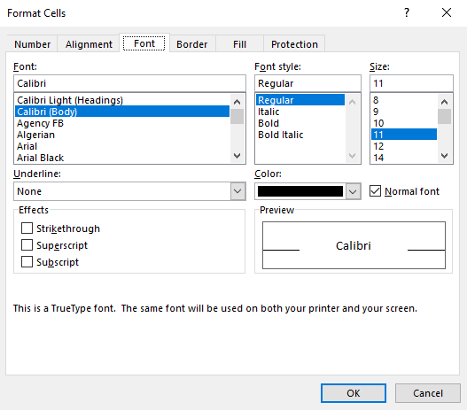
The Format Cells Dialog Box

Slide 22
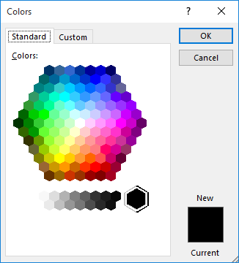
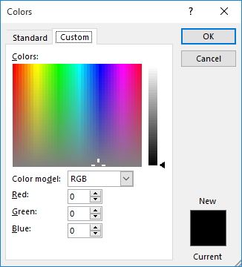
The Colors Dialog Box

Slide 23
Hyperlinks
Links within a document that, when selected, perform a particular action:
navigating to a different location within the document.
opening another document.
creating a new document.
navigating to a web page.
starting an email message.

Slide 24
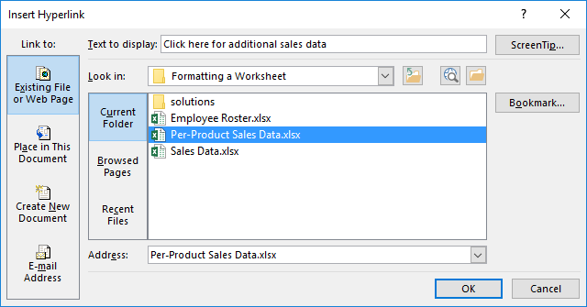
The Insert/Edit Hyperlink Dialog Box

Slide 25
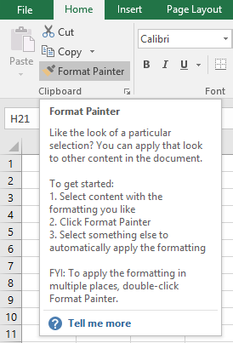
The Format Painter

Slide 26
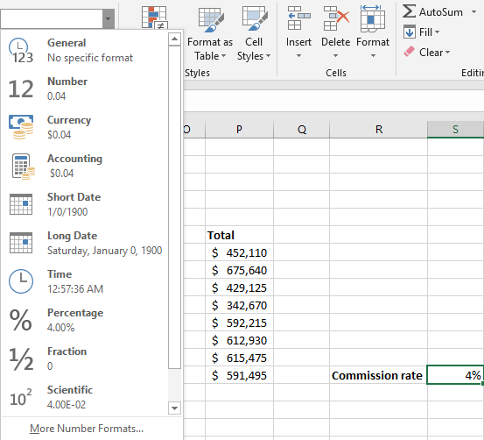
Number Formats
Number Format drop-down menu
Currency number
format
Percentage
number format

Slide 27
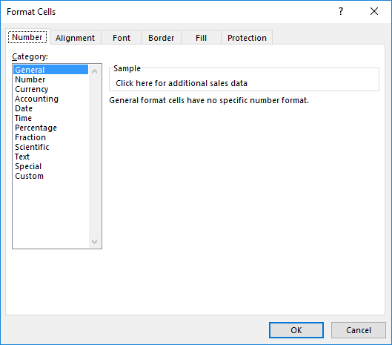
Number Format Tab

Slide 28
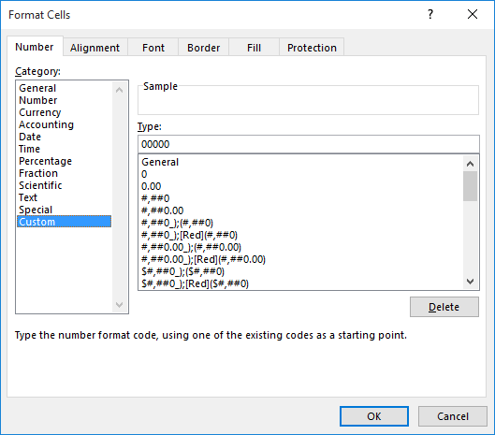
Custom Number Formats
Existing code strings to modify

Slide 29
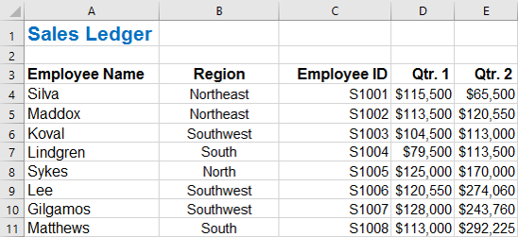
Alignment Options
Alignment commands
The Alignment group
Various text alignment configurations

Slide 30
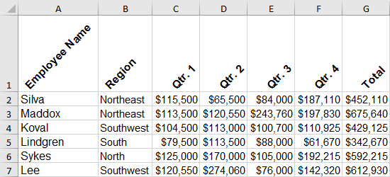
Orientation Options

Slide 31
The Indent Commands
Decrease Indent
button
Increase Indent
button

Slide 32
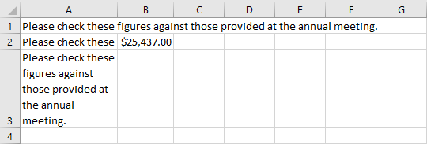
The Wrap Text Command
Spilled-over text
Truncated text
Wrapped text

Slide 33
The Merge & Center Options

Slide 34
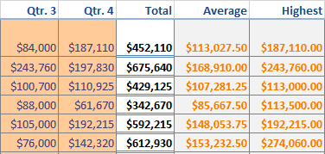
Cell Styles
Heading 3 style
Calculation style
Input style
Total style

Slide 35
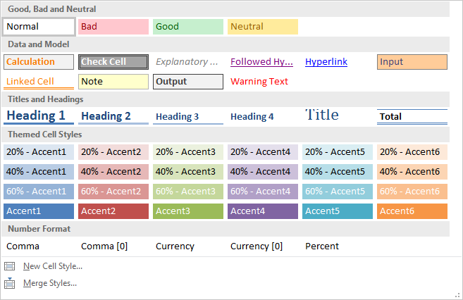
Galleries

Slide 36
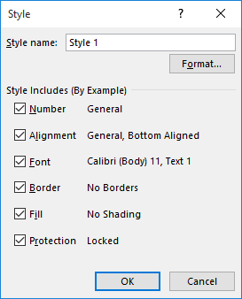
The Style Dialog Box
Formatting option
check boxes

Slide 37
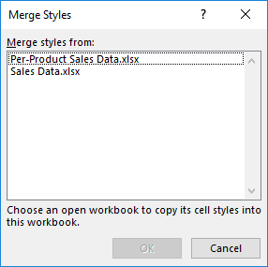
The Merge Styles Dialog Box

Slide 38
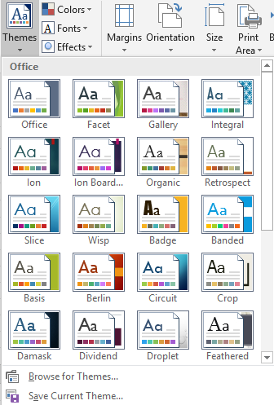
Themes

Slide 39
Theme Components
Colors:
4 text/background colors
6 accent colors
2 hyperlink colors
Fonts:
Heading font for the Title cell style.
Body font for labels, titles, and text on graphical objects.
Does not affect the default font type for cell data.
Effects:
Can’t be customized.
Select from a gallery of 15 predefined configurations.

Slide 40
Guidelines for Using Themes
Apply themes to worksheets whenever possible to make it easier for format the data.
Create a custom theme and set fonts, colors, effects to your liking.
Remember it is easier to modify an existing theme than to build one from scratch.
Keep in mind that themes are meant to facilitate reuse.
Remember all themes need to be stored in the default folder created by Excel.
Be consistent with themes across worksheets or related workbooks.
Keep in mind that manually changing the format of data will override a theme format.
Make sure that your cell styles work with your themes.
Choose colors that blend well together when creating custom themes.
Choose disparate colors primarily to highlight specific parts of your data.
Choose an easily readable font at an appropriate size.

Slide 41
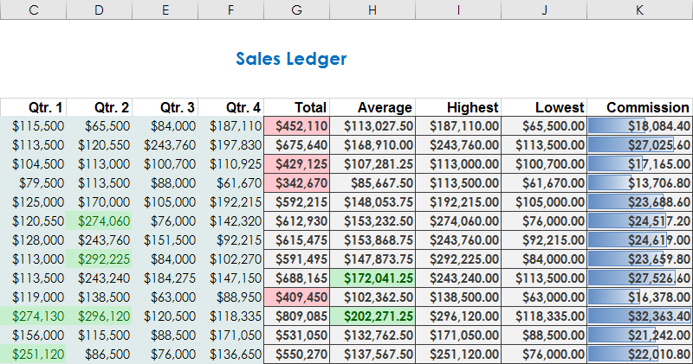
Conditional Formatting
Conditional formatting: Formatting applied to cells or ranges to make data visually stand out based on the data meeting particular criteria.

Slide 42
The Conditional Formatting Dialog Boxes

Slide 43
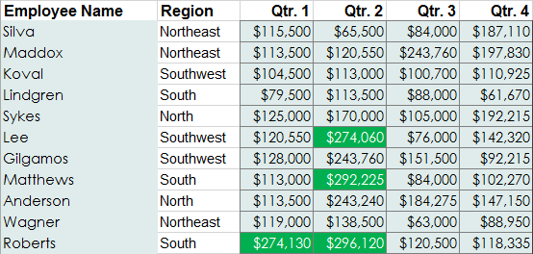
The Highlight Cells Rules

Slide 44
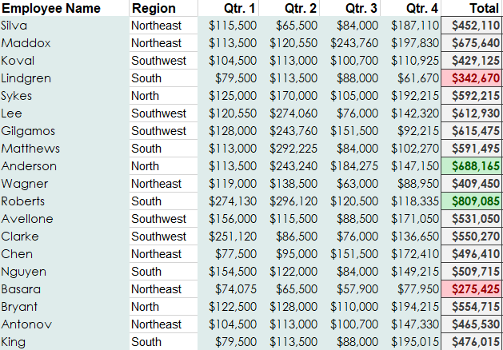
The Top/Bottom Rules

Slide 45
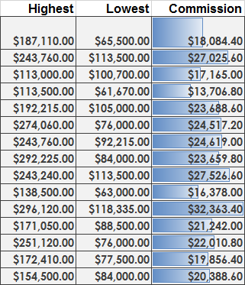
Data Bars

Slide 46
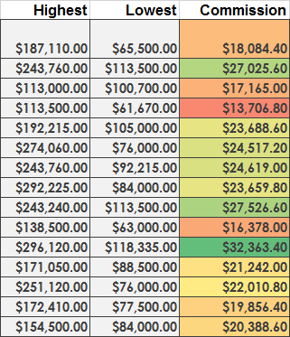
Color Scales

Slide 47
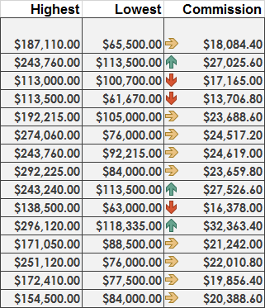
Icon Sets

Slide 48
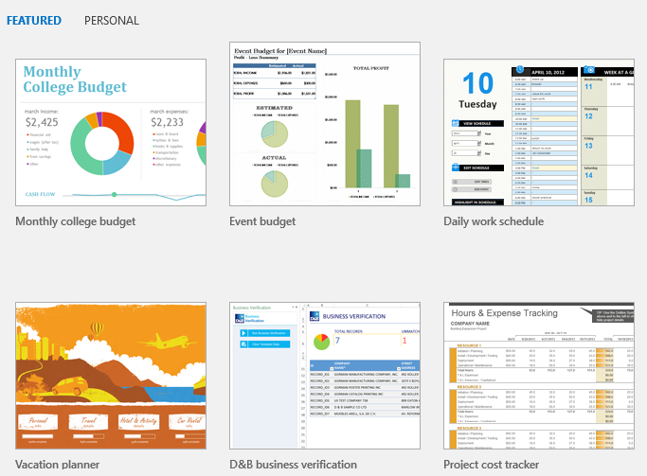
Templates

Slide 49
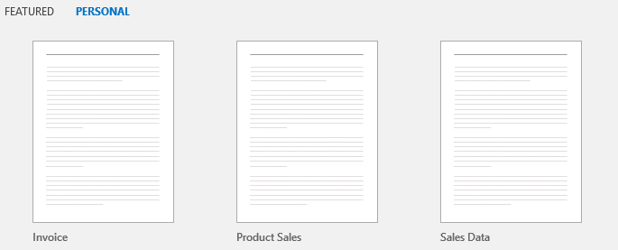
Templates and the Backstage View
FEATURED tab
PERSONAL tab

