Slide 1
ITI 494 Microsoft Word and Excel Foundations
Session II
www.profburnett.com
Master a Skill / Learn for Life

Slide 2
Outline
Lesson 1: Getting Started with Excel 2019
Lesson 2: Performing Calculations

Slide 3
Getting Started with Microsoft Office Excel 2019
Navigate the Excel User Interface
Use Excel Commands
Create and Save a Basic Workbook
Enter Cell Data
Use Excel Help

Slide 4
Spreadsheets, Worksheets, and Workbooks (Slide 1 of 2)
Spreadsheet: a paper or an electronic document, arranged in tabular form, that is used to store, manipulate, and analyze data.
Worksheet: an electronic spreadsheet that is used for entering, storing, and analyzing data in Excel.
Workbook: an Excel file that serves as a container to store related Excel worksheets.

Slide 5
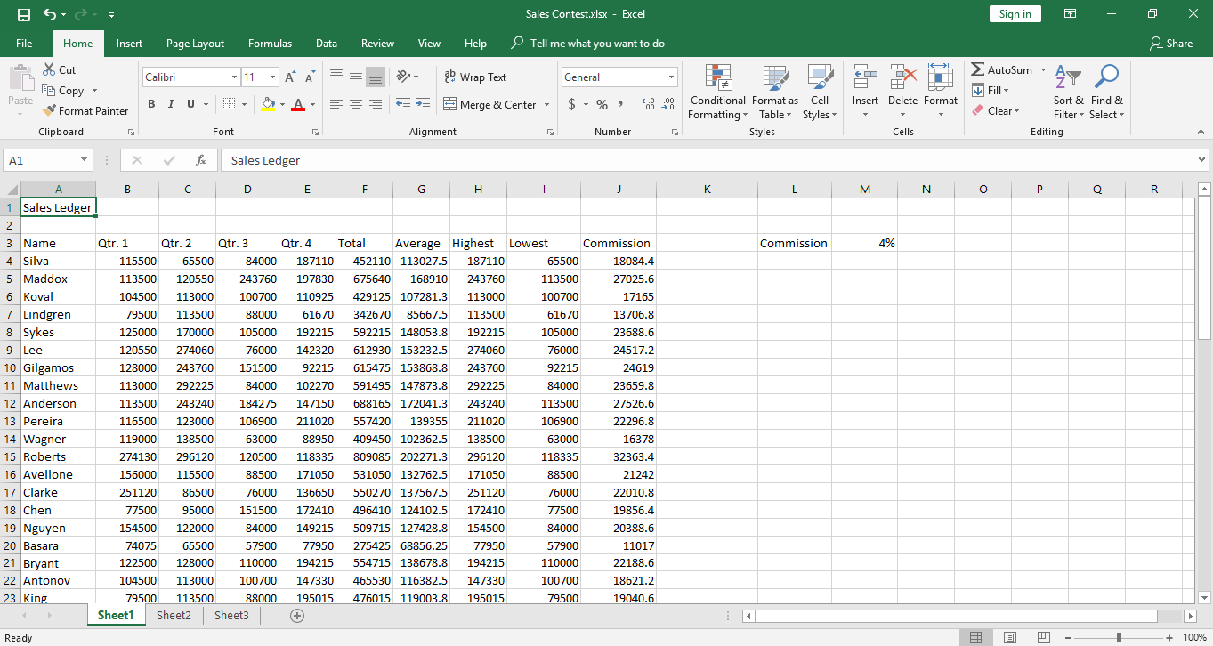
Spreadsheets, Worksheets, and Workbooks (Slide 2 of 2)
Workbook
Worksheets in the workbook
Worksheet

Slide 6
Cells and Ranges
Cell: a singular container that you can use to input and store data.
Range: a contiguous group of cells that typically contains related data.
Cell
Range

Slide 7
Cell and Range References
Cell reference: consists of a row header and a column header, which identify the cell at the intersection of the row and the column.
Range reference: consists of two cell references, separated by a colon, that represent cells at the top-left and bottom-right in the range.
Column headers
Row headers
Cell B6
Range D2:F6

Slide 8
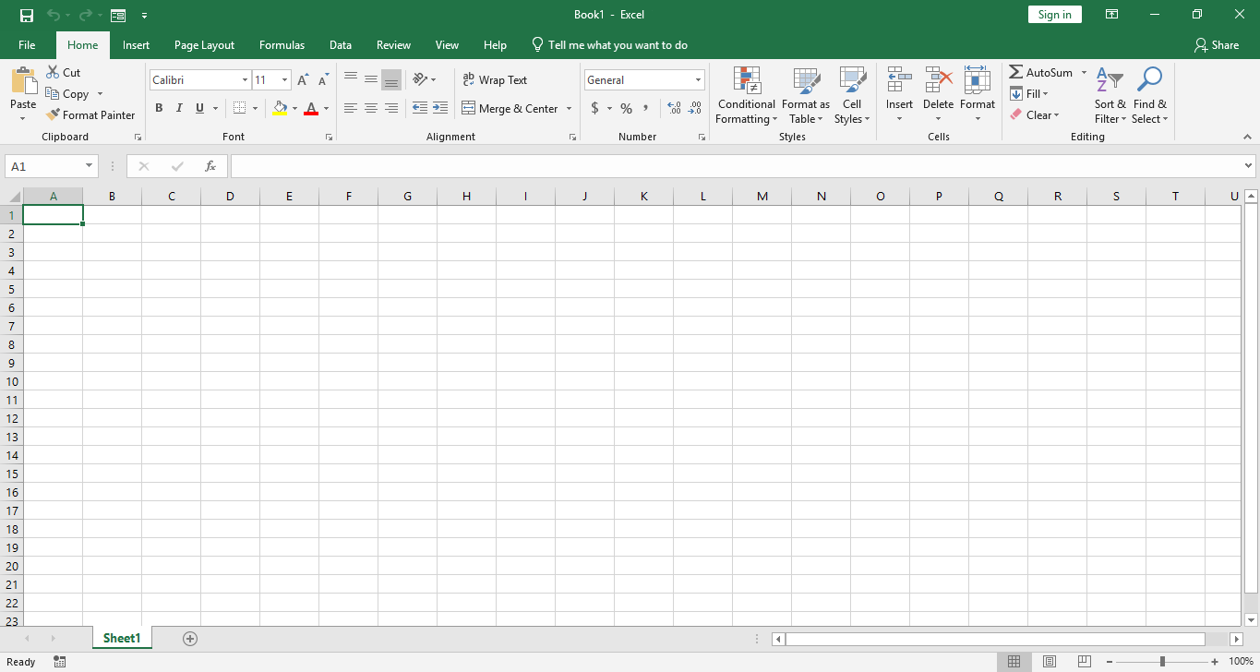
The General Excel UI
Quick Access Toolbar
Title bar
Ribbon
Status bar
View and zoom controls

Slide 9
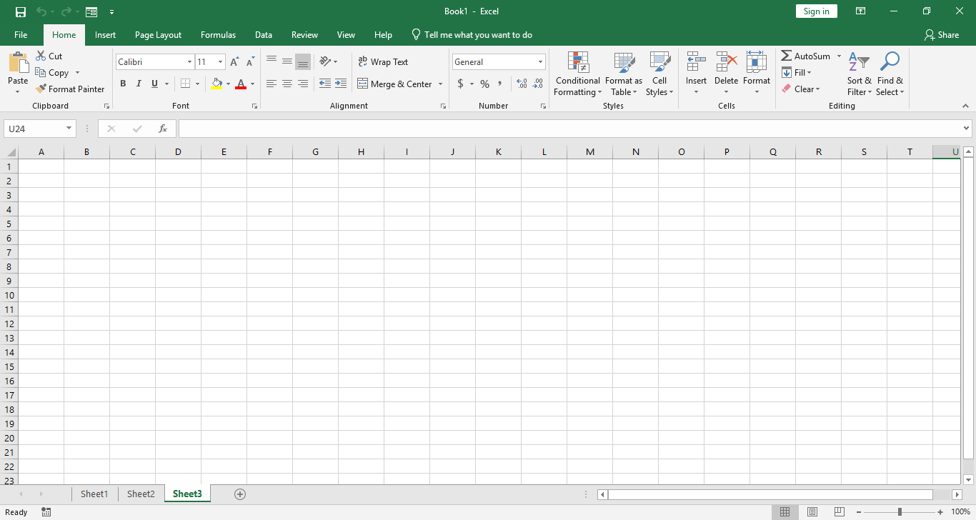
The Workbook and Worksheet UI Elements
Select All button
Name Box
Formula Bar
Column headers
Row headers
Scroll bars
Worksheet tab navigation controls
New sheet button
Worksheet tabs

Slide 10
Excel Window Commands
Maximize/Restore Down button
Ribbon Display Options button
Close button
Minimize button

Slide 11
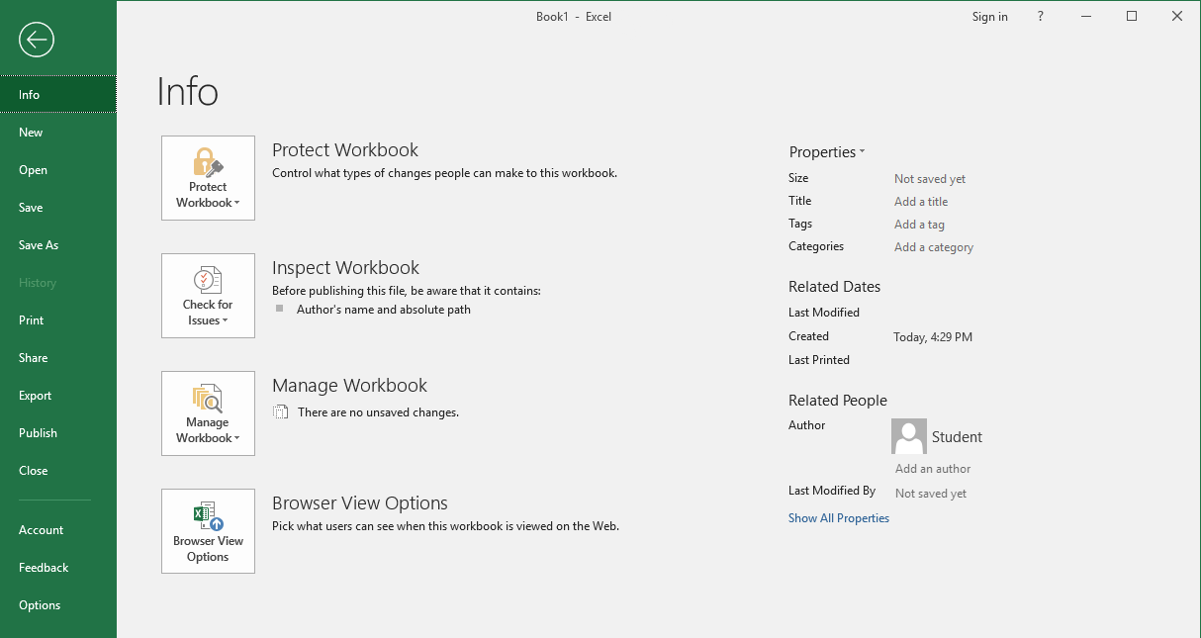
The Backstage View
Tabs and commands
Left pane
Right pane

Slide 12
Mouse Navigation
Navigation Option | Mouse Command
Select a particular cell. | Select the desired cell.
Select a range of cells. | Click and drag to select the desired range of cells.
Select an entire column or row. | Select the desired column or row header.
Move the worksheet display up or down by a single row. | Select one of the vertical scroll arrows.
Move the worksheet display left or right by a single column. | Select one of the horizontal scroll arrows.
Move the worksheet display by more than one row or column at a time. | Click and drag the vertical or horizontal scroll bars to the desired view.
Move the worksheet display one screen at a time. | On the vertical scroll bar, select the area between the scroll bar and the desired direction's scroll arrow.
Display a different worksheet. | Select the desired worksheet tab along the bottom of the workbook window.

Slide 13
Mouse Cursor Icons
Icon | Cursor Context/Location | Description
 | Placed on ribbon tabs or commands, Backstage tabs or commands, Quick Access Toolbar commands, scroll bars, sheet tabs and navigation commands, and view and zoom controls. | Select an element to perform the associated action.
 | Placed at any edge of a cell or range of cells. | Drag a cell or range of cells to move the data inside to another cell or range.
 | Placed over a cell in a worksheet. | Select an individual cell, or drag to select a range of cells.
 | Placed between worksheet column headers. | Resize the column to the left of the cursor, or double-click to AutoFit the column to the left of the cursor.
 | Placed between worksheet row headers. | Resize the row above the cursor, or double-click to AutoFit the column above the cursor.
 | Placed inside an active cell, the Formula Bar, or various text boxes. | Select inside a text box or the Formula Bar to begin typing data into it. Or, double-click an active cell to do likewise.
 | Placed at the bottom-right corner of a cell or range of cells. | Drag vertically or horizontally to copy or AutoFill data into adjacent cells.

Slide 14
Keyboard Navigation
Navigation Option | Keyboard Command
Move one cell up, down, left, or right from current cell. | Press the Up, Down, Left, or Right arrow key.
Move to the cell in column A of the current row. | Press the Home key.
Move to the first or last column or row of data. | Press and hold down the Ctrl key, and then press the Up, Down, Left, or Right arrow key.
Scroll up or down by one screen. | Press the Page Up or the Page Down key.
Scroll left or right by one screen. | Press Alt+Page Up or Alt+Page Down.
Move one cell to the right. | Press the Tab key. This will also enter data into the cell.
Move one cell to the left. | Press Shift+Tab.
Move one cell down. | Press the Enter key. This will also enter data into the cell. To enter data without navigating away, press Ctrl+Enter.
Move one cell up. | Press Shift+Enter.
Move to cell A1. | Press Ctrl+Home.
Navigate through the worksheets in a workbook. | Press Ctrl+Page Up or Ctrl+Page Down.

Slide 15
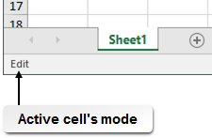
The Active Cell
Active cell: The currently selected cell a user can directly put data into.
Displayed with a solid green border.
Only one active cell when you select a range.
Displayed without a shaded background.
Three modes:
Ready
Enter
Edit

Slide 16
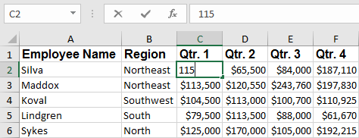
Basic Data Entry
Name Box
Formula Bar
Data being entered

Slide 17
Navigating the Excel User Interface

Slide 18
The Ribbon
Tell Me
Tabs
Dialog box launcher
Commands
Groups

Slide 19
The Ribbon Tabs
File
Home
Insert
Page Layout
Formulas
Data
Review
View
Help

Slide 20
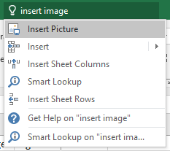
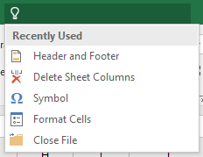
Tell Me
Search term
Search results
Last five commands executed from searches

Slide 21
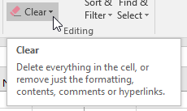
ScreenTips and KeyTips
ScreenTips: Small pop-up windows that appear when users place the mouse pointer over commands and provide information about the command.
KeyTips: An alternate method of executing Excel commands that appears when the user presses the Alt key
ScreenTip
KeyTips

Slide 22
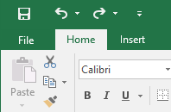
The Quick Access Toolbar
Undo/Redo buttons
Customize Quick Access Toolbar menu button
Save button

Slide 23
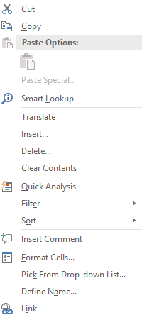
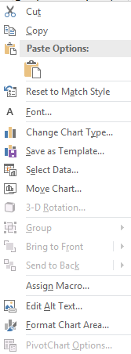
The Mini Toolbar and Context Menus
Mini toolbars
Context menus

Slide 24
Using Excel Commands

Slide 25
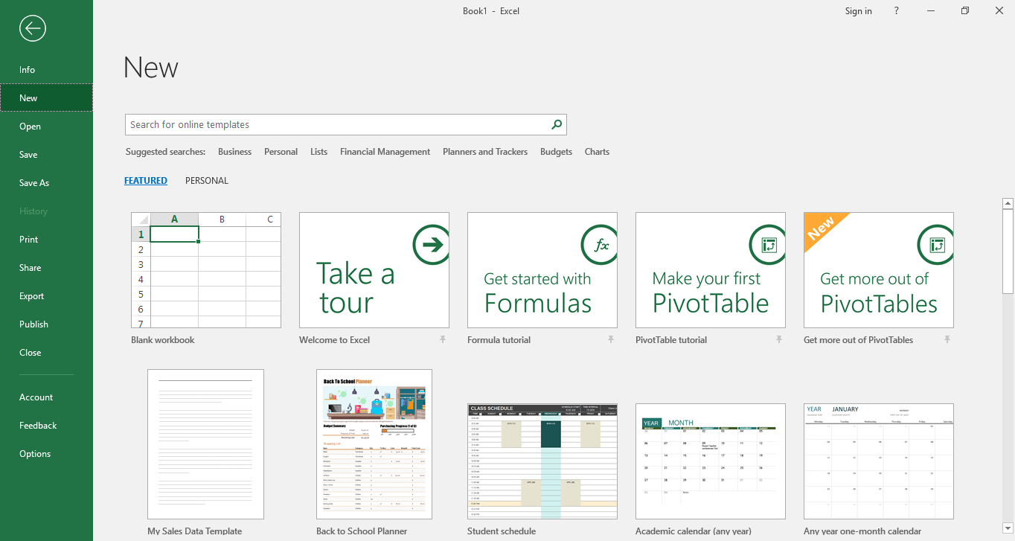
The New Tab
Start searching button
Template tiles

Slide 26
Excel 2019 File Formats
File Type and Extension | Description
Excel Workbook (.xlsx) | The default file type in Excel 2019.
Excel Macro-Enabled Workbook (.xlsm) | Allows you to save workbook files containing Visual Basic® for Applications macrocode.
Excel Binary Workbook (.xlsb) | Compressed, binary-based file format that reduces file size and improves performance in complex, calculation-dense workbooks. This file type may not be compatible with some applications that work only with XML-based files.
Excel 97-2003 Workbook (.xls) | The previous default Excel file format. The XLS format is a binary file format, which isn't as compatible with other computer applications as the newer, XML-based file format.
Excel Template (.xltx) | The default file type for Excel templates. This format is used to save workbooks as templates so that you can create new workbooks based on the template contents, layout, and format.
Excel Macro-Enabled Template (.xltm) | The default file format for Excel macro-enabled templates.
Excel 97-2003 Template (.xlt) | The default template file format in prior versions of Excel.
PDF (.pdf) | Allows you to save workbooks in the Portable Document Format (PDF).

Slide 27
The Save and Save As Commands
Save
Save changes to an existing workbook without changing the file name or the file location.
Save As
Save new workbook files.
Make changes to existing files, such as the file name and location.

Slide 28
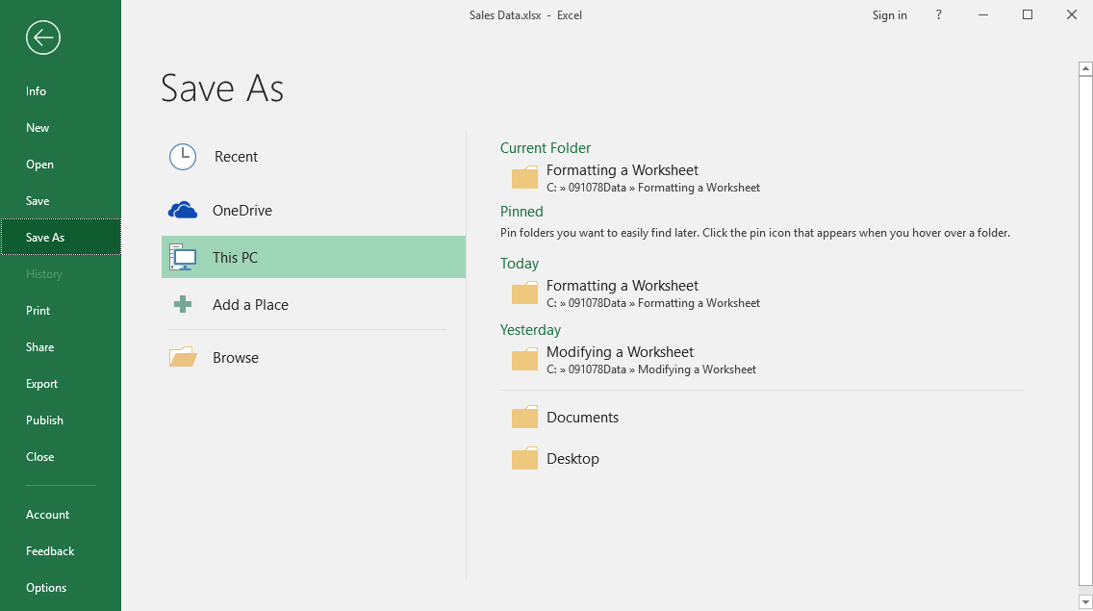
The Save As Screen

Slide 29
Compatibility Mode
Compatibility mode: A feature that allows users to open and work with files created in previous versions of the application.
Allows you to open and work with files created by earlier versions of Excel.
Preserves original file format.

Slide 30
The Convert Option
Convert option: A feature that enables users to convert files created in previous versions of Office applications to the newer file types.
Replaces old file with a new file in XLSX or XLSM file format.
Reduces the size of the workbook file.

Slide 31
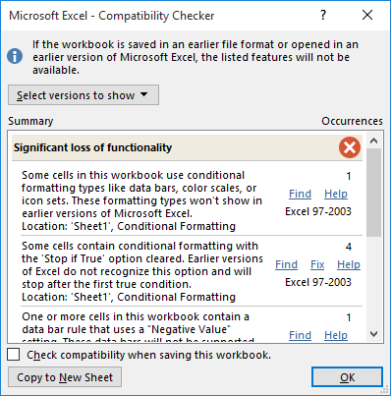
The Compatibility Checker
Compatibility Checker: A feature that enables users to determine which elements of application files are not compatible with previous versions of the applications.
Two levels of compatibility issues:
Minor loss of fidelity (often formatting).
Significant loss of functionality.

Slide 32
Creating and Saving a Basic Workbook

Slide 33
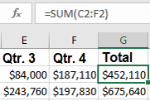
It’s Not WYSIWYG
What’s actually in the cell
What appears in the cell

Slide 34
Data Types
Data Category | Description
Values | Numeric constants that do not change unless you edit the cell contents. Examples include 1, 345, 11.6, and .002.
Labels/text | Alphanumeric text not used to perform calculations or store numeric values. Examples include "Sales," "Q1," and "Total."
Formulas | Mathematical equations used to perform calculations or data analysis. Formulas are dynamic, so the displayed value can change if you change the cell data "feeding" the formula.
Dates and times | Date and time values. These can be used both as simple labels or as part of formulas.

Slide 35
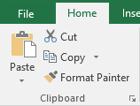
The Cut, Copy, and Paste Commands
Select an entire cell to cut or copy all of the data.
Remember that what you see isn't necessarily the data in the cell.
Select a portion of the cell data to cut or copy. You can do this:
Within the cell if it's in Edit mode.
In the Formula Bar with the desired cell selected.
The same is true of the Paste command. You can:
Paste the clipboard content into an entire cell.
Paste it alongside other cell content in a cell in either Edit mode or in the Formula Bar.

Slide 36
Drag-and-Drop Cut and Paste
Icon | Cursor Context/Location | Description
 | Over the green border for the selected cell or range anywhere other then on the fill handle. | Click and drag to cut and paste the content.
 | Press and hold the Ctrl key while mouse is over the green border for the selected cell or range anywhere other then on the fill handle. | Click and drag to copy and paste the content.

Slide 37
The Undo and Redo Commands
Redo command
Undo command

Slide 38
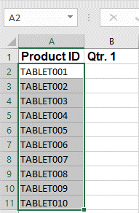
The AutoFill Feature
AutoFill: An Excel feature that recognizes data patterns in worksheets and fills in additional cells based on those patterns.
Fill handle

Slide 39
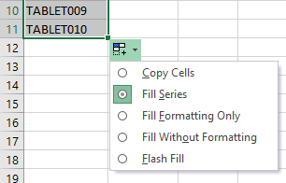
AutoFill Options

Slide 40
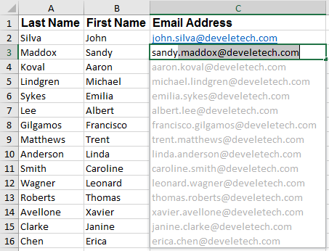
Flash Fill
Flash Fill: A feature which automatically recognizes patterns across rows as data is entered, and then copies those patterns down a column of entries.

Slide 41
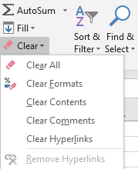
The Clear Command

Slide 42
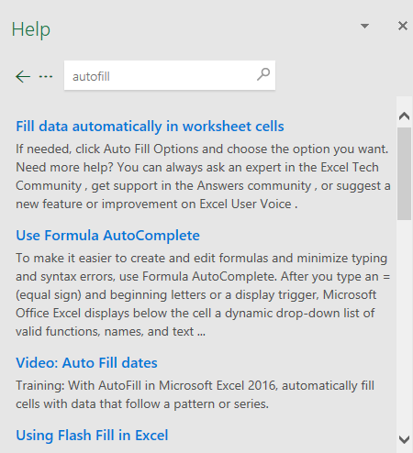
The Help Task Pane
Search field
Help toolbar
Search button
Content section

Slide 43
Performing Calculations
Create Worksheet Formulas
Insert Functions
Reuse Formulas and Functions

Slide 44
Excel Formulas
Formulas: Equations that perform simple or complex mathematical computations in worksheets.
Formulas will adjust their calculations when you change values used in the formula.
Formulas can use:
Fixed numbers.
References to values in other cells.
Formula
Displayed result

Slide 45
The Formula Bar
Cancel button
Insert Function button
Enter button
Formula Bar

Slide 46
A Basic Mathematical Formula
Result
Expression
Variable
Constant
Operator

Slide 47
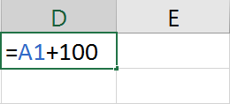
Elements of Excel Formulas
Constants: The numbers and text in a formula that do not change unless manually altered.
References: The cell or range references that Excel uses as value(s) to perform the calculations in a formula.
Mathematical Operators: Symbols that specify the kind of calculation that Excel should perform on the elements of a formula.
Constant
Operator
Equal sign
Reference

Slide 48
The Order of Operations
Order of operations:
Parentheses
Exponents
Multiplication and division
Addition and subtraction
If two operations are at the same order of preference, Excel reads left to right.
Second highest precedence
Third highest precedence
=(A2+B2)^2-10*C2
Highest precedence
Lowest precedence

Slide 49
Reference Operators
Reference Operator | Symbol | Function
Comma | , | A union operator— include each reference in a series. For example, A1,B3,C5 tells Excel to include the values in each of these three cells.
Colon | : | A range operator—include all cells in a range between the cell references on either side of the colon. For example, A1:A10 tells Excel to include the values in every cell from A1 to cell A10.
Space | N/A | An intersection operator—look for a value in the cell where two ranges intersect. For example, A9:J9 E2:E22 tells Excel to look for the value in the cell where these two ranges intersect, which in this case would be the value in cell E9.

Slide 50
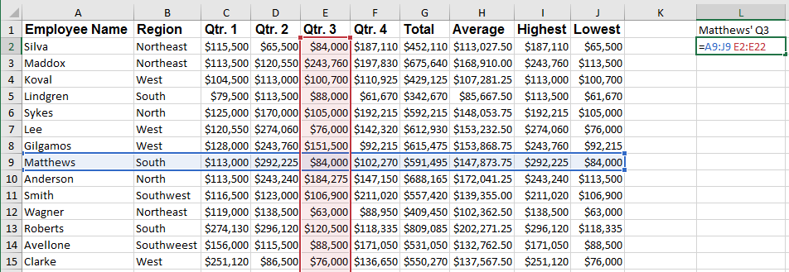
Intersection Operator Example
Intersection operation

Slide 51
Creating Worksheet Formulas

Slide 52
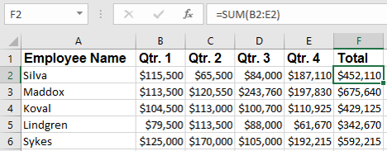
Functions
Functions: Built-in, pre-existing formulas users can insert into Excel worksheets.
Arguments: Elements of Excel functions that define the values and references the function will use to perform a particular calculation.
SUM function
Argument
Function result

Slide 53
The Function Library Group
Function categories

Slide 54
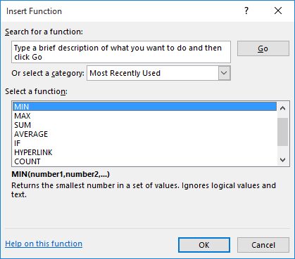
The Insert Function Dialog Box
Function description

Slide 55
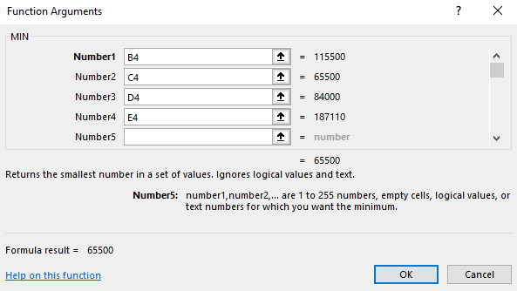
The Function Arguments Dialog Box
Collapse Dialog buttons
Required argument
Optional arguments
Function description
Formula result
Argument description

Slide 56
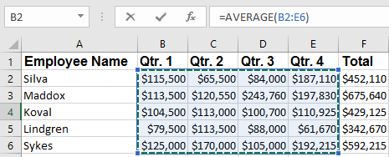
Graphical Cell and Range Reference Entry

Slide 57
The AutoSum Feature

Slide 58
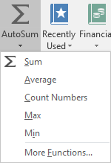
Other Commonly Used Functions

Slide 59
Basic Function Syntax
Equal sign
Function name
Arguments

Slide 60
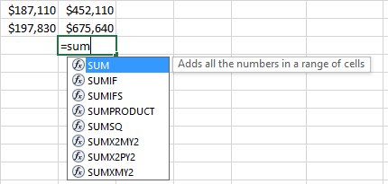
The Formula AutoComplete Feature
Selected function’s tooltip
Function started in cell
Available function options

Slide 61
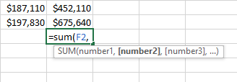
The Arguments Tooltip
Current argument

Slide 62
Formulas and the Cut, Copy, and Paste Commands
Can reuse formulas and functions using Cut, Copy, and Paste commands.
Remember, not a WYSIWYG environment:
The content is the formula or function.
What is displayed is the result.
This functionality allows you to reuse formulas and functions.

Slide 63
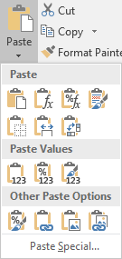
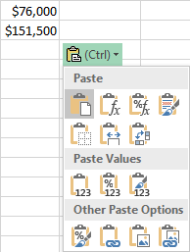
The Paste Options
Paste drop-down menu
Paste Options button

Slide 64
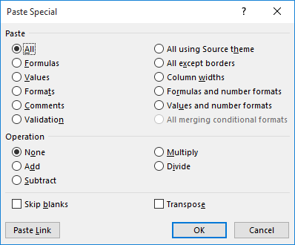
The Paste Special Dialog Box

Slide 65
Relative References
Relative reference: Cell or range references that change relative to the location of the cell when users move or copy a formula from one cell to another.
Original function
Copied function

Slide 66
Absolute References
Absolute reference: Cell or range references that do not change when users move or copy a formula from one cell to another.
Use whenever you want part of the calculation to include a value in a specific cell.
For example in multiplying:
a sales figure by the sales tax rate.
a sales rep's total sales by the commission rate.
Relative references
change
Absolute references
don’t change

Slide 67
Mixed References
Mixed reference: A cell or range reference that includes both relative and absolute references.
Mixed references
To cycle through relative, absolute, and mixed references:
Select the cell.
Place the insertion point in the Formula bar.
Press the F4 key.

Slide 68
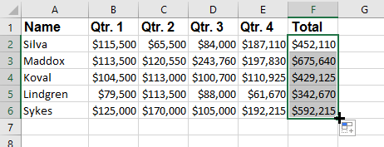
AutoFill and Formulas
Drag the fill handle.
Applies to rows and columns.
Double-click the fill handle.
Only applies to columns.
Will only copy to the first empty row if there is data missing.

Slide 69
Worksheet References
Cell reference
Worksheet reference

Slide 70
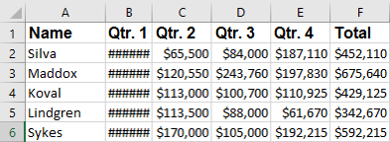
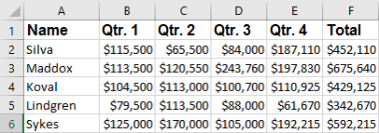
Excel Errors and Display Issues
Issue has been corrected
Cells displaying column width issue

Slide 71
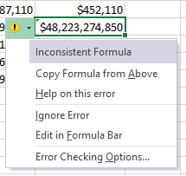
Error Indicators
Cell with error indicator
Error indicator drop-down menu

