Slide 1
ITI 494 Microsoft Word and Excel Foundations
Session II
www.profburnett.com
Master a Skill / Learn for Life

Slide 2
Outline
Lesson 6: Inserting Graphics
Lesson 7: Controlling Page Appearance
Lesson 8: Preparing to Publish

Slide 3
Inserting Graphic Objects
Insert Symbols and Special Characters
Add Images to a Document

Slide 4
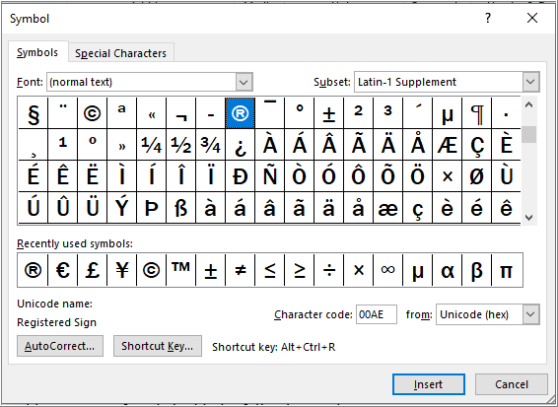
Symbols
Symbols: Characters used to represent an idea or a word, such as a copyright, trademark, or registered trademark.

Slide 5
Activity: Inserting Symbols and Special Characters
You must include the registered trademark symbol after the first instance of the organization name.
®

Slide 6
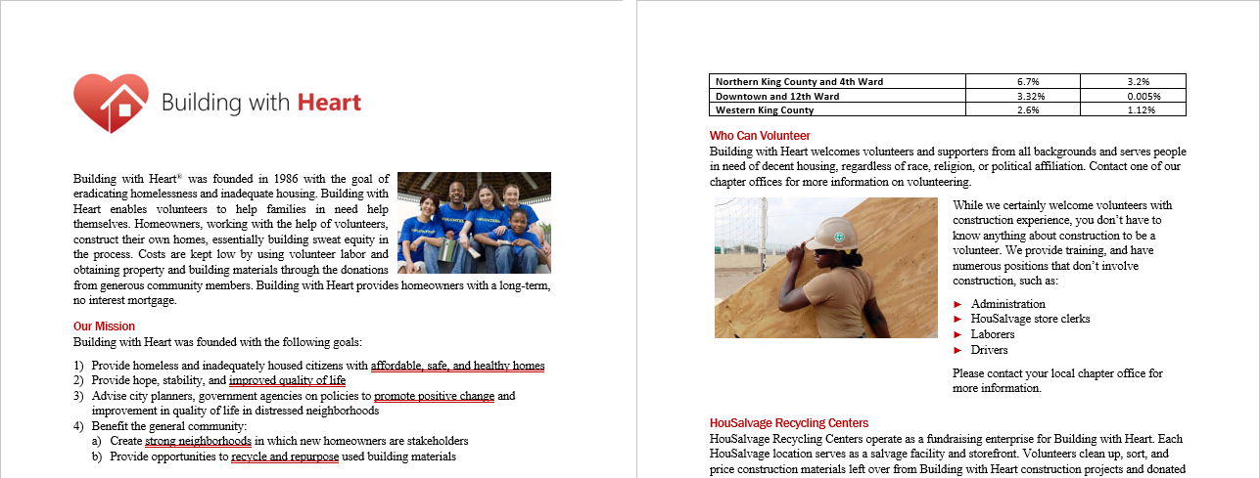
Activity: Adding Images to a Document
Add a logo
Add two photos

Slide 7
Controlling Page Appearance
Apply a Page Border and Color
Add Headers and Footers
Control Page Layout
Add a Watermark

Slide 8
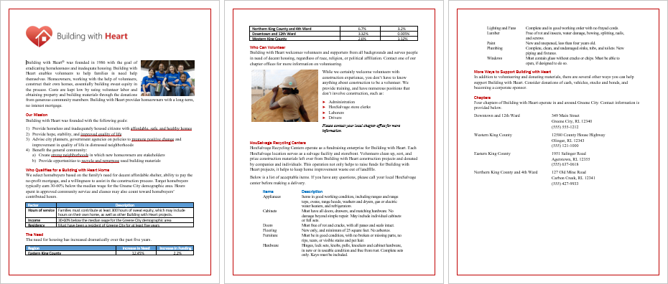
Activity: Applying a Page Border
Red, solid line on every page

Slide 9
Activity: Creating Headers and Footers
Add a header and footer.
They will appear on every page except page 1.
Organization name
Locale
Document title
Page number

Slide 10
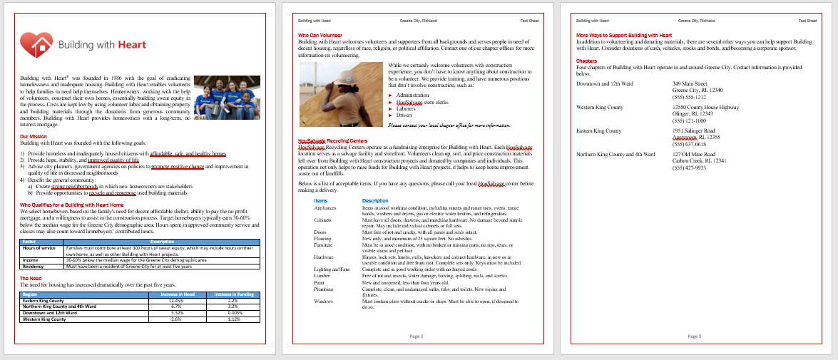
Activity: Controlling Page Layout
You’ll explore how the fact sheet will look with smaller margins.
After you change the margins, you'll have to make some adjustments to formatting throughout the document.

Slide 11
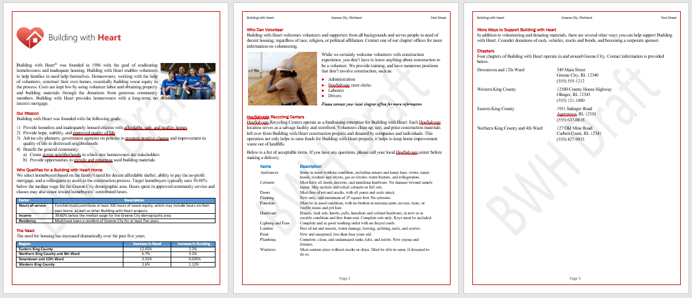
Activity: Adding a Watermark to a Document
To ensure the document is not inadvertently used as a completed document, you’ll embed a large "draft" watermark in the document background.
Custom watermark appears on all pages

Slide 12
Preparing to Publish a Document
Check Spelling, Grammar, and Readability
Use Research Tools
Check Accessibility
Save a Document to Other Formats

Slide 13
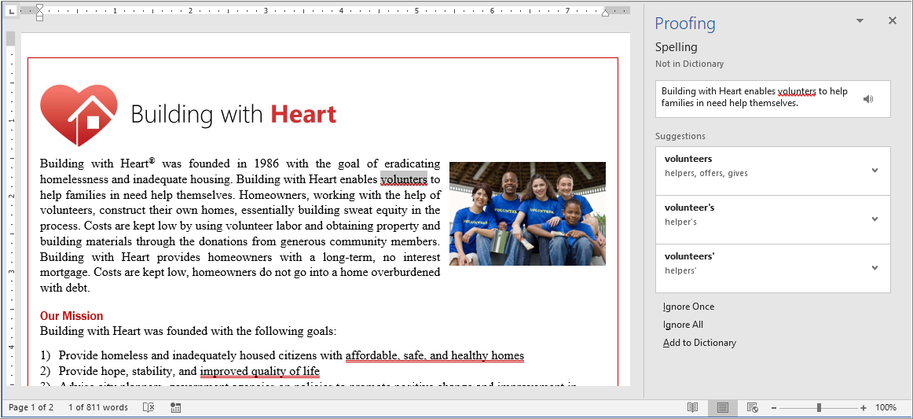
The Proofing Pane
Use the Proofing pane to check for spelling and grammar errors.

Slide 14
Activity: Checking Spelling, Grammar, and Readability
Before you distribute the Building with Heart fact sheet, you'll check it for spelling and grammar mistakes.
You'll also check its readability.

Slide 15
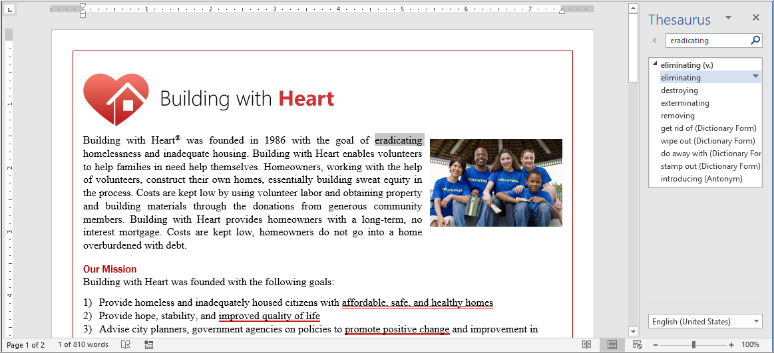
Activity: Using the Thesaurus
Find a better word than “eradicating” to use in the first paragraph.
Use Word’s Thesaurus feature.

Slide 16
Activity: Translating Text
Use the web to:
Determine if "sweat equity" is used correctly in the document
Translate the first paragraph of the document into Spanish

Slide 17
Activity: Checking Accessibility
The document will be published on the web, so you will check to see if you've properly prepared it for access through assistive technologies, such as a screen reader.

Slide 18
Activity: Saving in a Different File Format
You are going to save the document as a PDF, which you'll use to publish the document on the web.
Before you save it as a PDF, you will first save your revisions in a standard Word document, which you will use as your master document in the event that you want to make additional changes to it later.

