Slide 1
ITI 494 Microsoft Word and Excel Foundations
Session II
www.profburnett.com
Master a Skill / Learn for Life

Slide 2
Outline
Lesson 3: Working More Efficiently
Lesson 4: Managing Lists
Lesson 5: Adding Tables

Slide 3
Working More Efficiently
Make Repetitive Edits
Apply Repetitive Formatting
Use Styles to Streamline Repetitive Formatting Tasks

Slide 4
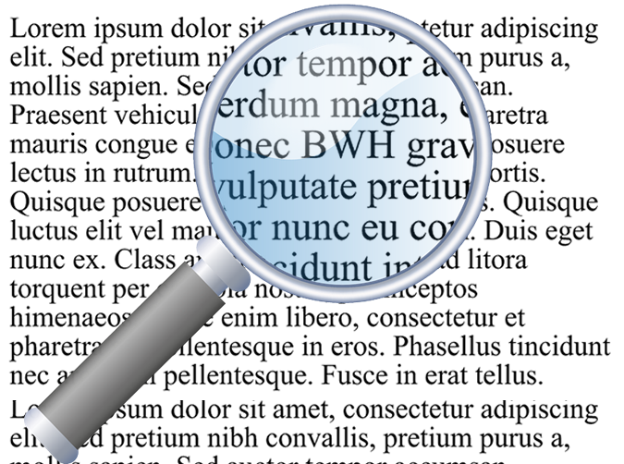
Activity: Using Find and Replace to Edit
Use Find and Replace to change every instance of BWH to Building with Heart.
Building with Heart

Slide 5
Activity: Copying and Repeating Formats
Continue formatting the Building with Heart fact sheet.
You've already applied some character and paragraph formatting.
Now make sure that formats are applied consistently.
For example, all headings will have the same large red text, centered on the page.

Slide 6
Activity: Clearing Formatting
A portion of text has several formats applied to it.
It does not fit well with the rest of the document.
You will clear all formatting from this text and start over.

Slide 7
Guidelines for Using Formatting Efficiently (Slide 1 of 2)
Managing Formatting and Styles
Use templates and Word styles for formats you use often:
Can be shared across all documents based on the template.
Help with consistency.
Multiple documents benefit from improvements to the template
Where to save styles:
Used only in one document – save directly in the document.
Used by multiple documents – save in the template.
Get in the habit of pasting text without the formatting.
Set your Paste Options to control the defaults for pasting text from different sources.
Use the Styles task pane and Style Inspector to understand the formatting of documents you didn’t create. Clean up and simplify as needed.
Keep formatting simple.

Slide 8
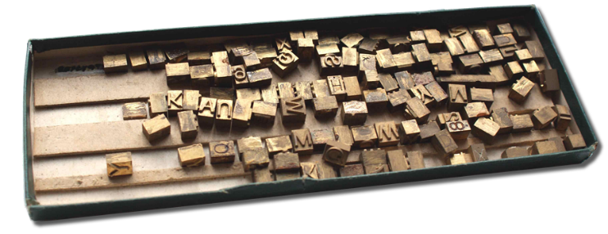
Guidelines for Using Formatting Efficiently (Slide 2 of 2)
Designing with Type
Try to use no more than two fonts per document.
In print, set size to 10–12 points.
On screen/web, set size to 15–25 points.
In long documents, aim for 45–90 characters per line of text.
To format paragraphs:
Indent first line in a paragraph by no more than 1 or 2 ems, or
Provide 4–10 points of extra space between paragraphs
If you must use the Justify format, consider using hyphenation.
Avoid using underline for emphasis:
Affects readability (cutting through letters like g that hang below the line)
In web documents, can be confused with links
Don't use both!

Slide 9
Activity: Creating and Applying Styles
You have expended much effort to apply formatting combinations.
Format Painter helps, but even that is tedious and has limitations.
You'll now take advantage of Word styles to define reusable formatting sets.

Slide 10
Managing Lists
Sort a List
Format a List

Slide 11
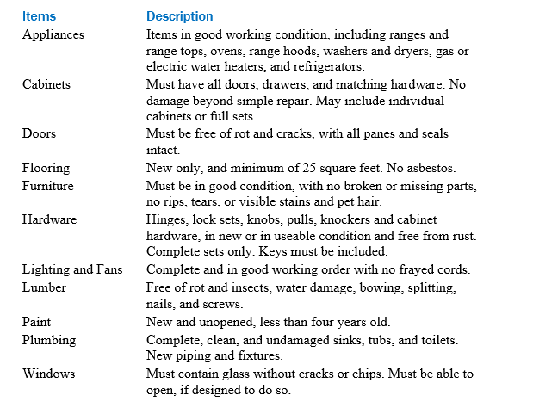
Activity: Sorting Lists
Sort this list alphabetically for quick lookup
Sort this list to show regions with the greatest need at the top

Slide 12
Activity: Formatting Lists
You will provide more detail in the Our Mission list.
You will create a sublist of “benefits to the general community.”

Slide 13
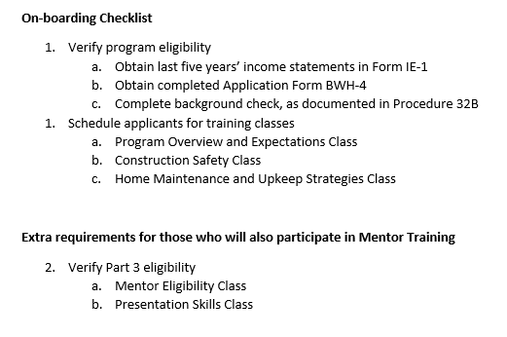
Activity: Resequencing Lists
Correct two lists that are out of sequence.
List should continue with 2
New list should start at 1

Slide 14
Adding Tables
Insert a Table
Modify a Table
Format a Table
Convert Text to a Table

Slide 15
Activity: Inserting a Table in a Document
Pull eligibility requirements out of the paragraph, and place them in a table instead.

Slide 16
Activity: Inserting a New Row in a Table
You need to insert a new row in the middle of the table.
Pressing Tab to create a new row only works from the last row, so you will have to use a different technique to insert a row.

Slide 17
Activity: Moving and Resizing Rows and Columns
You need to rearrange the order of rows in the table.
You will use two different techniques to accomplish this.
Then you will adjust the column widths.

Slide 18
Activity: Formatting a Table
You will apply a table style to change the table’s formatting.
Grid Table 4 - Accent 1
style

Slide 19
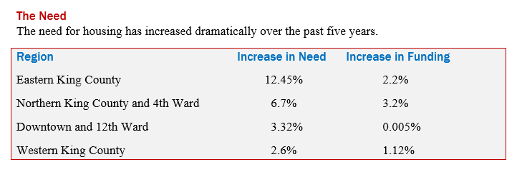
Activity: Converting Text to a Table
You will convert the tabbed text under "The Need" into a Word table, and apply a table style.
Convert tabbed text to table
Apply Grid Table 4 - Accent 1
style

