Slide 1

Knowing Technology V
Cloud Services
http://www.profburnett.com

Slide 2
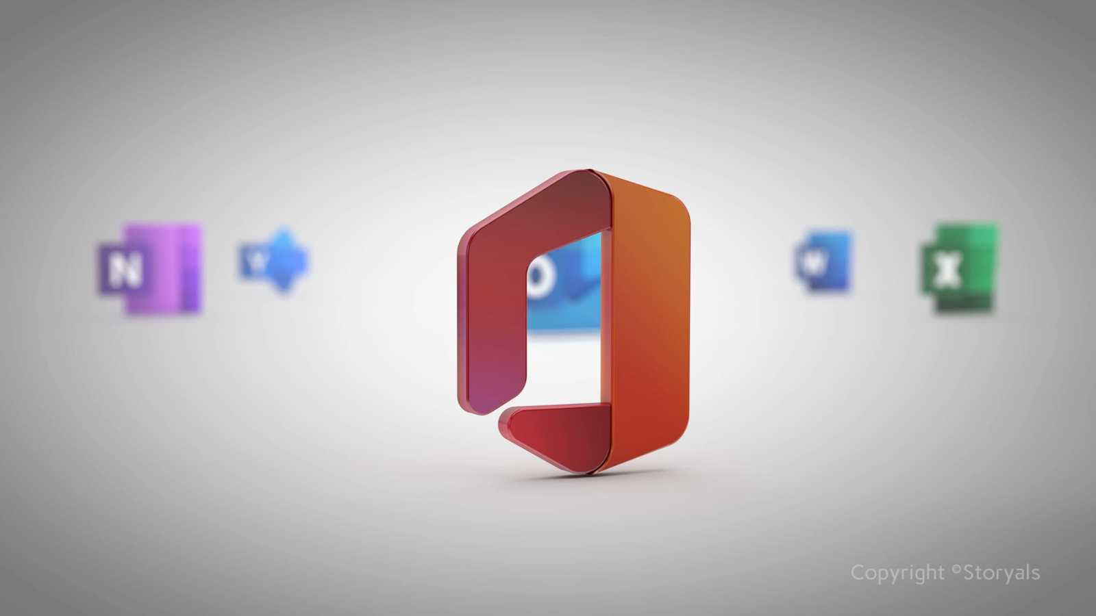

Slide 3
Outline
What is Cloud Computing?
Different CC Service Models
Why are Consumers Moving to the Cloud?
What are the Consumer-Based SaaS?
Cloud Financial Services
Cloud Productivity Applications
Cloud Social Media Services
Cloud Streaming Media Services
Cloud Mapping Services

Slide 4

What is Cloud Computing?

Slide 5
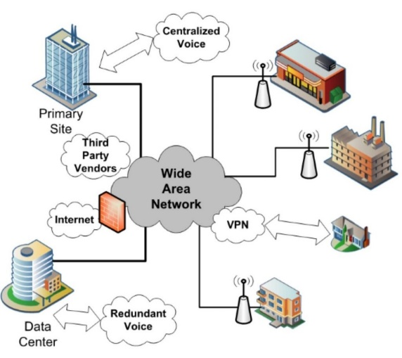
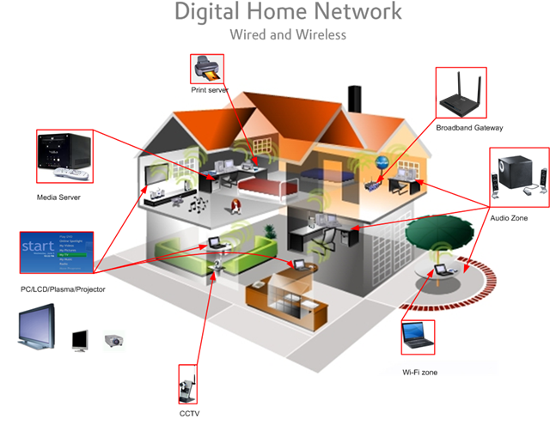
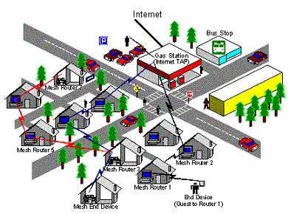
Your Internet
CAN / MAN
MAN / WAN
PAN / LAN / CAN

Slide 6



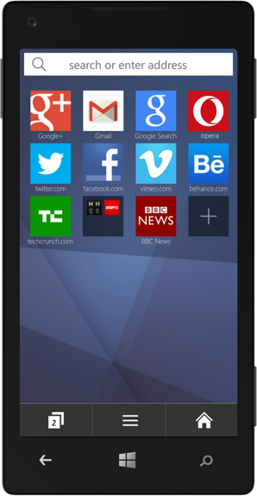
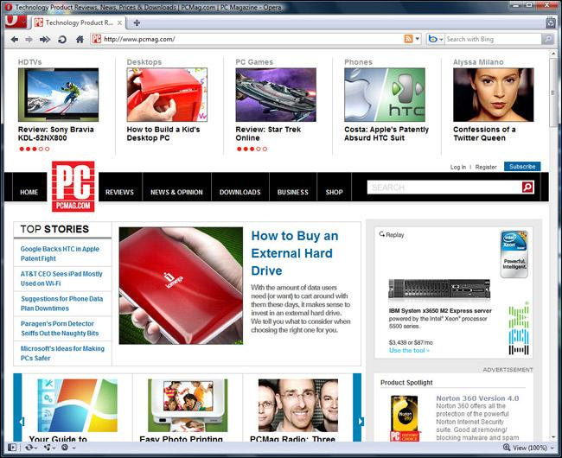




The World Wide Web

Slide 7
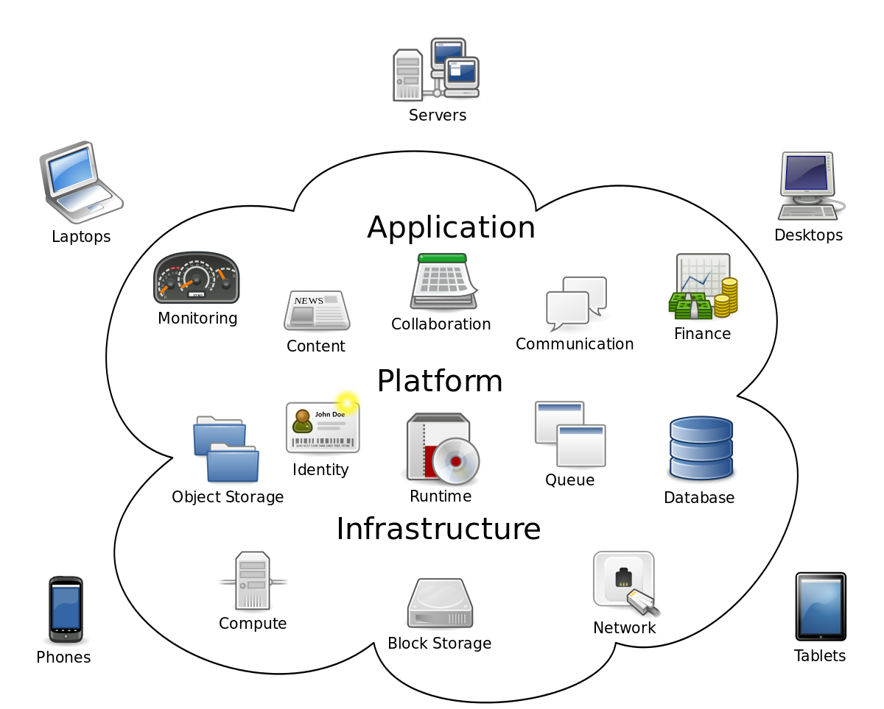
Cloud Computing

Slide 8
Cloud Computing Benefits
Agility
Cost reductions
Device and Location Independence
Maintenance
Multitenancy
Performance
Productivity
Reliability
Scalability and Elasticity
Security

Slide 9
Cloud Computing Issues
Availability of services
Limited Customization
Data access
Security
Costs
Regulations and Legal Issues
Privacy Issues

Slide 10
Why are Consumers Moving to the Cloud?
Consumer Demands
Growth of Internet Users
Unfettered Access to Data
Multiple Devices
Location Independence

Slide 11
Technology Developments
Increased Internet Bandwidth
Fiber-to-the-Home (FTTH)
Wireless Networks
Powerful Portable Devices
Reduced Cost of Storage

Slide 12
What are the Consumer-Based SaaS?
Type
Key Drivers
Data Storage
Financial Services
Productivity Applications
Social Media
Media Services
Digitalization
Open Source Software
Utility Computing
Virtulizaton
VOIP
IPTV

Slide 13
Key Cloud Security Terms
Data Encryption in Transit (EnT)
Secure Socket Layers (SSL) - (HTTPS – Secure Transactions)
Data Encryption in Storage (EnS)
Data Encryption at Rest (EaR)
Digital Certificate (X-509 Cert)
Digital Signature
Security Credentials (Username & Password)
Two-factor authorization (2FA)
Multifactor Authentication (MFA) (Username, Password, & PIN)

Slide 14



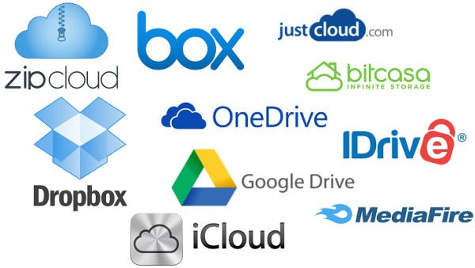

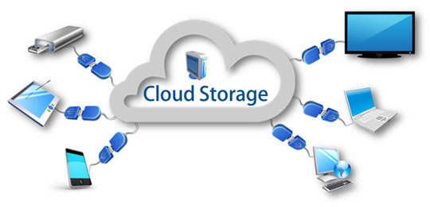
Why Do Cloud Storage?

Slide 15





How Does Cloud Storage Work?
US
Service
Provider
Canada
Australia

Slide 16
Cloud Storage
Advantages
Disadvantages
Pay for the storage you use.
Inexpensive storage availability.
Enhanced data protection.
Outsource storage maintenance.
Access to more robust resources and applications.
Natural disaster backup.
Accessibility.
Supplier stability.
Security of data in storage.

Slide 17

Cloud Storage
Service | Microsoft OneDrive | Google Drive | Apple iCloud Drive | DropBox
File size restrictions | 15GB | 5TB | 15GB | 10GB with website, none with Dropbox apps
Free storage? | 5GB** | 15GB | 5GB | 2GB
Device Account Needed | No | No | Apple Device Users | No
Paid plans | $2/month for 50GB** | $2/month 100GB, $10/month for 1TB | Free for I-Users | $10/month for 1TB
Security | EnT / EaR* MFA | MFA | MFA | MFA
OSes supported | Windows, Mac, Android, iOS, Windows Phone | Windows, Mac, Android, iOS |  | Windows, Mac, Linux, Android, iOS, Windows Phone, BlackBerry, Kindle Fire
EnT – Encryption in Transit
EaR - Encryption at Rest
EaR* - When used with Personal Vault
MFA – Multifactor Authentication

Slide 18
Exercise 1 - Cloud Storage
List the cloud storage services you have access to.
List the cloud storage services you use.
List the cloud storage services you want on your desktop.

Slide 19
Cloud (Online) Financial Services
Traditional Banks
Credit Unions
Online Banks
Regional Banks
Brokerage Accounts

Slide 20
Advantages of Cloud Banking
24/7 account and service access.
Speed and efficiency.
Online bill payment.
Low overhead can mean low fees.
Low overhead can mean high interest rates on deposit accounts.

Slide 21
Disadvantages of Cloud Banking
Technology issues.
Security issues.
Inefficient at complex transactions.
No relationship with personal banker.
Inconvenient to make deposits.

Slide 22







Traditional Banks (Cloud-Based)
According to Backrate.com

Slide 23










Credit Unions (Cloud Based)
According to Backrate.com

Slide 24










Exclusive Cloud Banks
According to Backrate.com

Slide 25










Top Regional Banks (Cloud based)
According to Backrate.com

Slide 26
Cloud Brokerage Accounts
Fidelity - Best research experience.
E*TRADE - Best web platform.
Charles Schwab - Best for IRA accounts.
Merrill Edge - Best rewards program.
Interactive Brokers - Best for professionals.
Firstrade - Best for Chinese-speaking clients.
tastytrade - Best desktop options trading platform
According to StockBrokers.com

Slide 27
Cloud Office Applications
Advantages
Disadvantages
Monthly cost is low.
No download or install of software.
Run on thin clients.
No need to purchase upgrades.
Portable.
Access may require connectivity.
Speed and accessibility issues.
Number of features available in Cloud versions limited.
Monthly subscription charge to use the service.
No control over the version of the software.
Reliant on the service provider for security and privacy.

Slide 28
Cloud Office Applications
Service | Office 365 | Google Workplace | ZoHo Docs | ThinkFree
Price | $5 per Month for Year | $5 per Month $60 per Year | Free & Up | Free – 30 days
Storage | 1 TB | Drive (30GB) | Docs: 5/250/1000GB | 1GB
Plan Choices | Multiple | 6 Options | 10 Plans
Apps | Word Processor Spreadsheet Presentation Email Calendar Site Builder Messaging Note Organizer | Word Processor Spreadsheet Presentation Email Calendar Site Builder Messaging Note Organizer | Word Processor Spreadsheet Presentation Email Calendar Site Builder Messaging Note Organizer Project Management | Word Processor Spreadsheet Presentation Notes Blogs
Commitment | Monthly | Annual | Monthly | Monthly

Slide 29
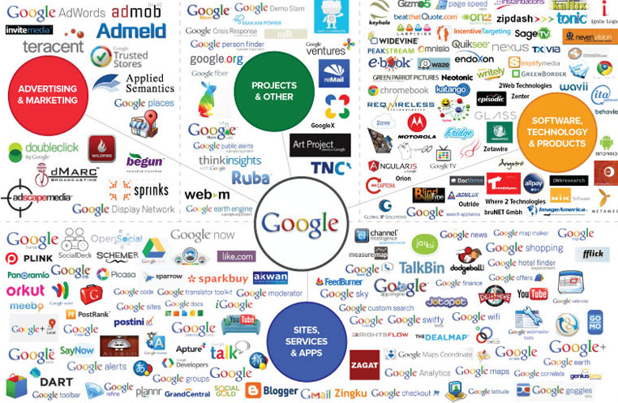
Google Products
Google Products

Slide 30
Exercise 2 - Cloud Banking & Office Apps
List the cloud banking services you have access to.
List the cloud banking services you use.
List the cloud Office Apps do you have access to?
List the cloud Office Apps you use.

Slide 31
Cloud Social Media
Cloud-based Media Technologies.
Facilitate sharing:
  Information
  Ideas
  Career interests
Interactive Web 3.0 Applications.
User-generated content:
  Texts
  Comments
  Digital photos
  Digital Videos
  Mashup Media
Facilitates development of online social networks that connect users with other individuals or groups.

Slide 32
Cloud Social Media
Advantages
Disadvantages
Sharing photos.
Sharing News and Information.
Sharing rankings and reviews.
Sharing content.
Sharing comments.
Mashing up online material.
Creating or working on a:
  Blog
  Microblog
  Video Log
  Micro Video Log
Trustworthiness (Hacking & Jacking)
Concentration (Media Conglomerates)
Reliability
Ownership of content
Privacy
Commercialization
Disparity

Slide 33
What are the Categories of Cloud Social Media?
Social Networking
Electronic Publishing
Photo Sharing
Online Audio
Online Video Platform
Microblogging
Livecasting
Virtual Worlds
Gaming
Productivity Apps
Aggregators
RSS
Search
Mobile
Interpersonal

Slide 34
Exercise 3
List the top three Cloud Social Media Network you belong to.
  _____________________
  _____________________
  _____________________
List the top three activities you do on your primary Cloud Social Media Networks.
  _____________________
  _____________________
  _____________________

Slide 35
What are Cloud Streaming Media Services?
Television
Video
Music

Slide 36
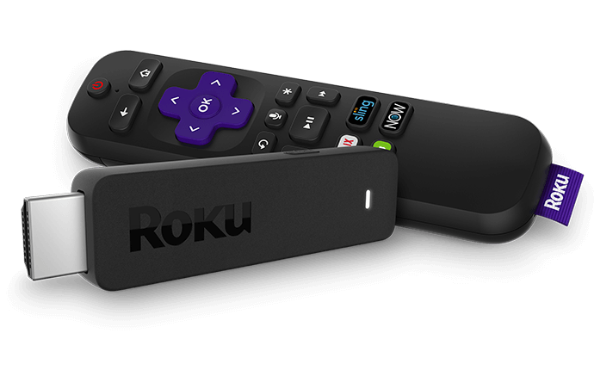
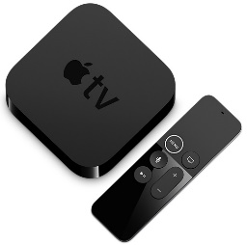
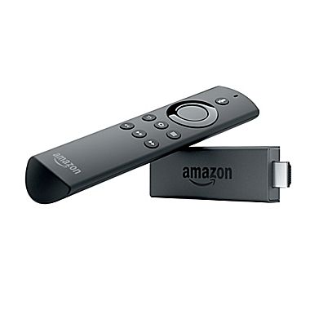

Cloud TV – Cut the Cord
CloudTV – Uses Internet Protocol Television (IPTV)
Software platform that virtualizes:
  Customer Premises Equipment (CPE) or;
  Set-top Box (STB) functionality.
Over The Top (OTT) online video service providers include:
  Netflex
  YouTube
  Hulu
  Amazon Prime
  Apple TV
Over The Top (OTT) STP video product providers include:
Roku
Apple TV
Amazon Fire
Google Chromecast 2

Slide 37






How to Access
Alternate Television Stations
OTT Streaming Media Products
Digital Broadcast
Amazon Fire
Roku
DMV – 108 Channels
ChromeCast
Nvidia Shield
Apple TV
63 Best Free Streaming Sites for Movies and TV Shows 2024

Slide 38

The Best Online Video Site
https://flixrave.to
Movie & TV Digital Video Quality
HD – High Definition (1920p × 1080p)
HDRip – HD Ripped from CD (720p × 480p)
SD – Standard Definition (640p x 480p)
TS – Telesync (Degraded SD Video Quality)
CAM – Movie Theater Camera Footage

Slide 39
New Streaming Media Outlets
Freemediaheckyeah (FMHY)
  HydraHD
  StreamFlix
  FlixHQ.click
Caveats (Add Browser Extensions)
  Use an ad blocker (Ghostery – Privacy Ad Blocker)
  Use a Pop-up Blocker (Popup Blocker (strict))
  Use a Privacy Tracker (Privacy Badger)

Slide 40
Cloud Media Devices - OTT
Service | RUKU TV | Roku Express | Roku Streaming Stick | Roku Streaming Stick+ | Roku Ultra 4K
Price | $149.99 (32”) | $29.99 | $49.99 | $69.99 | $99.99
4K (HDR) | YES | NO | YES | YES | YES
Service | Apple TV | Apple TV 4K (32GB) | Apple TV 4K (64GB)
Price | $149.00 | $179.00 | $199.00
4K (HDR) | NO | YES | YES
Service | Amazon Fire TV Stick | Amazon Fire TV 4k Ultra HD | Amazon Fire TV 4KHD w/Channels
Price | $39.99 | $69.99 | $79.99
4K (HDR) | NO | YES | YES
Service | Google Chromecast | Google Chromecast Ultra
Price | $35.00 | $69.00
4K (HDR) | NO | YES
Best OTT Devices in 2024

Slide 41
Cloud Video Media Services
On-Demand Streaming Services
Service | Netflix SD | Netflix 4K | Hulu | Hulu No Ads | Amazon Prime Video | Amazon Prime Video | YouTube Premium | Crackle
Price | $13 | $16 | $6 | $12 | $9 | $11 | $12 | Free
Service | CBS All-Access | Tubi | Britbox | Acorn TV
Price | $6 | Free | $7 | $6
Service | Shudder | CuriosityStream | Facebook Watch | Mubi
Price | $6 | $3 | $40 | $11

Slide 42
Cloud Video Media Services
Live TV Stream Services
Service | FuboTV | Hulu with Live TV | YouTube TV | SlingTV Orange | SlingTV Blue | Philo
Price | $55 | $45 | $50 | $25 | $40 | 20
Channels | 116 | 60 | 60 | 32 | 47 | 58
Service | AT&T TV Now
Price | $50 / $70
Channels | 54 / 71

Slide 43
Cloud Video Media Services
Sports Channel Replacement
Service | YouTube TV | Hulu with Live TV | Amazon Prime Video | FuboTV | CBS All-Access | Dazen | ESPN
Price | $50 | $45 | $9 | $55 | $6 | $14 | $5
Channels | 60 | 60 |  | 4 Networks |  |  | 30
Service | SlingTV Orange | SlingTV Blue | Apple TV+
Price | $25 | $40 | $6
Channels | 32 | 47 | 1

Slide 44
Cloud Video Media Services
Premium Paid Streaming Services
Service | HBO Now | Disney+ | Showtime | Starz | FuboTV | CBS All-Access | Dazen
Price | $50 | $7 | $11 | $9 | $55 | $6 | $14
Channels | 60 | Disney/Pixar/ Marvel/Star Wars/NatGEO | 60 |  | 4 Networks
Service | ESPN | SlingTV Orange | SlingTV Blue | Apple TV+
Price | $5 | $25 | $40 | $6
Channels | 30 | 32 | 47 | 1

Slide 45
Cloud IPTV Players (Windows)
VLC for Windows
MyIPTV Player
Perfect Player Windows
IPTV Smarters for PC
Kodi
OttPlayer
IP-TV Player
IPTV
ProgDVB/ProgTV
Free TV Player

Slide 46
Cloud IPTV Players (Android)
IPTV Smarters Pro
Lazy IPTV
TiviMate
GSE Smart IPTV
Perfect Player IPTV
IPTV
OTT Navigator

Slide 47
Cloud IPTV Players (IOS)
IPTV Stream Player
COBRA IPTV
Metropol IPTV
GSE SMART IPTV
Flash IPTV
IP Television – IPTV M3U
SteelTv IPTV
TVCast – Watch IPTV everywhere
Smash IPTV
IPTV SHQIP
UNOIPTV

Slide 48
Cloud Media Services - Music
Service | Spotify | Pandora | Napster / Rhapsody | SoundCloud | Groove Music | Apple Music | iTunes
# of Users | 75 M | 77 | 2.5 M | 175 M |  | 15 M | 800 M
# of Tracks | 30 M | 1.5 M | 32 M | 100 M | 40 M | 37 M | 40 M songs, 2.2 M apps, 25 K TV, 65 K Films
Platform | Web, Windows, iOS, Android Palm, Sonos, Symbian, Boxee, Telia Digital-TV, Virgin TiVo, webOS, Linux, PlayStation, Blackberry, Chromecast, Amazon Echo | Web, Windows, iOS, Android, Blackberry | Web, Windows, iOS, Android | Web, Windows, iOS, Android | Web, Windows, iOS, Android, Windows Phone Xbox 360, Xbox One, Sonos | Web, iOS, Android | Web, Windows, iOS, Android

Slide 49
Cloud Media Services - Pictures
Service | Flickr | 500Px | Photobucket | Canon Irista | SmugMug
Cost | $5.99/Month $49.99/Year | $4.99 Pro 14.99 Pro+ | $1.49/Mo $8.99/ Mo |  | Basic- 3.99/Mo Power-5.99/Mo Portfolio-14.99/Mo Business- 29.99/Mo
Registered Users
Storage | 1TB Free | 2,000 Photos | 100 GB | 15 GB – Free 100 GB – 2.25/Mo 500 GB – 7.99/Mo
Ads | Free – Yes Paid - No | Free – Yes Paid - No
Other

Slide 50
Cloud Media Services - Pictures
Service | iCloud | Google Photos | Dropbox | OneDrive | ISP
Cost | Included in Apple account | With Google account | Basic - Free Plus – 9.99 Month Pro – 19.99 Month | Free with Outlook of Office 365
Registered Users
Storage | 5 GB 50 GB 200 GB 2 TB | 15 GB | 2 GB 1 TB 1 TB | 5 GB 50 GB 1 TB 5 TB
Ads
Other

Slide 51
Exercise 4
List the Cloud Media Services You Have Access to.
  _____________
  _____________
  _____________
  _____________
  _____________
List the Cloud Media Services You Use.
  _____________
  _____________
  _____________
  _____________
  _____________

Slide 52
Cloud Mapping Services
Google Maps
Bing Maps
Yahoo Maps (Verizon)
MapQuest
OpenStreetMap
Rand McNally Maps
HERE
TomTom Navigator
TomTom Mobile
Waze

Slide 53
Exercise 5 – Cloud Services
Why do you like the Cloud Services you use?
What Cloud Services would you like to use more?
What are you next steps to use more Cloud Services?

Slide 54
Questions
and
Answers

Slide 55
Review
What is Cloud Computing?
Different CC Service Models
Why are Consumers Moving to the Cloud?
What are the Consumer-Based SaaS?
Cloud Financial Services
Cloud Productivity Applications
Cloud Social Media Services
Cloud Streaming Media Services
Cloud Mapping Services

Slide 56
Review
Defined Cloud Computing
Identified Cloud Computing Service Models
Identified why Consumers are Moving to the Cloud
Identified Consumer-Based SaaS
Identified what is Cloud Storage
Identified what is Cloud Financial Services
Identified what are Cloud Office Applications

