Slide 1

Knowing Technology I Introduction
http://www.profburnett.com

Slide 2
Outline
Introductions
Admin Announcements
Class Website
Class Schedule

Slide 3
Instructor Info
Carl Burnett
U.S. Army – ORSA Data Science Analyst
BAH – Consultant – Web Dev Program Manager
GDIT – Senior PM – U.S. Senate
Adjunct Prof – JHU
Prof – Montgomery College
cb@profburnett.com
240.696.1906

Slide 4
Introduce Yourselves
Name
What is your job or what was your job?
What do you to expect from the course?

Slide 5
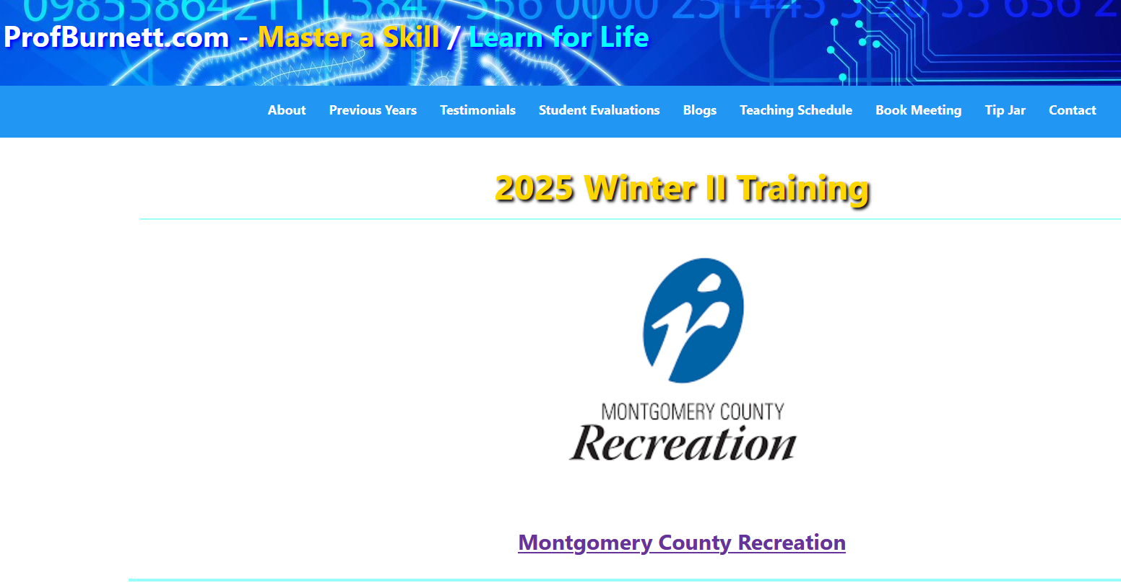
Profburnett.com

Slide 6
Knowing Technology Series
Knowing Technology I - Your Computer
Knowing Technology II - Your Files
Knowing Technology III: Networks
Knowing Technology IV: Internet Browsers
Knowing Technology V: The Cloud
Knowing Technology VI: Digital Security
Knowing Technology VII: Digital Privacy

Slide 7
Knowing Technology Series (Revised)
Knowing Technology I: Your Computer
Knowing Technology II: Your Smartphone
Knowing Technology III: Networks & The Cloud
Knowing Technology IV: Internet Browsers & Your Files
Knowing Technology V: Social Media Apps
Knowing Technology VI: Digital Security
Knowing Technology VII: Digital Privacy

Slide 8
Knowing Technology Series MC Recreation Course Schedule
Course | Date | Time
Knowing Technology I | Friday – 12/5/2025 | 10:00 – 11:30 AM
Knowing Technology II | Friday – 12/12/2025 | 10:00 – 11:30 AM
Knowing Technology III | Friday – 1/16/2026 | 10:00 – 11:30 AM
Knowing Technology IV | Friday – 1/23/2026 | 10:00 – 11:30 AM
Knowing Technology V | Friday – 1/30/2025 | 10:00 – 11:30 AM
Knowing Technology VI | Friday – 2/6/2026 | 10:00 – 11:30 AM
Knowing Technology VII | Friday – 2/13/2026 | 10:00 – 11:30 AM

