Slide 1

Knowing Technology I
Introduction
http://www.profburnett.com

Slide 2
Outline
Introductions
Admin Announcements
Class Website
Class Schedule

Slide 3
Instructor Info
Carl Burnett
U.S. Army – ORSA Data Science Analyst
BAH – Consultant – Web Dev Program Manager
GDIT – Senior PM – U.S. Senate
Adjunct Prof – JHU
Prof – Montgomery College
cb@profburnett.com
240.696.1906

Slide 4
Introduce Yourselves
Name
What is your job or what was your job?
What do you to expect from the course?

Slide 5
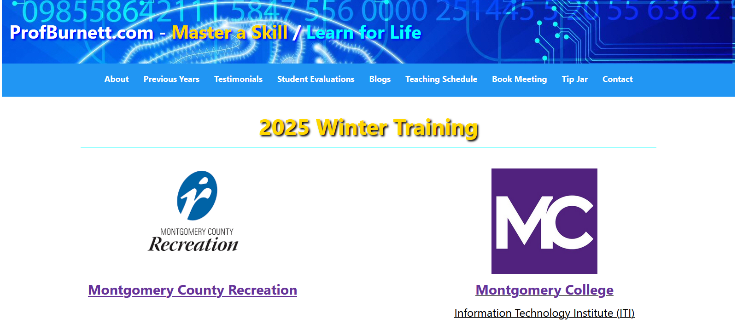
Profburnett.com

Slide 6
Knowing Technology Series
Knowing Technology I - Your Computer
Knowing Technology II - Your Files
Knowing Technology III: Networks
Knowing Technology IV: Internet Browsers
Knowing Technology V: The Cloud
Knowing Technology VI: Digital Security & Privacy

Slide 7
Knowing Technology Series
MC Recreation Course Schedule
Course | Date | Time
Knowing Technology I | Friday – 9/12/2025 | 10:00 – 11:30 AM
Knowing Technology II | Friday – 9/19/2025 | 10:00 – 11:30 AM
Knowing Technology III | Friday – 9/26/2025 | 10:00 – 11:30 AM
Knowing Technology IV | Friday – 10/3/2025 | 10:00 – 11:30 AM
Knowing Technology V | Friday – 10/10/2025 | 10:00 – 11:30 AM
Knowing Technology VI | Friday – 10/17/2025 | 10:00 – 11:30 AM

