Slide 1

Knowing Technology I
Your Computers
http://www.profburnett.com

Slide 2

Did You Know 2025

Slide 3
Session 1 – Your Computers
Computing Devices
Main Hardware Components
Peripherals and Connectors
Operating Systems
Application Software

Slide 4
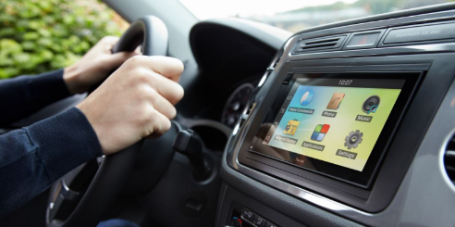

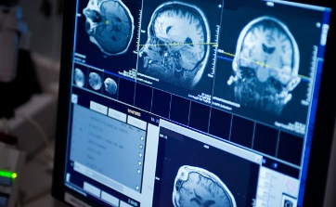


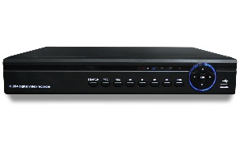
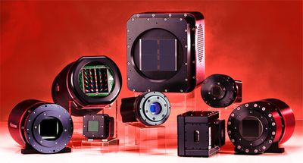
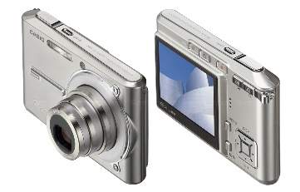
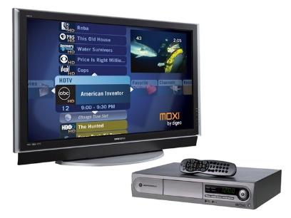
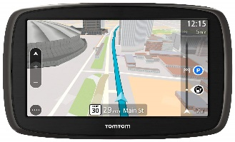
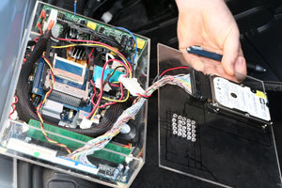
What are Digital Computing Devices?

Slide 5
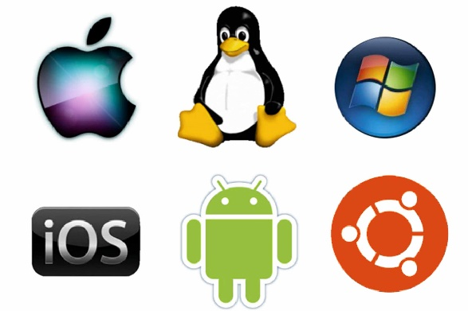
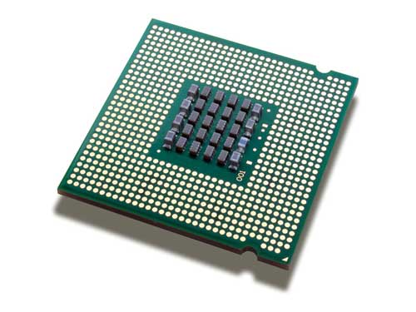
Computing Components
Hardware Component
Software Component

Slide 6
Computing Devices

Slide 7
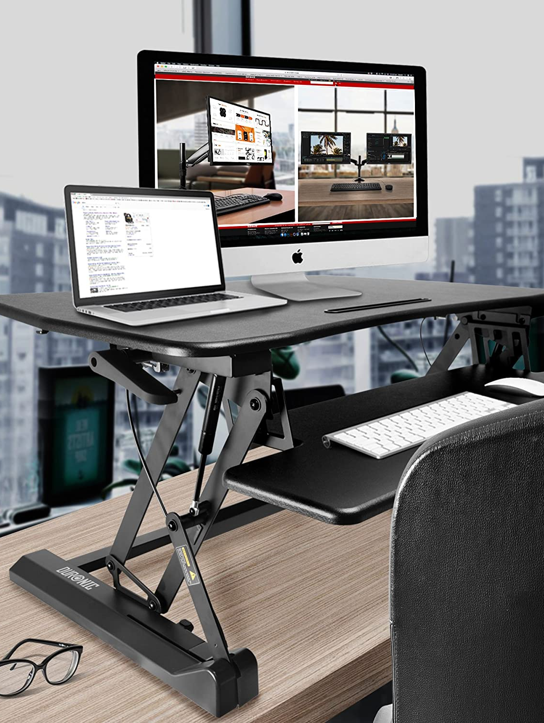
Desktop & Workstations
Computers that users do daily work.
Generally connected to a network with a network interface card (NIC).
Notes:
Workstations are specialized computers designed to handle tasks that demand high performance and are commonly utilized by professionals across various industries. Here's a more detailed exploration of workstations:
**Origin and Evolution:**
Workstations were first introduced in the 1960s and 1970s as minicomputers, which were smaller and more affordable than mainframe computers. Over time, they evolved to become the high-performance machines known as workstations that we see today.
**Characteristics of Workstations:**
- **High Performance:** Workstations are equipped with powerful processors, substantial RAM, and dedicated graphics cards. This enables them to manage demanding tasks such as graphic design, video editing, scientific simulations, and more.
- **Reliability:** Workstations are constructed with premium components and undergo rigorous testing to ensure consistent and reliable performance over extended periods.
- **Specialized Hardware:** Some workstations feature hardware tailored to specific industries. For example, workstations in graphics design might include color-accurate displays, while those in engineering might support high-performance computing.
- **Expandability:** Workstations often offer the flexibility to accommodate multiple hard drives, RAM modules, and other components, enabling users to customize their systems according to specific requirements.
- **Optimized Software:** Many workstations come with software optimizations for certain applications, enhancing overall performance and user experience.
**Role of Workstations:**
Workstations find use in a wide range of tasks, including:
- **Graphic Design and 3D Rendering:** Workstations are indispensable for tasks like video editing, 3D modeling, animation, and other graphics-intensive work.
- **Engineering and CAD:** Engineers employ workstations to execute complex simulations, computer-aided design (CAD), and computer-aided engineering (CAE) software.
- **Scientific Research:** Workstations play a key role in fields such as scientific research, simulations, and data analysis.
- **Financial Modeling:** Financial institutions utilize workstations for tasks like quantitative analysis, risk assessment, and the development of trading algorithms.
- **Software Development:** Developers rely on workstations for coding, compiling, and testing software, especially for resource-intensive projects.
**Network Interface Card (NIC):**
A Network Interface Card (NIC) is an essential component for connecting computers, including workstations, to networks. It enables communication between the workstation and other devices over a network, allowing users to access resources, share data, and communicate with others.
In summary, workstations are specialized computers that have evolved since their inception in the 1960s and 1970s. They are designed to efficiently handle resource-intensive tasks and are indispensable tools for professionals across various industries who require high performance and reliability in their work.

Slide 8
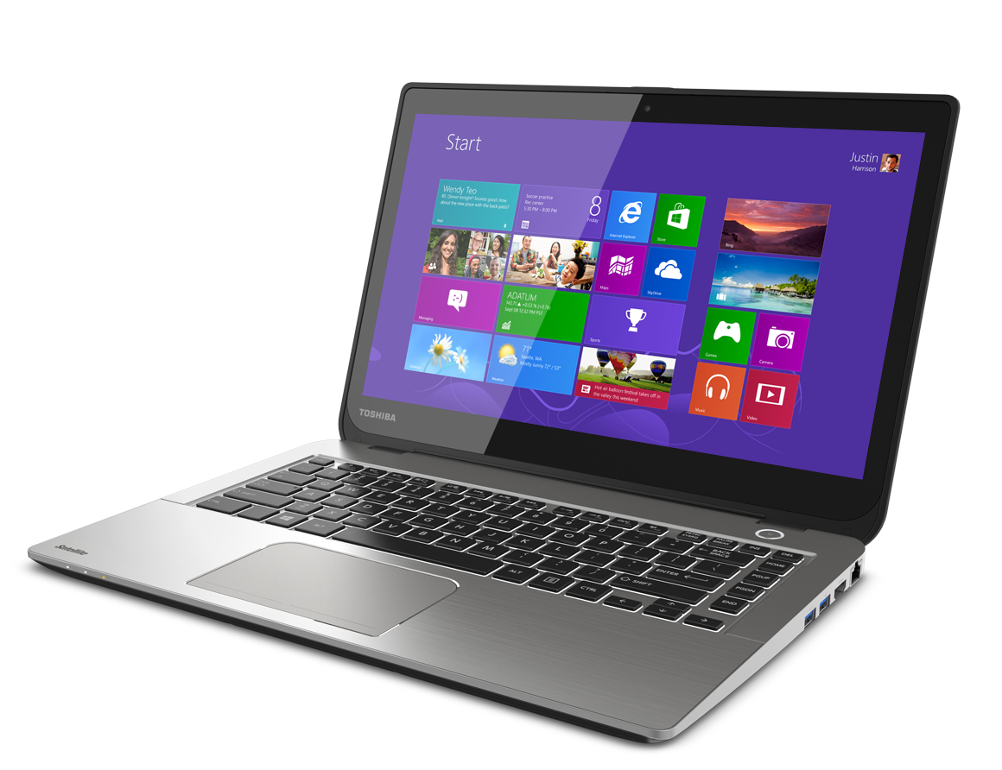
Laptops
Portable devices
Like desktop computers, but smaller components
Built-in keyboard and monitor
Need a power adapter
Docking stations
Cable locks
Notes:
Laptops, also known as notebooks, are portable computing devices that offer convenience and mobility. They were first introduced in the early 1980s and have since become an integral part of modern computing. Here's a more detailed exploration of laptops:
**Portability and Convenience:**
- Laptops were designed to provide a portable alternative to desktop computers, allowing users to carry their work, entertainment, and communication tools with them wherever they go.
- Their compact size and integrated components make laptops a versatile option for various tasks.
**Compact Design:**
- Laptops feature all the essential components of a desktop computer, including a central processing unit (CPU), memory (RAM), storage, graphics processing unit (GPU), and more.
- Despite their smaller form factor, laptops are equipped to handle a wide range of applications, from web browsing to complex tasks like video editing and software development.
**Built-In Keyboard and Monitor:**
- Laptops come with a built-in keyboard and monitor, allowing users to interact with the device without the need for external peripherals.
**Power Adapter:**
- Laptops require power to operate, and they come with a power adapter for charging the built-in battery. This battery allows the laptop to function without being connected to a power source for a certain amount of time, providing portability.
**Docking Stations:**
- Some laptops support docking stations, which allow users to easily connect their laptops to a larger monitor, keyboard, mouse, and other peripherals when they're working at a desk. Docking stations provide a desktop-like experience when needed.
**Cable Locks:**
- Cable locks are security devices that can be attached to laptops to deter theft. They typically consist of a cable that can be looped around a secure object, and a locking mechanism that prevents the laptop from being easily removed.
**Use Cases:**
- Laptops are widely used by students, professionals, and individuals who need to work or access information while on the move.
- They're suitable for tasks like word processing, web browsing, email, multimedia consumption, video conferencing, and more.
**Limitations:**
- Due to their compact size, laptops may have slightly reduced performance compared to their desktop counterparts with similar specifications.
- Upgrading certain components like the graphics card or CPU can be challenging or impossible in some laptops.
In summary, laptops have a history dating back to the early 1980s, when they were first introduced as a portable computing solution. They offer a portable and convenient way to perform various tasks while maintaining the capabilities of a desktop computer. Laptops have become an essential tool for individuals who need computing power while on the go or in environments where a traditional desktop setup is not feasible.

Slide 9
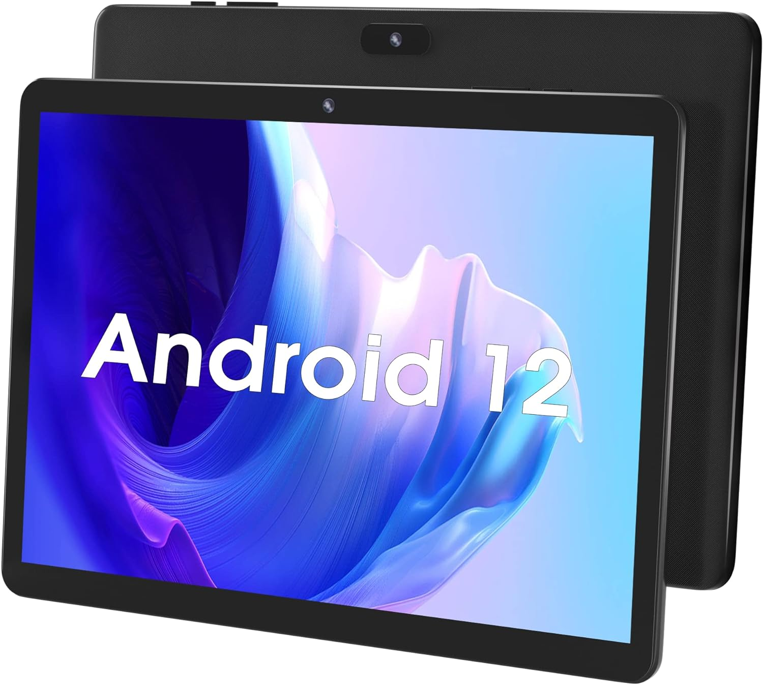
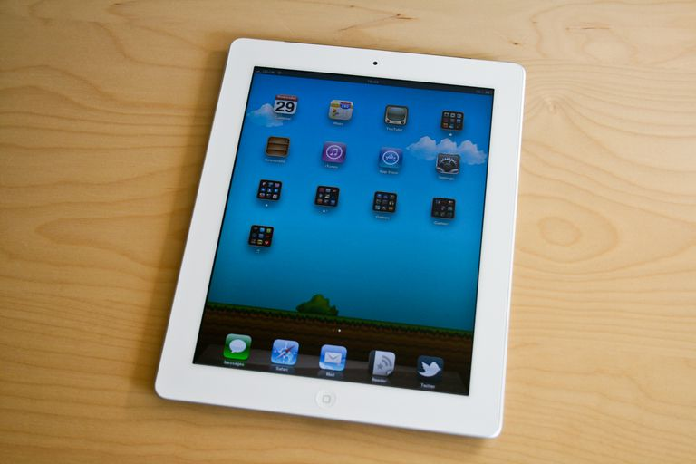
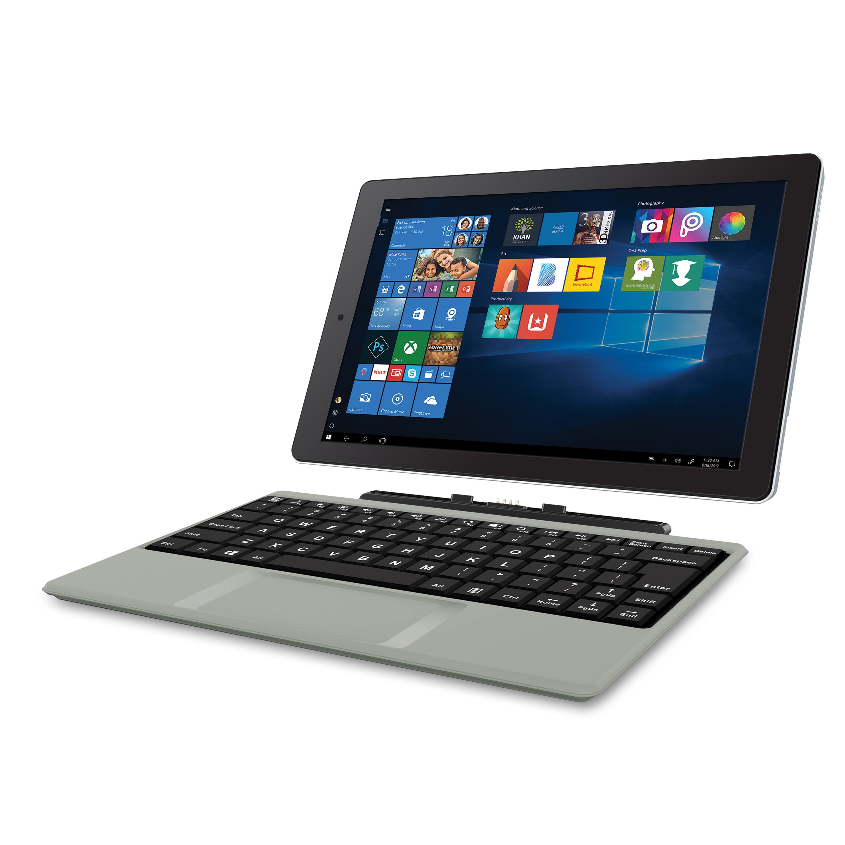
Tablets
Andorid
iPad
Windows Surface

Slide 10
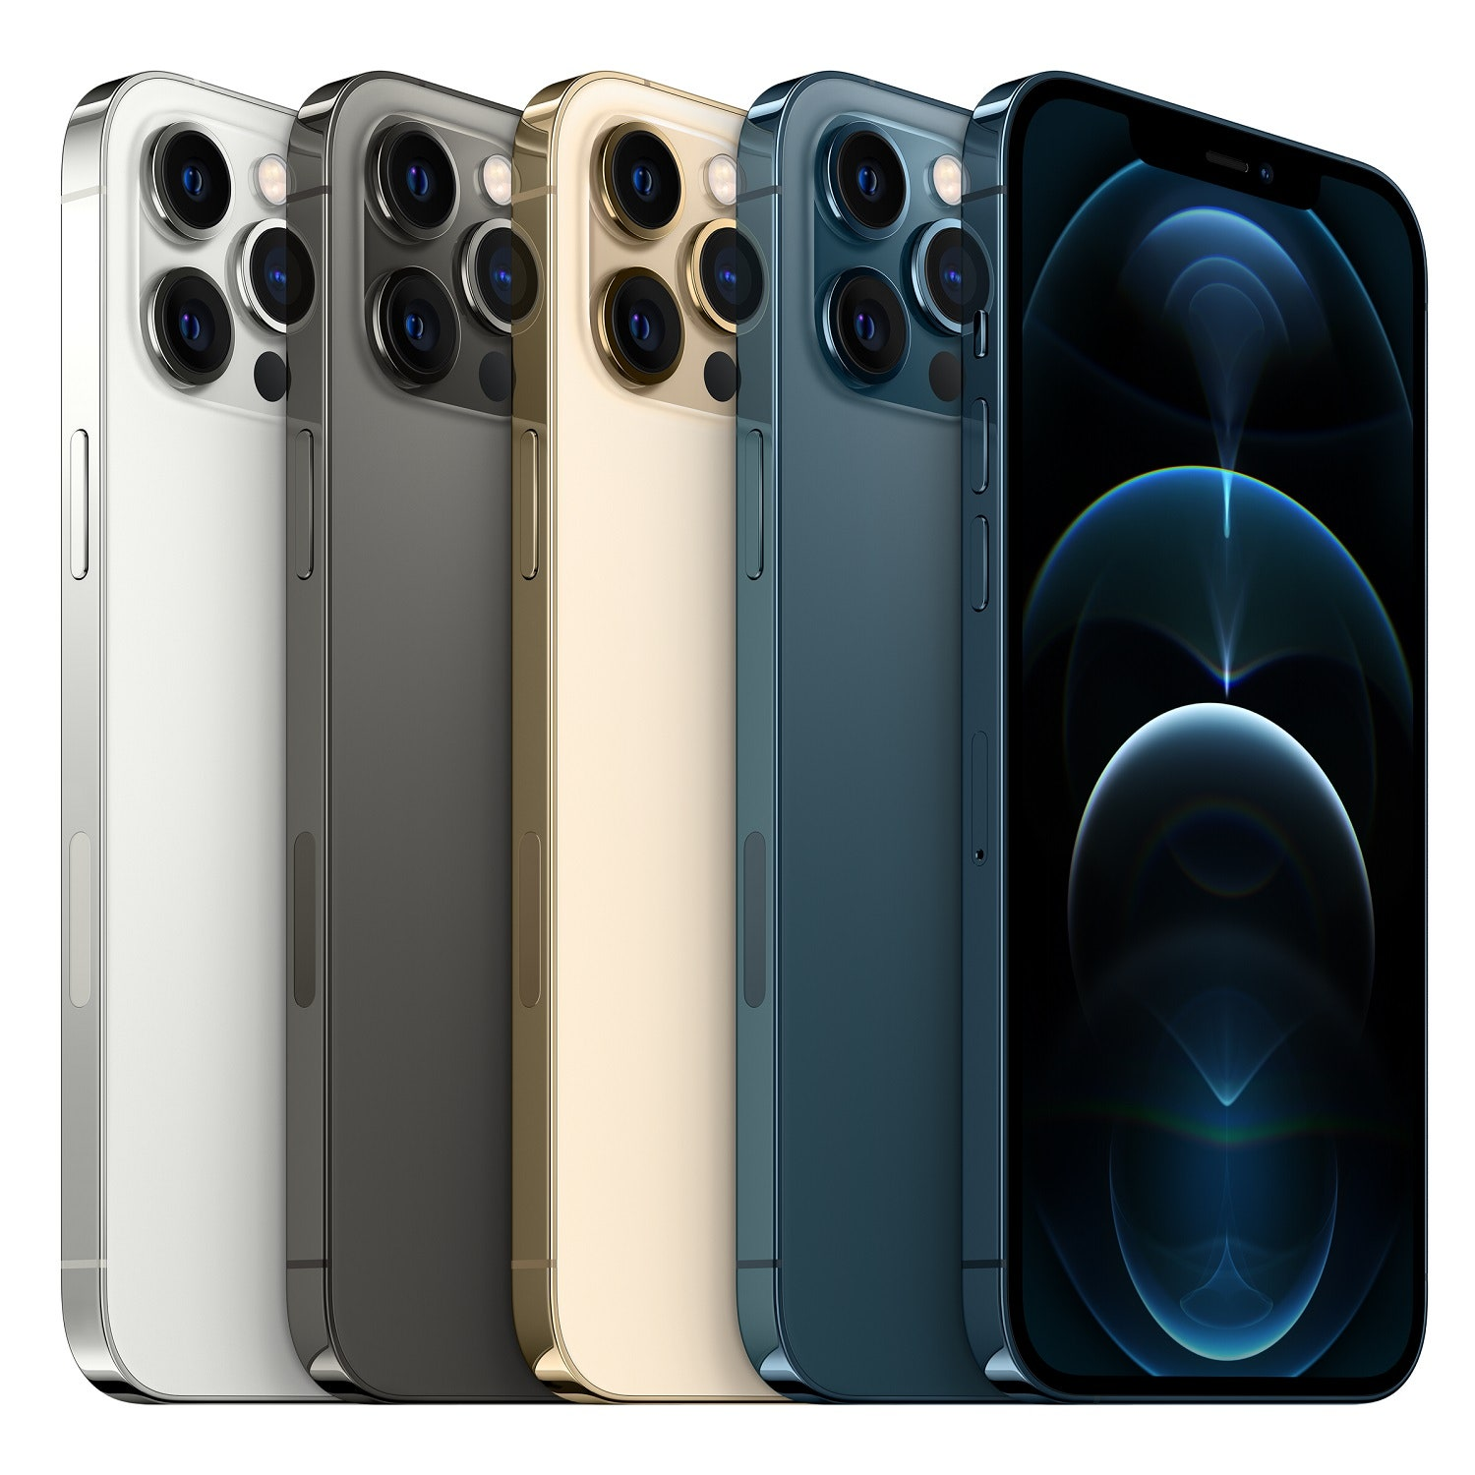
Smartphones
Smaller than laptops, very portable
No built-in hardware keyboard
Typically run a mobile OS, such as Android or iOS
Notes:
Tablets and smartphones represent a new era of mobile computing, offering compact size, portability, and powerful functionality. Here's a more detailed exploration of tablets and smartphones:
**Tablets:**
- Tablets are portable devices that fall between smartphones and laptops in terms of size and functionality.
- They are larger than smartphones, making them suitable for tasks like browsing, media consumption, and light productivity.
- Tablets lack a built-in hardware keyboard, relying primarily on touchscreens for input.
- Their form factor is well-suited for tasks that demand more screen real estate than smartphones can provide.
- Tablets typically run mobile operating systems like Android or iOS, offering app ecosystems optimized for touch interactions.
- The first modern tablet, the "Tablet PC," was introduced in the early 2000s. However, tablets gained significant popularity with the launch of the Apple iPad in 2010.
**Smartphones:**
- Smartphones are pocket-sized devices that are primarily used for communication, productivity, entertainment, and accessing the internet.
- They have a smaller form factor compared to tablets and laptops, making them highly portable and convenient to carry.
- Smartphones lack a built-in hardware keyboard as well, relying on touchscreen keyboards for text input.
- They are powered by mobile operating systems like Android or iOS, providing access to a wide range of apps.
- Smartphones have become essential tools in modern life, offering features beyond traditional calling and texting.
- The first commercially available smartphone was the IBM Simon Personal Communicator, released in 1994. However, smartphones experienced explosive growth in the late 2000s with the introduction of devices like the iPhone and various Android smartphones.
**Use Cases:**
- Tablets are often used for tasks like reading eBooks, watching videos, light gaming, web browsing, and taking notes.
- Smartphones serve as versatile communication devices, providing features like calling, texting, email, social media, and accessing a multitude of apps.
**Evolution and Impact:**
- Tablets and smartphones have revolutionized the way people interact with technology and consume content.
- Their touch-based interfaces and app ecosystems have driven significant changes in user behavior and expectations.
- The introduction of tablets and smartphones has led to a boom in mobile app development and a shift towards mobile-first design in various industries.
In summary, tablets and smartphones have significantly altered the way people interact with technology, offering portability, convenience, and a wide array of functionalities. Tablets gained prominence in the early 2010s, while smartphones have evolved over several decades to become integral parts of modern life.

Slide 11
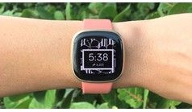
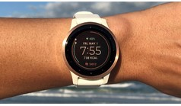

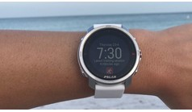
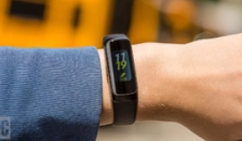

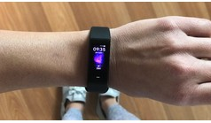
Fitness Trackers
Fitbit
Apple
Polar
Garmin
Samsung
Coros
Wyze
PC Magazine - Best Fitness Trackers for 2021

Slide 12
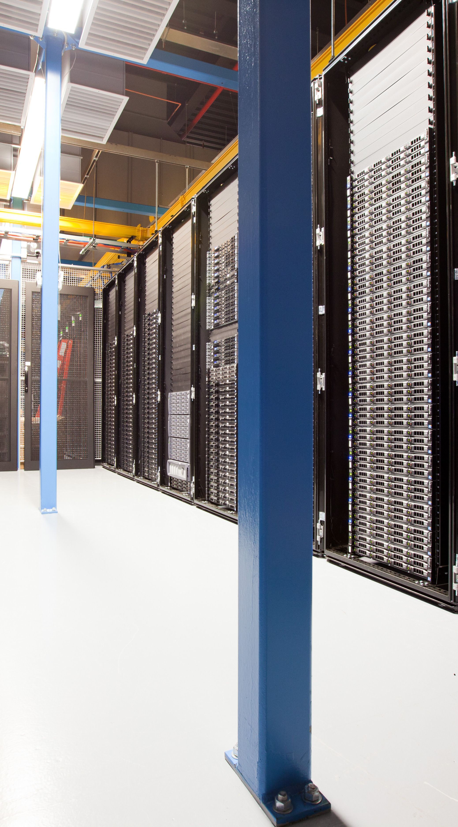
Servers
Centralized computers that allow many clients to access information.
Provide services such as:
  Web Servers
  File Servers
  Application Servers
Notes:
Servers are crucial components of network infrastructures that provide various services to clients or users. Here's a more detailed exploration of servers:
**Centralized Access:**
Servers are centralized computers designed to handle and manage resources, services, and data that multiple clients (such as workstations, laptops, or other devices) can access over a network. Servers play a vital role in sharing resources and delivering services efficiently.
**Types of Server Services:**
Servers offer a range of services to clients based on their functions and purposes. Some common server services include:
- **File Servers:** These store and manage files that can be accessed and shared by clients. They help in centralizing data and maintaining consistent versions of files.
- **Print Servers:** Print servers manage print jobs from clients and control printing tasks on networked printers, making printing more organized and efficient.
- **Web Servers:** Web servers host websites and web applications, delivering content to clients' web browsers when they request it. They handle requests for web pages, images, videos, and other web resources.
**Dedicated vs. Non-Dedicated Servers:**
- **Dedicated Servers:** These servers are solely dedicated to a specific task or service. For instance, a web server that exclusively hosts websites. Dedicated servers provide optimized performance for their designated tasks.
- **Non-Dedicated Servers (Shared Servers):** These servers handle multiple tasks or services simultaneously. For example, a server that hosts both web pages and email services. While they might not provide the same level of performance as dedicated servers, they offer cost-effective solutions for smaller organizations.
**Benefits of Servers:**
- **Resource Centralization:** Servers centralize resources like files, applications, and services, making them easier to manage and access.
- **Security:** Servers can offer enhanced security by controlling user access, implementing authentication methods, and maintaining data integrity.
- **Backup and Redundancy:** Servers often include backup and redundancy mechanisms to ensure data safety in case of hardware failures.
- **Scalability:** Servers can be scaled up to accommodate growing demands by adding more hardware resources or optimizing software configurations.
- **Remote Access:** Servers enable remote access, allowing users to access resources and services from different locations.
In summary, servers play a vital role in modern computing environments, providing various services to clients and contributing to efficient resource management, data sharing, and centralized control. The choice between dedicated and non-dedicated servers depends on the organization's specific needs and requirements.

Slide 13
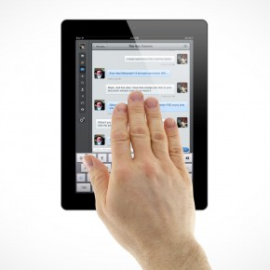
Interacting with Mobile Devices
Gesture-based interactions
  Tap
  Swipe
  Pinch
  Kinetics
Notes:
Interacting with mobile devices has evolved significantly with the introduction of gesture-based interactions, which enable users to control and navigate their devices in intuitive ways. Here's a more detailed exploration of these interactions:
**Gesture-Based Interactions:**
- Gesture-based interactions involve using physical movements or actions to control and interact with mobile devices, typically via touchscreens.
- These interactions offer a natural and intuitive way for users to communicate with their devices and perform various tasks.
**Tap:**
- Tapping is a fundamental gesture where users touch the screen briefly with a finger to trigger an action, select an item, open an app, or activate a link.
- It is one of the most common and basic gestures used for navigation and selection on mobile devices.
**Swipe:**
- Swiping involves dragging a finger across the screen in a specific direction, typically used for scrolling through content, navigating between pages, or dismissing notifications.
- Swipes can be used vertically, horizontally, or diagonally to achieve different functions.
**Pinch:**
- The pinch gesture involves placing two fingers on the screen and bringing them closer together or spreading them apart.
- Pinching is often used to zoom in or out on images, maps, and content, allowing users to control the level of detail.
**Kinetics:**
- Kinetics, also known as flicking or flinging, is a gesture where users quickly swipe a screen and then release their finger to initiate a motion that continues based on the initial speed and direction.
- This gesture is commonly used to scroll quickly through long lists or web pages.
**Additional Gestures:**
- Gestures have evolved to include more complex interactions, such as double-tap, long-press, and multi-finger gestures, offering users a variety of ways to interact with their devices.
**Impact and Evolution:**
- Gesture-based interactions have transformed the user experience on mobile devices, making them more intuitive and accessible to a wide range of users.
- These interactions have influenced user interface design, encouraging the development of touch-friendly interfaces that prioritize user convenience and fluidity.
**User Learning Curve:**
- While gestures enhance usability, there might be a learning curve as users adapt to new interaction methods.
- Consistency and visual cues in interface design can help users quickly grasp and become comfortable with different gestures.
In summary, gesture-based interactions, including tapping, swiping, pinching, and kinetics, have become integral to how users interact with mobile devices. These interactions offer a more natural and intuitive way to control devices, transforming the way people navigate through content, applications, and interfaces.

Slide 14
Hardware Components

Slide 15
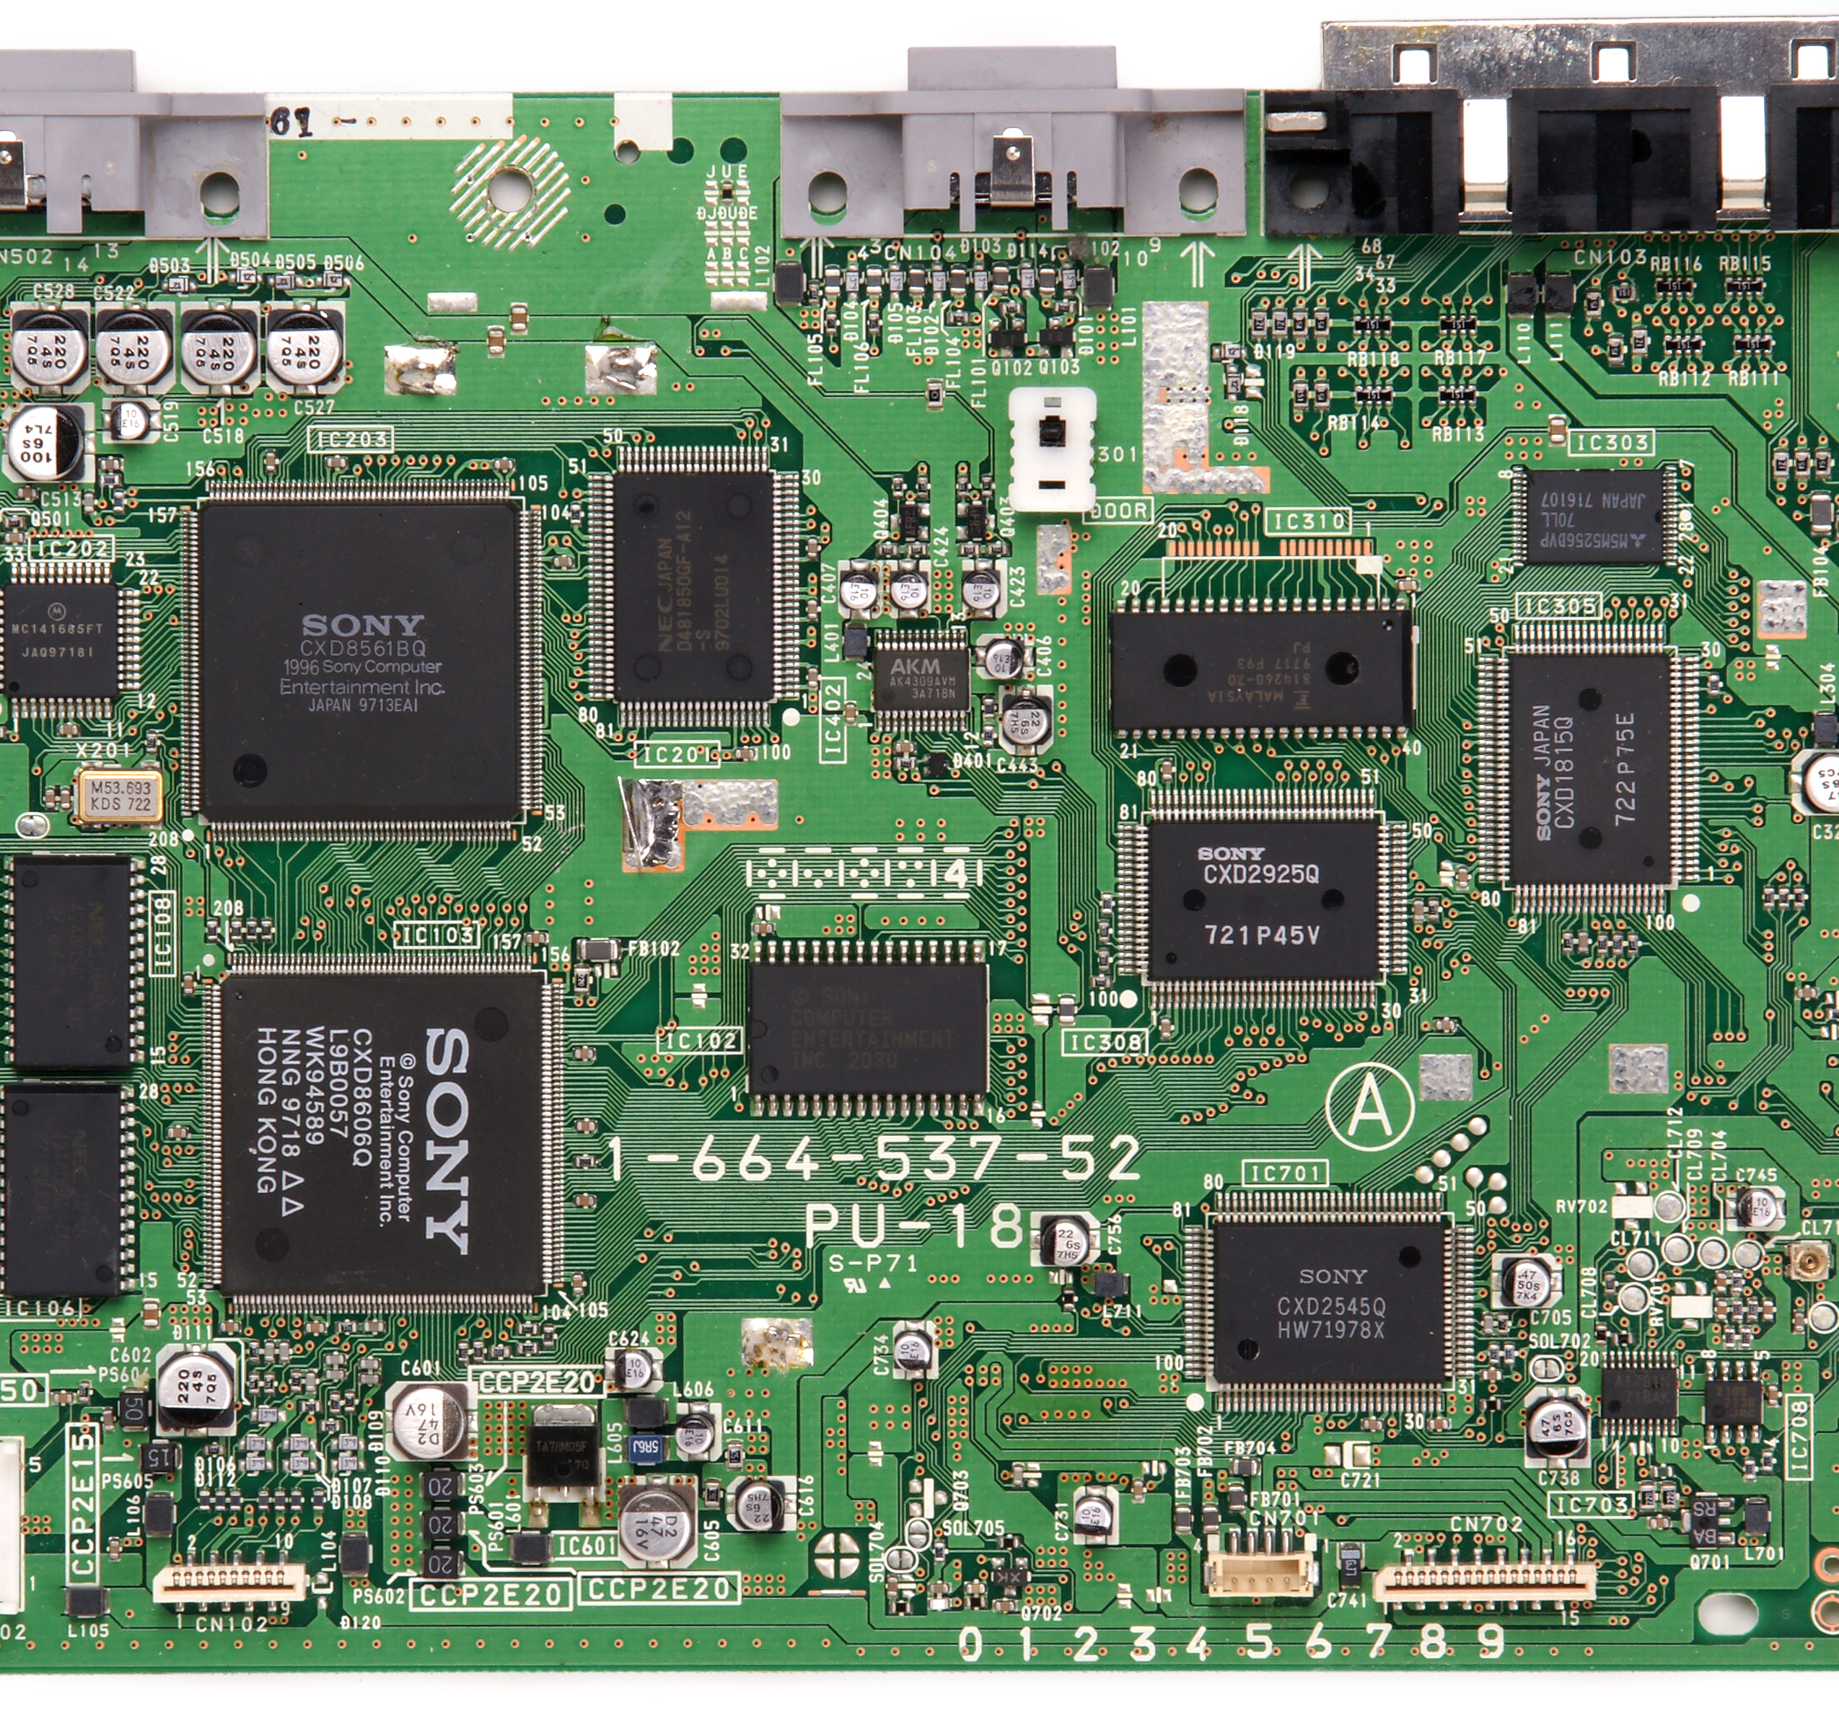
Motherboard
Connect all components together
Also called system board or mainboard
Form factor refers to size and shape
Chipset is the technology on the motherboard
– perform interface and peripheral functions
Notes:
Let's delve into a comprehensive understanding of the concept of a "Motherboard Overview" and the process of connecting all components together within a computer system.
The motherboard, also referred to as the system board or mainboard, plays a pivotal role in the functionality of a computer. It serves as a central hub that connects and facilitates communication between various hardware components within the system.
When we talk about connecting all components together, we are essentially discussing the intricate network of connections that enable different hardware elements such as the CPU (Central Processing Unit), RAM (Random Access Memory), storage devices, graphics card, and more to interact and function as a cohesive unit.
One key aspect of the motherboard is its form factor, which dictates its size, shape, and layout. The form factor is a critical consideration as it determines the compatibility of the motherboard with the computer case and other components. Common form factors include ATX, MicroATX, and Mini-ITX, each with its own dimensions and features.
The chipset is a fundamental technological component embedded on the motherboard. It holds paramount importance as it manages the communication between the CPU and various peripheral devices. This includes functions such as controlling data flow, managing memory access, and facilitating interactions with devices like USB ports, audio interfaces, and network connectors. In essence, the chipset acts as a bridge between the processor and the rest of the components, ensuring seamless data exchange and efficient system performance.
In conclusion, the motherboard serves as the backbone of a computer system, providing the physical and logical infrastructure necessary for all components to work in harmony. The form factor determines its size and compatibility, while the chipset is the driving force behind communication and interaction among components. Understanding these elements is essential for anyone seeking to build or comprehend the intricacies of computer hardware.

Slide 16
Motherboard Connectivity
Contains sockets or slots for:
  Processor (CPU)
  Memory (RAM)
  Expansion cards (PCI, PCIe)
  Disk controllers (PATA, SATA)
  Power connectors
  BIOS/firmware
  CMOS and CMOS battery
  Back panel connectors
  Front panel connectors
Notes:
The motherboard serves as a hub containing various sockets and slots that play vital roles in enabling a computer system to function seamlessly. Here's a detailed exploration of these essential components:
1. **Processor (CPU) Socket:** The motherboard features a designated socket where the Central Processing Unit (CPU) is installed. This socket is engineered to accommodate a specific type of CPU and provides the electrical and mechanical connections necessary for the processor to communicate with other components.
2. **Memory (RAM) Slots:** Multiple slots on the motherboard are designated for installing Random Access Memory (RAM) modules. RAM is a type of volatile memory that stores data temporarily for quick access by the CPU. These slots are designed to match the type and speed of RAM modules supported by the motherboard.
3. **Expansion Card Slots (PCI, PCIe):** The motherboard incorporates slots for expansion cards, which enhance the system's capabilities. These slots include PCI (Peripheral Component Interconnect) and PCIe (Peripheral Component Interconnect Express) slots. Expansion cards like graphics cards, sound cards, and network cards are inserted into these slots to provide additional functionality.
4. **Disk Controller Connectors (PATA, SATA):** The motherboard is equipped with connectors for connecting storage devices such as hard drives and solid-state drives. These connectors may include PATA (Parallel ATA) or SATA (Serial ATA) interfaces, allowing for data transfer between the storage devices and the rest of the system.
5. **Power Connectors:** Power connectors on the motherboard facilitate the supply of electrical power to various components, including the CPU, RAM, and other integrated circuits. These connectors ensure that the motherboard and its components receive the required power to function properly.
6. **BIOS/Firmware Chip:** The motherboard contains a BIOS (Basic Input/Output System) chip or similar firmware component. The BIOS is responsible for initializing hardware components during the boot-up process and provides low-level system functions before the operating system takes over.
7. **CMOS and CMOS Battery:** The motherboard features a complementary metal-oxide-semiconductor (CMOS) chip that stores BIOS settings and system configuration data. A small battery, often referred to as the CMOS battery, powers the CMOS chip, ensuring that the settings are retained even when the system is powered off.
8. **Back Panel Connectors:** These connectors are located on the rear side of the motherboard and provide ports for various external devices such as USB devices, audio peripherals, Ethernet cables, and video outputs. Back panel connectors enable communication between the computer system and external devices.
9. **Front Panel Connectors:** These connectors are located on the front or edge of the motherboard and provide connections for buttons, LEDs, and other components present on the computer's front panel case. They facilitate the interaction between the user and the system.
In summary, the motherboard's sockets and slots collectively form the foundation upon which a computer system is built. Each of these components has a specific function, contributing to the overall performance, expandability, and functionality of the system. Understanding these elements is essential for anyone involved in computer hardware assembly and troubleshooting.

Slide 17
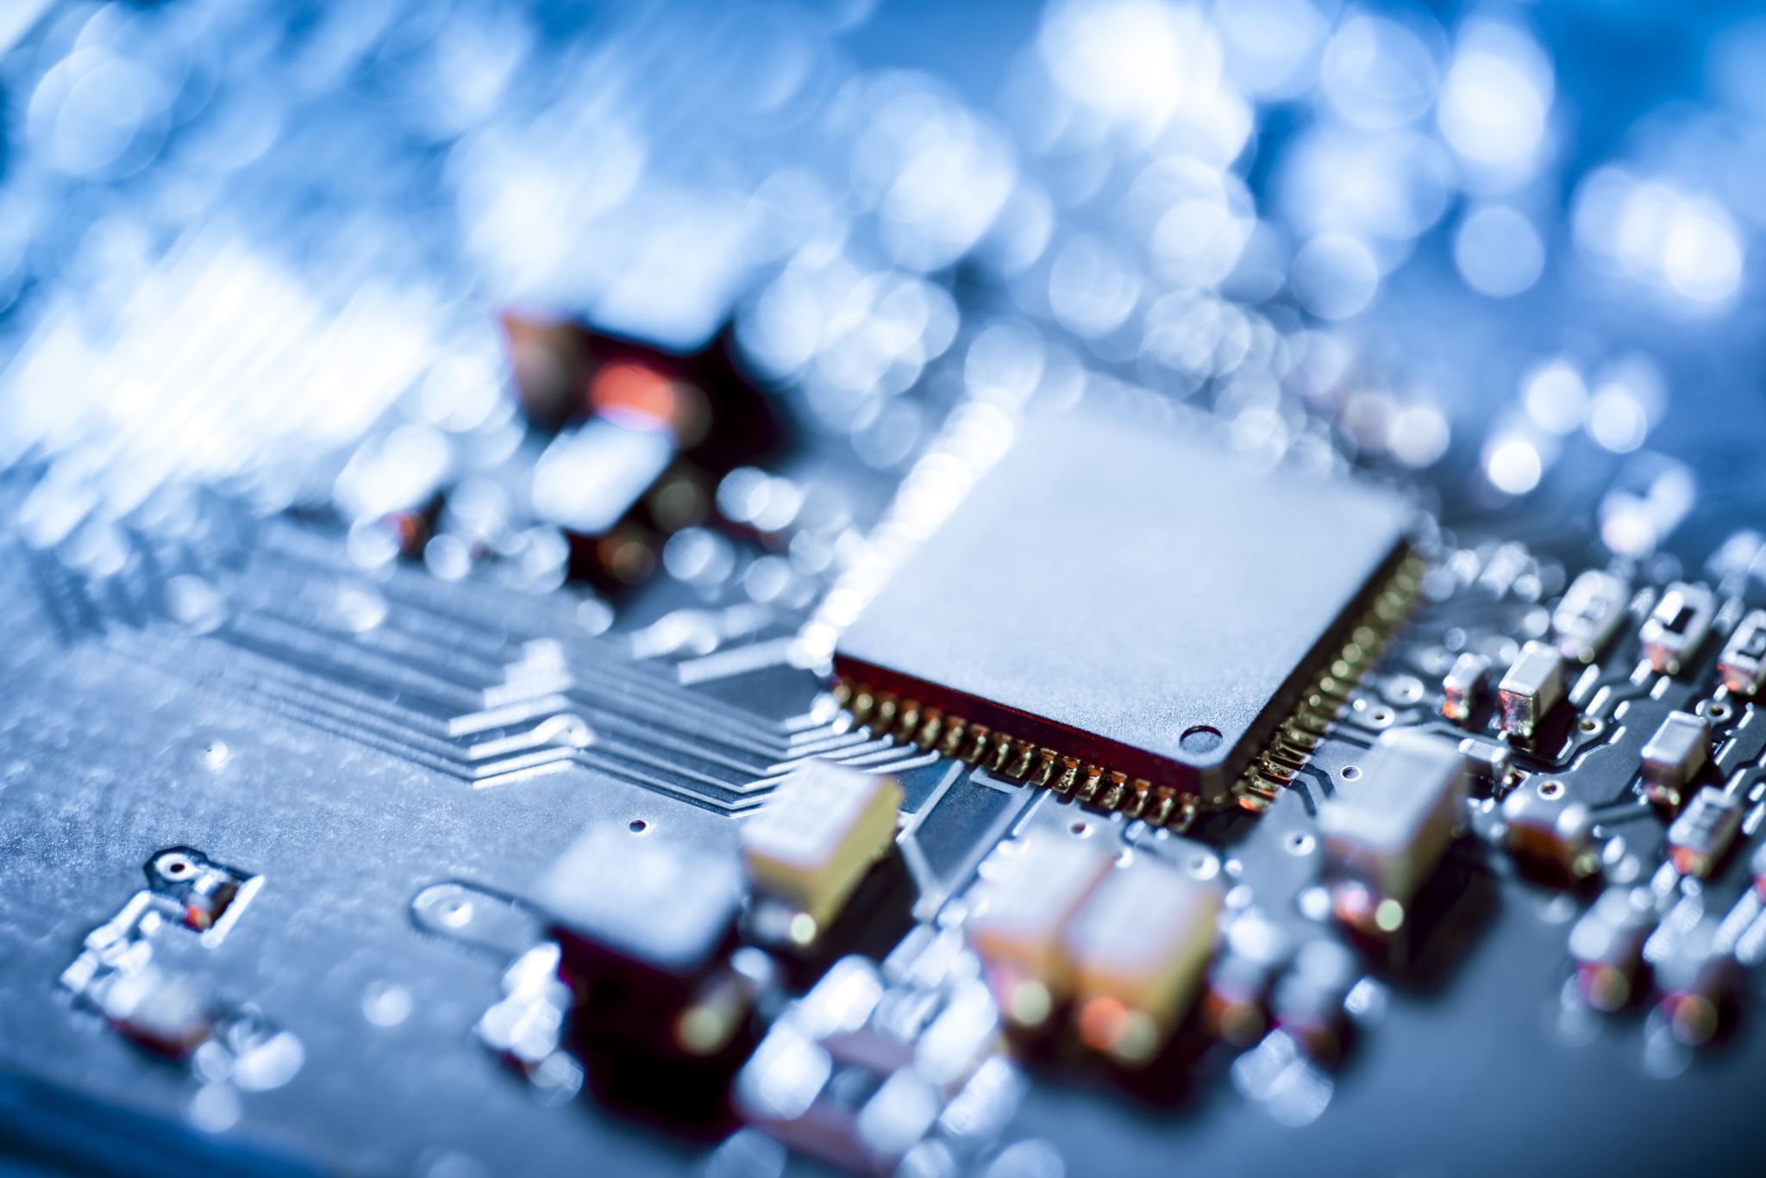
Processors (CPUs)
Central Processing Unit (CPU)
  The “brain” of the computer
Intel and AMD major manufacturers
Speed measured in gigahertz (GHz)
Processors perform binary math
Notes:
The Central Processing Unit (CPU), often referred to as the computer's "brain," is a critical component that governs the system's processing power and overall performance.
As the core processing unit, the CPU executes instructions, performs calculations, and manages data manipulation. It acts as the central hub for all tasks, coordinating the flow of information between various components and ensuring that software instructions are carried out accurately and efficiently.
Two prominent manufacturers in the CPU market are Intel and AMD. These companies produce a wide range of processors that cater to different performance levels and use cases. The choice between Intel and AMD often depends on factors such as computing needs, budget constraints, and specific requirements.
The speed of a CPU is measured in gigahertz (GHz), indicating how many cycles it can execute in one second. Higher GHz values generally signify faster processing capabilities, leading to quicker task execution and improved multitasking performance.
One of the primary functions of processors is to perform binary math operations. Computers communicate and process data using binary code, which consists of ones and zeros. CPUs excel at executing these binary operations, allowing them to perform complex calculations and logic operations at incredible speeds.
In essence, the CPU is the nucleus of computational activity within a computer system. Its processing power directly influences the system's ability to run applications, handle multitasking, and deliver responsive user experiences. As technology advances, CPUs continue to evolve, leading to higher speeds, improved efficiency, and enhanced capabilities for various computing tasks.

Slide 18
Memory
Read only memory (ROM)
  Permanent, no changes allowed
  Example: BIOS
Random access memory (RAM)
  Can be static or dynamic
    Static is nonvolatile, like a thumb drive
  Dynamic used inside computers
    Analogous to short-term memory
    Needs power to retain contents
Notes:
Read-Only Memory (ROM) serves as a permanent storage medium within a computer system where no modifications are allowed after initial programming.
One common example of ROM usage is the Basic Input/Output System (BIOS), a firmware that initializes hardware components during system startup. BIOS remains unaltered over time and retains its programmed instructions, ensuring stable system initialization.
On the other hand, Random Access Memory (RAM) functions as a volatile memory type in which data can be read from and written to while the computer is running. RAM can be classified as static or dynamic. Static RAM (SRAM) is nonvolatile, similar to a USB thumb drive, preserving data even when power is off. SRAM is often used in memory cache due to its speed. Dynamic RAM (DRAM), however, is more commonly used in computers. DRAM is analogous to short-term memory, as it stores data temporarily for quick access by the CPU. However, it requires a constant power supply to retain its contents, which is why data is lost when the system is powered down.
In essence, ROM and RAM fulfill distinct roles in a computer system. ROM provides a stable foundation of information that remains unchanged, while RAM serves as a dynamic workspace for processing data during active system use. Understanding the differences between these memory types is crucial for comprehending how data is managed and accessed within a computer environment.

Slide 19
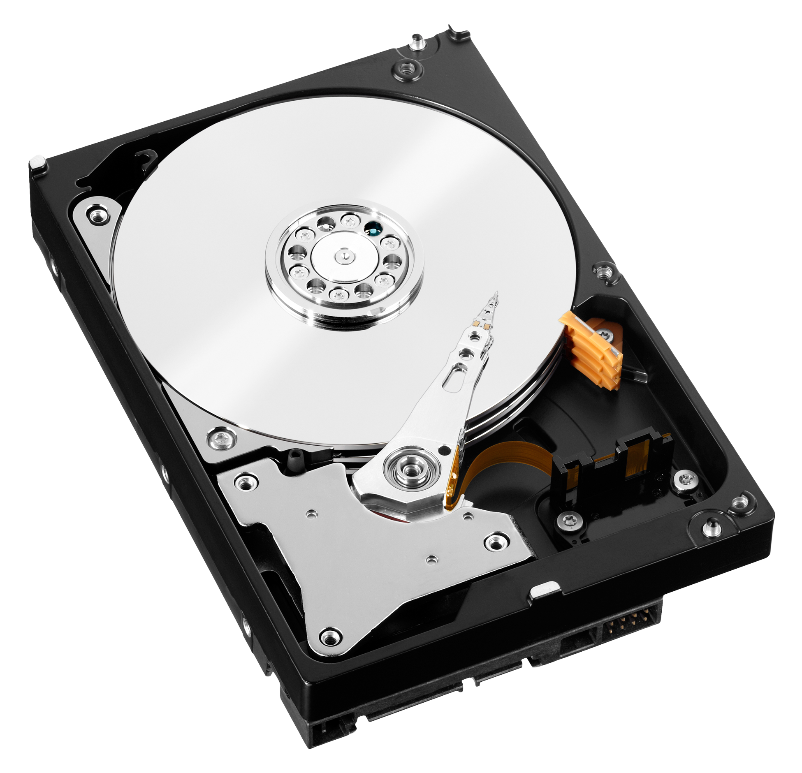
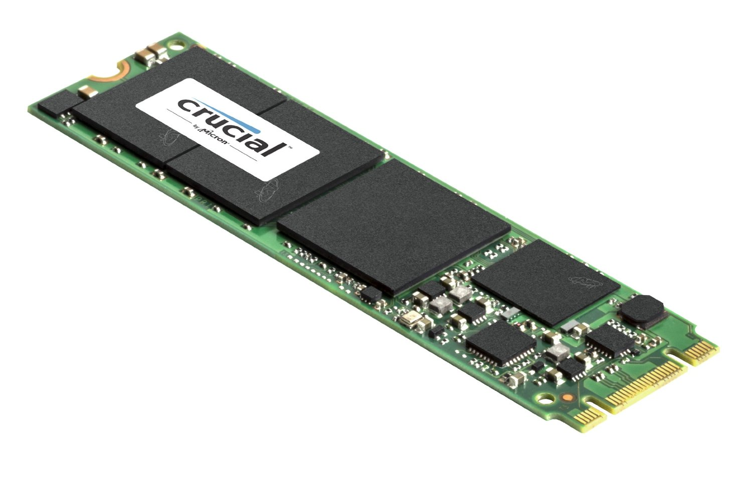
Hard Drives
Permanent long-term storage
Size usually in hundreds of gigabytes (GB) or terabytes (TB)
Spinning (or mechanical) hard disk drives (HDD) versus solid state hard drives (SSD)
Connected via SATA or PATA
Notes:
Hard drives are fundamental components in computers, providing permanent long-term storage for data and files.
These drives are available in various sizes, commonly measured in hundreds of gigabytes (GB) or terabytes (TB). This storage capacity allows users to store a multitude of documents, applications, multimedia files, and other data.
Two prominent types of hard drives are spinning (or mechanical) hard disk drives (HDD) and solid-state hard drives (SSD). HDDs consist of spinning disks (platters) and read/write heads that move across the platters to access data. On the other hand, SSDs use NAND-based flash memory to store data, resulting in significantly faster access times and improved durability compared to HDDs.
Hard drives are connected to the motherboard using different interfaces. SATA (Serial Advanced Technology Attachment) and PATA (Parallel ATA) are two common interfaces used for this purpose. SATA, being newer and faster, has largely replaced the older PATA technology. SATA cables are used to connect hard drives to the motherboard, facilitating data transfer and power supply.
In summary, hard drives play a crucial role in storing and preserving data over the long term. They come in varying sizes, ranging from hundreds of gigabytes to terabytes. The choice between HDDs and SSDs influences factors like speed, durability, and power consumption. These drives are connected to the motherboard via interfaces like SATA or PATA, enabling seamless data transfer between the storage device and other system components.

Slide 20
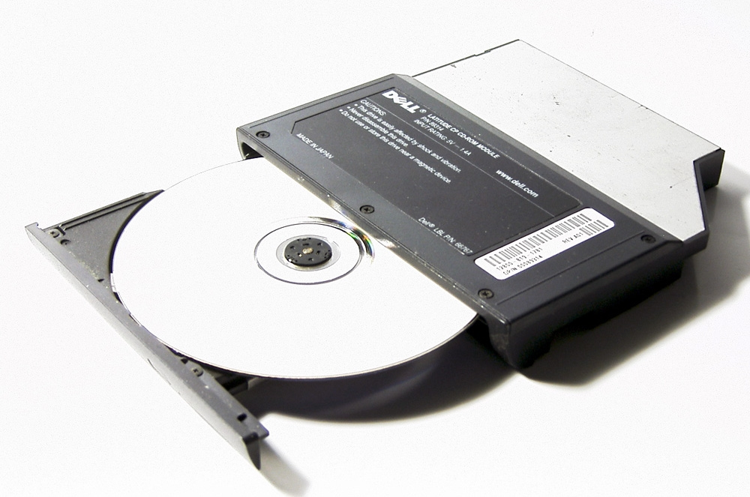
Optical drives
CD-ROM
  Compact Disc Read Only Memory
DVD-ROM
  Digital Video Disc Read Only Memory
BD-ROM
  Blu-ray Read Only Memory
Notes:
Optical drives, which were introduced as hardware components to read various types of optical discs, have played a significant role in data storage and media consumption. Here, we'll explore three common types of optical drives along with their associated disc formats and their respective creation periods:
1. **CD-ROM (Compact Disc Read Only Memory):**
CD-ROM drives were introduced in the early 1980s, marking a revolutionary advancement in data storage and distribution. Compact discs, which CD-ROM drives read, allowed for the distribution of software, multimedia content, and music in a standardized digital format.
2. **DVD-ROM (Digital Video Disc Read Only Memory):**
DVD-ROM drives emerged in the late 1990s, building upon the foundation of CD technology. DVDs, with their higher storage capacity, enabled the storage of more substantial multimedia files, movies, and complex software programs.
3. **BD-ROM (Blu-ray Read Only Memory):**
BD-ROM drives came into existence in the early 2000s, with Blu-ray technology introducing an even higher storage capacity compared to DVDs. This technology was particularly noteworthy for its ability to store high-definition video content and large data files.
These optical drives utilize lasers and sophisticated mechanisms to accurately read the data stored as microscopic indentations on the optical discs. Over time, the significance of optical drives has evolved due to the advent of digital distribution and cloud-based storage methods. While their popularity has waned, optical drives remain relevant for specific use cases, particularly those involving legacy software, physical media collections, and niche data storage needs.

Slide 21
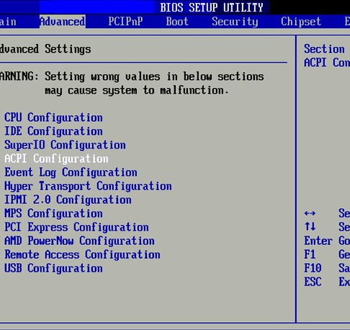
BIOS, and CMOS Battery
Basic Input/Output System (BIOS) boots the system and initiates hard drive and memory
CMOS battery helps chip store BIOS information when powered off

Slide 22
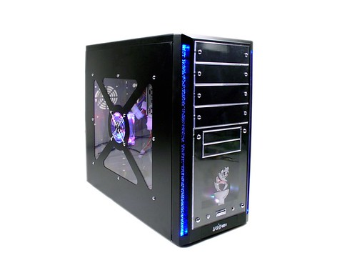
Panels
Panel Connectors
  For keyboards, mice, network cables, and more
  Will cover in detail in Chapter 2
  Power and reset buttons
  Drive activity lights
  Audio ports
  Other connectors, such as USB
Notes:
The back and front panels of a computer serve as crucial interfaces that facilitate connections, interactions, and control over various hardware components. Let's delve into the specific functionalities of these panels:
**Back Panel Connectors:**
The back panel of a computer features a range of connectors that provide access to external devices and peripherals. These connectors play a pivotal role in expanding the functionality of the computer. For instance, they accommodate connections for keyboards, mice, network cables, displays, audio devices, and more. These connectors facilitate seamless communication between the computer system and external hardware. A detailed exploration of back panel connectors will be provided in Chapter 2, where you'll gain insights into their roles and applications.
**Front Panel Connectors:**
The front panel of a computer, situated on the computer case's front side, offers easy access to several essential components and features. It includes controls and indicators that enable users to interact with the system conveniently. The front panel connectors typically include:
- **Power and Reset Buttons:** These buttons allow you to turn the computer on and off or initiate a system reset.
- **Drive Activity Lights:** These indicators provide visual feedback about the activity of hard drives or SSDs. They blink or light up when data is being read from or written to storage devices.
- **Audio Ports:** Front panel audio ports allow users to connect headphones, microphones, and other audio devices directly to the computer case, enabling convenient audio input and output.
Additionally, the front panel may include connectors such as USB ports, providing easy access for connecting USB devices like flash drives, external hard drives, and smartphones.
Understanding the functionalities of the back and front panels of a computer is essential for effectively utilizing the various connectors and controls available. These panels enable efficient communication between the computer and external devices, enhancing the overall user experience and system functionality.

Slide 23
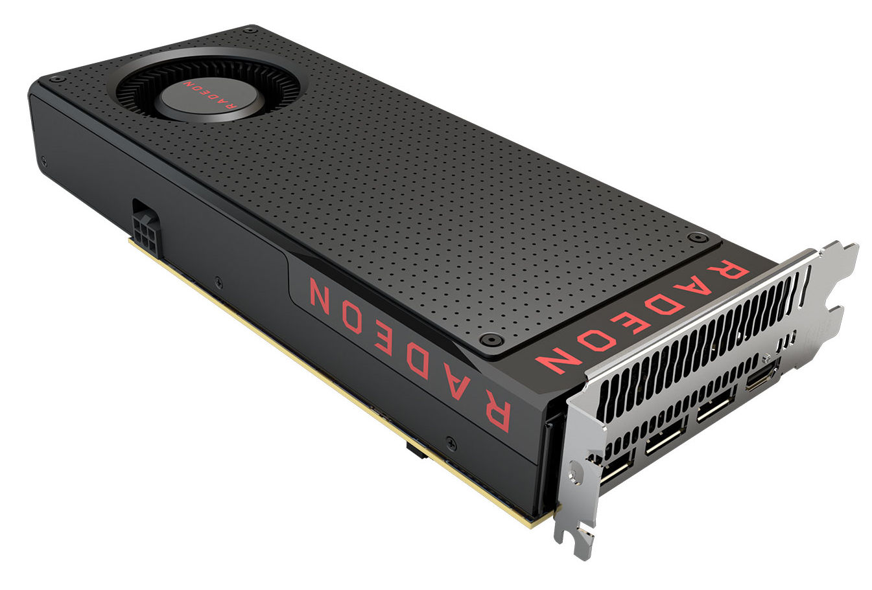
Video Cards
Also called graphics cards or video adapters
Responsible for rendering video
  Monitor is connected to them
Good ones will have a graphics processing unit (GPU) and their own memory
PCI (Peripheral Component
Interconnect) Connector
Notes:
Video cards, also known as graphics cards or video adapters, are integral components of computer systems that play a critical role in rendering video and graphics-intensive content. These cards are responsible for generating images, videos, and animations that are displayed on computer monitors and other output devices.
The key functions and characteristics of video cards include:
1. **Rendering Video:** Video cards are designed to handle the complex calculations required for rendering graphics and videos. They process data related to colors, textures, lighting, and other visual elements to create the images you see on your screen.
2. **Monitor Connectivity:** Video cards provide the necessary ports and connectors to connect computer monitors and other display devices. They offer a variety of output options, including HDMI, DisplayPort, DVI, and VGA, allowing users to connect their systems to various types of displays.
3. **Graphics Processing Unit (GPU):** High-quality video cards feature a dedicated Graphics Processing Unit (GPU), a specialized processor designed for handling graphics-related computations. GPUs are optimized for parallel processing, making them particularly effective at tasks like rendering 3D graphics and video playback.
4. **Dedicated Memory:** Advanced video cards often come equipped with their own dedicated memory, referred to as Video RAM (VRAM). This memory is used to store textures, frame buffers, and other graphics-related data, ensuring smoother performance and reduced reliance on the system's main memory.
5. **Interface:** Video cards are typically connected to the motherboard through a PCIe (Peripheral Component Interconnect Express) slot. PCIe offers high data transfer rates, which are essential for handling the large amount of data involved in rendering complex graphics.
6. **Gaming and Graphics Performance:** Video cards are especially important for gaming and graphics-intensive applications. A high-performance video card can significantly improve the quality and smoothness of gameplay, as well as the overall visual experience when working with graphic design, video editing, and 3D modeling software.
In summary, video cards are pivotal components that enhance the visual experience of a computer system. They are responsible for rendering graphics and videos, connecting monitors, and enabling tasks that demand intense graphical processing. The inclusion of a dedicated GPU and dedicated memory in advanced video cards contributes to improved performance and better graphics quality. The use of PCIe ensures efficient data communication between the video card and the rest of the system.

Slide 24
Sound Cards
Produce sound
Often integrated into the motherboard
Notes:
Sound cards are hardware components responsible for producing audio output from a computer system. They play a crucial role in generating sound effects, music, and speech that users hear through speakers or headphones. Sound cards enhance the multimedia experience by enabling high-quality audio playback and enabling communication through voice applications.
While many modern motherboards come with integrated audio capabilities, separate sound cards can offer several benefits:
1. **Enhanced Audio Quality:** Dedicated sound cards often provide superior audio quality compared to integrated solutions. They have specialized components and circuitry designed to minimize interference and produce clearer, more accurate sound.
2. **Audio Customization:** Some sound cards come with software that allows users to customize audio settings, equalizers, and effects. This enables users to tailor the audio output to their preferences and the type of content they're enjoying.
3. **Support for Surround Sound:** High-end sound cards can support surround sound formats like 5.1 or 7.1, creating a more immersive audio experience for gaming, movies, and multimedia content.
4. **Reduced System Load:** Offloading audio processing to a dedicated sound card can free up system resources (CPU) that would otherwise be used for audio processing. This can result in improved overall system performance, especially when multitasking or running resource-intensive applications.
5. **Specialized Audio Work:** Professionals in fields such as music production, audio engineering, and content creation may require specialized sound cards with advanced features and connectivity options to ensure precise audio recording and mixing.
6. **Connectivity Options:** Dedicated sound cards may offer a range of input and output options, including optical or coaxial digital outputs, analog outputs, and microphone inputs. This variety of connections allows users to connect a wide range of audio devices.
In summary, sound cards are responsible for producing audio output in computer systems. While integrated audio solutions are common, dedicated sound cards can provide improved audio quality, customization options, support for surround sound, and reduced strain on system resources. The choice between integrated audio and dedicated sound cards depends on the user's audio needs and preferences, as well as the intended usage of the computer system.

Slide 25
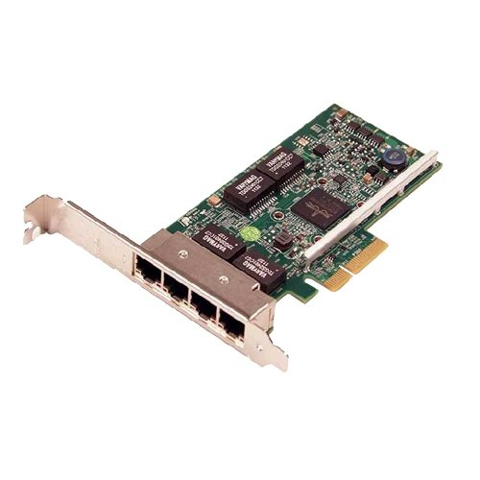
Network Cards
Network Interface Card (NIC)
Allow the computer to participate on a network
Wired (needs a cable to send/receive network signals) or
Wireless (no cable needed)
Notes:
Network cards, also known as Network Interface Cards (NICs), are vital components that enable computers to connect and participate in networks, whether local or global. They serve as the bridge between the computer and the network, facilitating communication and data exchange. Network cards play a crucial role in enabling internet connectivity, file sharing, and various network-based applications.
Key features and aspects of network cards include:
1. **Network Participation:** Network cards provide the essential hardware interface that allows computers to join and interact with networks. They enable the transmission and reception of data packets between the computer and other devices on the network.
2. **Wired and Wireless Connectivity:** Network cards come in two main types: wired and wireless. Wired network cards require a physical cable connection to send and receive network signals. They are commonly used in Ethernet networks. Wireless network cards, also known as wireless adapters, enable connectivity without the need for cables, using radio signals to communicate with wireless routers or access points.
3. **Data Transmission:** Network cards convert digital data from the computer into signals that can be transmitted over the network medium. They also interpret incoming signals and convert them back into usable data for the computer.
4. **Speed and Bandwidth:** Network cards are available in various speeds, often measured in megabits per second (Mbps) or gigabits per second (Gbps). The speed of the network card impacts the data transfer rate and overall network performance.
5. **Compatibility:** Network cards need to be compatible with the network type and protocols in use. For example, Ethernet network cards are designed to work with Ethernet networks, and wireless network cards support Wi-Fi protocols.
6. **Driver Software:** To ensure proper functioning, network cards require driver software that allows the operating system to communicate with the card effectively. These drivers provide necessary instructions for data transmission, reception, and network configuration.
In summary, network cards, or NICs, enable computers to participate in networks, whether wired or wireless. They serve as the conduit for data exchange, enabling internet connectivity, file sharing, and network-based applications. Wired network cards use physical cables to connect to networks, while wireless network cards utilize radio signals for communication. The choice between wired and wireless network cards depends on factors such as network infrastructure and mobility requirements.

Slide 26
Peripherals and Connectors

Slide 27
“Throughput” is a measure of the amount of data that can be transmitted through a communication channel per unit of time. Here are some common units of measure used to express throughput:
Bps (Bits per second)
Kbps (Kilobits per second)
Mbps (Megabits per second)
Gbps (Gigabits per second) backbone networks.
Tbps (Terabits per second)
Notes:
Peripherals and connectors play a vital role in expanding the capabilities of computer systems and facilitating communication between devices. Throughput, on the other hand, is a crucial metric that measures the amount of data that can be transmitted through a communication channel within a specific time frame. The following units of measure are commonly used to express throughput:
1. **Bits per Second (bps):** This is the fundamental unit for measuring throughput. It represents the number of individual bits transmitted or received per second. It's often used to describe data transfer rates for network connections and communication links.
2. **Kilobits per Second (Kbps):** One kilobit is equal to 1,000 bits. Kbps represents a higher level of throughput, typically used to describe internet connection speeds, data transfer rates, and communication speeds.
3. **Megabits per Second (Mbps):** One megabit is equal to 1,000 kilobits or 1,000,000 bits. Mbps is commonly used to describe higher-speed network connections, such as broadband internet, LANs, and digital video streams.
4. **Gigabits per Second (Gbps):** One gigabit is equal to 1,000 megabits or 1,000,000 kilobits. Gbps represents extremely high-speed data transmission rates, often associated with advanced network technologies, data centers, and high-performance computing environments.
5. **Bytes per Second (Bps):** This unit represents the number of bytes transmitted or received per second. It's often used to describe data storage transfer rates and communication speeds for devices like hard drives and solid-state drives.
6. **Kilobytes per Second (KBps):** One kilobyte is equal to 1,024 bytes. KBps is used to measure data transfer rates involving larger data volumes, such as file downloads and data backups.
7. **Megabytes per Second (MBps):** One megabyte is equal to 1,024 kilobytes or 1,048,576 bytes. MBps is commonly used to measure data transfer rates for tasks involving substantial data sizes, like video editing and large file transfers.
Understanding these units of measure for throughput is essential for evaluating the speed and efficiency of data transfer and communication within a computer system and across networks. It allows users to make informed decisions about hardware, connectivity options, and the overall performance of their computing environments.

Slide 28
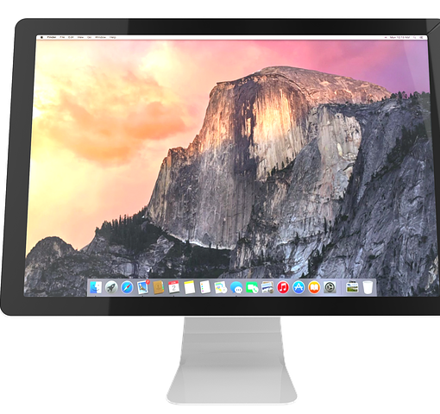
Display Devices
Four categories:
  CRTs
  Projectors
  Flat screens
  Touchscreens
Notes:
Display devices are crucial components that allow users to visually interact with and consume information from computer systems. Here's a more detailed exploration of the four categories of display devices mentioned:
**1. CRTs (Cathode Ray Tube Displays):**
CRTs were one of the earliest display technologies and were widely used in older computer systems and televisions. They operate by projecting an electron beam onto a phosphorescent screen, creating images through the illumination of pixels. CRTs were characterized by their bulky design and curved screens. However, their use has significantly diminished over time due to the emergence of more advanced display technologies.
**2. Projectors:**
Projectors are devices that project images or video onto a screen or surface, making them suitable for presentations, multimedia, and large-scale displays. They are commonly used in business settings, classrooms, and home theaters. Modern projectors use technologies like LCD (Liquid Crystal Display) or DLP (Digital Light Processing) to create high-quality images.
**3. Flat Screens:**
Flat screen displays encompass a wide range of technologies, including LCD, LED, and OLED. These displays feature flat, thin panels that emit light to create images. They are widely used in computer monitors, televisions, laptops, and mobile devices. Flat screens offer various benefits, including space-saving designs, energy efficiency, and vibrant color reproduction.
**4. Touchscreens:**
Touchscreens are displays that allow users to interact with the device by directly touching the screen. They are commonly used in smartphones, tablets, interactive kiosks, and some laptops. Touchscreens offer intuitive and interactive user experiences, enabling gestures like tapping, swiping, and pinching to control applications and navigate content.
Each category of display device has its own advantages and drawbacks, making them suitable for different applications and environments. As technology continues to evolve, display devices continue to improve in terms of resolution, color accuracy, energy efficiency, and interactive capabilities, enhancing the overall user experience across various devices and scenarios.

Slide 29
Flat Screen Monitors and Touchscreens
Flat screen technologies
  LCD
  Light-Emitting Diode (LED)
  Plasma
Touchscreens are flat screens that are sensitive to touch
  Popular for laptops, tablets, smartphones
  Considered input & output devices
Notes:
Flat screen monitors and touchscreens are integral components of modern computing and interactive devices. Here's a more detailed exploration of these technologies:
**Flat Screen Technologies:**
Flat screen monitors have revolutionized the way we interact with computers and consume digital content. They come in several technologies:
- **LCD (Liquid Crystal Display):** LCD monitors use liquid crystal cells to control the passage of light, creating images on the screen. They offer a balance between image quality, energy efficiency, and cost-effectiveness.
- **LED (Light-Emitting Diode):** LED monitors are a type of LCD monitor that uses LED backlighting instead of traditional fluorescent lamps. They offer improved color accuracy, energy efficiency, and thinner designs.
- **Plasma:** Plasma displays were once popular for larger screens due to their deep black levels and vibrant colors. However, they have become less common due to the prevalence of LCD and OLED technologies.
**Touchscreens:**
Touchscreens are display devices that allow users to interact with the screen by directly touching it. They have gained immense popularity and are used in various devices, including:
- **Laptops:** Some laptops feature touchscreens, allowing users to interact with applications using touch gestures in addition to traditional input methods.
- **Tablets:** Tablets are built around touchscreens, providing an intuitive and versatile interface for browsing, gaming, productivity, and more.
- **Smartphones:** Touchscreens are a defining feature of smartphones, enabling users to navigate, type, and interact with apps using their fingertips.
**Input & Output Devices:**
Touchscreens are unique devices that serve as both input and output mechanisms. They display visual information (output) and also sense touch interactions (input). Users can tap, swipe, pinch, and perform other gestures to control applications and navigate content.
**Advancements and Applications:**
Advancements in flat screen and touchscreen technologies have led to higher resolutions, faster response times, improved color accuracy, and enhanced touch sensitivity. Touchscreens have enabled the development of interactive kiosks, digital whiteboards, and other innovative applications.
In summary, flat screen monitors, including LCD, LED, and plasma technologies, offer improved image quality and space-saving designs compared to older CRT monitors. Touchscreens, commonly found in laptops, tablets, and smartphones, provide a dynamic and intuitive interface that merges input and output functionalities. Both technologies have transformed how we interact with digital content and devices in the modern computing landscape.

Slide 30
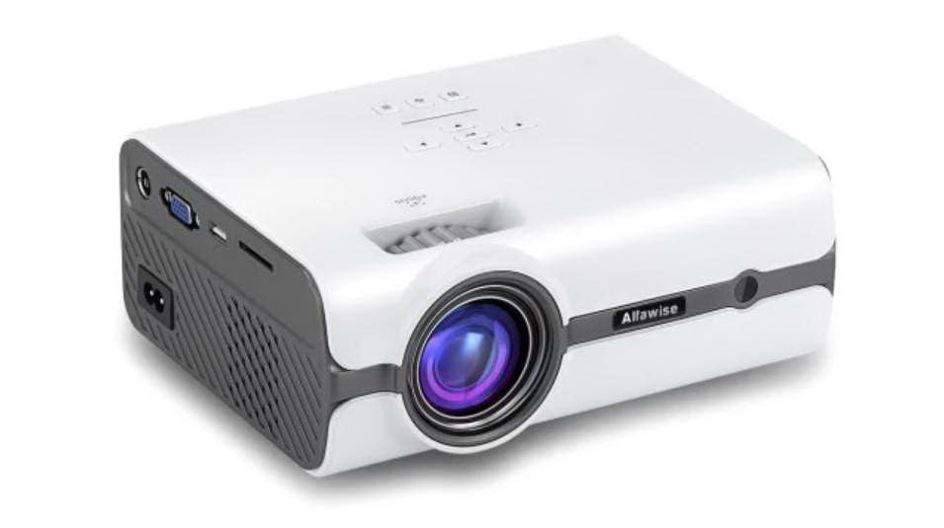
Projectors
Can be CRT or Liquid Crystal Display (LCD)
Often portable
Output measured in lumens
Notes:
Projectors are versatile display devices that can be used for a variety of applications, ranging from business presentations to home theater setups. Here's an expansion on the provided information about projectors:
**CRT and LCD Projectors:**
Projectors can utilize different technologies to create images. While CRT (Cathode Ray Tube) projectors were used in the past, modern projectors often employ LCD (Liquid Crystal Display) or other advanced technologies to produce high-quality images.
**Portability:**
Many projectors are designed to be portable, allowing users to easily transport them for presentations, events, or personal use. Portable projectors are compact and lightweight, making them convenient for on-the-go applications.
**Output Measured in Lumens:**
The output brightness of a projector is measured in lumens. Lumens indicate the amount of light emitted by the projector, which directly affects how well the projected image is visible in different lighting conditions. Projectors with higher lumen ratings are suitable for brighter environments or larger screens.
**Applications:**
Projectors have a wide range of applications, including:
- **Business Presentations:** Projectors are commonly used in boardrooms and conference rooms for displaying presentations, slideshows, and charts.
- **Home Theater:** Projectors can create a large cinematic experience at home, projecting movies and videos onto a screen or wall.
- **Education:** Projectors are used in classrooms to display educational content to a larger audience.
- **Digital Signage:** Large-scale projectors are used for digital signage in commercial spaces and public areas.
- **Entertainment Events:** Projectors are used for outdoor movie nights, live events, and performances.
**Technological Advancements:**
Projector technology has advanced significantly, leading to higher resolutions, improved color accuracy, and features like 3D projection and wireless connectivity. Some projectors even use laser light sources for longer lifespan and more consistent performance.
In summary, projectors are versatile devices that can use different technologies to project images onto screens or surfaces. They find applications in various fields, offering portability and the ability to create large, visually engaging displays. The brightness of a projector is measured in lumens, and advancements in technology continue to enhance the capabilities and features of projectors for both professional and personal use.

Slide 31
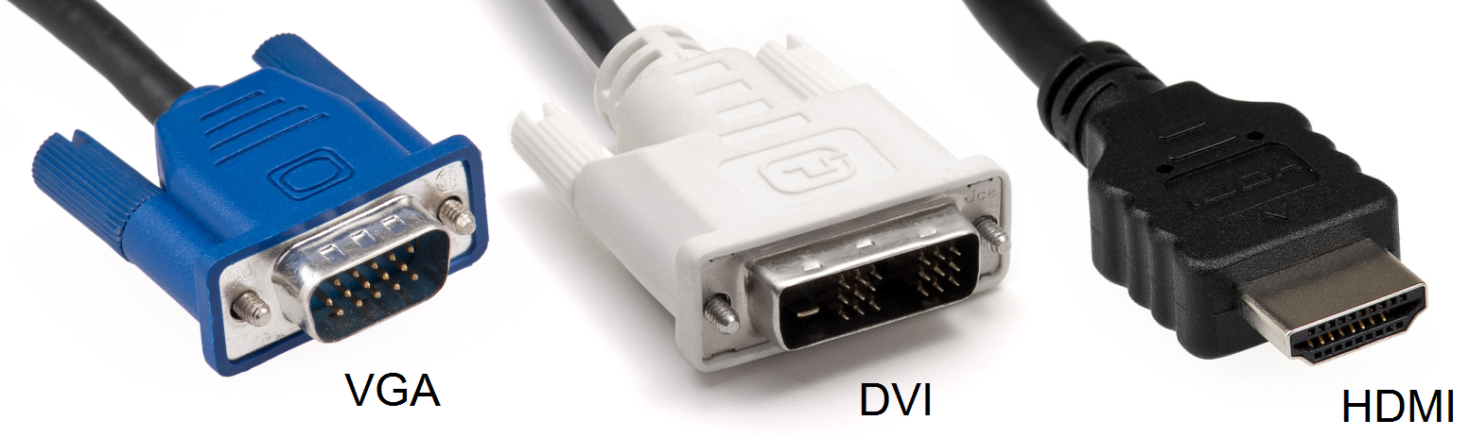
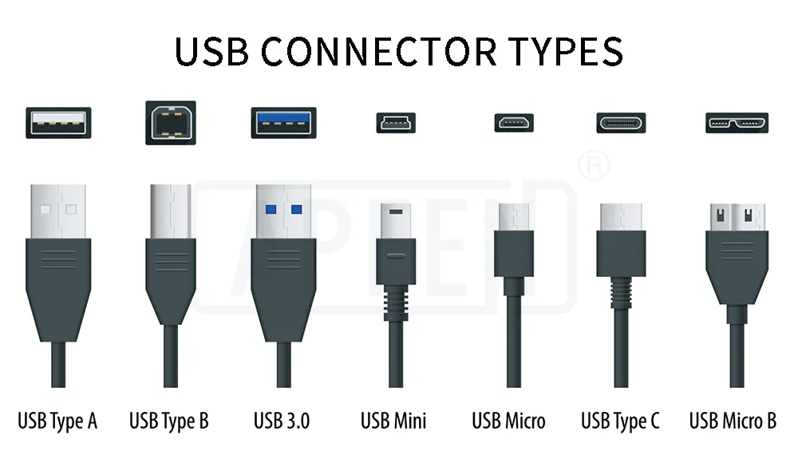
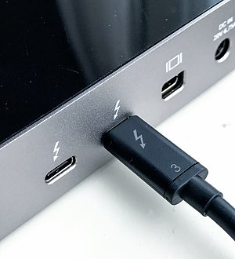
Video Connectors
Video Graphics Array (VGA)
Digital Visual Interface (DVI)
Universal Serial Bus (USB)
High Definition Multimedia
Interface (HDMI)
Display Port
Mini-DisplayPort
Thunderbolt
Notes:
Video connectors play a pivotal role in establishing connections between display devices and computer systems, enabling the transmission of video and audio signals. Here's a detailed exploration of the mentioned video connectors:
**1. Video Graphics Array (VGA):**
VGA is an older analog video connector that was widely used for connecting monitors and displays to computers. It uses a 15-pin connector and provides standard-definition video output. VGA has largely been replaced by digital interfaces that offer higher-quality video transmission.
**2. Digital Visual Interface (DVI):**
DVI is a versatile video connector that comes in different formats: DVI-A (analog), DVI-D (digital), and DVI-I (integrated analog and digital). DVI is capable of transmitting both analog and digital signals, making it compatible with a range of display devices.
**3. Universal Serial Bus (USB):**
While primarily known as a data transfer interface, USB connectors have also been utilized for video transmission. USB-C, a reversible and versatile connector, supports video output in addition to data and power delivery. This feature allows devices like laptops and smartphones to connect to displays using a single USB-C cable.
**4. High Definition Multimedia Interface (HDMI):**
HDMI is a widely used digital video and audio interface that supports high-definition video and audio transmission. It's commonly found in televisions, monitors, projectors, and multimedia devices. HDMI cables carry both video and audio signals, making them convenient for home theater setups and gaming consoles.
**5. DisplayPort:**
DisplayPort is a digital video and audio interface that offers high-quality video transmission and multiple display support from a single connector. It's used in various applications, including computer monitors, laptops, and graphics cards. DisplayPort can carry both video and audio signals, and it supports advanced features like daisy-chaining multiple displays.
**6. Mini-DisplayPort:**
Mini-DisplayPort is a smaller version of DisplayPort commonly used in laptops, tablets, and compact devices. It provides similar capabilities as its larger counterpart.
**7. Thunderbolt:**
Thunderbolt is a high-speed interface that combines data transfer, video output, and power delivery through a single cable. It uses a Mini-DisplayPort connector and is often found in Mac computers and certain Windows systems. Thunderbolt offers fast data transfer rates and is suitable for connecting external displays and peripherals.
In summary, video connectors enable the transmission of video and audio signals between computer systems and display devices. Different connectors offer varying levels of video quality, compatibility, and features. The choice of connector depends on factors such as the display device, computer system, desired video quality, and available ports.

Slide 32
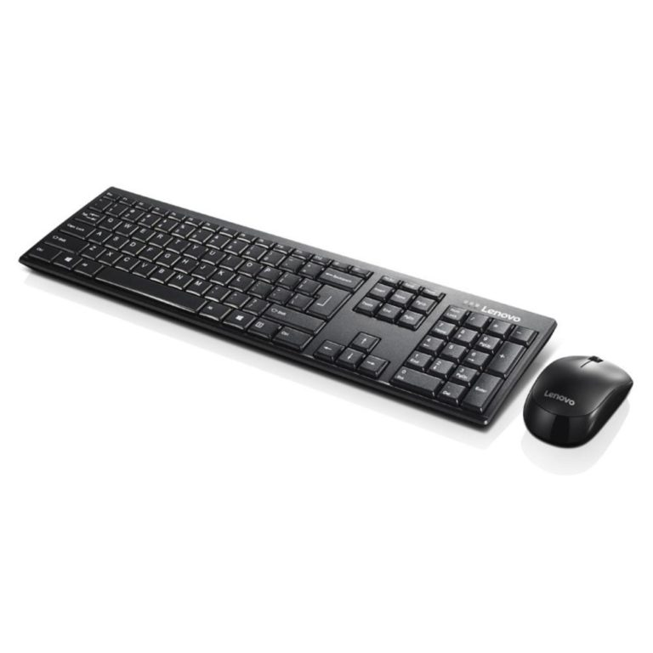
Primary Input Devices
Keyboard
Pointing devices
  Mouse
  Touchpad
  Joystick
  Stylus pen
  Trackball
Notes:
Primary input devices are essential components that allow users to interact with computers by providing input to control and manipulate the system. Here's a more detailed exploration of the mentioned primary input devices:
**1. Keyboard:**
The keyboard is a primary input device that enables users to enter text, numbers, and commands into a computer. It consists of a set of keys representing letters, numbers, symbols, and function keys. Keyboards come in various layouts and designs, such as QWERTY, AZERTY, and Dvorak, and they are integral for tasks ranging from word processing to coding.
**2. Pointing Devices:**
Pointing devices are used to move a cursor or pointer on the screen and interact with graphical user interfaces. They include:
- **Mouse:** A mouse is a hand-held device that allows users to move the cursor by sliding it across a surface. It typically has buttons for left-clicking, right-clicking, and scrolling.
- **Touchpad:** A touchpad is a built-in pointing device found on laptops. Users move their fingers across the touchpad to control the cursor, and tapping or clicking on the pad simulates mouse clicks.
- **Joystick:** Joysticks are primarily used for gaming and flight simulation. They provide precise control over movement and direction.
- **Stylus Pen:** Stylus pens are used on touchscreens, particularly on devices like tablets and smartphones. They offer a more precise way to interact with touch-sensitive displays, ideal for drawing and handwriting.
- **Trackball:** A trackball is a stationary pointing device that allows users to control the cursor by rotating a ball with their fingers. It's an alternative to the mouse.
Each of these primary input devices serves a specific purpose and caters to different types of tasks and preferences. They provide users with various options for interacting with computers and software in ways that are most comfortable and efficient for them.

Slide 33
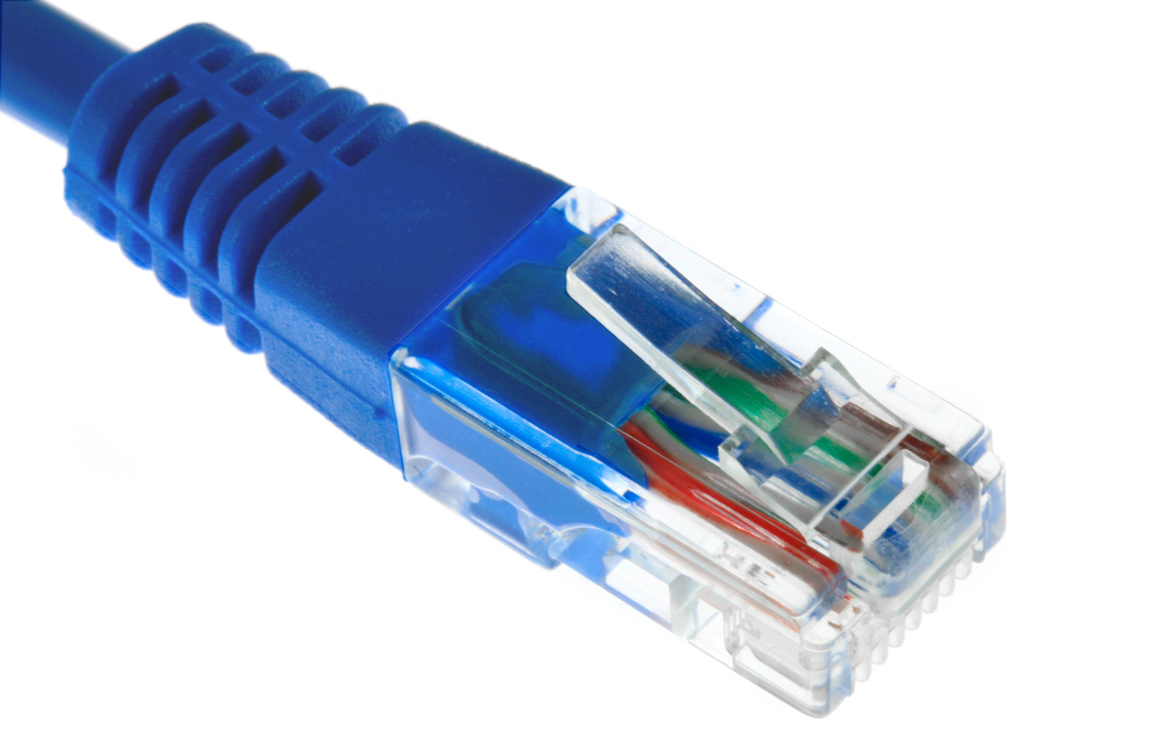
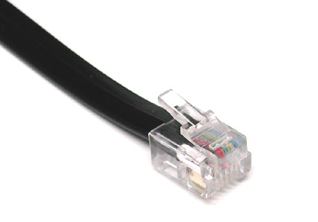
Network Communications Connectors
Network connectors (Ethernet ) (RJ-45)
Telephone connectors (POTS) (RJ-11)
Notes:
Communication connectors are essential components for establishing connections between devices and networks, enabling data transmission and communication. Here's a more detailed exploration of the mentioned communication connectors:
**1. Network Connectors (RJ-45):**
RJ-45 connectors are commonly used for networking purposes, specifically for Ethernet connections. They are used to establish wired connections between computers, routers, switches, and other networking equipment. RJ-45 connectors are associated with various Ethernet standards, such as Cat 5e, Cat 6, and Cat 6a, which determine the speed and quality of the network connection. These connectors are crucial for creating local area networks (LANs) and connecting devices to the internet.
**2. Telephone Connectors (RJ-11):**
RJ-11 connectors are used for telephone connections. They are commonly associated with landline telephones and fax machines. RJ-11 connectors support analog signals and are used to connect devices to a telephone line for voice communication. These connectors are recognizable by their small size and four or six contacts.
Both RJ-45 and RJ-11 connectors have standardized pinouts and are widely used in homes and businesses for communication purposes. RJ-45 connectors are essential for creating wired computer networks, while RJ-11 connectors are primarily used for traditional telephone connections. The choice of connector depends on the communication requirements and the specific devices being connected.
Analog and digital are two fundamental methods of representing and transmitting information. Here's a detailed comparison of analog and digital:
**Analog:**
Analog signals are continuous and represent information as varying physical quantities. In the context of sound, for example, analog signals represent sound waves as a continuous stream of voltage levels. Key characteristics of analog include:
1. **Continuous Nature:** Analog signals are continuous and can take on an infinite number of values within a given range.
2. **Smooth Transitions:** Analog signals provide smooth transitions between values, allowing for a theoretically infinite level of detail.
3. **Susceptibility to Interference:** Analog signals can be susceptible to interference and noise, which may degrade signal quality.
4. **Complexity:** Analog signal processing can be complex, especially when dealing with high-resolution or intricate signals.
Examples of analog devices include traditional landline telephones, vinyl records, and analog radios.
**Digital:**
Digital signals, on the other hand, represent information as discrete values, typically using binary code (0s and 1s). Digital signals are processed and transmitted using digital electronics. Key characteristics of digital include:
1. **Discrete Values:** Digital signals have discrete values and are quantized into a finite number of levels.
2. **Error Correction:** Digital signals are more resistant to noise and interference, and error correction techniques can be applied to ensure accurate data transmission.
3. **Easy Reproduction:** Digital signals can be reproduced exactly, making them highly reliable for storage and transmission.
4. **Less Susceptible to Quality Loss:** Digital signals do not degrade with distance or time as much as analog signals.
5. **Digital Processing:** Digital signals allow for efficient processing, manipulation, and storage using computers and digital devices.
Examples of digital devices include digital cameras, smartphones, CDs, and digital TVs.
**Choosing Between Analog and Digital:**
The choice between analog and digital depends on factors such as the nature of the data, the purpose of communication, and the technology being used. While analog signals can be more natural for certain types of data, digital signals offer advantages in terms of accuracy, reliability, and efficient processing. The shift toward digital technology has led to significant advancements in communication, data storage, and multimedia experiences.

Slide 34
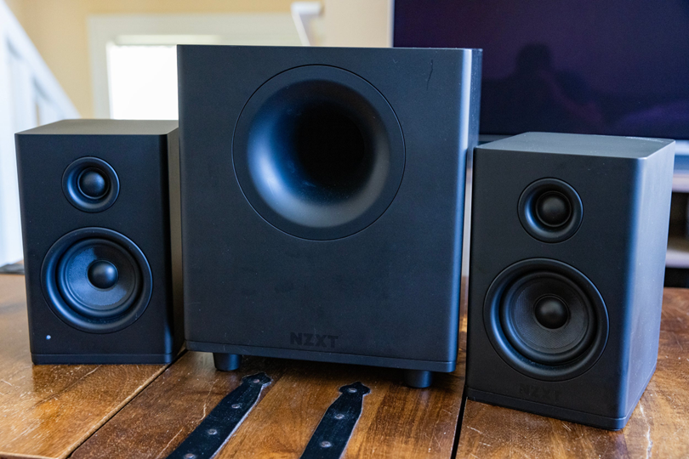
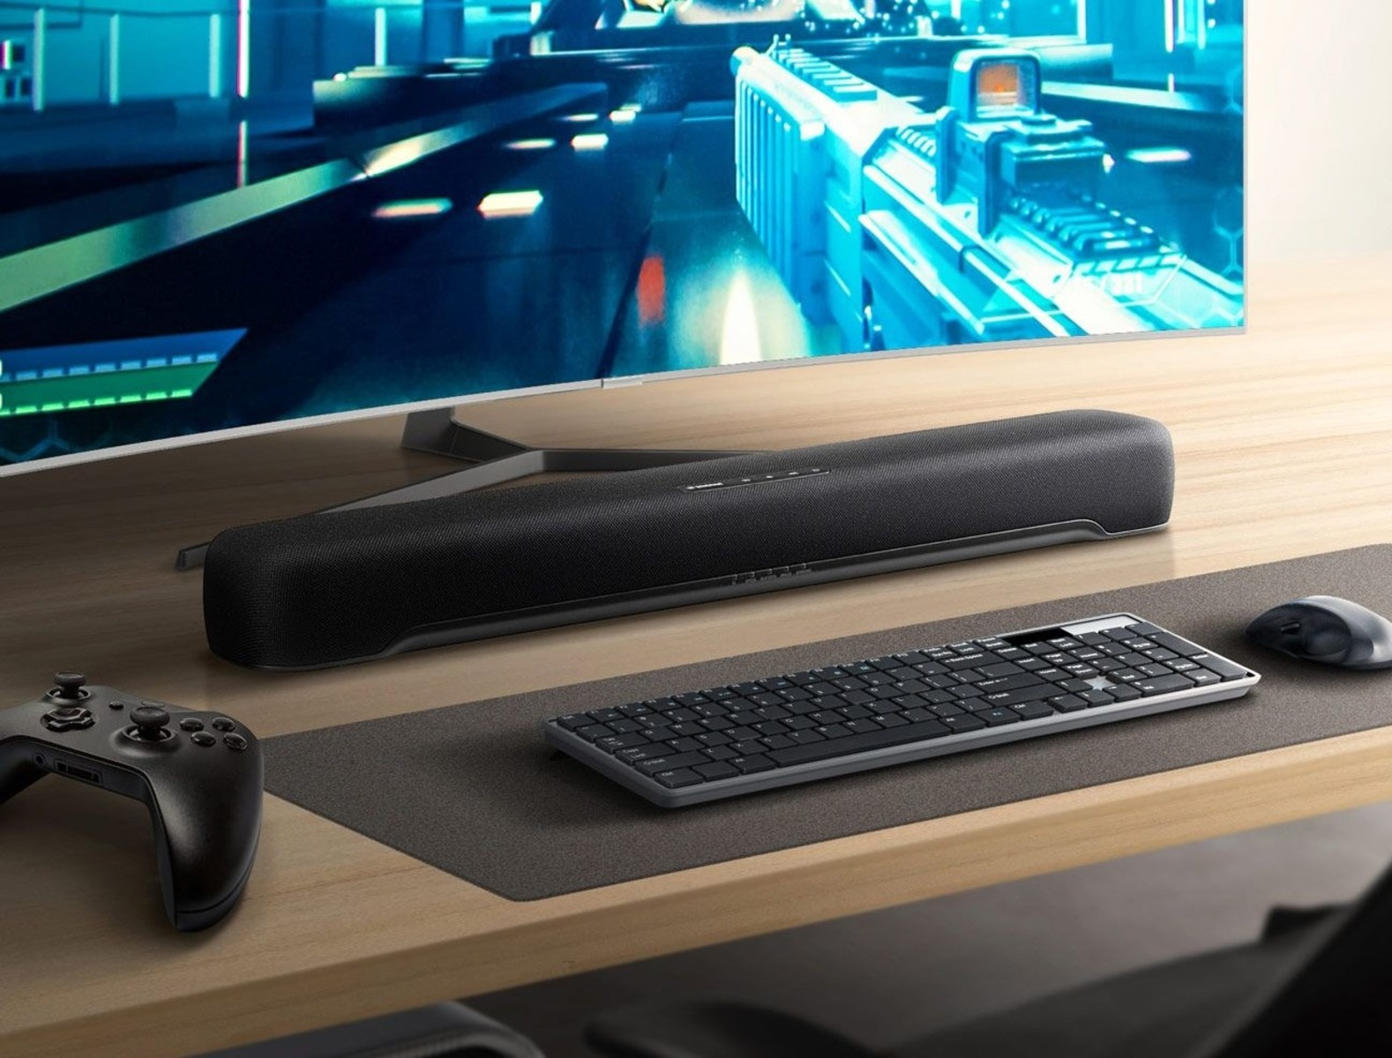

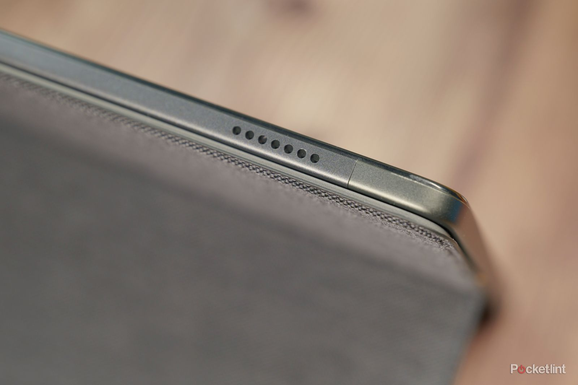
Speakers
Used for sound output for the computer.
External for Desktop and Workstations
Internal or Built-in for Laptops and Tablets

Slide 35
Cameras
Used to provide visual information to a computer.
  Teleconferencing
  Take Pictures
  Take Videos
External or Built-In.
Different Resolutions
  720p HD (HD Ready): 1280 x 720 pixels
  1080p FHD (Full HD): 1920 x 1080 pixels
  2K QHD (Quad HD): 2560 x 1440 pixels
  4K UHD (Ultra HD): 3840 x 2160 pixels

Slide 36
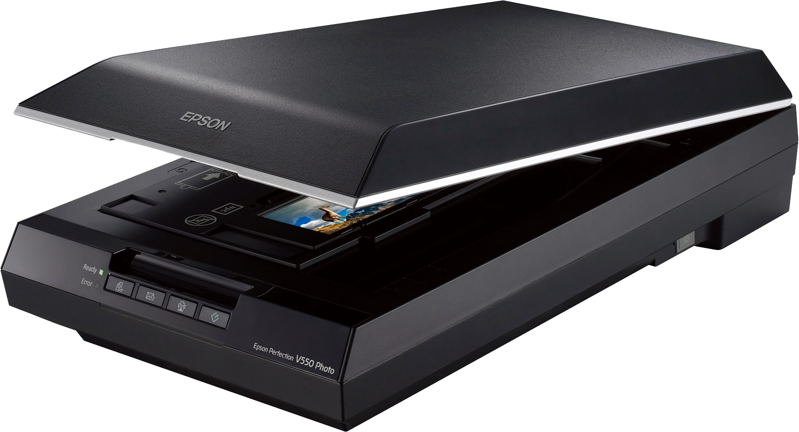
Scanner
Used to scan into a computer documents (text) or pictures (various formats).
Connected via USB.

Slide 37
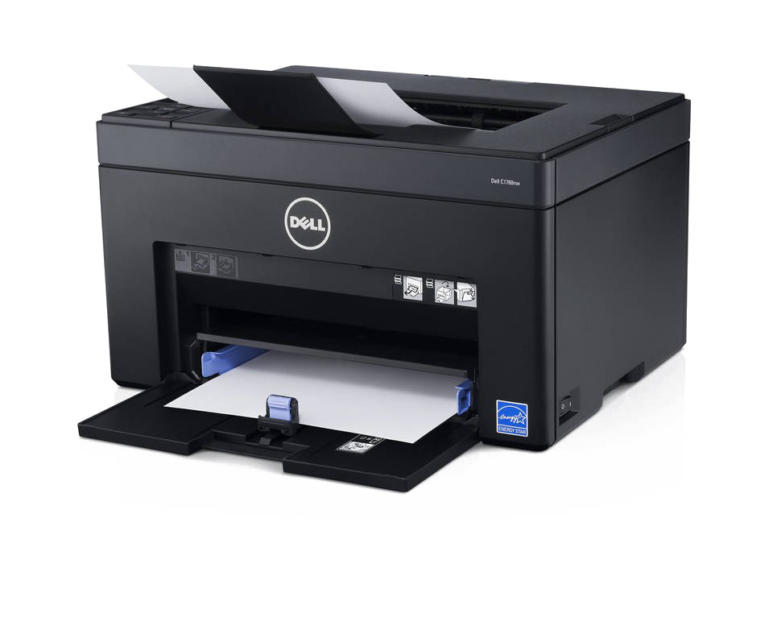
Printer Technologies
Inkjet
Laser
Some printers include fax services
  Multifunctional or all-in-one printer
  Considered input & output device
Notes:
Printer technologies have evolved to offer various methods of producing hard copies of digital documents and images. Here's a more detailed exploration of the mentioned printer technologies:
**1. Inkjet Printers:**
Inkjet printers create images by spraying tiny droplets of ink onto paper. They are versatile and capable of producing high-quality color prints. Inkjet printers are popular for home and small office use due to their affordability, ability to produce photo-quality prints, and compact size. They are suitable for tasks such as printing documents, photos, and graphics.
**2. Laser Printers:**
Laser printers use a laser beam to create an electrostatic image on a photosensitive drum. The drum then attracts toner particles, which are transferred onto paper and fused using heat. Laser printers are known for their fast print speeds, sharp text output, and efficient performance. They are commonly used in business environments for printing large volumes of documents.
**3. Multifunctional or All-in-One Printers:**
Multifunctional or all-in-one (AIO) printers combine multiple functionalities in a single device. They typically include printing, scanning, copying, and sometimes faxing capabilities. AIO printers offer convenience and space savings by consolidating various tasks into a single machine. They are suitable for both home and office environments.
**4. Fax Services:**
Some printers include integrated fax capabilities, allowing users to send and receive fax messages directly from the printer. While faxing has become less common due to digital communication methods, certain industries and offices may still require fax functionality.
**5. Input & Output Device:**
Printers are considered both input and output devices. They receive digital data from a computer (input) and produce physical hard copies (output). This dual functionality allows users to interact with both digital and physical formats.
Printer technologies continue to advance, offering improved print quality, speed, connectivity options, and energy efficiency. The choice of printer technology depends on factors such as the intended use, budget, print volume, and specific features required.

Slide 38
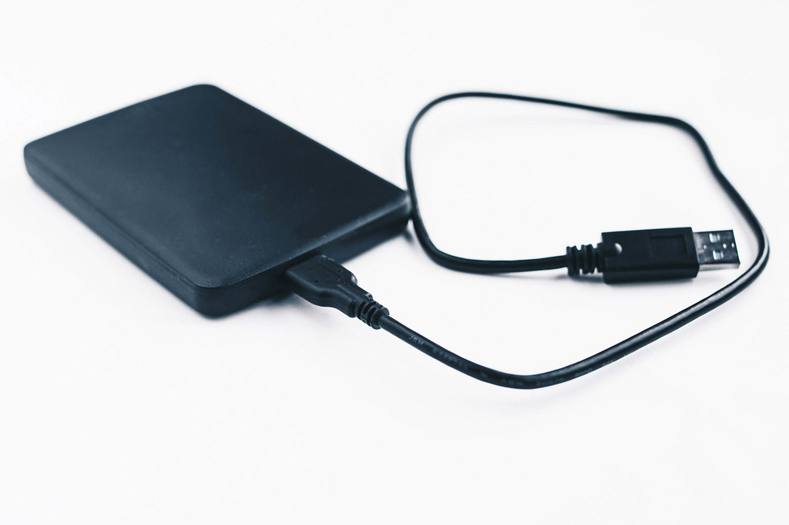
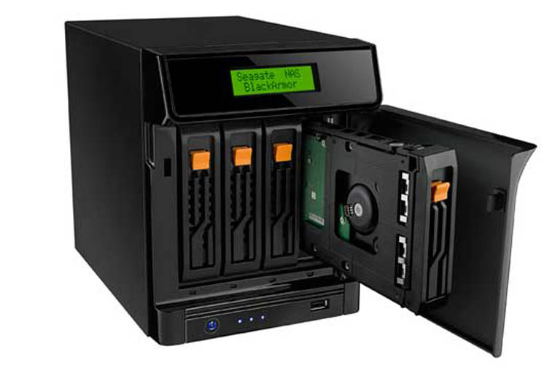
External Storage Devices
Flash drives
Memory cards
External hard drives
External optical drives
Network attached storage (NAS)
Notes:
Extended storage devices are essential for expanding the storage capacity of computers and providing a convenient way to store and access data. Here's a detailed exploration of the mentioned extended storage devices:
**1. Flash Drives:**
Flash drives, also known as USB drives or thumb drives, are portable storage devices that use flash memory to store data. They connect to a computer's USB port and offer a quick and easy way to transfer files between devices. Flash drives come in various storage capacities, making them ideal for carrying documents, media files, software, and more.
**2. Memory Cards:**
Memory cards are small storage devices used primarily in devices like cameras, smartphones, and tablets. They offer expandable storage and are available in different formats such as SD (Secure Digital), microSD, CompactFlash, and more. Memory cards are useful for capturing photos, videos, and other media on devices with limited internal storage.
**3. External Hard Drives:**
External hard drives are separate storage devices that connect to a computer via USB, Thunderbolt, or other interfaces. They offer large storage capacities and are commonly used for backup, data storage, and transferring large files. External hard drives can be portable or desktop models and come in various storage sizes and speeds.
**4. External Optical Drives:**
External optical drives, such as DVD or Blu-ray drives, provide the ability to read and write optical discs. While optical media usage has declined due to digital distribution, external optical drives can still be useful for tasks like burning discs, watching movies, or accessing older software.
**5. Network Attached Storage (NAS):**
NAS is a more advanced form of extended storage that involves dedicated network-connected devices. NAS devices consist of one or more hard drives and provide centralized storage accessible by multiple devices over a network. They are commonly used for data backup, file sharing, media streaming, and even hosting websites.
These extended storage devices cater to different needs, from convenient data transfer with flash drives to the comprehensive storage solutions offered by network attached storage (NAS). The choice of device depends on factors such as the amount of data you need to store, portability requirements, connectivity options, and intended usage scenarios.

Slide 39
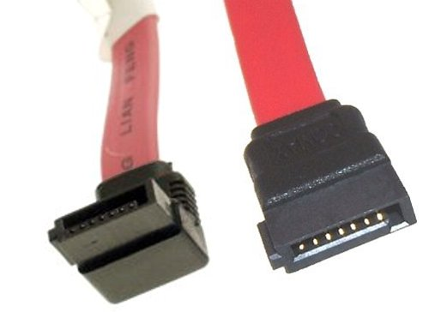
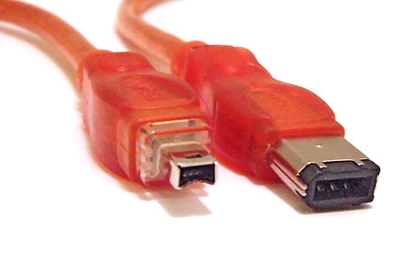
External Storage Connectors
USB
external Serial ATA (eSATA)
FireWire
Thunderbolt
Notes:
Extended storage connectors play a vital role in establishing connections between computers and external storage devices, enabling data transfer and expanding storage capabilities. Here's a more detailed exploration of the mentioned extended storage connectors:
**1. USB (Universal Serial Bus):**
USB connectors are among the most widely used and versatile connectors for extended storage devices. USB ports are found on almost every computer, making them a convenient choice for connecting devices like flash drives, external hard drives, and more. USB supports various data transfer speeds, with USB 3.0 and later versions offering faster rates for quick data transfer.
**2. External Serial ATA (eSATA):**
eSATA is an external version of the SATA (Serial ATA) interface used for connecting storage devices like external hard drives to computers. eSATA offers higher data transfer speeds compared to USB, making it suitable for tasks that involve transferring large files or working with high-definition media content.
**3. FireWire (IEEE 1394):**
FireWire, also known as IEEE 1394, was once a popular connector for connecting devices like external hard drives, digital cameras, and video cameras. It provided high-speed data transfer and was commonly used in professional audio and video production. While it has been largely replaced by USB and Thunderbolt, FireWire still finds use in legacy systems and equipment.
**4. Thunderbolt:**
Thunderbolt is a high-speed interface that combines data transfer, video output, and power delivery through a single cable. Thunderbolt connectors use the same physical interface as Mini-DisplayPort, making them versatile for connecting a range of devices. Thunderbolt offers fast data transfer rates and is particularly popular in professional and creative environments.
Each of these connectors offers distinct advantages and is suited to different use cases. USB is versatile and universally compatible, eSATA provides high-speed data transfer for storage devices, FireWire is used in legacy systems, and Thunderbolt offers exceptional speed and versatility for various devices, including external storage solutions. The choice of connector depends on factors such as data transfer requirements, device compatibility, and the intended usage scenario.

Slide 40
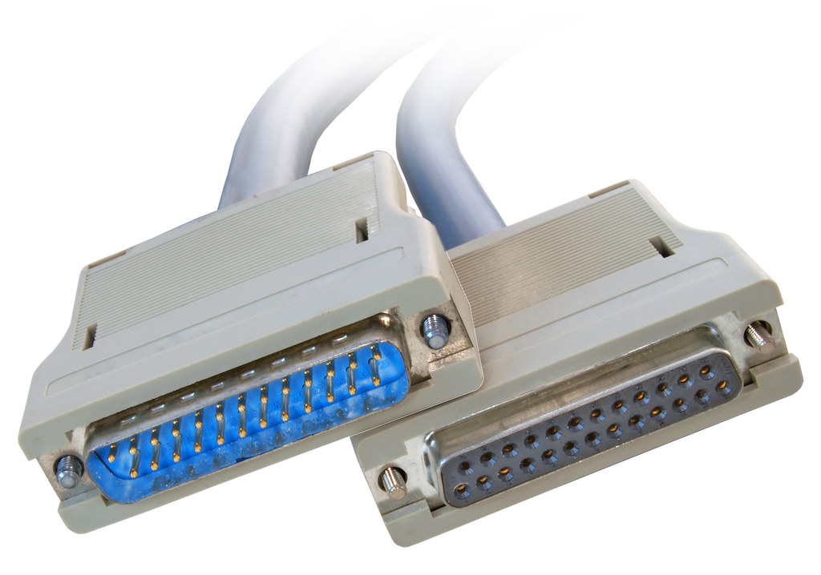


Printer Connections
Serial
Parallel
USB
Wired Network
Wireless Network
Notes:
Printer connections are vital for linking printers to computers or networks, facilitating the transfer of data for printing. Here's a more detailed exploration of the mentioned printer connection methods:
**1. Serial Connection:**
In serial transmission, data bits are sent sequentially, one after the other. This method is often used for connecting devices that are relatively far apart and require simple communication. Each bit is transmitted at a clock pulse, with a start and stop bit framing a data byte. Serial connections are slower compared to parallel connections but are suitable for longer distances.
**2. Parallel Connection:**
Parallel transmission involves sending multiple bits simultaneously over separate channels or wires. This method is faster than serial transmission for transferring data but is typically limited to short distances due to potential signal degradation. Parallel connections were more common in the past for connecting printers, but they have become less prevalent with the emergence of other connection types.
**3. USB (Universal Serial Bus):**
USB is a widely used standard for connecting various devices, including printers, to computers. USB offers multiple benefits, such as high data transfer rates, plug-and-play functionality, and the ability to provide power to connected devices. USB printers are common in home and office environments due to their ease of use and compatibility.
**4. Network Connection:**
Network-based printer connections utilize a network, often through Wi-Fi, to enable multiple devices to access and print documents on the same printer. This method is particularly useful in office environments where multiple users need access to a shared printer. Network printers can be conveniently placed in central locations, making them accessible to all authorized users.
Each printer connection method has its advantages and limitations, and the choice depends on factors such as the printer's location, the number of devices that need to connect, the required data transfer speeds, and the available infrastructure. As technology evolves, USB and network connections have become more common due to their convenience, speed, and ability to support a range of devices.

Slide 41

Installing Internal Devices
Power the computer off
  Can leave it plugged in
Remove the old component
Identify slot or connection for new device
Insert new device and attach power if needed
Turn the computer back on
  After verifying functionality, put the case back together.
Notes:
Installing internal devices in a computer requires careful steps to ensure proper installation and avoid any damage to components. Here's a more detailed breakdown of the process:
**1. Power Off the Computer:**
Before beginning any installation, make sure the computer is completely powered off. This prevents electrical shocks and ensures the safety of both the components and the installer.
**2. Leave It Plugged In (Optional):**
It's generally safe to leave the computer plugged into a power outlet while installing internal components, as long as the power switch is turned off and the power cable is unplugged from the power supply unit.
**3. Remove the Old Component:**
If you are replacing an existing component (e.g., upgrading a graphics card), carefully remove the old component from its slot or connection. Make sure to disconnect any power cables, data cables, and screws holding the component in place.
**4. Identify Slot or Connection for New Device:**
Identify the appropriate slot or connection on the motherboard for the new device. This may be a PCI Express slot, RAM slot, SATA connector, or other designated interface.
**5. Insert New Device and Attach Power (If Needed):**
Gently insert the new device into the designated slot or connection. Ensure that it is properly aligned and securely seated. If the new device requires power, connect the necessary power cables from the power supply unit.
**6. Turn the Computer Back On:**
Once the new component is installed and all connections are secure, turn the computer back on. This is an important step to test if the new device is recognized and functioning correctly.
**7. Verify Functionality:**
Check if the computer recognizes the new device and if it's functioning as expected. This may involve installing drivers or software to ensure proper functionality. Test any relevant features or functions associated with the new device.
**8. Put the Case Back Together:**
After confirming that the new device is working properly, carefully reassemble the computer case. Securely fasten any screws, close the case, and ensure that all cables are neatly organized and properly connected.
**Important Note:**
Always follow the manufacturer's instructions and guidelines when installing internal components. Proper grounding and anti-static precautions are essential to prevent damage to sensitive electronic components.
By following these steps, you can safely and effectively install new internal devices in your computer, enhancing its functionality and performance.

Slide 42

Installing External Devices
Make sure there is an available port
Plug it in to the computer
Plug in to power if needed
Notes:
Installing external devices is generally a straightforward process, but it's important to follow a few basic steps to ensure a proper and safe setup. Here's a more detailed guide to installing external devices:
**1. Check for Available Ports:**
Before connecting an external device, ensure that your computer has an available and compatible port for the device you intend to install. Different devices may require USB, Thunderbolt, HDMI, Ethernet, or other types of ports.
**2. Plug It into the Computer:**
Connect the external device's cable or connector to the corresponding port on your computer. Make sure the connection is secure but avoid using excessive force, as connectors can be delicate.
**3. Plug in to Power (If Needed):**
Some external devices, such as printers, monitors, or external hard drives, may require their own power source. If needed, plug the device into a power outlet or power strip. Ensure that the device's power supply is properly connected and functioning.
**4. Install Drivers or Software (If Needed):**
Depending on the device, you may need to install drivers or software to enable proper functionality. This is common for printers, graphics tablets, and certain peripherals. Follow the manufacturer's instructions to install any necessary software.
**5. Configure Settings (If Needed):**
For certain devices, such as monitors or external storage, you might need to configure settings to ensure optimal performance. This might involve adjusting display resolution, setting up automatic backups, or configuring network settings.
**6. Test Functionality:**
After connecting the device, test its functionality to make sure it's working as expected. For example, if you connected a printer, try printing a test page. If it's a monitor, ensure that it displays the expected content.
**7. Safely Disconnect the Device:**
Before disconnecting an external device, it's important to properly eject or disconnect it to avoid data corruption. For storage devices, use the "Safely Remove Hardware" option on your computer before unplugging.
By following these steps, you can ensure a smooth and hassle-free installation of external devices. Always consult the manufacturer's documentation for specific instructions and any additional setup requirements for the particular device you're installing.

Slide 43
Operating Systems

Slide 44
Core OS functions
Coordinating users and hardware
Provide environment for software to function
Provide structure for data management
Monitor system health and functionality
Notes:
The core functions of an operating system (OS) are essential for managing the hardware, software, and user interactions of a computer system. Here's a more detailed exploration of these functions:
**1. Coordinating Users and Hardware:**
- The OS acts as an intermediary between users and the computer's hardware components.
- It manages user authentication, ensuring that authorized users can access the system while maintaining security.
- The OS also handles user interfaces, allowing users to interact with the computer through graphical user interfaces (GUIs) or command-line interfaces (CLIs).
**2. Providing Environment for Software to Function:**
- The OS provides an environment in which software applications can execute and interact with hardware resources.
- It manages processes, allocating CPU time and memory to different programs to ensure smooth multitasking and efficient resource utilization.
- The OS creates an abstraction layer that isolates applications from the complexities of hardware, allowing software to be developed independently of specific hardware details.
**3. Providing Structure for Data Management:**
- The OS manages file systems, allowing users and applications to organize and access data stored on various storage devices.
- It provides functions for file creation, deletion, reading, and writing, ensuring that data is organized, secure, and accessible to authorized users.
**4. Monitoring System Health and Functionality:**
- The OS monitors system health and performance, checking for issues and anomalies that could affect the system's stability or efficiency.
- It provides diagnostic tools and system logs to help identify and troubleshoot problems.
- The OS also manages hardware errors and issues, often attempting to recover gracefully from errors without disrupting the entire system.
**5. Managing Hardware Resources:**
- The OS manages hardware components like central processing units (CPUs), memory, input/output devices, and storage devices.
- It allocates resources to different processes and applications based on priority and demand, optimizing overall system performance.
- The OS also handles hardware interactions, including device drivers that allow the OS to communicate with and control various hardware devices.
**6. Providing Security and Access Control:**
- The OS enforces access control mechanisms to protect data and resources from unauthorized access.
- It implements user permissions, authentication, and encryption to ensure data security and privacy.
- The OS also manages firewall settings, antivirus software, and other security features to defend against threats.
**7. Managing Networking and Connectivity:**
- In modern computing environments, the OS often manages network connections, allowing users and applications to connect to the internet and other devices.
- It handles network protocols, IP addresses, and network configuration settings to facilitate communication.
**8. Providing User Interfaces:**
- The OS offers user interfaces that enable users to interact with the computer system. This includes graphical interfaces, command-line interfaces, and touch-based interfaces in the case of mobile devices.
In summary, the core functions of an operating system are multifaceted and encompass a wide range of tasks, from managing hardware resources to providing an environment for software execution, ensuring data integrity, and safeguarding system security. These functions collectively create the foundation that allows modern computer systems to operate efficiently and effectively.

Slide 45
Types of Operating Systems
Workstation & Desktops
  Windows
  Mac OS
  Linux
Tablets
  Windows
  iPad
  Android
Mobile
  Android
  Apple iOS
Server
  Linux-based
  Windows-based
Virtual
Embedded
Notes:
These terms represent different categories of operating systems that cater to various computing needs and platforms. Let's explore each category in more detail:
**Workstation:**
- Workstation operating systems are optimized for high-performance tasks like graphic design, video editing, and scientific simulations.
- Examples include Linux distributions like Ubuntu Studio, macOS for Apple workstations, and Windows 10 Pro for PCs.
**Linux:**
- Linux is an open-source operating system kernel that forms the basis of numerous distributions (distros).
- Popular Linux distros include Ubuntu, Fedora, and Debian, each offering its own user interface and software ecosystem.
**Mac OS:**
- Mac OS is the operating system developed by Apple for its Mac computers.
- It provides a unique user experience and integrates seamlessly with Apple hardware and software.
**Windows:**
- Windows is Microsoft's operating system for personal computers.
- Windows versions like Windows 10 provide a wide range of functionalities and support for various applications.
**Chrome OS:**
- Chrome OS is designed by Google and primarily runs on Chromebooks.
- It's optimized for web-based activities and relies heavily on cloud services and online applications.
**Server:**
- Server operating systems are designed to manage and serve resources, applications, and services to other devices over a network.
- Linux-based servers (Ubuntu Server, CentOS), macOS-based servers, and Windows Server are common examples.
**Mobile:**
- Mobile operating systems power smartphones and tablets, providing user interfaces optimized for touchscreens.
- Apple iOS powers iPhones and iPads, Android is used by many smartphone manufacturers, and Windows Mobile is developed by Microsoft.
**Virtual:**
- Virtual operating systems are designed to run within a virtualized environment, allowing multiple operating systems to coexist on a single physical machine.
- Examples include virtual machines running on software like VMware or VirtualBox.
**Embedded:**
- Embedded operating systems are designed for specific devices with limited computing resources.
- They power devices like smart TVs, routers, IoT devices, and industrial machinery.
Each of these operating systems serves a unique purpose and is tailored to specific platforms and requirements, contributing to the diverse computing landscape we have today.

Slide 46

Windows
Launched by Microsoft in 1985
Most widely-used workstation and desktop OS in the world
Closed source
Notes:
**Windows: Microsoft's Iconic Operating System**
Since its launch in 1985, Windows has become synonymous with personal computing. Developed by Microsoft, Windows has left an indelible mark on the world of technology. Let's explore the key aspects and impact of the Windows operating system:
**Inception and Early Years:**
- Windows was introduced by Microsoft in 1985 with Windows 1.0.
- It aimed to provide a graphical user interface (GUI) on top of the existing MS-DOS operating system, making computing more accessible and user-friendly.
**Dominance in Workstations:**
- Windows has established itself as the most widely-used operating system for workstations around the globe.
- Its user-friendly interface, extensive software support, and compatibility with a wide range of hardware contributed to its popularity.
**Evolution of Versions:**
- Windows evolved through various versions, including Windows 3.1, Windows 95, Windows 98, and Windows ME.
- Windows NT introduced a more robust and stable platform for businesses and professional users.
- Windows 2000, Windows XP, Windows Vista, Windows 7, Windows 8, and Windows 10 followed, each with its own improvements and features.
**Closed Source Model:**
- Windows is considered a closed-source operating system, which means its source code is not publicly available.
- Microsoft controls the development, distribution, and licensing of Windows, allowing them to maintain a level of control over the platform.
**Graphical User Interface (GUI) Standardization:**
- Windows played a pivotal role in popularizing the GUI paradigm in personal computing.
- The familiar Windows interface, featuring windows, icons, menus, and pointers (WIMP), became a standard for graphical interfaces.
**Software Ecosystem:**
- The Windows ecosystem boasts a vast array of software applications, ranging from productivity tools to multimedia software and games.
- This software diversity has contributed to Windows' dominance in the consumer and business markets.
**User Customization and Productivity:**
- Windows offers customization options, allowing users to personalize their desktops and workflows.
- Microsoft has continually worked to improve user productivity, introducing features like the Start Menu, taskbar, and virtual desktops.
**Challenges and Innovations:**
- Windows faced challenges with certain versions, such as the mixed reception of Windows Vista and the radical departure from traditional interfaces in Windows 8.
- Microsoft addressed these challenges with subsequent releases, culminating in the well-received Windows 10.
**Continued Relevance:**
- Windows remains an integral part of computing, serving as the foundation for a wide range of devices, including desktops, laptops, tablets, and even some smartphones.
**Conclusion:**
Windows' journey from its inception in 1985 to its present state has solidified its place as a transformative and influential operating system. Its evolution, dominance in workstations, closed-source nature, and impact on user interfaces have left an enduring legacy in the world of technology. Windows continues to adapt to changing user needs and technological advancements, maintaining its role as a cornerstone of modern computing.

Slide 47

Mac OS
Introduced in 1984 by Apple
  “System Software”
First common GUI
Current version is macOS, which followed OS X
  Version names based on big cats or now California locations
Proprietary to Mac computers
Loyal users
Considered the best for graphics programs
Notes:
**macOS: Evolution of Apple's Operating System**
macOS, developed by Apple Inc., has a rich history that spans decades. From its early beginnings to its current state, macOS has undergone significant transformations. Let's explore the journey and characteristics of this operating system:
**Introduction and Early Stages:**
- macOS was initially introduced in 1984 under the name "System Software" for the Apple Macintosh.
- It marked a significant milestone by bringing the graphical user interface (GUI) to the mainstream, making personal computing more accessible and intuitive.
**Transition to Modern macOS:**
- The journey of macOS continued through various iterations, including System 7, Mac OS 8, Mac OS 9, and Mac OS X.
- Mac OS X, introduced in 2001, was a pivotal release that brought Unix-based architecture and advanced features to Apple's operating system.
**Naming Convention:**
- Mac OS X evolved into macOS with the release of macOS Sierra in 2016.
- The naming convention for macOS versions shifted from big cats (e.g., Leopard, Snow Leopard) to locations in California, reflecting the company's heritage and its California roots.
**Proprietary Nature:**
- macOS is exclusively designed for and tightly integrated with Apple hardware, such as Mac desktops and laptops.
- Apple's control over both the hardware and software aspects of its ecosystem contributes to a cohesive and optimized user experience.
**Loyal User Base:**
- macOS has cultivated a dedicated and loyal user base over the years.
- Apple's focus on design, user experience, and integration across devices has resonated with users seeking a seamless and elegant computing environment.
**Graphics and Creative Capabilities:**
- macOS is renowned for its capabilities in graphic design, media production, and creative tasks.
- Apple's emphasis on color accuracy, display quality, and tools like Final Cut Pro and Logic Pro has made macOS a preferred platform for professionals in the creative industries.
**Stability and User Experience:**
- Apple's control over the hardware and software ecosystem contributes to the stability and reliability of macOS.
- macOS is known for its user-friendly interface, consistent design language, and attention to detail.
**App Ecosystem:**
- The macOS App Store offers a wide range of applications, including productivity tools, creative software, and utilities.
- The store's curated approach ensures that apps meet certain quality and security standards.
**Continual Evolution:**
- With each new release, macOS introduces new features, improvements, and optimizations, enhancing the user experience and keeping pace with technological advancements.
**Conclusion:**
macOS, tracing its roots back to 1984, has evolved into a sophisticated and feature-rich operating system. Its focus on design aesthetics, user experience, creative capabilities, and tight integration with Apple's hardware ecosystem has garnered a loyal following. As technology continues to progress, macOS remains a symbol of Apple's commitment to innovation and user-centric computing.

Slide 48

Linux
Developed in 1991
Open source
Many versions
Uncommon for workstations
Very popular for servers
Notes:
Linux: Linux is a free, open-source operating system based on the UNIX operating system.
**Linux: A Brief Overview**
Developed in 1991 by Linus Torvalds, Linux is an open-source operating system kernel that has evolved into a powerful and versatile ecosystem. Let's delve into the details of Linux's history, characteristics, and applications:
**Historical Context:**
- Linux originated as a personal project by Linus Torvalds, a Finnish computer science student, who aimed to create a free and open-source operating system kernel.
- Linus released the first version of the Linux kernel in 1991, which marked the beginning of the Linux ecosystem's development.
**Open Source Philosophy:**
- Linux embodies the open-source philosophy, allowing anyone to view, modify, and distribute its source code.
- The open-source nature of Linux encourages collaboration and contributions from a global community of developers, resulting in continuous improvements and innovation.
**Diverse Versions (Distributions):**
- Linux is not just an operating system but a kernel that serves as the foundation for various operating system distributions (distros).
- Each Linux distribution includes the Linux kernel along with a selection of software packages, user interfaces, and system management tools.
- Popular Linux distributions include Ubuntu, Fedora, Debian, CentOS, and more, catering to different user preferences and use cases.
**Usage on Workstations:**
- While Linux is less common on traditional workstations compared to Windows and macOS, it has gained popularity among developers, researchers, and individuals who value customization and control.
- Linux provides a wide array of desktop environments (such as GNOME, KDE, and XFCE) that offer unique user interfaces and experiences.
**Prominence on Servers:**
- Linux has a significant presence in server environments, powering a substantial portion of web servers, data centers, cloud infrastructure, and supercomputers.
- Its stability, security features, and ability to be tailored to specific server needs have contributed to its popularity in server-centric applications.
**Community and Contributions:**
- The Linux community is characterized by its collaborative spirit and dedication to improving the operating system.
- Developers, users, and organizations contribute to various aspects of Linux, from coding and testing to documentation and support.
**Security and Stability:**
- Linux is known for its robust security features, with its open-source nature allowing for swift identification and resolution of security vulnerabilities.
- Its Unix-like architecture and permission system contribute to enhanced security and control over system resources.
**Conclusion:**
Linux's journey from its inception in 1991 to becoming a versatile and influential operating system reflects the power of open-source development and collaborative innovation. While it might not be as prevalent on workstations as some other operating systems, its impact on servers, embedded systems, supercomputing, and software development is undeniable. Linux continues to evolve and adapt to the ever-changing landscape of technology, driven by a vibrant and passionate community.

Slide 49

Apple iOS
Launched in 2007 with the first iPhone
Proprietary to Apple devices
  iPad, iPhone, iPod
Very popular
Notes:
**iOS: Apple's Mobile Operating System**
Debuting in 2007 alongside the first iPhone, iOS has become synonymous with the seamless and intuitive mobile experience provided by Apple devices. Here's a closer look at the evolution and defining features of iOS:
**Introduction with the iPhone:**
- iOS made its debut in 2007 as the operating system for the revolutionary iPhone, transforming the mobile landscape with its touch-based interface and innovative features.
**Exclusively Apple:**
- iOS is exclusively developed for Apple devices, including the iPad, iPhone, and iPod Touch.
- This proprietary approach enables Apple to tightly integrate hardware and software, resulting in a cohesive user experience.
**Range of Devices:**
- iOS powers a range of devices, from the compact iPod Touch to the iconic iPhone and the versatile iPad.
- Each device type offers a tailored experience, optimized for its form factor and capabilities.
**User-Focused Design:**
- iOS is renowned for its user-focused design, characterized by a minimalist interface, fluid animations, and intuitive gestures.
- Apple's emphasis on simplicity and elegance has resonated with users worldwide.
**App Ecosystem:**
- The App Store, an integral part of iOS, offers a vast array of applications covering diverse categories, from productivity to entertainment.
- The curated store ensures a level of quality and security for users.
**Regular Updates:**
- iOS receives regular updates that introduce new features, enhancements, and security improvements.
- These updates often provide users with access to innovative capabilities and refinements.
**Synchronization and Continuity:**
- iOS devices seamlessly integrate with other Apple devices, enabling features like Handoff, which allows users to start a task on one device and continue on another.
**Privacy and Security:**
- Apple places a strong emphasis on user privacy and data security.
- iOS features privacy controls and encryption measures to safeguard user information.
**Ecosystem Integration:**
- iOS devices are part of a larger Apple ecosystem that includes macOS, watchOS, and tvOS.
- This integration enables seamless interactions across devices and services.
**App Store Ecosystem:**
- Developers have embraced the iOS platform, creating a wide range of applications that cater to various needs and interests.
- The App Store's popularity has contributed to iOS's widespread adoption.
**Global Popularity:**
- iOS's user-friendly interface, strong security features, and vibrant app ecosystem have led to its widespread popularity around the world.
**Conclusion:**
iOS's journey began with the launch of the first iPhone in 2007, ushering in a new era of mobile computing. Its focus on user experience, integration with Apple's ecosystem, emphasis on privacy, and robust app ecosystem have solidified iOS's position as a leading mobile operating system. As Apple continues to innovate and release new devices, iOS remains at the heart of its commitment to providing users with intuitive, reliable, and enjoyable digital experiences.

Slide 50

Android
Launched by Google in 2008
Not open source, but cross-platform; supported by many hardware vendors
Biggest OS install base in the world
Notes:
**Android: A Global Mobile Operating System**
Introduced by Google in 2008, Android has reshaped the mobile landscape by offering a versatile and open platform for a wide range of devices. Let's delve into the key characteristics and impact of the Android operating system:
**Inception and Google's Involvement:**
- Android was founded in 2003 by Andy Rubin, Rich Miner, Nick Sears, and Chris White.
- Google acquired Android Inc. in 2005, which laid the foundation for its growth and eventual dominance.
**Open and Cross-Platform:**
- Android is built on an open-source foundation, making its source code accessible to developers.
- It is designed to be cross-platform, meaning it can run on various hardware devices from multiple manufacturers.
**Ecosystem Diversity:**
- Android is supported by a broad range of hardware vendors, leading to a diverse ecosystem of smartphones, tablets, smartwatches, and other devices.
- This diversity gives consumers a wide array of choices to fit their preferences and needs.
**App Ecosystem:**
- The Google Play Store hosts an extensive collection of applications catering to various interests and requirements.
- The open nature of Android has encouraged developers to create a vast array of apps.
**Customization and Personalization:**
- Android offers users a high degree of customization and personalization, allowing them to tweak the user interface, widgets, and overall experience.
- This flexibility has resonated with users who value individuality and control.
**Regular Updates:**
- Android receives updates regularly, often improving performance, introducing new features, and enhancing security.
- However, due to fragmentation, not all devices receive updates simultaneously.
**Global Reach:**
- Android has achieved remarkable global adoption, especially in emerging markets, due to its accessibility and affordability.
**Fragmentation Challenges:**
- While the open nature of Android has contributed to its growth, it has also led to fragmentation.
- Different manufacturers customize Android's user interface and features, leading to variations in user experience and software availability.
**Google Services Integration:**
- Android is deeply integrated with Google's suite of services, including Google Search, Maps, Gmail, and more.
- This integration enhances the overall user experience and provides seamless access to various Google offerings.
**Versatility and Innovation:**
- Android's openness has fueled innovation, giving developers the freedom to experiment with new ideas and technologies.
- This adaptability has led to the development of various device types, including smartphones, tablets, smart TVs, and wearables.
**Conclusion:**
Android's introduction in 2008 marked a significant turning point in the mobile industry. Its open nature, diverse ecosystem, customization options, and global reach have solidified its position as the largest mobile operating system in terms of the install base. While fragmentation poses challenges, Android's ability to cater to a wide range of user preferences and needs has contributed to its continued growth and innovation. As technology evolves, Android remains a driving force in shaping the future of mobile computing.

Slide 51
Virtual OSs
Multiple OSs running concurrently on one physical computer
  Virtualization
Virtual machine (VM)
Critical for cloud computing
Hypervisor enables virtualization
  Type 1 – bare-metal hypervisor
  Type 2 sits on an existing OS
Notes:
**Virtual Operating Systems: Unlocking Multi-OS Environments**
The concept of virtual operating systems (OSs) has transformed the way we interact with computing environments, allowing multiple operating systems to coexist on a single physical machine. This technological innovation, facilitated by virtualization, has profound implications for various industries, especially in the realm of cloud computing. Let's delve into the world of virtual OSs:
**Introduction to Virtualization:**
- Virtualization involves creating a virtual instance of a computer system, including its operating system, applications, and resources.
- This technology allows multiple virtual machines (VMs) to run concurrently on a single physical host, each operating as if it were on its own dedicated hardware.
**Key Components:**
- **Virtual Machine (VM):** A VM is a self-contained environment that emulates a complete computer system, including its OS, memory, storage, and network resources.
- **Hypervisor:** The hypervisor is the software layer responsible for managing and orchestrating VMs on the physical hardware.
**Critical Role in Cloud Computing:**
- Virtualization is a cornerstone of cloud computing, enabling the creation and management of numerous virtualized instances on a shared physical infrastructure.
- Cloud service providers leverage virtualization to offer scalable and efficient computing resources to clients.
**Types of Hypervisors:**
- **Type 1 (Bare-Metal Hypervisor):** This hypervisor runs directly on the physical hardware, without the need for a host operating system. It's ideal for enterprise environments and data centers.
- **Type 2 (Hosted Hypervisor):** Type 2 hypervisors are installed on top of an existing host operating system. They are commonly used for development, testing, and personal virtualization.
**Benefits of Virtual OSs:**
- **Resource Efficiency:** Virtualization optimizes hardware utilization, allowing multiple VMs to share physical resources while maintaining isolation.
- **Isolation and Security:** Each VM operates independently, providing strong isolation between different OSs and applications.
- **Flexibility and Scalability:** Virtual OSs can be easily created, cloned, and scaled up or down as needed, offering flexibility to accommodate changing workloads.
- **Testing and Development:** Virtual environments provide a safe and controlled space for software testing, development, and experimentation.
- **Legacy Software Support:** Virtualization enables running legacy applications on modern hardware, preserving compatibility.
**Challenges and Considerations:**
- **Performance Overhead:** Virtualization introduces some overhead due to the abstraction layer, which can impact performance compared to native systems.
- **Resource Allocation:** Proper allocation of resources among VMs is crucial to prevent resource contention and ensure optimal performance.
- **Security Management:** Managing security across multiple VMs requires careful consideration to prevent vulnerabilities and breaches.
**Conclusion:**
Virtual OSs, empowered by virtualization technology, have revolutionized the way we harness computing power. From efficient resource utilization and scalable cloud environments to versatile development and testing platforms, virtualization offers a multitude of benefits. As technology advances and demands evolve, the role of virtual OSs will continue to shape the landscape of computing, contributing to innovation, agility, and efficiency across various sectors.

Slide 52

Embedded OSs
Designed to be small and efficient
  Often responsible for a single task
Firmware is an example
Used in very small devices such as wristwatches and children’s toys
Typically not upgradeable
Notes:
**Embedded Operating Systems: Powering Specialized Devices**
Embedded operating systems (OSs) play a crucial role in powering a wide range of specialized devices, from small gadgets to industrial machinery. These compact and purpose-built systems are tailored to specific tasks and have distinct characteristics that set them apart. Let's delve into the world of embedded OSs:
**Small and Efficient Design:**
- Embedded OSs are crafted to be small and efficient, optimized for the limited resources available on embedded devices.
- They prioritize minimal memory usage and low processing power requirements to ensure smooth operation.
**Single-Task Focus:**
- Often, embedded OSs are dedicated to a single task or a specific set of tasks.
- This focused approach ensures that the OS remains streamlined and dedicated to its intended purpose.
**Firmware and Hardware Interaction:**
- Firmware is a prime example of an embedded OS. It's a type of software that is closely integrated with hardware components.
- Firmware provides essential functions for hardware initialization, configuration, and control.
**Wide Range of Applications:**
- Embedded OSs are found in a diverse range of devices, including wristwatches, children's toys, medical devices, automotive systems, industrial equipment, and more.
- Their presence is often unnoticed by users as they quietly power everyday objects.
**Notable Characteristics:**
- **Efficiency:** Embedded OSs prioritize efficient use of resources to ensure that devices can perform their tasks without excessive power consumption or slowdowns.
- **Predictability:** These OSs are engineered for deterministic behavior, ensuring that they consistently respond to inputs and events within predictable time frames.
- **Reliability:** Embedded OSs prioritize reliability to ensure that the devices they power function consistently and without interruptions.
- **Limited Upgradability:** Unlike consumer devices, embedded devices often lack the ability to upgrade their OSs due to hardware limitations or the complexity of the integration process.
**Challenges and Trade-offs:**
- Developing embedded OSs involves striking a delicate balance between performance, resource constraints, and the specific needs of the device.
- Due to limited hardware resources, debugging and troubleshooting embedded systems can be more challenging.
**Conclusion:**
Embedded operating systems are the unsung heroes that power a vast array of specialized devices, ranging from the smallest gadgets to complex industrial equipment. Their ability to efficiently manage resources, perform specific tasks reliably, and interact closely with hardware components makes them indispensable in the world of technology. As the Internet of Things (IoT) continues to expand, the role of embedded OSs will only become more crucial in powering the connected devices that shape our lives.

Slide 53
Things Operating Systems Manage
User accounts
Access control
Applications
Processes
Services
Devices
Disk space
Memory
Files, folders, and permissions
Notes:
**Key Aspects of Operating System Management**
Efficiently managing an operating system involves overseeing a multitude of essential components and processes. These aspects collectively ensure the proper functioning, security, and performance of the system. Let's explore these key aspects in detail:
**User Accounts:**
- User accounts enable individuals to access the system and its resources while maintaining security through authentication.
- User account management involves creating, modifying, and deleting accounts, as well as defining their access privileges.
**Access Control:**
- Access control governs who can access the system's resources and what actions they can perform.
- Permissions and privileges are assigned to users or groups, restricting unauthorized access and maintaining data security.
**Applications:**
- Managing applications involves installing, updating, and uninstalling software programs on the system.
- Ensuring compatibility, resolving conflicts, and maintaining a balance between functionality and performance are crucial.
**Processes:**
- Processes are running instances of programs that interact with the system's resources.
- Managing processes includes monitoring their performance, prioritizing their execution, and ensuring efficient resource allocation.
**Services:**
- Services are background processes that provide system functionalities or network-related tasks.
- Managing services involves starting, stopping, and configuring them to optimize performance and resource utilization.
**Devices:**
- Managing devices encompasses interactions with hardware components, such as printers, scanners, and external storage devices.
- Proper configuration and driver management are essential to ensure seamless device operation.
**Disk Space:**
- Efficient disk space management involves monitoring storage usage, optimizing file systems, and performing routine maintenance tasks to prevent data loss and performance issues.
**Memory:**
- Memory management focuses on allocating and deallocating memory resources for processes.
- Balancing memory demands, preventing memory leaks, and optimizing memory utilization are vital for system stability.
**Files, Folders, and Permissions:**
- Managing files and folders includes creating, organizing, and securing data.
- Permissions dictate who can access, modify, or delete files and folders, safeguarding sensitive information.
**Conclusion:**
The management of an operating system encompasses a wide array of crucial components, processes, and resources. Balancing efficient user account management, access control, applications, processes, services, devices, disk space, memory, and file systems contributes to a well-functioning and secure computing environment. By effectively overseeing these aspects, administrators ensure the optimal performance, stability, and reliability of the operating system, enabling users to harness its capabilities while maintaining data integrity and security.

Slide 54

User Accounts
Gives user access to the computer
Determines which resources the user can access, and what the user can do with them
Administrator, User, Guest
Notes:
**User Accounts: Balancing Access and Control**
User accounts are a fundamental element of operating systems, enabling users to interact with computers while maintaining security and control over system resources. Here's a closer look at the roles and functions of user accounts:
**Access Provision:**
- User accounts serve as gateways to the computer system, allowing individuals to log in and gain access to its functionalities.
- Each user account is associated with a unique set of credentials, typically a username and password.
**Resource Allocation:**
- User accounts determine the level of access a user has to various resources, including files, applications, and system settings.
- Access control mechanisms ensure that users can only interact with resources for which they have been granted permission.
**User Roles:**
- **Administrator:** Administrators have elevated privileges, allowing them to configure system settings, install software, and manage user accounts.
- **User:** Regular users have standard access rights and can perform everyday tasks without altering system configurations.
- **Guest:** Guest accounts offer limited access, often restricting users from making significant changes to the system.
**Functionality and Security:**
- User accounts balance the need for system functionality with security considerations.
- While administrators can make system-wide changes, the limitations of user and guest accounts prevent inadvertent or malicious alterations.
**User Profiles:**
- Each user account is associated with a user profile, which stores personal settings, preferences, and customizations.
- User profiles ensure a personalized computing experience, even when multiple individuals share the same computer.
**Single Sign-On and Authentication:**
- Some systems support single sign-on, enabling users to access multiple services with a single set of credentials.
- Strong authentication methods, such as two-factor authentication, enhance security by requiring additional verification steps.
**Guest Accounts: A Limited Approach:**
- Guest accounts are often provided for temporary or restricted access, such as in public computing environments.
- These accounts typically have limited permissions and erase user data after each session.
**Conclusion:**
User accounts play a pivotal role in managing access and control within operating systems. By defining roles, access levels, and privileges, user accounts strike a balance between enabling users to harness the system's capabilities and ensuring the security and integrity of the system and its resources. Through these mechanisms, operating systems provide a secure and efficient environment for users to perform tasks, customize settings, and interact with computing technologies.

Slide 55

Access Control
Security in place to control system configuration changes
Microsoft implements it with User Account Control (UAC)
Notes:
**Access Control: Safeguarding System Integrity**
Access control is a cornerstone of system security, ensuring that authorized users can access the resources they need while preventing unauthorized access or modifications. It plays a crucial role in maintaining the integrity and confidentiality of sensitive data within an operating system. Microsoft's User Account Control (UAC) is an example of how access control is implemented to enhance system security:
**System Configuration Changes:**
- Access control focuses on regulating changes to the system's configuration, settings, and critical files.
- It prevents unauthorized users or processes from altering configurations that could compromise system stability or security.
**User Account Control (UAC):**
- UAC is a security feature implemented in Microsoft Windows operating systems, starting with Windows Vista.
- It prompts users for permission or confirmation before allowing certain system-level changes to be made.
**User Account Control Mechanisms:**
- UAC works by requesting user approval or administrative privileges when attempting actions that could affect system settings, files, or applications.
- It employs consent prompts, password requirements, and user prompts to ensure that only authorized users can make changes.
**Elevated Privileges:**
- UAC separates standard user privileges from administrative privileges.
- Even users with administrative accounts must provide explicit consent to perform administrative tasks, reducing the risk of accidental or unauthorized changes.
**Benefits of Access Control:**
- **Security:** Access control prevents unauthorized users or malicious software from making unauthorized changes that could compromise system security.
- **System Integrity:** It safeguards system files and configurations, ensuring that the operating system functions as intended.
- **Data Protection:** Access control prevents unauthorized access to sensitive data, safeguarding privacy and compliance.
**Challenges and Considerations:**
- Striking the right balance between security and user experience is essential. Overly frequent prompts can be intrusive, while too few prompts may compromise security.
- Organizations need to establish proper access control policies and ensure that users understand the implications of their actions.
**Conclusion:**
Access control is a vital component of system security, especially in environments where multiple users access the same operating system. Implementing mechanisms like User Account Control (UAC) helps prevent unauthorized or accidental system changes, enhancing the overall security and stability of the operating system. By striking a balance between user convenience and security, access control contributes to a robust computing environment where users can confidently perform tasks without compromising system integrity.

Slide 56

Application Management
Windows Registry
Compartmentalized installation and easy uninstallation
Windows uses Programs and Features in Control Panel
Notes:
**Application Management: Organizing and Optimizing Software**
Efficient application management is crucial for maintaining a well-organized and functional operating system. It involves installing, organizing, updating, and uninstalling software applications to ensure a seamless computing experience. Here's how application management is handled, with a focus on Windows systems:
**Windows Registry: Central Configuration Hub:**
- The Windows Registry is a centralized database that stores configuration settings and options for both the operating system and installed applications.
- Applications may store their settings, preferences, and configuration details in the registry for easy access and retrieval.
**Installation and Uninstallation:**
- Modern operating systems provide compartmentalized installation and uninstallation processes for applications.
- During installation, applications are typically placed in designated directories, ensuring organized storage and separation from system files.
**Windows Programs and Features:**
- Windows provides a built-in utility called "Programs and Features" within the Control Panel.
- This utility allows users to view, modify, and uninstall installed applications in a user-friendly interface.
**Benefits of Effective Application Management:**
- **Resource Optimization:** Efficient application management prevents unnecessary resource consumption, improving system performance.
- **Conflict Prevention:** Well-managed applications reduce the risk of conflicts and compatibility issues between different software packages.
- **Security:** Regularly updating applications ensures that security patches are applied, safeguarding against vulnerabilities.
**Challenges and Considerations:**
- Over time, application clutter can accumulate, occupying storage space and potentially causing system slowdowns.
- Ensuring that users follow best practices when installing and uninstalling applications can prevent clutter and maintain system health.
**Application Lifecycles:**
1. **Installation:** Users or administrators initiate the installation of an application. During this phase, the application's files and configurations are placed on the system.
2. **Configuration:** Users set preferences, customize settings, and configure the application according to their needs.
3. **Usage:** Users interact with the application, performing tasks and utilizing its features.
4. **Updates and Maintenance:** Developers release updates and patches to address bugs, security vulnerabilities, and introduce new features.
5. **Uninstallation:** If an application is no longer needed, it can be uninstalled to free up resources and space.
**Conclusion:**
Efficient application management is essential for maintaining a well-organized and high-performing operating system. By effectively installing, organizing, updating, and uninstalling applications, users can optimize system resources, reduce conflicts, and ensure a secure and stable computing environment. The use of tools like the Windows Registry and built-in utilities simplifies the management process, contributing to a streamlined and productive user experience.

Slide 57

Process Management
Every task on a computer is run as a process
If the process hangs (freezes), user can stop (or kill) it
Windows Task Manager
Notes:
**Process Management on macOS and Windows: A Comparative Overview**
Process management is a critical aspect of both macOS and Windows operating systems, ensuring efficient resource allocation and task execution. While both systems share common principles, they have distinct implementations to cater to their respective user experiences. Here's a comparative look at process management on macOS and Windows:
**macOS Process Management:**
- **Activity Monitor:** macOS provides the "Activity Monitor" tool, which serves a similar purpose as the Windows Task Manager. It displays a list of running processes, resource utilization, and system performance metrics.
- **Force Quit:** In macOS, users can use the "Force Quit Applications" feature to terminate unresponsive or problematic applications. This is similar to the "End Task" function in Task Manager.
**Windows Process Management:**
- **Task Manager:** Windows offers the Task Manager, a comprehensive utility for managing processes, applications, and system performance. Users can view running processes, monitor resource usage, and terminate unresponsive tasks.
- **Process Explorer:** For more advanced users, Windows also provides "Process Explorer," a tool that provides detailed information about running processes, including handles and DLLs.
**Resource Allocation and Prioritization:**
- Both macOS and Windows employ process management to allocate system resources like CPU time, memory, and disk access.
- The operating systems prioritize processes based on factors like user interaction, task criticality, and system responsiveness.
**Force Termination:**
- On both macOS and Windows, users can forcefully terminate unresponsive processes to free up system resources.
- Force termination helps prevent hung processes from affecting the overall system performance.
**Process States:**
- Both operating systems recognize process states such as running, waiting, and terminated, providing insight into the status of each process.
**User Experience:**
- macOS and Windows offer user-friendly interfaces to manage processes, with visual representations and detailed information about resource usage.
- The management tools aim to empower users to troubleshoot and optimize their systems for a smooth experience.
**Conclusion:**
Process management is a universal necessity for maintaining system performance, stability, and user experience. While macOS and Windows have their own process management tools, they share common objectives in allocating resources, monitoring tasks, and providing users with the means to optimize their systems. Both operating systems aim to deliver efficient multitasking, responsive applications, and a seamless computing experience through effective process management.

Slide 58

Service Management
Services extend computer functionality, such as by managing print requests
Can start automatically at startup, or need to be manually started
Services management console in Windows used to start, stop, and configure
Notes:
**Service Management on macOS and Windows: A Comparative Insight**
Service management is a critical component of operating systems, allowing users to control and configure background processes and services that run continuously to support various functions. While both macOS and Windows offer service management functionalities, they have unique approaches tailored to their respective ecosystems. Here's a comparative overview of service management on macOS and Windows:
**macOS Service Management:**
- **LaunchDaemons and LaunchAgents:** In macOS, services are managed through "launchd," a unified system that controls daemons (background services) and agents (processes started on user login). It replaces traditional system startup mechanisms.
- **Preference Panes:** Some services can be configured using preference panes accessible through the System Preferences. These panes allow users to manage specific services and their settings.
**Windows Service Management:**
- **Services.msc:** Windows provides the "Services" management console (services.msc) to view and manage system and third-party services. Users can start, stop, and configure services through this utility.
- **Task Manager:** In recent Windows versions, Task Manager also includes a "Services" tab that displays running services and allows users to stop or restart them.
**Service States and Configuration:**
- Both macOS and Windows allow users to start, stop, restart, and configure services according to their needs.
- Some services are set to start automatically during system boot, while others are triggered by specific events or user actions.
**Automatic vs. Manual Startup:**
- On macOS, services can be configured to start automatically during system boot or on-demand based on user actions.
- Windows offers similar options, allowing users to set services to start automatically, manually, or only when required.
**Service Dependencies:**
- Both operating systems support service dependencies, allowing one service to start based on the status of another.
- These dependencies help ensure that services required for specific tasks are available when needed.
**User Experience and Customization:**
- macOS and Windows provide user-friendly interfaces to manage services, enabling users to control background processes.
- The management tools aim to enhance user control over system behavior while maintaining stability and performance.
**Conclusion:**
Service management is crucial for ensuring a well-functioning operating system that supports various tasks and functions seamlessly. While macOS and Windows offer distinct tools for service management, they share common goals of allowing users to configure, control, and optimize background processes. Both operating systems empower users to tailor their system's behavior to their needs, contributing to a responsive and efficient computing experience.

Slide 59

Device Management
Manage hardware devices, including installing and updating drivers
Device Manager in Windows
Notes:
**Device Management on macOS and Windows: A Comparative Overview**
Device management is a fundamental aspect of operating systems, enabling users to interact with and control hardware components efficiently. Both macOS and Windows offer comprehensive device management capabilities, each tailored to their respective ecosystems. Here's a comparative look at device management on macOS and Windows:
**Device Management on macOS:**
- **System Preferences:** macOS provides the "System Preferences" interface, where users can manage various hardware components and devices. This includes settings related to displays, printers, keyboards, mice, trackpads, and more.
- **Bluetooth and Wi-Fi:** macOS allows users to configure and manage Bluetooth devices and Wi-Fi connections through the "Bluetooth" and "Network" sections of System Preferences.
- **Automatically Installed Drivers:** macOS often includes drivers for a wide range of hardware components, reducing the need for manual driver installation.
**Device Management on Windows:**
- **Device Manager:** Windows offers the "Device Manager" utility, allowing users to view and manage hardware devices, drivers, and their properties. Device Manager provides a detailed overview of connected hardware components.
- **Settings App:** Recent versions of Windows include the "Settings" app, where users can configure hardware settings, manage Bluetooth devices, printers, and more.
- **Driver Installation:** Windows often requires users to manually install drivers for specific hardware components. This is done through Windows Update, manufacturer websites, or installation files.
**Plug and Play:**
- Both macOS and Windows support "plug and play," automatically recognizing and configuring new hardware devices when they are connected.
**Device Drivers:**
- In Windows, device drivers are essential for hardware communication, and users often need to ensure that the correct drivers are installed for optimal device performance.
- macOS usually includes built-in drivers for a wide range of devices, reducing the need for manual installations.
**User Experience and Customization:**
- Both operating systems aim to provide user-friendly interfaces for managing hardware devices, ensuring an intuitive and efficient experience.
- The tools and settings are designed to allow users to personalize their device settings and configurations.
**Conclusion:**
Device management is crucial for enabling users to interact effectively with hardware components and peripherals. While macOS and Windows have distinct tools and interfaces for device management, their goals remain consistent: providing users with easy access to hardware settings, configurations, and drivers. Both operating systems strive to ensure that users can optimize the performance of their hardware devices while enjoying a seamless and personalized computing experience.

Slide 60

Disk Management
Manages hard drives, optical drives, other storage media
Creating and deleting partitions
Formatting partitions
Windows uses Disk Management console
Notes:
**Disk Management: Ensuring Efficient Storage on Your Computer**
Disk management is a vital component of operating systems that oversees the organization and utilization of storage media, including hard drives, optical drives, and other storage devices. Both Windows and macOS offer disk management tools to help users optimize their storage space and enhance system performance. Here's a closer look at disk management, with a focus on its implementation in Windows systems:
**Hard Drive Management:**
- Disk management encompasses various tasks related to hard drives and storage media. It allows users to allocate space effectively, create partitions, format drives, and perform maintenance tasks.
**Partition Creation and Deletion:**
- Disk management tools enable users to create multiple partitions on a single hard drive. Partitions can help segregate data and operating systems for better organization.
- Users can also delete partitions when they are no longer needed or to repurpose the space.
**Partition Formatting:**
- Formatting is the process of preparing a partition for use. It involves setting up a file system that the operating system can understand.
- Common file systems include NTFS (Windows) and HFS+ (macOS).
**Disk Management in Windows:**
- Windows provides the "Disk Management" console as the primary tool for disk management tasks.
- Users can access Disk Management through the Control Panel or by searching for "Disk Management" in the Start menu.
**Disk Status and Information:**
- The Disk Management console displays a graphical representation of all connected hard drives and their partitions.
- Users can view details such as disk capacity, partition sizes, and the layout of the partitions.
**Resizing Partitions:**
- Disk Management allows users to resize partitions, adjusting their sizes to accommodate changing storage needs.
**Disk Maintenance and Troubleshooting:**
- Disk Management can also be used for disk maintenance, including marking partitions as active, changing drive letters, and checking disk integrity.
**Benefits of Effective Disk Management:**
- **Optimized Storage:** Proper disk management prevents data fragmentation and ensures efficient use of available space.
- **Organization:** Creating multiple partitions aids in organizing data, applications, and system files separately.
- **System Performance:** Well-maintained disks contribute to faster data access and improved overall system performance.
**Challenges and Considerations:**
- Resizing partitions can involve data loss, so it's important to back up data before making changes.
- Care should be taken to avoid inadvertently formatting or deleting partitions containing critical data.
**Conclusion:**
Disk management plays a crucial role in maintaining an efficient and organized storage environment. Whether it's creating partitions, formatting drives, or resizing partitions, proper disk management tools and practices contribute to enhanced data management and system performance. Windows' Disk Management console empowers users to take control of their storage resources and optimize them according to their needs.

Slide 61

Memory Management
OS manages physical memory
Virtual memory (hard drive space) used as a backup
  Swap file or page file
  Virtual memory manager
Notes:
**Memory Management: Ensuring Efficient Use of System Resources**
Memory management is a pivotal function of operating systems that involves overseeing the allocation and utilization of both physical and virtual memory. Both Windows and macOS employ sophisticated memory management techniques to optimize system performance and ensure smooth multitasking. Here's a closer look at memory management, with a focus on its role in the operating systems:
**Physical Memory Management:**
- Operating systems manage physical memory (RAM), ensuring that each running process has sufficient space to execute and store data.
- Memory management is responsible for allocating and deallocating memory blocks to processes as they are needed.
**Virtual Memory:**
- To provide an extended pool of memory beyond physical RAM, operating systems use virtual memory, which involves utilizing hard drive space as an extension of RAM.
- The swap file or page file is a portion of the hard drive reserved for this purpose.
**Page File and Swap File:**
- Windows and macOS use a page file (Windows) or swap file (macOS) to manage virtual memory.
- When physical memory becomes saturated, the operating system moves less-used data from RAM to the page or swap file, freeing up RAM for more critical processes.
**Virtual Memory Manager:**
- The virtual memory manager is a key component of the operating system responsible for coordinating the interaction between physical and virtual memory.
- It determines what data should be swapped between RAM and the page or swap file.
**Benefits of Effective Memory Management:**
- **Optimized Performance:** Proper memory management ensures that processes receive the memory resources they require, preventing slowdowns due to memory bottlenecks.
- **Multitasking:** Efficient memory allocation allows the system to support multiple processes simultaneously, enhancing multitasking capabilities.
- **Reduced Crashes:** By utilizing virtual memory as a backup, the risk of system crashes due to running out of physical memory is minimized.
**Challenges and Considerations:**
- Overusing virtual memory can lead to reduced system performance, as accessing data from the hard drive is slower than accessing it from RAM.
- Insufficient memory allocation can lead to slowdowns, freezes, or even crashes.
**Conclusion:**
Memory management is a crucial element of operating systems that contributes to overall system performance and user experience. By expertly managing physical and virtual memory resources, both Windows and macOS ensure that processes run efficiently, multitasking is smooth, and users can work without interruptions. Effective memory management is a cornerstone of modern computing, enabling users to harness the full potential of their systems.

Slide 62
Utility Programs
System Maintenance: Tools like disk cleaners and defragmenters remove unnecessary files, optimize storage, and improve overall system performance.
Security: Antivirus and firewall software protect the system from viruses, malware, and unauthorized access.
Data Management: Backup and recovery tools allow users to create copies of important data and restore it if it's lost.
File Management: Utilities help with tasks like organizing, searching, compressing, and previewing files.
System Optimization: System optimizers enhance performance by efficiently managing system resources and optimizing settings.
User Experience: Some utilities allow for customization of system settings to improve the user's experience.

Slide 63
Types of Utility Programs
Antivirus Software: Detects and removes viruses, malware, and other threats.
Disk Cleanup Tools: Scans for and removes unnecessary files, freeing up disk space.
File Compression Tools: Compress files to reduce their size, saving storage space.
Backup and Recovery Software: Creates copies of files and can restore them after data loss.
System Monitor: Provides real-time information about system resources like CPU usage and memory.
Disk Defragmenter: Organizes fragmented files on a hard drive to improve access speed.

Slide 64
Utility Programs
Utilities | Web Browser | File Management | Virus Protection | Voice | PDF
Windows PC | Chrome Edge Firefox Brave | Windows Explorer | BitDefender | Cortana | Adobe
Apple | Chrome Firefox Opera | Finder | BitDefender | Siri | Adobe
Android | Chrome Firefox | ES File Explorer – $2.99 ASTRO File Manager – Free Solid Explorer – $1.99 File Commander – Free Cheetah Mobile File Manager | BitDefender | OK Google | Adobe

Slide 65

Managing Folders and Files
File systems manage:
  Disk space and file access
  File names and directories (folders)
  File metadata
  Security
Notes:
**File Systems: Efficient Management of Data and Resources**
File systems are a fundamental component of operating systems, responsible for organizing and managing data on storage devices. Both Windows and macOS incorporate sophisticated file systems to facilitate efficient data storage, access, and organization. Let's delve deeper into the role of file systems, focusing on their management of various aspects in both operating systems:
**Disk Space and File Access:**
- File systems allocate and manage disk space to store files. They ensure that data is stored in a structured manner to prevent fragmentation.
- They handle file access, allowing users and applications to read, write, and modify files stored on the disk.
**File Names and Directories (Folders):**
- File systems manage file names and organize files into directories (also known as folders).
- They maintain a hierarchical structure of directories, making it easier to locate and manage files.
**File Metadata:**
- File systems store metadata associated with each file, including attributes like creation date, modification date, file size, and permissions.
- This metadata helps the operating system and users track and manage files effectively.
**Security:**
- File systems implement security measures to control access to files and directories.
- They enforce file permissions, ensuring that only authorized users or applications can access or modify specific files.
**File Systems in Windows:**
- Windows employs the New Technology File System (NTFS) as its primary file system.
- NTFS supports advanced features such as file encryption, compression, access control lists (ACLs), and more.
**File Systems in macOS:**
- macOS uses the Hierarchical File System Plus (HFS+) as its traditional file system.
- In recent versions, macOS has transitioned to the Apple File System (APFS), which offers improved performance, space efficiency, and data integrity.
**Benefits of Effective File Systems:**
- **Efficient Storage:** Proper file systems ensure that data is stored in a manner that minimizes fragmentation and optimizes disk space utilization.
- **Data Organization:** Hierarchical organization of directories and files makes it easy to find and manage data.
- **Data Integrity:** File systems maintain file metadata and provide mechanisms to prevent data corruption and ensure data consistency.
**Challenges and Considerations:**
- Choosing the appropriate file system is important based on the intended use case and the operating system being used.
- File systems need to manage file system metadata efficiently to prevent performance degradation.
**Conclusion:**
File systems are the backbone of data storage and management in operating systems. By effectively managing disk space, providing organized file access, maintaining metadata, and enforcing security measures, file systems contribute to the reliable and efficient storage and retrieval of data. Both Windows and macOS leverage sophisticated file systems to ensure that users can interact with their data seamlessly and securely.

Slide 66
Common File Systems
FAT – File Allocation Table
NTFS – New Technology File System
HFS - Hierarchical file system
Ext4 - Fourth Extended Filesystem (Linux)
Notes:
**Exploring Different File Systems: FAT, NTFS, HFS, Ext4**
File systems play a critical role in managing data on storage devices, and various file systems are used in different operating systems to meet specific needs. Let's take a closer look at some commonly used file systems—FAT, NTFS, HFS, and Ext4—exploring their characteristics and implementations:
**FAT (File Allocation Table):**
- Developed in the 1970s, FAT was one of the earliest file systems used in computers.
- FAT file systems are simple and widely compatible, making them suitable for devices like USB drives and memory cards.
- Versions include FAT12, FAT16, and FAT32, each specifying the size of clusters used to store data.
- While suitable for small devices and compatibility, FAT lacks advanced features like journaling and security.
**NTFS (New Technology File System):**
- Introduced by Microsoft in the mid-1990s, NTFS is the primary file system for Windows operating systems.
- NTFS offers advanced features such as support for large file sizes, file compression, encryption, access control lists (ACLs), and journaling for enhanced data integrity.
- Journaling helps prevent data loss in case of power outages or crashes.
- NTFS supports long file names and efficient storage of small files.
**HFS (Hierarchical File System):**
- HFS was the original file system used in early Macintosh computers.
- HFS offered features like support for metadata and file forks, allowing the storage of resource and data forks in a single file.
- HFS underwent an evolution with HFS+ (also known as Mac OS Extended), which introduced enhancements like larger file sizes, improved data structure, and Unicode support.
**Ext4 (Fourth Extended File System):**
- Ext4 is a widely used file system in Linux operating systems.
- It's a successor to Ext3, introducing improvements like support for larger file sizes and volumes, faster file system checks, and delayed allocation.
- Ext4 supports journaling, which aids in maintaining file system integrity.
**Choosing the Right File System:**
- The choice of file system depends on factors like the operating system being used, the intended use case, and desired features.
- NTFS is ideal for Windows systems due to its advanced features, including security and data integrity.
- HFS and HFS+ are designed for macOS systems and offer compatibility and support for Mac-specific features.
- Ext4 is commonly used in Linux systems, offering reliability and performance for diverse workloads.
**Compatibility and Interoperability:**
- While file systems are optimized for specific operating systems, tools and drivers can allow some level of compatibility between them.
- For example, Windows can read and write to FAT and NTFS, while Linux can read and write to Ext4.
**Conclusion:**
File systems like FAT, NTFS, HFS, and Ext4 form the foundation of data storage and management in various operating systems. Each file system brings unique features and capabilities to the table, catering to specific needs and requirements. Selecting the appropriate file system is essential to ensure optimal data organization, performance, and security for the given operating system and use case.

Slide 67
Navigating a File System
Search, sort, and display files
Identify file and folder size
Understand file and folder permissions
Read-only versus modifiable files
Notes:
**Navigating a File System: Mastering File and Folder Interaction**
Navigating a file system is a fundamental skill in working with computers, allowing users to efficiently find, organize, and interact with files and folders. Whether on Windows, macOS, or Linux, understanding how to search, sort, and interpret file attributes is essential. Here's a closer look at navigating a file system:
**Search, Sort, and Display Files:**
- Operating systems provide search functionality to quickly locate files by name, date, or content.
- Users can sort files by attributes such as name, size, type, or modification date.
- The ability to customize how files are displayed—icons, lists, or details—improves usability.
**Identify File and Folder Size:**
- File and folder size helps users manage storage space effectively.
- File explorers display size information in bytes, kilobytes, megabytes, or gigabytes.
- Identifying large files and folders assists in cleaning up and optimizing storage usage.
**Understanding File and Folder Permissions:**
- Operating systems enforce access control through permissions.
- Permissions dictate who can read, write, execute, or modify files and folders.
- Permissions are often represented using symbols like r (read), w (write), and x (execute).
**Read-Only versus Modifiable Files:**
- Read-only files cannot be modified, ensuring data integrity.
- Modifiable files can be edited, allowing users to update content.
**Graphical User Interface (GUI) Explorers:**
- GUI-based file explorers offer an intuitive interface for navigating file systems.
- Users interact with files and folders by clicking, dragging, and dropping.
- Context menus provide quick access to common actions like copy, paste, delete, and rename.
**Command-Line Interface (CLI):**
- CLI users navigate file systems using commands.
- Common commands include "cd" (change directory), "ls" (list files), "mkdir" (make directory), and "rm" (remove).
- CLI offers powerful scripting capabilities for advanced users.
**Benefits of Efficient File Navigation:**
- Time Efficiency: Efficient navigation minimizes time spent searching for files.
- Organization: Effective navigation contributes to an organized file structure.
- Collaboration: Understanding permissions ensures secure sharing and collaboration.
- Space Optimization: Identifying large files aids in optimizing storage.
**Challenges and Considerations:**
- Navigating complex directory structures can be challenging; creating an organized hierarchy is important.
- Misinterpreting file permissions can lead to accidental data exposure or restricted access.
**Conclusion:**
Mastering file system navigation is a cornerstone of computer literacy. Whether using a GUI explorer or a CLI, users benefit from the ability to quickly find files, understand their attributes, and manage them efficiently. Navigational skills enhance productivity, aid in file organization, and ensure effective collaboration across different operating systems.

Slide 68
Application Programs

Slide 69

Productivity Software
Word processing
Spreadsheet software
Presentation software
Visual diagramming software
Collaboration software
Email client software
Conferencing software
Instant messaging software
Online workspace
Document storage and sharing
Notes:
Productivity software refers to a category of computer programs designed to help individuals and teams complete tasks efficiently and manage their work effectively. Here's an expanded explanation of the types of productivity software you mentioned:
**Word Processing:**
Word processing software allows users to create, edit, format, and print text documents. It's commonly used for tasks like writing essays, reports, letters, and other text-based content. Popular word processing software includes Microsoft Word, Google Docs, and Apple Pages.
**Spreadsheet Software:**
Spreadsheet software enables users to create and manipulate data in tabular form, usually using rows and columns. It's used for tasks like financial calculations, data analysis, and organizing information. Microsoft Excel, Google Sheets, and Apple Numbers are well-known spreadsheet applications.
**Presentation Software:**
Presentation software helps users create visual slideshows for conveying information to an audience. Users can include text, images, charts, and animations to make their presentations engaging. Microsoft PowerPoint, Google Slides, and Apple Keynote are common tools for creating presentations.
**Visual Diagramming Software:**
Visual diagramming software allows users to create diagrams, flowcharts, mind maps, and other visual representations of concepts and ideas. These tools help in brainstorming, planning, and illustrating complex relationships. Microsoft Visio and Lucidchart are examples of such software.
**Collaboration Software:**
Collaboration software facilitates teamwork by allowing multiple users to work on the same project simultaneously, regardless of their physical locations. It includes features like real-time editing, commenting, and version tracking. Examples are Microsoft Teams, Slack, and Asana.
**Email Client Software:**
Email client software enables users to manage their email accounts, send and receive messages, and organize their emails efficiently. Popular email clients include Microsoft Outlook, Mozilla Thunderbird, and Apple Mail.
**Conferencing Software:**
Conferencing software allows users to hold virtual meetings, video conferences, and webinars. Participants can communicate through audio, video, and chat, making it easier to collaborate remotely. Examples are Zoom, Microsoft Teams, and Cisco Webex.
**Instant Messaging Software:**
Instant messaging software enables real-time text-based communication between users. It's commonly used for quick and informal conversations. Examples include WhatsApp, Slack, and Microsoft Teams' chat feature.
**Online Workspace:**
Online workspaces provide a digital environment where teams can collaborate on projects, store files, share documents, and communicate. These platforms often include a combination of productivity tools and communication features. Examples are Microsoft 365 (formerly Office 365), Google Workspace (formerly G Suite), and Dropbox Business.
**Document Storage and Sharing:**
Document storage and sharing platforms allow users to store files in the cloud and share them with others. This ensures easy access and collaboration while minimizing the risk of data loss. Examples include Google Drive, Dropbox, and Microsoft OneDrive.
Productivity software plays a crucial role in enhancing efficiency, communication, and organization in both personal and professional contexts. These tools empower users to create, collaborate, and manage their work effectively.

Slide 70

Business Software
Basic database software
Project management software
Business-specific software
  Desktop publishing or page layout software
  Computer-aided design or graphic design
  Medical and scientific software
Accounting software
Notes:
**Basic Database Software:**
Basic database software allows users to create and manage databases to organize and store structured information. It's commonly used to keep track of inventory, customer information, and other data. Microsoft Access and MySQL are examples of such software.
**Project Management Software:**
Project management software helps individuals and teams plan, execute, and track projects. It facilitates task scheduling, resource allocation, collaboration, and progress monitoring. Examples include Microsoft Project, Trello, and Asana.
**Business-Specific Software:**
Business-specific software refers to applications tailored for specific industries or tasks. These software solutions address the unique needs of various businesses, such as retail, manufacturing, healthcare, and more. Examples include Point of Sale (POS) software for retail and Electronic Health Record (EHR) software for healthcare.
**Desktop Publishing or Page Layout Software:**
Desktop publishing software is used to create documents that combine text and visuals for publishing purposes. It's commonly used for designing brochures, newsletters, magazines, and other printed materials. Adobe InDesign and QuarkXPress are popular tools for desktop publishing.
**Computer-Aided Design (CAD) or Graphic Design Software:**
CAD software enables users to create detailed designs and models for products, buildings, and other objects. Graphic design software is used to create visual content, such as illustrations, logos, and digital artwork. AutoCAD, Adobe Illustrator, and CorelDRAW are well-known software in these categories.
**Medical and Scientific Software:**
Medical and scientific software is designed for professionals in healthcare and research fields. It includes tools for data analysis, simulations, medical imaging, and clinical documentation. Examples are MATLAB for data analysis and imaging software like ImageJ for medical research.
**Accounting Software:**
Accounting software helps businesses and individuals manage financial transactions, track expenses, generate invoices, and maintain financial records. It streamlines bookkeeping processes and provides insights into financial health. QuickBooks, Xero, and FreshBooks are widely used accounting software options.
Each of these software categories serves specific purposes and plays a vital role in various industries and domains. They contribute to efficiency, organization, creativity, and better decision-making in their respective fields.

Slide 71

Web Browsers
Configuring
  Maintain current versions
  Managing plug-ins, add-ons, toolbars, and extensions
  Proxy settings
Security settings
  Cookies and cache
  Blocking scripts
  Controlling pop-ups
  Visiting secure websites
Private browsing
Notes:
**Maintaining Current Versions:**
Keeping your web browser up to date is essential for security and performance. Updates often include bug fixes, security patches, and new features.
**Managing Plug-ins, Add-ons, Toolbars, and Extensions:**
Web browsers allow you to enhance functionality through various add-ons, extensions, or plugins. However, it's important to manage these to prevent conflicts or security vulnerabilities.
**Proxy Settings:**
Proxy settings enable you to route your internet traffic through a proxy server, which can help with privacy, security, and accessing restricted content.
**Security Settings:**
Configuring security settings in your browser helps protect against malicious websites and downloads. Adjust settings to control warnings, blocking unsafe content, and managing certificates.
**Cookies and Cache:**
Cookies store data from websites to enhance user experience, while the cache stores temporary data to speed up browsing. You can clear cookies and cache to improve privacy and resolve browsing issues.
**Blocking Scripts:**
Scripts on websites can enhance functionality, but malicious scripts can pose security risks. Some browsers allow you to control which scripts are allowed to run.
**Controlling Pop-ups:**
Pop-up windows can be intrusive or carry malicious content. You can choose to block or allow pop-ups based on your preferences.
**Visiting Secure Websites:**
Always look for the "https://" and padlock icon in the address bar when visiting websites. This indicates a secure connection using encryption to protect your data.
**Private Browsing:**
Most browsers offer a private or incognito mode, which doesn't store browsing history, cookies, or search data. This can be useful for maintaining privacy.
Configuring these settings in your web browser ensures a personalized, secure, and efficient browsing experience while safeguarding your privacy and data.

Slide 72
Major Application Programs
Category | Office Productivity | Desktop Publishing | Email | Music
Window PC | MS Office | Adobe | Outlook | WMP / WMC
Apple | MS Office | Adobe | Outlook Apple Mail | iTunes
Android | - | - | Outlook Gmail | Poweramp BlackPlayer (Free)

Slide 73

Installing Software
Check for software compatibility
  Does it work with the OS?
  Enough computer hardware?
Understand licensing requirements
  Freeware
  Open source
  Shareware
  Single use
  Concurrent
  Corporate, Campus, Group, or Site
Notes:
When using software, it's essential to understand the licensing requirements, as each license type comes with its own set of terms, conditions, and restrictions. Some common types of software licenses include:
Freeware: Freeware is software that is available for use at no cost. Users can download, install, and use the software without paying any fees. Freeware often comes with some limitations, such as reduced functionality or lack of support, compared to paid versions. Examples include PDF readers like Adobe Acrobat Reader and some antivirus software.
Open Source: Open source software is released under a license that grants users the right to access, modify, and distribute the source code. This allows for a collaborative development model, where users can contribute to the improvement of the software. Popular open source licenses include the GNU General Public License (GPL), Apache License, and MIT License. Examples of open source software are the Linux operating system, the Apache web server, and the LibreOffice suite.
Shareware: Shareware is software that is distributed for free on a trial basis, with the understanding that users will pay for the full version if they find it useful. Shareware often includes limitations such as time restrictions, limited features, or frequent reminders to purchase the full version. Examples of shareware include WinRAR and some video editing software.
Single Use: A single-use license allows the software to be installed and used on one computer or device. This type of license is often more affordable than other licenses, but it limits the number of installations allowed. Examples include individual licenses for Microsoft Office or Adobe Creative Suite.
Concurrent: A concurrent license allows a specific number of users to access and use the software simultaneously. This type of license is commonly used in organizations where multiple users need access to the software, but not all at the same time. Concurrent licenses can help reduce the overall cost of software ownership compared to purchasing individual licenses for each user.
Corporate, Campus, Group, or Site: These types of licenses are tailored for organizations, educational institutions, or specific sites and allow for a predefined number of installations or users. These licenses often come with volume discounts and can include additional features, support, or customization options. Examples include Microsoft Office 365 for Business or Adobe Creative Cloud for Teams.
It's crucial to understand the licensing requirements of any software you use or plan to use to ensure compliance with the terms and conditions and avoid potential legal issues.

Slide 74
Installing and Uninstalling Software
Operating system features
Games and other features can be turned on or off in Control Panel
Applications
Registration and Activation
Uninstalling apps
Drivers
Usually installed when new hardware added
Notes:
**Operating System Features:**
The operating system on your computer has various functions or features. Some of these can be controlled through the Control Panel. For example, you can enable or disable games and other features from there.
**Applications:**
Applications are the software programs you use on your computer. These programs help you perform specific tasks, like browsing the internet, editing documents, or playing games.
**Registration and Activation:**
When you get a new computer or software, you might need to register it with the manufacturer. This is like telling them you have their product. Activation involves confirming your right to use that product by entering a special code.
**Uninstalling Apps:**
Uninstalling apps means removing software programs from your computer that you no longer need or want. It's similar to deleting files, but specifically for software.
**Drivers:**
Drivers are small pieces of software that help your computer communicate with hardware devices like printers, scanners, or graphic cards. They enable the computer to understand how to work with these devices and make sure everything functions correctly when you connect new hardware.
I hope this explanation is helpful! If you have any further questions, feel free to ask.

Slide 75

Updating and Patching Software
For security, always keep OS and other software current
  OSs generally have an automatic update feature (e.g. Windows Update)
Always keep security software updated
Drivers updated infrequently
Notes:
Updating and patching software is crucial to ensure the security and optimal performance of your computer. Here's a breakdown of the process:
**Keeping OS and Software Current:**
Regularly updating your operating system (OS) and other software is essential for security. These updates, also known as patches, fix vulnerabilities and bugs that could be exploited by malicious software. For example, Windows computers often have a feature called Windows Update that automatically downloads and installs these updates for you.
**Security Software Updates:**
It's equally important to keep your security software up to date. This software, like antivirus or firewall programs, helps protect your computer from viruses, malware, and other threats. Just like with your OS, security software companies release updates to stay ahead of new threats and ensure your computer's safety.
**Driver Updates:**
While OS and security software updates are frequent, driver updates happen less often. Drivers are specific software that allow your hardware (like printers or graphics cards) to work with your OS. Manufacturers release driver updates to improve compatibility and fix issues. Although not as frequent as other updates, keeping your drivers up to date can prevent hardware problems and improve performance.
Remember, these updates help keep your computer secure and running smoothly, so it's a good habit to regularly check for and apply them.

Slide 76
Windows Operating Systems
Release Dates | Desktop / Laptop | Tablet | Phone
5 October 2021 | Windows 11
29 July 2015 | Windows 10 |  | Windows 10 Mobile
26 October 2012 | Windows 8 | Windows RT 8.1 | Windows Phone 8
22 October 2009 | Windows 7 | Windows 7 Starter | Windows Phone 7
30 January 2007 | Windows Vista | Windows Vista Starter | Windows Mobile 6.5
25 April 2005 | Windows XP Professional x64
25 October 2001 | Windows XP | Windows XP Tablet PC Edition
17 February 2000 | Windows 2000 |  | Windows Mobile 2003
25 June 1998 | Windows 98 |  | Pocket PC 2002
24 August 1996 | Windows NT 4.0
24 August 1995 | Windows 95 |  | Pocket PC 2000
November 1993 | Windows for Workgroups 3.11
April 1992 | Windows 3.1
22 May 1990 | Windows 3.0
9 December 1987 | Windows 2.03
20 November 1985 | Windows 1.01

Slide 77
Apple Operating Systems
Release Dates | iMac/MacBook | iPad | iPhone | iPod / Touch
October 25, 2021 | OS 12 | iOS 15 | iOS 15 | iOS 15
November 12, 2020 | OS 11
October 7, 2019 | OS 10.15
September 24, 2018 | OS 10.14
September 25, 2017 | OS 10.13
September 20, 2016 | macOS 10.12 | 9.3.5 / 10.0.2 | 9.3.5 / 10.0.2 | 9.3.5 / 10.0.2
September 30, 2015 | OS X 10.11
October 16, 2014 | OS X 10.10 |  | 6.1.6 / 7.1.2 | 6.1.6 / 7.1.2
October 22, 2013 | OS X 10.9 | 5.1.1 (2012) |  | 5.1.1 (2012)
July 25, 2012 | OS X 10.8 |  | 4.2.1 | 4.2.1
July 20, 2011 | Mac OS X 10.7 |  | 3.1.3 | 3.1.3
August 28, 2009 | Mac OS X 10.6
October 26, 2007 | Mac OS X 10.5
April 29, 2005 | Mac OS X 10.4
October 24, 2003 | Mac OS X 10.3
August 24, 2002 | Mac OS X 10.2
September 25, 2001 | Mac OS X 10.1
March 24, 2001 | Mac OS X 10.0

Slide 78
Android Operating System
Release Date | Code name | Version number
September 8, 2020 | Android 11 | 11
September 3, 2019 | Android 10 | 10
August 6, 2018 | Pie | 9
August 21, 2017 | Oreo | 8.0 – 8.1
22 August 2016 | Nougat | 7.0
5 October 2015 | Marshmallow | 6.0 – 6.0.1
12 November 2014 | Lollipop | 5.0 – 5.1.1
31 October 2013 | KitKat | 4.4 – 4.4.4
9 July 2012 | Jelly Bean | 4.1 – 4.3.1
18 October 2011 | Ice Cream Sandwich | 4.0 – 4.0.4
22 February 2011 | Honeycomb | 3.0 – 3.2.6
6 December 2010 | Gingerbread | 2.3 – 2.3.7
20 May 2010 | Froyo | 2.2 – 2.2.3
26 October 2009 | Eclair | 2.0 – 2.1
15 September 2009 | Donut | 1.6
27 April 2009 | Cupcake | 1.5
9 February 2009 |  | 1.1
23 September 2008 |  | 1.0

Slide 79
Questions
and
Answers

Slide 80
Review – Your Computers
Computing Devices
Main Hardware Components
Peripherals and Connectors
Operating Systems
Application Software

