Slide 1
Knowing Technology IV
Your Internet Browsers, Search Engines, & Email
http://www.profburnett.com
Knowledge for the World

Slide 2
Course Outline
Intro to Internet Browsers
  Browsers
  Search Engines
  Websites
  Apps
  Printing
  Saving
Email Applications
  Online Email
  Offline Email Apps
  Sending and Receiving
  Reply and Reply All
  Spam mail

Slide 3


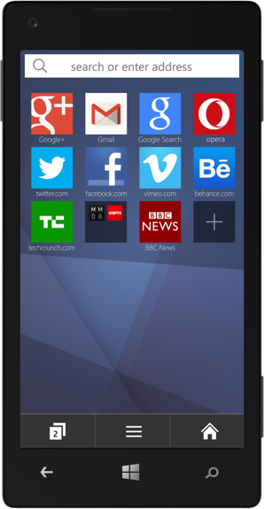
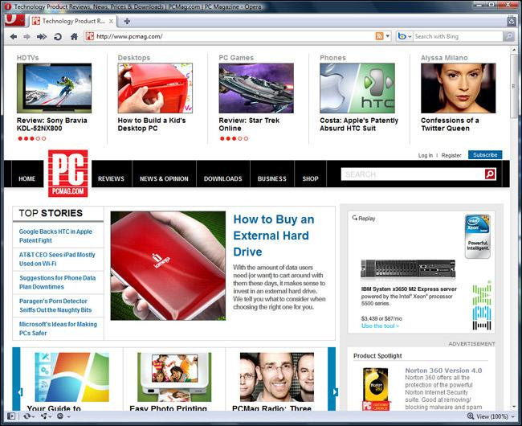




Web Browsers

Slide 4
What a Web Browser is NOT
Not a search engine.
Not an operating System.
Not email.
Not the Internet

Slide 5
Chrome (65.7%)
https://www.google.com/chrome/
Customize your Chrome
Personalize your web browser with themes, dark mode, and other options built just for you.
Browse across devices
Sign in to Chrome on any device to access your bookmarks, saved passwords, and more.
Save time with autofill
Use Chrome to save addresses, passwords, and more to quickly autofill your details.

Slide 6
Safari (17.9%)
https://www.apple.com/safari/
Built for Apple Devices
Better Privacy Controls than Chrome

Slide 7
Edge (5.3%)
https://www.microsoft.com/en-us/edge?ep=0&form=MA13M0&es=40
AI Theme Editor
AI Security Manager
Use for Gaming
Sync bookmarks and passwords across devices

Slide 8
Firefox (2.7%)
https://www.mozilla.org/en-US/firefox/
Single login
Better Privacy Controls Than Edge
Sync across devices

Slide 9
Opera (2.2%)
https://www.opera.com/
Tab Islands
Privacy better than Edge
Free VPN

Slide 10
Brave (1%)
https://brave.com/
Better Privacy than Firefox
Ad Blocking
Adherence to Web Standards

Slide 11
Internet Browsers Settings
Chrome
Safari
Edge
Firefox
Your (Profiles)
Autofill & Passwords
Privacy & Security
Performance
Appearance
Search Engine
Default Browser
On Startup
Languages
Sidebar
Downloads
Accessibility
System
Reset Settings
Extensions
General
Tabs
Autofill
Passwords
Search
Privacy
Websites
Profiles
Extensions
Advanced
Profiles
Privacy, Search
Appearance
Sidebar
Start, Home
Copy, Paste
Cookies and Permissions
Downloads
Family
Languages
Printers
System
Devices
Accessibility
General
Homepage
Search
Privacy & Security
Sync
Extensions and Themes

Slide 12
Exercise 1 – You Browser Settings
Review your browser settings.
Make changes based on your preferences.

Slide 13
Knowing Technology IV
Search Engines
http://www.profburnett.com

Slide 14
Search Engines
Google
Brave Search
MetaCrawler
Microsoft Bing
Qwant - Microsoft Bing
DuckDuckGo - Microsoft Bing
Lycos - Microsoft Bing
Yahoo! Search - Microsoft Bing
TorSearch – Dark Web
https://en.wikipedia.org/wiki/List_of_search_engines

Slide 15
Exercise 2 – You Search Engine
Review the search engine for your browser.
Make changes to the search engine you want to use based on your preferences.

Slide 16
Knowing Technology IV
Email
http://www.profburnett.com

Slide 17
Email Applications
Online (Webmail) Services
Offline Email Apps
Sending and Receiving
Reply and Reply All
Spam mail

Slide 18
Online (Webmail) Services
Apple Mail (48%)
Gmail (36%)
Outlook (Outlook.com, Hotmail.com, Live.com) (.65%)
Yahoo Mail (2.8%)
AOL Mail (Less than .01%)

Slide 19
Email Apps
Windows Email Apps
Apple Email Apps
Microsoft Outlook
Windows Mail
Thunderbird
Mailbird
eM Client
Kiwi for Gmail
Twobird
Microsoft Outlook
Apple Mail
Spark
Canary Mail
Mailspring
Mimestream

Slide 20

Exercise 3 - Email
List all the email addresses you use.
List the email services your use.
Identify the main email service you use.

Slide 21
Questions
and
Answers

Slide 22
Course Review
Intro to Internet Browsers
  Browsers
  Search Engines
  Websites
  Apps
  Printing
  Saving
Search Engines
Email Applications
  Online Email
  Offline Email Apps
  Sending and Receiving
  Reply and Reply All
  Spam mail

