Slide 1

Knowing Technology III
Smartphones
http://www.profburnett.com

Slide 2
Knowing Technology Series
(Revised)
Knowing Technology I: Your Computer
Knowing Technology II: Your Smartphone
Knowing Technology III: Networks & The Cloud
Knowing Technology IV: Internet Browsers & Your Files
Knowing Technology V: Social Media Apps
Knowing Technology VI: Digital Security
Knowing Technology VII: Digital Privacy

Slide 3
Knowing Technology III - Your Cellphone
Basic Smartphone Technology
Smartphone Terminology
Basic Smartphone Navigation
Voice Communication
  Phone Contacts
  Phone calls
  Video call
Messaging Communications
Email Communication
Sending files, photos, and videos
Apps
  Installing and Uninstalling Apps
  Camera Use
Settings
  Managing Key Smartphone Settings
  Font Sizes
  Volume and Alert Settings
Privacy and Security

Slide 4
Objectives
Understand Cellphone Technology
Understand Smartphone Terminology
Understand Basic Smartphone Navigation
Understand Basic Operations:
  Voice Calls
  Video Calls
  Messaging
  Email
Understand Apps
Understand Settings
Understand Privacy and Security

Slide 5
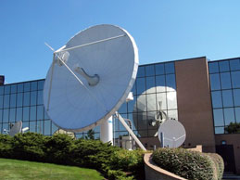
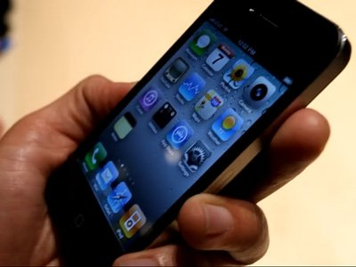
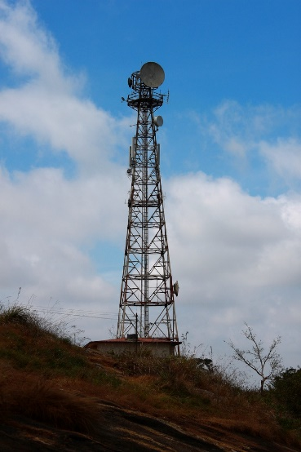
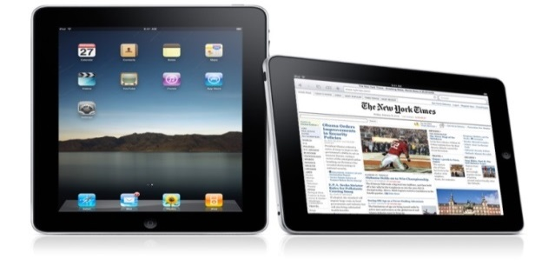
What are the Main Components of a
Cellphone Wireless Network?
Satellite Uplink
Cellphone Tower

Slide 6
Mobile Network Generations
Generation | Dates | Bandwidth | Technology | Network | Cell Site Distance
1G | 1970 - 1980 | 2 Kbps | FDMA | PTSN
2G | 1990 - 2004 | 64 Kbps | TDMA | PTSN
3G | 2004 - 2010 | 2 Mbps | CDMA (GSM) | Packet | 35 km
4G | 2010-2020 | 1 Gbps | CDMA (LTE) | Internet | 4 miles
5G | 2020 - Beyond | Higher than 1 Gbps | CDMA | Internet | See Chart

Slide 7
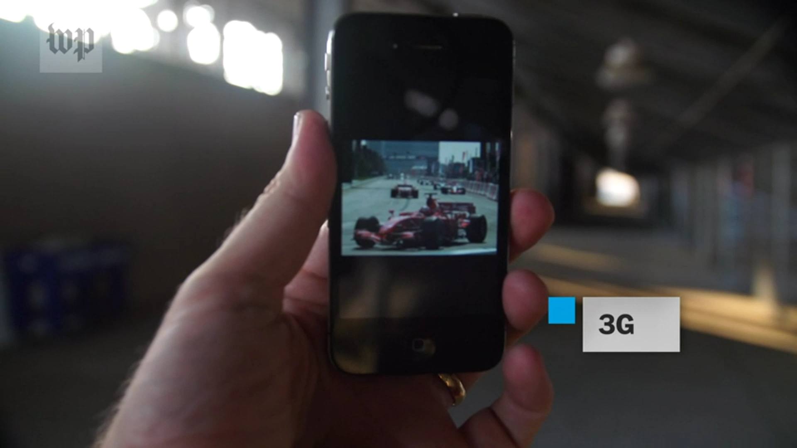

Slide 8
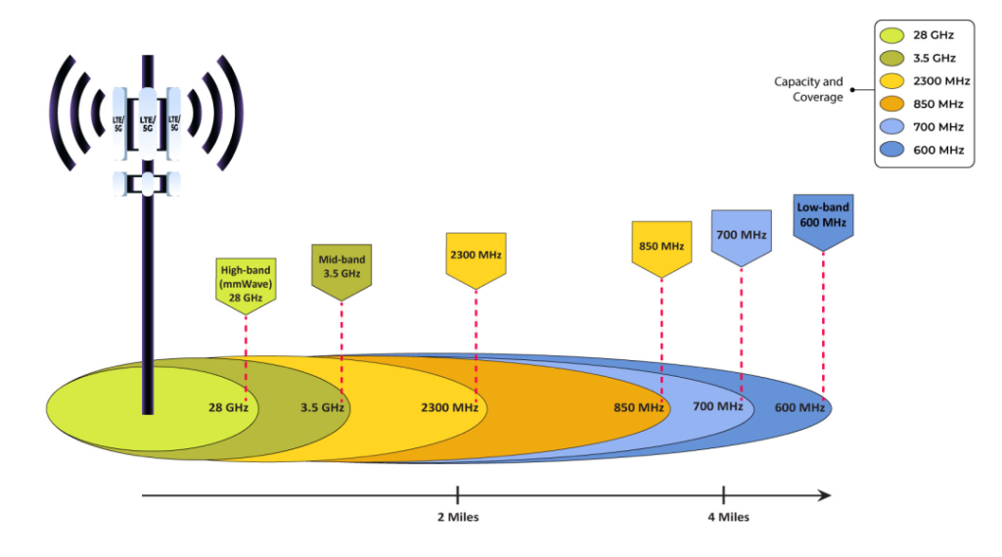
Low to High 5G Bands Distance

Slide 9
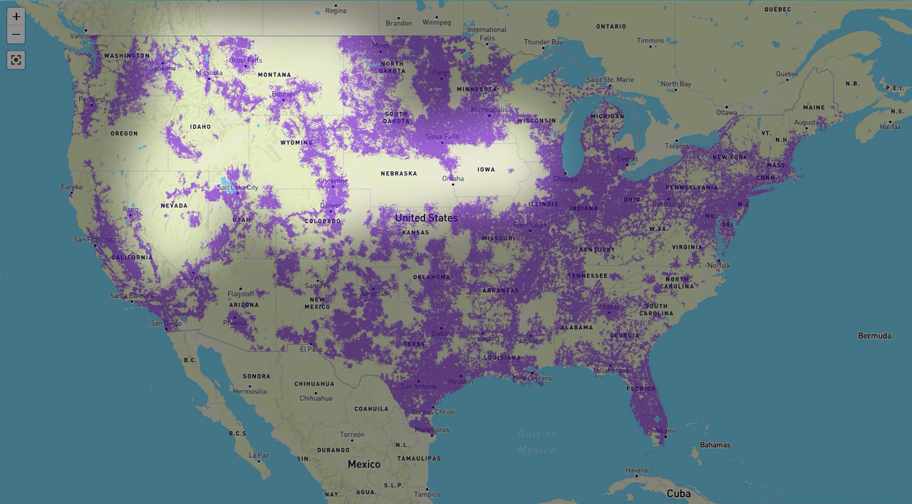

Slide 10
Smartphone Terminology
Apple - Makes iPhones and iPads
iOS – Operating System (OS) for Apple iPhones
Android – Google Operating System (OS) for other Smartphones (Samsung, Huawei, Google)
Mobile Data ($) – Data used on your cellular network (Cell Towers)
WiFi (Free) – Wireless Internet Protocol - used to connect to WiFi Internet Router
Apps (short for applications) – software programs installed on your smartphone that provide specific functionalities

Slide 11
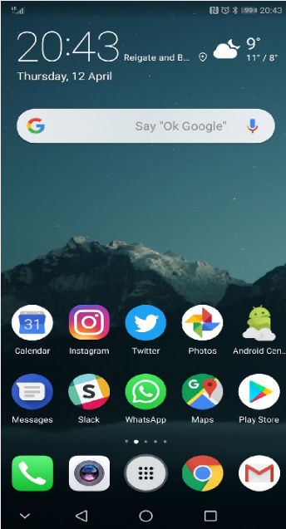

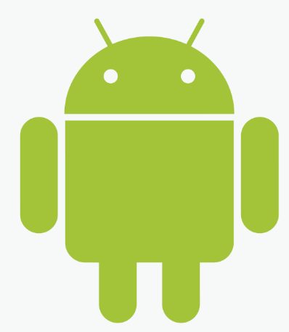

Basic Smartphone
Android
iPhone

Slide 12






Common Home Screen Elements
Name | Android Icon | iPhone Icon | Looks Like | Use
Phone |  |  | A phone | phone calls
Contacts |  |  | An avatar | View, add, edit, delete, or phone/text phone contacts
Texts |  |  | A speech bubble | View and send text messages

Slide 13


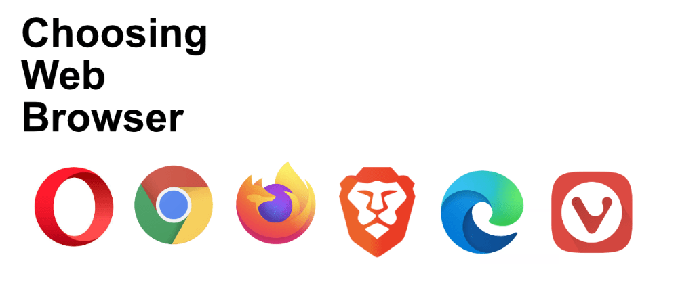
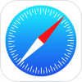


Common Home Screen Elements
Name | Android Icon | iPhone Icon | Looks Like | Use
Emails |  |  | A letter | View or send emails
Web browsers |  |  | An avatar | Browse web pages
Camera |  |  | A camera | Take photos or videos

Slide 14

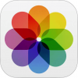

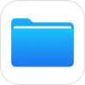


Common Home Screen Elements
Name | Android Icon | iPhone Icon | Looks Like | Use
Photos |  |  | A multi-coloured flower symbol | View, share or delete photos or videos
Files |  |  | A folder | View stored files
Google Play Store/ iPhone App Store |  |  | Play button (Android) A symbol (iOS) | Install and uninstall apps

Slide 15


Common Home Screen Elements
Name | Android Icon | iPhone Icon | Looks Like | Use
Settings |  |  | A cog, or multiple cogs | Edit phone settings, such as ringtones, wallpaper backgrounds, accounts, and more

Slide 16
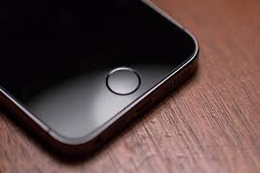
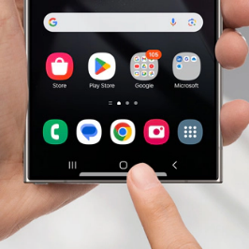
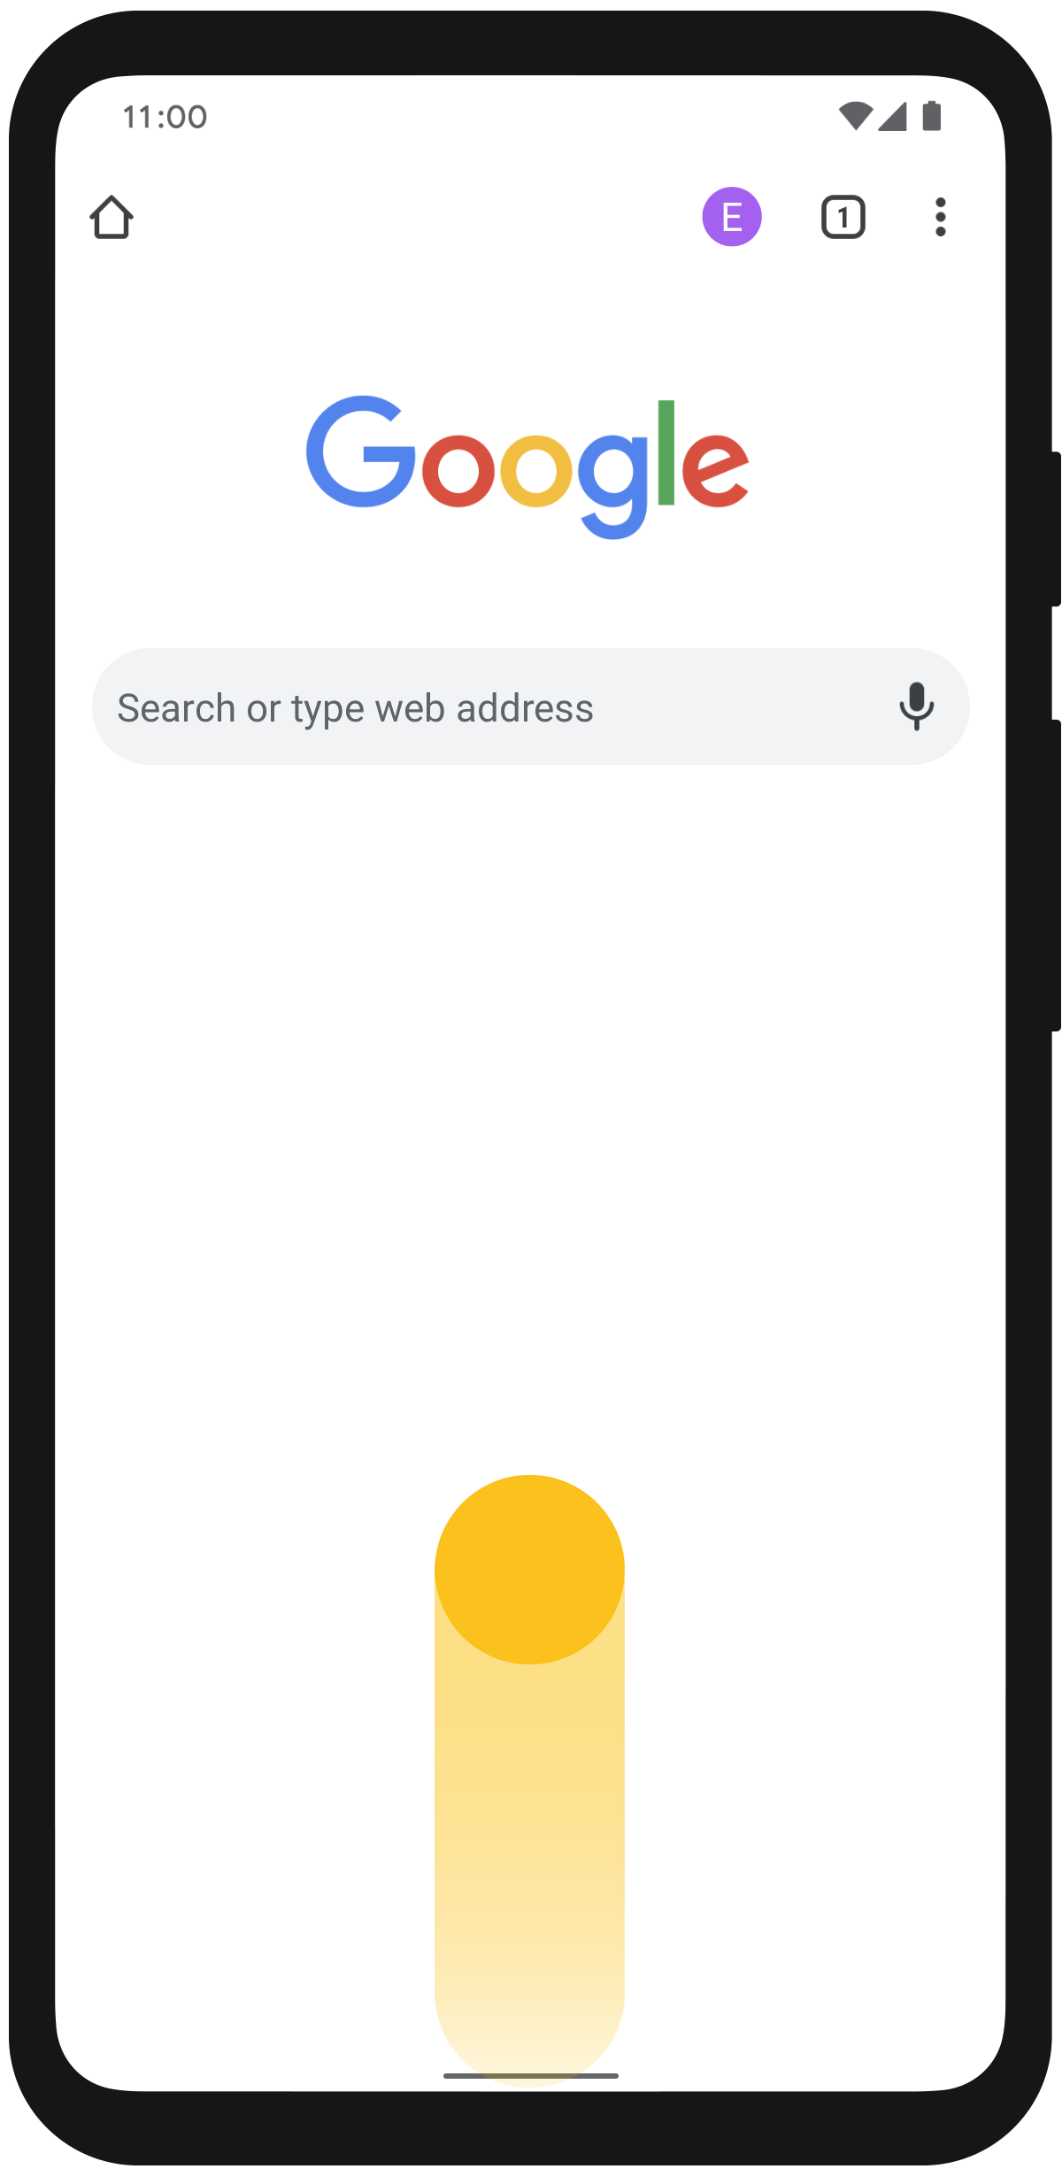
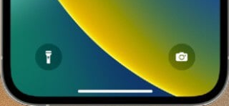
Basic Smartphone Navigation
Action | Android | iPhone | Used to | How
Home |  | Up to iPhone 8 After iPhone 8 | Return to the home screen from an app | Tap the center button at the bottom of the phone Swipe up

Slide 17
Basic Smartphone Navigation
Action | Used To | How to Use
Back | Return to the previous page in an app, or exit the app if on the first page | Tap the back arrow button, generally located on the left at the bottom of the phone

Slide 18
Basic Smartphone Navigation
Action | Used To | How to Use
View apps | Show a list of open apps and begin using a different app, or close an app | Tap the apps button, generally located on the right at the bottom of the phone OR slide your finger up the phone from the very bottom of the screen on newer devices

Slide 19
Basic Smartphone Navigation
Action | Used To | How to Use
View Notifications Drawer (Android) or Notification Centre (iOS) | View and interact with notifications such as text messages | Place your finger at the very top of the screen (top right on iOS) and slide it downwards

Slide 20
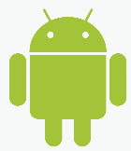
Users Guides
Android | Apple
Android Users Guide | iPhone Users Guide

Slide 21
Gestures and Commands
Android | Apple
Android Gestures and Commands | iPhone Gestures and Commands

Slide 22



Voice Communication
Android | Apple
Open your phone's Phone app. Pick who to call: To enter a number, tap Dialpad To pick a saved contact, tap Contacts We may show you suggested contacts to call based on your call history. To pick from numbers you’ve recently called, tap Recents To pick from contacts saved to Favorites, tap Favorites Tap Call . When you’re done with the call, tap End call If your call is minimized, drag the call bubble to the bottom right of the screen. | Making a Call on iPhone

Slide 23
Messaging
SMS – Short Messaging Services
RCS - Rich Communication Services

Slide 24
SMS – Short Messaging Services
Relies on GSM Protocols
224-character limit
No encryption
Upgraded to Multimedia Messaging Service (MMS) using General Packet Radio Service - (GPRS) (TCP/IP)

Slide 25
RCS - Rich Communication Services
Feature-rich multimedia services – Pictures, Video
No character limit
End-to-End TLS Encryption
Uses Cellular Network or WiFI

Slide 26
RCS Adoption
Android: Default – Google Messages
iOS: Built into iOS 18 (Nov 2024)
Verizon
  Shutdown SMS in Nov 2024 – Move to Google Messages
  Privacy and Data Cap Issues
AT&T: SMS Ends Dec 2024
T-Mobile:
  No Date on Service Cutoff
  Device Dependent

Slide 27
Messaging
Android | Apple
Messaging App on Your Phone Google Messages | iPhone Messaging

Slide 28
Private Apps
WhatApp (Meta)
Facebook Messenger
WeChat (China)
Viber (Japan)
Google Messages
Telegram (Russian)
Snapchat
Line (Google)
Discord
Kakao Talk
Signal

Slide 29
Backing up your messages on Android
https://www.androidpolice.com/back-up-android-text-sms-messages/
https://guidebooks.google.com/android/getstarted/backupyourmessages

Slide 30
Email Communication
Android | Apple
Getting Started with Email Getting Started with the Gmail App | Set up mail, contacts, and calendar accounts on iPhone

Slide 31
Sending files, photos, and videos
Android | Apple
Share Files & Links | Files Basics Get started with Photos and Videos on iPhone

Slide 32
Apps
Android | Apple
How to Use Apps on Android Phone | App Store on iPhone

Slide 33
Settings
Android | Apple
Change Settings & Permissions | iPhone Settings

Slide 34
Privacy and Security
Android | Apple
Keep Your Google Account Secure | iPhone Privacy & Security

Slide 35
Questions
and
Answers

Slide 36
Review
Understand Cellphone Technology
Understand Smartphone Terminology
Understand Basic Smartphone Navigation
Understand Basic Operations:
  Voice Calls
  Video Calls
  Messaging
  Email
Understand Apps
Understand Settings
Understand Privacy and Security

