Slide 1

Knowing Technology II
File Management
http://www.profburnett.com

Slide 2
Session 2 – File Management
File Management Principles
File Naming Conventions
File Types and Formats
Version Control
Data Storage and Backup
Local Storage Management
Remote (Cloud) Storage Management

Slide 3
File Management Principles
Plan early
Write it down
Make it logical - organize projects by
  Time period
  Researcher/project staff
  File type or function
  Location
  Research activity or experiment
  Specimen
  Or some other way your data and files naturally group together.
Follow it consistently
Avoid encoding information in the directory structure

Slide 4
Exercise 1
List all the devices your store data on.
Remember?
  Separate Devices
  Online Storage

Slide 5
Exercise 1 - List of Devices and Services
Storage Devices | Online Storage Services

Slide 6
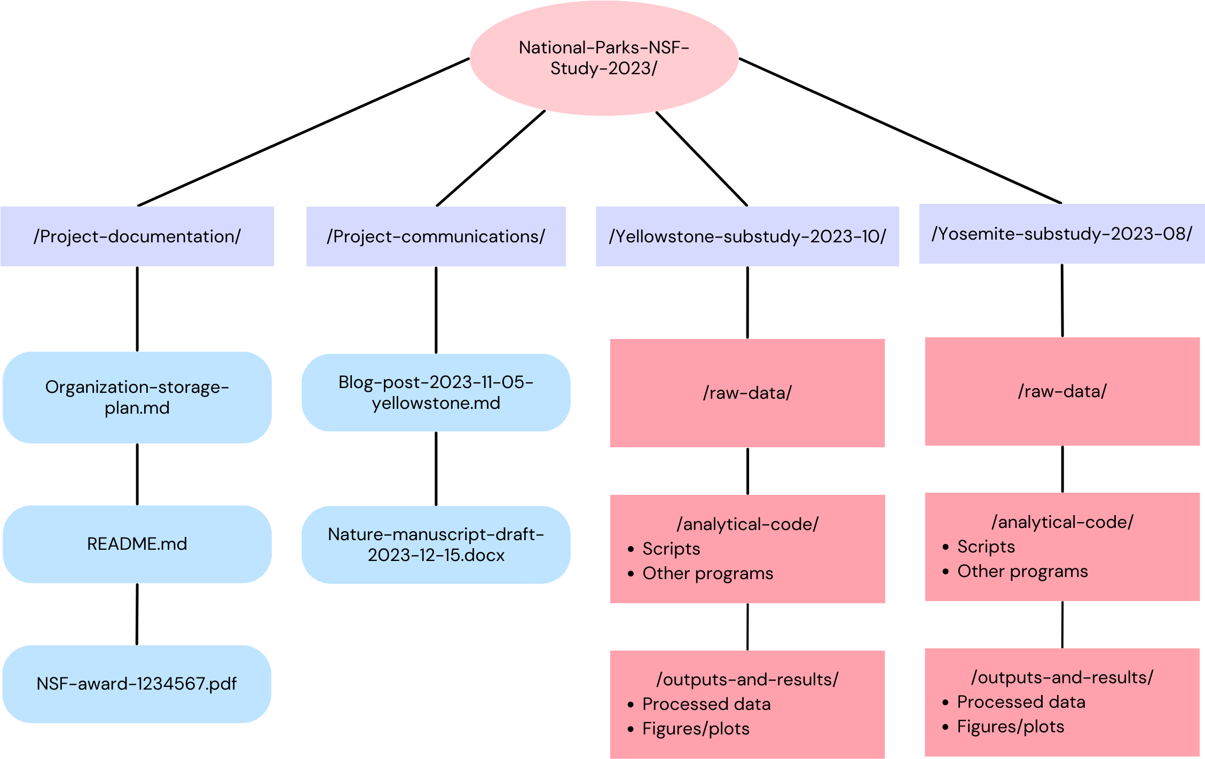
Example Directory Structure

Slide 7
Exercise 2
Develop a file structure for your files on each device or service.

Slide 8
Exercise 2 – Directory Structure for Devices and Services
Storage Devices | Directory Structure | Online Storage Services | Directory Structure

Slide 9
File Naming Conventions
Attributes and information to include:
  Date and time
  Name
  Data type
  Version number and/or status
  Data location
  Version Number

Slide 10
File Naming Conventions
Be consistent with naming.
Be consistent with case (lower case, UPPER CASE, or CamelCase).
Avoid spaces and special characters - Use only letters, numbers, and underscores or dashes.
Use a date format: YYYY-MM-DD or YYYYMMDD - it will sort chronologically.
Pad with zeroes: - If you expect at least e.g. 100 numbered files, start with 001, not 1.
Limit Filename to 32 characters.
Avoid vague terms

Slide 11


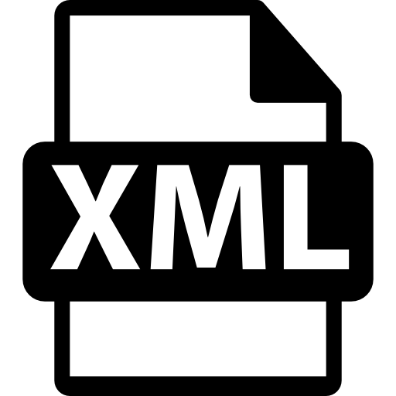






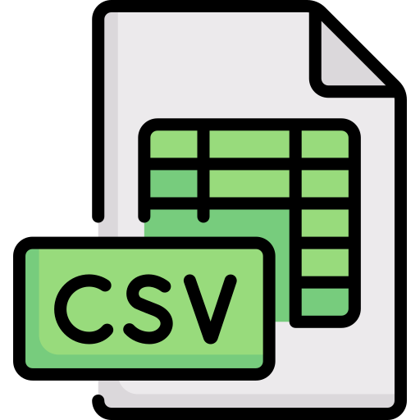


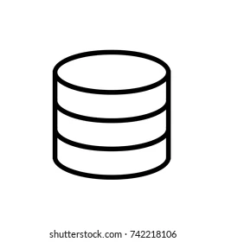


File Types and Formats
File Type | File Extension | File Icon
Plain Text, Rich Text | .txt, .rtf
xTensible Markup Language (XML) | .xml
Hyper Test Markup Language (HTML) | .htm, .html
Portable Document Format (PDF) | .pdf
Raster image | .tiff, .jpg .jpeg, .png
Vector image (SVG) | .svg
Tabular Data | .csv, .tsv. json
Database | .db, db3, SQLite

Slide 12

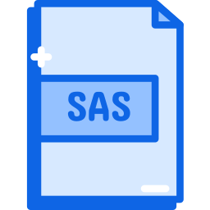



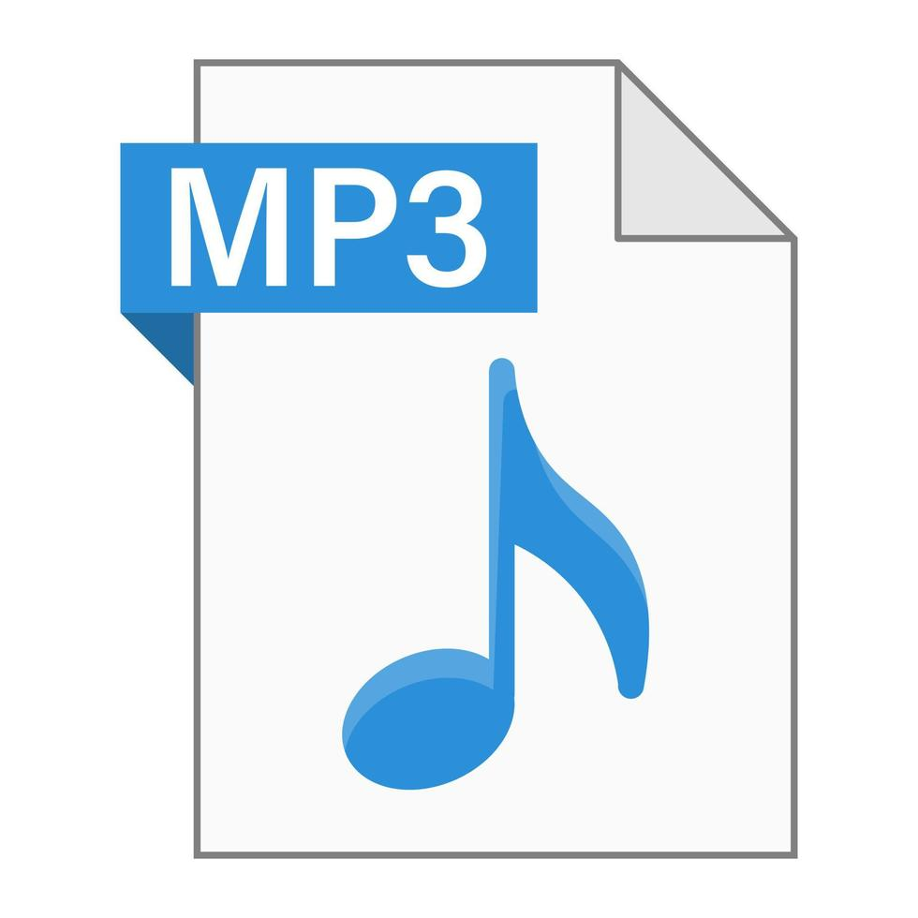









File Types and Formats
File Type | File Extension | File Icon
Statistical | .R, .Rmd, .Rdata, .por, .do, .dta, .sas
Geospatial | ESRI shapefiles, GML, NetCDF, GeoTIFF, GeoJSON
Audio | FLAC, WAV, AIFF, MP3
Video/Moving image: | MPEG-4, MOV, AVI, MXF
Code: | .py, .c, .cpp, .java, .js, .php

Slide 13
Version Control
Manually
File sharing platforms
Repository hosting platforms
Version control software
Electronic lab notebooks

Slide 14
Exercise 3
Develop a file naming convention that includes version control for each device or service.

Slide 15
Exercise 3 – File Naming for Devices and Services
Storage Devices | File Naming | Online Storage Services | File Naming

Slide 16
Data Storage and Backup
Store data files securely.
Regularly maintain backup copies in at least three locations
Consider individual storage vs. group storage.
Consider storage capacity.

Slide 17
Data Storage Questions
Control | How will you control access to keep the data secure? How will you ensure that collaborators can access your data securely? If creating, or collecting data in the field, how will you ensure its safe transfer into your main secured systems?
Sensitivity | Does your data contain personal information? Do you have an institutional review requirement? Are there a university data protection standards to provide protection guidance for highly sensitive data, sensitive data, internal use data, and public data.
Backup | How will the data be backed up? How much drive space or CDs or DVDs will be required to maintain a backup schedule? Who will be responsible for backup and recovery? How will data be recovered in the event of an incident? How long will your backups be stored?
Storage | How much data do you need to store? 5 megabytes (MB)? 5 gigabytes (GB)? 5 terabytes (TB)? Do you have enough storage, or will you need to include charges for additional services?

Slide 18
Local Storage Management
Local storage is either on a particular device or on a server that manages all office devices.
Pros of Local Storage
  Person/Organization has complete control over its data.
  Faster data access compared to cloud storage.
  No internet connection needed.
  Potential lower costs.
Cons of Local Storage
  May have limited capacity.
  More prone to data loss due to the lack of automatic backups.
  Data can also become more isolated with local storage, creating data silos and conflicting versions of the same file.

Slide 19
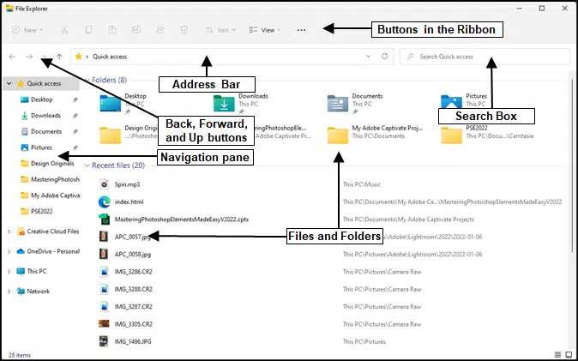
File Management on a PC
Windows 11
File Explorer

Slide 20
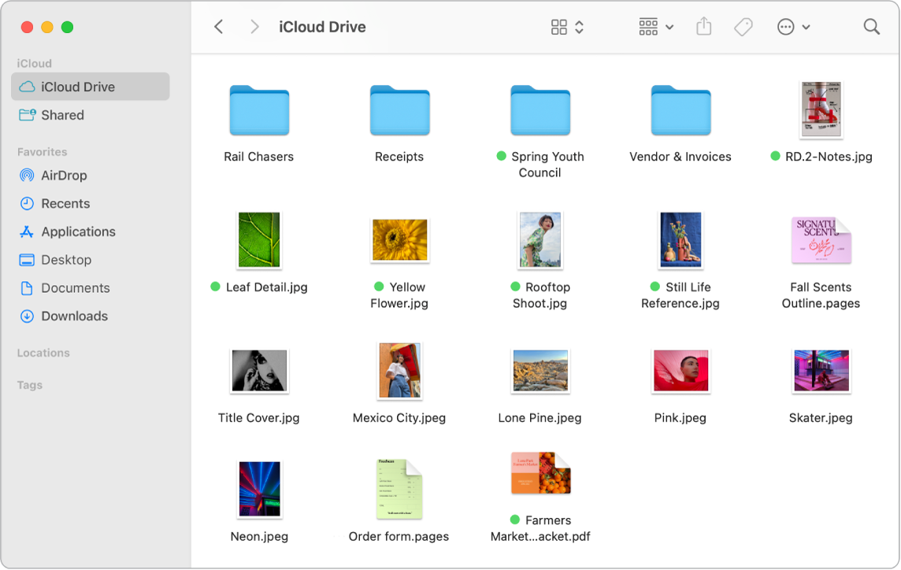
File Management on a MAC
Mac
Finder

Slide 21
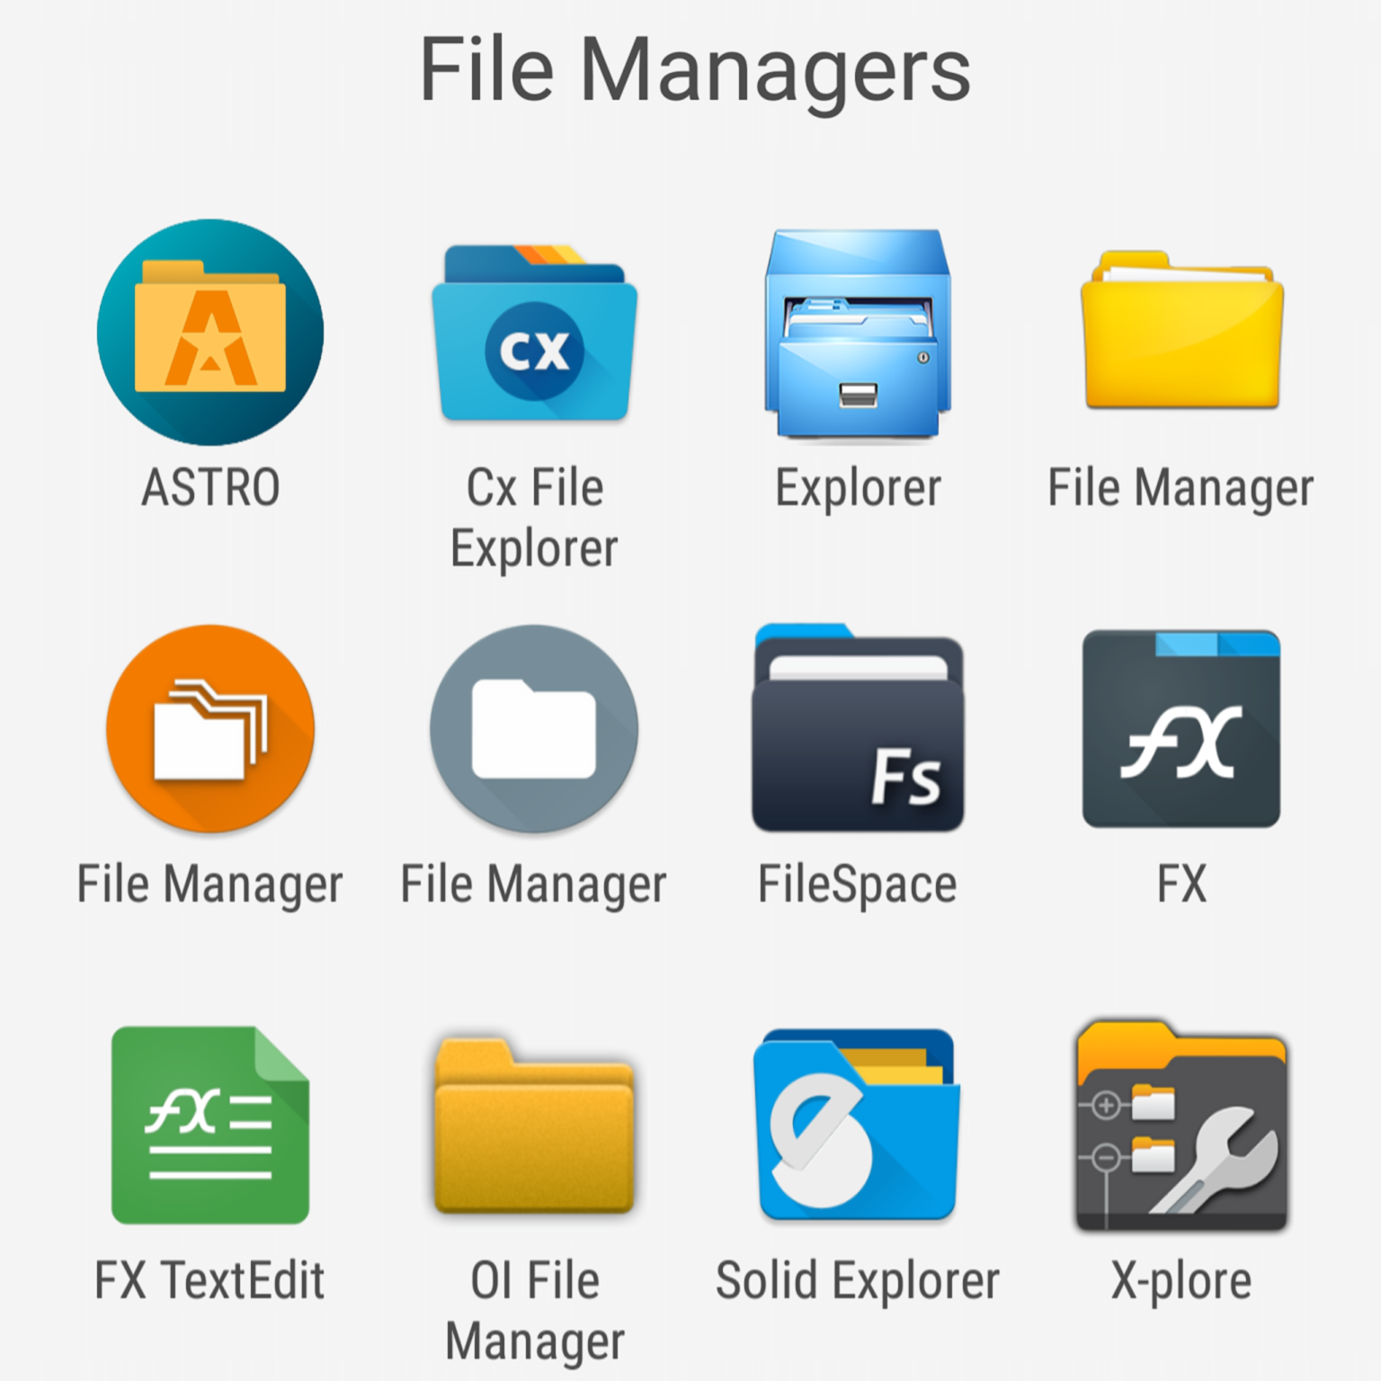
File Management on an Android
Android
File
Managers

Slide 22
Remote (Cloud) Storage Management
Cloud storage allows organizations to store their data with a cloud storage provider, which provides easy access to data online from remote servers.
Because of its flexible nature, cloud storage offers benefits that include scalability, accessibility, and cost-effectiveness.
Pros of Cloud Storage
  Compared to traditional local data storage methods, cloud storage is highly scalable.
  One key benefit of cloud storage is its improved accessibility, which enables greater collaboration.
  Cloud storage can be a key piece of business continuity planning as well.
  Built-in redundancy with data replicated across multiple servers, often in geographically distinct locations.
Cons of Cloud Storage
  Cloud storage relies on an internet connection for access, and particularly synchronization.
  Storage in the cloud is often more cost-effective than local storage.
  Cloud providers cover some security measures, while others are the customer’s responsibility.

Slide 23












Cloud Storage Management
Google Drive | Microsoft OneDrive | Dropbox
iCloud | IDrive | Box
pCloud | Sync.com | Mega
AWS Storage Gateway | Icedrive

Slide 24
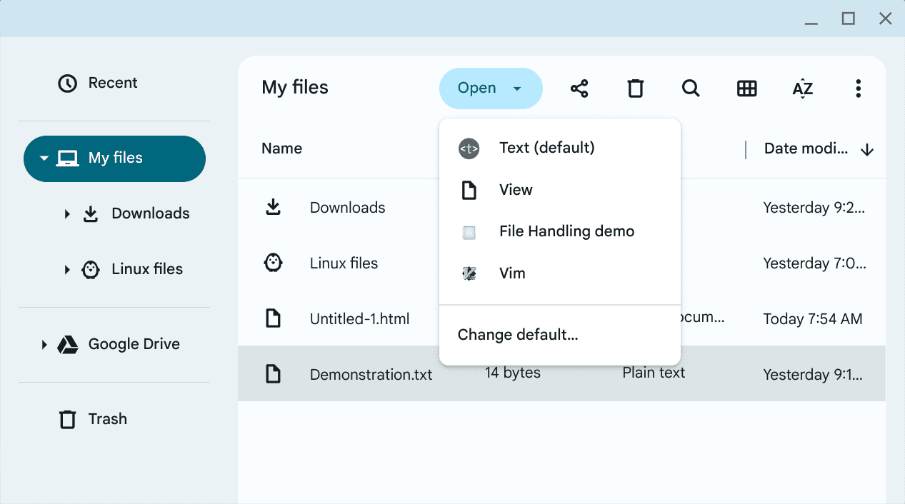
File Management on a Chromebook

Slide 25
Exercise 3
Identify where you will back up your files for each device or service.

Slide 26
Exercise 4 – Backup location for Devices and Services
Storage Devices | Backup location | Online Storage Services | Backup location

Slide 27
Questions
and
Answers

Slide 28
Session 2 Review
File Management Principles
File Naming Conventions
File Types and Formats
Version Control
Data Storage and Backup
Local Storage Management
Remote (Cloud) Storage Management

