Slide 1

Knowing Technology III
Networks
http://www.profburnett.com

Slide 2


Slide 3
Outline
Knowing Technology II - Your Networks, WWW, and
Internet of Things
What is a Digital Network?
What are Telecommunication Services?
What are the Main Components of a Wired (Landline) Telephone Network?
What are the Main Components of a Cellphone Wireless Network?
What are the Main Components of a Wired CATV Television Network?
What are Data Telecommunication Services?
What are the Main Components of a Wired Digital Network?
What are the Main Components of an IP Wireless Network?
Bluetooth Wireless Networks
Radio Telecommunication Services
Digital Convergence
What is the Internet?
What is the World Wide Web?
What is the IoT?
Questions & Answers

Slide 4
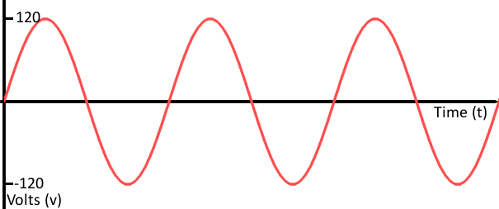
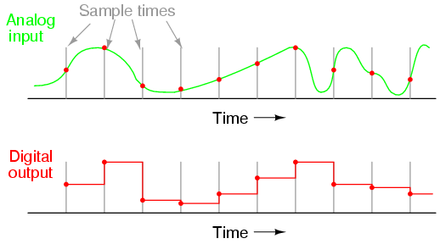
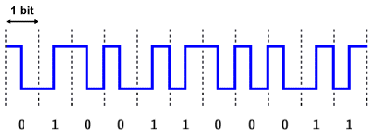
What is a Digital Network?
Analog versus Digital
Telephone Network
Television Network
Mobile Phone Network
Data Network
Radio Network
Satellite Network

Slide 5
What are Telecommunication Services?
Telecommunication Services are services provided by a telecommunication service provider.
Consumer telecommunication services include:
  POTS Phone
  Cellphone Services
  Television
  Data – IP Network
    Internet
    Security – Perimeter / Fire
    Utilities – Electric & Water
    Health Care – Remote Monitoring / Emergency Notification
  Radio
  Satellite
  GPS

Slide 6
Phone Telecommunication Services
Wired Telecommunication Services
  Plain Old Telephone Service (POTS)
  Integrated Services Digital Network (ISDN)
  Data over Cable Systems (DOCSIS)
  Internet Protocol (IP) Network
Wireless Telephone Services (Mobile)
  Wireless Cellular Network (1G – 5G)
Voice Over the Internet Protocol (VOIP)

Slide 7

Voice Over the Internet Protocol (VOIP)

Slide 8
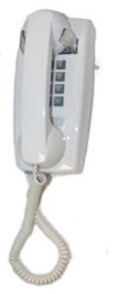
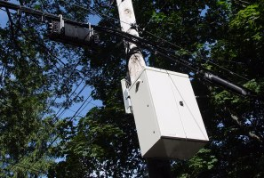
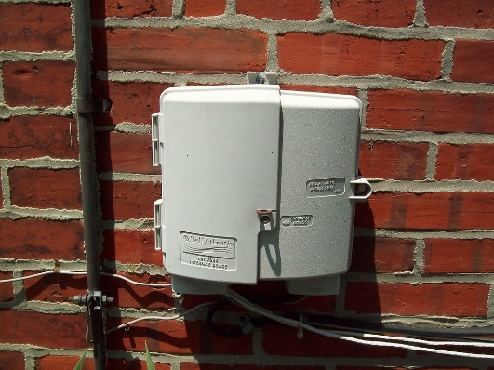
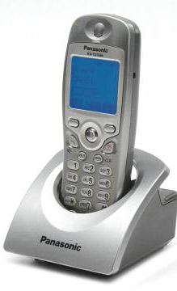
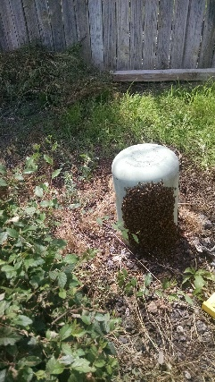
What are the Main Components of a
Wired (Landline) Telephone Network?
FIOS Hub
Telephone
Handsets
Telephone Network
Interface Box
Comcast Cable Hub

Slide 9
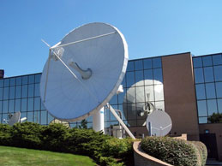
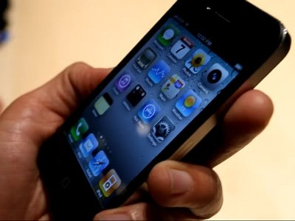
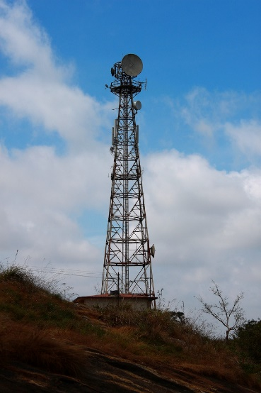
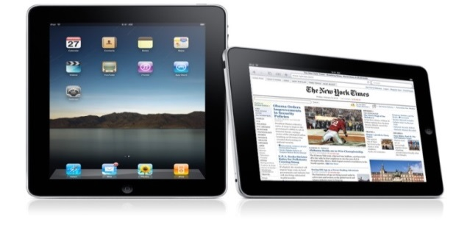
What are the Main Components of a
Cellphone Wireless Network?
Satellite Uplink
Cellphone Tower

Slide 10
Television Telecommunication Services
Broadcast Television
  Standard Definition – SDTV (Shutdown in 2009)
  Digital Television – DTV
  High Definition Television - HDTV
Cable Television Services – Digital Television (DTV / HDTV)
Satellite Television Services - Digital Television (DTV / HDTV)
Streaming Internet Television Services
  Digital Television (DTV / HDTV)
  Internet Protocol Television - IPTV

Slide 11
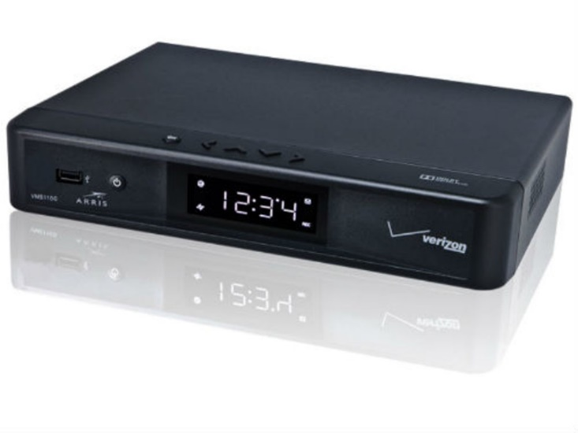
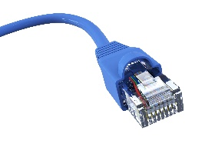
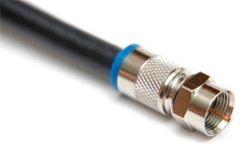
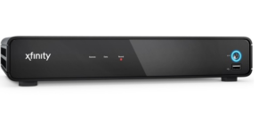
What are the Main Components of a
Wired CATV Television Network?
Cable
FIOS Hub
CATV Network
Interface Box
Comcast Cable Hub

Slide 12
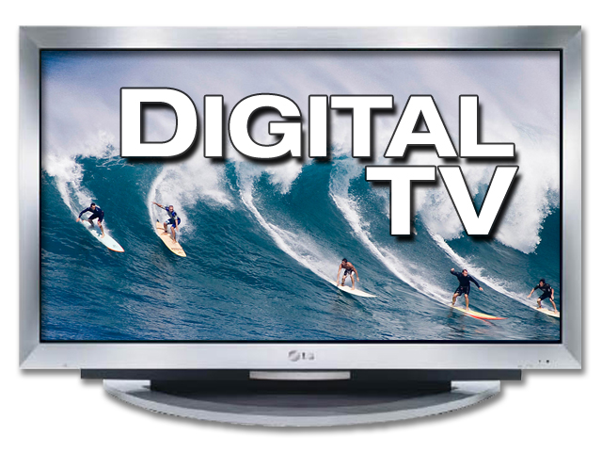
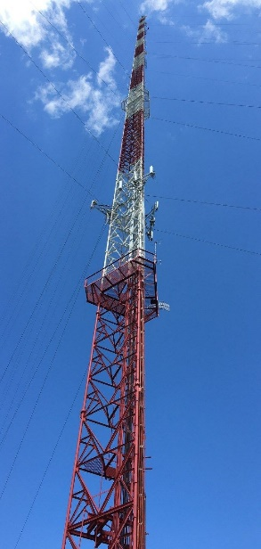
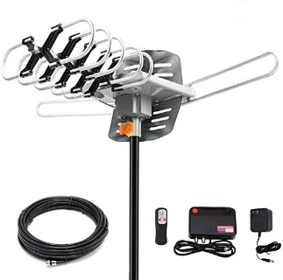
What are the Main Components of a
Digital Broadcast Television Network?
Directional DTV
Antenna
DTV Broadcast
Tower

Slide 13
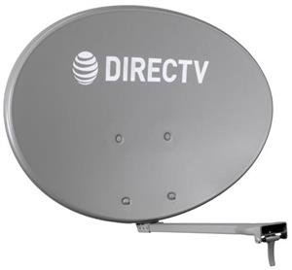
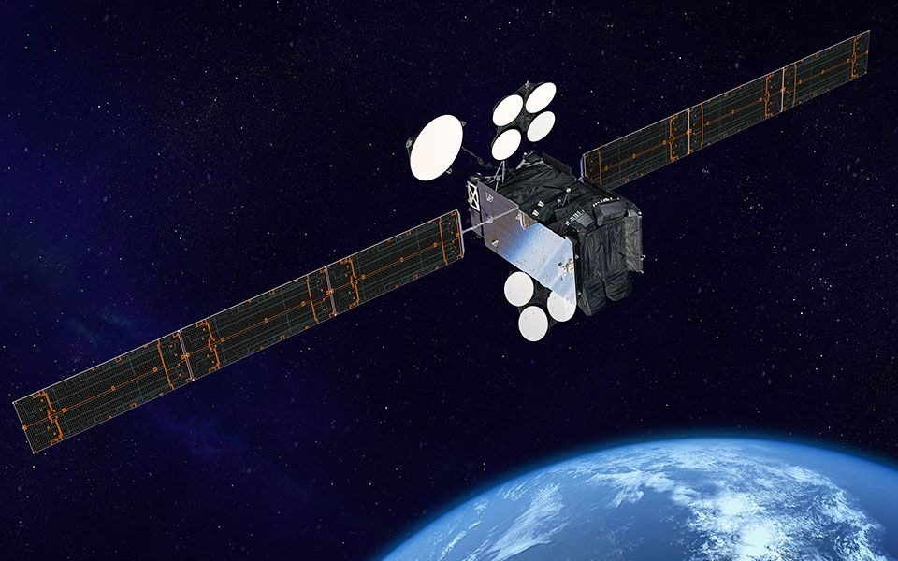
Satellite Television Network

Slide 14



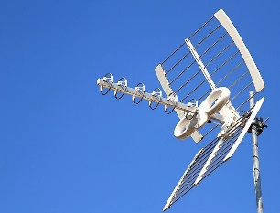


How to Access
Alternate Television Stations
OTT Streaming Media Devices
Digital Broadcast
Amazon Fire
Roku
DMV – 108 Channels
ChromeCast
Nvidia Shield
Apple TV
Online Sites

Slide 15
Data Telecommunication Services
Wireless IP Network (WiFi / WiMAX / WiBro / Bluetooth)
Internet Services (Comcast/Fios/Cox)
Home Energy Monitoring Services
Home Alarm Services
Home Emergency Health Care Monitoring Services
SMART Home Technology

Slide 16
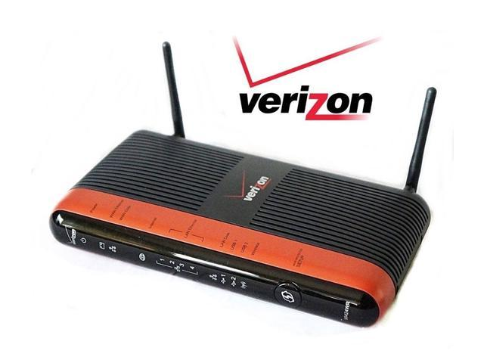
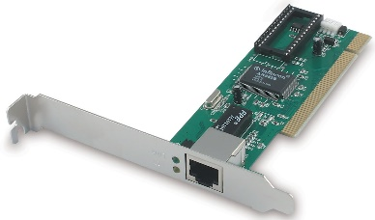

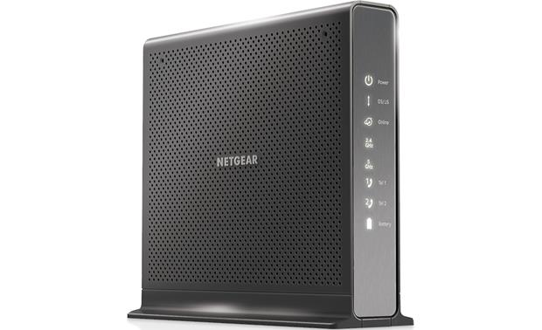
What are the Main Components of a
Wired Digital Network?
Network Interface Card
(NIC)
Verizon Router
Ethernet Cable
>100Mb
Comcast Cable Hub
Ethernet Cable
Coax Cable
Comcast Modem
IP Network
Interface Box
FIOS Hub

Slide 17
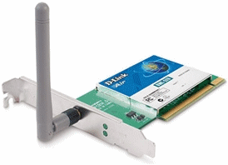
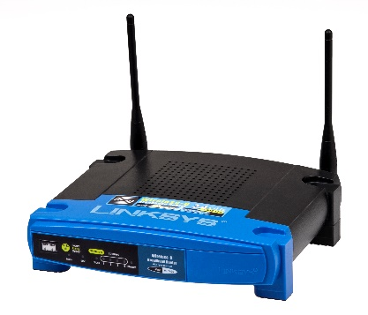
What are the Main Components of a
IP Wireless Network?
Fios Ethernet Cable
Wireless Network
Interface Card
(NIC)
Wireless Router
Cable Hub
IP Network
Interface Box
Comcast Modem
Comcast Coax Cable
FIOS Hub

Slide 18
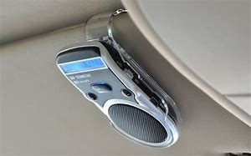

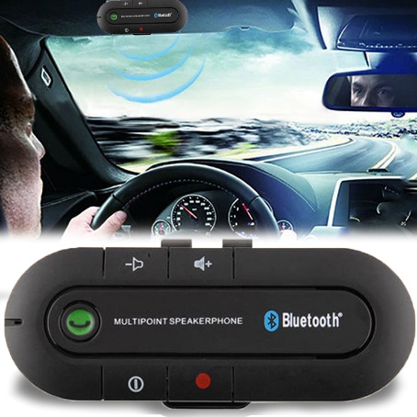
Bluetooth Wireless Networks

Slide 19


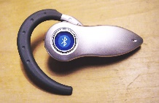
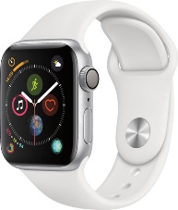

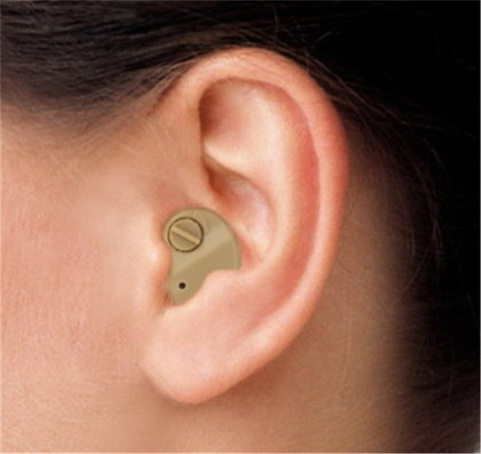
What is the difference between
PAN – Wireless – Mobile Network?
Mobile Wireless Network
Personal Area Network
(PAN - Bluetooth)
Computer Wireless Network
(WiFi)
Wireless Router
Comcast Cable Hub
Cellphone Area Coverage
449 / 618 / 2,269 / 7,521 Km
Area Coverage
115 Ft. / 35 M
Area Coverage
33 Ft. /10 M
FIOS Hub

Slide 20
Radio Telecommunication Services
Broadcast Radio
Terrestrial Digital Radio Broadcasting
  Digital Audio Broadcasting
Satellite Radio Services
  Sirius XM Satellite Radio.

Slide 21
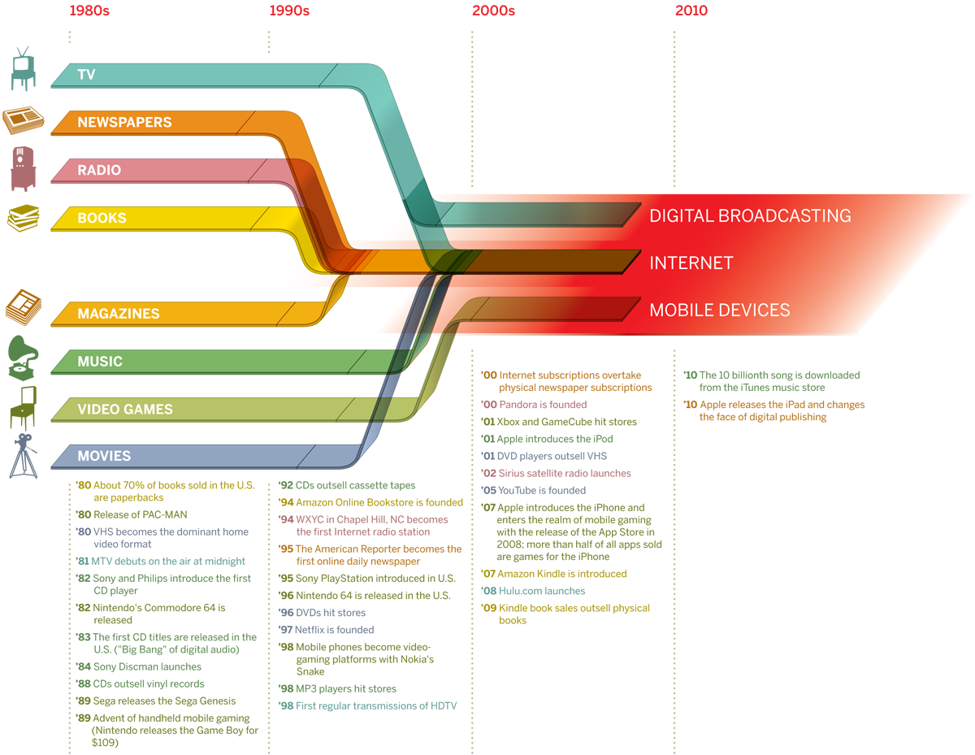
Digital Convergence

Slide 22
Student Exercise 1
List the digital telecommunication devices your interact with daily.
List the primary telecommunication device you use?
How do your telecommunication devices connect to a network.
(Wired, WiFi, or Mobile)

Slide 23

What is the Internet?
WANs
WANs
WANs
MANs
MANs
CANs
CANs
CANs
LANs
LANs
LANs
LANs
LANs
LANs
LANs
LANs
LANs

Slide 24
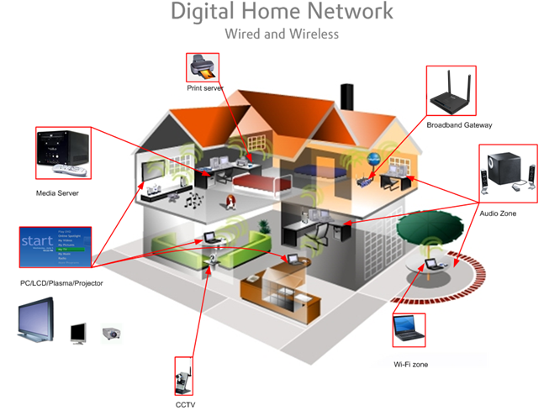
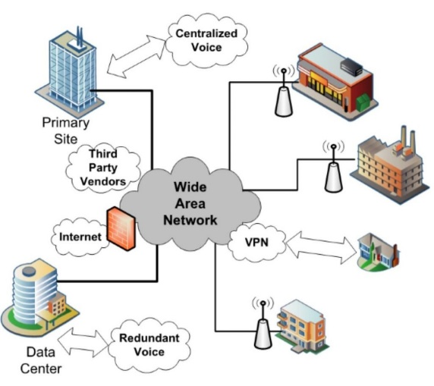
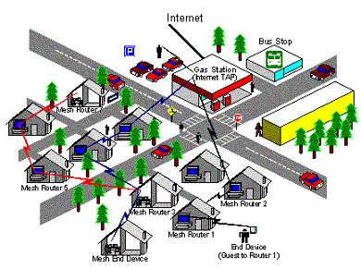
Your Internet
MAN / WAN
https://www.internetexchangemap.com/
CAN / MAN
PAN / LAN / CAN

Slide 25

What is the World Wide Web?

Slide 26


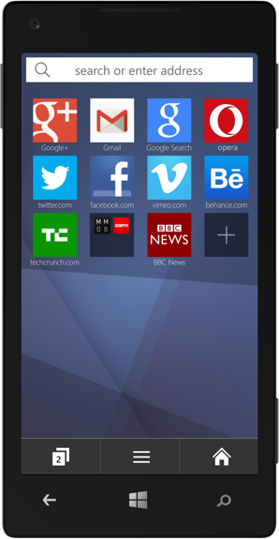
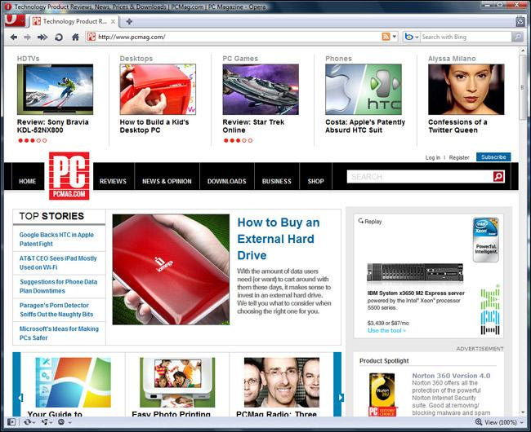





What is the World Wide Web?

Slide 27
How Do People Use the Worlds Wide Web?
Surf
Online Apps
  Text Messaging
  Email
  Netflix
  Hulu
  Google
  Facebook
  YouTube
  Wikipedia
  Amazon
  Yahoo
  MS Office 365
  Skype

Slide 28
Student Exercise 2
How is your main telecommunication devices configured to use the World Wide Web (WWW)?
What Browser do you use?
How does your device manage files?
What apps do you use?

Slide 29



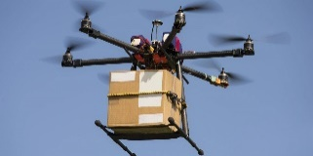

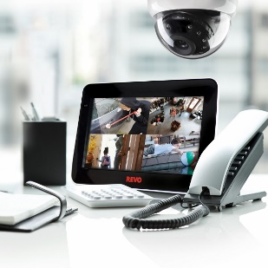

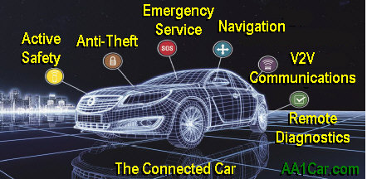



What is the IoT?
Internet
of
Things

Slide 30
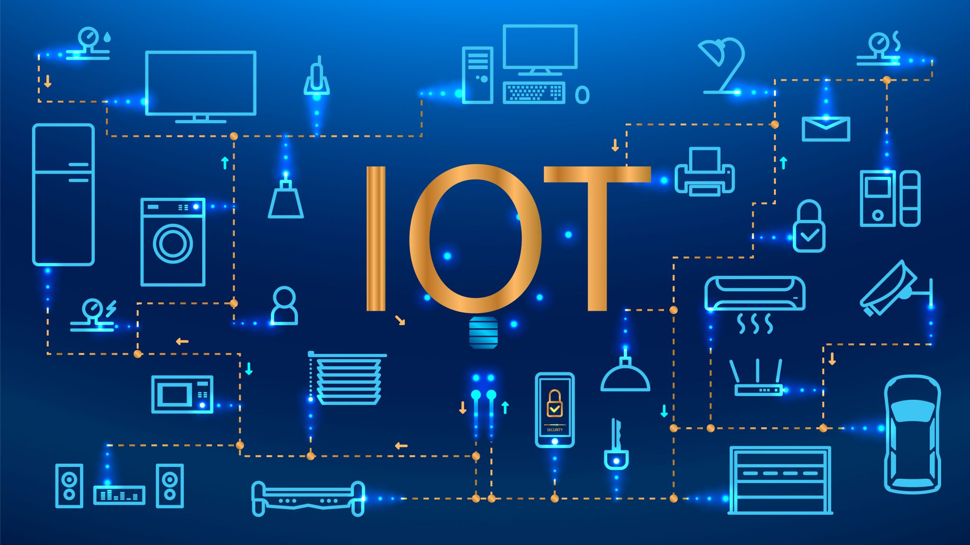

Slide 31
Questions
and
Answers

Slide 32
Review
Knowing Technology II - Your Networks, WWW, and
Internet of Things
What is a Digital Network?
What are Telecommunication Services?
What are the Main Components of a Wired (Landline) Telephone Network?
What are the Main Components of a Cellphone Wireless Network?
Cellular Messaging
What are the Main Components of a Wired CATV Television Network?
What are Data Telecommunication Services?
What are the Main Components of a Wired Digital Network?
What are the Main Components of an IP Wireless Network?
Bluetooth Wireless Networks
Radio Telecommunication Services
Digital Convergence
What is the Internet?
What is the World Wide Web?
What is the IoT?
Questions & Answers

