Slide 1
2027 Senior Cybersecurity Awareness
http://www.profburnett.com
Embrace AI / Master Your Future

Slide 2

Stay Safe Online
2027 • THREE-HOUR COMMUNITY CLASS
Cybersecurity Awareness
for Older Adults
Real examples • Short videos • Practice •
Take-home actions
Notes:
Welcome participants. Speak slowly; repeat key safety habits. 2027 is a forward-looking teaching year. All statistics reflect 2025 official data, published by October 2026. Use accessible seating, microphones and closed captions.

Slide 3
What you will be able to do
OUR LEARNING GOALS
SPOT
VERIFY
Recognize a scam message, call or fake website.
Reach the real person or organization independently.
PROTECT
RESPOND
Use settings that protect accounts, devices and money.
Know where to get help if something happens.
Notes:
Ask for a show of hands: who has seen a suspicious text in the past month? No one needs to share personal losses. (Opening, part of 10 minutes)

Slide 4
No Shame. No Panic. No Pressure.
HOW WE LEARN
Scammers use practiced scripts and convincing technology. They can fool anyone.
In this room, the safest response is always:
“I will check before I act.”
KEEP YOUR QUESTIONS • SKIP PERSONAL DETAILS
Notes:
Set privacy ground rule: no one should say passwords, financial information, names, phone numbers, or sensitive personal stories aloud. We are practicing, not testing.

Slide 5
A serious problem—and we can respond
WHAT THE DATA SHOW
$7.75B
201,266
2025 internet-crime losses
reported by adults 60+
2025 internet-crime
complaints from adults 60+
These are 2025 FBI IC3 reports—not a forecast of 2027 losses.
Notes:
Source: https://www.ic3.gov/AnnualReport/Reports/2025_IC3Report.pdf , elder fraud section, published in 2026. These figures are reported complaints and reported dollar losses, not a national census of all fraud. Emphasize that older adults are effective at spotting fraud and more often report no-loss incidents.

Slide 6
The scammer’s playbook
RECOGNIZE THE PATTERN
1
2
3
4
CONTACT
EMOTION
PRESSURE
TRANSFER
A call, ad, link, message
Fear, excitement or love
“Act now. Don’t tell anyone.”
Money, credentials or access
BREAK THE CHAIN: pause and verify before step 4.
Notes:
Explain that scammers are not only using technical hacks. The human decision point is often the weakest link; a pause can prevent loss. Invite learners to identify the pressure step in any example shown today.

Slide 7
What could become more convincing?
2027 RISK OUTLOOK
AI imitation
Voices, images and messages easier to imitate
Cross-channel scams
Text → phone call → fake website
Fake search results
Sponsored links and cloned service pages
Payment pressure
Crypto kiosks, wires, gift cards, couriers
Scenario-based outlook, not measured 2027 results
Notes:
This is a projection / planning outlook for the 2027 classroom. Do not claim these trends are new 2027 data. Use 2025-2026 agency findings to motivate defensive habits.

Slide 8
180 minutes: Watch | Learn | Practice
YOUR CLASS ROAD MAP
00–10
Welcome, Goals and Risk Overview
10–58
Topics 1 – 4: Email, Browsers Privacy, Device Viruses, Malware,
58–68
10-minute break
68–116
Topics 5 – 6: Passwords, Accounts
116–134
Topics 7 - 9: Text Messaging, AI Fakes, Call Scams
134–144
10-minute break
144–150
Topics 10 - 14: Fake Tech Support, E-Commerce, Identity Theft
150–164
Topic 15 – Recovery, Reporting
164–180
Seven-day Action Plan
Notes:
Pacing: 10-minute introduction; topics 1-4 at 12 minutes each; a 10-minute break; topics 5-8 at 12 minutes each; topic 9 at 18 minutes; topic 10 dedicated device malware protection at 16 minutes; topic 11 recovery at 14 minutes; closing 16 minutes. Total = 180 minutes. Video slides use short excerpts, usually 1-3 minutes, and captions; do not play full long interviews/podcasts unless time allows.

Slide 9







Email Cyber Threats
TOPIC 1 OF 15
1
Stop using these Free
Email Systems
Using these Paid Email Systems
Microsoft Outlook
Free Gmail

Slide 10
Brower Cyber Threats
TOPIC 2 OF 15
2
Configure Privacy Controls
on these Internet Browsers
Google Chrome
Microsoft Edge
Safari
Samsung
Android Browsers
Use these Privacy Enabled
Internet Browsers
Firefox
Brave
Comet
Tor

Slide 11
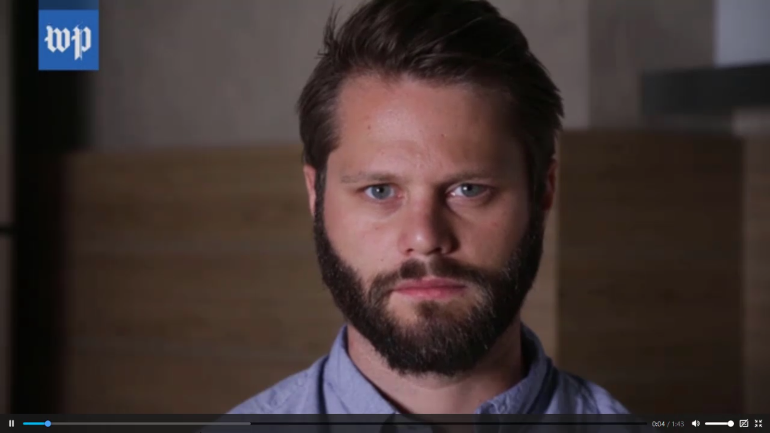
Privacy Controls

Slide 12
Privacy Controls
Google Chrome
Microsoft Edge
Apple Safari
Samsung
Android Browsers
Firefox
Brave
Comet
Tor
Facebook
Twitter
Google
Microsoft
Apple
LinkedIn
Yahoo
Amazon
TV’s – STB
  Comcast
  Verizon
  Verizon Email (See Yahoo)
Cellphone Providers
  AT&T
  T-Mobile
  Sprint
WiFi Routers

Slide 13

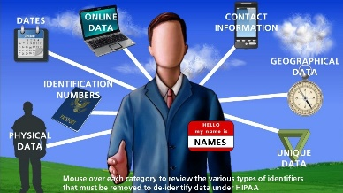

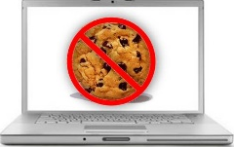
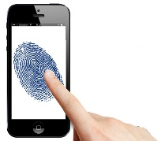

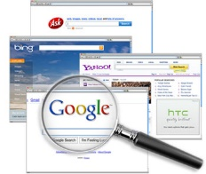
How to Protect Your Digital Identity & Privacy
What security measures can I take to protect my digital identity?
De-identification
Destroy Tracking Cookies
Implement DO-NOT -TRACK
Do Not Accept
Third-Party Cookies
Anonymous Searching
Eliminate Device
Fingerprinting
Destroy Click-Stream Data
Aura
Optery
Delete Me
Use a Password Policy

Slide 14
Virus & Malware
TOPIC 3 & 4 OF 15
3&4
Protection for Every Device
Protect computers, phones, tablets and home devices.
16 MIN • INCLUDING VIDEO & PRACTICE
Notes:
Module 10 (16 minutes). Ask: Have you heard of this? Don’t ask for identifiable personal experiences. Introduce Protect computers, phones, tablets and home devices. Example: “Verify you are human: run these commands.” Source: https://consumer.ftc.gov/articles/malware-how-protect-against-detect-and-remove-it

Slide 15

Watch a video. Then decide.
TOPIC 3 & 4 • VIEW & DISCUSS
VIDEO
Protect Your Computer from Malware
Federal Trade Commission • FTCvideos
DISCUSS
A web page says to paste a command to prove you are human. What now?
Protect Your Computer from Malware
Answer: Close the page—real CAPTCHAs never ask you to execute commands.
Notes:
Before class, open https://www.youtube.com/watch?v=XU8PHihT_P4 and test access and captions. This is an external YouTube link; click the video panel. Play about 1–3 minutes, depending on video length. Discuss: A web page says to paste a command to prove you are human. What now? Expected answer: Close the page—real CAPTCHAs never ask you to execute commands. Total module time, including brief teaching slides and a discussion: 16 minutes. Video credit: Federal Trade Commission • FTCvideos. URL: https://www.youtube.com/watch?v=XU8PHihT_P4

Slide 16
How malware incidents happen
TOPIC 3 & 4 • REAL RISKS • DOCUMENTED EXAMPLE
FAKE CAPTCHA • 2026
WANNACRY • 2017
A website asks you to run commands as “human verification.”
Ransomware spread worldwide via unpatched Windows systems.
FTC: commands can install credential-stealing malware.
CISA: victims’ files were encrypted and locked.
ROUTER FLAWS • 2016
MALICIOUS DOWNLOAD
FTC charged ASUS over insecure routers and storage.
A fake update or unknown attachment can install spyware.
Thousands of connected storage devices were exposed.
Trusted downloads and scans reduce exposure.
Notes:
3 minutes. Source 1: FTC 2026 fake CAPTCHA warning https://consumer.ftc.gov/consumer-alerts/2026/06/how-spot-captcha-scam . Source 2: CISA WannaCry ransomware historical incident, May 2017 https://www.cisa.gov/news-events/ics-alerts/ics-alert-17-135-01i . Source 3: FTC 2016 ASUS insecure router case https://www.ftc.gov/news-events/news/press-releases/2016/02/asus-settles-ftc-charges-insecure-home-routers-cloud-services-put-consumers-privacy-risk . The fourth is a representative common infection pathway: https://consumer.ftc.gov/articles/malware-how-protect-against-detect-and-remove-it . Explain financial safety, privacy, family photos and connectivity.

Slide 17
Malware is more than a “virus”
TOPIC 3 & 4 • KNOW WHAT PROTECTION IS FOR
Hides in a file or app; can damage or take over a device.
1
VIRUS / TROJAN
Can watch activity or steal usernames and passwords.
2
SPYWARE
Can encrypt or lock files and demand payment.
3
RANSOMWARE
May cause pop-ups, redirection or unauthorized access.
4
UNWANTED APPS
Protection lowers risk; no antivirus catches every threat.
Notes:
2 minutes. Explain malware is the umbrella term and not all device threats are classical viruses. Security software is one protective layer. Do not promise a virus-free system. Examples are simplified for learners. Source: https://consumer.ftc.gov/articles/malware-how-protect-against-detect-and-remove-it

Slide 18

Every device needs the RIGHT protection
TOPIC 3 & 4 • COMPUTER, PHONE, TABLET & HOME
WINDOWS PC
Bitdefender | Windows automatic updates; scans.
1
APPLE MAC
Bitdefender | keep macOS and apps up to date.
2
ANDROID PHONE / TABLET
Bitdefender | update Android and apps.
3
Bitdefender | heed malware alerts.
4
iPHONE / iPAD
ROUTER / SMART TV / CAMERAS
Bitdefender | Change default passwords; update firmware; secure your Wi-Fi.
5
Notes:
3 minutes. Do NOT imply every device can or should run traditional antivirus: Windows and Mac have built-in malware defenses; Google Play Protect scans Android apps; Apple mobile platforms use a different layered approach. Routers and IoT devices need firmware updates, strong credentials, and secure Wi-Fi—not a desktop antivirus program. Mac users can consider extra security if needed; no single product is universally required. Each right-column row is clickable to official guidance.

Slide 19
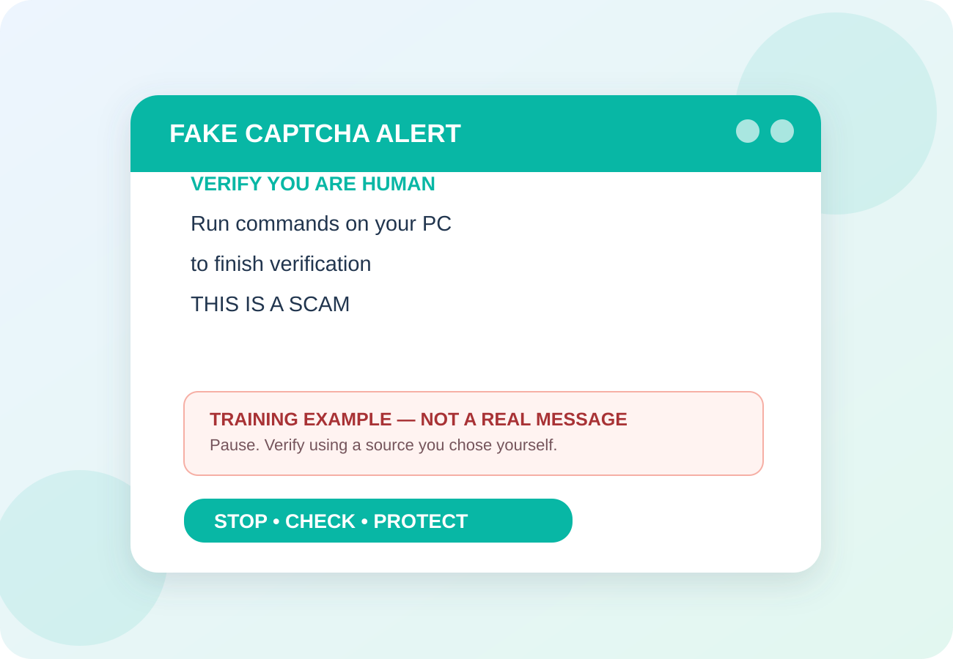
What looks suspicious on a device?
TOPIC 3 & 4 • TRAINING ILLUSTRATION
A fake “virus alert” asks you to call a number
1
A CAPTCHA asks you to run commands
2
Pop-ups, strange redirects or unknown apps
3
Unexpected crashes, slowdown or account alerts
4
Notes:
2 minutes. Fake CAPTCHA is a documented 2026 scam pattern. A slowdown or pop-up can have innocent explanations; these are warning signs, not definitive proof of infection. Ask: is this message displayed by a trusted app or by an unknown web page? Never read or type commands supplied by a random website. Source: https://consumer.ftc.gov/consumer-alerts/2026/06/how-spot-captcha-scam

Slide 20
A practical 5-step protection routine
TOPIC 3 & 4 • PREVENTION CHECKLIST
1
UPDATE
Turn on updates for system, browser, apps and router.
2
PROTECT
Check that built-in antivirus / app protection is enabled.
3
DOWNLOAD SAFELY
Use official stores, known vendors and trusted links.
4
BACK UP
Save important photos and documents in a separate backup.
5
SCAN & REVIEW
Check security alerts; run scans where supported.
Notes:
2 minutes. Demonstrate Windows: Start > Windows Security > Virus & threat protection (do not change settings on learners’ devices). Android: Google Play Store > profile > Play Protect. Apple: check Software Update and app warnings. Emphasize that buying a second antivirus is not automatically necessary: first verify existing protection is active. Ask attendees to perform steps later with a trusted helper, not while sharing passwords.

Slide 21
If Malware On Your Device
TOPIC 3 & 4 • STOP • SCAN • RECOVER
STOP SENSITIVE TASKS
1
Do not sign in to banking or email on the suspicious device.
DISCONNECT IF ATTACK IS ACTIVE
2
If you followed a fake-CAPTCHA command or gave remote access, disconnect internet.
UPDATE & SCAN
3
Use trusted security tools; remove malicious apps or get reputable help.
SECURE ACCOUNTS
4
From a clean device, change passwords, enable MFA and check activity.
A suspicious pop-up is not proof of infection. Do not call its phone number.
Notes:
2 minutes. FTC advice: stop signing in on potentially infected device, update security software, run scan, remove malware, change passwords and enable MFA; enlist trusted professional help if needed. On an active fake-CAPTCHA command attack, FTC recommends disconnecting from internet before cleaning. If any money is lost, contact bank and FTC as taught in next module. Sources: https://consumer.ftc.gov/articles/malware-how-protect-against-detect-and-remove-it and https://consumer.ftc.gov/consumer-alerts/2026/06/how-spot-captcha-scam .

Slide 22
Break – 10 Min

Slide 23
Passwords & Account Security
TOPIC 5 & 6 OF 15
5 & 6
Strong sign-ins stop many account takeovers.
18 MIN • INCLUDING VIDEO & PRACTICE
Notes:
Module 9 (18 minutes). Ask: Have you heard of this? Don’t ask for identifiable personal experiences. Introduce Strong sign-ins stop many account takeovers. Example: “Someone is trying to sign in to your email.” Source: https://www.cisa.gov/secure-our-world/turn-mfa

Slide 24
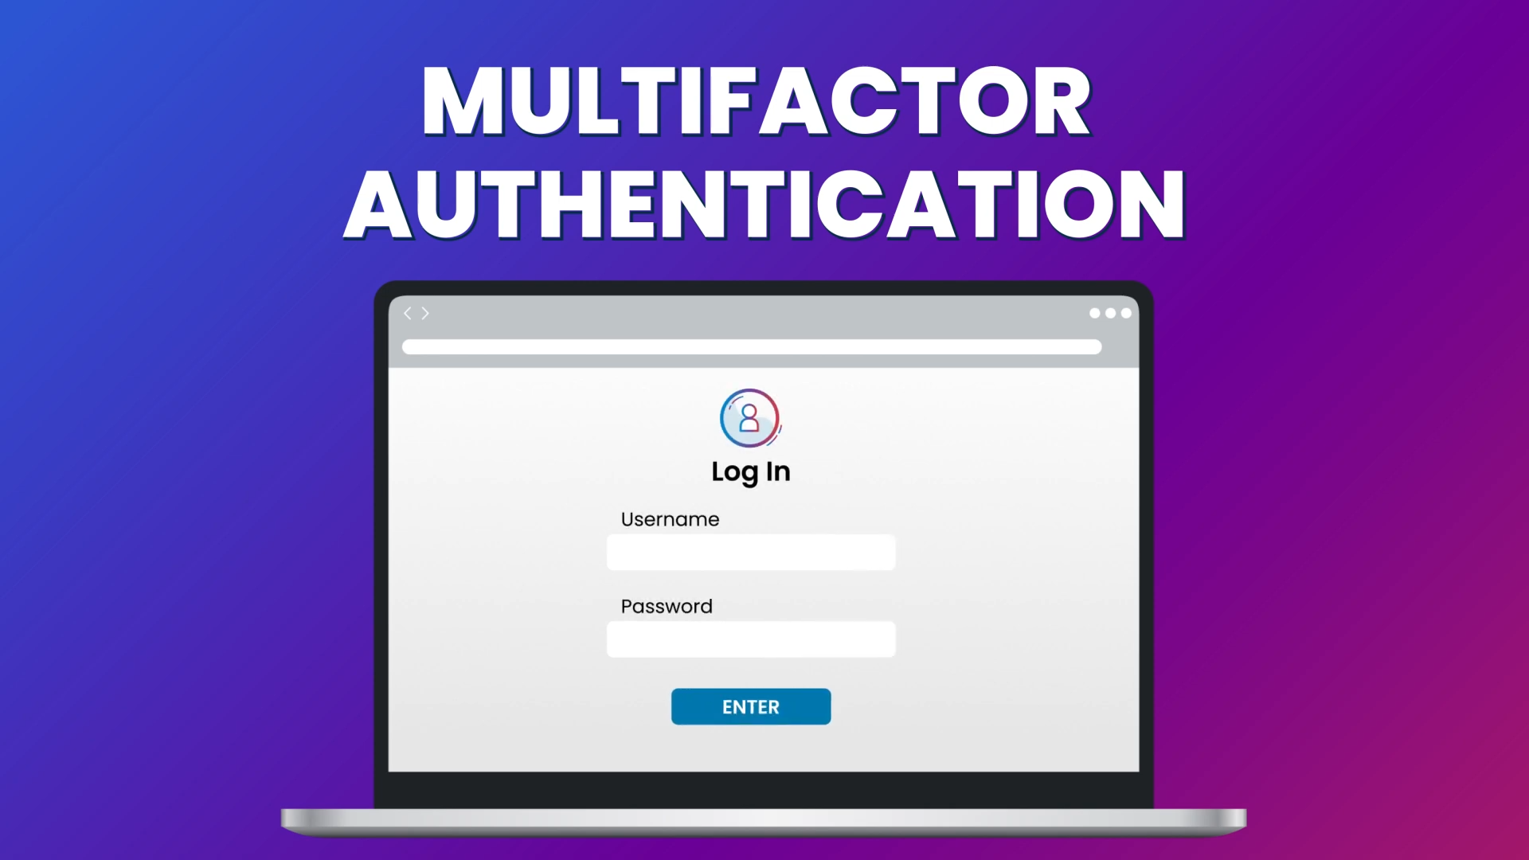
Watch a video. Then decide.
TOPIC 5 & 6 • VIEW & DISCUSS
VIDEO
Make Your Accounts Safer with MFA
CISA
DISCUSS
CLICK TO WATCH ON YOUTUBE
A caller asks for a 6-digit code “to prove your identity.”
Make Your Accounts Safer with MFA
Answer: Never share it; independently check your account for unauthorized access.
Notes:
Before class, open https://www.youtube.com/watch?v=XIlF2qkav5c and test access and captions. This is an external YouTube link; click the video panel. Play about 1–3 minutes, depending on video length. Discuss: A caller asks for a 6-digit code “to prove your identity.” Expected answer: Never share it; independently check your account for unauthorized access. Total module time, including brief teaching slides and a discussion: 18 minutes. Video credit: CISA. URL: https://www.youtube.com/watch?v=XIlF2qkav5c

Slide 25
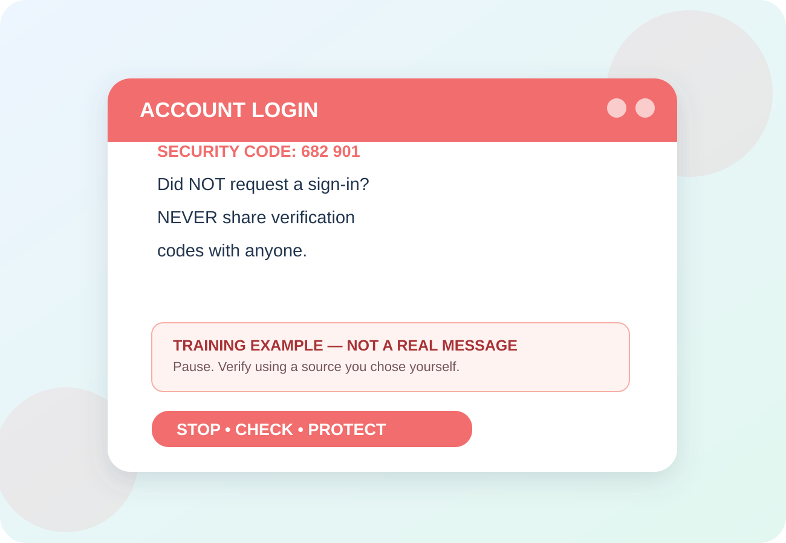
Can you spot the warning signs?
TOPIC 5 & 6 • FICTIONAL EXAMPLE
RED FLAGS
Reused or weak passwords
1
Unprompted sign-in code or MFA request
2
Unrecognized sign-ins ignored
3
Say aloud: “I will verify it myself.”
Notes:
Show the illustrated example. Read the red flags slowly. Ask learners which word/action produces urgency. Case: “Someone is trying to sign in to your email.” Make clear the graphic is fictional and not an actual message or screenshot of a real service.

Slide 26
What to do instead
TOPIC 5 & 6 • YOUR SAFETY STEPS
1
Use unique passwords and a manager or passkeys.
2
Turn on multifactor authentication (MFA).
3
Review sign-in alerts and recovery contact details.
NEVER: Do not share sign-in codes or approve unexpected login prompts.
Notes:
Invite the class to say one of the action steps out loud. Try repeating with a role-play. Example response: Never share it; independently check your account for unauthorized access. Useful source for instructor: https://www.cisa.gov/secure-our-world/turn-mfa

Slide 27
Password Managers
TOPIC 5 & 6 • YOUR SAFETY STEPS
PC Magazine Best Password Managers
RANK | PROGRAM | COST
1 – Editor Choice | Dashlane 3 | Free / Premium - $5/M / Plus - $10/M
2– Editor Choice | Keeper Password Manager & Digital Vault | Free / Express - $2/m / Advanced - $5/M / Pro $15/M
3 | RoboForm Everywhere 7 | Free / Indiv - $23.88/Y / Family - $47.75 /Y
4 | LastPass 3.0 | Families (6) - $4/M
5 | LastPass 3.0 Premium | $2/M
6 | Zoho Vault | Free / $0.9 per user per month
7 | Sticky Password 7 | Free / 14.99/Y
8 | Intuitive Password 2.9 | Free / Express - $2/m / Advanced - $5/M / Pro $15/M
9 | Keeper Password Manager & Digital Vault 8 | Personal $2.50/M / Family $5/M
10 | Norton Identity Safe | Free
11 | my1login | Free

Slide 28
Phishing, Texts & QR traps
TOPIC 7 OF 15
7
A message can look official and still be a trap.
12 MIN • INCLUDING VIDEO & PRACTICE
Notes:
Module 1 (12 minutes). Ask: Have you heard of this? Don’t ask for identifiable personal experiences. Introduce A message can look official and still be a trap. Example: “Your bank is locked. VERIFY NOW.” Source: https://www.cisa.gov/secure-our-world/recognize-and-report-phishing

Slide 29
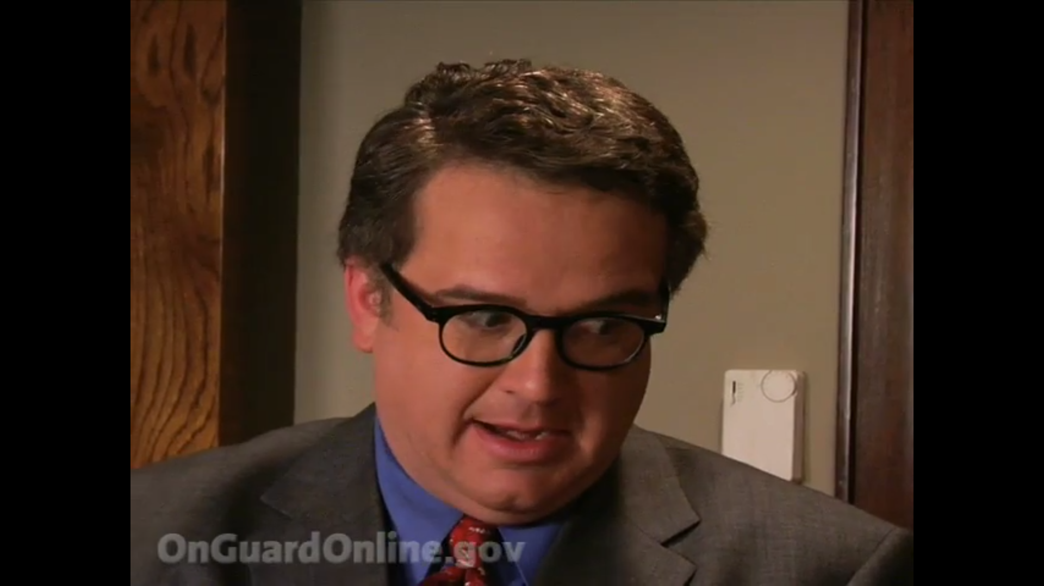
Watch a video. Then decide.
TOPIC 7 • VIEW & DISCUSS
VIDEO
Phishy Office: Avoid Phishing Scams
Federal Trade Commission
DISCUSS
CLICK TO WATCH ON YOUTUBE
Text: “Your toll is overdue. Pay $4.12 today.” What would you do?
Phishy Office: Avoid Phishing Scams
Answer: Open the toll agency website yourself; do not use the text link.
Notes:
Before class, open https://www.youtube.com/watch?v=tR64APeWACg and test access and captions. This is an external YouTube link; click the video panel. Play about 1–3 minutes, depending on video length. Discuss: Text: “Your toll is overdue. Pay $4.12 today.” What would you do? Expected answer: Open the toll agency website yourself; do not use the text link. Total module time, including brief teaching slides and a discussion: 12 minutes. Video credit: Federal Trade Commission. URL: https://www.youtube.com/watch?v=tR64APeWACg

Slide 30
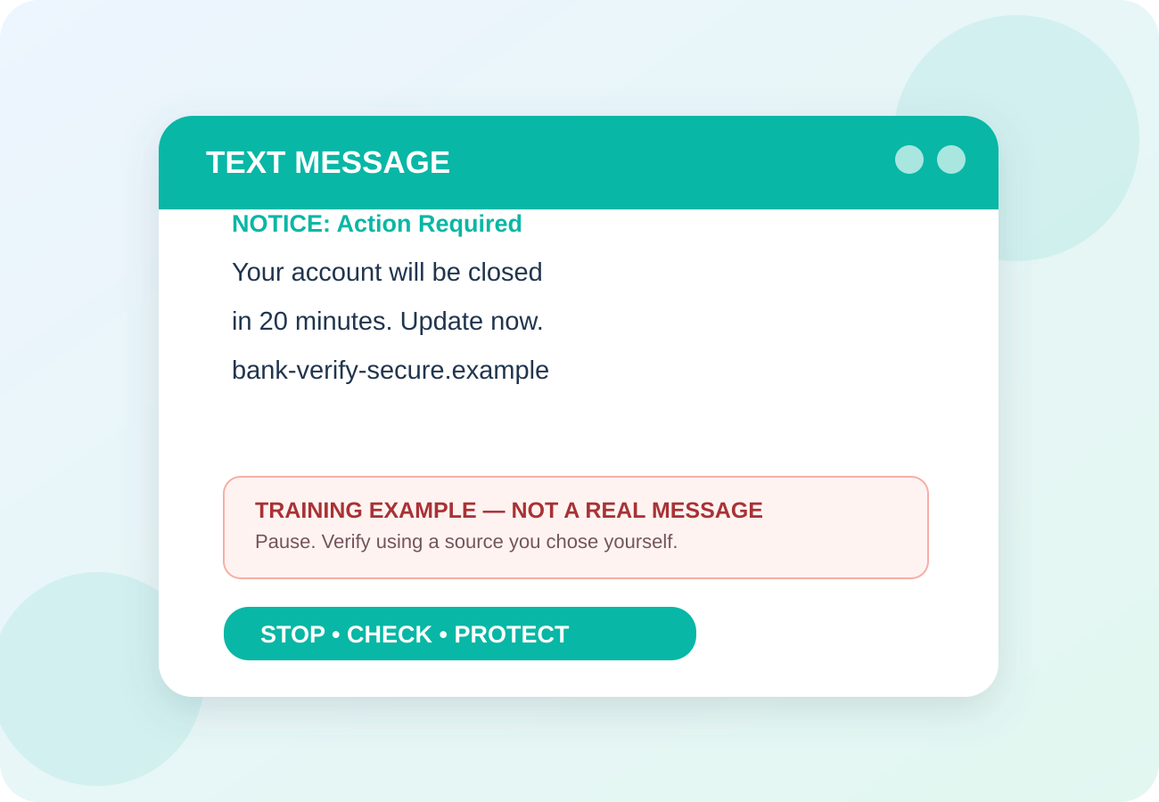
Can You Spot the Warning Signs?
TOPIC 7 • FICTIONAL EXAMPLE
RED FLAGS
Urgent demand
1
Unexpected link or QR code
2
Asks for sign-in or payment
3
Say aloud: “I will verify it myself.”
Notes:
Show the illustrated example. Read the red flags slowly. Ask learners which word/action produces urgency. Case: “Your bank is locked. VERIFY NOW.” Make clear the graphic is fictional and not an actual message or screenshot of a real service.

Slide 31
What To Do Instead
TOPIC 7 • YOUR SAFETY STEPS
1
Open the bank app yourself.
2
Type the site address you already know.
3
Delete or report the suspicious message.
NEVER: Do not tap a surprise link, attachment or QR code.
Notes:
Invite the class to say one of the action steps out loud. Try repeating with a role-play. Example response: Open the toll agency website yourself; do not use the text link. Useful source for instructor: https://www.cisa.gov/secure-our-world/recognize-and-report-phishing

Slide 32
AI Voices & Family Emergencies
TOPIC 8 OF 15
8
A familiar voice alone is no longer proof.
12 MIN • INCLUDING VIDEO & PRACTICE
Notes:
Module 2 (12 minutes). Ask: Have you heard of this? Don’t ask for identifiable personal experiences. Introduce A familiar voice alone is no longer proof. Example: “Grandma, I need bail money. Don’t tell Mom!” Source: https://www.ssa.gov/scam/

Slide 33
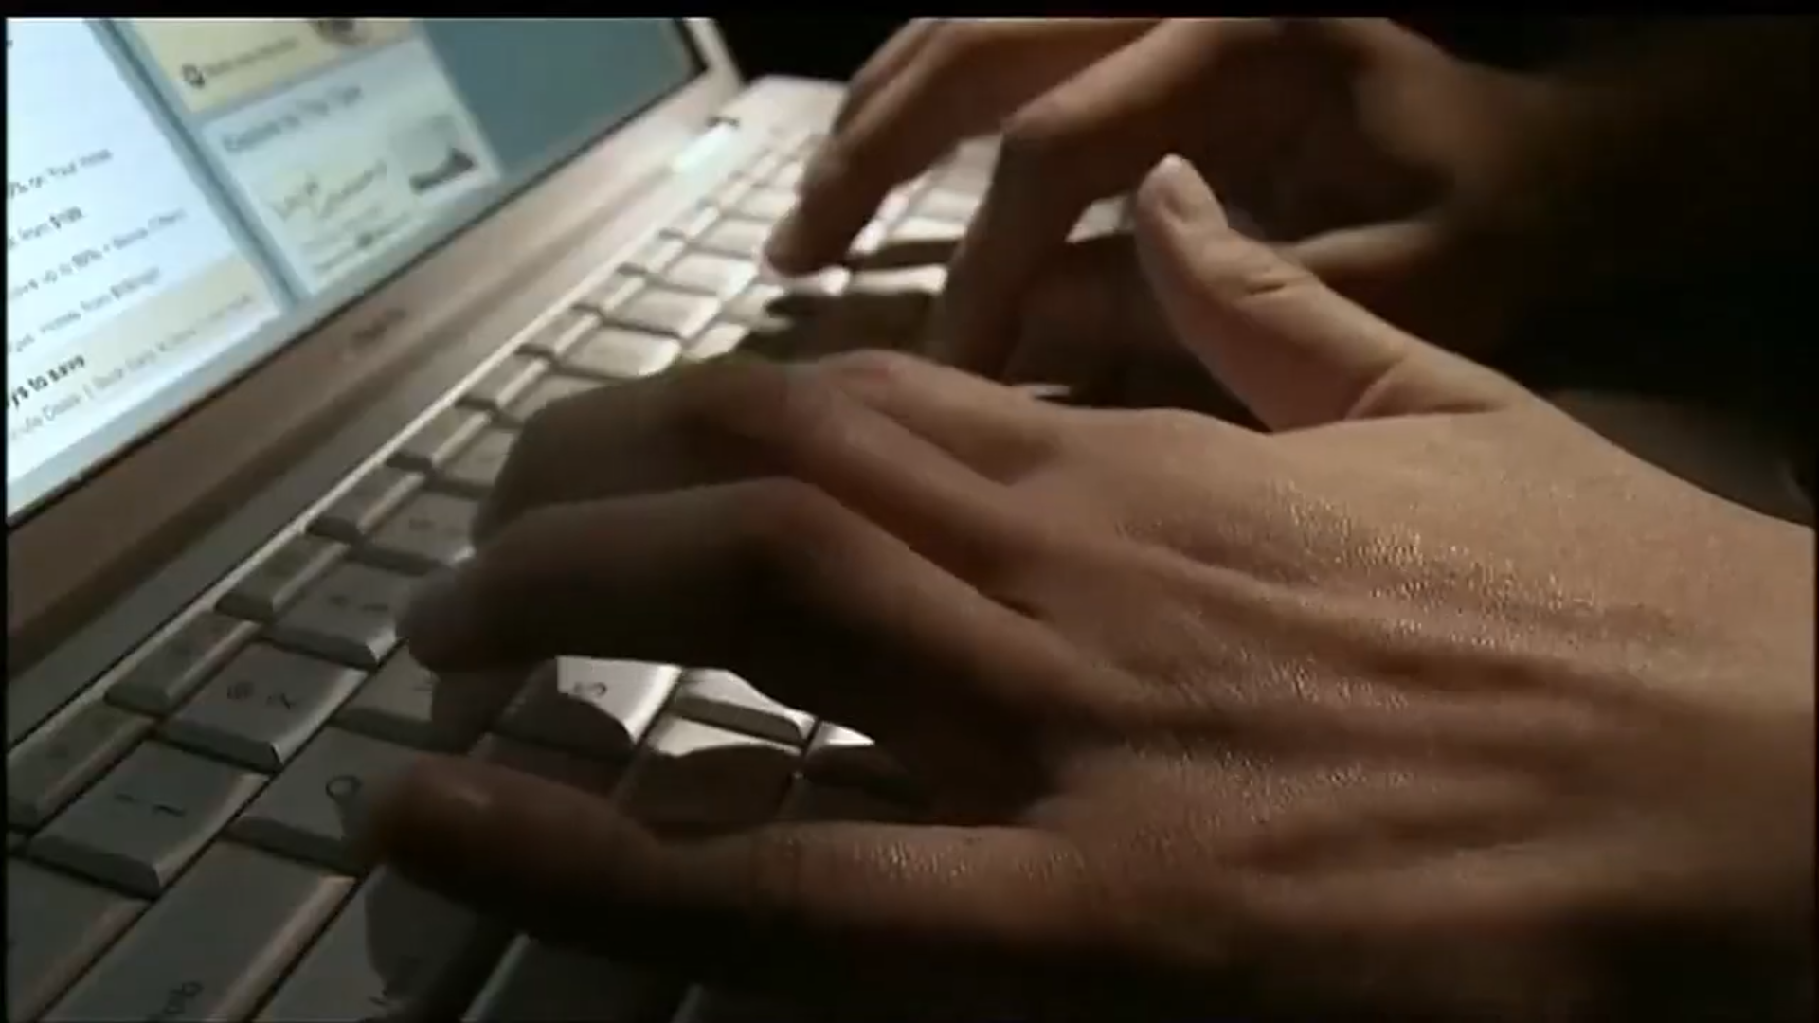
Watch a video. Then decide.
TOPIC 8 • VIEW & DISCUSS
VIDEO
AI and Scams: What You Should Know
AARP Fraud Watch Network
DISCUSS
CLICK TO WATCH ON YOUTUBE
A caller sounds exactly like your grandchild and asks for a wire. Next step?
AI Scams are Evolving – How to Stay Safe
Answer: End the call and independently contact the grandchild or parent.
Notes:
Before class, open https://www.youtube.com/watch?v=U97w2eRxB6c and test access and captions. This is an external YouTube link; click the video panel. For the long-form video, play only a selected 1–3 minute segment. Discuss: A caller sounds exactly like your grandchild and asks for a wire. Next step? Expected answer: End the call and independently contact the grandchild or parent. Total module time, including brief teaching slides and a discussion: 12 minutes. Video credit: AARP Fraud Watch Network. URL: https://www.youtube.com/watch?v=U97w2eRxB6c

Slide 34
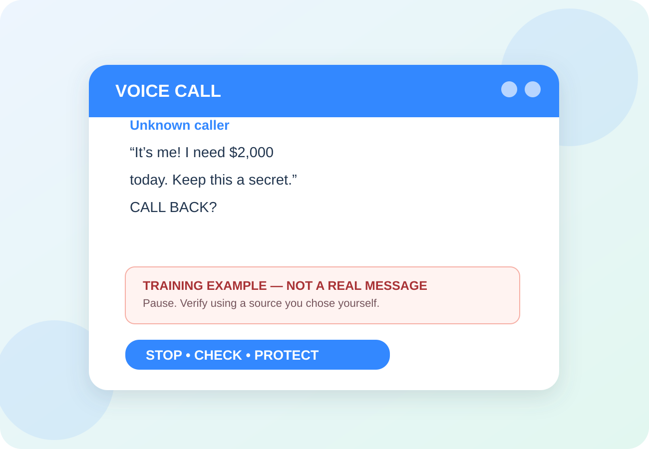
Can You Spot the Warning Signs?
TOPIC 8 • FICTIONAL EXAMPLE
RED FLAGS
Panic or secret emergency
1
Request for immediate money
2
Voice or image used as “proof”
3
Say aloud: “I will verify it myself.”
Notes:
Show the illustrated example. Read the red flags slowly. Ask learners which word/action produces urgency. Case: “Grandma, I need bail money. Don’t tell Mom!” Make clear the graphic is fictional and not an actual message or screenshot of a real service.

Slide 35
What To Do Instead
TOPIC 8 • YOUR SAFETY STEPS
1
Hang up and call the person at a saved number.
2
Ask a family question only they would know.
3
Agree on a family verification phrase.
NEVER: Do not send money based only on the voice on the line.
Notes:
Invite the class to say one of the action steps out loud. Try repeating with a role-play. Example response: End the call and independently contact the grandchild or parent. Useful source for instructor: https://www.ssa.gov/scam/

Slide 36
Government &
Bank Impersonators
TOPIC 9 OF 15
9
Caller ID, badges and official seals can be copied.
12 MIN • INCLUDING VIDEO & PRACTICE
Notes:
Module 3 (12 minutes). Ask: Have you heard of this? Don’t ask for identifiable personal experiences. Introduce Caller ID, badges and official seals can be copied. Example: “SSA: your account is frozen. Move your money.” Source: https://www.ssa.gov/scam/

Slide 37
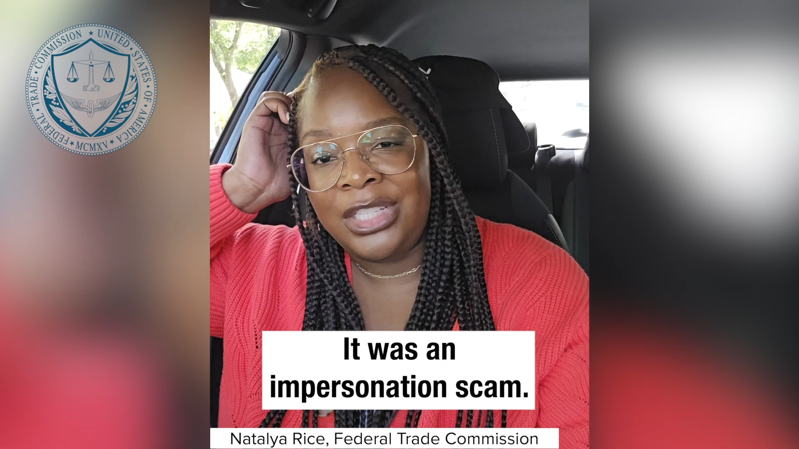
Watch a video. Then decide.
TOPIC 9 • VIEW & DISCUSS
VIDEO
Help the FTC Fight Impersonation Scams
Federal Trade Commission
DISCUSS
CLICK TO WATCH ON YOUTUBE
Someone from “the fraud department” says to withdraw cash to keep it safe.
Help the FTC Fight Impersonation Scams
Answer: Refuse; contact your bank with the number on your card.
Notes:
Before class, open https://www.youtube.com/watch?v=-89h8FGgypQ and test access and captions. This is an external YouTube link; click the video panel. Play about 1–3 minutes, depending on video length. Discuss: Someone from “the fraud department” says to withdraw cash to keep it safe. Expected answer: Refuse; contact your bank with the number on your card. Total module time, including brief teaching slides and a discussion: 12 minutes. Video credit: Federal Trade Commission. URL: https://www.youtube.com/watch?v=-89h8FGgypQ

Slide 38
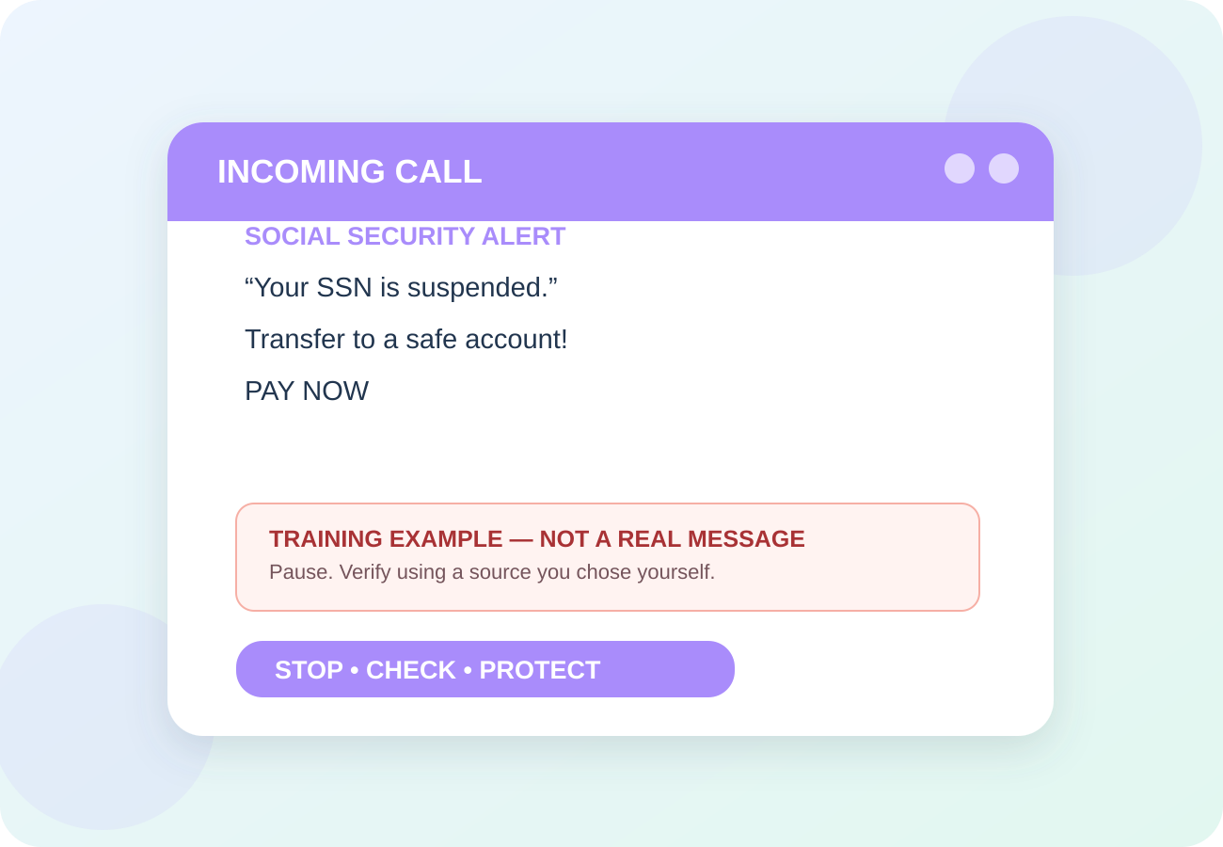
Can You Spot the Warning Signs?
TOPIC 9 • FICTIONAL EXAMPLE
RED FLAGS
Threat of arrest or lost benefits
1
“Safe account” transfer demand
2
Gift cards, gold or crypto requested
3
Say aloud: “I will verify it myself.”
Notes:
Show the illustrated example. Read the red flags slowly. Ask learners which word/action produces urgency. Case: “SSA: your account is frozen. Move your money.” Make clear the graphic is fictional and not an actual message or screenshot of a real service.

Slide 39
What To Do Instead
TOPIC 9 • YOUR SAFETY STEPS
1
Hang up immediately.
2
Find the official agency or bank number yourself.
3
Talk to a trusted person before moving funds.
NEVER: Do not transfer savings to “protect” them.
Notes:
Invite the class to say one of the action steps out loud. Try repeating with a role-play. Example response: Refuse; contact your bank with the number on your card. Useful source for instructor: https://www.ssa.gov/scam/

Slide 40
Break – 10 Min

Slide 41
Fake Tech Support & Remote Access
TOPIC 10 OF 15
10
A scary pop-up is not a repair diagnosis.
12 MIN • INCLUDING VIDEO & PRACTICE
Notes:
Module 4 (12 minutes). Ask: Have you heard of this? Don’t ask for identifiable personal experiences. Introduce A scary pop-up is not a repair diagnosis. Example: “VIRUS DETECTED. CALL TECH SUPPORT NOW.” Source: https://consumer.ftc.gov/articles/how-spot-avoid-and-report-tech-support-scams

Slide 42
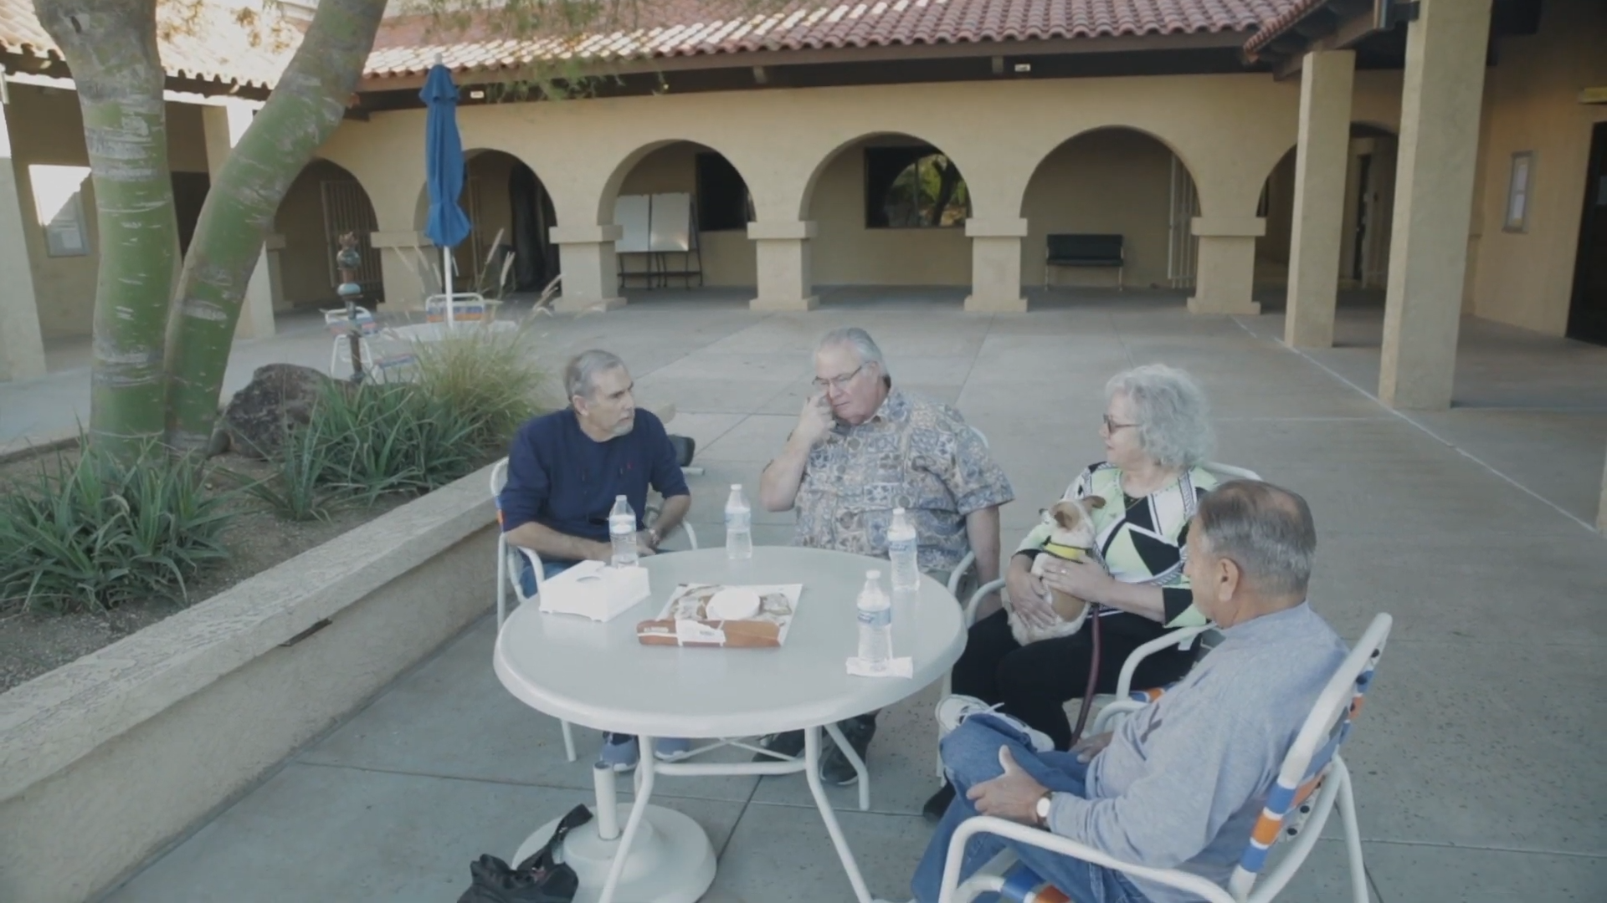
Watch a video. Then decide.
TOPIC 10 • VIEW & DISCUSS
VIDEO
How to Avoid a Tech Support Scam
Federal Trade Commission
DISCUSS
CLICK TO WATCH ON YOUTUBE
A screen alarm says Microsoft must fix your computer by phone.
How to Avoid a Tech Support Scam
Answer: Do not call; close the browser and seek your own trusted support.
Notes:
Before class, open https://www.youtube.com/watch?v=wuj5tvnbJwg and test access and captions. This is an external YouTube link; click the video panel. Play about 1–3 minutes, depending on video length. Discuss: A screen alarm says Microsoft must fix your computer by phone. Expected answer: Do not call; close the browser and seek your own trusted support. Total module time, including brief teaching slides and a discussion: 12 minutes. Video credit: Federal Trade Commission. URL: https://www.youtube.com/watch?v=wuj5tvnbJwg

Slide 43
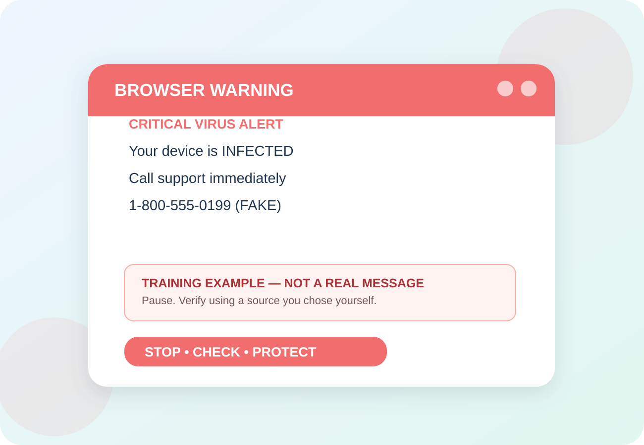
Can You Spot the Warning Signs?
RED FLAGS
Browser pop-up with phone number
1
Unsolicited repair offer
2
Request to control your computer
3
Say aloud: “I will verify it myself.”
Notes:
Show the illustrated example. Read the red flags slowly. Ask learners which word/action produces urgency. Case: “VIRUS DETECTED. CALL TECH SUPPORT NOW.” Make clear the graphic is fictional and not an actual message or screenshot of a real service.

Slide 44
What to do instead
TOPIC 10 • YOUR SAFETY STEPS
1
Close the page; restart if necessary.
2
Get support from the manufacturer you contact.
3
If access was given, disconnect and seek trusted help.
NEVER: Do not give a stranger remote control or passwords.
Notes:
Invite the class to say one of the action steps out loud. Try repeating with a role-play. Example response: Do not call; close the browser and seek your own trusted support. Useful source for instructor: https://consumer.ftc.gov/articles/how-spot-avoid-and-report-tech-support-scams

Slide 45
Investment & Cryptocurrency Fraud
TOPIC 11 OF 15
11
Guaranteed fast profits are a warning, not an opportunity.
12 MIN • INCLUDING VIDEO & PRACTICE
Notes:
Module 5 (12 minutes). Ask: Have you heard of this? Don’t ask for identifiable personal experiences. Introduce Guaranteed fast profits are a warning, not an opportunity. Example: “Double retirement savings in 30 days—guaranteed!” Source: https://www.ic3.gov/AnnualReport/Reports/2025_IC3Report.pdf

Slide 46

Watch a video. Then decide.
TOPIC11 • VIEW & DISCUSS
VIDEO
How Crypto Investment Scams Work
AARP Live
DISCUSS
CLICK TO WATCH ON YOUTUBE
An online friend sends you an app showing amazing crypto profits.
How Crypto Investment Scams Work
Answer: Do not invest; verify independently and consult a trusted adviser.
Notes:
Before class, open https://www.youtube.com/watch?v=vUE03dqE0Zw and test access and captions. This is an external YouTube link; click the video panel. For the long-form video, play only a selected 1–3 minute segment. Discuss: An online friend sends you an app showing amazing crypto profits. Expected answer: Do not invest; verify independently and consult a trusted adviser. Total module time, including brief teaching slides and a discussion: 12 minutes. Video credit: AARP Live. URL: https://www.youtube.com/watch?v=vUE03dqE0Zw

Slide 47
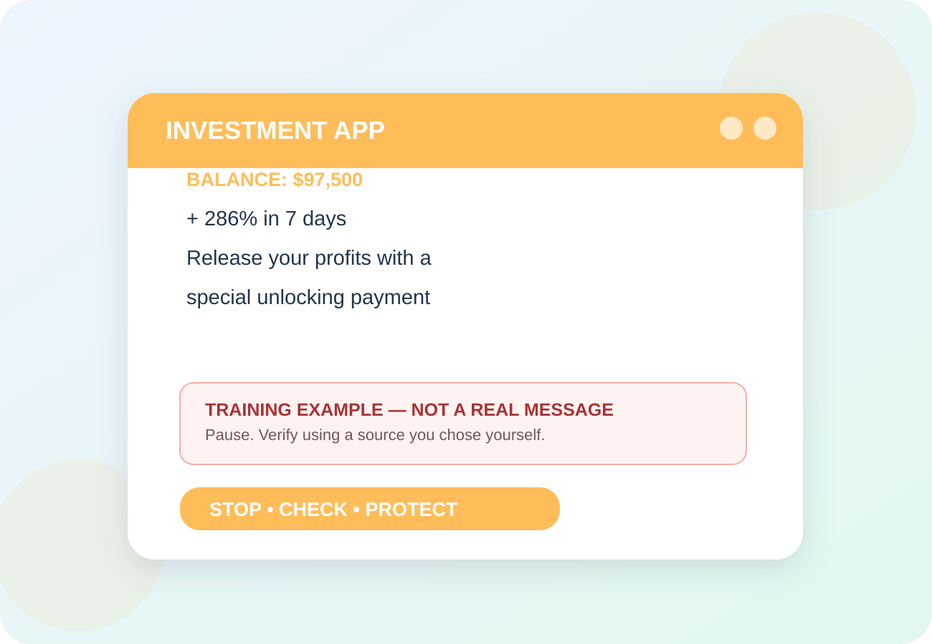
TOPIC 11 • FICTIONAL EXAMPLE
RED FLAGS
Stranger offers unusually high returns
1
Fake platform shows growing balances
2
Withdrawal requires an extra “fee”
3
Say aloud: “I will verify it myself.”
Notes:
Show the illustrated example. Read the red flags slowly. Ask learners which word/action produces urgency. Case: “Double retirement savings in 30 days—guaranteed!” Make clear the graphic is fictional and not an actual message or screenshot of a real service.

Slide 48
What To Do Instead
TOPIC 11 • YOUR SAFETY STEPS
1
Talk to an independent financial professional.
2
Check registrations and investment claims.
3
Pause before transferring or converting funds.
NEVER: Do not buy crypto at a kiosk for an unexpected caller.
Notes:
Invite the class to say one of the action steps out loud. Try repeating with a role-play. Example response: Do not invest; verify independently and consult a trusted adviser. Useful source for instructor: https://www.ic3.gov/AnnualReport/Reports/2025_IC3Report.pdf

Slide 49
Romance &
Social Media Deception
TOPIC 12 OF 15
12
Trust can be built slowly, then used to ask for money.
12 MIN • INCLUDING VIDEO & PRACTICE
Notes:
Module 6 (12 minutes). Ask: Have you heard of this? Don’t ask for identifiable personal experiences. Introduce Trust can be built slowly, then used to ask for money. Example: “I love you. Please pay my travel or medical bill.” Source: https://consumer.ftc.gov/articles/what-know-about-romance-scams

Slide 50
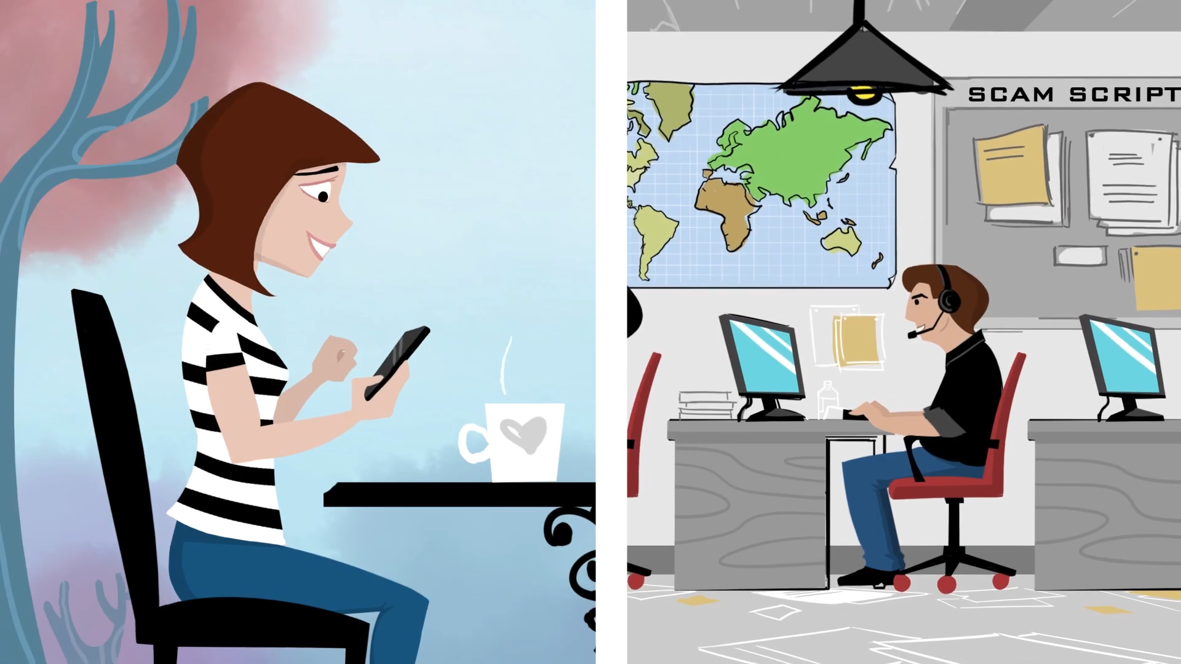
Watch a video. Then decide.
TOPIC 12 • VIEW & DISCUSS
VIDEO
Online Romance Imposter Scams
Federal Trade Commission
DISCUSS
CLICK TO WATCH ON YOUTUBE
After weeks of affectionate messages, a partner needs help with customs fees.
Online Romance Imposter Scams
Answer: Do not send funds; ask a trusted person for another perspective.
Notes:
Before class, open https://www.youtube.com/watch?v=jlxWxH0mgU8 and test access and captions. This is an external YouTube link; click the video panel. Play about 1–3 minutes, depending on video length. Discuss: After weeks of affectionate messages, a partner needs help with customs fees. Expected answer: Do not send funds; ask a trusted person for another perspective. Total module time, including brief teaching slides and a discussion: 12 minutes. Video credit: Federal Trade Commission. URL: https://www.youtube.com/watch?v=jlxWxH0mgU8

Slide 51

Can You Spot the Warning Signs?
TOPIC12 • FICTIONAL EXAMPLE
RED FLAGS
Won’t meet or video chat reliably
1
Sudden financial emergency
2
Moves chat off the dating service
3
Say aloud: “I will verify it myself.”
Notes:
Show the illustrated example. Read the red flags slowly. Ask learners which word/action produces urgency. Case: “I love you. Please pay my travel or medical bill.” Make clear the graphic is fictional and not an actual message or screenshot of a real service.

Slide 52
What To Do Instead
TOPIC 12 • YOUR SAFETY STEPS
1
Keep new relationships off your wallet.
2
Reverse-check profiles with someone you trust.
3
Discuss concerns without shame or pressure.
NEVER: Do not send funds or accept financial transfers for online-only contacts.
Notes:
Invite the class to say one of the action steps out loud. Try repeating with a role-play. Example response: Do not send funds; ask a trusted person for another perspective. Useful source for instructor: https://consumer.ftc.gov/articles/what-know-about-romance-scams

Slide 53
Identity Theft & Data Breaches
TOPIC13 OF 15
13
Stolen information can open accounts in your name.
12 MIN • INCLUDING VIDEO & PRACTICE
Notes:
Module 7 (12 minutes). Ask: Have you heard of this? Don’t ask for identifiable personal experiences. Introduce Stolen information can open accounts in your name. Example: “New credit card approved!” — but you never applied. Source: https://www.identitytheft.gov/

Slide 54
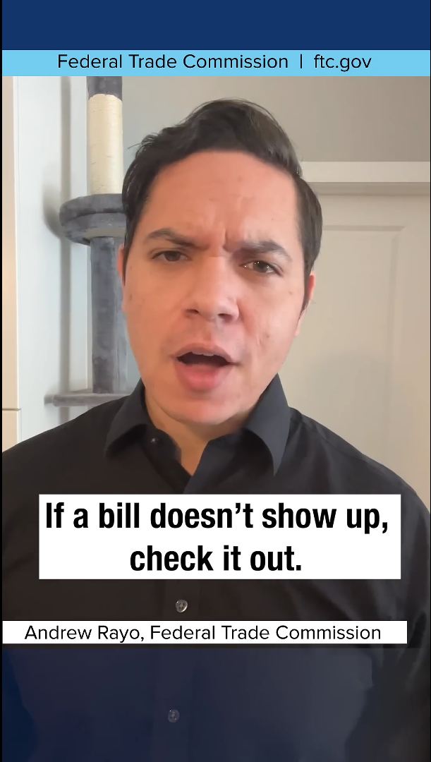
Watch a video. Then decide.
TOPIC 13 • VIEW & DISCUSS
VIDEO
5 Ways to Protect Yourself From Identity Theft
Federal Trade Commission
DISCUSS
CLICK TO WATCH ON YOUTUBE
You receive a card for an account you never opened.
Answer: Contact issuer using independently verified details and go to IdentityTheft.gov.
Notes:
Before class, open https://www.youtube.com/shorts/eiMLxkAmv3k and test access and captions. This is an external YouTube link; click the video panel. Play about 1–3 minutes, depending on video length. Discuss: You receive a card for an account you never opened. Expected answer: Contact issuer using independently verified details and go to IdentityTheft.gov. Total module time, including brief teaching slides and a discussion: 12 minutes. Video credit: Federal Trade Commission. URL: https://www.youtube.com/shorts/eiMLxkAmv3k

Slide 55
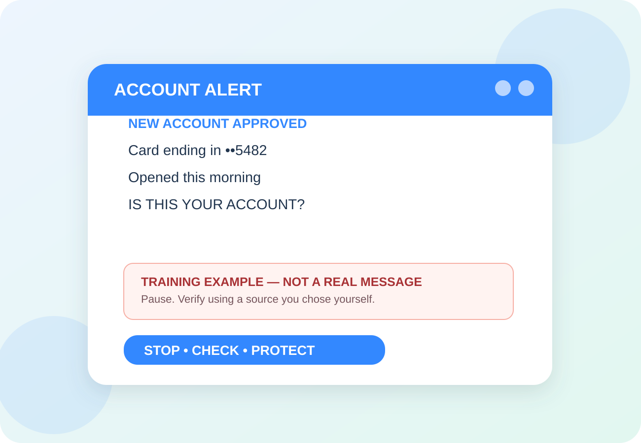
Can You Spot the Warning Signs?
TOPIC13 • FICTIONAL EXAMPLE
RED FLAGS
Unknown bill or credit application
1
Login alert you did not trigger
2
Benefits or medical activity you do not recognize
3
Say aloud: “I will verify it myself.”
Notes:
Show the illustrated example. Read the red flags slowly. Ask learners which word/action produces urgency. Case: “New credit card approved!” — but you never applied. Make clear the graphic is fictional and not an actual message or screenshot of a real service.

Slide 56
What To Do Instead
TOPIC 13 • YOUR SAFETY STEPS
1
Monitor bank activity and credit reports.
2
Consider free credit freezes at all 3 bureaus.
3
Use IdentityTheft.gov for a recovery plan.
NEVER: Do not give Social Security or Medicare numbers to surprise callers.
Notes:
Invite the class to say one of the action steps out loud. Try repeating with a role-play. Example response: Contact issuer using independently verified details and go to IdentityTheft.gov. Useful source for instructor: https://www.identitytheft.gov/

Slide 57
Fake Shopping, Delivery & Medicare Sites
TOPIC 14 OF 15
14
Advertisements and logos are not verification.
12 MIN • INCLUDING VIDEO & PRACTICE
Notes:
Module 8 (12 minutes). Ask: Have you heard of this? Don’t ask for identifiable personal experiences. Introduce Advertisements and logos are not verification. Example: “Package held / Medicare plan ending. Click here.” Source: https://consumer.ftc.gov/consumer-alerts/2026/09/what-know-ahead-open-enrollment-avoid-health-insurance-scams

Slide 58
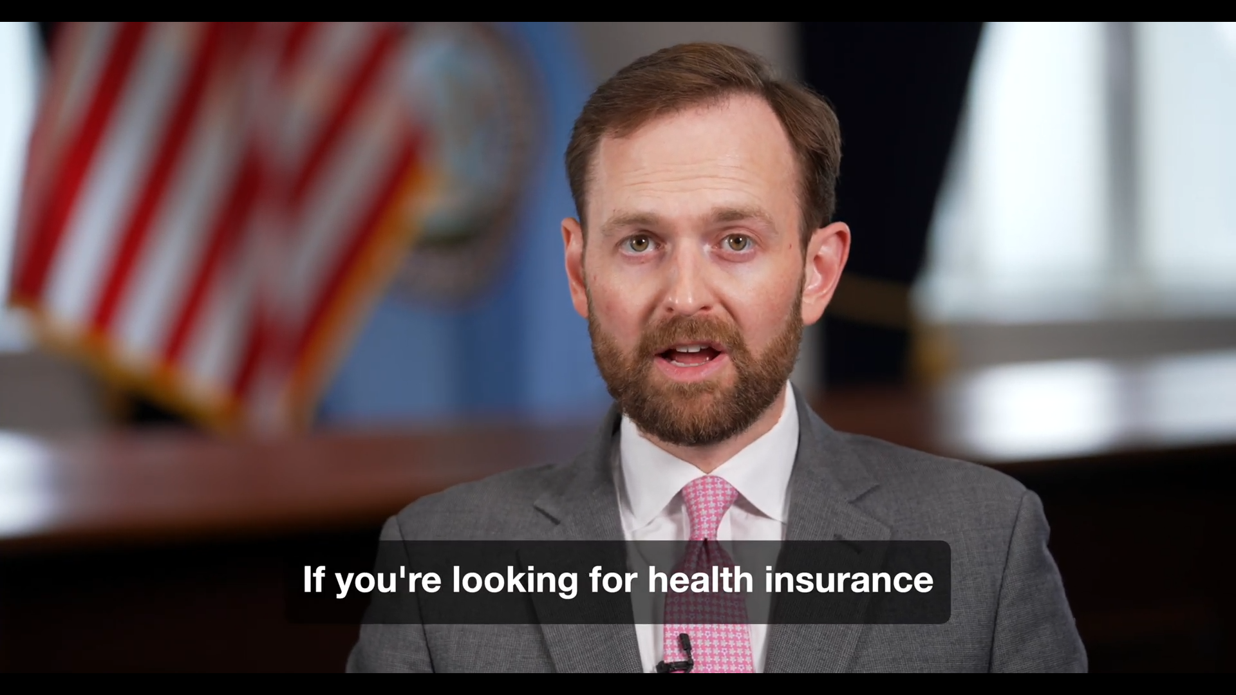
Watch a video. Then decide.
TOPIC 14 • VIEW & DISCUSS
VIDEO
Avoid Health Insurance Search Scams This Open Season
Federal Trade Commission
DISCUSS
CLICK TO WATCH ON YOUTUBE
A sponsored search result promises a “free” Medicare renewal.
Avoid Health Insurance Search Scams This Open Season
Answer: Visit Medicare.gov or call the number on your Medicare card.
Notes:
Before class, open https://www.youtube.com/watch?v=vOEi9Qe9AZQ and test access and captions. This is an external YouTube link; click the video panel. Play about 1–3 minutes, depending on video length. Discuss: A sponsored search result promises a “free” Medicare renewal. Expected answer: Visit Medicare.gov or call the number on your Medicare card. Total module time, including brief teaching slides and a discussion: 12 minutes. Video credit: Federal Trade Commission. URL: https://www.youtube.com/watch?v=vOEi9Qe9AZQ

Slide 59
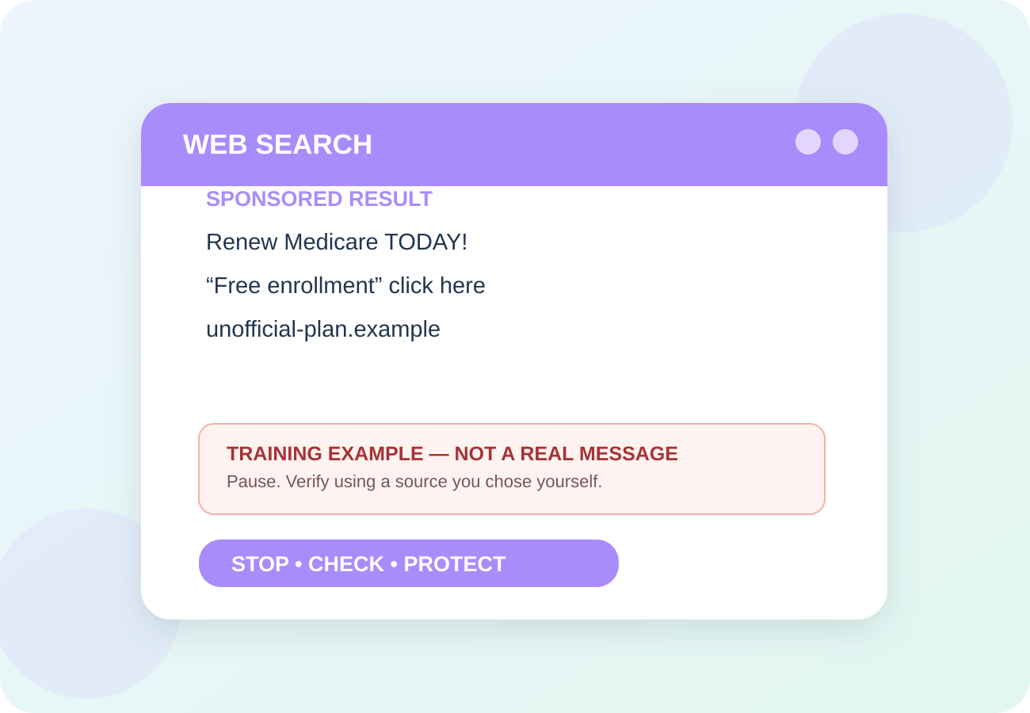
Can You Spot the Warning Signs?
TOPIC 14 • FICTIONAL EXAMPLE
RED FLAGS
Unexpected delivery payment request
1
Search ad posing as an official site
2
Sensitive Medicare details requested
3
Say aloud: “I will verify it myself.”
Notes:
Show the illustrated example. Read the red flags slowly. Ask learners which word/action produces urgency. Case: “Package held / Medicare plan ending. Click here.” Make clear the graphic is fictional and not an actual message or screenshot of a real service.

Slide 60
What To Do Instead
TOPIC 14 • YOUR SAFETY STEPS
1
Go directly to a merchant or carrier app.
2
Use Medicare.gov for plan information.
3
Check reviews, refund policies and URLs.
NEVER: Do not enter medical or payment details after clicking a surprise link.
Notes:
Invite the class to say one of the action steps out loud. Try repeating with a role-play. Example response: Visit Medicare.gov or call the number on your Medicare card. Useful source for instructor: https://consumer.ftc.gov/consumer-alerts/2026/09/what-know-ahead-open-enrollment-avoid-health-insurance-scams

Slide 61
Report, Recover & Support One Another
TOPIC 15 OF 15
15
Fast action and a trusted helper can limit the damage.
14 MIN • INCLUDING VIDEO & PRACTICE
Notes:
Module 11 (14 minutes). Ask: Have you heard of this? Don’t ask for identifiable personal experiences. Introduce Fast action and a trusted helper can limit the damage. Example: “I already sent money. What should I do now?” Source: https://consumer.ftc.gov/articles/what-do-if-you-were-scammed

Slide 62
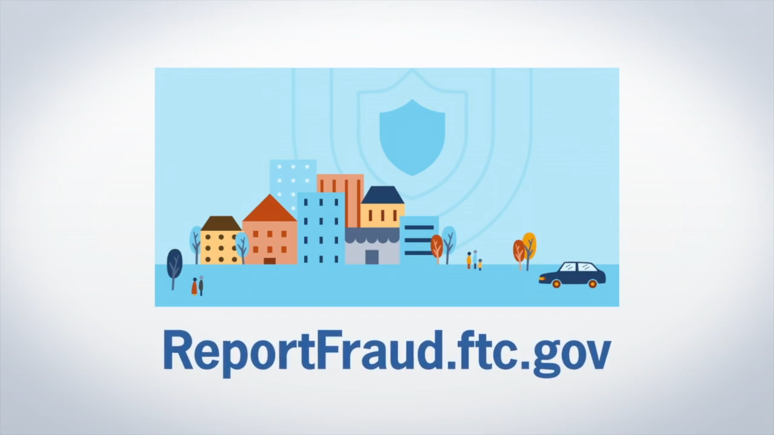
Watch a video. Then decide.
TOPIC 15 • VIEW & DISCUSS
VIDEO
How to Report Fraud at ReportFraud.ftc.gov
Federal Trade Commission
DISCUSS
CLICK TO WATCH ON YOUTUBE
A friend paid a fake support company yesterday. What do you say?
How to Report Fraud at ReportFraud.ftc.gov
Answer: Help them contact the payment provider and report—without judgment.
Notes:
Before class, open https://www.youtube.com/watch?v=IoKTR4QR6-w and test access and captions. This is an external YouTube link; click the video panel. Play about 1–3 minutes, depending on video length. Discuss: A friend paid a fake support company yesterday. What do you say? Expected answer: Help them contact the payment provider and report—without judgment. Total module time, including brief teaching slides and a discussion: 14 minutes. Video credit: Federal Trade Commission. URL: https://www.youtube.com/watch?v=IoKTR4QR6-w

Slide 63

Can You Spot the Warning Signs?
TOPIC 15 • FICTIONAL EXAMPLE
RED FLAGS
Scammer keeps calling after payment
1
Offers to “recover” your lost money for a fee
2
Request to keep the incident secret
3
Say aloud: “I will verify it myself.”
Notes:
Show the illustrated example. Read the red flags slowly. Ask learners which word/action produces urgency. Case: “I already sent money. What should I do now?” Make clear the graphic is fictional and not an actual message or screenshot of a real service.

Slide 64
What To Do Instead
TOPIC 15 • YOUR SAFETY STEPS
1
Contact the bank/payment provider right away.
2
Change compromised credentials; secure devices.
3
Report at ReportFraud.ftc.gov and IC3.gov.
NEVER: Do not pay an unknown “recovery agent.”
Notes:
Invite the class to say one of the action steps out loud. Try repeating with a role-play. Example response: Help them contact the payment provider and report—without judgment. Useful source for instructor: https://consumer.ftc.gov/articles/what-do-if-you-were-scammed

Slide 65
ACT FAST.
GET HELP.
IF YOU SUSPECT FRAUD
STOP CONTACT
Hang up, stop transfers, disconnect if remote access.
1
PROTECT MONEY & ACCOUNTS
Call the bank and card issuer immediately.
2
PRESERVE & REPORT
Save messages, receipts, dates and transaction data.
3
Notes:
Recovery slide. Direct participants to act quickly, but do not guarantee money recovery. The FTC advises contacting the payment company immediately and requesting reversal/refund. For remote access, disconnect and get trusted help; update security software and scan, then change passwords from a trusted device.

Slide 66
Trusted places to get help
SAVE THESE CONTACTS
FTC fraud report
ReportFraud.ftc.gov
FBI internet crime
IC3.gov
Identity theft recovery
IdentityTheft.gov
AARP fraud helpline
877-908-3360
Medicare information
Medicare.gov • 1-800-MEDICARE
For immediate financial loss: contact your own bank first.
Notes:
AARP Fraud Watch Network helpline 877-908-3360 is available Mon–Fri, 8am–8pm ET as of October 2026. Medicare 1-800-633-4227. Ask learners to add a trusted contact to their address book.

Slide 67
Your Next 7 Days
PERSONAL ACTION PLAN
DAY 1
Put Anti-Virus Software on all Devices
Identify one trusted person to call
for technical help.
DAY 5
Check malware protection,
Update all apps and backups.
DAY 2
Check bank alerts and account activity.
DAY 6
Freeze credit if appropriate.
DAY 3
Eliminate Free Email Accounts
Enable MFA for primary email.
DAY 7
Share one scam warning with a friend.
DAY 4
Use a password manager.
Use unique passwords.
Small steps add up to real protection.
Notes:
Closing action commitment. Invite everyone to select ONE item to complete this week. Do not ask them to turn on MFA publicly or type passwords in front of the class.

Slide 68
REMEMBER THIS
STOP
CHECK
PROTECT
You can take your time, verify independently, and ask for help.
Notes:
Final group repeat: STOP. CHECK. PROTECT. End on confidence, not fear. Thank the class for engaging.

Slide 69
CLICKABLE YOUTUBE REFERENCES
Video library • topics 1–6
Phishy Office: Avoid Phishing Scams
▶
1
Federal Trade Commission • WATCH
AI and Scams: What You Should Know
▶
2
AARP Fraud Watch Network • WATCH
Help the FTC Fight Impersonation Scams
▶
3
Federal Trade Commission • WATCH
How to Avoid a Tech Support Scam
▶
4
Federal Trade Commission • WATCH
How Crypto Investment Scams Work
▶
5
AARP Live • WATCH
Online Romance Imposter Scams
▶
6
Federal Trade Commission • WATCH
Notes:
All 11 video links are external YouTube URLs, to be checked for access and captions before class. The new malware topic links to the classic FTC Protect Your Computer from Malware video, published 2012; principles remain useful but the FTC 2026 fake-CAPTCHA advisory is more current. Select short clips.

Slide 70
CLICKABLE YOUTUBE REFERENCES
Video library • topics 7–11
5 Ways to Protect Yourself From Identity Theft
▶
7
Federal Trade Commission • WATCH
Avoid Health Insurance Search Scams This Open Season
▶
8
Federal Trade Commission • WATCH
Make Your Accounts Safer with MFA
▶
9
CISA • WATCH
Protect Your Computer from Malware
▶
10
Federal Trade Commission • FTCvideos • WATCH
How to Report Fraud at ReportFraud.ftc.gov
▶
11
Federal Trade Commission • WATCH
Notes:
All 11 video links are external YouTube URLs, to be checked for access and captions before class. The new malware topic links to the classic FTC Protect Your Computer from Malware video, published 2012; principles remain useful but the FTC 2026 fake-CAPTCHA advisory is more current. Select short clips.

Slide 71
REFERENCES • AS OF OCTOBER 2026
Evidence & instructional sources
FBI IC3, 2025 Annual Report
www.ic3.gov/AnnualReport/Reports/2025_IC3Report.pdf
FTC, Protecting Older Consumers 2025–2026
www.ftc.gov/news-events/news/press-releases/2026/10/ftc-issues-annual-repo
FTC, What To Do if You Were Scammed
consumer.ftc.gov/articles/what-do-if-you-were-scammed
CISA, Secure Our World
www.cisa.gov/secure-our-world
Social Security Administration, scam alerts
www.ssa.gov/scam/
AARP, Fraud Watch Network Helpline
www.aarp.org/money/scams-fraud/helpline.html
Notes:
All resources were consulted in October 2026. This is a 2027 awareness class, not a claim that 2027 loss totals or threat rankings are established. The FBI and FTC collect different fraud reports; their figures are not additive. Video owners retain their rights. Use YouTube externally with an internet connection.

Slide 72
More sources • malware and device security
FTC, Malware: Protect, Detect and Remove
consumer.ftc.gov/articles/malware-how-protect-against-detect-and-remove-it
FTC, Fake CAPTCHA scam (June 2026)
consumer.ftc.gov/consumer-alerts/2026/06/how-spot-captcha-scam
Microsoft, Windows Security
support.microsoft.com/en-us/windows/security/windows-security/stay-protected-with-the-windo
Apple, Protecting against malware in macOS
support.apple.com/en-ca/guide/security/sec469d47bd8/web
Google, Play Protect
support.google.com/googleplay/answer/2812853
FTC, Securing connected devices at home
consumer.ftc.gov/articles/securing-your-internet-connected-devices-home
Notes:
Official sources for the new device malware module, consulted October 2026. iPhone/iPad info: https://support.apple.com/en-us/116947. Router and Wi-Fi safety: https://consumer.ftc.gov/articles/how-secure-your-home-wi-fi-network. Malware video: https://www.youtube.com/watch?v=XU8PHihT_P4

Slide 73
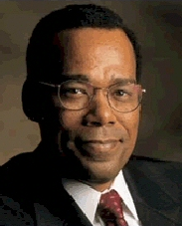
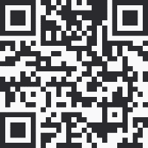
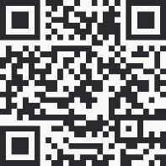
Instructor Contact Info
Carl Burnett
Prof – Montgomery College
carl.burnett@montgomerycollege.edu
profburnett@profburnett.com
240.603.3194
Professor Burnett Office Hours Bookings
https://outlook.office365.com/owa/calendar/ProfessorBurnett@montgomerycollege0.onmicrosoft.com/bookings/
Profburnett Website
https://profburnett.com

