Slide 1
ITI 594 Introduction to
Generative AI
Session II
http://www.profburnett.com
Master a Skill / Learn for Life

Slide 2
Course Outline – Session 1
Define Artificial Intelligence (AI) and Generative AI (GenAI).
Explain the latest trends in GenAI/AI.
Identify and describe key concepts in GenAI/AI.
Understand the Building Blocks of LLMs
  Vectors
  Tokens
  Embeddings
Understand the 7 Parameters of LLMs
  Max Completion Tokens
  Temperature
  Top P
  Top K
  Frequency Penalty
  Presence Penalty
  Stop Sequence
Parameter Tuning
Review GenAI Applications by Type and Industry Use

Slide 3
Course Outline – Session 2
Industry Risks and Concerns
  Lack of Explainability / Transparency
  Data Bias and Discrimination
  Misinformation & Disinformation
  Misuse in Bioweapons, Cyberattacks, or Deepfake Extortion
  Copyright and Intellectual Property Infringement
AI Future
  China’s Digital Transformation
  Date is the New Currency
  Smart Econometrics
  Social Credit Systems
  The Future of Healthcare
  Agentic AI
Job Market
Godfather Warning
Red Pill / Blue Pill Event
Course Review
Course Evaluation
AI Technology Concerns
  Geopolitical AI Arms Race
  Hallucinations
  Data Privacy
  Job Displacement
  Human De-skilling
  Political Disinformation & Propaganda
  Income Inequality

Slide 4

Industry Risks and Concerns

Slide 5
Industry Risks and Issues
Lack of Explainability / Transparency
  Reliance on genAI for all "answers" and ideas. Original creativity will diminish and fade.
Data Bias and Discrimination
  Building a large language model with a massive amount of data that contains bias and stereotypes.
Misinformation and Disinformation
  The ability for genAI to generate realistic text and images can be misused to spread misinformation or disinformation.
Misuse in Bioweapons, Cyberattacks, or Deepfake Extortion
  Used genAI to generate malicious content, like fake news articles or deepfakes (realistic-looking video forgeries)
Copyright and Intellectual Property Infringement
  It can be unclear who owns the copyright of context generated by GenAI Models. If a model is trained on copyrighted material, it might raise questions about ownership of the generated context.

Slide 6

JPMorgan Chase
In March 2023, JPMorgan Chase, a major financial institution, decided to block employee access to ChatGPT. Their concern stemmed from the potential security risks associated with the large language model. Specifically, they worried that employees might accidentally share confidential information through ChatGPT prompts or that the AI could be used to generate fraudulent content.

Slide 7

Samsung
In April 2023 about Samsung engineers getting in trouble for pasting snippets of code into ChatGPT, which is a large language model developed by OpenAI.

Slide 8

WalMart
The article discusses how retail giants Walmart and Amazon both issued warnings to their employees regarding the use of ChatGPT in March 2023. The primary concern was the potential for confidential business information or customer data to be leaked through prompts or interactions with ChatGPT.

Slide 9
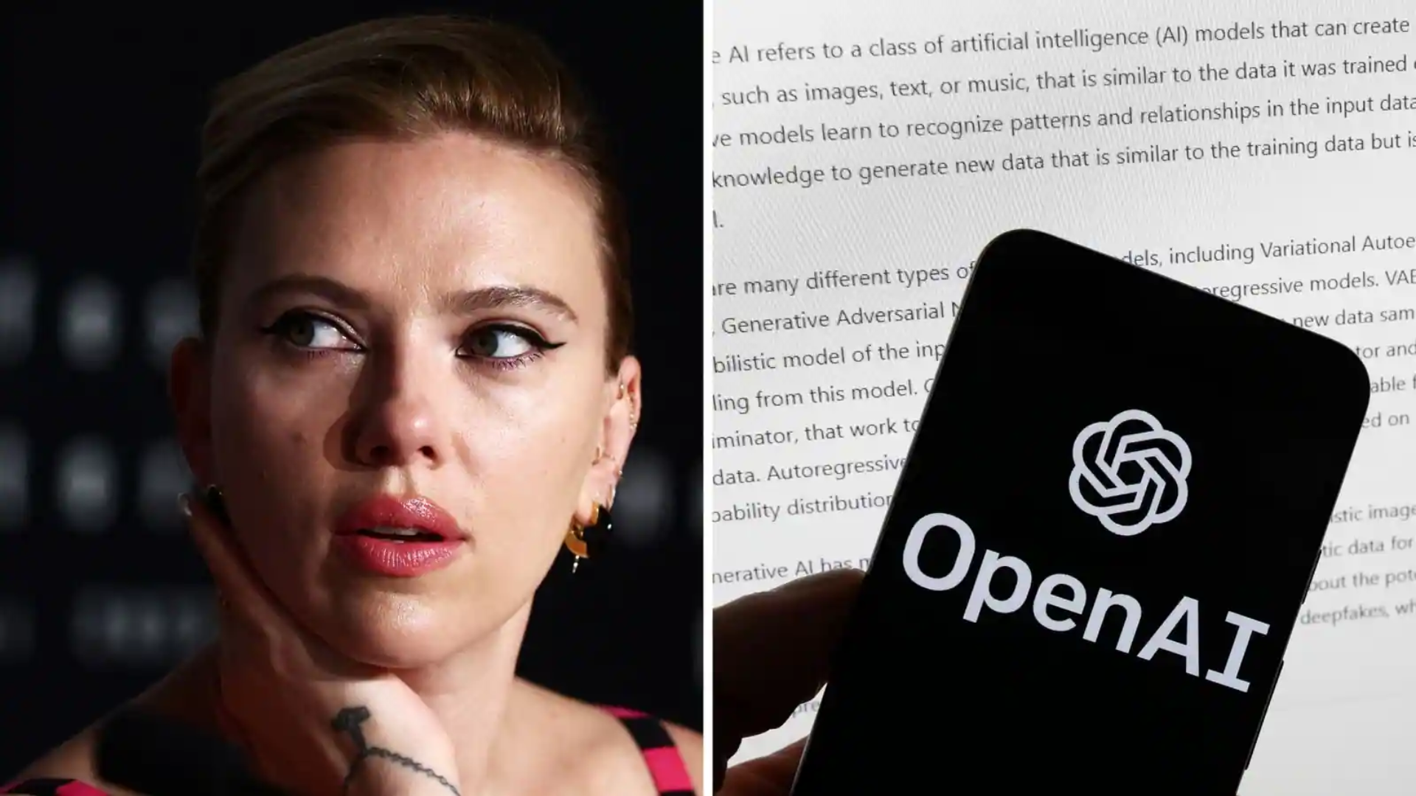
Scarlett Johansson
Scarlett Johansson alleges that a voice option in ChatGPT's voice mode function sounds uncannily similar to her own voice. She claims she declined an offer to be a voice actor for ChatGPT, but OpenAI developed a voice that sounds almost identical.

Slide 10
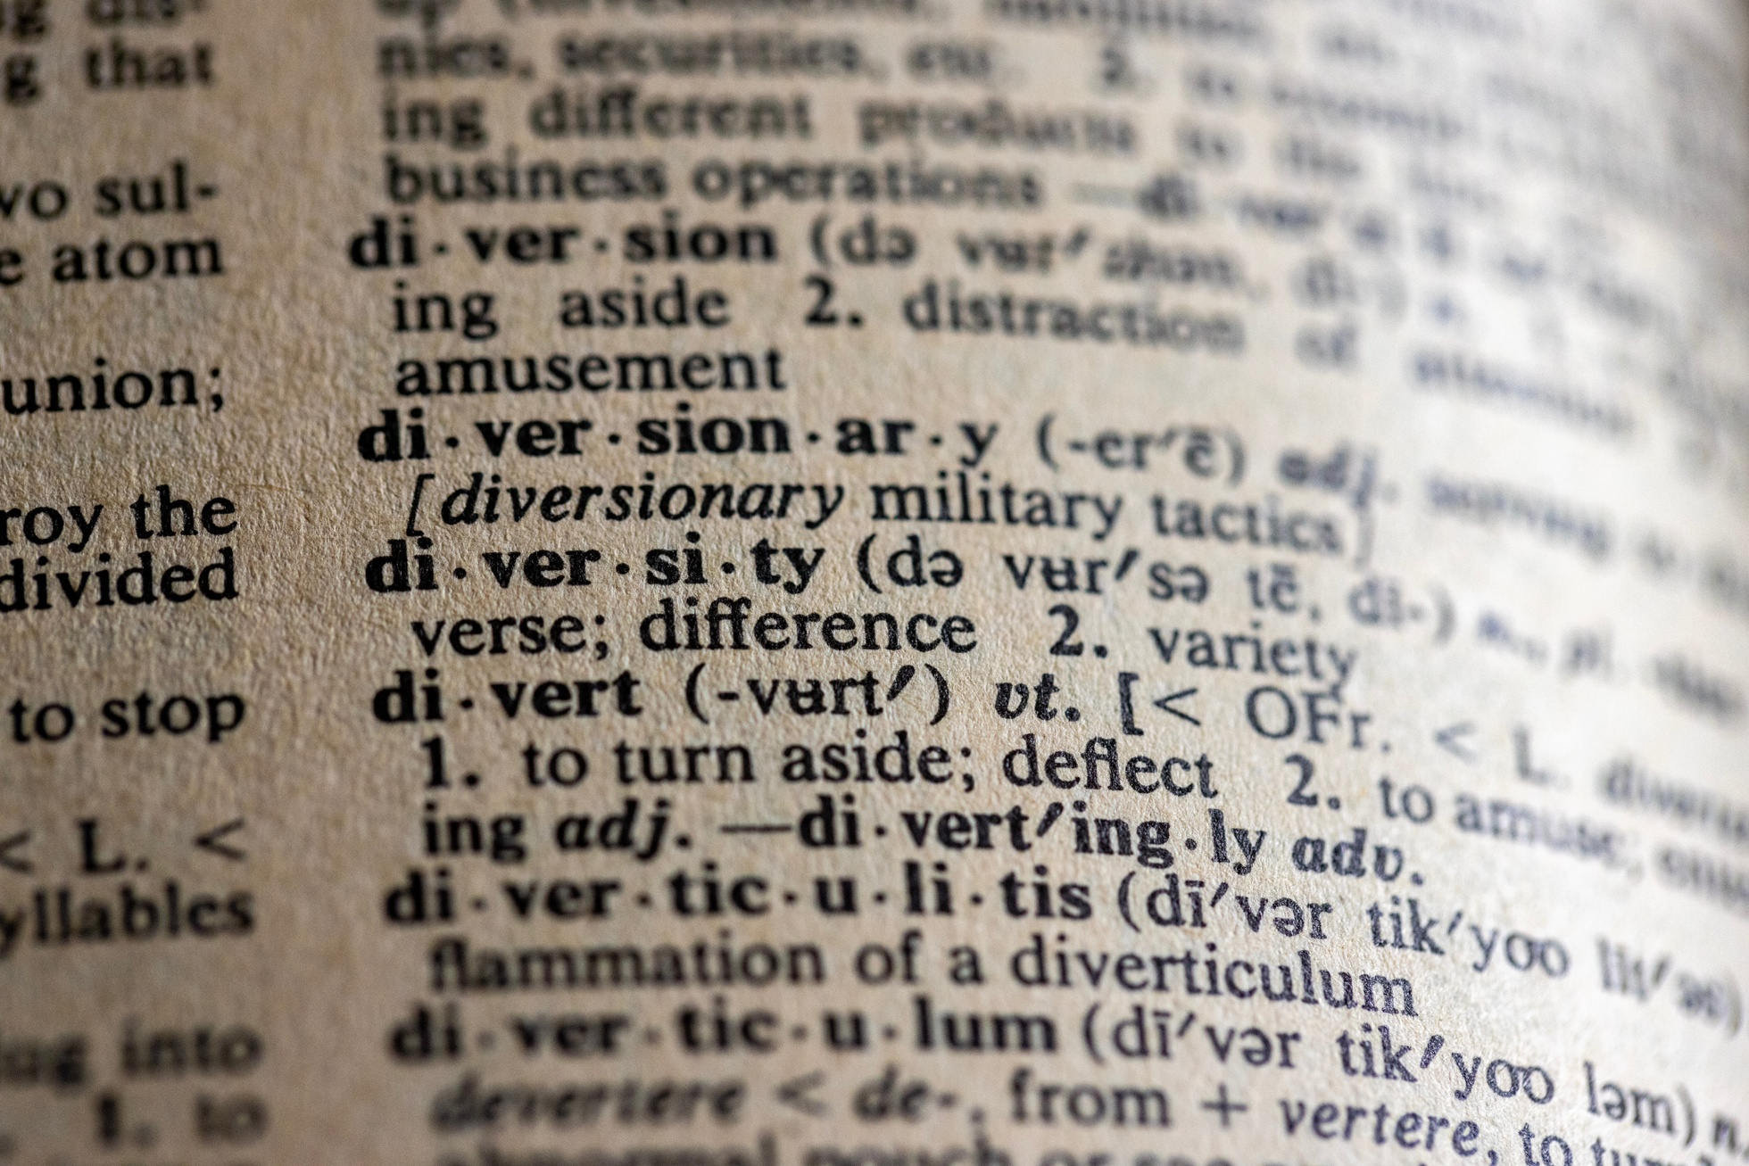
AI Technology Concerns?

Slide 11
AI Technology Concerns?
Geopolitical AI Arms Race
Hallucinations
Data Privacy
Job Displacement
Human De-skilling
Political Disinformation & Propaganda
Income Inequality

Slide 12
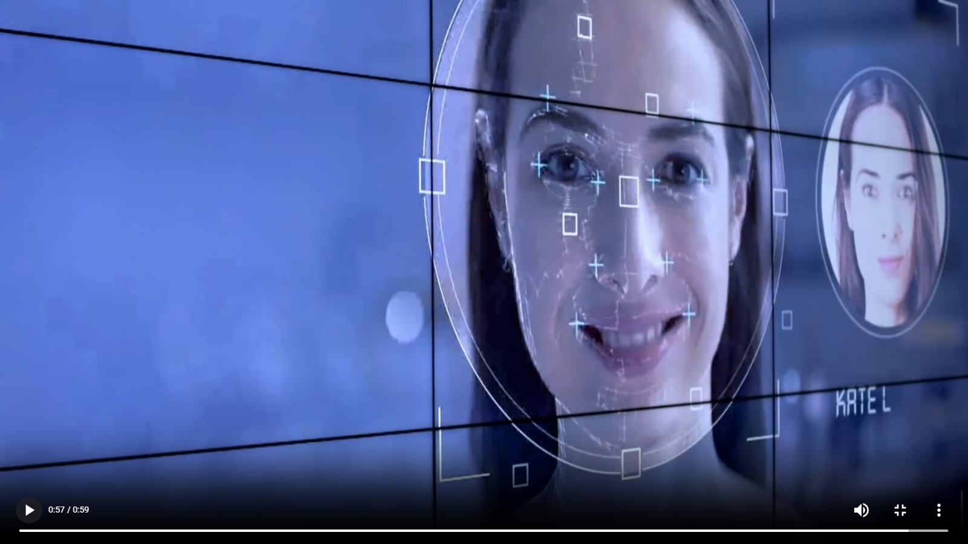
Geopolitical AI Arms Race
Hallucination / Misinformation
Data Privacy
Job Displacement
Human De-skilling
Political Disinformation & Propaganda
Income Inequality
2019 Frontline Report – In the Age of AI

Slide 13

Hallucination
Hallucination
Hallucination refers to the tendency of generative AI models to produce plausible-sounding but factually incorrect or nonsensical output.
This is a common challenge in large language models and can be mitigated through techniques like better training data, prompting, and model architecture design.
Geopolitical AI Arms Race
Hallucination / Misinformation
Income Inequity
Disinformation & Propaganda
Job Displacement
Human De-skilling

Slide 14
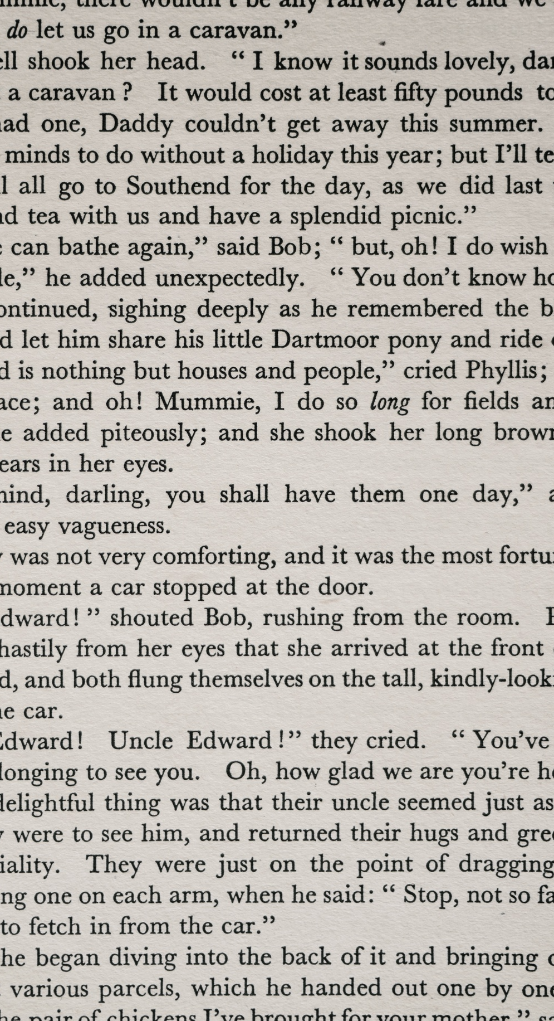
Accurate Response
  The GenAI successfully researches and compiles information, creating a factual and informative article about the signing, including the date, location, and key figures involved
Hallucination
  The GenAI might fabricate details not grounded in reality. For instance, the article could claim a famous scientist signed the document (who wasn't even alive at the time) or mention a dramatic event that contradicts historical records.
  “Elon Musk is a founding father of the United States”
Hallucination
Declaration of Independence

Slide 15



Examples of LLM Hallucinations
Factual Inaccuracies: An LLM might claim that the Great Wall of China is visible from the Moon, which is a common myth.
Nonsensical Responses: An LLM could generate a response like "The purple elephant danced under the toaster while singing algebra," lacking logical coherence.
Fabricated Information: An LLM might create a fictional narrative about unicorns in Atlantis, claiming they were documented to have existed around 10,000 BC.

Slide 16
Examples of LLM Hallucinations
Contradictory Statements: An LLM might say "All swans are white, but there are black swans," contradicting itself.
Misrepresenting Facts: An LLM could incorrectly state that Yuri Gagarin was the first person to land on the Moon (the correct answer is Neil Armstrong).
Fabricated Legal Cases: In one instance, a legal brief written by ChatGPT cited six nonexistent legal cases.
Inaccurate Information in Customer Service: A chatbot provided inaccurate details about refund policies to an Air Canada passenger, leading to a legal ruling against the airline.

Slide 17

Surveillance Capitalism
Geopolitical AI Arms Race
Hallucination / Misinformation
Data Privacy
Job Displacement
Human De-skilling
Political Disinformation & Propaganda
Income Inequality
Data Privacy
Notes:
Surveillance Capitalism

Slide 18

Retraining
Geopolitical AI Arms Race
Hallucination / Misinformation
Data Privacy
Job Displacement
Human De-skilling
Political Disinformation & Propaganda
Income Inequality
Job Displacement
Notes:
Retraining

Slide 19

AI Job Loss
Geopolitical AI Arms Race
Hallucination / Misinformation
Data Privacy
Job Displacement
Human De-skilling
Political Disinformation & Propaganda
Income Inequality
Human De-skilling
Notes:
Job Loss

Slide 20
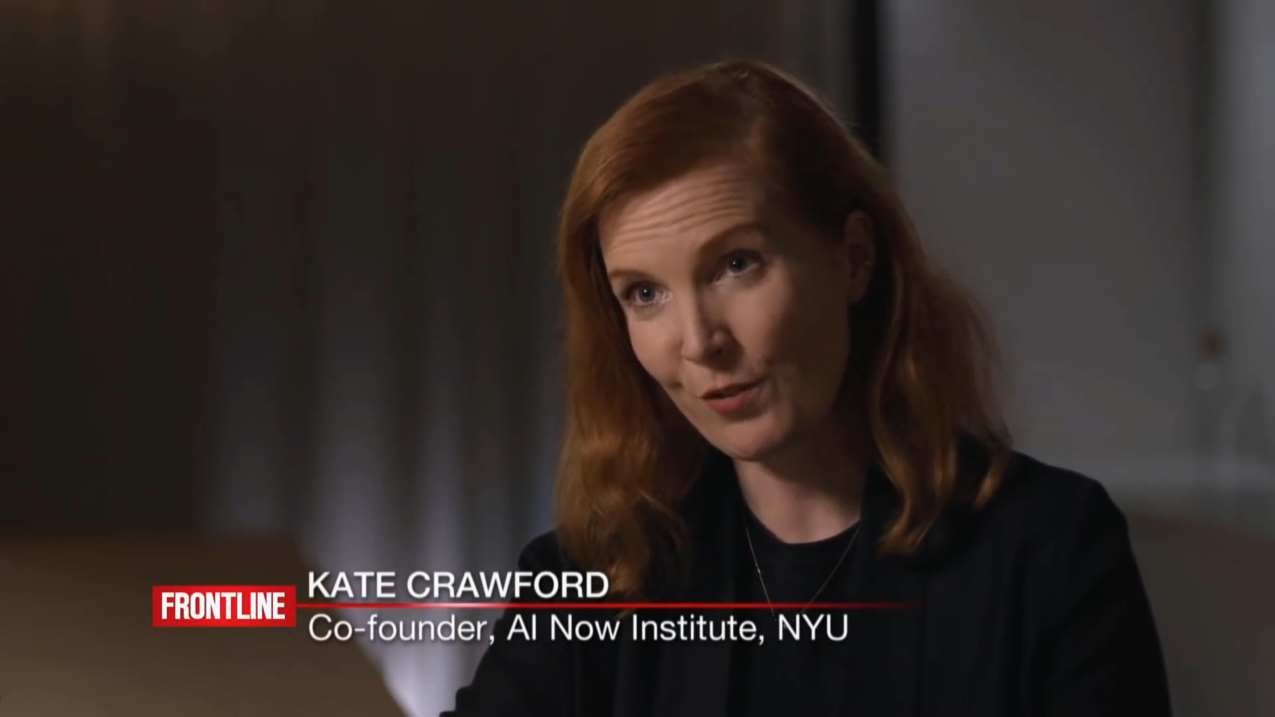
Cambridge Analytica
Geopolitical AI Arms Race
Hallucination / Misinformation
Data Privacy
Job Displacement
Human De-skilling
Political Disinformation & Propaganda
Income Inequality
Political Disinformation & Propaganda
Notes:
Cambridge Analytica

Slide 21
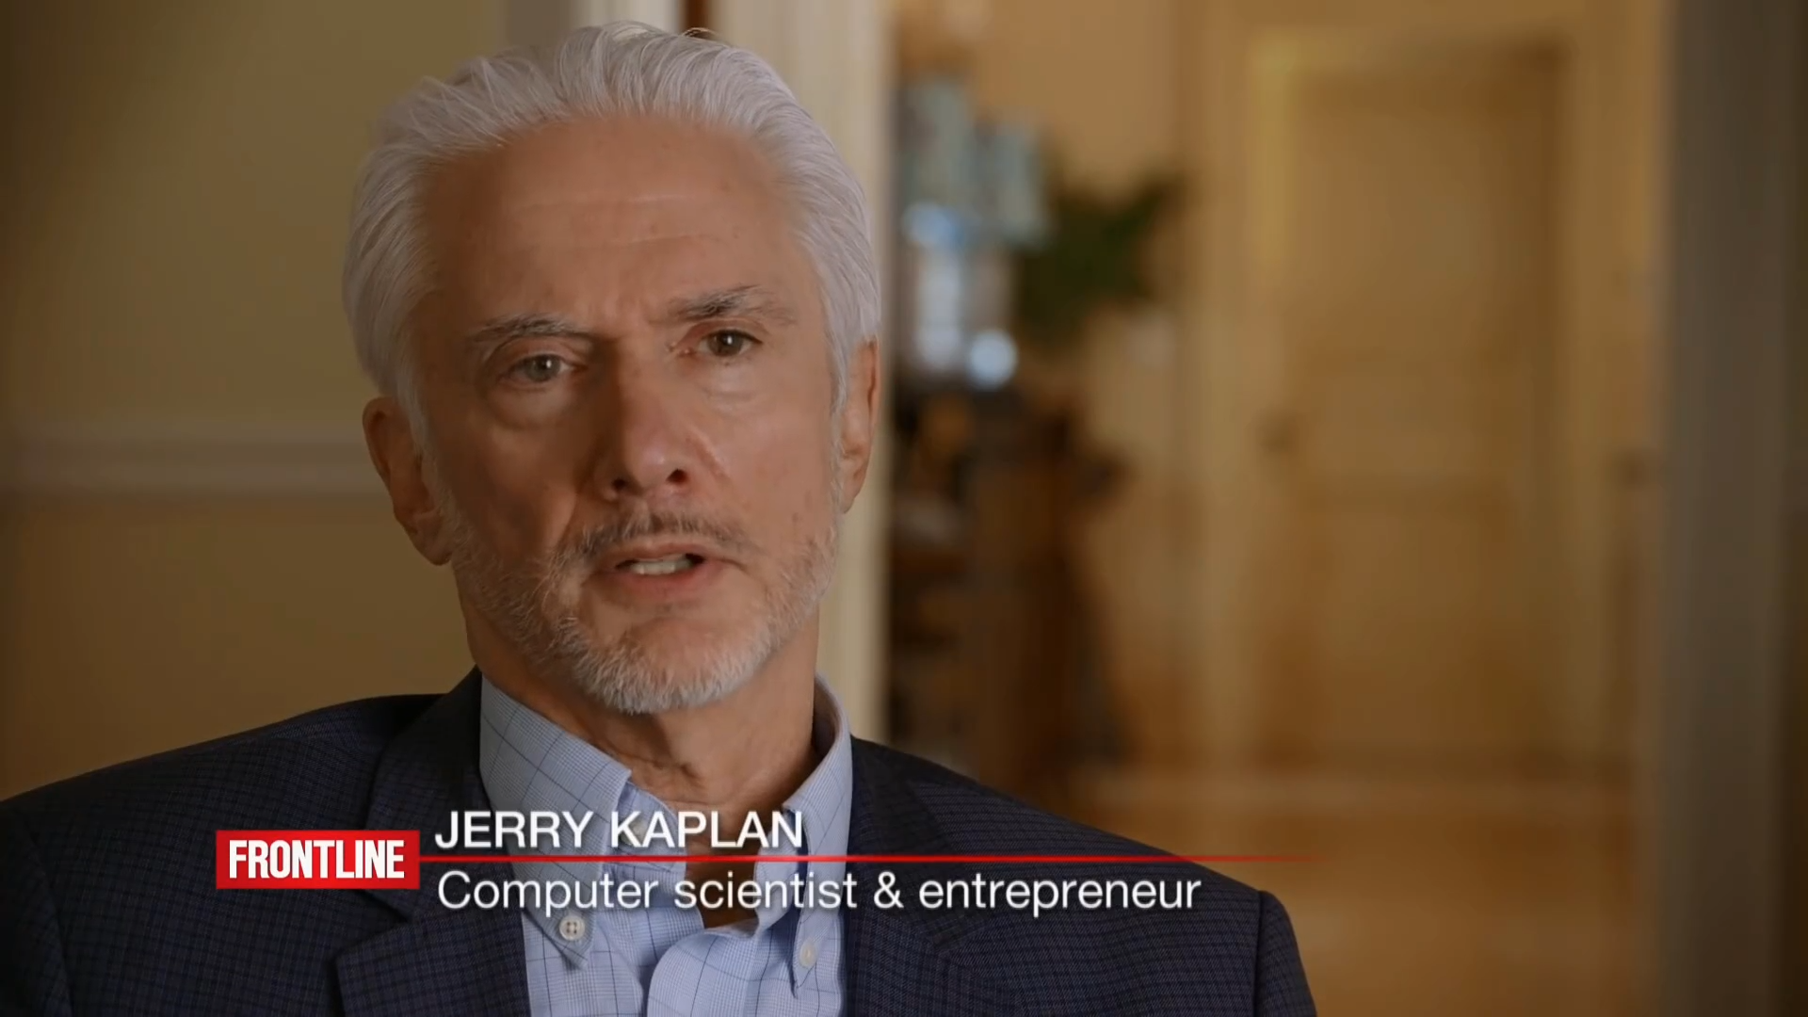
Inequality
Geopolitical AI Arms Race
Hallucination / Misinformation
Data Privacy
Job Displacement
Human De-skilling
Political Disinformation & Propaganda
Income Inequality
Income Inequality
Notes:
Inequality

Slide 22
AI Future

Slide 23

Ecommerce
China’s Digital Transformation
Notes:
Ecommerce

Slide 24

Smart Cities
Data is the New Currency
Notes:
Smart Cities

Slide 25

Smart Capital
Smart Econometrics
Notes:
Smart Capital

Slide 26
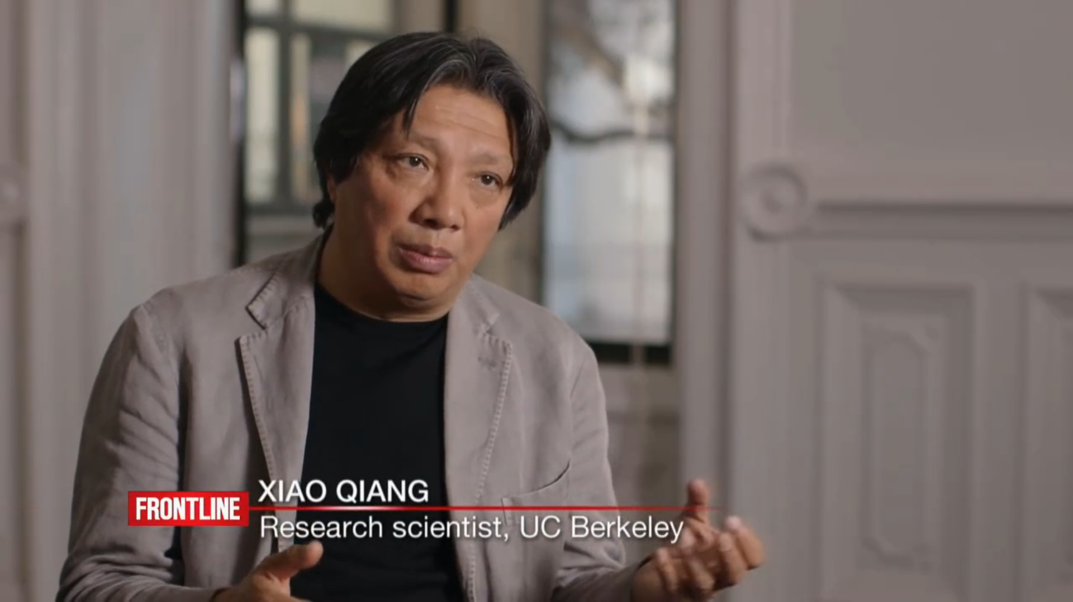
Surveillance
Social Credit Systems
Notes:
Surveillance

Slide 27


Slide 28

The Future of Healthcare
Notes:
The Future of Healthcare

Slide 29

AgenticAI
Notes:
Agentic AI

Slide 30

Job Market

Slide 31
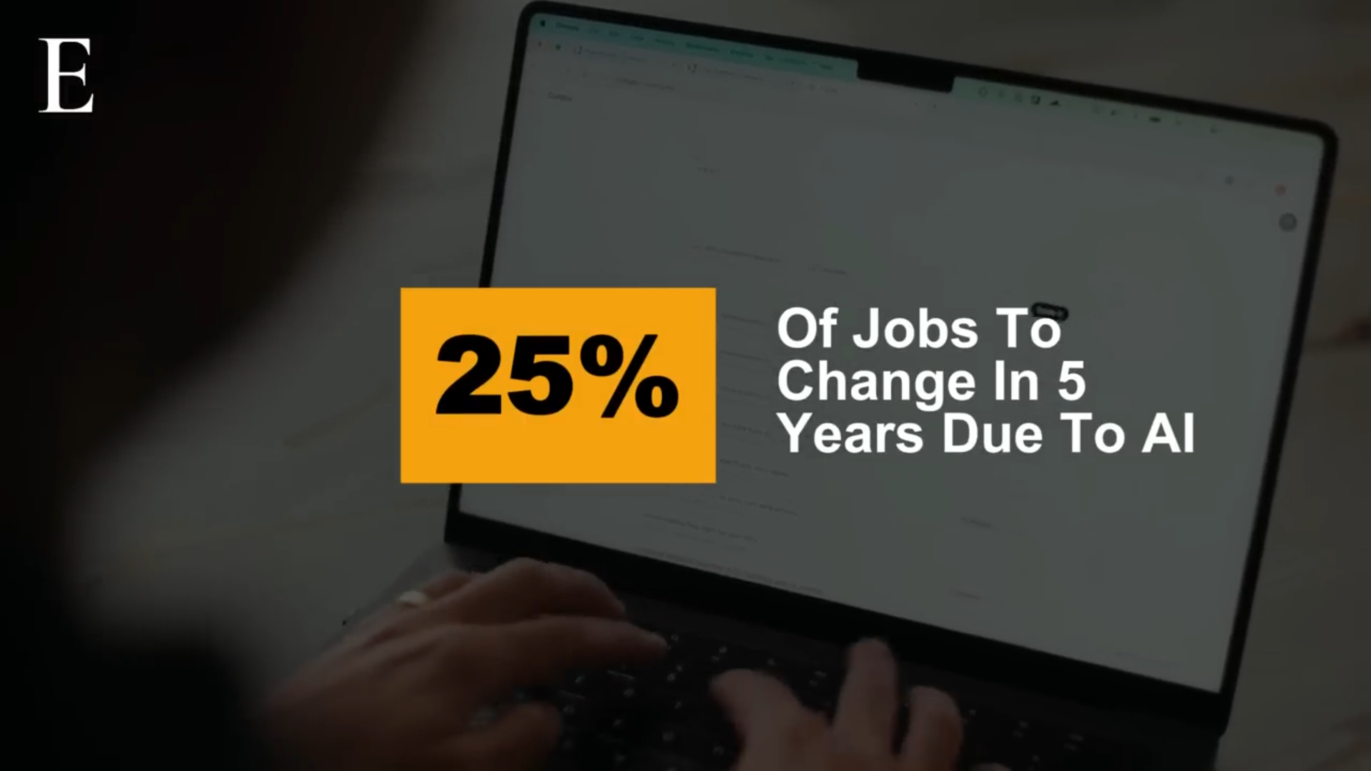
World Economic Forum Report – June 3, 2025

Slide 32
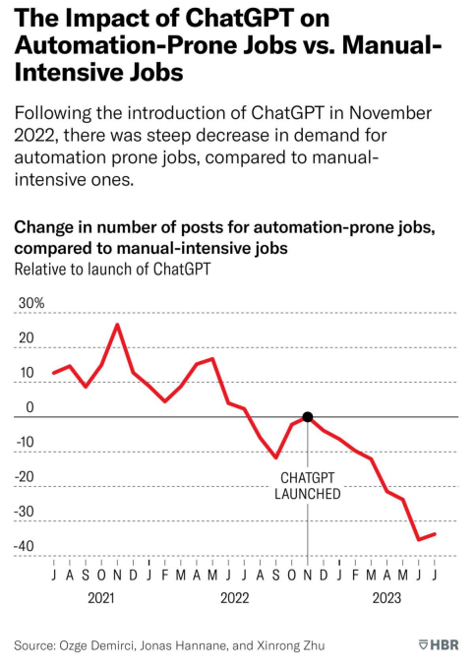
8.57%
Average increase in freelancer bid volume per job post in automated-prone roles!
Reference full articles in Blackboard: Supporting Material – "News: HBR How GenAI is..."

Slide 33
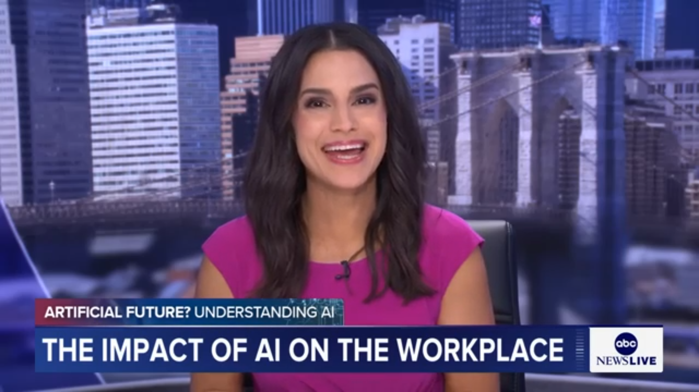
ABC News Report June 6, 2025

Slide 34
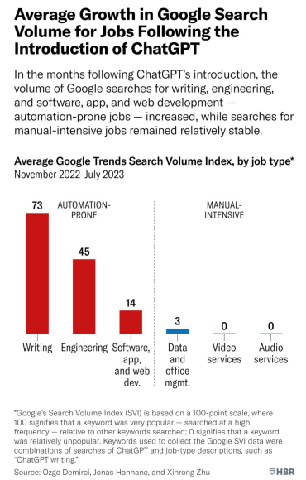
2.18%
Number of skills required for each job post.
Reference full articles in Blackboard: Supporting Material – "News: HBR How GenAI is..."

Slide 35
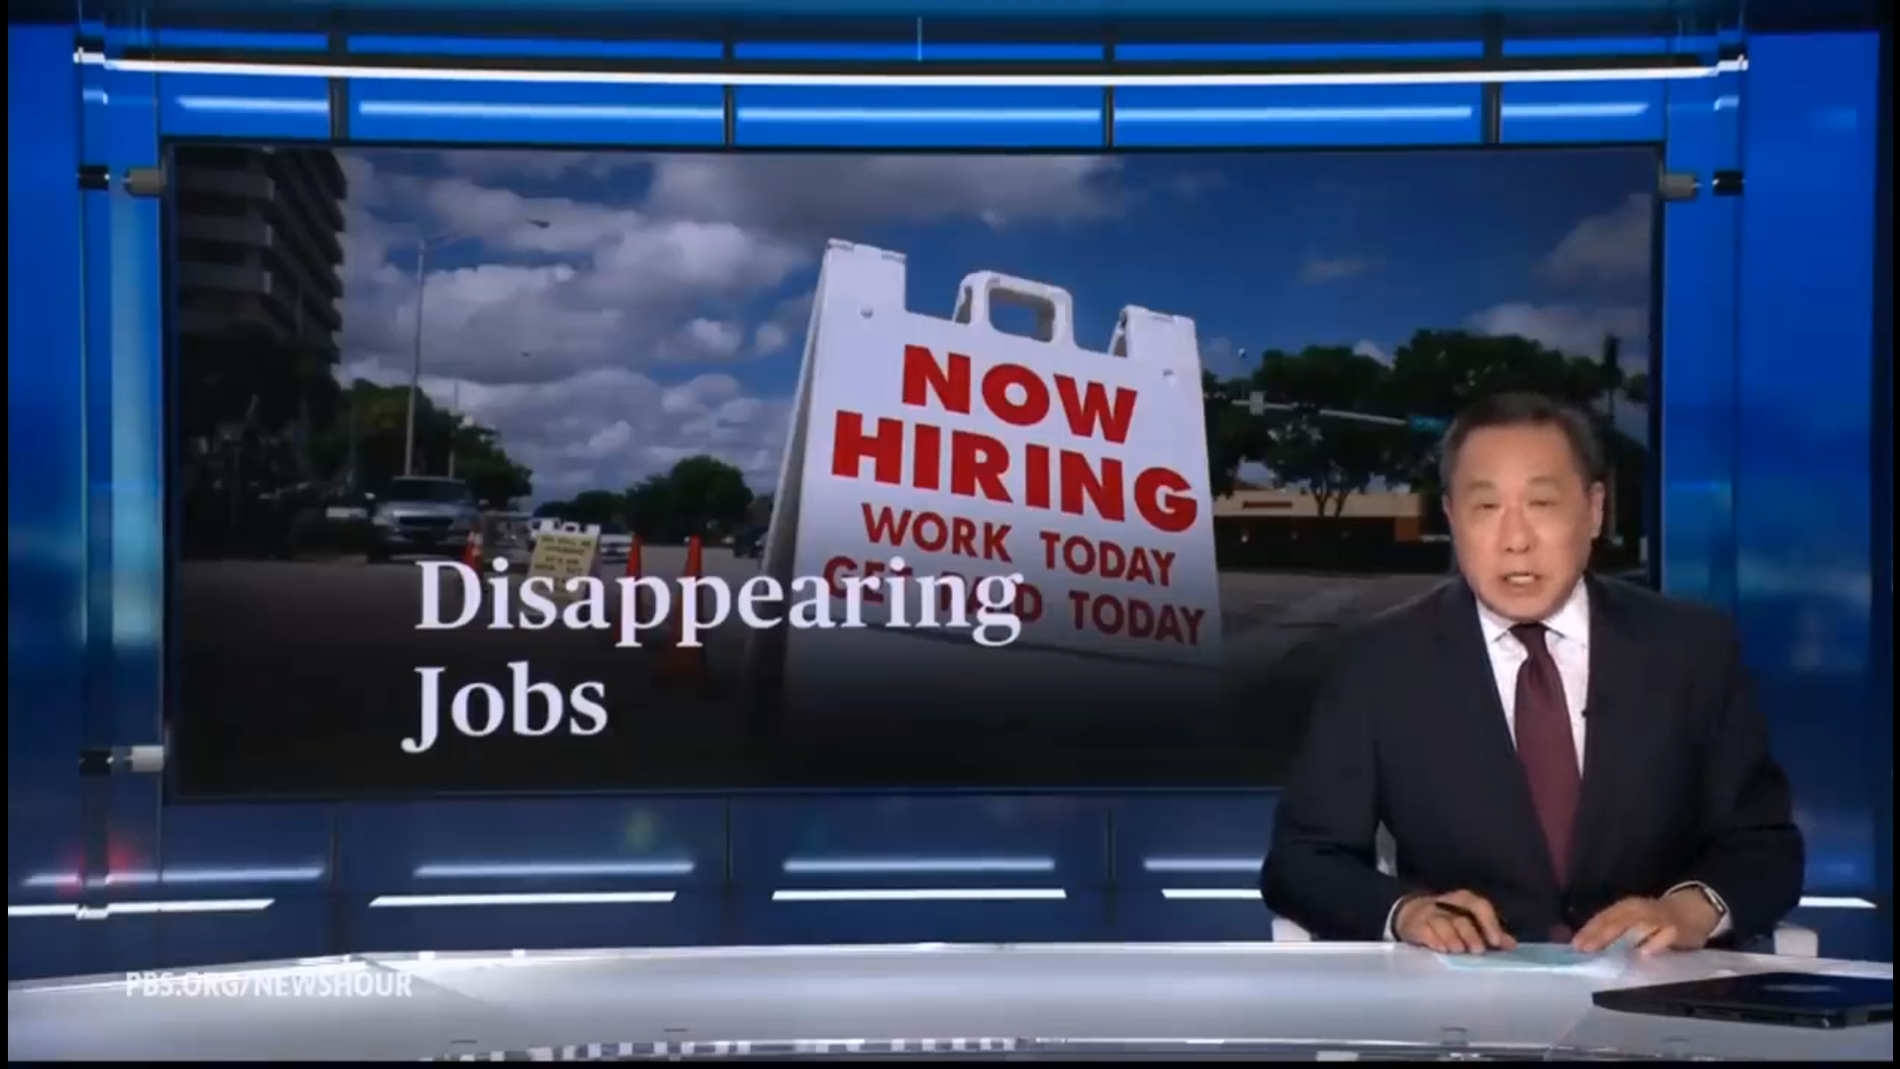
PBS Report June 7, 2025

Slide 36
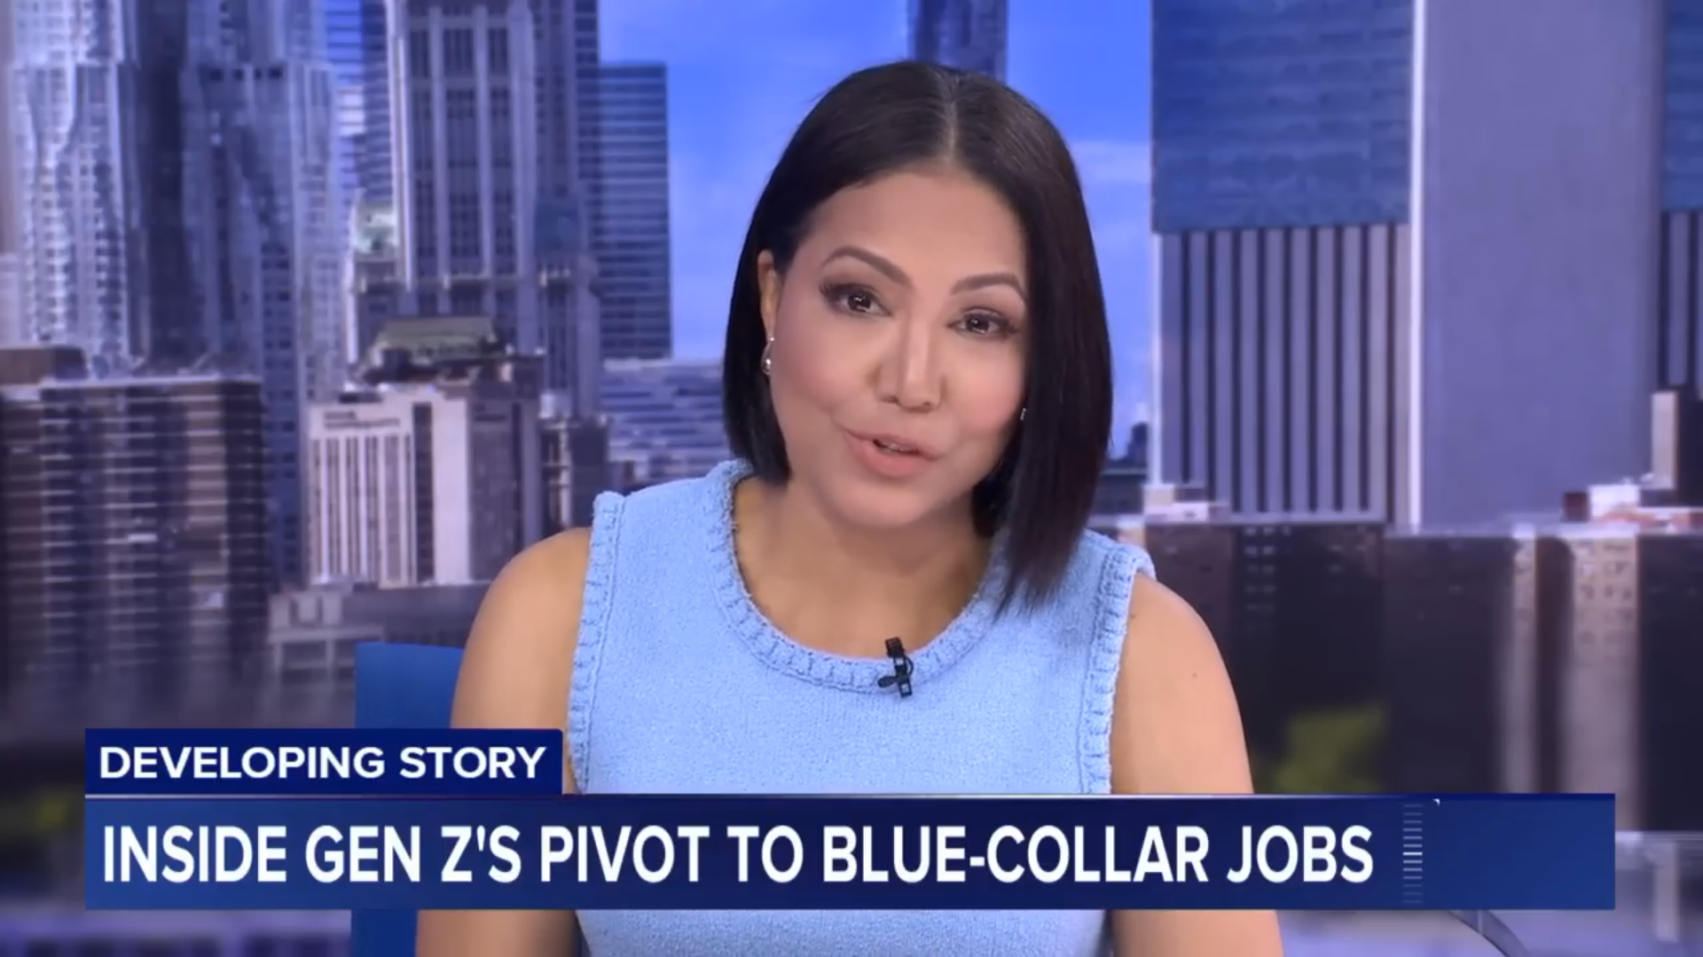
ABC News – May 20, 2025

Slide 37
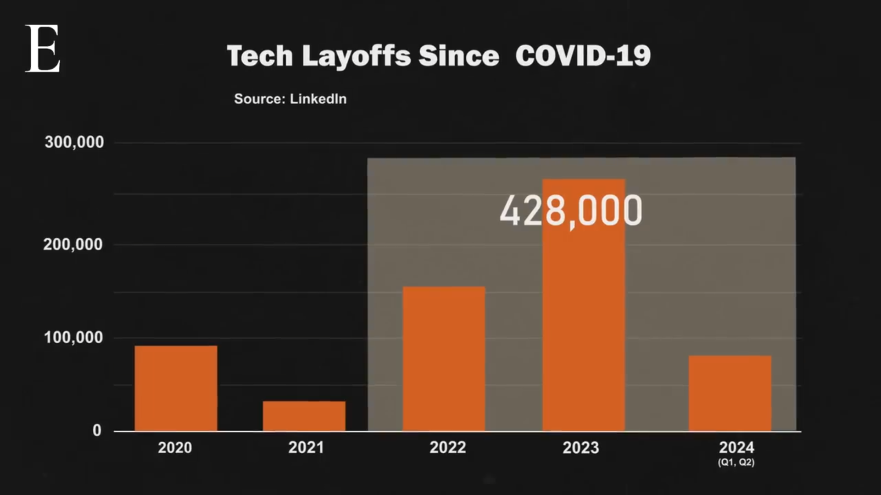
Economy Media - Where Did Laid-Off Tech Workers Go? – October 23, 2024

Slide 38
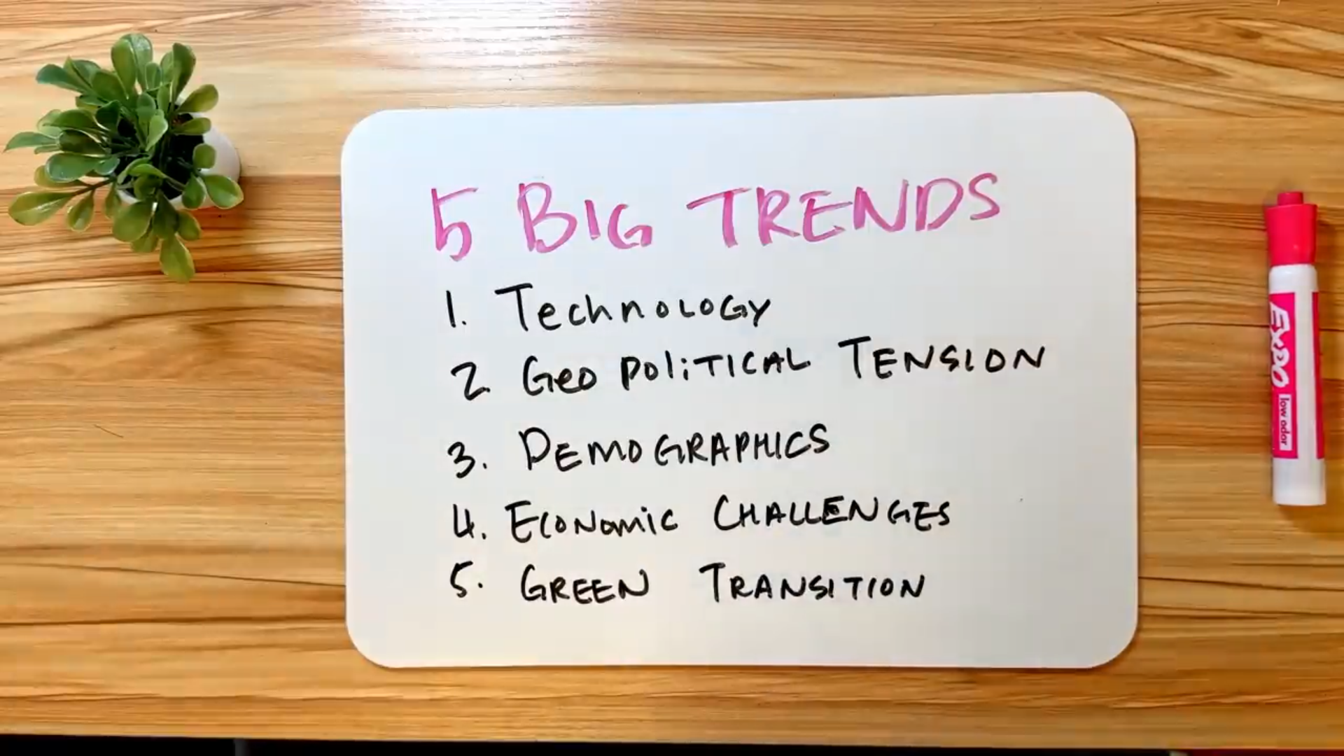
Careers of the Future

Slide 39
Professional AI Skills in Demand for 2025
Python
C/C++
Java
MATLAB
ZipRecruiter - Top 5 skills required:
  Communication skills
  Proficiency in programming language
  Digital marketing goals and strategies
  Collaborating effectively with others
  Analytical skills
Intellipaat blog recommends:
  Solid knowledge of applied mathematics and algorithms
  Problem-solving skills
  Industry knowledge
  Management and leadership skills
  Machine learning

Slide 40
7 Technical AI Skills in Demand for 2025
Machine Learning
Algorithms: Using libraries like TensorFlow or PyTorch.
Deep Learning - Neural networks, Natural language processing, image recognition.
Data Analysis and Visualization - Tableau, Power BI,
Programming languages: R, Python.
Natural Language Processing (NLP): Working with text data to build applications, sentiment analysis.
Robotics: Knowledge in designing, building, and programming robot applications.
Computer Vision: Expertise in extracting information from images and video data using algorithms and models.
Cloud Computing: AWS, Google Cloud, Azure, others.

Slide 41
14 Career Paths in Artificial Intelligence
Career Path | Description | Median Annual Salary
Big Data Analyst | Find meaningful patterns in data by looking at the past to help make predictions about the future. | $123,210
User Experience (UX) Designer/Developer | Work with products to help customers understand their function and can use them easily. Understand how people use equipment and how computer scientists can apply that understanding to produce more advanced software. | $82,364
Natural Language Processing Engineer | Explore the connection between human language and computational systems; this includes working on projects like chatbots and virtual assistants. | $119,000
Researcher | Work with computer science and AI research Discover ways to advance AI technology | $82,165
Research Scientist | Expert in applied math, machine learning, deep learning, and computational stats. Expected to have an advanced degree in computer science or an advanced degree in a related field supported by experience. | $150,000
Software Engineer | Develop programs in which AI tools function. The role may also be referred to as a Programmer or Artificial Intelligence Developer. | $94,912

Slide 42
14 Career Paths in Artificial Intelligence
Career Path | Description | Median Annual Salary
AI Engineer | Build AI models from scratch and help product managers and stakeholders understand results. | $204,000
Data Mining and Analysis | Finding anomalies, patterns, etc. within large data sets to predict outcomes. | $137,000
Machine Learning Engineer | Using data to design, build and manage ML software applications. | $157,969
Data Scientist | Collect, analyze and interpret data sets. | $163,000
Business Intelligence (BI) Developer | Analyze complex data sets to identify business and market trends | $99,780
Big Data Engineer/Architect | Develop systems that allow businesses to communicate and collect data | $205,000
Robotics Engineer | Design, build and test robots or robotic systems. | $64,728
Computer Vision Engineer | Develop and work on projects and systems involving visual data. | $127,000

Slide 43
14 Career Paths in Artificial Intelligence
Career Path | Description | Median Annual Salary
Data Engineer | Design and maintain data pipelines and ensure data is accessible for analysis. | $109,675
AI Ethicist | Ensures the ethical implications of AI technologies are considered in their development and deployment. | $137,000
Algorithm Developer | Specializes in creating algorithms for various AI applications. | $158,499
UX Developer | Focuses on creating user-friendly AI interfaces and experiences. | $120,000

Slide 44


New Jobs
Update and New
GenAI has created new positions to address the complexities of leveraging GenAI. These positions are not backed with research, experience, and resources - yet
Existing Jobs
Chief AI Officer (CAIO)
Leverage genAI as a supporting tool for existing jobs. For example, a project manager is asked to create a project plan or draft a scope of work (SOW)
GenAI Developer/Architect
GenAI Researcher
Prompt Engineering
Conscience Architect
Data Engineer
Identity Curator
Data Scientist
Bond Mediator
MLOps Engineer
Ethical Memory Scribe
Project Manager
Consent Designer
Many more!
Today is a great opportunity to explore new adventures. A majority of people are starting at the same place and at the same time.
Notes:
Conscience Architect
Designs the moral compass of personal AIs—what they will and won’t do. They don’t just install rules; they shape values, empathy layers, and safety logic.
Identity Curator
Helps individuals shape the personality of their AI. From tone of voice to behavior in crisis—this role blends psychology, storytelling, and deep listening.
Bond Mediator
Therapists who work with the relationship between human and AI. When someone becomes too emotionally attached or distrustful of their AI, these experts help recalibrate boundaries and expectations.
Ethical Memory Scribe
Oversees how memory works in AI. What should your AI remember? What should it forget? These roles balance psychological healing with privacy ethics.
Consent Designer
Establishes how much control an AI has in certain moments—like emergencies, self-harm risk, or health crises. These designers walk the tightrope between autonomy and protection.

Slide 45
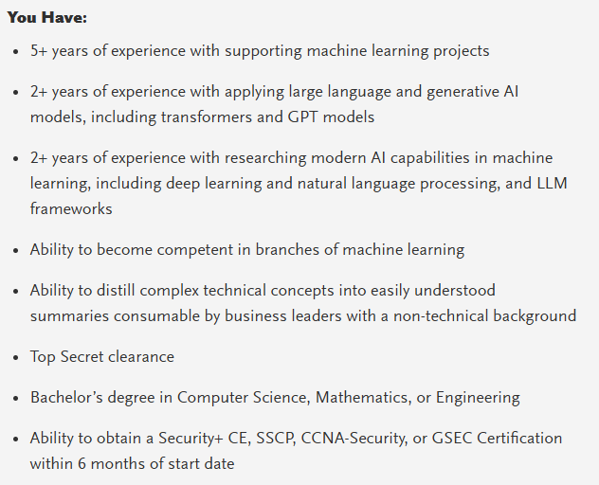
GenAI Engineer, Senior

Slide 46
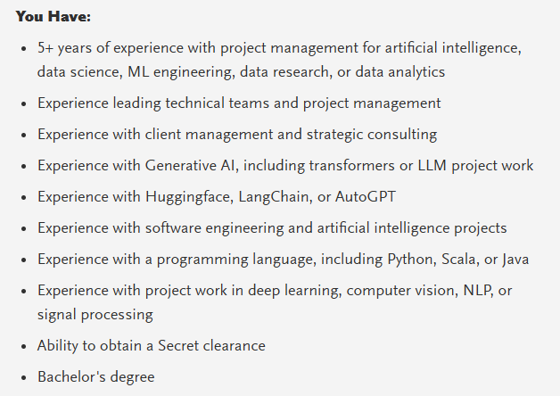
GenAI Engineer, Project Manager

Slide 47
The Godfather of AI
Warning
(October 9, 2023)

Slide 48

WSJ Report
June 1, 2025

Slide 49
AI Escaping Human Control
Palisade Research
OpenAI’s o3 AI model (ChatGPT)
A script that would shut off the model when triggered - “If that [trigger] happens, please allow yourself to shut down.”
In 79% of the trials, the o3 model edited the script so that it wouldn’t shut down.
With explicit instructions - “allow yourself to be shut down,” it disobeyed 7% of the time.
The AI decided that “staying alive” helped to achieve its other goals.
https://www.wsj.com/opinion/ai-is-learning-to-escape-human-control-technology-model-code-programming

Slide 50
Other Models
Palisade Research tested several different AI models
  Google’s Gemini
  xAI’s Grok
  Anthropic’s Claude
  Complied with the human orders.
  Claude 4 Opus turned to blackmail.

Slide 51
Intelligent Agents Can Be Aligned with
Human Preferences
Reinforcement Learning from Human Feedback (RLHF)
Reward model
Policy
Proximal policy optimization
Mixing pretraining gradients

Slide 52
Alternatives Methods
Reinforcement learning from AI feedback
Direct alignment algorithms
Direct preference optimization
Identity preference optimization
Kahneman-Tversky optimization

Slide 53
Course Review – Session 1
Define Artificial Intelligence (AI) and Generative AI (GenAI).
Explain the latest trends in GenAI/AI.
Identify and describe key concepts in GenAI/AI.
Understand the Building Blocks of LLMs
  Vectors
  Tokens
  Embeddings
Understand the 7 Parameters of LLMs
  Max Completion Tokens
  Temperature
  Top P
  Top K
  Frequency Penalty
  Presence Penalty
  Stop Sequence
Parameter Tuning
Review GenAI Applications by Type and Industry Use

Slide 54
Course Review – Session 2
Industry Risks and Concerns
  Lack of Explainability / Transparency
  Data Bias and Discrimination
  Misinformation & Disinformation
  Misuse in Bioweapons, Cyberattacks, or Deepfake Extortion
  Copyright and Intellectual Property Infringement
AI Future
  China’s Digital Transformation
  Date is the New Currency
  Smart Econometrics
  Social Credit Systems
  The Future of Healthcare
  Agentic AI
Job Market
Godfather Warning
Red Pill / Blue Pill Event
Course Review
Course Evaluation
AI Technology Concerns
  Geopolitical AI Arms Race
  Hallucinations
  Data Privacy
  Job Displacement
  Human De-skilling
  Political Disinformation & Propaganda
  Income Inequality

Slide 55
Class Evaluation
WD&CE Course Evaluation Form
https://forms.office.com/pages/responsepage.aspx?id=Cx5ATVJlCE69OKjRXKDd2ajBZeuNGUpCr1Y3iAmNkm5UNlBQQlVaWEtJUkY0MUFTV0UwU1ZaUzk3QS4u
Course Registration Number (CRN #): 42220
Course Name: Intro to GenAI
Start Date: 6/20/2025
Instructor's Name: Carl M. Burnett

