Slide 1
ITI 594 Introduction to Generative AI
Session I
http://www.profburnett.com
Master a Skill / Learn for Life

Slide 2
Course Outline – Session 1
Define Artificial Intelligence (AI) and Generative AI (GenAI).
Explain the latest trends in GenAI/AI.
Identify and describe key concepts in GenAI/AI.
Understand the Building Blocks of LLMs
Vectors
Tokens
Embeddings
Understand the 7 Parameters of LLMs
Max Completion Tokens
Temperature
Top P
Top K
Frequency Penalty
Presence Penalty
Stop Sequence
Parameter Tuning
Review GenAI Applications by Type and Industry Use

Slide 3
Course Outline – Session 2
Industry Risks and Concerns
Lack of Explainability / Transparency
Data Bias and Discrimination
Misinformation & Disinformation
Misuse in Bioweapons, Cyberattacks, or Deepfake Extortion
Copyright and Intellectual Property Infringement
AI Future
China’s Digital Transformation
Date is the New Currency
Smart Econometrics
Social Credit Systems
The Future of Healthcare
Agentic AI
Job Market
Godfather Warning
Red Pill / Blue Pill Event
Course Review
Course Evaluation
AI Technology Concerns
Geopolitical AI Arms Race
Hallucinations
Data Privacy
Job Displacement
Human De-skilling
Political Disinformation & Propaganda
Income Inequality

Slide 4
Define Artificial Intelligence (AI) and Generative AI (GenAI)

Slide 5
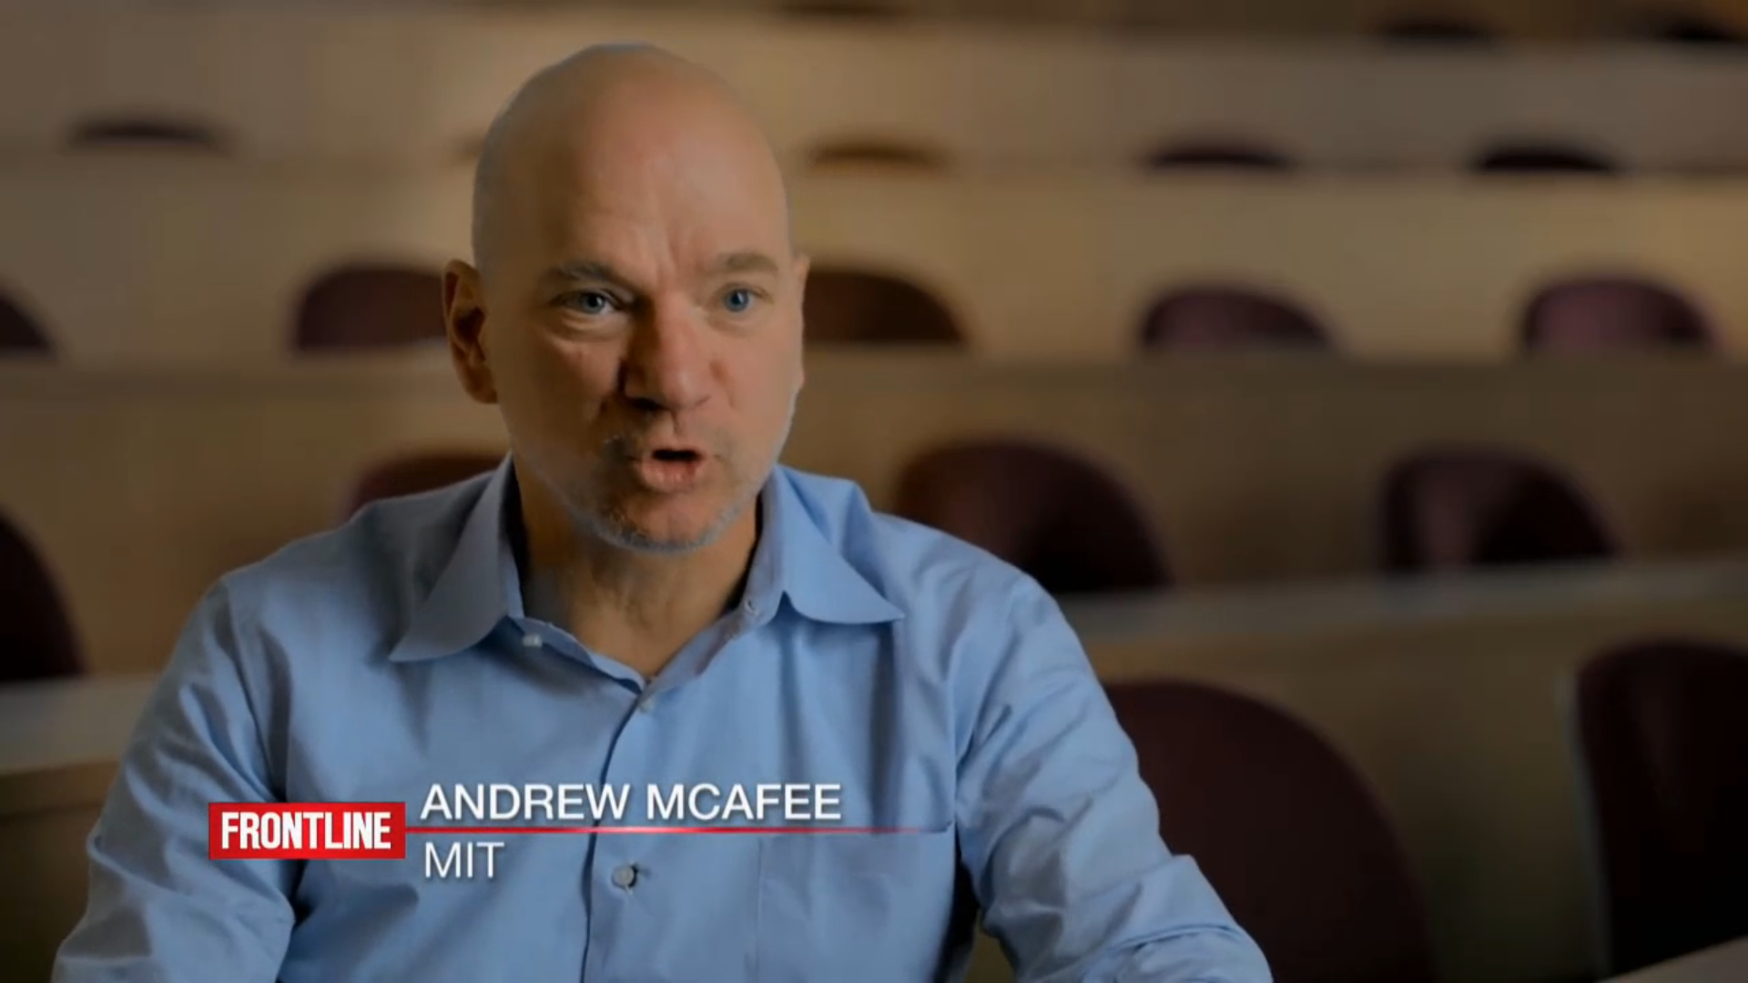
Social Development
Notes:
Social Development

Slide 6
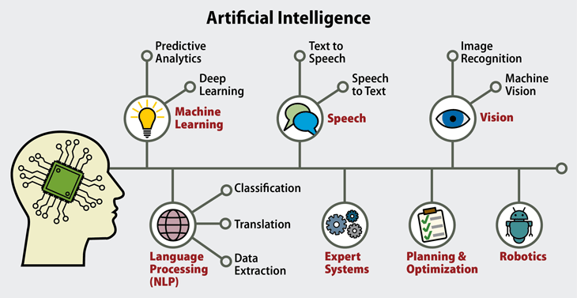
Artificial Intelligence (AI)

Slide 7
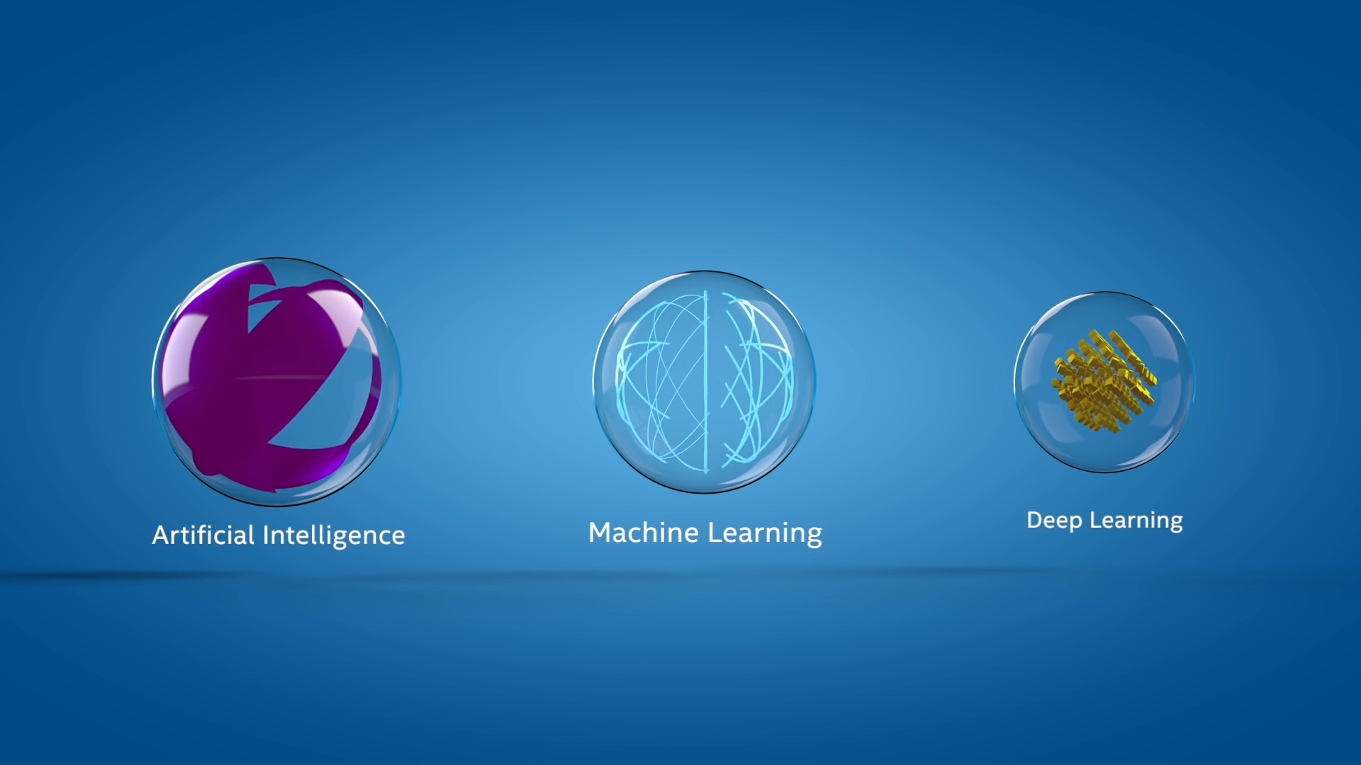
AI Explained and Released
Notes:
AI Explained

Slide 8



Why Now?
Architecture
Data
Technology
Creation of different Architectural Frameworks has enabled enhanced methods to process and analyze a vast amount of data and incorporate a “retention” memory factor.
There is now a vast amount of data available and generated that can be used to create GenAI models. In addition, verification and validation of the scaling law in models verifies the adage that “the more you have, the more accurate the model will be”.
Creation of advanced hardware to support intensive computational run-times. CPU vs GPU vs TPU vs NPUs.
These different models with varying parameter sizes and specializations demonstrate the diversity of large language models being developed for a range of applications in the field of generative AI.

Slide 9
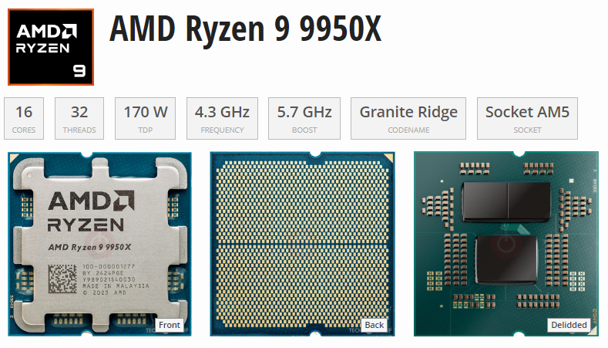
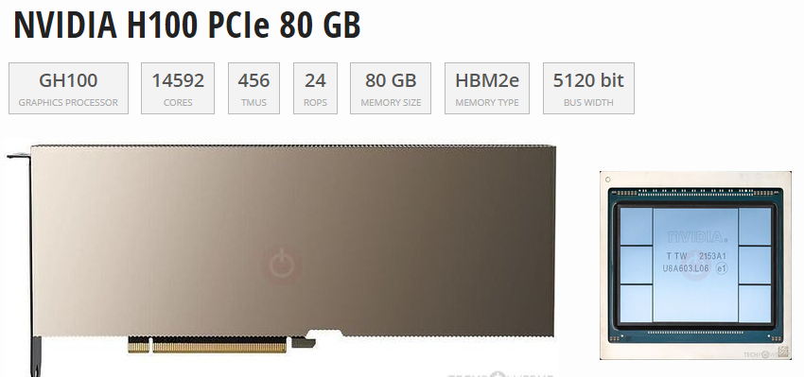
~$600
~$25,000

Slide 10
Processing Unit Comparisons
Comparative Analysis: Power FLOPS, & Bandwidth
Type | Flops (Peak) | Bandwidth | Power (W) | Flexibility | Best For
GPU | 19.5 – 312 TFLOPS (A100) | 1.6 TB/s (HBM3) | 400 W | High | AI / HPC Gaming
FPGA | 10-20 TFOPS | 100 GB/s 1 TB/s | 10 -50W | Very High | Edge / Telecom
ASIC | 4-1000s TOPS (Varies) | 20 PB/s (WSE-2) | 2W – 23kW | None | Specific AI Crypto
TPU | 275 TOPS (v4) | 1.2 TB/s (HBM3) | 100w-500kW | Moderate | ML Training / Inference
NPU | 15,8 TOPS (M2) | 50-100 GB/s | 1-5W | Low | Edge Inference
Name | Unit | Value
kiloFLOPS | kFLOPS | 10³
megaFLOPS | MFLOPS | 10⁶
gigaFLOPS | GFLOPS | 10⁹
teraFLOPS | TFLOPS | 10¹²
petaFLOPS | PFLOPS | 10¹⁵
exaFLOPS | EFLOPS | 10¹⁸
zettaFLOPS | ZFLOPS | 10²¹
yottaFLOPS | YFLOPS | 10²⁴
ronnaFLOPS | RFLOPS | 10²⁷
quettaFLOPS | QFLOPS | 10³⁰
https://theneildave.medium.com/gpu-vs-fpga-vs-asic-vs-tpu-vs-npu-benefits-use-cases-and-manufacturers-4419115069df
Notes:
Graphics Processing Units (GPUs)
Field-Programmable Gate Arrays (FPGAs)
Application-Specific Integrated Circuits (ASICs)
Tensor Processing Units (TPUs)
Neural Processing Units (NPUs)

Slide 11
Hierarchy of Intelligence
Artificial Intelligence (AI)
Machine Learning (ML)
Deep Learning (DL)
Neural Networks
Generative AI (GenAI):
Uses ML models
Deep learning architectures
Transformers and GANs

Slide 12
Hierarchy of Intelligence
Artificial Intelligence (AI)
AI is a field of computer science focused on creating system that can perform tasks requiring human-like intelligence, such as reasoning, learning, perception, and decision-making.
EX: IBM Watson, Google Bard, OpenAI Codex
Machine Learning (ML)
ML is a subset of AI that enables system to learn patterns from data and make predictions or decision without being explicitly programmed
EX: XGBoost, Random Forest
Deep Learning (DL)
DL is a specialized subset of ML that utilizes artificial neural networks with multiple layers to model complex patterns in data
EX: BERT (Bidirectional Encoder Representations from Transformers)
Neural Networks
A Neural Network is a computational model inspired by the human brain, consisting of interconnected layers of nodes (neurons) that process information through weighted connection and activation functions
EX: CNN – image/video recognition, Transformers – NLP AI apps
Generative AI (GenAI)
GenAI is a branch of AI that uses ML models, particularly deep learning architectures like transformers and GAN to generate content
EX: GPT, Stable Diffusion, MusicLM (Google DeepMind)

Slide 13
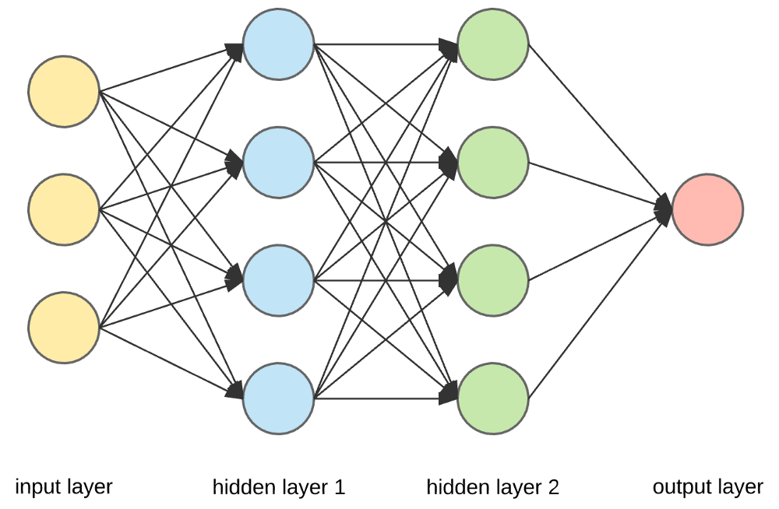
Neural Networks
Structure of Neural Networks
Consists of interconnected nodes called neurons, which process and transmit information.
Organized into layers, with each layer performing specific computations. Through
Neural networks recognize patterns and make accurate predictions based on vast amounts of data.

Slide 14
Types of Neural Networks
Convolutional Neural Networks (CNNs) (image and video recognition).
Recurrent Neural Networks (RNNs) process sequential data (speech recognition and language translation).
Generative Adversarial Networks (GANs) - Generate new content - Generative AI.

Slide 15
Latest Trends in GenAI/AI.

Slide 16
What is Generative AI?
Generative AI (GenAI) – A type of artificial intelligence
Can create:
New Text content
New Images
New Audio
New Video
Super-powered copycat that can learn the patterns of existing creative work and use that to generate new things.

Slide 17
Types of Uses
Content Creation
Generating text, images, music, and other media using generative AI models like GPT-3, DALL-E, and Midjourney.
Automated Workflows
Automating repetitive tasks and processes using language models to generate code, emails, and other documents.
Personalized Recommendations
Providing personalized recommendations for products, content, and services based on user preferences and behaviors.
Chatbots and Virtual Assistants
Creating conversational interfaces that can engage in natural language interactions, answer questions, and assist users.
Predictive Analytics
Generating insights and forecasts by analyzing data and patterns to identify trends and make predictions

Slide 18
Use By Industry
Healthcare
GenAI can assist in processing medical records, analyzing patient data, and aiding in diagnosis and treatment planning.
Finance
GenAI can be used for financial analysis, fraud detection, personalized investment recommendations, and automated portfolio management.
Retail and E-commerce
GenAI can optimize product recommendations, personalize customer experiences, automate customer service, and streamline inventory management.
Education
GenAI can provide personalized learning experiences, assist in grading and feedback, and create interactive educational content.
Media and Entertainment
GenAI can generate personalized content recommendations, automate video editing, and create synthetic media like deepfakes and CGI.

Slide 19
Key Concepts in GenAI/AI.

Slide 20



What is a "Framework"
Frameworks in GenAI
Hugging Face Transformers
Proprietary AI Platforms
Frameworks provide a structured approach to building and deploying generative AI models, including tools for data preprocessing, model training, security, and deployment.
The Hugging Face Transformers library is a popular framework for working with pre-trained language models, offering a wide range of models and utilities for fine-tuning and deploying these models.
Offer powerful, ready-to-use genAI modesl that enable test generation, image creation, etc. For example:
OpenAI API
Anthropic Clause API
Google Gemini
Generative AI frameworks provide a structured and scalable approach to building and deploying complex AI models, offering tools and utilities to streamline the development process.

Slide 21
Generative AI Frameworks
Tools
Platform
Facilitates the Development of AI Models

Slide 22
AI Frameworks
Generative AI Frameworks
TensorFlow (Google)
PyTorch (Meta/Facebook)
Keras
JAX (Google)
Hugging Face Transformers
FastAI
OpenVINO (Intel)
NNX (Open Neural Network Exchange)
MXNet (Apache)
MindSpore (Huawei)
LangChain
Other Notable Frameworks & Agents
LlamaIndex
Amazon Bedrock – Offers Models
OpenAI – Company - ChatGPT
DSPy - Stanford
Diffusers - Hugging Face
AWS Audit Manager
NIST AI Risk Management Framework
PandasAI – AI Agent
Auto-Gen - Microsoft – AI Agent
LangGraph - LangChain – AI Agent

Slide 23
AI Frameworks Comparison
Framework | Speed (Training/Inference) | Ease of Use | Best Use Cases
TensorFlow | (High, especially with XLA & TPUs) | Medium | Production deployment, mobile (TF Lite), large-scale ML
PyTorch | (Fast, especially for research prototyping) | Easy | Research, NLP, computer vision, deep learning R&D
Keras | (Depends on TensorFlow backend) | Very Easy | Beginners, fast prototyping, small-to-mid DL models
JAX | (Very fast, excellent for TPU/GPU) | Moderate | Mathematical ML research, custom models, optimization
Hugging Face Transformers | (Depends on backend, good for inference) | Easy | NLP tasks, pretrained model usage (GPT, BERT, etc.)
FastAI | (Built on PyTorch, optimized) | Very Easy | Education, transfer learning, image classification
OpenVINO | (Highly optimized for Intel HW) | Medium | Edge AI, inference on Intel CPUs/VPUs
ONNX | (Highly optimized for cross-platform inference) | Moderate | Model deployment across platforms and frameworks
MXNet | (Optimized for scalability) | Medium | Scalable deep learning, distributed training
MindSpore | (Optimized for Huawei ecosystem) | Medium | Cloud-edge-device synergy, embedded AI

Slide 24
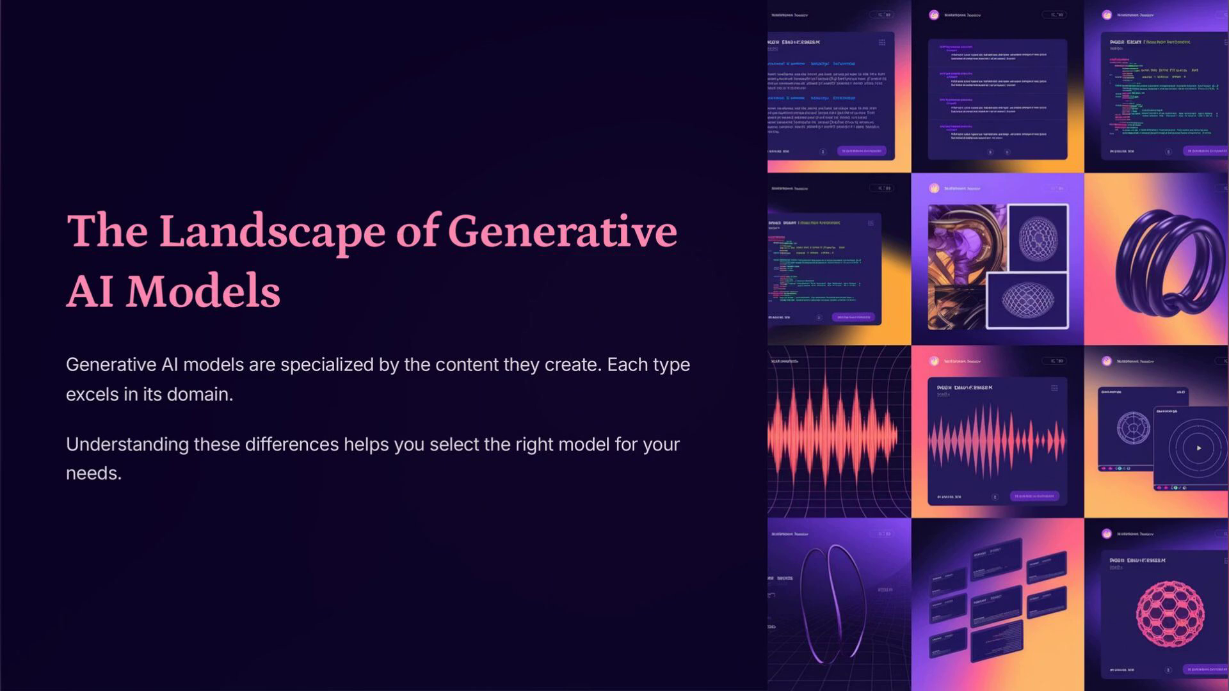
GenAI Models
Notes:
Generative AI Explained: Models and Techniques

Slide 25
Types of Generative AI Neural Network Models
Generative Adversarial Networks (GANs)
Variational Autoencoders (VAEs)
Transformer-based Language Models
Diffusion Models
Autoregressive Models
Flow-based Models

Slide 26
Generative Adversarial Networks (GANs)
How they work:
Two neural networks
Generator <> Discriminator - Compete
The generator creates data, and the discriminator tries to tell if it's real or fake.
Use cases: Image generation, art synthesis, video upscaling, deepfakes.
Examples: StyleGAN, BigGAN.

Slide 27

Generative Adversarial Networks (GANs)
Notes:
Generative Adversarial Networks (GANs)

Slide 28
Variational Autoencoders (VAEs)
How they work: Learn to compress data into a latent space and then decode it back to generate new similar data.
Use cases: Image and text generation, anomaly detection.
Examples:
Vanilla VAE
Conditional VAE.

Slide 29
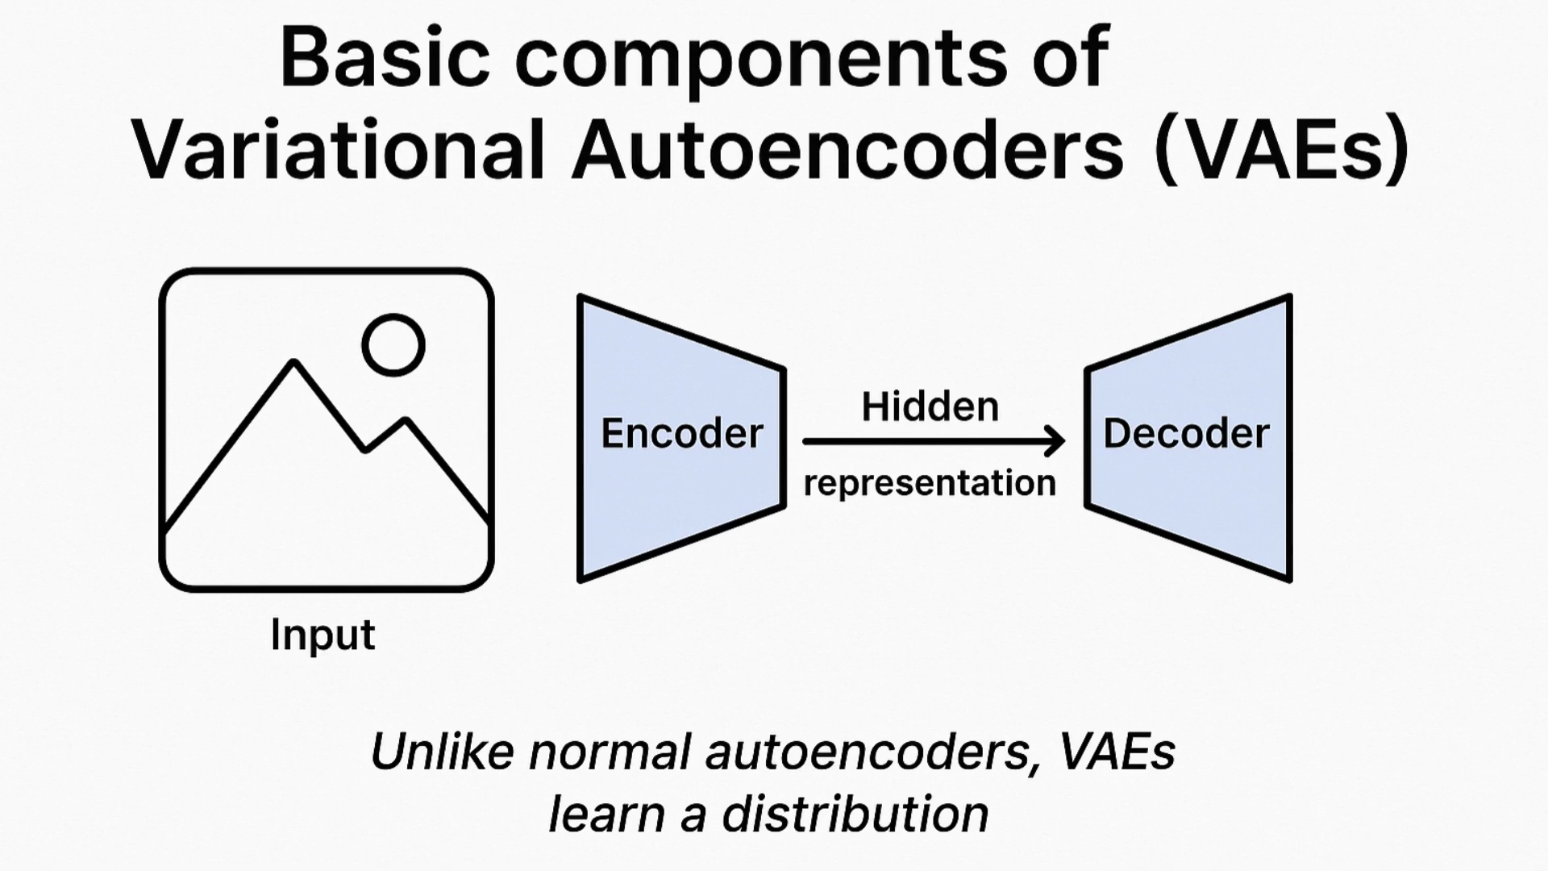
Variational Autoencoders (VAEs)
Notes:
Variational Autoencoders (VAEs)

Slide 30
Transformer-based Language Models
How they work: Use attention mechanisms to generate coherent sequences of text or code.
Use cases: Text completion, summarization, translation, coding assistants.
Examples:
GPT (Generative Pre-trained Transformer): GPT-4, GPT-3.5 (OpenAI)
PaLM - Pathways Language Model (Google)
LLaMA - Large Language Model Meta AI (Meta)
Claude (Anthropic)

Slide 31
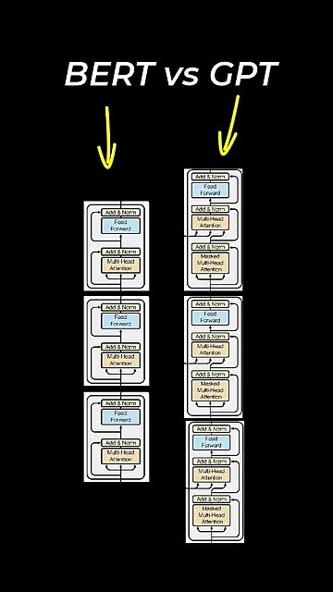
Notes:
Transformer-based Language Models

Slide 32
Diffusion Models
How they work: Start with noise and gradually improve it to resemble training data through a learned denoising process.
Use cases: High-quality image and video generation.
Examples:
DALL·E 3
Stable Diffusion
Imagen

Slide 33

Diffusion Models
Notes:
Diffusion Models

Slide 34
Autoregressive Models
How they work: Generate data one step at a time, using previous steps as context.
Use cases: Text, music, and code generation.
Examples:
GPT
PixelCNN (for images)
WaveNet (for audio)

Slide 35

Autoregressive Models
Notes:
Autoregressive Models

Slide 36
Flow-based Models
How they work: Use invertible transformations to map data to a latent space and back.
Use cases: Real-time data synthesis with exact likelihood estimation.
Examples:
RealNVP
Glow.

Slide 37
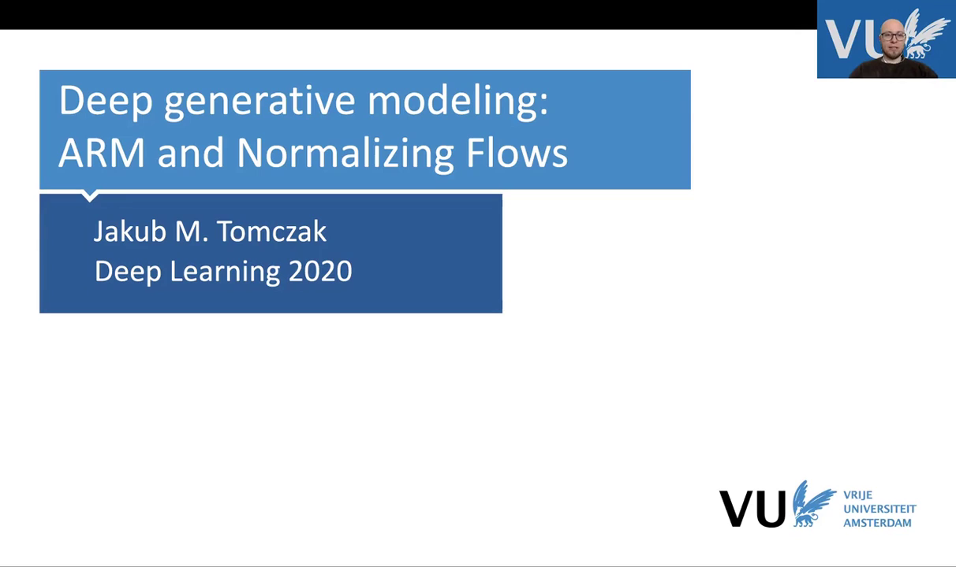
Arms & Flow Models
Notes:
Flow-based Models

Slide 38
Transformers, Encoders & Decoders, RAG

Slide 39

Transformer Explained
A Transformer is like a super-powered party listener for computers. it can focus on what each person is saying and how it related to what others are saying, even in a big crowd.
Listen to Everyone (Attention)
Pays attention to all the information. It treats each information like a friend at a party
Who's Important Now
Not all friends are equally important in every conversation. The Transformer can focux on the most relevant information for the task at hand.
Talk Back
Once the Transformer understand the information, it can use it to do something cool, like write a poem or answer you question.
Encoder
Part of your brain that figures out what everyone is saying.
Decoder
Part of your brain that uses what you heard to say something new.

Slide 40


Transformer Architecture
Transformer Architecture
Attention Mechanism
The transformer architecture is a deep learning model that uses attention mechanisms to capture long-range dependencies in sequential data, such as language and speech. It is the foundation for many state-of-the-art Large Language Models (LLMs).
The attention mechanism allows the transformer to focus on the most relevant parts of the input when generating the output, enabling it to understand and generate contextual and coherent text.
The transformer architecture is a fundamental component of modern Large Language Models, enabling them to understand and generate human-like text with impressive capabilities.

Slide 41


Transformer Architecture
Parallelization
Scalability
The transformer architecture is highly parallelizable, allowing for efficient computation on modern hardware, such as GPUs and TPUs, which is crucial for training and deploying large-scale language models.
The transformer architecture can be scaled up to handle larger and more complex language tasks, enabling the development of powerful LLMs that can perform a wide range of natural language processing tasks.
Its attention mechanism, parallelization, and scalability make it a crucial technology for the advancement of Generative AI.

Slide 42
Encoders and Decoders
Encoder
Decoder
Bidirectionality
An encoder is responsible for converting the input data (e.g., text, image, or audio) into a numerical representation, often in the form of a fixed-length vector. This numerical representation is then used by the language model to understand and process the input.
A decoder is responsible for generating the output data, such as text, from the internal representation of the language model. The decoder takes the numerical representation generated by the encoder and produces the desired output.
Some language models, like BERT, use a bidirectional encoder, which allows the model to understand the context of the input from both the left and right sides. This can lead to more accurate and contextual understanding of the input.

Slide 43
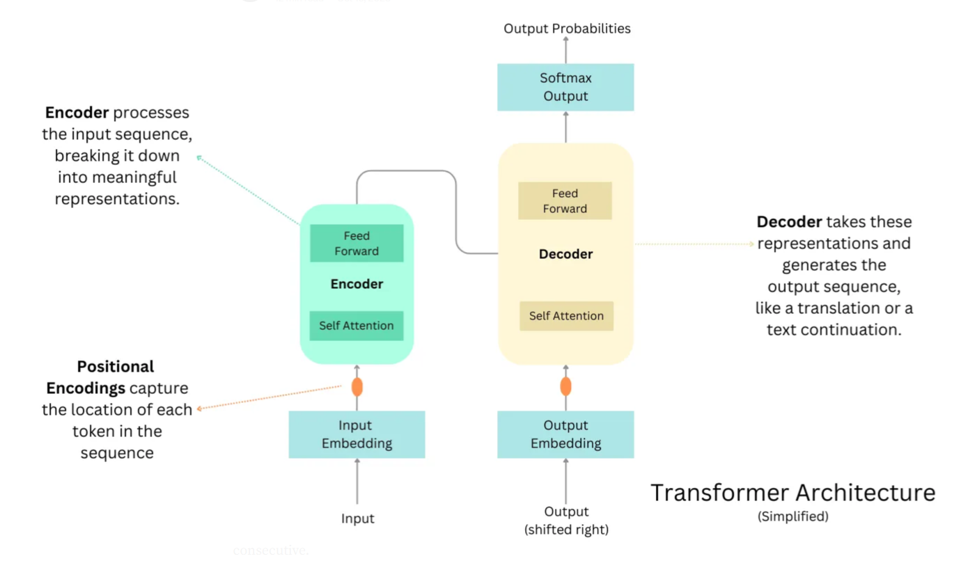
Source: LINK
Notes:
Source: https://raw.githubusercontent.com/snatch59/keras-autoencoders/master/assets/autoencoder_latent_space.png

Slide 44


Retrieval Augmented Generation (RAG)
What is Retrieval Augmented Generation?
How does RAG work?
RAG is fundamentally an architectural pattern that integrates a retrieval system with a generation system. In practice, a RAG pipeline consists of two primary components – a retriever and a generator – working together.
The retriever is responsible for finding relevant information from an external knowledge source (e.g., a set of documents or a database) given a user query, and the generator is a language model that produces the final output (answer or text) conditioned on both the user’s input and the retrieved information.
Retrieval-Augmented Generation (RAG) is an AI framework that combines large language models (LLMs) with external information retrieval to produce more accurate and contextually relevant outputs.

Slide 45
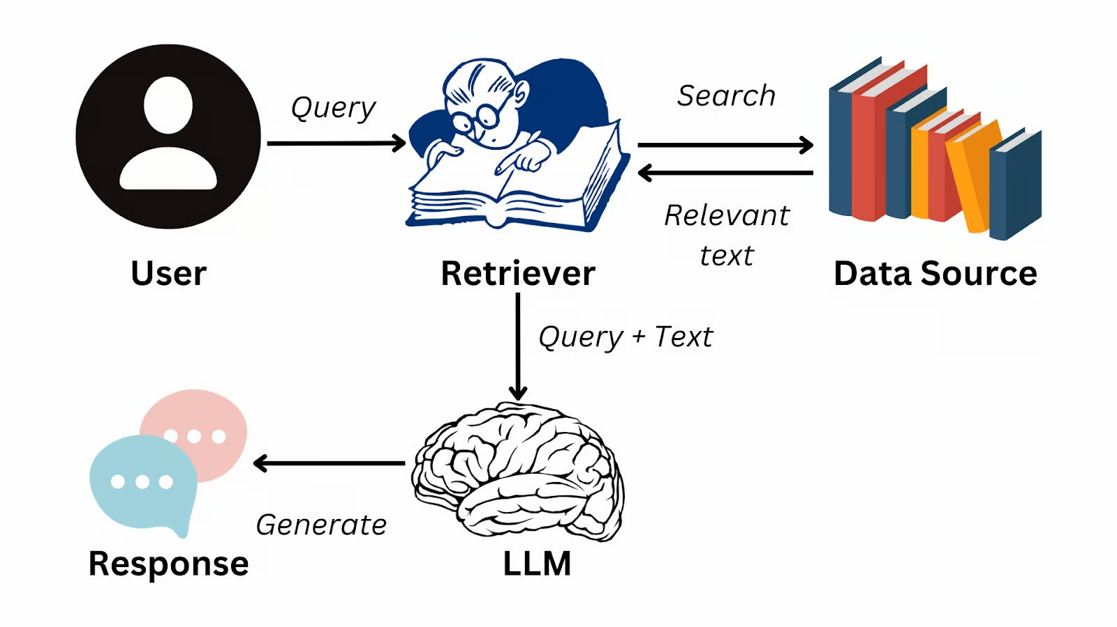
Retrieval Augmented Generation (RAG)
https://www.datacamp.com/blog/what-is-retrieval-augmented-generation-rag

Slide 46
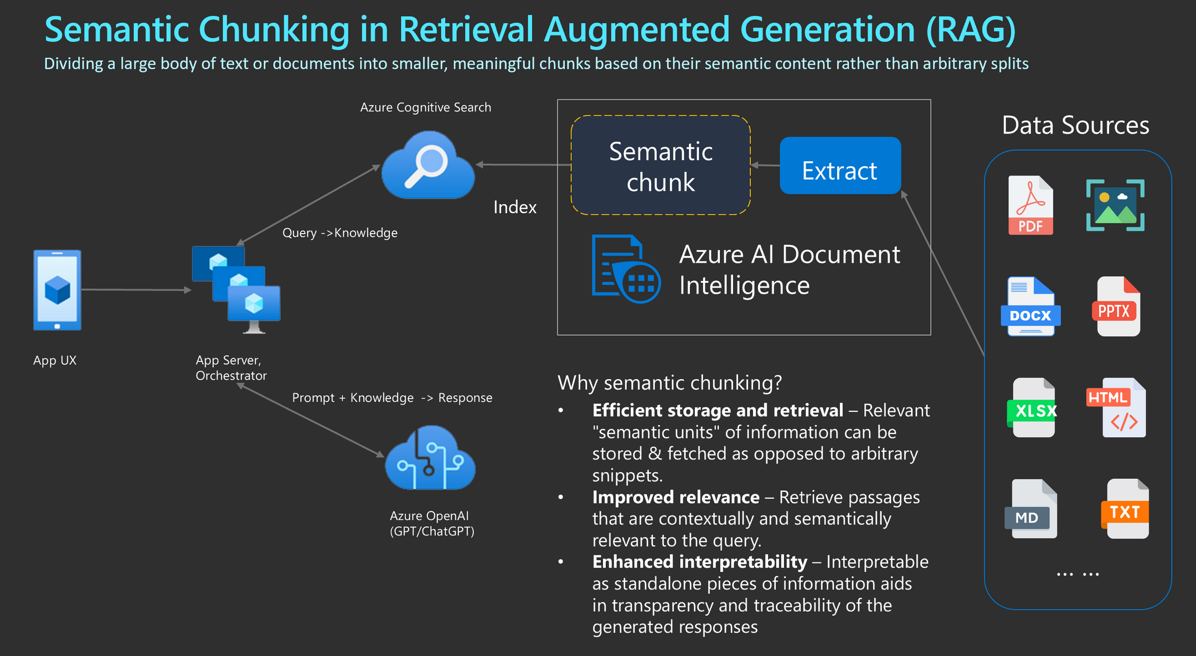

Slide 49
c

Slide 50
Large Learning Models (LLMs)

Slide 51

Model Selection - What is the Objective?
OpenAI GPT
Google BERT
Hugging Face Transformers
A large language model developed by OpenAI that can generate human-like text and perform a variety of natural language processing tasks.
A transformer-based language model developed by Google that can be fine-tuned for various natural language processing tasks, such as question answering and text classification.
Testing the waters approach. Models are developed by various people and/or groups. Maintenace is not guaranteed.
Each framework has its own strengths and capabilities, and the choice of which to use depends on the specific requirements of the task at hand.

Slide 52


Large Language Model (LLM)
What is a Large Language Model?
Trained on Massive Data
A large language model is a type of artificial intelligence that has been trained on a vast amount of text data, allowing it to understand and generate human-like language.
Large language models are trained on huge datasets, often consisting of billions of words from sources like books, websites, and other textual data.
Able to Understand and Generate Language
Continuously Evolving
Large language models are constantly being updated and improved, with new and more powerful versions being released regularly.
These models can understand and generate human-like text, making them useful for tasks like language translation, text summarization, and question answering.
Large language models are a powerful tool for natural language processing, with the ability to understand and generate human-like text. As they continue to evolve, they are likely to play an increasingly important role in various applications and industries.

Slide 53
Large Language Model (LLM)
Understand, generate, and translate human language.
Trained on massive datasets of text
Learns patterns and relationships in language
Uses machine learning
Neural Network
Transformer Model

Slide 54
LLM Architecture
Training Data:
Enormous datasets
Billions of words
Learns language nuances - grammar, syntax, relationships
Transformer Architecture:
Use transformer models
Excel at processing sequential data like text.
Self-attention - considers the context of each word
Capabilities:
Text generation: Creating new text, like articles, stories, or code.
Question answering: Providing answers to questions based on the input text.
Summarization: Condensing large amounts of text into shorter, more concise versions.
Translation: Translating text between different languages.
Code generation: Generating code in various programming languages.
LLMs
“Foundation models"
Trained on vast amounts of data
Can be adapted to a wide range of tasks

Slide 55
Building Blocks of an LLM
Vectors, Tokens, and Embeddings
Tokens are the representations of text in the form of a vector.
Embeddings: The Semantic Space - Embeddings are the foundational aspect of LLMs

Slide 56
LLM Building Blocks Comparisons
Tokens vs. Vectors:
Tokens are the linguistic units
Vectors are the mathematical representations of these units.
Every token is mapped to a vector in the LLM’s processing pipeline.
Vectors vs. Embeddings:
All embeddings are vectors
Not all vectors are embeddings.
Embeddings are vectors specifically trained to capture deep semantic relationships.
Tokens and Embeddings:
The transition from tokens to embeddings
Movement from a discrete representation of language to a Nuanced, continuous, and contextually aware semantic space.

Slide 57
Technologies used in GenAI/AI

Slide 58
Building Blocks of an LLM
Vectors, Tokens, and Embeddings
Tokens are the representations of text in the form of a vector.
Embeddings: The Semantic Space - Embeddings are the foundational aspect of LLMs
https://thenewstack.io/the-building-blocks-of-llms-vectors-tokens-and-embeddings/

Slide 59
Vectors
A single-dimensional array.
Used to represent text or data in a numerical form that the model can understand and process.

Slide 60
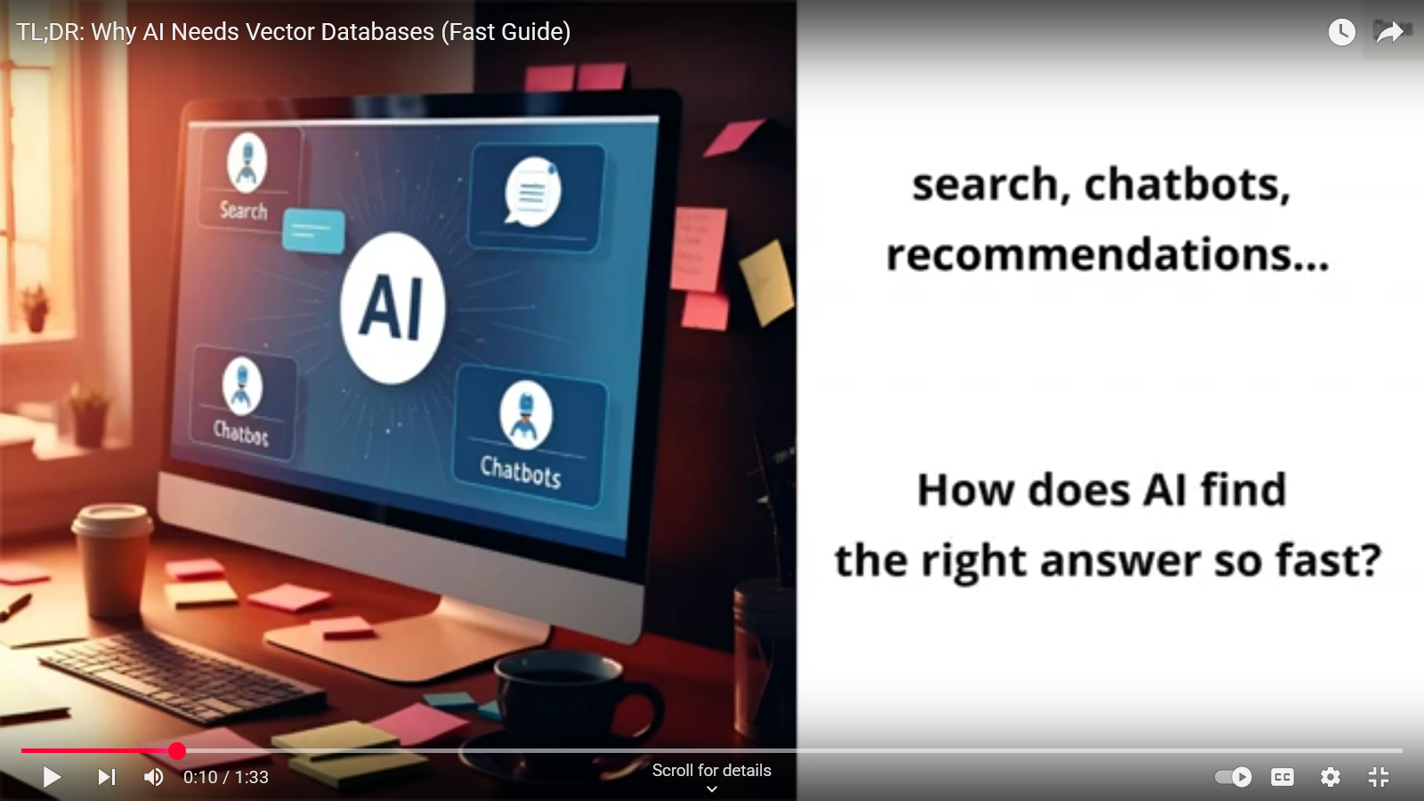

Slide 61
Tokens
Basic units of text processed
Can be individual words, subwords, or even characters
Tokens are used as input and output in generative AI tasks.

Slide 62
Embeddings: The Semantic Space
Tokens are vector representations of text.
Embeddings are tokens with semantic context.
Represent the meaning and context of the text.
Tokens are encoded or decoded by a tokenizer.
Embedding models are responsible for generating text embeddings in the form of a vector.
Embeddings enable LLMs to comprehend the context, nuance, and subtle meanings of words and phrases.
Results of the model learning from vast amounts of text data and its relationships with other tokens.

Slide 63
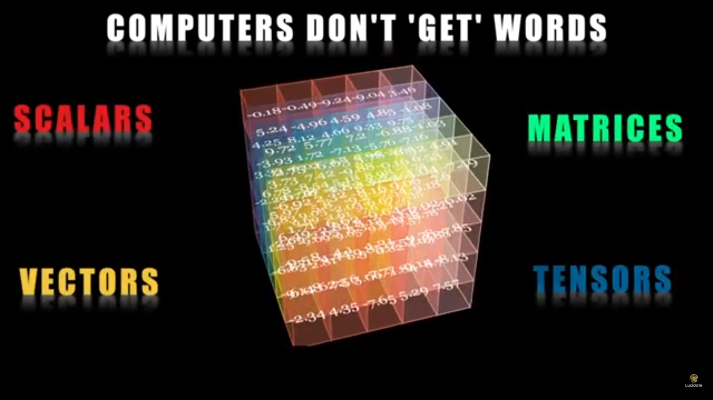

Slide 64
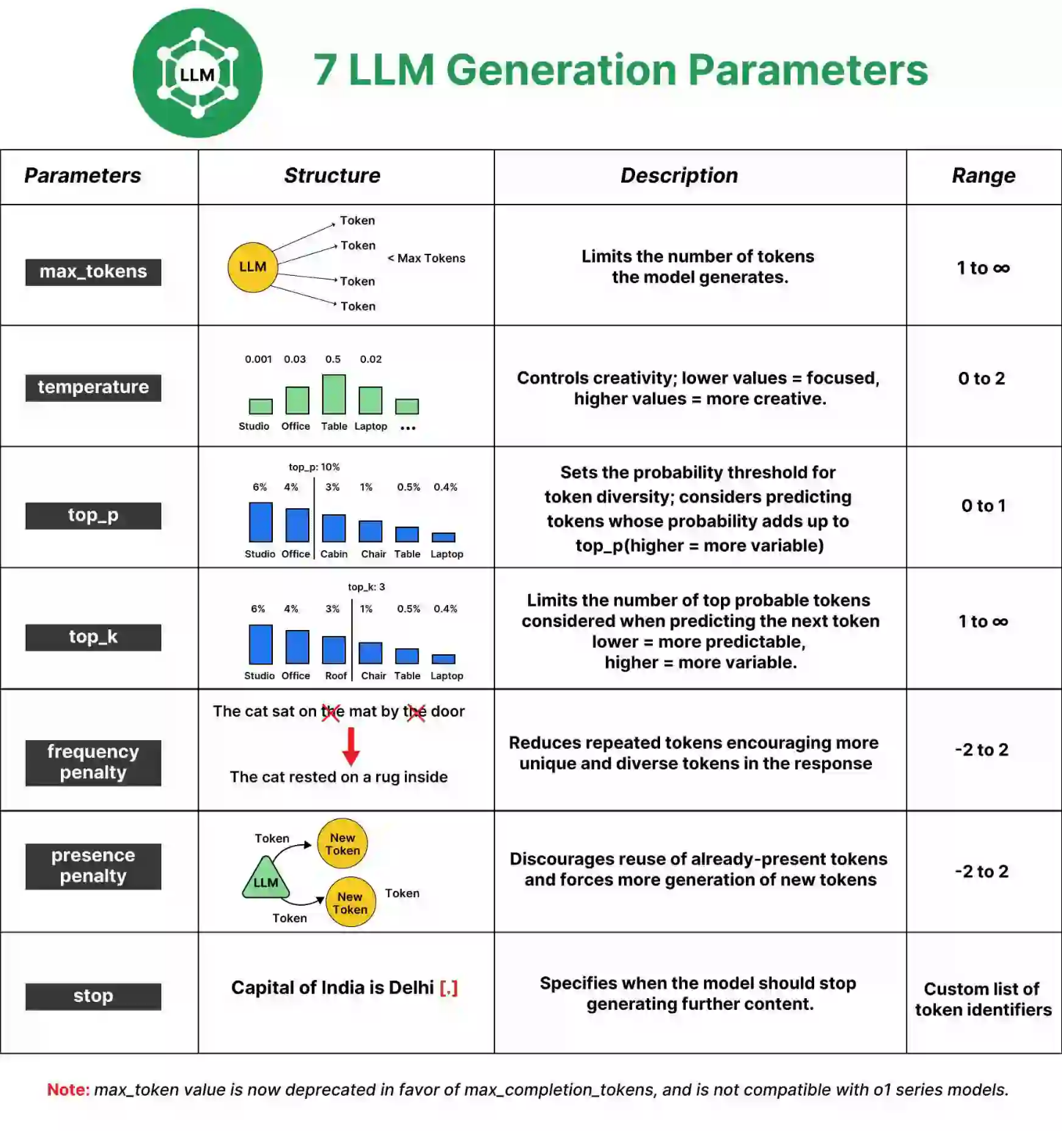

Reference - https://www.analyticsvidhya.com/blog/2024/10/llm-parameters/
Notes:
The max_tokens parameter controls the length of the output generated by the model. A “token” can be as short as one character or as long as one word, depending on the complexity of the text.
Low Value (e.g., 10): Produces shorter responses.
High Value (e.g., 1000): Generates longer, more detailed responses.
Why is it Important?
By setting an appropriate max_tokens value, you can control whether the response is a quick snippet or an in-depth explanation. This is especially important for applications where brevity is key, like text summarization, or where detailed answers are needed, like in knowledge-intensive dialogues.
Note: Max_token value is now deprecated in favor of max_completion_tokens and is not compatible with o1 series models.

Slide 65
Max Tokens Example
max_tokens = 10
Output: “The capital of India is New Delhi. Here are”
The response is very brief and incomplete, cut off due to the token limit. It provides basic information but doesn’t elaborate. The sentence begins but doesn’t finish, cutting off just before listing places to visit.

Slide 66
Max Tokens Example
max_tokens = 20
Output: “The capital of India is New Delhi. Here are seven places to visit in New Delhi:\n1.”
With a slightly higher token limit, the response begins to list places but only manages to start the first item before being cut off again. It’s still too short to provide useful detail or even finish a single place description.

Slide 67
Reference - https://www.analyticsvidhya.com/blog/2024/10/llm-parameters/
Notes:
The max_tokens parameter controls the length of the output generated by the model. A “token” can be as short as one character or as long as one word, depending on the complexity of the text.
Low Value (e.g., 10): Produces shorter responses.
High Value (e.g., 1000): Generates longer, more detailed responses.
Why is it Important?
By setting an appropriate max_tokens value, you can control whether the response is a quick snippet or an in-depth explanation. This is especially important for applications where brevity is key, like text summarization, or where detailed answers are needed, like in knowledge-intensive dialogues.
Note: Max_token value is now deprecated in favor of max_completion_tokens and is not compatible with o1 series models.

Slide 68
Temperature - Definition
Temperature is a parameter used in generative AI models, such as language models, to control the level of randomness or exploration during the generation process.

Slide 69
Temperature - What it Does
Determines how likely the model is to generate more common or predictable outputs (low temperature)
Versus more novel and unexpected outputs (high temperature).

Slide 70
Temperature - Range of Values
Range from 0 to 1
0 representing complete determinism (the model always chooses the most likely output)
1 representing complete randomness (the model randomly selects an output)
Importance in Generative AI

Slide 71
Temperature - Impact on Generation
Used to control the diversity and creativity of the generated outputs
Higher temperatures - more diverse but potentially less coherent.
Lower temperatures – more predictable but potentially less novel outputs.

Slide 72
Temperature - Importance in Generative AI
Crucial hyperparameter
Allows developers to fine-tune the balance between consistency and creativity in the generated outputs
Depends on the specific use case and desired outcome

Slide 73
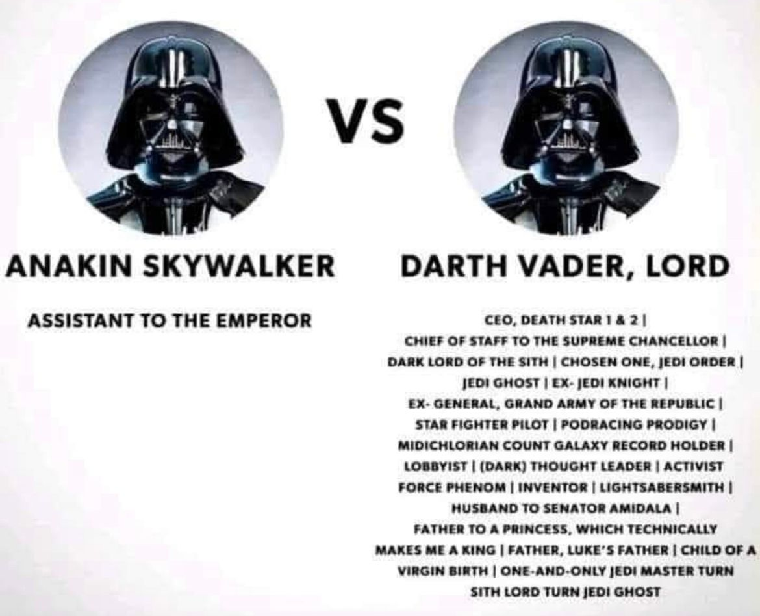
Write a Job Title:
Low Temperature – not very creative, direct, and concise
High Temperature – higher liberty to use creative words and outputs from model

Slide 74
Reference - https://www.analyticsvidhya.com/blog/2024/10/llm-parameters/
Notes:
The max_tokens parameter controls the length of the output generated by the model. A “token” can be as short as one character or as long as one word, depending on the complexity of the text.
Low Value (e.g., 10): Produces shorter responses.
High Value (e.g., 1000): Generates longer, more detailed responses.
Why is it Important?
By setting an appropriate max_tokens value, you can control whether the response is a quick snippet or an in-depth explanation. This is especially important for applications where brevity is key, like text summarization, or where detailed answers are needed, like in knowledge-intensive dialogues.
Note: Max_token value is now deprecated in favor of max_completion_tokens and is not compatible with o1 series models.

Slide 75


Top P/K
Top-P (Top-p Sampling)
Top-K (Top-k Sampling)
Top-P sampling is a technique in generative AI models that selects the most likely tokens from the model's output distribution, up to a specified cumulative probability (p). This helps reduce the likelihood of generating low-probability, nonsensical output.
Top-K sampling is a method that selects the k most likely tokens from the model's output distribution, ignoring the rest. This can help produce more diverse and coherent output compared to greedy decoding.
Understanding these key generative AI terms is crucial for effectively leveraging and interpreting the output of these powerful models.

Slide 76





Today the garden had. . . .
Temperature, Top P, Top K, impact the generated outcome. Here is how to interpret.
Flowers (0.50)
trees (0.23)
Herbs (0.05)
Bugs (0.03)
Low
Temperature
High
- high possible words
- low possible words
- you want explicit direct language
- you want "creative" context

Slide 77
Today the garden had. . . .
Temperature, Top P, Top K, impact the generated outcome. Here is how to interpret.
Flowers (0.50)
trees (0.23)
Herbs (0.05)
Bugs (0.03)
The model returns a random word from a set of top K possible words
Top K
For example: K = 2

Slide 78
Today the garden had. . . .
Temperature, Top P, Top K, impact the generated outcome. Here is how to interpret.
Flowers (0.50)
trees (0.23)
Herbs (0.05)
Bugs (0.03)
The model returns a random word from a set of words with the sum of likelihoods not exceeding P
For example: P = 0.75
Flower (.50) + Trees (.23) + Herbs (.05) = 0.78 > 0.75
Top P

Slide 79
Reference - https://www.analyticsvidhya.com/blog/2024/10/llm-parameters/

Slide 80
Frequency Penalty
The Frequency Penalty parameter discourages the model from repeating previously used words.
It reduces the probability of tokens that have already appeared in the output.
Low Value (e.g., 0.0): The model won’t penalize for repetition.
High Value (e.g., 2.0): The model will heavily penalize repeated words, encouraging the generation of new content.
Avoids repetitive outputs - creative writing
Lower penalties in technical writing, where repeated terminology could be beneficial for clarity.

Slide 81
Reference - https://www.analyticsvidhya.com/blog/2024/10/llm-parameters/

Slide 82
Presence Penalty
The Presence Penalty parameter is similar to the frequency.
Penalizing based on how often a word is used.
Low Value (e.g., 0.0): The model won’t penalize for reusing words.
High Value (e.g., 2.0): The model will avoid using any word that has already appeared.
Presence penalties help encourage more diverse content generation.
Useful when model introduce new ideas – brainstorming.

Slide 83
Reference - https://www.analyticsvidhya.com/blog/2024/10/llm-parameters/

Slide 84
Stop Sequence
The Stop parameter lets you define a sequence of characters or words that signals stop generating further content.
Allows clean end the generation.
Example Stop Sequences: Could be periods (.), newlines (\n), or specific phrases like “The end”.
Convenient when a model should stop once it has reached a logical conclusion
Certain number of ideas - Q&A or dialogue-based models.

Slide 85

Fine-tuning, Parameter Tuning, and Token Limits for LLMs
Fine-tuning
Parameter Tuning
Token Limits
Adapting a pre-trained large language model to a specific task or domain by training it on a smaller, task-specific dataset
Adjusting the hyperparameters of a model, such as learning rate, batch size, and number of layers, to optimize its performance on a given task
The maximum number of tokens (words or subwords) a model can process at once, which can impact the length of input texts and the model's ability to capture long-range dependencies
Fine-tuning, parameter tuning, and token limits are important considerations when working with large language models to ensure optimal performance on specific tasks and applications.

Slide 86
GPT, Bert, Bart, Gemini

Slide 87
What is GPT?
GPT
GPT stands for Generative Pre-trained Transformer, which is a type of large language model developed by OpenAI. It is a neural network-based architecture that can generate human-like text, answer questions, and perform a variety of other language-related tasks. (OpenAI, Gemini, Apple Intelligence)
Generative
Generative models are a type of machine learning model that can generate new data, such as text, images, or audio, based on the patterns in the training data. GPT is a generative model that can generate coherent and contextually relevant text.
Pre-trained
GPT models are pre-trained on a large corpus of text data, which allows them to learn the patterns and structures of natural language. This pre-training enables the models to be applied to a variety of language-related tasks, even with limited task-specific training data.
Transformer
The Transformer is a neural network architecture that uses attention mechanisms to capture the relationships between different parts of the input sequence. This allows the model to better understand the context and generate more coherent and relevant output.

Slide 88
What is Bert?
BERT (Bidirectional Encoder Representations from Transformers)
Purpose: Primarily a language representation model focused on understanding the meaning and context of words within sentence.
Function: Analyzes text bidirectionally (both forward and backward) to understand relationships between words and their context.
Use cases: Used in various applications, including improving search engine algorithms, language translation, text classification, and other NLP tasks where understanding the meaning of text is crucial.
Architecture: An encoder-only Transformer model, meaning it processes input and generates a rich vector representation of the text, but doesn't generate new text directly.
Training: Pre-trained on massive amounts of unlabeled text data, enabling it to learn general language patterns and context.

Slide 89
What is Bard?
Generative artificial intelligence chatbot Engaging in natural language conversations with users.
Architecture: specifically fine-tuned for conversational tasks.
Applications:
Chatbots
Customer service bots
educational chatbots
Open-domain conversations
Training: Trained on labeled conversational data, allowing it to learn how to respond to different user prompts and maintain context in a conversation.
Now Gemini

Slide 90
What is Bart?
BART: Bidirectional Encoder-Decoder model
Combining the strengths of both BERT and GPT (Generative Pre-trained Transformer). It uses a bidirectional encoder for understanding text and an autoregressive decoder for generating new text.
Training: BART is pre-trained using a denoising autoencoder approach, where text is corrupted with random noise and the model is trained to reconstruct the original text. This training objective allows BART to learn both context and generation.
Strengths: BART is particularly effective for text generation tasks, such as summarization, translation, and dialogue generation.

Slide 91
Gemini
Previously based on the LaMDA and PaLM LLMs.
Multimodal: Can process and generate text, images, audio, and code.
Transformer Architecture:
It uses a more advanced neural network architecture to understand language and context better.
Advanced Capabilities:
Capable of more complex tasks like image generation, code writing, and more nuanced language understanding.
Updated Name:
Bard was rebranded to Gemini to reflect the more advanced capabilities of the underlying AI model.

Slide 92
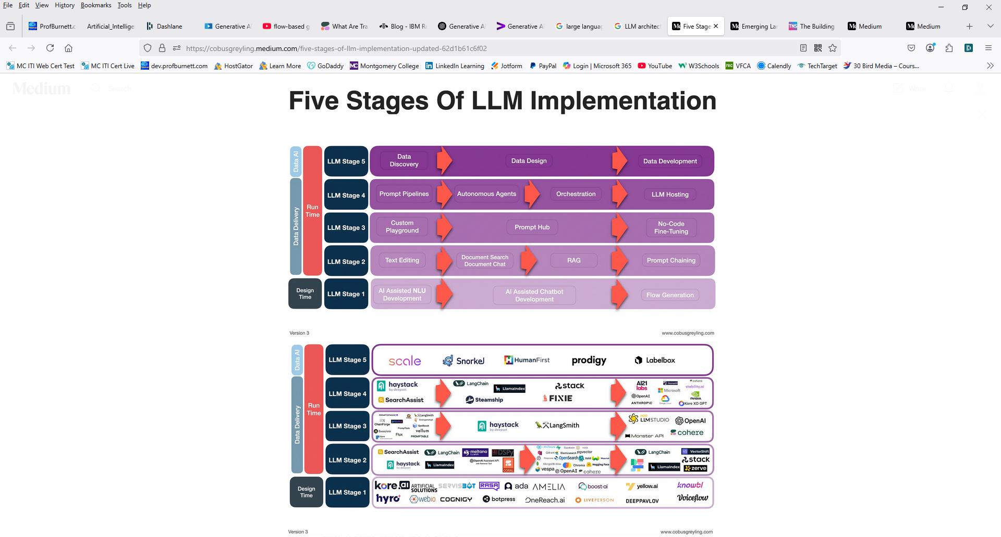
Five Stages of LLM Implementation
https://medium.com/@cobusgreyling/five-stages-of-llm-implementation-updated-62d1b61c6f02

Slide 93
Five Stages of LLM Implementation
https://medium.com/@cobusgreyling/five-stages-of-llm-implementation-updated-62d1b61c6f02

Slide 94
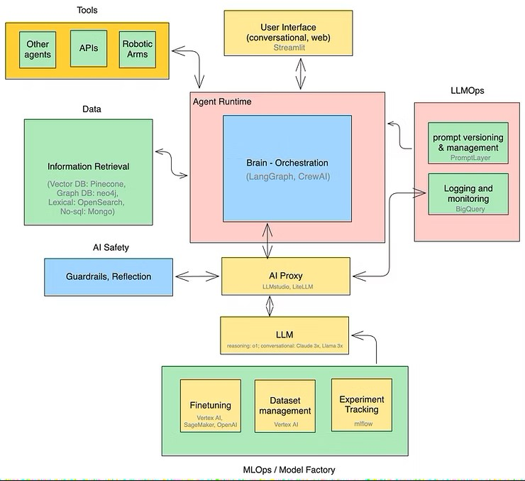
Emerging Architectures of LLM Applications
https://www.tensorops.ai/post/emerging-architectures-of-llm-applications-2025-update

Slide 95
GenAI Applications

Slide 96
GenAI - Text-Based Output
Application | Description | Example Tools/Models
Text Generation | Produces human-like text responses. | ChatGPT Claude Gemini Mistral
Summarization | Condenses long content into shorter summaries. | ChatGPT BART Claude
Translation | Translates between languages. | Google Translate DeepL ChatGPT
Text Completion | Completes partially written sentences or paragraphs. | ChatGPT

Slide 97
GenAI - Text-Based Output (Continued)
Application | Description | Example Tools/Models
Sentiment Analysis | Analyzes emotions or opinions in text. | Hugging Face Transformers
Code Generation | Writes code from natural language prompts. | GitHub Copilot Amazon Q (CodeWhisperer) Cody
Question Answering | Answers queries based on context or knowledge base. | LangChain QA agents ChatGPT RAG systems

Slide 98
GenAI - Image-Based Output
Application | Description | Example Tools/Models
Image Generation | Creates images from text prompts. | DALL·E 3 Midjourney Stable Diffusion
Image Editing | Modifies or enhances images. | Adobe Firefly Runway ML DALL·E inpainting
Style Transfer | Applies visual styles from one image to another. | DeepArt Prisma
Image Captioning | Generates textual descriptions of images. | BLIP OpenAI CLIP ChatGPT
Object Detection / Recognition | Identifies objects in an image. | YOLOv7 Detectron2

Slide 99
GenAI - Audio-Based Output
Application | Description | Example Tools/Models
Speech Synthesis (TTS) | Converts text into spoken voice. | ElevenLabs Amazon Polly Google TTS
Voice Cloning | Mimics a specific voice. | Descript Overdub Resemble.ai
Music Generation | Composes original music from prompts. | Suno AI AIVA MuseNet
Audio Enhancement | Denoises or improves sound quality. | Adobe Podcast Enhance Dolby.io

Slide 100
GenAI - Video-Based Output
Application | Description | Example Tools/Models
Video Generation | Creates videos from text or images. | Runway Gen-2 Pika Labs Synthesia
Lip Syncing / Talking Avatars | Syncs avatars with voice. | HeyGen D-ID Synthesia
Video Editing | AI-assisted cutting, transitions, effects. | Runway ML Adobe Premiere AI
Motion Capture / Animation | Tracks and animates movement. | RADiCAL Move.ai

Slide 101
GenAI - Multimodal / Cross-Modal Output
Application | Description | Example Tools/Models
Multimodal Q&A | Processes images + text for responses. | ChatGPT Gemini Claude 3 Opus
AR/VR Content Creation | AI-generated immersive experiences. | NVIDIA Omniverse Spline AI
Digital Twins | Creates simulations of real-world entities. | Siemens Unity ML tools

Slide 102
Google I/O – May 2025
Search | Agentic | Visual | Music | Research | Development | Other
AI Mode | Project Mariner | gemini.google.com | Lyria 2 | Deep Research | Google AI Studio | SignGemma
Project Astra’s | Agent Mode | Imagen 4 |  | Canvas | Vertex AI | MedGemma
 | Colab | Veo 3 |  | Gemini Diffusion | 2.5 Pro
 |  | Flow TV |  |  | 2.5 Flash
 |  | SynthID Detector |  |  | Gemini API
 |  |  |  |  | Vertex AI
 |  |  |  |  | Stitch
 |  |  |  |  | Flutter 3.32
 |  |  |  |  | Gemini Code Assist
 |  |  |  |  | Firebase announced

Slide 103
GenAI - Healthcare
Application | Description | Tools/Models
Medical Documentation | Generate patient notes and summaries. | Nuance DAX Nabla Copilot
Clinical Decision Support | Assist diagnosis or treatment plans using medical data. | MedPaLM IBM Watson Health
Medical Imaging | Enhance and interpret scans (X-rays, MRIs). | Arterys Aidoc
Drug Discovery | Simulate molecular interactions and design compounds. | Insilico DeepMind AlphaFold
Patient Engagement | AI chatbots for scheduling, FAQs, symptom checks. | Babylon Health Ada Health

Slide 104
GenAI - Finance & Banking
Application | Description | Tools/Models
Report Generation | Automate earnings summaries, financial statements. | BloombergGPT
Risk Modeling | Predict fraud or credit default scenarios. | H2O.ai SAS GenAI
Chatbots / Virtual Advisors | Client support and investment guidance. | Kasisto Amelia
Sentiment Analysis | Analyze market sentiment in news/social media. | MarketPsych Accern
Personalized Finance | Budgeting and insights based on user behavior. | Cleo Copilot AI

Slide 105
GenAI - Education
Application | Description | Tools/Models
AI Tutoring | Personal tutors for students in various subjects. | Khanmigo Scribe AI
Content Creation | Generate quizzes, lesson plans, and summaries. | Quizlet Q-Chat MagicSchool
Language Learning | Conversational AI for speaking and writing practice. | Duolingo Max Speak
Essay Feedback | AI reviews grammar, structure, and content. | Grammarly WriteLab
Accessibility Tools | Text-to-speech or summarization for diverse learners. | Read&Write Whisper AI

Slide 106
GenAI - Media & Entertainment
Application | Description | Tools/Models
Script Writing | Generate storylines, scenes, or full scripts. | ChatGPT Sudowrite
Music Creation | Compose music tracks or soundscapes. | Suno AI AIVA
Video Generation | Produce content or avatars from text. | Pika Labs Runway ML Synthesia
Game Design | Generate environments, characters, dialogue. | Scenario.gg Inworld AI
Personalized News | AI-curated content feeds. | Artifact Feedly AI

Slide 107
GenAI - Retail & E-Commerce
Application | Description | Tools/Models
Product Descriptions | Auto-generate SEO-optimized listings. | Jasper Copy.ai
Virtual Try-On | Generate simulations of users with products. | Zyler Vue.ai
Personalized Recommendations | Tailored shopping suggestions using behavior data. | Amazon Personalize Coveo
Visual Search | Search by image rather than text. | Google Lens Syte
Chatbots | Pre/post-sale support, product inquiries. | Ada Gorgias Drift

Slide 108
GenAI - Manufacturing & Supply Chain
Application | Description | Tools/Models
Predictive Maintenance | Use sensor data to forecast equipment failure. | SparkCognition Uptake
Supply Chain Optimization | AI modeling of logistics and demand. | Llamasoft o9 Solutions
Digital Twin Simulation | Simulate factory environments. | Siemens NVIDIA Omniverse
Automated Design | Generate product blueprints or iterations. | Autodesk Dreamcatcher

Slide 109
GenAI - Legal
Application | Description | Tools/Models
Contract Drafting | Generate or summarize legal contracts. | Harvey Spellbook
Legal Research | Extract insights from case law, regulations. | CoCounsel (Casetext) LexisNexis AI
E-Discovery | Automatically classify and organize legal documents. | Relativity AI
Client Chatbots | Legal Q&A and support bots. | DoNotPay LawDroid

Slide 110
GenAI - Government & Public Sector
Application | Description | Tools/Models
Policy Drafting | Help write legislation, policies, or public statements. | ChatGPT GovTech platforms
Public Service Chatbots | Virtual assistants for citizens. | NYC's MyCity chatbot
Threat Detection | Analyze data for security risks or misinformation. | Primer AI Palantir
Smart City Planning | Generate traffic or zoning simulations. | UrbanFootprint CityFormLab

Slide 111
GovTech Platforms
Name | Description
CivicPlus | Offers tools for website development, online forms, and citizen engagement.
Accela | Provides a platform for government operations, including permitting, licensing, and citizen services
GovPilot | A web-based management platform for local governments
CentralSquare Technologies | Offers solutions for public administration and public safety.
ClearGov Inc. | Specializes in budgeting and licensing process simplification for local governments.
Esri | Provides GIS and spatial technology solutions for governments.
Avenu Insights & Analytics | Helps governments increase revenue, improve operations, and build community trus
Bond Link | A platform for debt management and investor engagement in the municipal bond market.
Citibot | Provides AI-powered chatbots for local government customer service.
GovStack | A global community focused on the digitalization of public sector infrastructure.

Slide 112
GenAI - HR & Talent Management
Application | Description | Tools/Models
Resume Screening | Match applicants to job descriptions using NLP. | HireVue Pymetrics
Job Description Writing | Automate writing inclusive, targeted JDs. | Textio Jasper
Interview Coaching | AI-based mock interviews. | Interview Warmup (Google) Yoodli
Employee Feedback Analysis | Summarize employee engagement surveys. | Lattice AI Culture Amp

Slide 113
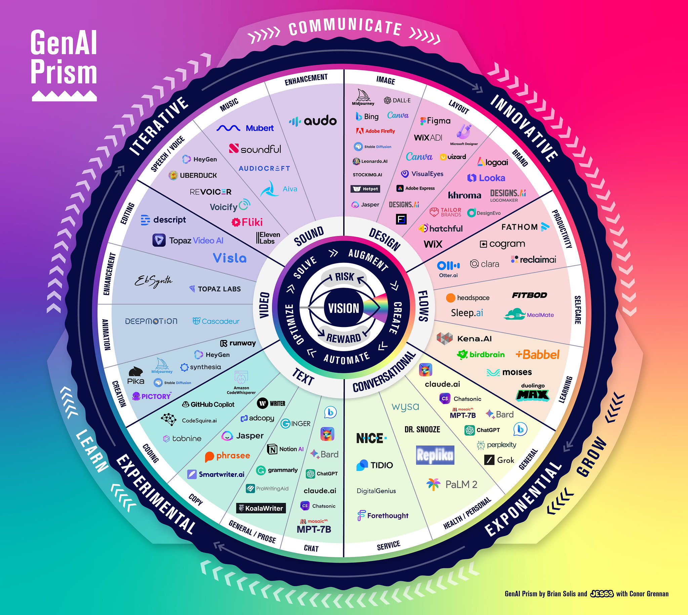

Slide 114
AI Chatbots

Slide 115
GPT Chatbot Versions
Version | Release Date | Training Data Availability | Underlying LLM | Licensing
ChatGPT (GPT-3.5) | Nov 30, 2022 | Not disclosed | GPT-3.5 | Proprietary
ChatGPT (GPT-4) | Mar 14, 2023 | Not disclosed | GPT-4 | Proprietary
ChatGPT (GPT-4 Turbo) | Nov 2023 | Not disclosed | GPT-4 Turbo | Proprietary
ChatGPT (GPT-4o) | May 13, 2024 | Not disclosed | GPT-4o (multimodal) | Proprietary
GPT-4o mini | Jul 18, 2024 | Not disclosed | GPT-4o mini | Proprietary
OpenAI o1-preview / o1-mini | Sep 12, 2024 | Not disclosed | o1-preview / o1-mini | Proprietary
OpenAI o1 | Dec 5, 2024 | Not disclosed | o1 | Proprietary
GPT-4.5 (Orion) | Feb 27, 2025 | Not disclosed | GPT-4.5 | Proprietary
OpenAI o3-mini | Jan 31, 2025 | Not disclosed | o3-mini | Proprietary
OpenAI o3 | Apr 16, 2025 | Not disclosed | o3 | Proprietary
OpenAI o3-pro | Jun 10, 2025 | Not disclosed | o3-pro | Proprietary
GPT-4.1 (mini / nano) | Apr 14, 2025 | Not disclosed | GPT-4.1 family | Proprietary
ChatGPT Agent Mode | Jul 17, 2025 | Not disclosed | Agent framework (GPT-based) | Proprietary
ChatGPT-5 | Aug 7, 2025 | Not disclosed | GPT-5 | Proprietary

Slide 116
Gemini Chatbot Versions
Version / Milestone | Release Date | Training Data Availability | Underlying LLM | Licensing
Bard (LaMDA) preview | Mar 21, 2023 | Not disclosed | LaMDA | Proprietary
Bard → PaLM 2 backend | May 10, 2023 | Not disclosed | PaLM 2 | Proprietary
Bard powered by Gemini Pro | Dec 6, 2023 | Not disclosed | Gemini Pro | Proprietary
Rebrand to Gemini (Gemini app / Advanced) | Feb 8, 2024 | Not disclosed | Gemini Pro / Ultra (Advanced) | Proprietary
Gemini 1.5 Pro (I/O updates, 2M tokens preview) | May 14, 2024 | Not disclosed | Gemini 1.5 Pro | Proprietary
Gemini 1.5 Flash (debut) | May 14, 2024 | Not disclosed | Gemini 1.5 Flash | Proprietary
Gemini 2.0 Flash (Experimental preview) | Dec 11, 2024 | Not disclosed | Gemini 2.0 Flash | Proprietary
Gemini 2.5 Pro (GA on Vertex AI) | Jun 17, 2025 | Not disclosed | Gemini 2.5 Pro | Proprietary
Gemini 2.5 Flash (GA on Vertex AI) | Jun 17, 2025 | Not disclosed | Gemini 2.5 Flash | Proprietary

Slide 117
Microsoft Copilot Chatbot Versions
Version / Branding | Release Date | Training Data Availability | Underlying LLM | Licensing
Bing Chat (Preview) | Feb 7, 2023 | Not disclosed | Prometheus (GPT-4-based) | Proprietary
Microsoft Copilot (General Rollout) | Sep–Nov 2023 | Not disclosed | Prometheus (GPT-4-based) | Proprietary
Microsoft 365 Copilot | Nov 1, 2023 (GA) | Not disclosed | GPT-4 integrated with Microsoft Graph | Proprietary (Enterprise)
Copilot in Windows | Sep 26, 2023 (Windows 11 update) | Not disclosed | GPT-4-based Prometheus + Microsoft Graph | Proprietary
Copilot Pro (subscription tier) | Jan 15, 2024 | Not disclosed | GPT-4 Turbo | Proprietary (consumer subscription)
Copilot Chat (Enterprise) | Jan 15, 2025 | Not disclosed | GPT-4 + Microsoft enterprise data integration | Proprietary

Slide 118
Grok Chatbot Versions
Version | Release Date | Training Data Availability | Underlying LLM | Licensing
Grok-1 | Mar 17, 2024 | Not fully disclosed; 314B param MoE | Mixture-of-Experts (MoE) | Open-sourced (Apache-2.0)
Grok-1.5 | Mar 28, 2024 | Not disclosed; extended 128k tokens | Enhanced MoE | Proprietary
Grok-1.5 Vision | Apr 12, 2024 | Not disclosed; multimodal (image) | MoE with vision capabilities | Proprietary
Grok-2 | Mid/Late 2024 | Not disclosed; improved reasoning & Aurora integration | Next-gen Grok LLM | Proprietary
Grok-3 | Feb 17, 2025 | Not disclosed; trained on Colossus cluster | Advanced reasoning & coding model | Proprietary
Grok-4 | Jul 10–14, 2025 | Not disclosed; scientist-level reasoning & multimodal | Multi-agent LLM with tool use | Proprietary (subscription tiers)

Slide 119
Claude Chatbot Versions
Version | Release Date | Training Data Availability | Underlying LLM | Licensing
Claude 1 | Mar 2023 | Not disclosed | Claude 1 LLM | Proprietary
Claude 2 | Jul 2023 | Not disclosed | Claude 2 LLM | Proprietary
Claude 2.1 | Nov 2023 | Not disclosed | Claude 2.1 LLM | Proprietary
Claude 3 (Haiku, Sonnet, Opus) | Mar 2024 | Not disclosed | Claude 3 family | Proprietary
Claude 3.5 Sonnet | Jun 20, 2024 | Not disclosed | Claude 3.5 Sonnet | Proprietary
Claude 3.5 Haiku | 2025 | Not disclosed | Claude 3.5 Haiku | Proprietary
Claude 3.7 Sonnet | Early 2025 | Not disclosed | Claude 3.7 Sonnet | Proprietary
Claude 4 (Opus, Sonnet) | May 22, 2025 | Not disclosed | Claude 4 family | Proprietary
Claude 4.1 (Opus, Sonnet) | Aug 5, 2025 | Not disclosed | Claude 4.1 family | Proprietary

Slide 120
Ernie Bot Chatbot Versions
Version | Release Date | Training Data Availability | Underlying LLM | Licensing
Ernie Bot (initial) | Aug 31, 2023 (public) | Not disclosed | ERNIE 3.0 Titan | Proprietary
Ernie 4.0 | Oct 2023 | Not disclosed | ERNIE 4.0 | Proprietary
Ernie 4.0 Turbo | Jun 2024 | Not disclosed | ERNIE 4.0 Turbo | Proprietary
Ernie 4.5 Turbo / Ernie X1 | Apr 2025 | Not disclosed; reasoning-enhanced | ERNIE 4.5 Turbo / X1 | Mixed: Proprietary + open-source (Apache 2.0)
Ernie 5.0 (planned) | Late 2025 (expected) | Not disclosed | ERNIE 5.0 (in development) | To be determined

Slide 121
DeepSeek Chatbot Versions
Version / Milestone | Release Date | Training Data Availability | Underlying LLM | Licensing
DeepSeek Chatbot (R1 launch) | Jan 10, 2025 | Not disclosed | DeepSeek‑R1 | App proprietary; model MIT
DeepSeek‑R1 (open weights) | Jan 20, 2025 | Not disclosed (RL post‑training; open weights) | DeepSeek‑R1 reasoning | MIT
DeepSeek‑R1‑0528 update | May 28, 2025 | Not disclosed | DeepSeek‑R1 | MIT
DeepSeek‑R1‑Distill (1.5B–70B) | May 29, 2025 | Distilled on synthetic R1 traces | Distilled variants (LLaMA/Qwen bases) | MIT
DeepSeek‑V3 (initial) | Dec 2024 | Not disclosed | DeepSeek‑V3 MoE | MIT (from Mar 25, 2025)
DeepSeek‑V3‑0324 (weights) | Mar 25, 2025 | Not disclosed | DeepSeek‑V3 | MIT
DeepSeek‑V3.1 | Aug 21, 2025 | Not disclosed | DeepSeek‑V3.1 hybrid | MIT
DeepSeek‑V2 | May 6, 2024 | Not disclosed | DeepSeek‑V2 MoE | Model License (models); code MIT
DeepSeek‑V2‑Lite | Jan 3, 2025 | Not disclosed | DeepSeek‑V2‑Lite | Model License
DeepSeek‑V2.5 | Jan 3, 2025 | Not disclosed | DeepSeek‑V2.5 | Model License

Slide 122
Pricing for Large Language Models (LLMs)
Provider | Model Name | Context Length | Input Price / 1K tokens | Output Price / 1K tokens | Notes
OpenAI | See Breakout
MS Copilot | See Breakout
DeepSeek | See Breakout
Anthropic | Claude 3 Opus | 200K | $0.015 | $0.075 | Most capable Claude
 | Claude 3 Sonnet | 200K | $0.003 | $0.015 | Balanced performance
 | Claude 3 Haiku | 200K | $0.00025 | $0.00125 | Fastest, lowest cost
Google | Gemini 1.5 Pro | 1M (adaptive) | $0.007 | $0.021 | Long context, streaming supported
 | Gemini 1.0 Pro | 32K | $0.002 | $0.006 | Lower cost, older
Mistral | Mistral Medium (via Azure) | 32K | $0.002 | $0.006 | Azure-hosted
 | Mistral Small | 32K | ~$0.0008 | ~$0.0024 | Model available via API or open weights
Meta | LLaMA 3 (70B) | ~128K | Free (open weights) | Free (self-hosted) | Requires infrastructure
Cohere | Command R+ | 128K | $0.002 | $0.004 | RAG-optimized
AI21 | Jurassic-2 Ultra | 8K | $0.0125 | $0.0125 | Older pricing model

Slide 123
Session 1 Review
Define Artificial Intelligence (AI) and Generative AI (GenAI).
Explain the latest trends in GenAI/AI.
Identify and describe key concepts in GenAI/AI.
Understand the Building Blocks of LLMs
Vectors
Tokens
Embeddings
Understand the 7 Parameters of LLMs
Max Completion Tokens
Temperature
Top P
Top K
Frequency Penalty
Presence Penalty
Stop Sequence
Parameter Tuning
Review GenAI Applications by Type and Industry Use

Slide 124
Session 2 Review
Industry Risks and Concerns
Lack of Explainability / Transparency
Data Bias and Discrimination
Misinformation & Disinformation
Misuse in Bioweapons, Cyberattacks, or Deepfake Extortion
Copyright and Intellectual Property Infringement
AI Future
China’s Digital Transformation
Date is the New Currency
Smart Econometrics
Social Credit Systems
The Future of Healthcare
Agentic AI
Job Market
Godfather Warning
Red Pill / Blue Pill Event
Course Review
Course Evaluation
AI Technology Concerns
Geopolitical AI Arms Race
Hallucinations
Data Privacy
Job Displacement
Human De-skilling
Political Disinformation & Propaganda
Income Inequality

