Slide 1
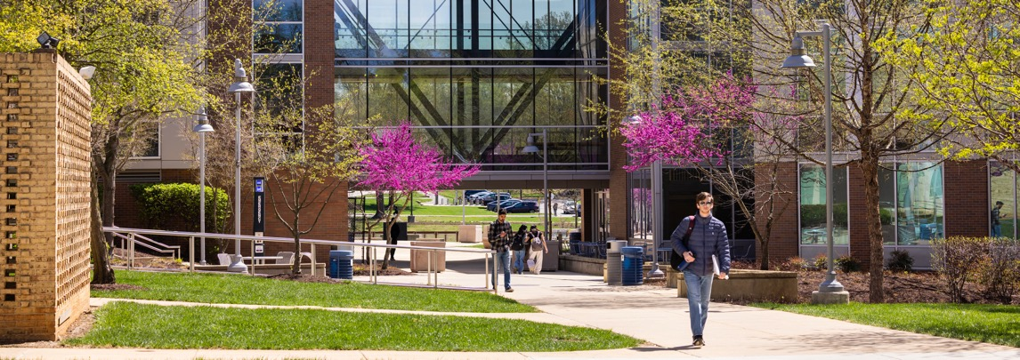
ITI 555 Introduction to Generative AI
Introduction
Prof. burnett | Embrace AI / Master Your Future
Notes:
TO CHANGE IMAGE, DELETE IMAGE AND CLICK ON THE ICON TO ADD AN IMAGE, OR RIGHT CLICK TO REPLACE IMAGE
TO ADJUST THE SCALE OR POSITION OF THE IMAGE WITHIN THE MASK, SELECT THE IMAGE, GO TO PICTURE FORMAT, AND SELECT CROP
TIP: For best results, choose an image with a strong horizontal focal point so it aligns well within the custom linear shape.
To ensure legibility, the blue color should only be used with bold text.

Slide 2

Outline
Introductions
Class Outline
Review Class Website
Notes:
TO CHANGE IMAGE, DELETE IMAGE AND CLICK ON THE ICON TO ADD AN IMAGE, OR RIGHT CLICK TO REPLACE IMAGE
TO ADJUST THE SCALE OR POSITION OF THE IMAGE WITHIN THE MASK, SELECT THE IMAGE, GO TO PICTURE FORMAT, AND SELECT CROP, MOVE OR SCALE IMAGE
TIP: For best results, choose an image with a strong vertical focal point.
To ensure legibility, the blue color should only be used with bold text.

Slide 3
Outline
Introductions
Class Outline
Review Class Website
Notes:
TO CHANGE IMAGE, DELETE IMAGE AND CLICK ON THE ICON TO ADD AN IMAGE, OR RIGHT CLICK TO REPLACE IMAGE
TO ADJUST THE SCALE OR POSITION OF THE IMAGE WITHIN THE MASK, SELECT THE IMAGE, GO TO PICTURE FORMAT, AND SELECT CROP, MOVE OR SCALE IMAGE
TIP: For best results, choose an image with a strong vertical focal point.
To ensure legibility, the blue color should only be used with bold text.

Slide 4
Instructor Info
Carl M. Burnett
US Army Corps of Engineers (CWO) - 22 Years
  Class-C Licensed Nuclear Reactor Operator
  Electrical Power Systems Engineer
  ORSA Computer Analyst
  Manpower Analyst - Expert System Developer
IT Contractor - 20 Years
  Booz Allen Hamilton
  General Dynamics IT
  Independent IT Consultant
Founder / CEO – 25 Years
  PRPI (1994-1995)
  TRECN (1995-1998)
  GFI (1998-2003)
  Geocode-LA (2005-2015)
  BWGM (2015-2020)
Former Standards Development Member:
  International Committee for Information Technology Standards (INCITS) – US Rep to ISO (2000-2007)
  Society of Motion Picture and Television Engineers (SMPTE) (2000-2021)
  Internet Engineering Task Force (IETF) (2000-2021)
Adjunct Professor JHU (2003 – 2007)
USA Pickleball
  USA Pickleball Ambassador (2020 – Present)
  USA PPR Certified Coach (2022 – Present)
  USA Verified Referee Trainee (2025 – Present)
  VP, International Pickleball Federation (IPF)
  (2022-2024)
MCC Instructor (2007 – Present)

Slide 5

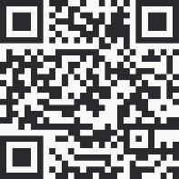
Instructor Contact Info
Carl Burnett
Prof – Montgomery College
carl.burnett@montgomerycollege.edu
profburnett@profburnett.com
240.603.3194
Professor Burnett Office Hours Bookings
https://outlook.office365.com/owa/calendar/ProfessorBurnett@montgomerycollege0.onmicrosoft.com/bookings/
Profburnett Website
https://profburnett.com

Slide 6
Introduce Yourselves
Name
Job
What do you to expect from course?

Slide 7
Administrative
Announcements

Slide 8
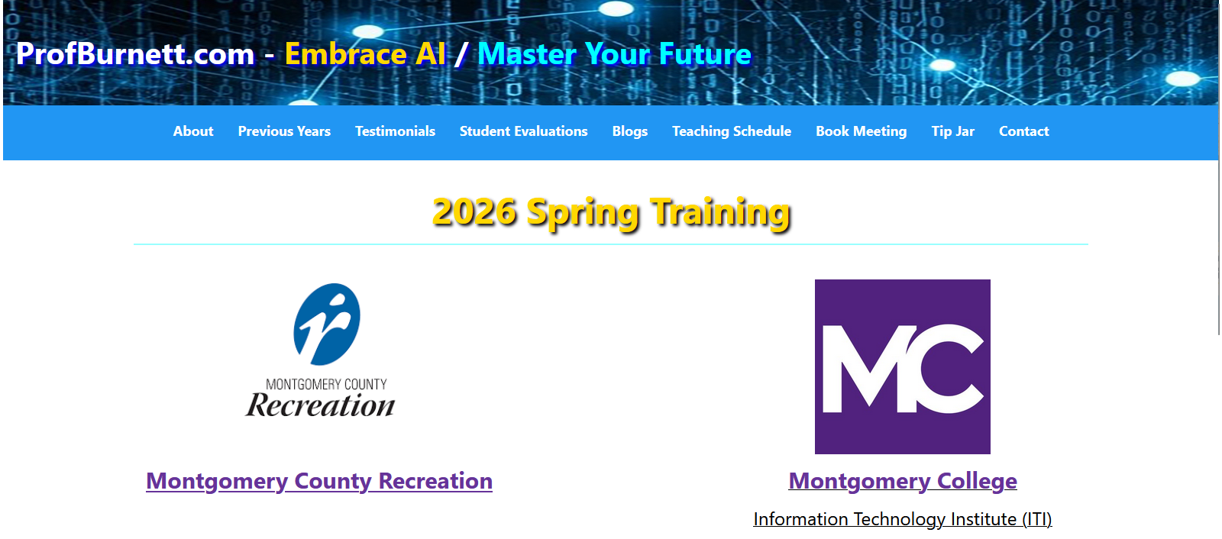
Profburnett.com

Slide 9
Attendance
Please fill out the Name Verification Sheet.
Attendance will be called at the start of each class.
If you come in late, please see me during the break to make sure you are accounted for.

Slide 10
Course Completion
You are required to attend 80% of the classes to receive a certificate of attendance.
You must complete Mastery Level 3 on all quizzes and hands-on exercises to obtain a Montgomery College Generative AI Microcredential.
Learn more about the GenAI Microcredential at Credly and MC

Slide 11
Campus Logistics
Restrooms
Vending Machines
Bookstore

Slide 12
Opening delays or cancellations
In case of inclement weather or other catastrophes, please check the Montgomery College Web Site
www.montgomerycollege.edu
or call 240-567-5000 for class
delays or cancellations.

Slide 13
Class Schedule
ITI 555 Introduction to Generative AI
Start Date | End Date | Location | Days | Hours | CRN
6/15/2026 | 6/24/2026 | GBTC | Monday / Wednesday | 6:30 - 8:30 PM | 42973
7/14/2026 | 7/23/2026 | East County | Tuesday / Thursday | 6:30 - 8:30 PM | 13811
8/3/2026 | 8/12/2026 | Rockville | Monday / Wednesday | 6:30 - 8:30 PM | 13812

Slide 14
Course Outline – Session I
Define Artificial Intelligence (AI) and Generative AI (GenAI).
Explain the latest trends in GenAI/AI.
Identify and describe key concepts in GenAI/AI.
Understand the Building Blocks of LLMs
Introduction to Prompt Engineering Frameworks
AI Quiz
LLM Quiz

Slide 15
Course Outline – Session II
Discover personal organization tools using Microsoft Copilot’s task management
Discover Copilot Chat, Personal, and Enterprise Editions
Learn how to organize yourself with Microsoft Copilot AI
Prompt Engineering Exercises using Microsoft Copilot AI

Slide 16
Course Outline – Session III
Introduction to the Major LLMs
  ChatGPT 5.1
  Gemini 2.5 Pro
  Claude Sonnet 4.5
  Grok 4
  Kimi K2 Thinking (Moonshot)
Advanced Prompt Engineering Techniques
LLM Prompt Engineering Exercises

Slide 17
Course Outline – Session IV
Industry Risks and Concerns
AI Technology Concerns
AI Future
Job Market
Creator Warning
AI technology Concern Quiz
Course Review
Course Evaluation

Slide 18
Set Up Your MyMC Account
Claim Your MC Email Account (Watch Video)
Sign in to your Email.
Access the Blackboard Course.

Slide 19
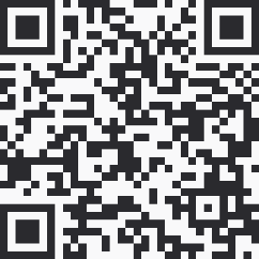
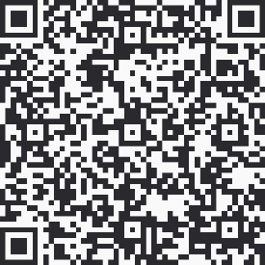
Optional GenAI Account Setups
Perplexity Pro Account
Setup a Perplexity Pro Account.
Comet Browser
Get the Comet browser to use Perplexity Pro in your own workspace.
Comet provides a better AI Internet experience, with answers on every page, task automation, and personalized browsing.

