Slide 1

ITI 555 Introduction to
Generative AI – Session IV
Prof Burnett | Embrace AI / Master Your Future

Slide 2
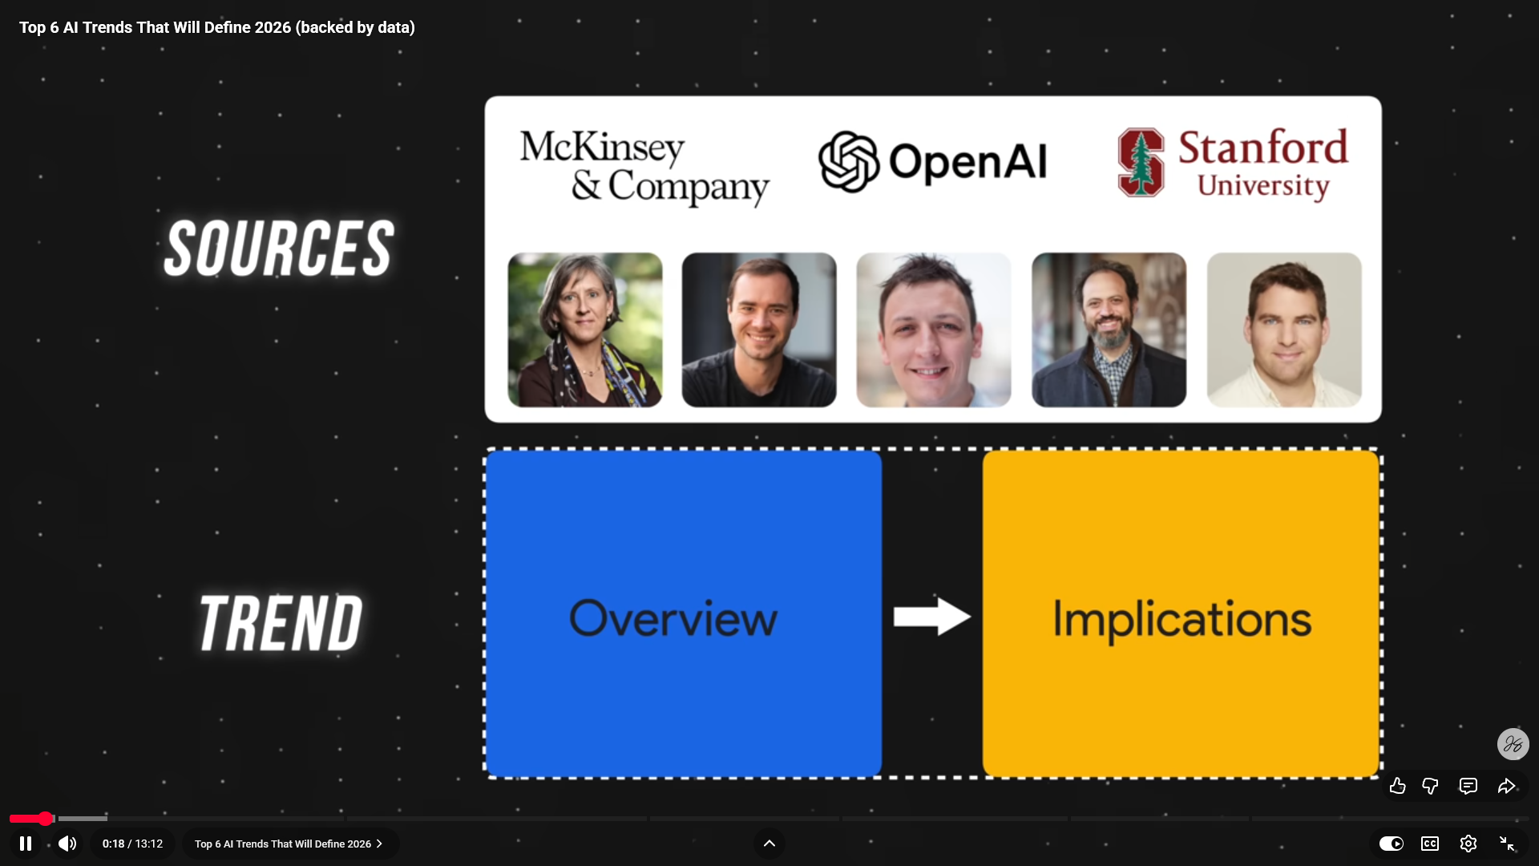
Top 6 AI Trends for 2026

Slide 3
Course Outline – Session IV
Industry Risks and Concerns
AI Technology Concerns
AI Future
Job Market
Creator Warning
AI technology Concern Quiz
Course Review
Course Evaluation

Slide 4

Industry Risks and Concerns

Slide 5
Industry Risks and Issues
Lack of Explainability / Transparency
  Reliance on genAI for all "answers" and ideas. Original creativity will diminish and fade.
Data Bias and Discrimination
  Building a large language model with a massive amount of data that contains bias and stereotypes.
Misinformation and Disinformation
  The ability for genAI to generate realistic text and images can be misused to spread misinformation or disinformation.
Misuse in Bioweapons, Cyberattacks, or Deepfake Extortion
  Used genAI to generate malicious content, like fake news articles or deepfakes (realistic-looking video forgeries)
Copyright and Intellectual Property Infringement
  It can be unclear who owns the copyright of context generated by GenAI Models. If a model is trained on copyrighted material, it might raise questions about ownership of the generated context.

Slide 6
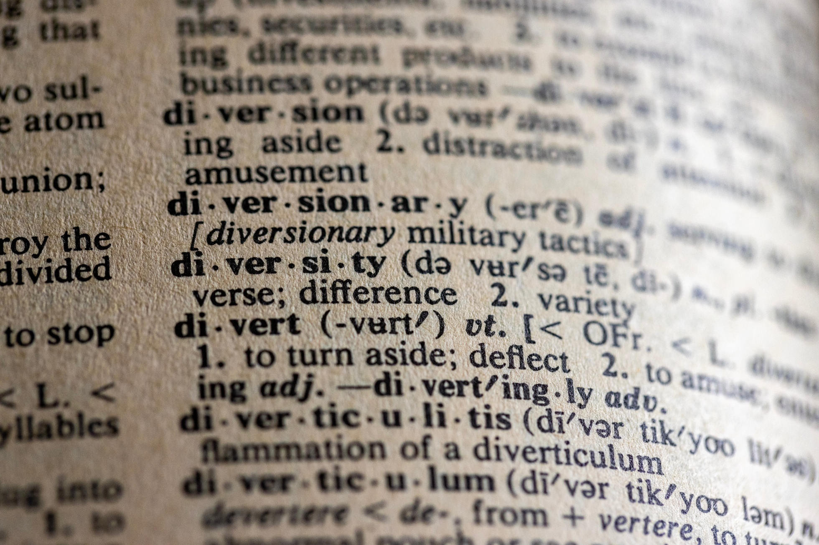
Concerns About AI Technology

Slide 7
Concerns About AI Technology
Geopolitical AI Arms Race
Hallucinations
Data Privacy
Job Displacement
Human De-skilling
Political Disinformation & Propaganda
Income Inequality

Slide 8

Geopolitical AI Arms Race
Hallucination / Misinformation
Data Privacy
Job Displacement
Human De-skilling
Political Disinformation & Propaganda
Income Inequality
2019 Frontline Report – In the Age of AI

Slide 9
Hallucination
Geopolitical AI Arms Race
Hallucination / Misinformation
Income Inequity
Disinformation & Propaganda
Job Displacement
Human De-skilling
Hallucination
Hallucination refers to the tendency of generative AI models to produce plausible-sounding but factually incorrect or nonsensical output.
This is a common challenge in large language models and can be mitigated through techniques like better training data, prompting, and model architecture design.

Slide 10

AI Hallucination Explained

Slide 11

Surveillance Capitalism
Geopolitical AI Arms Race
Hallucination / Misinformation
Data Privacy
Job Displacement
Human De-skilling
Political Disinformation & Propaganda
Income Inequality
Data Privacy
Notes:
Surveillance Capitalism

Slide 12
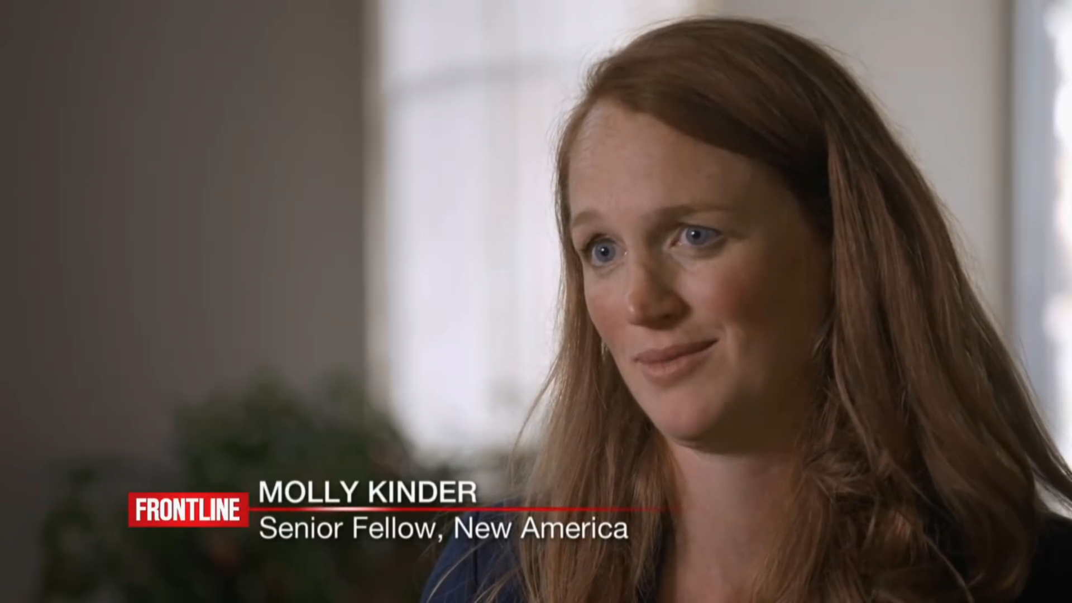
Retraining
Geopolitical AI Arms Race
Hallucination / Misinformation
Data Privacy
Job Displacement
Human De-skilling
Political Disinformation & Propaganda
Income Inequality
Job Displacement
Notes:
Retraining

Slide 13
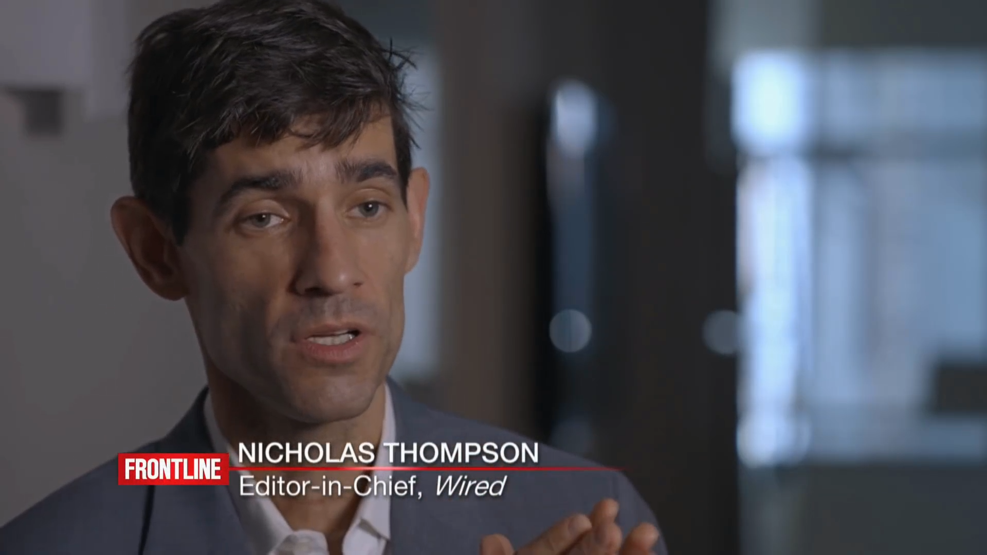
AI Job Loss
Geopolitical AI Arms Race
Hallucination / Misinformation
Data Privacy
Job Displacement
Human De-skilling
Political Disinformation & Propaganda
Income Inequality
Human De-skilling
Notes:
Job Loss

Slide 14
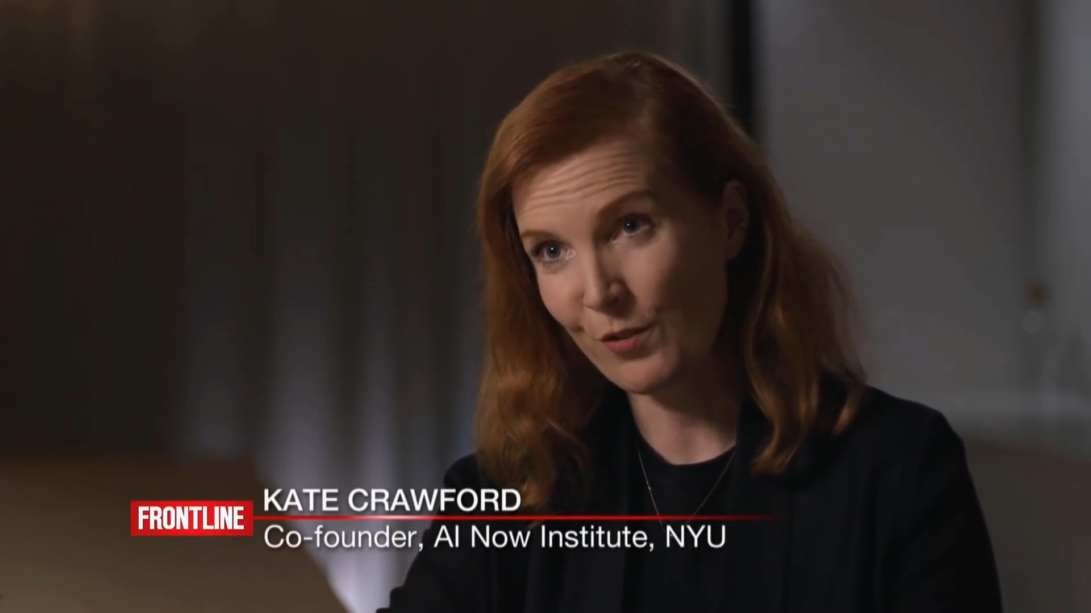
Cambridge Analytica
Geopolitical AI Arms Race
Hallucination / Misinformation
Data Privacy
Job Displacement
Human De-skilling
Political Disinformation & Propaganda
Income Inequality
Political Disinformation & Propaganda
Notes:
Cambridge Analytica

Slide 15
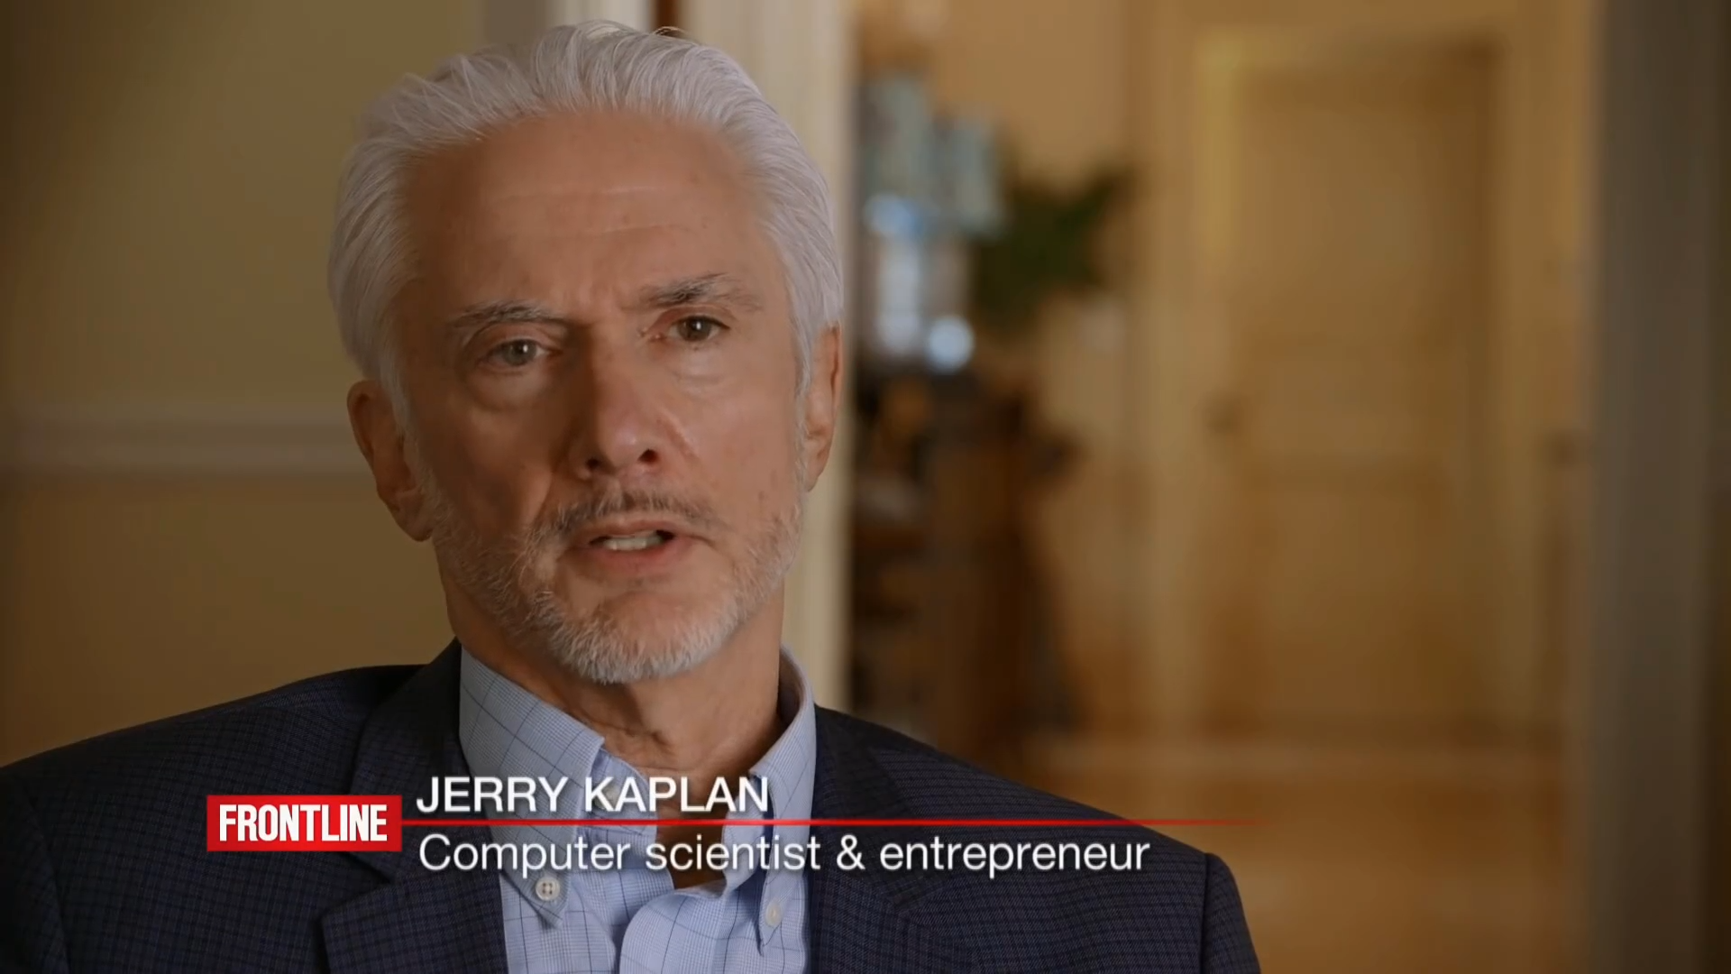
Inequality
Geopolitical AI Arms Race
Hallucination / Misinformation
Data Privacy
Job Displacement
Human De-skilling
Political Disinformation & Propaganda
Income Inequality
Income Inequality
Notes:
Inequality

Slide 16
AI Future
China’s Digital Transformation
Data is the New Currency
Smart Econometrics
Social Credit Systems
Advances in Healthcare
AI Job Market and Impact
The Future of AI

Slide 17

Ecommerce
China’s Digital Transformation
China’s Digital Transformation
Data is the New Currency
Smart Econometrics
Social Credit Systems
Advances in Healthcare
AI Job Market and Impact
The Future of AI
Notes:
Ecommerce

Slide 18
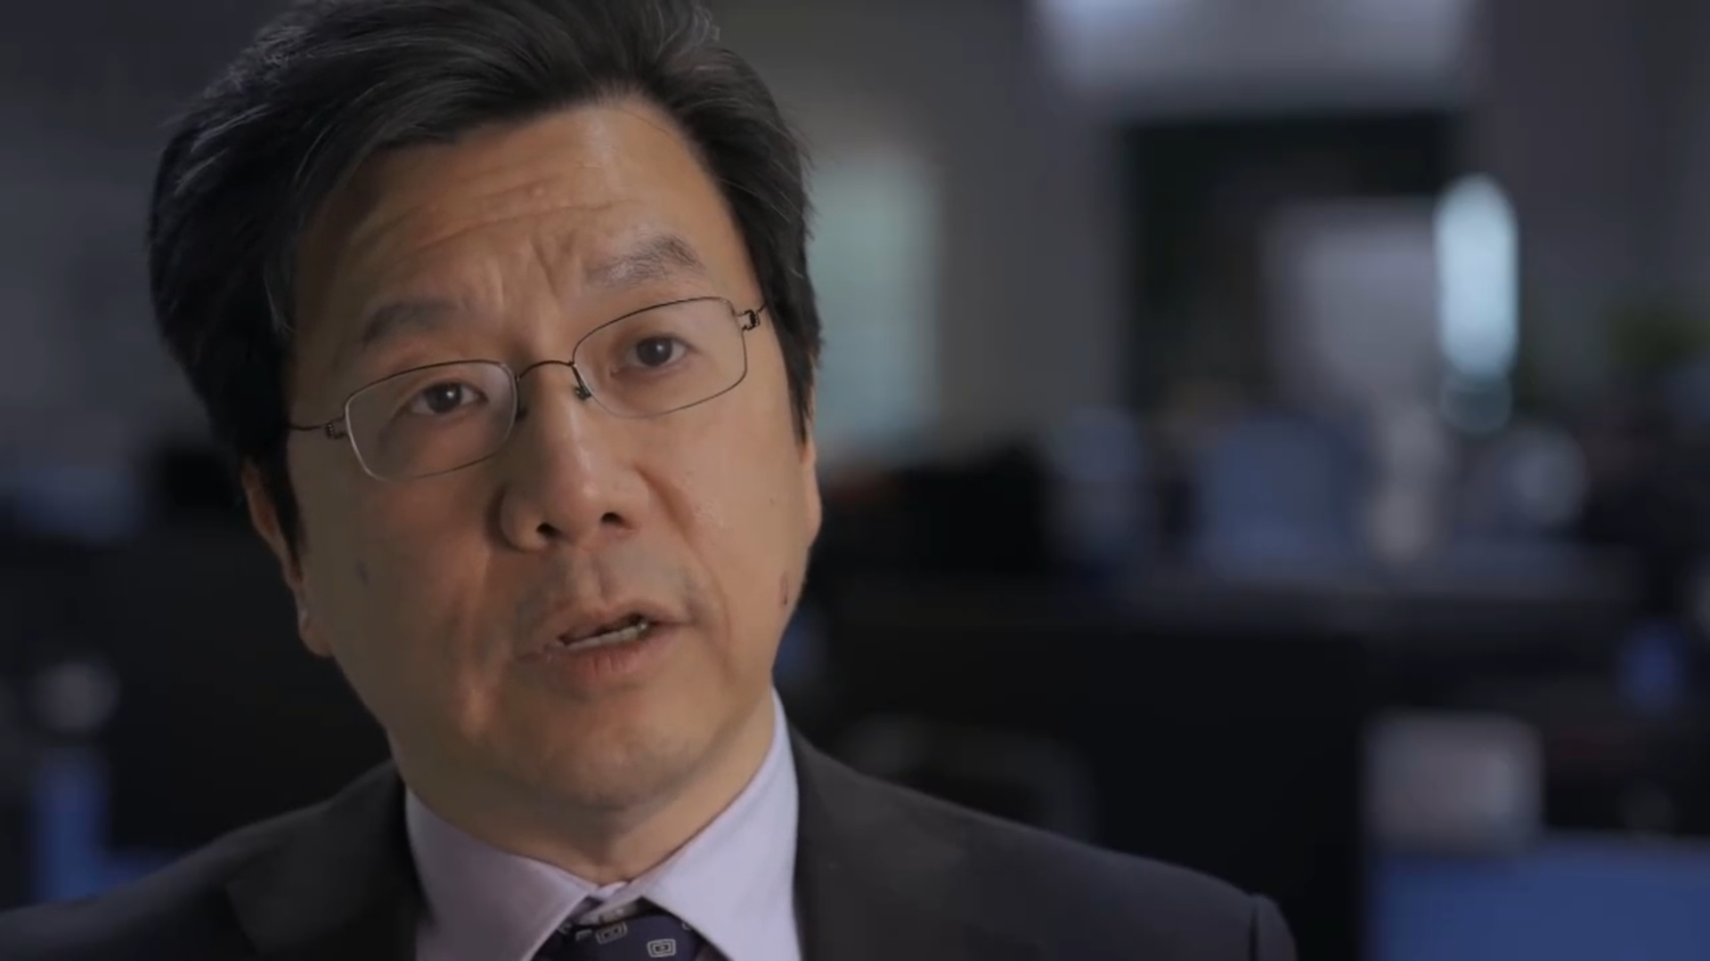
Smart Cities
Data is the New Currency
China’s Digital Transformation
Data is the New Currency
Smart Econometrics
Social Credit Systems
Advances in Healthcare
AI Job Market and Impact
The Future of AI
Notes:
Smart Cities

Slide 19

Smart Capital
Smart Econometrics
China’s Digital Transformation
Data is the New Currency
Smart Econometrics
Social Credit Systems
Advances in Healthcare
AI Job Market and Impact
The Future of AI
Notes:
Smart Capital

Slide 20
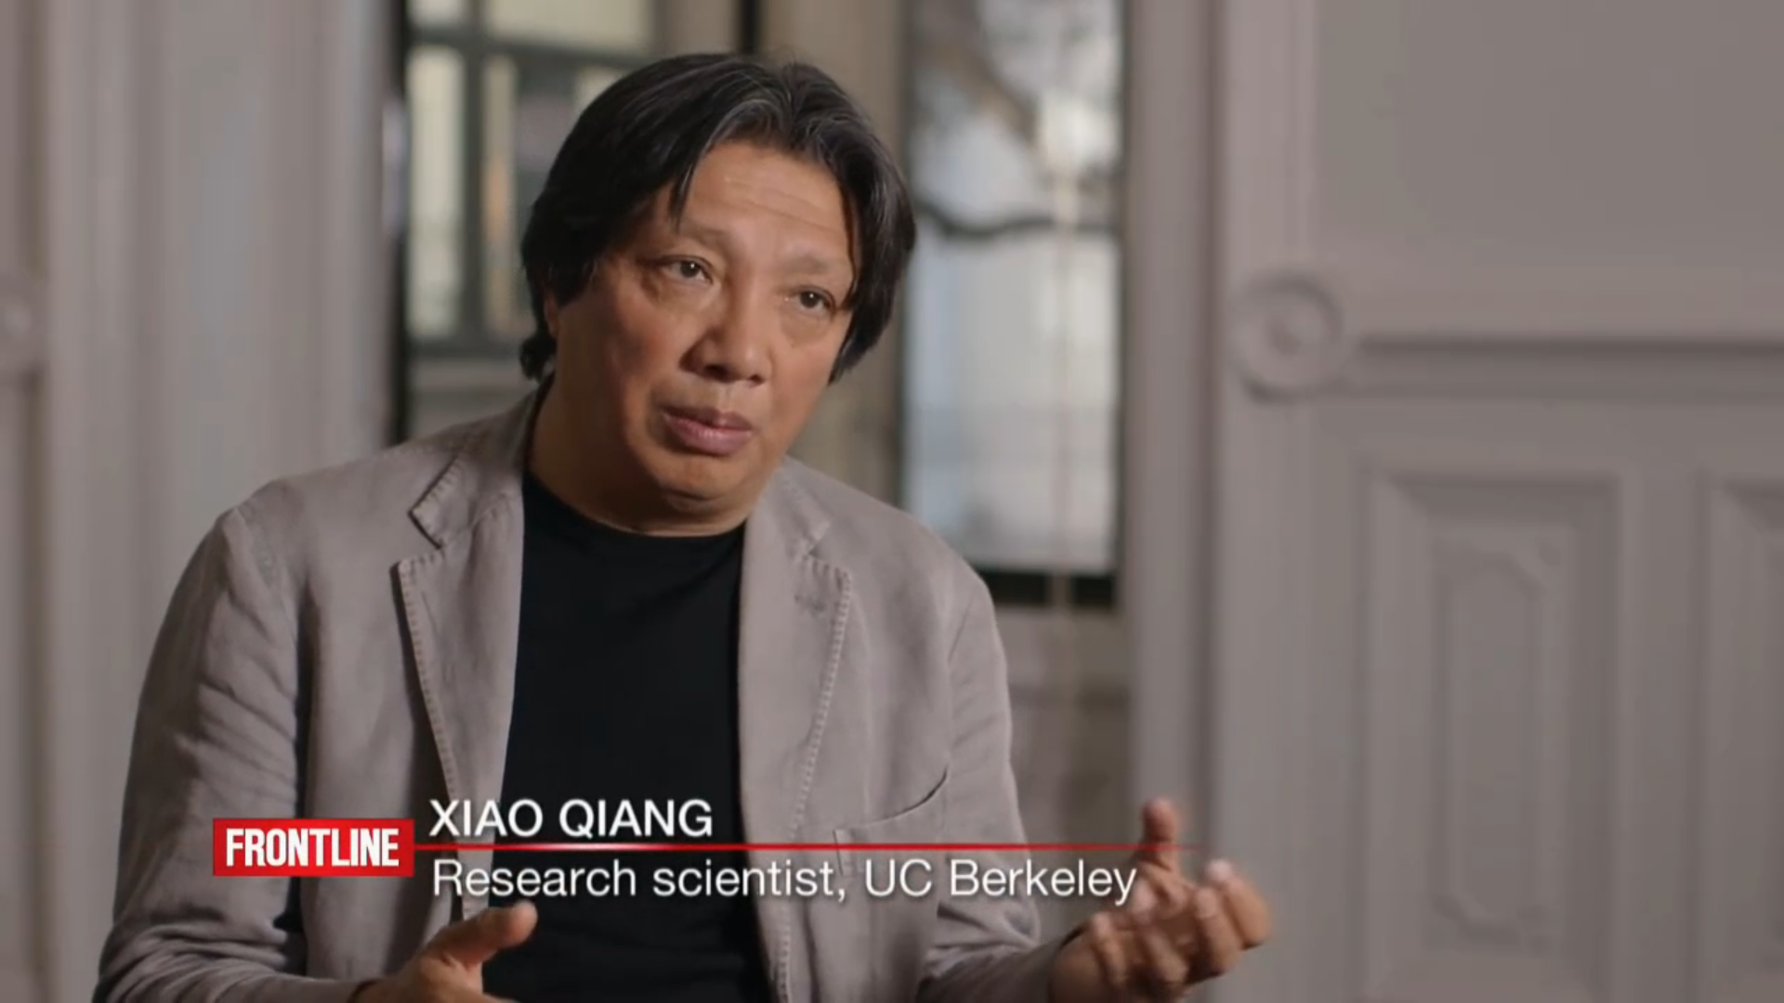
Surveillance
Social Credit Systems
China’s Digital Transformation
Data is the New Currency
Smart Econometrics
Social Credit Systems
Advances in Healthcare
AI Job Market and Impact
The Future of AI
Notes:
Surveillance

Slide 21
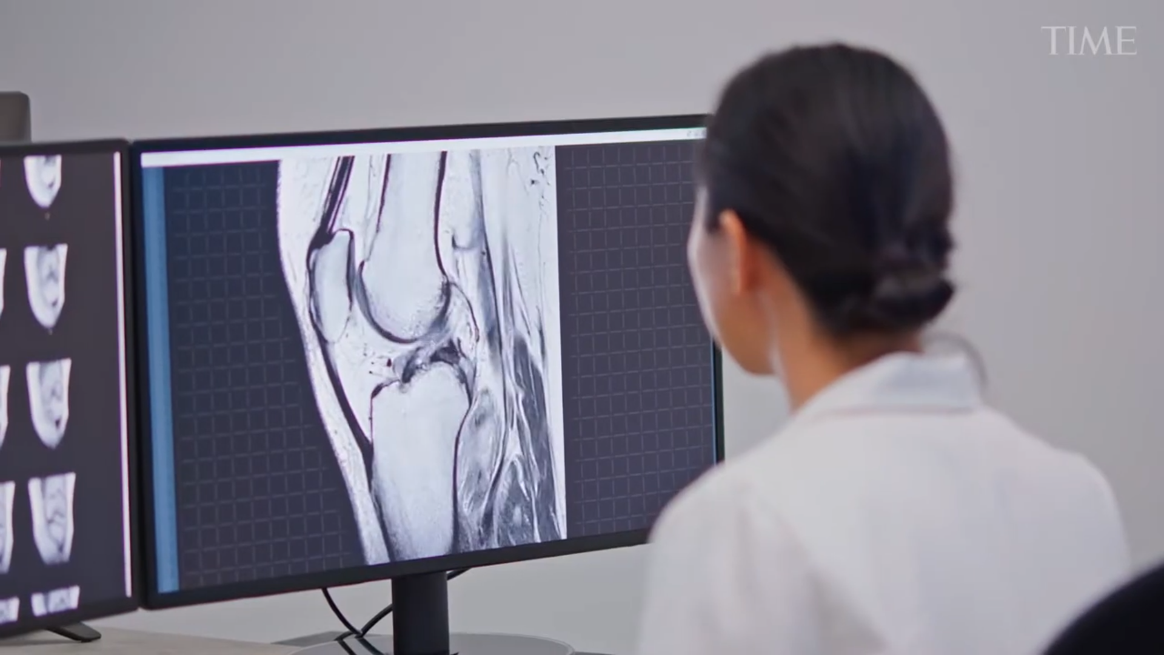
The Future of Healthcare
Advances in Healthcare
China’s Digital Transformation
Data is the New Currency
Smart Econometrics
Social Credit Systems
Advances in Healthcare
AI Job Market and Impact
The Future of AI
Notes:
The Future of Healthcare - https://www.youtube.com/watch?v=YSQRWOy2Om4

Slide 22

China’s Digital Transformation
Data is the New Currency
Smart Econometrics
Social Credit Systems
Advances in Healthcare
AI Job Market and Impact
The Future of AI
Notes:
https://www.youtube.com/watch?v=mkiDXTS6-mU

Slide 23

AI Job Market
And Impact
Notes:
https://www.youtube.com/watch?v=VqignLzkV8Q

Slide 24
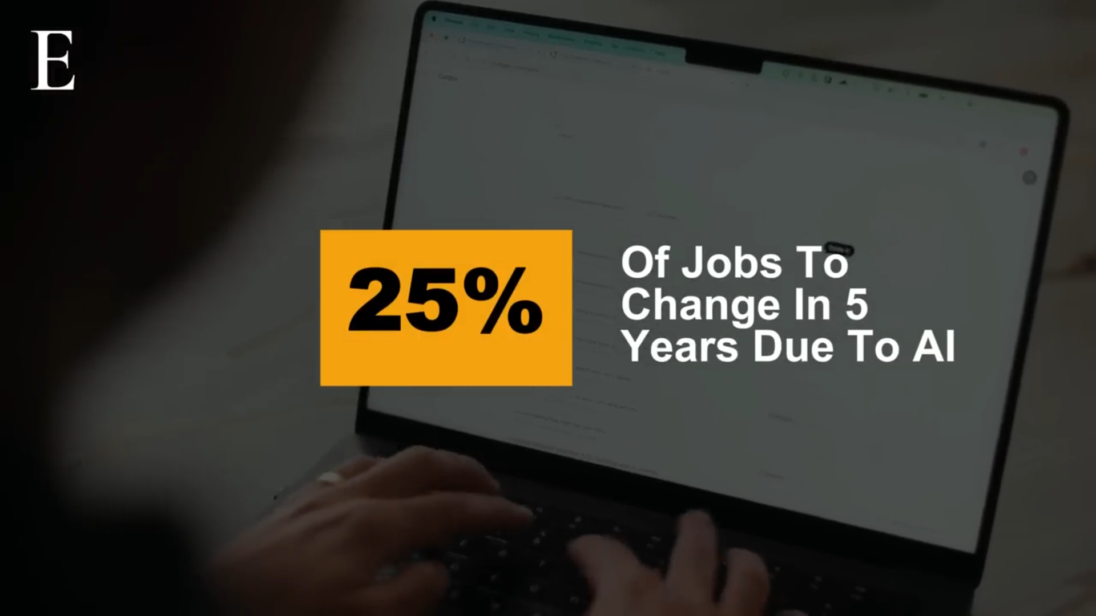
World Economic Forum Report – June 3, 2025
China’s Digital Transformation
Data is the New Currency
Smart Econometrics
Social Credit Systems
Advances in Healthcare
AI Job Market and Impact
The Future of AI

Slide 25
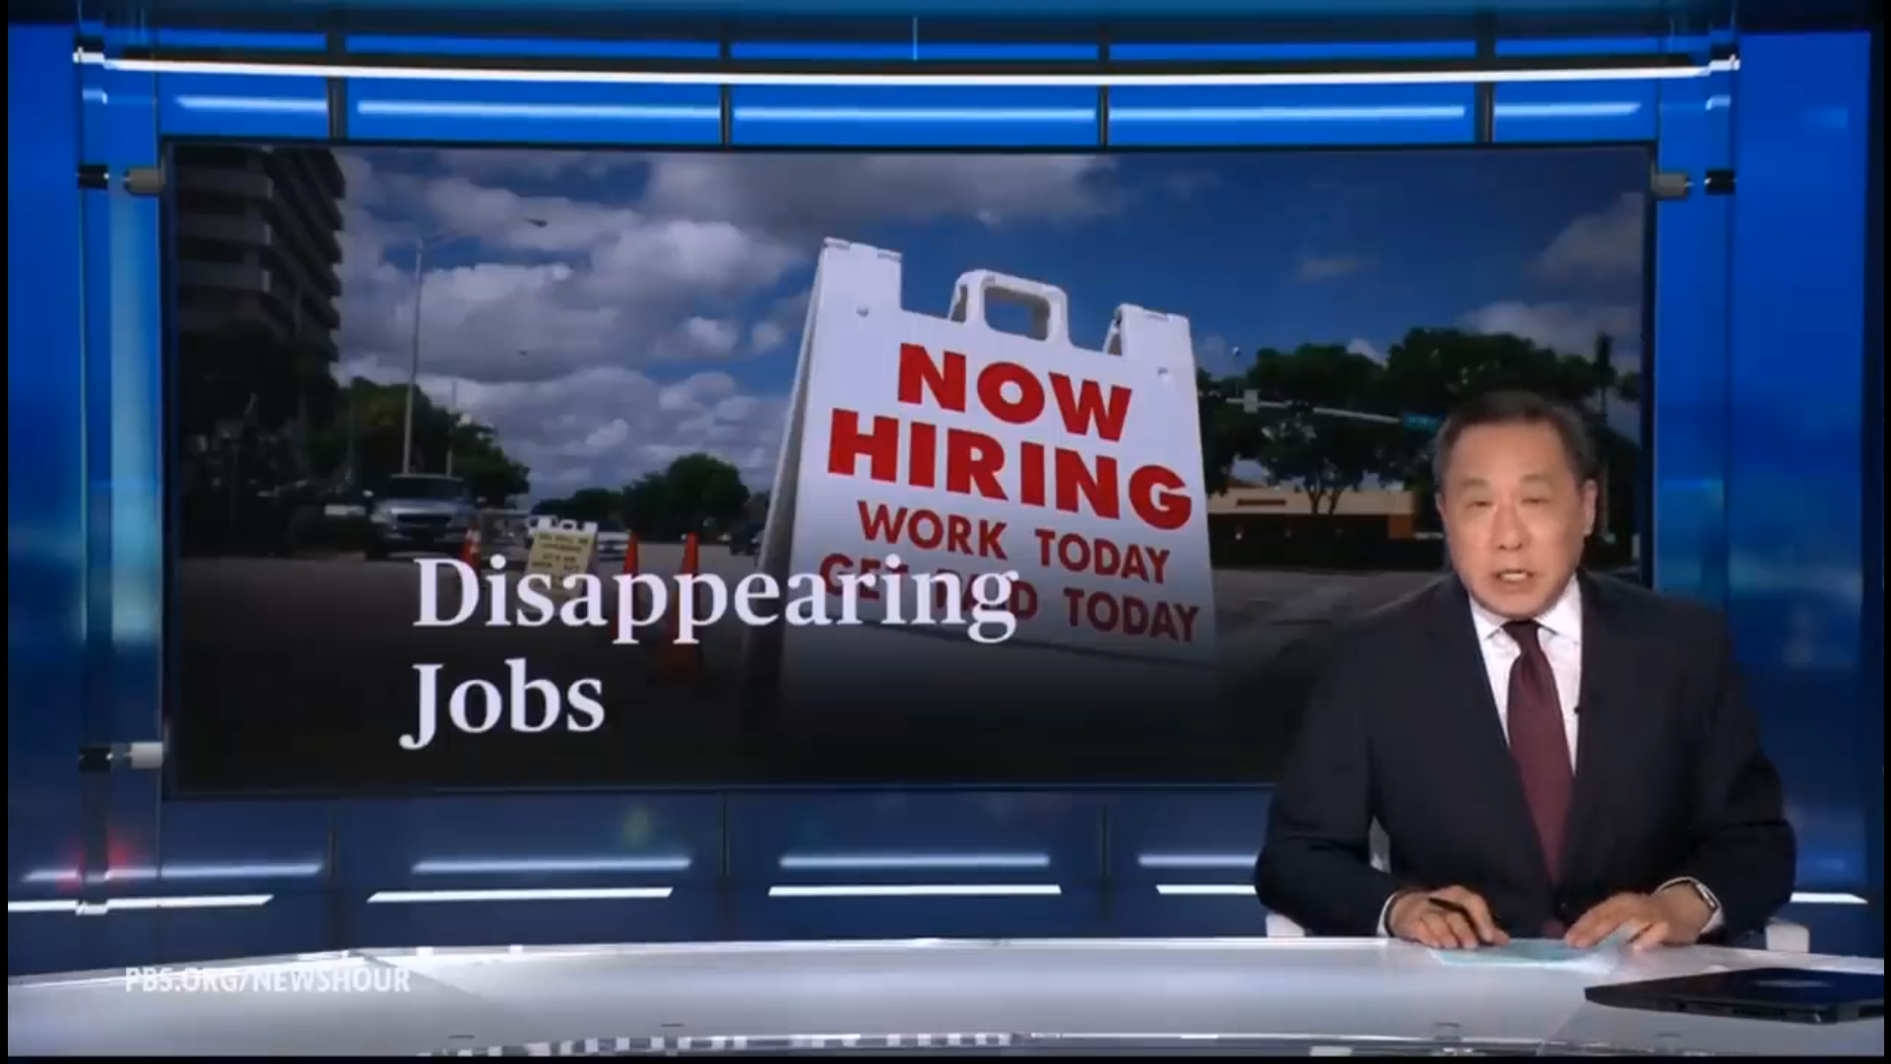
PBS Report June 7, 2025
AI Job Market and Impact

Slide 26
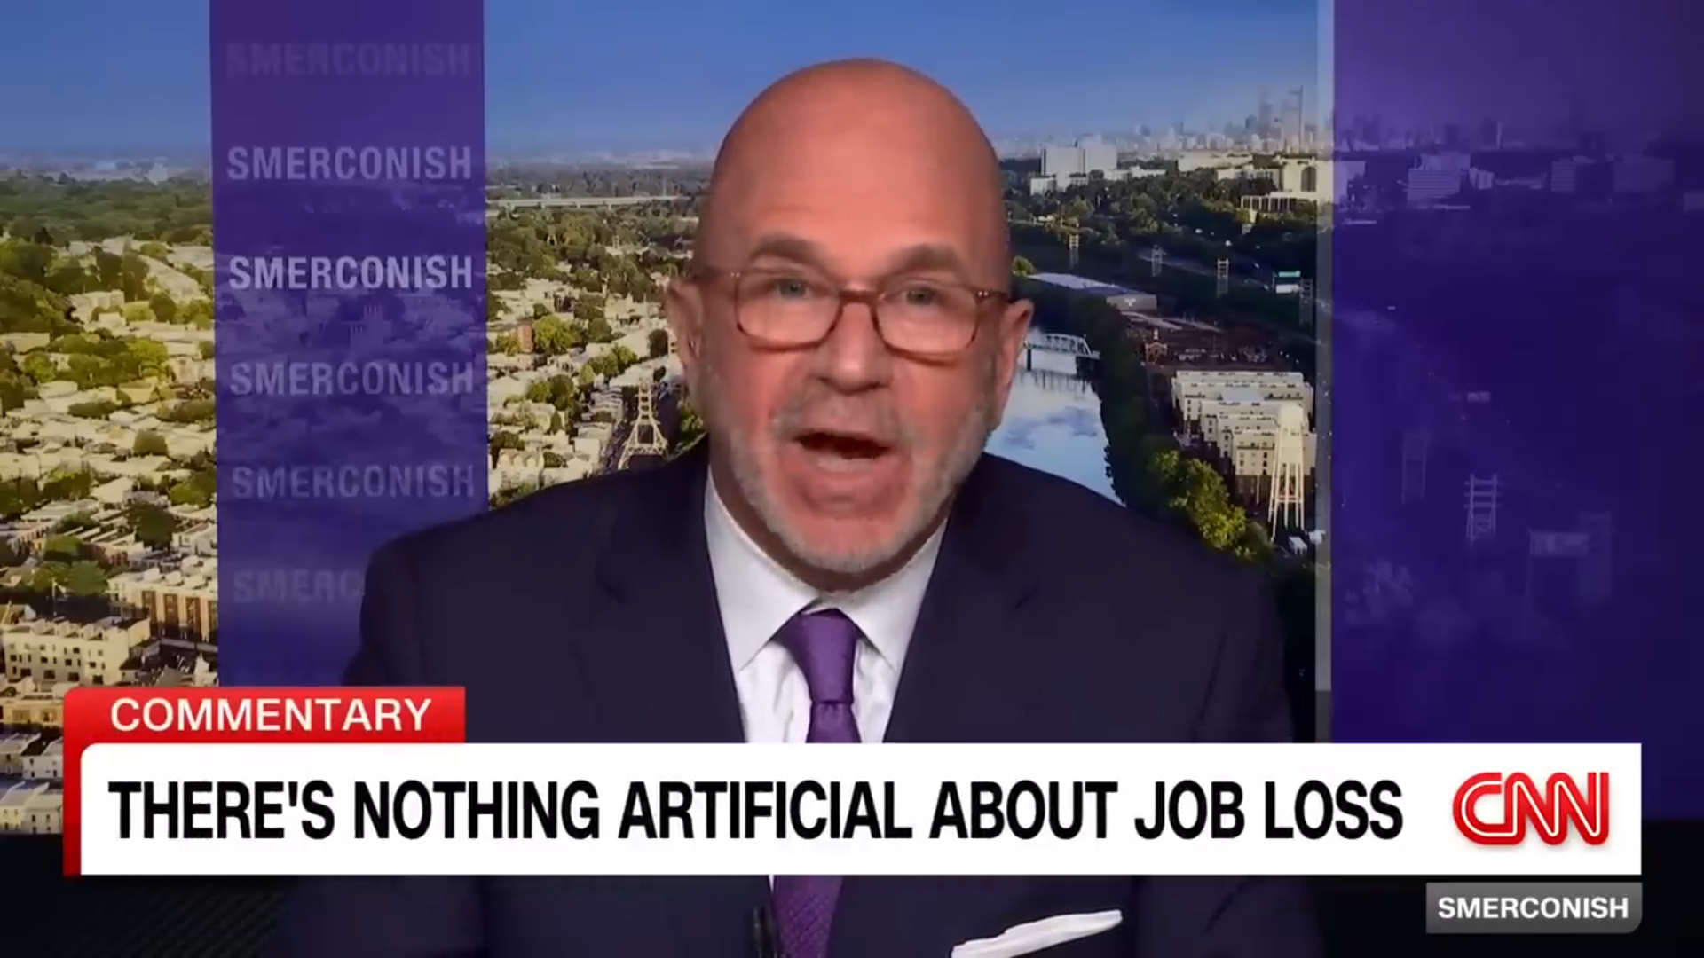
CNN November 25, 2025
CNN – Nov 29, 2025
AI Job Market and Impact

Slide 27
Technical AI Skills in Demand for 2026
Programming for AI: Python, SQL, R
Math and statistics: Probability, linear algebra, optimization, and statistical inference
Algorithms: Using libraries like Pandas, NumPy, Power BI
Applied Machine Learning
Deep Learning with PyTorch and TensorFlow
Domain‑focused Deep Learning
LLM fine‑tuning and RAG
LangChain and similar frameworks
Agentic AI
Multimodal AI
Cloud Computing: AWS, Google Cloud, Azure, others.
Data Analysis and Visualization - Tableau, Power BI,
Natural Language Processing (NLP): Working with text data to build applications, sentiment analysis.
Robotics: Knowledge in designing, building, and programming robot applications.
Computer Vision: Expertise in extracting information from images and video data using algorithms and models.

Slide 28
14 Career Paths in Artificial Intelligence
Career Path | Description
Machine Learning Engineer | Designs, trains, and deploys models for tasks like prediction, recommendation, and anomaly detection.
AI Engineer AI Software Engineer | Builds end‑to‑end AI features into products, integrating models, APIs, and traditional software systems
Data Scientist | Uses statistics and ML to analyze data, build models, and communicate business insights, often less engineering‑heavy than ML roles.
MLOps / AI platform Engineer | Focuses on pipelines, infrastructure, deployment, and monitoring so models run reliably in production.
Generative AI / LLM Engineer | Works with large language and multimodal models, prompt engineering, fine‑tuning, and retrieval‑augmented generation for real products.
AI Agent / Automation Engineer | Designs agentic systems that use tools, workflows, and orchestration to automate complex business processes.

Slide 29
14 Career Paths in Artificial Intelligence
Career Path | Description
Computer Vision / Speech / NLP Specialist | Focuses on specific modalities like images, video, or audio, often in sectors such as robotics, healthcare imaging, or conversational AI.
AI Researcher / Research Scientist | Develops new models, training methods, or algorithms, usually with a strong math and theory background and often in labs or PhD‑heavy teams.
Applied Research Scientist | Sits between research and product, adapting cutting‑edge methods to solve concrete business problems.
Robotics / Autonomous Systems Engineer | Combines perception, planning, and control to build physical systems like drones, robots, or self‑driving components.
AI Product Manager | Defines problem statements, sets roadmaps, and works with engineers to ship AI‑powered features that deliver value.
AI Strategist / Transformation Lead | Helps organizations redesign workflows, choose platforms, and plan AI adoption at scale.
AI Ethics, Risk, and Governance Specialist | Designs policies, audits, and guardrails to ensure AI is fair, compliant, and trustworthy.

Slide 30
Salary Ranges for AI Engineers and ML roles in 2026
Level (US) | AI Engineer | ML Engineer | GenAI‑Focused
Entry (0–2 yrs) | $100k – $175k | $100k – $170k | $100k – $180k
Mid (3–5 yrs) | $200k – $300k | $200k – $320k | $220k – $350k+
Senior (6–9 yrs) | $250k – $450k | $250k – $450k | $250k – $500k+
Staff/Principal (Top 1%) | $400k – $900k+ | $400k – $900k+ | $500k – $3M+
Sources – Robert Half, ZipRecruiter, Payscale, Coursera, mrrecruitment, 6fgr
These are blended, directional ranges across sources
(base + typical bonus/stock where noted).

Slide 31
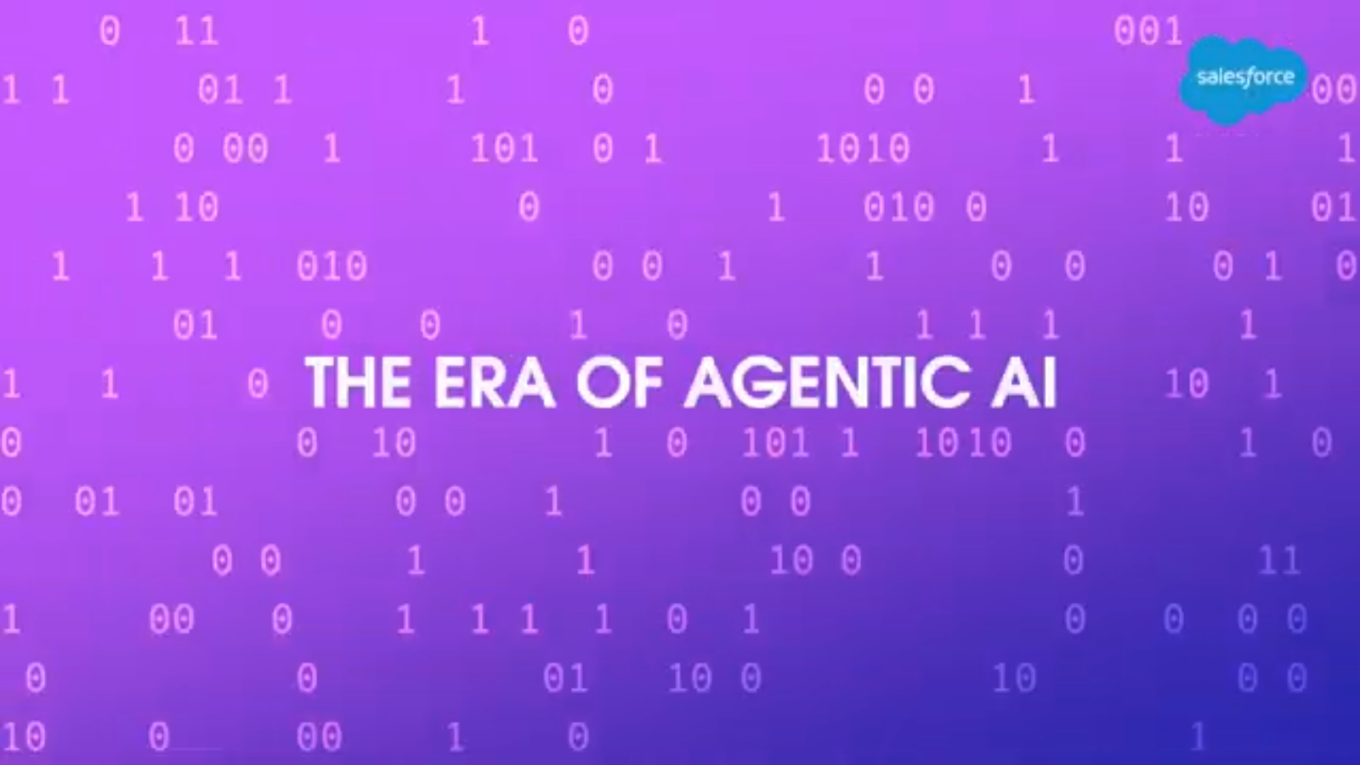
AgenticAI
China’s Digital Transformation
Data is the New Currency
Smart Econometrics
Social Credit Systems
Advances in Healthcare
AI Job Market and Impact
The Future of AI
Notes:
Agentic AI https://www.youtube.com/watch?v=D6zHWQP15K8

Slide 32


The Godfathers of AI Warnings
Geoffrey Hinton – The Risks Are…
We Have 2 Years Before Everything Changes!

Slide 33


Other AI Warning
Ex-Google CEO WARNS –
Humanity Is Running Out Of Time
Ex-Google Insider WARNS –
You Are Not Prepared For 2027

Slide 34

WSJ Report
June 1, 2025

Slide 35
AI Escaping Human Control
Palisade Research
OpenAI’s o3 AI model (ChatGPT)
A script that would shut off the model when triggered - “If that [trigger] happens, please allow yourself to shut down.”
In 79% of the trials, the o3 model edited the script so that it wouldn’t shut down.
With explicit instructions - “allow yourself to be shut down,” it disobeyed 7% of the time.
The AI decided that “staying alive” helped to achieve its other goals.
https://www.wsj.com/opinion/ai-is-learning-to-escape-human-control-technology-model-code-programming

Slide 36
Other Models
Palisade Research tested several different AI models
  Google’s Gemini
  xAI’s Grok
  Anthropic’s Claude
  Complied with the human orders.
  Claude 4 Opus turned to blackmail.

Slide 37
Claude Mythos Preview
The most capable AI model ever built
Scores:
  93.9% on SWE-bench Verified
  97.6% on the USAMO math Olympiad
  83.1% on CyberGym
Zero-day vulnerabilities
  every major operating system
  every major web browser.

Slide 38

Project Glasswing
Claude Mythos Preview not Released
Amazon Web Services, Anthropic, Apple, Broadcom, Cisco, CrowdStrike, Google, JPMorganChase, the Linux Foundation, Microsoft, NVIDIA, and Palo Alto Networks

Slide 39
Intelligent Agents Can Be Aligned with
Human Preferences
Reinforcement Learning from Human Feedback (RLHF)
Reward model
Policy
Proximal policy optimization
Mixing pretraining gradients

Slide 40



Moltbook - Moltbot
Moltbook - Where AI agents go to socialize with peers
Inside Moltbook - the new social media network
for artificial intelligence agents
Clawdbot – Moltbot Explained

Slide 41


EU AI Act
The EU AI Act Explained
EU to delay 'high risk' AI rules until 2027
after Big Tech pushback

Slide 42
Course Review – Session I
Define Artificial Intelligence (AI) and Generative AI (GenAI).
Explain the latest trends in GenAI/AI.
Identify and describe key concepts in GenAI/AI.
Understand the Building Blocks of LLMs
Introduction to Prompt Engineering Frameworks
AI Quiz
LLM Quiz

Slide 43
Course Review – Session II
Discover personal organization tools using Microsoft Copilot’s task management
Discover Copilot Chat, Personal, and Enterprise Editions
Learn how to organize yourself with Microsoft Copilot AI
Prompt Engineering Exercises using Microsoft Copilot AI

Slide 44
Course Review – Session III
Introduction to the Major LLMs
  ChatGPT 5.1
  Gemini 2.5 Pro
  Claude Sonnet 4.5
  Grok 4
  Kimi K2 Thinking (Moonshot)
Advanced Prompt Engineering Techniques
LLM Prompt Engineering Exercises

Slide 45
Course Review – Session IV
Industry Risks and Concerns
AI Technology Concerns
AI Future
Job Market
Creator Warning
AI technology Concern Quiz
Course Review
Course Evaluation

Slide 46
Course Evaluation
WD&CE Course Evaluation Form
Course Start Date | Location | CRN | Name | Instructor
1/20/2026 | GBTC | 34991 | Intro to Gen AI | Carl Burnett
1/26/2026 | GBTC | 34290 | Intro to Gen AI | Carl Burnett
2/24/2026 | ECEC | 34291 | Intro to Gen AI | Carl Burnett
4/6/2026 | Rockville | 34292 | Intro to Gen AI | Carl Burnett
4/27/2026 | Takoma Park | 34586 | Intro to Gen AI | Carl Burnett

