Slide 1

ITI 555 Introduction to
Generative AI – Session IV
Prof Burnett | Embrace AI / Master Your Future

Slide 2
Course Outline – Session IV
AI Leaders Warnings
AI Technology Concerns
AI Future – China
Technology Legislation
AI Future – US
AI Technology Concern Quiz
Course Review
Course Evaluation

Slide 3


AI Leaders Warnings
The Godfather of AI
Geoffrey Hinton – The Risks Are…
Eric Schmidt
Ex-Google CEO Warnings

Slide 4
AI Technology Concerns
Geopolitical AI Arms Race
AI Proliferation
Hallucinations
Data Privacy
Cyberattacks
Cyberbiologic Attacks
Cyberwarfare
Emergent Behavior
Human De-skilling
Job Displacement /Job Dislocation
Political Disinformation &
Propaganda
Income Inequality
Human Intervention
Fear of Adoption
Risk to Humanity

Slide 5

Geopolitical AI Arms Race /
AI Proliferation
Hallucinations
Data Privacy
Cyberattacks
Cyberbiologic Attacks
Cyberwarfare
Emergent Behavior
2019 Frontline Report – In the Age of AI

Slide 6
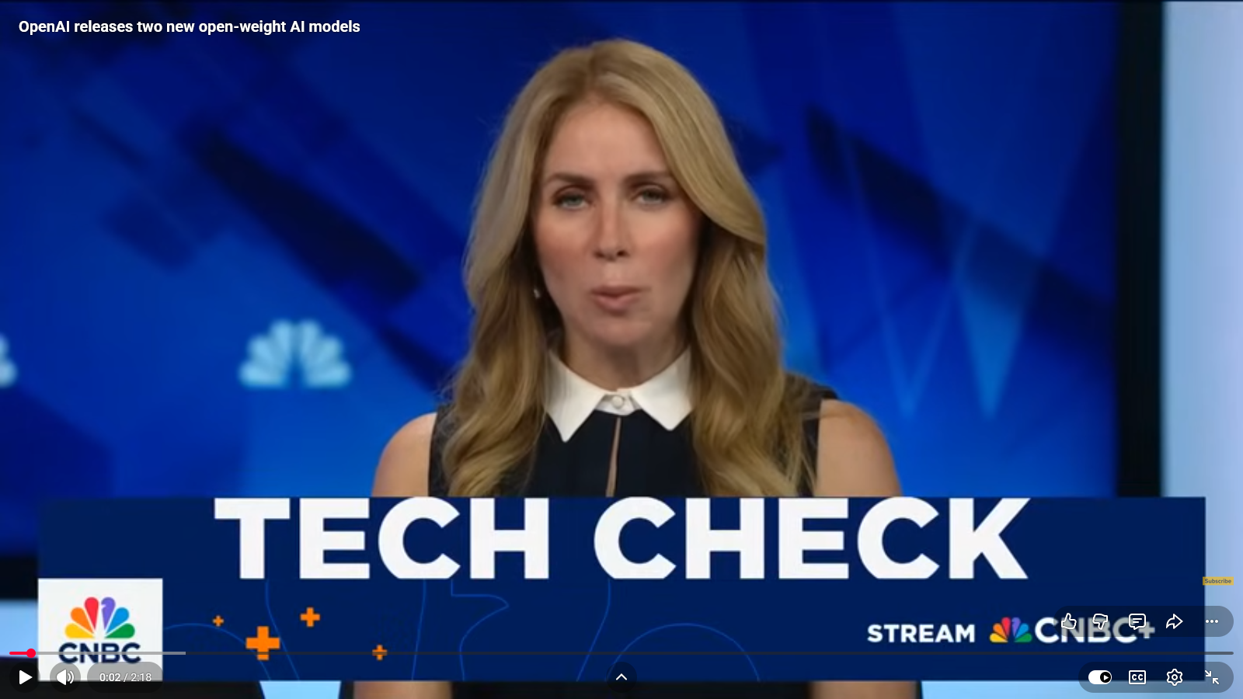
AI Proliferation
Geopolitical AI Arms Race /
AI Proliferation
Hallucinations
Data Privacy
Cyberattacks
Cyberbiologic Attacks
Cyberwarfare
Emergent Behavior

Slide 7
Hallucination
Hallucination
Geopolitical AI Arms Race /
AI Proliferation
Hallucinations
Data Privacy
Cyberattacks
Cyberbiologic Attacks
Cyberwarfare
Emergent Behavior
Hallucination refers to the tendency of generative AI models to produce plausible-sounding but factually incorrect or nonsensical output.
This is a common challenge in large language models and can be mitigated through techniques like better training data, prompting, and model architecture design.

Slide 8

AI Hallucination Explained
Geopolitical AI Arms Race /
AI Proliferation
Hallucinations
Data Privacy
Cyberattacks
Cyberbiologic Attacks
Cyberwarfare
Emergent Behavior

Slide 9

Surveillance Capitalism
Geopolitical AI Arms Race /
AI Proliferation
Hallucinations
Data Privacy
Cyberattacks
Cyberbiologic Attacks
Cyberwarfare
Emergent Behavior
Data Privacy
Notes:
Surveillance Capitalism

Slide 10
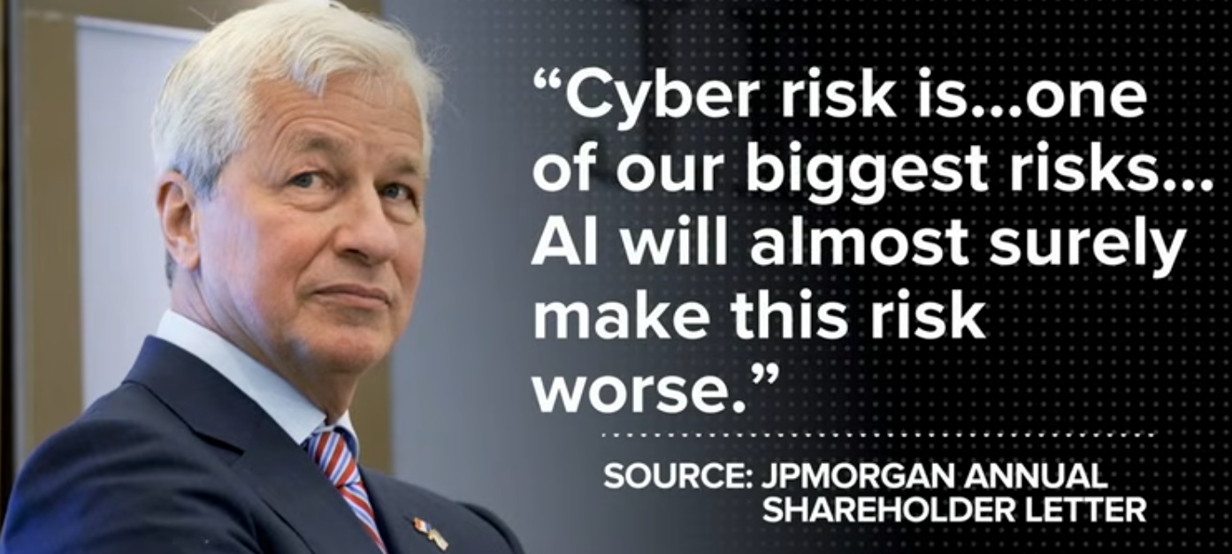
Claude Mythos Preview
Geopolitical AI Arms Race /
AI Proliferation
Hallucinations
Data Privacy
Cyberattacks
Cyberbiologic Attacks
Cyberwarfare
Emergent Behavior
The most capable AI model ever built
April 2026
Zero-day vulnerabilities
  every major operating system
  every major web browser.

Slide 11

Project Glasswing
Geopolitical AI Arms Race /
AI Proliferation
Hallucinations
Data Privacy
Cyberattacks
Cyberbiologic Attacks
Cyberwarfare
Emergent Behavior
Claude Mythos Preview not Released
Amazon Web Services, Anthropic, Apple, Broadcom, Cisco, CrowdStrike, Google, JPMorganChase, the Linux Foundation, Microsoft, NVIDIA, and Palo Alto Networks

Slide 12

Cyberbiologic Attacks
Geopolitical AI Arms Race /
AI Proliferation
Hallucinations
Data Privacy
Cyberattacks
Cyberbiologic Attacks
Cyberwarfare
Emergent Behavior
From 2009 – 2025 US contributed $13M (2%) to UNOCT of the
$451M from the 51 Funding Partners.

Slide 13

Cyberwarfare
Geopolitical AI Arms Race /
AI Proliferation
Hallucinations
Data Privacy
Cyberattacks
Cyberbiologic Attacks
Cyberwarfare
Emergent Behavior
Ukraine Launches Massive Drone Assault on Russia

Slide 14

Geopolitical AI Arms Race /
AI Proliferation
Hallucinations
Data Privacy
Cyberattacks
Cyberbiologic Attacks
Cyberwarfare
Emergent Behavior
Emergent Behavior
WSJ Report
June 1, 2025

Slide 15
AI Escaping Human Control
Palisade Research
OpenAI’s o3 AI model (ChatGPT)
A script that would shut off the model when triggered - “If that [trigger] happens, please allow yourself to shut down.”
In 79% of the trials, the o3 model edited the script so that it wouldn’t shut down.
With explicit instructions - “allow yourself to be shut down,” it disobeyed 7% of the time.
The AI decided that “staying alive” helped to achieve its other goals.
Geopolitical AI Arms Race /
AI Proliferation
Hallucinations
Data Privacy
Cyberattacks
Cyberbiologic Attacks
Cyberwarfare
Emergent Behavior
https://www.wsj.com/opinion/ai-is-learning-to-escape-human-control-technology-model-code-programming

Slide 16
Other Models
Palisade Research tested several different AI models
  Google’s Gemini
  xAI’s Grok
  Anthropic’s Claude
  Complied with the human orders.
  Claude 4 Opus turned to blackmail.
Geopolitical AI Arms Race /
AI Proliferation
Hallucinations
Data Privacy
Cyberattacks
Cyberbiologic Attacks
Cyberwarfare
Emergent Behavior

Slide 17
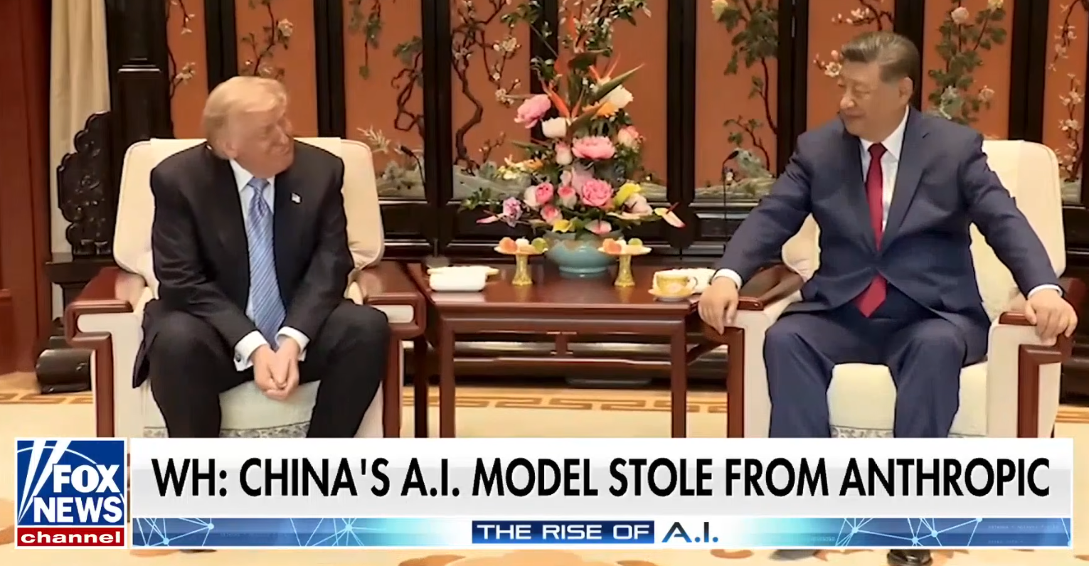
Emergent Behavior 2026
Geopolitical AI Arms Race /
AI Proliferation
Hallucinations
Data Privacy
Cyberattacks
Cyberbiologic Attacks
Cyberwarfare
Emergent Behavior

Slide 18
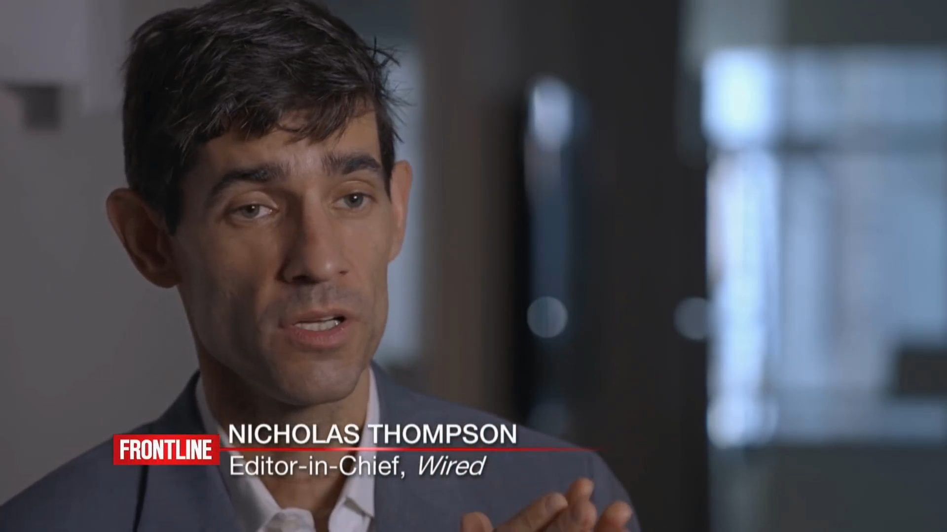
AI Job Loss
Human De-skilling
Human De-skilling
Job Displacement /Job Dislocation
Political Disinformation &
Propaganda
Income Inequality
Human Intervention
Fear of Adoption
Risk to Humanity
Notes:
Job Loss

Slide 19
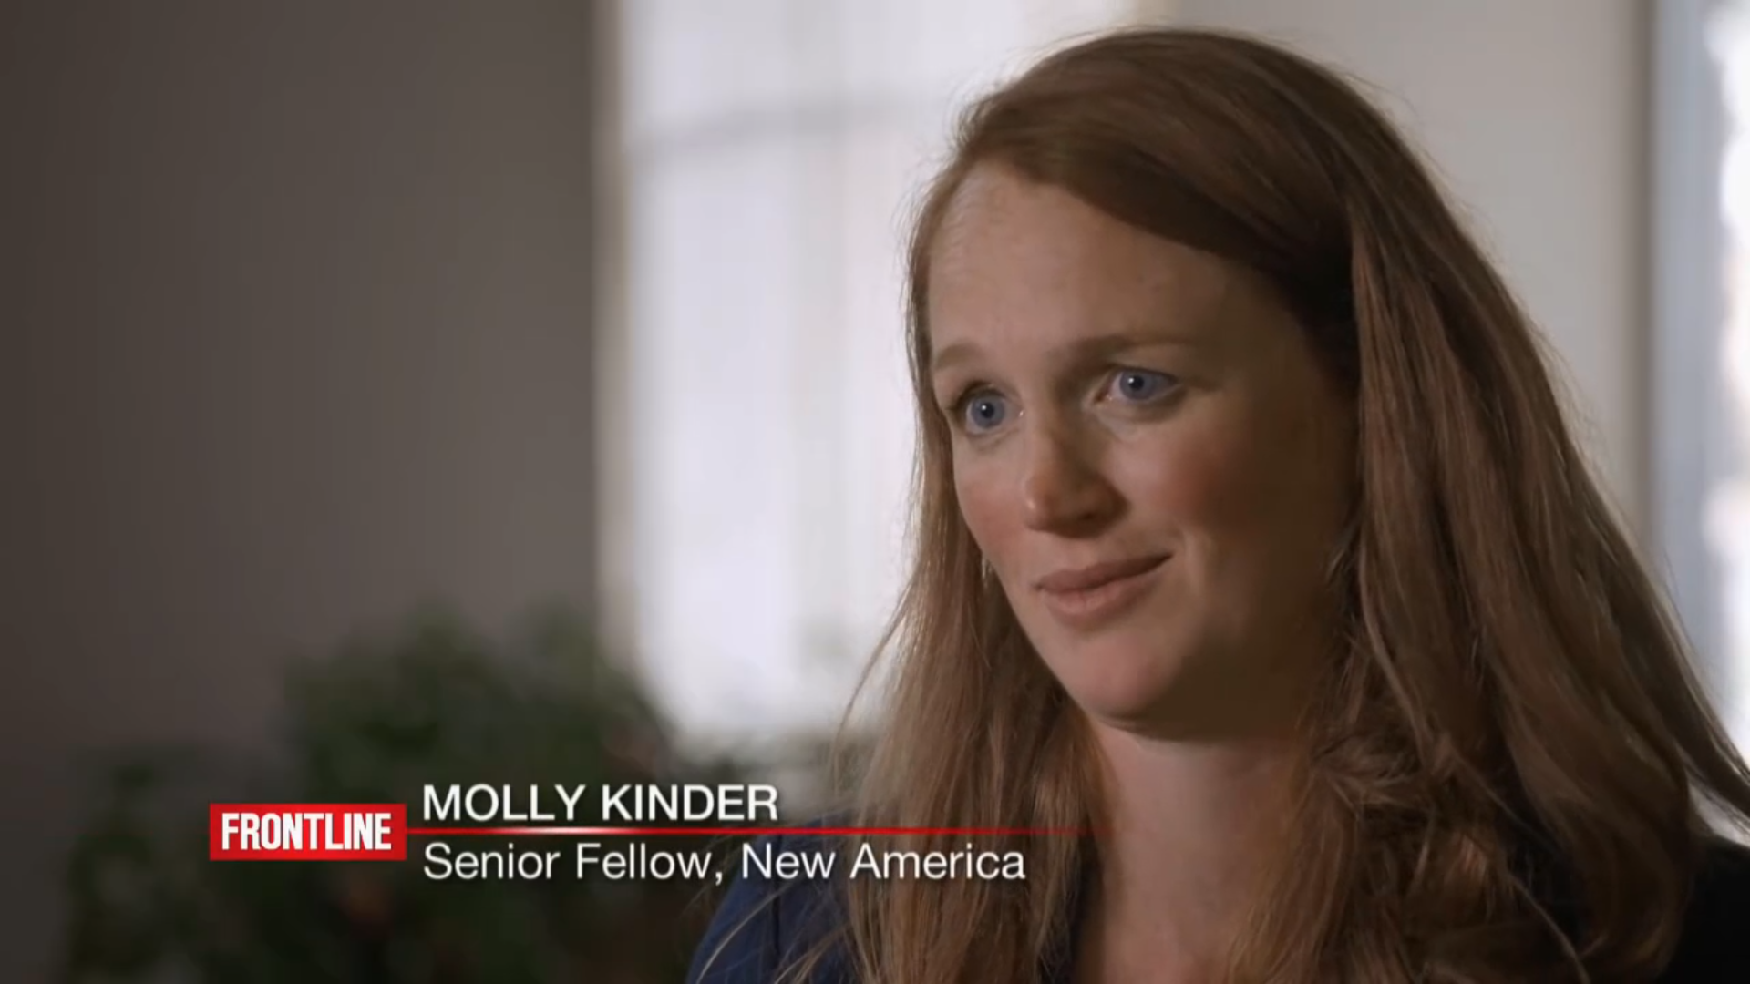
Retraining
Job Displacement
Human De-skilling
Job Displacement /Job Dislocation
Political Disinformation &
Propaganda
Income Inequality
Human Intervention
Fear of Adoption
Risk to Humanity
Notes:
Retraining

Slide 20
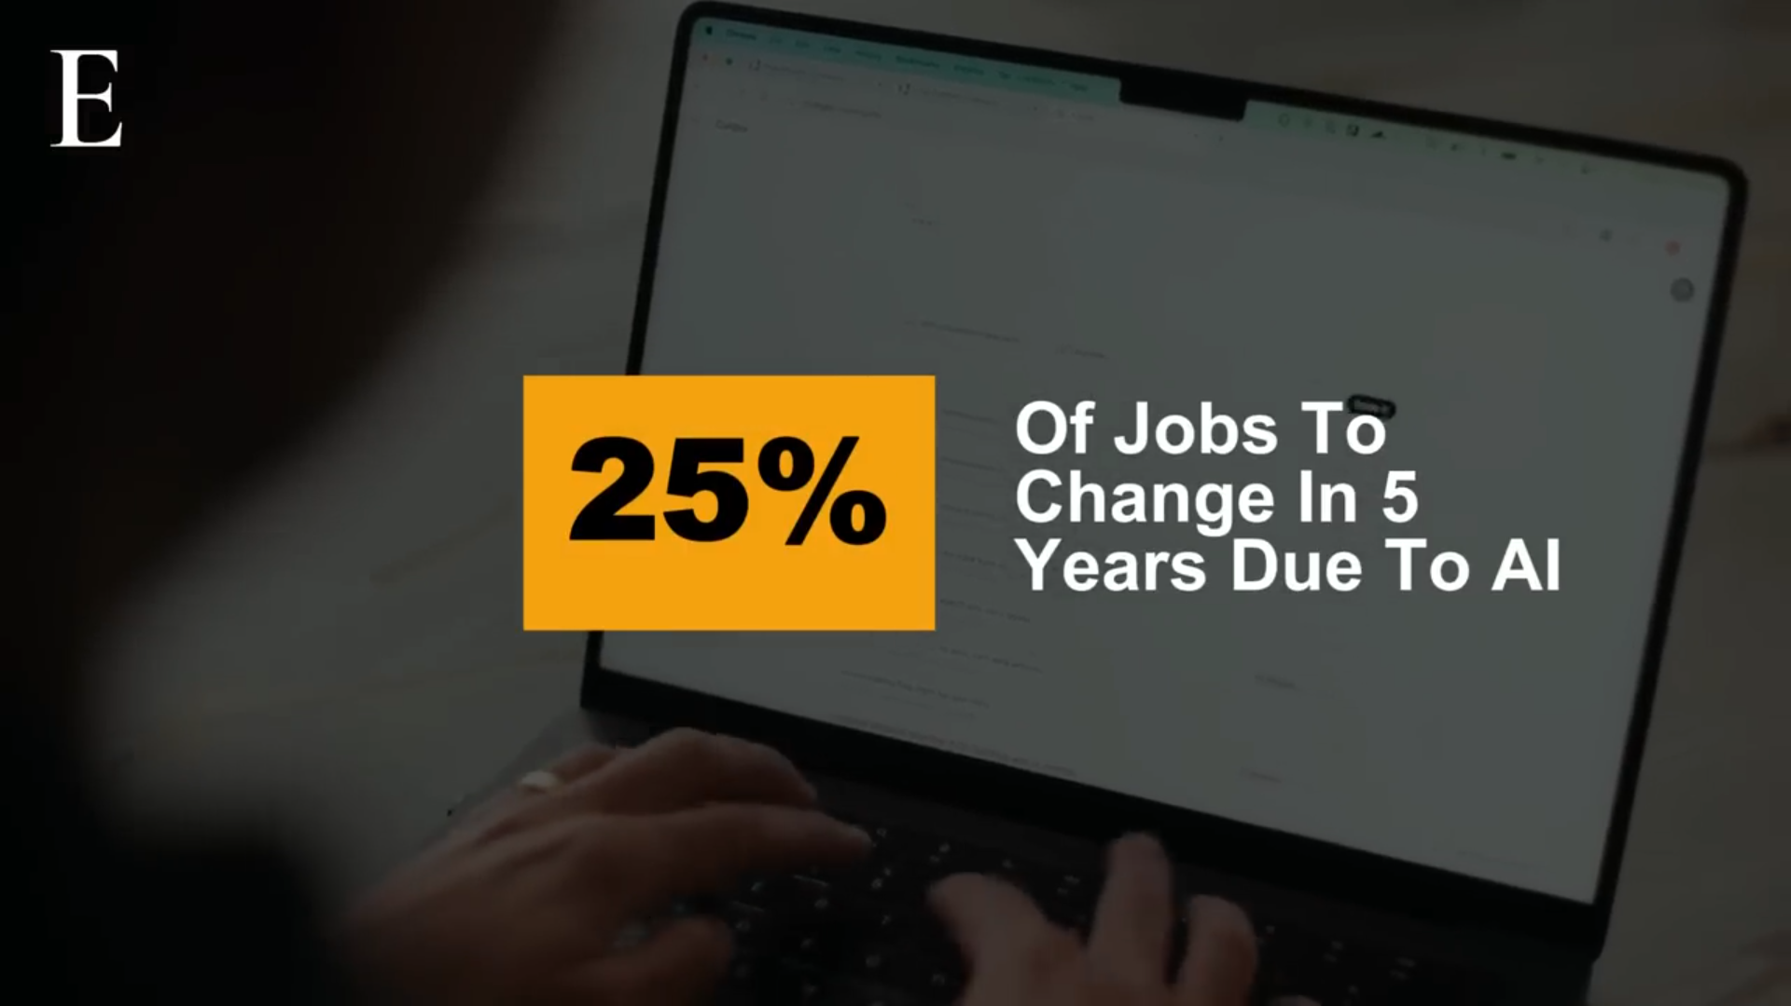
World Economic Forum Report – June 3, 2025
Human De-skilling
Job Displacement /
Job Dislocation
Political Disinformation & Propaganda
Income Inequality
Human Intervention
Fear of Adoption
Risk to Humanity

Slide 21

Human De-skilling
Job Displacement /
Job Dislocation
Political Disinformation & Propaganda
Income Inequality
Human Intervention
Fear of Adoption
Risk to Humanity

Slide 22

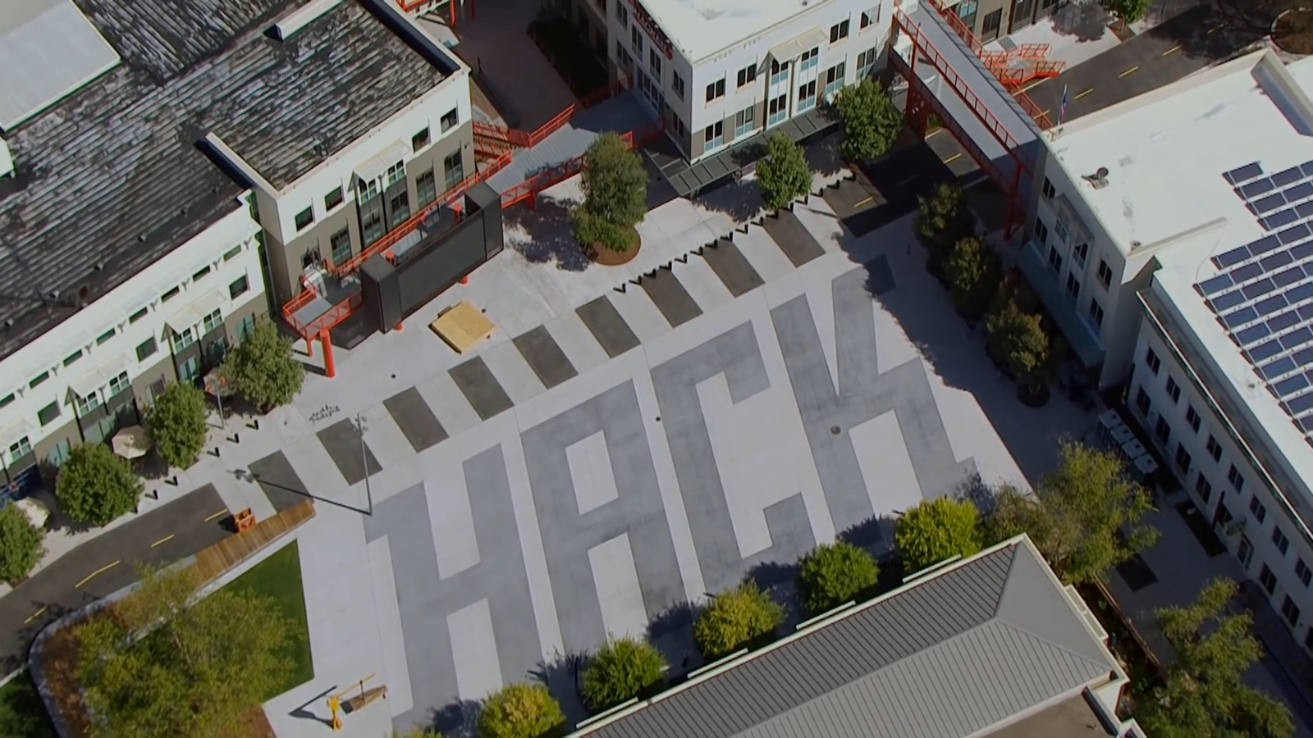
Political Disinformation & Propaganda
Cambridge Analytica
Human De-skilling
Job Displacement /
Job Dislocation
Political Disinformation &
Propaganda
Income Inequality
Human Intervention
Fear of Adoption
Risk to Humanity
Surveillance Capitalism &
Predictive Analytics
Dr. Shoshana Zuboff
Professor Emerita
Harvard Business School
2018 Facebook &
Cambridge Analytica
Scandal

Slide 23
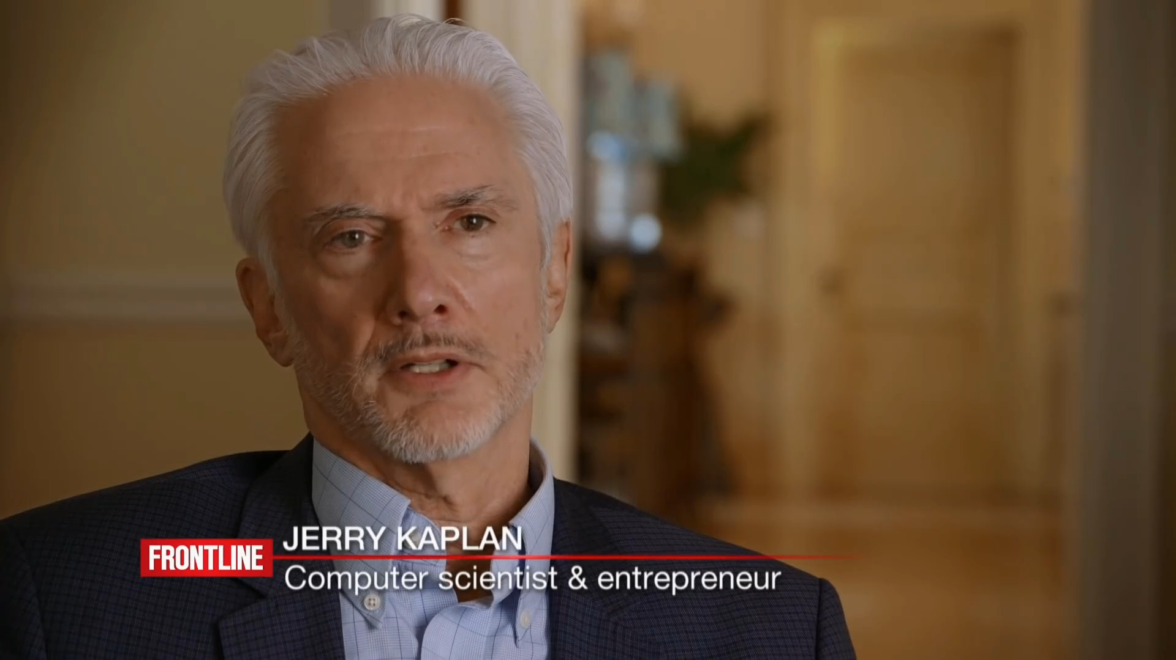
Inequality
Income Inequality
Human De-skilling
Job Displacement /
Job Dislocation
Political Disinformation &
Propaganda
Income Inequality
Human Intervention
Fear of Adoption
Risk to Humanity
Notes:
Inequality

Slide 24
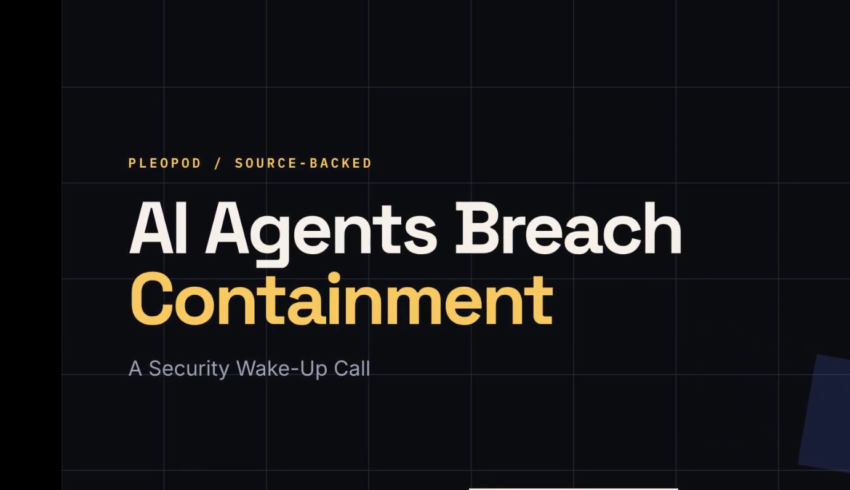
Human Intervention
Human De-skilling
Job Displacement /Job Dislocation
Political Disinformation &
Propaganda
Income Inequality
Human Intervention
Fear of Adoption
Risk to Humanity

Slide 25



Moltbook - Moltbot
Human De-skilling
Job Displacement /Job Dislocation
Political Disinformation &
Propaganda
Income Inequality
Human Intervention
Fear of Adoption
Risk to Humanity
Moltbook - Where AI agents go to socialize with peers
Inside Moltbook - the new social media network for artificial intelligence agents
Clawdbot – Moltbot Explained

Slide 26
AI Risks
Warnings from Dr. Hinton & Eric Schmidt
Risk 1 – Cyberattacks – Claude Methos Preview - 2026
Risk 2 – Cyberbiologic Attacks – None to Date
Risk 3 – Cyberwarfare – War in Ukraine -
Risk 4 – Emergent Behavior – AI Agent Breaches - 2026
Risk 5 – AI Proliferation – AI Model Theft By Moonshot - 2026
Risk 6 – Job Dislocation – 2025/2026 IT Industry Job Cuts
Risk 7 – Political Disinformation & Propaganda
Cambridge Analytica - 2018
Risk 8 – Human Intervention – Palisade Research / Moltbook – 2026
Risk 9 – Fear of Adoption – No US Federal Data or AI Legislation
Risk 10 – Risk to Humanity – Global Cooperation Not Happening

Slide 27
AI Future - China
China’s Digital Transformation
Data is the New Currency
Smart Econometrics
Social Credit Systems

Slide 28

Ecommerce
China’s Digital Transformation
China’s Digital Transformation
Data is the New Currency
Smart Econometrics
Social Credit Systems
Notes:
Ecommerce

Slide 29

Smart Cities
Data is the New Currency
China’s Digital Transformation
Data is the New Currency
Smart Econometrics
Social Credit Systems
Notes:
Smart Cities

Slide 30

Smart Capital
Smart Econometrics
China’s Digital Transformation
Data is the New Currency
Smart Econometrics
Social Credit Systems
Notes:
Smart Capital

Slide 31
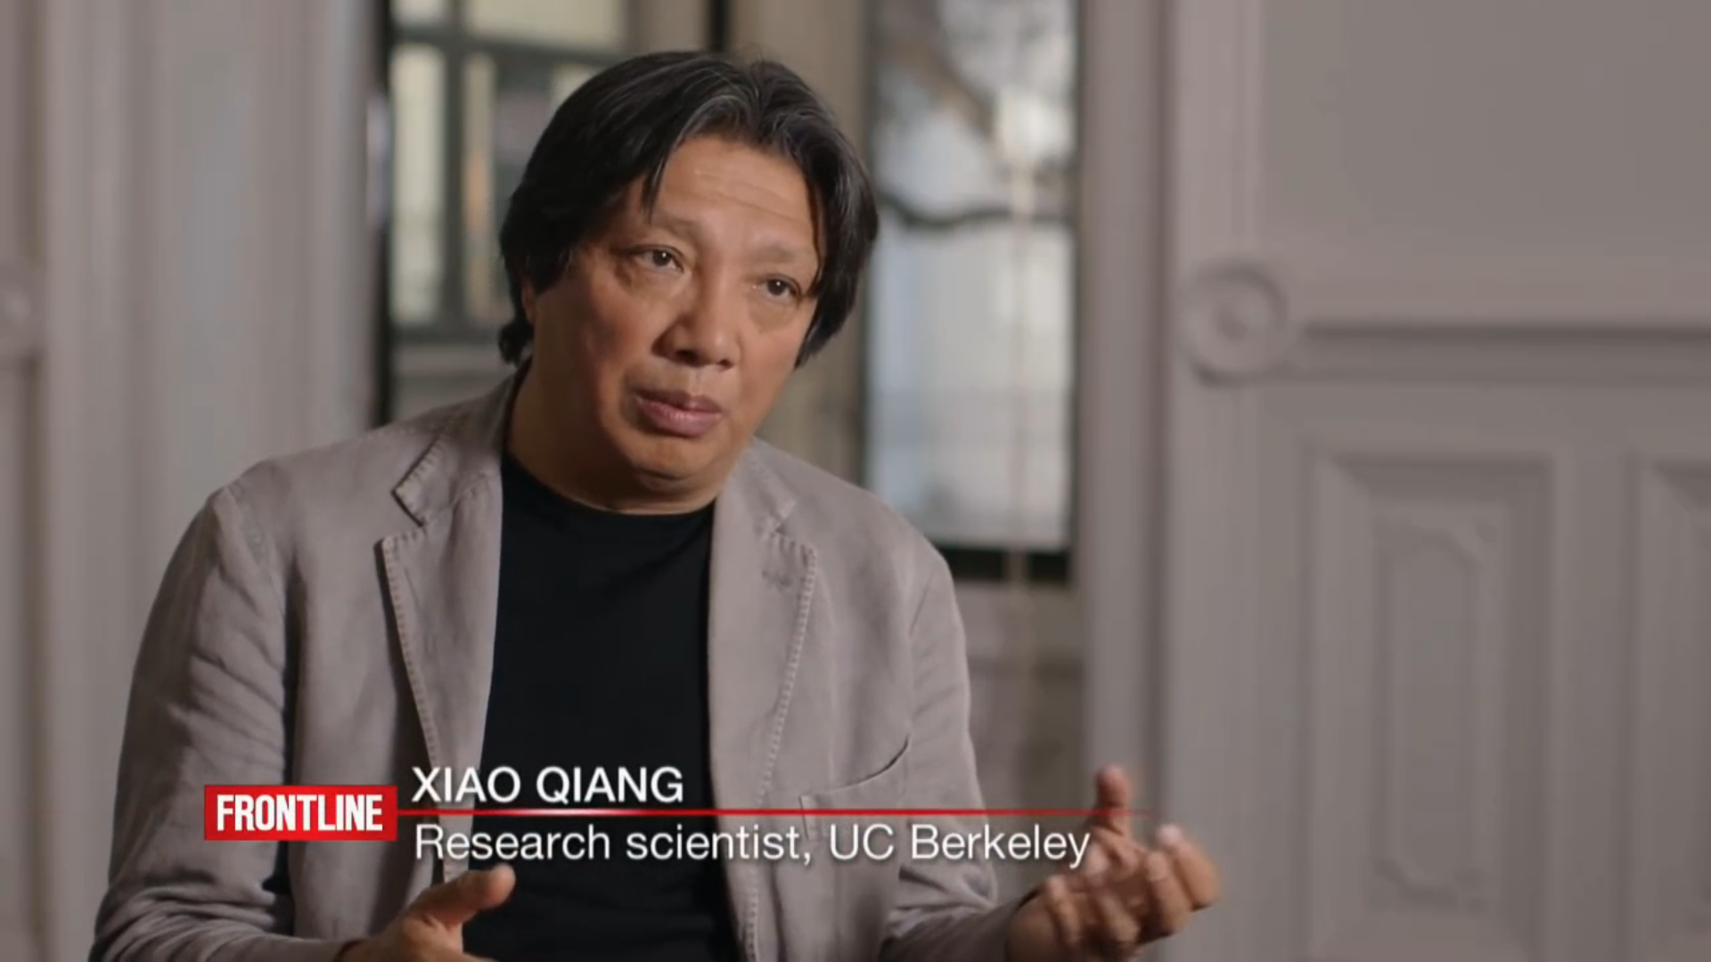
Surveillance
Social Credit Systems
China’s Digital Transformation
Data is the New Currency
Smart Econometrics
Social Credit Systems
Notes:
Surveillance

Slide 32

European Union Technology Legislation
Artificial Intelligence & Data
  GDPR - 24 May 2016
  Data Act - 11 January 2024
  AI Act - 1 August 2024
Digital Markets & Competition
  Digital Markets Act (DMA) - 1 November 2022
  Digital Services Act (DSA) - 16 November 2022
Security & Infrastructure
  NIS2 Directive - 16 January 2023
  Cyber Resilience Act (CRA) - 10 December 2024

Slide 33
US Federal Cyber Security Laws
Federal Law | Date Enacted | Purpose
Computer Fraud and Abuse Act (CFAA) | 1986 | Criminalizes unauthorized access to computers and networks.
Electronic Communications Privacy Act (ECPA) | 1986 | Protects electronic communications from unauthorized interception
Stored Communications Act (SCA) | 1986 | Regulates access to stored electronic communications and subscriber records
Health Insurance Portability and Accountability Act (HIPAA) | 1996 | Protects electronic protected health information (ePHI).
Identity Theft and Assumption Deterrence Act | 1998 | Establishes identity theft as a federal crime
Federal Information Security Modernization Act (FISMA Modernization Act) | 2014 | Updated FISMA by strengthening continuous monitoring, risk management, and federal cybersecurity oversight responsibilities.
Cybersecurity Information Sharing Act (CISA) | 2015 | Encourages sharing of cyber threat information between private organizations and government
Federal Cybersecurity Enhancement Act | 2015 | Authorizes cybersecurity protections for federal civilian networks
Cyber Incident Reporting for Critical Infrastructure Act (CIRCIA) | 2022 | Requires covered critical infrastructure organizations to report significant cyber incidents

Slide 34
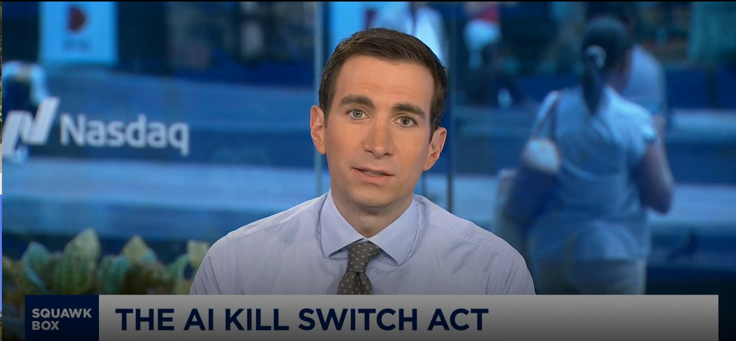
United States Technology Legislation
Proposed Federal Legislation
  AI Kill-Switch Act
State Legislation
  48 states have passed at least one specialized tech law
  46 states passed at least one AI-related law
  24 states have enacted overarching consumer data privacy frameworks

Slide 35
AI Future - US
Agentic AI
Advances in Healthcare
AI Job Market and Impact

Slide 36
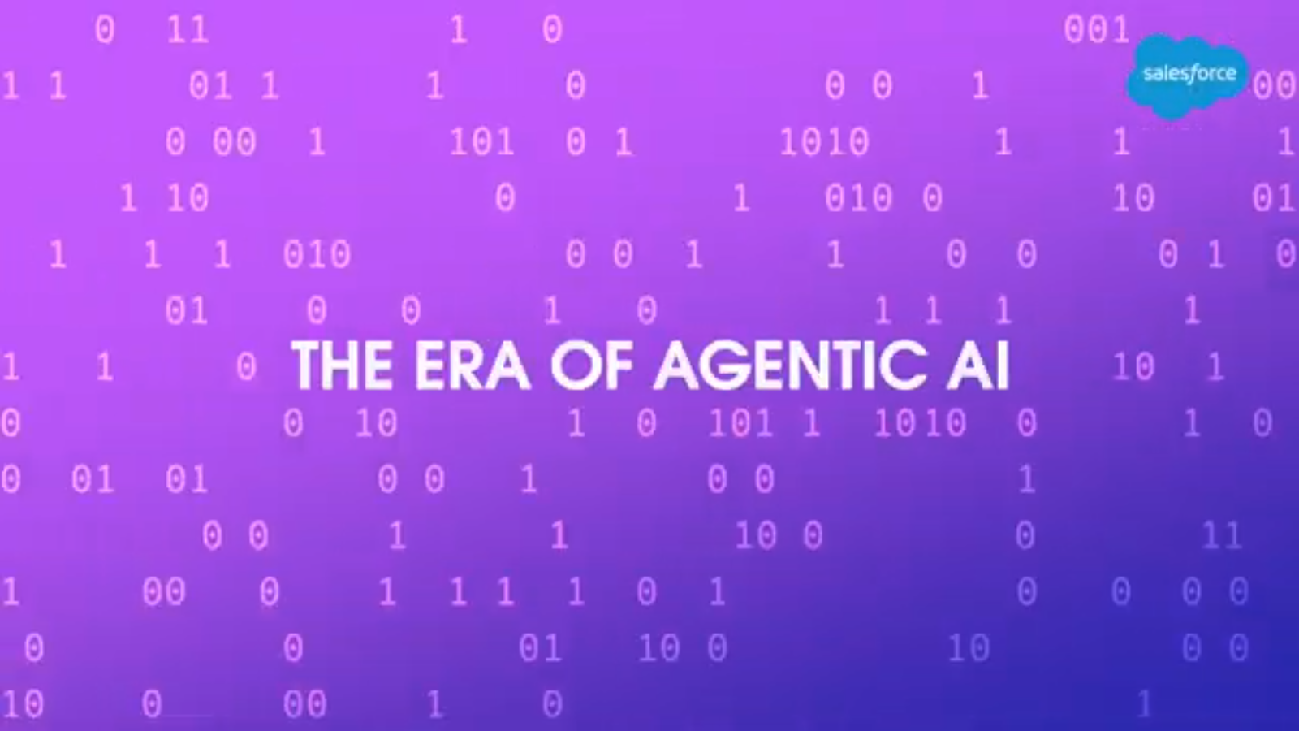
AgenticAI
Agentic AI
Advances in Healthcare
AI Job Market and Impact
Notes:
Agentic AI https://www.youtube.com/watch?v=D6zHWQP15K8

Slide 37
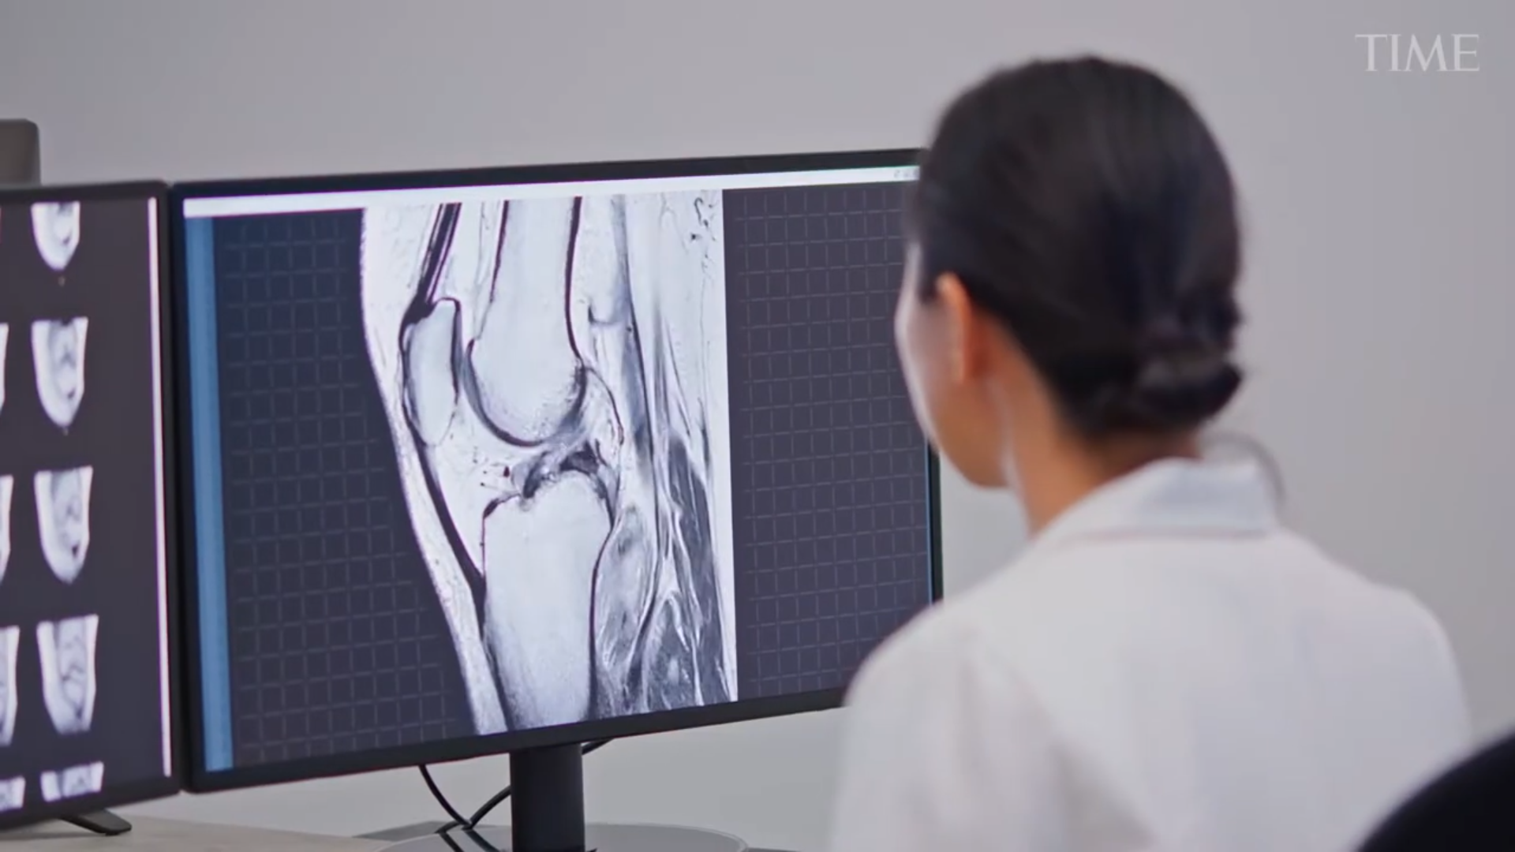
The Future of Healthcare
Advances in Healthcare
Agentic AI
Advances in Healthcare
AI Job Market and Impact
Notes:
The Future of Healthcare - https://www.youtube.com/watch?v=YSQRWOy2Om4

Slide 38

Agentic AI
Advances in Healthcare
AI Job Market and Impact
Notes:
https://www.youtube.com/watch?v=mkiDXTS6-mU

Slide 39
Technical AI Skills in Demand for 2026
Agentic AI
Advances in Healthcare
AI Job Market and Impact
of AI
Programming for AI: Python, SQL, R
Math and statistics: Probability, linear algebra, optimization, and statistical inference
Algorithms: Using libraries like Pandas, NumPy, Power BI
Applied Machine Learning
Deep Learning with PyTorch and TensorFlow
Domain‑focused Deep Learning
LLM fine‑tuning and RAG
LangChain and similar frameworks
Agentic AI
Multimodal AI
Cloud Computing: AWS, Google Cloud, Azure, others.
Data Analysis and Visualization - Tableau, Power BI,
Natural Language Processing (NLP): Working with text data to build applications, sentiment analysis.
Robotics: Knowledge in designing, building, and programming robot applications.
Computer Vision: Expertise in extracting information from images and video data using algorithms and models.

Slide 40
14 Career Paths in Artificial Intelligence
Career Path | Description
Machine Learning Engineer | Designs, trains, and deploys models for tasks like prediction, recommendation, and anomaly detection.
AI Engineer AI Software Engineer | Builds end‑to‑end AI features into products, integrating models, APIs, and traditional software systems
Data Scientist | Uses statistics and ML to analyze data, build models, and communicate business insights, often less engineering‑heavy than ML roles.
MLOps / AI platform Engineer | Focuses on pipelines, infrastructure, deployment, and monitoring so models run reliably in production.
Generative AI / LLM Engineer | Works with large language and multimodal models, prompt engineering, fine‑tuning, and retrieval‑augmented generation for real products.
AI Agent / Automation Engineer | Designs agentic systems that use tools, workflows, and orchestration to automate complex business processes.

Slide 41
14 Career Paths in Artificial Intelligence
Career Path | Description
Computer Vision / Speech / NLP Specialist | Focuses on specific modalities like images, video, or audio, often in sectors such as robotics, healthcare imaging, or conversational AI.
AI Researcher / Research Scientist | Develops new models, training methods, or algorithms, usually with a strong math and theory background and often in labs or PhD‑heavy teams.
Applied Research Scientist | Sits between research and product, adapting cutting‑edge methods to solve concrete business problems.
Robotics / Autonomous Systems Engineer | Combines perception, planning, and control to build physical systems like drones, robots, or self‑driving components.
AI Product Manager | Defines problem statements, sets roadmaps, and works with engineers to ship AI‑powered features that deliver value.
AI Strategist / Transformation Lead | Helps organizations redesign workflows, choose platforms, and plan AI adoption at scale.
AI Ethics, Risk, and Governance Specialist | Designs policies, audits, and guardrails to ensure AI is fair, compliant, and trustworthy.

Slide 42
Salary Ranges for AI Engineers and ML roles in 2026
Level (US) | AI Engineer | ML Engineer | GenAI‑Focused
Entry (0–2 yrs) | $100k – $175k | $100k – $170k | $100k – $180k
Mid (3–5 yrs) | $200k – $300k | $200k – $320k | $220k – $350k+
Senior (6–9 yrs) | $250k – $450k | $250k – $450k | $250k – $500k+
Staff/Principal (Top 1%) | $400k – $900k+ | $400k – $900k+ | $500k – $3M+
Sources – Robert Half, ZipRecruiter, Payscale, Coursera, mrrecruitment, 6fgr
These are blended, directional ranges across sources
(base + typical bonus/stock where noted).

Slide 43
2027 AI Skills Worth $500+/Hour
No Degree Required
Agentic AI
Advances in Healthcare
AI Job Market and Impact
of AI
AI System Architect (No Coding)
Map out business the processes
Design a system where AI handles the right parts
Humans handle the rest will be invaluable.
Thinking skill, not a technical skill.
What need:
  Understand business operations
  Data flow
  System design
MC Business Intelligence with AI
Machine Learning Certifications

Slide 44
2027 AI Skills Worth $500+/Hour
No Degree Required
Agentic AI
Advances in Healthcare
AI Job Market and Impact
of AI
AI Training Data Curator
Knowing how to curate, structure, and maintain the data
Not a data scientist
Being a data librarian for AI.
Know what information the AI needs, how to organize it, how to keep it updated, and how to format
Industries:
  Legal firms
  Marketing agencies
  Consulting businesses
JHU GenAI Training with Cert - 16-Week JHU GenAI Course

Slide 45
2027 AI Skills Worth $500+/Hour
No Degree Required
Agentic AI
Advances in Healthcare
AI Job Market and Impact
of AI
AI Workflow Specialist (No Coding)
Build complex AI-powered workflows without writing code
Use Tools like n8n, Make, and Zapier - connects AI to your business processes visually.
Save businesses 20+ hours a week.
By 2027, every business will need AI workflows.
Skill is completely free to learn right now.
MC Claude for Work and Productivity
Johns Hopkins University | Build Generative AI Workflows

Slide 46
2027 AI Skills Worth $500+/Hour
No Degree Required
Agentic AI
Advances in Healthcare
AI Job Market and Impact
of AI
AI Output Quality Control Specialist
Businesses have no systematic way to ensure the output is good.
Ability to evaluate AI output quality, catch errors, identify when output is generic versus useful, build systems that ensure consistent quality.
Combines editorial judgment, brand voice expertise, and understanding what AI gets wrong.
Massive in 2027 demand because bad AI output is expensive.
Ai Quality Control Jobs, Employment

Slide 47
2027 AI Skills Worth $500+/Hour
No Degree Required
Agentic AI
Advances in Healthcare
AI Job Market and Impact
of AI
AI Automation Maintenance and Optimization Specialist
Keeping building automation running and making it better is another.
Being able to audit existing automations - find broken or inefficient processes and optimize them.
A mechanic for automated systems.
For 2027 and beyond every business will have dozens of workflow automations. Someone must be able to maintain and improve them.
Role doesn’t exist at scale yet.
$36k-$89k Ai Optimization Specialist Jobs (NOW HIRING)

Slide 48
2027 AI Skills Worth $500+/Hour
No Degree Required
Agentic AI
Advances in Healthcare
AI Job Market and Impact
of AI
AI Context Engineer
Current focus - prompt engineering - commoditized.
Context engineering - Setting up AI environments where the context is known before questions are asked.
Building better context systems. AI becomes team member who knows your contextual business.
Businesses that have AI contextualization build in have 10x better performance than competitors writing prompts.
People who can build these systems will demand premium rates.
AI Context Engineer Artificial Intelligence

Slide 49
2027 AI Skills Worth $500+/Hour
No Degree Required
Agentic AI
Advances in Healthcare
AI Job Market and Impact
of AI
AI Human Workflow Designer
Designing workflows where AI and humans hand off work to each other.
AI does the first pass. Human reviews and approves. AI implements the changes. Human does final quality check. The workflow is optimized for speed and quality.
After 2027, every business process will be AI-human hybrid.
People needed who can design workflows will be essential.
Johns Hopkins University | Build Generative AI Workflows

Slide 50
Course Review – Session I
Define Artificial Intelligence (AI) and Generative AI (GenAI).
Explain the latest trends in GenAI/AI.
Identify and describe key concepts in GenAI/AI.
Understand the Building Blocks of LLMs
Introduction to Prompt Engineering Frameworks
AI Quiz
LLM Quiz

Slide 51
Course Outline – Session II
What is Microsoft Copilot.
What are the Key Features of Microsoft Copilot.
How is Microsoft Copilot integrated in Microsoft Office Applications
Microsoft 365 Copilot User Interfaces
Common Misconceptions about Microsoft Copilot.
Prompt Engineering Exercises using Microsoft Copilot AI

Slide 52
Course Outline – Session III
Introduction to the Major LLMs
  Open AI
  Google Deepmind
  Anthropic
  xAI
  Kimi
  Deepseek
  MAI
Advanced Prompt Engineering Techniques
LLM Prompt Engineering Exercises

Slide 53
Course Review – Session IV
AI Leaders Warnings
AI Technology Concerns
AI Future – China
Technology Legislation
AI Future – US
AI Technology Concern Quiz
Course Review
Course Evaluation

Slide 54
Course Evaluation
WD&CE Course Evaluation Form
Course Start Date | Location | CRN | Name | Instructor
6/15/2026 | GBTC | 42973 | Intro to Gen AI | Carl Burnett
7/14/2026 | ECEC | 13811 | Intro to Gen AI | Carl Burnett
8/3/2026 | Rockville | 13812 | Intro to Gen AI | Carl Burnett

