Slide 1

ITI 555 Introduction to
Generative AI - Session III
Prof Burnett | Embrace AI / Master Your Future

Slide 2
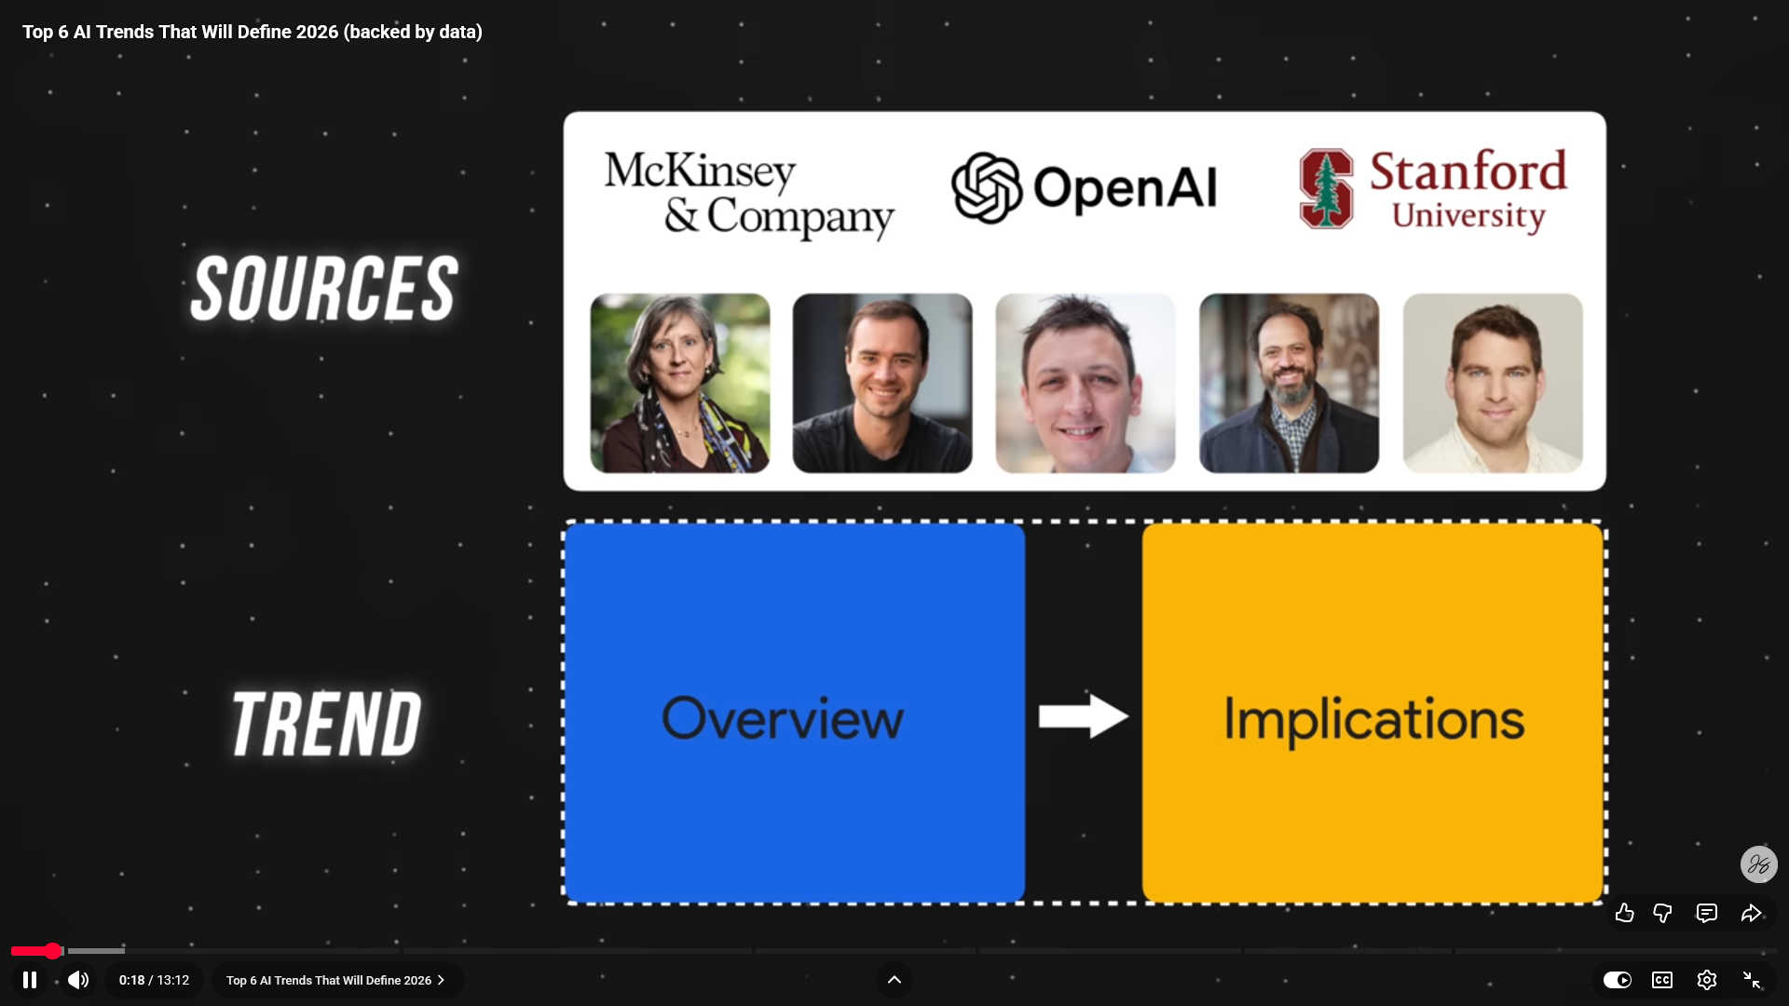
Top 6 AI Trends for 2026

Slide 3
Course Outline – Session III
Introduction to the Major LLMs
  Open AI
  Google Deepmind
  Anthropic
  xAI
  Kimi
  Deepseek
  MAI
Advanced Prompt Engineering Techniques
LLM Prompt Engineering Exercises

Slide 4
Course Outline – Session IV
AI Leaders Warnings
AI Technology Concerns
AI Future – China
AI Future – US
Technology Legislation
AI Technology Concern Quiz
Course Review
Course Evaluation

Slide 5
Introduction to the Major AI LLMs

Slide 6
OpenAI LLM Offerings
LLM | Best For
ChatGPT | General questions, ideas, web help
Codex | Agentic AI

Slide 7
OpenAI ChatGPT Features
ChatGPT
LLM | Best For
ChatGPT Work | General questions, ideas, web help
Deep Research | Accurate research using authenticated sources
Images | Image Creation
Shopping | Shopping LLM
Study Mode | Step-by-step guidance helping you learn and retain knowledge.
Voice | Voice Commands
Voice with Video | Talk to ChatGPT with Video Creation

Slide 8
OpenAI Codex Features
ChatGPT CODEX
LLM | Best For
Prompting | Developing Prompts
Personalize ChatGPT | Select preferences that should apply across chats
Skills & Plugins | Complete repeatable work with the right instructions, resources, and tools.
Permissions | Permissions control how ChatGPT (in the desktop app) and Codex (in the CLI or IDE) handle local actions.

Slide 9
OpenAI ChatGPT Licensing Options
License | Access to | Pricing / Mo
Free | Limited GPT-5.5 Instant | Free
Go | More GPT-5.5 Instant | $8
Plus | Advanced reasoning models with GPT-5.6 | $20
Pro | Pro reasoning with GPT-5.6 Sol Pro | $100
Business | Access ChatGPT, ChatGPT Work, and Codex | $20
Enterprise | Expanded context window that supports longer inputs and larger files | Custom
Higher Ed | Access ChatGPT, ChatGPT Work, and Codex | Custom
K-12 Teachers | Access ChatGPT | Custom

Slide 10
Which ChatGPT Model Should You Use?
Task | ChatGPT Option | Base model | Why this is the best fit
General questions | Instant | GPT-5.6 Sol | Fast responses; unnecessary to spend extra reasoning time on straightforward questions
Writing & editing | Instant | GPT-5.6 Sol | Excellent balance of writing quality, responsiveness, tone control, rewriting, and summarization
Coding | High | GPT-5.6 Sol | Extended reasoning is valuable for debugging, code generation, refactoring, and multi-file logic
Mathematics | High | GPT-5.6 Sol | Better suited to multi-step calculations, proofs, equations, and checking intermediate reasoning
Data analysis | High | GPT-5.6 Sol | Strong choice for interpreting datasets, statistics, spreadsheets, patterns, and analytical reasoning
Research | Extra High | GPT-5.6 Sol | More reasoning effort is useful for synthesizing sources, evaluating evidence, and complex research questions
Scientific work | GPT-6 Pro | GPT-6 Astra | Best choice when available for the most demanding scientific reasoning and research workflows
Software architecture | GPT-6 Pro | GPT-6 Astra | Best suited to difficult end-to-end system design, architecture decisions, tradeoffs, and complex implementation planning
Long reports | GPT-5.6 Sol Pro | GPT-5.6 Sol Pro | Designed for difficult tasks and longer-running workflows; useful for complex professional documents
Brainstorming | Instant | GPT-5.6 Sol | Speed and conversational responsiveness are generally more valuable than maximum reasoning depth
Education & tutoring | Medium | GPT-5.6 Sol | Good balance between responsiveness and reasoning; useful for explaining concepts step-by-step
Business strategy | Extra High | GPT-5.6 Sol | Deeper reasoning helps with scenarios, competitive analysis, risks, strategic alternatives, and recommendations

Slide 11
ChatGPT Model Options
Model option | Training data used | Training / knowledge date* | Base LLM | Best use case | Strengths | Weaknesses
Instan Paid plans | Public, licensed, human-created/synthetic and multimodal training data; exact mix/size not public | Feb. 16, 2026 | GPT-5.6 Sol | Everyday work, questions, writing, summaries, brainstorming | Fast; strong general knowledge; good writing; can automatically add reasoning | Less deliberate than manually selecting higher reasoning
Medium | Same GPT-5.6-family training foundation; exact dataset not disclosed | Feb. 16, 2026 | GPT-5.6 Sol | Analysis, coding, teaching, business work | Better reasoning than Instant; good speed/quality balance | Slower than Instant
High | Same GPT-5.6-family foundation | Feb. 16, 2026 | GPT-5.6 Sol | Complex analysis, mathematics, coding, research | Extended reasoning; stronger on multi-step problems | Increased response time
Extra High | Same GPT-5.6-family foundation | Feb. 16, 2026 | GPT-5.6 Sol | Advanced research, science, engineering, difficult professional tasks | Highest selectable reasoning effort for regular Sol | More latency; limited to eligible plans
Pro GPT-5.6 | GPT-5.6 training foundation; exact corpus not disclosed | Feb. 16, 2026 | GPT-5.6 Sol Pro | Very difficult professional tasks and long-running workflows | Highest-quality GPT-5.6 option; deep reasoning | Usage limits; slower/more compute-intensive

Slide 12
ChatGPT Model Options
Model option | Training data used | Training / knowledge date* | Base LLM | Best use case | Strengths | Weaknesses
Instant Free/Go | GPT-5.6-family training data; exact corpus not disclosed | Feb. 16, 2026 | GPT-5.6 Luna | Everyday questions, writing and general assistance | Very fast and efficient; unlimited everyday text chats subject to safeguards | Lower capability than Sol on the hardest professional work
Think Free/Go | GPT-5.6-family training data | Feb. 16, 2026 | GPT-5.6 Luna | Harder questions requiring more reasoning | Gives Luna additional reasoning time | Not equivalent to GPT-5.6 Sol reasoning
GPT-6 Pro (rolling out) | New GPT-6 pre-training, reinforcement-learning and alignment stack; exact dataset/size not disclosed | Apr. 30, 2026 | GPT-6 Astra | Hardest research, coding, computer-use and end-to-end professional workflows | OpenAI's most capable current model; major gains in computer use, coding, research and complex multistep work | Limited rollout; usage limits; not currently included in ordinary Plus Chat access

Slide 13
Google DeepMind AI Offerings
LLM MODEL | Best For
Gemini | Frontier Model
Lyria | Advanced music generation model
Veo | Video generation model
Imagen | Text-to-image model
Gemma | Most capable open models
Google AI Studio | Google AI Studio is next generation family of multimodal generative AI models
Google Antigravity | An agentic development platform that is designed to help you develop AI agents

Slide 14
Google DeepMind Gemini Models
LLM | Best For
Gemini | Frontier Model
Gemini Omni | Create anything from video
Nano Banana | Create and edit images
Gemini Embedding | State-of-the-art multimodal embedding model
Gemini Robotics 2 | The intelligence layer for robotics

Slide 15
Google DeepMind Gemini Features
LLM | Best For
Images | Image Creation with Nano Banana 2
Video | Video Creation with Omni
Library | Document Repro
Notebooks | Shopping LLM
Daily Brief | Daily personalized overview. (Paid subscribers)
Gemini

Slide 16
Google Gemini Licensing Options
License | Access to | Pricing / Mo
Free |  | Free
Plus | 2x higher usage limits Access to Flash Thinking | $4.99
Pro | 4x higher usage limits Access to Pro model Access Deep Research, video generation | $19.99
Ultra | 5x higher usage limits than Pro plan Access Deep Think | $99.99
Enterprise |  | Custom
Higher Ed |  | Custom
K-12 Teachers |  | Custom

Slide 17
Which Gemini Model Should You Use?
Task | Recommendation | Rationale
General questions | Gemini 3.8 Flash | Instant time-to-first-token, accurate factual knowledge, cost efficiency
Writing and editing | Gemini 3.8 Flash | Excellent tone, strong structural organization, and low latency
Coding | Gemini 3.8 Flash | Optimized for long-horizon agentic coding, automated refactoring, multi-file codebases
Mathematics | Gemini 3.1 Pro | Deep Think reasoning chains to prevent calculation drift
Data analysis | Gemini 3.1 Pro | Efficiently ingests tabular data and long datasets within a unified multimodal context window
Research | Gemini 3.1 Pro | Excels at dozens of academic PDFs, books, and source materials
Scientific work | Gemini 3.1 Pro | Handles multimodal diagrams, domain-specific nomenclature, and formal reasoning
Software architecture | Gemini 3.1 Pro | Grasps broad system dependencies, distributed patterns, and trade-offs
Long reports | Gemini 3.1 Pro | Maintains narrative cohesion, formatting standards, and structural continuity
Brainstorming | Gemini 3.8 Flash | Rapid generation speed, divergent thinking, exploratory back-and-forth
Education and tutoring | Gemini 3.1 Pro | Ideal for Socratic dialogue, pedagogical breakdown, patient step-by-step guidance
Business strategy | Gemini 3.1 Pro | Superior synthesizing competitive landscapes, financial filings, and scenario forecasting

Slide 18
Gemini Model Options
Model Options | Training Data Used | Training Date | Base LLM | Best Use Case | Strengths | Weaknesses
Gemini 3.1 Pro | Web documents, books, code repositories, academic papers, multimodal audio, image, and video data storage | 2025 – early 2026 | Gemini 3 Foundation (Sparse MoE Transformer) | Deep research, repository-scale code refactoring, complex mathematical proofs, and advanced multi-turn agentic planning google+1 | Deep Think reasoning modes; native 1M+ multimodal context processing; high accuracy on complex benchmarks google+1 | Higher inference latency; significantly higher compute and token pricing compared to Flash tiers google+1
Gemini 3.8 Flash cloud.google+1 | Large-scale diverse web datasets, synthetic reasoning corpora, software repositories, and RL human/agent feedback deepmind+1 | Mid 2026 (Updated Sept 2026) | Gemini 3 Flash Architecture (Distilled MoE Transformer) | High-throughput agentic workflows, long-horizon coding tasks, API backend services, and production web applications cloud.google+1 | Near-Pro level coding performance; extremely fast response times; cost-effective pricing; native tool use and computer interaction cloud.google+1 | Occasional nuance loss on edge-case theoretical proofs; higher rate of degradation over extreme multi-turn sessions

Slide 19
Gemini Model Options
Model Options | Training Data Used | Training Date | Base LLM | Best Use Case | Strengths | Weaknesses
Gemini 3.5 Flash-Lite google+1 | Filtered web text, high-density structured corpora, conversational datasets, and task-specific instruction pairs | Late 2025 | Gemini 3 Compact | High-volume micro-tasks, content categorization, real-time customer chatbots, and subagent delegation | Lowest cost per million tokens; rapid time-to-first-token; low memory overhead | Limited multi-step reasoning depth; strictly text-focused performance with reduced abstract synthesis capability
Gemini Nano | Curated small-footprint text and conversational corpora, heavily quantized | Rolling releases (Device platform specific) | Gemini Nano Backbone | On-device smart replies, local document summarization, voice transcription, and offline privacy tasks | Zero server latency; runs completely offline on mobile/edge NPUs; privacy-preserving local data handling | Constrained context window; smaller parameter capacity
Gemini 3 Pro Image (Nano Banana Pro) | Paired text-image corpora, photographic archives, graphic design assets, and human datasets | Early 2026 | Gemini 3 Multimodal Native Diffusion / Autoregressive Hybrid storage | Graphic asset creation, consistent character illustration, legible typography rendering, and iterative visual design | Native rendered text; guided composition; support for up to 10–14 reference inputs for character consistency | High generation latency; expensive compute per image output; fixed maximum resolution tiers

Slide 20
Anthropic AI Offerings
Product | Best For
Claude | Frontier Model
Claude Code | Work with Claude directly in your codebase
Claude Code for Enterprise | Enterprise coding agent
Claude Cowork | Completes tasks you can steer from anywhere
@Claude | Tag Claude in Slack
Claude Design | Design a prototype, deck, or one-pager
Claude Science | Perform analyses, searches databases, data wrangling
Claude Security | Validates findings, and suggests patches in your codebase
Claude for Chrome | Works with Claude Code, Cowork, and Claude Desktop
Claude for Slack | Reads threads, understands full context, and reacts in real time
Claude for Microsoft 365 | Works inside Excel, PowerPoint, Word, and Outlook.

Slide 21
Anthropic Claude Models
LLM | Best For
Haiku | Fastest model, a lightweight version
Sonnet | Hybrid reasoning model
Opus | Hybrid reasoning model built for coding and AI agents
Fable | Knowledge work and coding problems.
Mythos | Cybersecurity and biology research.

Slide 22
Anthropic Claude Features
Claude
LLM | Best For
Projects | Materials and custom instructions
Artifacts | Interactive side panel that displays standalone code, documents, or apps
Code | Link to Claude Code
Design | Build interactive prototypes, wireframes, slides

Slide 23
Anthropic Claude Licensing Options
License | Type | Access to | Pricing / Mo
Free | Individual |  | Free
Pro | Individual | Includes Claude Code, Cowork, Design, Science, Research, Claude for Microsoft 365 | $17
Max | Individual | Choose 5x or 20x more usage than Pro* | $100
Team (Standard Seat) | Business | 20 - 150 | $20
Enterprise | Business |  | Custom
API |  | See Next Chart

Slide 24
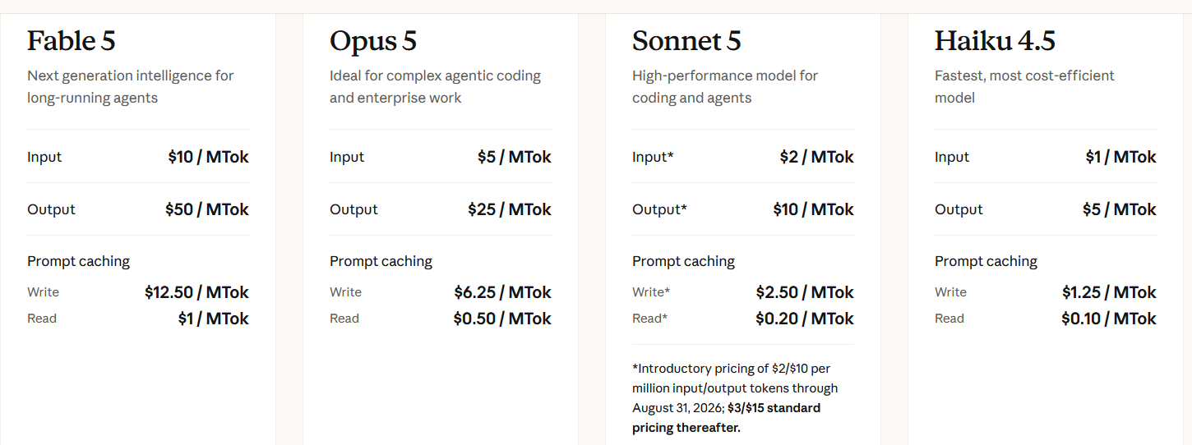
Anthropic Claude API Licensing Options

Slide 25
Which Claude Model Should You Use?
Task | Recommended Model | Why
General questions | Claude Haiku 4.5 | Fastest and cheapest tier
Writing and editing | Claude Sonnet 5 | Sonnet 5 is the best combination of speed and intelligence
Coding | Claude Opus 5 | Opus 5 is built for complex agentic coding and enterprise work —
Mathematics | Claude Fable 5.1 | Fable 5.1 is positioned for demanding reasoning and problem-solving
Data analysis | Claude Opus 5 or Sonnet 5 | Both have a 1M-token context for large datasets;
Research | Claude Fable 5.1 deep, research; Sonnet 5 for lighter tasks | Fable 5.1's long-horizon agentic capability and 1M context suit multi-step research synthesis across many sources
Scientific work | Claude Fable 5.1 | Same reasoning tier as math
Software architecture | Claude Opus 5 | Explicitly positioned for complex agentic coding and enterprise work
Long reports | Claude Fable 5.1 (synthesis) Sonnet 5 - cost-effective | Fable 5.1's 1M context
Brainstorming | Claude Sonnet 5 Haiku 4.5 for high-volume | Iterative idea generation favors speed and cost
Education and tutoring | Claude Sonnet 5 | Strong balance of intelligence, speed, and cost for explanations
Business strategy | Claude Opus 5 or Fable 5.1 | Strategic synthesis benefits from strong reasoning;

Slide 26
Claude Model Options
Model Option | Training Data Used | Training Data Cutoff | Base LLM | Best Use Case | Strengths | Weaknesses
Claude Fable 5.1 | Not publicly itemized; broad mix of licensed and public data | June 2026 | Anthropic's proprietary Transformer architecture same underlying weights as Mythos 5.1 | Demanding reasoning and long-horizon agentic work | 1M-token context, 128K max output, | Slowest and most expensive tier ($10/$50 per Mtok)
Claude Mythos 5.1 | Same training pipeline as Fable 5.1 | June 2026 | Identical weights to Fable 5.1, without the added safety classifiers | Project Glasswing | Same raw capability as Fable 5.1 | Not publicly available; invite-only
Claude Opus 5 | Same general pipeline | May 2026 | Anthropic proprietary architecture | Complex agentic coding and enterprise work — | 1M-token context, 128K max output, | Moderate latency; costs more than Sonnet
Claude Sonnet 5 | Same general pipeline | January 2026 | Anthropic proprietary architecture | Best combination of speed and intelligence | 1M-token context, fast, strong cost/performance | Earlier knowledge cutoff than Opus 5/Fable 5.1
Claude Haiku 4.5 | Same general pipeline | July 2025 | Anthropic proprietary architecture | Fast, high-volume, low-cost tasks: | Fastest, cheapest ($1/$5 per MTok), | Only 200K context 64K max output,

Slide 27
xAI Offerings
Product | Best For
Chat | Chat, search, reason, and create
Build | A coding agent and CLI for complex coding work
Imagine | State-of-the-art image and video generation, editing, and restyling
Voice | Voice agents.

Slide 28
xAI Models
LLM | Best For
Grok | Chat, search, reason, and create
Super Grok | Extended capabilities of Grok

Slide 29
xAI Grok Features
Grok
LLM | Best For
Imagine | State-of-the-art image and video generation, editing, and restyling
Automations | Covers native scheduling features on Grok and third-party browser tools designed for bulk media generation.
Skills and Connectors | AI persistent long-term memory Customized workflow expertise Real-time external app integration. Skills store reusable instructions and domain knowledge Connectors link Grok directly to external data sources and tools via OAuth.
Projects | Create custom workspaces, upload files for smarter chats, and collaborate securely

Slide 30
xAI Grok Licensing Options
License | Type | Access to | Pricing / Mo
Grok Free | Individual |  | Free
Grok Business | Team | All Grok models Grok Build access Team seat management | $30
Grok Enterprise | Business |  | Custom
SuperGrok Lite | Individual | 2x longer conversations | $10
SuperGrok | Individual | 5x longer conversations | $30
SuperGrok Plus | Individual | Create apps with a single prompt | $100
SuperGrok Heavy | Individual | Solve extremely hard problems | $300
API |  | See Next Chart

Slide 31
xAI Grok Licensing Options
Monthly Subscription Tiers
Plan | Monthly Price | Best For | Key Features
Free | $0 | Casual users | Limited weekly pool, Grok 4 Mini access
X Premium | $8 | Budget X users | Higher limits, Grok 4, verified checkmark
SuperGrok Lite | $10 | Light AI use | Basic Imagine, entry-level weekly pool
SuperGrok | $30 | Professionals | DeepSearch, Big Brain, Imagine, Grok 4.5 rollout
X Premium+ | $40 | Heavy X users | Bundled social perks + Grok access
SuperGrok Plus | $100 | Power users | Higher headroom, priority access at peak times
SuperGrok Heavy | $300 | Researchers | Full Grok 4.5, Grok 4 Heavy, multi-agent, Grok Bot beta
Grok Business | $30/seat | Teams | Data privacy guarantee, centralized billing

Slide 32
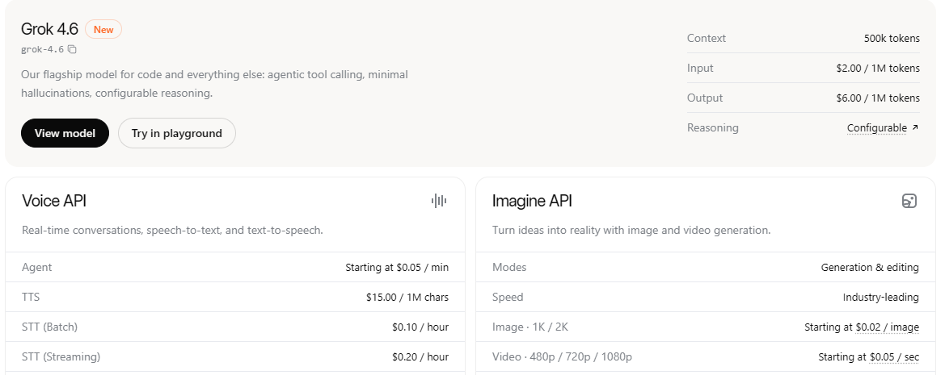
xAI Grok Developer Licensing Options
Pricing by Model

Slide 33
Which Grok Model Tier Should You Use?
Task | Recommended model | Why
General questions | Grok 4.6 | 4.6 is the current flagship for chat and everyday Q&A.
Writing and editing | Grok 4.6 | Best prose control, instruction following, and revision loops.
Coding | Grok 4.6 | Official pick for code and agents.
Mathematics | Grok 4.6 | Hard math benefits from configurable reasoning effort.
Data analysis | Grok 4.6 | 4.6 for interpretation, modeling choices, and analysis agents.
Research | Grok 4.6 | 4.6 plus live search is the practical research stack.
Scientific work | Grok 4.6 | Best current reasoning for STEM, papers, and technical critique. Still verify citations and results; the model does not replace primary literature or lab data.
Software architecture | Grok 4.6 | 4.6 is stronger at system design, tradeoffs, and multi-file reasoning.
Long reports | Grok 4.3 or Grok 4.20 | 4.3 (1M) and 4.20 (up to ~1–2M) win when the source pack is huge. 4.6 is higher quality per page but only 500k context, so split or compact very large corpora.
Brainstorming | Grok 4.6 | 4.6 is enough for most ideation.
Education and tutoring | Grok 4.6 | 4.6 explains, quizzes, and adapts well
Business strategy | Grok 4.6 | Use 4.6 for structured strategy, market framing, and memo-quality writing.

Slide 34
xAI Grok Model Options
Model | Training Data Used | Training Cutoff | Base LLM | Best Use Case | Strengths | Weaknesses
Grok 4.6 | Public web, scientific/legal text, X posts, source code | Jun 2026; knowledge cutoff Feb 1, 2026 | Proprietary xAI | Coding, long-running agents, knowledge work, general chat | Strongest Grok on agentic coding | Higher price ($2 / $6 per 1M in/out); smaller context than 4.3 / 4.20; closed weights;
Grok 4.5 | Curated datasets | Feb 1, 2026 | Proprietary xAI | Coding, agentic tool use, chat, knowledge work, | Highest intelligence / strong agentic tool calling | Higher token pricing 500k context
Grok 4.3 | Similar broad web + X data + STEM/coding focus | Dec 2025 | Proprietary xAI | General reasoning, production agentic | Strong tool calling & instruction following | Less capable than 4.5
Grok 4.20 | Prior-generation data mix + RL for reasoning/tool use | 2025 | Proprietary xAI | Multi-agent orchestration, pure reasoning | Long context (up to 1M+); specialized variants for multi-agent or fast non-reasoning; solid agentic capabilities | Superseded by 4.3/4.5
grok-build-0.1 | Coding-focused training data | Recent | Proprietary xAI | Early-access coding / Grok Build CLI | Optimized for build/coding agent scenarios | Limited general capabilities
Grok Imagine (API) | Image/video generation training data | Ongoing / model-specific | Proprietary xAI | Image generation/video generation | Industry-leading speed; quality and resolution options | Specialized only
Grok Voice (API) | Speech / conversational data | Ongoing | Proprietary xAI | Real-time voice chat, | Natural voice interactions, real-time capabilities | Specialized only

Slide 35
Moonshot AI Offerings xAI Offerings
Product | Best For
Kimi | Agentic Workspace
Kimi Work | AI Desktop Agent
Kimi Code | AI Code CLI for terminal & IDEs
Kimi WebBridge | Browser Extension
Kimi Platform | Access to Latest Models

Slide 36
Moonshot AI Models
LLM | Release Date | Best For
K2 Thinking | November 2025 | Reasoning model
K2.5 | January 2026
K2.6 | April 2026 | A general-purpose multimodal model with support for text, image, and video inputs. 256K context window.
K2.7 Code | June 2026 | A specialized coding model. 256K context window and supports multi-step tool invocation.
K3 | July 2026 | The flagship model.

Slide 37
Moonshot AI Models
API Model | Role | Key notes
kimi-k3 | Flagship | 2.8T-parameter MoE, native vision, 1M-token context; aimed at long-horizon coding, knowledge work, and deep reasoning.
kimi-k2.7-code | Coding specialist | 256K context; stronger long-context instruction-following and coding success.
kimi-k2.7-code-highspeed | Fast coding variant | About 180 tokens/s, up to ~260 tokens/s in short contexts.
kimi-k2.6 | General multimodal/agent model | Text, image, and video input; thinking/non-thinking modes; dialogue and agent tasks; 256K context.

Slide 38
Moonshot AI Features
Kimi
KIMI | Used For
Agent | General-purpose autonomous agent, designed to handle complex professional tasks in research, coding, and office work without any preset workflows.
Agent Swarm | Agent Swarm is a "horizontal scaling" architecture on top of the single Agent.
Websites | AI Website Builder
Docs | Create, convert, review, and visualize documents
Slides | AI Presentation Maker
Excel | Intelligent AI Excel agent.
Deep Research | Broaden, Deepen, and Diversify Your Research
Kimi Claw | Kimi's zero-deployment cloud platform for running OpenClaw — an AI assistant with its own personality and long-term memory.

Slide 39
Moonshot Kimi Licensing Options
Option | What it covers | Key terms
Kimi K3 open-weight license | Downloading and using Kimi K3 model weights/code | Broad permission to use, copy, modify, distribute, sublicense, sell, deploy, fine-tune, and create derivatives.
Kimi K2 / K2 Thinking license | Older open-weight Kimi models | Modified MIT-style license, with extra attribution required for very large commercial products.
Kimi Platform / API terms | Using hosted Kimi models through Moonshot’s API | A non-exclusive license to access Moonshot’s APIs and integrate them into your own applications during the service term.

Slide 40
Moonshot Kimi Membership Plans
Plan | Price | Best for | Main limits/highlights
Andante | ¥49 / $79 month | Everyday use | About 30 Agent uses, 1 parallel task, 6 scheduled tasks, 6 widget tasks, 20 projects/20GB
Moderato | *¥99 / $14,75 month | Productivity upgrade | About 60 Agent uses, 2 parallel tasks, 25 Agent Swarm uses, Dream Memory
Allegretto | *¥199 / $29.65 month | Professional use | About 150 Agent uses, 50 Agent Swarm uses, Goal Mode, dedicated Kimi Claw
Allegro | ¥699 / $104.16 month | Heavy/professional use | About 360 Agent uses, 4 parallel tasks, 120 Agent Swarm uses, 1M-token chats, 100 projects/50GB

Slide 41
Which Kimi Model Tier Should You Use?
Model | Context | Best For | Price (per 1M)
kimi-k3 | 1M tokens | Frontier intelligence, deep reasoning, massive documents | $3.00 / $15.00
kimi-k2.7-code | 256K tokens | Complex software engineering, debugging | $0.95 / $4.00
kimi-k2.7-code-highspeed | 256K tokens | Real-time coding, IDE integration (~180–260 tok/s) | $0.95 / $4.00
kimi-k2.6 | 256K tokens | Agentic research, multimodal reasoning, 300-agent swarm | $0.95 / $4.00

Slide 42
Moonshot Kimi Model Options
Model | Parameters | Context Window | Training Date | Architecture | Best Use Case | Strengths | Weaknesses
kimi-k3 FLAGSHIP | 2.8T (MoE) | 1,048,576 tokens | July 2026 | Mixture-of-Experts | Frontier intelligence, software engineering, knowledge work | Largest context window (1M | Highest API cost ($3/$15 per 1M), newer model with less community testing
kimi-k2.7-code CODE | 1T (MoE) | 256,000 tokens | June 2026 | Mixture-of-Experts | Complex coding tasks, software engineering, debugging, code review, long-context codebases | Superior coding accuracy, reliable long-context instruction following, | Text-only (no vision), specialized for code only, not ideal for general creative tasks
kimi-k2.6 | 1T (MoE) | 256,000 tokens | April 2026 | Mixture-of-Experts | Agentic tasks, coding with vision, | Strong agentic capabilities | Not as strong as Claude Opus

Slide 43
Deepseek AI Offerings
(Hangzhou DeepSeek Artificial Intelligence Basic Technology Research Co., Ltd.)
Product | Best For
DeepSeek App | AI Assistant
DeepSeek Chat | Chatbot
DeepSeek Platform | DeepSeek API Platform

Slide 44
Deepseek AI Model Licensing Pricing
Input / Output | DeepSeek-v4-Flash | DeepSeek-v4-Pro
1M INPUT TOKENS (CACHE HIT) | $0.0028 | $0.003625
1M INPUT TOKENS (CACHE MISS) | $0.14 | $0.435
1M OUTPUT TOKENS | $0.28 | $0.87

Slide 45
Which Deepseek LLM Model Tier Should You Use?
Deepseek
Model Tier | Use Case
DeepSeek-V4-Pro | Mission-Critical Accuracy High Performance on Complex Tasks Enterprise-Level Solutions
DeepSeek-V4-Flash | Cost-Effective, High-Volume Processing Simple Agent Tasks & Rapid Responses Budget-Conscious Workflows

Slide 46
Deepseek LLM Model Options
Model | Training Data Used | Training Cutoff | Base LLM | Best Use Case | Strengths | Weaknesses
DeepSeek-V4-Pro | >33T tokens | April 24, 2026 | DeepSeek-V4 architecture, 1.6T total parameters | Complex agentic tasks, advanced coding, world-class reasoning in Math/STEM. World-class reasoning, leading open-source agentic capabilities, rich world knowledge. | More expensive
DeepSeek-V4-Flash | >32T tokens | April 24, 2026 | DeepSeek-V4 architecture, 284B total parameters | High-volume, cost-sensitive tasks, simpler agent tasks, rapid responses. | Lower accuracy - 37% high hallucination rate 84%

Slide 47
MAI Models & Licensing Options
MAI
License | Best For | To Access | Pricing / Mo
MAI-Voice-2 | NLP generation model Turn text into natural-sounding speech | Copilot Daily and Podcasts | Free
MAI-1-preview | Evaluation Foundation model | Inhouse MAI | Free
MAI-Image-2.5 | Create images from any text or photo | MAI Playground | Free
MAI-Code-1-Flash | Programming Code | VS Code | Free
MAI-Thinking-1 | Reasoning model | Microsoft Foundry (Private) | Free
MAI-Transcribe-1.5 | Audio transcripts across 43 languages. | MAI Playground | Free
Microsoft Frontier Tuning | Tune Frontier MAI models into your unique business needs. | Microsoft Foundry (Private) | Free
MAI-Cyber-1-Flash | Cybersecurity model built into MDASH for multi-agent vulnerability identification and remediation. | Microsoft Foundry (Private) | Free

Slide 48
GenAI Multi-Model Applications
Name | Current Version* | Release Date | Included LLMs | Licensing | Fee
Poe (Quora) | Poe 2026 | December 2022 | GPT-4/4o, Claude family, Gemini family, Llama, Mistral, more models | end-user license | Free tier $20/month
Perplexity Pro | 2026 | August 2022 | Multiple including OpenAI, Anthropic, and Google | Subscription | Free tier; Pro plan $20/month
ChatHub | ChatHub 2026 | 2023 | ChatGPT, Claude, Gemini, other models | Proprietary requires users API credentials | APIs
TypingMind | TypingMind 2026 | 2023 | OpenAI, Anthropic, Google Gemini, Meta Llama, Mistral, other | Proprietary software license; BYOK (Bring Your Own Key) access | One-time license separate API charges
OpenRouter | OpenRouter 2026 | 2023 | 300+ models | Pay-as-you-go API | Usage-based pricing
Monica AI | Monica 2026 | 2023 | Multiple LLMs | Proprietary SaaS/browser extension | Free tier; subscription plans

Slide 49
GenAI Multi-Model Applications
Name | Current Version* | Release Date | Included LLMs | Licensing | Fee
Cursor | Cursor 2026 | 2023 | GPT family, Claude family, Gemini models | Proprietary developer tool | Free tier; Pro plans available
Magai | Magai 2026 | 2023 | GPT, Claude, Gemini, and additional models | Proprietary SaaS | Subscription-based plans
ChatPlayground | ChatPlayground 2026 | 2023 | Multiple LLMs | Proprietary SaaS | Freemium/subscription
Open WebUI | v0.6.x series (2026) | 2023 | Local and cloud-hosted models (Llama, Mistral, DeepSeek) | Open-source (Apache 2.0) | Free self-hosted; infrastructure costs only

Slide 50
Prompt Engineering Framework Comparison
Framework | Core Components | Best For | Key Advantage | Evaluation Capability
SPEAR | Start, Provide, Explain, Ask, Rinse & Repeat | Beginners, quick setups | Simple, repeatable process | Basic feedback built-in
ICE | Instruction, Context, Examples | Detailed, complex tasks | Clear structure for detailed prompts | Manual evaluation
CRISPE | Capacity/role, Insight, Statement, Personality, Experiment | Enterprise use, team projects | Fine-tuned style and deep customization | Built-in evaluation tools
CRAFT | Context, Role, Action, Format, Target Audience | Specialized AI interactions | Precise control and role definition | Supports metric-driven testing

Slide 51
Advanced Prompt Engineering Techniques
Clarifying Questions Framework

Slide 52
Clarifying Questions Framework
Ask any model to clarify first:
  Boost accuracy
  Cuts rewrites
  Surfaces blind spots
AI workflow should mirror improve learning, trust, and performance
Best results come from cycles
  Clarifying
  Refining
  Verifying
Clarity is a force multiplier.

Slide 53
Clarifying Questions Framework
The Goldilocks Rule for Follow-Ups
Start with 1–3 clarifying questions.
If the task is high-stakes or fuzzy, allow up to 5.
Ask for batched questions to reduce back-and-forth.
Tell the model to justify each question in one short line (this teaches reasoning and avoids spammy queries).

Slide 54
Clarifying Questions Framework
The C.O.A.C.H. Framework for Clarifying Questions
C — Context: What background matters here?
O — Outcome: What result do you want — and by when?
A — Audience: Who is this for? What reading level?
C — Constraints: Word count, tone, tools, data sources, and budget.
H — Handoff: How should I deliver it — bullets, draft, table, code, or slide outline?

Slide 55
Clarifying Questions Framework
Starter Pack: 10 Clarifying Questions Your AI Should Ask
What’s the exact goal and success metric?
Who’s the audience and reading level?
What tone should I use (friendly, formal, expert, playful)?
What must I avoid (jargon, clichés, claims without sources)?
Any style examples to follow?
What format do you want back (list, draft, table, code)?
What constraints exist (time, word limit, region, budget)?
Which sources should I prioritize — or ignore?
What’s been tried already, and what failed?
Anything confidential or off-limits?

Slide 56
Clarifying Questions
One-Liner in Every Prompt
Default: “Before you answer, ask me 3 clarifying questions to remove ambiguity.”
In a hurry: “Ask 1 clarifying question, then answer.”
For complex work: “Ask up to 5 clarifying questions in one batch.”
Why it works:
  LLMs are trained to choose helpful next steps.
  Tell LLMs to gather missing info - guides them away from assumptions and toward your real goal.
  Prompt engineering emphasize being specific, iterative, and explicit about what you want.

Slide 57
Clarifying Questions Framework
Copy-Paste Prompt Templates
Briefing (universal): You are my [role]. Task: [what]. Audience: [who]. Constraints: [limit]. Before you answer, ask me 3 clarifying questions using C.O.A.C.H., then propose an outline.
Research: Collect sources from [domains]. Summarize with citations. Ask me 3 questions about scope, dates, and credibility before you start.
Writing: Draft a 900-word article at a 7th-grade level. Avoid jargon. Ask me about angle, audience, and must-include points first.
Coding: Generate [language] code with tests. Ask me about environment, versions, inputs/outputs, and constraints before coding.

Slide 58
Advanced Prompt Engineering Techniques
Recursive Prompting

Slide 59
Recursive Prompting
A sequence of prompts
Build on each other to iteratively refine an AI’s output
Core Idea
Start with an initial prompt that sets the goal and context.
Review response - issue a follow‑up prompt that corrects, narrows, or deepens.
You repeat this loop, using each answer as the input to the next prompt, until the result matches your intent.

Slide 60
Recursive Prompting
Why Use It
Higher accuracy
More depth
Better control
Clearer structure

Slide 61
Recursive Prompting
Prompt Pattern
Define the objective:
  You are an expert X. Goal: Y.
  First, ask me 3–5 questions you need answered.
Clarify context:
  Answer those questions;
  Ask the model to restate the plan or outline.
Generate draft:
  produce a rough version (outline, skeleton, or first draft).
Recursively refine: issue targeted follow‑ups like
  Tighten section 2
  Add edge cases
  Critique and then improve this

Slide 62
Recursive Prompting
Examples
Example 1: Act like a Senior Project Manager. I want to [task]. Before you start, list the top 3 bottlenecks or missing specs. Then ask me 3 targeted questions that remove the biggest unknowns. After I answer, give me an outline and proceed.
Example 2: Outline a 4‑week module on recursive prompting for educators; list learning objectives and weekly topics.
Example 3: Expand week 2 into a 90‑minute lesson plan with activities and assessment ideas.
Example 4: Generate a rubric to evaluate students’ ability to design recursive prompts for complex tasks.

Slide 63
Prompt Engineering Exercises

Slide 64
LLM Prompt Engineering Exercise 1
Complete the steps for each LLM listed below:
  ChatGPT
  Gemini
  Claude Sonnet
  Grok
  Kimi
  Optional – Deepseek R1

Slide 65
LLM Prompt Engineering Exercise 1
Step 1:
Complete your name in Question 1
Select the LLM you will be using in Question 2

Slide 66
LLM Prompt Engineering Exercise 1
Step 2:
Determine which Prompt Engineering Framework you will use to construct your prompt query.
  SPEAR
  CRISPE
  ICE
  CRAFT
Select the Framework in Question 3.

Slide 67
LLM Prompt Engineering Exercise 1
Step 3:
Describe the core components for the selected prompt engineering framework.
Paste the completed prompt components into Question 4 on Blackboard for the LLM you selected.

Slide 68
LLM Prompt Engineering Exercise 1
Step 4:
Based on the prompt engineering framework components you selected, create a completed prompt.
Paste the completed prompt into Question 5 on Blackboard for the LLM you selected.

Slide 69
LLM Prompt Engineering Exercise 1
Step 5:
Share the results generated by your prompt in Question 6.

Slide 70
Prompt Engineering Exercise 2
Clarifying Questions Framework
Step 1 - Complete your name in Question 1
Step 2 – Select a Clarifying Questions Prompt Template for a Briefing, Research, Writing, or Coding prompt.
Step 3 - Select the LLM you will be using in Question 2
Step 4 - Paste the selected prompt into Question 4.
Step 5 - Share the results generated by your prompt in Question 5.

Slide 71
Prompt Engineering Exercise 3
Recursive Prompting
Step 1 - Complete your name in Question 1.
Step 2 – Use Example 1 of Recursive Prompting.
Act like a [Role]. I want to [state task]. Before you start, list the top 3 bottlenecks or missing [list criteria]. Then ask me 3 targeted questions that remove the biggest unknowns. After I answer, give me an outline and proceed.
Step 3 - Select the LLM you will be using in Question 2.
Step 4 - Paste the completed Recursive Prompt into Question 3.
Step 5 - Share the results generated by your Recursive Prompt in Question 4.

Slide 72
Session Review
Introduction to the Major LLMs
  ChatGPT
  Gemini
  Claude
  Grok
  Kimi
  Deepseek
  MAI
Advanced Prompt Engineering Techniques
LLM Prompt Engineering Exercises

