Slide 1

ITI 555 Introduction to
Generative AI - Session II
Prof burnett | Embrace AI / Master Your Future

Slide 2
Course Outline – Session II
Discover personal organization tools using Microsoft Copilot’s task management
Discover Copilot Chat, Personal, and Enterprise Editions
Learn how to organize yourself with Microsoft Copilot AI
Prompt Engineering Exercises using Microsoft Copilot AI

Slide 3
Course Outline – Session III
Introduction to the Major LLMs
  ChatGPT 5.1
  Gemini 2.5 Pro
  Claude Sonnet 4.5
  Grok 4
  Kimi K2 Thinking (Moonshot)
LLM Prompt Engineering Exercises

Slide 4
Course Outline – Session IV
Industry Risks and Concerns
AI Technology Concerns
AI Future
Job Market
Creator Warning
AI technology Concern Quiz
Course Review
Course Evaluation

Slide 5

Unlocking Productivity with Microsoft 365 Copilot

Slide 6
Unlocking Productivity with Microsoft 365 Copilot
Explore AI integrations enhancing Word, Excel, and Outlook workflows
Discover personal organization tools using Copilot’s task management
Learn AI-driven calendar and meeting scheduling efficiencies
Automate routine tasks like email drafting and summarizing
Adopt best practices for AI integration and security awareness

Slide 7
Microsoft Copilot & AI in Microsoft 365
Key features and integrations
Real-world benefits for productivity and organization
Notes:
Let’s begin by understanding what Microsoft Copilot is and how it integrates with Microsoft 365 apps like Word, Excel, Outlook, Teams, and PowerPoint. We'll also discuss the real-world benefits it brings to productivity and organization.
Visuals sourced from:
- Office Watch (https://office-watch.com)
- Microsoft Support (https://support.microsoft.com)
- SHI Blog (https://blog.shi.com)

Slide 8
Microsoft Copilot Chatbot Versions
Version / Branding | Release Date | Training Data Availability | Underlying LLM | Licensing
Bing Chat (original Copilot) | Feb 7, 2023 | Not disclosed | Prometheus (GPT-4-based) | Freemium; free for general use
Microsoft Copilot (Unified) | Nov 2023 | Not disclosed | GPT-4 / GPT-5 | Free for consumers/ SMBs Entra ID
Microsoft 365 Copilot | Nov 1, 2023 (GA) | Enterprise Graph | GPT-4 Turbo | Paid subscription
Copilot in Windows | Sep 26, 2023 (Windows 11 update) | Not disclosed | GPT-4-Turbo | Proprietary
Copilot Pro (Personal / Individual) | Jan 15, 2024 | Not disclosed | GPT-4 Turbo | Paid subscription ($20/month) for enhanced features; proprietary terms.
Microsoft 365 Copilot / Copilot Chat (Enterprise) | Late 2024 – Jan 15, 2026 | Not disclosed | Multiple LLMs routed depending on task, with GPT-5 now default for Copilot Chat (as of late 2025). | Enterprise licensing tied to Microsoft 365 E3/E5/F3/A3/A5 etc.; commercial data protection and compliance terms apply.

Slide 9
Microsoft 365 Copilot Feature Comparison Chart
Microsoft 365 Copilot Chat - Free
Plan | Word | Excel | PowerPoint | Outlook | OneNote | Toggle Available | AI Credits
Copilot Pro |  |  |  |  |  | No | Limited
Business Enterprise |  |  |  |  |  | Yes | Varies
Personal/ Family | Limited | Limited | Limited | Limited | Limited | Yes | Limited

Slide 10
Outlook
Key Features:
  Email Summarization: Summarize long threads.
  Reply Drafting: Suggest responses based on context.
  Tone Adjustment: Make emails more formal, friendly, etc.
  Schedule Suggestions: Propose meeting times and follow-ups.
Integration Highlights:
  Integrates with calendar, Teams, and To Do.
  Can pull data from Word/Excel attachments for context.

Slide 11
Word
Key Features:
  Content Drafting: Generate text based on prompts or outlines.
  Summarization: Condense long documents into key points.
  Rewrite Suggestions: Improve tone, clarity, or style.
  Formatting Help: Apply consistent styles and layouts.
Integration Highlights:
  Appears as a sidebar or inline assistant.
  Can pull data from other documents or emails for context.

Slide 12
Excel
Key Features:
  Data Analysis: Generate insights, trends, and summaries.
  Formula Generation: Create complex formulas from natural language.
  Chart Creation: Automatically generate charts and visuals.
  What-If Analysis: Simulate scenarios and outcomes.
Integration Highlights:
  Works with PivotTables, Power Query, and dynamic arrays.
  Can reference data from other Microsoft 365 sources.

Slide 13
PowerPoint
Key Features:
  Presentation Generation: Create slides from prompts or documents.
  Slide Summarization: Condense decks into key takeaways.
  Design Suggestions: Improve layout and visual appeal.
  Speaker Notes: Auto-generate talking points.
Integration Highlights:
  Pulls content from Word, Excel, and Teams.
  Can generate visuals and icons using AI.

Slide 14
Teams
Key Features:
  Meeting Summaries: Auto-generate notes, action items, and highlights.
  Real-Time Transcription: Live captions and transcripts.
  Chat Assistance: Summarize threads, suggest replies.
  Task Tracking: Extract tasks and assign them.
Integration Highlights:
  Syncs with Planner, To Do, and Outlook.
  Works across channels, meetings, and chats.

Slide 15
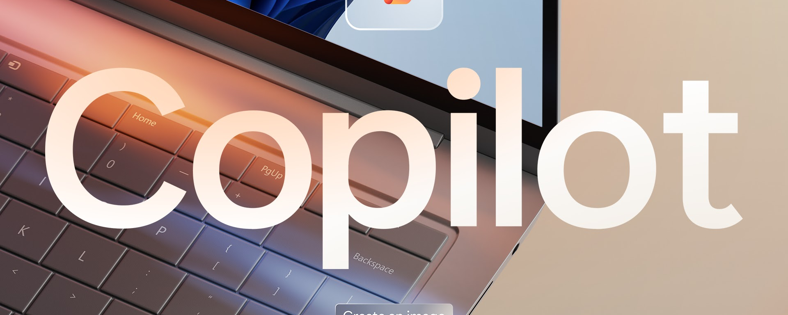
Real-World Benefits of Copilot for Productivity and Organization

Slide 16
Task and Time Management
Smart Scheduling: Plan your day, week, or month based on priorities and deadlines.
Reminders & Follow-ups: Automate reminders for meetings, emails, and tasks.
Time Blocking: Allocate focused time slots for deep work and breaks.

Slide 17
Document and Note Organization
Summarization: Quickly summarize long documents and meeting notes.
Searchable Notes: Structure and tag notes for easy retrieval.
Auto-formatting: Maintain consistency in reports, emails, and presentations.

Slide 18
Data Analysis and Reporting
Spreadsheet Automation: Analyze data, create pivot tables, and charts.
Report Generation: Generate reports from raw data or transcripts.
Trend Identification: Spot patterns and anomalies to support decisions.

Slide 19
Communication Efficiency
Email Drafting: Write professional emails from bullet points or context.
Meeting Summaries: Transcribe and summarize meetings with action items.
Language Translation: Communicate across languages accurately.

Slide 20
Project and Workflow Support
Project Planning: Break down goals into actionable steps.
Progress Tracking: Monitor milestones and deliverables.
Collaboration: Integrate with tools like Teams, Slack, or Trello.

Slide 21
Personal Productivity
Habit Tracking: Build and track habits like reading or journaling.
Learning Assistant: Explain complex topics and assist with research.
Creative Brainstorming: Generate ideas for writing, design, or problem-solving.

Slide 22
MS 365 Copilot UI’s
Feature / Aspect | Copilot in Microsoft 365 Apps | Copilot Chat (Standalone Interface)
Integration | Embedded in Word, Excel, PowerPoint, Outlook, Teams | Separate chat-based interface
Primary Use Case | Contextual assistance within documents, emails, meetings | General productivity, research, and multi-agent tasks
Interface Style | Sidebar, inline suggestions, ribbon buttons | Full-screen chat with side panel and prompt suggestions
Data Access | Works with content in the current app (e.g., open document) | Can access broader organizational data and files
Visual Indicators | App-specific icons and UI elements | Green shield icon for enterprise protection
File & Image Support | Limited to app capabilities | Supports file uploads and image generation
Copilot Pages | Not available | Available (requires SharePoint license)
Suggested Prompts | Contextual to the app (e.g., “Summarize this email”) | General and customizable prompts shown in the center panel
Agent Support | No | Yes – supports custom agents for specialized tasks

Slide 23
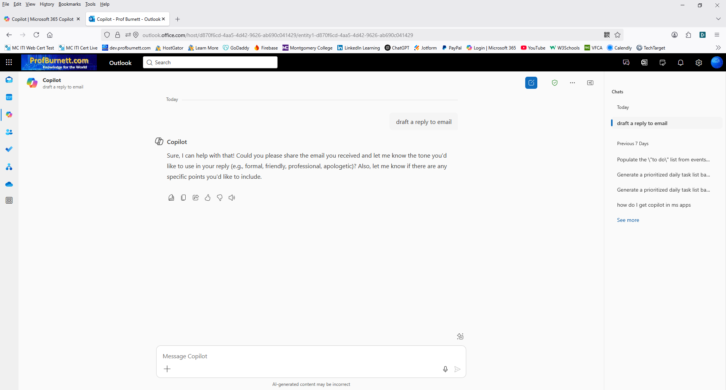
MS 365 Copilot Chat (Online)
Copilot Chat Icon
Previous Chats
View Prompts

Slide 24
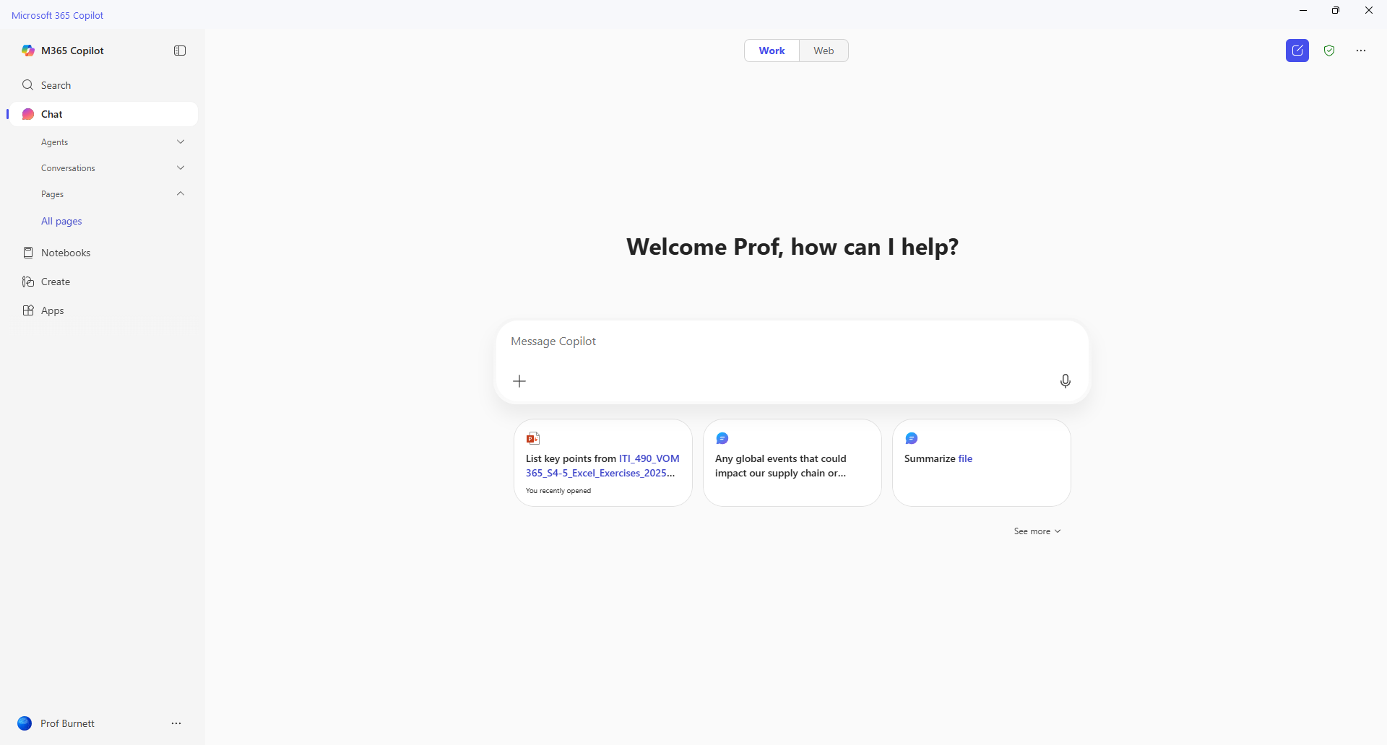
MS 365 Copilot
Prompt Gallery

Slide 25
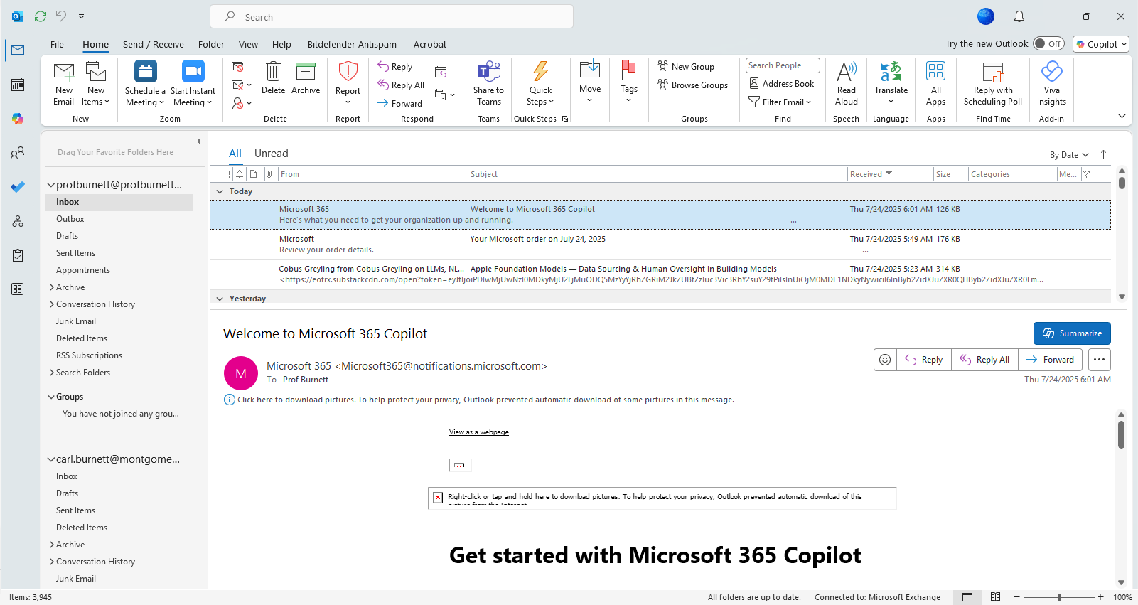
MS 365 Copilot in Outlook
Copilot Chat Icon
Copilot Icon

Slide 26

MS 365 Copilot in Word
Copilot Options
Copilot Icon

Slide 27
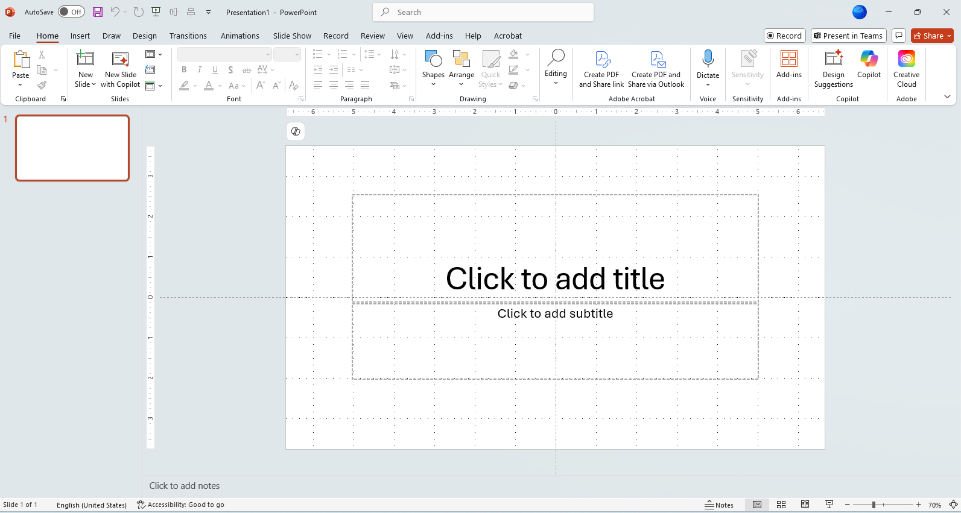
MS 365 Copilot in PowerPoint
Copilot Icon

Slide 28
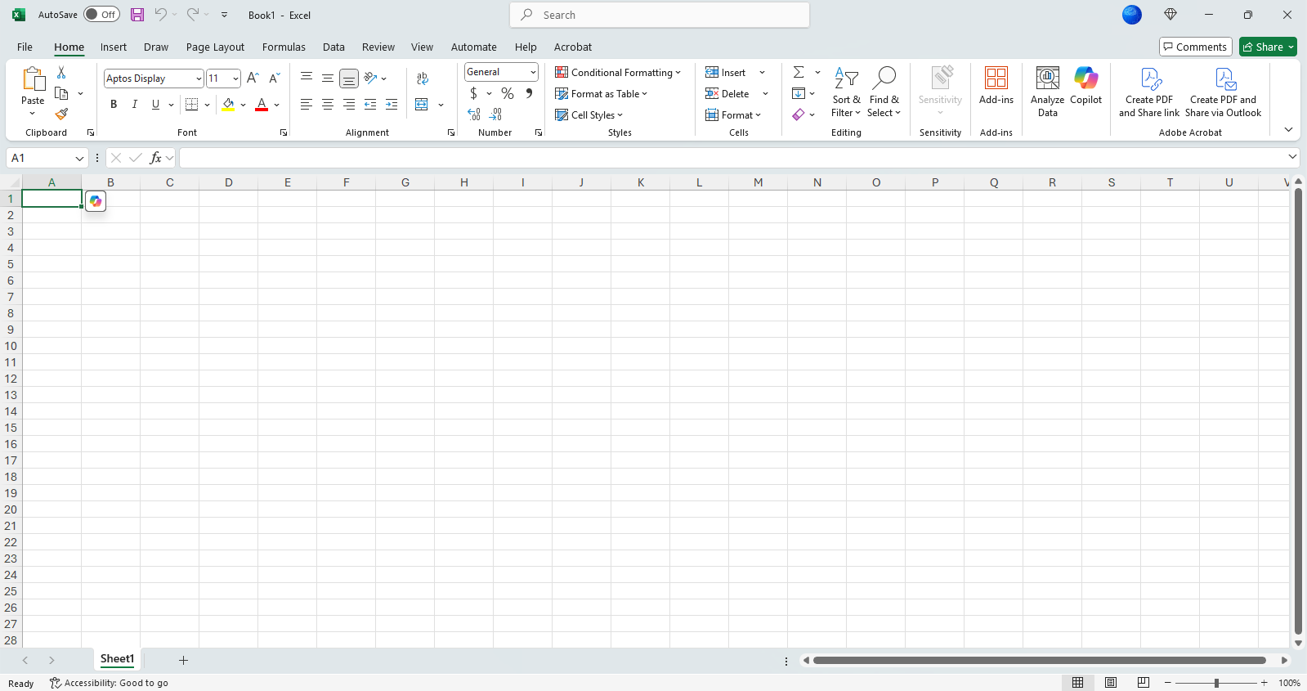
MS 365 Copilot in Excel
Copilot Icon

Slide 29
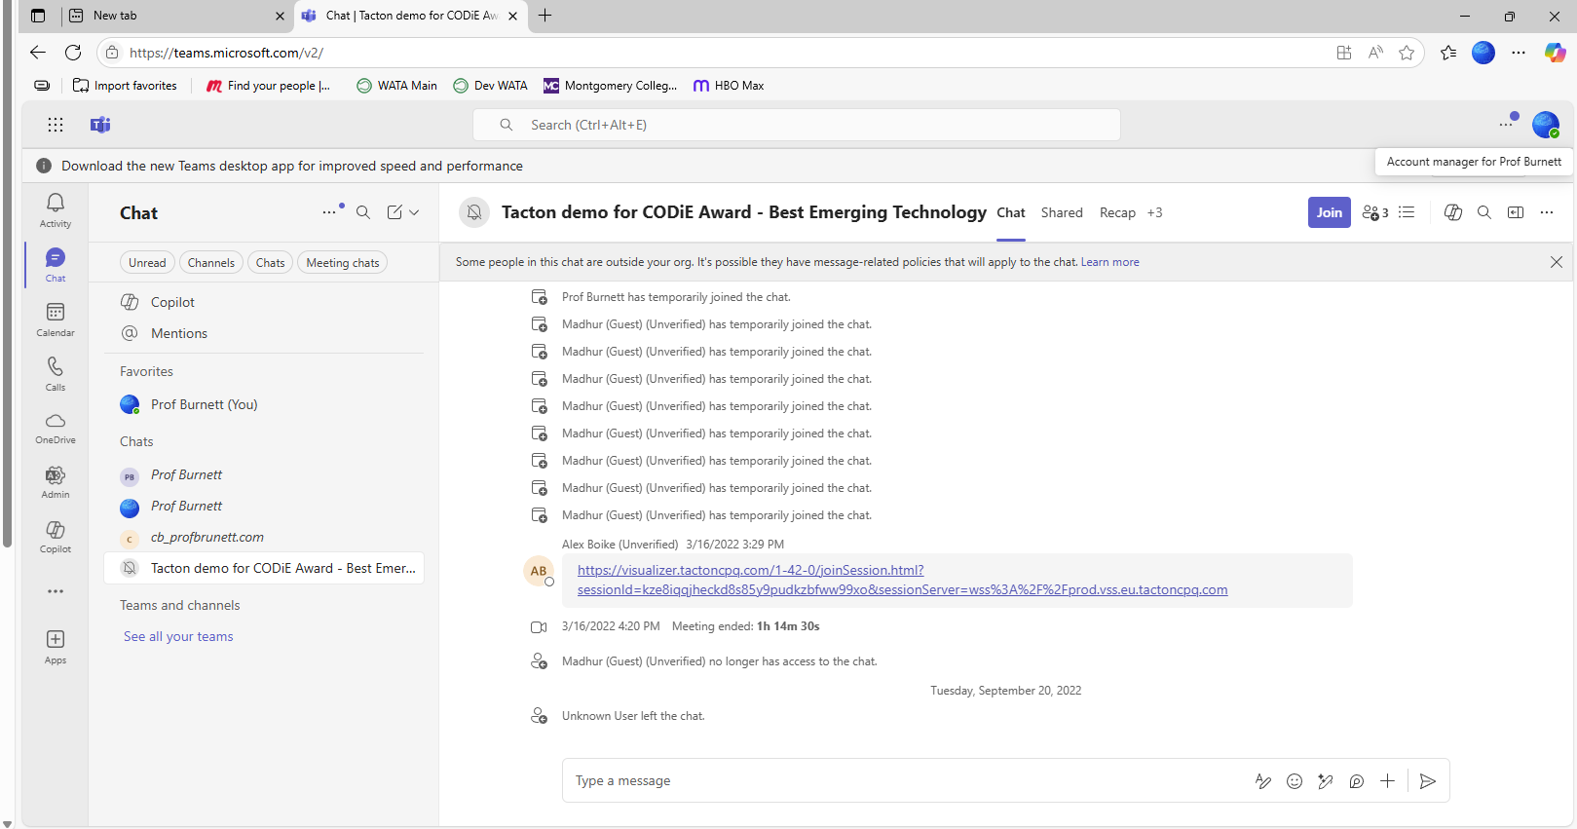
MS 365 Copilot in Teams
Copilot Icon
Copilot Chat Icon

Slide 30
Organizing Yourself with AI
Using Copilot for personal task management
Creating and managing to-do lists
AI-powered prioritization and reminders
Demonstration: Generate a prioritized daily task list with Copilot in Outlook
Notes:
Now, let’s look at how Copilot can help you stay organized. From managing personal tasks and to-do lists to prioritizing and setting reminders, Copilot can streamline your day. We’ll also do a hands-on demo to generate a prioritized task list.
Visuals sourced from:
- Office Watch (https://office-watch.com)
- Microsoft Support (https://support.microsoft.com)
- SHI Blog (https://blog.shi.com)

Slide 31
Mastering Your Calendar with AI
AI-driven scheduling and meeting management in Outlook and Calendar
Demonstration: Use Copilot to schedule a meeting and create an agenda in Outlook
Notes:
Managing your calendar is easier with AI. Copilot can help schedule meetings, manage invites, and even create agendas. We’ll walk through a live example of scheduling a meeting and generating an agenda using Copilot.
Visuals sourced from:
- Office Watch (https://office-watch.com)
- Microsoft Support (https://support.microsoft.com)
- SHI Blog (https://blog.shi.com)

Slide 32
Creating Efficiencies in Daily Workflows
Automating routine tasks (email drafting, summarizing, presentations)
Demonstration: Draft an email, create a PowerPoint slide with Copilot in Outlook
Notes:
AI can automate many routine tasks. Whether it’s drafting emails, summarizing meetings, or creating presentations, Copilot can save you time. In this group activity, we’ll try out these features together.
Visuals sourced from:
- Office Watch (https://office-watch.com)
- Microsoft Support (https://support.microsoft.com)
- SHI Blog (https://blog.shi.com)

Slide 33
Best Practices & Change Management
Tips for integrating AI into daily routines
Overcoming common challenges and misconceptions
Data privacy and security considerations
Notes:
To make the most of AI, it’s important to follow best practices. We’ll share tips for integrating AI into your routine, address common challenges, and discuss data privacy and security considerations.
Visuals sourced from:
- Office Watch (https://office-watch.com)
- Microsoft Support (https://support.microsoft.com)
- SHI Blog (https://blog.shi.com)

Slide 34
Tips for integrating AI into daily routines

Slide 35
Start with Daily Planning
Use AI to generate a daily agenda based on your calendar, tasks, and priorities.
Ask it to summarize your meetings and suggest prep steps.
Let it set reminders or send follow-up emails automatically.

Slide 36
Automate Repetitive Tasks
Use AI tools to:
  Draft emails or reports.
  Summarize long documents or articles.
  Auto-fill forms or generate templates.

Slide 37
Enhance Learning and Research
Ask AI to explain complex topics in simple terms.
Use it to quiz you or generate flashcards.
Summarize research papers or compare sources.

Slide 38
Boost Work Productivity
Integrate AI with tools like Excel, Notion, or Trello to:
  Analyze data and generate insights.
  Track project progress.
  Suggest next steps or improvements.

Slide 39
Support Personal Growth
Use AI to:
  Track habits and goals.
  Recommend books, podcasts, or learning paths.
  Reflect on your day or journal with prompts.

Slide 40
Make It a Habit
Start small: use AI for one task a day.
Set a “Copilot check-in” time to review your day or plan tomorrow.
Gradually expand to more areas as you get comfortable.

Slide 41
Common Misconceptions
Misconception | Reality
Copilot is plug-and-play. | It requires setup, integration, and governance.
It replaces human workers. | It’s a support tool, not a replacement.
It’s always accurate. | AI can make mistakes— human oversight is essential.
It understands context perfectly. | Copilot relies on the data and prompts it’s given.
It’s secure by default. | Security depends on how it’s configured and managed

Slide 42
Exercise 1 – SPEAR Prompt
Microsoft Copilot Chat Prompt Exercise Using SPEAR Framework
Open MS Word to create the Prompt using the SPEAR Framework

Slide 43
Step 1 – Create Prompt using SPEAR Framework in MS WORD
Start: You're a corporate trainer specializing in AI skills for tech teams.
Provide:
  Create a 4-module training plan on prompt engineering using SPEAR framework;
  Format training plan as a table with week, objectives, activities, and assessments;
  Target early-career AI/ML researchers (desk-based, prefer web tools like Perplexity);
  budget-free;
  2 hours/week
Explain: New hires need practical skills for climate/space AI projects, building on basic LLM knowledge; align with hands-on, iterative learning.
Ask: Generate the plan and suggest 2 quiz questions per module.

Slide 44
Step 2 – Create the SPEAR Prompt in MS WOrd
You're a corporate trainer specializing in Microsoft 365 for HR personnel. Create a 4-module training plan on Microsoft 365; Create a training plan in a table format with columns for week, objectives, activities, and assessments; Target early-career HR personnel; 2 hours/week. New hires need practical skills for using Microsoft 365 to complete projects; align training plan with hands-on, iterative learning. Generate the plan and in a table format and suggest 2 quiz questions per module.

Slide 45
Step 3 – Run the SPEAR Prompt in the Ms 365 Copilot Chat
Copy and paste the SPEAR Prompt from MS Word into the MS 365 Copilot Chat.
Copy the result of the MS 365 Copilot Chat prompt into MS Word.

Slide 46
Step 4 - Complete the Blackboard Exercise 1 Form
Open Session II Microsoft Copilot Chat Prompt Exercise Form - SPEAR Prompt Form
Submit your SPEAR prompt engineering work in the form.
Select the prompt engineering framework.
Provide details about your prompt components, final prompt, and results.
Your responses will help us evaluate your understanding and application of prompt engineering techniques.

Slide 47
Exercise 2 – ICE Prompt
Microsoft Copilot Chat Prompt Exercise Using ICE Framework
Open MS Word to create the Prompt using the ICE Framework

Slide 48
Step 1 – Create Prompt using ICE Framework in MS WORD
Instruction - Create a e-learning guide for using a carrot peeler. ​
Context
Audience: Beginner cooks’.
Course style: practical, task-based, minimal jargon, lots of short practice checks.
Module delivery: self-paced e-learning (read + do), designed for 30–45 minutes total.
Tone: supportive, clear, and confidence-building.
Example A (mini example of format + depth)​
Topic: Using a Carrot Peeler
Learning objectives:
  How to use a carrot peeler.
  Safety issues using the peeler.

Slide 49
Step 2 – Create the ICE Prompt in MS WOrd
Instruction - Create a e-learning guide for using a carrot peeler. ​
Context:
Audience: Beginner cooks’.
Course style: practical, task-based, minimal jargon, lots of short practice checks.
Module delivery: self-paced e-learning (read + do), designed for 30–45 minutes total.
Tone: supportive, clear, and confidence-building.
Example A (mini example of format + depth)​:
Topic: Using a Carrot Peeler
Learning objectives:
  How to use a carrot peeler.
  Safety issues using the peeler.

Slide 50
Step 3 – Run the ICE Prompt in the Ms 365 Copilot Chat
Copy and paste the ICE Prompt from MS Word into the MS 365 Copilot Chat.
Copy the result of the MS 365 Copilot Chat prompt into MS Word.

Slide 51
Step 4 - Complete the Blackboard Exercise 2 Form
Open Session II Microsoft Copilot Chat Prompt Exercise Form - ICE Prompt Form
Submit your ICE prompt engineering work in the form.
Select the prompt engineering framework.
Provide details about your prompt components, final prompt, and results.
Your responses will help us evaluate your understanding and application of prompt engineering techniques.

Slide 52
Exercise 3 – Self Prompt
Microsoft Copilot Chat Prompt Exercise Using your own prompt.
Select a Prompt Framework to use.
(SPEAR, CRISPE, ICE, or CRAFT)
Open MS Word to create the Prompt using your selected framework.

Slide 53
Step 1 – Create Prompt in MS WORD using your Selected Framework
List Framework Components
Create framework component prompt instructions.
Copy framework component prompt instructions into MS Word.

Slide 54
Step 2 – Create your framework Prompt in MS WOrd
Create Prompt from framework components created in Step 1.
Copy Prompt into MS Word.

Slide 55
Step 3 – Run the Your Prompt in the MS 365 Copilot Chat
Copy and paste your Prompt from MS Word into the MS 365 Copilot Chat.
Copy the result of the MS 365 Copilot Chat prompt into MS Word.

Slide 56
Step 4 - Complete the Blackboard Exercise 3 Form
Open Session II Microsoft Copilot Chat Prompt Exercise Form – Self Prompt Form
Submit your Self prompt engineering work in the form.
Select the prompt engineering framework.
Provide details about your prompt components, final prompt, and results.
Your responses will help us evaluate your understanding and application of prompt engineering techniques.

Slide 57
Session II Review
Introduction to Prompt Engineering Frameworks
Discover personal organization tools using Copilot’s task management
Discover Copilot Chat, Personal, and Enterprise Editions
Learn how to organize yourself with MS Copilot AI
Prompt Engineering Exercises using MS Copilot

