Slide 1

ITI 555 Introduction to
Generative AI - Session II
Prof burnett | Embrace AI / Master Your Future

Slide 2
Course Outline – Session II
What is Microsoft Copilot.
What are the Key Features of Microsoft Copilot.
How is Microsoft Copilot integrated in Microsoft Office Applications
Microsoft 365 Copilot User Interfaces
Common Misconceptions about Microsoft Copilot.
Prompt Engineering Exercises using Microsoft Copilot AI

Slide 3
Course Outline – Session III
Introduction to the Major LLMs
  Open AI
  Google Deepmind
  Anthropic
  xAI
  Kimi
  Deepseek
  MAI
Advanced Prompt Engineering Techniques
LLM Prompt Engineering Exercises

Slide 4
Course Outline – Session IV
AI Leaders Warnings
AI Technology Concerns
AI Future – China
AI Future – US
Technology Legislation
AI Technology Concern Quiz
Course Review
Course Evaluation

Slide 5

Unlocking Productivity with Microsoft 365 Copilot

Slide 6
What Is Microsoft Copilot?
A family of AI assistants, not a single app
Built into Microsoft 365, Windows, Edge, and the web
Uses large language models (LLMs) plus Microsoft services
Designed to assist work, not replace people

Slide 7
How Copilot Uses Data
Copilot uses pre‑trained AI models (e.g., GPT‑5)
Your organization’s data is NOT used to train the model
Work data is used only at runtime to answer your question
Access is controlled by existing permissions

Slide 8
Which Copilot Should I Use?
Copilot Version | Best For | Key Limitation
Copilot (Consumer) | General questions, ideas, web help | No work data access
Copilot Chat (Work) | Secure AI chat at work | No deep M365 integration
Microsoft 365 Copilot | Writing, meetings, email, Excel, Teams | Requires license
Copilot Studio / GitHub | Custom agents, automation, coding | Setup & governance needed

Slide 9
Version / Name | Release Date | Training Data | Underlying LLM | Licensing Provisions
Microsoft 365 Copilot | November 1, 2023 | Not publicly disclosed | Large Language Models from OpenAI integrated with Microsoft Graph | Paid add-on for Microsoft 365 commercial customers.
Copilot Pro | January 2024 | Not publicly disclosed | GPT-4 Turbo with priority access and enhanced image generation capabilities | Monthly consumer subscription license.
Microsoft 365 Copilot Chat | Announced and expanded during 2024-2025 rollout | Not publicly disclosed | Microsoft Copilot platform using OpenAI LLMs and enterprise grounding data | Included in many Microsoft 365 commercial offerings
Microsoft 365 Copilot App | January 2025 | Not publicly disclosed | Microsoft Copilot orchestration layer using OpenAI models and Microsoft Graph | Requires Microsoft 365 account; premium features require Microsoft 365 Copilot licensing.
Microsoft Copilot (2026) | Ongoing updates through 2025-2026 | Not publicly disclosed | GPT-4-class and newer OpenAI models orchestrated through Microsoft's Copilot platform | Free consumer tier, Microsoft 365 Copilot business licensing, and enterprise plans.

Slide 10
Microsoft 365 Copilot Feature Comparison Chart
Microsoft 365 Copilot Chat - Free
Plan | Word | Excel | PowerPoint | Outlook | OneNote | Toggle Available | AI Credits
Copilot Pro |  |  |  |  |  | No | Limited
Business Enterprise |  |  |  |  |  | Yes | Varies
Personal/ Family | Limited | Limited | Limited | Limited | Limited | Yes | Limited

Slide 11
Microsoft Copilot Offerings
Version / Name | Initial Release Date | Training Data Used | Underlying LLM | Licensing Provisions
Microsoft Copilot (Consumer) | February 7, 2023 (launched as Bing Chat, later rebranded) | Public web content, Microsoft Search index, user prompts, and Microsoft AI safety tuning. Does not train on a user's personal content by default. | Microsoft Prometheus architecture built on OpenAI GPT models; current versions use advanced OpenAI models. | Free tier available; Copilot Pro subscription provides premium access and additional features.
Microsoft 365 Copilot | General Availability: November 1, 2023 | Microsoft Graph data (emails, chats, meetings, files, calendars) plus organizational content and user prompts, all within tenant security boundaries. | Large Language Models from OpenAI combined with Microsoft's orchestration layer and Microsoft Graph grounding. | Requires qualifying Microsoft 365 license plus Microsoft 365 Copilot license (per user).
GitHub Copilot | June 2022 (General Availability) | Public source code, open-source repositories, documentation, and natural-language/code training datasets used by OpenAI and GitHub. | OpenAI Codex initially; now supports multiple models including GPT-family and other partner models. | Individual, Business, and Enterprise subscriptions; enterprise controls and indemnification available.

Slide 12
Microsoft Copilot Offerings
Version / Name | Initial Release Date | Training Data Used | Underlying LLM | Licensing Provisions
Microsoft Copilot Pro | January 2024 | Same foundation as consumer Copilot with enhanced access to premium models and Microsoft 365 Personal/Family integration. | Latest consumer Copilot models with priority access. | Monthly subscription (approximately $20/user/month in the U.S.).
Microsoft Security Copilot | April 2024 (General Availability) | Security telemetry from Microsoft Defender, Sentinel, Intune, Entra, threat intelligence, and organizational security data. | OpenAI models combined with Microsoft's security-specific AI orchestration and threat intelligence. | Consumption-based licensing and security workload integration.
Copilot Studio | November 2023 (evolved from Power Virtual Agents) | Organization-specific data sources, connectors, websites, databases, and knowledge repositories configured by customers. | Multiple Microsoft and partner foundation models selected through the Copilot platform. | Included capabilities with Microsoft 365 Copilot licensing for many scenarios; advanced usage may incur consumption charges.

Slide 13
Microsoft 365 Apps that support Copilot
MS 365 App | Underlying LLM | Release Date | Licensing Provisions
Word | Latest OpenAI models via Microsoft 365 Copilot orchestration layer. | Nov 1, 2023 GA | Microsoft 365 Copilot license + qualifying Microsoft 365 subscription.
Excel | Same as Word. | Nov 1, 2023 GA | Same licensing.
PowerPoint | Same as Word. | Nov 1, 2023 GA | Same licensing.
Outlook | Same as Word. | Nov 1, 2023 GA | Same licensing.
Teams | Same as Word. | Nov 1, 2023 GA | Same licensing.
OneNote | Same as Word. | 2023 rollout period | Same licensing.
Loop | Same as Word. | 2023 rollout period | Same licensing.
Microsoft 365 Copilot Chat | Microsoft states it uses the latest available models | 2023 rollout | Included for eligible Microsoft Entra users with qualifying subscriptions.
GitHub Copilot | MAI-Code-1-Flash | Build 2026 announcement | Included within applicable GitHub Copilot offerings.

Slide 14
MS 365 Outlook Copilot Integration
Key Features:
  Email Summarization: Summarize long threads.
  Reply Drafting: Suggest responses based on context.
  Tone Adjustment: Make emails more formal, friendly, etc.
  Schedule Suggestions: Propose meeting times and follow-ups.
Integration Highlights:
  Integrates with calendar, Teams, and To Do.
  Can pull data from Word/Excel attachments for context.

Slide 15
MS 365 Word Copilot Integration
Key Features:
  Content Drafting: Generate text based on prompts or outlines.
  Summarization: Condense long documents into key points.
  Rewrite Suggestions: Improve tone, clarity, or style.
  Formatting Help: Apply consistent styles and layouts.
Integration Highlights:
  Appears as a sidebar or inline assistant.
  Can pull data from other documents or emails for context.

Slide 16
MS 365 Excel Copilot Integration
Key Features:
  Data Analysis: Generate insights, trends, and summaries.
  Formula Generation: Create complex formulas from natural language.
  Chart Creation: Automatically generate charts and visuals.
  What-If Analysis: Simulate scenarios and outcomes.
Integration Highlights:
  Works with PivotTables, Power Query, and dynamic arrays.
  Can reference data from other Microsoft 365 sources.

Slide 17
MS 365 PowerPoint Copilot Integration
Key Features:
  Presentation Generation: Create slides from prompts or documents.
  Slide Summarization: Condense decks into key takeaways.
  Design Suggestions: Improve layout and visual appeal.
  Speaker Notes: Auto-generate talking points.
Integration Highlights:
  Pulls content from Word, Excel, and Teams.
  Can generate visuals and icons using AI.

Slide 18
MS 365 Teams Copilot Integration
Key Features:
  Meeting Summaries: Auto-generate notes, action items, and highlights.
  Real-Time Transcription: Live captions and transcripts.
  Chat Assistance: Summarize threads, suggest replies.
  Task Tracking: Extract tasks and assign them.
Integration Highlights:
  Syncs with Planner, To Do, and Outlook.
  Works across channels, meetings, and chats.

Slide 19
MS 365 Copilot User Interfaces
Feature / Aspect | Copilot in Microsoft 365 Apps | Copilot Chat (Standalone Interface)
Integration | Embedded in Word, Excel, PowerPoint, Outlook, Teams | Separate chat-based interface
Primary Use Case | Contextual assistance within documents, emails, meetings | General productivity, research, and multi-agent tasks
Interface Style | Sidebar, inline suggestions, ribbon buttons | Full-screen chat with side panel and prompt suggestions
Data Access | Works with content in the current app (e.g., open document) | Can access broader organizational data and files
Visual Indicators | App-specific icons and UI elements | Green shield icon for enterprise protection
File & Image Support | Limited to app capabilities | Supports file uploads and image generation
Copilot Pages | Not available | Available (requires SharePoint license)
Suggested Prompts | Contextual to the app (e.g., “Summarize this email”) | General and customizable prompts shown in the center panel
Agent Support | No | Yes – supports custom agents for specialized tasks

Slide 20
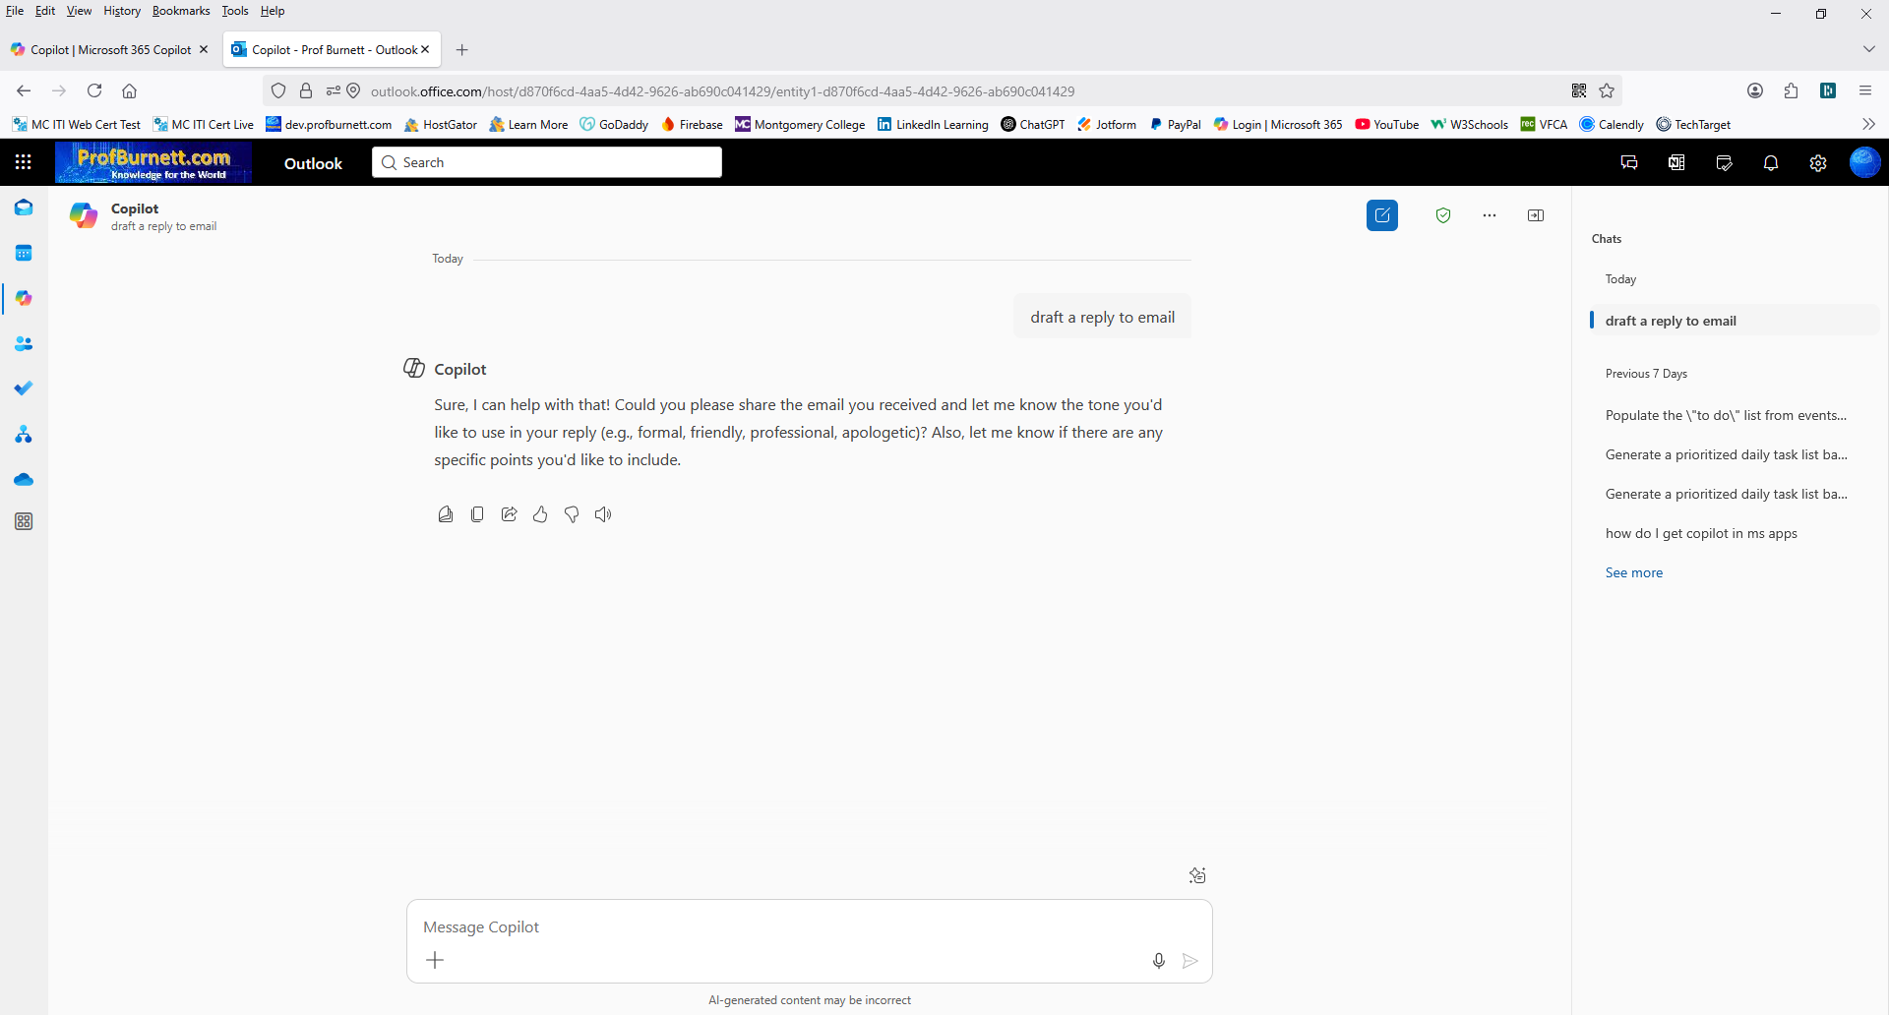
MS 365 Copilot Chat (Online)
Copilot Chat Icon
Previous Chats
View Prompts

Slide 21
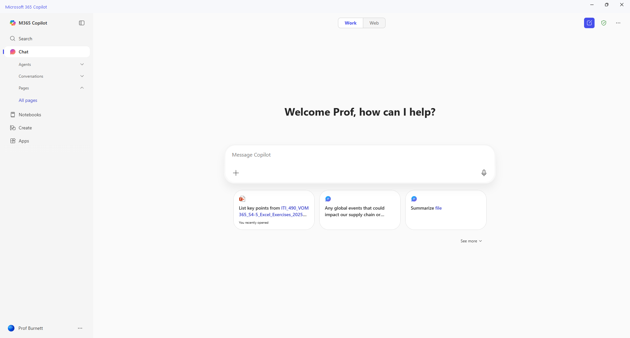
MS 365 Copilot
Prompt Gallery

Slide 22
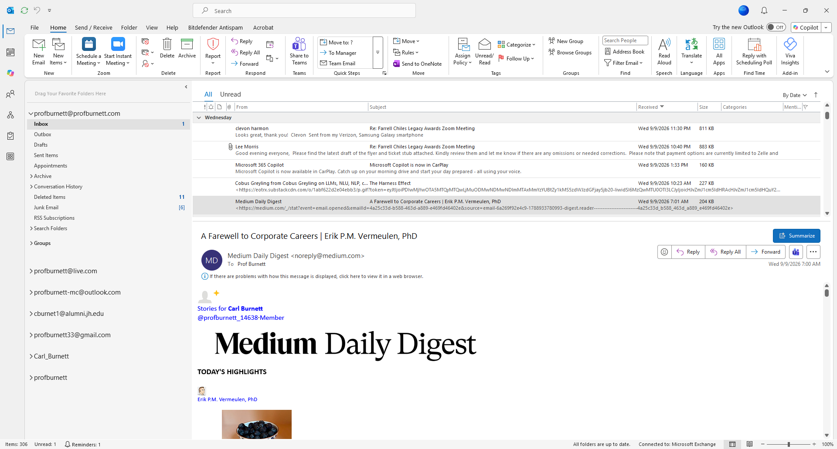
MS 365 Copilot in Outlook
Copilot Chat Icon
Copilot Icon

Slide 23
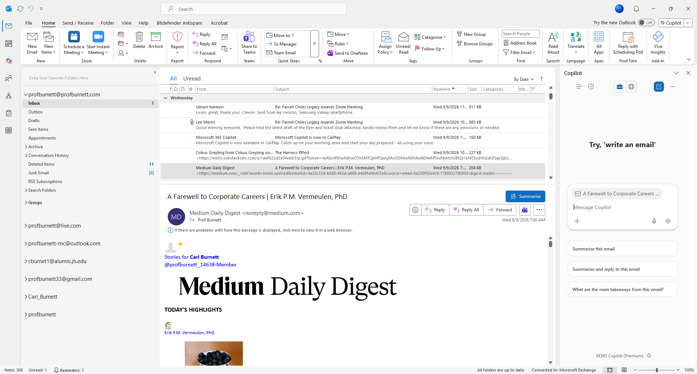
MS 365 Copilot in Outlook
Copilot Sidebar Window

Slide 24
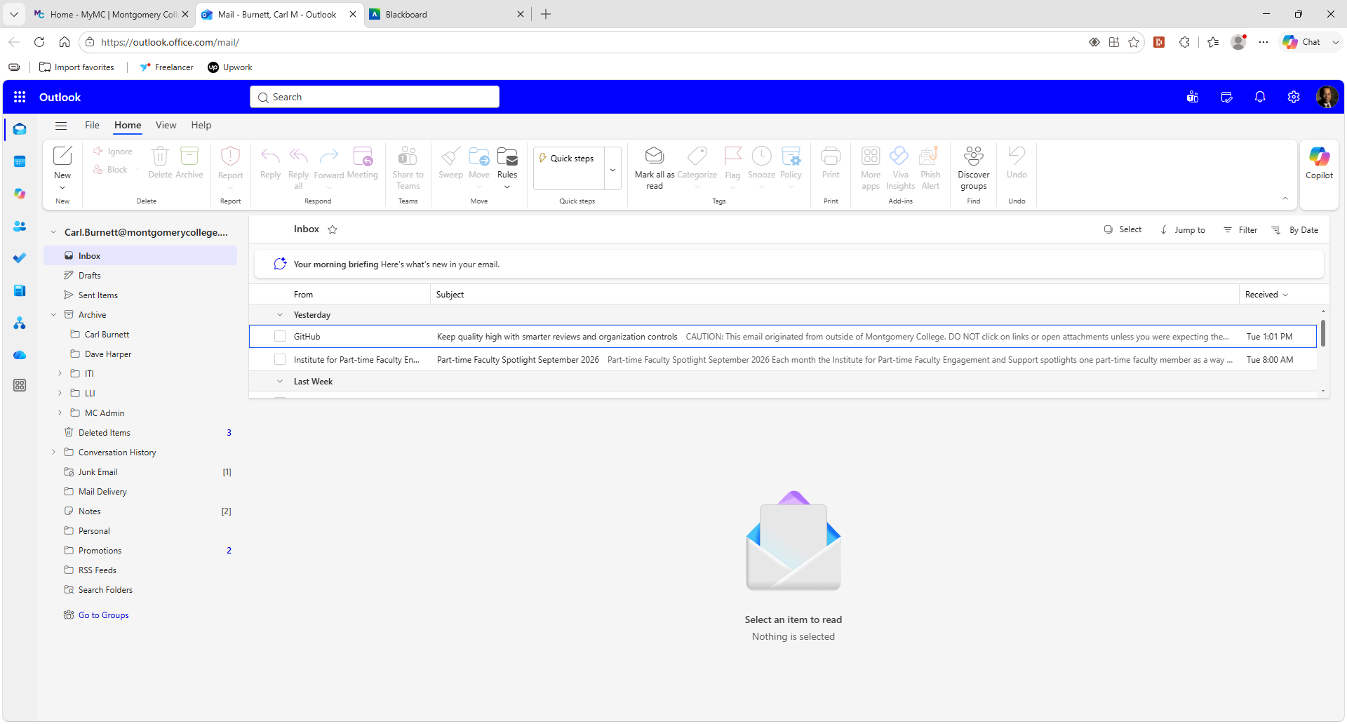
MS 365 Copilot Outlook in a Browser
Copilot Chat Icon
Copilot Icon

Slide 25
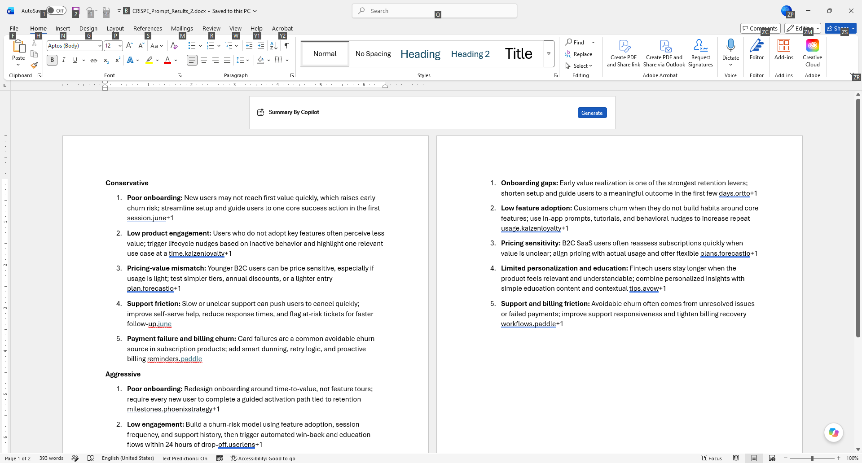
MS 365 Copilot DAB in MS 365 Apps
Copilot Options
Copilot Dynamic Action Button (DAB)

Slide 26
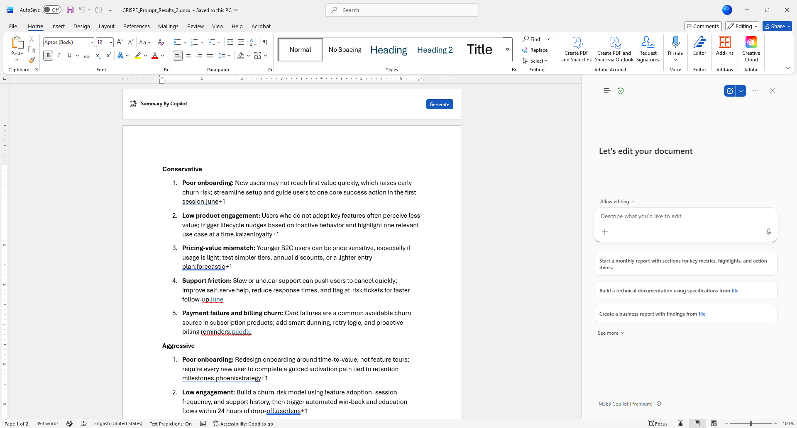
MS 365 Copilot DAB in MS 365 Apps
Copilot Options
Copilot Window Sidebar
(App Specific)

Slide 27
Common Misconceptions about Microsoft Copilot
Misconception | Reality
Copilot is plug-and-play. | It requires setup, integration, and governance.
It replaces human workers. | It’s a support tool, not a replacement.
It’s always accurate. | AI can make mistakes— human oversight is essential.
It understands context perfectly. | Copilot relies on the data and prompts it’s given.
It’s secure by default. | Security depends on how it’s configured and managed

Slide 28
Prompt Engineering Exercises using Microsoft Copilot AI

Slide 29
Prompt Engineering Framework Comparison
Framework | Core Components | Best For | Key Advantage | Evaluation Capability
SPEAR | Start, Provide, Explain, Ask, Rinse & Repeat | Beginners, quick setups | Simple, repeatable process | Basic feedback built-in
ICE | Instruction, Context, Examples | Detailed, complex tasks | Clear structure for detailed prompts | Manual evaluation
CRISPE | Capacity/role, Insight, Statement, Personality, Experiment | Enterprise use, team projects | Fine-tuned style and deep customization | Built-in evaluation tools
CRAFT | Context, Role, Action, Format, Target Audience | Specialized AI interactions | Precise control and role definition | Supports metric-driven testing

Slide 30
Exercise 1 – SPEAR Prompt
Microsoft Copilot Chat Prompt Exercise Using SPEAR Framework
Open MS Word to create the Prompt using the SPEAR Framework

Slide 31
Step 1 – Create Prompt using SPEAR Framework in MS WORD
Start: You're a corporate trainer specializing in AI skills for tech teams.
Provide:
  Create a 4-module training plan on prompt engineering using SPEAR framework;
  Format training plan as a table with week, objectives, activities, and assessments;
  Target early-career AI/ML researchers (desk-based, prefer web tools like Perplexity);
  budget-free;
  2 hours/week
Explain: New hires need practical skills for climate/space AI projects, building on basic LLM knowledge; align with hands-on, iterative learning.
Ask: Generate the plan and suggest 2 quiz questions per module.

Slide 32
Step 2 – Create the SPEAR Prompt in MS WOrd
You're a corporate trainer specializing in Microsoft 365 for HR personnel. Create a 4-module training plan on Microsoft 365; Create a training plan in a table format with columns for week, objectives, activities, and assessments; Target early-career HR personnel; 2 hours/week. New hires need practical skills for using Microsoft 365 to complete projects; align training plan with hands-on, iterative learning. Generate the plan and in a table format and suggest 2 quiz questions per module.

Slide 33
Step 3 – Run the SPEAR Prompt in the Ms 365 Copilot Chat
Copy and paste the SPEAR Prompt from MS Word into the MS 365 Copilot Chat.
Copy the result of the MS 365 Copilot Chat prompt into MS Word.

Slide 34
Step 4 - Complete the Blackboard Exercise 1 Form
Open Session II Microsoft Copilot Chat Prompt Exercise Form - SPEAR Prompt Form
Submit your SPEAR prompt engineering work in the form.
Select the prompt engineering framework.
Provide details about your prompt components, final prompt, and results.
Your responses will help us evaluate your understanding and application of prompt engineering techniques.

Slide 35
Exercise 2 – ICE Prompt
Microsoft Copilot Chat Prompt Exercise Using ICE Framework
Open MS Word to create the Prompt using the ICE Framework

Slide 36
Step 1 – Create Prompt using ICE Framework in MS WORD
Instruction - Create a e-learning guide for using a carrot peeler. ​
Context
Audience: Beginner cooks’.
Course style: practical, task-based, minimal jargon, lots of short practice checks.
Module delivery: self-paced e-learning (read + do), designed for 30–45 minutes total.
Tone: supportive, clear, and confidence-building.
Example A (mini example of format + depth)​
Topic: Using a Carrot Peeler
Learning objectives:
  How to use a carrot peeler.
  Safety issues using the peeler.

Slide 37
Step 2 – Create the ICE Prompt in MS WOrd
Instruction - Create a e-learning guide for using a carrot peeler. ​
Context:
Audience: Beginner cooks’.
Course style: practical, task-based, minimal jargon, lots of short practice checks.
Module delivery: self-paced e-learning (read + do), designed for 30–45 minutes total.
Tone: supportive, clear, and confidence-building.
Example A (mini example of format + depth)​:
Topic: Using a Carrot Peeler
Learning objectives:
  How to use a carrot peeler.
  Safety issues using the peeler.

Slide 38
Step 3 – Run the ICE Prompt in the Ms 365 Copilot Chat
Copy and paste the ICE Prompt from MS Word into the MS 365 Copilot Chat.
Copy the result of the MS 365 Copilot Chat prompt into MS Word.

Slide 39
Step 4 - Complete the Blackboard Exercise 2 Form
Open Session II Microsoft Copilot Chat Prompt Exercise Form - ICE Prompt Form
Submit your ICE prompt engineering work in the form.
Select the prompt engineering framework.
Provide details about your prompt components, final prompt, and results.
Your responses will help us evaluate your understanding and application of prompt engineering techniques.

Slide 40
Exercise 3 – Self Prompt
Microsoft Copilot Chat Prompt Exercise Using your own prompt.
Select a Prompt Framework to use.
(SPEAR, CRISPE, ICE, or CRAFT)
Open MS Word to create the Prompt using your selected framework.

Slide 41
Step 1 – Create Prompt in MS WORD using your Selected Framework
List Framework Components
Create framework component prompt instructions.
Copy framework component prompt instructions into MS Word.

Slide 42
Step 2 – Create your framework Prompt in MS WOrd
Create Prompt from framework components created in Step 1.
Copy Prompt into MS Word.

Slide 43
Step 3 – Run the Your Prompt in the MS 365 Copilot Chat
Copy and paste your Prompt from MS Word into the MS 365 Copilot Chat.
Copy the result of the MS 365 Copilot Chat prompt into MS Word.

Slide 44
Step 4 - Complete the Blackboard Exercise 3 Form
Open Session II Microsoft Copilot Chat Prompt Exercise Form – Self Prompt Form
Submit your Self prompt engineering work in the form.
Select the prompt engineering framework.
Provide details about your prompt components, final prompt, and results.
Your responses will help us evaluate your understanding and application of prompt engineering techniques.

Slide 45
Session II Review
What is Microsoft Copilot.
What are the Key Features of Microsoft Copilot.
How is Microsoft Copilot integrated in Microsoft Office Applications
Microsoft 365 Copilot User Interfaces
Common Misconceptions about Microsoft Copilot.
Prompt Engineering Exercises using Microsoft Copilot AI

