Slide 1

ITI 555 Introduction to Generative AI
Session I
Prof burnett | Embrace AI / Master Your Future
Notes:
TO CHANGE IMAGE, DELETE IMAGE AND CLICK ON THE ICON TO ADD AN IMAGE, OR RIGHT CLICK TO REPLACE IMAGE
TO ADJUST THE SCALE OR POSITION OF THE IMAGE WITHIN THE MASK, SELECT THE IMAGE, GO TO PICTURE FORMAT, AND SELECT CROP
TIP: For best results, choose an image with a strong horizontal focal point so it aligns well within the custom linear shape.
To ensure legibility, the blue color should only be used with bold text.

Slide 2
Course Outline – Session I
Define Artificial Intelligence (AI) and Generative AI (GenAI).
Explain the latest trends in GenAI/AI.
Identify and describe key concepts in GenAI/AI.
Understand the Building Blocks of LLMs
Introduction to Prompt Engineering Frameworks
AI Quiz
LLM Quiz

Slide 3
Course Outline – Session II
Discover personal organization tools using Microsoft Copilot’s task management
Discover Copilot Chat, Personal, and Enterprise Editions
Learn how to organize yourself with Microsoft Copilot AI
Prompt Engineering Exercises using Microsoft Copilot AI

Slide 4
Course Outline – Session III
Introduction to the Major LLMs
  ChatGPT 5.1
  Gemini 2.5 Pro
  Claude Sonnet 4.5
  Grok 4
  Kimi K2 Thinking (Moonshot)
Advanced Prompt Engineering Techniques
LLM Prompt Engineering Exercises

Slide 5
Course Outline – Session IV
Industry Risks and Concerns
AI Technology Concerns
AI Future
Job Market
Creator Warning
AI technology Concern Quiz
Course Review
Course Evaluation

Slide 6
Define Artificial Intelligence (AI) and Generative AI (GenAI)

Slide 7
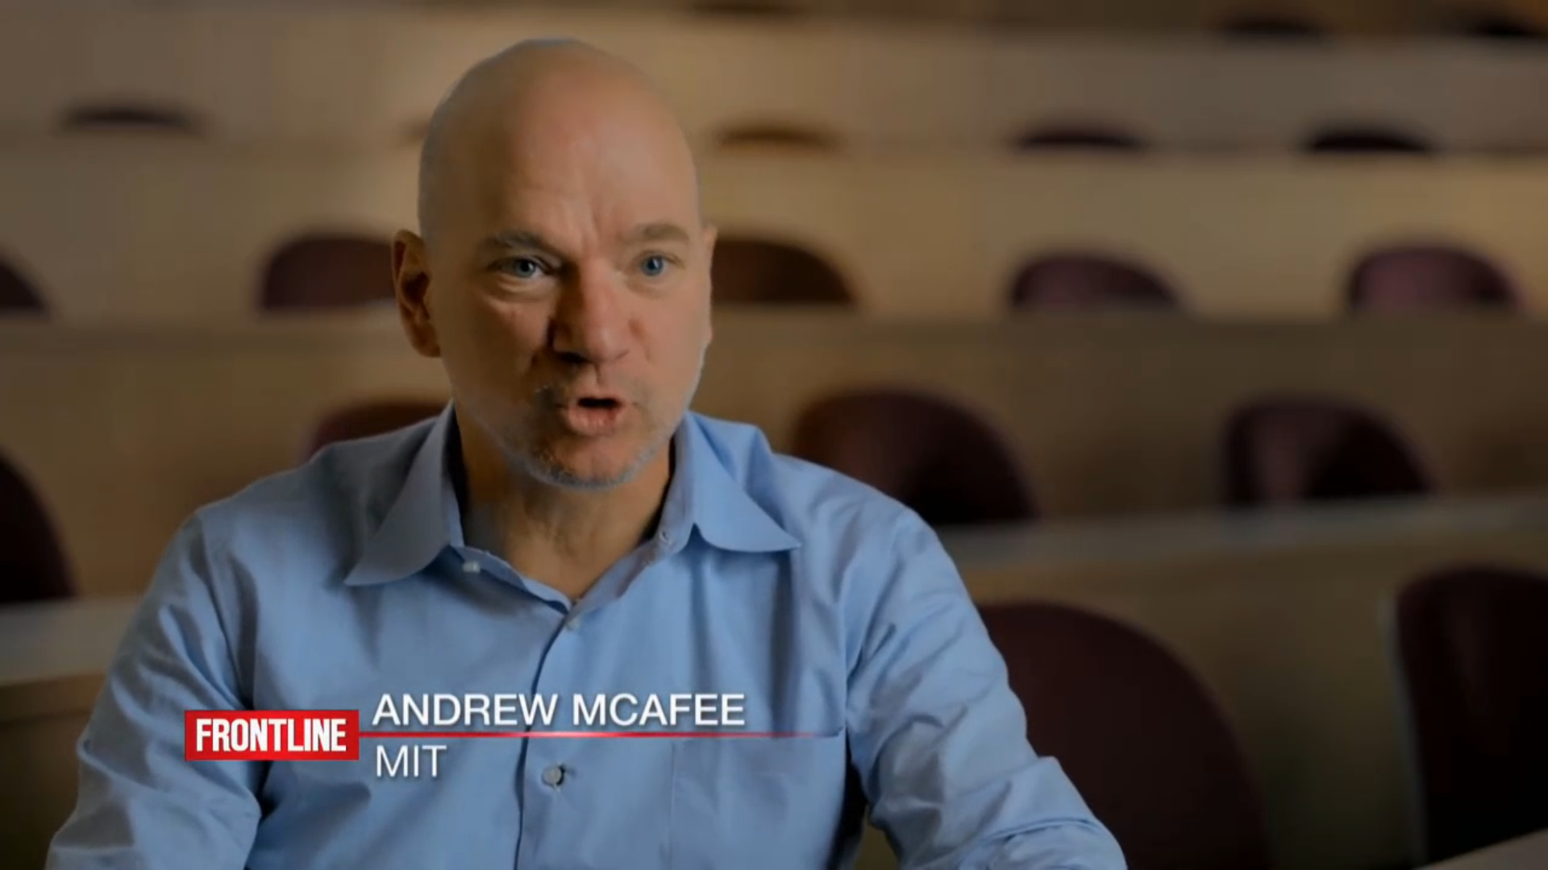
Social Development
Notes:
Social Development

Slide 8
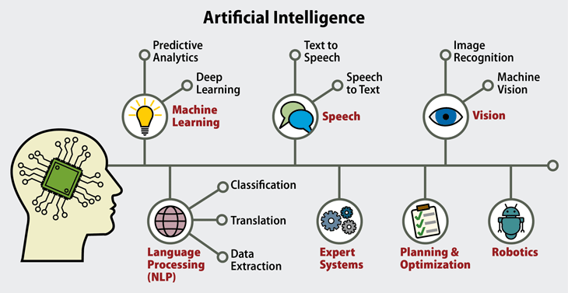
Artificial Intelligence (AI)

Slide 9
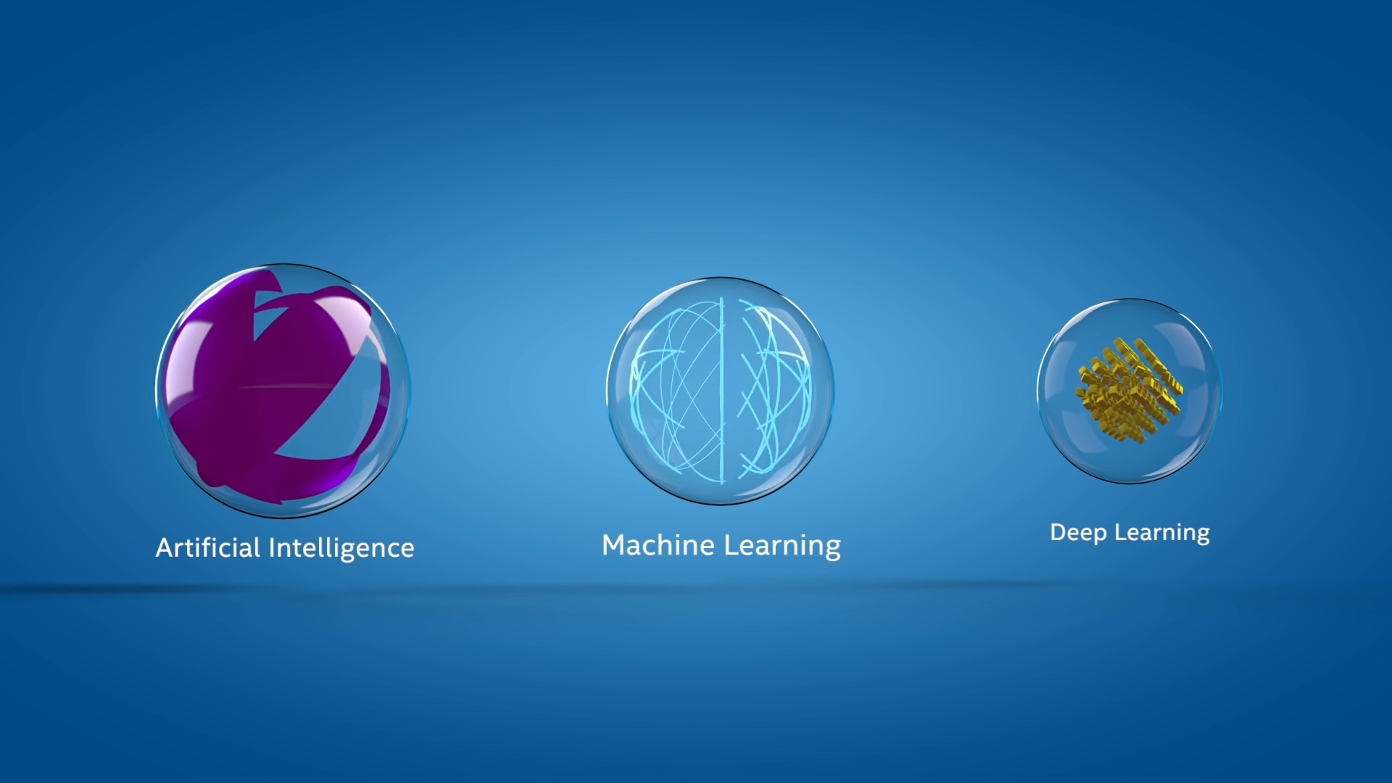
AI Explained
Notes:
AI Explained

Slide 10
Why Now?
Architecture
Data
Technology
Creation of different Architectural Frameworks has enabled enhanced methods to process and analyze a vast amount of data and incorporate a “retention” memory factor.
There is now a vast amount of data available and generated that can be used to create GenAI models. In addition, verification and validation of the scaling law in models verifies the adage that “the more you have, the more accurate the model will be”.
Creation of advanced hardware to support intensive computational run-times. CPU vs GPU vs TPU vs NPUs.
These different models with varying parameter sizes and specializations demonstrate the diversity of large language models being developed for a range of applications in the field of generative AI.

Slide 11
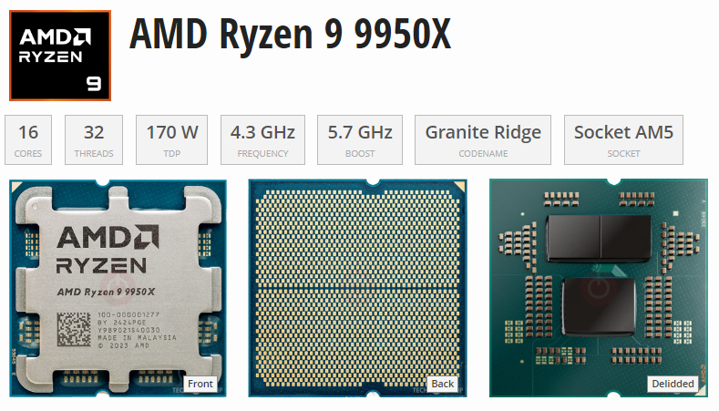

~$600
~$25,000

Slide 12
Processing Unit Comparisons
Comparative Analysis: Power FLOPS, & Bandwidth
Type | Flops (Peak) | Bandwidth | Power (W) | Flexibility | Best For
GPU | 19.5 – 312 TFLOPS (A100) | 1.6 TB/s (HBM3) | 400 W | High | AI / HPC Gaming
FPGA | 10-20 TFOPS | 100 GB/s 1 TB/s | 10 -50W | Very High | Edge / Telecom
ASIC | 4-1000s TOPS (Varies) | 20 PB/s (WSE-2) | 2W – 23kW | None | Specific AI Crypto
TPU | 275 TOPS (v4) | 1.2 TB/s (HBM3) | 100w-500kW | Moderate | ML Training / Inference
NPU | 15,8 TOPS (M2) | 50-100 GB/s | 1-5W | Low | Edge Inference
Name | Unit | Value
kiloFLOPS | kFLOPS | 10³
megaFLOPS | MFLOPS | 10⁶
gigaFLOPS | GFLOPS | 10⁹
teraFLOPS | TFLOPS | 10¹²
petaFLOPS | PFLOPS | 10¹⁵
exaFLOPS | EFLOPS | 10¹⁸
zettaFLOPS | ZFLOPS | 10²¹
yottaFLOPS | YFLOPS | 10²⁴
ronnaFLOPS | RFLOPS | 10²⁷
quettaFLOPS | QFLOPS | 10³⁰
https://theneildave.medium.com/gpu-vs-fpga-vs-asic-vs-tpu-vs-npu-benefits-use-cases-and-manufacturers-4419115069df
Notes:
Graphics Processing Units (GPUs)
Field-Programmable Gate Arrays (FPGAs)
Application-Specific Integrated Circuits (ASICs)
Tensor Processing Units (TPUs)
Neural Processing Units (NPUs)

Slide 13
Hierarchy of Intelligence
Artificial Intelligence (AI)
Machine Learning (ML)
Deep Learning (DL)
Neural Networks
Generative AI (GenAI):
  Uses ML models
  Deep learning architectures
  Transformers and GANs

Slide 14
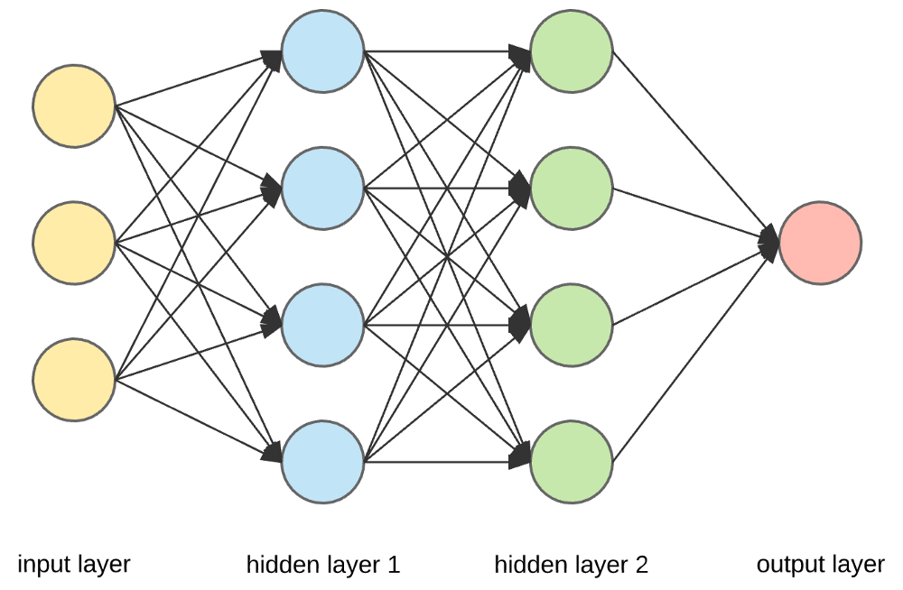
Neural Networks
Structure of Neural Networks
Consists of interconnected nodes called neurons, which process and transmit information.
Organized into layers, with each layer performing specific computations. Through
Neural networks recognize patterns and make accurate predictions based on vast amounts of data.

Slide 15
Types of Neural Networks
Convolutional Neural Networks (CNNs) (image and video recognition).
Recurrent Neural Networks (RNNs) process sequential data (speech recognition and language translation).
Generative Adversarial Networks (GANs) - Generate new content - Generative AI.

Slide 16
Latest Trends in GenAI/AI.

Slide 17
What is Generative AI?
Generative AI (GenAI) – A type of artificial intelligence
Can create:
New Text content
New Images
New Audio
New Video
Super-powered copycat that can learn the patterns of existing creative work and use that to generate new things.

Slide 18
Types of Uses
Content Creation
  Generating text, images, music, and other media using generative AI models like GPT-3, DALL-E, and Midjourney.
Automated Workflows
  Automating repetitive tasks and processes using language models to generate code, emails, and other documents.
Personalized Recommendations
  Providing personalized recommendations for products, content, and services based on user preferences and behaviors.
Chatbots and Virtual Assistants
  Creating conversational interfaces that can engage in natural language interactions, answer questions, and assist users.
Predictive Analytics
  Generating insights and forecasts by analyzing data and patterns to identify trends and make predictions

Slide 19
Use By Industry
Healthcare
  GenAI can assist in processing medical records, analyzing patient data, and aiding in diagnosis and treatment planning.
Finance
  GenAI can be used for financial analysis, fraud detection, personalized investment recommendations, and automated portfolio management.
Retail and E-commerce
  GenAI can optimize product recommendations, personalize customer experiences, automate customer service, and streamline inventory management.
Education
  GenAI can provide personalized learning experiences, assist in grading and feedback, and create interactive educational content.
Media and Entertainment
  GenAI can generate personalized content recommendations, automate video editing, and create synthetic media like deepfakes and CGI.

Slide 20
Key Concepts in GenAI/AI.

Slide 21
What is a "Framework"
Frameworks in GenAI
Hugging Face Transformers
Proprietary AI Platforms
Frameworks provide a structured approach to building and deploying generative AI models, including tools for data preprocessing, model training, security, and deployment.
The Hugging Face Transformers library is a popular framework for working with pre-trained language models, offering a wide range of models and utilities for fine-tuning and deploying these models.
Offer powerful, ready-to-use genAI models that enable test generation, image creation, etc. For example:
OpenAI API
Anthropic Clause API
Google Gemini
Generative AI frameworks provide a structured and scalable approach to building and deploying complex AI models, offering tools and utilities to streamline the development process.

Slide 22
Generative AI Frameworks
Tools
Platform
Facilitates the Development of AI Models

Slide 23
Types of Generative AI Neural Network Models
Generative Adversarial Networks (GANs)
Variational Autoencoders (VAEs)
Transformer-based Language Models
Diffusion Models
Autoregressive Models
Flow-based Models

Slide 24
Generative Adversarial Networks (GANs)
How they work:
  Two neural networks
  Generator <> Discriminator - Compete
  The generator creates data, and the discriminator tries to tell if it's real or fake.
Use cases: Image generation, art synthesis, video upscaling, deepfakes.
Examples: StyleGAN, BigGAN.

Slide 25
Variational Autoencoders (VAEs)
How they work: Learn to compress data into a latent space and then decode it back to generate new similar data.
Use cases: Image and text generation, anomaly detection.
Examples:
  Vanilla VAE
  Conditional VAE.

Slide 26
Transformer-based Language Models
How they work: Use attention mechanisms to generate coherent sequences of text or code.
Use cases: Text completion, summarization, translation, coding assistants.
Examples:
  GPT (Generative Pre-trained Transformer):
  GPT-4, GPT-3.5 (OpenAI)
  PaLM - Pathways Language Model (Google)
  LLaMA - Large Language Model Meta AI (Meta)
  Claude (Anthropic)

Slide 27
Diffusion Models
How they work: Start with noise and gradually improve it to resemble training data through a learned denoising process.
Use cases: High-quality image and video generation.
Examples:
  DALL·E 3
  Stable Diffusion
  Imagen

Slide 28
Autoregressive Models
How they work: Generate data one step at a time, using previous steps as context.
Use cases: Text, music, and code generation.
Examples:
  GPT
  PixelCNN (for images)
  WaveNet (for audio)

Slide 29
Flow-based Models
How they work: Use invertible transformations to map data to a latent space and back.
  Invertible Transformations - Reversibility
  Map data to a latent space – New representation
  And back – No Data Loss
Use cases: Real-time data synthesis with exact likelihood estimation.
Examples:
  RealNVP
  Glow
Notes:
Invertible transformations: These are mathematical functions or operations that can be reversed. If you apply an invertible transformation to data, you can also apply its inverse to recover the original data.
Map data to a latent space: A latent space is a new representation of the data, often lower-dimensional and more abstract, where similar data points are closer together. The mapping process involves transforming the original data into this space, which might capture hidden or essential features.
And back: The invertibility means you can go from the latent space back to the original data without loss. In other words, there’s a one-to-one correspondence between the original data and its representation in latent space.
Why is this important?
Invertible mappings are crucial for models that need to generate new data (like images or text) or perform efficient probabilistic inference.
Examples: Normalizing flows (like RealNVP or Glow models) use a series of invertible transformations to model complex data distributions, enabling both sampling and density estimation.
Summary:
This concept is about creating a reversible process that encodes data into a compressed, structured format (latent space) and can decode it back to its original form without information loss. This is key for understanding, generating, or manipulating complex data in modern machine learning systems.

Slide 30
Transformers, Encoders & Decoders, RAG

Slide 31
Transformer Explained
A Transformer is like a super-powered party listener for computers. it can focus on what each person is saying and how it related to what others are saying, even in a big crowd.
Listen to Everyone (Attention)
  Pays attention to all the information. It treats each information like a friend at a party
Who's Important Now
  Not all friends are equally important in every conversation. The Transformer can focus on the most relevant information for the task at hand.
Talk Back
  Once the Transformer understand the information, it can use it to do something cool, like write a poem or answer you question.
Encoder
  Part of your brain that figures out what everyone is saying.
Decoder
  Part of your brain that uses what you heard to say something new.

Slide 32
Encoders and Decoders
Encoder
Decoder
Bidirectionality
An encoder is responsible for converting the input data (e.g., text, image, or audio) into a numerical representation, often in the form of a fixed-length vector. This numerical representation is then used by the language model to understand and process the input.
A decoder is responsible for generating the output data, such as text, from the internal representation of the language model. The decoder takes the numerical representation generated by the encoder and produces the desired output.
Some language models, like BERT, use a bidirectional encoder, which allows the model to understand the context of the input from both the left and right sides. This can lead to more accurate and contextual understanding of the input.

Slide 33
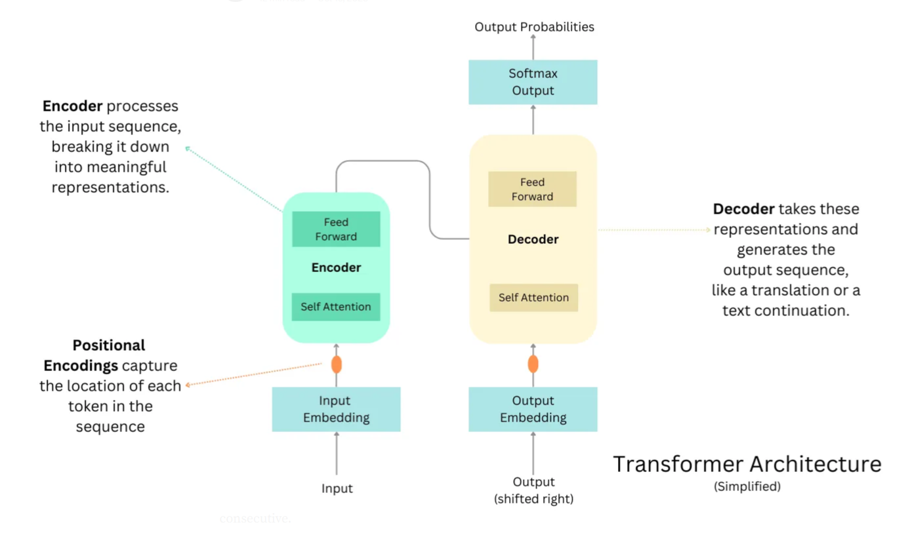
Notes:
Source: https://raw.githubusercontent.com/snatch59/keras-autoencoders/master/assets/autoencoder_latent_space.png

Slide 34
Retrieval Augmented Generation (RAG)
What is Retrieval Augmented Generation?
How does RAG work?
RAG is fundamentally an architectural pattern that integrates a retrieval system with a generation system. In practice, a RAG pipeline consists of two primary components – a retriever and a generator – working together.
The retriever is responsible for finding relevant information from an external knowledge source (e.g., a set of documents or a database) given a user query, and the generator is a language model that produces the final output (answer or text) conditioned on both the user’s input and the retrieved information.
Retrieval-Augmented Generation (RAG) is an AI framework that combines large language models (LLMs) with external information retrieval to produce more accurate and contextually relevant outputs.

Slide 35
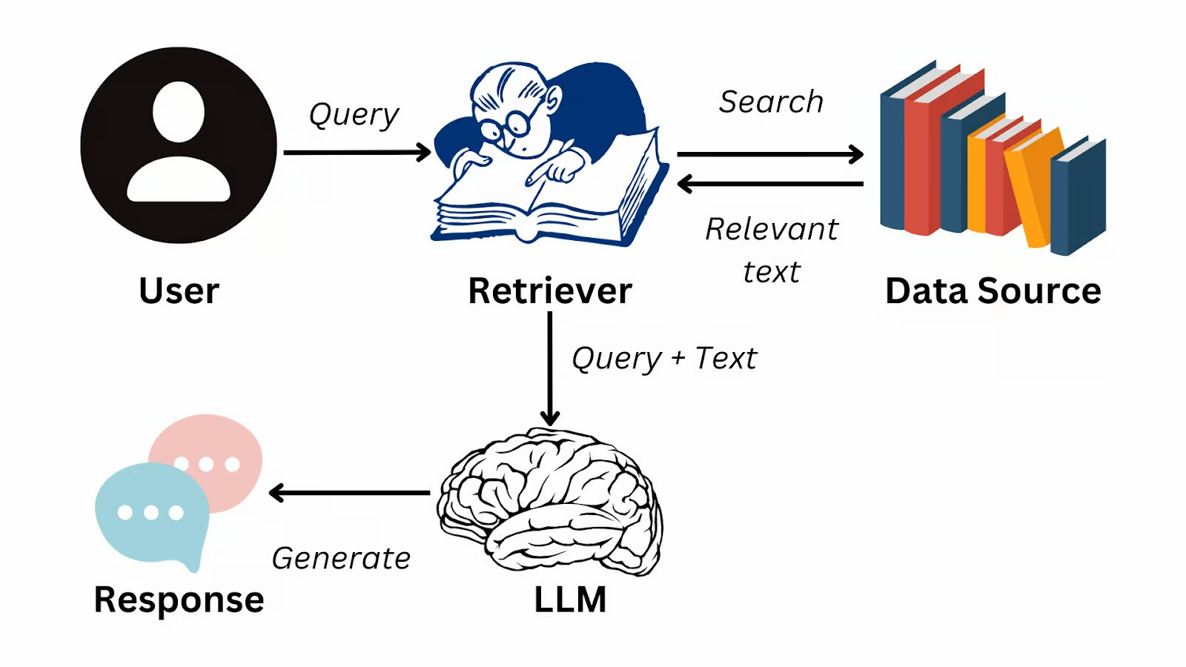
Retrieval Augmented Generation (RAG)
https://www.datacamp.com/blog/what-is-retrieval-augmented-generation-rag

Slide 36
Large Language Models (LLMs)

Slide 37
Large Language Model (LLM)
Understand, generate, and translate human language.
Trained on massive datasets of text
Learns patterns and relationships in language
Uses machine learning
Neural Network
Transformer Model

Slide 38
Building Blocks of an LLM
Vectors, Tokens, and Embeddings
Tokens are the representations of text in the form of a vector.
Embeddings: The Semantic Space
- Embeddings are the foundational aspect of LLMs

Slide 39
LLM Building Blocks Comparisons
Tokens vs. Vectors:
  Tokens are the linguistic units
  Vectors are the mathematical representations of these units.
  Every token is mapped to a vector in the LLM’s processing pipeline.
Vectors vs. Embeddings:
  All embeddings are vectors
  Not all vectors are embeddings.
  Embeddings are vectors specifically trained to capture deep semantic relationships.
Tokens and Embeddings:
  The transition from tokens to embeddings
  Movement from a discrete representation of language to a Nuanced, continuous, and contextually aware semantic space.

Slide 40
GPT, Bert, Bart, Gemini

Slide 41
What is GPT?
GPT
  GPT stands for Generative Pre-trained Transformer, which is a type of large language model developed by OpenAI. It is a neural network-based architecture that can generate human-like text, answer questions, and perform a variety of other language-related tasks. (OpenAI, Gemini, Apple Intelligence)
Generative
  Generative models are a type of machine learning model that can generate new data, such as text, images, or audio, based on the patterns in the training data. GPT is a generative model that can generate coherent and contextually relevant text.
Pre-trained
  GPT models are pre-trained on a large corpus of text data, which allows them to learn the patterns and structures of natural language. This pre-training enables the models to be applied to a variety of language-related tasks, even with limited task-specific training data.
Transformer
  The Transformer is a neural network architecture that uses attention mechanisms to capture the relationships between different parts of the input sequence. This allows the model to better understand the context and generate more coherent and relevant output.

Slide 42
What is Bert?
BERT (Bidirectional Encoder Representations from Transformers)
Purpose: Primarily a language representation model focused on understanding the meaning and context of words within sentence.
Function: Analyzes text bidirectionally (both forward and backward) to understand relationships between words and their context.
Use cases: Used in various applications, including improving search engine algorithms, language translation, text classification, and other NLP tasks where understanding the meaning of text is crucial.
Architecture: An encoder-only Transformer model, meaning it processes input and generates a rich vector representation of the text, but doesn't generate new text directly.
Training: Pre-trained on massive amounts of unlabeled text data, enabling it to learn general language patterns and context.

Slide 43
What is Bard?
Generative artificial intelligence chatbot
Engaging in natural language conversations with users.
Architecture: specifically fine-tuned for conversational tasks.
Applications:
  Chatbots
  Customer service bots
  educational chatbots
  Open-domain conversations
Training: Trained on labeled conversational data, allowing it to learn how to respond to different user prompts and maintain context in a conversation.
Now Gemini

Slide 44
What is Bart?
BART: Bidirectional Encoder-Decoder model
Combining the strengths of both BERT and GPT (Generative Pre-trained Transformer). It uses a bidirectional encoder for understanding text and an autoregressive decoder for generating new text.
Training: BART is pre-trained using a denoising autoencoder approach, where text is corrupted with random noise and the model is trained to reconstruct the original text. This training objective allows BART to learn both context and generation.
Strengths: BART is particularly effective for text generation tasks, such as summarization, translation, and dialogue generation.

Slide 45
Gemini
Previously based on the LaMDA and PaLM LLMs.
Multimodal: Can process and generate text, images, audio, and code.
Transformer Architecture:
  It uses a more advanced neural network architecture to understand language and context better.
Advanced Capabilities:
  Capable of more complex tasks like image generation, code writing, and more nuanced language understanding.
Updated Name:
  Bard was rebranded to Gemini to reflect the more advanced capabilities of the underlying AI model.

Slide 46
Introduction to Prompt Engineering

Slide 47
What is Prompt Engineering?
The process of crafting, refining, and optimizing instructions to guide generative AI models.
It involves selecting the most appropriate:
  Formats
  Phrases
  Words
  Symbols
Helps AI systems understand user intent and respond meaningfully.

Slide 48
Prompt Engineering Purpose
Addresses a fundamental challenge:
  Search Engines find information by Keyword
  AI provides information by Concept
  AI can provide output in specific Format
  AI requires detailed, well-structured instructions
  Prompt engineering uses specified frameworks to query AI models with relevant conceptual context.
  Crucial for the quality and relevance of the AI's response.

Slide 49
Prompt Engineering Key Applications
Design and testing of prompts for AI applications
Used across various industries:
  Healthcare
  Cybersecurity
  Business
  Education.
Example - A physician prompts a medical LLM to generate differential diagnoses by providing:
  Symptoms
  Patient details
  Medical test results

Slide 50
Prompt Engineering Common Techniques
Chain-of-thought (CoT): Breaks down complex reasoning into intermediate steps to help models produce more accurate results
Prompt Chaining: Splits complex tasks into smaller subtasks, using the AI's outputs to accomplish overarching goals
Complexity-based Prompting: Performs multiple reasoning rollouts and selects the most commonly reached conclusion from the longest chains of thought

Slide 51
Open-source Tools for Prompt Engineering
Enables prompt creation
Management
Testing
Evaluation
Workflow automation for large language models.

Slide 52
Top Open-Source Prompt Engineering Tools
PromptLayer: Provides versioning, tracking, and analytics for prompt management at enterprise scale.​
OpenPrompt: Advanced template system with evaluation tools and dynamic context management, suited for complex prompt workflows.​
Agenta: Simplifies prompt testing and version control, enables rapid development and multi-model comparison.​
PromptAppGPT: Low-code platform for easy team collaboration and prototyping LLM-enabled applications.​
PromptTools: CLI-based open-source tool for flexible, hands-on prompt management and testing.​
Prompt Engine: Targets bias reduction and precision, provides analytics and real-time feedback for prompt improvement.​

Slide 53
Top Open-Source Agentic AI &
Prompt Engineering Tools
LangSmith: Specialized for chain tracing, debugging, and prompt experimentation within LangChain workflows.​
LangChain: Modular framework for building advanced LLM workflows, supporting reusable prompts, memory, and agent-based multi-step tasks.​
Langfuse: Platform for monitoring, evaluating, and debugging prompts, integrates with popular frameworks like LangChain and OpenAI SDKs.​
Haystack: Orchestration framework for customizable, production-ready LLM applications; includes prompt pipelines and context-enrichment for RAG tasks.​
Latitude: Focuses on scalable, production-ready LLM solutions with collaborative development features.​
Flowise: Visual low-code tool for chaining models and prototyping prompt workflows.​

Slide 54
Prompt Engineering Frameworks

Slide 55
Prompt Engineering Frameworks
SPEAR (Start, Provide, Explain, Ask, Rinse & Repeat): A beginner-friendly, five-step method focused on clarity and repeatability.​
CRISPE (Capacity/role, Insight, Statement, Personality, Experiment): Balanced for both analysis and creativity, commonly used in enterprise settings for thorough prompt evaluation and iteration.​
ICE (Instruction, Context, Examples): A template-based approach, ideal for detailed, explicit prompt creation, especially for complex or technical tasks.​
CRAFT (Capability, Role, Action, Format, Tone): Gives granular control over model behavior, especially in specialized AI applications.​

Slide 56
Prompt Engineering Framework
BAB (Before, After, Bridge): Adapted from copywriting, useful for narrative prompts, customer service, and marketing tasks needing emotional resonance.​
CIDI (Context, Instructions, Details, Input): Breaks down tasks for precision and actionable AI results, aiding project/content management.​
SIX THINKING HATS: Encourages prompts from six perspectives—facts, emotions, risks, benefits, creativity, process—for decision making and creativity.​
CLEAR (used in academics): Structures prompts for logical, coherent outputs in teaching and research.​
Tree of Thought: Maps reasoning step-by-step, supporting complex problem-solving and brainstorming.​

Slide 57
Framework Comparison
Framework | Core Components | Best For | Key Advantage | Evaluation Capability
SPEAR | Start, Provide, Explain, Ask, Rinse & Repeat | Beginners, quick setups | Simple, repeatable process | Basic feedback built-in
ICE | Instruction, Context, Examples | Detailed, complex tasks | Clear structure for detailed prompts | Manual evaluation
CRISPE | Capacity/role, Insight, Statement, Personality, Experiment | Enterprise use, team projects | Fine-tuned style and deep customization | Built-in evaluation tools
CRAFT | Context, Role, Action, Format, Target Audience | Specialized AI interactions | Precise control and role definition | Supports metric-driven testing

Slide 58
Framework Strengths and Use Cases
SPEAR: Favored for fast implementation and clear results, especially in training and onboarding scenarios.​
ICE: Useful where a nuanced prompt is needed; popular for technical support and customer engagement flows.​
CRISPE: Tailored for organizational use, allowing in-depth personality and experimentation; often selected for iterative, scalable model builds.​
CRAFT: Chosen when granular output control, such as specific formatting or response tone, is critical for specialized domains like finance or healthcare.​

Slide 59
SPEAR Framework Use Case
Content Strategy Development: Applied to blog ideation, SEO strategies, and editorial planning owing to its clarity and simplicity.​
Market Research: Used for concise survey generation and competitive analysis, prioritizing actionable insights.​
Customer Support Prompts: Delivers fast, accurate responses to support tickets, FAQs, and basic troubleshooting.​
Basic Analytical Requests: Ideal for summary generation and single-step data interpretation tasks.​

Slide 60
SPEAR Framework Components
Start: Define the problem or task you want the AI to help with.
Provide: Include specific examples or format guidance to shape the AI’s response.
Explain: Describe the situation as if explaining it to a person, giving necessary context.
Ask: State the precise question or main request for the AI to focus on.
Rinse & Repeat: Review and adjust the prompt as needed to achieve the desired outcome.

Slide 61
SPEAR Components Example
Start: You're a corporate trainer specializing in AI skills for tech teams.
Provide:
  Create a 4-module training plan on prompt engineering using SPEAR framework;
  Format training plan as a table with week, objectives, activities, and assessments;
  Target early-career AI/ML researchers (desk-based, prefer web tools like Perplexity);
  budget-free;
  2 hours/week
Explain: New hires need practical skills for climate/space AI projects, building on basic LLM knowledge; align with hands-on, iterative learning.
Ask: Generate the plan and suggest 2 quiz questions per module.

Slide 62
SPEAR Prompt
You're a corporate trainer specializing in Microsoft 365 for HR personnel. Create a 4-module training plan on Microsoft 365; Create a training plan in a table format with columns for week, objectives, activities, and assessments; Target early-career HR personnel; 2 hours/week. New hires need practical skills for using Microsoft 365 to complete projects; align training plan with hands-on, iterative learning. Generate the plan and in a table format and suggest 2 quiz questions per module.

Slide 63
SPEAR Results
SPEAR Prompt Results using Comet and ChatGPT 5.2 LLM

Slide 64
CRISPE Framework Use Case
Strategic Planning & Execution: Powers business strategy sessions, campaign management, and organizational goal setting by supporting iterative feedback and adaptation.​
Educational Content Creation: Tailors content for diverse audiences, from syllabi to assessment item generation.​
Product Feature Prioritization: Guides decision-making for tech product development and roadmap planning.​
Healthcare & Policy Analysis: Ensures precision and compliance in regulated sectors, suitable for complex report writing and recommendations.​
Enterprise Team Collaboration: Facilitates coordination and continuous improvement in cross-functional teams.​

Slide 65
CRISPE Framework Components
Clarity: Ensure the prompt is unambiguous and the AI clearly understands the task or question, minimizing confusion.​
Relevance: Align the prompt closely with the task's objectives and the intended context, ensuring responses are suitable and on-topic.​
Iteration: Encourage refinement by allowing prompts to be adjusted based on feedback, supporting continual improvement and more effective outputs.​
Specificity: Add detailed information, constraints, or requirements to guide the AI toward highly tailored, precise responses.​
Parameters: Define explicit boundaries or conditions (such as tone, format, or content limits), shaping the scope and style of the response.​
Examples: Provide sample inputs/outputs or reference formats to illustrate expectations and help the AI understand the desired outcome.​

Slide 66
CRISPE Components Example
Context:
You are building an internal training syllabus to onboard entry-level personnel to Microsoft Office 365 (Microsoft 365) for everyday office work (email, files, collaboration, meetings, and basic document/spreadsheet/presentation tasks).
The learners have mixed computer experience, limited formal IT background, and will use Windows 11 laptops plus the Microsoft 365 web apps. Training must be practical, task-based, and aligned to common workplace workflows (not “feature tours”).​
Role:
Act as a corporate instructional designer and Microsoft 365 trainer with experience designing onboarding programs for entry-level staff. Write in clear, plain language and assume learners may be anxious about technology.​

Slide 67
CRISPE Components Example
Instructions:
Create a complete syllabus for a short course titled: “Microsoft 365 Essentials for Entry-Level Staff.”
The syllabus must include:
  learning outcomes,
  weekly/module breakdown,
  delivery plan,
  hands-on labs,
  assessment plan, and
  required resources.
Focus on the most job-relevant apps: Outlook, Teams, OneDrive, SharePoint (basic), Word, Excel (basic), and PowerPoint.​
Steps:
Propose 5–7 measurable course learning outcomes (use action verbs).​
Produce a module-by-module syllabus (6 modules total). For each module include: topic title, time estimate, objectives, key concepts, guided demo, hands-on lab tasks, and “common mistakes to avoid.”​
Add a short capstone scenario that forces learners to use multiple apps together (e.g., Teams + OneDrive + Outlook + Word/Excel/PowerPoint).​
Provide an assessment plan with: (a) knowledge checks per module, (b) a practical skills checklist, and (c) a rubric for the capstone.​
Provide instructor notes: pacing guidance, differentiation for mixed skill levels, and accessibility considerations.​

Slide 68
CRISPE Components Example
Parameters (constraints + formatting)
Audience: entry-level office staff (0–12 months experience).​
Duration: 2 weeks total, 5 sessions, 2 hours each (10 hours).​
Modality: blended (live instructor-led + self-paced practice).​
Environment: Microsoft 365 web apps + desktop apps where relevant; assume no admin permissions.​
Output format:
  Section A: Course overview (bullets)
  Section B: Learning outcomes (numbered)
  Section C: Syllabus table (modules as rows)
  Section D: Capstone scenario + rubric (table)
  Section E: Materials/resources + instructor notes​

Slide 69
CRISPE Components Example
Examples (to match the desired specificity)
Use this level of specificity for labs and outcomes:
Outcome example: “Send a Teams meeting invite from Outlook, attach an agenda stored in OneDrive, and apply correct sharing permissions.”​
Lab task example: “Create a Word memo using a template, export to PDF, store it in OneDrive, then share a view-only link with your manager.”​
Common mistake example: “Sharing a file with ‘Anyone with the link’ when the document contains internal-only content.”​

Slide 70
CRISPE Components Example (Option)
Optional follow-up prompt (the “iteration” pass):
Revise the syllabus for a healthcare front-desk setting (HIPAA-sensitive), adding a 15-minute segment on safe sharing, MFA basics, and spotting phishing in Outlook, while keeping total time at 10 hours.

Slide 71
CRISPE Prompt
CRISPE Prompt Document

Slide 72
CRISPE Results
CRISPE Results using Comet and ChatGPT 5.2 LLM

Slide 73
ICE Framework Use Case
Technical Documentation: Breaks down instructions and examples for software guides, user manuals, or API docs.​
Instructional Design: Crafts explicit, reproducible guides for e-learning modules and training flows.​
Complex Querying: Used in scenarios like multi-part code generation or layered data analysis requiring detailed context and explicit examples.​
Customer Communication Flows: Structures onboarding, feedback, and support prompts for high-volume enterprise communications.​

Slide 74
ICE Framework Components
Instruction: Clearly defines the specific task, query, or action for the AI, ensuring that the model understands what is required and minimizing ambiguity. For example: “Summarize the following article,” or “Generate five product ideas.”​
Context: Supplies background information, constraints, or any relevant details that help the AI interpret the request and tailor its response appropriately. This might include the topic, intended audience, related documents, or organizational guidelines.​
Examples: Offers sample inputs, desired outputs, or reference formats to illustrate expectations and further clarify the response style and content. For instance, showing the AI a prior summary, a preferred format, or output samples increases consistency and output accuracy.​

Slide 75
ICE Components Example
Instruction
Create a reproducible e-learning “module guide” for learning HTML that another instructor could reuse for any HTML topic by swapping only the topic variables.​
Output must be: (1) a reusable template, then (2) a filled example module for the topic provided.​
Context
Audience: beginners with no coding background using a web browser + VS Code (or any text editor).
Course style: practical, task-based, minimal jargon, lots of short practice checks.
Module delivery: self-paced e-learning (read + do), designed for 30–45 minutes total.
Tone: supportive, clear, and confidence-building.
Quality constraints:
Use headings exactly: Overview, Prereqs, Learning objectives, Key concepts, Walkthrough, Practice, Check for understanding, Common mistakes, Extension, Answer key.
Every “Practice” item must include an input snippet and an expected output/behavior description.
Use simple HTML only (no CSS/JS unless explicitly requested).​

Slide 76
ICE Components Example
Example A (mini example of format + depth)​
Topic: “HTML links”
Learning objectives:
  Create an anchor tag using href.
  Explain absolute vs relative URLs.
Practice (one item):
  Input:
  xml
  <a href="https://example.com">Visit Example</a>
  Expected behavior: The text “Visit Example” appears as a clickable link that opens example.com.

Slide 77
ICE Components Example
Example B (mini example of “Common mistakes” style)​
Mistake: Forgetting to include https:// in an absolute URL.
Symptom: Link navigates to a broken/relative path.
Fix: Add the full protocol + domain.
Now generate using this variable topic:
Topic: “HTML lists (ordered and unordered)”
Learner project: “Create a simple ‘Grocery List’ page containing one unordered list and one ordered list.”
  What the model should produce (structure preview)
  Reusable template (with placeholders like {TOPIC}, {PROJECT}, {PRACTICE_ITEM_1}), so future modules remain consistent.​
  Filled module for “HTML lists,” including at least:
3 learning objectives
  1 walkthrough with a complete HTML file
  4 practice items with expected behavior
  5-question knowledge check + answer key​
If you want, the template can be adapted to SCORM-friendly text chunks (screen-by-screen) or a specific authoring tool (Rise 360, Storyline, Moodle), but the ICE structure stays the same.

Slide 78
ICE Prompt
ICE Prompt using Example A

Slide 79
ICE Result
ICE Prompt using Comet and ChatGPT 5.2 LLM

Slide 80
CRAFT Framework Use Case
Persona/Role-based Prompts: Creates specific professional or creative voices for sales, marketing, or brand communication.​
Data Analysis & Template Outputs: Directs AI to deliver tabular, visual, or formatted outputs in analytics dashboards or reports.​
Creative Writing & Social Media: Supports varied tones, narrative flows, and targeted audience engagement—especially for branded content, campaigns, or fiction.​
Interview & Recruitment Flows: Generates question sets or character-based scenarios in HR, consulting, or journalism.​
Healthcare/Finance Compliance: Constrains AI outputs for regulatory document drafting and review.​

Slide 81
CRAFT Framework Components
Context: Define the purpose, goals, and necessary background information for the prompt. This ensures the AI understands the task’s scope and any relevant constraints.​
Role: Assign a specific role or persona to the AI—such as “technical writer,” “educator,” or “financial analyst”—to guide the model's responses in line with desired expertise or tone.​
Action: Provide explicit instructions for the task or request, such as summarizing points, generating examples, or organizing information. This directs the AI to perform a specific action.​
Format: Specify the desired structure for the output (e.g., bulleted list, essay, table, step-by-step guide), ensuring the response is organized and easy to follow.​
Target Audience: Identify who the output is for, including their knowledge level, preferences, or expectations. This tailors the content to be accessible, relevant, and engaging for the intended audience.

Slide 82
CRAFT Components Example
Context
You are designing a practical training plan to teach web design from zero to job-ready basics for entry-level learners. The plan must emphasize real workflows, accessibility, and responsive design.
Constraints: limited jargon, lots of hands-on practice, and outcomes that map to workplace tasks.
Role
Act as a senior web design instructor and instructional designer who has built beginner-to-intermediate curricula for adult learners and career switchers.
Use plain language, define terms once, and include coaching notes for common learner pitfalls.

Slide 83
CRAFT Components Example
Action
Create a complete training plan that includes:
  6–8 measurable learning outcomes.
  A module-by-module sequence (8 modules total) with time estimates, prerequisites, lecture/demo topics, and hands-on labs.
  A capstone project brief (requirements, deliverables, milestones) that integrates skills across modules.
  An assessment plan: knowledge checks per module, a skills checklist, and a capstone rubric.
  Instructor notes: pacing, differentiation for mixed skill levels, accessibility guidance, and suggestions for remediation.

Slide 84
CRAFT Components Example
Format
Output exactly in this structure:
  Course overview (bullets)
  Learning outcomes (numbered)
  Modules table with columns: Module, Time, Objectives, Key concepts, Demo, Lab, Common mistakes
  Capstone project brief (bullets)
  Capstone rubric (table)
  Assessments + instructor notes (bullets)

Slide 85
CRAFT Components Example
Target audience
Audience: entry-level learners with no prior design or coding experience, using a modern browser and a simple editor (VS Code or equivalent).
Goal: competence in designing and building a responsive, accessible multi-section website using HTML/CSS fundamentals and basic design principles (layout, typography, color, spacing).

Slide 86
CRAFT Prompt
CRAFT Prompt

Slide 87
CRAFT Result
CRAFT Prompt Results

Slide 88
12 Prompt Engineering Secrets
Secret #1: Be Specific (Really Specific)
Secret #2: Give Context, Not Just Commands
Secret #3: Ask the AI to “Show Its Work”
Secret #4: Use Role-Playing
Secret #5: Iterate (The AI Doesn’t Always Get It Right on the First Try)
Secret #6: Chain Your Prompts
Secret #7: Use “Few-Shot” Examples
Secret #8: Give the output format
Secret #9: Negative prompt
Secret #10: Ask for reference
Secret #11: Chunking
Secret #12: Ask Questions

Slide 89
Session I Review
Define Artificial Intelligence (AI) and Generative AI (GenAI).
Explain the latest trends in GenAI/AI.
Identify and describe key concepts in GenAI/AI.
Understand the Building Blocks of LLMs
Introduction to Prompt Engineering Frameworks
AI Quiz
LLM Quiz

Slide 90
Student Quizzes
(on Blackboard)
Quiz 1 - Artificial Intelligence / Machine Learning / Deep Learning / Neural Network Quiz
Quiz 2 - Generative AI & Large Language Model Technologies Quiz

