Slide 1
ITI 555 Introduction to
Generative AI
Session I
http://www.profburnett.com
Embrace AI / Master Your Future

Slide 2
Course Outline – Session I
Define Artificial Intelligence (AI) and Generative AI (GenAI).
Explain the latest trends in GenAI/AI.
Identify and describe key concepts in GenAI/AI.
Understand the Building Blocks of LLMs
Understand the 7 Parameters of LLMs
Parameter Tuning
AI Quiz
LLM Quiz
Review GenAI Applications by Type and Industry Use

Slide 3
Course Outline – Session II
Introduction to Prompt Engineering Frameworks
Discover personal organization tools using Copilot’s task management
Discover Copilot Chat, Personal, and Enterprise Editions
Learn how to organize yourself with MS Copilot AI
Prompt Engineering Exercise using MS Copilot

Slide 4
Course Outline – Session III
Introduction to the Major LLMs
  ChatGPT 5.1
  Gemini 2.5 Pro
  Claude Sonnet 4.5
  Grok 4
  Kimi K2 Thinking (Moonshot)
LLM Prompt Engineering Exercises

Slide 5
Course Outline – Session IV
Industry Risks and Concerns
  Lack of Explainability / Transparency
  Data Bias and Discrimination
  Misinformation & Disinformation
  Misuse in Bioweapons, Cyberattacks, or Deepfake Extortion
  Copyright and Intellectual Property Infringement
AI Future
  China’s Digital Transformation
  Date is the New Currency
  Smart Econometrics
  Social Credit Systems
  The Future of Healthcare
  Agentic AI
Job Market
Godfather Warning
Red Pill / Blue Pill Event
Course Review
Course Evaluation
AI Technology Concerns
  Geopolitical AI Arms Race
  Hallucinations
  Data Privacy
  Job Displacement
  Human De-skilling
  Political Disinformation & Propaganda
  Income Inequality

Slide 6
Define Artificial Intelligence (AI) and Generative AI (GenAI)

Slide 7
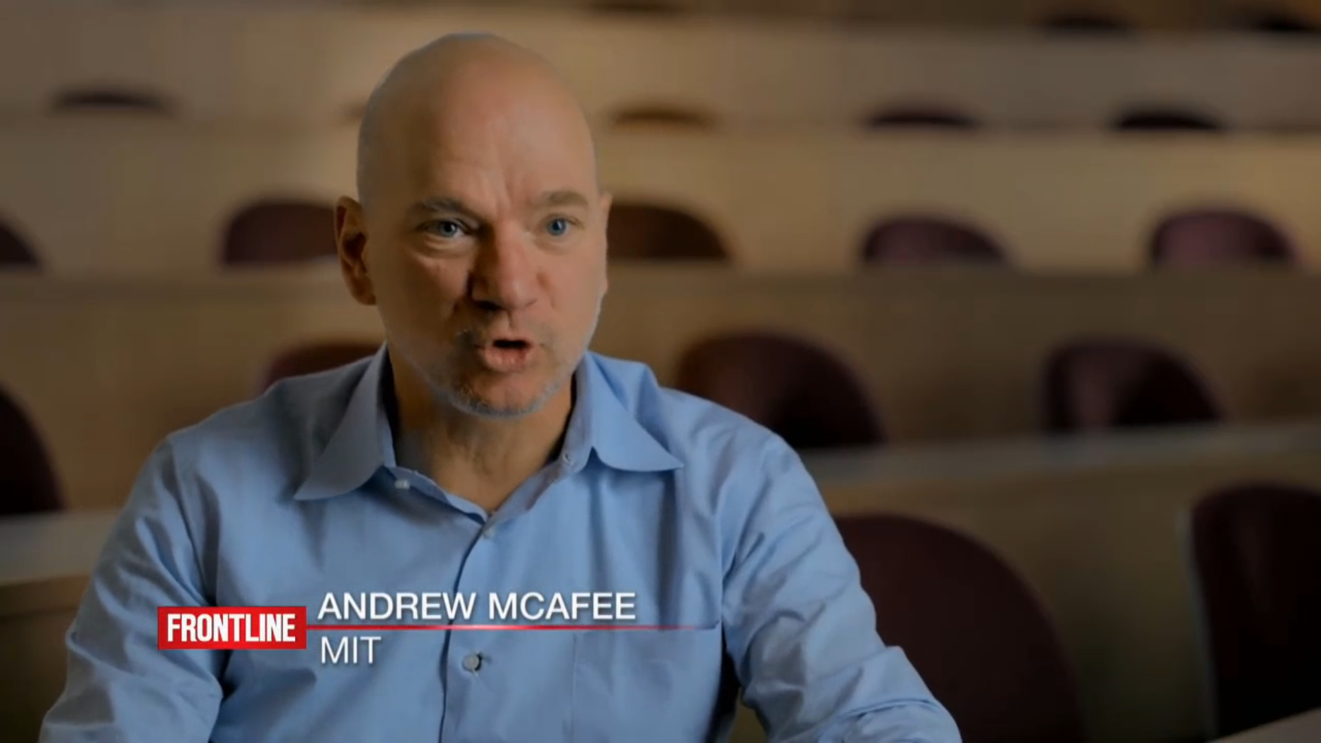
Social Development
Notes:
Social Development

Slide 8
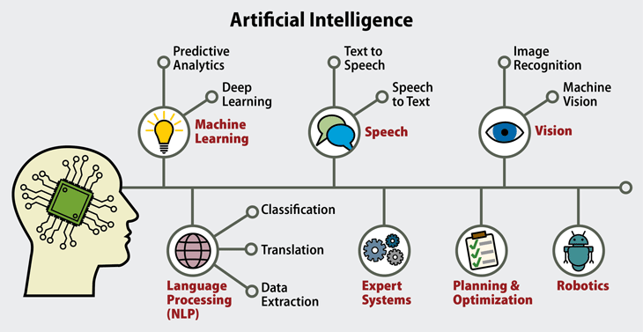
Artificial Intelligence (AI)

Slide 9
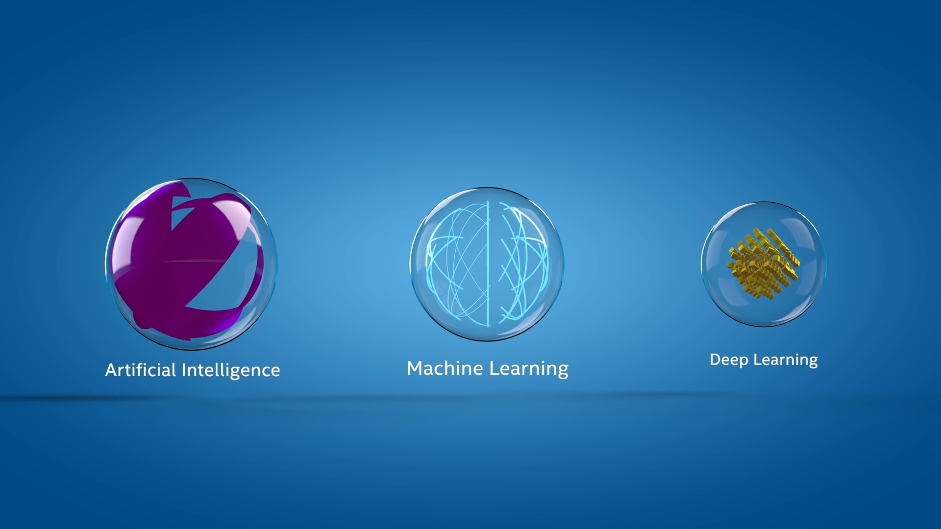
AI Explained and Released
Notes:
AI Explained

Slide 10



Why Now?
Architecture
Data
Technology
Creation of different Architectural Frameworks has enabled enhanced methods to process and analyze a vast amount of data and incorporate a “retention” memory factor.
There is now a vast amount of data available and generated that can be used to create GenAI models. In addition, verification and validation of the scaling law in models verifies the adage that “the more you have, the more accurate the model will be”.
Creation of advanced hardware to support intensive computational run-times. CPU vs GPU vs TPU vs NPUs.
These different models with varying parameter sizes and specializations demonstrate the diversity of large language models being developed for a range of applications in the field of generative AI.

Slide 11
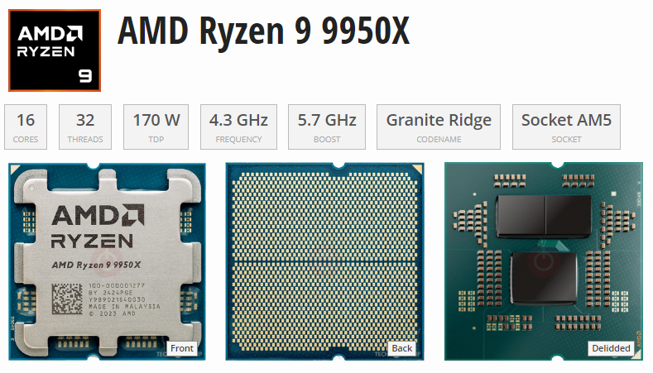
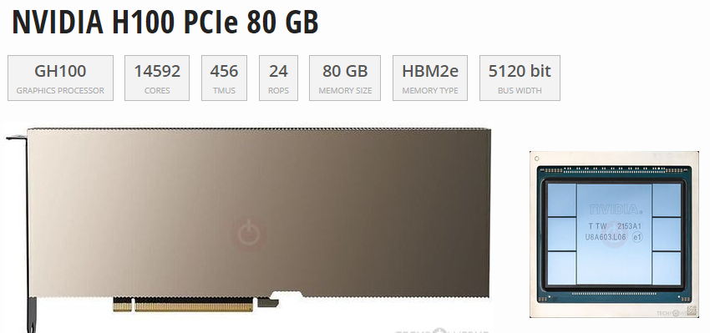
~$600
~$25,000

Slide 12
Processing Unit Comparisons
Comparative Analysis: Power FLOPS, & Bandwidth
Type | Flops (Peak) | Bandwidth | Power (W) | Flexibility | Best For
GPU | 19.5 – 312 TFLOPS (A100) | 1.6 TB/s (HBM3) | 400 W | High | AI / HPC Gaming
FPGA | 10-20 TFOPS | 100 GB/s 1 TB/s | 10 -50W | Very High | Edge / Telecom
ASIC | 4-1000s TOPS (Varies) | 20 PB/s (WSE-2) | 2W – 23kW | None | Specific AI Crypto
TPU | 275 TOPS (v4) | 1.2 TB/s (HBM3) | 100w-500kW | Moderate | ML Training / Inference
NPU | 15,8 TOPS (M2) | 50-100 GB/s | 1-5W | Low | Edge Inference
Name | Unit | Value
kiloFLOPS | kFLOPS | 10³
megaFLOPS | MFLOPS | 10⁶
gigaFLOPS | GFLOPS | 10⁹
teraFLOPS | TFLOPS | 10¹²
petaFLOPS | PFLOPS | 10¹⁵
exaFLOPS | EFLOPS | 10¹⁸
zettaFLOPS | ZFLOPS | 10²¹
yottaFLOPS | YFLOPS | 10²⁴
ronnaFLOPS | RFLOPS | 10²⁷
quettaFLOPS | QFLOPS | 10³⁰
https://theneildave.medium.com/gpu-vs-fpga-vs-asic-vs-tpu-vs-npu-benefits-use-cases-and-manufacturers-4419115069df
Notes:
Graphics Processing Units (GPUs)
Field-Programmable Gate Arrays (FPGAs)
Application-Specific Integrated Circuits (ASICs)
Tensor Processing Units (TPUs)
Neural Processing Units (NPUs)

Slide 13
Hierarchy of Intelligence
Artificial Intelligence (AI)
Machine Learning (ML)
Deep Learning (DL)
Neural Networks
Generative AI (GenAI):
  Uses ML models
  Deep learning architectures
  Transformers and GANs

Slide 14
Hierarchy of Intelligence
Artificial Intelligence (AI)
AI is a field of computer science focused on creating system that can perform tasks requiring human-like intelligence, such as reasoning, learning, perception, and decision-making.
EX: IBM Watson, Google Bard, OpenAI Codex
Machine Learning (ML)
ML is a subset of AI that enables system to learn patterns from data and make predictions or decision without being explicitly programmed
EX: XGBoost, Random Forest
Deep Learning (DL)
DL is a specialized subset of ML that utilizes artificial neural networks with multiple layers to model complex patterns in data
EX: BERT (Bidirectional Encoder Representations from Transformers)
Neural Networks
A Neural Network is a computational model inspired by the human brain, consisting of interconnected layers of nodes (neurons) that process information through weighted connection and activation functions
EX: CNN – image/video recognition, Transformers – NLP AI apps
Generative AI (GenAI)
GenAI is a branch of AI that uses ML models, particularly deep learning architectures like transformers and GAN to generate content
EX: GPT, Stable Diffusion, MusicLM (Google DeepMind)

Slide 15
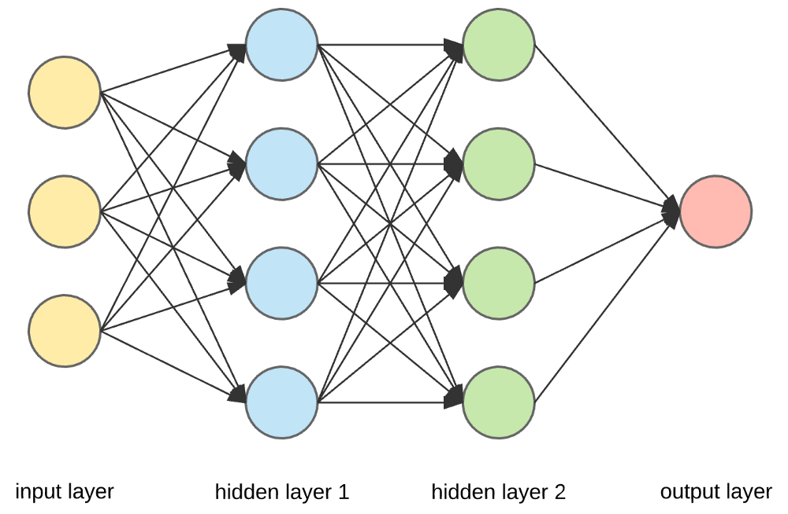
Neural Networks
Structure of Neural Networks
Consists of interconnected nodes called neurons, which process and transmit information.
Organized into layers, with each layer performing specific computations. Through
Neural networks recognize patterns and make accurate predictions based on vast amounts of data.

Slide 16
Types of Neural Networks
Convolutional Neural Networks (CNNs) (image and video recognition).
Recurrent Neural Networks (RNNs) process sequential data (speech recognition and language translation).
Generative Adversarial Networks (GANs) - Generate new content - Generative AI.

Slide 17
Latest Trends in GenAI/AI.

Slide 18
What is Generative AI?
Generative AI (GenAI) – A type of artificial intelligence
Can create:
New Text content
New Images
New Audio
New Video
Super-powered copycat that can learn the patterns of existing creative work and use that to generate new things.

Slide 19
Types of Uses
Content Creation
  Generating text, images, music, and other media using generative AI models like GPT-3, DALL-E, and Midjourney.
Automated Workflows
  Automating repetitive tasks and processes using language models to generate code, emails, and other documents.
Personalized Recommendations
  Providing personalized recommendations for products, content, and services based on user preferences and behaviors.
Chatbots and Virtual Assistants
  Creating conversational interfaces that can engage in natural language interactions, answer questions, and assist users.
Predictive Analytics
  Generating insights and forecasts by analyzing data and patterns to identify trends and make predictions

Slide 20
Use By Industry
Healthcare
  GenAI can assist in processing medical records, analyzing patient data, and aiding in diagnosis and treatment planning.
Finance
  GenAI can be used for financial analysis, fraud detection, personalized investment recommendations, and automated portfolio management.
Retail and E-commerce
  GenAI can optimize product recommendations, personalize customer experiences, automate customer service, and streamline inventory management.
Education
  GenAI can provide personalized learning experiences, assist in grading and feedback, and create interactive educational content.
Media and Entertainment
  GenAI can generate personalized content recommendations, automate video editing, and create synthetic media like deepfakes and CGI.

Slide 21
Key Concepts in GenAI/AI.

Slide 22



What is a "Framework"
Frameworks in GenAI
Hugging Face Transformers
Proprietary AI Platforms
Frameworks provide a structured approach to building and deploying generative AI models, including tools for data preprocessing, model training, security, and deployment.
The Hugging Face Transformers library is a popular framework for working with pre-trained language models, offering a wide range of models and utilities for fine-tuning and deploying these models.
Offer powerful, ready-to-use genAI models that enable test generation, image creation, etc. For example:
OpenAI API
Anthropic Clause API
Google Gemini
Generative AI frameworks provide a structured and scalable approach to building and deploying complex AI models, offering tools and utilities to streamline the development process.

Slide 23
Generative AI Frameworks
Tools
Platform
Facilitates the Development of AI Models

Slide 24
AI Frameworks
Generative AI Frameworks
TensorFlow (Google)
PyTorch (Meta/Facebook)
Keras
JAX (Google)
Hugging Face Transformers
FastAI
OpenVINO (Intel)
NNX (Open Neural Network Exchange)
MXNet (Apache)
MindSpore (Huawei)
LangChain
Other Notable Frameworks & Agents
LlamaIndex
Amazon Bedrock – Offers Models
OpenAI – Company - ChatGPT
DSPy - Stanford
Diffusers - Hugging Face
AWS Audit Manager
NIST AI Risk Management Framework
PandasAI – AI Agent
Auto-Gen - Microsoft – AI Agent
LangGraph - LangChain – AI Agent

Slide 25
AI Frameworks Comparison
Framework | Speed (Training/Inference) | Ease of Use | Best Use Cases
TensorFlow | (High, especially with XLA & TPUs) | Medium | Production deployment, mobile (TF Lite), large-scale ML
PyTorch | (Fast, especially for research prototyping) | Easy | Research, NLP, computer vision, deep learning R&D
Keras | (Depends on TensorFlow backend) | Very Easy | Beginners, fast prototyping, small-to-mid DL models
JAX | (Very fast, excellent for TPU/GPU) | Moderate | Mathematical ML research, custom models, optimization
Hugging Face Transformers | (Depends on backend, good for inference) | Easy | NLP tasks, pretrained model usage (GPT, BERT, etc.)
FastAI | (Built on PyTorch, optimized) | Very Easy | Education, transfer learning, image classification
OpenVINO | (Highly optimized for Intel HW) | Medium | Edge AI, inference on Intel CPUs/VPUs
ONNX | (Highly optimized for cross-platform inference) | Moderate | Model deployment across platforms and frameworks
MXNet | (Optimized for scalability) | Medium | Scalable deep learning, distributed training
MindSpore | (Optimized for Huawei ecosystem) | Medium | Cloud-edge-device synergy, embedded AI

Slide 26
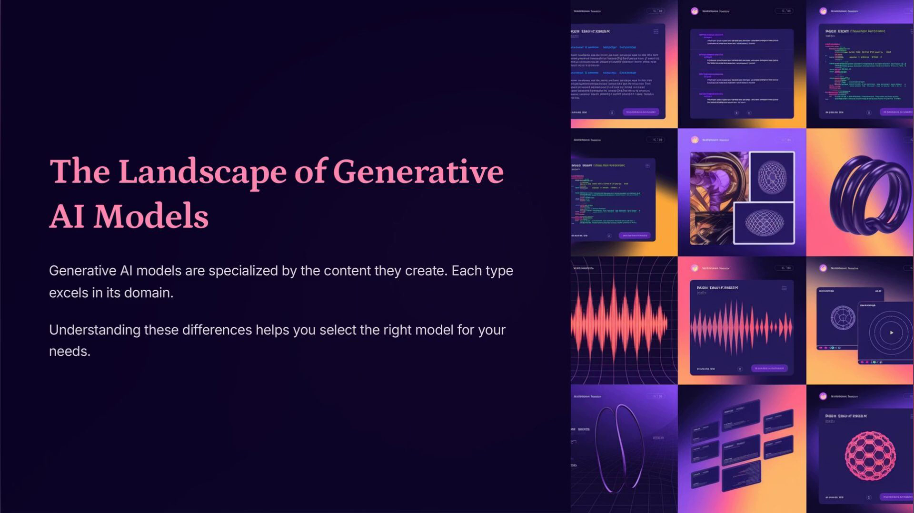
GenAI Models
Notes:
Generative AI Explained: Models and Techniques

Slide 27
Types of Generative AI Neural Network Models
Generative Adversarial Networks (GANs)
Variational Autoencoders (VAEs)
Transformer-based Language Models
Diffusion Models
Autoregressive Models
Flow-based Models

Slide 28
Generative Adversarial Networks (GANs)
How they work:
  Two neural networks
  Generator <> Discriminator - Compete
  The generator creates data, and the discriminator tries to tell if it's real or fake.
Use cases: Image generation, art synthesis, video upscaling, deepfakes.
Examples: StyleGAN, BigGAN.

Slide 29

Generative Adversarial Networks (GANs)
Notes:
Generative Adversarial Networks (GANs)

Slide 30
Variational Autoencoders (VAEs)
How they work: Learn to compress data into a latent space and then decode it back to generate new similar data.
Use cases: Image and text generation, anomaly detection.
Examples:
  Vanilla VAE
  Conditional VAE.

Slide 31
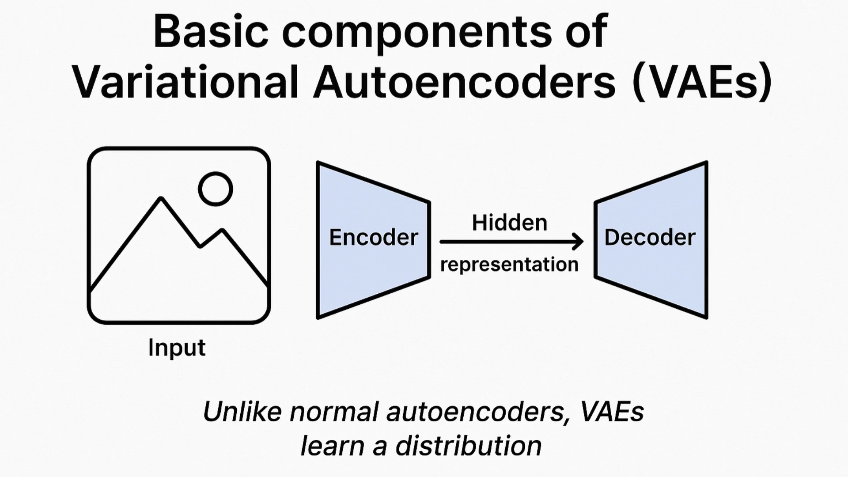
Variational Autoencoders (VAEs)
Notes:
Variational Autoencoders (VAEs)

Slide 32
Transformer-based Language Models
How they work: Use attention mechanisms to generate coherent sequences of text or code.
Use cases: Text completion, summarization, translation, coding assistants.
Examples:
  GPT (Generative Pre-trained Transformer): GPT-4, GPT-3.5 (OpenAI)
  PaLM - Pathways Language Model (Google)
  LLaMA - Large Language Model Meta AI (Meta)
  Claude (Anthropic)

Slide 33
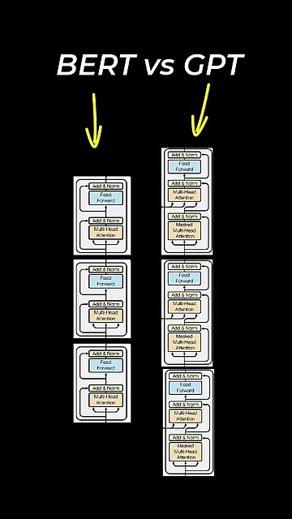
Notes:
Transformer-based Language Models

Slide 34
Diffusion Models
How they work: Start with noise and gradually improve it to resemble training data through a learned denoising process.
Use cases: High-quality image and video generation.
Examples:
  DALL·E 3
  Stable Diffusion
  Imagen

Slide 35

Diffusion Models
Notes:
Diffusion Models

Slide 36
Autoregressive Models
How they work: Generate data one step at a time, using previous steps as context.
Use cases: Text, music, and code generation.
Examples:
  GPT
  PixelCNN (for images)
  WaveNet (for audio)

Slide 37

Autoregressive Models
Notes:
Autoregressive Models

Slide 38
Flow-based Models
How they work: Use invertible transformations to map data to a latent space and back.
  Invertible Transformations - Reversibility
  Map data to a latent space – New representation
  And back – No Data Loss
Use cases: Real-time data synthesis with exact likelihood estimation.
Examples:
  RealNVP
  Glow
Notes:
Invertible transformations: These are mathematical functions or operations that can be reversed. If you apply an invertible transformation to data, you can also apply its inverse to recover the original data.
Map data to a latent space: A latent space is a new representation of the data, often lower-dimensional and more abstract, where similar data points are closer together. The mapping process involves transforming the original data into this space, which might capture hidden or essential features.
And back: The invertibility means you can go from the latent space back to the original data without loss. In other words, there’s a one-to-one correspondence between the original data and its representation in latent space.
Why is this important?
Invertible mappings are crucial for models that need to generate new data (like images or text) or perform efficient probabilistic inference.
Examples: Normalizing flows (like RealNVP or Glow models) use a series of invertible transformations to model complex data distributions, enabling both sampling and density estimation.
Summary:
This concept is about creating a reversible process that encodes data into a compressed, structured format (latent space) and can decode it back to its original form without information loss. This is key for understanding, generating, or manipulating complex data in modern machine learning systems.

Slide 39
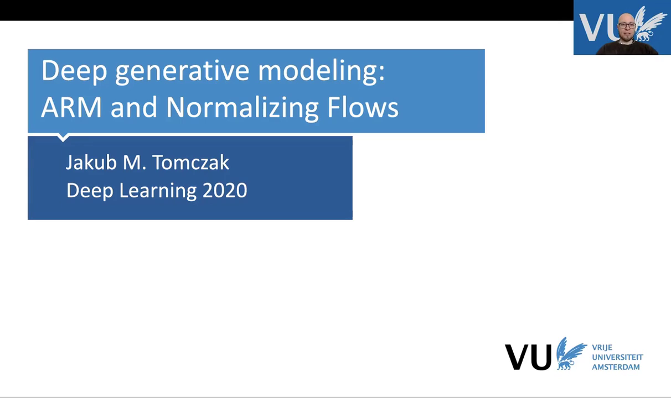
Arms & Flow Models
Notes:
Flow-based Models

Slide 40
Transformers, Encoders & Decoders, RAG

Slide 41

Transformer Explained
A Transformer is like a super-powered party listener for computers. it can focus on what each person is saying and how it related to what others are saying, even in a big crowd.
Listen to Everyone (Attention)
  Pays attention to all the information. It treats each information like a friend at a party
Who's Important Now
  Not all friends are equally important in every conversation. The Transformer can focus on the most relevant information for the task at hand.
Talk Back
  Once the Transformer understand the information, it can use it to do something cool, like write a poem or answer you question.
Encoder
  Part of your brain that figures out what everyone is saying.
Decoder
  Part of your brain that uses what you heard to say something new.

Slide 42


Transformer Architecture
Transformer Architecture
Attention Mechanism
The transformer architecture is a deep learning model that uses attention mechanisms to capture long-range dependencies in sequential data, such as language and speech. It is the foundation for many state-of-the-art Large Language Models (LLMs).
The attention mechanism allows the transformer to focus on the most relevant parts of the input when generating the output, enabling it to understand and generate contextual and coherent text.
The transformer architecture is a fundamental component of modern Large Language Models, enabling them to understand and generate human-like text with impressive capabilities.

Slide 43


Transformer Architecture
Parallelization
Scalability
The transformer architecture is highly parallelizable, allowing for efficient computation on modern hardware, such as GPUs and TPUs, which is crucial for training and deploying large-scale language models.
The transformer architecture can be scaled up to handle larger and more complex language tasks, enabling the development of powerful LLMs that can perform a wide range of natural language processing tasks.
Its attention mechanism, parallelization, and scalability make it a crucial technology for the advancement of Generative AI.

Slide 44
Encoders and Decoders
Encoder
Decoder
Bidirectionality
An encoder is responsible for converting the input data (e.g., text, image, or audio) into a numerical representation, often in the form of a fixed-length vector. This numerical representation is then used by the language model to understand and process the input.
A decoder is responsible for generating the output data, such as text, from the internal representation of the language model. The decoder takes the numerical representation generated by the encoder and produces the desired output.
Some language models, like BERT, use a bidirectional encoder, which allows the model to understand the context of the input from both the left and right sides. This can lead to more accurate and contextual understanding of the input.

Slide 45
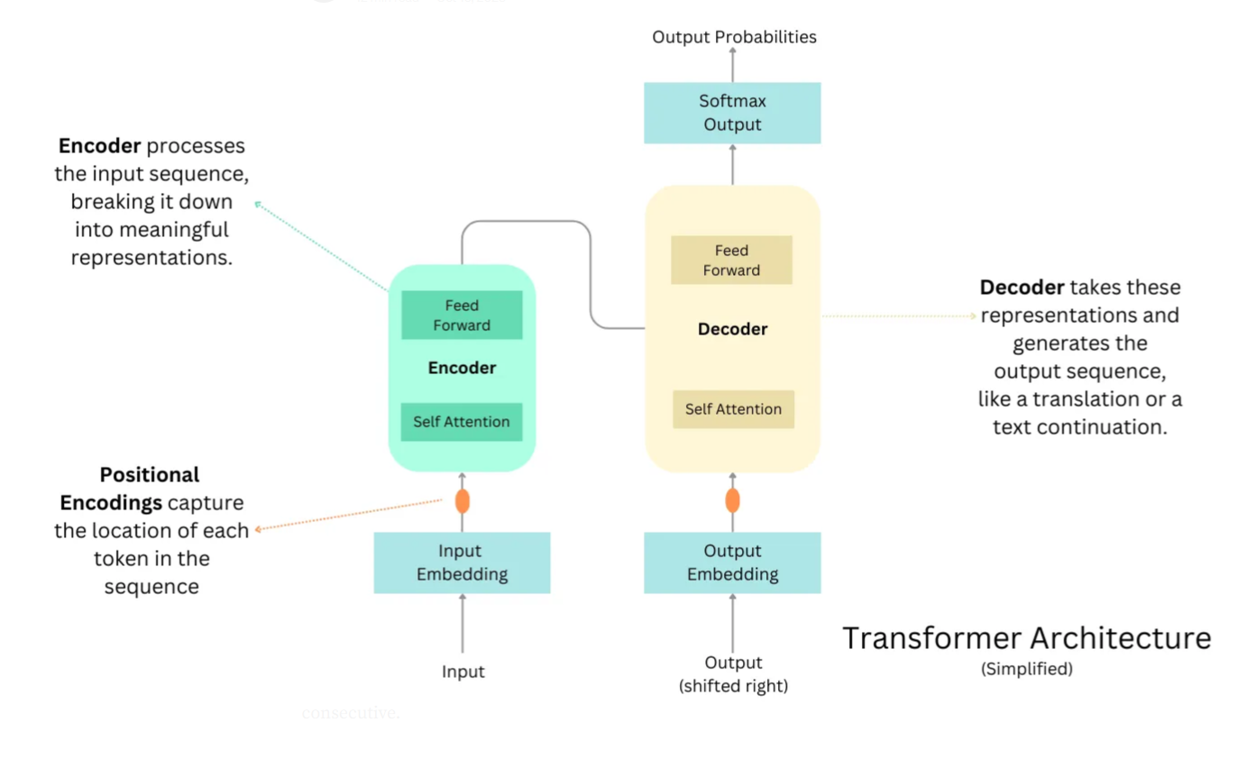
Source: LINK
Notes:
Source: https://raw.githubusercontent.com/snatch59/keras-autoencoders/master/assets/autoencoder_latent_space.png

Slide 46


Retrieval Augmented Generation (RAG)
What is Retrieval Augmented Generation?
How does RAG work?
RAG is fundamentally an architectural pattern that integrates a retrieval system with a generation system. In practice, a RAG pipeline consists of two primary components – a retriever and a generator – working together.
The retriever is responsible for finding relevant information from an external knowledge source (e.g., a set of documents or a database) given a user query, and the generator is a language model that produces the final output (answer or text) conditioned on both the user’s input and the retrieved information.
Retrieval-Augmented Generation (RAG) is an AI framework that combines large language models (LLMs) with external information retrieval to produce more accurate and contextually relevant outputs.

Slide 47
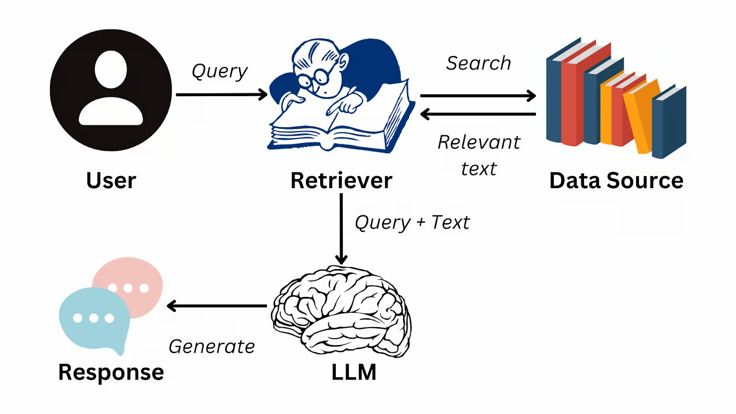
Retrieval Augmented Generation (RAG)
https://www.datacamp.com/blog/what-is-retrieval-augmented-generation-rag

Slide 48
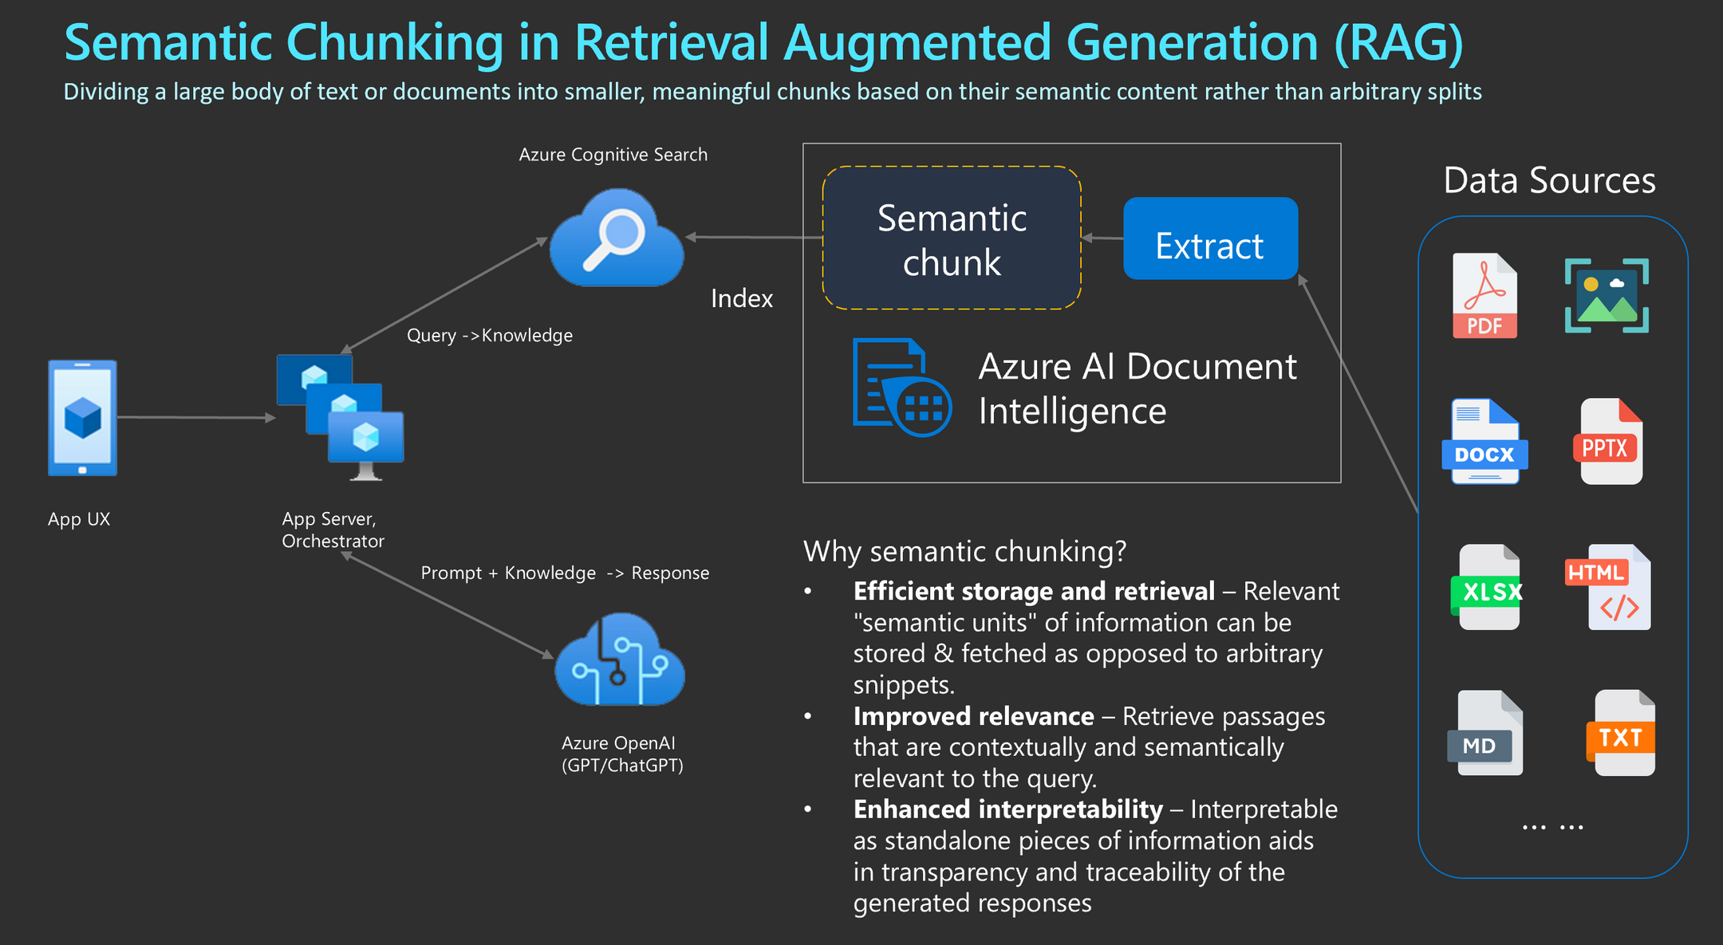

Slide 51
c

Slide 52
Large Language Models (LLMs)

Slide 53

Model Selection - What is the Objective?
OpenAI GPT
Google BERT
Hugging Face Transformers
A large language model developed by OpenAI that can generate human-like text and perform a variety of natural language processing tasks.
A transformer-based language model developed by Google that can be fine-tuned for various natural language processing tasks, such as question answering and text classification.
Testing the waters approach. Models are developed by various people and/or groups. Maintenace is not guaranteed.
Each framework has its own strengths and capabilities, and the choice of which to use depends on the specific requirements of the task at hand.

Slide 54


Large Language Model (LLM)
What is a Large Language Model?
Trained on Massive Data
A large language model is a type of artificial intelligence that has been trained on a vast amount of text data, allowing it to understand and generate human-like language.
Large language models are trained on huge datasets, often consisting of billions of words from sources like books, websites, and other textual data.
Able to Understand and Generate Language
Continuously Evolving
Large language models are constantly being updated and improved, with new and more powerful versions being released regularly.
These models can understand and generate human-like text, making them useful for tasks like language translation, text summarization, and question answering.
Large language models are a powerful tool for natural language processing, with the ability to understand and generate human-like text. As they continue to evolve, they are likely to play an increasingly important role in various applications and industries.

Slide 55
Large Language Model (LLM)
Understand, generate, and translate human language.
Trained on massive datasets of text
Learns patterns and relationships in language
Uses machine learning
Neural Network
Transformer Model

Slide 56
LLM Architecture
Training Data:
  Enormous datasets
  Billions of words
  Learns language nuances - grammar, syntax, relationships
Transformer Architecture:
  Use transformer models
  Excel at processing sequential data like text.
  Self-attention - considers the context of each word
Capabilities:
  Text generation: Creating new text, like articles, stories, or code.
  Question answering: Providing answers to questions based on the input text.
  Summarization: Condensing large amounts of text into shorter, more concise versions.
  Translation: Translating text between different languages.
  Code generation: Generating code in various programming languages.
LLMs
  “Foundation models"
  Trained on vast amounts of data
  Can be adapted to a wide range of tasks

Slide 57
Building Blocks of an LLM
Vectors, Tokens, and Embeddings
Tokens are the representations of text in the form of a vector.
Embeddings: The Semantic Space - Embeddings are the foundational aspect of LLMs

Slide 58
LLM Building Blocks Comparisons
Tokens vs. Vectors:
  Tokens are the linguistic units
  Vectors are the mathematical representations of these units.
  Every token is mapped to a vector in the LLM’s processing pipeline.
Vectors vs. Embeddings:
  All embeddings are vectors
  Not all vectors are embeddings.
  Embeddings are vectors specifically trained to capture deep semantic relationships.
Tokens and Embeddings:
  The transition from tokens to embeddings
  Movement from a discrete representation of language to a Nuanced, continuous, and contextually aware semantic space.

Slide 59
Technologies used in GenAI/AI

Slide 60
Building Blocks of an LLM
Vectors, Tokens, and Embeddings
Tokens are the representations of text in the form of a vector.
Embeddings: The Semantic Space - Embeddings are the foundational aspect of LLMs
https://thenewstack.io/the-building-blocks-of-llms-vectors-tokens-and-embeddings/

Slide 61
Vectors
A single-dimensional array.
Used to represent text or data in a numerical form that the model can understand and process.

Slide 62
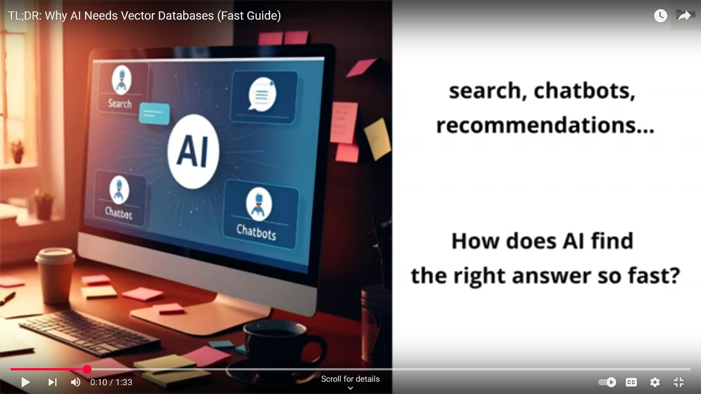

Slide 63
Tokens
Basic units of text processed
Can be individual words, subwords, or even characters
Tokens are used as input and output in generative AI tasks.

Slide 64
Embeddings: The Semantic Space
Tokens are vector representations of text.
Embeddings are tokens with semantic context.
Represent the meaning and context of the text.
Tokens are encoded or decoded by a tokenizer.
Embedding models are responsible for generating text embeddings in the form of a vector.
Embeddings enable LLMs to comprehend the context, nuance, and subtle meanings of words and phrases.
Results of the model learning from vast amounts of text data and its relationships with other tokens.

Slide 65
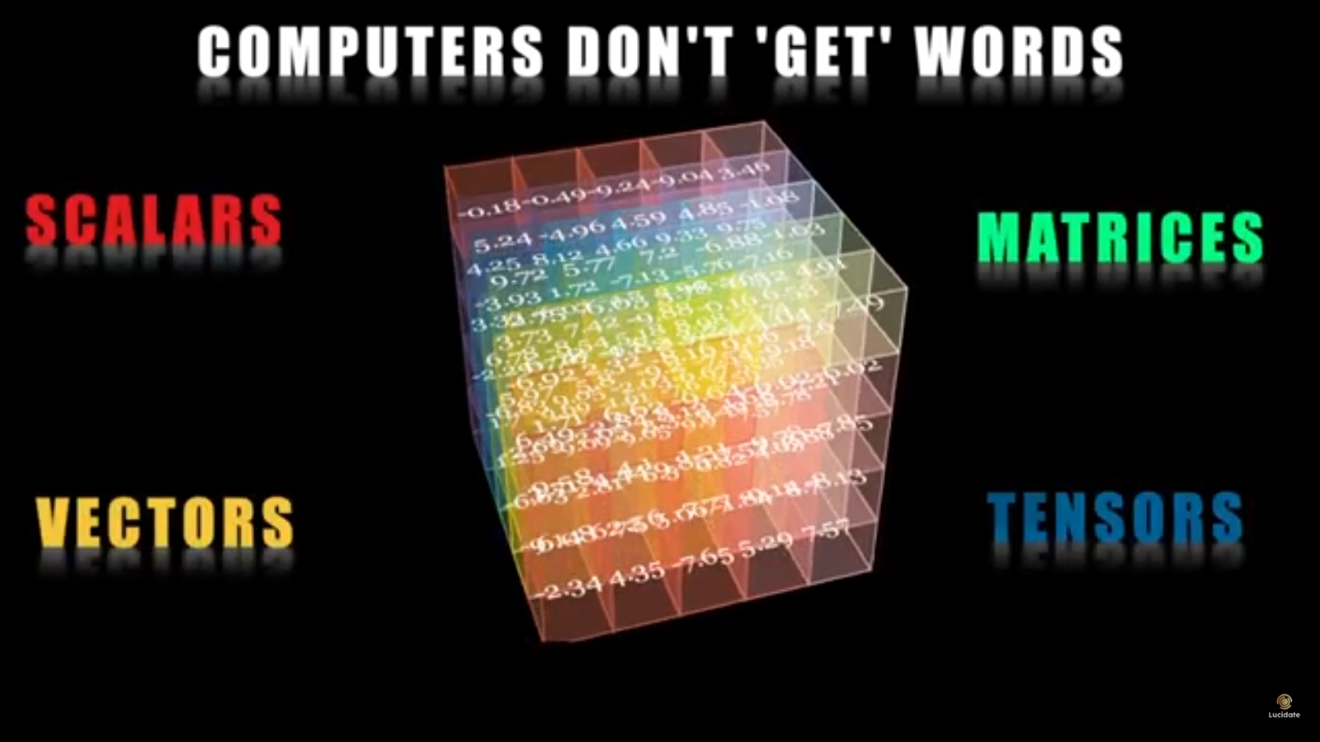

Slide 66
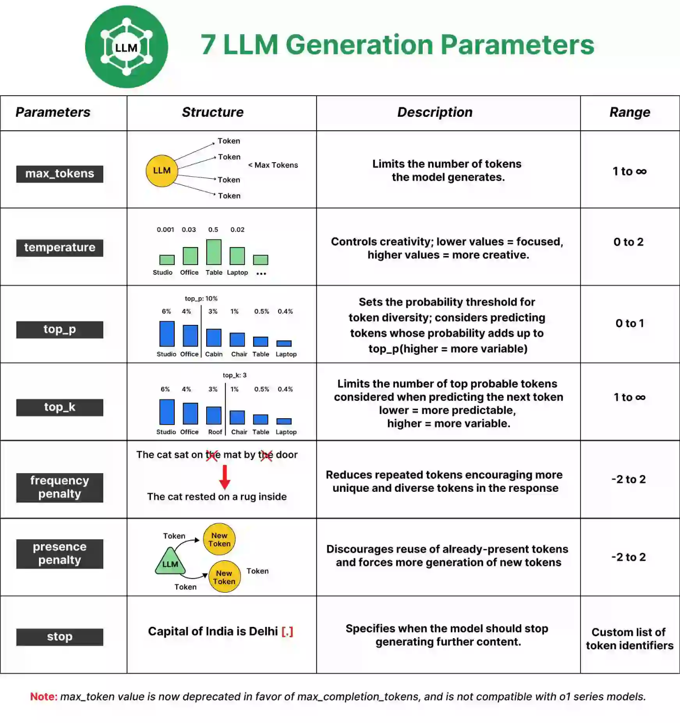

Reference - https://www.analyticsvidhya.com/blog/2024/10/llm-parameters/
Notes:
The max_tokens parameter controls the length of the output generated by the model. A “token” can be as short as one character or as long as one word, depending on the complexity of the text.
Low Value (e.g., 10): Produces shorter responses.
High Value (e.g., 1000): Generates longer, more detailed responses.
Why is it Important?
By setting an appropriate max_tokens value, you can control whether the response is a quick snippet or an in-depth explanation. This is especially important for applications where brevity is key, like text summarization, or where detailed answers are needed, like in knowledge-intensive dialogues.
Note: Max_token value is now deprecated in favor of max_completion_tokens and is not compatible with o1 series models.

Slide 67
Max Tokens Example
max_tokens = 10
Output: “The capital of India is New Delhi. Here are”
The response is very brief and incomplete, cut off due to the token limit. It provides basic information but doesn’t elaborate. The sentence begins but doesn’t finish, cutting off just before listing places to visit.

Slide 68
Max Tokens Example
max_tokens = 20
Output: “The capital of India is New Delhi. Here are seven places to visit in New Delhi:\n1.”
With a slightly higher token limit, the response begins to list places but only manages to start the first item before being cut off again. It’s still too short to provide useful detail or even finish a single place description.

Slide 69
Reference - https://www.analyticsvidhya.com/blog/2024/10/llm-parameters/
Notes:
The max_tokens parameter controls the length of the output generated by the model. A “token” can be as short as one character or as long as one word, depending on the complexity of the text.
Low Value (e.g., 10): Produces shorter responses.
High Value (e.g., 1000): Generates longer, more detailed responses.
Why is it Important?
By setting an appropriate max_tokens value, you can control whether the response is a quick snippet or an in-depth explanation. This is especially important for applications where brevity is key, like text summarization, or where detailed answers are needed, like in knowledge-intensive dialogues.
Note: Max_token value is now deprecated in favor of max_completion_tokens and is not compatible with o1 series models.

Slide 70
Temperature - Definition
Temperature is a parameter used in generative AI models, such as language models, to control the level of randomness or exploration during the generation process.

Slide 71
Temperature - What it Does
Determines how likely the model is to generate more common or predictable outputs
(low temperature)
Versus more novel and unexpected outputs (high temperature).

Slide 72
Temperature - Range of Values
Range from 0 to 1
0 representing complete determinism
(the model always chooses the most likely output)
1 representing complete randomness
(the model randomly selects an output)
Importance in Generative AI

Slide 73
Temperature - Impact on Generation
Used to control the diversity and creativity of the generated outputs
Higher temperatures - more diverse but potentially less coherent.
Lower temperatures – more predictable but potentially less novel outputs.

Slide 74
Temperature - Importance in Generative AI
Crucial hyperparameter
Allows developers to fine-tune the balance between consistency and creativity in the generated outputs
Depends on the specific use case and desired outcome

Slide 75
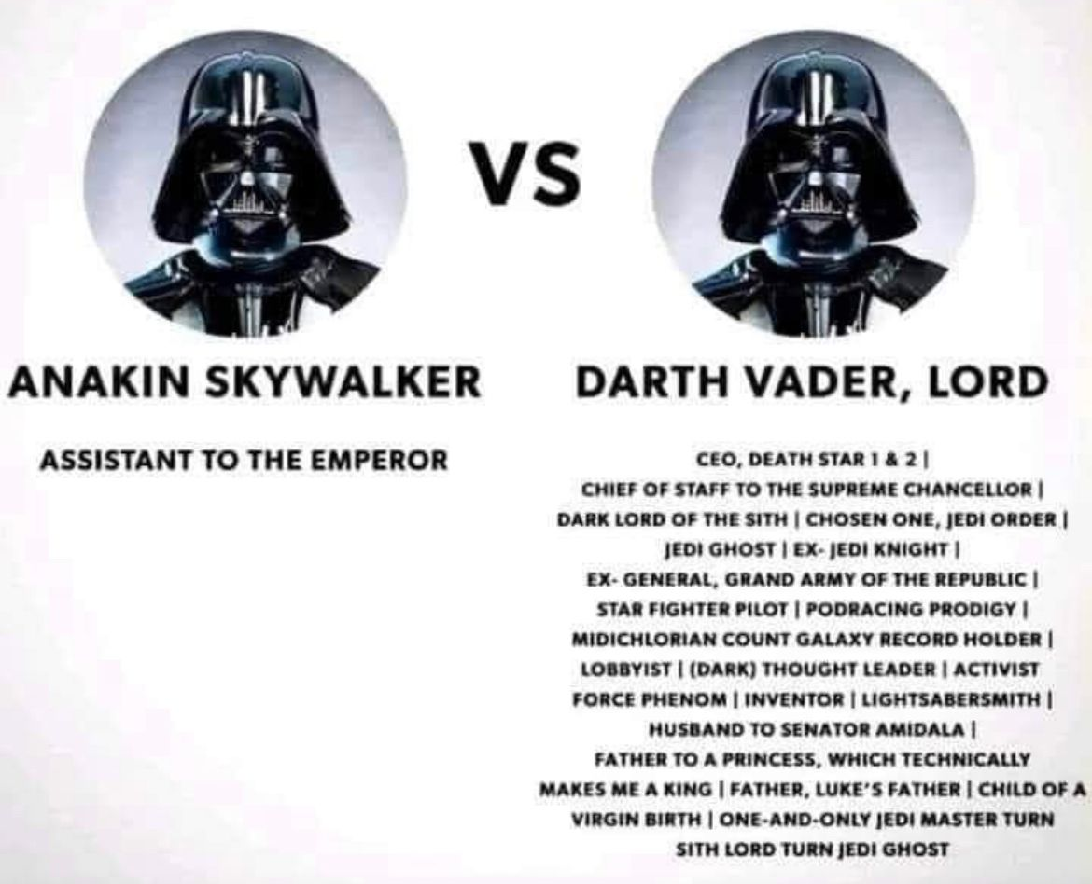
Write a Job Title:
Low Temperature – not very creative, direct, and concise
High Temperature – higher liberty to use creative words and outputs from model

Slide 76
Reference - https://www.analyticsvidhya.com/blog/2024/10/llm-parameters/
Notes:
The max_tokens parameter controls the length of the output generated by the model. A “token” can be as short as one character or as long as one word, depending on the complexity of the text.
Low Value (e.g., 10): Produces shorter responses.
High Value (e.g., 1000): Generates longer, more detailed responses.
Why is it Important?
By setting an appropriate max_tokens value, you can control whether the response is a quick snippet or an in-depth explanation. This is especially important for applications where brevity is key, like text summarization, or where detailed answers are needed, like in knowledge-intensive dialogues.
Note: Max_token value is now deprecated in favor of max_completion_tokens and is not compatible with o1 series models.

Slide 77


Top P/K
Top-P (Top-p Sampling)
Top-K (Top-k Sampling)
Top-P sampling is a technique in generative AI models that selects the most likely tokens from the model's output distribution, up to a specified cumulative probability (p). This helps reduce the likelihood of generating low-probability, nonsensical output.
Top-K sampling is a method that selects the k most likely tokens from the model's output distribution, ignoring the rest. This can help produce more diverse and coherent output compared to greedy decoding.
Understanding these key generative AI terms is crucial for effectively leveraging and interpreting the output of these powerful models.

Slide 78





Today the garden had. . . .
Temperature, Top P, Top K, impact the generated outcome. Here is how to interpret.
Flowers (0.50)
trees (0.23)
Herbs (0.05)
Bugs (0.03)
Low
Temperature
High
- high possible words
- low possible words
- you want explicit direct language
- you want "creative" context

Slide 79
Today the garden had. . . .
Temperature, Top P, Top K, impact the generated outcome. Here is how to interpret.
Flowers (0.50)
trees (0.23)
Herbs (0.05)
Bugs (0.03)
The model returns a random word from a set of top K possible words
Top K
For example: K = 2

Slide 80
Today the garden had. . . .
Temperature, Top P, Top K, impact the generated outcome. Here is how to interpret.
Flowers (0.50)
trees (0.23)
Herbs (0.05)
Bugs (0.03)
The model returns a random word from a set of words with the sum of likelihoods not exceeding P
For example: P = 0.75
Flower (.50) + Trees (.23) + Herbs (.05) = 0.78 > 0.75
Top P

Slide 81
Reference - https://www.analyticsvidhya.com/blog/2024/10/llm-parameters/

Slide 82
Frequency Penalty
The Frequency Penalty parameter discourages the model from repeating previously used words.
It reduces the probability of tokens that have already appeared in the output.
  Low Value (e.g., 0.0): The model won’t penalize for repetition.
  High Value (e.g., 2.0): The model will heavily penalize repeated words, encouraging the generation of new content.
Avoids repetitive outputs - creative writing
Lower penalties in technical writing, where repeated terminology could be beneficial for clarity.

Slide 83
Reference - https://www.analyticsvidhya.com/blog/2024/10/llm-parameters/

Slide 84
Presence Penalty
The Presence Penalty parameter is similar to the frequency.
Penalizing based on how often a word is used.
  Low Value (e.g., 0.0): The model won’t penalize for reusing words.
  High Value (e.g., 2.0): The model will avoid using any word that has already appeared.
Presence penalties help encourage more diverse content generation.
Useful when model introduce new ideas – brainstorming.

Slide 85
Reference - https://www.analyticsvidhya.com/blog/2024/10/llm-parameters/

Slide 86
Stop Sequence
The Stop parameter lets you define a sequence of characters or words that signals stop generating further content.
Allows clean end the generation.
  Example Stop Sequences: Could be periods (.), newlines (\n), or specific phrases like “The end”.
Convenient when a model should stop once it has reached a logical conclusion
Certain number of ideas - Q&A or dialogue-based models.

Slide 87

Fine-tuning, Parameter Tuning, and Token Limits for LLMs
Fine-tuning
Parameter Tuning
Token Limits
Adapting a pre-trained large language model to a specific task or domain by training it on a smaller, task-specific dataset
Adjusting the hyperparameters of a model, such as learning rate, batch size, and number of layers, to optimize its performance on a given task
The maximum number of tokens (words or subwords) a model can process at once, which can impact the length of input texts and the model's ability to capture long-range dependencies
Fine-tuning, parameter tuning, and token limits are important considerations when working with large language models to ensure optimal performance on specific tasks and applications.

Slide 88
LLM User Account Management
Large Language Models (LLMs):
  Count the number of tokens in each input prompt and output response
  Token Counting - Specialized Tokenizers (e.g., byte pair encoding).
LLM Platforms / Associated API services:
  Maintain logs
  Usage Dashboards
  Users account allocated a monthly quota of tokens
Commercial and Open-Source Monitoring Platforms:
  Langfuse
  Traceloop
  Langtrace
  Helicone
  Moesi

Slide 89
LLM User Account Management
User accounts tracked using unique user identifiers:
  Assigning each user a unique user ID, username, email, or;
  API key/token that identifies their requests.
API usage - system reads the API key - maps to corresponding user account.
Middleware or backend services log and aggregate usage data
Systems use session alias tables to handle multiple API keys per user,
Authentication methods include:
  JSON Web Tokens (JWT)
  Request metadata
  User-Agent strings or query parameters
LLM service providers maintain detailed logs and dashboards that capture individual user activity for:
  Billing
  Quota Enforcement
  Analytics
  Behavior Monitoring.

Slide 90
GPT, Bert, Bart, Gemini

Slide 91
What is GPT?
GPT
  GPT stands for Generative Pre-trained Transformer, which is a type of large language model developed by OpenAI. It is a neural network-based architecture that can generate human-like text, answer questions, and perform a variety of other language-related tasks. (OpenAI, Gemini, Apple Intelligence)
Generative
  Generative models are a type of machine learning model that can generate new data, such as text, images, or audio, based on the patterns in the training data. GPT is a generative model that can generate coherent and contextually relevant text.
Pre-trained
  GPT models are pre-trained on a large corpus of text data, which allows them to learn the patterns and structures of natural language. This pre-training enables the models to be applied to a variety of language-related tasks, even with limited task-specific training data.
Transformer
  The Transformer is a neural network architecture that uses attention mechanisms to capture the relationships between different parts of the input sequence. This allows the model to better understand the context and generate more coherent and relevant output.

Slide 92
What is Bert?
BERT (Bidirectional Encoder Representations from Transformers)
Purpose: Primarily a language representation model focused on understanding the meaning and context of words within sentence.
Function: Analyzes text bidirectionally (both forward and backward) to understand relationships between words and their context.
Use cases: Used in various applications, including improving search engine algorithms, language translation, text classification, and other NLP tasks where understanding the meaning of text is crucial.
Architecture: An encoder-only Transformer model, meaning it processes input and generates a rich vector representation of the text, but doesn't generate new text directly.
Training: Pre-trained on massive amounts of unlabeled text data, enabling it to learn general language patterns and context.

Slide 93
What is Bard?
Generative artificial intelligence chatbot
Engaging in natural language conversations with users.
Architecture: specifically fine-tuned for conversational tasks.
Applications:
  Chatbots
  Customer service bots
  educational chatbots
  Open-domain conversations
Training: Trained on labeled conversational data, allowing it to learn how to respond to different user prompts and maintain context in a conversation.
Now Gemini

Slide 94
What is Bart?
BART: Bidirectional Encoder-Decoder model
Combining the strengths of both BERT and GPT (Generative Pre-trained Transformer). It uses a bidirectional encoder for understanding text and an autoregressive decoder for generating new text.
Training: BART is pre-trained using a denoising autoencoder approach, where text is corrupted with random noise and the model is trained to reconstruct the original text. This training objective allows BART to learn both context and generation.
Strengths: BART is particularly effective for text generation tasks, such as summarization, translation, and dialogue generation.

Slide 95
Gemini
Previously based on the LaMDA and PaLM LLMs.
Multimodal: Can process and generate text, images, audio, and code.
Transformer Architecture:
  It uses a more advanced neural network architecture to understand language and context better.
Advanced Capabilities:
  Capable of more complex tasks like image generation, code writing, and more nuanced language understanding.
Updated Name:
  Bard was rebranded to Gemini to reflect the more advanced capabilities of the underlying AI model.

Slide 96
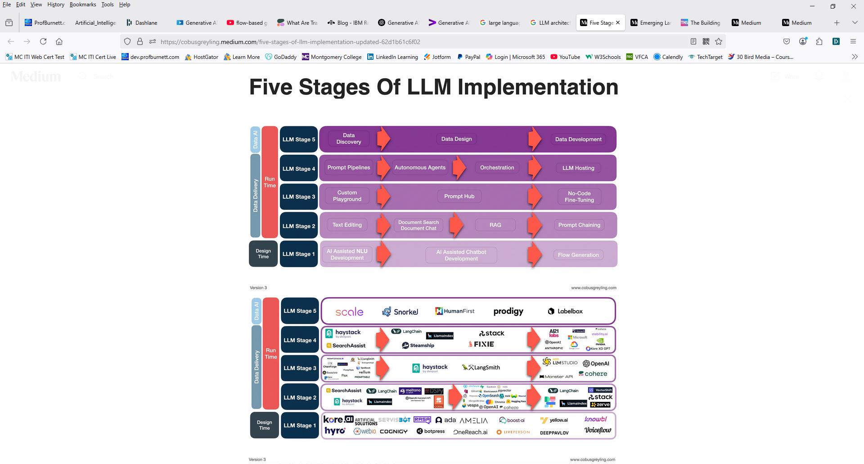
Five Stages of LLM Implementation
https://medium.com/@cobusgreyling/five-stages-of-llm-implementation-updated-62d1b61c6f02

Slide 97
Five Stages of LLM Implementation
https://medium.com/@cobusgreyling/five-stages-of-llm-implementation-updated-62d1b61c6f02

Slide 98
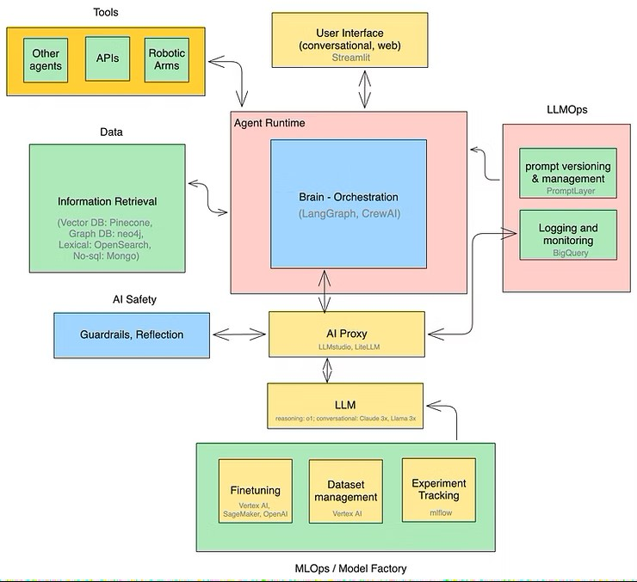
Emerging Architectures of LLM Applications
https://www.tensorops.ai/post/emerging-architectures-of-llm-applications-2025-update

Slide 99
GenAI Applications by Type

Slide 100
GenAI - Text-Based Output
Application Type | Description | Recommended Models
Content Creation | Writing, blog posts, marketing copy, creative content | GPT-5.2 Claude Opus 4.5 Gemini 3 Pro Grok 4.1
Document Analysis | PDF extraction, compliance review, regulatory analysis | Claude 3.5 Sonnet GPT-4 Turbo Gemini Pro Mistral Large
Code Generation | Software development, debugging, multi-language support | Claude Opus 4.5 GPT-5.2 Code Llama StarCoder

Slide 101
GenAI - Text-Based Output
Application Type | Description | Recommended Models
Research & Analysis | Complex reasoning, research synthesis, analytical writing | GPT-5.2 DeepSeek-R1 Gemini 3 Pro Claude Opus
Customer Support | Customer inquiries, FAQ automation, knowledge bases | GPT-5.2 Claude Opus 4.5 Llama 3.3 Qwen 2.5
Business Intelligence | Data insights, spreadsheet analysis, report generation | GPT-5.2 Search Gemini 3 Pro Claude Opus DeepSeek

Slide 102
GenAI - Text-Based Output
Key Insights & Selection Criteria
Proprietary models offer cutting - edge performance
Open-source options enable on-prem control & customization
Context windows vary - critical for document analysis
Cost-performance tradeoff matters for scale

Slide 103
GenAI - Image-Based Output
Application Type | Description | Recommended Models
Text-to-Image | Converting text prompts into high-quality images with precise adherence | GPT-Image 1.5 DALL-E 3 Gemini 3 Pro FLUX 1.1
Photorealism | Photo-quality images with realistic lighting, materials, and perspective | GPT-Image 1.5 Gemini 3 Pro FLUX 1.1 Adobe Firefly
Artistic & Design | Concept art, aesthetic styles, and creative visual interpretations | Midjourney v6 DALL-E 3 Recraft v3 Leonardo AI

Slide 104
GenAI - Image-Based Output
Application Type | Description | Recommended Models
Commercial | Brand assets, product mockups, social media, advertising visuals | GPT-Image 1.5 Adobe Firefly Canva AI DALL-E 3
Design & Illustration | UI mockups, character designs, illustrations, visual prototyping | Midjourney v6 Recraft v3 Leonardo AI Hunyuan
Film & VFX | Scene design, set visualization, character concepts, virtual production | Midjourney v6 FLUX 1.1 GPT-Image 1.5 Leonardo AI

Slide 105
GenAI - Image-Based Output
Application | Description | Example Tools/Models
Image Generation | Creates images from text prompts. | DALL·E 3 Midjourney Stable Diffusion
Image Editing | Modifies or enhances images. | Adobe Firefly Runway ML DALL·E inpainting
Style Transfer | Applies visual styles from one image to another. | DeepArt Prisma
Image Captioning | Generates textual descriptions of images. | BLIP OpenAI CLIP ChatGPT
Object Detection / Recognition | Identifies objects in an image. | YOLOv7 Detectron2

Slide 106
GenAI - Image-Based Output
Key Insights & Selection Criteria
Text rendering accuracy varies - GPT-Image 1.5 excels at typography and logos
Speed vs quality tradeoff - FLUX 1.1 Schnell for fast iterations, Pro for premium results
Artistic merit - Midjourney v6 dominates aesthetic quality and visual interpretation
Commercial rights - Choose licensed models (Adobe Firefly, DALL-E) for commercial use

Slide 107
GenAI - Image-Based Output
Quick Model Comparison
Model | Best For
GPT-Image 1.5 | Text accuracy, commercial design, precise prompt execution
Midjourney v6 | Artistic quality, aesthetic design, creative interpretation
FLUX 1.1 | Speed, realism, commercial production, efficiency
Gemini 3 Pro | Multimodal integration, Google ecosystem, speed
Adobe Firefly | Commercial safety, Creative Cloud integration, brand use

Slide 108
GenAI - Audio-Based Output
Application Type | Description | Recommended Models
Text-to-Speech | Natural speech synthesis with emotion, prosody, and multilingual support | OpenAI TTS ElevenLabs v3 Google WaveNet MS VibeVoice
Voice Cloning | Replicating speaker identity from short audio samples with high fidelity | ElevenLabs Clone Resemble.ai OpenVoice Coqui XTTS
Music Generation | Creating original compositions, full tracks, and instrumentals from text | Suno v4 Udio AIVA Soundraw

Slide 109
GenAI - Audio-Based Output
Application Type | Description | Recommended Models
Voice Conversion | Real-time voice timbre transfer and speech-to-speech conversion | RVC (Real-time) Kyutai TTS Bark (Suno) Chatterbox
Audio Enhancement | Mixing, mastering, noise removal, and quality improvement for audio | iZotope AI Landr Deezer Stem Separation Spectral Subtraction Opus Pro
Vocal Synthesis | Generating AI singing voices and emotional vocal performances | Synthesizer V Studio2 ACE Studio Mureka Voice CeVIO AI

Slide 110
GenAI - Audio-Based Output
Key Insights & Selection Criteria
Latency matters - Real-time TTS for voice agents vs. pre-rendered for content
Multilingual support - ElevenLabs v3 and WaveNet excel at 29+ languages
Voice cloning accuracy - Requires 3-10 seconds of sample audio minimum
Music quality vs speed - Suno for full songs, Udio for creative control

Slide 111
GenAI - Audio-Based Output
Quick Model Comparison
Model | Best For
ElevenLabs v3 | Professional TTS, multilingual, voice cloning, low latency
Suno v4 | Full song generation, custom lyrics, voice cloning, quality
RVC (Real-time) | Real-time voice conversion, singing, open-source, low latency
Udio | Creative music control, 30-second clips, producer workflow
Google WaveNet | Enterprise TTS, 90+ voices, SSML control, accessibility

Slide 112
GenAI - Video-Based Output
Application Type | Description | Recommended Models
Text-to-Video | Converting text prompts into cinematic videos with realistic physics and motion | Sora 2 Google Veo 3 Runway Gen-4.5 Kling 2.0
Image-to-Video | Animating static images with temporal consistency and natural motion dynamics | Pika 2.1 Runway Gen-4.5 Luma Dream Machine Google Veo 3
Photorealism | Generating highly realistic scenes with physics simulation and depth perception | Sora 2 Kling 2.0 Google Veo 3 Runway Gen-4.5

Slide 113
GenAI - Video-Based Output
Application Type | Description | Recommended Models
Avatar & Character | Creating digital avatars for corporate training, presentations, and personalized video | Synthesia Studio Kling 2.0 HeyGen Colossyan
Animation & Style | Generating animated content with artistic styles and creative visual interpretation | Runway Gen-4.5 Pika 2.1 Luma Dream Machine AnimateDiff
Commercial & Marketing | Generating professional ad content, product demos, and social media video campaigns | Runway Gen-4.5 Synthesia Studio Pika 2.1 Magic Hour

Slide 114
GenAI - Video-Based Output
Key Insights & Selection Criteria
Video length & resolution - Sora 2 supports up to 60 seconds; most others 15-30 seconds max
Motion coherence - Runway Gen-4.5 excels at camera movement and cinematic quality
Speed vs quality - Pika 2.1 fastest; Sora 2/Veo 3 for premium results (slower processing)
Business use - Synthesia dominates avatar/training; Runway for creative control

Slide 115
GenAI - Video-Based Output
Quick Model Comparison
Model | Best For
Sora 2 | Long-form videos, photorealism, complex physics, up to 60 seconds
Runway Gen-4.5 | Cinematic quality, creative control, camera movement, professional production
Pika 2.1 | Speed, short-form content, image-to-video, accessibility and ease of use
Synthesia Studio | Corporate avatars, training videos, business communication at scale
Google Veo 3 | Realistic scenes, multimodal input, Google ecosystem integration

Slide 116
GenAI Code Generation AI Models
Application Type | Description | Primary Use | Recommended Models
Function Completion | Auto-complete functions, method signatures, single-file context up to 32K tokens | IDE Autocomplete, Fast Inference | Codestral 25.01 Claude 3.7 GPT-4o CodeLlama 70B
Test Generation | Unit tests, integration tests, edge cases; automate test suite creation from code | Quality Assurance, Coverage | Claude 3.7 GPT-4o Qwen2.5-Coder DeepSeek-R1
Code Refactoring | Multi-file architectural changes, API migrations, pattern updates with planning | Large Codebases, Governance | Claude 3.7 Thinking Open AI o3 DeepSeek-R1 Qwen-32B GPT-4

Slide 117
GenAI Code Generation AI Models
Application Type | Description | Primary Use | Recommended Models
Bug Fixing & Debugging | Root-cause analysis, patch generation, vulnerability detection, security fixes | SWE-Bench Tasks, Repo Issues | Claude 3.7 ChatGPT o1/o3 DeepSeek-V3 Qwen-32B
Smart Contract Generation | Solidity code, EVM bytecode, gas optimization, vulnerability prevention | Web3, DeFi Development | DeepSeek-R1 Qwen Qwen2.5-Coder Codestral
Fill-in-Middle (FIM) | Code context from left and right; predict middle code token stream | Bidirectional Context, Low-Latency | Codestral FIM Mode CodeLlama DeepSeek Coder Qwen2.5-Coder

Slide 118
GenAI Code Generation AI Models Benchmark Performance & Capabilities
Human Evaluation (164 functions):
  Claude 3.7: 92%
  GPT-4: 90.2%
  Codestral: 81%
  CodeLlama-70B: 48.8%
  measures single-function generation accuracy
SWE-Bench Verified (real GitHub issues):
  Claude 3.7: 70.3% vs o1: 49%
  evaluates bug-fix, refactoring, feature implementation on real repositories
MBPP (974 basic Python programs):
  tests code generation for simple algorithmic problems
  less indicative of production use
Repository-level benchmarks:
  EvoCodeBench
  LiveCodeBench measure real-world complexity: multi-file context, dependency management, API correctness

Slide 119
GenAI Code Generation AI Models
Proprietary vs Open-Source Strategic Comparison
Proprietary (Claude, GPT-4, o3):
  Highest accuracy (90-92% HumanEval)
  Best reasoning
  Lowest privacy
  Ideal for complex refactoring
  Architectural planning
  API-dependent
Open-Source Self-Hosted
(DeepSeek, Qwen, CodeLlama):
  7-34B models for on-device coding
  Full data privacy
  Apache 2.0/MIT licensed
  70-80% accuracy
  Optimal for compliance-heavy orgs
Lightweight Commercial (Codestral 25.01):
  22B parameters
  2x faster inference
  81% Human Eval
  Ideal for IDE integration
  Cost efficiency
  Proprietary licensing restricts production use
Multi-Model Strategy:
  Top enterprises deploy Claude for refactoring
  GPT-4 for planning
  DeepSeek-R1 for specialized tasks (smart contracts)
  Codestral for IDE completions to optimize cost & accuracy.

Slide 120
GenAI Code Generation AI Models
IDE Integration & Deployment Platforms
IDE/Platform | Supported Models | Primary Features | Best For
GitHub Copilot | GPT-4o, o3, Claude 3.7, Gemini 2.5 | IDE inline, chat, multi-file refactor, PR review | Enterprise development, rapid iteration
VSCode + Extensions | Codestral, DeepSeek, CodeLlama (local or cloud) | Inline completion, FIM, debug support | Privacy-first, self-hosted, cost control
JetBrains (IntelliJ) | Copilot, Claude API, Codestral, local models | Native IDE integration, refactoring tools, test generation | Professional development teams, Java/Kotlin
Claude Code (CLI) | Claude 3.7 Thinking, 3.7 Sonnet | Terminal agent, file editing, command execution, autonomous | Large refactors, architectural planning, DevOps
Cursor.sh | GPT-4, Claude 3.7, local DeepSeek | AI-first IDE, composer mode, symbol definitions, codebase indexing | Full-stack developers, startup-like iteration speed

Slide 121
GenAI Code Generation AI Models
Language Support & Programming Use Cases
Polyglot Support (80+ languages):
  Codestral
  Claude
  GPT-4 handle Python
  Java
  C++
  JavaScript
  Go
  Rust
  Solidity
  SQL
  specialized models excel in their primary language
Python dominant benchmark:
  Human Eval 164 problems all Python; real-world SWE-Bench tests multi-language repos
  Accuracy varies by language (Python highest, Solidity lowest)
Real-world application gaps:
  Pure code generation (92% Human Eval) vs production debugging (70.3% SWE-Bench)
  Models struggle with legacy codebases, custom frameworks, architectural decisions requiring business context
Specialized domains:
  Web3 (Solidity): DeepSeek-R1 26.3%
  ML frameworks: Claude best; data pipelines
  GPT-4; DevOps/IaC: Codestral efficient

Slide 122
GenAI Code Generation AI Models Strategic Implementation & Adoption
Tier-1: Reasoning tasks (refactoring, architecture):
  Claude 3.7 Thinking or o3
  Cost & latency acceptable for 10-50 request/day high-stakes decisions
Tier-2: Daily IDE completions:
  Codestral 25.01 (speed/cost) or Qwen2.5-Coder (on-device)
  1000s requests/day require low-latency, high-frequency inference
Tier-3: Niche expertise (smart contracts, data platforms):
  DeepSeek-R1-Qwen-32B for Solidity
  Custom fine-tuning of CodeLlama on proprietary codebase patterns
Hybrid multi-model enterprise strategy:
  Use Claude for refactoring agent
  GPT-4 for code review
  Codestral IDE
  DeepSeek for specialized tasks
  Avoid single-vendor lock-in
  Optimize cost/accuracy per task

Slide 123
GenAI Code Generation AI Models
Best Models by Frontend Task (JS/TS)
Inline completion (React/Next/Vue components, hooks, handlers, small utilities)
  GitHub Copilot (primary)
  Codestral (fast completion; trained on 80+ languages incl. JavaScript)
Multi-file refactors (component extraction, routing migrations, state management rewrites)
  Claude 3.7 Sonnet (primary “reasoning/refactor” pick)
  GitHub Copilot Chat with model choice (good when staying inside IDE workflows)
Bug-fixing & “why is this broken?” debugging
(TypeScript errors, React rendering bugs, async issues)
  Claude 3.7 Sonnet (best for tracing causes across files)
  GitHub Copilot Chat (quick iteration + IDE context)

Slide 124
GenAI Code Generation AI Models Best Models by Frontend Task (JS/TS)
TypeScript-heavy work (typing props, generics, API client typing, zod schemas)
  GitHub Copilot (strong TS support)
  Codestral (good broad JS support; useful for quick type scaffolds)
Local/offline or “no code leaves the machine” setups
  Code Llama (supports TypeScript/JavaScript)
  Codestral can be used depending on your deployment/license constraints (but many teams use it for completion speed)

Slide 125
GenAI Code Generation AI Models Best Models by Frontend Task (JS/TS)
Practical “best stack” recommendation:
  Copilot as the daily driver for JS/TS completion + chat in-editor.
  Claude as the escalation model for bigger refactors and thorny debugging.
  Codestral as the speed layer if you want snappier completions or a second opinion on implementation patterns.
  Which frontend stack is the priority:
    React/Next
    Angular
    Vue/Nuxt
    Svelte/SvelteKit

Slide 126
GenAI Code Generation AI Models
Recommended Models (Language × Task)
Programming language | Task | Recommended models (priority order)
Python | Function completion / FIM | Codestral (fast FIM) GitHub Copilot (Auto / GPT-*Codex family where available) Claude (for higher reasoning)
Python | Debugging / bug-fixing | Claude 3.7 Sonnet (strong repo-level reasoning) GitHub Copilot with model choice (Claude/OpenAI/Gemini options) DeepSeek (self-hosted option)

Slide 127
GenAI Code Generation AI Models
Recommended Models (Language × Task)
Programming language | Task | Recommended models (priority order)
JavaScript / TypeScript | IDE completion | GitHub Copilot (JS is among best-supported languages) Codestral (80+ languages incl. JavaScript) Code Llama (TypeScript/JavaScript supported)
JavaScript / TypeScript | Refactoring across files | Claude 3.7 Sonnet GitHub Copilot Chat model selection
Java / Kotlin | App modernization / refactor | GitHub Copilot app modernization supports Java and .NET scenarios Claude 3.7 Sonnet for deeper reasoning Codestral for quick edits/completion

Slide 128
GenAI Code Generation AI Models
Recommended Models (Language × Task)
Programming language | Task | Recommended models (priority order)
C / C++ | Completion + fixes | Codestral (C/C++ supported) ; Code Llama (C++ supported; code completion/debugging)
Bash / Shell | Script generation | Codestral (Bash supported) Code Llama (Bash supported)
SQL | Text-to-SQL & query writing | GitHub Copilot (broad language coverage incl. SQL noted in docs/industry guidance) Claude 3.7 Sonnet for complex query reasoning

Slide 129
GenAI Code Generation AI Models
Recommended Models (Language × Task)
Programming language | Task | Recommended models (priority order)
C# / .NET | Completion + modernization | GitHub Copilot app modernization supports .NET GitHub Copilot in IDEs with model choice
Solidity | Contract generation + gas optimization | DeepSeek-family (often used in open/self-hosted setups) Codestral (broad language coverage) Qwen/CodeLlama as open alternatives if preferred

Slide 130
GenAi Multimodal Applications
Application Type | Description | Recommended Models
Text-to-Everything | Single prompts generating images, videos, audio, and code simultaneously | GPT-4o Gemini Ultra 2 Claude Opus 4.5 DeepSeek
Vision-Language | Understanding images and video with reasoning, description, and context extraction | GPT-4o Claude Vision Gemini Pro Vision LLaVA 2.0
Audio-Visual Sync | Synchronized audio and video generation with emotion and contextual alignment | Gemini Multimodal GPT-4 AV Suno+ Runway Synthesia

Slide 131
GenAi Multimodal Applications
Application Type | Description | Recommended Models
Format Conversion | Converting content across modalities: text-to-video, images-to-narratives, speech-to-text | GPT-4o Gemini Ultra 2 Claude Opus 4.5 Runway
Real-Time Interactive | Live multimodal interaction: voice input generating video, image prompts with audio | Gemini Live GPT-4 Voice Claude Chat HeyGen
Enterprise & Analytics | Processing documents, charts, voice, and video simultaneously for business intelligence | Gemini Enterprise GPT-4 Ent. Claude Ent. Azure AI

Slide 132
GenAi Multimodal Applications
Key Insights & Selection Criteria
Unified models win: Purpose-built multimodal (Gemini) outperform bolt-ons (GPT-4 added vision later)
Latency vs quality: E2E generation is slower; consider API chaining for speed
Context preservation: Gemini excels at maintaining context across 6+ data types
Cost of integration: Unified multimodal APIs cheaper than chaining multiple specialized models

Slide 133
GenAi Multimodal Applications Quick Model Comparison
Model | Best For
Gemini Ultra 2 | Enterprise multimodal, native 6+ modalities, Google ecosystem, best reasoning
GPT-4o | E2E generation, popular API, broad integration, creative output quality
Claude Opus 4.5 | Vision accuracy, long context, minimal hallucinations, detailed analysis
Grok 5.0 | Real-time information, speed, conversational tone, multimodal generation
DeepSeek | Cost-effective multimodal, reasoning, open weights for customization

Slide 134
GenAI Applications by Industry

Slide 135
GenAI - Education
Application Type | Description | Recommended Models
Personalized Tutoring | Adaptive learning, individualized pace, real-time feedback | Khanmigo Course Hero Gauthmath Playlab
Automated Grading | Essay evaluation, rubric-based scoring, instant feedback | Turnitin Gradescope MagicSchool EduAide
Lesson Planning | Interactive lessons, differentiated content, curriculum alignment | Curipod TeachBetter.ai Google Learn EduAide

Slide 136
GenAI - Education
Application Type | Description | Recommended Models
Intelligent Tutoring | Multi-subject adaptive systems, mastery-based learning | Khan Academy Carnegie Learning Squirrel AI ALEKS
Writing Support | Grammar, plagiarism detection, citations, writing feedback | Grammarly AI Turnitin QuillBot Otter.ai
Study Materials | Study guides, flashcards, practice tests, spaced repetition | Quizlet AI TurboLearn AI Brainly Studyforce AI

Slide 137
GenAI – Education
Key Insights & Implementation
Teacher enablement is critical - AI augments, not replaces, educator expertise
Equity & access - ensure diverse learners benefit from personalization
Data privacy - FERPA compliance and student data protection mandatory
Adoption growth - 40% of teachers using AI tools; adoption doubling annually

Slide 138
GenAI – Education
Quick Model Comparison
Model | Best For
Khanmigo & Khan Academy | Safe, monitored AI tutoring for K-12, proven curriculum alignment
MagicSchool AI | Teacher-first platform, 60+ educator-focused tools, FERPA compliant
Curipod & TeachBetter.ai | Interactive lessons, classroom engagement, real-time student feedback
Turnitin & Grammarly AI | Academic integrity, writing assessment, plagiarism detection
Quizlet AI & TurboLearn AI | Student study tools, spaced repetition, active recall practice

Slide 139
GenAI Finance & Banking
Application Type | Description | Recommended Models
Fraud Detection | Real-time transaction monitoring and anomaly detection | Feedzai DataVisor Stripe Radar Vesta AI Kount Intelligence
Credit Risk | Loan approval, risk scoring, default prediction | DataRobot Upstart AI Equifax AI Insights Experian DataLabs ZestAI Lending
Trading & Portfolio | Market prediction, strategy optimization, rebalancing | Ayasdi FinAI Numerai AlphaSense GenAI Palantir Gotham Finance Canoe GenAI Trading

Slide 140
GenAI Finance & Banking
Application Type | Description | Recommended Models
Compliance & AML | KYC verification, sanctions screening, regulatory reporting | ComplyAdvantage Trunomi Compliance IBM Watson Risk FICO Falcon AML Actimize Compliance
Customer Service | Chatbots, account inquiries, personalized advice | OpenAI GPT-4 Finance Claude 3 Finance Google Bard Banking FinBERT NLP Specialized Banking LLMs
Forecasting | Cash flow, revenue, market volatility, stress testing | Meta's Prophet Advanced Workday Finance Agent Oracle Cloud Finance AI SoftCo Finance Automation Adaptive Insights

Slide 141
GenAI Finance & Banking
Key Insights & Implementation
Regulatory compliance is non-negotiable - all deployments require audit trails and explainability
Real-time processing - fraud detection reduces false positives by 30%+ and speeds decisions
Integration critical - seamless EHR/ERP connection drives adoption and ROI
Cost savings - automation reduces operational overhead by 40-60%

Slide 142
GenAI Finance & Banking
Quick Model Comparison
Model | Best For
Feedzai & DataRobot | Enterprise fraud and credit risk, proven compliance track record
Upstart AI & Upstart AI | Consumer lending, instant loan decisions, credit underwriting
Ayasdi FinAI & Numerai | Algorithmic trading, portfolio optimization, hedge funds
ComplyAdvantage & FICO Falcon AML | Regulatory compliance, AML screening, risk management
Workday Finance Agent & Oracle Cloud Finance AI | Enterprise CFO automation, forecasting, financial planning

Slide 143
GenAI - Government & Public Sector
Application Type | Description | Recommended Models
Citizen Services | Benefits processing, eligibility screening, chatbots, FedRAMP compliance | GSA USAi Platform Open GPT-4 Google Gemini Anthropic Claude Meta Llama
Regulatory Compliance | Policy analysis, audit trails, compliance reporting, legislative support | OMB/NIST AI Framework Palantir Foundry Deloitte Policy AI RegTech Solutions C3 Metrics Analytics
Permitting & Licensing | Permit processing, zoning assistance, license eligibility, document extraction | Accela Automation Granicus GovOS Civic AI CityWorks By Azteca Municode AI

Slide 144
GenAI - Government & Public Sector
Application Type | Description | Recommended Models
Public Safety | Predictive policing, crime patterns, incident prioritization, evidence mgmt | Palantir Apollo Geolitica ShotSpotter AI Axon Evidence AI IBM Crime Analytics
Proactive Services Zero Bureaucracy & e-Government | Auto benefits delivery, predictive case prioritization, voice assistants | KrattAI Virtual Assistant e-Governance Platform Unified Data Platform Proactive Services Engine TI-Hüpe AI Education
Healthcare (Int'l) | AI triage, operational automation, clinical support, regulatory compliance | NHS AI Triage NHS Digital Foundation DeepMind Microsoft Health MHRA AI Regulatory

Slide 145
GovTech Platforms
Name | Description
CivicPlus | Offers tools for website development, online forms, and citizen engagement.
Accela | Provides a platform for government operations, including permitting, licensing, and citizen services
GovPilot | A web-based management platform for local governments
CentralSquare Technologies | Offers solutions for public administration and public safety.
ClearGov Inc. | Specializes in budgeting and licensing process simplification for local governments.
Esri | Provides GIS and spatial technology solutions for governments.
Avenu Insights & Analytics | Helps governments increase revenue, improve operations, and build community trus
Bond Link | A platform for debt management and investor engagement in the municipal bond market.
Citibot | Provides AI-powered chatbots for local government customer service.
GovStack | A global community focused on the digitalization of public sector infrastructure.

Slide 146
GenAI - Government & Public Sector
Key Insights & Implementation
FedRAMP 20x critical - GSA's first 3 AI authorizations launched January 2026, enabling $3B cost savings in first year through routine task automation
Multi-model strategy - Agencies adopt USAi for unified access (GPT-4, Gemini, Claude, Llama) to avoid vendor lock-in and optimize for task specificity
Proactive citizen services - Estonia's 130+ AI use cases model shows 40% case resolution without citizen intervention; automated benefit delivery at scale
Governance over innovation speed - Transparent frameworks, audit trails, and citizen trust more critical than rapid deployment in public sector

Slide 147
GenAI - Government & Public Sector
Quick Model Comparison
Model/Platform | Best For
GSA USAi Platform | Federal agencies, unified AI access, FedRAMP 20x compliance, multi-model support
Accela Automation & Granicus GovOS | State/local permitting, licensing, permit automation, citizen portals
Granicus GovOS | Law enforcement, predictive analytics, crime intelligence, evidence management
Granicus GovOS & Granicus GovOS | Proactive services, voice-based citizen interaction, 130+ use case deployment model
NHS Digital Foundation | Healthcare AI governance, clinical transparency, MHRA compliance frameworks

Slide 148
GenAI - Healthcare
Application Type | Description | Recommended Models
Clinical Decision | Analysis of EHRs, patient data, diagnoses and treatment plans | IBM Watson Tempus AI DeepScribe Augmedix Butterfly Network AI
Medical Imaging | Radiology, pathology analysis, tumor/lesion detection | Aidoc DeepMind MURA Zebra Medical Philips Intellispace Siemens AI-Rad
Drug Discovery | Novel molecules, interactions, efficacy prediction, rare diseases | DeepMind AlphaFold 3 Schrödinger Helm Recursion OpenAI Biomedical BioDrop AI

Slide 149
GenAI - Healthcare
Application Type | Description | Recommended Models
Genomics | Genetic data analysis, protein prediction, mutations, treatment | AlphaFold 3 Invitae GIA Tempus Precision ProLLM Framework GenAI Genomics
Documentation | Medical notes, clinical text analysis, patient records | Augmedix DocAssist Savana NLP Nuance DAX GPT-4 Clinical Deduce Health
Risk Analytics | Outcome prediction, high-risk identification, readmissions | IBM Watson Analytica Tempus Risk Analytics Optum Healthcare AI Health Catalyst Clarity Predicative

Slide 150
GenAI – Healthcare
Key Insights & Selection Criteria
FDA clearance is critical - verify regulatory status before deployment
Clinical validation - peer-reviewed evidence of accuracy and safety required
Data security - HIPAA compliance and data privacy non-negotiable
Interoperability - EHR integration capability essential for adoption

Slide 151
GenAI – Healthcare
Quick Model Comparison
Model | Best For
DeepMind AlphaFold 3 | Protein structure, drug discovery, genomics research
Tempus AI | Precision oncology, treatment matching, genomic analysis
Aidoc | Radiology automation, urgent finding detection
IBM Watson | Enterprise deployment, clinical decision support
Augmedix | Clinical documentation, EHR automation, physician efficiency

Slide 152
GenAI - HR & Talent Management
Application Type | Description | Recommended Models & Platforms
Resume Screening | Semantic resume parsing, skill extraction, fraud detection, candidate ranking by fit | hireEZ Maki CVViZ HireScreen Jobscan Resume AI Oracle HCM
Interview Notetaking | Auto transcription, structured summaries, competency scoring, evidence capture, interviewer coaching | Metaview Maki HireScreen Interview AI Workday Oracle HCM Zoom +Integration Support

Slide 153
GenAI - HR & Talent Management
Application Type | Description | Recommended Models & Platforms
Skills Assessment | Role-specific tests, simulations, adaptive evaluations, fair bias-resistant scoring | Maki Adaptive Skills Testing Metaview Workday Oracle Bias-Aware Scoring
Interview Scheduling | Intelligent scheduling across zones, automated reminders, rescheduling, calendar sync | Maki Metaview Multi-Zone Coordination Workday Oracle Two-Way Candidate Engagement

Slide 154
GenAI - HR & Talent Management
Application Type | Description | Recommended Models & Platforms
Performance Reviews | Automated evaluation, bias mitigation, real-time feedback, coaching recommendations, insights | Workday Oracle HCM Real-Time Feedback Agents Bias Mitigation Tools Peoplebox.ai 15Five
Retention & Engagement | Predictive turnover, sentiment analysis, engagement scoring, at-risk identification, interventions | Workday Oracle HCM Culture Monkey Officevibe
Career Development | Personalized learning paths, skill gap analysis, succession planning, role readiness prediction | Workday Oracle HCM LinkedIn Learning Coursera
Job Posting & Description | Auto-generated job descriptions from intake calls, role-based templating, compliance checking | Metaview Job Posts Workday Oracle HCM

Slide 155
GenAI - HR & Talent Management
Platform Comparison: Specialized AI Recruiting Tools
Platform | Primary Focus | Key Features & Strengths
Metaview | Interview Intelligence & Analytics | AI notetaker, structured summaries, competency scorecards, interviewer coaching, market intel, ATS integration
Maki | High-Volume Screening & Assessment | AI screening agents, skills tests, interview scheduling, conversational adaptive screening, role simulations
hireEZ | Agentic AI Sourcing & Screening | Applicant Match (semantic ranking), web sourcing agents, fraud detection, analytics dashboards
Workday | Enterprise HCM + Talent Lifecycle | Unified HR, performance mgmt, learning, succession planning, predictive workforce analytics, 20% time-to-hire reduction
Oracle HCM | Enterprise Talent + Workforce Planning | Global HR suite, AI recruiting, talent mgmt, workforce analytics, modular architecture, 35% efficiency gain

Slide 156
GenAI - HR & Talent Management
Key Insights & Strategic Implementation
AI reduces time-to-hire by 20-35% - automation of screening, scheduling, and notetaking frees recruiters for relationship-building; enterprise platforms (Workday, Oracle) show proven ROI
Bias mitigation critical for compliance - consistent, structured evaluation logic reduces adverse impact; required for EEOC audit trails and fair hiring practices
High-volume vs. strategic hiring need different tools - Maki for frontline/early-career (adaptive screening); Metaview for corporate roles (interview intelligence); hireEZ for speed + quality (semantic sourcing)
Employee retention prediction gains 44% adoption rate - AI-driven engagement analytics and sentiment analysis enabling proactive intervention before turnover occurs

Slide 157
GenAI - HR & Talent Management
Best Practices & AI Governance in HR
Human review required at decision gates - AI screens and ranks, but final offer decisions remain human-led; maintain audit trails for all algorithmic decisions
Transparent scoring rubrics essential - Communicate to candidates how AI scoring works; provide explanations and appeals mechanisms; build trust and fairness
Data literacy and prompt design skills - HR and TA teams need training on AI tool usage, bias recognition, and ethical evaluation; continuous model monitoring for drift
Privacy and GDPR compliance mandatory - Ensure secure candidate data handling, consent for recording/storage, data retention policies, cross-border data transfer compliance

Slide 158
GenAI - HR & Talent Management
AI HR Adoption by Organization Scale
Startups/Scale-ups (50-500 employees) - Metaview or Maki for lean teams; focus on screening speed + interview quality; minimal legacy system integrations needed
Mid-Market (500-5K employees) - Maki + hireEZ for sourcing/screening + Metaview for interview intelligence; or single unified platform approach with Workday/Oracle
Enterprise (5K+ employees) - Workday or Oracle HCM for unified HR ecosystem; predictive analytics for workforce planning; advanced retention/succession modeling
Multi-Country/Regulated Industries - Oracle HCM preferred for compliance complexity; Workday for real-time global visibility; specialized tools (Maki) for consistent processes across regions

Slide 159
GenAI - Legal
Application Type | Description | Recommended Models
Contract Review | Risk flagging, clause extraction, 90% time reduction, audit trails | Luminance AI Spellbook Legal Kira M&A LawGeex AI Sirion Contract AI
Due Diligence | M&A document analysis, risk assessment, transaction support | Kira Systems Litera Rapid Legartis AI Thomson Reuters Eikon Axiom Data Science
Legal Research | Case analytics, litigation strategy, predictive insights | Harvey AI CoCounsel Lexis+ AI Westlaw AI Assisted LexisNexis Lexis+

Slide 160
GenAI - Legal
Application Type | Description | Recommended Models
Document Drafting | Auto generation, clause libraries, intelligent redlining | LawGeex Draft Volo Document AI Thomson Reuters DealExpress Everlaw Documents
Compliance | Regulatory monitoring, audit trails, policy analysis, governance | MetaCompliance AI Compliance.ai RegTech Solutions Deloitte Regulatory AI Diligent ESG AI
eDiscovery | Document review, privilege ID, predictive coding, litigation | Everlaw AI Relativity AI Logikcull Thomson Reuters Zylab LexisNexis+ AI

Slide 161
GenAI – Legal
Key Insights & Implementation
Explainability critical - firms with audit trails and source traceability gain competitive advantage and reduce malpractice risk
Governance mandatory - firms using AI with formal strategy are 3.9x more likely to gain competitive advantage
Human + AI hybrid - attorneys using AI for research/draft see faster, more strategic work; AI as collaborator not replacement
Multi-model architecture - firms adopting Google Gemini alongside OpenAI avoid single-vendor lock-in and optimize for task specificity

Slide 162
GenAI – Legal
Quick Model Comparison
Model | Best For
Luminance AI & Luminance AI | Enterprise contracts, M&A diligence, machine learning maturity, proven ROI
Luminance AI & CoCounsel | Legal research, litigation strategy, case analytics, predictive insights
Spellbook Legal & LawGeex AI | Contract drafting, clause suggestions, real-time redlining with transparency
LawGeex AI & Relativity AI | eDiscovery, document review, litigation support, predictive coding
Thomson Reuters & LexisNexis+ AI | Integrated research platforms, compliance, multi-practice solutions

Slide 163
GenAI - Manufacturing & Supply Chain
Application Type | Description | Recommended Models
Predictive Maintenance | Equipment failure prediction, downtime reduction 50%, asset life extension 40% | Siemens GE Predix IBM Maximo Augmento AI Maintenance AI Pro
Quality Control | Vision-based defect detection, 99.9% accuracy, defect reduction 30-40% | Cognex AI Vision Basler Quality Inspektlabs Vision ISRA Surface Vision Optometrics Defect
Demand Forecasting | SKU-level predictions, inventory cost reduction 25-40%, stockout prevention | Invisible AI Forecasting Blue Yonder DataRobot Forecast Relex Solutions Kinaxis RapidResponse

Slide 164
GenAI - Manufacturing & Supply Chain
Application Type | Description | Recommended Models
Production Planning | Schedule optimization, lead time reduction 15-30%, waste minimization | Exostellar Production Siemens Opcenter Dude Solutions SAP Supply Chain AI Wonderware MES AI
Route Optimization | Real-time routing, fuel reduction 25%, delivery cost reduction 20% | Optima Route Optimizer Ortec Solutions Upper Route Planner Maxwell Logistics Routepoint AI
Risk Management | Supplier monitoring, disruption detection, proactive mitigation | LogistiQ Risk Everstream Analytics Resilinc Platform Avetta Risk AI Supply Dynamics

Slide 165
GenAI - Manufacturing & Supply Chain
Key Insights & Implementation
Agentic AI emerging - autonomous agents managing production, replenishment, and logistics 24/7 with 30% faster delivery, 12% fuel cost reduction
ROI proven - McKinsey studies show AI extends machine life 40%, slashes downtime 50%, improves OEE significantly
Integration critical - seamless ERP/MES/IoT connection drives adoption; edge computing enables real-time decisions
Human + AI wins - augmented workforce with AI-enabled decision support outperforms pure automation

Slide 166
GenAI - Manufacturing & Supply Chain
Quick Model Comparison
Model | Best For
Siemens & GE Predix | Enterprise-scale predictive maintenance, brownfield integration, legacy system support
Cognex AI Vision & Basler Quality | Real-time quality control, defect detection, production line integration
Blue Yonder & Invisible AI Forecasting | Demand planning, inventory optimization, multi-SKU forecasting
Ortec Solutions & Upper Route Planner | Logistics optimization, real-time routing, fuel/cost reduction
Everstream Analytics & Resilinc Platform | Supply chain risk, supplier intelligence, disruption prevention

Slide 167
GenAI - Media & Entertainment
Application Type | Description | Recommended Models
Text-to-Video | Photorealistic videos, cinematic quality, native audio sync | Goggle Veo 3.1 OpenAI Sora 2 Pro Kling AI 2.6 Hailuo 2.3 Adobe Firefly Video
Image Generation | Concept art, digital art, photorealistic images for design | Midjourney 6.1 DALL-E 3 Runway ML Gen-3 Stability AI XL Adobe Firefly Video
Music Generation | Original compositions, soundtracks, voice synthesis, audio | Suno AI 4.0 ElevenLabs Music Udio AI Music AIVA Composer Google MusicLM

Slide 168
GenAI - Media & Entertainment
Application Type | Description | Recommended Models
Avatar Generation | Digital avatars, talking heads, synthetic characters, NPCs | HeyGen Avatar D-ID Avatar Synthesia Studio Nvidia ACE Soul Machines
Game Creation | Procedural worlds, NPCs, physics simulation, immersion | Google World Models Nvidia GauGAN 3 Inworld AI NPCs Unreal Metahuman Unity Sentis AI
Video Editing | Automated editing, effects, color, motion, post-production | Runway Edit Pro Descript AI Editor Adobe Premiere AI CapCut Pro AI Frame.io Collab AI

Slide 169
GenAI - Media & Entertainment
Key Insights & Implementation
Democratization of content - anyone can create film-quality visuals and audio
Hybrid workflows - AI augments human creativity, speeds production, reduces costs 40-60%
AI-driven content - 10-30% of long-form film/animation by 2026 significantly influenced by AI
Rights & attribution - critical to address copyright, talent compensation, and creator ownership

Slide 170
GenAI - Media & Entertainment
Quick Model Comparison
Model | Best For
Goggle Veo 3.1 & OpenAI Sora 2 Pro | Professional film production, photorealistic video, physics accuracy
Kling AI 2.6 & Hailuo 2.3 | Complex motion, action sequences, dance, fast marketing content
Midjourney 6.1 & DALL-E 3 | Concept art, creative design, editorial, art direction
Suno AI 4.0 & ElevenLabs Music | Original music, voice synthesis, audio production, sound design
HeyGen Avatar & Synthesia Studio | Avatar videos, multilingual presentations, digital influencers

Slide 171
GenAI - Retail & E-Commerce
Application Type | Description | Recommended Models
Recommendations | Personalized product discovery, AOV increase 20-40% | Nosto AI Bloomreach Amazon Personalize 7Learnings Dynamic Yield
Dynamic Pricing | Real-time optimization, competitor analysis, margin maximize | Revionics Blackcurve Prisync Competera Orbee
Visual Search | Image recognition, AR try-on, 3D visualization, discovery | Google Lens Shopping Pinterest Visual Alibaba iFashion Catchoom Tryllion AR

Slide 172
GenAI - Retail & E-Commerce
Application Type | Description | Recommended Models
Customer Service | Conversational commerce, instant checkout, 24/7 support | ChatGPT Shopping Gemini Commerce Shopify Sidekick Zendesk AI Gorgias AI
Inventory | Demand forecasting, stockout prevention, supply chain | DataRobot Forecast SAP Forecas+ Verta AI Relex AI Blue Yonder
Content Generation | Auto descriptions, SEO optimization, A/B testing, catalog | Copy.ai Commerce Jasper Commerce AI Copy WriteWay Outranking

Slide 173
GenAI - Retail & E-Commerce
Key Insights & Implementation
Hyper-personalization wins - retailers using AI personalization achieve 40% higher revenue and 15-30% conversion lift
Cost reduction - AI-driven inventory cuts costs 25-40% while reducing stockouts by 60-75%
Agentic AI emerging - autonomous agents managing pricing, inventory, and customer operations 24/7
Visual & voice shopping - 91% Gen Z interest in AR; voice commerce growing 25% YoY

Slide 174
GenAI - Retail & E-Commerce
Quick Model Comparison
Model | Best For
Nosto AI & Bloomreach | Enterprise personalization, omnichannel recommendations, proven ROI
Revionics & Blackcurve | Competitive pricing, margin optimization, real-time adjustments
Google Lens Shopping & Pinterest Visual | Visual search integration, AR experiences, discovery acceleration
ChatGPT Shopping & Gemini Commerce | Conversational shopping, instant checkout, multilingual support
DataRobot Forecast & Relex AI | Demand forecasting, supply chain automation, predictive analytics

Slide 175
Gen AI - Weather Forecasting and Prediction LLMs
Name | Version | Release Date | Training Data Used | Underlying LLMs | Type of Licensing
ClimateLLM | 2025 | Feb-25 | Real meteorological datasets (including global reanalysis datasets and observational records) | Custom MoE, LLM-based | Academic/Research (arXiv)
CLLMate | v1 (2024) | Mar-24 | ERA5 meteorological raster data (2015-2023), 41K+ environment-focused news articles | Llama3-8B with vision | Academic/Research (arXiv)
GenCast | 2024 | Dec-24 | Historical reanalysis and operational forecast datasets | Proprietary LLM-based | Presumed Commercial/Proprietary
WeatherNext | 2024 | 2024 | Meteorological reanalysis and forecast archives | Google DeepMind Gemini | Presumed Commercial/Proprietary
GPT-4o | 2024 | Dec-24 | OpenAI's broad training data + expert climate data for evaluation | Proprietary OpenAI LLM | Commercial

Slide 176
Gen AI - Weather Forecasting and Prediction LLMs
Name | Version | Release Date | Training Data Used | Underlying LLMs | Type of Licensing
Aurora (Microsoft) | 1.3 billion parameter foundation model | Public/Research about 2024-2025 | Over 1 million hours of atmospheric data including satellites, radar, weather stations, simulations, forecasts | Large-scale Foundation model, deep learning | Open source
Pangu-Weather | Multiple versions including Lite2 | Released January 2023 (public github) | ERA5 dataset (ECMWF) — global atmospheric reanalysis data | 3D Neural Networks (AI deep learning) | BY-NC-SA 4.0 (non-commercial for trained model parameters)
Stormer (Argonne/UCLA) | Not explicitly stated; research published 2024 | Research published mid-2024 | 6-hourly atmospheric data at 1.40625° resolution with 13 pressure levels (less data than Pangu-Weather) | Transformer neural network, uses randomized iterative forecasting | Not explicitly stated, likely research use
Spire AI-WX | Version details not public | Launched March 2025 (company announcement) | Proprietary satellite-derived data, atmospheric profiles, soil moisture, ocean surface winds | AI ensemble model, built on NVIDIA Omniverse Blueprint for Earth-2 | Proprietary commercial licensing

Slide 177
Gen AI - Weather Forecasting and Prediction LLMs
Model Name | Version | Release Date | Training Data | Architecture/LLM | Licensing Type
GraphCast | 1.0 | Nov 2023 | ERA5 Reanalysis (1979-2017), 40 years | Graph Neural Network (GNN) | Open Source Apache 2.0
GraphCast Small | 1.0 | Nov 2023 | ERA5 Reanalysis (1979-2015), Low-res | Graph Neural Network (GNN) | Open Source Apache 2.0
AIFS | 1.0 | Jan 2024 | ECMWF Operational Data, 40+ years | Graph Neural Network Encoder | Proprietary (ECMWF)
FourCastNet | v0.0.0 | July 2022 | ERA5 Reanalysis (1979-2015), 10TB | Fourier Neural Operator (AFNO) | Open Source Apache 2.0
FourCastNet v3 | v3 | 2024 | ERA5 Enhanced (1979-2021), 10TB+ | Fourier Neural Operator (AFNO) | Open Source Apache 2.0

Slide 178
Gen AI - Weather Forecasting and Prediction LLMs
Model Name | Version | Release Date | Training Data | Architecture/LLM | Licensing Type
NeuralGCM | 1.0 | Jan 2026 | NASA Satellite Precip (2001-2018) | Hybrid Physics + Neural | Open Research
ClimaX | 1.0 | 2024 | CMIP6 Climate Data, Diverse Variables | Transformer Encoder-Decoder | Open Research
Prithvi WxC | 1.0 | Sept 2024 | NASA MERRA-2 (40 years, 160 vars) | Transformer Encoder-Decoder | Open Source Apache 2.0

Slide 179
Gen AI - Weather Forecasting and Prediction LLMs
Model Performance & Capabilities
GraphCast dominates 6-10 day range - outperforms ECMWF HRES physics model; 10-day forecast in 60 seconds; highest skill scores in medium-range
FourCastNet excels at speed - 7-day forecast in <2 seconds on GPU; ideal for high-frequency ensemble generation and real-time decision support
NeuralGCM improves precipitation - addresses weak point of pure AI models through satellite data training; top 0.1% extreme rainfall accuracy
Prithvi enables multi-task foundation approach - single model for forecasting, downscaling, parameterization; fine-tunes efficiently with minimal data

Slide 180
Gen AI - Weather Forecasting and Prediction LLMs
Technical Architecture & Training Strategy
Graph Neural Networks (GNNs) - GraphCast & AIFS leverage spatial structure of atmospheric data; efficient representation of long-range dependencies
Fourier operators for speed - FourCastNet's AFNO uses spectral convolutions; processes entire global field at once without sequential iteration
Physics-AI hybrids - NeuralGCM combines differential equations with learned parameterization; improves extreme event accuracy without pure learning bias
Foundation model scaling - Prithvi's 2.3B parameters trained with masked reconstruction + forecasting; enables cross-domain fine-tuning (downscaling, nowcasting)

Slide 181
Gen AI - Weather Forecasting and Prediction LLMs
Deployment Status & Licensing Model
Model | Deployment Status | Licensing & Access
GraphCast | Research & Experimental (Google Cloud, Hugging Face) | Open Source (Apache 2.0)
AIFS | Operational at ECMWF (Real-Time Production) | Proprietary (ECMWF Licensing)
FourCastNet | Research, Commercial (NGC, Meteomatics) | Open Source (Apache 2.0)
NeuralGCM | Research Publication & Google Release | Open Research
ClimaX | Research & Fine-Tuning Workflows | Open Research
Prithvi WxC | Hugging Face, ECCC Testing, Academic Use | Open Source (Apache 2.0)

Slide 182
Gen AI - Weather Forecasting and Prediction LLMs
Primary Use Cases & Applications
GraphCast/AIFS - Operational weather services, atmospheric pattern prediction, renewable energy optimization, aviation routing, hurricane tracking 6-15 days
FourCastNet - High-frequency ensemble forecasting, real-time decision support, severe weather nowcasting, energy demand prediction
NeuralGCM - Extreme precipitation prediction, convective storm modeling, climate simulation with improved physics representation
Prithvi WxC - Precipitation nowcasting (ECCC), climate downscaling for regional models, gravity wave effects in atmospheric dynamics

Slide 183
Gen AI - Weather Forecasting and Prediction LLMs
Strategic Insights & Future Direction
Hybrid physics-AI is winning - Pure neural networks underestimate extremes; NeuralGCM & ClimaX address by combining differential equations with learned components
Speed + accuracy paradigm shift - FourCastNet <2 sec vs ECMWF hours; enables cost reduction, ensemble scaling, and new use cases impossible with physics models
Foundation models democratizing access - Prithvi & ClimaX open-source models reduce barrier to entry; regional agencies can fine-tune without 40-year dataset
Vendor diversification critical - AIFS operational at ECMWF; GraphCast research-grade; FourCastNet commercial; agencies adopting multi-model ensemble approach for robustness

Slide 184
Session 1 Review
Define Artificial Intelligence (AI) and Generative AI (GenAI).
Explain the latest trends in GenAI/AI.
Identify and describe key concepts in GenAI/AI.
Understand the Building Blocks of LLMs
  Vectors
  Tokens
  Embeddings
Understand the 7 Parameters of LLMs
  Max Completion Tokens
  Temperature
  Top P
  Top K
  Frequency Penalty
  Presence Penalty
  Stop Sequence
Parameter Tuning
Review GenAI Applications by Type and Industry Use

Slide 185
Student Quizzes (on Blackboard)
Quiz 1 - Artificial Intelligence / Machine Learning / Deep Learning / Neural Network Quiz
Quiz 2 - Generative AI & Large Language Model Technologies Quiz

