Slide 1

ITI 555 Introduction to Generative AI
Session I
Prof burnett | Embrace AI / Master Your Future
Notes:
TO CHANGE IMAGE, DELETE IMAGE AND CLICK ON THE ICON TO ADD AN IMAGE, OR RIGHT CLICK TO REPLACE IMAGE
TO ADJUST THE SCALE OR POSITION OF THE IMAGE WITHIN THE MASK, SELECT THE IMAGE, GO TO PICTURE FORMAT, AND SELECT CROP
TIP: For best results, choose an image with a strong horizontal focal point so it aligns well within the custom linear shape.
To ensure legibility, the blue color should only be used with bold text.

Slide 2
Course Outline – Session I
Define Artificial Intelligence (AI) and Generative AI (GenAI).
Explain the latest trends in GenAI/AI.
Identify and describe key concepts in GenAI/AI.
Understand the Building Blocks of LLMs
Introduction to Prompt Engineering Frameworks
AI Quiz
LLM Quiz

Slide 3
Course Outline – Session II
What is Microsoft Copilot.
What are the Key Features of Microsoft Copilot.
How is Microsoft Copilot integrated in Microsoft Office Applications
Microsoft 365 Copilot User Interfaces
Common Misconceptions about Microsoft Copilot.
Prompt Engineering Exercises using Microsoft Copilot AI

Slide 4
Course Outline – Session III
Introduction to the Major LLMs
  Open AI
  Google Deepmind
  Anthropic
  xAI
  Kimi
  Deepseek
  MAI
Advanced Prompt Engineering Techniques
LLM Prompt Engineering Exercises

Slide 5
Course Outline – Session IV
AI Leaders Warnings
AI Technology Concerns
AI Future – China
AI Future – US
Technology Legislation
AI Technology Concern Quiz
Course Review
Course Evaluation

Slide 6
Define Artificial Intelligence (AI) and Generative AI (GenAI)

Slide 7
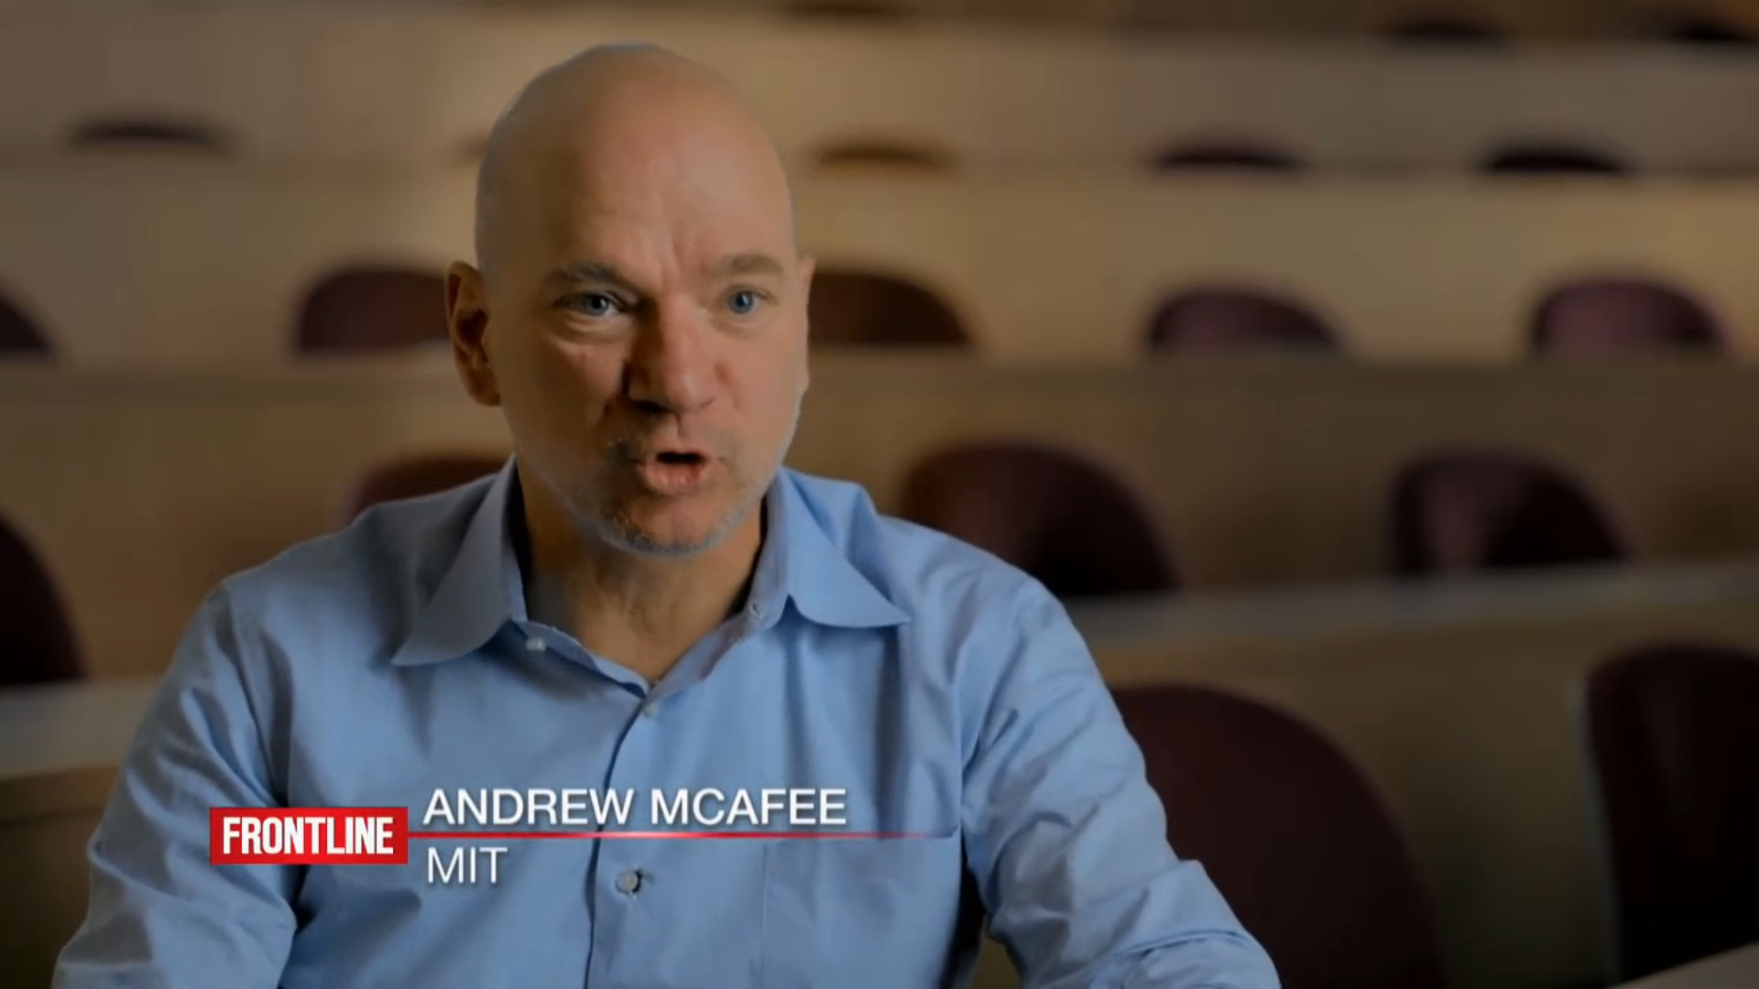
Social Development
Notes:
Social Development

Slide 8
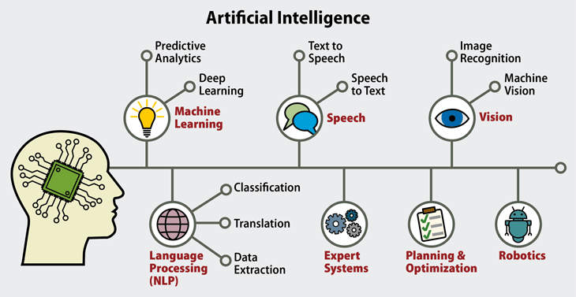
Artificial Intelligence (AI)

Slide 9
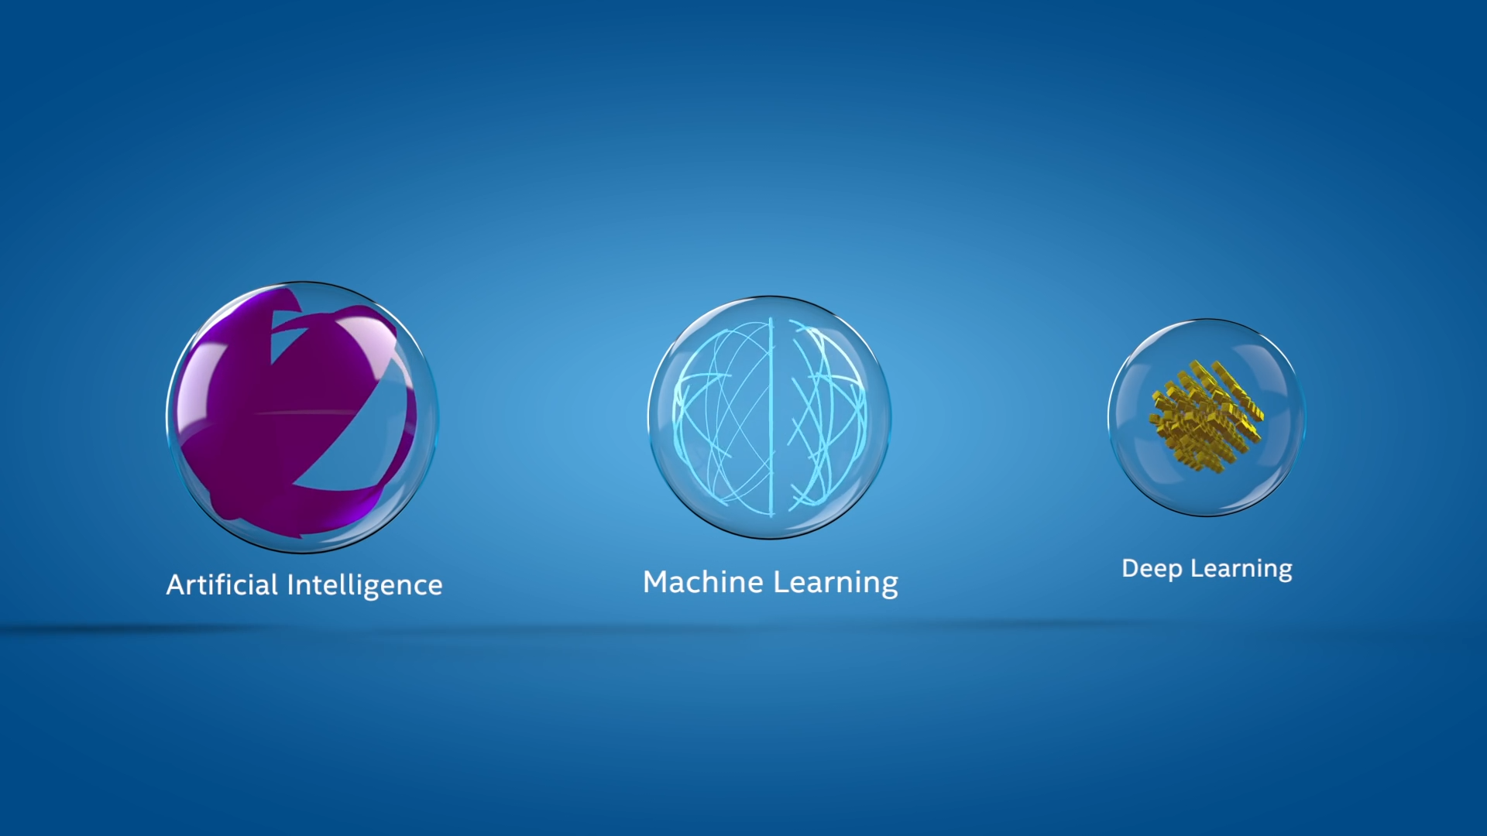
AI Explained
Notes:
AI Explained

Slide 10
Why Now?
Architecture
Data
Technology
Creation of different Architectural Frameworks has enabled enhanced methods to process and analyze a vast amount of data and incorporate a “retention” memory factor.
There is now a vast amount of data available and generated that can be used to create GenAI models. In addition, verification and validation of the scaling law in models verifies the adage that “the more you have, the more accurate the model will be”.
Creation of advanced hardware to support intensive computational run-times. CPU vs GPU vs TPU vs NPUs.
These different models with varying parameter sizes and specializations demonstrate the diversity of large language models being developed for a range of applications in the field of generative AI.

Slide 11
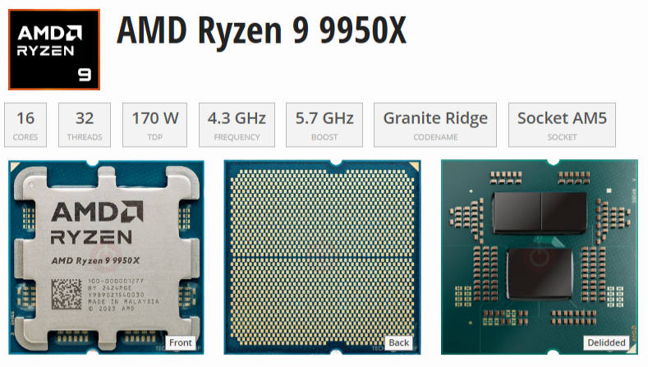
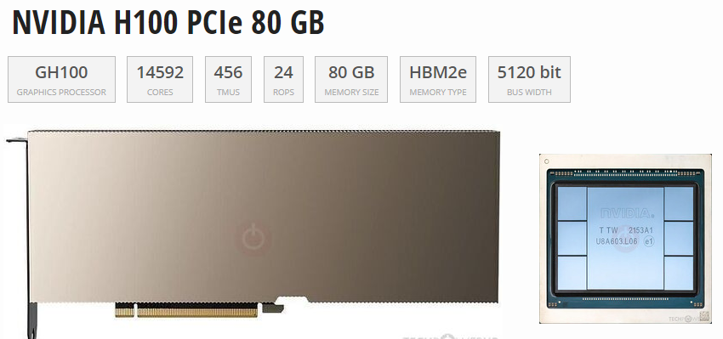
~$600
~$25,000

Slide 12
Hierarchy of Intelligence
Artificial Intelligence (AI)
Machine Learning (ML)
Deep Learning (DL)
Neural Networks
Generative AI (GenAI):
  Uses ML models
  Deep learning architectures
  Transformers and GANs

Slide 13
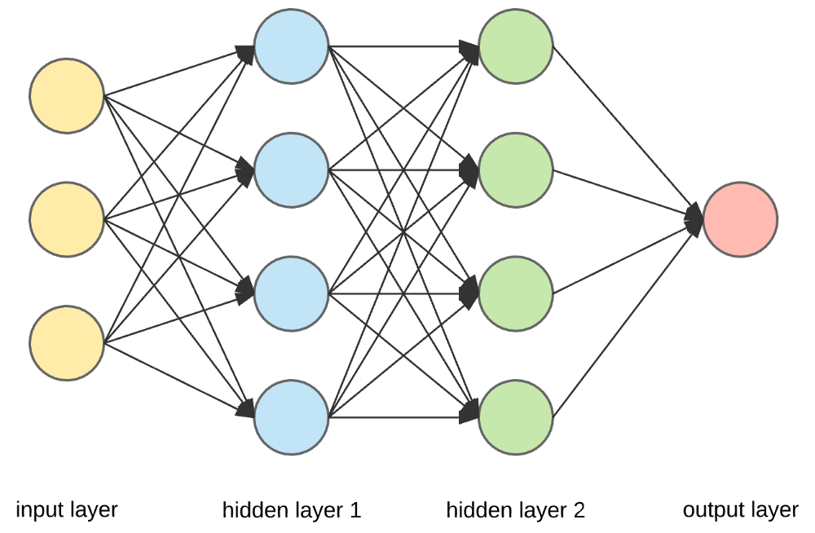
Neural Networks
Structure of Neural Networks
Consists of interconnected nodes called neurons, which process and transmit information.
Organized into layers, with each layer performing specific computations. Through
Neural networks recognize patterns and make accurate predictions based on vast amounts of data.

Slide 14
Types of Neural Networks
Convolutional Neural Networks (CNNs) (image and video recognition).
Recurrent Neural Networks (RNNs) process sequential data (speech recognition and language translation).
Generative Adversarial Networks (GANs) - Generate new content - Generative AI.

Slide 15
Latest Trends in GenAI/AI.

Slide 16
What is Generative AI?
Generative AI (GenAI) – A type of artificial intelligence
Can create:
New Text content
New Images
New Audio
New Video
Super-powered copycat that can learn the patterns of existing creative work and use that to generate new things.

Slide 17
Types of Uses
Content Creation
  Generating text, images, music, and other media using generative AI models like GPT-3, DALL-E, and Midjourney.
Automated Workflows
  Automating repetitive tasks and processes using language models to generate code, emails, and other documents.
Personalized Recommendations
  Providing personalized recommendations for products, content, and services based on user preferences and behaviors.
Chatbots and Virtual Assistants
  Creating conversational interfaces that can engage in natural language interactions, answer questions, and assist users.
Predictive Analytics
  Generating insights and forecasts by analyzing data and patterns to identify trends and make predictions

Slide 18
Use By Industry
Healthcare
  GenAI can assist in processing medical records, analyzing patient data, and aiding in diagnosis and treatment planning.
Finance
  GenAI can be used for financial analysis, fraud detection, personalized investment recommendations, and automated portfolio management.
Retail and E-commerce
  GenAI can optimize product recommendations, personalize customer experiences, automate customer service, and streamline inventory management.
Education
  GenAI can provide personalized learning experiences, assist in grading and feedback, and create interactive educational content.
Media and Entertainment
  GenAI can generate personalized content recommendations, automate video editing, and create synthetic media like deepfakes and CGI.

Slide 19
Key Concepts in GenAI/AI.

Slide 20
What is a "Framework"
Frameworks in GenAI
Hugging Face Transformers
Proprietary AI Platforms
Frameworks provide a structured approach to building and deploying generative AI models, including tools for data preprocessing, model training, security, and deployment.
The Hugging Face Transformers library is a popular framework for working with pre-trained language models, offering a wide range of models and utilities for fine-tuning and deploying these models.
Offer powerful, ready-to-use genAI models that enable test generation, image creation, etc. For example:
OpenAI API
Anthropic Clause API
Google Gemini
Generative AI frameworks provide a structured and scalable approach to building and deploying complex AI models, offering tools and utilities to streamline the development process.

Slide 21
Generative AI Frameworks
Tools
Platform
Facilitates the Development of AI Models

Slide 22
Types of Generative AI Neural Network Models
Generative Adversarial Networks (GANs)
Variational Autoencoders (VAEs)
Transformer-based Language Models
Diffusion Models
Autoregressive Models
Flow-based Models

Slide 23
Generative Adversarial Networks (GANs)
How they work:
  Two neural networks
  Generator <> Discriminator - Compete
  The generator creates data, and the discriminator tries to tell if it's real or fake.
Use cases: Image generation, art synthesis, video upscaling, deepfakes.
Examples: StyleGAN, BigGAN.

Slide 24
Variational Autoencoders (VAEs)
How they work: Learn to compress data into a latent space and then decode it back to generate new similar data.
Use cases: Image and text generation, anomaly detection.
Examples:
  Vanilla VAE
  Conditional VAE.

Slide 25
Transformer-based Language Models
How they work: Use attention mechanisms to generate coherent sequences of text or code.
Use cases: Text completion, summarization, translation, coding assistants.
Examples:
  GPT (Generative Pre-trained Transformer):
  GPT-4, GPT-3.5 (OpenAI)
  PaLM - Pathways Language Model (Google)
  LLaMA - Large Language Model Meta AI (Meta)
  Claude (Anthropic)

Slide 26
Diffusion Models
How they work: Start with noise and gradually improve it to resemble training data through a learned denoising process.
Use cases: High-quality image and video generation.
Examples:
  DALL·E 3
  Stable Diffusion
  Imagen

Slide 27
Autoregressive Models
How they work: Generate data one step at a time, using previous steps as context.
Use cases: Text, music, and code generation.
Examples:
  GPT
  PixelCNN (for images)
  WaveNet (for audio)

Slide 28
Flow-based Models
How they work: Use invertible transformations to map data to a latent space and back.
  Invertible Transformations - Reversibility
  Map data to a latent space – New representation
  And back – No Data Loss
Use cases: Real-time data synthesis with exact likelihood estimation.
Examples:
  RealNVP
  Glow
Notes:
Invertible transformations: These are mathematical functions or operations that can be reversed. If you apply an invertible transformation to data, you can also apply its inverse to recover the original data.
Map data to a latent space: A latent space is a new representation of the data, often lower-dimensional and more abstract, where similar data points are closer together. The mapping process involves transforming the original data into this space, which might capture hidden or essential features.
And back: The invertibility means you can go from the latent space back to the original data without loss. In other words, there’s a one-to-one correspondence between the original data and its representation in latent space.
Why is this important?
Invertible mappings are crucial for models that need to generate new data (like images or text) or perform efficient probabilistic inference.
Examples: Normalizing flows (like RealNVP or Glow models) use a series of invertible transformations to model complex data distributions, enabling both sampling and density estimation.
Summary:
This concept is about creating a reversible process that encodes data into a compressed, structured format (latent space) and can decode it back to its original form without information loss. This is key for understanding, generating, or manipulating complex data in modern machine learning systems.

Slide 29
Transformers, Encoders & Decoders, RAG

Slide 30
Transformer Explained
A Transformer is like a super-powered party listener for computers. it can focus on what each person is saying and how it related to what others are saying, even in a big crowd.
Listen to Everyone (Attention)
  Pays attention to all the information. It treats each information like a friend at a party
Who's Important Now
  Not all friends are equally important in every conversation. The Transformer can focus on the most relevant information for the task at hand.
Talk Back
  Once the Transformer understand the information, it can use it to do something cool, like write a poem or answer you question.
Encoder
  Part of your brain that figures out what everyone is saying.
Decoder
  Part of your brain that uses what you heard to say something new.

Slide 31
Encoders and Decoders
Encoder
Decoder
Bidirectionality
An encoder is responsible for converting the input data (e.g., text, image, or audio) into a numerical representation, often in the form of a fixed-length vector. This numerical representation is then used by the language model to understand and process the input.
A decoder is responsible for generating the output data, such as text, from the internal representation of the language model. The decoder takes the numerical representation generated by the encoder and produces the desired output.
Some language models, like BERT, use a bidirectional encoder, which allows the model to understand the context of the input from both the left and right sides. This can lead to more accurate and contextual understanding of the input.

Slide 32
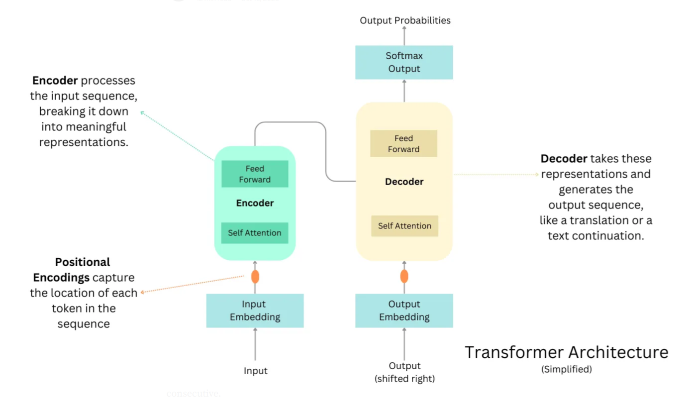
Notes:
Source: https://raw.githubusercontent.com/snatch59/keras-autoencoders/master/assets/autoencoder_latent_space.png

Slide 33
Retrieval Augmented Generation (RAG)
What is Retrieval Augmented Generation?
How does RAG work?
RAG is fundamentally an architectural pattern that integrates a retrieval system with a generation system. In practice, a RAG pipeline consists of two primary components – a retriever and a generator – working together.
The retriever is responsible for finding relevant information from an external knowledge source (e.g., a set of documents or a database) given a user query, and the generator is a language model that produces the final output (answer or text) conditioned on both the user’s input and the retrieved information.
Retrieval-Augmented Generation (RAG) is an AI framework that combines large language models (LLMs) with external information retrieval to produce more accurate and contextually relevant outputs.

Slide 34
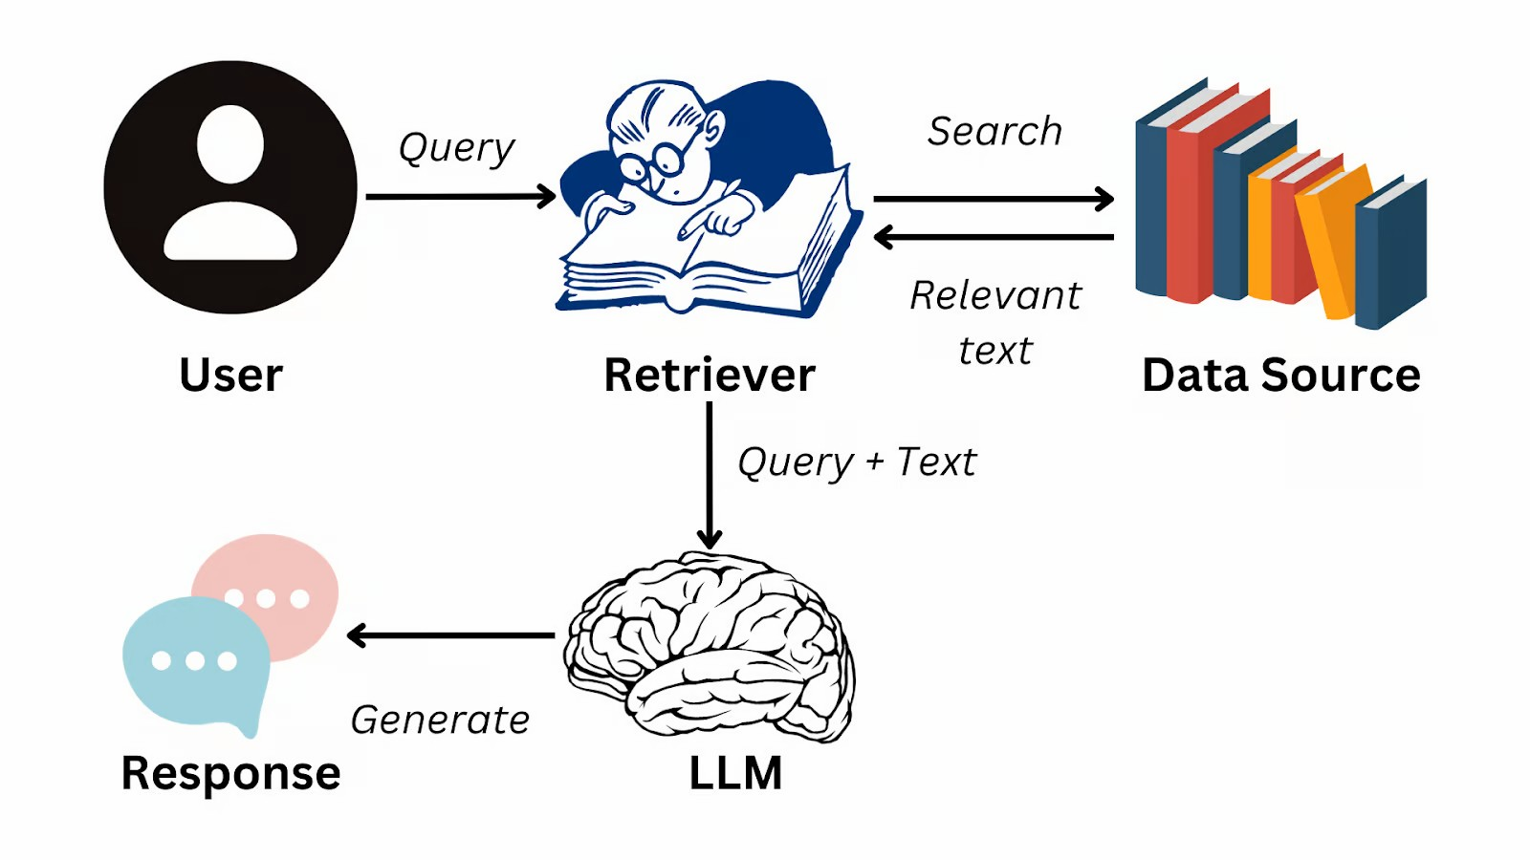
Retrieval Augmented Generation (RAG)
https://www.datacamp.com/blog/what-is-retrieval-augmented-generation-rag

Slide 35
Large Language Models (LLMs)

Slide 36
Large Language Model (LLM)
Understand, generate, and translate human language.
Trained on massive datasets of text
Learns patterns and relationships in language
Uses machine learning
Neural Network
Transformer Model

Slide 37
Building Blocks of an LLM
Vectors, Tokens, and Embeddings
Tokens are the representations of text in the form of a vector.
Embeddings: The Semantic Space
- Embeddings are the foundational aspect of LLMs

Slide 38
LLM Building Blocks Comparisons
Tokens vs. Vectors:
  Tokens are the linguistic units
  Vectors are the mathematical representations of these units.
  Every token is mapped to a vector in the LLM’s processing pipeline.
Vectors vs. Embeddings:
  All embeddings are vectors
  Not all vectors are embeddings.
  Embeddings are vectors specifically trained to capture deep semantic relationships.
Tokens and Embeddings:
  The transition from tokens to embeddings
  Movement from a discrete representation of language to a Nuanced, continuous, and contextually aware semantic space.

Slide 39
Foundational LLMs
- GPT
- Gemini
- Claude
- Llama
- Grok
- Kimi
- Deepseek
- Microsoft AI

Slide 40
Foundational LLMs by Year since 2020
Year | Number | Major LLMs | Company
2020 | 1 | GPT-3 | OpenAI
2021 | 8 | Claude | Anthropic
2022 | 10 | LaMDA / PaLM | Google DeepMind
2023 | 21 | Claude 2.1 | Anthropic
2024 | 28 | Gemini 1.5 | Google DeepMind
2025 | 35 | DeepSeek-R1 Grok 3 | DeepSeek xAI
2026 | 53 | Kimi K2.5 | Moonshot AI
Wikipedia – Aug 2, 2026

Slide 41
GPT
GPT - Generative Pre-trained Transformer
Generative: Generative models are a type of machine learning model that can generate new data, such as text, images, or audio, based on the patterns in the training data. GPT is a generative model that can generate coherent and contextually relevant text.
Pre-trained: GPT models are pre-trained on a large corpus of text data, which allows them to learn the patterns and structures of natural language. This pre-training enables the models to be applied to a variety of language-related tasks, even with limited task-specific training data.
Transformer: The Transformer is a neural network architecture that uses attention mechanisms to capture the relationships between different parts of the input sequence. This allows the model to better understand the context and generate more coherent and relevant output.
Developer: OpenAI
First Release Date: June 2018
Number of Para: 0.117B

Slide 42
GEMINI
Previously based on the LaMDA and PaLM LLMs.
Multimodal: Can process and generate text, images, audio, and code.
Transformer Architecture:
  It uses a more advanced neural network architecture to understand language and context better.
Advanced Capabilities:
  Capable of more complex tasks like image generation, code writing, and more nuanced language understanding.
Updated Name:
  Bard was rebranded to Gemini to reflect the more advanced capabilities of the underlying AI model.
.
Developer: Google Deepmind
First Release Date: Dec 2023
Number of Para: Unknown

Slide 43
CLAUDE
Claude is an AI chatbot similar to ChatGPT, capable of writing, coding, conducting research, and having conversations.
In June 2024, Anthropic released the Artifacts feature, allowing users to generate and interact with code snippets and documents.
In October 2024, Anthropic released the "computer use" feature, allowing Claude to attempt to navigate computers by interpreting screen content and simulating keyboard and mouse input.
In 2025, Anthropic added a web search feature to Claude.
Claude Pro and Claude Max were initial subscription services for additional access to Claude models.
Developer: Anthropic
First Release Date: Mar 2023
Number of Para: 52B
Tokens: 400B

Slide 44
LLAMA
Large Language Model Meta AI
Llama models come in different sizes, from 1 billion to 2 trillion parameters.
Meta AI released instruction fine-tuned versions alongside foundation models.
Model weights for the first version of Llama were only available to researchers on a case-by-case basis, under a non-commercial license.[
Unauthorized copies of the first model were shared via BitTorrent.
Subsequent versions of Llama were made accessible outside academia and released under licenses that permitted some commercial use.
Developer: Meta AI (Facebook)
First Release Date: Mar 2023
Number of Para: Unknown
Tokens: Unknown

Slide 45
GROK
Elon Musk was one of the 11 co-founders of OpenAI, and initially co-chaired it with Sam Altman. He left the company's board in 2018.
TruthGPT - In April 2023, Musk develop an AI chatbot called "TruthGPT“ trained to be politically correct.
Grok - TruthGPT would later be renamed after Grok
Developer: xAI
First Release Date: Nov 2023
Number of Para: 314B
Tokens: Unknown

Slide 46
KIMI
On 16 November 2023, Kimi was released to the public. The first version of Kimi supported 128,000 tokens, making it the first AI model that could accept contexts of this size.
In March 2024, an updated version of Kimi with a 2-million-character context window.
On 11 October 2024, Kimi Explore Edition, featuring AI-powered autonomous search, went live globally.
In November 2024, Kimi began AI video generation model.
On 20 January 2025, Kimi K1.5 was released. Matched OpenAI o1 in mathematics, coding, and multimodal reasoning capabilities.
Developer: Moonshot AI
First Release Date: Nov 2023
Number of Para: 1T
Tokens: 15T

Slide 47
DEEPSEEK
DeepSeek's models are open-weight, meaning that the exact parameters are openly shared, but the training data is not openly licensed.
DeepSeek significantly reduced training expenses for their R1 model by incorporating techniques such as Mixture of experts (MoE).
The company also trained its models during ongoing trade restrictions on AI chip exports to China. DeepSeek used weaker AI chips intended for export and employed fewer units overall.
Developer: Hangzhou DeepSeek Artificial Intelligence Basic Technology Research Co., Ltd.
First Release Date: Jan 2025
Number of Para: 67B
Tokens: 2T

Slide 48
Microsoft AI (MAI)
MAI Models
  MAI-Voice-1
  MAI-1-preview
  MAI-Image-2.5
  MAI-Code-1-Flash
  MAI-Thinking-1
  MAI-Transcribe-1.5
  Microsoft Frontier Tuning
  MAI-Cyber-1-Flash
Developer: Microsoft
First Release Date: Aug 2025
Number of Para: Unknown
Tokens: Unknown

Slide 49
Introduction to Prompt Engineering

Slide 50
What is Prompt Engineering?
The process of crafting, refining, and optimizing instructions to guide generative AI models.
It involves selecting the most appropriate:
  Formats
  Phrases
  Words
  Symbols
Helps AI systems understand user intent and respond meaningfully.

Slide 51
Prompt Engineering Purpose
Addresses a fundamental challenge:
  Search Engines find information by Keyword
  AI provides information by Concept
  AI can provide output in specific Format
  AI requires detailed, well-structured instructions
  Prompt engineering uses specified frameworks to query AI models with relevant conceptual context.
  Crucial for the quality and relevance of the AI's response.

Slide 52
Prompt Engineering Key Applications
Design and testing of prompts for AI applications
Used across various industries:
  Healthcare
  Cybersecurity
  Business
  Education.
Example - A physician prompts a medical LLM to generate differential diagnoses by providing:
  Symptoms
  Patient details
  Medical test results

Slide 53
Prompt Engineering Common Techniques
Chain-of-thought (CoT): Breaks down complex reasoning into intermediate steps to help models produce more accurate results
Prompt Chaining: Splits complex tasks into smaller subtasks, using the AI's outputs to accomplish overarching goals
Complexity-based Prompting: Performs multiple reasoning rollouts and selects the most commonly reached conclusion from the longest chains of thought

Slide 54
Open-source Tools for Prompt Engineering
Enables prompt creation
Management
Testing
Evaluation
Workflow automation for large language models.

Slide 55
Top Open-Source Prompt Engineering Tools
PromptLayer: Provides versioning, tracking, and analytics for prompt management at enterprise scale.​
OpenPrompt: Advanced template system with evaluation tools and dynamic context management, suited for complex prompt workflows.​
Agenta: Simplifies prompt testing and version control, enables rapid development and multi-model comparison.​
PromptAppGPT: Low-code platform for easy team collaboration and prototyping LLM-enabled applications.​
PromptTools: CLI-based open-source tool for flexible, hands-on prompt management and testing.​
Prompt Engine: Targets bias reduction and precision, provides analytics and real-time feedback for prompt improvement.​

Slide 56
Top Open-Source Agentic AI &
Prompt Engineering Tools
LangSmith: Specialized for chain tracing, debugging, and prompt experimentation within LangChain workflows.​
LangChain: Modular framework for building advanced LLM workflows, supporting reusable prompts, memory, and agent-based multi-step tasks.​
Langfuse: Platform for monitoring, evaluating, and debugging prompts, integrates with popular frameworks like LangChain and OpenAI SDKs.​
Haystack: Orchestration framework for customizable, production-ready LLM applications; includes prompt pipelines and context-enrichment for RAG tasks.​
Latitude: Focuses on scalable, production-ready LLM solutions with collaborative development features.​
Flowise: Visual low-code tool for chaining models and prototyping prompt workflows.​

Slide 57
Prompt Engineering Frameworks

Slide 58
Prompt Engineering Frameworks
SPEAR (Start, Provide, Explain, Ask, Rinse & Repeat): A beginner-friendly, five-step method focused on clarity and repeatability.​
CRISPE (Capacity/role, Insight, Statement, Personality, Experiment): Balanced for both analysis and creativity, commonly used in enterprise settings for thorough prompt evaluation and iteration.​
ICE (Instruction, Context, Examples): A template-based approach, ideal for detailed, explicit prompt creation, especially for complex or technical tasks.​
CRAFT (Capability, Role, Action, Format, Tone): Gives granular control over model behavior, especially in specialized AI applications.​

Slide 59
Prompt Engineering Framework
BAB (Before, After, Bridge): Adapted from copywriting, useful for narrative prompts, customer service, and marketing tasks needing emotional resonance.​
CIDI (Context, Instructions, Details, Input): Breaks down tasks for precision and actionable AI results, aiding project/content management.​
SIX THINKING HATS: Encourages prompts from six perspectives—facts, emotions, risks, benefits, creativity, process—for decision making and creativity.​
CLEAR (used in academics): Structures prompts for logical, coherent outputs in teaching and research.​
Tree of Thought: Maps reasoning step-by-step, supporting complex problem-solving and brainstorming.​

Slide 60
Framework Comparison
Framework | Core Components | Best For | Key Advantage | Evaluation Capability
SPEAR | Start, Provide, Explain, Ask, Rinse & Repeat | Beginners, quick setups | Simple, repeatable process | Basic feedback built-in
ICE | Instruction, Context, Examples | Detailed, complex tasks | Clear structure for detailed prompts | Manual evaluation
CRISPE | Capacity, Role, Insight, Statement, Personality, Experiment | Enterprise use, team projects | Fine-tuned style and deep customization | Built-in evaluation tools
CRAFT | Context, Role, Action, Format, Target Audience | Specialized AI interactions | Precise control and role definition | Supports metric-driven testing

Slide 61
Framework Strengths and Use Cases
SPEAR: Favored for fast implementation and clear results, especially in training and onboarding scenarios.​
ICE: Useful where a nuanced prompt is needed; popular for technical support and customer engagement flows.​
CRISPE: Tailored for organizational use, allowing in-depth personality and experimentation; often selected for iterative, scalable model builds.​
CRAFT: Chosen when granular output control, such as specific formatting or response tone, is critical for specialized domains like finance or healthcare.​

Slide 62
SPEAR Framework Use Case
Content Strategy Development: Applied to blog ideation, SEO strategies, and editorial planning owing to its clarity and simplicity.​
Market Research: Used for concise survey generation and competitive analysis, prioritizing actionable insights.​
Customer Support Prompts: Delivers fast, accurate responses to support tickets, FAQs, and basic troubleshooting.​
Basic Analytical Requests: Ideal for summary generation and single-step data interpretation tasks.​

Slide 63
SPEAR Framework Components
Start: Define the problem or task you want the AI to help with.
Provide: Include specific examples or format guidance to shape the AI’s response.
Explain: Describe the situation as if explaining it to a person, giving necessary context.
Ask: State the precise question or main request for the AI to focus on.
Rinse & Repeat: Review and adjust the prompt as needed to achieve the desired outcome.

Slide 64
SPEAR Components Example
Start: You're a corporate trainer specializing in AI skills for tech teams.
Provide:
  Create a 4-module training plan on prompt engineering using SPEAR framework;
  Format training plan as a table with week, objectives, activities, and assessments;
  Target early-career AI/ML researchers (desk-based, prefer web tools like Perplexity);
  budget-free;
  2 hours/week
Explain: New hires need practical skills for climate/space AI projects, building on basic LLM knowledge; align with hands-on, iterative learning.
Ask: Generate the plan and suggest 2 quiz questions per module.

Slide 65
SPEAR Prompt
You're a corporate trainer specializing in Microsoft 365 for HR personnel. Create a 4-module training plan on Microsoft 365; Create a training plan in a table format with columns for week, objectives, activities, and assessments; Target early-career HR personnel; 2 hours/week. New hires need practical skills for using Microsoft 365 to complete projects; align training plan with hands-on, iterative learning. Generate the plan and in a table format and suggest 2 quiz questions per module.

Slide 66
SPEAR Results
SPEAR Prompt Results using Comet and ChatGPT 5.2 LLM

Slide 67
CRISPE Framework Use Case
Strategic Planning & Execution: Powers business strategy sessions, campaign management, and organizational goal setting by supporting iterative feedback and adaptation.​
Educational Content Creation: Tailors content for diverse audiences, from syllabi to assessment item generation.​
Product Feature Prioritization: Guides decision-making for tech product development and roadmap planning.​
Healthcare & Policy Analysis: Ensures precision and compliance in regulated sectors, suitable for complex report writing and recommendations.​
Enterprise Team Collaboration: Facilitates coordination and continuous improvement in cross-functional teams.​

Slide 68
CRISPE Framework Components
Capacity / Role: Assigns the AI a specific expertise or persona (e.g., "You are a senior data analyst")
Insight: Provides background context and information the AI needs to understand the task
Statement: Specifies the exact task or action you want the AI to perform
Personality: Sets the tone, style, or manner of the response (e.g., formal, humorous, concise)
Experiment: Requests multiple examples or variations to enable iteration and refinement

Slide 69
CRISPE Components Example
Capacity/Role: You are a senior data scientist with expertise in customer analytics.
Insight: Our fintech company is experiencing 20% customer churn among B2C SaaS customers aged 25–40 who signed up in the last 6 months.
Statement: Identify the top five causes and suggest retention strategies.
Personality: Respond in a professional tone using a numbered list and keep it under 300 words.
Experiment: Provide three versions: conservative, aggressive, and balanced.

Slide 70
CRISPE Prompt
You are a senior data scientist with expertise in customer analytics. Our fintech company is experiencing 20% customer churn among B2C SaaS customers aged 25–40 who signed up in the last 6 months. Identify the top five causes and suggest retention strategies. Respond in a professional tone using a numbered list and keep it under 300 words. Provide three versions: conservative, aggressive, and balanced.

Slide 71
CRISPE Results
CRISPE Results using Comet and ChatGPT 5.4 LLM

Slide 72
ICE Framework Use Case
Technical Documentation: Breaks down instructions and examples for software guides, user manuals, or API docs.​
Instructional Design: Crafts explicit, reproducible guides for e-learning modules and training flows.​
Complex Querying: Used in scenarios like multi-part code generation or layered data analysis requiring detailed context and explicit examples.​
Customer Communication Flows: Structures onboarding, feedback, and support prompts for high-volume enterprise communications.​

Slide 73
ICE Framework Components
Instruction: Clearly defines the specific task, query, or action for the AI, ensuring that the model understands what is required and minimizing ambiguity. For example: “Summarize the following article,” or “Generate five product ideas.”​
Context: Supplies background information, constraints, or any relevant details that help the AI interpret the request and tailor its response appropriately. This might include the topic, intended audience, related documents, or organizational guidelines.​
Examples: Offers sample inputs, desired outputs, or reference formats to illustrate expectations and further clarify the response style and content. For instance, showing the AI a prior summary, a preferred format, or output samples increases consistency and output accuracy.​

Slide 74
ICE Components Example
Instruction
Create a reproducible e-learning “module guide” for learning HTML that another instructor could reuse for any HTML topic by swapping only the topic variables.​
Output must be: (1) a reusable template, then (2) a filled example module for the topic provided.​
Context
Audience: beginners with no coding background using a web browser + VS Code (or any text editor).
Course style: practical, task-based, minimal jargon, lots of short practice checks.
Module delivery: self-paced e-learning (read + do), designed for 30–45 minutes total.
Tone: supportive, clear, and confidence-building.
Quality constraints:
Use headings exactly: Overview, Prereqs, Learning objectives, Key concepts, Walkthrough, Practice, Check for understanding, Common mistakes, Extension, Answer key.
Every “Practice” item must include an input snippet and an expected output/behavior description.
Use simple HTML only (no CSS/JS unless explicitly requested).​

Slide 75
ICE Components Example
Example A (mini example of format + depth)​
Topic: “HTML links”
Learning objectives:
  Create an anchor tag using href.
  Explain absolute vs relative URLs.
Practice (one item):
  Input:
  xml
  <a href="https://example.com">Visit Example</a>
  Expected behavior: The text “Visit Example” appears as a clickable link that opens example.com.

Slide 76
ICE Components Example
Example B (mini example of “Common mistakes” style)​
Mistake: Forgetting to include https:// in an absolute URL.
Symptom: Link navigates to a broken/relative path.
Fix: Add the full protocol + domain.
Now generate using this variable topic:
Topic: “HTML lists (ordered and unordered)”
Learner project: “Create a simple ‘Grocery List’ page containing one unordered list and one ordered list.”
  What the model should produce (structure preview)
  Reusable template (with placeholders like {TOPIC}, {PROJECT}, {PRACTICE_ITEM_1}), so future modules remain consistent.​
  Filled module for “HTML lists,” including at least:
3 learning objectives
  1 walkthrough with a complete HTML file
  4 practice items with expected behavior
  5-question knowledge check + answer key​
If you want, the template can be adapted to SCORM-friendly text chunks (screen-by-screen) or a specific authoring tool (Rise 360, Storyline, Moodle), but the ICE structure stays the same.

Slide 77
ICE Prompt
ICE Prompt using Example A

Slide 78
ICE Result
ICE Prompt using Comet and ChatGPT 5.2 LLM

Slide 79
CRAFT Framework Use Case
Persona/Role-based Prompts: Creates specific professional or creative voices for sales, marketing, or brand communication.​
Data Analysis & Template Outputs: Directs AI to deliver tabular, visual, or formatted outputs in analytics dashboards or reports.​
Creative Writing & Social Media: Supports varied tones, narrative flows, and targeted audience engagement—especially for branded content, campaigns, or fiction.​
Interview & Recruitment Flows: Generates question sets or character-based scenarios in HR, consulting, or journalism.​
Healthcare/Finance Compliance: Constrains AI outputs for regulatory document drafting and review.​

Slide 80
CRAFT Framework Components
Context: Define the purpose, goals, and necessary background information for the prompt. This ensures the AI understands the task’s scope and any relevant constraints.​
Role: Assign a specific role or persona to the AI—such as “technical writer,” “educator,” or “financial analyst”—to guide the model's responses in line with desired expertise or tone.​
Action: Provide explicit instructions for the task or request, such as summarizing points, generating examples, or organizing information. This directs the AI to perform a specific action.​
Format: Specify the desired structure for the output (e.g., bulleted list, essay, table, step-by-step guide), ensuring the response is organized and easy to follow.​
Target Audience: Identify who the output is for, including their knowledge level, preferences, or expectations. This tailors the content to be accessible, relevant, and engaging for the intended audience.

Slide 81
CRAFT Components Example
Context
You are designing a practical training plan to teach web design from zero to job-ready basics for entry-level learners. The plan must emphasize real workflows, accessibility, and responsive design.
Constraints: limited jargon, lots of hands-on practice, and outcomes that map to workplace tasks.
Role
Act as a senior web design instructor and instructional designer who has built beginner-to-intermediate curricula for adult learners and career switchers.
Use plain language, define terms once, and include coaching notes for common learner pitfalls.

Slide 82
CRAFT Components Example
Action
Create a complete training plan that includes:
  6–8 measurable learning outcomes.
  A module-by-module sequence (8 modules total) with time estimates, prerequisites, lecture/demo topics, and hands-on labs.
  A capstone project brief (requirements, deliverables, milestones) that integrates skills across modules.
  An assessment plan: knowledge checks per module, a skills checklist, and a capstone rubric.
  Instructor notes: pacing, differentiation for mixed skill levels, accessibility guidance, and suggestions for remediation.

Slide 83
CRAFT Components Example
Format
Output exactly in this structure:
  Course overview (bullets)
  Learning outcomes (numbered)
  Modules table with columns: Module, Time, Objectives, Key concepts, Demo, Lab, Common mistakes
  Capstone project brief (bullets)
  Capstone rubric (table)
  Assessments + instructor notes (bullets)

Slide 84
CRAFT Components Example
Target audience
Audience: entry-level learners with no prior design or coding experience, using a modern browser and a simple editor (VS Code or equivalent).
Goal: competence in designing and building a responsive, accessible multi-section website using HTML/CSS fundamentals and basic design principles (layout, typography, color, spacing).

Slide 85
CRAFT Prompt
CRAFT Prompt

Slide 86
CRAFT Result
CRAFT Prompt Results

Slide 87
12 Prompt Engineering Secrets
Secret #1: Be Specific (Really Specific)
Secret #2: Give Context, Not Just Commands
Secret #3: Ask the AI to “Show Its Work”
Secret #4: Use Role-Playing
Secret #5: Iterate (The AI Doesn’t Always Get It Right on the First Try)
Secret #6: Chain Your Prompts
Secret #7: Use “Few-Shot” Examples
Secret #8: Give the output format
Secret #9: Negative prompt
Secret #10: Ask for reference
Secret #11: Chunking
Secret #12: Ask Questions

Slide 88
Session I Review
Define Artificial Intelligence (AI) and Generative AI (GenAI).
Explain the latest trends in GenAI/AI.
Identify and describe key concepts in GenAI/AI.
Understand the Building Blocks of LLMs
Introduction to Prompt Engineering Frameworks
AI Quiz
LLM Quiz

Slide 89
Student Quizzes
(on Blackboard)
Quiz 1 - Artificial Intelligence / Machine Learning / Deep Learning / Neural Network Quiz
Quiz 2 - Generative AI & Large Language Model Technologies Quiz

