Slide 1
ITI 519 - IT Foundation
Session I
Course Overview Presentation
http://www.profburnett.com

Slide 2
Outline
Introductions
Class Outline
Review Class Website

Slide 3
Instructor Info
Carl Burnett
U.S. Army – ORSA Data Science Analyst
BAH – Consultant – Web Dev Program Manager
GDIT – Senior PM – U.S. Senate
Adjunct Prof – JHU
Prof – Montgomery College
cb@profburnett.com
240.696.1906

Slide 4
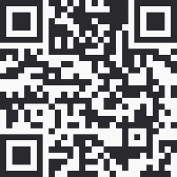
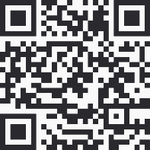
Instructor Info
Profburnett Scheduler https://calendly.com/profburnett
Carl Burnett
Prof – Montgomery College
cb@profburnett.com
240.603.3194
Profburnett Website https://profburnett.com

Slide 5
Introduce Yourselves
Name
What do you do?
What do want to learn from this course?

Slide 6
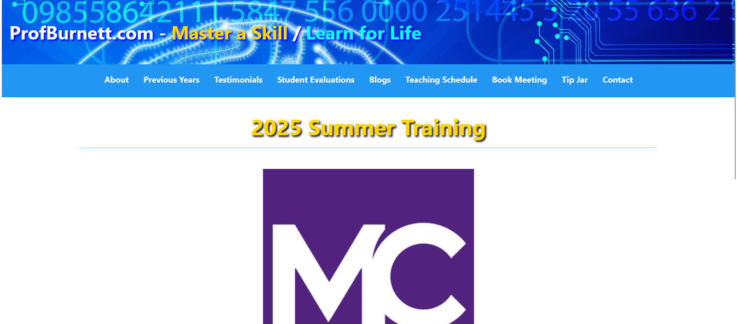
Profburnett.com

Slide 7
Administrative Announcements

Slide 8
Certificate of Course Completion
You are required to attend 80% of the classes.
Please sign in the chat area with your name for each session.

Slide 9
Class Schedule ITI 519 - IT Foundation
Date | Day | Hours
6/2/2025 – 6/4/2025 | Monday & Wednesday | 6:30 – 9:30 PM
All Classes held in East County Education Center, Silver Spring, MD 20904, Lab 142

Slide 10
Outline
Session 1 – 6/2/2025
Ch 1: Core Hardware Components
Ch 2: Peripherals &: Connectors
Ch 3: Computing Devices & the Internet of Things (IoT)
Ch 4: Operating Systems
Ch 5: Software Applications
Ch 6: Software Development
Session 2 – 6/4/2025
Ch 7: Database Fundamentals
Ch 8: Networking Concepts & Technologies
Ch 9: Security Concepts & Threats
Ch 10: Security Best Practices
Ch 11: Business Continuity & Computer Support
AI and Beyond

Slide 11
Course Review
Session 1 – 6/2/2025
Ch 1: Core Hardware Components
Ch 2: Peripherals &: Connectors
Ch 3: Computing Devices & the Internet of Things (IoT)
Ch 4: Operating Systems
Ch 5: Software Applications
Ch 6: Software Development
Session 2 – 6/4/2025
Ch 7: Database Fundamentals
Ch 8: Networking Concepts & Technologies
Ch 9: Security Concepts & Threats
Ch 10: Security Best Practices
Ch 11: Business Continuity & Computer Support
AI and Beyond

