Slide 1
ITI 499 - Mastering Windows Fundamentals
Session III
Managing Applications
The Internet, World Wide Web, Cloud, & IoT
Web Browsers
www.profburnett.com
Master a Skill / Learn for Life

Slide 2
Session Outline
Managing Applications
The Internet, World Wide Web, Cloud, & IoT
Web Browsers

Slide 3
Applications (Apps)
Also known as programs
App types include:
Productivity
Web browsing
Email
Games
Listed alphabetically on the Start menu
Use index list to jump to a section of the alphabetized list
Written to run on the specific operating system or family of operating systems:
Microsoft Windows
macOS
Sources of apps:
Pre-installed with the operating system
Commercial purchases
Free downloads
Software installed by your organization (on work computers)

Slide 4
Windows Universal Apps
Alarms & Clock
Calculator
Calendar
Camera
Connect
Cortana
Feedback Hub
Get Help
Groove Music
Mail
Maps
Messaging
Microsoft Edge
Mixed Reality Portal
Movies & TV
News
OneDrive
OneNote
Paid Wi-Fi & Cellular
Paint 3D
People
Photos
Settings
SketchBook
Skype
Sticky Notes
Store
Tips
Twitter
View 3D
Voice Recorder
Weather
Windows Defender Security Center
Xbox

Slide 5
Desktop Applications vs. Windows Apps
Application | App
Geared toward traditional computers, such as workstations, notebook computers, and 2-in-1 devices (notebook/tablet hybrids with detachable keyboard). | Runs on all Windows device families. Geared toward tablets and phones, but also works on Xbox video game consoles and networked Internet of Things objects like the Raspberry Pi.
Best suited for keyboard and mouse, but compatible with touchscreen interfaces. | Optimized for touchscreen interfaces, but can also be used with keyboard and mouse.
Downloaded from the software company website or purchased at a physical store. | Downloaded from the Windows Store.

Slide 6
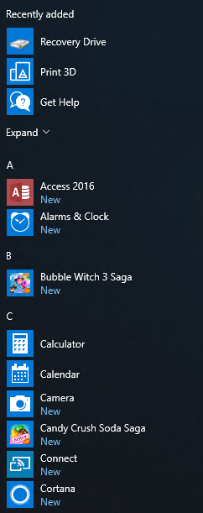
All Apps List
Select any category divider to display the index.

Slide 7
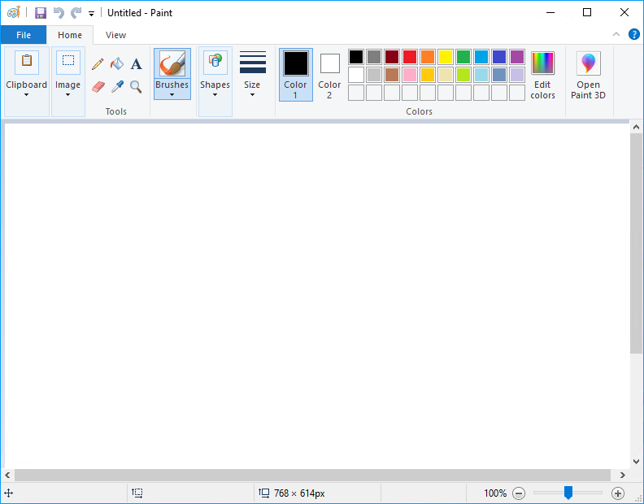
Desktop Application Windows
Maximize/Resize
Minimize
Close
Title Bar
Toolbar
Tabs
Body
Scroll Bar
Resize Corner
Status Bar

Slide 8
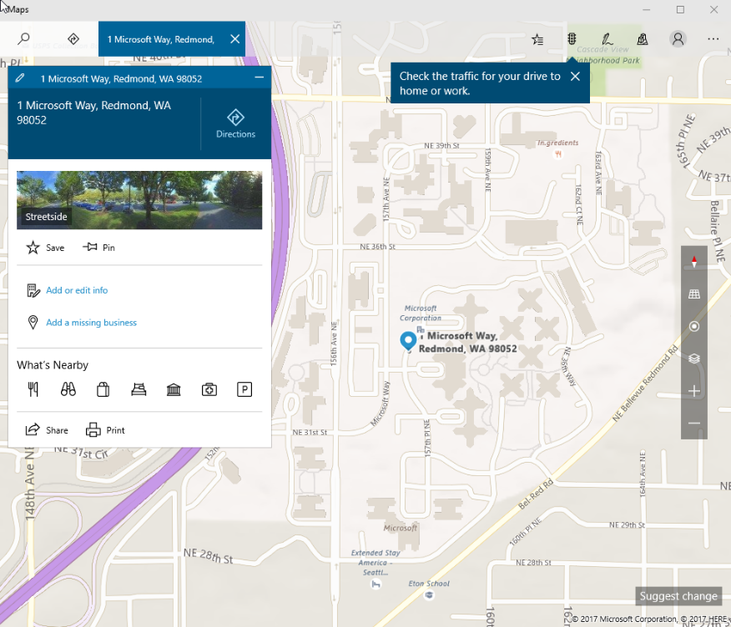
Common App Features
Menu Icons
Minimize
Maximize
Close
Account associated with the app

Slide 9
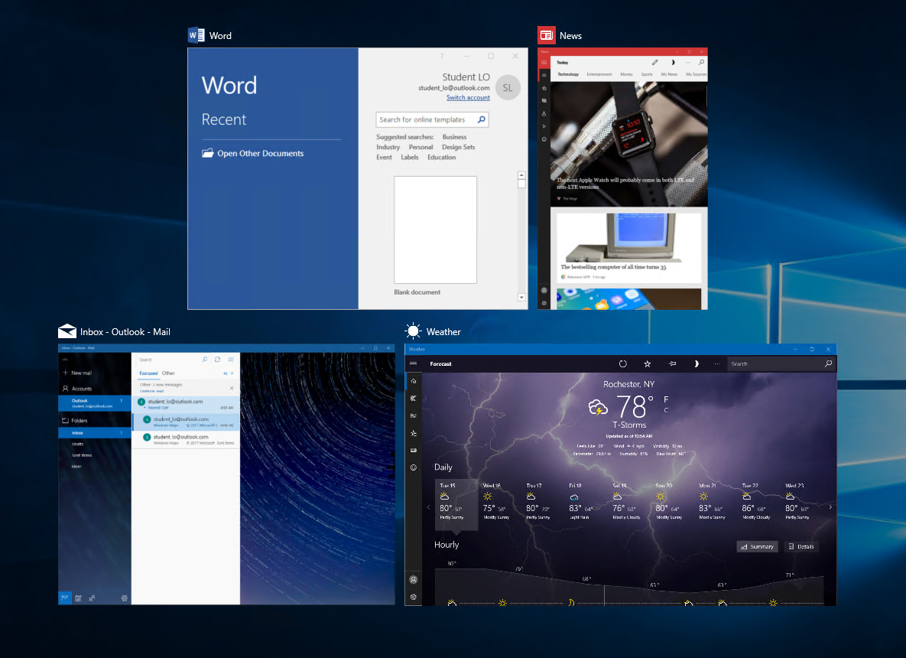
Task View
Previews of Open Applications

Slide 10
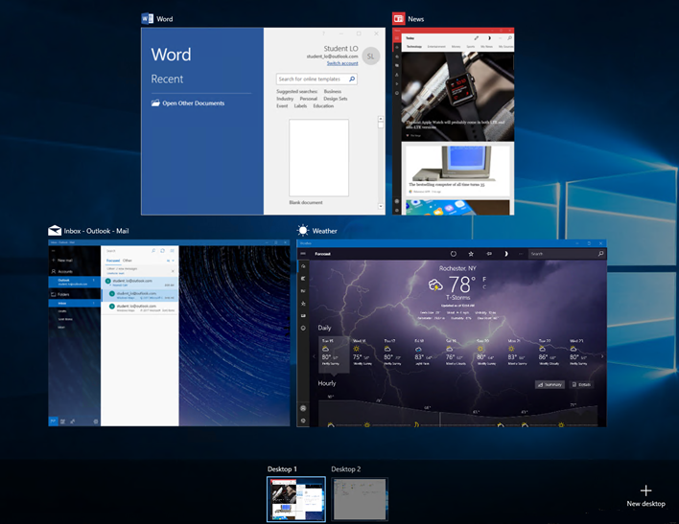
Virtual Desktops
Previews of Open Applications on Desktop 1
Previews of Virtual Desktops
Create New Desktop

Slide 11
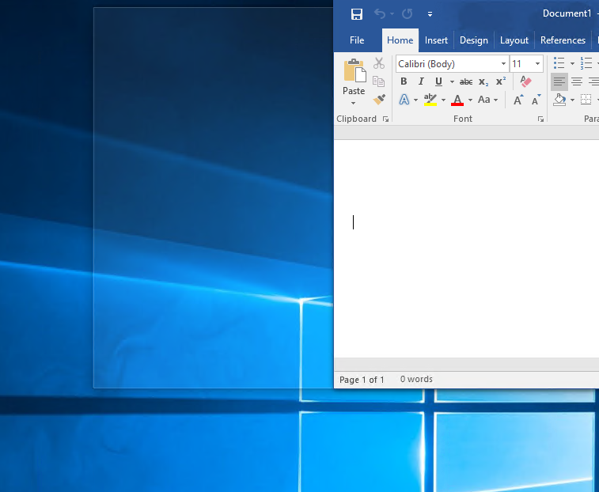
The Snap Feature
Snap Size Preview
App being snapped

Slide 12
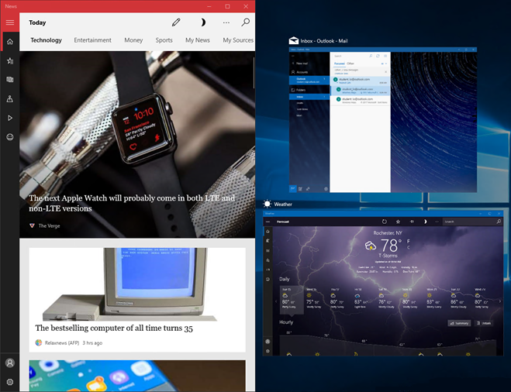
Snap Assist
Program Snapshots in Snap Assist
Snapped Program

Slide 13
Keyboard Actions for Multitasking
Shortcut Description
Alt+Tab Repeat to select thumbnail of desired window.
Windows+Tab
Displays thumbnails of all open windows. Use arrow key to move between thumbnails, then press Spacebar to select desired window.
Windows+Down arrow
Minimize current window.
Windows+Up arrow
Maximize current window.
Alt+F4
Close current window.
Ctrl+F4
Close current tab or instance.
Windows+Left arrow
Snaps current window to left side of the screen.
Windows+Right arrow
Snaps current window to right side of the screen.
Windows+Ctrl+D
Create another virtual desktop.
Windows+Ctrl+ Left arrow
or
Windows+Ctrl+ Right arrow
Switch between virtual desktops.
Windows+Ctrl+ F4
Close current virtual desktop

Slide 14
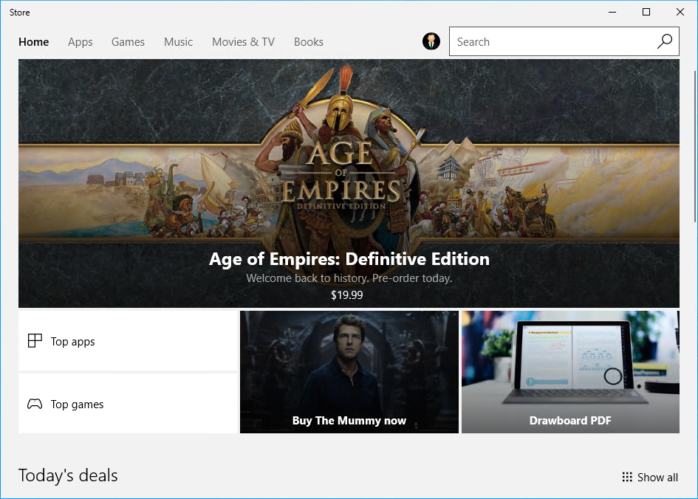
The Windows Store

Slide 15
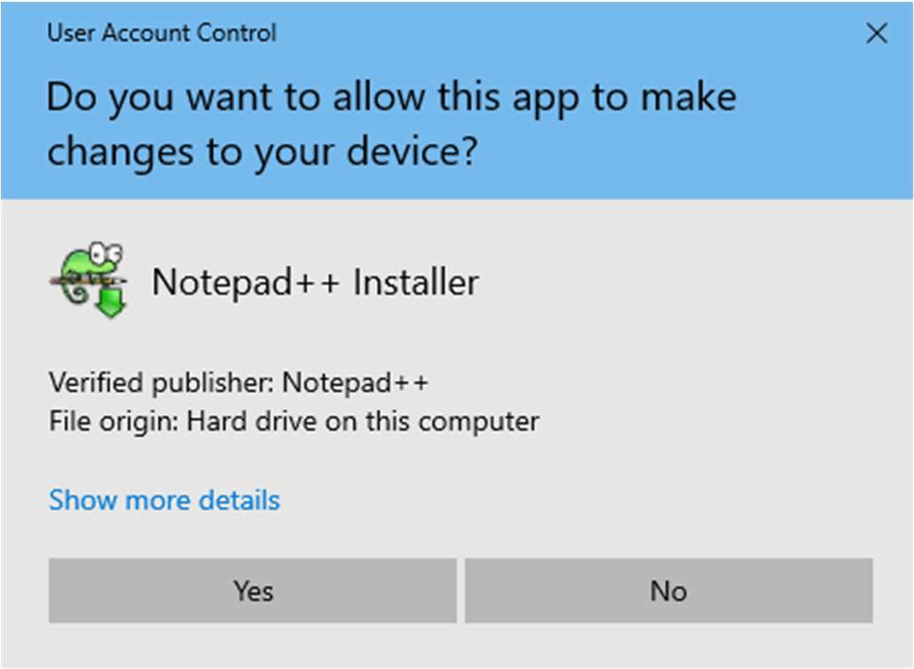
User Account Control
This is a protective feature in Windows
It’s an alert system to make sure you would like to make a particular change (such as installing an application)

Slide 16
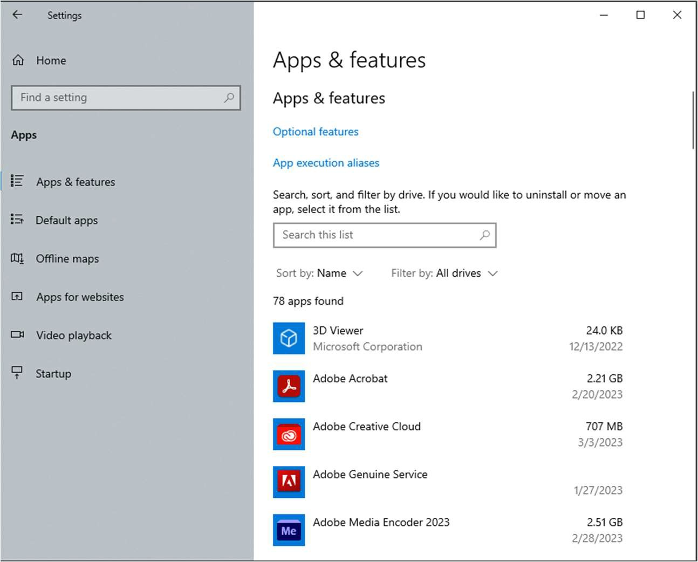
Apps & Features
Here we can manage all of our installed applications
Uninstall Applications
Change Default Applications
Etc.

Slide 17
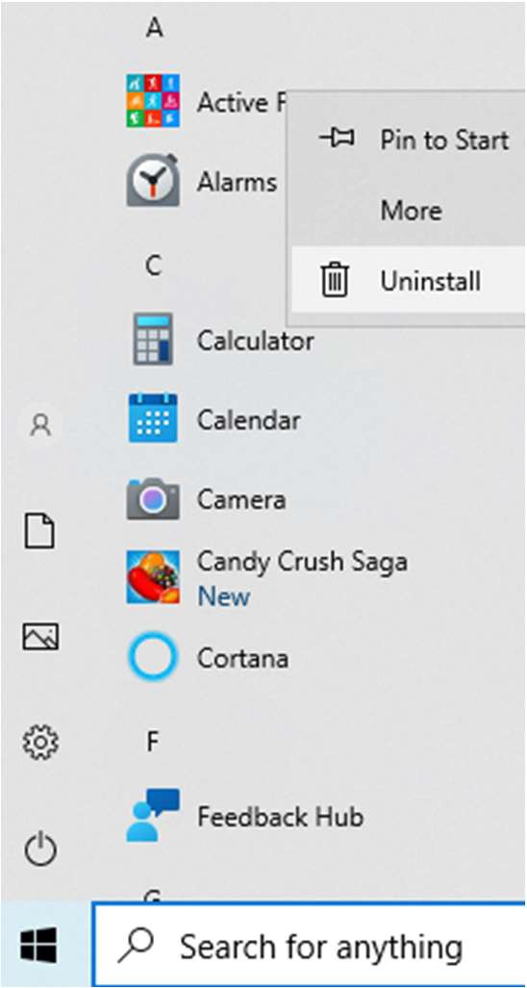
App Uninstall

Slide 18
Class Exercises
Exercise 3.1 – Install App From Microsoft Store
Exercise 3.2 – Uninstall an App

Slide 19
What is the Internet?
WANs
WANs
WANs
MANs
MANs
CANs
CANs
CANs
LANs
LANs
LANs
LANs
LANs
LANs
LANs
LANs
LANs

Slide 20
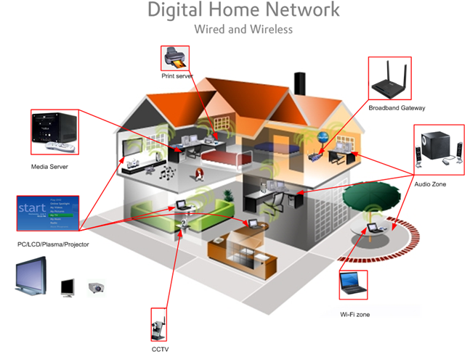
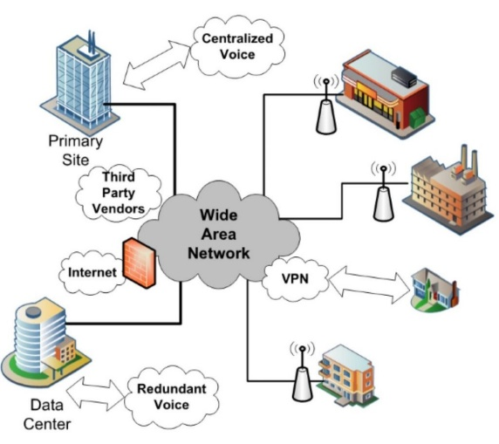
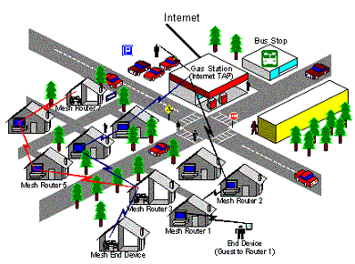
Your Internet
MAN / WAN
https://www.internetexchangemap.com/
CAN / MAN
PAN / LAN / CAN

Slide 21
What is the World Wide Web?

Slide 22
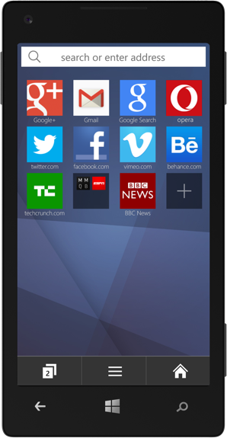
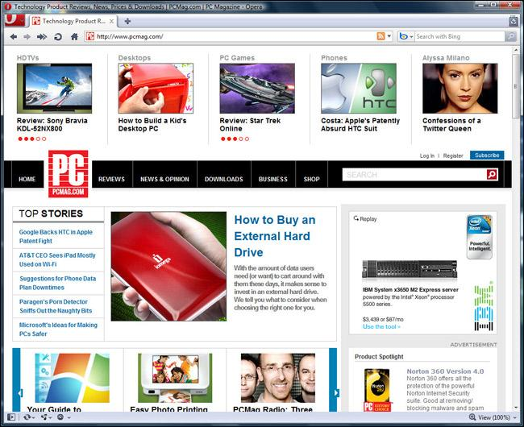
What is the World Wide Web?

Slide 23
How Do People Use the Worlds Wide Web?
Surf
Online Apps
Text Messaging
Email
Netflix
Hulu
Google
Facebook
YouTube
Wikipedia
Amazon
Yahoo
MS Office 365
Skype

Slide 24
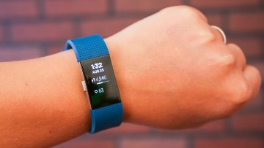
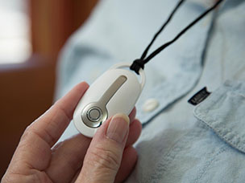
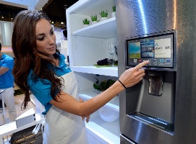
What is the IoT?
Internet of Things

Slide 26
Web Browsers

Slide 27
What a Web Browser is NOT
Not a search engine.
Not an operating System.
Not email.
Not the Internet

Slide 28
Chrome (65.7%)
https://www.google.com/chrome/
Customize your Chrome Personalize your web browser with themes, dark mode, and other options built just for you.
Browse across devices Sign in to Chrome on any device to access your bookmarks, saved passwords, and more.
Save time with autofill Use Chrome to save addresses, passwords, and more to quickly autofill your details.

Slide 29
Safari (17.9%)
https://www.apple.com/safari/
Built for Apple Devices
Better Privacy Controls than Chrome

Slide 30
Edge (5.3%)
https://www.microsoft.com/en-us/edge?ep=0&form=MA13M0&es=40
AI Theme Editor
AI Security Manager
Use for Gaming
Sync bookmarks and passwords across devices

Slide 31
Firefox (2.7%)
https://www.mozilla.org/en-US/firefox/
Single login
Better Privacy Controls Than Edge
Sync across devices

Slide 32
Opera (2.2%)
https://www.opera.com/
Tab Islands
Privacy better than Edge
Free VPN

Slide 33
Brave (1%)
https://brave.com/
Better Privacy than Firefox
Ad Blocking
Adherence to Web Standards

Slide 34
Internet Browsers Settings
Chrome
Safari
Edge
Firefox
Your (Profiles)
Autofill & Passwords
Privacy & Security
Performance
Appearance
Search Engine
Default Browser
On Startup
Languages
Sidebar
Downloads
Accessibility
System
Reset Settings
Extensions
General
Tabs
Autofill
Passwords
Search
Privacy
Websites
Profiles
Extensions
Advanced
Profiles
Privacy, Search
Appearance
Sidebar
Start, Home
Copy, Paste
Cookies and Permissions
Downloads
Family
Languages
Printers
System
Devices
Accessibility
General
Homepage
Search
Privacy & Security
Sync
Extensions and Themes

Slide 35
More Actions
Action | Description
New window | Open a second instance of Edge.
New InPrivate window | Open an instance of Edge that won't save your browsing data.
Zoom | Make the page view smaller or larger.
Favorites | Open your saved favorites.
Cast media to device | Connect to a wireless display and audio devices.
Find on page | Find specific text within a page.
Read aloud | Have Edge read the contents of the current page aloud.
Print | Print a website with a printer or to a PDF.

Slide 36
More Actions (Cont.)
Action | Description
Pin this page to Start | Pin the current web page to the Start menu for easy access.
Pin this page to the taskbar | Pin the current web page to the taskbar for easy access.
F12 Developer Tools | Open a window into the web page's code.
Open with Internet Explorer | Open the page with the legacy browser Internet Explorer.
Send feedback | Share your experience of using Cortana and Edge with Microsoft.
Extensions | Personalize the browser and extend its capabilities.
What's new and tips | New browser features and tips to optimize your experience.
Settings | Access browser settings.

Slide 37
Class Exercises
Exercise 3.3 – Browse the Web
Exercise 3.4 – Use Search in Address Bar
Exercise 3.5 – Use Search in Address Bar to Search for Topic
Exercise 3.6 – Set up a Homepage in Browser

Slide 38
Session Review
Managing Applications
The Internet, World Wide Web, Cloud, & IoT
Web Browsers

