Slide 1
ITI 499 - Mastering Windows Fundamentals
Session II
File Management
File Explorer
OneDrive
www.profburnett.com
Master a Skill / Learn for Life

Slide 2
Session Outline
File Management
File Explorer
OneDrive

Slide 3
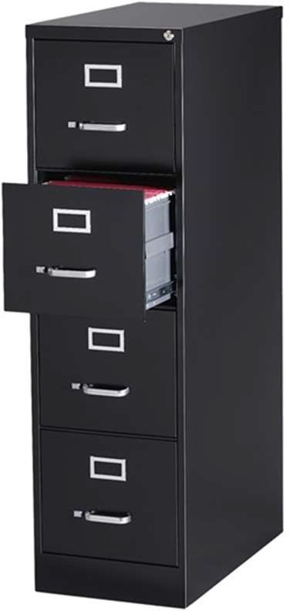
File Management
Overview of File Explorer
Think of it as a virtual file cabinet
Folder structure & File paths
File Management
Create & Save Files
Name & Rename Files
Copy, Move, & Locate Files
Delete & Restore Files
Search for Files & Folders

Slide 4
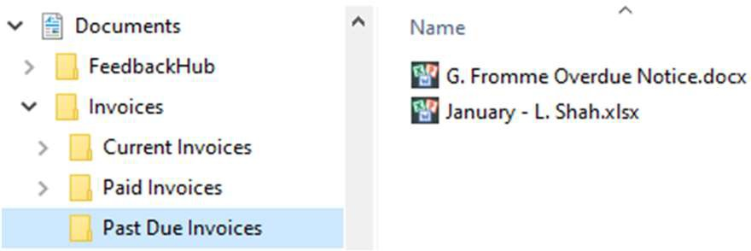
Files & Folders
Current Invoices
Invoice
Folders and subfolders
Files in selected folder
Past Due Invoices
Invoice
Paid Invoices
Invoice
Physical cabinet, folder, paper
Folders and files on computer

Slide 5
Common File Extensions/Types
File Extensions (the suffix at the end of each file) will help you determine what type of file you dealing with:
.jpg, .png → Picture files
.pdf → Portable Document Format (Adobe Acrobat) file
.xls / .xlsx → Spreadsheet files (Excel)
.doc / .docx, .rtf, .txt → Document files (Word)
.ppt / .pptx → Presentation files (PowerPoint)
.mp3, .m4a, .aac → Sound or Music files
TIP: Not sure what kind of file you are looking at? Search the extension on the web to find out

Slide 6
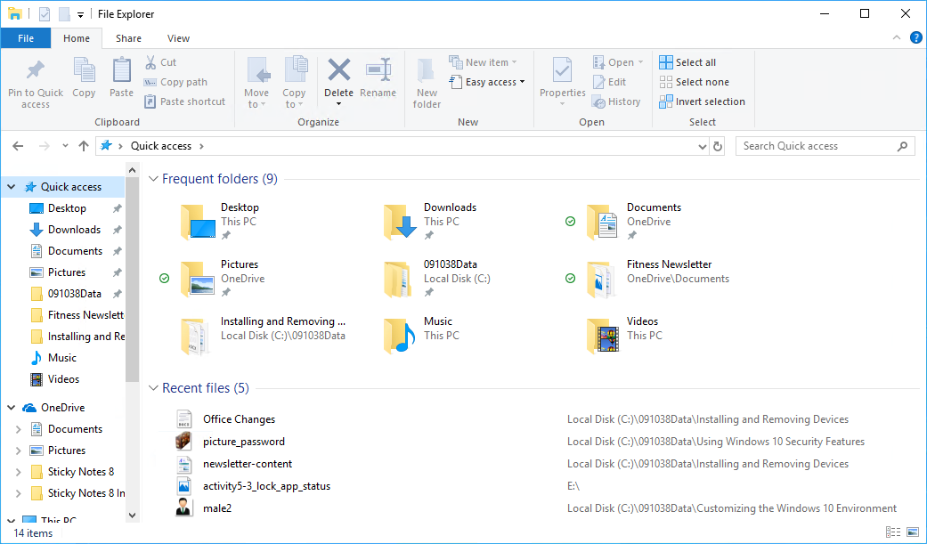
File Explorer
Navigation Pane
Content Pane

Slide 7
File Explorer Window
Address Bar
Search Bar
Ribbon
Back and Forward Buttons
Up to Button
Caret

Slide 8
File Explorer Ribbon
Ribbon Tabs

Slide 9
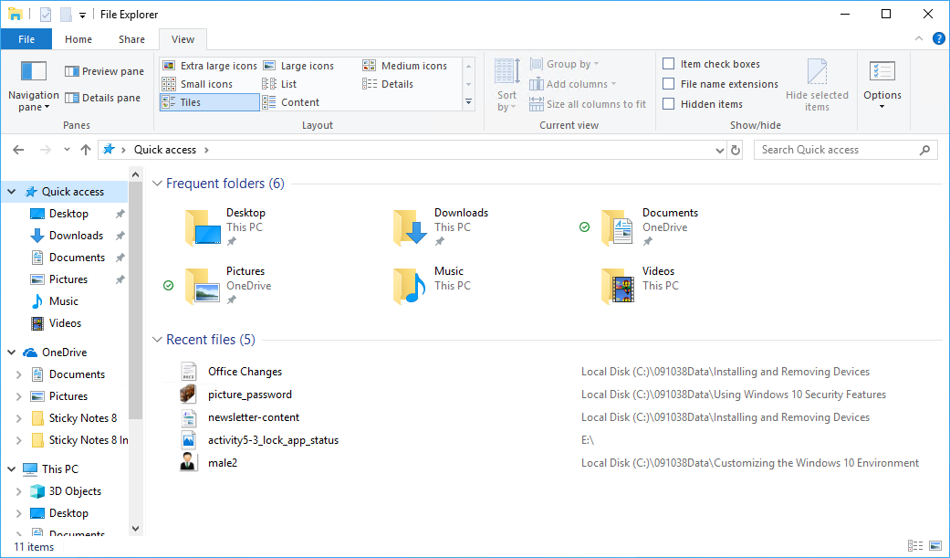
Quick Access
Quick Access

Slide 10
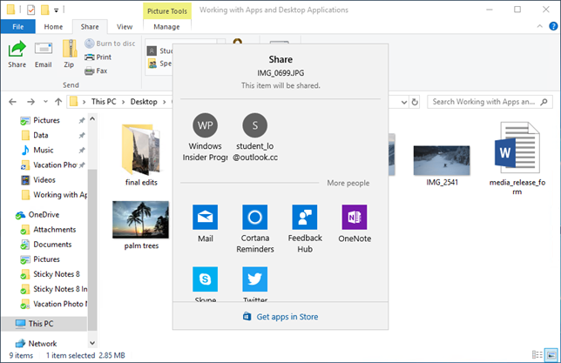
File Share
Share Icon
Apps with the Share Contract

Slide 11
Class Exercises
Exercise 2-1 – Create a File Using WordPad or Notepad
Exercise 2-2 – Rename, Delete, and Restore a File
Exercise 2-3 – Create a new Folder
Exercise 2-4 – Create Subfolders
Exercise 2-5 – Create Desktop Shortcuts
Exercise 2-6 – Search Files In Explorer
Exercise 2-7 – Arrange Files

Slide 12
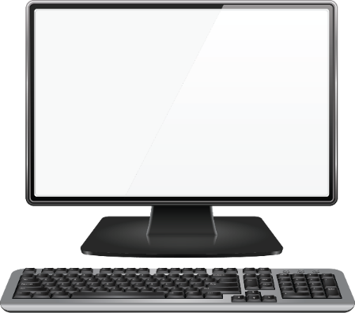
Cloud Computing
Cloud
File 1
Folder A
Personal Computer
Tablet
File 1
File 1
Folder A
Folder A

Slide 13
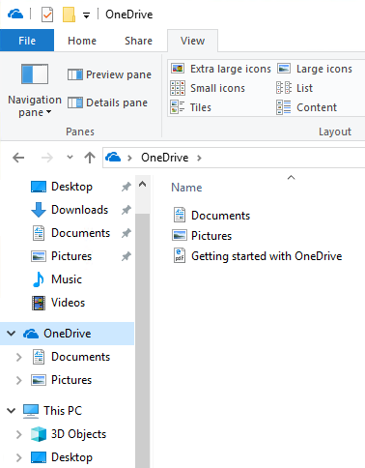
OneDrive
Cloud-based file storage.
Files are accessible at any time, from any device connected to the Internet.
Files are kept up to date on local device and the cloud.
Good for backing up files.

Slide 14
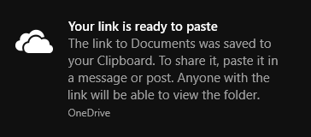
OneDrive Sharing
Share a link to the file in the cloud so that there is only one copy.
Can share files and folders with specific permissions.
Edit
Read-only

Slide 15
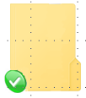
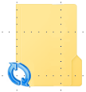
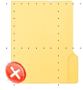
File Sync
OneDrive Icon | Description
 | In sync with online version.
 | Syncing.
 | Local version is out of sync. You will need to check the sync status in the taskbar.

Slide 16
OneDrive Taskbar

Slide 17
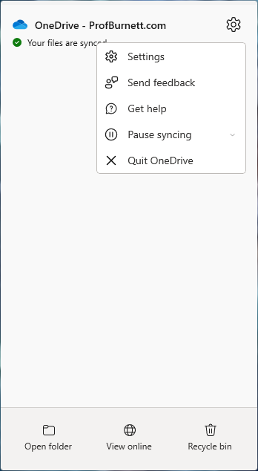
OneDrive Settings

Slide 18
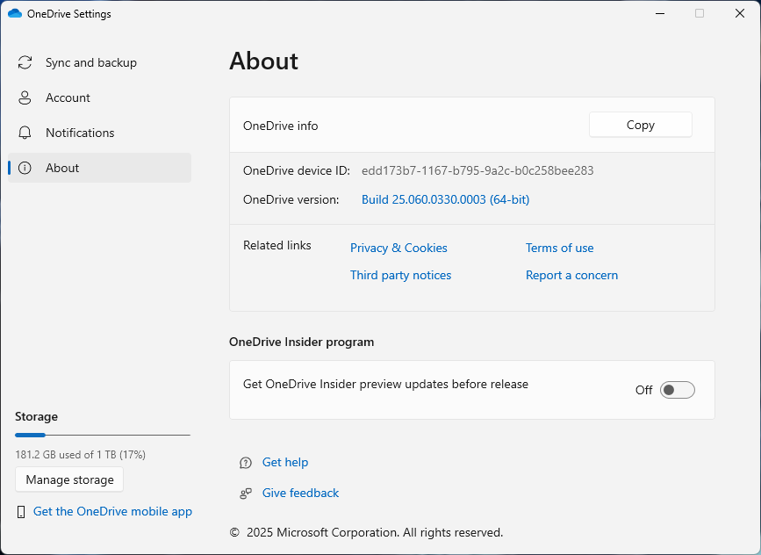
OneDrive About

Slide 19
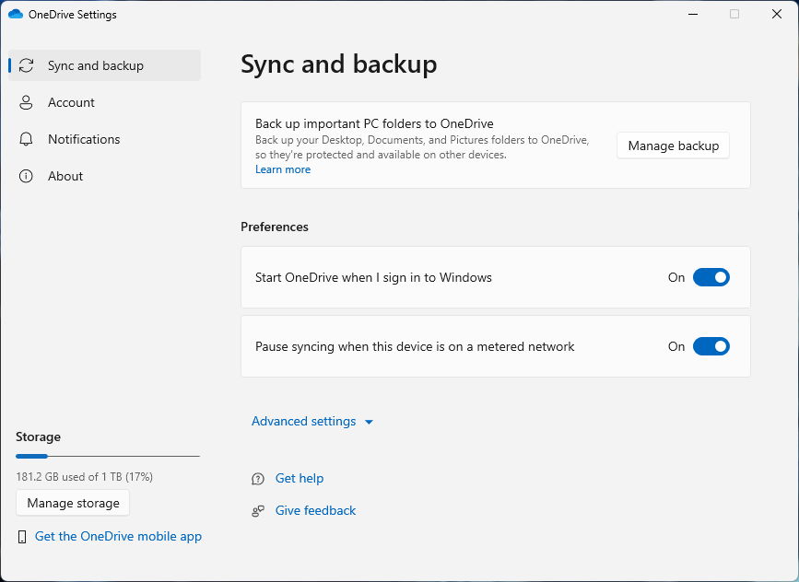
OneDrive Sync and Backup

Slide 20
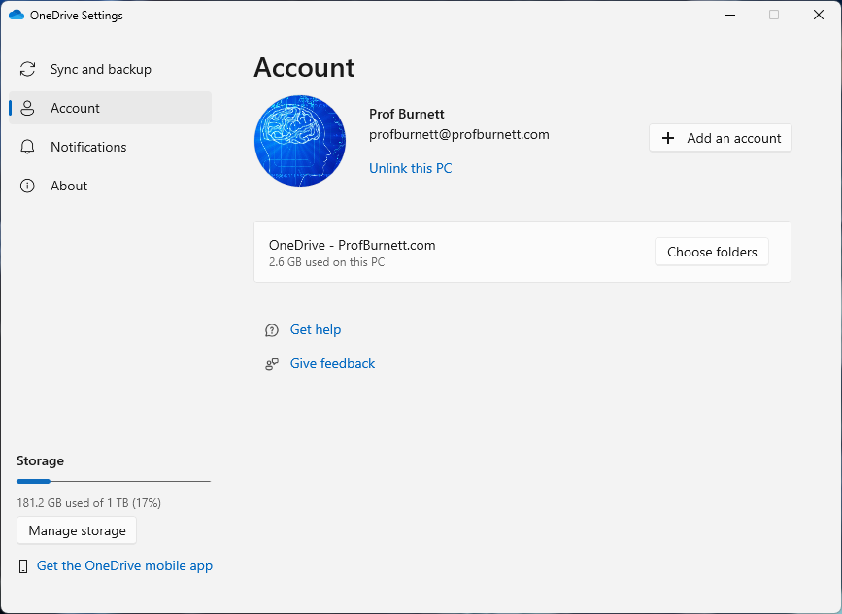
OneDrive Account

Slide 21
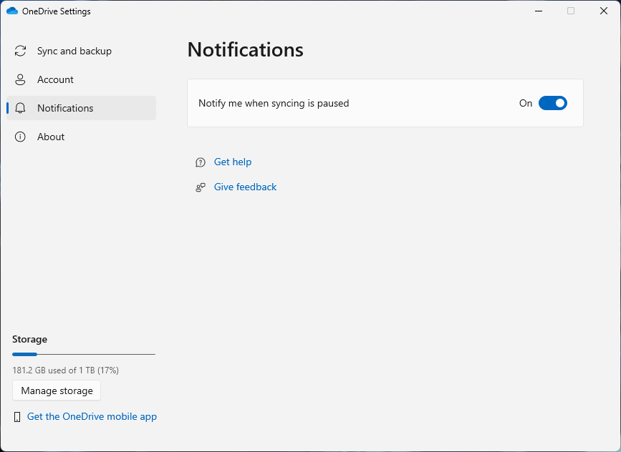
OneDrive Notifications

Slide 22
Class Exercises
Exercise 2-8 – Review OneDrive in File Explorer
Exercise 2-9 – Review OneDrive in Taskbar

Slide 23
Session Review
File Management
File Explorer
OneDrive

