Slide 1
ITI 499 - Mastering Windows Fundamentals
Session I
Intro to Windows 10
Understanding Window User Interface (UI)
www.profburnett.com
Master a Skill / Learn for Life

Slide 2
Session Outline
Intro to Windows 10
Understanding the Windows User Interface (UI)

Slide 3
Mouse Actions
Primary mouse button - by default, is the left mouse button
Secondary mouse button - by default, is the right mouse button
The primary mouse button can be configured to be the right mouse button, which then makes the left mouse button the secondary mouse button
Hover ➔ hover the pointer over an item to see information (no buttons are clicked)
Click
Double-click
Triple-click
Right-click
Drag ➔ when you hold down the primary button and move an item from one place to another

Slide 4
Basic Mouse/Pointer Controls
The Pointer
This interacts with whatever you have it "pointed at." Use the mouse buttons to perform a command
Right Click vs. Left Click
Right Click allows you to display additional information and/or properties of the item selected (often a menu or list of options)
Left click is the default button when clicking on items; it directly interacts with the object (ex: Launch an application)
Double Click is always the left mouse button (never the right)
Scroll Wheel
Allows you to scroll up or down within a given page/application

Slide 5
The Lock Screen

Slide 6
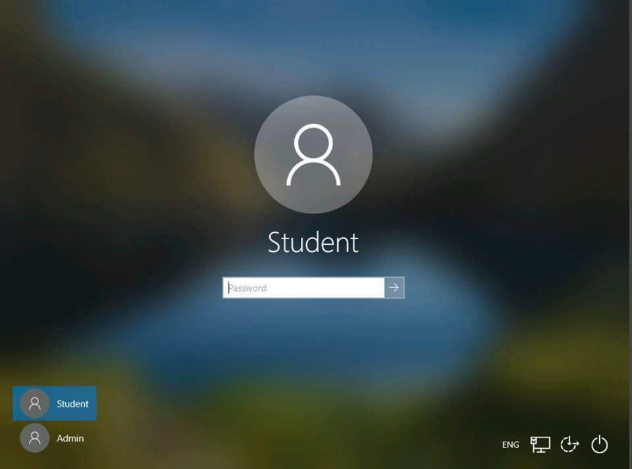
The Login Screen
User account
Password text box
Power Button
Ease of Access
Available accounts
Connection+

Slide 7
Account Types
Local Account
Microsoft Account
Domain Account
Administrator
Standard User

Slide 8
Local Account
Specific to the device where it was created
Can use installed apps, go online, change personalization settings, and do basic work
The account only applies to the computer where the account was created
Configuration only applies to this computer

Slide 9
Microsoft Account
The primary type of account for Windows
Requested for some apps and features
Used to access and manage Microsoft cloud-based services
Synchronizes settings and apps between devices
Allows you to:
Store and share files with OneDrive
Use Windows Hello
Backup settings
Use bundled Windows 10 apps
Download and install Windows Store apps.
Microsoft accounts include:
Outlook and Hotmail accounts
Microsoft 365 apps
OneDrive
Xbox Live

Slide 10
Domain Account
A work or school account created and configured by a network administrator.
Provides access to network resources, including:
Email
Network apps
Network devices
The account is controlled by a network administrator who:
May limit what you can do on the local computer.
May limit which settings you can change.
May prevent you from installing apps or hardware.

Slide 11
Sign-In Options
Password
PIN
Picture password
Biometric authentication

Slide 12
Windows Hello
Uses a PIN and/or biometric system built into Windows 10
Allows authentication by face or fingerprint
Replaces passwords with two-factor authentication
Verifies credentials along with device-specific credentials
Releases credentials that can authenticate you
It is the second factor in two-factor authentication

Slide 13
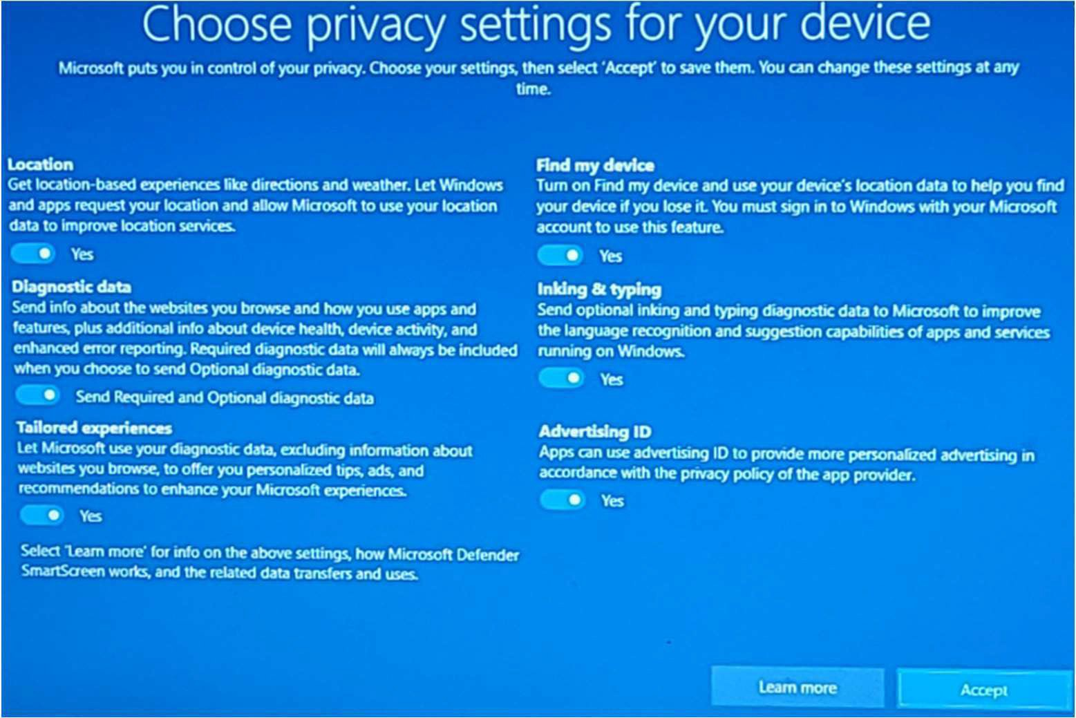
First Run Messages & Prompts

Slide 14
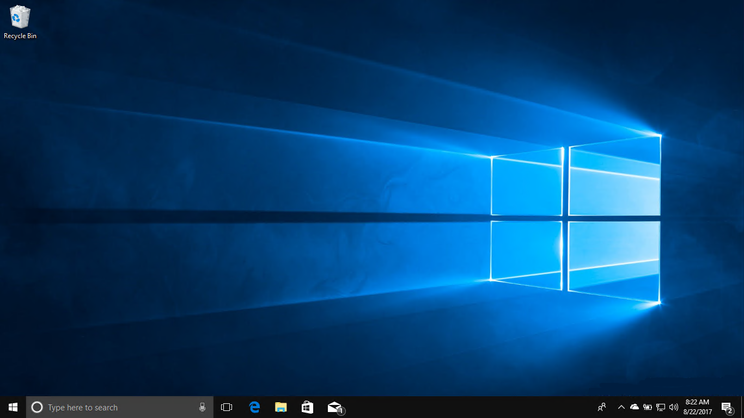
Desktop
Recycle Bin
Desktop Background
Start Button
Taskbar

Slide 15
Taskbar
File Explorer
Start Button
Edge
Windows Store
Search/Cortana
Task View
Mail
System Notification Area

Slide 16
Notification Area
Wired Connection
Show Hidden Icons
Date and Time
People
OneDrive
Battery
Speakers
Action Center

Slide 17
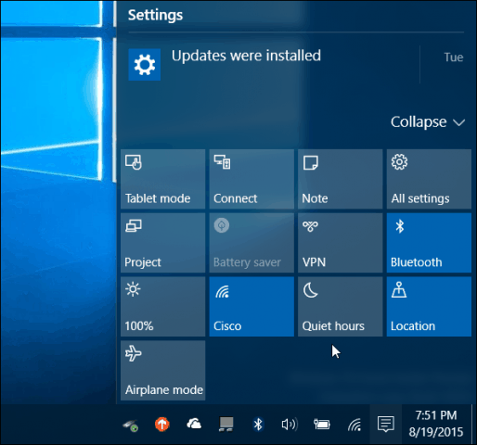
Action Center
Windows Key + A

Slide 18
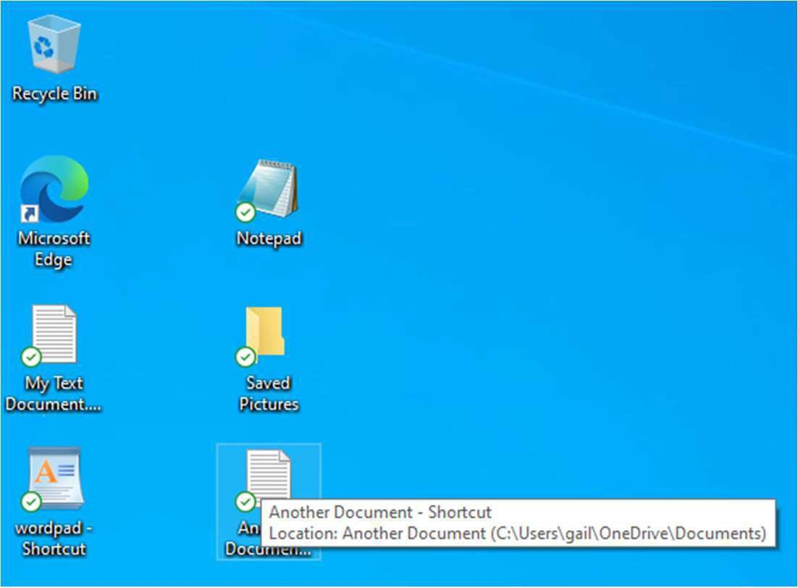
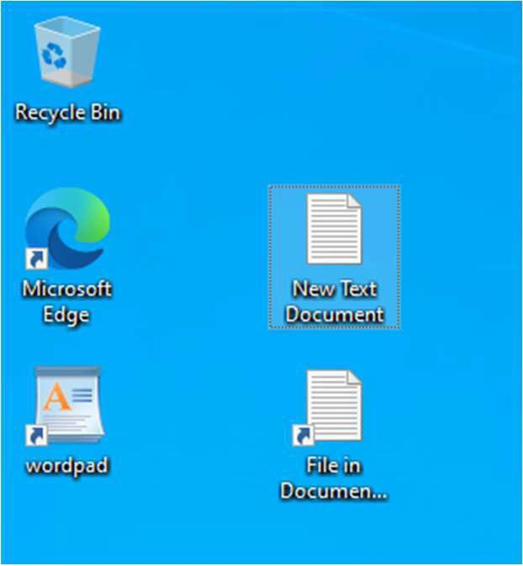
Shortcuts: Local vs. Microsoft Accounts
Microsoft Account User
Local Account User

Slide 19
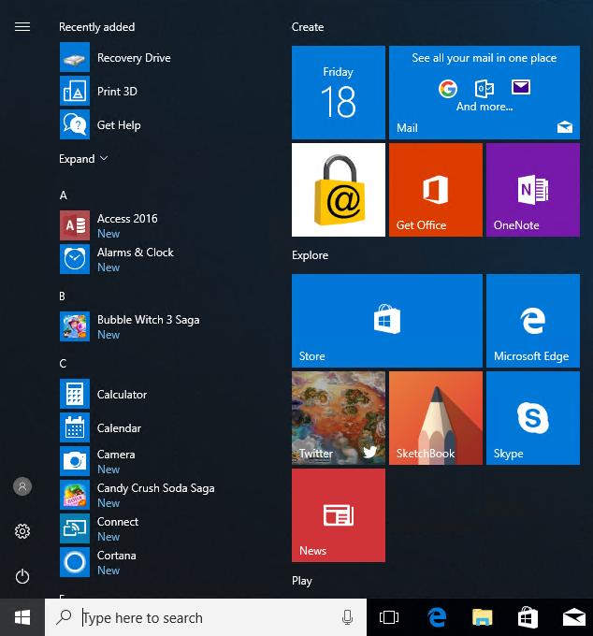
Start Menu
Start Menu List
Tiles
Live Tile
Start Button
Start Menu

Slide 20
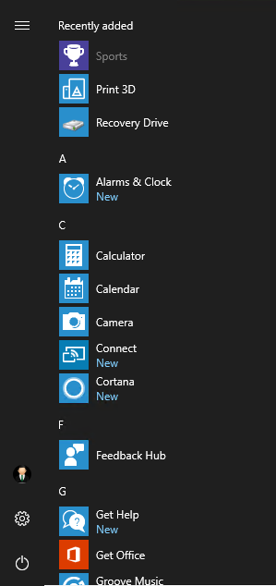
Start Menu List
Three Bar Button
Recently Added Apps
Alphabetical List of Apps
Account ID
Settings
Power

Slide 21
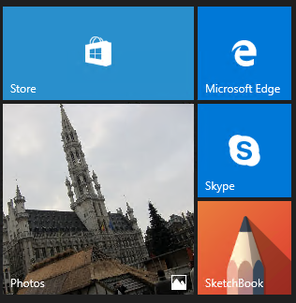
Tiles
Tile Sizes
Live Tile

Slide 22
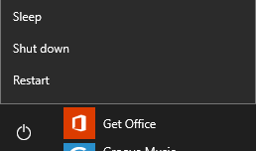
PC Power Options

Slide 23
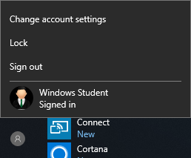
Account ID Options

Slide 24
Task View
Student LO
..-1,..... ..""" SL
Previews of Open Applications
. ........... MONTGOMERY
IYI- COLLEGE
INFORMATION TECHNOLOGY INSTITUTE (ITI}
Copyright© 2021 Logical Operations, Inc. All rights reserved.

Slide 25
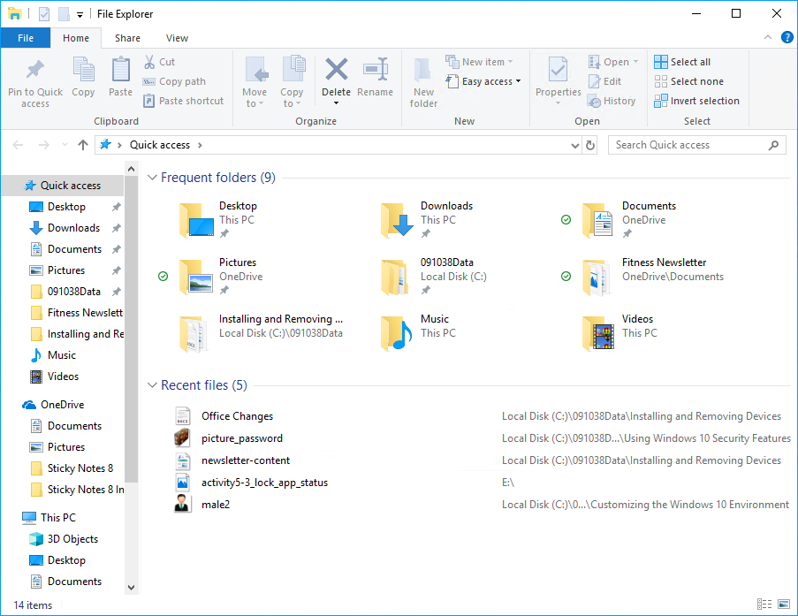
File Explorer
Navigation Pane
Content Pane

Slide 26
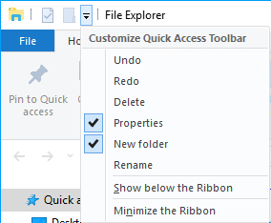
The Quick Access Toolbar and Menu
Quick Access Toolbar
Customize Quick Access Toolbar Menu
These are the actions available for use on the Quick Access Toolbar.
A check indicates the icon is already on the toolbar.

Slide 27
The Ease of Access Menu
Feature | Description
Narrator | Reads aloud what is on the screen.
Magnifier | Enlarges the whole screen or portions of the screen.
On-Screen Keyboard | Places a keyboard on the screen.
High Contrast | Changes display settings so objects on screen are easier to distinguish.
Sticky Keys | Allows you to press key combinations one key at a time.
Filter Keys | Ignores keystrokes repeated rapidly or keystrokes held down for several seconds unintentionally.

Slide 28
Clipboard
Clipboard Function | Keyboard Shortcut | Used To
Cut | Ctrl+X | Remove the selected item from its original location and place it on the clipboard.
Copy | Ctrl+C | Keep the selected item in its original location and also place it on the clipboard.
Paste | Ctrl+V | Place clipboard items (cut or copied) into a new location within a document or in a file created by another program. The contents of the clipboard remain there until you replace them with another selection, lock or sign out of your account, or turn off your PC. This enables you to paste the same item over and over again.
Paste Special | Ctrl+Alt+V | Paste items in a special format of your choosing. For example, you can select Unformatted Text from the Paste Special dialog box to remove any bold formatting or coloring in the text you copied to the clipboard.

Slide 29
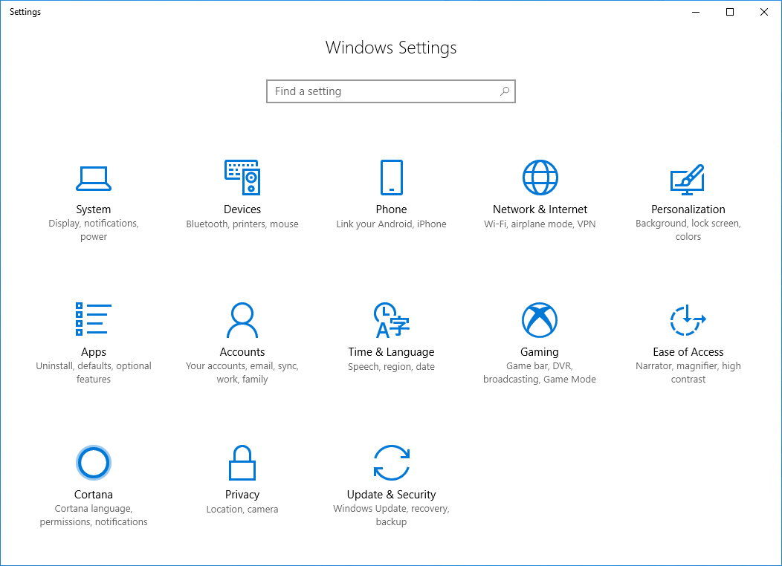
Settings

Slide 30
Class Exercises
Exercise 1.1 – The Mouse
Exercise 1.2 – Start Menu & Taskbar
Exercise 1.3 – Application Windows
Exercise 1.4 – Cut/Copy/Paste
Exercise 1.5 – Task View

Slide 31
Session Review
Intro to Windows 10
Understanding the Windows User Interface (UI)

