Slide 1
ITI 499 - Mastering Windows Fundamentals
Session I
Course Overview Presentation
www.profburnett.com
Master a Skill / Learn for Life

Slide 2
Outline
Introductions
Class Outline
Review Class Website

Slide 3
Instructor Info
Carl Burnett
U.S. Army – ORSA Data Science Analyst
BAH – Consultant – Web Dev Program Manager
GDIT – Senior PM – U.S. Senate
Adjunct Prof – JHU
Prof – Montgomery College
cb@profburnett.com
240.696.1906

Slide 4
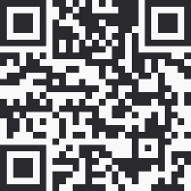
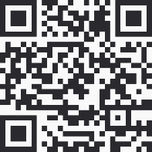
Instructor Info
Professor Burnett Office Hours Bookings https://outlook.office365.com/owa/calendar/ProfessorBurnett@montgomerycollege0.onmicrosoft.com/bookings/
Carl Burnett
Prof – Montgomery College
cb@profburnett.com
240.603.3194
Profburnett Website https://profburnett.com

Slide 5
Introduce Yourselves
Name
What do you do or want to do?
What do you to expect from course?

Slide 6
Administrative Announcements

Slide 7
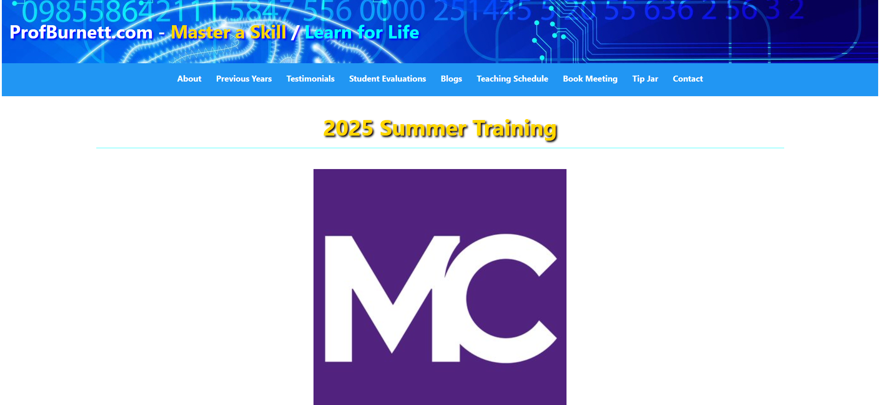
Profburnett.com

Slide 8
Certificate of Course Completion
You are required to attend 80% of the classes.
Please sign in the chat area with your name for each session.

Slide 9
Class Schedule ITI 499 - Mastering Windows Fundamentals
Date | Day | Hours
5/27/2025 - 6/5/2025 | Tuesday & Thursday | 6:30 – 9:30 PM
East County Education Center (ECEC), Silver Spring, MD

Slide 10
Class Schedule
Session I
Course Overview
Intro to Windows 10
Windows User Interface
Session II
File Management
Session III
Managing Applications
Browsing the WWW
Customization Windows 10
Session IV
Personalization & Customization
Settings & Security
Course Review

Slide 11
Set Up Your MyMC Account
Claim Your MC Email Account (Watch Video)
Sign in to your Email.
Access the BlackBoard Course.

