Slide 1
ITI 499 – Mastering Windows Fundamentals Session 3 - Managing Applications & Browsing the Web
http://www.profburnett.com

Slide 2
Session 3 - Managing Applications & Browsing the Web
Managing Applications in Windows (Microsoft 365)
Running and closing applications
Switching between open applications
Installing and uninstalling applications (from the Microsoft Store)
Using Browsers on the World Wide Web
Download and attach files
Windows Task Manager

Slide 3
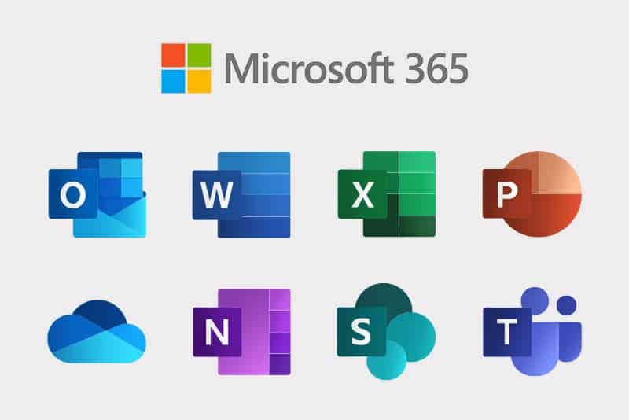
Microsoft 365 Applications

Slide 4
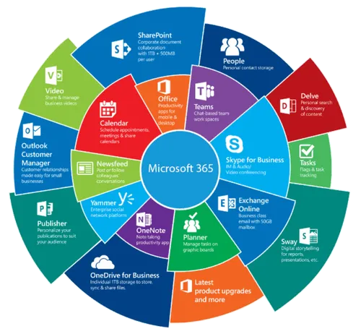
Microsoft 365 Applications

Slide 5
Installing and uninstalling applications (from the Microsoft Store)

Slide 6
Microsoft Store

Slide 7
Knowing Technology IV Your Internet Browsers
http://www.profburnett.com

Slide 8
Introduction to Internet Browsers
Browsers
Websites
Apps
Printing
Saving
Search Engines

Slide 9
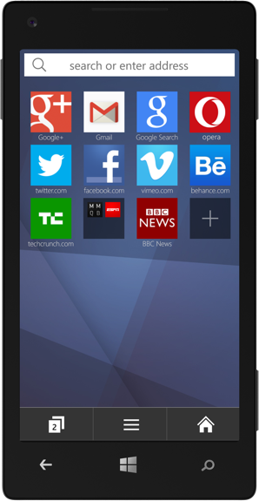
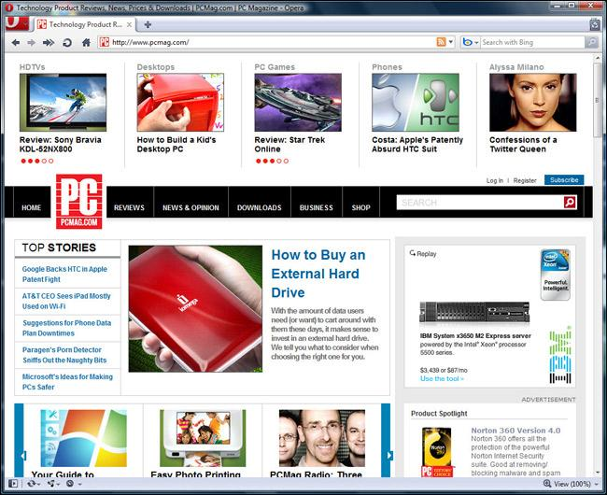
Web Browsers

Slide 10
What a Web Browser is NOT
Not a search engine.
Not an operating System.
Not email.
Not the Internet

Slide 11
Chrome (65.7%)
https://www.google.com/chrome/
Customize your Chrome Personalize your web browser with themes, dark mode, and other options built just for you.
Browse across devices Sign in to Chrome on any device to access your bookmarks, saved passwords, and more.
Save time with autofill Use Chrome to save addresses, passwords, and more to quickly autofill your details.

Slide 12
Safari (17.9%)
https://www.apple.com/safari/
Built for Apple Devices
Better Privacy Controls than Chrome

Slide 13
Edge (5.3%)
https://www.microsoft.com/en-us/edge?ep=0&form=MA13M0&es=40
AI Theme Editor
AI Security Manager
Use for Gaming
Sync bookmarks and passwords across devices

Slide 14
Firefox (2.7%)
https://www.mozilla.org/en-US/firefox/
Single login
Better Privacy Controls Than Edge
Sync across devices

Slide 15
Opera (2.2%)
https://www.opera.com/
Tab Islands
Privacy better than Edge
Free VPN

Slide 16
Brave (1%)
https://brave.com/
Better Privacy than Firefox
Ad Blocking
Adherence to Web Standards

Slide 17
Internet Browsers Settings
Chrome
Safari
Edge
Firefox
Your (Profiles)
Autofill & Passwords
Privacy & Security
Performance
Appearance
Search Engine
Default Browser
On Startup
Languages
Sidebar
Downloads
Accessibility
System
Reset Settings
Extensions
General
Tabs
Autofill
Passwords
Search
Privacy
Websites
Profiles
Extensions
Advanced
Profiles
Privacy, Search
Appearance
Sidebar
Start, Home
Copy, Paste
Cookies and Permissions
Downloads
Family
Languages
Printers
System
Devices
Accessibility
General
Homepage
Search
Privacy & Security
Sync
Extensions and Themes

Slide 18
Knowing Technology IV Email
http://www.profburnett.com

Slide 19
Email Applications
Online (Webmail) Services
Offline Email Apps
Sending and Receiving
Reply and Reply All
Spam mail

Slide 20
Online (Webmail) Services
Apple Mail (48%)
Gmail (36%)
Outlook (Outlook.com, Hotmail.com, Live.com) (.65%)
Yahoo Mail (2.8%)
AOL Mail (Less than .01%)

Slide 21
Email Apps
Windows Email Apps
Apple Email Apps
Microsoft Outlook
Windows Mail
Thunderbird
Mailbird
eM Client
Kiwi for Gmail
Twobird
Microsoft Outlook
Apple Mail
Spark
Canary Mail
Mailspring
Mimestream

Slide 22
Task Manager
http://www.profburnett.com

Slide 23
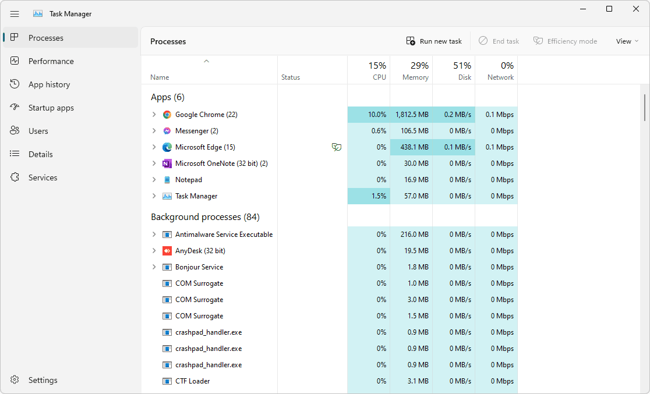
Task Manager

