Slide 1
ITI 499 – Mastering Windows Fundamentals Session II
http://www.profburnett.com

Slide 2
Session 2 - File Management
Working with Files and Folders
Understanding File Types
Understanding the Folder Structure (Hierarchy) & File Paths
Creating, moving, and copying files and folders
Creating Shortcuts to files & folders
Renaming and deleting files and folders
Recover Deleted Files
Searching for files and folders

Slide 3
File Types

Slide 4
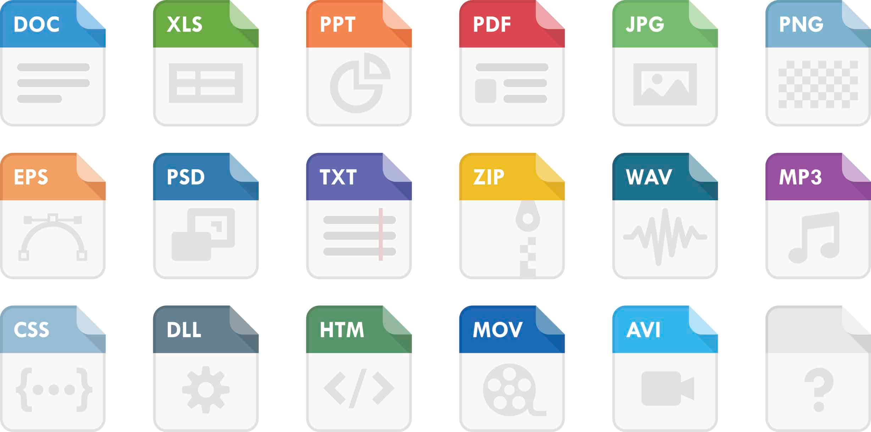
File Type Extensions and Icons

Slide 6
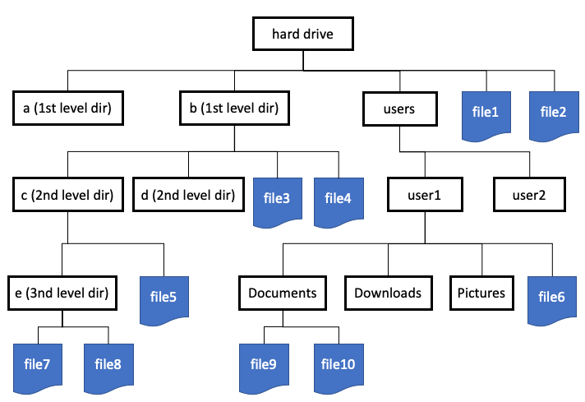

Slide 7
Session 2 - File Management
Creating, moving, and copying files and folders
Creating Shortcuts to files & folders
Renaming and deleting files and folders
Recover Deleted Files
Searching for files and folders

