Slide 1
ITI 499 – Mastering Windows Fundamentals
http://www.profburnett.com

Slide 2
Instructor Info
Profburnett Scheduler https://calendly.com/profburnett
Carl Burnett
Prof – Montgomery College
cb@profburnett.com
240.603.3194
Profburnett Website https://profburnett.com

Slide 3
Introduce Yourselves
Name
What do you do?
What do want to learn from this course?

Slide 4
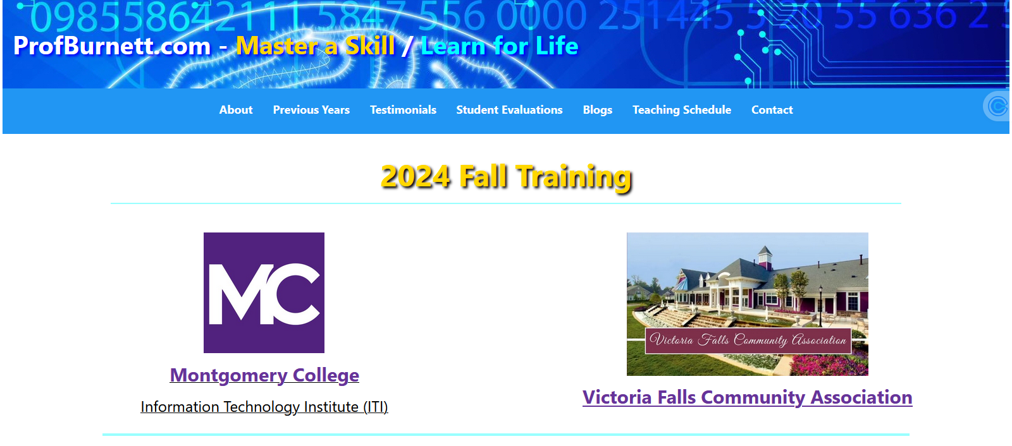
Profburnett.com

Slide 5
Outline
Session 1 - Windows User Interface
Session 2 - File Management
Session 3 - Managing Applications & Browsing the Web
Session 4 - Personalization (Customization) & Settings

Slide 6
Session 1 - Windows User Interface
Class Overview & Introduction to Windows
Overview of Windows operating system
Key features of Windows
Understanding the Windows User Interface
Overview of the mouse/pointer
Desktop
Start menu
Taskbar (Icons/Buttons, Notification Area/Action Center, Search Tool)

Slide 7
Session 2 - File Management
Working with Files and Folders
Understanding File Types
Understanding the Folder Structure (Hierarchy) & File Paths
Creating, moving, and copying files and folders
Creating Shortcuts to files & folders
Renaming and deleting files and folders
Recover Deleted Files
Searching for files and folders

Slide 8
Session 3 - Managing Applications & Browsing the Web
Managing Applications in Windows
Running and closing applications
Switching between open applications
Installing and uninstalling applications (from the Microsoft Store)
Using Edge to browse the World Wide Web
Download and attach files
Task Manager

Slide 9
Session 4 - Personalization (Customization) & Settings
Personalizing Windows
Customizing the desktop background and/or theme
Changing mouse settings
Finding System Information
Overview of Windows Update & Windows Defender
Review, Course Evaluations, Q&A

Slide 10
Questions
and
Answers

Slide 11
Course Review
Session 1 - Windows User Interface
Session 2 - File Management
Session 3 - Managing Applications & Browsing the Web
Session 4 - Personalization (Customization) & Settings

