Slide 1
HTML5-CSS3
Session VIII
Chapter 20 - How to use SASS and Less
www.profburnett.com
Master a Skill / Learn for Life

Slide 2
Outline
CSS Use
CSS Methodologies
CSS Precompliers and Postprocessors
Comparison of CSS Processors
SasS
{less}
Stylus
PostCSS

Slide 3
CSS Use
CSS for basic styling
CSS for layout
Float
Flexbox
Grid

Slide 4
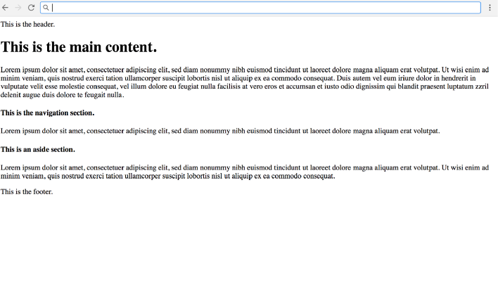
No CSS

Slide 5
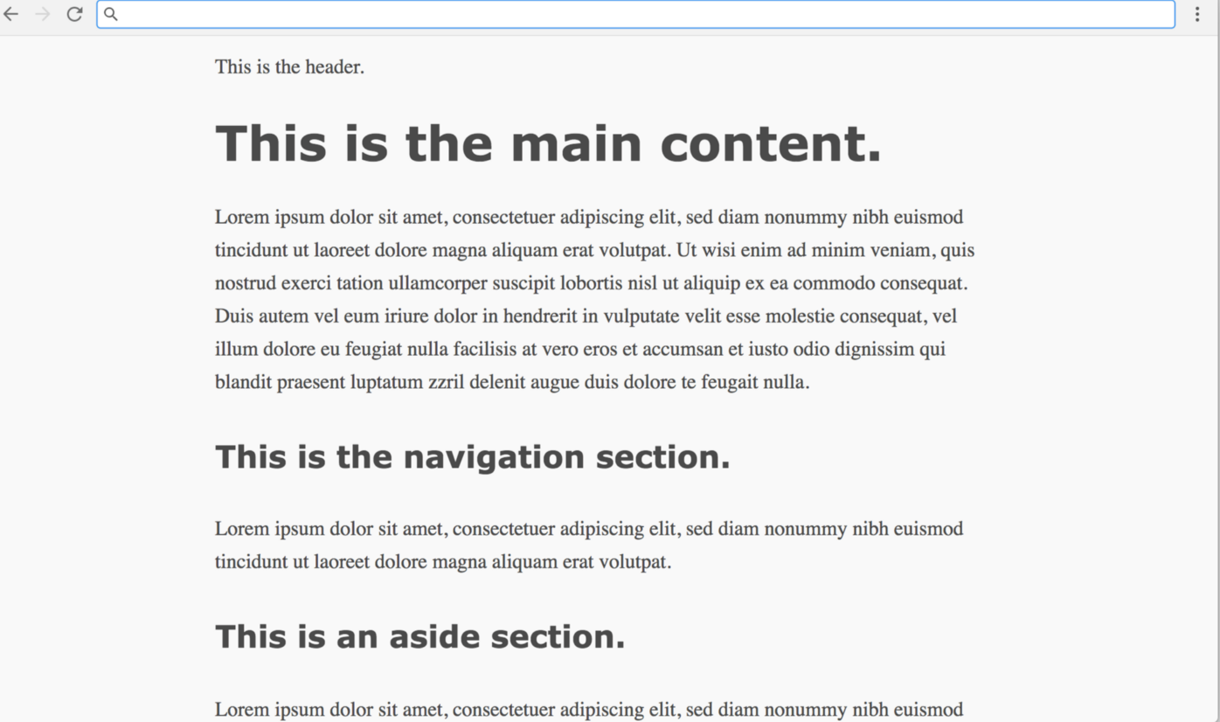
CSS for Basic Styling (Early 1990’s)

Slide 6
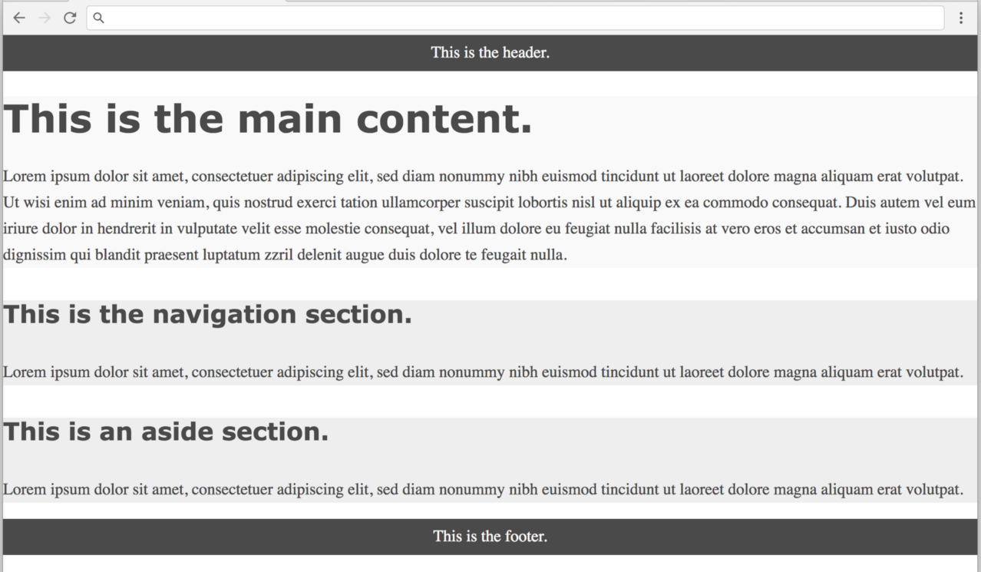
CSS for Layout (1999)

Slide 7
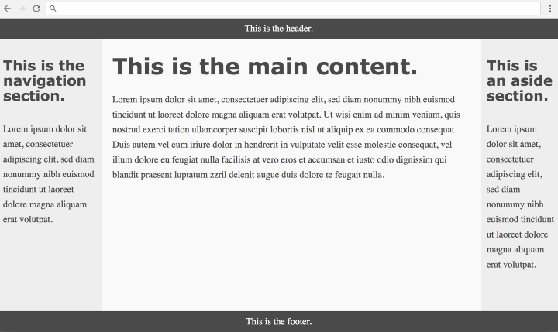
Float-Based CSS Layout (2006)

Slide 8
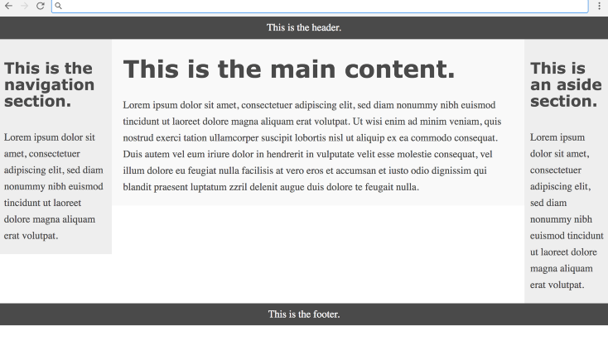
Flexbox-based CSS Layout (2015)

Slide 9
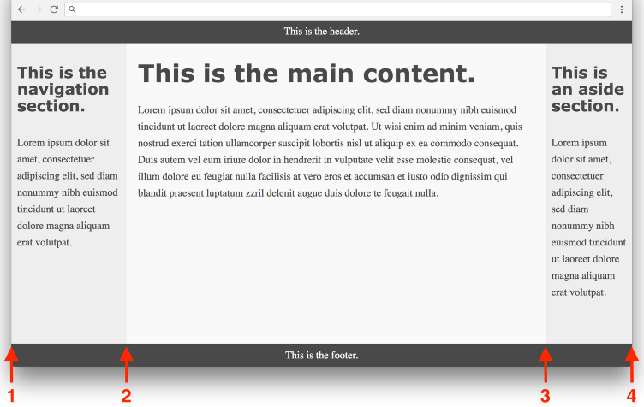
Grid-based CSS Layout (2018)

Slide 10
CSS Methodologies

Slide 11
Strategy & Structure
Style Architecture
Performance Driven Selectors
Reusable Code
Minify & Compress Files
Reduce HTTP Requests
Cache Common Files
Ref: http://learn.shayhowe.com/advanced-html-css/performance-organization/

Slide 12
Style Architecture
Responsive Web Design (RWD)
Object Oriented CSS (OOCSS)
Scalable & Modular Architecture for CSS (SMACSS)
Adaptive Web Design (AWD)
BEM (Block, Element, Modifier)

Slide 13
Object Oriented CSS
Separation of Structure From Skin
Separation of Containers and Content
The Benefits Of OOCSS
Faster Websites
Maintainable Stylesheets
Ref: http://www.smashingmagazine.com/2011/12/an-introduction-to-object-oriented-css-oocss/

Slide 14
Scalable & Modular Architecture for CSS
Categorizing CSS Rules
Base
Layout
Module
State
Theme
Depth of Applicability
Selector Performance
HTML5 and SMACSS
Prototyping
Preprocessors
Drop the Base
The Icon Module
Complicated Inheritance
Ref: https://smacss.com/

Slide 15
Adaptive Web Design
Three layers of Progressive Enhancement
Content layer = rich semantic HTML markup
Presentation layer = CSS and styling
Client-side scripting layer = JavaScript or jQuery behaviors
Ref: http://www.techrepublic.com/blog/web-designer/what-is-the-difference-between-responsive-vs-adaptive-web-design/

Slide 16
Performance Driven Selectors
Keep Selectors Short
Favor Classes
/* Bad */
header nav ul li a {...}
/* Good */
.primary-link {...}
/* Bad */
button strong span {...}
button strong span .callout {...}
/* Good */
button span {...}
button .callout {...}
/* Bad */
#container header nav {...}
/* Good */
.primary-nav {...}
/* Bad */
article.feat-post {...}
/* Good */
.feat-post {...}
Ref: http://learn.shayhowe.com/advanced-html-css/performance-organization/#performance-driven-selectors

Slide 17
Reusable Code
/* Bad */
.news {
background: #eee;
border-radius: 5px;
box-shadow: inset 0 1px 2px rgba(0, 0, 0, .25); }
.social {
background: #eee;
border-radius: 5px;
box-shadow: inset 0 1px 2px rgba(0, 0, 0, .25); }
/* Good */
.news,
.social {
background: #eee;
border-radius: 5px;
box-shadow: inset 0 1px 2px rgba(0, 0, 0, .25); }
/* Even Better */
.modal {
background: #eee;
border-radius: 5px;
box-shadow: inset 0 1px 2px rgba(0, 0, 0, .25); }
Ref: http://learn.shayhowe.com/advanced-html-css/performance-organization/#reusable-code

Slide 18
Minify & Compress Files
JavaScript Minifiers
Packer
JSMin
Closure compiler
YUICompressor (also does CSS)
AjaxMin (also does CSS)
CSS Minifiers
CSSTidy
Minify
YUICompressor (also does JS)
AjaxMin (also does JS)
CSSCompressor
Others
YUICompressor - .NET Port that can compress on the fly or at build time. Also on NuGet.
AjaxMin - Has MSBuild tasks and can be integrated into your project's build.
SquishIt - Used at runtime in your ASP.NET applications' views and does magic at runtime.
Chirpy - "Mashes, minifies, and validates your javascript, stylesheet, and dotless files."
Combres - ".NET library which enables minification, compression, combination, and caching of JavaScript and CSS resources for ASP.NET and ASP.NET MVC web applications."
Cassette by Andrew Davey - Does it all, compiles CoffeeScript, script combining, smart about debug- and release-time.
https://www.hanselman.com/blog/TheImportanceAndEaseOfMinifyingYourCSSAndJavaScriptAndOptimizingPNGsForYourBlogOrWebsite.aspx

Slide 19
Reduce HTTP Requests
Combine Like Files
Image Sprites
Image Data URI
AJAX
Ref: http://learn.shayhowe.com/advanced-html-css/performance-organization/#reduce-http-requests

Slide 20
Cache Common Files
ExpiresByType text/css "access plus 1 year"
ExpiresByType application/javascript "access plus 1 year"
Ref: http://learn.shayhowe.com/advanced-html-css/performance-organization/#performance-driven-selectors

Slide 21
CSS Precompilers (Pre-Processors)
Sass
SCSS
Less.js
Stylus
CSS-Crush
Myth
Rework

Slide 22
CSS Postprocessors
PostCSS
Pleeease
Bless
CSSNext
Stylecow
-prefix-free

Slide 23
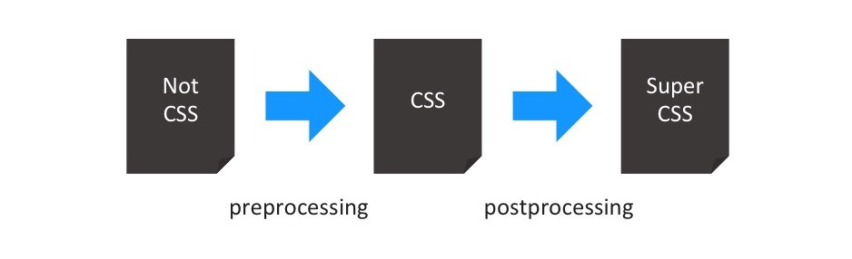
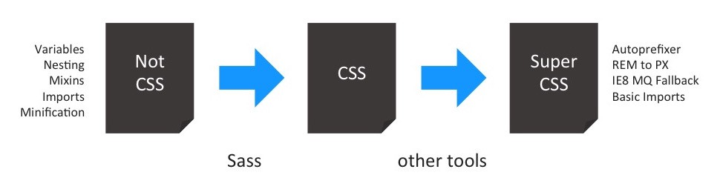
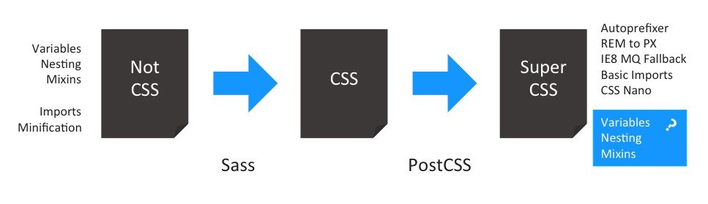
Comparison of CSS Processors

Slide 24
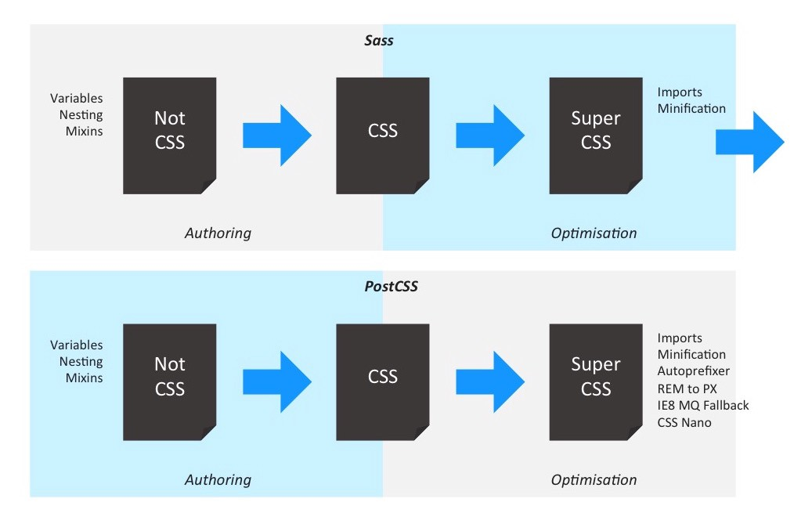
Comparison of CSS Processors

Slide 25
Sass (Syntactically Awesome StyleSheets)
Fully CSS-compatible
Two Syntaxes – SCSS (Sassy CSS) and Sass
Ruby Module or Ruby on Rails
Language extensions such as variables, nesting, and mixins
Many useful functions for manipulating colors and other values
Advanced features like control directives for libraries
Well-formatted, customizable output
Variables
Nesting
Partials
Import
Mixins
Inheritance
Operators

Slide 26
{less} - Leaner Style Sheets
Backwards-compatible language extension for CSS.
JavaScript tool that converts your Less styles to CSS styles.
Uses Node.js
Variables
Mixins
Nesting
Operations
Escaping
Functions
Namespaces and Accessors
Maps
Scope

Slide 27
Stylus
Selectors
Variables
Interpolation
Operators
Mixins
Functions
Keyword Arguments
Rest Params
Conditionals
Hashes Objects
Iteration

Slide 28
PostCSS
Increase code readability with Autoprefixer
Tomorrow’s CSS - PostCSS Preset Env
The end of global CSS - CSS Modules
Avoid errors in your CSS - stylelint
Powerful grid system - LostGrid
PostCSS plugins

Slide 29
CSS Tools
CodeKit (Paid)
Compass.app (Paid, Open Source)
Ghostlab (Paid)
Hammer (Paid)
Koala (Open Source)
LiveReload (Paid, Open Source)
Prepros (Paid)
Scout-App (Free, Open Source)

Slide 30
Review
CSS Use
CSS Methodologies
CSS Precompliers and Postprocessors
Comparison of CSS Processors
SasS
{less}
Stylus
PostCSS

