Slide 1
HTML5-CSS3
Session VII
Chapter 15 - How to work with Fonts and Printing
Chapter 16 - How to Use CSS3 Transitions, Transforms, Animation and Filters
www.profburnett.com
Master a Skill / Learn for Life

Slide 2
Class Outline
Chapter 15 - How to work with Fonts and Printing
Chapter 16 - How to Use CSS3 Transitions, Transforms, Animation and Filters

Slide 3
Working with Text
Font Families
  Serif – Times New Roman
  San Serif - Arial
  Monospace – Courier New
  Cursive – Lucida Handwriting
  Fantasy - Impact
Notes:
The font family of a text is set with the font-family property. There are many different types of font families.
This list includes Serif, Sans Serif, Monospace, Cursive and Fatasy font families.
When you define a font family to be used in a web page there should be several font names as a "fallback" font for the page. If the browser does not support the first font, it tries the next font. Start with the font you want, and end with a generic family, to let the browser pick a similar font in the generic family, if no other fonts are available.

Slide 4
How to Specify a Font Family
font-family: Arial, Helvetica, san-serif;
font-family: “Times New Roman”, Times, serif;
font-family: “Courier New”, Courier, monospace;
Web Safe Font Combinations
W3C Example
Notes:
The way you specify the font family you would like to use is to declare the primary font you want, then a secondary or third font and then the font family.
[First Bullet]
In this example we are declare two fonts to be used. The first is Arial, then Helvetica, and then the font family. In the case, san-serif.
[Second Bullet]
In the next example we declare a serif font family.
[Last Bullet]
In the last example we declare a monospace font family.
[First Button - Go to W3C Website]
If you’re not sure about the combinations you should use to declare a font family you can use this website to see what are web safe fonts to use. Here they identify San-Serif font families, Serif font families, and Monospaced font families.
In this example we have a stylization rule that uses a pseudo-class to define the font family. Two families have been defined by class. The classes are serif and sanserif. Each class is further defined by fonts to be used in the font family.
In the HTML code for the web page the classes are used to stylize each paragraph by font family.
Now replace one of the font families with another font family and see the results. You can also add another monospace font family if you want.
[Minimize Browser]
Once you have completed this exercise come back and restart the video.

Slide 5
How to Specify a Font Size
font-size: 12 pt;
font-size: 150%
font-size: 1.5 em;
Notes:
You can also specify the font size of a font. The size can be an absolute size like 12 points or pixels or it can be specified in relative terms. When specifying in relative size we use a percentage.
This enables the font to size itself based on the device that will display the web page.

Slide 6
Other Font Styling Properties
font-style: normal | italic | oblique | initial | inherited
CSS Font Styling Properties
W3C Example
font-variant: normal | small-caps | initial | inherited
CSS Font Variant Properties
W3C Example
font-weight: normal | bold | bolder | lighter | number | initial |
inherited
CSS Font Weight Properties
W3C Example
Notes:
There are other font styling properties that can be used to stylize a font.
[First Button - Go to W3C Website]
The font styling properties are listed for you here. One of the items you need to check is the version of browser supports this CSS font styling rules. Listed here are the versions of the major browsers and what version support font styling using these properties.
You can also experiment with the “Play It” feature to see how the font changes look in different browsers.
[Minimize Browser]
[Second Button - Go to W3C Website]
The font variant is another font property that can be specified in CSS. Again, one of the items you need to check is the version of browser to see if it supports this CSS font variant styling rules.
You can also experiment with the “Play It” feature to see how the font variant changes look in different browsers.
[Minimize Browser]
[Third Button - Go to W3C Website]
You can also specify the font weight properties. Also check is the version of browser to see if it supports this CSS font weight styling rules.
You can also experiment with the “Play It” feature to see how the font variant changes look in different browsers.
[Minimize Browser]
[Exercise Buttons]
There are three exercises you can do to make changes to font style, font variant, and the font weight properties.
Once you have completed these exercises come back and restart the video.

Slide 7
Indenting and Aligning Text
text-align: center | right | left
CSS Text Align Properties
W3C Example
text-indent: length| % | initial | inherited
CSS Text Indent Properties
W3C Example
vertical-align: length | % | baseline | sub | super | top | text-top | middle | bottom | text-bottom | initial | inherited
CSS Vertical Align Properties
W3C Example
Notes:
There are also text alignment styling properties that can be used to align text.
The text align properties are listed for you here. One of the items you need to check is the version of browser supports this CSS text alignment rules. Listed here are the versions of the major browsers and what version support text align styling using these properties.
You can also experiment with the “Play It” feature to see how the text align changes look in different browsers.
The text indent is another text alignment property that can be specified in CSS. Again, one of the items you need to check is the version of browser to see if it supports this CSS text indent styling rules.
You can also experiment with the “Play It” feature to see how the text indent properties look in different browsers.
You can also specify the vertical alignment of images using the vertical-align properties. Also check is the version of browser to see if it supports this CSS vertical-align properties rules.
You can also experiment with the “Play It” feature to see how the image vertical-align properties look in different browsers.
There are three exercises you can do to make changes to text alignment, text indent, and image vertical-alignment properties.
Once you have completed these exercises come back and restart the video.

Slide 8
Decorating Text
text-transform: none | capitalize | uppercase | lowercase | initial | inherited;
Text-transform Properties
W3C Example
text-decoration: none | underline | overline | line-through | initial | inherited;
Text-decoration Properties
W3C Example
text-shadow: h-shadow | v-shadow | blur | color | none | initial | inherited;
Text-Shadow Properties
W3C Example
Notes:
There are also text transformation properties that can be used to transform text.
[First Button - Go to W3C Website]
The text transformation properties are listed for you here. One of the items you need to check is the version of browser supports this CSS text transformation rules. Listed here are the versions of the major browsers and what version support text transformation using these properties.
You can also experiment with the “Play It” feature to see how the text transformation changes look in different browsers.
[Minimize Browser]
[Second Button - Go to W3C Website]
The text decoration another text property that can be specified in CSS. Again, one of the items you need to check is the version of browser to see if it supports this CSS text decoration styling rules.
You can also experiment with the “Play It” feature to see how the text decoration properties look in different browsers.
[Minimize Browser]
[Third Button - Go to W3C Website]
You can also specify the text shadow using the text shadow properties. Also check is the version of browser to see if it supports this CSS text shadow properties rules.
You can also experiment with the “Play It” feature to see how the text shadow properties look in different browsers.
[Minimize Browser]
There are three exercises you can do to make changes to text transformation, text decoration, and text shadow properties.
Once you have completed these exercises come back and restart the video.

Slide 9
Image Floating
float: none | left | right | initial | inherited;
Image Floating Properties
W3C Example
Notes:
There are also image floating properties that can be used to specify whether or not a CSS element box should float.
[First Button - Go to W3C Website]
The image floating properties are listed for you here. One of the items you need to check is the version of browser supports this CSS image floating rules. Listed here are the versions of the major browsers and what version support image floating using these properties.
You can also experiment with the “Play It” feature to see how image floating properties changes look in different browsers.
[Minimize Browser]
There is an exercise you can do to make changes to image floating properties.
Once you have completed these exercises come back and restart the video.

Slide 10
A media query for printing at the end of a style sheet
@media print {
body {
font-family: "Times New Roman", Times, serif;
background-color: white;
}
}
A style element for printing in the head section of the HTML
<style media="print">
font-family: "Times New Roman", Times, serif;
background-color: white;
</style>

Slide 11
Recommendations for formatting printed pages
Change the text color to black and the background color to white.
Change text other than headings to a serif font to make the text easier to read when printed.
Use a base font size that’s easy to read when printed.
Keep the line length of the text to 65 characters or fewer.
Remove site navigation since it can’t be used from a printed page.
Remove as many images as possible, especially animated images.

Slide 12
CSS that uses two of the Properties for printing
img { display: none; }
h1, h2, h3 { page-break-after: avoid; }

Slide 13
The link elements in the head section
<link rel="stylesheet" href="styles/speaker.css">
<link rel="stylesheet" href="styles/speaker_print.css"
media="print">
Changes to the printed page
The navigation menu and side aren’t printed.
The headings, text, and borders are set to black.
The article is wider.
The font for the text has been changed to a serif font so it’s easier to read.

Slide 14
The style sheet for the printed web page
body {
font-family: "Times New Roman", Times, serif;
width: auto;
}
h1, h2 {
font-family: Verdana, Arial, Helvetica, sans-serif;
}
#nav_menu {
display: none;
}
aside {
display: none;
}
article {
width: auto;
}
header {
border-bottom: 2px solid black;
}
header h2 {
color: black;
font-size: 180%;
}
header h3 {
color: black;
font-size: 120%;
}
footer {
border-top: 2px solid black;
}

Slide 15
Student Exercise 1
Complete Exercise 15-1 & 2, page 547
Download Chapter 15 exercise zip file to desktop. Unzip files and folders and place in Session 4 local development folder.
Students will upload local development site to testing development site.
Students will preview in browser development files.
Students will upload files to live site.
Students will preview in browser live files.

Slide 16
Properties for working with transitions
transition
transition-property
transition-duration
transition-timing-function
transition-delay
The syntax for the shorthand transition property
transition: [property] [duration] [timing-function]
[delay];

Slide 17
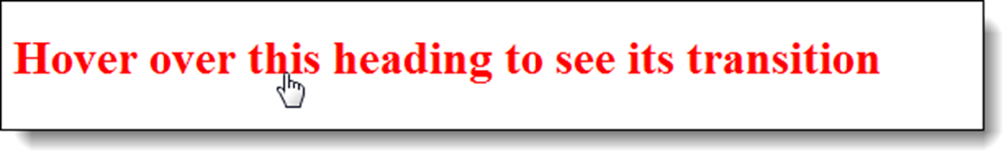
Transition - mouse hovers over a heading
Before the transition
During the transition

Slide 18
HTML Element Transitioned
<h1>Hover over this heading to see its transition</h1>
CSS for Two Property Transition
h1 { font-size: 120%;
color: blue;
transition: font-size 2s ease-out 1s,
color 2s ease-in 1s; }
h1:hover {
cursor: pointer;
font-size: 180%;
color: red; }

Slide 19
Transition for One Property
h1 { font-size: 120%;
transition: font-size 2s ease-out;
-webkit-transition: font-size 2s ease-out; }
h1:hover { font-size: 180%; }
Transition for All properties
transition: all 2s ease-out 1s

Slide 20
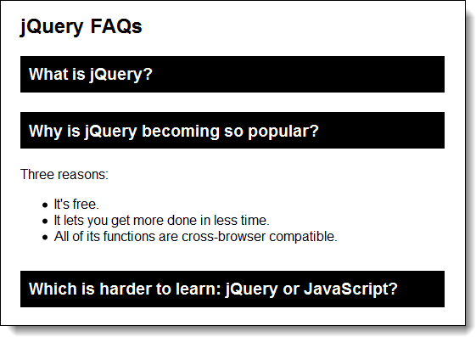
Accordion Created with CSS3 Transitions

Slide 21
HTML for Accordion
<h1>jQuery FAQs</h1>
<div id="accordion">
<h3><a href="#Q1">What is jQuery?</a></h3>
<div id="Q1">Contents for first panel</div>
<h3><a href="#Q2">Why is jQuery becoming so
popular?</a></h3>
<div id="Q2">Contents for second panel</div>
<h3><a href="#Q3">Which is harder to learn:
...?</a></h3>
<div id="Q3">Contents for third panel</div>
</div>

Slide 22
CSS for the Transitions
#accordion div {
overflow: hidden;
height: 0;
transition: height 2s ease-in-out;
-webkit-transition: height 2s ease-in-out;
}
#accordion div:target { height: 120px; }

Slide 23
Properties for 2D Transforms
transform, transform-origin
Methods for 2D transforms
rotate(angle)
rotateX(angle)
rotateY(angle)
scaleX(value)
scaleY(value)
scale(x-value,y-value)
skewX(angle)
skewY(angle)
skew(x-angle,y-angle)
translateX(value)
translateY(value)
translate(x-value,y-value)
matrix(a,b,c,d,e,f)

Slide 24

Image - Right Origin Rotated Right
The CSS for the transform
The HTML for the original and rotated images
<p><img src="images/01.jpg" >
<img src="images/01.jpg" class="image1">
</p>
.image1 {
transition: 2s; }
.image1:hover {
transform: rotateY(180deg);
transform-origin: right; }

Slide 25
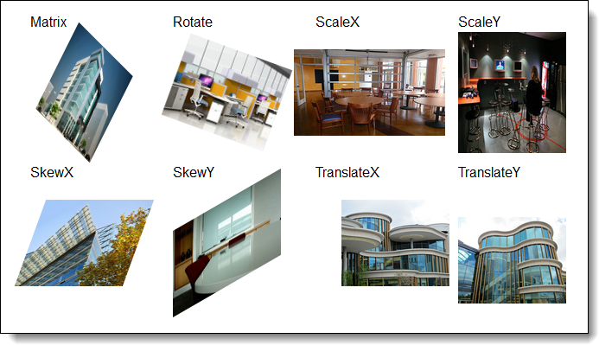
Images with 8 different transforms applied

Slide 26
HTML for the Images with Transforms
<ul>
<li><p>Matrix</p><img src="images/01.jpg" class="image1"></li>
<li><p>Rotate</p><img src="images/02.jpg" class="image2"></li>
<li><p>ScaleX</p><img src="images/03.jpg" class="image3"></li>
<li><p>ScaleY</p><img src="images/04.jpg" class="image4"></li>
<li><p>SkewX</p><img src="images/05.jpg" class="image5"></li>
<li><p>SkewY</p><img src="images/06.jpg" class="image6"></li>
<li><p>TranslateX</p><img src="images/07.jpg" class="image7"></li>
<li><p>TranslateY</p><img src="images/08.jpg" class="image8"></li>
</ul>

Slide 27
The CSS for the 2D Transforms
.image1 {transform: matrix(0.5,0.5,-0.5,1,0,0);}
.image2 {transform: rotate(20deg);}
.image3 {transform: scaleX(1.4);}
.image4 {transform: scaleY(1.4);}
.image5 {transform: skewX(-20deg);}
.image6 {transform: skewY(-30deg);}
.image7 {transform: translateX(30px);}
.image8 {transform: translateY(20px);}

Slide 28
Properties for Animations
animation
animation-name
animation-duration
animation-delay
animation-iteration-count
animation-timing-function
animation-direction
Syntax for Shorthand Animation Property
animation: [name] [duration] [timing-function] [delay]
[iteration-count] [direction];

Slide 29


A simple animation that moves a heading and changes its color Starting in blue with a left margin of 20%
Ending in red with a left margin of 60%

Slide 30
HTML for the Heading
<h1>This text will animate.</h1>
The CSS for the animation
h1 {animation: moveright 3s 2s infinite ease-in-out
alternate; }
@keyframes moveright {
from { margin-left: 20%;
color: blue; }
to { margin-left: 60%;
color: red; }
}

Slide 31
Slide Show Animation with Captions
The HTML for an unordered list that contains the images and captions
The CSS for the animation
<ul>
<li>
<h2>Front of Building</h2>
<img src="images/01.jpg" alt="">
</li>
...
</ul>
ul { animation: slideshow 15s infinite alternate; }
@keyframes slideshow {
0% {left: 0%;}
10% {left: 0%;}
20% {left: -100%;}
30% {left: -100%;}
40% {left: -200%;}
50% {left: -200%;}
60% {left: -300%;}
70% {left: -300%;}
80% {left: -400%;}
90% {left: -400%;}
100% {left: -400%;}
}
The CSS for the ul and li elements
ul { list-style: none;
width: 500%;
position: relative; }
ul li { width: 20%;
float: left; }

Slide 32
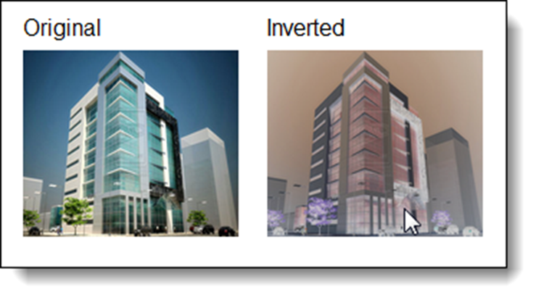
The syntax for adding a filter to an element
filter: filtermethod(value);
An image before and after its colors are inverted
The filter methods
blur(value)
brightness(value)
contrast(value)
drop-shadow(values)
grayscale(value)
hue-rotate(angle)
invert(value)
opacity(value)
saturate(value)
sepia(value)
The HTML for the images
<li>Original<br><img src="images/01.jpg" alt=""></li>
<li>Inverted<br><img src="images/01.jpg" class="image1” alt=""></li>
The CSS for the filter
.image1:hover { filter: invert(.80); )

Slide 33
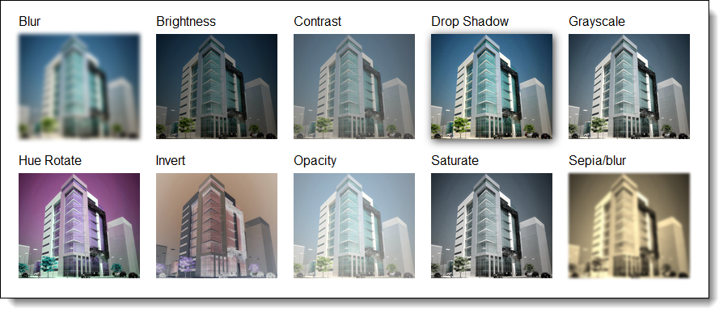
Different filters applied to an image in Chrome

Slide 34
HTML for the Images
CSS for the Filters
<ul>
<li>Blur<br> <img src="images/01.jpg" class="image1“ alt=""></li>
<li>Brightness<br> <img src="images/01.jpg" class="image2“ alt=""></li>
<li>Contrast<br> <img src="images/01.jpg" class="image3“ alt=""></li>
<li>Drop Shadow<br> <img src="images/01.jpg" class="image4“ alt=""></li>
<li>Grayscale<br> <img src="images/01.jpg" class="image5“ alt=""></li>
<li>Hue Rotate<br> <img src="images/01.jpg" class="image6“ alt=""></li>
<li>Invert<br> <img src="images/01.jpg" class="image7“ alt=""></li>
<li>Opacity<br> <img src="images/01.jpg" class="image8“ alt=""></li>
<li>Saturate<br> <img src="images/01.jpg" class="image9“ alt=""></li>
<li>Sepia/blur<br> <img src="images/01.jpg" class="image10“ alt=""></li>
</ul>
.image1 { filter: blur(2px); }
.image2 { filter: brightness(50%); }
.image3 { filter: contrast(50%);}
.image4 { filter: drop-shadow(2px 2px 5px #333); }
.image5 { filter: grayscale(50%); }
.image6 { filter: hue-rotate(90deg); }
.image7 { filter: invert(.8); }
.image8 { filter: opacity(.50); }
.image9 { filter: saturate(30%); }
.image10{ filter: sepia(100%) blur(1px); }

Slide 35
Session 7 – Chapter 16 Student Exercise
Complete Exercise 16-1 on page 567 using Dreamweaver.
Students will upload test files to development site.
Students will preview in browser development files.
Students will upload files to live site.
Students will preview in browser live files.

Slide 36
Class Review
Chapter 15 - How to work with Fonts and Printing
Chapter 16 - How to Use CSS3 Transitions, Transforms, Animation and Filters

