Slide 1
HTML5-CSS3
Session V
Chapter 11 - How to Work with Images and Icons
Chapter 12 - How to Work with Tables
www.profburnett.com
Master a Skill / Learn for Life

Slide 2
Class Outline
Chapter 11 - How to Work with Images and Icons
Chapter 12 - How to Work with Tables

Slide 3



Image Types
Joint Pictures Engineering Group (JPEG) Image
Photographs
Can Be Compressed
30% Compression
Graphics Interchange Format (GIF) Image
Bitmaps
256 Colors
Animation
Portable Network Graphics (PNG)
Compression
Animation
Color Depth
No License Needed

Slide 4
Attributes of the <img> tag
src – relative or absolute URL
alt – alternate text
height – height of the image in pixels
Width – width of the image in pixels

Slide 5
CSS properties for sizing an image
height - The height property sets the height of an element. (Note: The height property does not include padding, borders, or margins; it sets the height of the area inside the padding, border, and margin of the element!)
width - The width property sets the width of an element. (Note: The width property does not include padding, borders, or margins; it sets the width of the area inside the padding, border, and margin of the element!)
CSS Syntax: height / width : auto|length|initial|inherit;
Auto - The browser calculates the height. This is default
Length - Defines the height in px, cm, etc.
% - Defines the height in percent of the containing block
Initial - Sets this property to its default value.
Inherit - Inherits this property from its parent element.

Slide 6
The HTML for Two Images
<p><img src="images/students.jpg"
alt="teacher and students"
height="300" width="400">&nbsp;&nbsp;
<img id="small" src="images/students.jpg"
alt="teacher and students"></p>
CSS
#small {
height: 150px;
width: 200px; }
Web Page Example

Slide 7
The Property for Aligning Images Vertically
vertical-align
W3C Exercise
Common Keywords for the Vertical-Align Property
bottom
middle
top
text-bottom
text-top

Slide 8
HTML for Web Page with Three Images
<h2>To order now:</h2>
<p><img src="images/computer.gif" alt="web address">
<b>Web:</b> www.murach.com</p>
<p><img src="images/telephone.gif" alt="phone">
<b>Phone:</b> 1-800-221-5528</p>
<p><img src="images/fax.gif" alt="fax">
<b>Fax:</b> 1-559-440-0963</p>
CSS
img {
vertical-align: middle;
margin-right: 10px; }
Web Page Example

Slide 9
The Properties for Floating Images
float
clear
W3C Exercise

Slide 10
HTML & CSS for a Web Page
<img src="images/students.jpg"
alt="teacher and students">
<ul>
<li>in college and university MIS programs that focus
on providing students with practical, real-world
experience</li>
<li>by technical institutes and community colleges
that focus on the skills that employers are
looking for</li>
<li>in Continuing Ed and Extension programs where the
students are professionals who are expanding
their skills</li>
</ul>
<p id="last">So if your program fits one of those profiles, please take a look at our books. I&rsquo;m confident you&rsquo;ll discover a new level of structure, clarity, and relevance that will benefit both you and your students.</p>
img {
float: left;
margin-top: 15px;
margin-bottom: 10px; }
#last { clear: left; }
Web Page Example

Slide 11
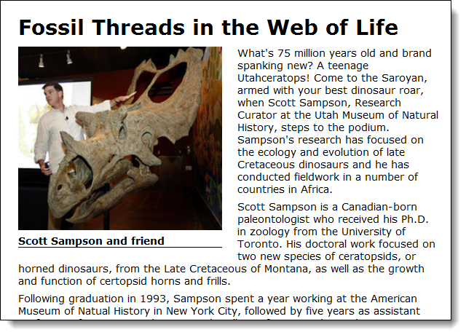
A Web Page with Figure and Figcaption Elements

Slide 12
The HTML for the Figure and Figcaption Elements
<article>
<h1>Fossil Threads in the Web of Life</h1>
<figure>
<img src="images/sampson_dinosaur.jpg"
alt="Scott Sampson">
<figcaption>Scott Sampson and friend</figcaption>
</figure>
<p>What's 75 million years old and brand spanking
...
</p>
</article>

Slide 13
The CSS for the Figure and Figcaption Elements
figure {
float: left;
margin-right: 1.5em; }
figcaption {
display: block;
font-weight: bold;
padding-top: .25em;
margin-bottom: 1em;
border-bottom: 1px solid black; }
Web Page Example

Slide 14

Thumbnails in a Web Page
Web Page Example

Slide 15
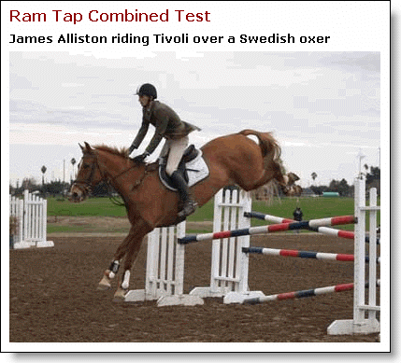
Photo displayed when fifth thumbnail is clicked

Slide 16
The HTML for the Thumbnails
<h3>Ram Tap Combined Test</h3>
<p>
<a href="p1.html"><img src="thumbnails/t1.jpg"
alt="Photo 1"></a>
<a href="p2.html"><img src="thumbnails/t2.jpg"
alt="Photo 2"></a>
<a href="p3.html"><img src="thumbnails/t3.jpg"
alt="Photo 3"></a>
<a href="p4.html"><img src="thumbnails/t4.jpg"
alt="Photo 4"></a>
<a href="p5.html"><img src="thumbnails/t5.jpg"
alt="Photo 5"></a>
<a href="p6.html"><img src="thumbnails/t6.jpg"
alt="Photo 6"></a>
</p>

Slide 17
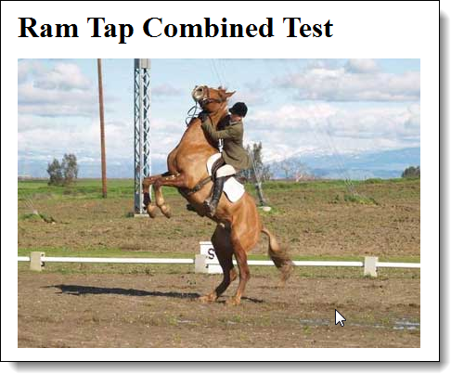
An image that’s been rolled over

Slide 18
The HTML for the page
The CSS for the image rollover
<body>
<h1>Ram Tap Combined Test</h1>
<p id="image1"></p>
</body>
#image1 {
background-image: url("h1.jpg");
width: 434px;
height: 312px;
}
#image1:hover {
background-image: url("h2.jpg");
}

Slide 19
Attribute of the img element that identifies a map element
usemap
Attribute of the map element that gives it a name
name
Attributes of the area elements of an image map
href
shape
coords
alt

Slide 20
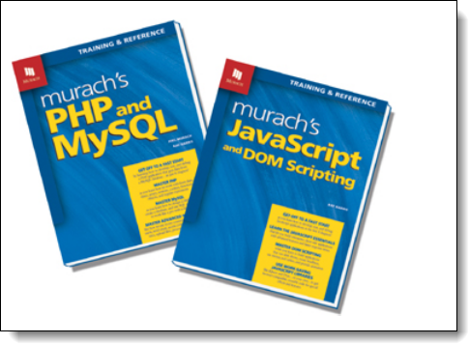
An image with hotspots created by an image map

Slide 21
The HTML for the Image and Image Map
<img src="images/html.gif"
alt="HTML and JavaScript books" usemap="#books">
<map name="books">
<area href="html5.html" alt="HTML5 book"
title="HTML5" shape="poly"
coords="1,19,114,0,122,53,106,143,26,158,24,149">
<area href="javascript.html" alt="JavaScript book"
title="JavaScript" shape="poly"
coords="128,21,241,42,218,178,103,159">
</map>

Slide 22
Related Skills for Working with Images

Slide 23
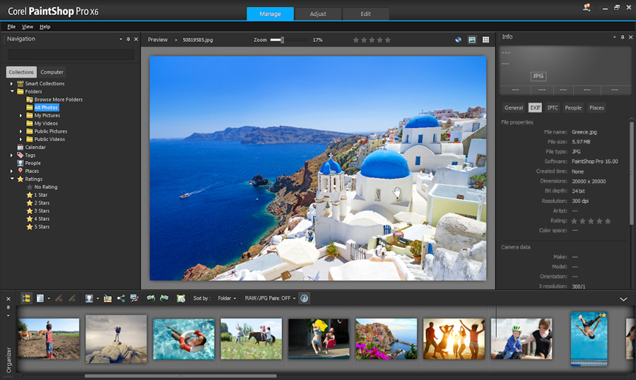
An image editor as it is used to size an image

Slide 24






Popular Image Editing Software
Corel PaintShop Pro X6
Adobe Photoshop
Inkscape
GIMP
MAC
Adobe Fireworks
Pixelmator

Slide 25
Creative Commons Licenses
License | Symbol | Description
Attribution CC BY |  | lets others distribute, remix, tweak, and build upon your work, even commercially, as long as they credit you for the original creation.
Attribution-ShareAlike CC BY-SA |  | lets others remix, tweak, and build upon your work even for commercial purposes, as long as they credit you and license their new creations under the identical terms
Attribution-NoDerivs CC BY-ND |  | allows for redistribution, commercial and non-commercial, as long as it is passed along unchanged and in whole, with credit to you.
Attribution-NonCommercial CC BY-NC |  | lets others remix, tweak, and build upon your work non-commercially, and although their new works must also acknowledge you and be non-commercial, they don’t have to license their derivative works on the same terms.
Attribution-NonCommercial-ShareAlike CC BY-NC-SA |  | lets others remix, tweak, and build upon your work non-commercially, as long as they credit you and license their new creations under the identical terms.
Attribution-NonCommercial-NoDerivs CC BY-NC-ND |  | most restrictive of our six main licenses, only allowing others to download your works and share them with others as long as they credit you, but they can’t change them in any way or use them commercially.

Slide 26
Free Photo Websites
30 Best Websites To Download Free Stock Photos

Slide 27
Icon Libraries
Font Awesome
Glyphicons
Glyphish
Flaticon

Slide 28
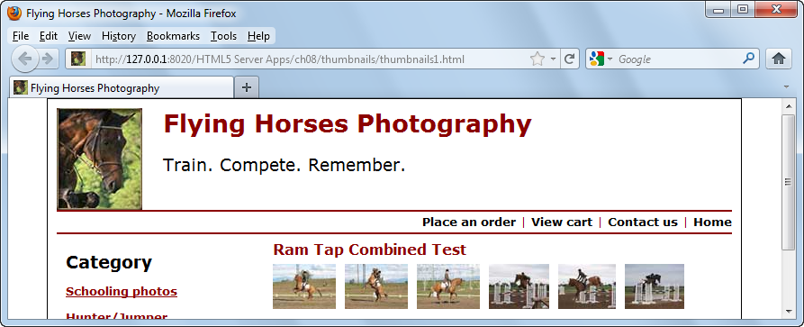
A Web Page with Favicons
The link element that links to the favicon
<link rel="shortcut icon" href="images/favicon.ico">

Slide 29
Popular programs and tools for creating favicons
Favicon ICO Generator
Axialis Icon Workshop
Photoshop plug-in
Favicon from Pics

Slide 30
Student Exercise 1
Complete Exercise 11-1 on page 420 using Dreamweaver
Students will upload test files to development site.
Students will preview in browser development files.
Students will upload files to live site.
Students will preview in browser live files.

Slide 31
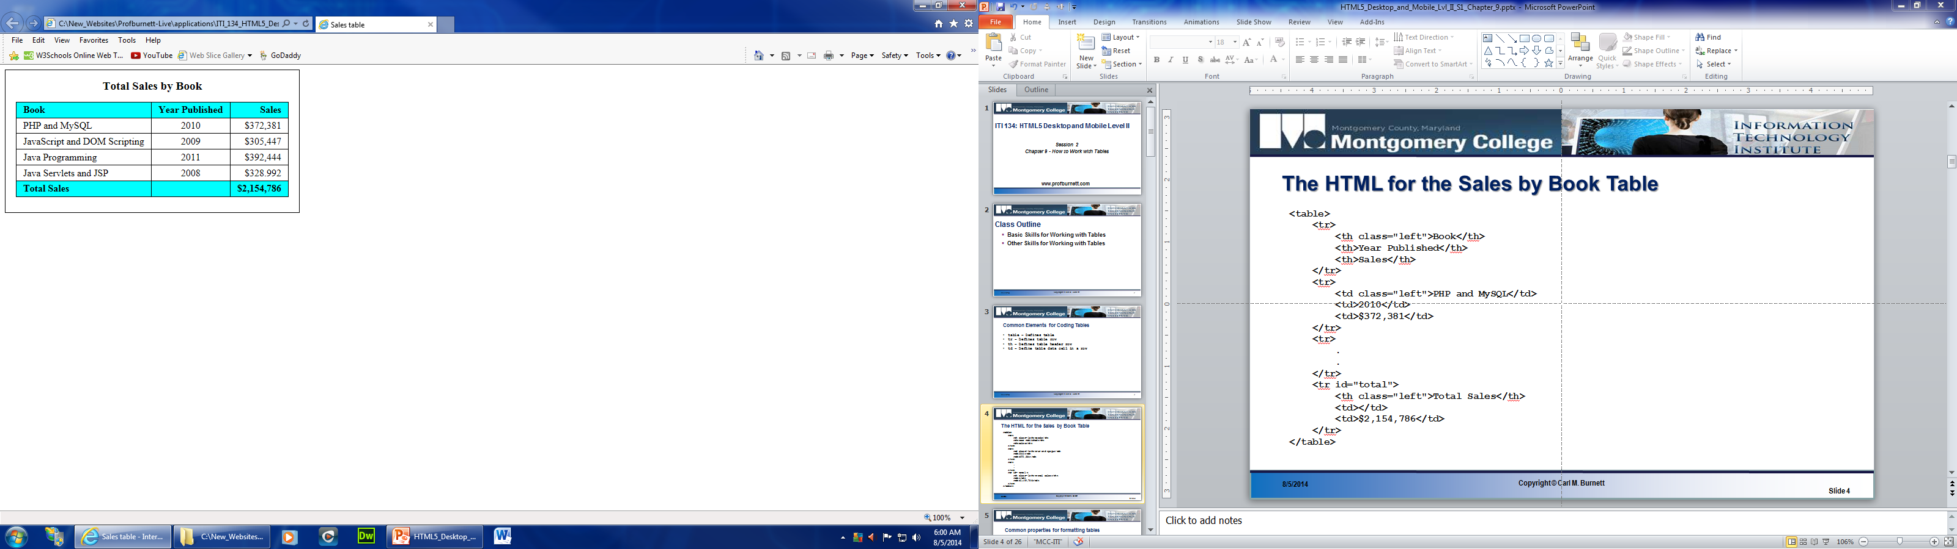
How to Work with Tables
Table Header Cells
Table Caption
Table Header
Table Rows
Table Body
Table Footer
Table Data Cells

Slide 32
Common Elements for Coding Tables
Element | Description
table | Defines table
tr | Defines table row
th | Defines table header row
td | Defines table data cell in a row

Slide 33
The HTML for the Sales by Book Table
<table>
<tr>
<th class="left">Book</th>
<th>Year Published</th>
<th>Sales</th>
</tr>
<tr>
<td class="left">PHP and MySQL</td>
<td>2010</td>
<td>$372,381</td>
</tr>
<tr>
.
.
</tr>
<tr id="total">
<th class="left">Total Sales</th>
<td></td>
<td>$2,154,786</td>
</tr>
</table>
Example

Slide 34
Common Properties for Formatting Tables
Property | Description
border-collapse | Keyword defines space between borders. Values: collapse or separate (default)
border-spacing | Relative or absolute value of space between cells
padding | Space between cell content
text-align | Horizontal Alignment
vertical-align | Vertical Alignment

Slide 35
CSS for the Sales by Book Table
table {
border: 1px solid black;
border-collapse: collapse; }
th, td {
border: 1px solid black;
padding: .2em .7em;
text-align: right; }
th.left, td.left { text-align: left; }
#total { font-weight: bold; }
Example

Slide 36
The elements for the header, body, and footer
Element | Description
thead | Groups one of more rows in table header
tbody | Groups the rows between header and footer
tfoot | Groups one of more rows in table footer

Slide 37
HTML & CSS for a table with a header, body, and footer
<table>
<thead>
<tr>
<th class="left">Book</th>
<th>Year published</th>
<th>Total sales</th>
</tr>
</thead>
<tbody>
<tr>
<td class="left">PHP and MySQL</td>
<td>2010</td>
<td>$372,381</td>
</tr>
.
.
</tbody>
<tfoot>
<tr>
<th class="left">Total Sales</th>
<td></td>
<td>$2,154,786</td>
</tr>
</tfoot>
</table>
thead, tfoot { background-color: aqua; }
tfoot { font-weight: bold; }
Example

Slide 38
The Syntax for CSS3 structural pseudo-class selectors
Element | Description
:nth-child(n) | nth child of parent
:nth-last-child(n) | nth child of parent counting backwards
:nth-of-type(n) | nth element of its type within the parent
:nth-last-of-type(n) | nth element of its type counting backwards
Value | Description
odd | Every odd child or element
even | Every even child or element
n | Every nth child or element
2n | Same as even
3n | Every third child or element (3,6,9…..)
2n+1 | Same as odd
3n+1 | Every third child or element starting with 1 (1, 4, 7, ……)

Slide 39
CSS3 for formatting a table without using classes
th:first-child, td:first-child {
text-align: left; }
th:nth-child(2), td:nth-child(2) {
text-align: center; }
tbody tr:nth-child(even) {
background-color: silver; }
Example

Slide 40
The HTML for the figure and figcaption elements
<figure>
<figcaption>Total Sales by Book</figcaption>
<table>
.
.
</table>
</figure>
The CSS for the figure and figcaption elements
figure, figcaption {
margin: 0;
padding: 0; }
figure {
border: 1px solid black;
width: 450px;
padding: 15px; }
figcaption {
display: block;
font-weight: bold;
text-align: center;
font-size: 120%;
padding-bottom: .25em; }
table {
border-collapse: collapse;
border: 1px solid black;
margin: 10px auto; }
Example

Slide 41
Attributes for merging cells
Element | Description
colspan | The number of columns that will span cells
rowspan | The number of rows that will span cells

Slide 42
The HTML for the table
<table>
<thead>
<tr>
<th rowspan="2">Book</th>
<th colspan="4">Sales</th>
</tr>
<tr>
<th>North</th>
<th>South</th>
<th>West</th>
<th>Total</th>
</tr>
</thead>
<tbody>
.
.
</tbody>
<tfoot>
<tr>
<th>Sales Totals</th>
<td>$140,775</td>
<td>$165,550</td>
<td>$762,794</td>
<td>$1,069,119</td>
</tr>
</tfoot>
</table>
The CSS for the merged cells
th:first-child { vertical-align: bottom; }
th:nth-child(2) { text-align: center; }
tr:nth-child(2) th { text-align: right; }
Example

Slide 43
Attributes that can be used for accessibility
Attribute | Description
caption | Describes the content of the table
headers | Identifies one or more header cells
scope | Keyword that associates with column or row. Keywords: col , row, rowgroup for merged cells

Slide 44
Session 5 – Chapter 12 Student Exercise
Complete Exercise 12-1 on page 445 using Dreamweaver.
Students will upload test files to development site.
Students will preview in browser development files.
Students will upload files to live site.
Students will preview in browser live files.

Slide 45
Class Review
Chapter 11 - How to Work with Images and Icons
Chapter 12 - How to Work with Tables

