Slide 1

HTML5
Session I
Chapter 1 - Introduction to Web Development Chapter 18 - How to Design a Web Site
Chapter 19 - How to Deploy a Web Site on a Web Server
www.profburnett.com
Master a Skill / Learn for Life

Slide 2
Session Outline
Introduction to Web Development
How to Design a Web Site
How to Deploy a Web Site on a Web Server

Slide 3
Intro to Web Outline
The Internet & The Web
Intro to HTML & CSS
Critical Web Development Issues

Slide 4

What is the Internet?
WANs
WANs
WANs
MANs
MANs
CANs
CANs
CANs
LANs
LANs
LANs
LANs
LANs
LANs
LANs
LANs
LANs

Slide 5



Components of the Web

Slide 6

Web Request-Response Cycle Static Web Page
Request Transmitted
Web Server
Processes Request
User Sends Request by URL
DNS Lookup
Internet
Browser Decodes HTML from Web Server
Web Server
Results Send
to User
Results Displayed
to User
Results Formatted in HTML for Browser
Request
Response

Slide 7



The Web Medium Dynamic Web Site
Server Side
Client Side
Internet
Web Server
Application Server
Database Server
HTML5
CSS
JavaScript
jQuery
MEAN
LAMP
AMMP
HTTP
TCP/IP
Java
C#
Python
SQL
XML

Slide 8
Desktop Web Browsers
Edge
Firefox
Chrome
Opera
Safari
Brave

Slide 9
Web Building Blocks
Hypertext
Stylization
Interactivity
Metadata

Slide 10
Key Technologies
Hypertext Markup Language - HTML
HTML5
Cascading Style Sheets - CSS
JavaScript
Asynchronous JavaScript - AJAX
XML

Slide 11
Server Side Scripting
PHP
JavaScript (Angular, ReactJS)
Java
Python (Django, Flask, Pylons)
Ruby (Ruby on Rails)
C# (ASP)
PERL
SQL
AJAX
XML

Slide 12
HTML Standards
Version | Year | Description
HTML | 1991
HTML 1.0 | 1993
HTML 2.0 | 1995
HTML 3.2 | 1997
HTML 4.01 | 1999
XHTML 1.0 | 2000 | Incorporated XML
HTML5 | 2012 | Working Draft in 2008

Slide 13
CSS Standards
Version | Year
1.0 | 1996
2.0 | 1998
2.1 | 2004
3.0 | 2012

Slide 14
HTML Document
HTML5-CSS3 Student Home Page

Slide 15
CSS Document
body {
font-family: Arial, Helvetica, sans-serif;
font-size: 82.5%;
width: 500px;
margin: 0 auto;
padding: 1em;
border: 1px solid navy;
}
h1 {
margin: 0;
padding: .25em;
color: navy;
font-size: 250%;
}
img {
float: left;
margin: 0 1em;
}
p {
margin: 0;
padding-bottom: .5em;
}

Slide 16
Viewing Web Pages
URI
URI - Uniform Resource Identifier
URL - Uniform Resource Locator URN - Uniform Resource Name
URL
URN
http://www.profburnett.com/2014/spring/2014_Spring_Session_I.html
File Name
Directories
Domain Name
Protocol

Slide 17
Critical Web Development Issues
Usability
Responsive Web Design (RWD)
Mobility
IoT

Slide 18
Break
Next – How to Design a Web Site

Slide 19
How to Design a Web Site Outline
Users and Usability
Design Guidelines
Design Methods and Procedures
Responsive Web Design

Slide 20


Users and Usability
What Do Users Want?
Quick & Easy Info
Easy-to-Use

Slide 21





Users and Usability
How do Users Use a Web Page?
Click Buttons
Scan
Click Links
Give Up

Slide 22
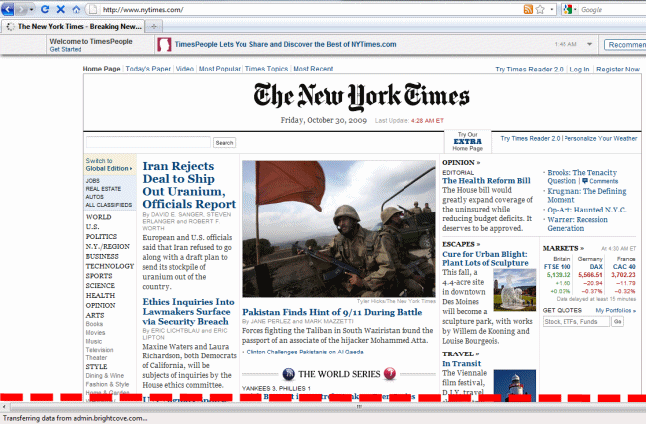
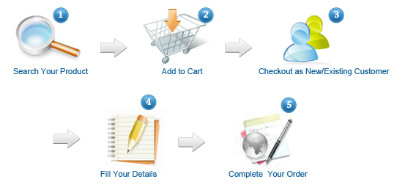
Improving Usability
Above the Fold
Group Components
Communicate Order
Adhere to Conventions

Slide 23
Usability Conventions
Header Conventions
Logo, Tag Line, Utilities
Unique Tag Line
Nav Bar Sectionalizes
Utilities - Useful - Not Prime
May include Search
Navigation Conventions
Underlined Text
Image Text Clickable
Image Clickable
Buttons 3D
Column Text Clickable
Cart Symbol – Shopping Cart
Logo Image – Home Page

Slide 24
Home Page Design Guidelines
Emphasize Value and Difference
Empathize Highest Priority
Don’t Welcome – Waste of Space
Group Navigation
Use Icons for Navigation
Use Dropdowns for Navigation
Home Page Different from main pages
No Active link on Home Page to Home Page
Home Page Title = Organization Name
Ecommerce – Include Shopping Cart Symbol and Link

Slide 25
Space Design Guidelines
Breadcrumbs
Keep Header Small
Prioritize Components
Give Important Item Priority Location

Slide 26
Web Writing Guidelines
Use Fewer Words
Inverted Pyramid
Use Heading and Subheadings
Use Bulleted and Number Lists
Use Tables
Don’t Use All Caps
Make Text Links Explicit
Chunk Long Pages into Shorter pages

Slide 27
Graphic Design Principles
Alignment
Proximity
Repetition
Contrast

Slide 28
Typographical Guidelines
Limit Paragraphs to 65 Characters
Use San Serif Fonts that are Easy to Read
Show Heading and Text Relationship
Dark Text / Light Background
Don’t Center or Justify Text
No Space for Indented First Lines
Don’t Reverse Text

Slide 29
Design Methods and Procedures

Slide 30
Developmental Team
For Design
Requirements Specialist
Usability Specialist
Marketing Specialist
Writers
Web Designers
Graphic Designers
For Implementation
HTML & CSS Specialist
Client-side Programmers
Server-side Programmers
XML Programmer
DBA
Network Admin

Slide 31
Design Methods
Top-Down - SDLC
Stepwise – Iterative
Prototyping
RAD
JAD
Extreme - Agile

Slide 32
Web Site Lifecycle
Design
Implement
Maintain

Slide 33
Easy to Maintain Web Site
Use HTML for Content
Use CSS for Layout and Formatting
Don’t Use Tables
Don’t Use Frames
Get Design Right First

Slide 34
Procedure for Designing Web Site
Define Audience and Goals
Design Home Page
Design Primary Content Pages
Design Other Pages
Plan Navigation
Plan Folders

Slide 35

Plan Navigation
Home
Page
FAQ
Help
About
Us
Contact
Us
Shopping
Cart
Products
Services
Board
History

Slide 36
Plan Navigation – Personal Website
Home Page
Knowledge's (Strengths)
Skills
Abilities (What Jobs I can Do)
Employment History
Current
Historical
Hobbies
About Me
Where I Grew Up
Where I Live Now
Education’
Contact Me

Slide 37
Plan Folders
Root
Products
Services
Images
About Us
Single
Pages
Shopping Cart

Slide 38
Plan Folders – Personal Website
Root Folder
About Me Folder
Employment History Page Folder
Education Page Folder
Other Page Folder
Images Folder
PDF File Folder
.DOC File Folder
Graphics Folder
Button Folder
Home Page
About Me Page

Slide 39
Implementing Web Site
Develop HTML & CSS Templates
Develop Web Pages
Test Entire Site
Deploy Site

Slide 40
Maintaining Web Site
Plan Changes
Design Changes
Test Changes
Deploy Changes

Slide 41

Responsive Web Design (RWD)
Flexible images are also sized in relative units, so as to prevent them from displaying outside their containing element.

Slide 42



Responsive Web Design (RWD)
Media queries allow the page to use different CSS style rules based on characteristics of the device the site is being displayed on, most commonly the width of the browser.

Slide 43
Templates & Frameworks
Web Based
HTML5
CSS3
JavaScript
Mobile

Slide 44
Break
Next – How to Deploy a Web Site on a Web Server

Slide 45
How to Deploy a Web Site on a Web Server Outline
Web Host & Domain Name
Tools for Web Development
Setting Up Your Development Environment
Student Exercise 1

Slide 46
Web Hosting
Free web hosting
Shared web hosting
Reseller web hosting
Virtual Dedicated Server
Dedicated hosting
Managed hosting
Colocation web hosting
Cloud hosting
Clustered hosting
Grid hosting
Home server

Slide 47
Domain Name Services
Domain Name System (DNS)
Top Level Domains (TLD)
.com
.net
.org
.edu
.biz
.gov
Global Top Level Domain (gTLD)

Slide 48
Domain Name Registration
Internet Corporation for Assigned Names and Numbers (ICANN)
WHOIS
Registrant
name servers
expiration dates

Slide 49
Wireframe Design Apps
frame box
Gliffy
Mockflow
Mockingbird
Proto
Wireframe
iPhone Mockup (iPhone)
Mokk.me (iPhone)
Sketch Design Resources
UI8 Design Resources

Slide 50
Online Web Editors
WIX - http://www.wix.com
Godaddy Website Builder - https://www.godaddy.com/
Weebly - http://www.weebly.com/
About.me – http://about.me
WebsiteBuilder - https://www.websitebuilder.com/
IM Creator - http://www.imcreator.com/
Jimdo - https://www.jimdo.com/
Ucraft - https://www.ucraft.com/
WebNode - https://us.webnode.com/
WordPress - http://www.wordpress.com

Slide 51
Free Web Development IDEs
Brackets
Visual Studio Code
Aptana (JAVA Required)
Eclipse (JAVA Required)
Atom by Github
Google Web Designer
Komodo Edit
Netbeans
Light Table
RJ TextEd
CodeLobster
Bluefish
Coda
Sublime Text
CoffeeCup Free HTML Editor
Webuilder
ICEcoder
BBEdit
Code Writer

Slide 52
Downloadable Desktop Web Development Apps
Justinmind
Craft by InVision LABS
Bolt 2.0 ($)
Flair Builder ($)
Indigo Studio ($$$)
Omnigraffle (iOS)($)
TETHR (iOS)
iPlotz (iPhone & Android)
Mockups.me - (Web & Desktop)
Balsamiq ($ - Web & Desktop)

Slide 53
Cloud-Based Web Development Sites
Adobe Dreamweaver
Axure ($)
Fluid ($)
HotGloo ($)
Moqups ($)
Invision ($$$)
Pidoco ($)
Protoshare ($)
Solidify ($)
UXPin ($)
Codepen
Cloud9
Codeanywhere
CodeEnvy
Kodingen

Slide 54

Adobe Dreamweaver

Slide 55
Other Tools for Web Site Construction
WS-FTP
FileZilla
PayPal - http://www.paypal.com
Square - https://squareup.com/
Authorize.Net - http://www.authorize.net/

Slide 56
Session 1 - Student Exercise
Students will setup Adobe Dreamweaver development environment for local, testing and live website using Dreamweaver site server setup.
Download Testing Server files and folders to your local development folder.
Change the student name in the index.html file to your name.
Upload local development site index.html file to testing development site.
Preview testing development files.
Upload testing development site to live site.
Preview in browser live files.

Slide 57
Session Review
Introduction to Web Development
How to Design a Web Site
How to Deploy a Web Site on a Web Server

